Slide 1
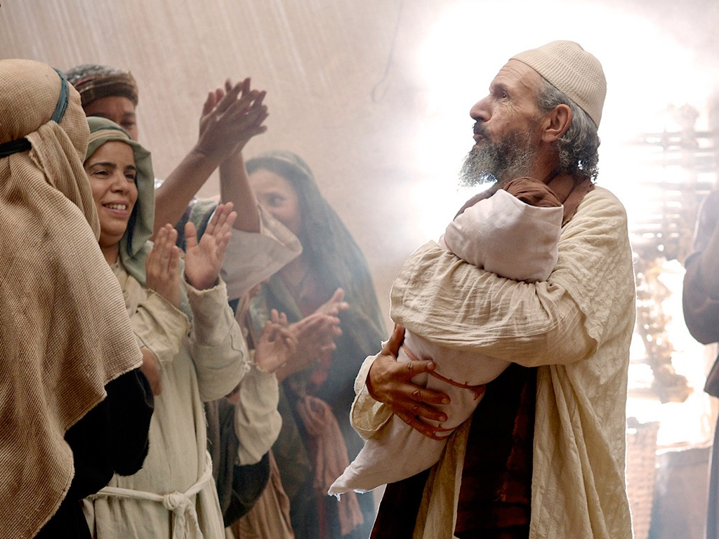
Introduction of the King
§§ 1-27
The Messianic identity of Jesus Christ is proved in his arrival, John's testimony, and approvals at his baptism and temptation
Section summaries based on J. Dwight Pentecost,
A Harmony of the Words and Works of Jesus Christ (Grand Rapids: Zondervan, 1981)
Dr. Rick Griffith • Jordan Evangelical Theological Seminary • BibleStudyDownloads.org

Slide 2
Pentecost Outline
Introduction of the King
Authentication of the King
Controversy over the King
Instruction of the Twelve by the King
Opposition to the King
Preparation of the Disciples by the King
Official Presentation of the King
Preparation for the Death of the King
Rejection of the King
Resurrection of the King

Slide 3

Increasing Polarization
Resurrection
Preparation
for Death
Preparation
of Disciples
Instruction
Authentication
Introduction
Controversy
Opposition
Presentation
Rejection
Notes:
The Life of Christ brought increasing polarization. The more Jesus showed about himself, the greater the resistance to him and his message. Also, the more intense the controversy leading to opposition, the higher priority Christ placed on preparing his men for when he would be gone. The climactic rejection when he presented himself as king of Israel at the Triumphal Entry resulted in rejection to the point of crucifixion followed by the victory of resurrection.
Introduction of the King
Authentication of the King
Controversy over the King
Instruction of the Twelve by the King
Opposition to the King
Preparation of the Disciples by the King
Official Presentation of the King
Preparation for the Death of the King
Rejection of the King
Resurrection of the King

Slide 4

Great Periods in the Life of Christ
55
“The Son of Man… came to minister and to give his life a ransom for many” (Mark 10:45)
Climactic Galilean
Early Samaritan
Later Samaritan
Early Judean
Later Judean
Early Perean
Later Perean
Opening Events
Closing Events
Preparation
Confirmation
Walk Thru the New Testament seminar (used with permission)
Notes:
The Walk Thru outline of the life of Christ forms a chiasm or literary arrangement with repeating elements in the opposite order. This structure makes Confirmation parallel to Preparation, Closing Events parallel to Opening Events, etc. until the only event without parallel becomes the focus: Climatic Galilean. Such an arrangement of material was common in antiquity and is seen in both the OT (e.g., Zephaniah) and the NT (1 Thess) where the central teaching appears in the middle of each writing.
Small Group Assignment: Explain this slide to your group member(s) and have the others explain it back.
After the beginning events of stages 1-3, Jesus also gets farther away from his Jewish roots in Judea (4), to go to the Samaritans (5), and even farther to Galilee (6), where most Gentiles lived. He ministered to Jews in Galilee, of course, but this climatic period was the focus of his ministry.
_______
LC-00-Syllabus-63
LC-01-Introduction-265
LC-05-Opposition-4

Slide 5
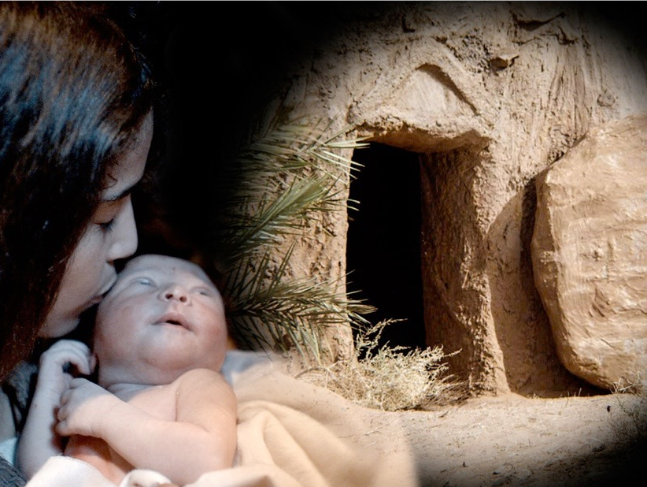
Introduction
§§ 1-2
The Gospel writers introduce the Person of Christ by emphasizing their sources and his deity to establish the validity of their claims

Slide 6
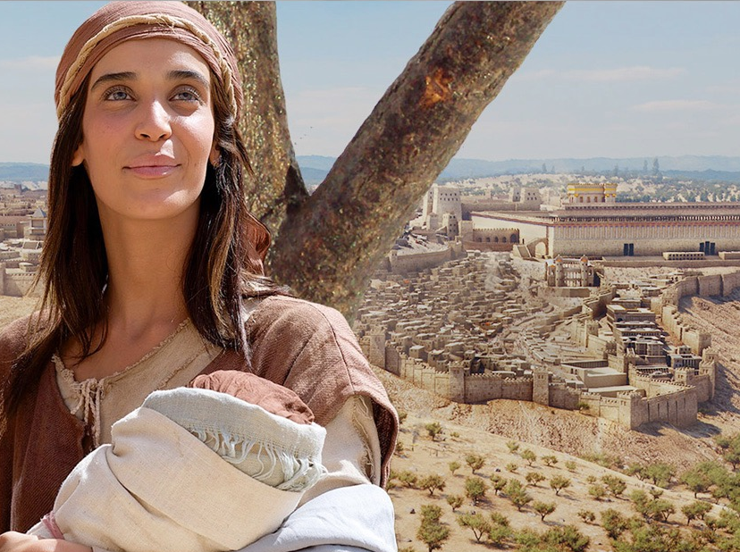
A. The Source of Knowledge
§ 1
Luke 1:1-4
Luke's account is carefully researched and authoritative so his readers can rely on what they have been taught

Slide 7
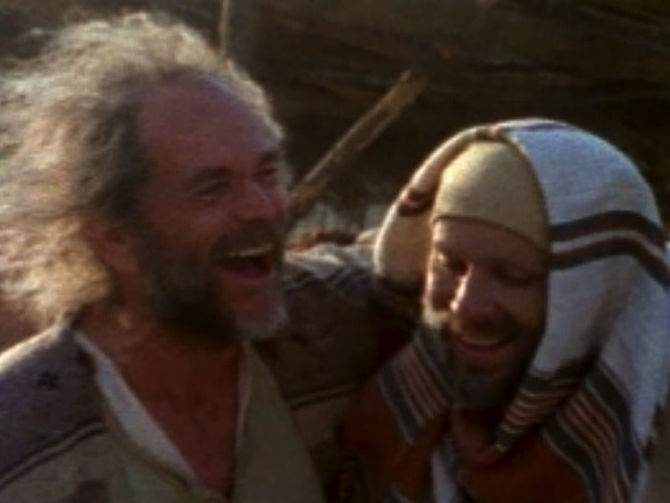
Who was Luke?
Medical doctor
Traveling companion of Paul
Articulate historian & writer

Slide 8
Authorship
94
External Evidence
Church Fathers of the latter half of the 2nd century agreed that Luke, "the beloved physician" (Col. 4:14), wrote this Gospel which bears his name:
The earliest evidence
for Lukan authorship – Muratorian Canon and
the Anti-Marcionite Prologue.
Further citations to Lukan authorship are given by Irenaeus, Tertullian, Clement of Alexandria,
Origen, Eusebius, and Jerome.
Internal Evidence
1. Several factors signify that Luke and Acts had the same author.
2. The "we sections" in Acts
3. Use of more technical medical terms is compatible with authorship by a doctor

Slide 9
NT Overview (History)
38
124
39-41
"To the remotest part of the earth" (Acts 1:8)
Acts 9 13 14 15 16 18 21 27 28
Apr 48-
Sep 49
1
Galatia
Apr 50-
Sep 52
2
Aegean
Spr 53-
May 57
3
Asia
Feb 60-
Mar 62
1
Rome
Spr 62-
Fall 67
4
Spain
Aut 67-
Spr 68
2
Rome
Summer 35-
37
Damascus
Antioch
May 57-
Aug 59
Trials
Fall 49
The
Council
Spring 68
Expansion of Church
35 48 49 50 52 53 57 60 62 67 68 95
Matt
Luke
Date
The Book of Acts ends with Paul's two year imprisonment,
ending in AD 62, and Luke was written before Acts. The best estimate is probably that Luke wrote his account during Paul's two-year imprisonment at Caesarea (Jun 57-Aug 59).
Gospels & Acts
1234
Journeys
Rome
Imprisonments
Gospels & Acts
Notes:
By this time, the Jews had the gospel of Matthew that was directed towards Jewish readers. Matthew gave evidences for Jesus as the long-awaited Messiah, or ruler promised in the OT. But now after the East was reached was the time for Luke to present Jesus to the westerners. Paul was awaiting trial for two years in Israel. Luke was with him and in the perfect time and place to write a history of Jesus for Gentiles.

Slide 10
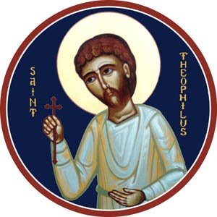
Who was Theophilus?
“Lover of God”
Believer in Jesus
Probably Wealthy Benefactor

Slide 11
Circumstances
94
Origin/Recipients
Assuming the dating presented
is correct, Luke wrote from Caesarea. He clearly wrote to Theophilus.
The title of "most excellent" for Theophilus probably indicates that he was an official. As a man of high social standing, he may have assumed responsibility for publishing Luke and Acts.

Slide 12
Circumstances
94
In line with writing to Gentiles, Luke:
Translates Aramaic terms
Traces Christ's genealogy to Adam
Refers to Roman rulers for dating
Avoids noting fulfilled prophecies
Quotes the Septuagint
Explains Jewish customs, and
Explains Israel’s geography.

Slide 13
Occasion
94
Undoubtedly Theophilus considered Luke a tremendous source to provide an orderly account of the life of Christ.
Luke wrote to strengthen the wealthy Christian's faith by showing that his faith rested on firm historical facts.
Perhaps even more significantly, Luke sought to explain to his wider Gentile audience how Christ died for the entire world after being rejected by Israel.

Slide 14
Purpose
95
Kingdom
Ecclesiastical
Instructional / Edification
Narration of History
Soteriological / Evangelistic
Conciliation
Apologetic

Slide 15
Characteristics
96
Glory
Superb Style
Joy
Prayer
Humanity of Christ
Universal
Money
Septuagint
Forgiveness
Temple
Redemptive Mission
Gentile
Holy Spirit
Abrahamic & Davidic Covenants
Secular History
Individual
Comprehensive
Emphasis on Women

Slide 16
Argument
96
Luke's Gospel is written from a Gentile mind to the Gentile mind to confirm Theophilus' faith but also to answer how the Jewish Savior could be a Savior for Gentiles. Luke performs this task masterfully by tracing the divinely directed kingdom message from Jews to Gentiles. Since Israel has rejected its Messiah, all men can receive salvation by simple faith. This message is continued in Luke's Book of Acts, which chronicles the kingdom message from its reception by Jerusalem Jews to Gentiles in the uttermost part of the Roman Empire.

Slide 17
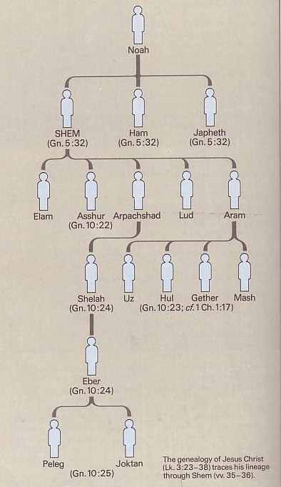
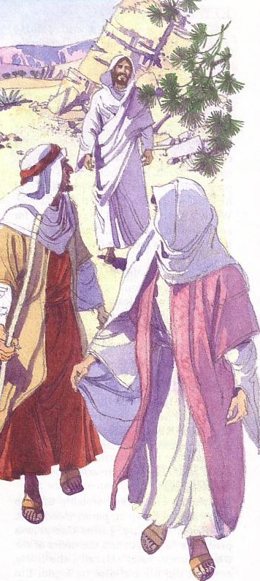
Synthesis
97
1:1-4 Sources
1:5–4:13 Pre-public Life
Nuh
SEM
(Kej 5:32)
HAM
(Kej 5:32)
YAFET
(Kej 5:32)
4:14–21:38 Ministry
Elam
Asyur
(Kej10:22)
Arpakhsad
Lud
Aram
22–23 Passion
Selah
(Kej10:24)
Us
Hul Geter
(Kej10:23;1Taw1:17)
Mas
24 Final Events
Eber
(Kej10:24)
Geneologi Yesus Kritus (Luk 3:23-38) mengesani keturunan melalui Sem (w.35-36)
Peleg Yoktan
(Kej10:25)

Slide 18
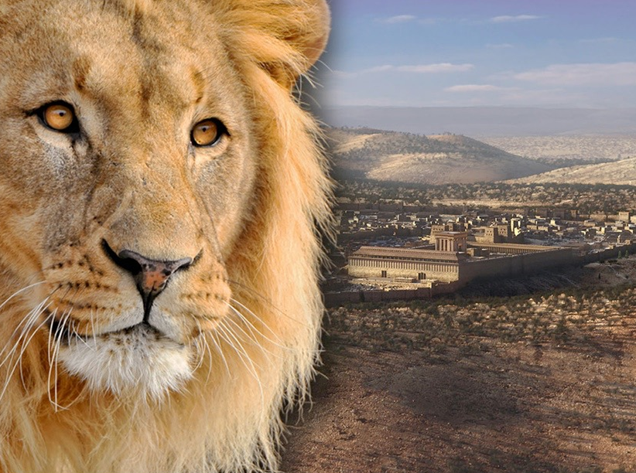
B. The Preexistence of Christ
§ 2
John 1:1-18
Christ's relation to the Father, creation, men, and John shows Him God in the flesh and redeemer of believers despite Israel's rejection
Notes:
Intro: Fact or Fiction...

Slide 19
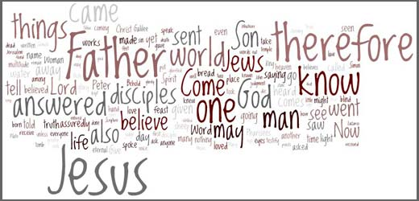
How Does God Speak to Us?
God has spoken in written & oral language

Slide 20
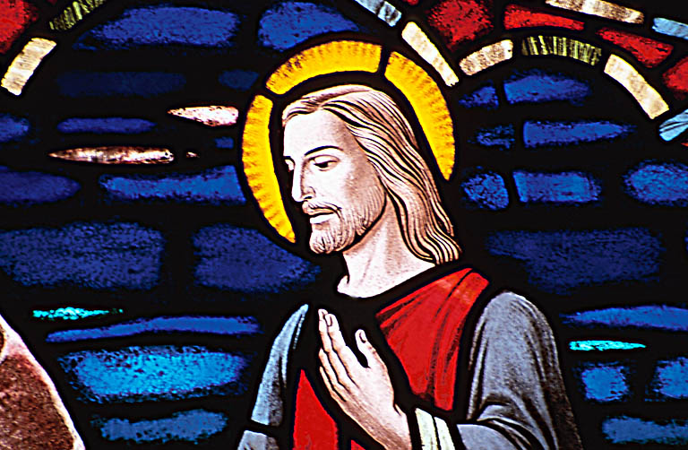
How Does God Speak to Us?
But has especially spoken through a person—Jesus Christ!
Jesus is the logos (word)
This means Jesus fully reveals who God is.
He is the Perfect Revelation.

Slide 21
LOGOS
Greek Philosophy:
"Reason"
Philo: "unity with God but distinct; creator, sustainer, & revealer"
OT: "that which lies behind"
Notes:
The background of logos is threefold:
Greek Philosophy: "The term was used technically in the Greek philosophy of this period, particularly by the Stoics, to denote the controlling Reason of the universe, the all-
pervasive Mind which ruled and gave meaning to all things. LOGOS was one of the purest and most general concepts of that ultimate Intelligence, Reason, or Will that is called God" (Merrill C. Tenney, The Gospel of John [Grand Rapids: Eerdmans, 1948; reprint 1975], 62).
OT: "In the LXX Logos is used to translate Heb. dāḇār. The root of this signifies 'that which lies behind', and so when translated as 'word' it, too, means meaningful sound; it may also mean 'thing.'" Some say it is the OT Wisdom literature whereas others say it refers to the Torah.
Philo: Philo was a Jewish philosopher in the first century AD down in Alexandria, Egypt. He combined Jewish and Greek ideas to try to evangelize Greeks to Judaism. The New Bible Dictionary notes that only Philo's "Logos-teaching provides a clear theological scheme in which the Word possesses a like unity with God and a like distinction from him, and in which both creative and sustaining activity in the universe and revelatory activity towards man is ascribed to it."

Slide 22


Exact Beginnings
"In the beginning
was the Word"
(John 1:1)
"In the beginning God created the heavens and the earth"
(Genesis 1:1)
Notes:
This does NOT say that Jesus' existence began with Gen 1:1. "The word 'was' (imperfect tense) implies timelessness. Jesus existed before Gen 1:1. He has a beginning of no beginning" [Jeffrey Khoo, The Story of Jesus, www.febc.edu.sg]

Slide 23

Jesus has always been God
"In the beginning
was the Word,
and the Word was with God,
and the Word was God"
(John 1:1)
Notes:
Scripture is very clear that Jesus is God. Christians have always believed this key doctrine called the deity of Christ.

Slide 24
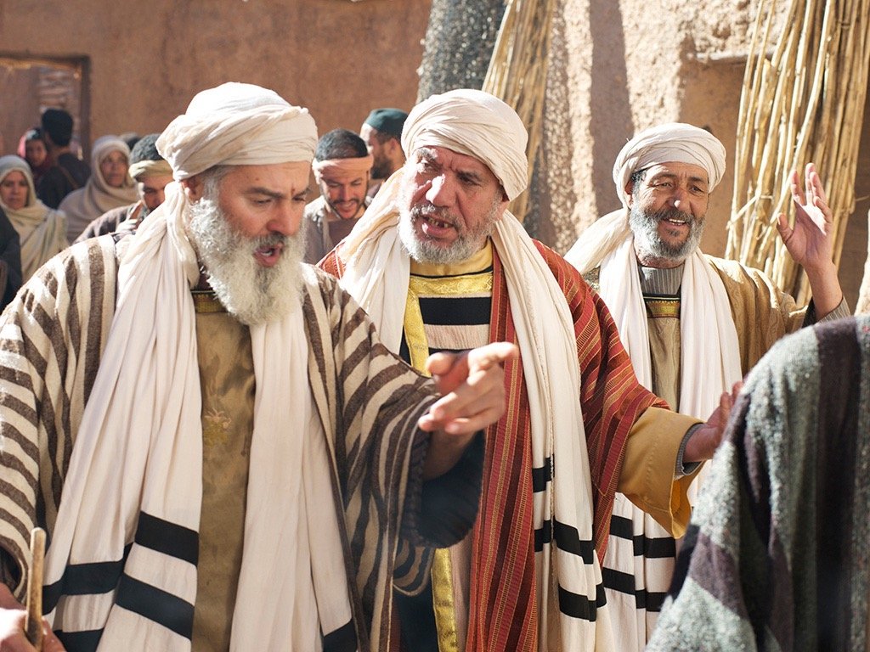
Jews rejected Christ even though he was Jewish (1:11)
"He came to that which was his own,
but his own did not receive [Gr. 'welcome alongside'] him" (NIV).

Slide 25
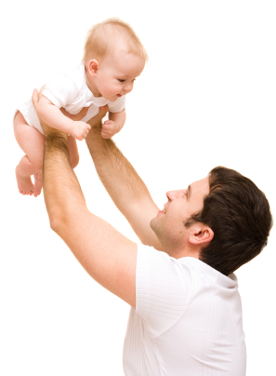
You become a child of God by believing that Jesus is God:
"But to all who believed him and accepted him, he gave the right to become children of God"
(John 1:12 NLT)

Slide 26

God became man in Jesus
"So the Word became human and lived here on earth among us. He was full of unfailing love and faithfulness. And we have seen his glory, the glory of the only Son of the Father" (John 1:14 NLT)

Slide 27
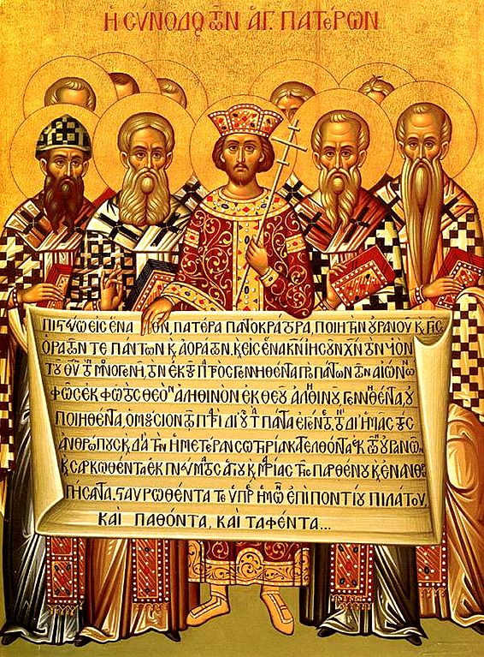
The Nicene Creed
(AD 325)
153e
Dr. Rick Griffith, Crossroads International Church Singapore
CICFamily.com & BibleStudyDownloads.org
Notes:
The Nicene Creed (AD 325) was the second oldest creedal statement of the Early Church, preceded only by The Apostle’s Creed of 1^{st to} 3rd centuries. But why do we have it in the first place?
___________
LC-00-Syllabus-88
NS-04-John1-12-slide 163
TH-03-Nicene Creed-1

Slide 28
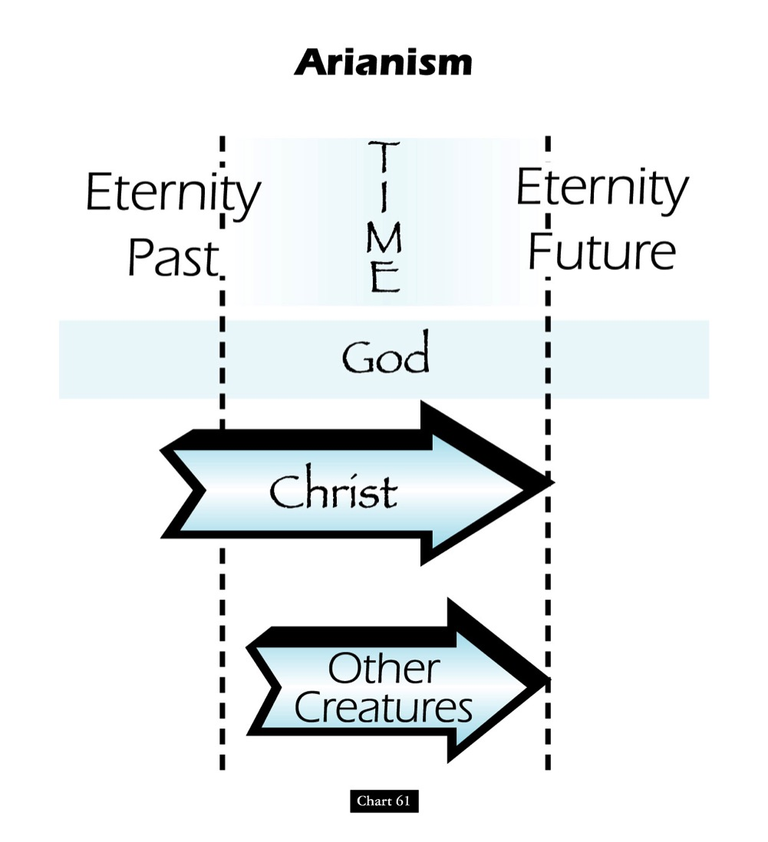
Teachings of the Heretic Arius
Eternity
Past
Eternity
Future
TIME
God
Christ
Other
Creatures
John D. Hannah, Charts of Ancient & Medieval Church History (Grand Rapids: Zondervan, 2001)
Notes:
One of the early heretical leaders was named Arius. He denied that Christ was "co-eternal" with the Father. Arius taught that Christ had a beginning point in eternity past.

Slide 29
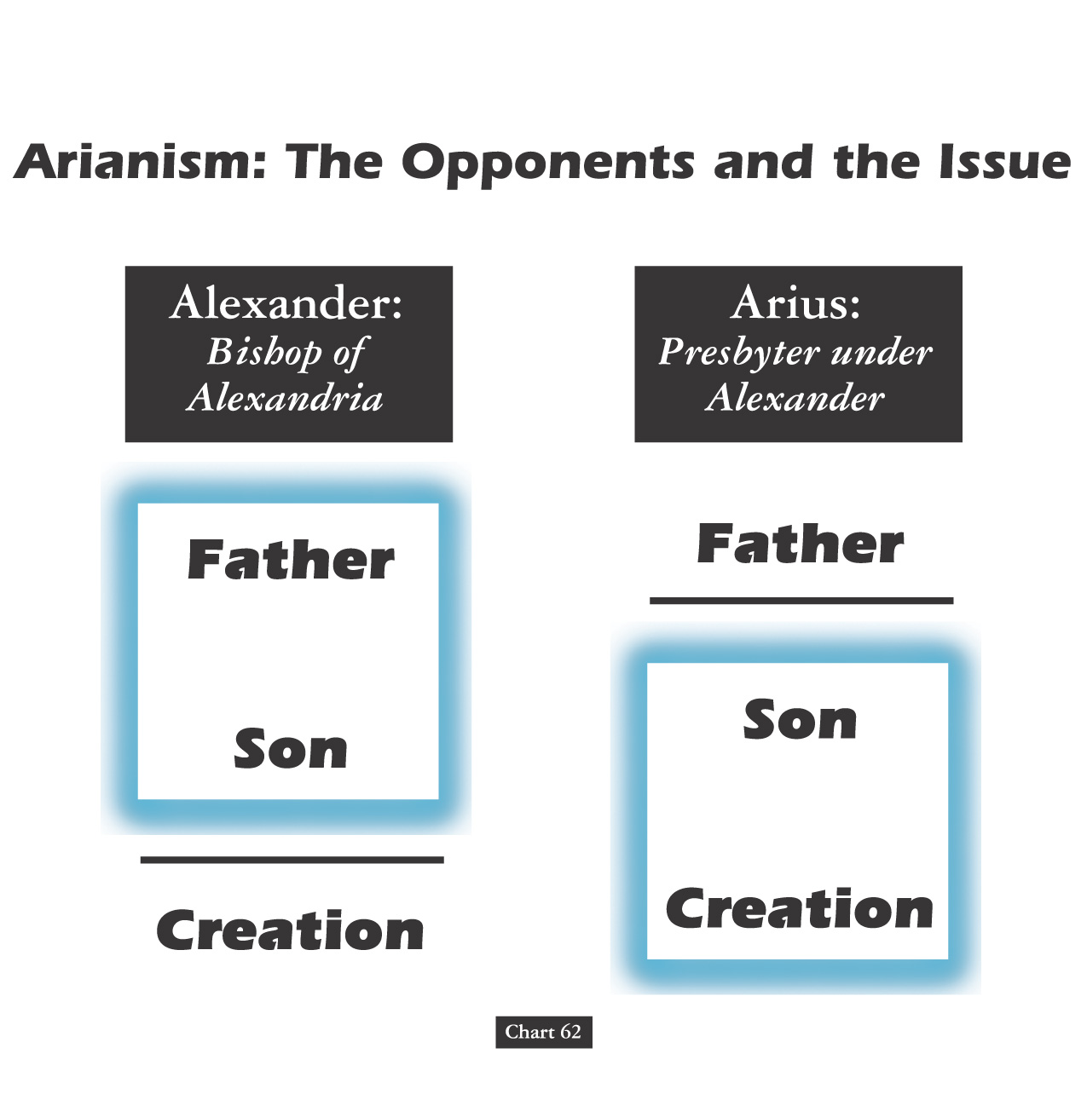
Alexander versus the Heretic Arius
Alexander:
Bishop of Alexandria
Arius:
Presbyter under Alexander
Father
Father
Son
Son
Creation
Creation
John D. Hannah, Charts of Ancient & Medieval Church History (Grand Rapids: Zondervan, 2001)
Notes:
We have come today to worship Jesus Christ. But why do we believe what we do about Jesus? It’s because the NT says so—but how we interpret it came through seeing what heretics taught too. For example, two hundred years after Christ, Alexander was a key leader who held to the orthodox view that the Father and Son stood apart from creation.
• However, Alexander was the “boss” of the pastor Arius in his city. Arius believed only the Father to be separate from creation. Arius taught that the Father created Jesus, then Jesus created the world after this.

Slide 30
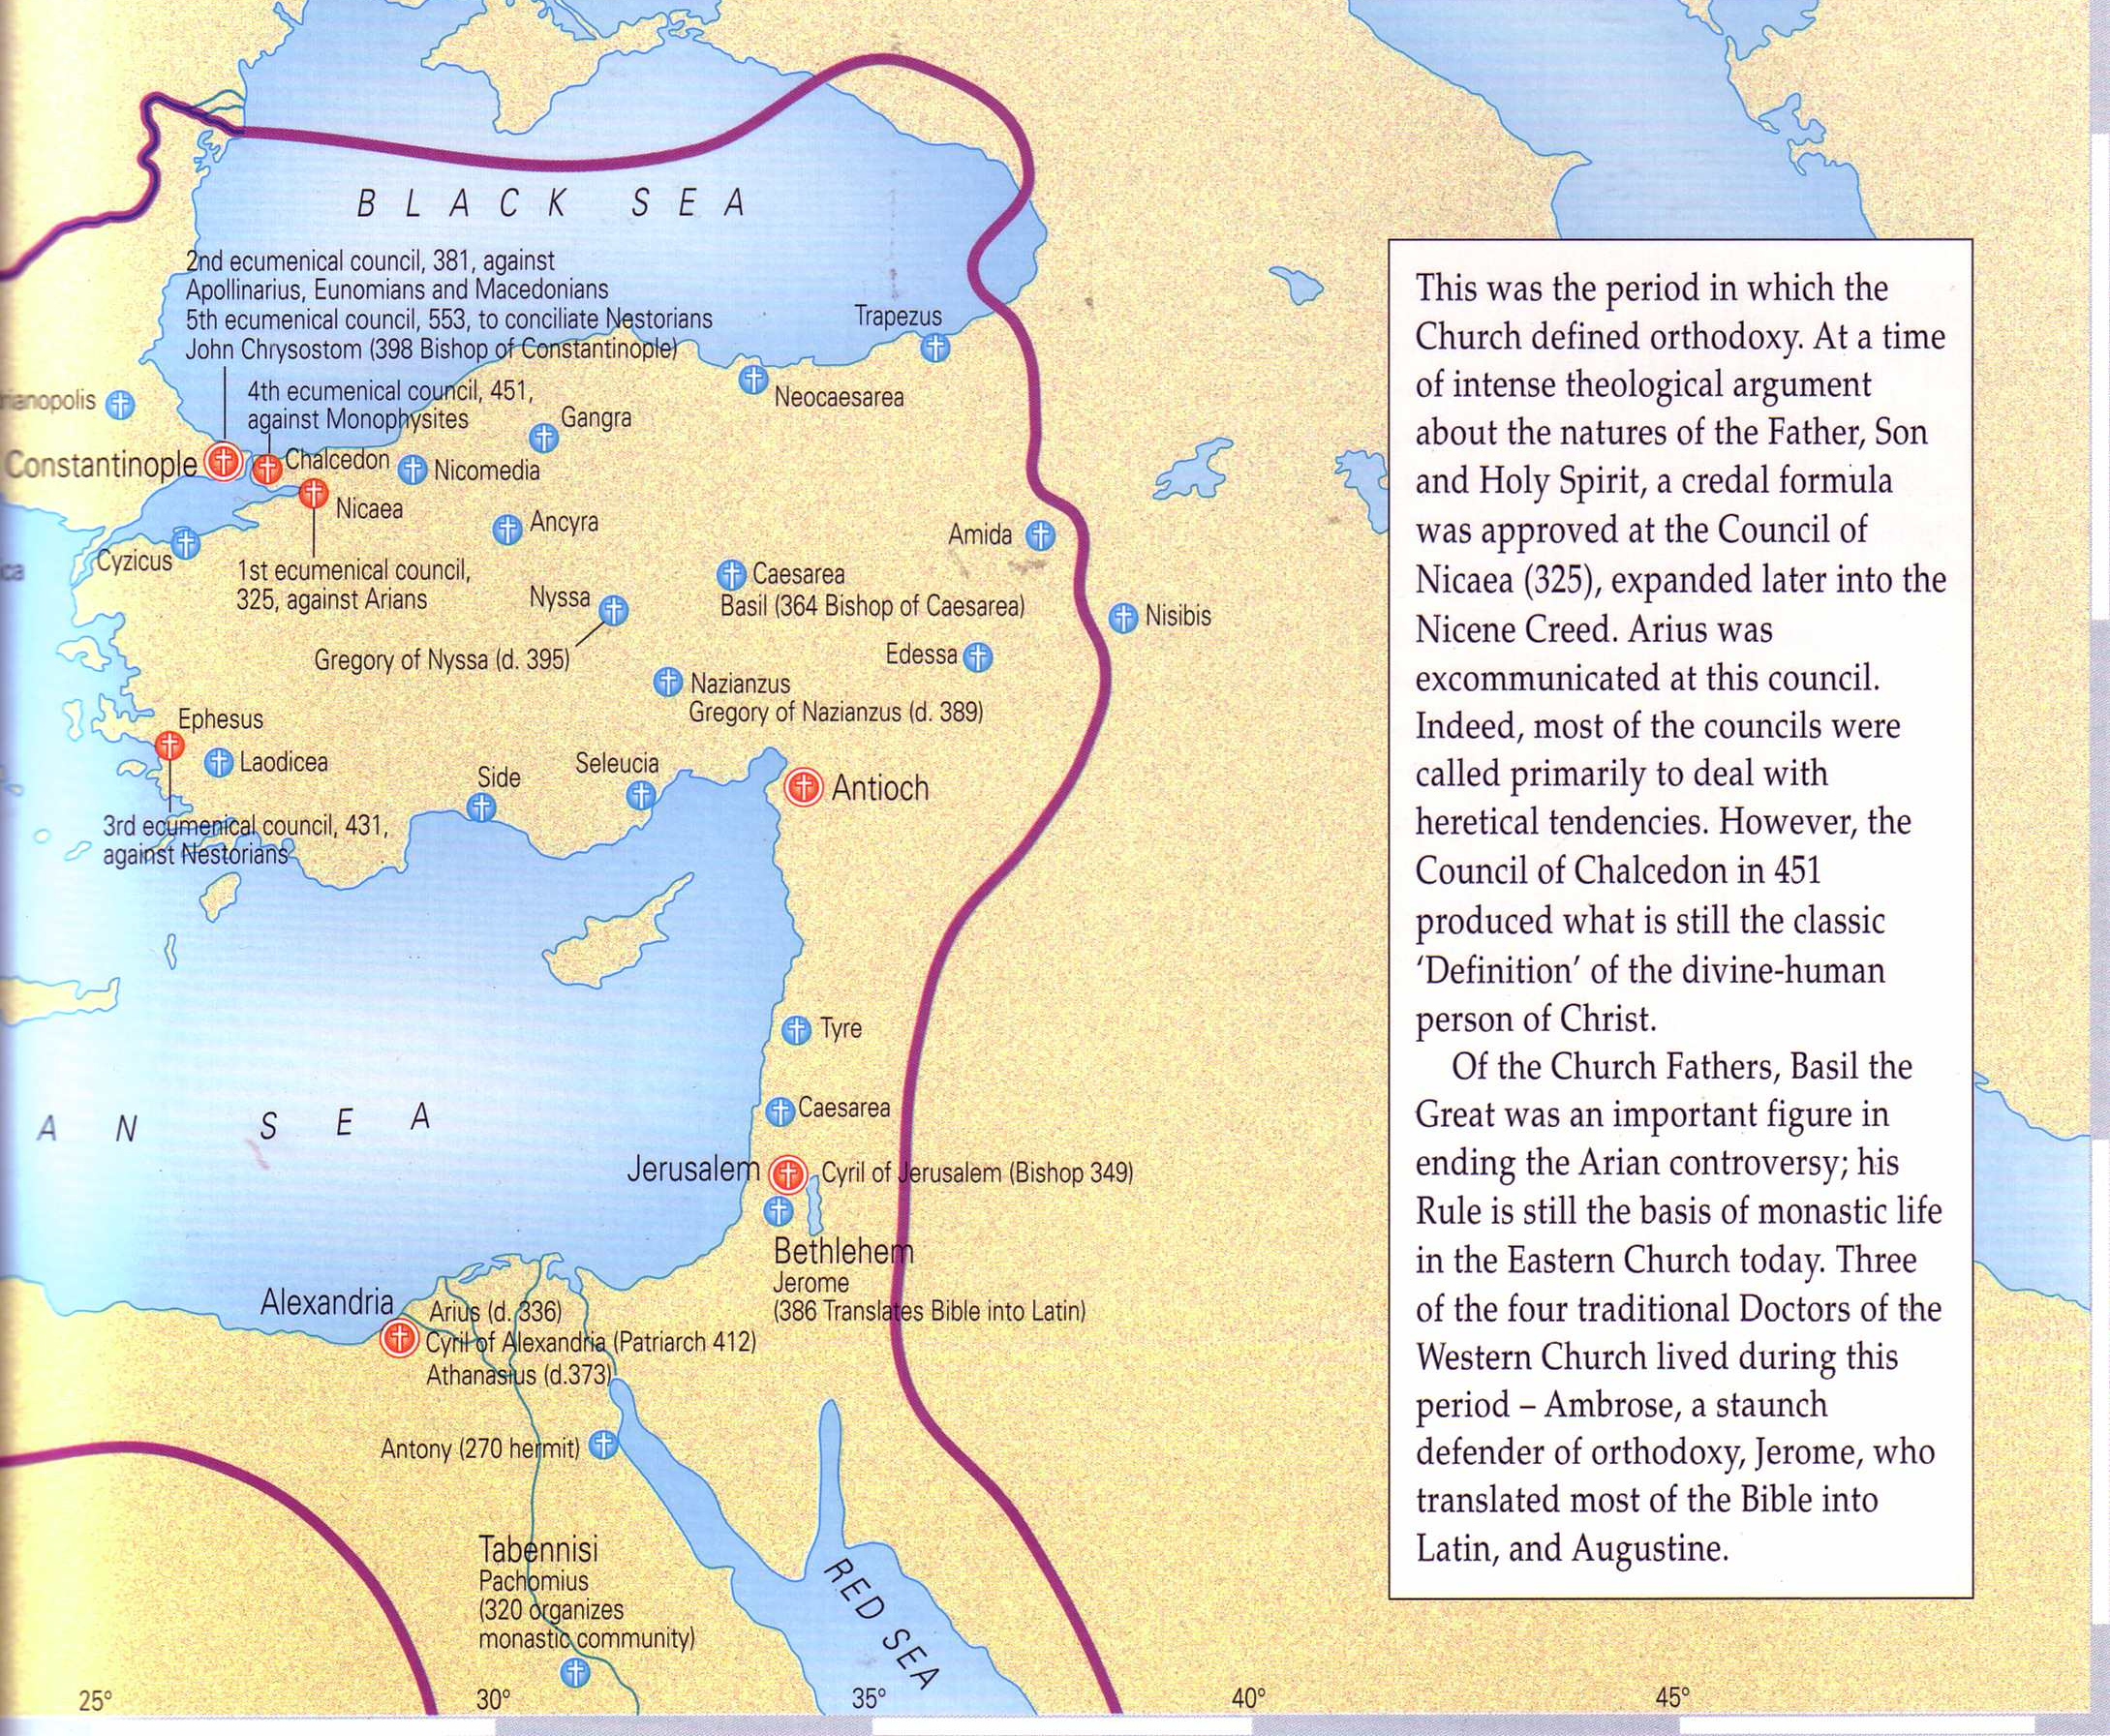

What About Nicea
(AD 325)?
Nicea
Bishops throughout the Eastern Empire gathered & excommunicated Arius of Alexandria
Alexander
Arius
The Atlas of the Bible and the History of Christianity, ed. Tim Dowley (London: Three’s Company, 1997), 77
Notes:
Nicea was a city in what is modern NW Turkey. It was the place where the controversy was resolved and a creed developed.
• The conflict was between Alexander and Arius in Alexandria, Egypt.
• However, to affirm the biblical teaching, 300 church leaders gathered together in the city of Nicea. Here by a vote of 300 to 3 the bishops rejected Arius.

Slide 31
What About Nicaea?
300 votes
Fiction
Fact
3 votes
Arians:
"Jesus Not God"
Orthodox:
"Jesus is God"
Arians:
"Jesus Not God"
Orthodox:
"Jesus is God"
AD 325
Council of Nicaea
Notes:
Brown claims (without support) that the Nicaea vote on whether Jesus was co-eternal with God was very close. The truth is that the vote of the 302 leaders present was 300 to 3. Along with Arius, "The two dissenting bishops were Secundus of Ptolemais and Theonas of Mamarica, both Libyan bishops associated with Arius. All three went into exile after the Council of Nicea" (Paul L. Maier in The Da Vinci Code: Fact or Fiction? with Hank Hanegraaff [Wheaton: Tyndale, 2004], 15, n. 6, on p. 73).

Slide 32
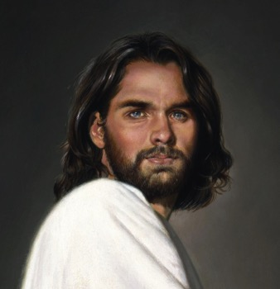
1st century belief in Deity
Paul:
"Christ, who is God over all"
Rom. 9:5
Peter:
"God and Savior Jesus Christ"
2 Pet. 1:1
The Father:
"About the Son He says, 'Your throne, O God…'" Heb. 1:8
Jesus:
"I and the Father are one"
John 10:30
Notes:
There is NO doubt that the earliest Christians believed that Jesus was God! Hebrews 1:8 gives us the witness of the Father himself, and where can one find a more reliable witness than God himself?

Slide 33
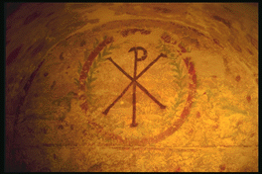
Belief in Christ's Deity Before Nicaea
Ignatius: "God Himself was manifest in human form" (AD 105)
Clement: "It is fitting that you should think of Jesus Christ as of God" (AD 150)
Irenaeus: "He is God, for the name Emmanuel indicates this" (AD 180)
Tertullian: "… Christ our God" (AD 200)
Origen: "No one should be offended that the Savior is also God" (AD 225)
Lactantius: "We believe Him to be God"
(AD 304)
Bercot, 93-100 in Garlow & Jones, 94
Notes:
Over and over the early church fathers affirmed that Jesus was God--all long BEFORE Nicaea!

Slide 34
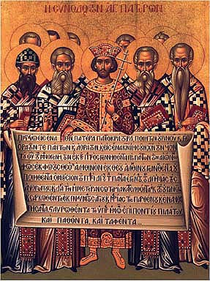
The Nicene Creed (AD 325)
We believe in one God,
the Father All Governing,
Creator of all things
visible and invisible;
And in one Lord Jesus Christ,
the Son of God,
Light from Light,
true God from true God
Notes:
The orthodox view won out and was expressed in the Nicene Creed. Let’s remind ourselves of this important teaching as we affirm aloud this great summary of Christian teaching. Reading together…(recite text)

Slide 35
The Nicene Creed (AD 325)
begotten not created,
of the same essence
as the Father,
through whom all things
came into being,
both in heaven and on earth;
Who for us men and for our salvation
came down and was incarnate,
becoming human.

Slide 36
The Nicene Creed (AD 325)
He suffered
and the third day he rose,
and ascended
into the heavens.
And he will come to judge
both the living and the dead.
And we believe in the Holy Spirit.

Slide 37
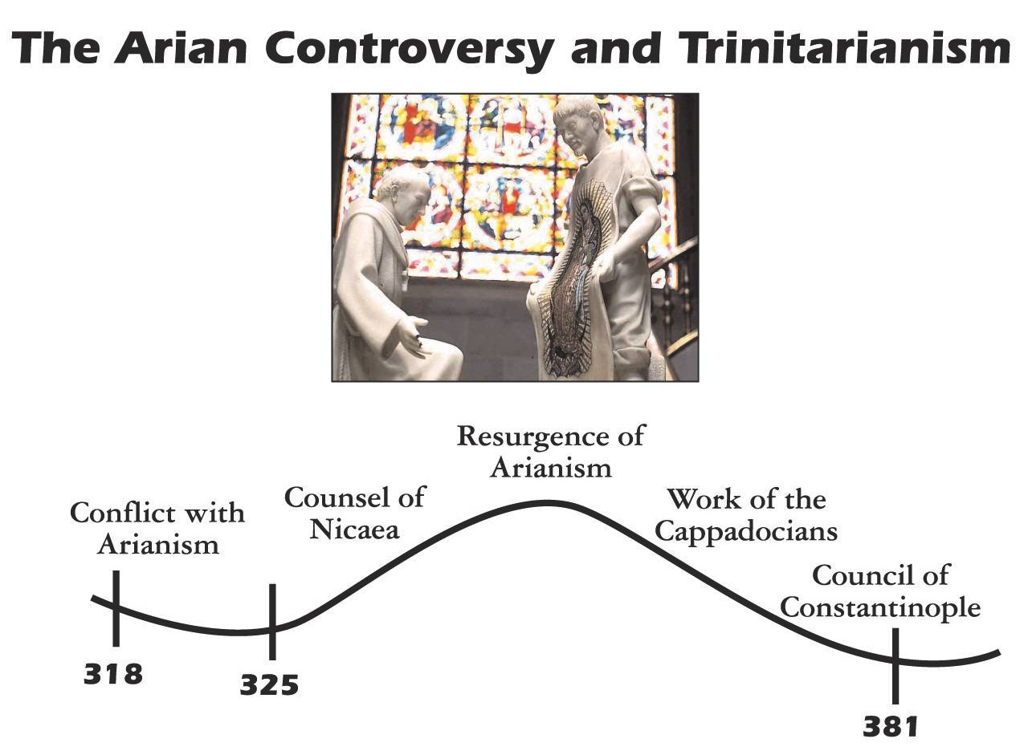

The Arian Controversy and Trinitarianism
Resurgence of Arianism
Work of the Cappadocians
Conflict with Arianism
Council of Nicaea
Council of Constantinople
Initial Rejection of Arianism
Final Rejection of Arianism
John D. Hannah, Charts of Ancient & Medieval Church History (Grand Rapids: Zondervan, 2001)
Notes:
Unfortunately, Nicea did not end the Arian controversy, which later resurged until its final rejection almost 60 years later.

Slide 38
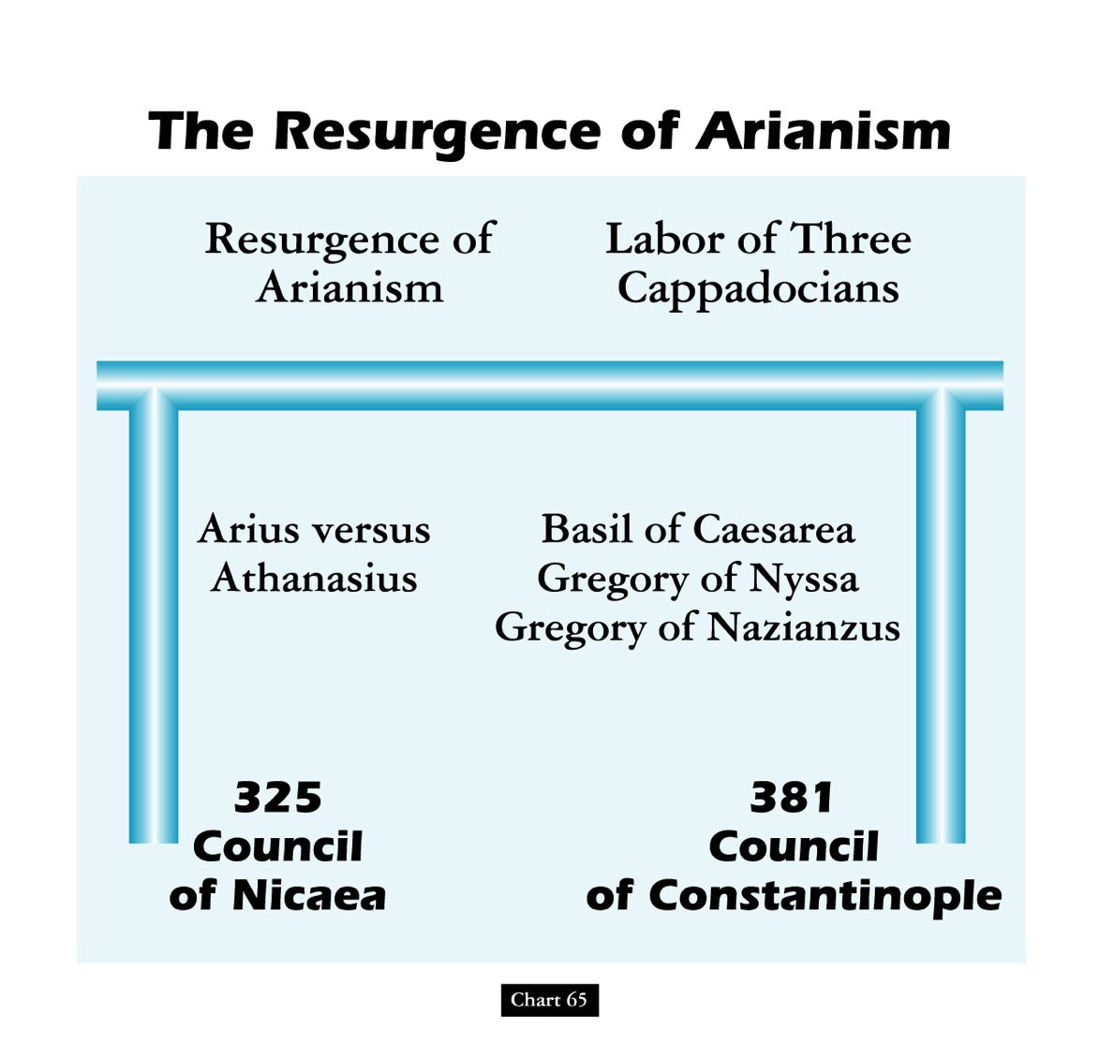
The Resurgence of Arianism
Resurgence of Arianism
Labor of Three Cappadocians
Arius versus
Athanasius
Basil of Caesarea
Gregory of Nyssa
Gregory of Nazianzus
325
Council
of Nicaea
381
Council
of Constantinople
John D. Hannah, Charts of Ancient & Medieval Church History (Grand Rapids: Zondervan, 2001)
Notes:
God raised up Basil and the "Two Gregorys" to finally nail the coffin in Arianism. (However, this same heresy came back in the 1800s in a cult called Jehovah's Witnesses which teaches that Jesus was created by the Father.)

Slide 39
Christ Alone is the Light
John (1:6-9)
Came to the world (6)
Came into existence (6)
A Man (6)
Testified of the Light (7-8)
Jesus (1:1-5)
Made the world (3)
Was in the beginning (1a)
The Word, or God (1c)
Was the Light Himself (9)

Slide 40

Introduction of the King
§§ 1-27
Arrival
Ambassador
Approval
Ancestry
Advent
Infancy/
Childhood
Baptism
Temptation
Herald
Notes:
Jesus did all that we should expect of the Messiah (King) from the start:
1—He arrived in the proper lineage of David, born of a virgin, and knew his deity even at age 12
2—His forerunner John knew his role in preparing Israel for her king
3—He had the best witnesses possible in the Father (baptism), Spirit (temptation), and John (prophesied herald)

Slide 41
Introduction of the King
§§ 1-27
Arrival
Ancestry
Advent
Infancy/
Childhood
Notes:
Jesus did all that we should expect of the Messiah (King) from the start:
1—He arrived in the proper lineage of David, born of a virgin, and knew his deity even at age 12
2—His forerunner John knew his role in preparing Israel for her king
3—He had the best witnesses possible in the Father (baptism), Spirit (temptation), and John (prophesied herald)

Slide 42

A. The Arrival of the King
§§ 3-19
His lineage, birth, infancy, and childhood show that Jesus is the Messiah of Israel

Slide 43
1. His Ancestry
§ 3
Matthew 1:1-17; Luke 3:23b-38
The genealogy of Jesus establishes his legal and physical right to the throne of David in fulfillment of the Davidic Covenant

Slide 44
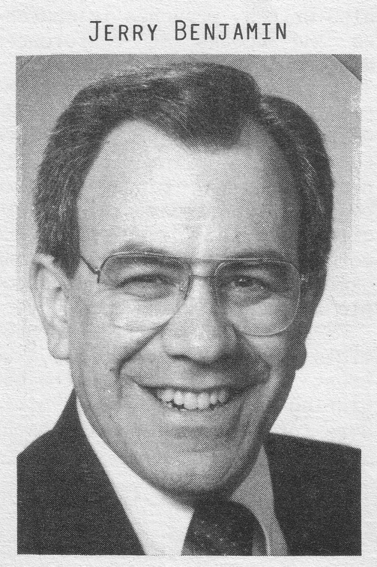
A boring way to begin a book?
ESV Matthew 1:1 The book of the genealogy of Jesus Christ, the son of David, the son of Abraham. 2 Abraham was the father of Isaac, and Isaac the father of Jacob, and Jacob the father of Judah and his brothers, 3 and Judah the father of Perez and Zerah by Tamar, and Perez the father of Hezron, and Hezron the father of Ram, 4 and Ram the father of Amminadab, and Amminadab the father of Nahshon, and Nahshon the father of Salmon, 5 and Salmon the father of Boaz by Rahab, and Boaz the father of Obed by Ruth, and Obed the father of Jesse, 6 and Jesse the father of David the king. And David was the father of Solomon by the wife of Uriah, 7 and Solomon the father of Rehoboam, and Rehoboam the father of Abijah, and Abijah the father of Asaph, 8 and Asaph the father of Jehoshaphat, and Jehoshaphat the father of Joram, and Joram the father of Uzziah, 9 and Uzziah the father of Jotham, and Jotham the father of Ahaz, and Ahaz the father of Hezekiah, 10 and Hezekiah the father of Manasseh, and Manasseh the father of Amos, and Amos the father of Josiah, 11 and Josiah the father of Jechoniah and his brothers, at the time of the deportation to Babylon. 12 And after the deportation to Babylon: Jechoniah was the father of Shealtiel, and Shealtiel the father of Zerubbabel, 13 and Zerubbabel the father of Abiud, and Abiud the father of Eliakim, and Eliakim the father of Azor, 14 and Azor the father of Zadok, and Zadok the father of Achim, and Achim the father of Eliud, 15 and Eliud the father of Eleazar, and Eleazar the father of Matthan, and Matthan the father of Jacob, 16 and Jacob the father of Joseph the husband of Mary, of whom Jesus was born, who is called Christ.
Jeremiah Benjamin
"The first verse stunned me," Jerry recalls. "It said that Jesus was related to my forefathers."
Notes:
Most of us, if we are honest, find that the first few verses of the NT are boring. They may be good for getting us to sleep if we have insomnia, but they aren't generally appreciate as literature [read 1:1-3 with a yawn].
While I was a student at Dallas Seminary, I had the privilege of meeting Jeremiah Benjamin—a true Jewish name if you ever heard one! Jerry was from such a strictly orthodox Jewish family that the New Testament was forbidden in his home. However, a Christian student once gave him a NT and challenged him to read it. So he snuck into his room, climbed into bed, pulled the sheets over him and took out his flashlight.
[Animation] "The first verse stunned me," Jerry later recalled. "It said that Jesus was related to my forefathers."
My experience with Jerry helped me to see that Matthew's beginning didn't interest me because I am a Gentile who wasn't looking for Israel's king. I didn't even know what questions to ask or what to look for. But Matthew was written for the Jewish heart and mind. Therefore, he starts off with a bang: Jesus was actually a direct descendant of King David and therefore fulfilled the lineage necessary to be Israel's king!

Slide 45
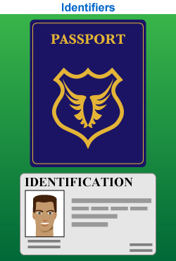
Proof That Jesus is King
Notes:
"Persons traveling by plane to another country must identify themselves. Picture identification, like a driver's license and a passport, are usually required. These identifiers are carefully examined to ensure that all the passengers are safe from harm. A man who identifies himself as the Messiah also needs the correct identification. For instance, He must be descended from the line of David, be born in the right city, be born at the right time, and be able to perform amazing works" (Rick Griffith, "Advanced Studies in the NT," Lesson 1, Topic 3, internetseminary.org accessed 17 Jan 2016).

Slide 46
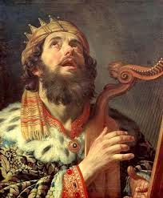
David Listed Before Abraham
"This is a record of the ancestors of Jesus the Messiah, a descendant of David and of Abraham"
(Matt. 1:1 NLT)

Slide 47
Messianic Titles
69
Matthew presents Christ as Messiah
in all three required aspects:
Prophet: Discourses (chs. 5–7, 10, 13, 18, 23–25)
Priest: Atoning death (chs. 26–27)
King: "son of David" (1:1; 9:27; 12:23, etc.)
Support for a literal view of the kingdom is extensive

Slide 48
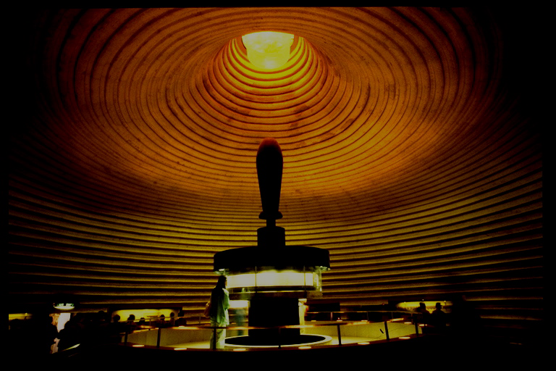
ABRAHAMIC COVENANT
The Call to Abraham Gen. 12:1-3
The Covenant to Abraham Gen. 15:9-18
ETERNAL
LITERAL
UNCONDITIONAL
Gen. 13:15
Gen. 13:14-16
Gen. 15:9-18
LAND
SEED
BLESSING
Gen. 12:1
Gen. 12:2
Gen. 12:3
The Amplified Subcovenants
Land
Davidic
Deut. 30:1-10
2 Sam. 7:4-16
The Very "Backbone" of Biblical Revelation
18
©2004 TBBMI
7.2.05B.

Slide 49
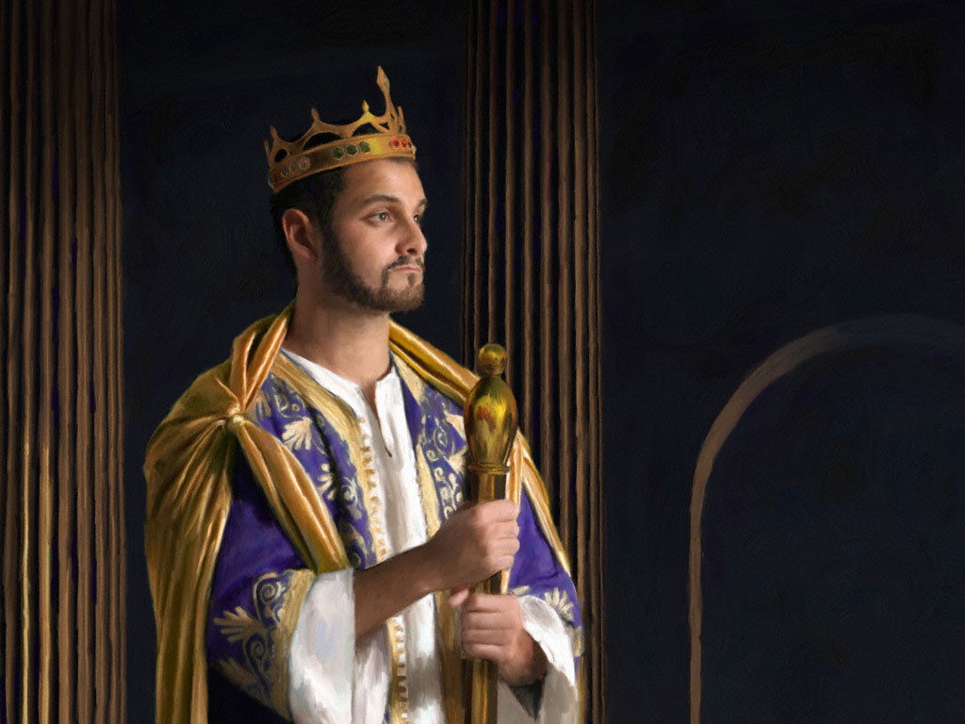
KEY VERSE:
2 Samuel 7:12-13
209
"For when you (David) die, I will raise up one of your descendants, and I will make his kingdom strong. He is the one who will build a house—a temple—for my name. And I will establish the throne of his kingdom forever."

Slide 50

THE DAVIDIC COVENANT
ITS THREE GUARANTEES
2 Samuel 7
¹⁶ Your house and your kingdom will endure forever before me; your throne will be established forever.
forever
forever
19
6
©2004 TBBMI
8.0.05B.

Slide 51
So, then, the question must be asked:
Who is qualified to sit on that Davidic throne?
20
©2004 TBBMI
8.0.05B.

Slide 52
STUDY HELP #16
THE DAVIDIC DYNASTY
The Royal Genealogy of Jesus Christ
21
1
©2004 TBBMI
8.0.05B.

Slide 53
THE LINE OF DAVID: The Royal Genealogy of Jesus Christ*
*VASTLY ABBREVIATED
22
1
Notes:
What about the genealogy of the Lord Jesus Christ, out of that line of David, according to Scripture? What do the scriptures have to say about all that? We are given a long and complex genealogy...
/// so this one will be vastly abbreviated.

Slide 54
THE LINE OF DAVID: The Royal Genealogy of Jesus Christ*
ADAM EVE
Scripture Location:
Genesis 3:20
*VASTLY ABBREVIATED
23
Notes:
We begin with Adam and Eve, first recounted in Genesis 3:20...

Slide 55
THE LINE OF DAVID: The Royal Genealogy of Jesus Christ*
ADAM EVE
Scripture Location:
Genesis 4:1-2; 4:8
CAIN ABEL
*VASTLY ABBREVIATED
24
1
Notes:
From their union came the brothers Cain and Abel.
//// And we know that Cain slew Abel because of Cain's jealousy of the gifts Abel made in sacrifice to the Lord. As a replacement for that murdered brother who was more favored by God, another son was born to Adam and Eve...

Slide 56
THE LINE OF DAVID: The Royal Genealogy of Jesus Christ*
ADAM EVE
Scripture Location:
Genesis 4:25
CAIN ABEL SETH
*VASTLY ABBREVIATED
25
Notes:
He was Seth, the beginning of a godly line of men. AND RIGHT HERE is where the royal genealogy of Jesus Christ gets underway.

Slide 57
THE LINE OF DAVID: The Royal Genealogy of Jesus Christ*
ADAM EVE
Scripture Location:
Genesis 5:29
CAIN ABEL SETH
NOAH
*VASTLY ABBREVIATED
26
Notes:
From Seth...followed Noah. By the way...dotted lines represent an abbreviation of all the Biblical names that actually occur during the long lines of descent. Scripture tells us the names of each one.

Slide 58
THE LINE OF DAVID: The Royal Genealogy of Jesus Christ*
ADAM EVE
Scripture Location:
Genesis 11:26
CAIN ABEL SETH
NOAH
ABRAHAM
*VASTLY ABBREVIATED
27
Notes:
Eventually through this line...we arrive at Abraham.

Slide 59
THE LINE OF DAVID: The Royal Genealogy of Jesus Christ*
ADAM EVE
Scripture Location:
Matthew 1:2-6
CAIN ABEL SETH
NOAH
ABRAHAM (Sarah)
*VASTLY ABBREVIATED
DAVID
28
Notes:
And from Abraham, a thousand years later, appears David..

Slide 60
THE LINE OF DAVID: The Royal Genealogy of Jesus Christ*
ADAM EVE
Scripture Location:
2 Samuel 12:24
CAIN ABEL SETH
NOAH
ABRAHAM
*VASTLY ABBREVIATED
DAVID BATHSHEBA
29
Notes:
And...among other of David's several wives...appears Bathsheba.

Slide 61
THE LINE OF DAVID: The Royal Genealogy of Jesus Christ*
ADAM EVE
Scripture Location:
2 Samuel 5:14
CAIN ABEL SETH
NOAH
ABRAHAM
*VASTLY ABBREVIATED
DAVID BATHSHEBA
NATHAN SOLOMON
30
Notes:
Among the children of David and Bathsheba are these two sons: Nathan and Solomon. And here the line splits. Note that. It's a crucial place.

Slide 62
THE LINE OF DAVID: The Royal Genealogy of Jesus Christ*
ADAM EVE
Scripture Location:
Luke 3:23
Plus Others
CAIN ABEL SETH
NOAH
ABRAHAM
*VASTLY ABBREVIATED
DAVID BATHSHEBA
NATHAN SOLOMON
LUKE 3:23 (see other references)
MARY
31
Notes:
From the line of son Nathan, eventually appears Mary, the mother of Jesus.

Slide 63
THE LINE OF DAVID: The Royal Genealogy of Jesus Christ*
LUKE 3:23 (see other references)
Luke 3:23: "Now Jesus himself was about 30 years old when He began His ministry. He was the son, so it was thought, of Joseph." (NIV)
"Luke was tracing the line of Mary. Many interpreters [among varied positions…] argue that Luke was giving the genealogy of Mary, showing that she also was in the line of David and that therefore Jesus was qualified as the Messiah, not only through Joseph (since he was the oldest legal heir) but also through Mary."
Louis Barbieri, The Bible Knowledge Commentary, eds. John Walvoord & Roy Zuck (Victor Books, 1983), 212.
32
1
Notes:
Luke wrote about this in his Gospel. In his third chapter, verse 23: "Now Jesus himself was about 30 years old when He began His ministry. He was the son, SO IT WAS THOUGHT, of Joseph."
//// This further explanation from two eminent Bible scholars: "Luke was tracing the line of Mary. Many interpreters [among varied other positions…] argue that Luke was giving the genealogy of Mary, showing that she also was in the line of David and that therefore Jesus was qualified as the Messiah, not only through Joseph (since he was the oldest legal heir) but also through Mary."

Slide 64
THE LINE OF DAVID: The Royal Genealogy of Jesus Christ*
ADAM EVE
Scripture Location:
Matthew 1:16
CAIN ABEL SETH
NOAH
ABRAHAM
*VASTLY ABBREVIATED
DAVID BATHSHEBA
NATHAN SOLOMON
MARY JOSEPH
33
Notes:
And from Solomon's side...the line of descent leads directly to Joseph, Jesus' FOSTER-father. And then the climactic event of the ages...from Joseph and Mary, through the intervention of the Holy Spirit in Mary's womb…

Slide 65
THE LINE OF DAVID: The Royal Genealogy of Jesus Christ*
ADAM EVE
Scripture Location:
Matthew 1:16
CAIN ABEL SETH
NOAH
ABRAHAM
*VASTLY ABBREVIATED
DAVID BATHSHEBA
NATHAN SOLOMON
MARY JOSEPH
JESUS CHRIST
34
Notes:
…the Lord Jesus Christ enters the earth. And, you might say, "well…we all know that. What is the importance of such an emphasis on it?" Answer: earthly kingship presents two requirements...

Slide 66
THE LINE OF DAVID: The Royal Genealogy of Jesus Christ*
ADAM EVE
CAIN ABEL SETH
NOAH
ABRAHAM
DAVID BATHSHEBA
NATHAN SOLOMON
BLOOD SUCCESSION
LEGAL SUCCESSION
The FAMILY Right
Luke 3:23-38
The LEGAL Right
Matt 1:1-17
MARY JOSEPH
JESUS CHRIST
35
3
Notes:
FIRST…a family qualification by right of a bloodline succession.
//// SECOND…there must also be a legal qualification by right of traditional succession.
//// The family right and blood line through Mary – the mother of Jesus – as it is laid out in Luke's gospel, third chapter, verses 23-38,
//// While the legal line of Jesus' father – Joseph -- appears in detail in Matthew's Gospel, chapter 1, verses 1-17.
Much has been written all about this...far more than can be described here. So you are encouraged to dig into these ideas. They are rich with meaning, significance and credibility toward establishing the Lord's place in the great Plan of the Ages.

Slide 67
THE LINE OF DAVID: The Royal Genealogy of Jesus Christ*
ADAM EVE
CAIN ABEL SETH
NOAH
ABRAHAM
DAVID BATHSHEBA
NATHAN SOLOMON
The FAMILY Right
Luke 3:23-38
The LEGAL Right
Matt 1:1-17
BLOOD
RIGHT
MARY JOSEPH
JESUS CHRIST
36
Notes:
So...to sum up...
Mary, Jesus' birth mother, supplies his bloodline directly back to the throne of David...and beyond.

Slide 68
THE LINE OF DAVID: The Royal Genealogy of Jesus Christ*
ADAM EVE
CAIN ABEL SETH
NOAH
ABRAHAM
DAVID BATHSHEBA
NATHAN SOLOMON
The FAMILY Right
Luke 3:23-38
The LEGAL Right
Matt 1:1-17
BLOOD
RIGHT
LEGAL
RIGHT
MARY JOSEPH
JESUS CHRIST
37
Notes:
...and Joseph…as the foster-father and a descendant of King Solomon… has the right of legal succession to bestow upon his foster son, Jesus. A remarkable evidence of the credibility and reliability of the Scriptural record.

Slide 69

HAVE YOU EVER CONSIDERED THE INCREDIBLE PROBABILITIES OF THE BIRTH AND LIFE OF JESUS CHRIST?
JUST AN ACCIDENT OF BIRTH?
STUDY HELP #17
39
2
©2006 TBBMI
9.65.05B.
Notes:
With Study Help #17 in hand…place yourself here in a rocky field outside Bethlehem where a shepherd tends his flock –– as it has been for thousands of years on this same land…just outside that ancient little town where Jesus was born. From here you could have seen and heard the angelic announcement of his miraculous birth! Which leads to another another question…
//// Have you ever considered the astonishing statistical probabilities of the birth and life of Jesus Christ?
//// Was it just an accident of birth?

Slide 70
HAVE YOU EVER CONSIDERED THE INCREDIBLE PROBABILITIES OF THE BIRTH AND LIFE OF JESUS CHRIST?
*
JUST AN ACCIDENT OF BIRTH?
IN THE OLD TESTAMENT: MORE THAN 300 REFERENCES TO A COMING MESSIAH WERE FULFILLED UPON THE BIRTH, LIFE AND CRUCIFIXION OF JESUS CHRIST. WITH THAT SAID…
STUDY HELP #17
*Source: Josh McDowell, Evidence That Demands A Verdict, 1972, page 175; Peter Stoner, Science Speaks, Moody Press, 1963.
40
Notes:
In the Old Testament…more than 300 references to a coming Messiah were fulfilled upon the birth, life and crucifixion of Jesus Christ. So then, with that said, according to established scientific techniques of probability and statistics.

Slide 71
THAT SAID…
WHAT ARE THE CHANCES OF ONLY 8 PREDICTIONS BEING FULFILLED IN THE LIFE OF ANY ONE INDIVIDUAL BETWEEN THEN AND NOW?
_{ANSWER: ONE CHANCE IN}
_{100 QUADRILLION (10} ¹⁷₎
_{1:100,000,000,000,000,000}
*Source: Josh McDowell, Evidence That Demands A Verdict, 1972, page 175; Peter Stoner, Science Speaks, Moody Press, 1963.
41
2
Notes:
What, then, are the chances of only EIGHT predictions being fulfilled in the life of any one individual between then and now?
//// The answer: one chance in 100 quadrillion…or…10 to the 17th!
//// and here is what that number looks like typed out!
If you think that is incredible…here comes another one.

Slide 72
TAKE IT A STEP FURTHER…
WITH JUST 48 (OF THE 300) PREDICTIONS BEING FULFILLED IN THE LIFE OF ANY ONE INDIVIDUAL BETWEEN THEN AND NOW:
_{ANSWER: one chance in 10}¹⁵⁷
1:10,000,000,000,000,000,000,000,000,000,000,000,000,000, 000,000,000,000,000,000,000,000,000,000,000,000,000,000, 000,000,000,000,000,000,000,000,000,000,000,000,000,000, 000,000,000,000,000,000,000,000,000,000,000,000
*Source: Josh McDowell, Evidence That Demands A Verdict, 1972, page 175; Peter Stoner, Science Speaks, Moody Press, 1963.
42
3
Notes:
Another measure of scientific probability…
//// Then…with just 48 of the 300 predictions being fulfilled in the life of any one individual between then and now:
//// The answer: one chance in 10 to the 157th!
//// Typed out…here you are!
Before your very eyes…statistical probabilities produced by a world-renowned scientist…according to established scientific procedures of statistics and probability.

Slide 73
Three-Part Genealogy of Christ Through Joseph (1:1-17)
From Abraham to David
– 14 generations
From David to Captivity in Babylon
– 14 generations
From Captivity to Christ
– 14 generations

Slide 74
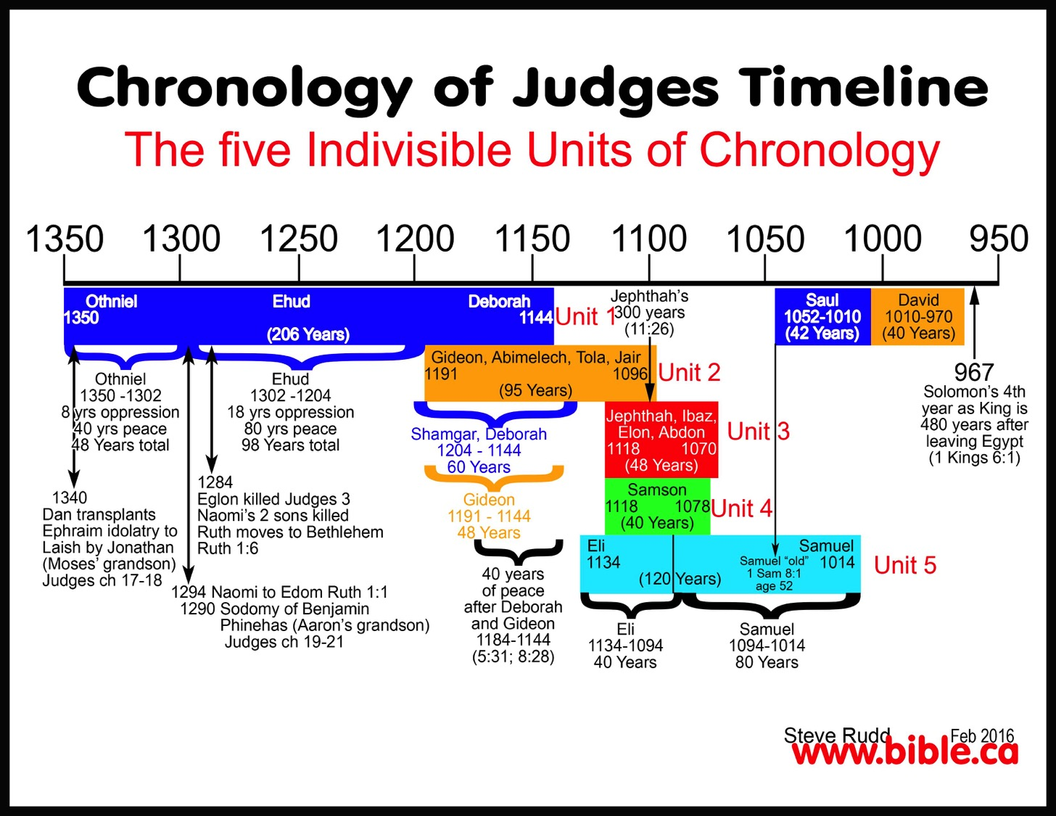
Chronological Overlaps
Chronology of Judges Timeline
The Five Indivisible Units of Chronology

Slide 75
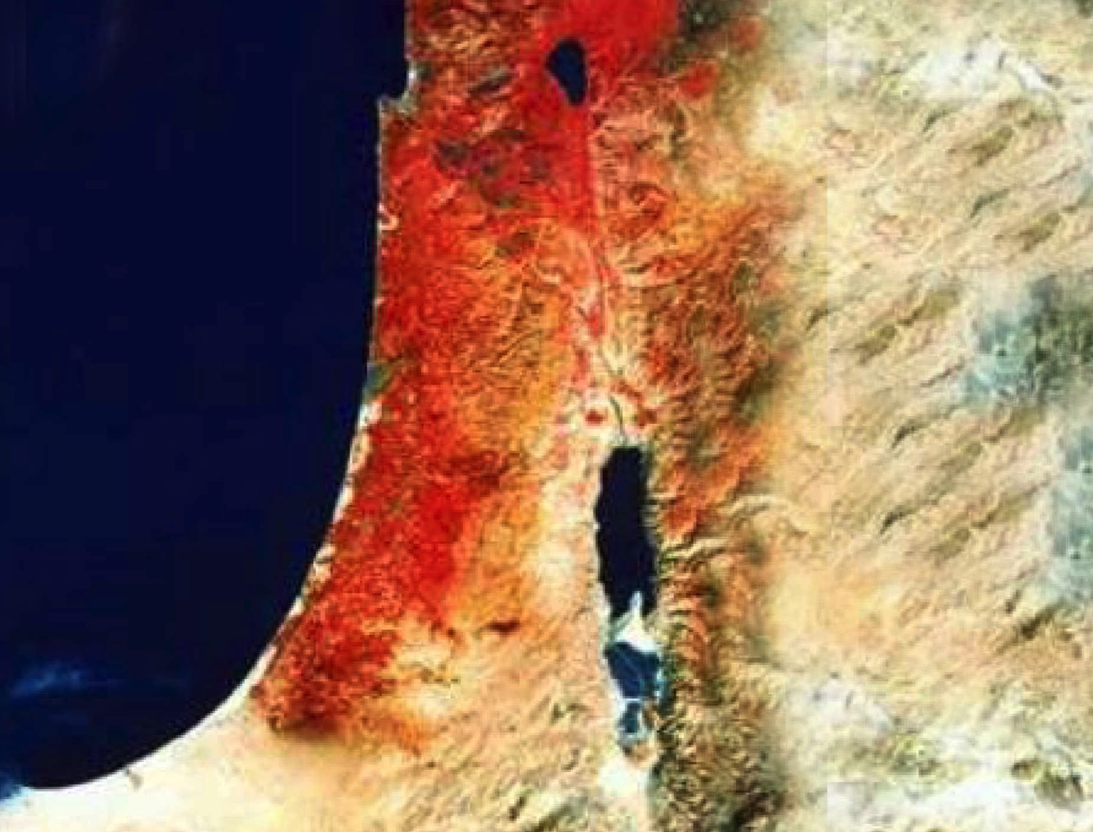

Date
Genealogy
OTS 186
David as Designate
David as King
Era of Judges
1373
1105
1049
1030
1010
971
Othniel
Samson
Samuel's Lifetime
Ruth's Life
Ruth Written
Since the genealogy (4:18-21) ends with David (not Solomon), it was probably penned after David's anointing (ca. 1030 BC) &, at the latest, just before Solomon's crowning as king (971 BC).
Authorship by Samuel pushes the date back to probably 1030-1020 BC.
The story occurs in the previous era of the judges (1:1; 1373-1049 BC).
Since Ruth was David's great-grandmother (4:17) and he began ruling in 1010 BC, some believe Ruth lived in the latter part of the 12th century.
Thus, Samuel records events that occurred about one century earlier.

Slide 76

Promises of the Davidic Covenant
9g
22
What did God promise David in 2 Samuel 7:12-16?
New Dynasty
(2 Sam 7)

Slide 77
Kingdom & Covenants Timeline
22 &
337
9g
Dr. Rick Griffith • BibleStudyDownloads.org
Kingdom Teaching...
Adam rules with God (Gen. 1:26, 28; 2:19)
Satan begins rule as god of this world (Gen. 3:15;
2 Cor. 4:4)
God covenants with Abraham to reestablish man's rule via Israel as a "kingdom of priests" (Gen. 12:1-3; Exod. 19:6)
Israel's failure to witness to nations as a kingdom of priests is judged via exile under foreign rule
Israel rejects Messiah's offer of kingdom (Matt. 12:41-42; 23:37-39)
Jesus extends His kingdom in mystery form to the Church (Matt. 13)
Christ subdues Israel's enemies and nation believes (Rom. 11:26-27)
Christ rules over everything with saints (Eph. 1:9-10; Rev. 20:1-6; 22:5b)
Fall of Man (Gen. 3)
Noahic Covenant
Genesis 6:18; 9:8-17
Land Covenant
ISRAEL
CHURCH
MESSIANIC KINGDOM
(National Focus)
The "New Man" (Eph. 2:15)
Millennial Eternal
land
Genesis 15:18 (cf. Deut. 30:1-10) promises:
Land from Wadi of Egypt to Euphrates River (Isa. 27:12)
Eternal possession of land (Gen. 17:8) after exile/restoration
Whole world blessed via the land (Isa. 14:1-2)
Israel judged for rejecting Messiah by dispersion away from land for 19 centuries
(AD 70–AD 1948) but now partially restored (Ezek. 37:1-7)
Full restoration (Ezek. 37:8-28) Jerusalem world capital
(Isa. 2:1-5)
New Jerusalem
(Rev. 21–22)
Davidic Covenant
Christ is Head over His Church, which is a spiritual temple (Eph. 2:19-22; 2 Cor. 6:16)
Christ reigns over the world
(Isa. 11)
with saints (Rev. 5:10; 20:4-6)
Christ hands kingdom over to Father (1
Cor. 15:24)
Genesis 12:1-3
2 Samuel 7:12-16 promises:
Sons ("house" never wiped out)
Kingdom (political dynasty)
Throne (right to rule by descendants)
Temple (son to build it)
seed
Abrahamic Covenant
New Covenant
All
things made new!
(Rev. 21:5)
All 5 elements fulfilled in national restoration (Zech. 8)
Jeremiah 31:31-34 promises:
Forgiveness
Indwelling Spirit
New heart, nature, mind
Reunification of Israel and Judah
No need for evangelism
Mosaic Law replaced with first three elements of the New Covenant (Luke 22:20; 2 Cor. 3:6)
blessing
Mosaic Covenant
Law abolished, fulfilled, and replaced at the cross (Rom. 7:1-6;1 Cor. 9:19-21; Heb. 8:13)
Eighth Edition
29 Aug 2016
Temporary (Gal. 3:19) and conditional (Deut. 28) to reveal sin (Rom. 7:7) and regulate Israel (Gal. 3:23-25)
Scripture has a dual kingdom-covenant theme. Israel's role from Abraham to Christ expands to include the Church (continuity) yet the Church never replaces the nation as the "new Israel" (discontinuity). Israel will again enjoy world prominence after trusting Christ at His second coming.
Notes:
Slides 13 and 139 repeated

Slide 78
Promises of the Davidic Covenant
9g
22
What did God promise David in 2 Samuel 7:12-16?
Sons: "house" never wiped out
Kingdom: political dynasty (each Jerusalem king will be one of his direct descendants)
Throne: As an eternal covenant (v. 16), the right to rule will remain with his family forever
Temple: Solomon will build it
Discipline: God will punish disobedient kings but still unconditionally keep these promises
New Dynasty
(2 Sam 7)

Slide 79

The Kingdom in Matthew 1
Fall of the Kingdom
Establishing the Eternal Kingdom
ABRAHAM
Solomon
Shealtiel
Isaac
Rehoboam
Zerubbabel
Jacob
Abijah
Abiud
Judah
Asa
Eliakim
Perez
Jehoshaphat
Azor
"Thus there were fourteen generations in all from Abraham to David, fourteen from David to the exile to Babylon, and fourteen from the exile to Christ."
Matthew 1:17
Ahaziah
Hezron
Jehoram
Zadok
Joash
Ram
Uzziah
Akim
Amaziah
Amminadab
Jotham
Eliud
Nahshon
Ahaz
Eleazar
Salmon
Hezekiah
Matthan
Boaz
Manasseh
Jacob
Obed
Amon
Joseph +
Mary
Rise of the Kingdom
Jesse
Josiah
KING DAVID
JECONIAH (EXILE)
JESUS CHRIST

Slide 80
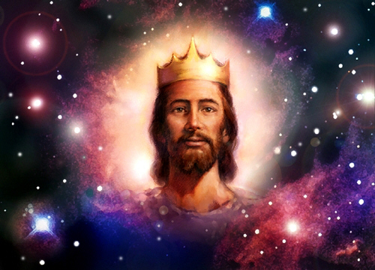
Matthew says Jesus is King!

Slide 81
Some of the many authors who have written on Jesus' genealogy:
Criswell, W. A.
Danker, Frederick
Ellis, E. Earle
Fitzmeyer, Joseph
Godet, F. A.
Hendricksen, William
Hoehner, Harold
Ironside, F. A.
Marshall, I. Howard
McGee, J. Vernon
Morgan, G. Campbell
MacArthur, John
Scofield, C. I.
Swindoll, Charles
Unger, Merrill
Walvoord, John
Zuck, Roy
38
©2004 TBBMI
8.0.05B.

Slide 82
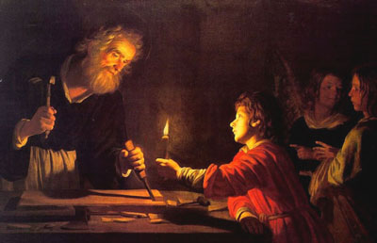
Birth & Childhood of Jesus
Adapted from a 2006 Class Presentation by Connie Tong for
Dr. Rick Griffith • Singapore Bible College • BibleStudyDownloads.org

Slide 83
Genealogy of Jesus
Matthew
from
Abraham
down to
Jesus

Slide 84
15
P1 Million
14
P500,000
How many generations were there from Abraham to Jesus?
13
P250,000
12
P125,000
11
P64,000
10
P32,000
9
P16,000
8
P8,000
7
P4,000
6
P2,000
5
P1,000
4
P500
3
P300
2
P200
50:50
1
P100
A: 14 x 3
B: 14 x 4
C: 13 x 5
D: 15 x 2

Slide 85
Genealogy of Jesus
Matthew
Abraham
David
Babylonian exile
Jesus
from
Abraham
down to
Jesus

Slide 86
Genealogy of Jesus
Matthew
from
Abraham
down to
Jesus
Adam
up to
Jesus
from
Luke

Slide 87
Jesus'
Focus
Davidic heritage
messianic role

Slide 88
2. His Advent
§§ 4-11
The arrival of both John and Christ is announced and fulfilled to show through their births that Jesus is the promised Messiah
Notes:
Arabic edited

Slide 89
Birth & Childhood of Jesus
Adapted from a 2006 Class Presentation by Connie Tong for
Dr. Rick Griffith • Singapore Bible College • BibleStudyDownloads.org

Slide 90

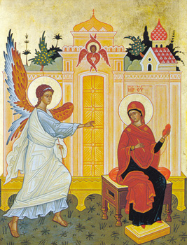
same main details
Of
Matthew & Luke
Mary & Joseph were godly parents
virginal conception of Mary
an angel announced the birth of Jesus

Slide 91
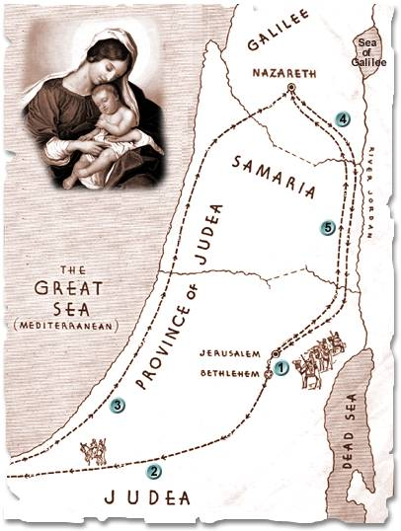
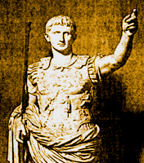
named the child in advance
born in
Bethlehem in
the time
of Herod
Nazareth
Bethlehem
the family settled in Nazareth

Slide 92
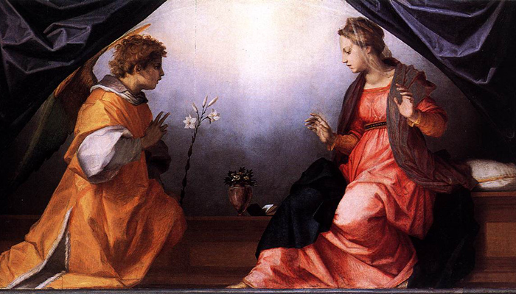
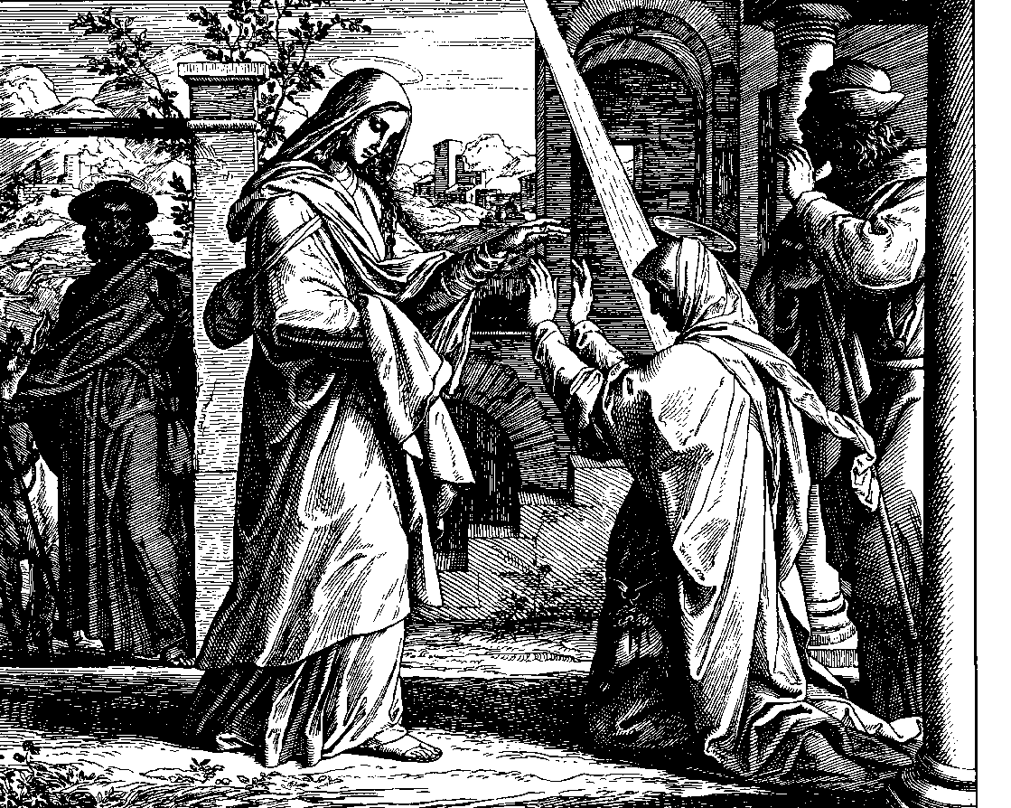
Timeline of
Infancy stories of Jesus
M
A
T
T
H
E
w
Luke
birth of John predicted
birth of Jesus predicted
Mary conceived
Mary & Elizabeth met

Slide 93
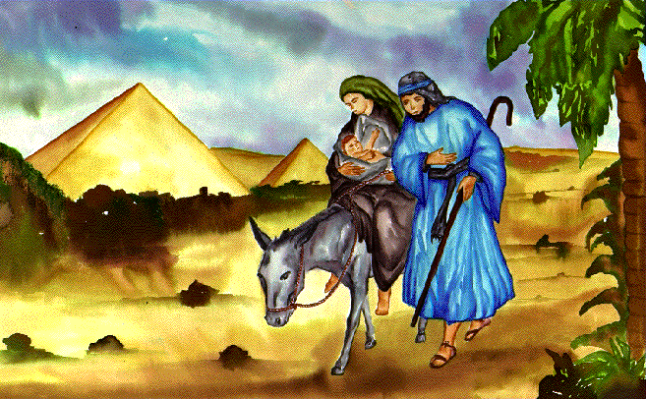
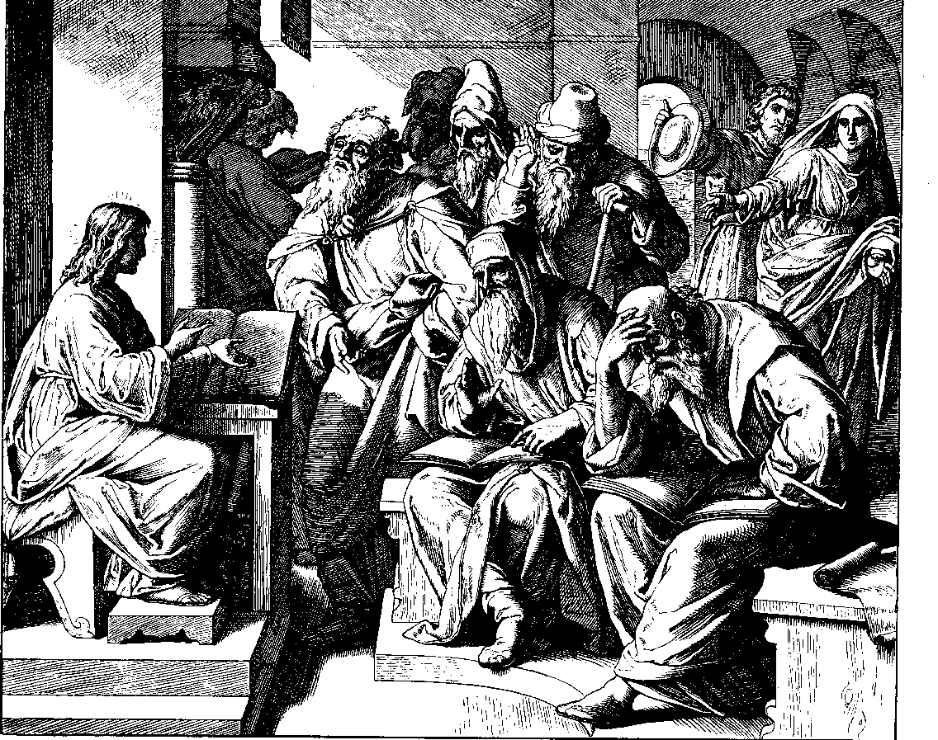
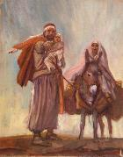
birth of John
Jesus born
in Bethlehem
birth of Jesus
flight to Egypt
killing of the infants
returned to Nazareth
Jesus in the temple
at the age of 12

Slide 94
a. The Annunciation of the Birth of John to Zechariah
§ 4
Luke 1:5-25
Gabriel tells Zechariah that his wife Elizabeth would miraculously give birth to John to set him apart as the forerunner of Messiah

Slide 95
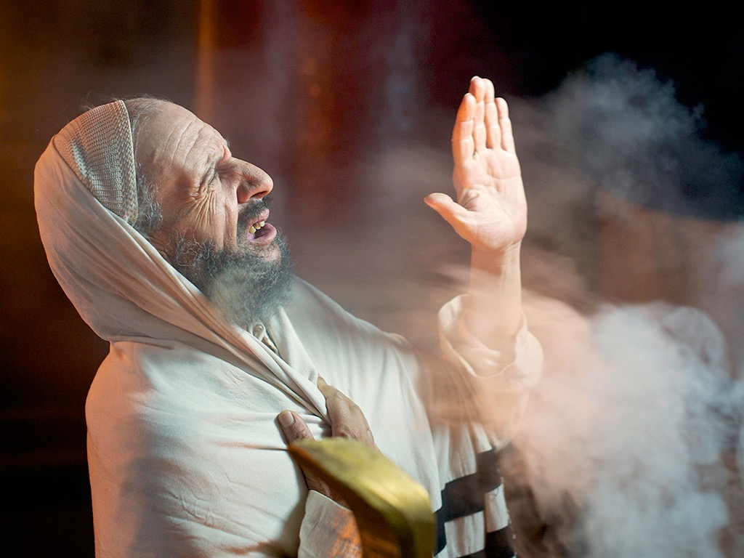

Luke 1:5-25, 39-45
ZECHARIAH IS PROMISED A SON
Free
Bible
images
Notes:
Luke's gospel is known for its many parables by Jesus.

Slide 96
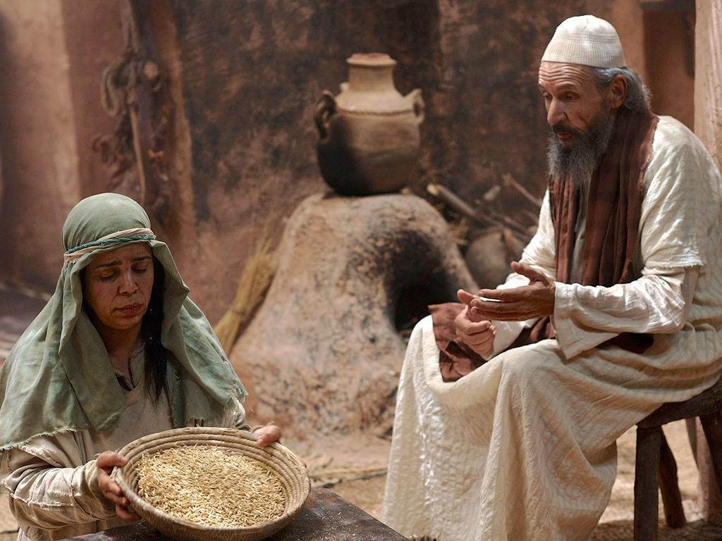
Notes:
Luke 1:5-25
Luke 1:5 When Herod was king of Judea, there was a Jewish priest named Zechariah. He was a member of the priestly order of Abijah, and his wife, Elizabeth, was also from the priestly line of Aaron.
NLT (2nd ed) here and throughout these slides

Slide 97
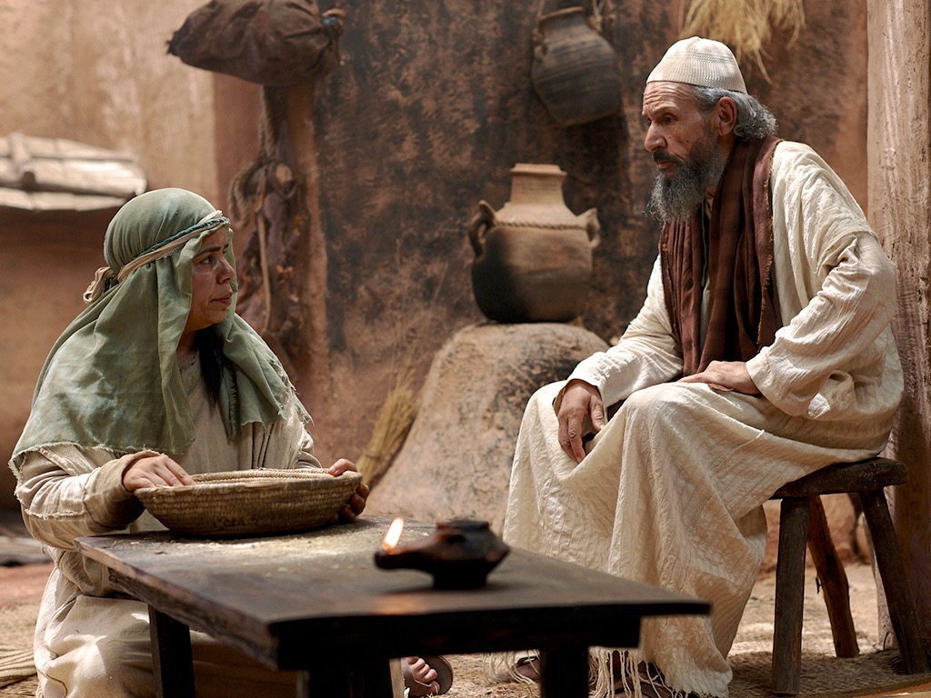
Notes:
⁶ Zechariah and Elizabeth were righteous in God’s eyes, careful to obey all of the Lord’s commandments and regulations. ⁷ They had no children because Elizabeth was unable to conceive, and they were both very old.

Slide 98
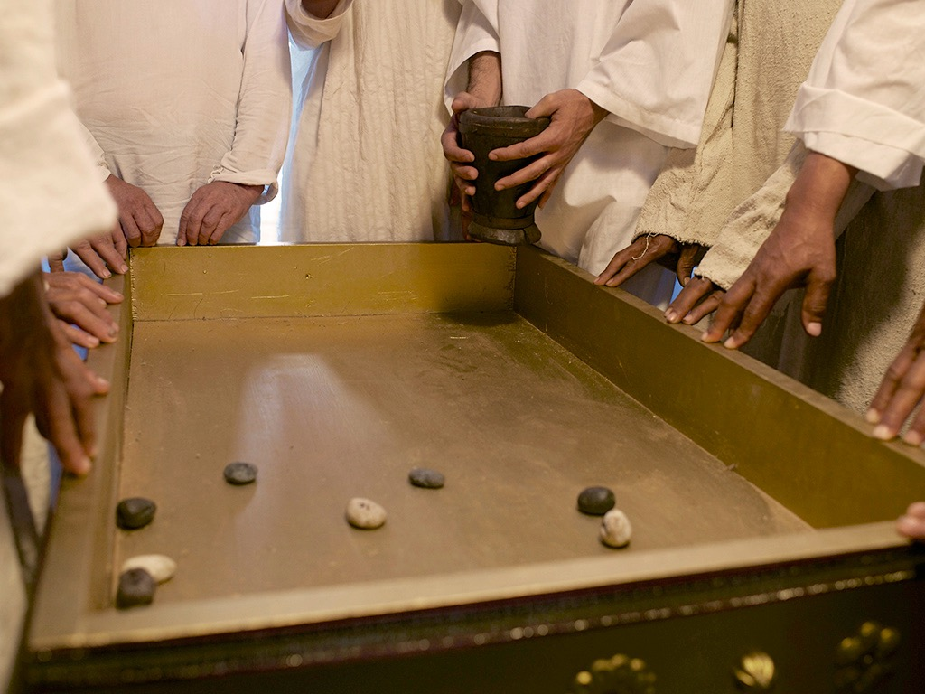
Notes:
Luke 1:8 One day Zechariah was serving God in the Temple, for his order was on duty that week.

Slide 99
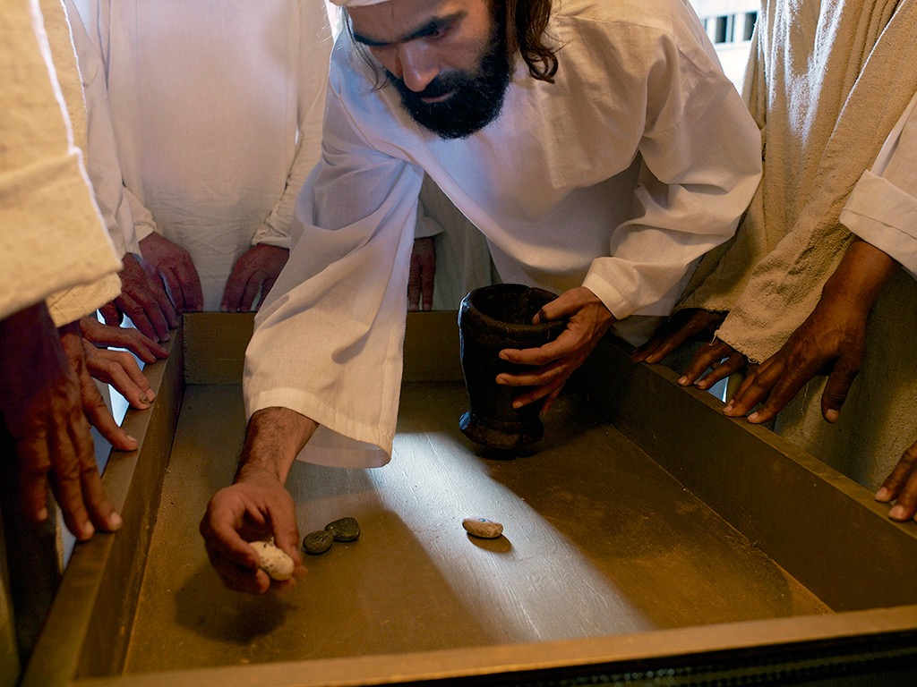
Notes:
⁹ As was the custom of the priests, he was chosen by lot to enter the sanctuary of the Lord and burn incense.

Slide 100
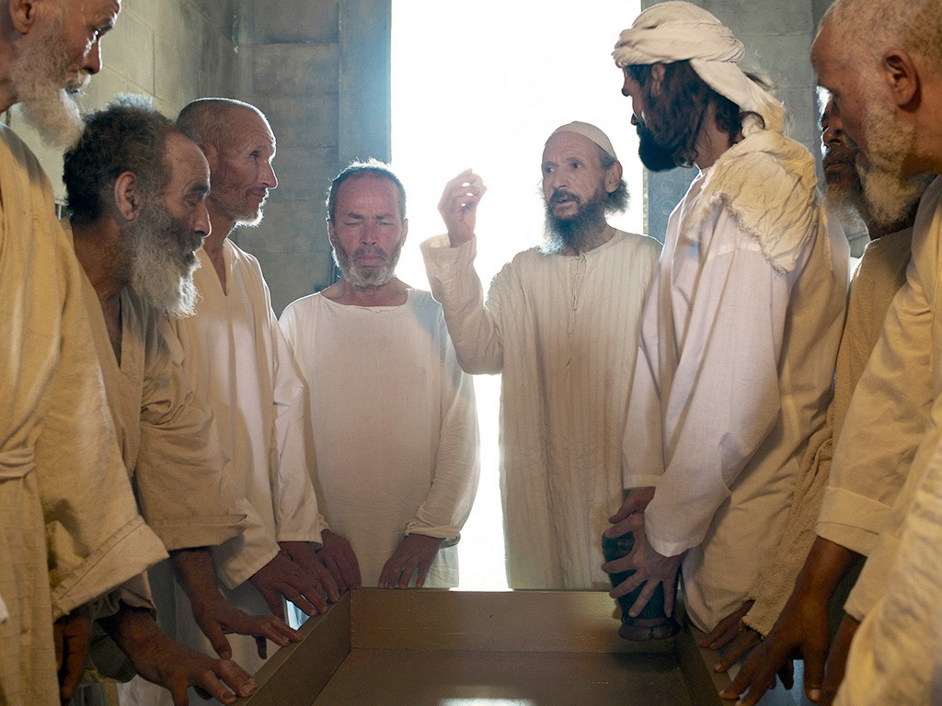

Slide 101
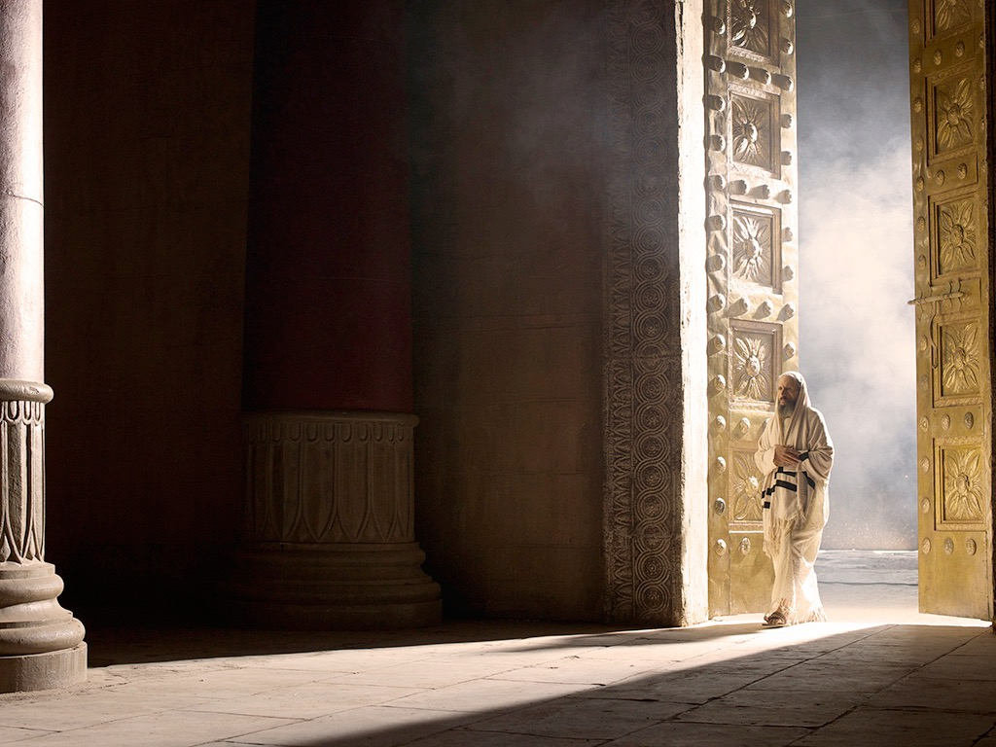

Slide 102
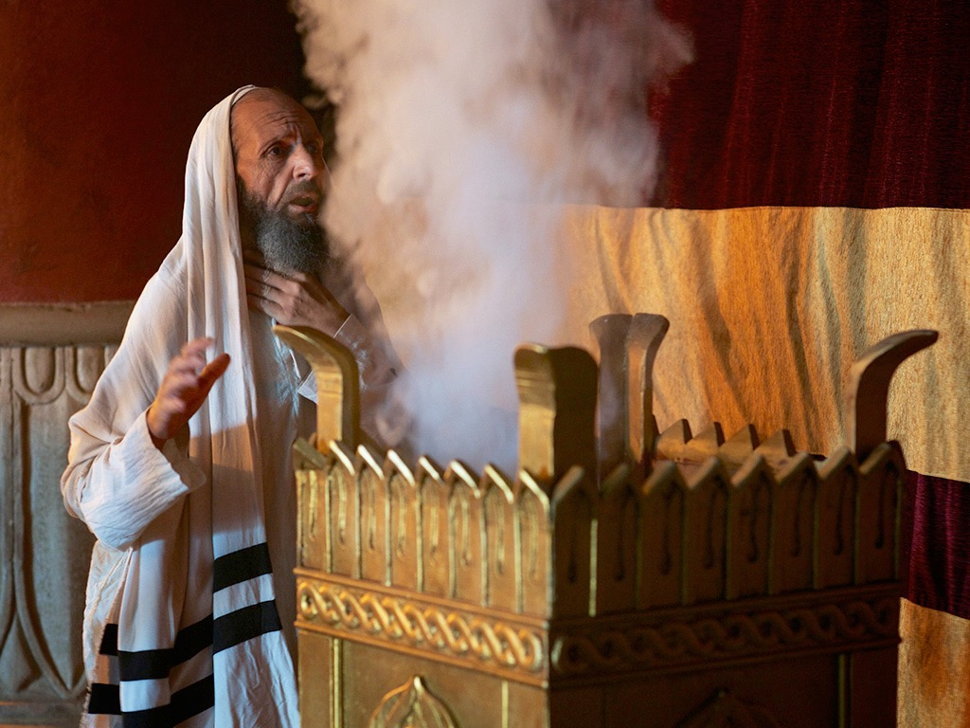
Notes:
¹⁰ While the incense was being burned, a great crowd stood outside, praying.

Slide 103
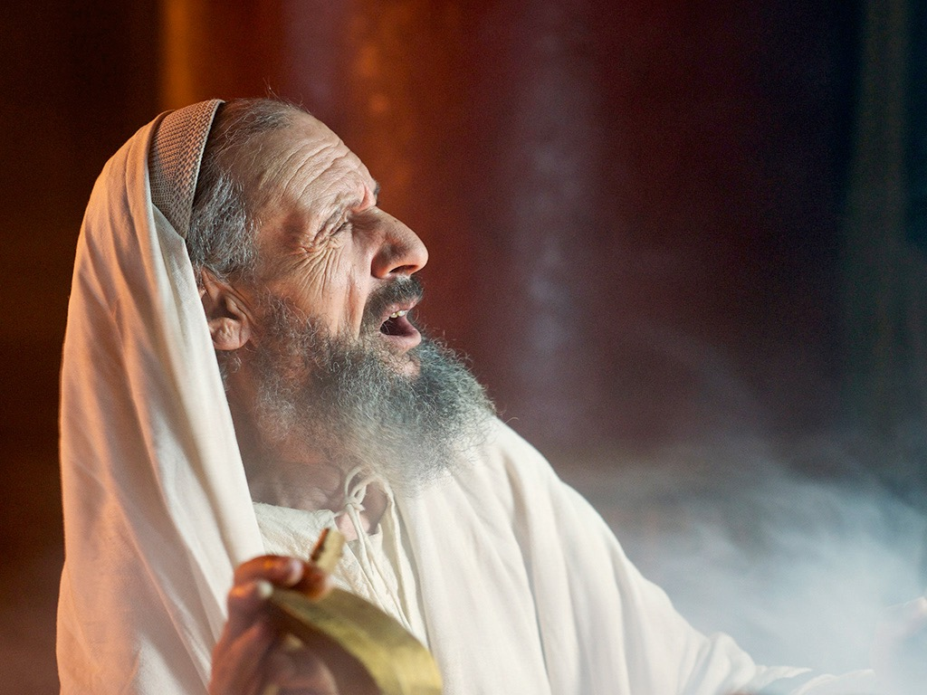
Notes:
Luke 1:11 While Zechariah was in the sanctuary, an angel of the Lord appeared to him, standing to the right of the incense altar.

Slide 104
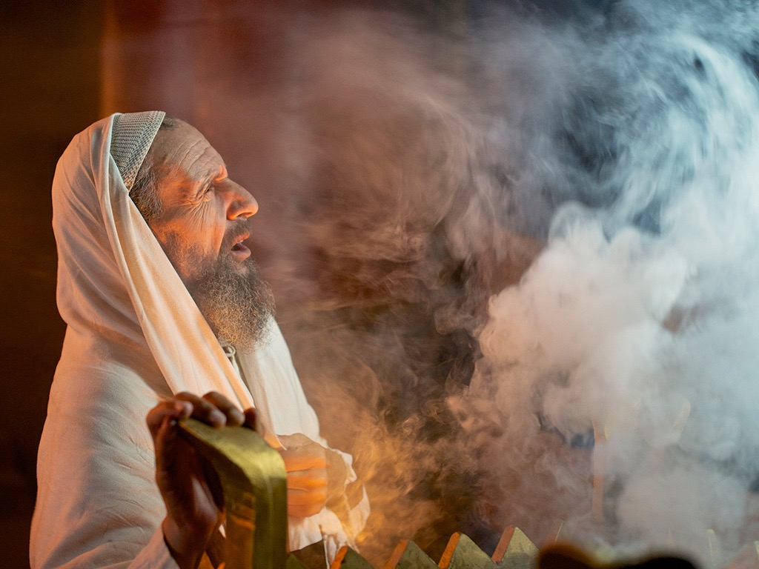
Notes:
¹² Zechariah was shaken and overwhelmed with fear when he saw him. ¹³ But the angel said, “Don’t be afraid, Zechariah! God has heard your prayer. Your wife, Elizabeth, will give you a son, and you are to name him John. ¹⁴ You will have great joy and gladness, and many will rejoice at his birth, ¹⁵ for he will be great in the eyes of the Lord. He must never touch wine or other alcoholic drinks. He will be filled with the Holy Spirit, even before his birth.ª ¹⁶ And he will turn many Israelites to the Lord their God. ¹⁷ He will be a man with the spirit and power of Elijah. He will prepare the people for the coming of the Lord. He will turn the hearts of the fathers to their children,ª and he will cause those who are rebellious to accept the wisdom of the godly.”

Slide 105
Notes:
Luke 1:18 Zechariah said to the angel, “How can I be sure this will happen? I’m an old man now, and my wife is also well along in years.”
Luke 1:19 Then the angel said, “I am Gabriel! I stand in the very presence of God. It was he who sent me to bring you this good news! ²⁰ But now, since you didn’t believe what I said, you will be silent and unable to speak until the child is born. For my words will certainly be fulfilled at the proper time.”

Slide 106
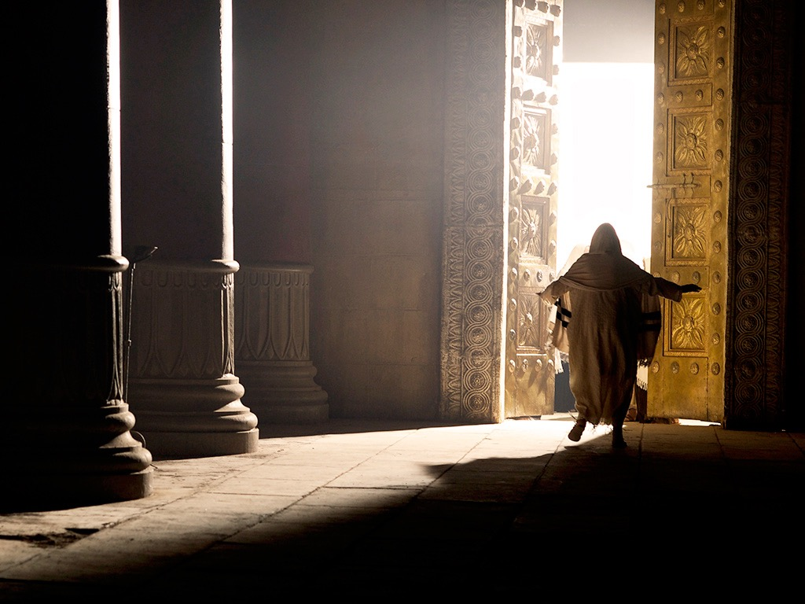
Notes:
Luke 1:21 Meanwhile, the people were waiting for Zechariah to come out of the sanctuary, wondering why he was taking so long.

Slide 107
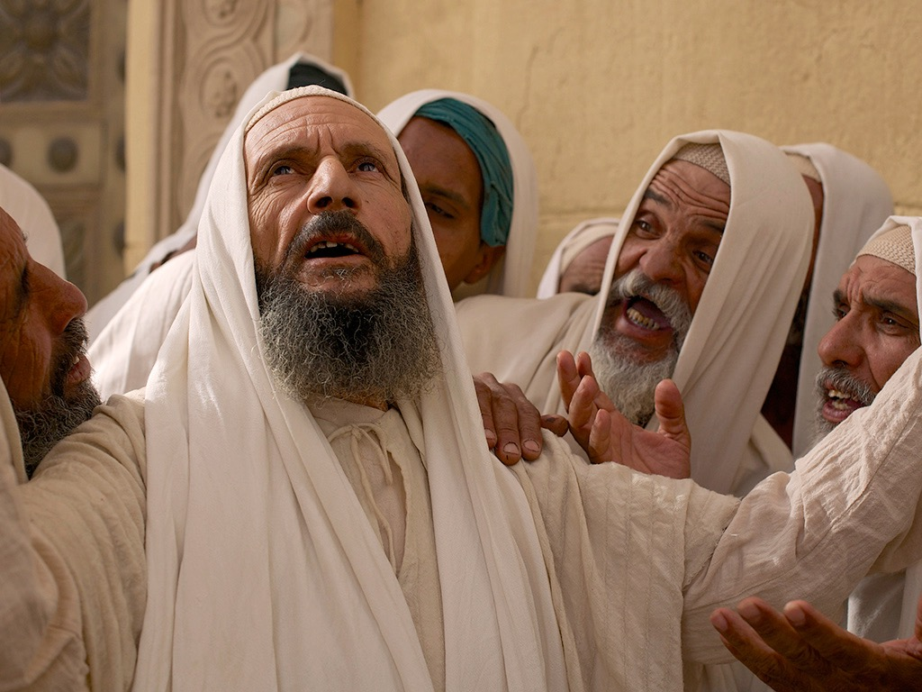
Notes:
²² When he finally did come out, he couldn’t speak to them.

Slide 108

Notes:
Then they realized from his gestures and his silence that he must have seen a vision in the sanctuary.

Slide 109

Notes:
Luke 1:23 When Zechariah’s week of service in the Temple was over, he returned home. ²⁴ Soon afterward his wife, Elizabeth, became pregnant and went into seclusion for five months.

Slide 110

Notes:
²⁵ “How kind the Lord is!” she exclaimed. “He has taken away my disgrace of having no children.”

Slide 111
THE WORD IN PICTURES
Free
Bible
images

Slide 112

Used with Permission
THE
GOSPEL
——OF—— MATTHEW
THE
GOSPEL
——OF—— MARK
THE
GOSPEL
——OF—— LUKE
THE
GOSPEL
——OF—— JOHN
Due to the Lumo Project producing its own publishing material we regret to inform you that we cannot license our photos to other clients outside of freebibleimages.org.
These images are not licensed for reuse in video, epublishing or other media. Downloaded pictures and files cannot be redistributed through any other website than freebibleimages.org or used in any context where the accompanying message is undermining of the Christian faith and gospel.
Photos can only be used on educational presentations, blogs and social media, all of which should be accompanied with reference to www.LumoProject.com.
Picture courtesy of BBM
© All Rights Reserved.
www.bigbookmedia.com

Slide 113
b. The Annunciation of the Birth of Jesus to Mary
§ 5
Luke 1:26-38
Gabriel tells the Virgin Mary that her conception by the Spirit would bear Jesus as Messiah and God-man without a fallen nature

Slide 114


AN ANGEL VISITS MARY
Free
Bible
images
Luke 1:26-38
Notes:
Miraculous births of John and Jesus show that God controls all things—from barren women to the dictates of kings—to give Israel’s Messiah to the world (1:57–2:20).

Slide 115


Slide 116


Slide 117


Slide 118


Slide 119


Slide 120


Slide 122


Slide 123


Slide 124
THE WORD IN PICTURES
Free
Bible
images

Slide 125
Used with Permission
THE
GOSPEL
——OF—— MATTHEW
THE
GOSPEL
——OF—— MARK
THE
GOSPEL
——OF—— LUKE
THE
GOSPEL
——OF—— JOHN
Due to the Lumo Project producing its own publishing material we regret to inform you that we cannot license our photos to other clients outside of freebibleimages.org.
These images are not licensed for reuse in video, epublishing or other media. Downloaded pictures and files cannot be redistributed through any other website than freebibleimages.org or used in any context where the accompanying message is undermining of the Christian faith and gospel.
Photos can only be used on educational presentations, blogs and social media, all of which should be accompanied with reference to www.LumoProject.com.
Picture courtesy of BBM
© All Rights Reserved.
www.bigbookmedia.com

Slide 126


Responses to Amazing Birth News
101e
Zechariah
Mary
Too old for baby
Too young for baby
"How can I be sure?"
"How will this be?"
Doubted God's word
Asked God's method
Ended up dumb
Ended up submissive

Slide 127

Bethlehem was David's City

Slide 128

SON of the
HIGHEST

Slide 129

"HE WILL BE GREAT, AND WILL BE CALLED THE SON OF THE HIGHEST"
(LUKE 1:32)

Slide 130

"THE LORD GOD WILL GIVE HIM THE THRONE OF HIS FATHER DAVID"
(LUKE 1:32)

Slide 131


"HE WILL REIGN OVER THE THRONE OF JACOB FOREVER, AND OF HIS KINGDOM THERE WILL BE NO END"
(LUKE 1:33)

Slide 132


Free
Bible
images
OLD AND NEW TESTAMENTS
PROPHECIES ABOUT
THE BIRTH OF JESUS

Slide 133


Slide 134


Slide 135


Slide 136


Slide 137


Slide 138


Slide 140


Slide 141


Slide 142


Slide 143


Slide 144
Used with Permission
THE
GOSPEL
——OF—— MATTHEW
THE
GOSPEL
——OF—— MARK
THE
GOSPEL
——OF—— LUKE
THE
GOSPEL
——OF—— JOHN
Due to the Lumo Project producing its own publishing material we regret to inform you that we cannot license our photos to other clients outside of freebibleimages.org.
These images are not licensed for reuse in video, epublishing or other media. Downloaded pictures and files cannot be redistributed through any other website than freebibleimages.org or used in any context where the accompanying message is undermining of the Christian faith and gospel.
Photos can only be used on educational presentations, blogs and social media, all of which should be accompanied with reference to www.LumoProject.com.
Picture courtesy of BBM
© All Rights Reserved.
www.bigbookmedia.com

Slide 145
c. The Arrival of Mary in Judea
§ 6
Luke 1:39-45
Mary visits her cousin Elizabeth to confirm to them that God would fulfill the prophecies about the babies John and Jesus

Slide 146
d. The Anthem of Mary
§ 7
Luke 1:46-56
Mary praises God for His grace in using a humble woman like her to bear the Messiah to fulfill the Abrahamic Covenant

Slide 147
e. The Advent of John
§ 8
Luke 1:57-80
Zechariah prophesies after John's birth that God will use John in the desert (not the temple) to fulfill His covenants by the Messiah

Slide 148
Luke 1:57-80
THE ADVENT
OF JOHN
Free
Bible
images

Slide 149


Slide 150


Slide 151


Slide 152


Slide 153


Slide 154


Slide 156


Slide 157
f. The Announcement of the Birth of Jesus to Joseph
§ 9
Matthew 1:18-25
An angel convinces Joseph to marry Mary to bear the Messiah as a virgin so that Joseph serve as the faithful foster father of Jesus

Slide 158

Mary's Husband Joseph

Slide 159



1. The Virgin Birth (1:18 – 25)
Marriage custom
betrothal, binding
marriage contract
wedding took place
a year later

Slide 160

Matthew 1:21
“She will give birth to a son, and you are to give him the name Jesus, because he will save his people from their sins.”
YHWH saves or YHWH is salvation

Slide 161
g. The Advent of Jesus
§ 10
Luke 2:1-7
Jesus is born humbly in Bethlehem to prove His lineage from David, fulfill Micah 5:2, and die as the Messianic deity, pictured in His swaddling clothes
Notes:
Jesus, born humbly in Bethlehem during the census under Caesar Augustus (December 5 BC-January 4 BC), proves His lineage from David and fulfills Micah 5:2 so that He would die as God who was made man, the Messiah, pictured in His swaddling clothes

Slide 162

Church Nativity Scene

Slide 163

Insure that Baby!

Slide 164


Church Nativity Scene

Slide 165

Church Nativity Scene

Slide 166

The Target of Theft

Slide 167

Church Nativity Scene

Slide 168

Church Nativity Scene

Slide 169

Church Nativity Scene

Slide 170

Church Nativity Scene

Slide 171

Brickhouse Security GPS Device
Notes:
Brickhouse security has come to the rescue of frustrated church owners in New Jersey which keep having their Mary, Joseph and Jesus taken by crazy crooked Christians, reports MyFoxDC.
The GPS provided by Brickhouse is given to qualified religious institutions and placed inside the dolls. The CEO of Brickhouse Todd Morris said that "we then monitor it from our cloud-based mapping system, and set up alerts so that they'll get a text message or an e-mail if Baby Jesus is in motion," So for those that are tempted to steal these holy figures, they may receive a surprise knock on the door this Christmas.
http://hexus.net/ce/news/gadgets/64061-churches-use-gps-trackers-stem-stolen-baby-jesus-problem/

Slide 172

Church Nativity Scene

Slide 173

Church Nativity Scene
Notes:
This Jesus figure was stolen two years running in Florida, but was recovered after being stolen this year as a GPS device had been fitted Photo: AP
By Tom Leonard in New York
5:18PM GMT 10 Dec 2008
http://www.telegraph.co.uk/news/worldnews/northamerica/usa/3702961/Baby-Jesus-watched-over-by-GPS.html
Faced with rising thefts and vandalism, churches, community officials and ordinary people across the United States are fitting their displays with satellite tracking devices and hidden cameras.
Around 70 churches have so far taken up a New York security company's offer to use its GPS and camera systems for a month to safeguard mangers and menorahs.
Some families are doing the same and the new security measures are already showing success.
After its expensive life-size, £1,350 ceramic Jesus figure was stolen two years running, the community of Wellington, in Palm Beach County, Florida, installed a GPS device inside it this year.
When it was stolen again, police were able to track it down to a nearby home where it was found face down on a carpet. An 18-year-old woman is being prosecuted over the theft.
Related Articles
Mystery 'Jesus' pebbles
10 Dec 2008
Vase discovery linked to Mary Magdalene
10 Dec 2008
Brickhouse Security in New York said it got the idea to offer 200 religious organisations a month's free use of its high-tech equipment after a few churches asked if they could hire the devices just for December.
This year's tally of baby Jesus thefts so far includes one from a Methodist church in Pennsylvania in which the figurine was replaced by a pumpkin and another in Arkansas in which the thief not only stole the plastic baby but also the concrete block and chain to which it was attached.
In the past, some have been defaced with swear words and Satanic symbols. However, it is unclear whether most of the thefts are harmless pranks or the result of anti-Christian sentiment.
Brickhouse said its GPS device can track objects virtually anywhere in the world. If it is moved, a silent alarm is triggered, and police or the owner can go on the internet to see on a map where the object is going.

Slide 174

The Date of Jesus' Birth
Adapted from a 2006 Class Presentation by Jordan Tan for
Dr. Rick Griffith • Singapore Bible College • BibleStudyDownloads.org

Slide 175
Fact or
Fiction
Jordan Tan #172

Slide 176

Born in the 11th year of Singapore's independence.
Started my studies in Singapore Bible College at the age of 28.
Which year was I born in?
1965
July 2004
1976
Notes:
I was born in 1976...

Slide 177
The Historical
JESUS
Notes:
Today, we will continue to look at JESUS...
more precisely, the historical Jesus..

Slide 178
The New Testament Bookshelf
The Gospels
History
Matthew
Acts
Mark
Luke
John
Letters by Paul
Luke
1 Thessalonians
1 Corinthians
2 Thessalonians
2 Corinthians
Philippians
Romans
Galatians
Ephesians
Colossians
1 Timothy
2 Timothy
Philemon
Titus
General Letters
Prophecy
Hebrew
James
1 Peter
2 Peter
1 John
2 John
3 John
Revelation
Jude
Notes:
Our text for today comes from the book of Luke....

Slide 179
The Structure of Luke
Birth of Jesus
Jesus in Galilee
Ministry in or near Jerusalem
Infancy
Infancy
1-2
3:1-4:13
4:14-9:50
9:51 ---------- 18:34
18:35-21:38
22-24
Introduction to Jesus’ Ministry
Travel Narrative
Passion & Resurrection
Notes:
and as our sister, Mary, has given us the structure of Luke last week.
Today, i will focus on the infancy... or rather the birth of Jesus.

Slide 180
The Birth of Christ
Dionysus Exiguus A.D. 1
King Herod 4-6 B.C.
The Star of Bethlehem 5-7 B.C.
Quirinius A.D. 6
Blomberg, 188
Notes:
As many of you know, our calendar division of BC and AD is actually a Christian invention.
Before Christ and Anno Domini (The Year of the Lord)
1. Dionysus Exiguus in the early sixth century dated the birth of Jesus and since the Roman Empire was Christian, they decided that the calendar should be based on Christ. What Dionysus didn't factor in was the evidence from Josephus.
2. King Herod... once again, we know from Josephus that King Herod died in 4 BC and together with other data we can derive Christ birth between 4-6 BC
3. There are also attempts to link the star of Bethlehem with an unusual conjunction of planets and even a comet or supernova around 5-7 BC. (But this theory diminishes the supernatural power of God in creating the star just for the occasion of Christ's birth)
4. Quirinius and his census literally places Christ's birth as 6 A.D

Slide 181
Biblical Texts
Luke 2:2 (NIV)
(This was the first census that took place while Quirinius was governor of Syria.)
Luke 3:23 (NIV)
Now Jesus himself was about thirty years old when he began his ministry. He was the son, so it was thought, of Joseph, the son of Heli
Notes:
We will focus on 2 verses today for our search of the Historical Jesus...
Luke 2:2 and Luke 3:23

Slide 182

Info #1
Jesus was born during the census of Quirinius
Info #2
Jesus was about thirty years old when he began his ministry
THE BIG
QUESTION
SO WHAT ABOUT QUIRINIUS AND THE CENSUS?
Notes:
The big question is...
so what about Quirinius and the census? what's so important or interesting?

Slide 183
Quirinius was sent by Augustus to be governor of Syria (and Judea) in A.D. 6 (not 6 B.C.) and thereafter did take a notable census for the empire. Josephus tells us that Quirinius visited Judea in A.D. 6-7 to assess the property of the Jews in preparation for the registering and taxing of that property. There is no evidence that he was governor of the region twice or that he undertook a census of the region twice. It has been suggested that Luke may have confused Quirinius with P. Quintilius Varus who was legate of Syria during the period 6-3 B.C. Against this is the fact that Luke was apparently knowledgeable about Latin names and would have known a cognomen (Quirinius) from a mere nomen (Quintilius).
Notes:
read....
that's too much info so i'll just give you some points.

Slide 184
A Roman census would not have required Jews to travel to their ancestral home for registration. In any case, is it probable that the Romans would undertake such a census in a client state that already had its own ruler (Herod)? In response to these problems various answers have been given. In the first place, if there was a census that affected Judea during the reign of Herod the Great, it would probably proceed along the lines of a Jewish census, not a Roman one. In that case it is plausible that Jews would return to their ancestral homes and that both adults would go (especially if Mary was also of Davidic descent).
Notes:
read....
that's too much info so i'll just give you some points.

Slide 185
Second, elsewhere Luke manifests a knowledge of the later census by Quirinius which prompted the revolt of Judas the Galilean in A.D. 6-7 (Acts 5:37). Is it likely that he would have confused this census, which he knew to be a later one, with one during the reign of Herod? It is not certain that Luke in 2:1 means that Augustus took one enormous census of the whole empire. The language is general and may mean no more than that the various parts of the empire were subject to various censuses during the time of Augustus…
Notes:
read....
that's too much info so i'll just give you some points.

Slide 186

QUIRINIUS
Quirinius was sent by Augustus to be governor of Syria in A.D. 6-7 whereby he conducted a notable census for the Roman Empire.
Quirinius was also appointed as consul in the Syria area earlier in 12 B.C.
“Governor” can actually refer to many leadership roles. Certain inscriptions show that between 7-10 B.C. Quirinius performed military functions in Syria.
Joel B. Green, Dictionary of Jesus and the Gospels (IVP), 66
Notes:
so although Quirinius was officially governor of Syria and Judea only in 6 AD, it does not mean he wasn't around doing a census or something else...

Slide 187
THE CENSUSES
Roman censuses were conducted every fourteen years.
(prōtē) First or former?
Luke’s precise wording could mean that he is either referring to the first or former census under Quirinius rule of Syria.
This means before A.D. 6.
Joel B. Green, Dictionary of Jesus and the Gospels (IVP), 66
Notes:
Therefore, the census in Luke 2:2 could mean the one before Quirinius was governor, or the one before Quirinius census in 6 AD

Slide 188
THE NEXT BIG
QUESTION
WHAT ABOUT HEROD?
Notes:
HOW ABOUT HEROD??

Slide 189
KING HEROD
From the records of Josephus, we see that Herod died about 4 BC.
Matthew 2:1 (NIV)
After Jesus was born in Bethlehem in Judea, during the time of King Herod, Magi from the east came to Jerusalem
Matthew 2:16 (NIV)
When Herod realized that he had been outwitted by the Magi, he was furious, and he gave orders to kill all the boys in Bethlehem and its vicinity who were two years old and under, in accordance with the time he had learned from the Magi.
Blomberg, 188
Notes:
from Josephus, we know that King Herod died about 4 BC.
Matt 2:1 tells us that Jesus was born when King Herod was still alive
Matt 2:16 tells us that Jesus could possibly be 2 years old when Herod ordered the massacre of the innocents... before 4BC... possibly 6 or even 7 BC.

Slide 190

Putting it together
Prior
Census
8-7 BC
Death of
King Herod
4 BC
Census by Quirinius
AD 6-7
14 years
Therefore, we can conclude that Jesus was born between 8-4 BC
Notes:
now let's put what we have together...

Slide 191
Jesus was born between 4-7 BC
Biblical Texts
Luke 2:2 (NIV)
(This was the first census that took place while Quirinius was governor of Syria.)
Luke 3:23 (NIV)
Now Jesus himself was about thirty years old when he began his ministry. He was the son, so it was thought, of Joseph, the son of Heli,
Notes:
looking at luke 2:2...
my conclusion is that Jesus was born between 5-7 BC

Slide 192
ONE MORE BIG
QUESTION
Jesus was about thirty when he began his ministry…
SO??
Notes:
Now Luke 3:23 says Jesus was about thirty when he began his ministry...
SO??

Slide 193
We know from Jewish history that the Levites began service about the age of thirty.
However, traditional Jewish historiography uses estimates rather than definitive numbers for age.
This would lead us to believe that Jesus began his ministry between AD 25-27
Notes:
In Luke 2:2, we could link the information provided by Luke to Roman history...
here in Luke 3:23 however, we see certain links to Jewish history.
The levites and jewish historiography...
But for sure, it helps us to the conclusion that ....

Slide 194

However, we should also consider this definitive work

Slide 195
Dating the Birth of Christ
56
Date of Birth: ca. December 5 BC/January 4 BC
Jesus was born between these two dates:
Census of Quirinius/Cyrenius (Luke 2:1-5)
Death of
Herod the Great
(Matt. 2:1; Luke 1:5)
6 BC
29 March-11 April
4 BC
Harold W. Hoehner, Chronological Aspects of the Life of Christ (Zondervan, 1977), 114

Slide 196
Dating the Start of Christ's Ministry
56
Commencement of Ministry: ca. Autumn AD 29
Jesus probably began his ministry between these two dates:
15th YEAR OF THE REIGN OF TIBERIUS*
(Luke 3:1-3)
19 August
AD 28
31 December
AD 29
*Reckoned from either the Julian Calendar or Tiberius Regnal Year
Harold W. Hoehner, Chronological Aspects of the Life of Christ (Zondervan, 1977), 114

Slide 197
FACT OR FICTION?
IN CONCLUSION
Luke affirms to us, the readers of the book, that Jesus existed historically by showing when he was born according to world history current to his time.
When we acknowledge and show Jesus as a true, genuine historical figure, it helps us to debunk arguments regarding whether he really existed or was just a myth.

Slide 198
h. The Announcement to the Shepherds
§ 11
Luke 2:8-20
God's angels recruit shepherds as His unlikely yet unprejudiced witnesses of the birth of Israel's Savior and Messianic Ruler in the coming kingdom
Notes:
Arabic edited

Slide 199

Bored Shepherds
"Nothing exciting ever happens on this job."

Slide 200

"The Savior—yes, the Messiah, the Lord—has been born today in Bethlehem, the city of David!" (Luke 2:11 NLT)

Slide 201
3. His Infancy and Childhood
§ 12-19
Selected events from the infancy and childhood of Jesus affirm Jesus as the promised Messiah

Slide 202
a. His Circumcision
§ 12
Luke 2:21
Jesus is circumcised as a sign of the Abrahamic Covenant to make Him eligible to fulfill the promises that God gave to Abraham

Slide 203
b. His Presentation
§ 13
Luke 2:22-38
Jesus is presented in the temple for Mary to obey the Law as ceremonially clean and to redeem Jesus from the Aaronic priesthood

Slide 204

Simeon blessed Jesus at the temple (Luke 2:21-32)

Slide 205
c. His Infancy
§14-16
The worship by the Magi, escape to Egypt, and escape to Nazareth all fulfill prophecies to confirm Jesus as Israel's Messiah

Slide 206


Chapter Two
Bethlehem
Egypt
Nazareth

Slide 207
“All this took place to fulfill what the Lord had said through the prophet”
“completing”
or
“filling full”
fulfill

Slide 208
OT Prophecies
1. Literal
Straightforward predictions
Birthplace in Bethlehem
Matt. 2:6
Micah 5:2

Slide 209

OT Prophecies
2. Typological
Correspondence between
OT & NT events
e.g. Hosea 11:1 ----- > Matt 2:15
“Out of Egypt I called my son.”

Slide 210


Hosea 11:1
God called Israel out of Egypt
Matthew 2:15
Jesus also fled to and returned from Egypt

Slide 211
OT Prophecies
3. = Literal + Typological
Isaiah 7:14 … give you a sign: the virgin will be…
____________________________________________
you: Hebrew is plural
virgin: Hebrew means “a young woman of marriageable age”

Slide 212
OT Prophecies
3. = Literal + Typological
ultimate prediction pointed to Jesus
Ahaz
Jesus

Slide 213
(1) In Bethlehem
c. His Infancy
§ 14
Matthew 2:1-12
Gentiles worship Jesus as King of the Jews in Bethlehem to fulfill Micah 5:2 and show Him as eventual Sovereign Ruler over all nations

Slide 214

Bethlehem
"And you, O Bethlehem in the land of Judah, are not least among the ruling cities of Judah, for a ruler will come from you who will be the shepherd for my people Israel"
(Micah 5:2 quoted in Matthew 2:6 NLT)

Slide 215

Journey to Bethlehem

Slide 216

One King 19/30
Jesus was easily identifiable

Slide 217
2. Birth in Bethlehem …
“But you, Bethlehem, in the land of Judah, are by no means least among the rulers of Judah; for out of you will come a ruler who will be the shepherd of my people Israel.”
(Micah 5:2)

Slide 218

…and visit of the Magi (2:1-12)

Slide 219

Who Were the Magi?

Slide 220


What Kind of Kingdom Did Isaiah
(and Matthew) Envision?
78b
Political
Physical
Emotional
Intellectual
Spiritual

Slide 221

What is the contemporary application of following the star?

Slide 222

What kind of star was it?
Notes:
What kind of star was it?

Slide 223
Where did the Magi come from?
15
P1 Million
14
P500,000
13
P250,000
12
P125,000
11
P64,000
10
P32,000
9
P16,000
8
P8,000
7
P4,000
6
P2,000
5
P1,000
4
P500
3
P300
2
P200
50:50
1
P100
A: Babylon
B: Assyria
C: Persia
D: Arab Peninsula?

Slide 224

Arab Magi?
Their Location:
  East can mean southeast as much as northeast
  Assyria, Babylonia and Persia were always called lands of the north (Jer. 1:13-15; 6:22; 25:9).
Notes:
After this slide, will go to Dr Rick's NT Survey: Matthew, p78f, “Arab Magi in Matthew 2”

Slide 225
Arab Magi?
Their Gifts (Matt. 2:11):
  These all came from Spice Trade route southeast of Israel.
  "And all from Sheba will come, bearing gold and incense" (Isa. 60:6; cf. Ps. 72:10). Sheba was the land of present-day southern Saudi Arabia.
Notes:
After this slide, will go to Dr Rick's NT Survey: Matthew, p78f, “Arab Magi in Matthew 2”

Slide 226
Arab Magi?
Their Gifts (Matt. 2:11):
  Frankincense came only from southern Arabia, although it was sold throughout the Middle East.
  Gold came from the Arabian Peninsula in the land of Ophir that is present-day Yemen
Notes:
After this slide, will go to Dr Rick's NT Survey: Matthew, p78f, “Arab Magi in Matthew 2”

Slide 227
Arab Magi?
Their Role: Arabs redeem Israel!
  Joseph saved from his brothers by Ishmaelites of Arabia who brought him to Egypt (Gen. 37:27-28).
  Opposition to Moses by Israel's own elders forced him to seek refuge in Midian of Arabia (Exod. 2:13-15).
Notes:
After this slide, will go to Dr Rick's NT Survey: Matthew, p78f, “Arab Magi in Matthew 2”

Slide 228
Arab Magi?
Their Role: Arabs redeem Israel!
  Even in the future tribulation, Israel will find refuge in the desert (Rev. 12:14), presumably in Arabia
Notes:
After this slide, will go to Dr Rick's NT Survey: Matthew, p78f, “Arab Magi in Matthew 2”

Slide 229


Slide 230
(2) In Egypt
c. His Infancy
§ 15
Matthew 2:13-18
Joseph, Mary, and Jesus flee to Egypt to escape death by Herod to fulfill Hosea 11:1 and preserve Christ to redeem the world

Slide 231

Journey to Bethlehem, Flight to Egypt & Return to Nazareth (Matthew 2)
79
79

Slide 232

3. Flight to Egypt (2:13-15)

Slide 233


4. Killing of the innocents

Slide 234
(3) In Nazareth
c. His Infancy
§ 16
Matthew 2:19-23; Luke 2:39
The family returns to Israel and chooses Nazareth (not Bethlehem) to fulfill prophecies of the Messiah's humble origins

Slide 235


5. Return to Nazareth (2:19-23)
“He will be called a
Nazarene.”

Slide 236
Theme
Jesus' birth fulfilled
the OT Prophecies
2. Men's obedience fulfilled
God's plan

Slide 237
Birth & Childhood of Jesus
Connie Tong

Slide 238
d. His Boyhood
§ 17-19
The early life of Christ shows that while He grew physically, intellectually, spiritually, and socially, He knew of His deity

Slide 239
(1) His growth
d. His Boyhood
§ 17
Luke 2:40
Jesus grows physically, intellectually, and spiritually, showing His training in the Scriptures from his youth in a godly home

Slide 240
(2) His visit to Jerusalem
d. His Boyhood
§ 18
Luke 2:41-50
Jesus teaches Israel's leaders at age 12 not merely as a "son of the law" but as the Son of God who knew His deity and mission

Slide 241
(3) His development
d. His Boyhood
§ 19
Luke 2:51-52
During the 18 years of unrecorded events, Jesus grows mentally, physically, spiritually, and socially as a perfect and obedient man

Slide 242
Introduction of the King
§§ 1-27
Arrival
Ambassador
Ancestry
Advent
Infancy/
Childhood
Notes:
Jesus did all that we should expect of the Messiah (King) from the start:
1—He arrived in the proper lineage of David, born of a virgin, and knew his deity even at age 12
2—His forerunner John knew his role in preparing Israel for her king
3—He had the best witnesses possible in the Father (baptism), Spirit (temptation), and John (prophesied herald)

Slide 243
The Ambassador of the King
§ 20-23
John the Baptist precedes Jesus Christ to prepare Israel to receive Him as the long-awaited Messiah

Slide 244
1. The Message to John
§20
Mark 1:1; Luke 3:1-2
John receives a prophetic message from God in the desert to separate Israel to the Lord in preparation for the Messiah

Slide 245

John the Baptist
Luke
3:1-2
In the fifteenth year of the reign of Tiberius Caesar, Pontius Pilate being governor of Judea, and Herod being tetrarch of Galilee, and his brother Philip tetrarch of the region of Ituraea and Trachonitis, and Lysanias tetrarch of Abilene,
in the high-priesthood of Annas and Caiaphas, the word of God came to John the son of Zechariah in the wilderness;
Notes:
Note how many opportunities exist for errors in this single passage. If the time of even one of these reigns is inaccurate, then Luke would be disproven as a historian and inerrancy impossible. But each of these men was in leadership in AD 29 when John began his ministry. Each period is as follows:
Tiberius (AD 14-37)
Pilate (AD 26-36)
Philip (4 BC-AD 34)
Lysanias (AD 14-29)
Annas (AD 6-15 but wielding considerable power after that—probably died about AD 40; see Annas had been high priest from A.D. 6 to 15. The Romans had removed him from office yet he still wielded considerable power behind the scenes (https://www.blueletterbible.org/faq/don_stewart/don_stewart_1314.cfm)
Caiaphas (AD 18-36): Caiaphas was the ruling High Priest at the time of Jesus ministry (A.D. 18-36). He was the son-in-law of Annas. (https://www.blueletterbible.org/faq/don_stewart/don_stewart_1314.cfm)
——————
https://www.internationalstandardbible.com/L/lysanias.html
International Standard Bible Encyclopedia Online
Accessed 17 June 2022
Lysanias
li-sa'-ni-as (Lusanias): Mentioned in Lu 3:1 as tetrarch of Abilene in the 15th year of the reign of Tiberius Caesar, and thus fixing the date of the preaching of John the Baptist in the wilderness at about 26 or 28 AD. A Lysanias is mentioned by Josephus as having ruled over Chalcis and Abilene, and as having been slain by Mark Antony at the instigation of Cleopatra. As this happened about 36 BC, Luke has been charged with inaccuracy. Inscriptions, however, corroborate the view that the Lysanias of Luke was probably a descendant of the Lysanias mentioned by Josephus (compare Schurer,H J the Priestly Code (P), div I, volumeII , App. 1, p. 338).
——————
https://www.oxfordreference.com/view/10.1093/oi/authority.20110803100120769
Accessed 17 June 2022
The reference to Lysanias in Luke 3: 1 as the tetrarch of Abilene NW of Damascus may be a mistake, since the only Lysanias certainly known died in 36 bce. There was, however, possibly another, unknown, Lysanias in the fifteenth year of the reign of Tiberius (28 or 29 ce) to which Luke is referring, since an inscription bearing the name Lysanias was found at Abila, the city in Abilene, and dated between 14 and 29 ce.

Slide 246
The Duration of Christ's Ministry
56
Autumn AD 29 – 3 April AD 33 (3.5 Years)
John alone notes three Passovers
Therefore, Christ's ministry was at least 2.5 years
Commencement of Christ's Ministry
Passover #1
April 7,
AD 30
Passover #2
Passover #3
April 25,
AD 32
Passover #4
April 3,
AD 33
Autumn
AD 29
John 2:13, 23
Unstated by John
Mark 2:23-28
Luke 6:1-5
Matthew 12:1-8
John 6:4
John 11:55–12:1
Harold W. Hoehner, Chronological Aspects of the Life of Christ (Zondervan, 1977), 114
Notes:
Christ's 3½ year ministry spanned four Passovers. However, the Synoptics mention only one Passover (#2 on this timeline), which could give the impression of only a year-old ministry. John fills in the details, though, by showing three other Passovers not mentioned by Matthew, Mark, or Luke.

Slide 247
Chronology of Jesus & Acts
38a
4 BC
1 BC
AD 1
14
29
30
33
35
Jesus
Born
–1 year–
Tiberius
Crowned
15th Yr.
Tiberius
–
John &
Jesus
Jesus
Died
Paul
Believed
“In the 15th year of Tiberius… John preached” (Luke 3:1)
32-33 years
“Now Jesus himself was about 30 years old when he began his ministry” (Luke 3:23)

Slide 248
Age of Jesus
When He Began His Ministry
38a
“Now Jesus himself was about 30 years old when he began his ministry” (Luke 3:23)
1yr
3 yrs
28 / 29 years
4 3 2 1 1 2 3 4 5 6 7 8 ……………………………………………….…………………… 26 27 28 29
BC AD
3 + 1 + 28 = 32 years (Non-inclusive of AD 29)
3 + 1 + 29 = 33 years (Inclusive of AD 29)
Adapted from Michele Ang (NT Survey student, SBC, 2006)

Slide 249
2. The Message from John
§ 21
Matthew 3:1-6; Mark 1:2-6; Luke 3:3-6
John preaches repentance for the forgiveness of sins and baptizes to prepare for the Messianic kingdom on earth ruled by Jesus
Notes:
John the Baptist Prepares the Way
Matt. 3:1 In those days John the Baptist came to the Judean wilderness and began preaching. His message was, ² “Repent of your sins and turn to God, for the Kingdom of Heaven is near.” ³ The prophet Isaiah was speaking about John when he said,
“He is a voice shouting in the wilderness,
‘Prepare the way for the LORD’s coming!
Clear the road for him!’”
Matt. 3:4 John’s clothes were woven from coarse camel hair, and he wore a leather belt around his waist. For food he ate locusts and wild honey. ⁵ People from Jerusalem and from all of Judea and all over the Jordan Valley went out to see and hear John. ⁶ And when they confessed their sins, he baptized them in the Jordan River.
Mark 1:2 just as the prophet Isaiah had written:
“Look, I am sending my messenger ahead of you,
and he will prepare your way.
³ He is a voice shouting in the wilderness,
‘Prepare the way for the LORD’s coming!
Clear the road for him!’”
Mark 1:4 This messenger was John the Baptist. He was in the wilderness and preached that people should be baptized to show that they had repented of their sins and turned to God to be forgiven. ⁵ All of Judea, including all the people of Jerusalem, went out to see and hear John. And when they confessed their sins, he baptized them in the Jordan River. ⁶ His clothes were woven from coarse camel hair, and he wore a leather belt around his waist. For food he ate locusts and wild honey.
Luke 3:3 Then John went from place to place on both sides of the Jordan River, preaching that people should be baptized to show that they had repented of their sins and turned to God to be forgiven. ⁴ Isaiah had spoken of John when he said,
“He is a voice shouting in the wilderness,
‘Prepare the way for the LORD’s coming!
Clear the road for him!
⁵ The valleys will be filled,
and the mountains and hills made level.
The curves will be straightened,
and the rough places made smooth.
⁶ And then all people will see
the salvation sent from God.’”

Slide 250
John the Baptist
Luke
3:3-4
and he went into all the region about the Jordan, preaching a baptism of repentance for the forgiveness of sins.
As it is written in the book of the words of Isaiah the prophet, "The voice of one crying in the wilderness: Prepare the way of the Lord, make his paths straight.

Slide 251
John the Baptist
Luke
3:5-6
Every valley shall be filled, and every mountain and hill shall be brought low, and the crooked shall be made straight, and the rough ways shall be made smooth;
and all flesh shall see the salvation of God."

Slide 252

JOHN THE BAPTIST
Matthew 3:1-16
Mark 1:1-11
Luke 3:1-22
John 1:1-34
Free
Bible
images
Notes:
John the Baptist Prepares the Way
Matt. 3:1 In those days John the Baptist came to the Judean wilderness and began preaching. His message was, ² “Repent of your sins and turn to God, for the Kingdom of Heaven is near.” ³ The prophet Isaiah was speaking about John when he said,
“He is a voice shouting in the wilderness,
‘Prepare the way for the LORD’s coming!
Clear the road for him!’”
Matt. 3:4 John’s clothes were woven from coarse camel hair, and he wore a leather belt around his waist. For food he ate locusts and wild honey. ⁵ People from Jerusalem and from all of Judea and all over the Jordan Valley went out to see and hear John. ⁶ And when they confessed their sins, he baptized them in the Jordan River.
Matt. 3:7 But when he saw many Pharisees and Sadducees coming to watch him baptize, he denounced them. “You brood of snakes!” he exclaimed. “Who warned you to flee the coming wrath? ⁸ Prove by the way you live that you have repented of your sins and turned to God. ⁹ Don’t just say to each other, ‘We’re safe, for we are descendants of Abraham.’ That means nothing, for I tell you, God can create children of Abraham from these very stones. ¹⁰ Even now the ax of God’s judgment is poised, ready to sever the roots of the trees. Yes, every tree that does not produce good fruit will be chopped down and thrown into the fire.
Matt. 3:11 “I baptize with water those who repent of their sins and turn to God. But someone is coming soon who is greater than I am—so much greater that I’m not worthy even to be his slave and carry his sandals. He will baptize you with the Holy Spirit and with fire. ¹² He is ready to separate the chaff from the wheat with his winnowing fork. Then he will clean up the threshing area, gathering the wheat into his barn but burning the chaff with never-ending fire.”
The Baptism of Jesus
Matt. 3:13 Then Jesus went from Galilee to the Jordan River to be baptized by John. ¹⁴ But John tried to talk him out of it. “I am the one who needs to be baptized by you,” he said, “so why are you coming to me?”
Matt. 3:15 But Jesus said, “It should be done, for we must carry out all that God requires.” So John agreed to baptize him.
Matt. 3:16 After his baptism, as Jesus came up out of the water, the heavens were opened and he saw the Spirit of God descending like a dove and settling on him.
MARK
John the Baptist Prepares the Way
Mark 1:1 This is the Good News about Jesus the Messiah, the Son of God. It began ² just as the prophet Isaiah had written:
“Look, I am sending my messenger ahead of you,
and he will prepare your way.
³ He is a voice shouting in the wilderness,
‘Prepare the way for the LORD’s coming!
Clear the road for him!’”
Mark 1:4 This messenger was John the Baptist. He was in the wilderness and preached that people should be baptized to show that they had repented of their sins and turned to God to be forgiven. ⁵ All of Judea, including all the people of Jerusalem, went out to see and hear John. And when they confessed their sins, he baptized them in the Jordan River. ⁶ His clothes were woven from coarse camel hair, and he wore a leather belt around his waist. For food he ate locusts and wild honey.
Mark 1:7 John announced: “Someone is coming soon who is greater than I am—so much greater that I’m not even worthy to stoop down like a slave and untie the straps of his sandals. ⁸ I baptize you with water, but he will baptize you with the Holy Spirit!”
The Baptism and Temptation of Jesus
Mark 1:9 One day Jesus came from Nazareth in Galilee, and John baptized him in the Jordan River. ¹⁰ As Jesus came up out of the water, he saw the heavens splitting apart and the Holy Spirit descending on him like a dove. ¹¹ And a voice from heaven said, “You are my dearly loved Son, and you bring me great joy.”
John the Baptist Prepares the Way
Luke 3:1 It was now the fifteenth year of the reign of Tiberius, the Roman emperor. Pontius Pilate was governor over Judea; Herod Antipas was ruler over Galilee; his brother Philip was ruler over Iturea and Traconitis; Lysanias was ruler over Abilene. ² Annas and Caiaphas were the high priests. At this time a message from God came to John son of Zechariah, who was living in the wilderness. ³ Then John went from place to place on both sides of the Jordan River, preaching that people should be baptized to show that they had repented of their sins and turned to God to be forgiven. ⁴ Isaiah had spoken of John when he said,
“He is a voice shouting in the wilderness,
‘Prepare the way for the LORD’s coming!
Clear the road for him!
⁵ The valleys will be filled,
and the mountains and hills made level.
The curves will be straightened,
and the rough places made smooth.
⁶ And then all people will see
the salvation sent from God.’”
Luke 3:7 When the crowds came to John for baptism, he said, “You brood of snakes! Who warned you to flee the coming wrath? ⁸ Prove by the way you live that you have repented of your sins and turned to God. Don’t just say to each other, ‘We’re safe, for we are descendants of Abraham.’ That means nothing, for I tell you, God can create children of Abraham from these very stones. ⁹ Even now the ax of God’s judgment is poised, ready to sever the roots of the trees. Yes, every tree that does not produce good fruit will be chopped down and thrown into the fire.”
Luke 3:10 The crowds asked, “What should we do?”
Luke 3:11 John replied, “If you have two shirts, give one to the poor. If you have food, share it with those who are hungry.”
Luke 3:12 Even corrupt tax collectors came to be baptized and asked, “Teacher, what should we do?”
Luke 3:13 He replied, “Collect no more taxes than the government requires.”
Luke 3:14 “What should we do?” asked some soldiers.
John replied, “Don’t extort money or make false accusations. And be content with your pay.”
Luke 3:15 Everyone was expecting the Messiah to come soon, and they were eager to know whether John might be the Messiah. ¹⁶ John answered their questions by saying, “I baptize you with water; but someone is coming soon who is greater than I am—so much greater that I’m not even worthy to be his slave and untie the straps of his sandals. He will baptize you with the Holy Spirit and with fire. ¹⁷ He is ready to separate the chaff from the wheat with his winnowing fork. Then he will clean up the threshing area, gathering the wheat into his barn but burning the chaff with never-ending fire.” ¹⁸ John used many such warnings as he announced the Good News to the people.
Luke 3:19 John also publicly criticized Herod Antipas, the ruler of Galilee, for marrying Herodias, his brother’s wife, and for many other wrongs he had done. ²⁰ So Herod put John in prison, adding this sin to his many others.
The Baptism of Jesus
Luke 3:21 One day when the crowds were being baptized, Jesus himself was baptized. As he was praying, the heavens opened, ²² and the Holy Spirit, in bodily form, descended on him like a dove. And a voice from heaven said, “You are my dearly loved Son, and you bring me great joy.”
JOHN
Prologue: Christ, the Eternal Word
John 1:1 In the beginning the Word already existed.
The Word was with God,
and the Word was God.
² He existed in the beginning with God.
³ God created everything through him,
and nothing was created except through him.
⁴ The Word gave life to everything that was created,
and his life brought light to everyone.
⁵ The light shines in the darkness,
and the darkness can never extinguish it.
John 1:6 God sent a man, John the Baptist, ⁷ to tell about the light so that everyone might believe because of his testimony. ⁸ John himself was not the light; he was simply a witness to tell about the light. ⁹ The one who is the true light, who gives light to everyone, was coming into the world.
John 1:10 He came into the very world he created, but the world didn’t recognize him. ¹¹ He came to his own people, and even they rejected him. ¹² But to all who believed him and accepted him, he gave the right to become children of God. ¹³ They are reborn—not with a physical birth resulting from human passion or plan, but a birth that comes from God.
John 1:14 So the Word became human and made his home among us. He was full of unfailing love and faithfulness. And we have seen his glory, the glory of the Father’s one and only Son.
John 1:15 John testified about him when he shouted to the crowds, “This is the one I was talking about when I said, ‘Someone is coming after me who is far greater than I am, for he existed long before me.’”
John 1:16 From his abundance we have all received one gracious blessing after another. ¹⁷ For the law was given through Moses, but God’s unfailing love and faithfulness came through Jesus Christ. ¹⁸ No one has ever seen God. But the unique One, who is himself God, is near to the Father’s heart. He has revealed God to us.
The Testimony of John the Baptist
John 1:19 This was John’s testimony when the Jewish leaders sent priests and Temple assistants from Jerusalem to ask John, “Who are you?” ²⁰ He came right out and said, “I am not the Messiah.”
John 1:21 “Well then, who are you?” they asked. “Are you Elijah?”
“No,” he replied.
“Are you the Prophet we are expecting?”
“No.”
John 1:22 “Then who are you? We need an answer for those who sent us. What do you have to say about yourself?”
John 1:23 John replied in the words of the prophet Isaiah:
“I am a voice shouting in the wilderness,
‘Clear the way for the LORD’s coming!’”
John 1:24 Then the Pharisees who had been sent ²⁵ asked him, “If you aren’t the Messiah or Elijah or the Prophet, what right do you have to baptize?”
John 1:26 John told them, “I baptize with water, but right here in the crowd is someone you do not recognize. ²⁷ Though his ministry follows mine, I’m not even worthy to be his slave and untie the straps of his sandal.”
John 1:28 This encounter took place in Bethany, an area east of the Jordan River, where John was baptizing.
Jesus, the Lamb of God
John 1:29 The next day John saw Jesus coming toward him and said, “Look! The Lamb of God who takes away the sin of the world! ³⁰ He is the one I was talking about when I said, ‘A man is coming after me who is far greater than I am, for he existed long before me.’ ³¹ I did not recognize him as the Messiah, but I have been baptizing with water so that he might be revealed to Israel.”
John 1:32 Then John testified, “I saw the Holy Spirit descending like a dove from heaven and resting upon him. ³³ I didn’t know he was the one, but when God sent me to baptize with water, he told me, ‘The one on whom you see the Spirit descend and rest is the one who will baptize with the Holy Spirit.’ ³⁴ I saw this happen to Jesus, so I testify that he is the Chosen One of God.”

Slide 253

Notes:
John was the son of the priest Zechariah, so John also qualified as a priest. But instead of sacrificial ministry in priestly robes at the temple, God called John to testify of the Ultimate Sacrifice out in the desert!

Slide 254

Notes:
Rather than eating the rich meat of the sacrificial animals, John ate locusts and honey—not your typical priestly diet!

Slide 255

Notes:
Instead of teaching in the temple courts to those required by Jewish Law to come to the temple, John preached in the desert to those who made the arduous journey to the wilderness.

Slide 256

Notes:
John baptized on the opposite side of the Jordan River in modern-day Jordan.

Slide 257

Notes:
Self-immersion baptism had obscure origins in the Intertestamental Era. Some scholars saw it as a rite developed for Gentile women who wished to become Jews, whereas Gentile men would be circumcised. In any case, John was the first to perform baptism and do so for those repenting of their sins.

Slide 258

Notes:
The Jewish leaders were envious of the great following that John had, despite not receiving their education or titles.

Slide 259
3. The Explanation by John
§ 22
Matthew 3:7-10; Luke 3:7-14
John warns of Israel’s judgment by Messiah to convince the Jewish leaders of their need for changed lives resulting from repentance
Notes:
John was not impressed to see the Jewish leaders at his baptisms since they had no change in mind (repentance) nor change in behavior.
Matt. 3:7 But when he saw many Pharisees and Sadducees coming to watch him baptize, he denounced them. “You brood of snakes!” he exclaimed. “Who warned you to flee the coming wrath? ⁸ Prove by the way you live that you have repented of your sins and turned to God. ⁹ Don’t just say to each other, ‘We’re safe, for we are descendants of Abraham.’ That means nothing, for I tell you, God can create children of Abraham from these very stones. ¹⁰ Even now the ax of God’s judgment is poised, ready to sever the roots of the trees. Yes, every tree that does not produce good fruit will be chopped down and thrown into the fire.
Luke 3:7 When the crowds came to John for baptism, he said, “You brood of snakes! Who warned you to flee the coming wrath? ⁸ Prove by the way you live that you have repented of your sins and turned to God. Don’t just say to each other, ‘We’re safe, for we are descendants of Abraham.’ That means nothing, for I tell you, God can create children of Abraham from these very stones. ⁹ Even now the ax of God’s judgment is poised, ready to sever the roots of the trees. Yes, every tree that does not produce good fruit will be chopped down and thrown into the fire.”
Luke 3:10 The crowds asked, “What should we do?”
Luke 3:11 John replied, “If you have two shirts, give one to the poor. If you have food, share it with those who are hungry.”
Luke 3:12 Even corrupt tax collectors came to be baptized and asked, “Teacher, what should we do?”
Luke 3:13 He replied, “Collect no more taxes than the government requires.”
Luke 3:14 “What should we do?” asked some soldiers.
John replied, “Don’t extort money or make false accusations. And be content with your pay.”

Slide 260

Notes:
What did John mean?
Matt. 3:1 In those days John the Baptist came to the Judean wilderness and began preaching. His message was, ² “Repent of your sins and turn to God, for the Kingdom of Heaven is near.”
What would have happened if the people had turned from sin to God?
The OT envisions a believing Israel in the earthly kingdom ruled by the Messiah. If Israel had trusted in Christ, then he would have brought in that kingdom just as John promised. Jesus made the same promise in Matthew 4:17.

Slide 261


Slide 262


Slide 263


Slide 264


Slide 265


Slide 266


Slide 267


Slide 268


Slide 269
THE WORD IN PICTURES
Free
Bible
images

Slide 270
4. The Promise by John
§ 23
Matthew 3:11-12; Mark 1:7-8; Luke 3:15-18
John warns that the Messiah will give the Spirit to fulfill Joel 2:28 and Ezekiel 36:25-27 and judge Israel of all unfit for the kingdom
Notes:
Matt. 3:11 “I baptize with water those who repent of their sins and turn to God. But someone is coming soon who is greater than I am—so much greater that I’m not worthy even to be his slave and carry his sandals. He will baptize you with the Holy Spirit and with fire. ¹² He is ready to separate the chaff from the wheat with his winnowing fork. Then he will clean up the threshing area, gathering the wheat into his barn but burning the chaff with never-ending fire.”
Mark 1:7 John announced: “Someone is coming soon who is greater than I am—so much greater that I’m not even worthy to stoop down like a slave and untie the straps of his sandals. ⁸ I baptize you with water, but he will baptize you with the Holy Spirit!”
Luke 3:15 Everyone was expecting the Messiah to come soon, and they were eager to know whether John might be the Messiah. ¹⁶ John answered their questions by saying, “I baptize you with water; but someone is coming soon who is greater than I am—so much greater that I’m not even worthy to be his slave and untie the straps of his sandals. He will baptize you with the Holy Spirit and with fire. ¹⁷ He is ready to separate the chaff from the wheat with his winnowing fork. Then he will clean up the threshing area, gathering the wheat into his barn but burning the chaff with never-ending fire.” ¹⁸ John used many such warnings as he announced the Good News to the people.

Slide 271
Introduction of the King
§§ 1-27
Arrival
Ambassador
Approval
Ancestry
Advent
Infancy/
Childhood
Baptism
Temptation
Herald
Notes:
Jesus did all that we should expect of the Messiah (King) from the start:
1—He arrived in the proper lineage of David, born of a virgin, and knew his deity even at age 12
2—His forerunner John knew his role in preparing Israel for her king
3—He had the best witnesses possible in the Father (baptism), Spirit (temptation), and John (prophesied herald)

Slide 272
The Approval of the King
§§ 24-27
The Father, Spirit, and John all testify through Christ's baptism, temptation, and herald, respectively, that Jesus is the Messiah

Slide 273

Jesus' Baptism & Temptation (3:23–4:11)
79

Slide 274
1. At His Baptism
§ 24
Matthew 3:13-17; Mark 1:9-11; Luke 3:21-23a
At his baptism, the Father approves of Christ's person and messianic work through the designated forerunner, John the Baptist

Slide 275
JOHN THE BAPTIST
Matthew 3:1-16
Mark 1:1-11
Luke 3:1-22
John 1:1-34
Free
Bible
images
Notes:
Isaiah 40 serves as the primary background to John the Baptist. God comforts his people despite telling of their coming exile—and he does so by promising a voice from the wilderness, not from the temple.

Slide 276


Slide 278


Slide 279


Slide 280


Slide 281
THE WORD IN PICTURES
Free
Bible
images

Slide 282
Used with Permission
THE
GOSPEL
——OF—— MATTHEW
THE
GOSPEL
——OF—— MARK
THE
GOSPEL
——OF—— LUKE
THE
GOSPEL
——OF—— JOHN
Due to the Lumo Project producing its own publishing material we regret to inform you that we cannot license our photos to other clients outside of freebibleimages.org.
These images are not licensed for reuse in video, epublishing or other media. Downloaded pictures and files cannot be redistributed through any other website than freebibleimages.org or used in any context where the accompanying message is undermining of the Christian faith and gospel.
Photos can only be used on educational presentations, blogs and social media, all of which should be accompanied with reference to www.LumoProject.com.
Picture courtesy of BBM
© All Rights Reserved.
www.bigbookmedia.com

Slide 283
2. Through His Temptation
§ 25
Matthew 4:1-11; Mark 1:9-11; Luke 4:1-13
At the temptation of Christ, the Holy Spirit approves of Jesus as Messiah in that He could not be made to sin

Slide 284


The Things of the World
Comparing Some Key Texts
World
(1 John 2:15-16)
Sources of Temptation
Eve
(Gen. 3)
Christ
(Matt. 4; Luke 4)
"Cravings of sinful man"
Ungodly bodily desires
• sex outside marriage
• gluttony
• etc.
"Good for food"
Stones to bread
"Lust of the eyes"
Greed, coveting
(10th commandment)
"Pleasing to the eye"
Possess all kingdoms
"Boasting of what he has and does"
Pride & boasting of:
• occupation
• position
• worldly advantages
• etc.
"Desirable for gaining wisdom"
Acclaim by men
("throw yourself from the temple")

Slide 285

The Ministry Beginning & Temptation of Jesus
Adapted from a 2006 Class Presentation by William Heng for
Dr. Rick Griffith • Singapore Bible College • BibleStudyDownloads.org

Slide 286

The Servant King
by Graham Kendrick
Notes:
LC-01-Introduction-221
NS-02-Mark9-16-beginning on slide 275

Slide 287

From heaven You came, helpless babe
Entered our world, Your glory veiled
Not to be served but to serve
And give Your life that we might live

Slide 288
This is our God, the SERVANT KING;
He calls us now to follow Him
To bring our lives as a daily offering
Of worship to the SERVANT KING.

Slide 289
There in the garden of tears
My heavy load He chose to bear;
His heart with sorrow was torn,
Yet not my will, but Yours he said.

Slide 290
This is our God, the SERVANT KING;
He calls us now to follow Him
To bring our lives as a daily offering
Of worship to the SERVANT KING.

Slide 291
Come see His hands and his feet,
The scars that speak of sacrifice
Hands that flung stars into space
To cruel nails surrendered

Slide 292
This is our God, the SERVANT KING;
He calls us now to follow Him
To bring our lives as a daily offering
Of worship to the SERVANT KING.

Slide 293
So let us learn how to serve,
And in our lives enthrone Him
Each other's needs to prefer
For it is Christ we're serving

Slide 294
This is our God, the SERVANT KING;
He calls us now to follow Him
To bring our lives as a daily offering
Of worship to the SERVANT KING.
Of worship to the SERVANT KING.

Slide 295

Matthew 4:1-11
Satan tempted Jesus
—But what preceded this?
Notes:
Selling your ideas is challenging. First, you must get your listeners to agree with you in principle. Then, you must move them to action. Use the Dale Carnegie Training® Evidence – Action – Benefit formula, and you will deliver a motivational, action-oriented presentation.

Slide 296
Presentation Agenda
Review
The Beginnings of Jesus' Ministry
Matthew 3 – The Baptism of Jesus
Historical Setting
Exposition of Matthew 4 Temptation
Theme
Application

Slide 297
Review
The Genealogy of Christ
The Certainty of the Gospel
Jesus was a Genuine Historical Figure
The Birth of Christ was the Fulfillment of God's Salvation Plan
Notes:
Open your presentation with an attention-getting incident. Choose an incident your audience relates to. The incidence is the evidence that supports the action and proves the benefit. Beginning with a motivational incident prepares your audience for the action step that follows.

Slide 298

The Beginnings of Jesus' Ministry
Jesus comes from Galilee to be baptized
Jesus returns to Jordan to call disciples
John the Baptist preaches in the wilderness of Judea and baptizes in River Jordan
2
1
5
4
3
Jesus returns to Galilee (first miracle in Cana)
The Holy Spirit leads Jesus into the wilderness to be tested
Notes:
Jesus begins His return to Galilee

Slide 299
The Baptism of Jesus had two purposes:
1. The Father confirmed Christ's appointment to His messianic work
2. The manifestation of the Trinity
Notes:
A third purpose is actually "to fulfill all righteousness," in the words of Jesus. He refused to ask others to do what he himself had not done.

Slide 300

Historical Setting
Time: AD 30 (John the Baptist AD 29)
Then (4:1) – immediately (Mark 1:12)
Place: Led up into the wilderness – Likely the wilderness was higher than the bed of the Jordan River in the barren region northwest of the Dead Sea

Slide 301

Exposition on Matthew 4:1-11
"Then Jesus was led by the Spirit into the desert to be tempted by the devil" (4:1)
Verse 1 sums up the whole passage
The Spirit is the same Spirit noted in (3:16)……….the Spirit of God

Slide 302

"After fasting forty days and forty nights, he was hungry" (4:2)

Slide 303
To be tempted had two-fold meaning:
Incite or entice to evil; seduce
Vs
Test
God does not tempt men with evil
(James 1:13; e.g., Abraham in Gen 22:1)

Slide 304

The tempter came to him and said, "If you are the Son of God, tell these stones to become bread."
Repeated phrase: "If you are the Son of God" (4:3, 6)
1st Temptation
"does not live" (4:4): The verb in Greek is in future tense but it is unclear whether it is meant as a command or a statement of reality.

Slide 305

2nd Temptation
Ps 91:11-12 (4:6): Is not incorrect citation but rather using it in wrong context (misapplication)
"holy city": The temple in Jerusalem
"highest point of the temple": Southeast temple wall with a vertical drop of 500 to 600 feet into the Kidron Valley.

Slide 306

3rd Temptation
"bow down" (4:9): To throw oneself to the ground as a sign of devotion before a divine being or a high-ranking person.
"very high mountain": Likely symbolic as the traditional Mount of Temptation was not high enough to view all the kingdoms of the world

Slide 307

Theme:
The Victorious King
Notes:
To complete the Dale Carnegie Training® Evidence – Action – Benefit formula, follow the action step with the benefits to the audience. Consider their interests, needs, and preferences. Support the benefits with evidence; i.e., statistics, demonstrations, testimonials, incidents, analogies, and exhibits and you will build credibility.

Slide 308

The temptation is in all three Synoptic Gospels. Luke and Mark add:
Luke 4:1-13
Full of the Holy Spirit
2nd and 3rd temptation in the reverse order
Mark 1:12-13
At once the Spirit sent Him out………
He was with the wild animals

Slide 309
Contextual Relationships
In Context of the Bible:
Jesus was the fulfillment of God's promises to Israel, coming as Messiah and Redeemer: Savior of the world as well as Savior of Israel

Slide 310

In Context of Matthew
Matthew proved that Jesus was the fulfillment of God's promises to Israel. It also explained that the Kingdom is postponed due to Israel's rejection of Christ as King and for believing Jews to see His present Kingdom authority residing in the Church.

Slide 311

In the Context of the Passage
To show Jesus as King
To show Jesus is sinless
To model for us how to fight temptation
To show us Christ is qualified to help us have victory over Satan

Slide 312

Application
Today we have seen the importance of spiritual preparation and seen how Jesus used God's Word to have victory over Satan

Slide 313

God's testing increases our faith and develops perseverance in us so that we will remain faithful to our calling (James 1:2-4)

Slide 314

In your next trial, look to Jesus' model since he is qualified to help us resist the devil

Slide 315
3. By His Herald
§§ 26-27
John testifies that he is the forerunner fulfilling Isaiah 40:3 to prepare Israel before Jesus begins His public ministry

Slide 316
Christ Alone is the Light
John (1:6-9)
Came to the world (6)
Came into existence (6)
A Man (6)
Testified of the Light (7-8)
Jesus (1:1-5)
Made the world (3)
Was in the beginning (1a)
The Word, or God (1c)
Was the Light Himself (9)
Notes:
LC-01-Intro-252
NS-04-John1-12-slide 175

Slide 317
a. Testimony of John Before the Leaders
§26
John 1:19-28
John answers Israel's leaders that he is the forerunner of Messiah to fulfill Malachi 4:5 so they will accept Christ and His message

Slide 318
JOHN THE BAPTIST
Matthew 3:1-16
Mark 1:1-11
Luke 3:1-22
John 1:1-34
Free
Bible
images
Notes:
Isaiah 40 serves as the primary background to John the Baptist. God comforts his people despite telling of their coming exile—and he does so by promising a voice from the wilderness, not from the temple.

Slide 319
Notes:
John serves as the wilderness voice of God. Although born into the priestly line of Aaron through his father Zechariah, John is a non-conformist who grows up in the desert rather than around the temple rituals. He doesn't perform any sacrifices. Nor does not wear linen like the temple priests. Instead, he likely lived in a desert community such as the Essenes rather than be raised by Zechariah and Elizabeth—and wore camel's hair clothes!

Slide 320
Notes:
He did not eat the meat of sacrificial animals like his fellow priests, even though he was entitled to it. He preferred insects instead, reminding us that God often uses the non-conformance individuals!

Slide 321
Notes:
Also, instead of going to the people to preach in their cities, John's audiences had to do the hard work of traveling to the Judean wilderness. They seem even to believe in some sort of reincarnation of famous OT figures, based on their questions.

Slide 322

¹⁹ Now this was John’s testimony when the Jewish leaders in Jerusalem sent priests and Levites to ask him who he was.
²⁰ He did not fail to confess, but confessed freely, “I am not the Messiah.”
²¹ They asked him, “Then who are you? Are you Elijah?”
He said, “I am not.”
“Are you the Prophet?”
He answered, “No.”
John 1:19-21 NIV84

Slide 323
²² Finally they said, “Who are you? Give us an answer to take back to those who sent us. What do you say about yourself?”
²³ John replied in the words of Isaiah the prophet, “I am the voice of one calling in the wilderness, ‘Make straight the way for the Lord.’ ”
²⁴ Now the Pharisees who had been sent
²⁵ questioned him, “Why then do you baptize if you are not the Messiah, nor Elijah, nor the Prophet?”
John 1:22-25 NIV84

Slide 324
b. Testimony of John to Christ
§ 27
John 1:29-34
John testifies that Jesus is Israel's Passover Lamb and the Son of God to prepare Israel before Jesus begins His public ministry

Slide 325

How Well Do You Know the Life of Christ?
How Well Do You Know the Life of Christ?
53
4
Guest at Wedding
Can you number these events in chronological order?
6
Interview with Nicodemus
3
Enemy's 3 Temptations
7
Message on Mount
1
Birth in Bethlehem
5
Housecleaning the Temple (1st time)
10
Washing Disciples' Feet
8
Parables of Kingdom
2
Carpenter in Nazareth
9
Tomb of Lazarus
Terry Hall, Bible Panorama, 121

Slide 326
AN ALPHABETIZED LIFE OF JESUS
54
AN ALPHABETIZED LIFE OF JESUS (Adapted from Terry Hall, Bible Panorama, 139)
Angels | Luke 1:5-38; Matthew 1:18-25 | Nazareth, Jerusalem
Birth | Luke 2:1-20; Matthew 2:1-12 | Bethlehem
Carpenter | Matthew 2:19-23; Luke 2:39-52 | Nazareth
Dove | Matthew 3:11-17; Luke 3:15-23 | Jordan River
Enemy | Matthew 4:1-11; Luke 4:1-13 | Wilderness, northeast Judea
Followers | John 1:19-51; Mark 3:14-19 | Perea, Galilee
Guest | John 2:1-11 | Cana
Housecleaning | John 2:13-22 | Jerusalem
Interview | John 3:1-21 | Jerusalem
Jacob's well | John 4:5-42 | Samaria
Kin | Luke 4:16-31 | Nazareth
Location | Matthew 4:13-22 | Capernaum
Message | Matthew 5–7 | Capernaum area
Nature | Luke 7:1-35 | Capernaum area, Galilea
Opposition | Matthew 12:22-50 | Capernaum
Parables | Matthew 13:1-53; Mark 4:1-34 | Capernaum area
Question | Matthew 16:13-28; Luke 9:22-36 | Caesarea Philippi
Revelation | Matthew 17:1-13 | Iturea, Mt. Hermon
Stoning | John 10:22-39 | Jerusalem
Tomb | John 11:1-54 | Bethany near Jerusalem
Upset | Matthew 21–23 | Jerusalem
Vision | Matthew 24–25 | Jerusalem, Mt. Olivet
Washing | John 13 | Jerusalem, Upper Room
Xecution | Matthew 26:30–27:56 | Jerusalem
Yes! | Matthew 28; Luke 24:1-49 | Jerusalem, Judea, Galilea
Zion | Luke 24:50-53; Acts 1:1-12 | Jerusalem, Mt. Olivet

Slide 327
Great Periods in the Life of Christ
55
“The Son of Man… came to minister and to give his life a ransom for many” (Mark 10:45)
Climactic Galilean
Early Samaritan
Later Samaritan
Early Judean
Later Judean
Early Perean
Later Perean
Opening Events
Closing Events
Preparation
Confirmation
Walk Thru the New Testament seminar (used with permission)

Slide 328
THE WORD IN PICTURES
Pictures of Jesus from…
Free
Bible
images

Slide 329
Used with Permission
THE
GOSPEL
——OF—— MATTHEW
THE
GOSPEL
——OF—— MARK
THE
GOSPEL
——OF—— LUKE
THE
GOSPEL
——OF—— JOHN
Due to the Lumo Project producing its own publishing material we regret to inform you that we cannot license our photos to other clients outside of freebibleimages.org.
These images are not licensed for reuse in video, epublishing or other media. Downloaded pictures and files cannot be redistributed through any other website than freebibleimages.org or used in any context where the accompanying message is undermining of the Christian faith and gospel.
Photos can only be used on educational presentations, blogs and social media, all of which should be accompanied with reference to www.LumoProject.com.
Picture courtesy of BBM
© All Rights Reserved.
www.bigbookmedia.com

Slide 330
Black

Slide 331


Life of Christ link at BibleStudyDownloads.org
Get this presentation for free!
Notes:
NT Survey (ns)

