Slide 1
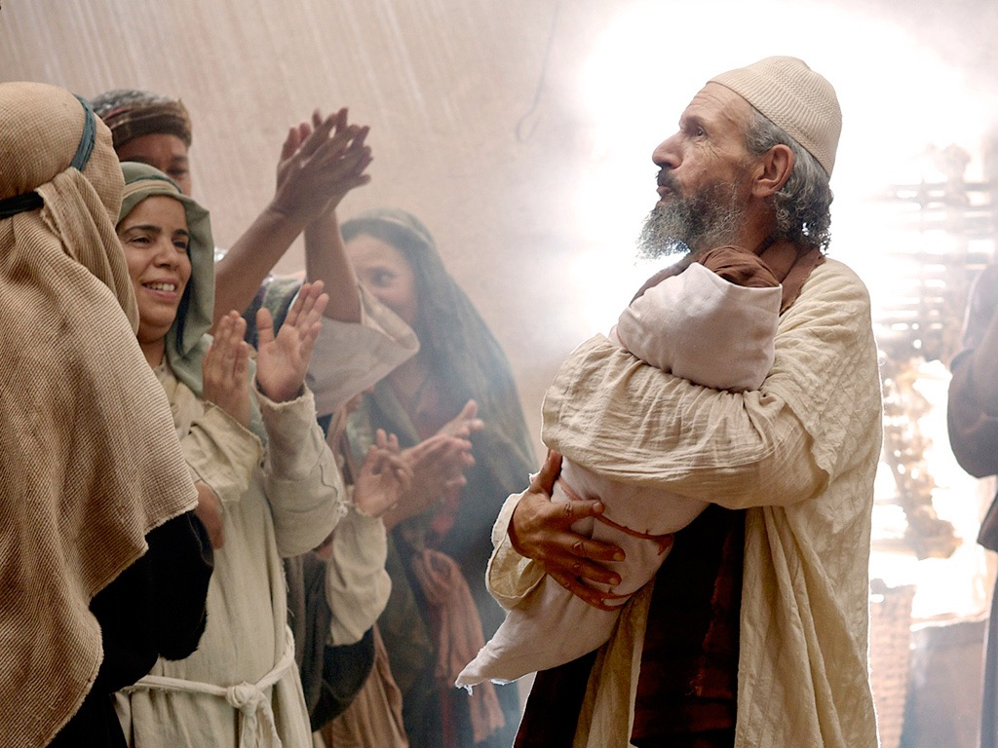
Introduction of the King
§§ 1-27
The Messianic identity of Jesus Christ is evident in his arrival, the testimony by John, and his approval in his baptism and temptation
Section summaries based on J. Dwight Pentecost,
A Harmony of the Words and Works of Jesus Christ (Grand Rapids: Zondervan, 1981)
Dr. Rick Griffith • Jordan Evangelical Theological Seminary • BibleStudyDownloads.org

Slide 2
Pentecost Outline
Introduction of the King
Authentication of the King
Controversy over the King
Instruction of the Twelve by the King
Opposition to the King
Preparation of the Disciples by the King
Official Presentation of the King
Preparation for the Death of the King
Rejection of the King
Resurrection of the King

Slide 3

Introduction of the King
§§ 1-27
Arrival
Ambassador
Approval
Ancestry
Advent
Infancy/
Childhood
Baptism
Temptation
Herald
Notes:
Jesus did all that we should expect of the Messiah (King) from the start:
1—He arrived in the proper lineage of David, born of a virgin, and knew his deity even at age 12
2—His forerunner John knew his role in preparing Israel for her king
3—He had the best witnesses possible in the Father (baptism), Spirit (temptation), and John (prophesied herald)

Slide 4
Introduction of the King
§§ 1-27
Arrival
Ancestry
Advent
Infancy/
Childhood
Notes:
Jesus did all that we should expect of the Messiah (King) from the start:
1—He arrived in the proper lineage of David, born of a virgin, and knew his deity even at age 12
2—His forerunner John knew his role in preparing Israel for her king
3—He had the best witnesses possible in the Father (baptism), Spirit (temptation), and John (prophesied herald)

Slide 5

A. The Arrival of the King
§§ 3-19
The lineage, birth, infancy, and childhood of Jesus show that He is the Messiah of Israel

Slide 6
1. His Ancestry
§ 3
Matthew 1:1-17; Luke 3:23b-38
The genealogy of Jesus establishes his legal and physical right to the throne of David in fulfillment of the Davidic Covenant

Slide 7
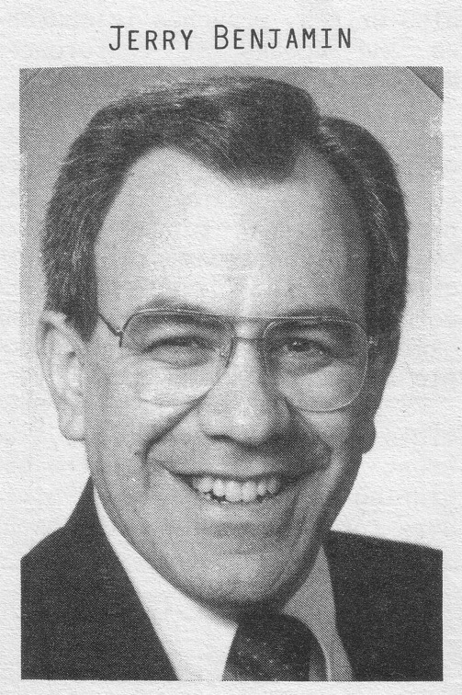
A boring way to begin a book?
ESV Matthew 1:1 The book of the genealogy of Jesus Christ, the son of David, the son of Abraham. 2 Abraham was the father of Isaac, and Isaac the father of Jacob, and Jacob the father of Judah and his brothers, 3 and Judah the father of Perez and Zerah by Tamar, and Perez the father of Hezron, and Hezron the father of Ram, 4 and Ram the father of Amminadab, and Amminadab the father of Nahshon, and Nahshon the father of Salmon, 5 and Salmon the father of Boaz by Rahab, and Boaz the father of Obed by Ruth, and Obed the father of Jesse, 6 and Jesse the father of David the king. And David was the father of Solomon by the wife of Uriah, 7 and Solomon the father of Rehoboam, and Rehoboam the father of Abijah, and Abijah the father of Asaph, 8 and Asaph the father of Jehoshaphat, and Jehoshaphat the father of Joram, and Joram the father of Uzziah, 9 and Uzziah the father of Jotham, and Jotham the father of Ahaz, and Ahaz the father of Hezekiah, 10 and Hezekiah the father of Manasseh, and Manasseh the father of Amos, and Amos the father of Josiah, 11 and Josiah the father of Jechoniah and his brothers, at the time of the deportation to Babylon. 12 And after the deportation to Babylon: Jechoniah was the father of Shealtiel, and Shealtiel the father of Zerubbabel, 13 and Zerubbabel the father of Abiud, and Abiud the father of Eliakim, and Eliakim the father of Azor, 14 and Azor the father of Zadok, and Zadok the father of Achim, and Achim the father of Eliud, 15 and Eliud the father of Eleazar, and Eleazar the father of Matthan, and Matthan the father of Jacob, 16 and Jacob the father of Joseph the husband of Mary, of whom Jesus was born, who is called Christ.
Jeremiah Benjamin
"The first verse stunned me," Jerry recalls. "It said that Jesus was related to my forefathers."
Notes:
Most of us, if we are honest, find that the first few verses of the NT are boring. They may be good for getting us to sleep if we have insomnia, but they aren't generally appreciate as literature [read 1:1-3 with a yawn].
While I was a student at Dallas Seminary, I had the privilege of meeting Jeremiah Benjamin—a true Jewish name if you ever heard one! Jerry was from such a strictly orthodox Jewish family that the New Testament was forbidden in his home. However, a Christian student once gave him a NT and challenged him to read it. So he snuck into his room, climbed into bed, pulled the sheets over him and took out his flashlight.
[Animation] "The first verse stunned me," Jerry later recalled. "It said that Jesus was related to my forefathers."
My experience with Jerry helped me to see that Matthew's beginning didn't interest me because I am a Gentile who wasn't looking for Israel's king. I didn't even know what questions to ask or what to look for. But Matthew was written for the Jewish heart and mind. Therefore, he starts off with a bang: Jesus was actually a direct descendant of King David and therefore fulfilled the lineage necessary to be Israel's king!

Slide 8

Proof That Jesus is King
Notes:
"Persons traveling by plane to another country must identify themselves. Picture identification, like a driver's license and a passport, are usually required. These identifiers are carefully examined to ensure that all the passengers are safe from harm. A man who identifies himself as the Messiah also needs the correct identification. For instance, He must be descended from the line of David, be born in the right city, be born at the right time, and be able to perform amazing works" (Rick Griffith, "Advanced Studies in the NT," Lesson 1, Topic 3, internetseminary.org accessed 17 Jan 2016).

Slide 9
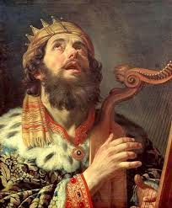
David Listed Before Abraham
"This is a record of the ancestors of Jesus the Messiah, a descendant of David and of Abraham"
(Matt. 1:1 NLT)

Slide 10
Messianic Titles
69
Matthew presents Christ as Messiah
in all three required aspects:
Prophet: Discourses (chs. 5–7, 10, 13, 18, 23–25)
Priest: Atoning death (chs. 26–27)
King: "son of David" (1:1; 9:27; 12:23, etc.)
Support for a literal view of the kingdom is extensive

Slide 11
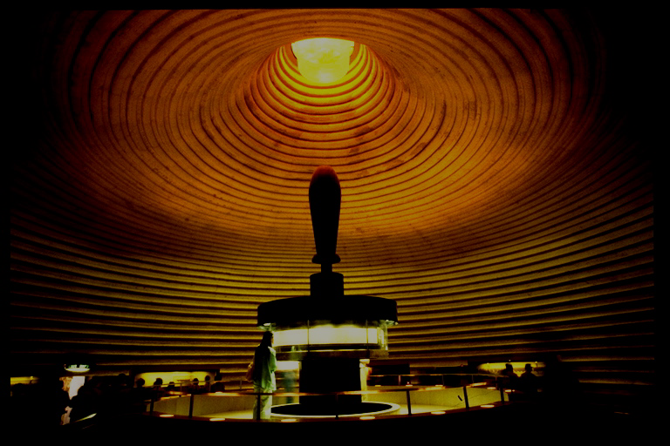
ABRAHAMIC COVENANT
The Call to Abraham Gen. 12:1-3
The Covenant to Abraham Gen. 15:9-18
ETERNAL
LITERAL
UNCONDITIONAL
Gen. 13:15
Gen. 13:14-16
Gen. 15:9-18
LAND
SEED
BLESSING
Gen. 12:1
Gen. 12:2
Gen. 12:3
The Amplified Subcovenants
Land
Davidic
Deut. 30:1-10
2 Sam. 7:4-16
The Very "Backbone" of Biblical Revelation
18
©2004 TBBMI
7.2.05B.

Slide 12
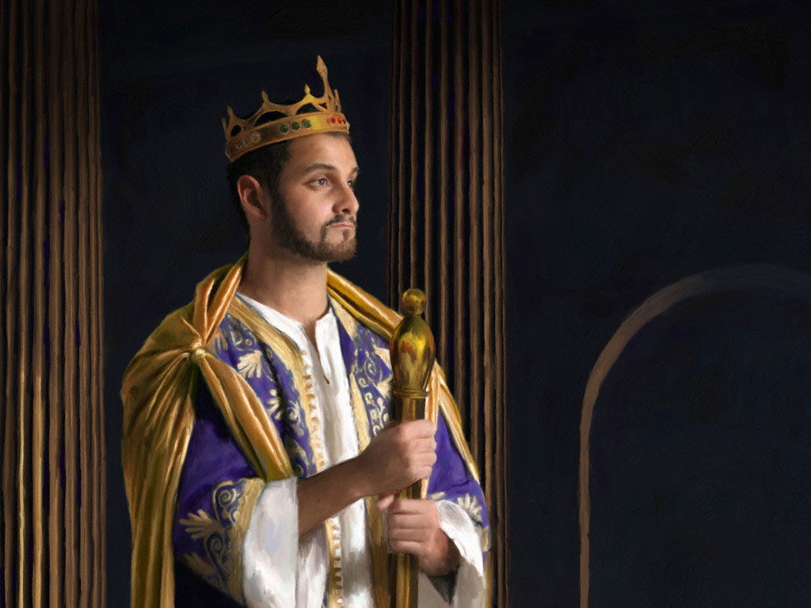
KEY VERSE:
2 Samuel 7:12-13
209
"For when you (David) die, I will raise up one of your descendants, and I will make his kingdom strong. He is the one who will build a house—a temple—for my name. And I will establish the throne of his kingdom forever."

Slide 13

THE DAVIDIC COVENANT
ITS THREE GUARANTEES
2 Samuel 7
¹⁶ Your house and your kingdom will endure forever before me; your throne will be established forever.
forever
forever
19
6
©2004 TBBMI
8.0.05B.

Slide 14
So, then, the question must be asked:
Who is qualified to sit on that Davidic throne?
20
©2004 TBBMI
8.0.05B.

Slide 15
STUDY HELP #16
THE DAVIDIC DYNASTY
The Royal Genealogy of Jesus Christ
21
1
©2004 TBBMI
8.0.05B.

Slide 16
THE LINE OF DAVID: The Royal Genealogy of Jesus Christ*
*VASTLY ABBREVIATED
22
1
Notes:
What about the genealogy of the Lord Jesus Christ, out of that line of David, according to Scripture? What do the scriptures have to say about all that? We are given a long and complex genealogy...
/// so this one will be vastly abbreviated.

Slide 17
THE LINE OF DAVID: The Royal Genealogy of Jesus Christ*
ADAM EVE
Scripture Location:
Genesis 3:20
*VASTLY ABBREVIATED
23
Notes:
We begin with Adam and Eve, first recounted in Genesis 3:20...

Slide 18
THE LINE OF DAVID: The Royal Genealogy of Jesus Christ*
ADAM EVE
Scripture Location:
Genesis 4:1-2; 4:8
CAIN ABEL
*VASTLY ABBREVIATED
24
1
Notes:
From their union came the brothers Cain and Abel.
//// And we know that Cain slew Abel because of Cain's jealousy of the gifts Abel made in sacrifice to the Lord. As a replacement for that murdered brother who was more favored by God, another son was born to Adam and Eve...

Slide 19
THE LINE OF DAVID: The Royal Genealogy of Jesus Christ*
ADAM EVE
Scripture Location:
Genesis 4:25
CAIN ABEL SETH
*VASTLY ABBREVIATED
25
Notes:
He was Seth, the beginning of a godly line of men. AND RIGHT HERE is where the royal genealogy of Jesus Christ gets underway.

Slide 20
THE LINE OF DAVID: The Royal Genealogy of Jesus Christ*
ADAM EVE
Scripture Location:
Genesis 5:29
CAIN ABEL SETH
NOAH
*VASTLY ABBREVIATED
26
Notes:
From Seth...followed Noah. By the way...dotted lines represent an abbreviation of all the Biblical names that actually occur during the long lines of descent. Scripture tells us the names of each one.

Slide 21
THE LINE OF DAVID: The Royal Genealogy of Jesus Christ*
ADAM EVE
Scripture Location:
Genesis 11:26
CAIN ABEL SETH
NOAH
ABRAHAM
*VASTLY ABBREVIATED
27
Notes:
Eventually through this line...we arrive at Abraham.

Slide 22
THE LINE OF DAVID: The Royal Genealogy of Jesus Christ*
ADAM EVE
Scripture Location:
Matthew 1:2-6
CAIN ABEL SETH
NOAH
ABRAHAM (Sarah)
*VASTLY ABBREVIATED
DAVID
28
Notes:
And from Abraham, a thousand years later, appears David..

Slide 23
THE LINE OF DAVID: The Royal Genealogy of Jesus Christ*
ADAM EVE
Scripture Location:
2 Samuel 12:24
CAIN ABEL SETH
NOAH
ABRAHAM
*VASTLY ABBREVIATED
DAVID BATHSHEBA
29
Notes:
And...among other of David's several wives...appears Bathsheba.

Slide 24
THE LINE OF DAVID: The Royal Genealogy of Jesus Christ*
ADAM EVE
Scripture Location:
2 Samuel 5:14
CAIN ABEL SETH
NOAH
ABRAHAM
*VASTLY ABBREVIATED
DAVID BATHSHEBA
NATHAN SOLOMON
30
Notes:
Among the children of David and Bathsheba are these two sons: Nathan and Solomon. And here the line splits. Note that. It's a crucial place.

Slide 25
THE LINE OF DAVID: The Royal Genealogy of Jesus Christ*
ADAM EVE
Scripture Location:
Luke 3:23
Plus Others
CAIN ABEL SETH
NOAH
ABRAHAM
*VASTLY ABBREVIATED
DAVID BATHSHEBA
NATHAN SOLOMON
LUKE 3:23 (see other references)
MARY
31
Notes:
From the line of son Nathan, eventually appears Mary, the mother of Jesus.

Slide 26
THE LINE OF DAVID: The Royal Genealogy of Jesus Christ*
LUKE 3:23 (see other references)
Luke 3:23: "Now Jesus himself was about 30 years old when He began His ministry. He was the son, so it was thought, of Joseph." (NIV)
"Luke was tracing the line of Mary. Many interpreters [among varied positions…] argue that Luke was giving the genealogy of Mary, showing that she also was in the line of David and that therefore Jesus was qualified as the Messiah, not only through Joseph (since he was the oldest legal heir) but also through Mary."
Louis Barbieri, The Bible Knowledge Commentary, eds. John Walvoord & Roy Zuck (Victor Books, 1983), 212.
32
1
Notes:
Luke wrote about this in his Gospel. In his third chapter, verse 23: "Now Jesus himself was about 30 years old when He began His ministry. He was the son, SO IT WAS THOUGHT, of Joseph."
//// This further explanation from two eminent Bible scholars: "Luke was tracing the line of Mary. Many interpreters [among varied other positions…] argue that Luke was giving the genealogy of Mary, showing that she also was in the line of David and that therefore Jesus was qualified as the Messiah, not only through Joseph (since he was the oldest legal heir) but also through Mary."

Slide 27
THE LINE OF DAVID: The Royal Genealogy of Jesus Christ*
ADAM EVE
Scripture Location:
Matthew 1:16
CAIN ABEL SETH
NOAH
ABRAHAM
*VASTLY ABBREVIATED
DAVID BATHSHEBA
NATHAN SOLOMON
MARY JOSEPH
33
Notes:
And from Solomon's side...the line of descent leads directly to Joseph, Jesus' FOSTER-father. And then the climactic event of the ages...from Joseph and Mary, through the intervention of the Holy Spirit in Mary's womb…

Slide 28
THE LINE OF DAVID: The Royal Genealogy of Jesus Christ*
ADAM EVE
Scripture Location:
Matthew 1:16
CAIN ABEL SETH
NOAH
ABRAHAM
*VASTLY ABBREVIATED
DAVID BATHSHEBA
NATHAN SOLOMON
MARY JOSEPH
JESUS CHRIST
34
Notes:
…the Lord Jesus Christ enters the earth. And, you might say, "well…we all know that. What is the importance of such an emphasis on it?" Answer: earthly kingship presents two requirements...

Slide 29
THE LINE OF DAVID: The Royal Genealogy of Jesus Christ*
ADAM EVE
CAIN ABEL SETH
NOAH
ABRAHAM
DAVID BATHSHEBA
NATHAN SOLOMON
BLOOD SUCCESSION
LEGAL SUCCESSION
The FAMILY Right
Luke 3:23-38
The LEGAL Right
Matt 1:1-17
MARY JOSEPH
JESUS CHRIST
35
3
Notes:
FIRST…a family qualification by right of a bloodline succession.
//// SECOND…there must also be a legal qualification by right of traditional succession.
//// The family right and blood line through Mary – the mother of Jesus – as it is laid out in Luke's gospel, third chapter, verses 23-38,
//// While the legal line of Jesus' father – Joseph -- appears in detail in Matthew's Gospel, chapter 1, verses 1-17.
Much has been written all about this...far more than can be described here. So you are encouraged to dig into these ideas. They are rich with meaning, significance and credibility toward establishing the Lord's place in the great Plan of the Ages.

Slide 30
THE LINE OF DAVID: The Royal Genealogy of Jesus Christ*
ADAM EVE
CAIN ABEL SETH
NOAH
ABRAHAM
DAVID BATHSHEBA
NATHAN SOLOMON
The FAMILY Right
Luke 3:23-38
The LEGAL Right
Matt 1:1-17
BLOOD
RIGHT
MARY JOSEPH
JESUS CHRIST
36
Notes:
So...to sum up...
Mary, Jesus' birth mother, supplies his bloodline directly back to the throne of David...and beyond.

Slide 31
THE LINE OF DAVID: The Royal Genealogy of Jesus Christ*
ADAM EVE
CAIN ABEL SETH
NOAH
ABRAHAM
DAVID BATHSHEBA
NATHAN SOLOMON
The FAMILY Right
Luke 3:23-38
The LEGAL Right
Matt 1:1-17
BLOOD
RIGHT
LEGAL
RIGHT
MARY JOSEPH
JESUS CHRIST
37
Notes:
...and Joseph…as the foster-father and a descendant of King Solomon… has the right of legal succession to bestow upon his foster son, Jesus. A remarkable evidence of the credibility and reliability of the Scriptural record.

Slide 32

HAVE YOU EVER CONSIDERED THE INCREDIBLE PROBABILITIES OF THE BIRTH AND LIFE OF JESUS CHRIST?
JUST AN ACCIDENT OF BIRTH?
STUDY HELP #17
39
2
©2006 TBBMI
9.65.05B.
Notes:
With Study Help #17 in hand…place yourself here in a rocky field outside Bethlehem where a shepherd tends his flock –– as it has been for thousands of years on this same land…just outside that ancient little town where Jesus was born. From here you could have seen and heard the angelic announcement of his miraculous birth! Which leads to another another question…
//// Have you ever considered the astonishing statistical probabilities of the birth and life of Jesus Christ?
//// Was it just an accident of birth?

Slide 33
HAVE YOU EVER CONSIDERED THE INCREDIBLE PROBABILITIES OF THE BIRTH AND LIFE OF JESUS CHRIST?
*
JUST AN ACCIDENT OF BIRTH?
IN THE OLD TESTAMENT: MORE THAN 300 REFERENCES TO A COMING MESSIAH WERE FULFILLED UPON THE BIRTH, LIFE AND CRUCIFIXION OF JESUS CHRIST. WITH THAT SAID…
STUDY HELP #17
*Source: Josh McDowell, Evidence That Demands A Verdict, 1972, page 175; Peter Stoner, Science Speaks, Moody Press, 1963.
40
Notes:
In the Old Testament…more than 300 references to a coming Messiah were fulfilled upon the birth, life and crucifixion of Jesus Christ. So then, with that said, according to established scientific techniques of probability and statistics.

Slide 34
THAT SAID…
WHAT ARE THE CHANCES OF ONLY 8 PREDICTIONS BEING FULFILLED IN THE LIFE OF ANY ONE INDIVIDUAL BETWEEN THEN AND NOW?
_{ANSWER: ONE CHANCE IN}
_{100 QUADRILLION (10} ¹⁷₎
_{1:100,000,000,000,000,000}
*Source: Josh McDowell, Evidence That Demands A Verdict, 1972, page 175; Peter Stoner, Science Speaks, Moody Press, 1963.
41
2
Notes:
What, then, are the chances of only EIGHT predictions being fulfilled in the life of any one individual between then and now?
//// The answer: one chance in 100 quadrillion…or…10 to the 17th!
//// and here is what that number looks like typed out!
If you think that is incredible…here comes another one.

Slide 35
TAKE IT A STEP FURTHER…
WITH JUST 48 (OF THE 300) PREDICTIONS BEING FULFILLED IN THE LIFE OF ANY ONE INDIVIDUAL BETWEEN THEN AND NOW:
_{ANSWER: one chance in 10}¹⁵⁷
1:10,000,000,000,000,000,000,000,000,000,000,000,000,000, 000,000,000,000,000,000,000,000,000,000,000,000,000,000, 000,000,000,000,000,000,000,000,000,000,000,000,000,000, 000,000,000,000,000,000,000,000,000,000,000,000
*Source: Josh McDowell, Evidence That Demands A Verdict, 1972, page 175; Peter Stoner, Science Speaks, Moody Press, 1963.
42
3
Notes:
Another measure of scientific probability…
//// Then…with just 48 of the 300 predictions being fulfilled in the life of any one individual between then and now:
//// The answer: one chance in 10 to the 157th!
//// Typed out…here you are!
Before your very eyes…statistical probabilities produced by a world-renowned scientist…according to established scientific procedures of statistics and probability.

Slide 36
Three-Part Genealogy of Christ Through Joseph (1:1-17)
From Abraham to David
– 14 generations
From David to Captivity in Babylon
– 14 generations
From Captivity to Christ
– 14 generations

Slide 37
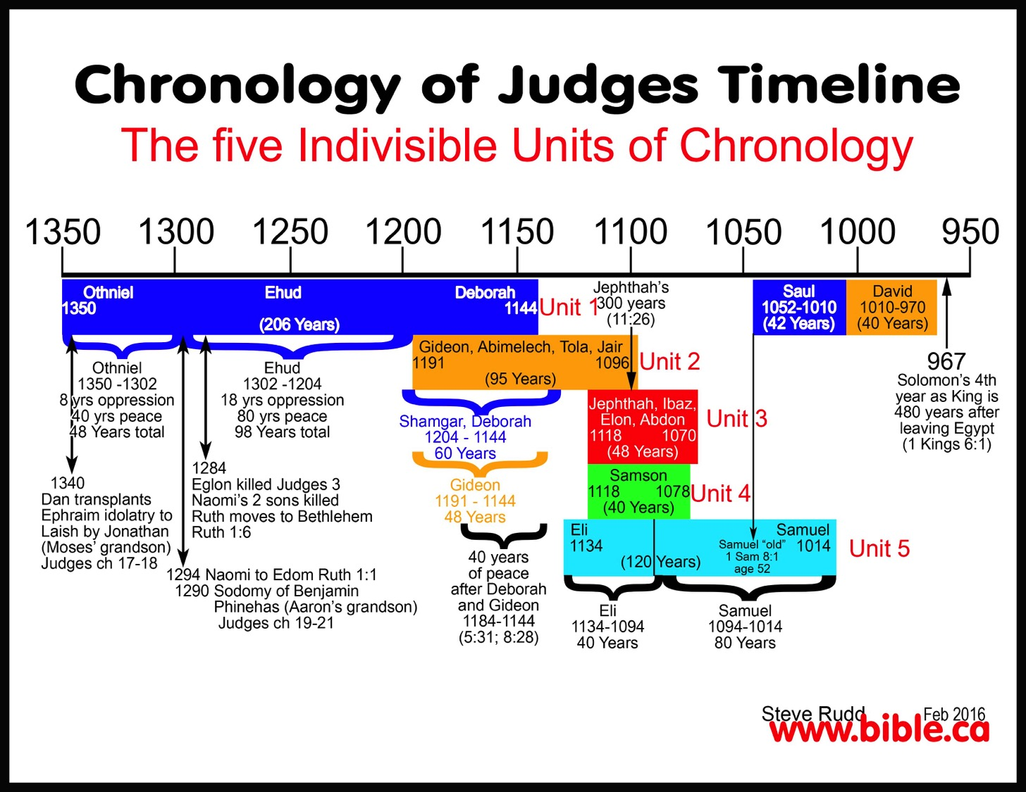
Chronological Overlaps
Chronology of Judges Timeline
The Five Indivisible Units of Chronology

Slide 38
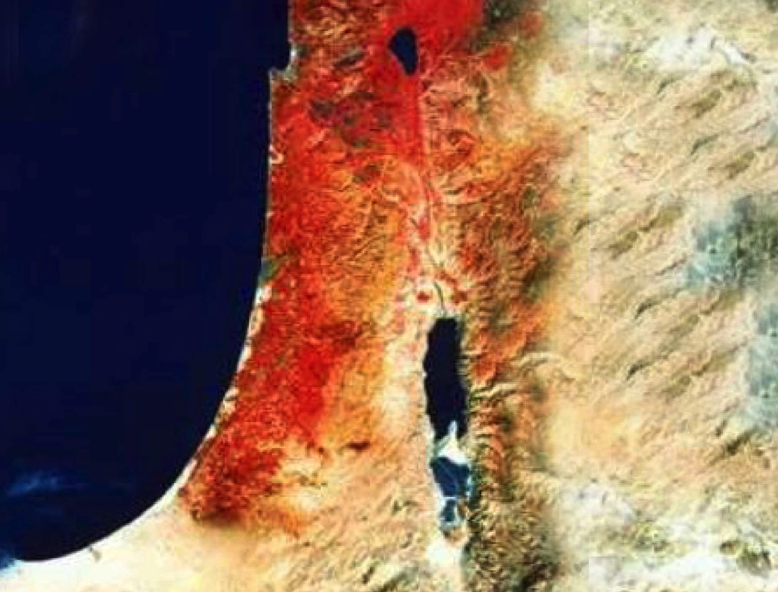

Date
Genealogy
OTS 186
David as Designate
David as King
Era of Judges
1373
1105
1049
1030
1010
971
Othniel
Samson
Samuel's Lifetime
Ruth's Life
Ruth Written
Since the genealogy (4:18-21) ends with David (not Solomon), it was probably penned after David's anointing (ca. 1030 BC) &, at the latest, just before Solomon's crowning as king (971 BC).
Authorship by Samuel pushes the date back to probably 1030-1020 BC.
The story occurs in the previous era of the judges (1:1; 1373-1049 BC).
Since Ruth was David's great-grandmother (4:17) and he began ruling in 1010 BC, some believe Ruth lived in the latter part of the 12th century.
Thus, Samuel records events that occurred about one century earlier.

Slide 39

Promises of the Davidic Covenant
9g
22
What did God promise David in 2 Samuel 7:12-16?
New Dynasty
(2 Sam 7)

Slide 40
Kingdom & Covenants Timeline
22 &
337
9g
Dr. Rick Griffith • BibleStudyDownloads.org
Kingdom Teaching...
Adam rules with God (Gen. 1:26, 28; 2:19)
Satan begins rule as god of this world (Gen. 3:15;
2 Cor. 4:4)
God covenants with Abraham to reestablish man's rule via Israel as a "kingdom of priests" (Gen. 12:1-3; Exod. 19:6)
Israel's failure to witness to nations as a kingdom of priests is judged via exile under foreign rule
Israel rejects Messiah's offer of kingdom (Matt. 12:41-42; 23:37-39)
Jesus extends His kingdom in mystery form to the Church (Matt. 13)
Christ subdues Israel's enemies and nation believes (Rom. 11:26-27)
Christ rules over everything with saints (Eph. 1:9-10; Rev. 20:1-6; 22:5b)
Fall of Man (Gen. 3)
Noahic Covenant
Genesis 6:18; 9:8-17
Land Covenant
ISRAEL
CHURCH
MESSIANIC KINGDOM
(National Focus)
The "New Man" (Eph. 2:15)
Millennial Eternal
land
Genesis 15:18 (cf. Deut. 30:1-10) promises:
Land from Wadi of Egypt to Euphrates River (Isa. 27:12)
Eternal possession of land (Gen. 17:8) after exile/restoration
Whole world blessed via the land (Isa. 14:1-2)
Israel judged for rejecting Messiah by dispersion away from land for 19 centuries
(AD 70–AD 1948) but now partially restored (Ezek. 37:1-7)
Full restoration (Ezek. 37:8-28) Jerusalem world capital
(Isa. 2:1-5)
New Jerusalem
(Rev. 21–22)
Davidic Covenant
Christ is Head over His Church, which is a spiritual temple (Eph. 2:19-22; 2 Cor. 6:16)
Christ reigns over the world
(Isa. 11)
with saints (Rev. 5:10; 20:4-6)
Christ hands kingdom over to Father (1
Cor. 15:24)
Genesis 12:1-3
2 Samuel 7:12-16 promises:
Sons ("house" never wiped out)
Kingdom (political dynasty)
Throne (right to rule by descendants)
Temple (son to build it)
seed
Abrahamic Covenant
New Covenant
All
things made new!
(Rev. 21:5)
All 5 elements fulfilled in national restoration (Zech. 8)
Jeremiah 31:31-34 promises:
Forgiveness
Indwelling Spirit
New heart, nature, mind
Reunification of Israel and Judah
No need for evangelism
Mosaic Law replaced with first three elements of the New Covenant (Luke 22:20; 2 Cor. 3:6)
blessing
Mosaic Covenant
Law abolished, fulfilled, and replaced at the cross (Rom. 7:1-6;1 Cor. 9:19-21; Heb. 8:13)
Eighth Edition
29 Aug 2016
Temporary (Gal. 3:19) and conditional (Deut. 28) to reveal sin (Rom. 7:7) and regulate Israel (Gal. 3:23-25)
Scripture has a dual kingdom-covenant theme. Israel's role from Abraham to Christ expands to include the Church (continuity) yet the Church never replaces the nation as the "new Israel" (discontinuity). Israel will again enjoy world prominence after trusting Christ at His second coming.
Notes:
Slides 13 and 139 repeated

Slide 41
Promises of the Davidic Covenant
9g
22
What did God promise David in 2 Samuel 7:12-16?
Sons: "house" never wiped out
Kingdom: political dynasty (each Jerusalem king will be one of his direct descendants)
Throne: As an eternal covenant (v. 16), the right to rule will remain with his family forever
Temple: Solomon will build it
Discipline: God will punish disobedient kings but still unconditionally keep these promises
New Dynasty
(2 Sam 7)

Slide 42

The Kingdom in Matthew 1
Fall of the Kingdom
Establishing the Eternal Kingdom
ABRAHAM
Solomon
Shealtiel
Isaac
Rehoboam
Zerubbabel
Jacob
Abijah
Abiud
Judah
Asa
Eliakim
Perez
Jehoshaphat
Azor
"Thus there were fourteen generations in all from Abraham to David, fourteen from David to the exile to Babylon, and fourteen from the exile to Christ."
Matthew 1:17
Ahaziah
Hezron
Jehoram
Zadok
Joash
Ram
Uzziah
Akim
Amaziah
Amminadab
Jotham
Eliud
Nahshon
Ahaz
Eleazar
Salmon
Hezekiah
Matthan
Boaz
Manasseh
Jacob
Obed
Amon
Joseph +
Mary
Rise of the Kingdom
Jesse
Josiah
KING DAVID
JECONIAH (EXILE)
JESUS CHRIST

Slide 43
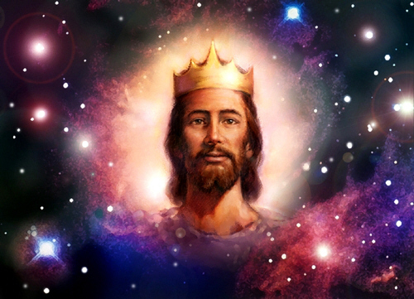
Matthew says Jesus is King!

Slide 44
Some of the many authors who have written on Jesus' genealogy:
Criswell, W. A.
Danker, Frederick
Ellis, E. Earle
Fitzmeyer, Joseph
Godet, F. A.
Hendricksen, William
Hoehner, Harold
Ironside, F. A.
Marshall, I. Howard
McGee, J. Vernon
Morgan, G. Campbell
MacArthur, John
Scofield, C. I.
Swindoll, Charles
Unger, Merrill
Walvoord, John
Zuck, Roy
38
©2004 TBBMI
8.0.05B.

Slide 45
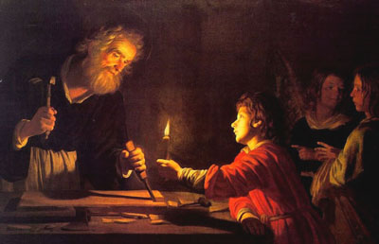
Birth & Childhood of Jesus
Adapted from a 2006 Class Presentation by Connie Tong for
Dr. Rick Griffith • Singapore Bible College • BibleStudyDownloads.org

Slide 46
Genealogy of Jesus
Matthew
from
Abraham
down to
Jesus

Slide 47
15
P1 Million
14
P500,000
How many generations were there from Abraham to Jesus?
13
P250,000
12
P125,000
11
P64,000
10
P32,000
9
P16,000
8
P8,000
7
P4,000
6
P2,000
5
P1,000
4
P500
3
P300
2
P200
50:50
1
P100
A: 14 x 3
B: 14 x 4
C: 13 x 5
D: 15 x 2

Slide 48
Genealogy of Jesus
Matthew
Abraham
David
Babylonian exile
Jesus
from
Abraham
down to
Jesus

Slide 49
Genealogy of Jesus
Matthew
from
Abraham
down to
Jesus
Adam
up to
Jesus
from
Luke

Slide 50
Jesus'
Focus
Davidic heritage
messianic role

Slide 51
2. His Advent
§§ 4-11
The arrival of both John and Christ is announced and fulfilled to show through their births that Jesus is the promised Messiah
Notes:
Arabic edited

Slide 52
Birth & Childhood of Jesus
Adapted from a 2006 Class Presentation by Connie Tong for
Dr. Rick Griffith • Singapore Bible College • BibleStudyDownloads.org

Slide 53

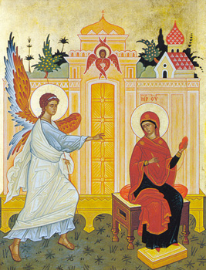
same main details
Of
Matthew & Luke
Mary & Joseph were godly parents
virginal conception of Mary
an angel announced the birth of Jesus

Slide 54
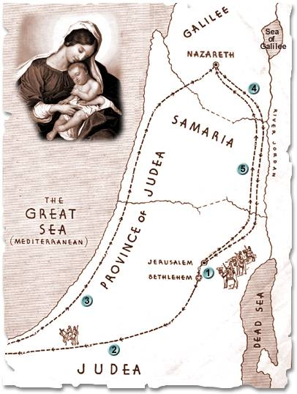
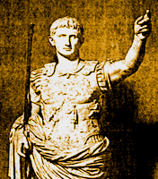
named the child in advance
born in
Bethlehem in
the time
of Herod
Nazareth
Bethlehem
the family settled in Nazareth

Slide 55
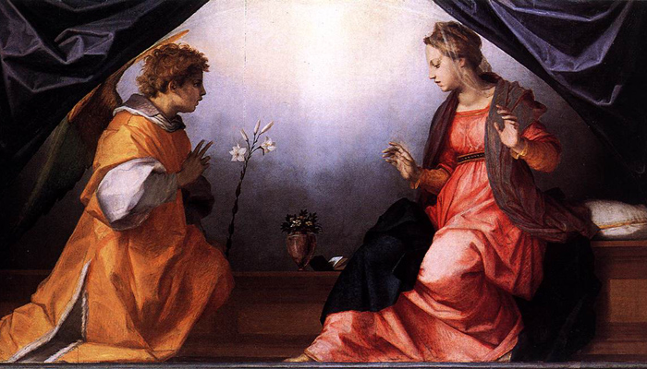
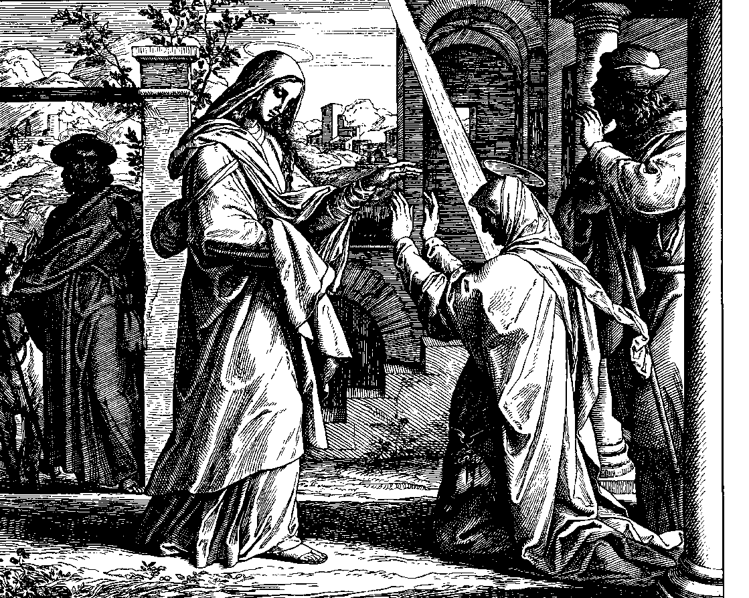
Timeline of
Infancy stories of Jesus
M
A
T
T
H
E
w
Luke
birth of John predicted
birth of Jesus predicted
Mary conceived
Mary & Elizabeth met

Slide 56
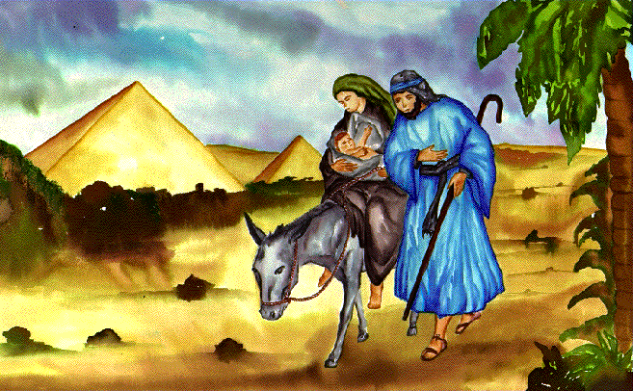
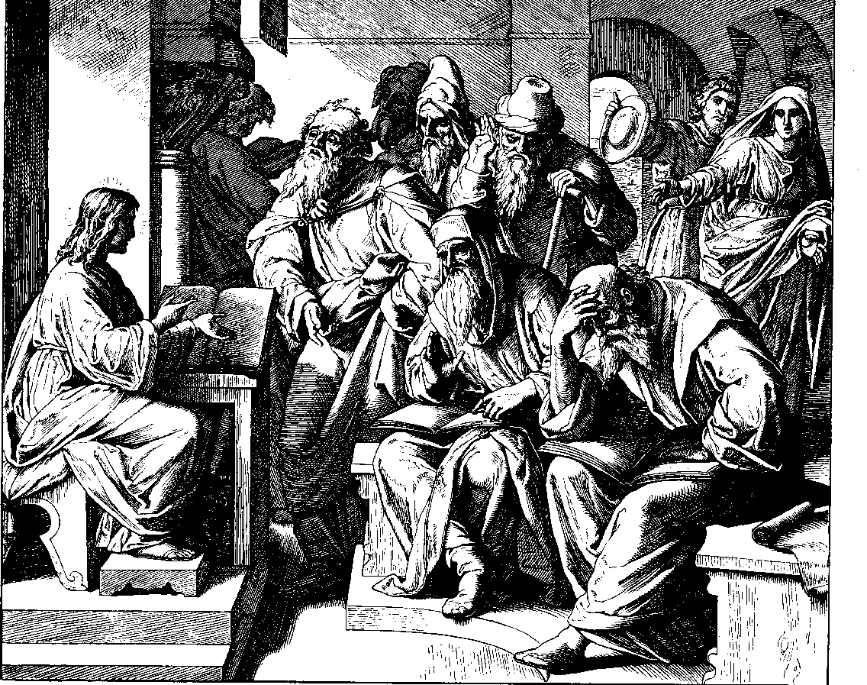
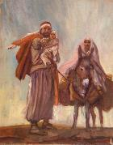
birth of John
Jesus born
in Bethlehem
birth of Jesus
flight to Egypt
killing of the infants
returned to Nazareth
Jesus in the temple
at the age of 12

Slide 57
a. The Annunciation of the Birth of John to Zechariah
§ 4
Luke 1:5-25
Gabriel announces to Zechariah that his wife Elizabeth would miraculously give birth to the forerunner of Messiah to set John apart for God's service before his birth

Slide 58
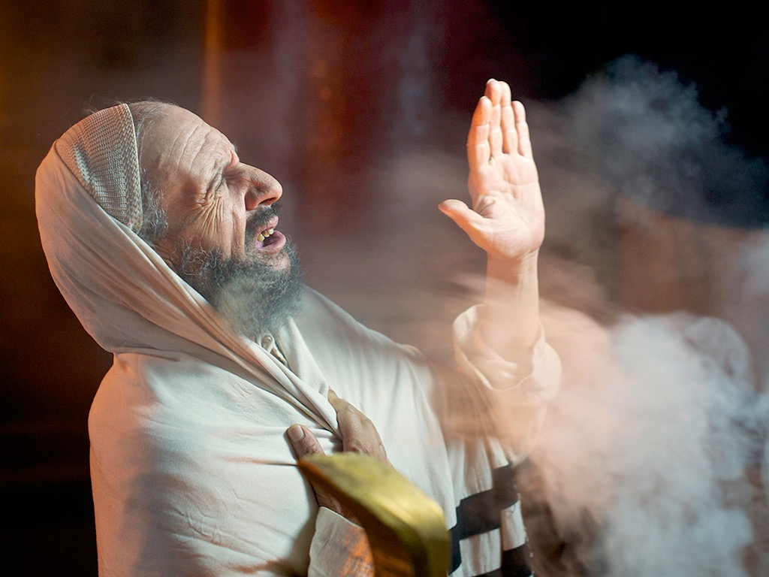

Luke 1:5-25, 39-45
ZECHARIAH IS PROMISED A SON
Free
Bible
images
Notes:
Luke's gospel is known for its many parables by Jesus.

Slide 59
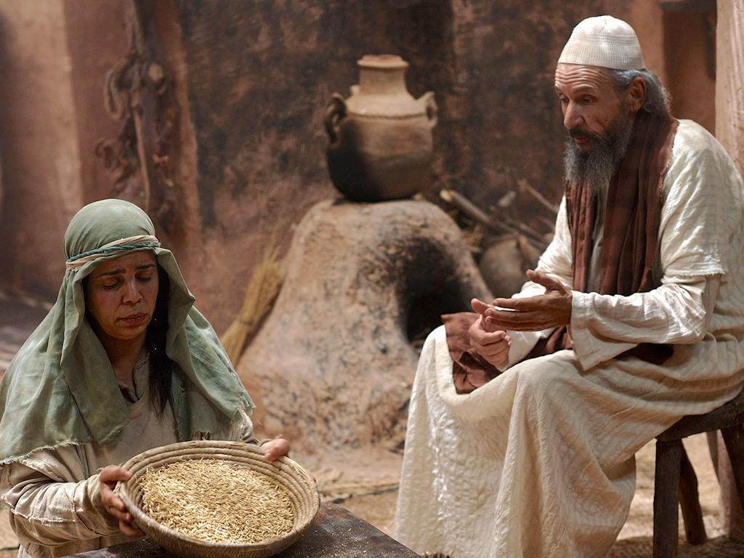
Notes:
Luke 1:5-25
Luke 1:5 When Herod was king of Judea, there was a Jewish priest named Zechariah. He was a member of the priestly order of Abijah, and his wife, Elizabeth, was also from the priestly line of Aaron.
NLT (2nd ed) here and throughout these slides

Slide 60
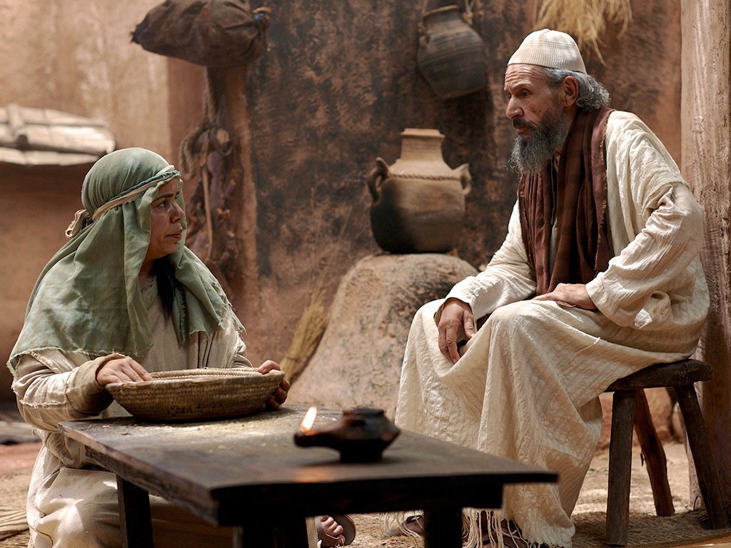
Notes:
⁶ Zechariah and Elizabeth were righteous in God’s eyes, careful to obey all of the Lord’s commandments and regulations. ⁷ They had no children because Elizabeth was unable to conceive, and they were both very old.

Slide 61
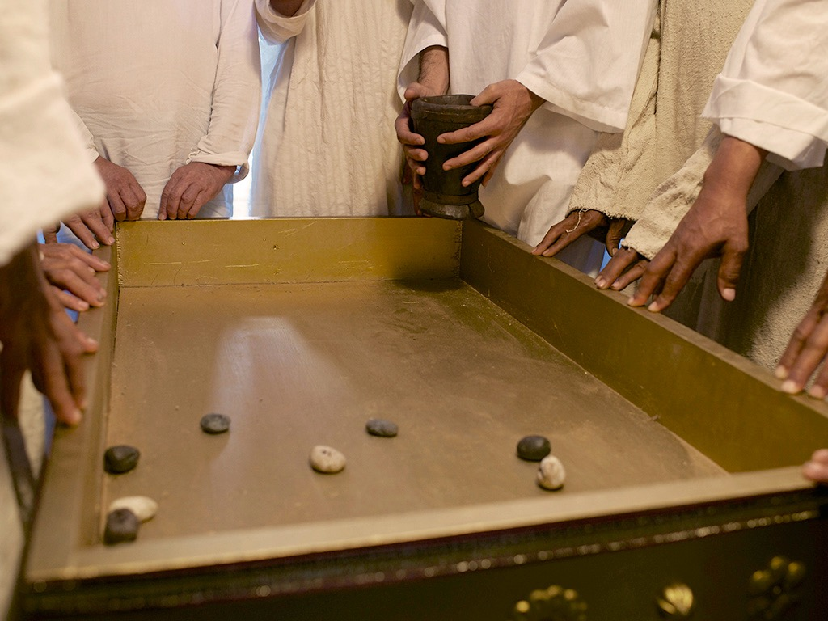
Notes:
Luke 1:8 One day Zechariah was serving God in the Temple, for his order was on duty that week.

Slide 62
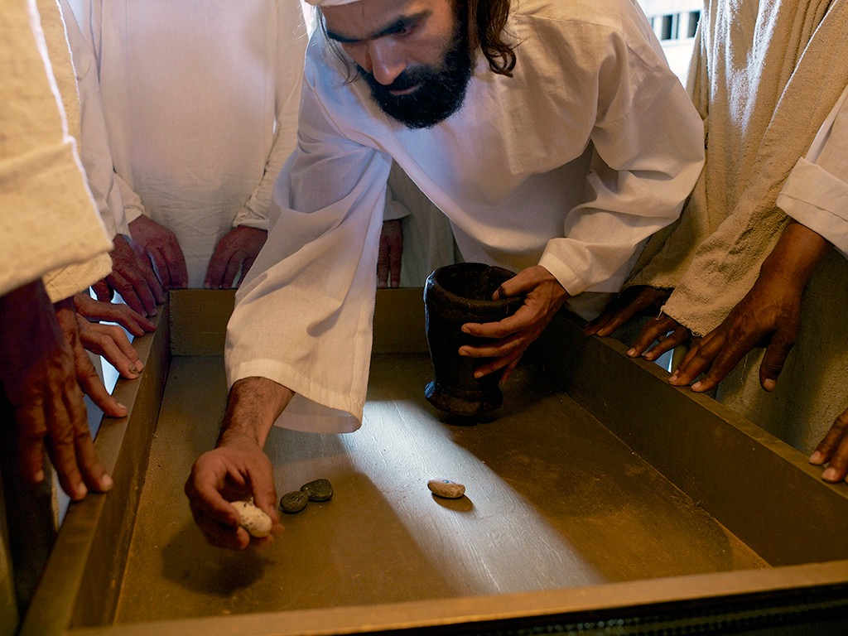
Notes:
⁹ As was the custom of the priests, he was chosen by lot to enter the sanctuary of the Lord and burn incense.

Slide 63
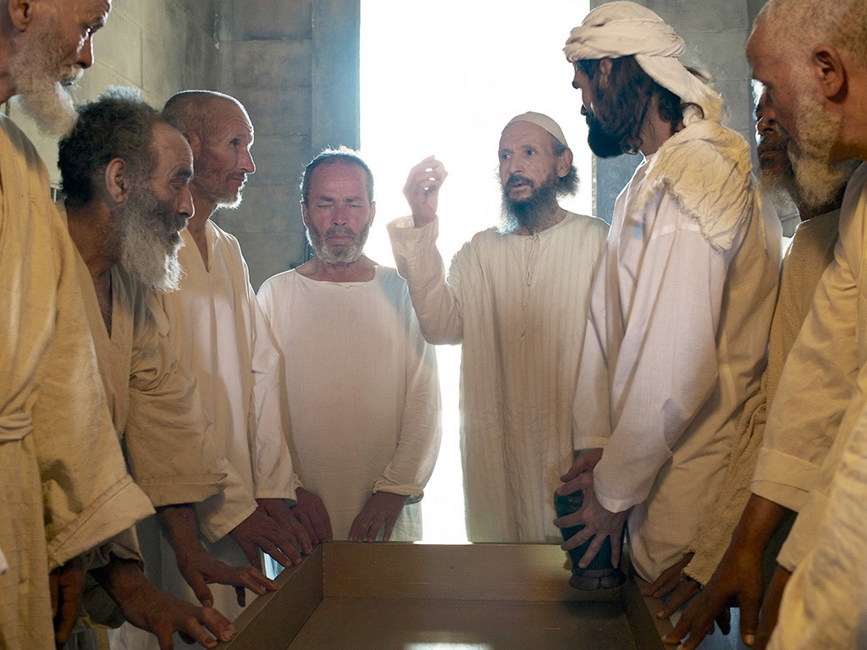

Slide 64
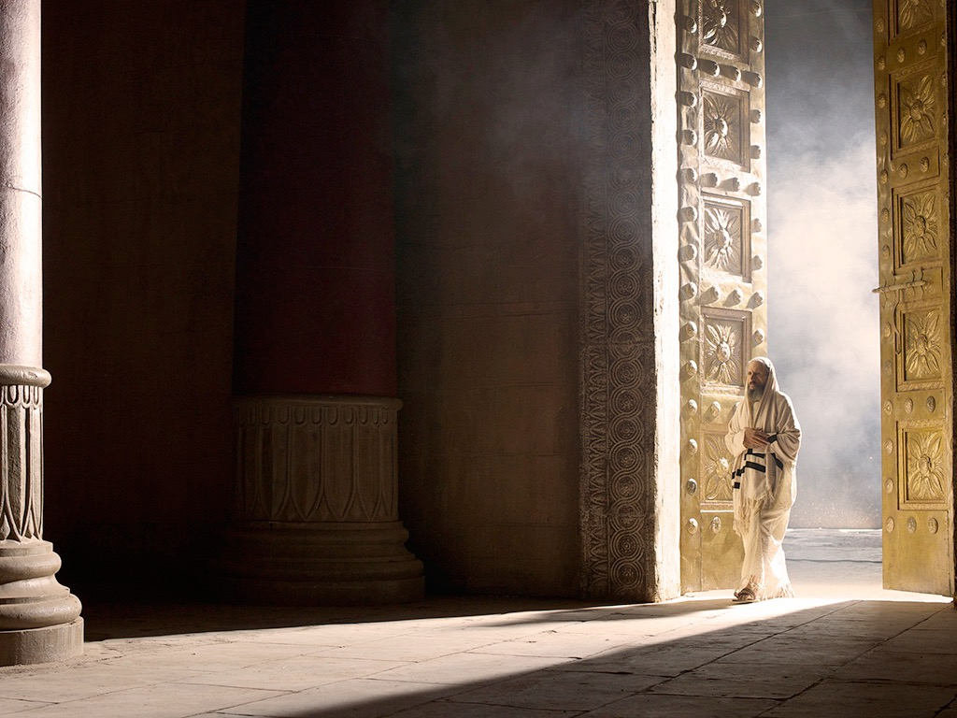

Slide 65
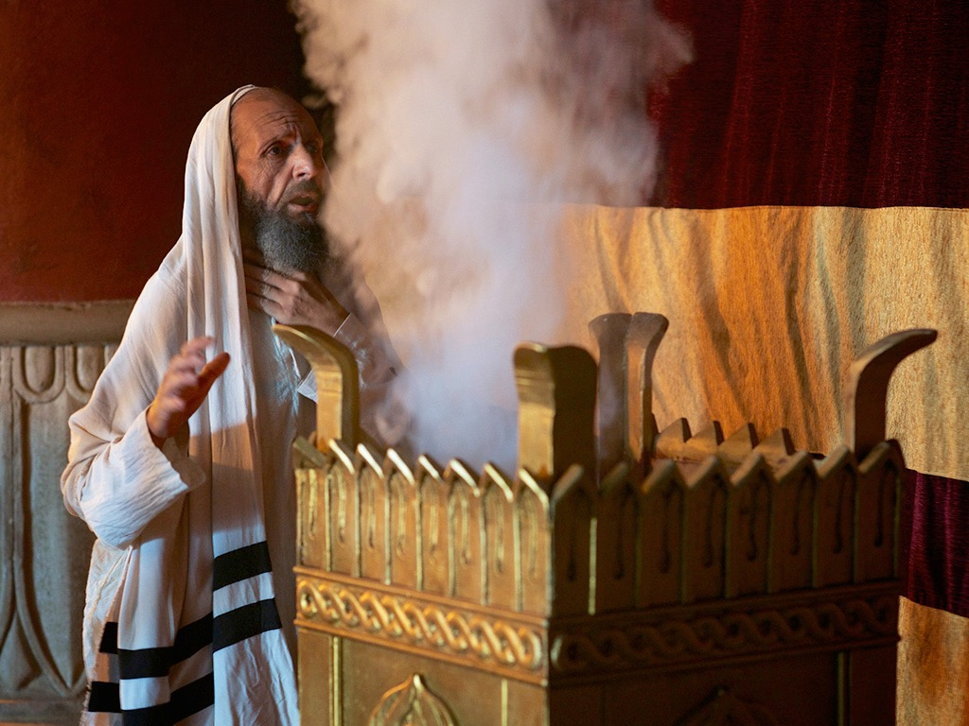
Notes:
¹⁰ While the incense was being burned, a great crowd stood outside, praying.

Slide 66
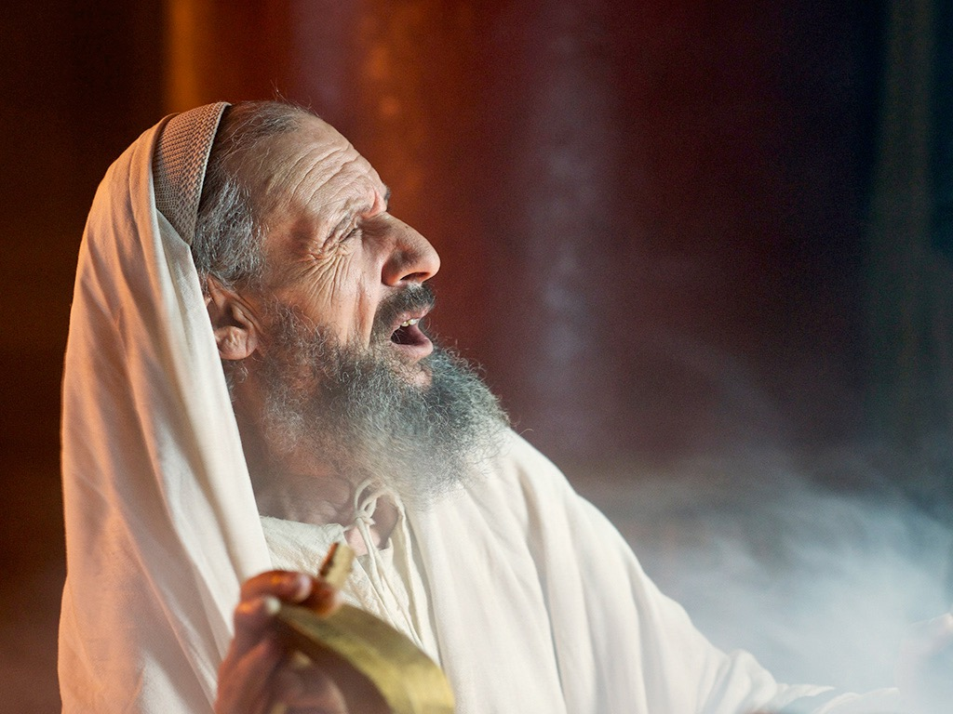
Notes:
Luke 1:11 While Zechariah was in the sanctuary, an angel of the Lord appeared to him, standing to the right of the incense altar.

Slide 67
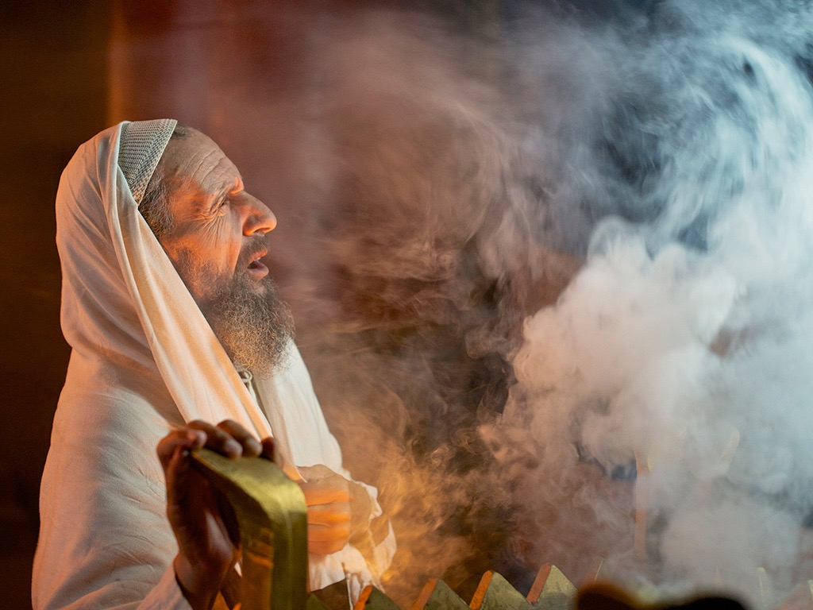
Notes:
¹² Zechariah was shaken and overwhelmed with fear when he saw him. ¹³ But the angel said, “Don’t be afraid, Zechariah! God has heard your prayer. Your wife, Elizabeth, will give you a son, and you are to name him John. ¹⁴ You will have great joy and gladness, and many will rejoice at his birth, ¹⁵ for he will be great in the eyes of the Lord. He must never touch wine or other alcoholic drinks. He will be filled with the Holy Spirit, even before his birth.ª ¹⁶ And he will turn many Israelites to the Lord their God. ¹⁷ He will be a man with the spirit and power of Elijah. He will prepare the people for the coming of the Lord. He will turn the hearts of the fathers to their children,ª and he will cause those who are rebellious to accept the wisdom of the godly.”

Slide 68
Notes:
Luke 1:18 Zechariah said to the angel, “How can I be sure this will happen? I’m an old man now, and my wife is also well along in years.”
Luke 1:19 Then the angel said, “I am Gabriel! I stand in the very presence of God. It was he who sent me to bring you this good news! ²⁰ But now, since you didn’t believe what I said, you will be silent and unable to speak until the child is born. For my words will certainly be fulfilled at the proper time.”

Slide 69
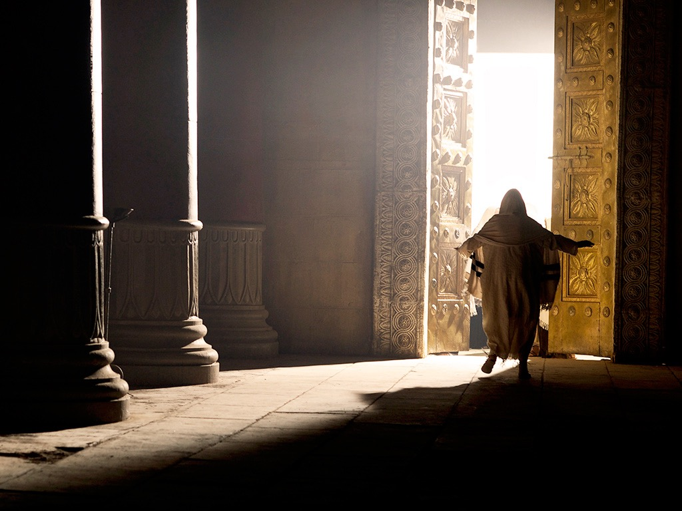
Notes:
Luke 1:21 Meanwhile, the people were waiting for Zechariah to come out of the sanctuary, wondering why he was taking so long.

Slide 70
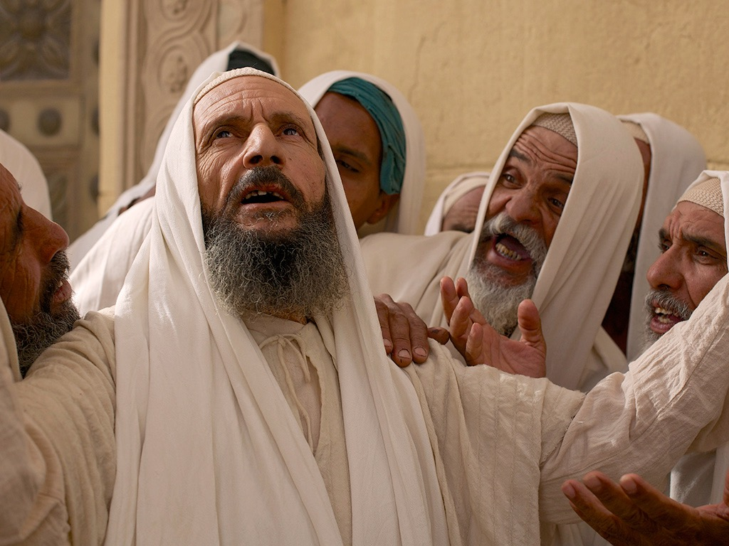
Notes:
²² When he finally did come out, he couldn’t speak to them.

Slide 71
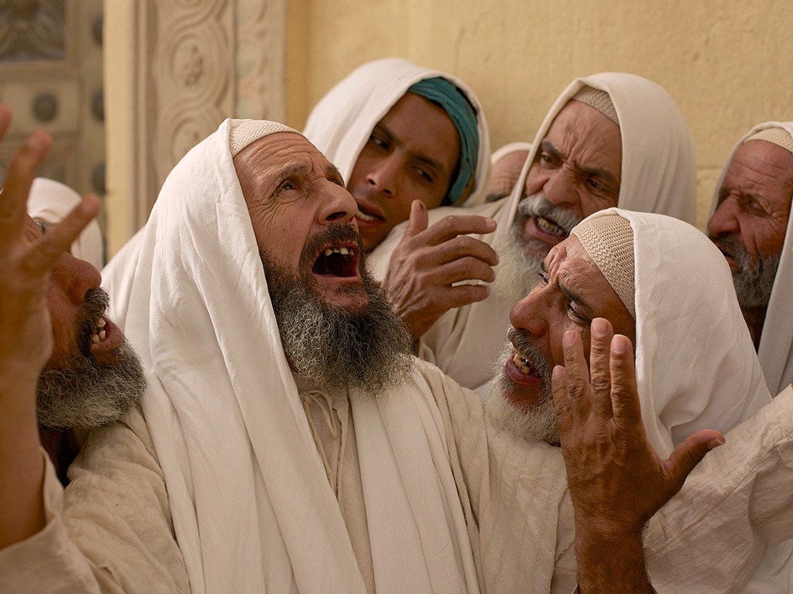
Notes:
Then they realized from his gestures and his silence that he must have seen a vision in the sanctuary.

Slide 72
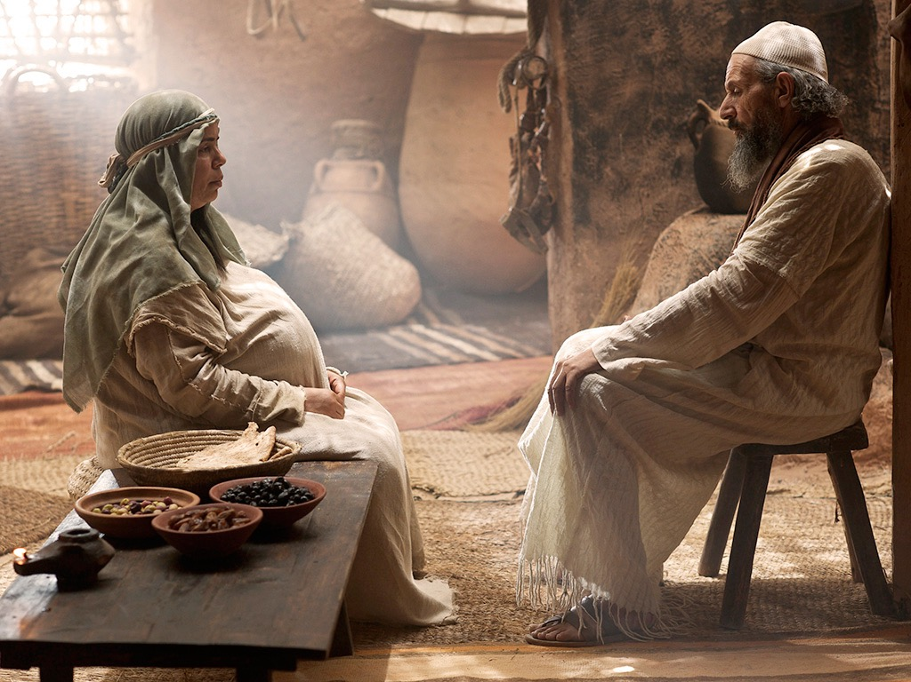
Notes:
Luke 1:23 When Zechariah’s week of service in the Temple was over, he returned home. ²⁴ Soon afterward his wife, Elizabeth, became pregnant and went into seclusion for five months.

Slide 73
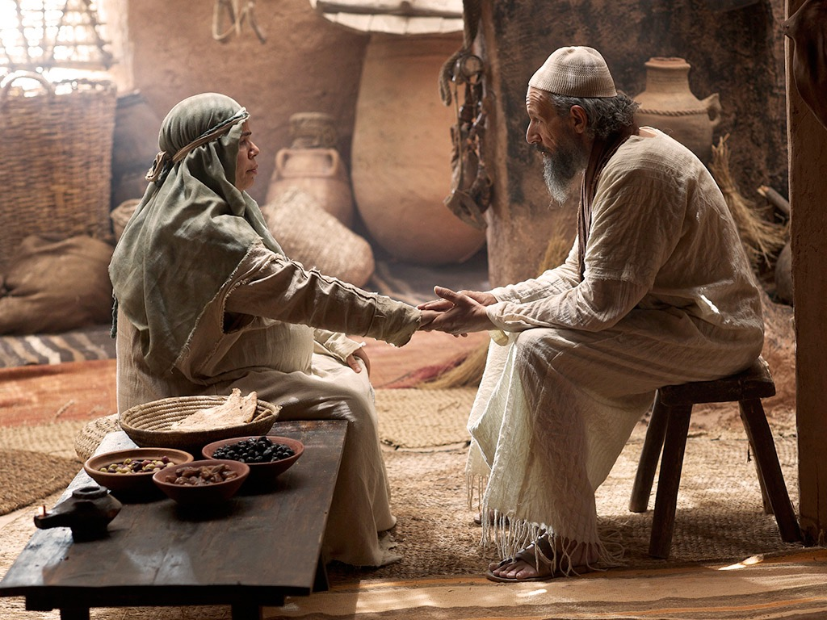
Notes:
²⁵ “How kind the Lord is!” she exclaimed. “He has taken away my disgrace of having no children.”

Slide 74
THE WORD IN PICTURES
Free
Bible
images

Slide 75

Used with Permission
THE
GOSPEL
——OF—— MATTHEW
THE
GOSPEL
——OF—— MARK
THE
GOSPEL
——OF—— LUKE
THE
GOSPEL
——OF—— JOHN
Due to the Lumo Project producing its own publishing material we regret to inform you that we cannot license our photos to other clients outside of freebibleimages.org.
These images are not licensed for reuse in video, epublishing or other media. Downloaded pictures and files cannot be redistributed through any other website than freebibleimages.org or used in any context where the accompanying message is undermining of the Christian faith and gospel.
Photos can only be used on educational presentations, blogs and social media, all of which should be accompanied with reference to www.LumoProject.com.
Picture courtesy of BBM
© All Rights Reserved.
www.bigbookmedia.com

Slide 76
b. The Annunciation of the Birth of Jesus to Mary
§ 5
Luke 1:26-38
Gabriel announces to the Virgin Mary that she would miraculously conceive and bear the Messiah, Jesus, so that God could become incarnate without a fallen nature and in order that Mary might know that she became pregnant by the Holy Spirit

Slide 77


AN ANGEL VISITS MARY
Free
Bible
images
Luke 1:26-38
Notes:
Miraculous births of John and Jesus show that God controls all things—from barren women to the dictates of kings—to give Israel’s Messiah to the world (1:57–2:20).

Slide 78
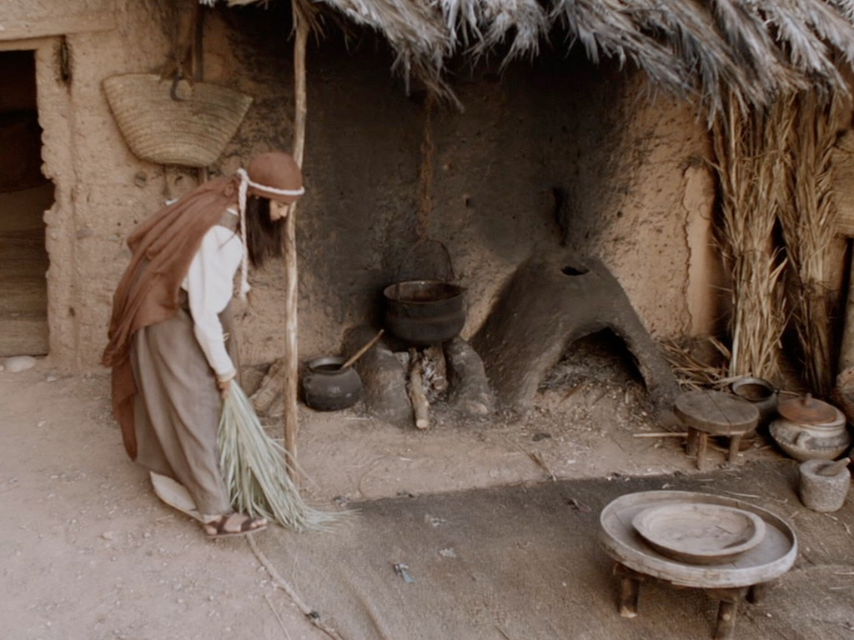

Slide 79


Slide 80
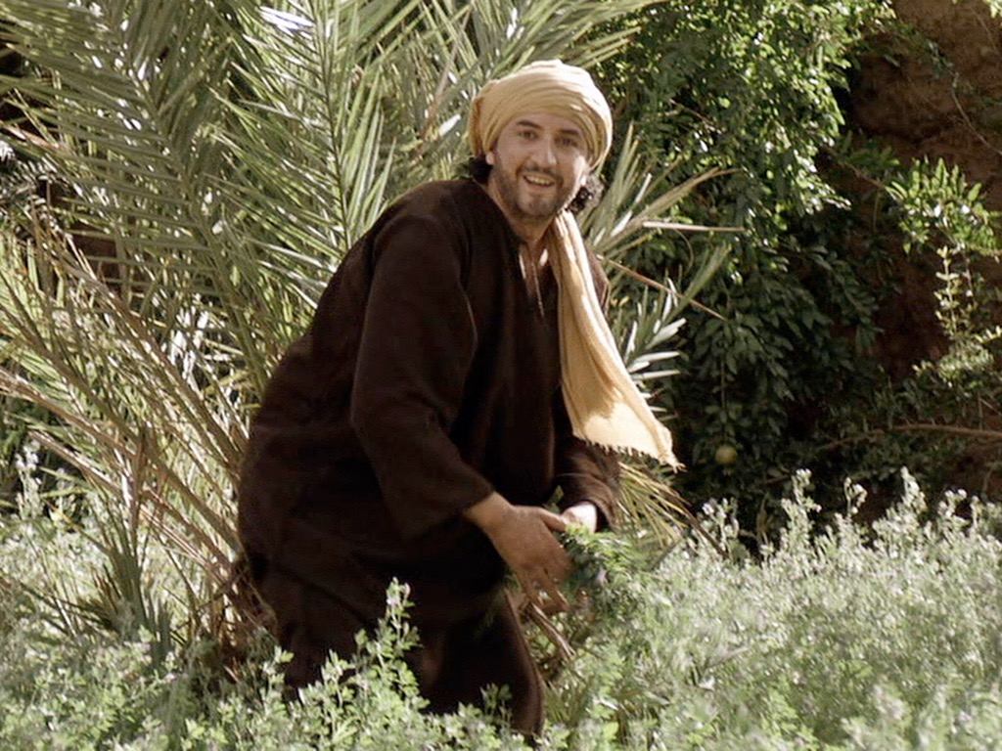

Slide 81


Slide 82


Slide 83


Slide 85


Slide 86
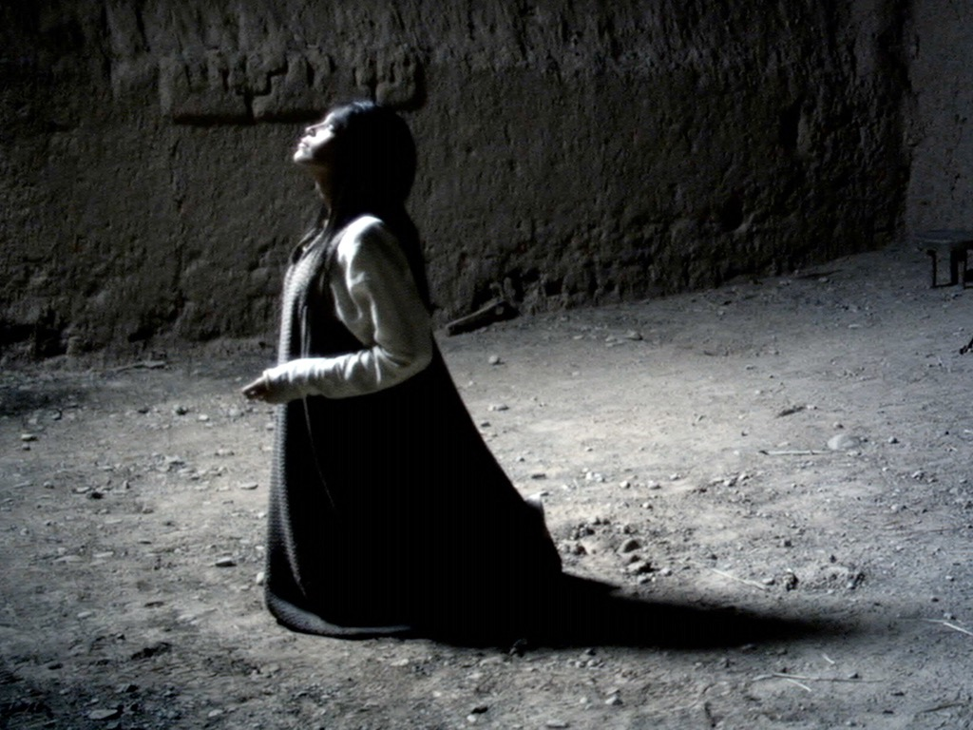

Slide 87
THE WORD IN PICTURES
Free
Bible
images

Slide 88
Used with Permission
THE
GOSPEL
——OF—— MATTHEW
THE
GOSPEL
——OF—— MARK
THE
GOSPEL
——OF—— LUKE
THE
GOSPEL
——OF—— JOHN
Due to the Lumo Project producing its own publishing material we regret to inform you that we cannot license our photos to other clients outside of freebibleimages.org.
These images are not licensed for reuse in video, epublishing or other media. Downloaded pictures and files cannot be redistributed through any other website than freebibleimages.org or used in any context where the accompanying message is undermining of the Christian faith and gospel.
Photos can only be used on educational presentations, blogs and social media, all of which should be accompanied with reference to www.LumoProject.com.
Picture courtesy of BBM
© All Rights Reserved.
www.bigbookmedia.com

Slide 89

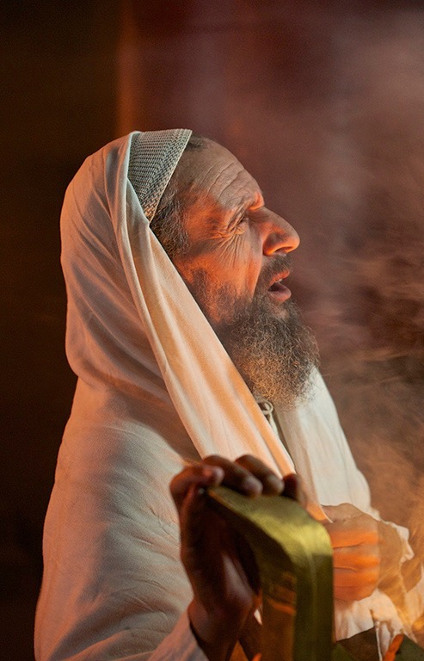
Responses to Amazing Birth News
101e
Zechariah
Mary
Too old for baby
Too young for baby
"How can I be sure?"
"How will this be?"
Doubted God's word
Asked God's method
Ended up dumb
Ended up submissive

Slide 90

Bethlehem was David's City

Slide 91

SON of the
HIGHEST

Slide 92
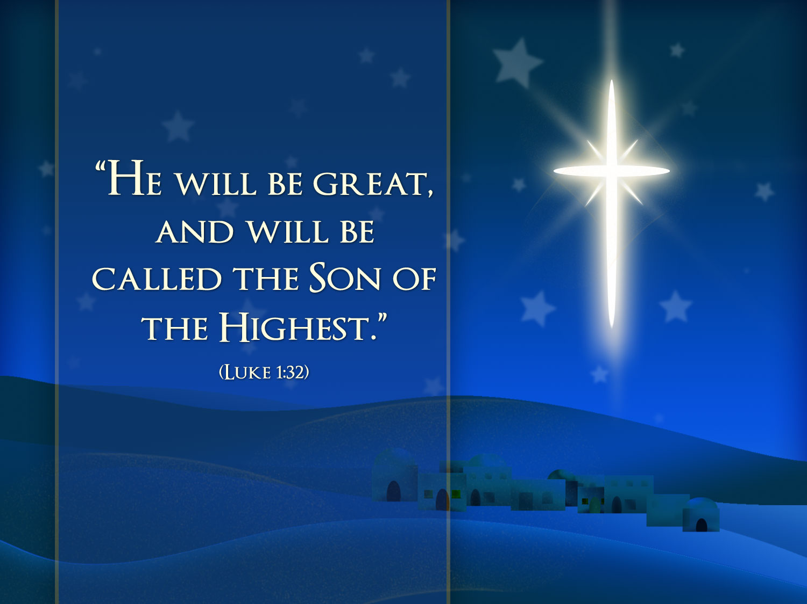
"HE WILL BE GREAT, AND WILL BE CALLED THE SON OF THE HIGHEST"
(LUKE 1:32)

Slide 93

"THE LORD GOD WILL GIVE HIM THE THRONE OF HIS FATHER DAVID"
(LUKE 1:32)

Slide 94

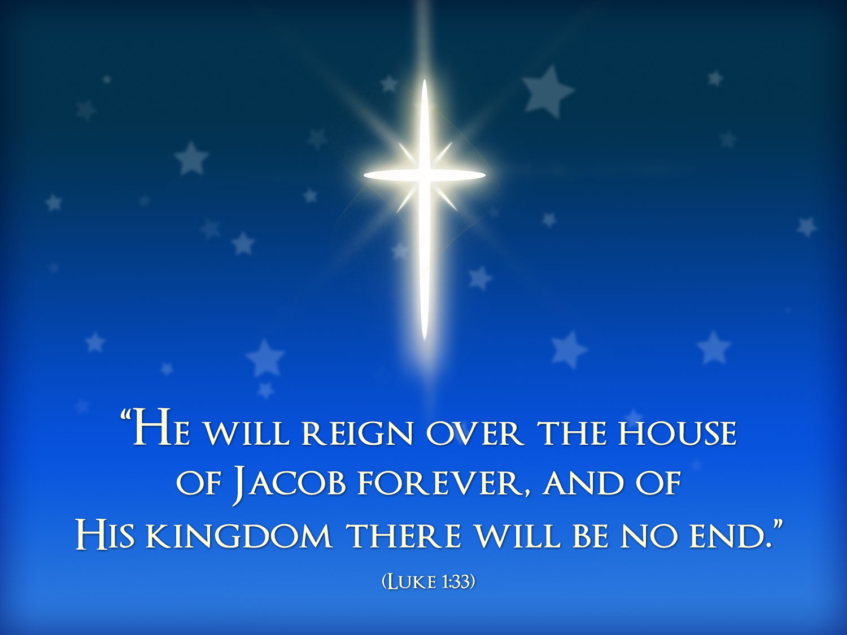
"HE WILL REIGN OVER THE THRONE OF JACOB FOREVER, AND OF HIS KINGDOM THERE WILL BE NO END"
(LUKE 1:33)

Slide 95
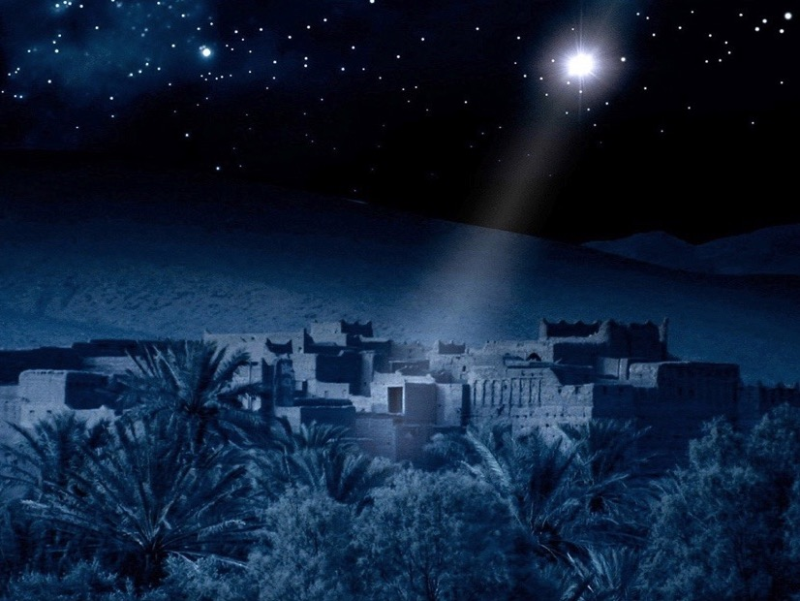

Free
Bible
images
OLD AND NEW TESTAMENTS
PROPHECIES ABOUT
THE BIRTH OF JESUS

Slide 96


Slide 97


Slide 98
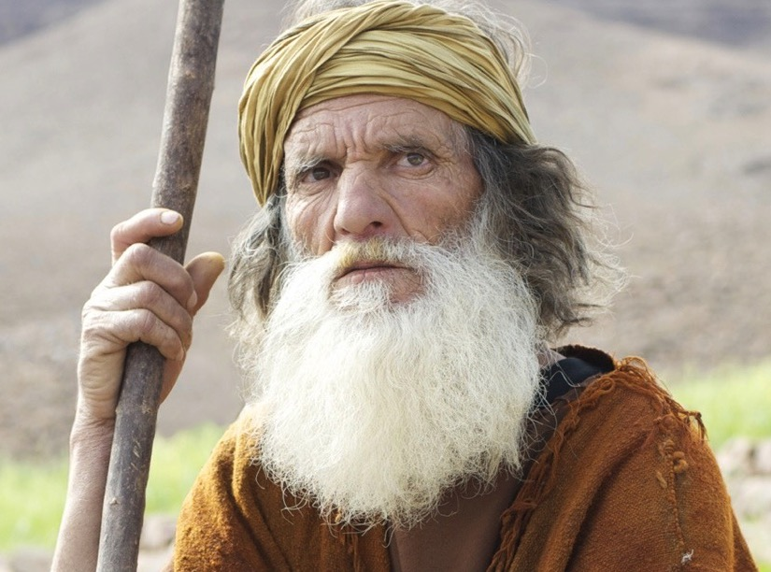

Slide 99
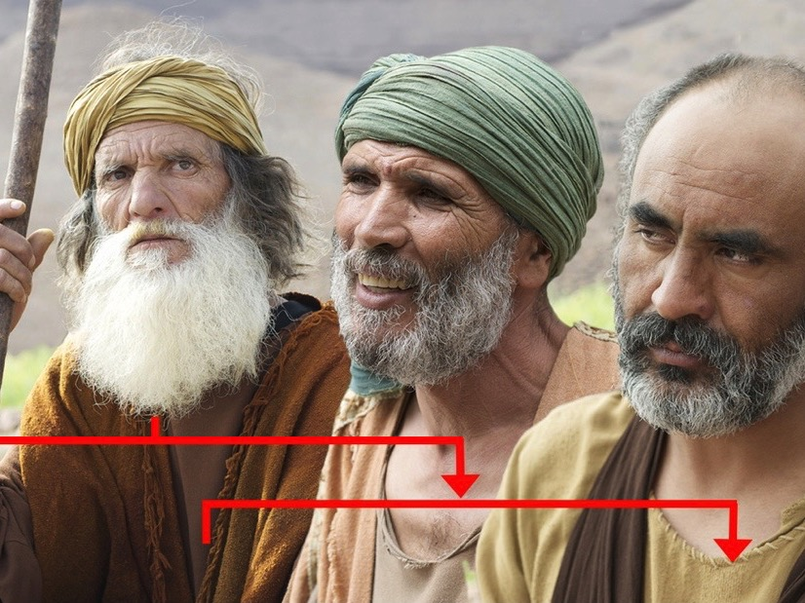

Slide 100
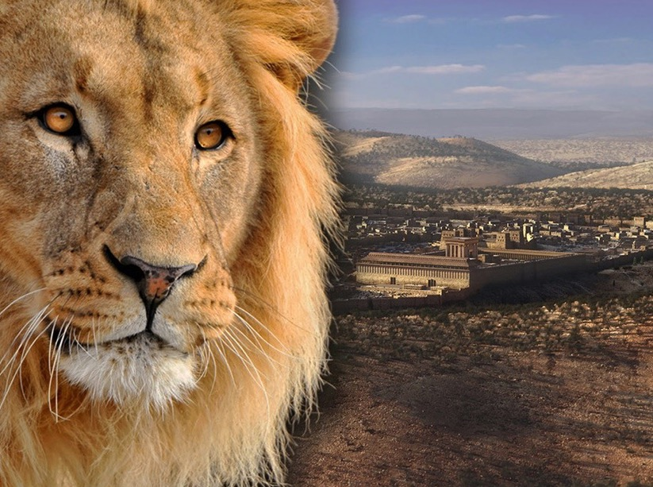

Slide 101
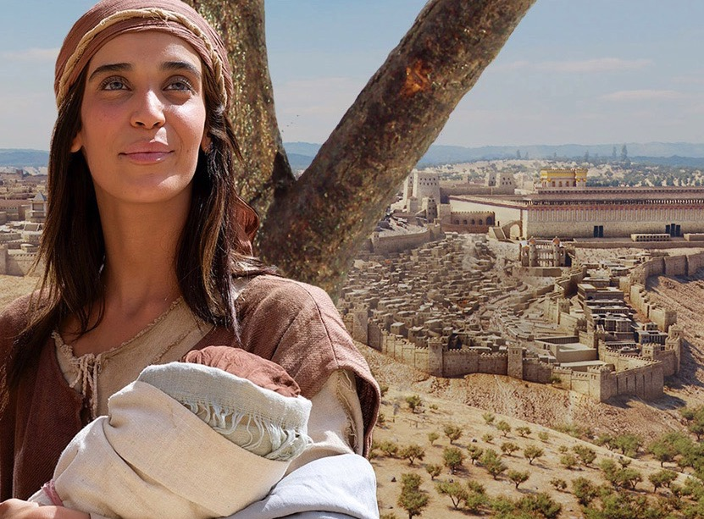

Slide 103
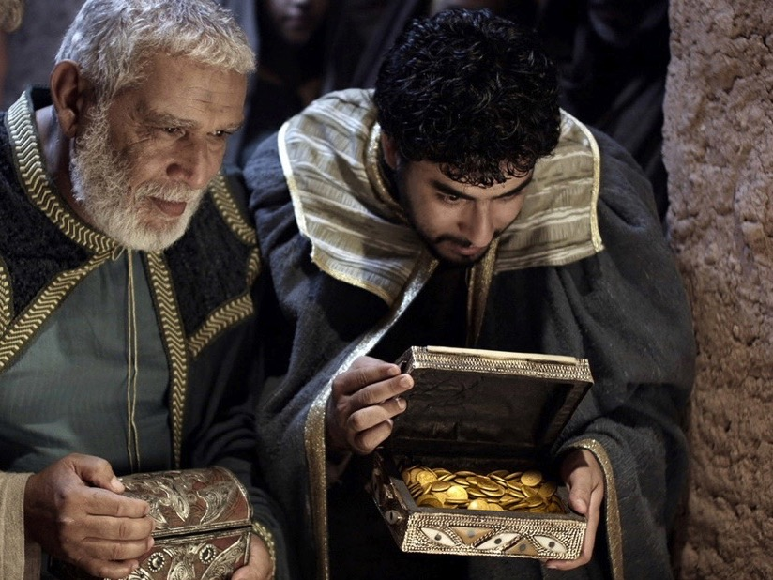

Slide 104
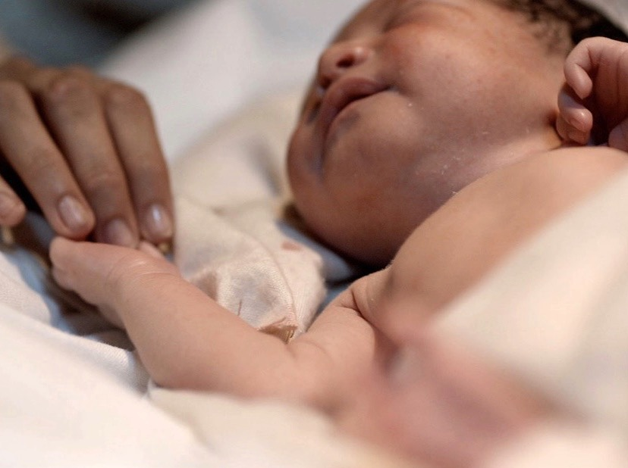

Slide 105
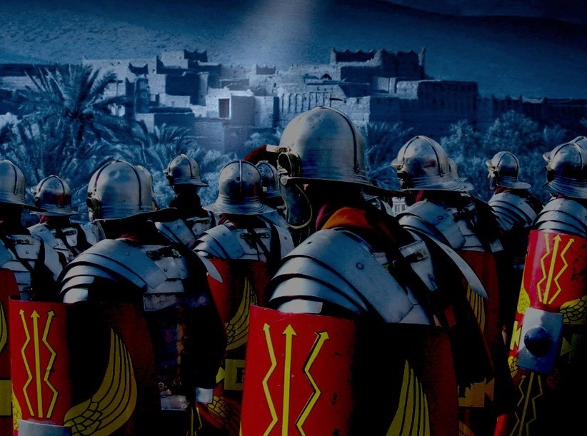

Slide 106
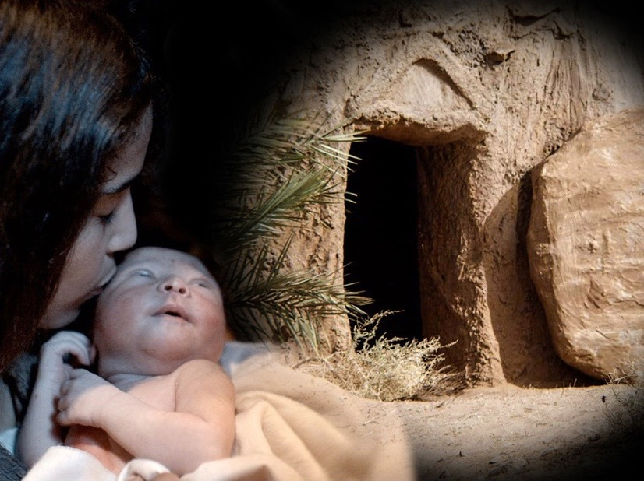

Slide 107
Used with Permission
THE
GOSPEL
——OF—— MATTHEW
THE
GOSPEL
——OF—— MARK
THE
GOSPEL
——OF—— LUKE
THE
GOSPEL
——OF—— JOHN
Due to the Lumo Project producing its own publishing material we regret to inform you that we cannot license our photos to other clients outside of freebibleimages.org.
These images are not licensed for reuse in video, epublishing or other media. Downloaded pictures and files cannot be redistributed through any other website than freebibleimages.org or used in any context where the accompanying message is undermining of the Christian faith and gospel.
Photos can only be used on educational presentations, blogs and social media, all of which should be accompanied with reference to www.LumoProject.com.
Picture courtesy of BBM
© All Rights Reserved.
www.bigbookmedia.com

Slide 108
c. The Arrival of Mary in Judea
§ 6
Luke 1:39-45
Mary's visit to her cousin Elizabeth confirms to Zechariah, Elizabeth, and Mary that God's prophecies about the babies John and Jesus would come to pass

Slide 109
d. The Anthem of Mary
§ 7
Luke 1:46-56
Mary praises God for His grace in allowing such a humble woman as her to bear the Messiah demonstrating that she understood the Messianic implications of this conception as fulfilling the Abrahamic Covenant by the power of God

Slide 110
e. The Advent of John
§ 8
Luke 1:57-80
John's birth and Zechariah's prophecy at the boy's circumcision testify of God's sovereign way to fulfill the Abrahamic, Davidic, and New Covenants through the Messiah of whom John would precede as the forerunner in the desert rather than temple priest

Slide 111
Luke 1:57-80
THE ADVENT
OF JOHN
Free
Bible
images

Slide 112
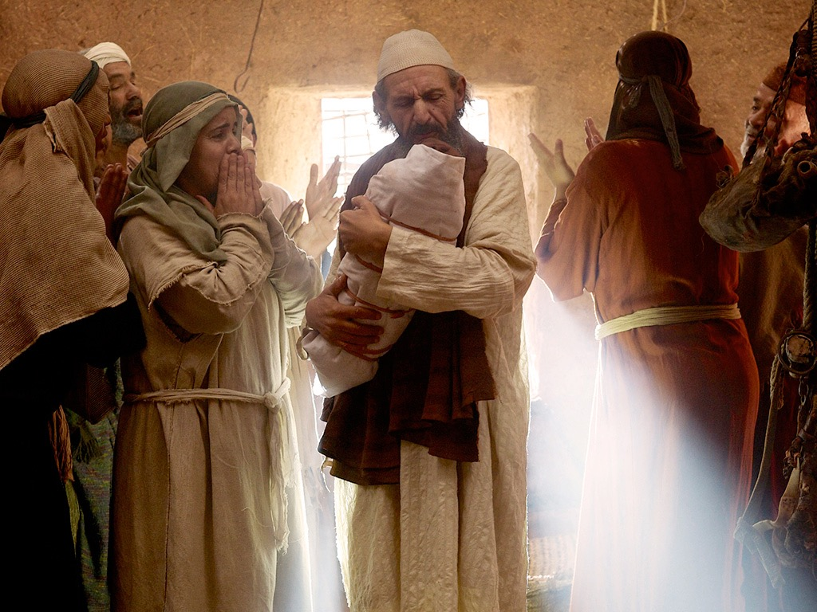

Slide 113
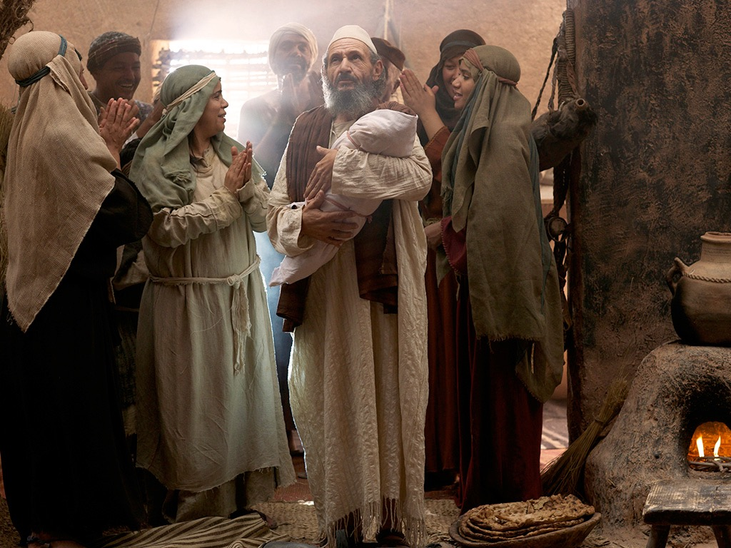

Slide 114


Slide 115
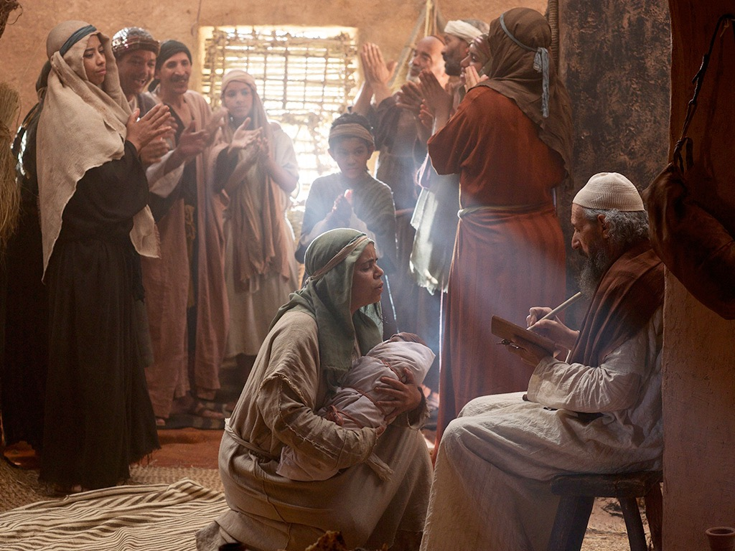

Slide 116


Slide 117


Slide 119


Slide 120
f. The Announcement of the Birth of Jesus to Joseph
§ 9
Matthew 1:18-25
An angel of the Lord announces to Joseph that Mary would bear the Messiah as a virgin so that Joseph would be prepared as the foster father to marry her and Joseph acts in implicit faith by keeping her a virgin until Jesus' birth

Slide 121

Mary's Husband Joseph

Slide 122



1. The Virgin Birth (1:18 – 25)
Marriage custom
betrothal, binding
marriage contract
wedding took place
a year later

Slide 123

Matthew 1:21
“She will give birth to a son, and you are to give him the name Jesus, because he will save his people from their sins.”
YHWH saves or YHWH is salvation

Slide 124
g. The Advent of Jesus
§ 10
Luke 2:1-7
Jesus is born humbly in Bethlehem during the census under Caesar Augustus (December 5 BC-January 4 BC) as proof of His lineage from David and in fulfilment of Micah 5:2 in order that He would die as God made man, the Messiah, pictured in His swaddling clothes

Slide 125

Church Nativity Scene

Slide 126

Insure that Baby!

Slide 127


Church Nativity Scene

Slide 128

Church Nativity Scene

Slide 129

The Target of Theft

Slide 130

Church Nativity Scene

Slide 131

Church Nativity Scene

Slide 132

Church Nativity Scene

Slide 133

Church Nativity Scene

Slide 134

Brickhouse Security GPS Device
Notes:
Brickhouse security has come to the rescue of frustrated church owners in New Jersey which keep having their Mary, Joseph and Jesus taken by crazy crooked Christians, reports MyFoxDC.
The GPS provided by Brickhouse is given to qualified religious institutions and placed inside the dolls. The CEO of Brickhouse Todd Morris said that "we then monitor it from our cloud-based mapping system, and set up alerts so that they'll get a text message or an e-mail if Baby Jesus is in motion," So for those that are tempted to steal these holy figures, they may receive a surprise knock on the door this Christmas.
http://hexus.net/ce/news/gadgets/64061-churches-use-gps-trackers-stem-stolen-baby-jesus-problem/

Slide 135

Church Nativity Scene

Slide 136

Church Nativity Scene
Notes:
This Jesus figure was stolen two years running in Florida, but was recovered after being stolen this year as a GPS device had been fitted Photo: AP
By Tom Leonard in New York
5:18PM GMT 10 Dec 2008
http://www.telegraph.co.uk/news/worldnews/northamerica/usa/3702961/Baby-Jesus-watched-over-by-GPS.html
Faced with rising thefts and vandalism, churches, community officials and ordinary people across the United States are fitting their displays with satellite tracking devices and hidden cameras.
Around 70 churches have so far taken up a New York security company's offer to use its GPS and camera systems for a month to safeguard mangers and menorahs.
Some families are doing the same and the new security measures are already showing success.
After its expensive life-size, £1,350 ceramic Jesus figure was stolen two years running, the community of Wellington, in Palm Beach County, Florida, installed a GPS device inside it this year.
When it was stolen again, police were able to track it down to a nearby home where it was found face down on a carpet. An 18-year-old woman is being prosecuted over the theft.
Related Articles
Mystery 'Jesus' pebbles
10 Dec 2008
Vase discovery linked to Mary Magdalene
10 Dec 2008
Brickhouse Security in New York said it got the idea to offer 200 religious organisations a month's free use of its high-tech equipment after a few churches asked if they could hire the devices just for December.
This year's tally of baby Jesus thefts so far includes one from a Methodist church in Pennsylvania in which the figurine was replaced by a pumpkin and another in Arkansas in which the thief not only stole the plastic baby but also the concrete block and chain to which it was attached.
In the past, some have been defaced with swear words and Satanic symbols. However, it is unclear whether most of the thefts are harmless pranks or the result of anti-Christian sentiment.
Brickhouse said its GPS device can track objects virtually anywhere in the world. If it is moved, a silent alarm is triggered, and police or the owner can go on the internet to see on a map where the object is going.

Slide 137

The Date of Jesus' Birth
Adapted from a 2006 Class Presentation by Jordan Tan for
Dr. Rick Griffith • Singapore Bible College • BibleStudyDownloads.org

Slide 138
Fact or
Fiction
Jordan Tan #172

Slide 139

Born in the 11th year of Singapore's independence.
Started my studies in Singapore Bible College at the age of 28.
Which year was I born in?
1965
July 2004
1976
Notes:
I was born in 1976...

Slide 140
The Historical
JESUS
Notes:
Today, we will continue to look at JESUS...
more precisely, the historical Jesus..

Slide 141
The New Testament Bookshelf
The Gospels
History
Matthew
Acts
Mark
Luke
John
Letters by Paul
Luke
1 Thessalonians
1 Corinthians
2 Thessalonians
2 Corinthians
Philippians
Romans
Galatians
Ephesians
Colossians
1 Timothy
2 Timothy
Philemon
Titus
General Letters
Prophecy
Hebrew
James
1 Peter
2 Peter
1 John
2 John
3 John
Revelation
Jude
Notes:
Our text for today comes from the book of Luke....

Slide 142
The Structure of Luke
Birth of Jesus
Jesus in Galilee
Ministry in or near Jerusalem
Infancy
Infancy
1-2
3:1-4:13
4:14-9:50
9:51 ---------- 18:34
18:35-21:38
22-24
Introduction to Jesus’ Ministry
Travel Narrative
Passion & Resurrection
Notes:
and as our sister, Mary, has given us the structure of Luke last week.
Today, i will focus on the infancy... or rather the birth of Jesus.

Slide 143
The Birth of Christ
Dionysus Exiguus A.D. 1
King Herod 4-6 B.C.
The Star of Bethlehem 5-7 B.C.
Quirinius A.D. 6
Blomberg, 188
Notes:
As many of you know, our calendar division of BC and AD is actually a Christian invention.
Before Christ and Anno Domini (The Year of the Lord)
1. Dionysus Exiguus in the early sixth century dated the birth of Jesus and since the Roman Empire was Christian, they decided that the calendar should be based on Christ. What Dionysus didn't factor in was the evidence from Josephus.
2. King Herod... once again, we know from Josephus that King Herod died in 4 BC and together with other data we can derive Christ birth between 4-6 BC
3. There are also attempts to link the star of Bethlehem with an unusual conjunction of planets and even a comet or supernova around 5-7 BC. (But this theory diminishes the supernatural power of God in creating the star just for the occasion of Christ's birth)
4. Quirinius and his census literally places Christ's birth as 6 A.D

Slide 144
Biblical Texts
Luke 2:2 (NIV)
(This was the first census that took place while Quirinius was governor of Syria.)
Luke 3:23 (NIV)
Now Jesus himself was about thirty years old when he began his ministry. He was the son, so it was thought, of Joseph, the son of Heli
Notes:
We will focus on 2 verses today for our search of the Historical Jesus...
Luke 2:2 and Luke 3:23

Slide 145

Info #1
Jesus was born during the census of Quirinius
Info #2
Jesus was about thirty years old when he began his ministry
THE BIG
QUESTION
SO WHAT ABOUT QUIRINIUS AND THE CENSUS?
Notes:
The big question is...
so what about Quirinius and the census? what's so important or interesting?

Slide 146
Quirinius was sent by Augustus to be governor of Syria (and Judea) in A.D. 6 (not 6 B.C.) and thereafter did take a notable census for the empire. Josephus tells us that Quirinius visited Judea in A.D. 6-7 to assess the property of the Jews in preparation for the registering and taxing of that property. There is no evidence that he was governor of the region twice or that he undertook a census of the region twice. It has been suggested that Luke may have confused Quirinius with P. Quintilius Varus who was legate of Syria during the period 6-3 B.C. Against this is the fact that Luke was apparently knowledgeable about Latin names and would have known a cognomen (Quirinius) from a mere nomen (Quintilius).
Notes:
read....
that's too much info so i'll just give you some points.

Slide 147
A Roman census would not have required Jews to travel to their ancestral home for registration. In any case, is it probable that the Romans would undertake such a census in a client state that already had its own ruler (Herod)? In response to these problems various answers have been given. In the first place, if there was a census that affected Judea during the reign of Herod the Great, it would probably proceed along the lines of a Jewish census, not a Roman one. In that case it is plausible that Jews would return to their ancestral homes and that both adults would go (especially if Mary was also of Davidic descent).
Notes:
read....
that's too much info so i'll just give you some points.

Slide 148
Second, elsewhere Luke manifests a knowledge of the later census by Quirinius which prompted the revolt of Judas the Galilean in A.D. 6-7 (Acts 5:37). Is it likely that he would have confused this census, which he knew to be a later one, with one during the reign of Herod? It is not certain that Luke in 2:1 means that Augustus took one enormous census of the whole empire. The language is general and may mean no more than that the various parts of the empire were subject to various censuses during the time of Augustus…
Notes:
read....
that's too much info so i'll just give you some points.

Slide 149

QUIRINIUS
Quirinius was sent by Augustus to be governor of Syria in A.D. 6-7 whereby he conducted a notable census for the Roman Empire.
Quirinius was also appointed as consul in the Syria area earlier in 12 B.C.
“Governor” can actually refer to many leadership roles. Certain inscriptions show that between 7-10 B.C. Quirinius performed military functions in Syria.
Joel B. Green, Dictionary of Jesus and the Gospels (IVP), 66
Notes:
so although Quirinius was officially governor of Syria and Judea only in 6 AD, it does not mean he wasn't around doing a census or something else...

Slide 150
THE CENSUSES
Roman censuses were conducted every fourteen years.
(prōtē) First or former?
Luke’s precise wording could mean that he is either referring to the first or former census under Quirinius rule of Syria.
This means before A.D. 6.
Joel B. Green, Dictionary of Jesus and the Gospels (IVP), 66
Notes:
Therefore, the census in Luke 2:2 could mean the one before Quirinius was governor, or the one before Quirinius census in 6 AD

Slide 151
THE NEXT BIG
QUESTION
WHAT ABOUT HEROD?
Notes:
HOW ABOUT HEROD??

Slide 152
KING HEROD
From the records of Josephus, we see that Herod died about 4 BC.
Matthew 2:1 (NIV)
After Jesus was born in Bethlehem in Judea, during the time of King Herod, Magi from the east came to Jerusalem
Matthew 2:16 (NIV)
When Herod realized that he had been outwitted by the Magi, he was furious, and he gave orders to kill all the boys in Bethlehem and its vicinity who were two years old and under, in accordance with the time he had learned from the Magi.
Blomberg, 188
Notes:
from Josephus, we know that King Herod died about 4 BC.
Matt 2:1 tells us that Jesus was born when King Herod was still alive
Matt 2:16 tells us that Jesus could possibly be 2 years old when Herod ordered the massacre of the innocents... before 4BC... possibly 6 or even 7 BC.

Slide 153

Putting it together
Prior
Census
8-7 BC
Death of
King Herod
4 BC
Census by Quirinius
AD 6-7
14 years
Therefore, we can conclude that Jesus was born between 8-4 BC
Notes:
now let's put what we have together...

Slide 154
Jesus was born between 4-7 BC
Biblical Texts
Luke 2:2 (NIV)
(This was the first census that took place while Quirinius was governor of Syria.)
Luke 3:23 (NIV)
Now Jesus himself was about thirty years old when he began his ministry. He was the son, so it was thought, of Joseph, the son of Heli,
Notes:
looking at luke 2:2...
my conclusion is that Jesus was born between 5-7 BC

Slide 155
ONE MORE BIG
QUESTION
Jesus was about thirty when he began his ministry…
SO??
Notes:
Now Luke 3:23 says Jesus was about thirty when he began his ministry...
SO??

Slide 156
We know from Jewish history that the Levites began service about the age of thirty.
However, traditional Jewish historiography uses estimates rather than definitive numbers for age.
This would lead us to believe that Jesus began his ministry between AD 25-27
Notes:
In Luke 2:2, we could link the information provided by Luke to Roman history...
here in Luke 3:23 however, we see certain links to Jewish history.
The levites and jewish historiography...
But for sure, it helps us to the conclusion that ....

Slide 157

However, we should also consider this definitive work

Slide 158
Dating the Birth of Christ
56
Date of Birth: ca. December 5 BC/January 4 BC
Jesus was born between these two dates:
Census of Quirinius/Cyrenius (Luke 2:1-5)
Death of
Herod the Great
(Matt. 2:1; Luke 1:5)
6 BC
29 March-11 April
4 BC
Harold W. Hoehner, Chronological Aspects of the Life of Christ (Zondervan, 1977), 114

Slide 159
Dating the Start of Christ's Ministry
56
Commencement of Ministry: ca. Autumn AD 29
Jesus probably began his ministry between these two dates:
15th YEAR OF THE REIGN OF TIBERIUS*
(Luke 3:1-3)
19 August
AD 28
31 December
AD 29
*Reckoned from either the Julian Calendar or Tiberius Regnal Year
Harold W. Hoehner, Chronological Aspects of the Life of Christ (Zondervan, 1977), 114

Slide 160
FACT OR FICTION?
IN CONCLUSION
Luke affirms to us, the readers of the book, that Jesus existed historically by showing when he was born according to world history current to his time.
When we acknowledge and show Jesus as a true, genuine historical figure, it helps us to debunk arguments regarding whether he really existed or was just a myth.

Slide 161
h. The Announcement to the Shepherds
§ 11
Luke 2:8-20
The angels of God announce to shepherds as most unlikely yet unprejudiced witnesses for God to give them a sign of His presence in the birth of the Savior who had come as Messiah, Ruler, and Redeemer of Israel in the Messianic Kingdom
Notes:
Arabic edited

Slide 162

Bored Shepherds
"Nothing exciting ever happens on this job."

Slide 163

"The Savior—yes, the Messiah, the Lord—has been born today in Bethlehem, the city of David!" (Luke 2:11 NLT)

Slide 164
3. His Infancy and Childhood
§ 12-19
Selected events from the infancy and childhood of Jesus are recorded in order to affirm that Jesus is the promised Messiah

Slide 165
a. His Circumcision
§ 12
Luke 2:21
Jesus is circumcised as a sign of the Abrahamic Covenant to make Him eligible to fulfill the promises that God had given to Abraham

Slide 166
b. His Presentation
§ 13
Luke 2:22-38
Jesus is presented in the temple in obedience to the Law for Mary to be ceremonially clean and for Jesus to be redeemed from the Aaronic priesthood

Slide 167

Simeon blessed Jesus at the temple (Luke 2:21-32)

Slide 168
c. His Infancy
§14-16
The worship by Magi, escape to Egypt and escape to Nazareth all fulfill prophecy in order to substantiate Christ as Israel's Messiah

Slide 169


Chapter Two
Bethlehem
Egypt
Nazareth

Slide 170
“All this took place to fulfill what the Lord had said through the prophet”
“completing”
or
“filling full”
fulfill

Slide 171
OT Prophecies
1. Literal
Straightforward predictions
Birthplace in Bethlehem
Matt. 2:6
Micah 5:2

Slide 172

OT Prophecies
2. Typological
Correspondence between
OT & NT events
e.g. Hosea 11:1 ----- > Matt 2:15
“Out of Egypt I called my son.”

Slide 173


Hosea 11:1
God called Israel out of Egypt
Matthew 2:15
Jesus also fled to and returned from Egypt

Slide 174
OT Prophecies
3. = Literal + Typological
Isaiah 7:14 … give you a sign: the virgin will be…
____________________________________________
you: Hebrew is plural
virgin: Hebrew means “a young woman of marriageable age”

Slide 175
OT Prophecies
3. = Literal + Typological
ultimate prediction pointed to Jesus
Ahaz
Jesus

Slide 176
(1) In Bethlehem
c. His Infancy
§ 14
Matthew 2:1-12
Jesus is worshipped as King of the Jews by Gentiles in Bethlehem to fulfill Micah 5:2 and to show that this same Babe will someday rule as King of kings and Lord of lords, the Sovereign Messiah over all nations

Slide 177

Bethlehem
"And you, O Bethlehem in the land of Judah, are not least among the ruling cities of Judah, for a ruler will come from you who will be the shepherd for my people Israel"
(Micah 5:2 quoted in Matthew 2:6 NLT)

Slide 178

Journey to Bethlehem

Slide 179

One King 19/30
Jesus was easily identifiable

Slide 180
2. Birth in Bethlehem …
“But you, Bethlehem, in the land of Judah, are by no means least among the rulers of Judah; for out of you will come a ruler who will be the shepherd of my people Israel.”
(Micah 5:2)

Slide 181

…and visit of the Magi (2:1-12)

Slide 182

Who Were the Magi?

Slide 183


What Kind of Kingdom Did Isaiah
(and Matthew) Envision?
78b
Political
Physical
Emotional
Intellectual
Spiritual

Slide 184

What is the contemporary application of following the star?

Slide 185

What kind of star was it?
Notes:
What kind of star was it?

Slide 186
Where did the Magi come from?
15
P1 Million
14
P500,000
13
P250,000
12
P125,000
11
P64,000
10
P32,000
9
P16,000
8
P8,000
7
P4,000
6
P2,000
5
P1,000
4
P500
3
P300
2
P200
50:50
1
P100
A: Babylon
B: Assyria
C: Persia
D: Arab Peninsula?

Slide 187

Arab Magi?
Their Location:
  East can mean southeast as much as northeast
  Assyria, Babylonia and Persia were always called lands of the north (Jer. 1:13-15; 6:22; 25:9).
Notes:
After this slide, will go to Dr Rick's NT Survey: Matthew, p78f, “Arab Magi in Matthew 2”

Slide 188
Arab Magi?
Their Gifts (Matt. 2:11):
  These all came from Spice Trade route southeast of Israel.
  "And all from Sheba will come, bearing gold and incense" (Isa. 60:6; cf. Ps. 72:10). Sheba was the land of present-day southern Saudi Arabia.
Notes:
After this slide, will go to Dr Rick's NT Survey: Matthew, p78f, “Arab Magi in Matthew 2”

Slide 189
Arab Magi?
Their Gifts (Matt. 2:11):
  Frankincense came only from southern Arabia, although it was sold throughout the Middle East.
  Gold came from the Arabian Peninsula in the land of Ophir that is present-day Yemen
Notes:
After this slide, will go to Dr Rick's NT Survey: Matthew, p78f, “Arab Magi in Matthew 2”

Slide 190
Arab Magi?
Their Role: Arabs redeem Israel!
  Joseph saved from his brothers by Ishmaelites of Arabia who brought him to Egypt (Gen. 37:27-28).
  Opposition to Moses by Israel's own elders forced him to seek refuge in Midian of Arabia (Exod. 2:13-15).
Notes:
After this slide, will go to Dr Rick's NT Survey: Matthew, p78f, “Arab Magi in Matthew 2”

Slide 191
Arab Magi?
Their Role: Arabs redeem Israel!
  Even in the future tribulation, Israel will find refuge in the desert (Rev. 12:14), presumably in Arabia
Notes:
After this slide, will go to Dr Rick's NT Survey: Matthew, p78f, “Arab Magi in Matthew 2”

Slide 192


Slide 193
(2) In Egypt
c. His Infancy
§ 15
Matthew 2:13-18
Joseph, Mary, and Jesus flee to Egypt to escape the Babe's potential death by Herod to fulfill Hosea 11:1 and preserve Christ so he can redeem the world

Slide 194

Journey to Bethlehem, Flight to Egypt & Return to Nazareth (Matthew 2)
79
79

Slide 195

3. Flight to Egypt (2:13-15)

Slide 196


4. Killing of the innocents

Slide 197
(3) In Nazareth
c. His Infancy
§ 16
Matthew 2:19-23; Luke 2:39
The family returns to Israel by angelic revelation and choose Nazareth rather than Bethlehem to avoid Archelaus so that the prophecies concerning the Messiah's humble origins might be fulfilled

Slide 198


5. Return to Nazareth (2:19-23)
“He will be called a
Nazarene.”

Slide 199
Theme
Jesus' birth fulfilled
the OT Prophecies
2. Men's obedience fulfilled
God's plan

Slide 200
Birth & Childhood of Jesus
Connie Tong

Slide 201
d. His Boyhood
§ 17-19
The selected events from the early life of Christ argue that while He grew physically, intellectually, spiritually and socially He was fully aware of His deity as well as his humanity

Slide 202
(1) His growth
d. His Boyhood
§ 17
Luke 2:40
Jesus grows physically, intellectually, and spiritually, giving evidence that He received training in the Scriptures from his youth in a godly home

Slide 203
(2) His visit to Jerusalem
d. His Boyhood
§ 18
Luke 2:41-50
Jesus' instruction of the teachers of the law in the temple at age twelve shows that He was not merely a "son of the law" but fully understood His deity, mission, and relationship with the Father even at an early age

Slide 204
(3) His development
d. His Boyhood
§ 19
Luke 2:51-52
In the eighteen years of unrecorded events in Jesus' life He grew intellectually, physically, spiritually and socially, thus substantiating His manhood as perfect and His obedience complete

Slide 205
Introduction of the King
§§ 1-27
Arrival
Ambassador
Ancestry
Advent
Infancy/
Childhood
Notes:
Jesus did all that we should expect of the Messiah (King) from the start:
1—He arrived in the proper lineage of David, born of a virgin, and knew his deity even at age 12
2—His forerunner John knew his role in preparing Israel for her king
3—He had the best witnesses possible in the Father (baptism), Spirit (temptation), and John (prophesied herald)

Slide 206
The Ambassador of the King
§ 20-23
John the Baptist precedes Jesus Christ to prepare Israel to receive Him as the long awaited Messiah

Slide 207
1. The Message to John
§20
Mark 1:1; Luke 3:1-2
John receives a prophetic message from God in the desert to separate Israel to the Lord in preparation for the Messiah

Slide 208

John the Baptist
Luke
3:1-2
In the fifteenth year of the reign of Tiberius Caesar, Pontius Pilate being governor of Judea, and Herod being tetrarch of Galilee, and his brother Philip tetrarch of the region of Ituraea and Trachonitis, and Lysanias tetrarch of Abilene,
in the high-priesthood of Annas and Caiaphas, the word of God came to John the son of Zechariah in the wilderness;
Notes:
Note how many opportunities exist for errors in this single passage. If the time of even one of these reigns is inaccurate, then Luke would be disproven as a historian and inerrancy impossible. But each of these men was in leadership in AD 29 when John began his ministry. Each period is as follows:
Tiberius (AD 14-37)
Pilate (AD 26-36)
Philip (4 BC-AD 34)
Lysanias (AD 14-29)
Annas (AD 6-15 but wielding considerable power after that—probably died about AD 40; see Annas had been high priest from A.D. 6 to 15. The Romans had removed him from office yet he still wielded considerable power behind the scenes (https://www.blueletterbible.org/faq/don_stewart/don_stewart_1314.cfm)
Caiaphas (AD 18-36): Caiaphas was the ruling High Priest at the time of Jesus ministry (A.D. 18-36). He was the son-in-law of Annas. (https://www.blueletterbible.org/faq/don_stewart/don_stewart_1314.cfm)
——————
https://www.internationalstandardbible.com/L/lysanias.html
International Standard Bible Encyclopedia Online
Accessed 17 June 2022
Lysanias
li-sa'-ni-as (Lusanias): Mentioned in Lu 3:1 as tetrarch of Abilene in the 15th year of the reign of Tiberius Caesar, and thus fixing the date of the preaching of John the Baptist in the wilderness at about 26 or 28 AD. A Lysanias is mentioned by Josephus as having ruled over Chalcis and Abilene, and as having been slain by Mark Antony at the instigation of Cleopatra. As this happened about 36 BC, Luke has been charged with inaccuracy. Inscriptions, however, corroborate the view that the Lysanias of Luke was probably a descendant of the Lysanias mentioned by Josephus (compare Schurer,H J the Priestly Code (P), div I, volumeII , App. 1, p. 338).
——————
https://www.oxfordreference.com/view/10.1093/oi/authority.20110803100120769
Accessed 17 June 2022
The reference to Lysanias in Luke 3: 1 as the tetrarch of Abilene NW of Damascus may be a mistake, since the only Lysanias certainly known died in 36 bce. There was, however, possibly another, unknown, Lysanias in the fifteenth year of the reign of Tiberius (28 or 29 ce) to which Luke is referring, since an inscription bearing the name Lysanias was found at Abila, the city in Abilene, and dated between 14 and 29 ce.

Slide 209
The Duration of Christ's Ministry
56
Autumn AD 29 – 3 April AD 33 (3.5 Years)
John alone notes three Passovers
Therefore, Christ's ministry was at least 2.5 years
Commencement of Christ's Ministry
Passover #1
April 7,
AD 30
Passover #2
Passover #3
April 25,
AD 32
Passover #4
April 3,
AD 33
Autumn
AD 29
John 2:13, 23
Unstated by John
Mark 2:23-28
Luke 6:1-5
Matthew 12:1-8
John 6:4
John 11:55–12:1
Harold W. Hoehner, Chronological Aspects of the Life of Christ (Zondervan, 1977), 114
Notes:
Christ's 3½ year ministry spanned four Passovers. However, the Synoptics mention only one Passover (#2 on this timeline), which could give the impression of only a year-old ministry. John fills in the details, though, by showing three other Passovers not mentioned by Matthew, Mark, or Luke.

Slide 210
Chronology of Jesus & Acts
38a
4 BC
1 BC
AD 1
14
29
30
33
35
Jesus
Born
–1 year–
Tiberius
Crowned
15th Yr.
Tiberius
–
John &
Jesus
Jesus
Died
Paul
Believed
“In the 15th year of Tiberius… John preached” (Luke 3:1)
32-33 years
“Now Jesus himself was about 30 years old when he began his ministry” (Luke 3:23)

Slide 211
Age of Jesus
When He Began His Ministry
38a
“Now Jesus himself was about 30 years old when he began his ministry” (Luke 3:23)
1yr
3 yrs
28 / 29 years
4 3 2 1 1 2 3 4 5 6 7 8 ……………………………………………….…………………… 26 27 28 29
BC AD
3 + 1 + 28 = 32 years (Non-inclusive of AD 29)
3 + 1 + 29 = 33 years (Inclusive of AD 29)
Adapted from Michele Ang (NT Survey student, SBC, 2006)

Slide 212
2. The Message from John
§ 21
Matthew 3:1-6; Mark 1:2-6; Luke 3:3-6
John preaches repentance for the forgiveness of sins and baptizes in preparation for the Messianic kingdom to be established on earth with the King as its ruler

Slide 213
John the Baptist
Luke
3:3-4
and he went into all the region about the Jordan, preaching a baptism of repentance for the forgiveness of sins.
As it is written in the book of the words of Isaiah the prophet, "The voice of one crying in the wilderness: Prepare the way of the Lord, make his paths straight.

Slide 214
John the Baptist
Luke
3:5-6
Every valley shall be filled, and every mountain and hill shall be brought low, and the crooked shall be made straight, and the rough ways shall be made smooth;
and all flesh shall see the salvation of God."

Slide 215

JOHN THE BAPTIST
Matthew 3:1-16
Mark 1:1-11
Luke 3:1-22
John 1:1-34
Free
Bible
images

Slide 216


Slide 217


Slide 218


Slide 219


Slide 220


Slide 221


Slide 222


Slide 223


Slide 224


Slide 225


Slide 226


Slide 227


Slide 228


Slide 229


Slide 230


Slide 231
THE WORD IN PICTURES
Free
Bible
images

Slide 232
3. The Explanation by John
§ 22
Matthew 3:7-10; Luke 3:7-14
John preaches of Israel’s judgment at the advent of Messiah to convince both the leaders and the people to exhibit the changed lives resulting from repentance

Slide 233
4. The Promise by John
§ 23
Matthew 3:11-12; Mark 1:7-8; Luke 3:15-18
John preaches hope and promises that the Messiah would give the Spirit to fulfill Joel 2:28 and Ezekiel 36:25-27 and judge the nation to remove all unfit for the kingdom

Slide 234
Introduction of the King
§§ 1-27
Arrival
Ambassador
Approval
Ancestry
Advent
Infancy/
Childhood
Baptism
Temptation
Herald
Notes:
Jesus did all that we should expect of the Messiah (King) from the start:
1—He arrived in the proper lineage of David, born of a virgin, and knew his deity even at age 12
2—His forerunner John knew his role in preparing Israel for her king
3—He had the best witnesses possible in the Father (baptism), Spirit (temptation), and John (prophesied herald)

Slide 235
The Approval of the King
§§ 24-27
The Father, Spirit, and John all testify through Christ's baptism, temptation, and herald, respectively, that Jesus is the Messiah

Slide 236

Jesus' Baptism & Temptation (3:23–4:11)
79

Slide 237
1. At His Baptism
§ 24
Matthew 3:13-17; Mark 1:9-11; Luke 3:21-23a
At his baptism, the Father officially approves of Christ's person and messianic work through the designated forerunner, John the Baptist

Slide 238
JOHN THE BAPTIST
Matthew 3:1-16
Mark 1:1-11
Luke 3:1-22
John 1:1-34
Free
Bible
images
Notes:
Isaiah 40 serves as the primary background to John the Baptist. God comforts his people despite telling of their coming exile—and he does so by promising a voice from the wilderness, not from the temple.

Slide 239


Slide 241


Slide 242


Slide 243


Slide 244
THE WORD IN PICTURES
Free
Bible
images

Slide 245
Used with Permission
THE
GOSPEL
——OF—— MATTHEW
THE
GOSPEL
——OF—— MARK
THE
GOSPEL
——OF—— LUKE
THE
GOSPEL
——OF—— JOHN
Due to the Lumo Project producing its own publishing material we regret to inform you that we cannot license our photos to other clients outside of freebibleimages.org.
These images are not licensed for reuse in video, epublishing or other media. Downloaded pictures and files cannot be redistributed through any other website than freebibleimages.org or used in any context where the accompanying message is undermining of the Christian faith and gospel.
Photos can only be used on educational presentations, blogs and social media, all of which should be accompanied with reference to www.LumoProject.com.
Picture courtesy of BBM
© All Rights Reserved.
www.bigbookmedia.com

Slide 246
2. Through His Temptation
§ 25
Matthew 4:1-11; Mark 1:9-11; Luke 4:1-13
At the temptation of Christ, the Holy Spirit approves of Jesus as Messiah in that He could not be made to sin

Slide 247


The Things of the World
Comparing Some Key Texts
World
(1 John 2:15-16)
Sources of Temptation
Eve
(Gen. 3)
Christ
(Matt. 4; Luke 4)
"Cravings of sinful man"
Ungodly bodily desires
• sex outside marriage
• gluttony
• etc.
"Good for food"
Stones to bread
"Lust of the eyes"
Greed, coveting
(10th commandment)
"Pleasing to the eye"
Possess all kingdoms
"Boasting of what he has and does"
Pride & boasting of:
• occupation
• position
• worldly advantages
• etc.
"Desirable for gaining wisdom"
Acclaim by men
("throw yourself from the temple")

Slide 248

The Ministry Beginning & Temptation of Jesus
Adapted from a 2006 Class Presentation by William Heng for
Dr. Rick Griffith • Singapore Bible College • BibleStudyDownloads.org

Slide 249

The Servant King
by Graham Kendrick
Notes:
LC-01-Introduction-221
NS-02-Mark9-16-beginning on slide 275

Slide 250

From heaven You came, helpless babe
Entered our world, Your glory veiled
Not to be served but to serve
And give Your life that we might live

Slide 251
This is our God, the SERVANT KING;
He calls us now to follow Him
To bring our lives as a daily offering
Of worship to the SERVANT KING.

Slide 252
There in the garden of tears
My heavy load He chose to bear;
His heart with sorrow was torn,
Yet not my will, but Yours he said.

Slide 253
This is our God, the SERVANT KING;
He calls us now to follow Him
To bring our lives as a daily offering
Of worship to the SERVANT KING.

Slide 254
Come see His hands and his feet,
The scars that speak of sacrifice
Hands that flung stars into space
To cruel nails surrendered

Slide 255
This is our God, the SERVANT KING;
He calls us now to follow Him
To bring our lives as a daily offering
Of worship to the SERVANT KING.

Slide 256
So let us learn how to serve,
And in our lives enthrone Him
Each other's needs to prefer
For it is Christ we're serving

Slide 257
This is our God, the SERVANT KING;
He calls us now to follow Him
To bring our lives as a daily offering
Of worship to the SERVANT KING.
Of worship to the SERVANT KING.

Slide 258

Matthew 4:1-11
Satan tempted Jesus
—But what preceded this?
Notes:
Selling your ideas is challenging. First, you must get your listeners to agree with you in principle. Then, you must move them to action. Use the Dale Carnegie Training® Evidence – Action – Benefit formula, and you will deliver a motivational, action-oriented presentation.

Slide 259
Presentation Agenda
Review
The Beginnings of Jesus' Ministry
Matthew 3 – The Baptism of Jesus
Historical Setting
Exposition of Matthew 4 Temptation
Theme
Application

Slide 260
Review
The Genealogy of Christ
The Certainty of the Gospel
Jesus was a Genuine Historical Figure
The Birth of Christ was the Fulfillment of God's Salvation Plan
Notes:
Open your presentation with an attention-getting incident. Choose an incident your audience relates to. The incidence is the evidence that supports the action and proves the benefit. Beginning with a motivational incident prepares your audience for the action step that follows.

Slide 261

The Beginnings of Jesus' Ministry
Jesus comes from Galilee to be baptized
Jesus returns to Jordan to call disciples
John the Baptist preaches in the wilderness of Judea and baptizes in River Jordan
2
1
5
4
3
Jesus returns to Galilee (first miracle in Cana)
The Holy Spirit leads Jesus into the wilderness to be tested
Notes:
Jesus begins His return to Galilee

Slide 262
The Baptism of Jesus had two purposes:
1. The Father confirmed Christ's appointment to His messianic work
2. The manifestation of the Trinity
Notes:
A third purpose is actually "to fulfill all righteousness," in the words of Jesus. He refused to ask others to do what he himself had not done.

Slide 263

Historical Setting
Time: AD 30 (John the Baptist AD 29)
Then (4:1) – immediately (Mark 1:12)
Place: Led up into the wilderness – Likely the wilderness was higher than the bed of the Jordan River in the barren region northwest of the Dead Sea

Slide 264

Exposition on Matthew 4:1-11
"Then Jesus was led by the Spirit into the desert to be tempted by the devil" (4:1)
Verse 1 sums up the whole passage
The Spirit is the same Spirit noted in (3:16)……….the Spirit of God

Slide 265

"After fasting forty days and forty nights, he was hungry" (4:2)

Slide 266
To be tempted had two-fold meaning:
Incite or entice to evil; seduce
Vs
Test
God does not tempt men with evil
(James 1:13; e.g., Abraham in Gen 22:1)

Slide 267

The tempter came to him and said, "If you are the Son of God, tell these stones to become bread."
Repeated phrase: "If you are the Son of God" (4:3, 6)
1st Temptation
"does not live" (4:4): The verb in Greek is in future tense but it is unclear whether it is meant as a command or a statement of reality.

Slide 268

2nd Temptation
Ps 91:11-12 (4:6): Is not incorrect citation but rather using it in wrong context (misapplication)
"holy city": The temple in Jerusalem
"highest point of the temple": Southeast temple wall with a vertical drop of 500 to 600 feet into the Kidron Valley.

Slide 269

3rd Temptation
"bow down" (4:9): To throw oneself to the ground as a sign of devotion before a divine being or a high-ranking person.
"very high mountain": Likely symbolic as the traditional Mount of Temptation was not high enough to view all the kingdoms of the world

Slide 270

Theme:
The Victorious King
Notes:
To complete the Dale Carnegie Training® Evidence – Action – Benefit formula, follow the action step with the benefits to the audience. Consider their interests, needs, and preferences. Support the benefits with evidence; i.e., statistics, demonstrations, testimonials, incidents, analogies, and exhibits and you will build credibility.

Slide 271

The temptation is in all three Synoptic Gospels. Luke and Mark add:
Luke 4:1-13
Full of the Holy Spirit
2nd and 3rd temptation in the reverse order
Mark 1:12-13
At once the Spirit sent Him out………
He was with the wild animals

Slide 272
Contextual Relationships
In Context of the Bible:
Jesus was the fulfillment of God's promises to Israel, coming as Messiah and Redeemer: Savior of the world as well as Savior of Israel

Slide 273

In Context of Matthew
Matthew proved that Jesus was the fulfillment of God's promises to Israel. It also explained that the Kingdom is postponed due to Israel's rejection of Christ as King and for believing Jews to see His present Kingdom authority residing in the Church.

Slide 274

In the Context of the Passage
To show Jesus as King
To show Jesus is sinless
To model for us how to fight temptation
To show us Christ is qualified to help us have victory over Satan

Slide 275

Application
Today we have seen the importance of spiritual preparation and seen how Jesus used God's Word to have victory over Satan

Slide 276

God's testing increases our faith and develops perseverance in us so that we will remain faithful to our calling (James 1:2-4)

Slide 277

In your next trial, look to Jesus' model since he is qualified to help us resist the devil

Slide 278
3. By His Herald
§§ 26-27
John testifies that he is the forerunner of the Messiah fulfilling Isaiah 40:3 to prepare Israel and her leaders before the beginning of Christ's public ministry

Slide 279
Christ Alone is the Light
John (1:6-9)
Came to the world (6)
Came into existence (6)
A Man (6)
Testified of the Light (7-8)
Jesus (1:1-5)
Made the world (3)
Was in the beginning (1a)
The Word, or God (1c)
Was the Light Himself (9)
Notes:
LC-01-Intro-252
NS-04-John1-12-slide 175

Slide 280
a. Testimony of John Before the Leaders
§26
John 1:19-28
John answers the questioning by Israel's leaders regarding his person that he is the forerunner of Messiah in fulfillment of Malachi 4:5 to prepare these leaders to accept Christ and His message

Slide 281
JOHN THE BAPTIST
Matthew 3:1-16
Mark 1:1-11
Luke 3:1-22
John 1:1-34
Free
Bible
images
Notes:
Isaiah 40 serves as the primary background to John the Baptist. God comforts his people despite telling of their coming exile—and he does so by promising a voice from the wilderness, not from the temple.

Slide 282
Notes:
John serves as the wilderness voice of God. Although born into the priestly line of Aaron through his father Zechariah, John is a non-conformist who grows up in the desert rather than around the temple rituals. He doesn't perform any sacrifices. Nor does not wear linen like the temple priests. Instead, he likely lived in a desert community such as the Essenes rather than be raised by Zechariah and Elizabeth—and wore camel's hair clothes!

Slide 283
Notes:
He did not eat the meat of sacrificial animals like his fellow priests, even though he was entitled to it. He preferred insects instead, reminding us that God often uses the non-conformance individuals!

Slide 284
Notes:
Also, instead of going to the people to preach in their cities, John's audiences had to do the hard work of traveling to the Judean wilderness. They seem even to believe in some sort of reincarnation of famous OT figures, based on their questions.

Slide 285

¹⁹ Now this was John’s testimony when the Jewish leaders in Jerusalem sent priests and Levites to ask him who he was.
²⁰ He did not fail to confess, but confessed freely, “I am not the Messiah.”
²¹ They asked him, “Then who are you? Are you Elijah?”
He said, “I am not.”
“Are you the Prophet?”
He answered, “No.”
John 1:19-21 NIV84

Slide 286
²² Finally they said, “Who are you? Give us an answer to take back to those who sent us. What do you say about yourself?”
²³ John replied in the words of Isaiah the prophet, “I am the voice of one calling in the wilderness, ‘Make straight the way for the Lord.’ ”
²⁴ Now the Pharisees who had been sent
²⁵ questioned him, “Why then do you baptize if you are not the Messiah, nor Elijah, nor the Prophet?”
John 1:22-25 NIV84

Slide 287
b. Testimony of John to Christ
§ 27
John 1:29-34
John testifies publicly for the first time that Christ is the Messiah of Israel through a soteriological testimony of Christ's work as the Lamb of God and Christ's person as the Son of God in order to prepare Israel before the inception of Christ's public ministry

Slide 288

How Well Do You Know the Life of Christ?
How Well Do You Know the Life of Christ?
53
4
Guest at Wedding
Can you number these events in chronological order?
6
Interview with Nicodemus
3
Enemy's 3 Temptations
7
Message on Mount
1
Birth in Bethlehem
5
Housecleaning the Temple (1st time)
10
Washing Disciples' Feet
8
Parables of Kingdom
2
Carpenter in Nazareth
9
Tomb of Lazarus
Terry Hall, Bible Panorama, 121

Slide 289
AN ALPHABETIZED LIFE OF JESUS
54
AN ALPHABETIZED LIFE OF JESUS (Adapted from Terry Hall, Bible Panorama, 139)
Angels | Luke 1:5-38; Matthew 1:18-25 | Nazareth, Jerusalem
Birth | Luke 2:1-20; Matthew 2:1-12 | Bethlehem
Carpenter | Matthew 2:19-23; Luke 2:39-52 | Nazareth
Dove | Matthew 3:11-17; Luke 3:15-23 | Jordan River
Enemy | Matthew 4:1-11; Luke 4:1-13 | Wilderness, northeast Judea
Followers | John 1:19-51; Mark 3:14-19 | Perea, Galilee
Guest | John 2:1-11 | Cana
Housecleaning | John 2:13-22 | Jerusalem
Interview | John 3:1-21 | Jerusalem
Jacob's well | John 4:5-42 | Samaria
Kin | Luke 4:16-31 | Nazareth
Location | Matthew 4:13-22 | Capernaum
Message | Matthew 5–7 | Capernaum area
Nature | Luke 7:1-35 | Capernaum area, Galilea
Opposition | Matthew 12:22-50 | Capernaum
Parables | Matthew 13:1-53; Mark 4:1-34 | Capernaum area
Question | Matthew 16:13-28; Luke 9:22-36 | Caesarea Philippi
Revelation | Matthew 17:1-13 | Iturea, Mt. Hermon
Stoning | John 10:22-39 | Jerusalem
Tomb | John 11:1-54 | Bethany near Jerusalem
Upset | Matthew 21–23 | Jerusalem
Vision | Matthew 24–25 | Jerusalem, Mt. Olivet
Washing | John 13 | Jerusalem, Upper Room
Xecution | Matthew 26:30–27:56 | Jerusalem
Yes! | Matthew 28; Luke 24:1-49 | Jerusalem, Judea, Galilea
Zion | Luke 24:50-53; Acts 1:1-12 | Jerusalem, Mt. Olivet

Slide 290

Great Periods in the Life of Christ
55
“The Son of Man… came to minister and to give his life a ransom for many” (Mark 10:45)
Climactic Galilean
Early Samaritan
Later Samaritan
Early Judean
Later Judean
Early Perean
Later Perean
Opening Events
Closing Events
Preparation
Confirmation
Walk Thru the New Testament seminar (used with permission)

Slide 291
THE WORD IN PICTURES
Pictures of Jesus from…
Free
Bible
images

Slide 292
Used with Permission
THE
GOSPEL
——OF—— MATTHEW
THE
GOSPEL
——OF—— MARK
THE
GOSPEL
——OF—— LUKE
THE
GOSPEL
——OF—— JOHN
Due to the Lumo Project producing its own publishing material we regret to inform you that we cannot license our photos to other clients outside of freebibleimages.org.
These images are not licensed for reuse in video, epublishing or other media. Downloaded pictures and files cannot be redistributed through any other website than freebibleimages.org or used in any context where the accompanying message is undermining of the Christian faith and gospel.
Photos can only be used on educational presentations, blogs and social media, all of which should be accompanied with reference to www.LumoProject.com.
Picture courtesy of BBM
© All Rights Reserved.
www.bigbookmedia.com

Slide 293
Black

Slide 294


Life of Christ link at BibleStudyDownloads.org
Get this presentation for free!
Notes:
NT Survey (ns)

