Slide 1
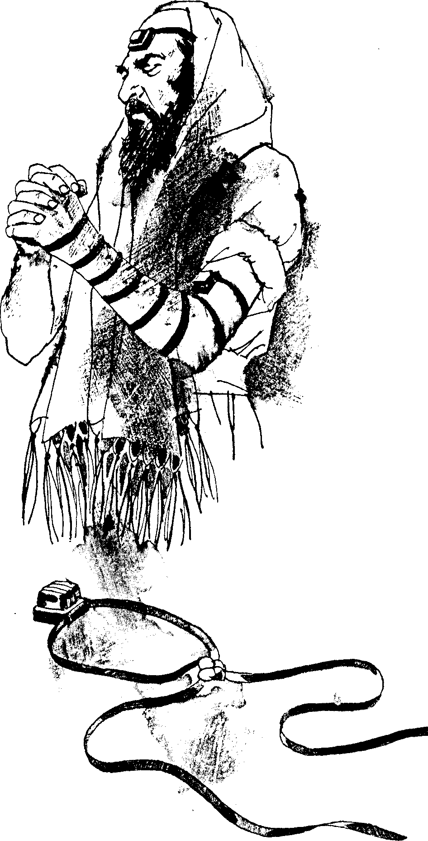
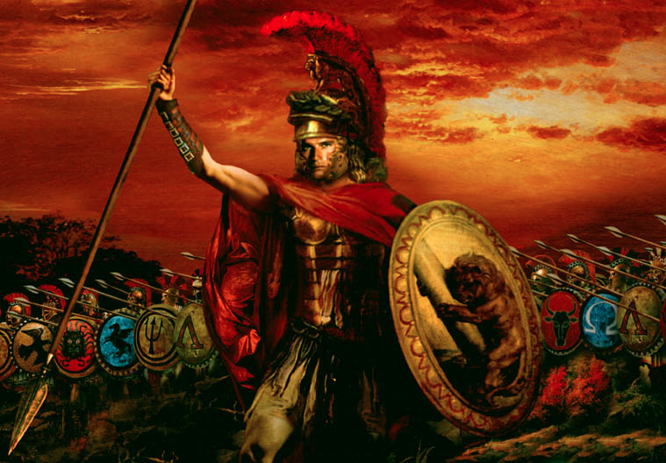
Backgrounds to the New Testament
8
Dr. Rick Griffith • Jordan Evangelical Theological Seminary • BibleStudyDownloads.org

Slide 2
Kingdom & Covenants Timeline
22
CH-34a
OS1-22
OS2-337
NS-9g
SA-19
34a
Dr. Rick Griffith • BibleStudyDownloads.org
22
Kingdom Teaching...
Adam rules with God (Gen. 1:26, 28; 2:19)
Satan begins rule as god of this world (Gen. 3:15;
2 Cor. 4:4)
God covenants with Abraham to reestablish man's rule via Israel as a "kingdom of priests" (Gen. 12:1-3; Exod. 19:6)
Israel's failure to witness to nations as a kingdom of priests is judged via exile under foreign rule
Israel rejects Messiah's offer of kingdom (Matt. 12:41-42; 23:37-39)
Jesus extends His kingdom in mystery form to the Church (Matt. 13)
Christ subdues Israel's enemies and nation believes (Rom. 11:26-27)
Christ rules over everything with saints (Eph. 1:9-10; Rev. 20:1-6; 22:5b)
337
9g
Fall of Man (Gen. 3)
Noahic Covenant
19
Genesis 6:18; 9:8-17
Land Covenant
ISRAEL
CHURCH
MESSIANIC KINGDOM
(National Focus)
The "New Man" (Eph. 2:15)
Millennial Eternal
land
Genesis 15:18 (cf. Deut. 30:1-10) promises:
Land from Wadi of Egypt to Euphrates River (Isa. 27:12)
Eternal possession of land (Gen. 17:8) after exile/restoration
Whole world blessed via the land (Isa. 14:1-2)
Israel judged for rejecting Messiah by dispersion away from land for 19 centuries
(AD 70–AD 1948) but now partially restored (Ezek. 37:1-7)
Full restoration (Ezek. 37:8-28) Jerusalem world capital
(Isa. 2:1-5)
New Jerusalem
(Rev. 21–22)
Davidic Covenant
Christ is Head over His Church, which is a spiritual temple (Eph. 2:19-22; 2 Cor. 6:16)
Christ reigns over the world
(Isa. 11)
with saints (Rev. 5:10; 20:4-6)
Christ hands kingdom over to Father (1
Cor. 15:24)
Genesis 12:1-3
2 Samuel 7:12-16 promises:
Sons ("house" never wiped out)
Kingdom (political dynasty)
Throne (right to rule by descendants)
Temple (son to build it)
seed
Abrahamic Covenant
New Covenant
All
things made new!
(Rev. 21:5)
All 5 elements fulfilled in national restoration (Zech. 8)
Jeremiah 31:31-34 promises:
Forgiveness
Indwelling Spirit
New heart, nature, mind
Reunification of Israel and Judah
No need for evangelism
Mosaic Law replaced with first three elements of the New Covenant (Luke 22:20; 2 Cor. 3:6)
blessing
Mosaic Covenant
Law abolished, fulfilled, and replaced at the cross (Rom. 7:1-6; 1 Cor. 9:19-21; Heb. 8:13)
10th Edition
10 Nov 2020
Temporary (Gal. 3:19) and conditional (Deut. 28) to reveal sin (Rom. 7:7) and regulate Israel (Gal. 3:23-25)
Scripture has a dual kingdom-covenant theme. Israel's role from Abraham to Christ expands to include the Church (continuity) yet the Church never replaces the nation as the "new Israel" (discontinuity). Israel will enjoy world prominence after trusting Christ at His second coming.
Notes:
All agree that a partial fulfillment of the covenant to Abraham exists now to the Church in the indwelling Holy Spirit and forgiveness of sins (Jer 31:31-34)—and the ultimate fulfillment will be in the eternal state.
The main area of disagreement relates to the time period from now to eternity. Will there be a literal land, throne, and worldwide blessing to national (ethnic) Israel before the eternal kingdom? This chart shows verses giving a resounding YES to that question in a present partial fulfillment and a future full fulfillment in the normal sense of language in the verses cited. But the messianic kingdom will be in two stages—first in a millennial fulfillment to last 1000 years, but then, after that, the eternal stage in the new Jerusalem after the destruction of our present heavens and earth (Rev 21–22). What an amazing future remains for those who trust Jesus!
____________
Common English-51
CH-02-Nature-103-p34a
OC-10-Chronology-42
OS-00-Intro & Biblical Theology-25 & 90
OS-02-Exodus-267-p22
OS-05-Deut-248-p22
OS-10-2Sam-96-p22
OS-12-Kings & Prophets Charts-25
OS-13-1 Chron-46
OS-23-Isaiah-97-p337
OS-24-Jeremiah-174-p337
OS-23-Isaiah-97-p337
OS-28-Hosea-49
OS-31-Obadiah-164
05-Acts1-2-slide 45
NS-09-Gal-143-p9g
NS-19-Hebrews-342-p9g
SA-08-Mosaic Law-19-p38a

Slide 3
Stages of God's Plan
In History
9a
Exodus
Judges
Captivity
Church
Beginnings
Patriarchs
Conquests
Silent Years
Kingdom
Restoration
United Kingdom
Divided Kingdom

Slide 4
The Intertestamental Era (425 BC—5 BC)
10
Issue /
Time Period
Malachi
(close of OT)
Intertestamental Era
Advent of Christ
Rulers Over Israel
Persia
(208 yrs.)
Greeks (188 yrs.)
Hasmoneans (80 yrs.)
Rome
(58 yrs.)
Political Stability
Peace / autonomy
Many wars
(Dan. 11:1-35)
Peace (but via Rome!)
Expectation of Messiah & Kingdom
Moderate
Increasing
“Two Messiahs”
High
Language in Palestine
Hebrew / Aramaic
Greek (Septuagint)
Aramaic / Greek / Latin

Slide 5
The Intertestamental Era (3 slides)
The Intertestamental Era (425 BC—5 BC)
10
Issue /
Time Period
Malachi
(close of OT)
Intertestament Era
Advent of Christ
Ability to Evangelize
Limited
Increased
Extensive
Road System
Very Limited
Expanded
Extensive
Places of Worship
Temple only
Rise of Synagogues
Synagogues / Temple
Religious Leaders
Priests/Levites
Rise of Jewish Sects
Pharisees / Sadducees

Slide 6
The Intertestamental Era
The Intertestamental Era (425 BC—5 BC)
10
Issue /
Time Period
Malachi
(close of OT)
Intertestament Era
Advent of Christ
Priesthood achieved by . . .
Genealogy
Fighting illegitimate high priest
Bribes / Executions
Extent of Power
Local Jurisdiction
Rise of Sanhedrin
Corrupt Sanhedrin
Hermeneutic
Literal
Instable + Apocalyptic
Letterism
Authority
OT Law
Rise of Oral Law
Pharisees

Slide 7
The “Kingdom Stage” is Set!
10
The time was right:
Galatians 4:4 NIV
“But when the time had fully come, God sent his Son, born of a woman, born under law, to redeem those under law, that we might receive the full rights of sons.”
Politically
Prophetically
(Dan. 9:25-26)
Linguistically
Emotionally
Religiously
Transportationally

Slide 8
The Gospel of Matthew
10
(probably written in the 40s)
answers the two questions all Jews were asking:
Q: Non-Christian Jews asked, “How do we know Jesus is the Messiah?” (Matthew 1–10)
Answer:
His advent (1-2) and approvals (3:1–4:11) show Jesus fulfilled OT Messianic prophecies
His early ministry (4:12-25) and Sermon on Mount (5–7) reveal that he has the prophetic office
He shows messianic power by healing (8:1–9:34) and authority by delegation (9:35-10:35)
Q: Christian Jews asked, “Yes, He's Messiah, but where's the promised kingdom?” (Matthew 11–28)
Answer:
Israel rejected the kingdom Jesus offered as Messiah so he now has authority over the church (11–16)
Jesus prepared the disciples for church issues since the political kingdom is delayed (17–20)
Israel rejected Him as Messiah but God sovereignly used this to pay for man's sin (21–27)
Christ defeated death to show his messianic authority & ability to bring in the kingdom (28)

Slide 9
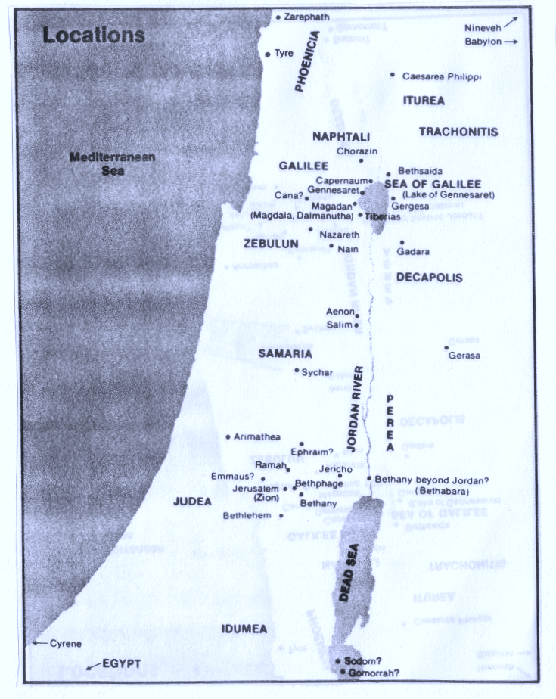
Every Geographical Location in the Gospels
From Jerusalem: Miles
Bethany 2
Bethlehem 6
Caesarea Philippi 105
Cana 69
Capernaum 85
Emmaus 7
Jericho 15
Jordan 21
Mediterranean 40
Sidon 130
Sychar 31
Tyre 106
Zarephath 118
From Capernaum:
Bethsaida 6
Caesarea Philippi 27
Cana 16
Nain 22
Mediterranean 32
Nazareth 23
Zarephath 45
Tyre 37
11

Slide 10
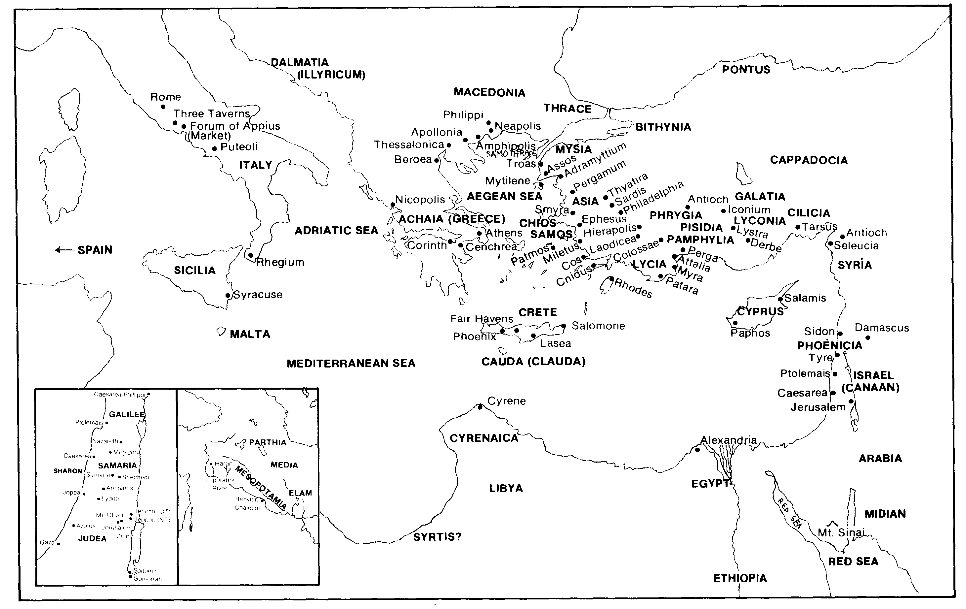
Every Geographical Location
in Acts / Epistles
12

Slide 11
Authors of the New Testament
13
Name | Nationality | Home Town | Occupation | Relation-ships | Chapters Written | Verses Written | Books Written
Matthew | Jew | Capernaum | Tax Collector | Apostle of Jesus Christ | 28 | 1,071 | Gospel of Matthew
Mark | Jew / Roman | Jerusalem | Missionary | Disciple of Peter | 16 | 678 | Gospel of Mark
Luke | Greek | Antioch | Physician | Disciple of Paul | 52 | 2,158 | Gospel of Luke Acts
John | Jew | Bethsaida or Capernaum | Fisherman | Apostle of Jesus Christ | 50 | 1,414 | Gospel of John 1 John 2 John 3 John Revelation

Slide 12
Authors of the New Testament
13
Name | Nationality | Home Town | Occupation | Relation-ships | Chapters Written | Verses Written | Books Written
Paul | Jew | Tarsus | Tentmaker | Apostle of Jesus Christ | 87 (100)* | 2,033 (2,336)* | Romans 1 Corinthians 2 Corinthians Galatians Ephesians Philippians Colossians Philemon 1 Thessalonians 2 Thessalonians 1 Timothy 2 Timothy Titus (Hebrews?)
*Indicates total if Hebrews is assigned to Paul.

Slide 13
Authors of the New Testament
13
Name | Nationality | Home Town | Occupation | Relation-ships | Chapters Written | Verses Written | Books Written
James | Jew | Nazareth | Carpenter? | Brother of Jesus Christ | 5 | 108 | James
Peter | Jew | Bethsaida | Fisherman | Apostle of Jesus Christ | 8 | 166 | 1 Peter 2 Peter
Jude | Jew | Nazareth | Carpenter? | Brother of Jesus Christ | 1 | 25 | Jude

Slide 14
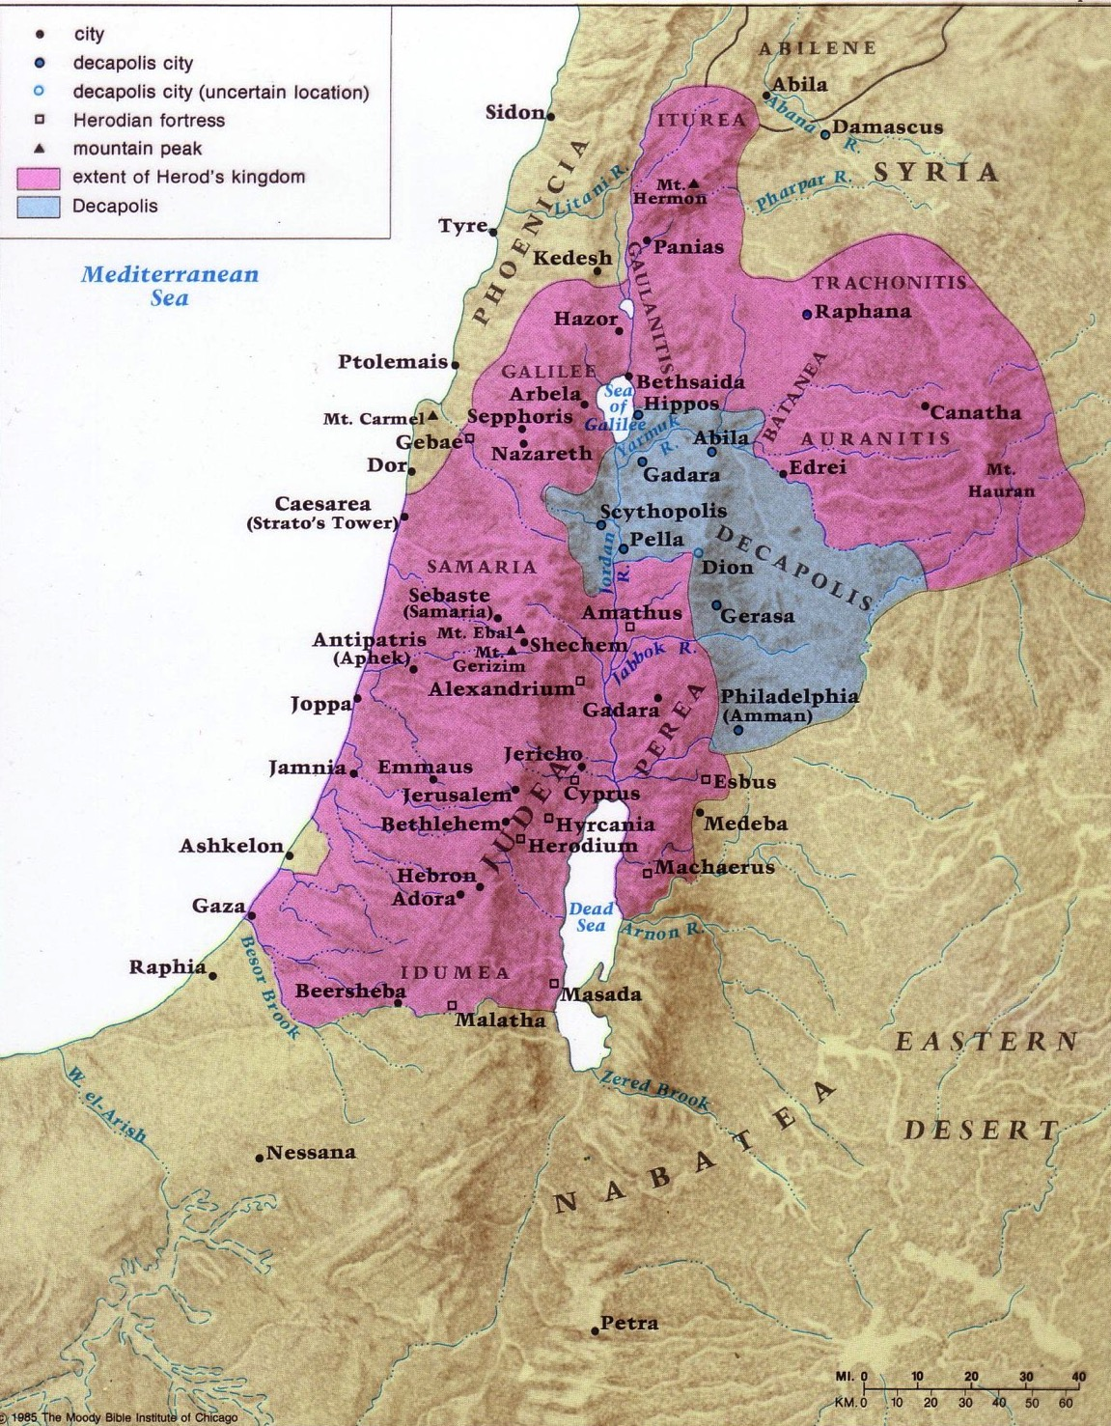
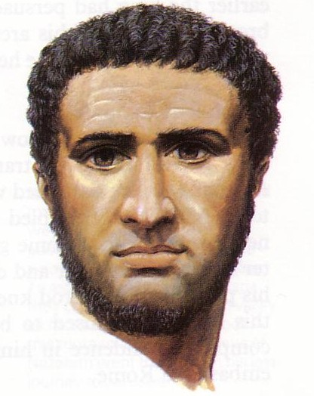
Israel under Herod the Great
81
Notes:
The realm that Herod ruled extended to that of the size of David nearly 1000 years earlier!
___
NB-07 Politics 4-Herodians & Rome-18
NS-00-NT Backgrounds-14

Slide 15
Herod's Three Ruling Sons
80 & 89
Philip Antipas Archelaus
Beitzel, Moody Atlas of Bible Lands, ed. 1

Slide 16
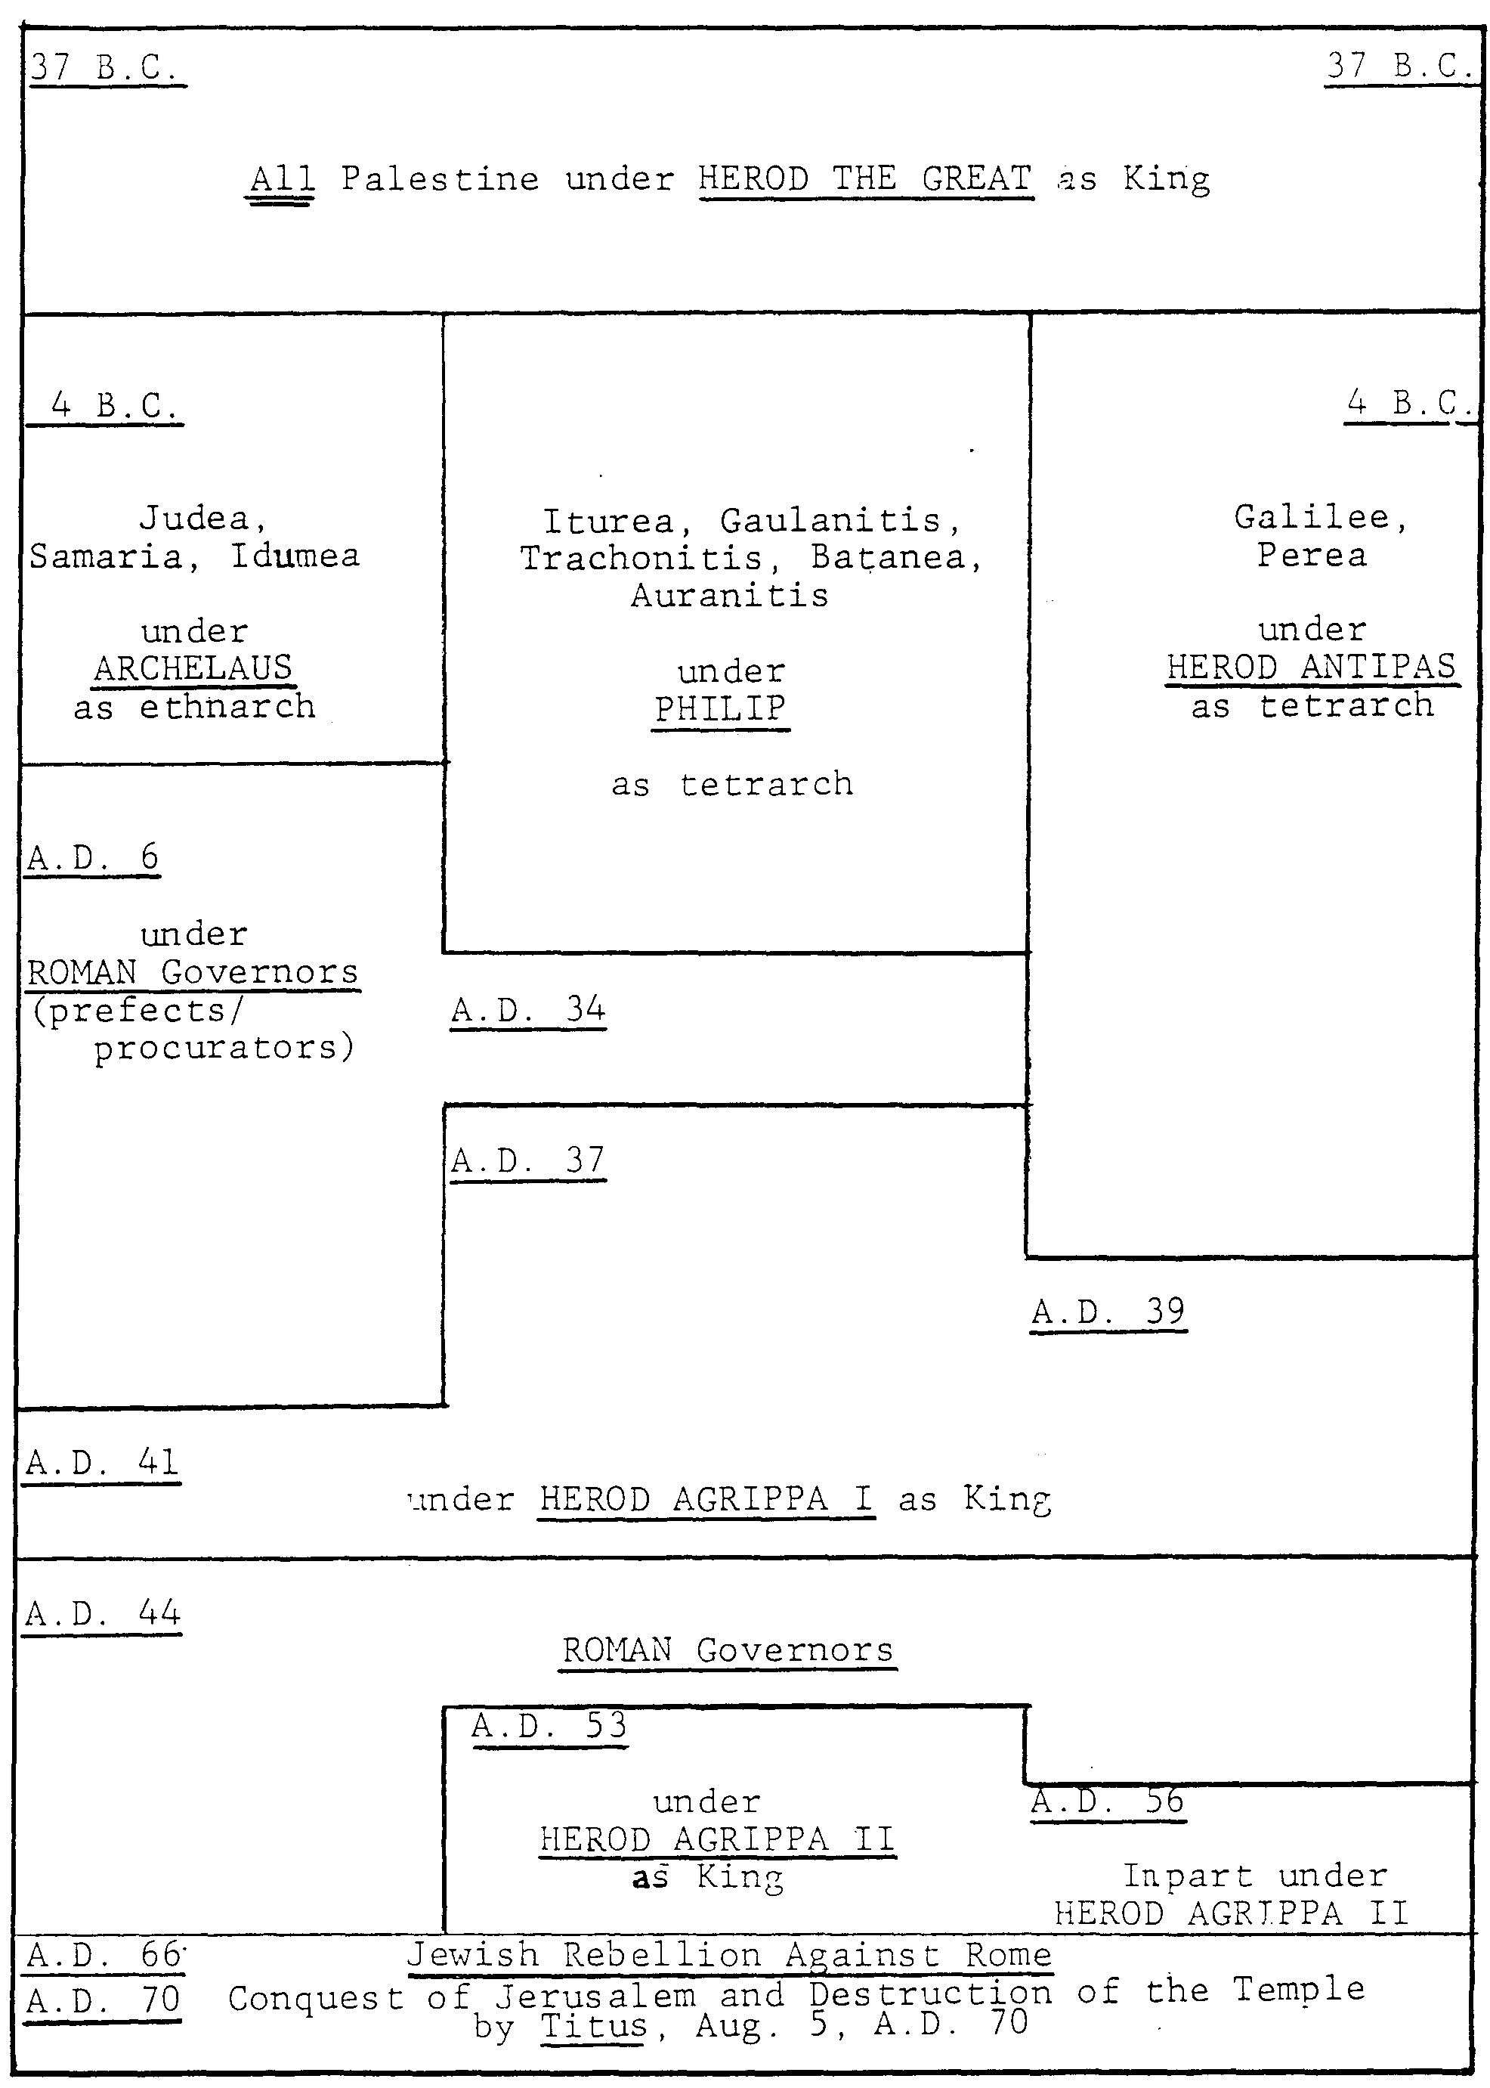
Chronology of the Herodian Dynasty (37 BC—AD 70)
37 BC
88
Herod the Great King over all Israel
Archelaus Ethnarch of Judea, Samaria, Idumea | Philip Tetrarch of Iturea, Gaulanitis, Trachonitis, Batanea, Auranitis | Antipas Tetrarch of Galilee & Perea
Romans Governors (prefects or procurators)
 | Agrippa I
King eventually over all Israel | Agrippa I
Romans Governors (prefects or procurators)
 | Agrippa II King
 |  | Partially under Herod Agrippa II
Jewish Revolt Against Rome Titus destroyed Jerusalem and Temple on 5 Aug AD 70
4 BC
AD 6
AD 34
AD 37
AD 39
AD 41
AD 44
AD 53
AD 56
Adapted from John Grassmick,
Dallas Seminary
AD 66
AD 70

Slide 17
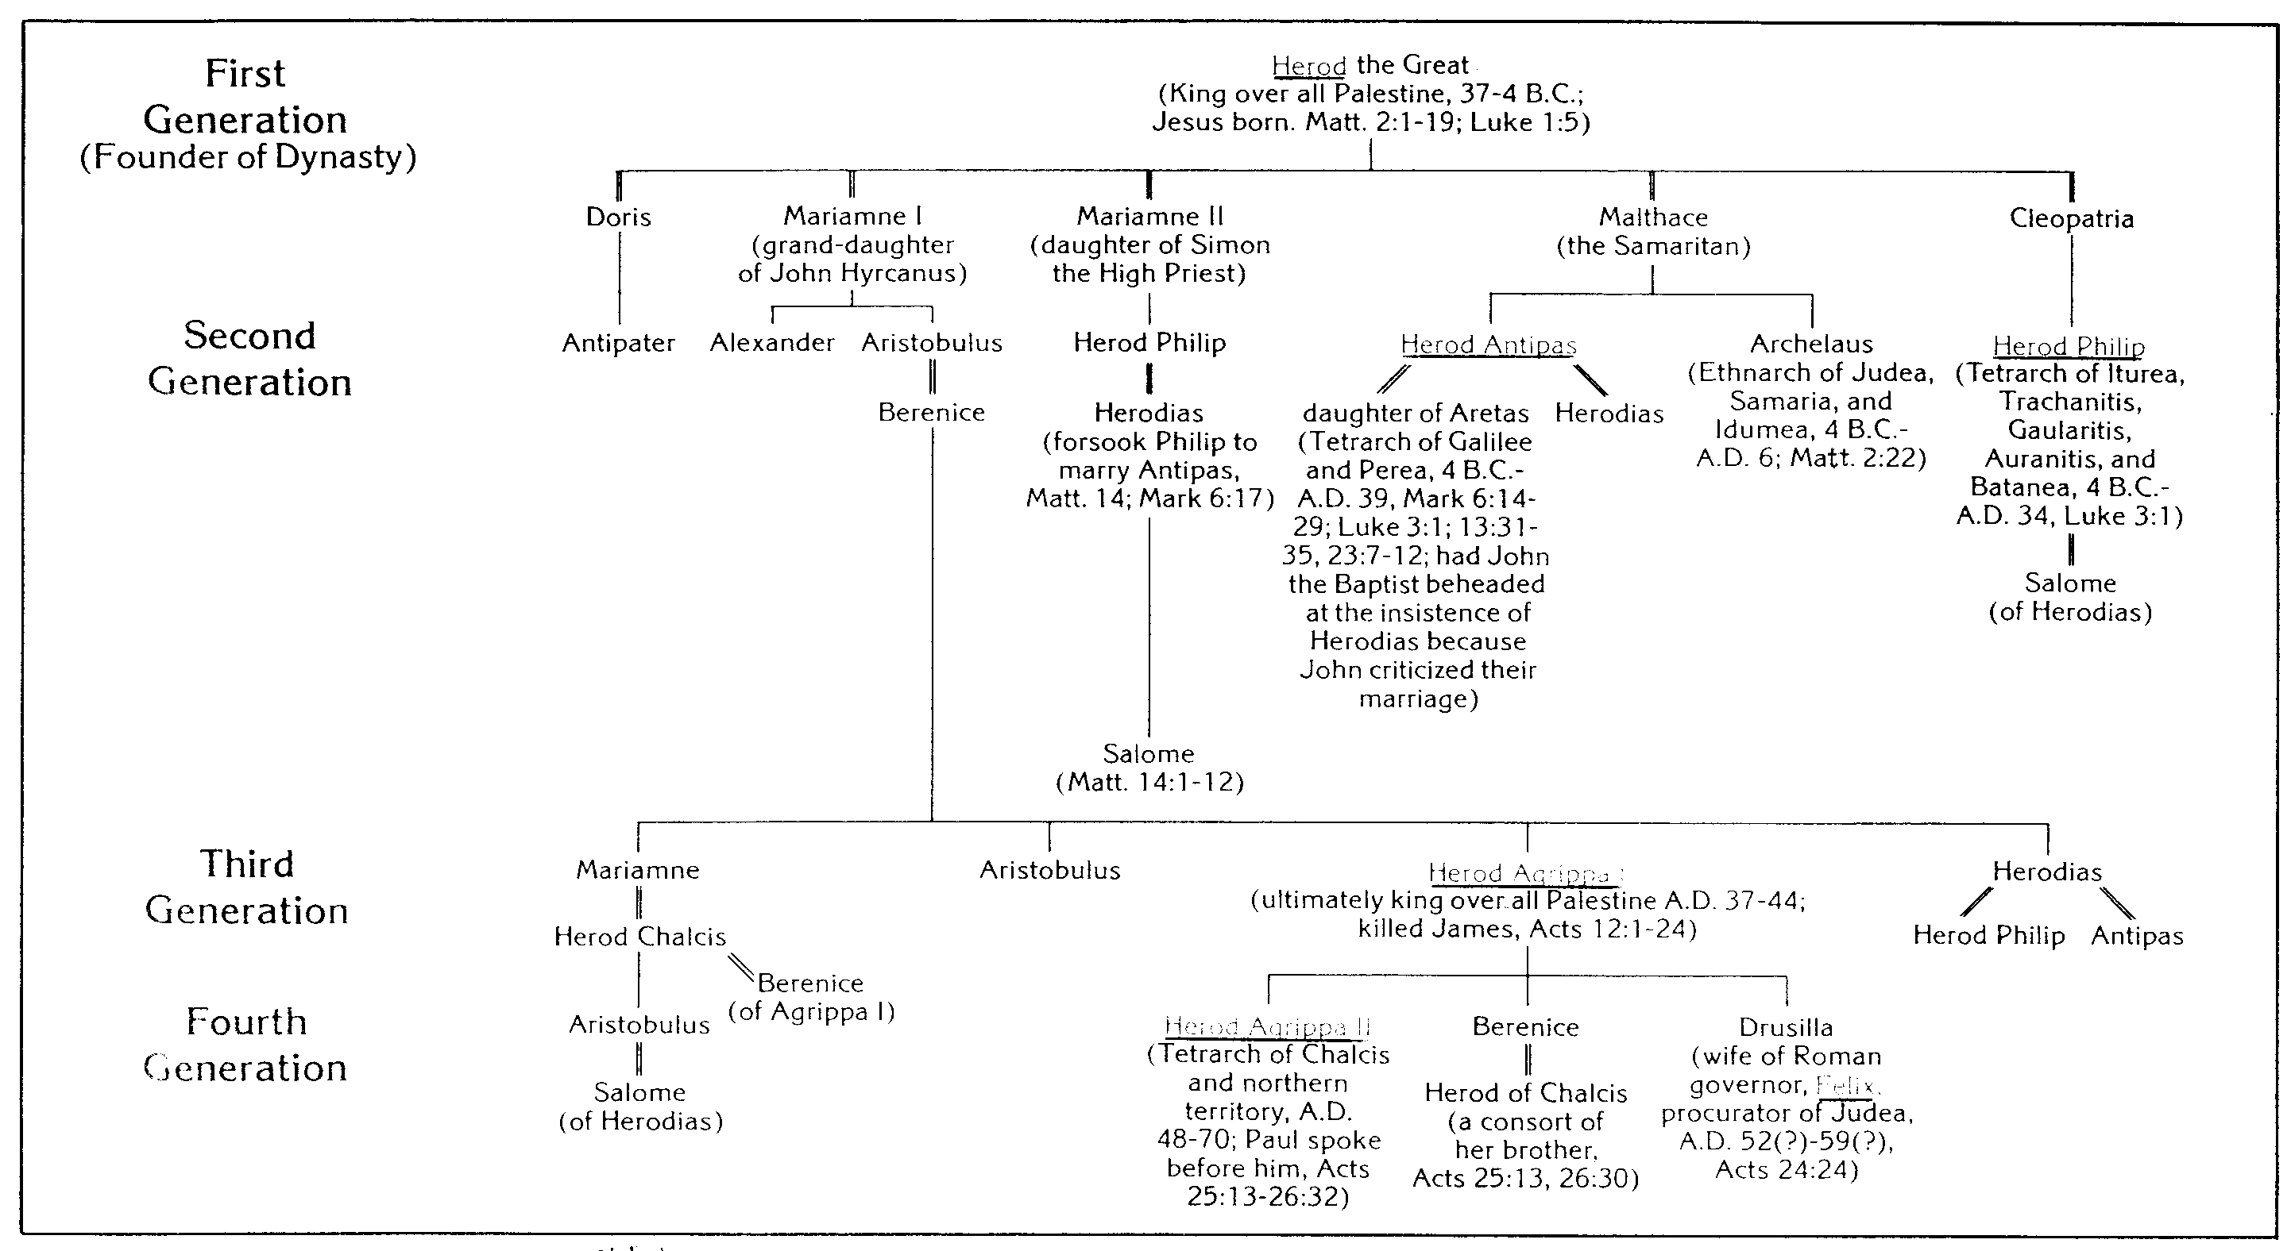
Genealogical Chart
of the Herodian Dynasty
H. Wayne House
17

Slide 18
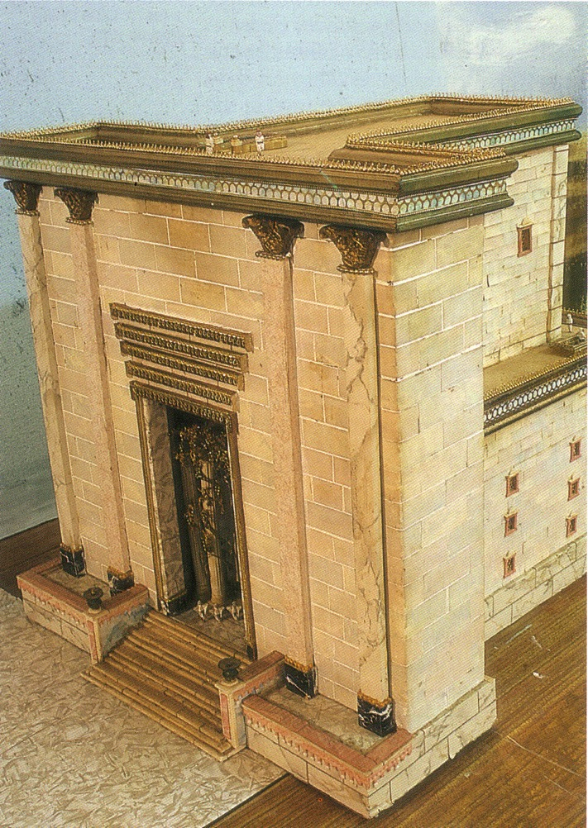
The Temple

Slide 19
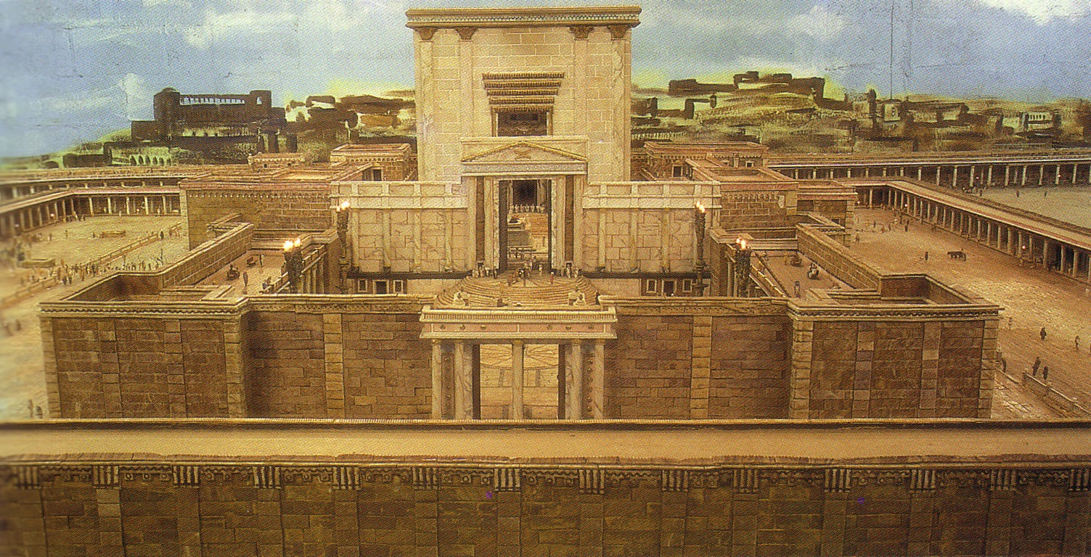
The Temple from the East

Slide 20
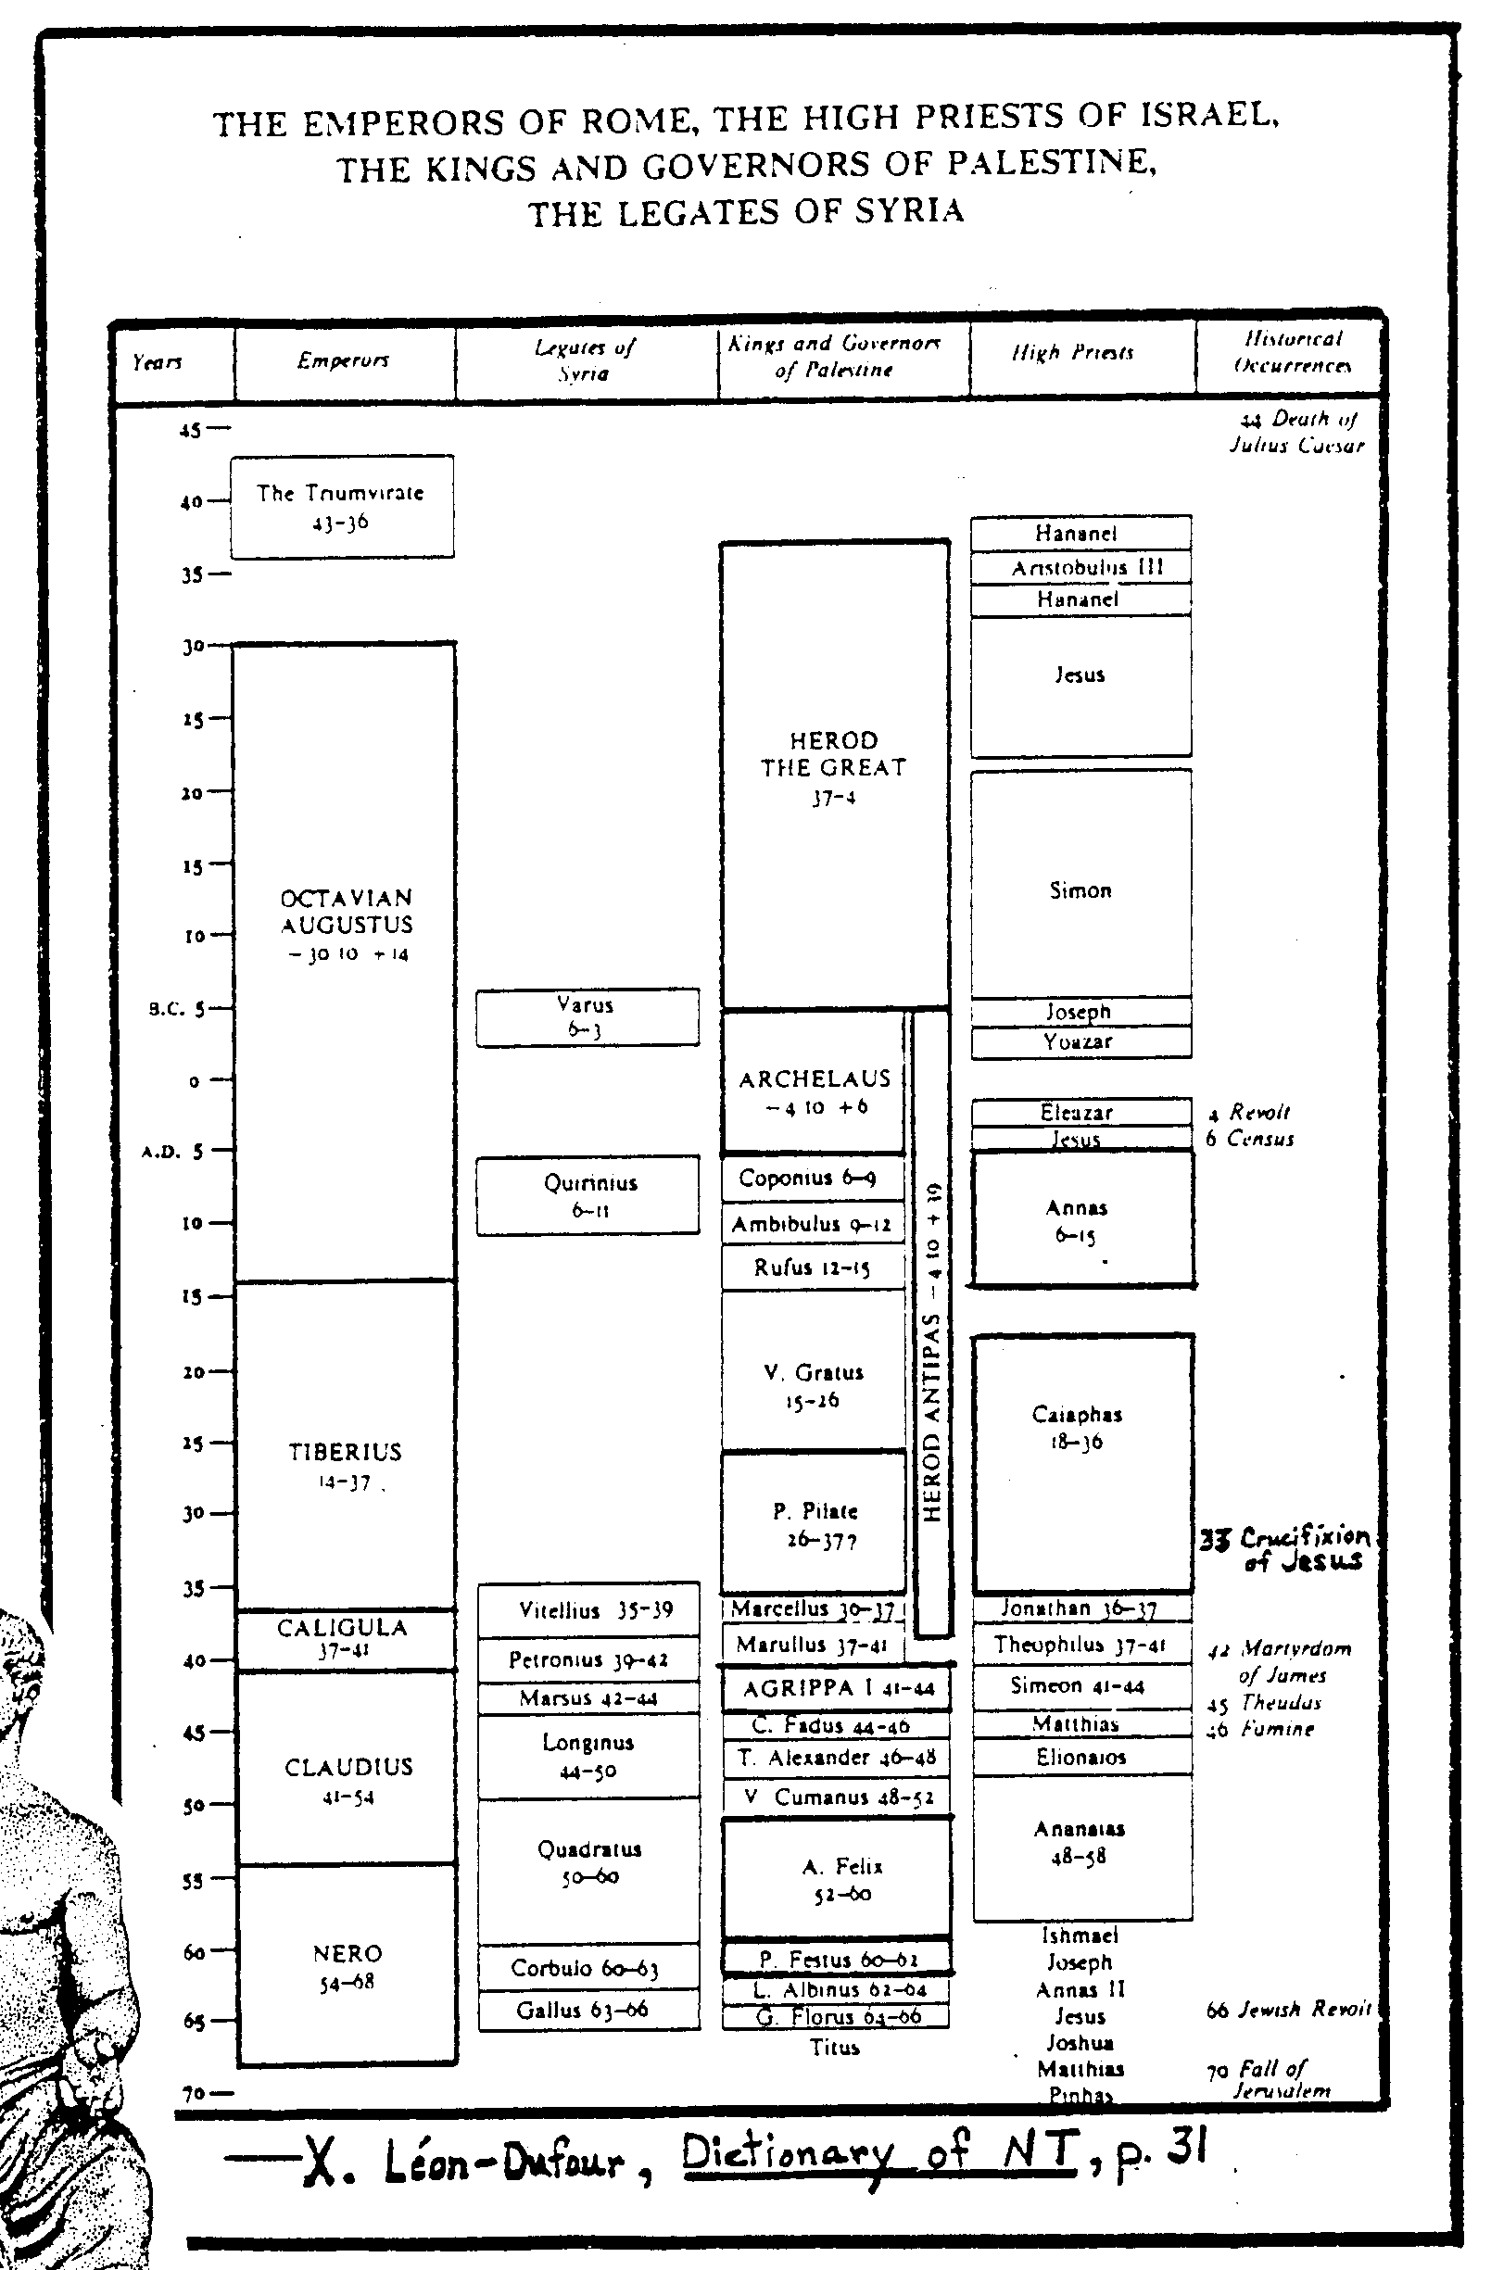
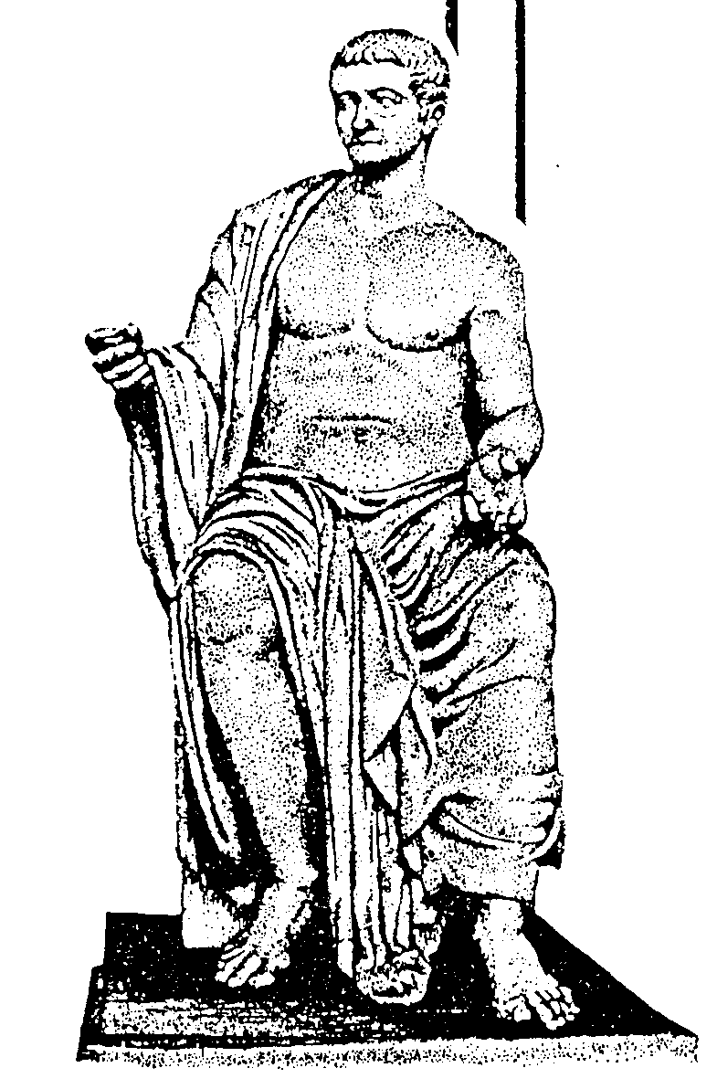
19
Roman and Jewish Leaders

Slide 21
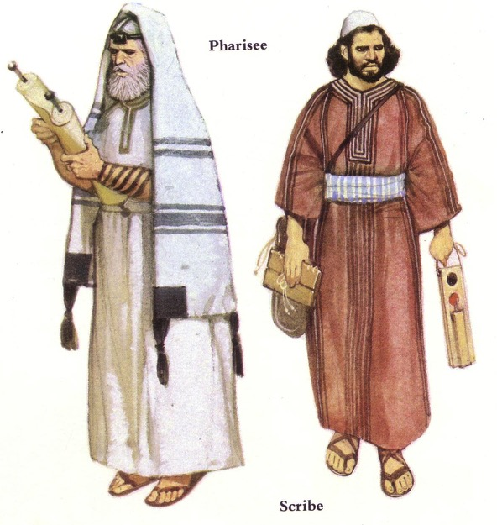
Jewish Sects
Influential Subgroups in First Century Israel

Slide 22
The Jewish Sects
115a
Pharisees
Integration
Religion
Sicarii
Zealots
Politics
Sadducees
Herodians
Revolt
Resignation
Attitude towards life is in white
Isolation
Essenes
Samaritans
Notes:
Two sects lay at opposite ends of the political spectrum. Even beyond the Zealots were the Sicari (dagger men not considered a sect), and the Herodians, collaborators with the Romans also not generally thought a sect.
Likewise, two sects lay at polar extremes religiously with 6000 Pharisees involved in the life of the community while many Essenes withdrew to the Dead Sea.
Only about 1 in 20 Jews were involved in these sects, but they still wielded immense power just like a few religious and political leaders today have influence beyond than their elite few might seem.
_____
NB-10 Religion 1 Sects, Diaspora, Rabbis (115-26)-12
NS-00-NT Bkgrds-21

Slide 23
The Jewish Sects
115a
Pharisees
Integration
Religion
Sicarii
Zealots
Politics
Sadducees
Herodians
Revolt
Resignation
Attitude towards life is in white
Isolation
Essenes
Samaritans

Slide 24
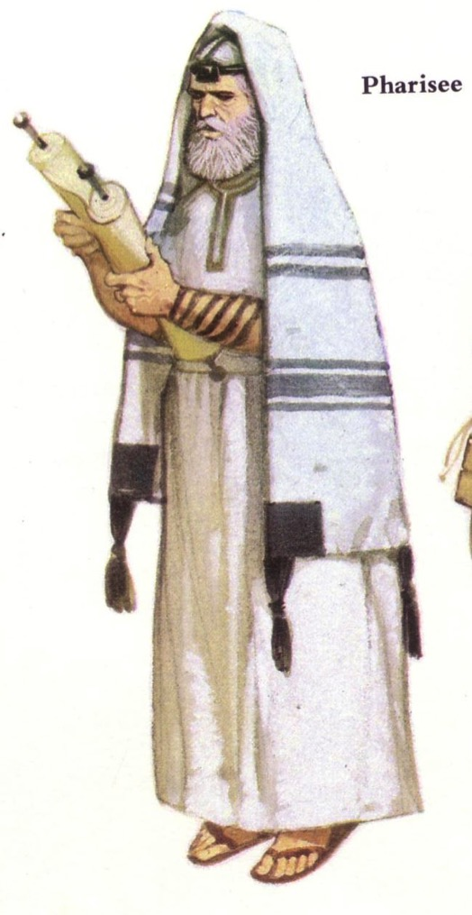
Pharisees
65-66
123
Roots: Hasidim (2nd cent. BC)
They accepted as equally inspired and authoritative all 39 OT books and the oral tradition.
They held to a mediating view that made it impossible for either free will or the sovereignty of God to cancel out the other.
They accepted a rather developed hierarchy of angels and demons.
Bible Visual Resource Book, 185

Slide 25
Pharisees & Phylacteries
123
4. They taught that there was a future for the dead.
5. They believed in the immortality of the soul and in reward and retribution after death.
6. They were champions of human equality.
7. The emphasis of their teaching was ethical rather than theological.
Bible Visual Resource Book, 185

Slide 26
The Jewish Sects
115a
Pharisees
Integration
Religion
Sicarii
Zealots
Politics
Sadducees
Herodians
Revolt
Resignation
Attitude towards life is in white
Isolation
Essenes
Samaritans

Slide 27
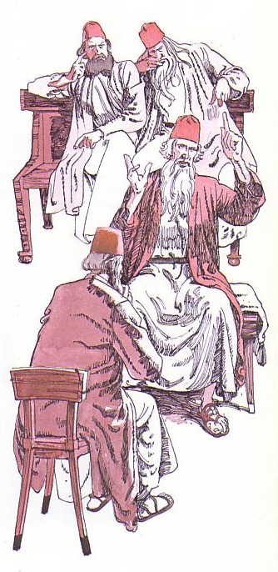
Sadducees
123
They probably began during the Hasmonean period (166 – 63 BC). They ended c. A.D. 70 with the fall of Jerusalem.
1.They denied that the oral law was authoritative and binding.
2. They interpreted Mosaic law more literally than did the Pharisees.
3. They were very exacting in Levitical purity.
4. They attributed all to free will.

Slide 28
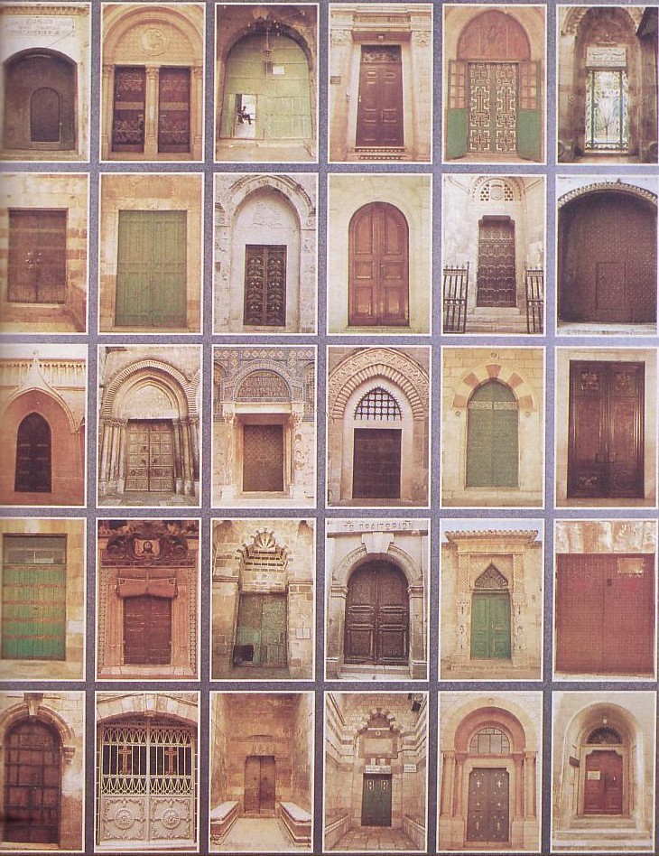
Sadducees went through any door into Jerusalem!
123
5. They argued there is neither resurrection of the dead nor a future life.
6. They rejected a belief in angels and demons.
7. They rejected the idea of a spiritual world.
8. Only the books of Moses were canonical.
Bible Visual Resource Book, 185

Slide 29
The Jewish Sects
115a
Pharisees
Integration
Religion
Sicarii
Zealots
Politics
Sadducees
Herodians
Revolt
Resignation
Attitude towards life is in white
Isolation
Essenes
Samaritans

Slide 30
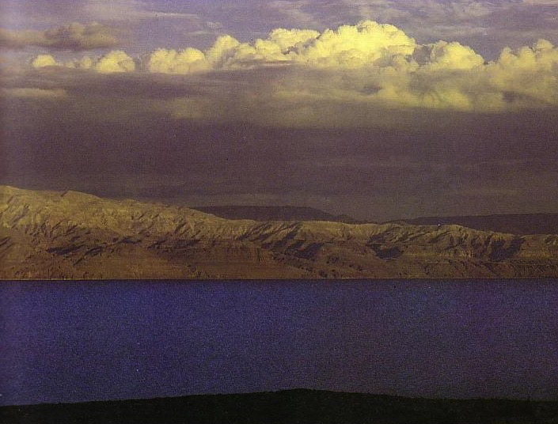
Essenes
123
They probably came from the Hasidim, along with the Pharisees, from whom they later separated (1 Macc. 2:42; 7:13). These strict and zealous Jews took part with the Maccabees in a revolt against the Syrians around 165-155 BC.
They strictly observed the purity laws of the Torah.
They were notable for their communal ownership of property.
They had a strong sense of mutual responsibility.
Daily worship was an important feature along with a daily study of their sacred scriptures.
Jewish Sects

Slide 31
Essenes
123
They probably came from the Hasidim, along with the Pharisees, from whom they later separated (1 Macc. 2:42; 7:13). These strict and zealous Jews took part with the Maccabees in a revolt against the Syrians around 165-155 BC.
They required solemn oaths of piety and obedience.
They sacrificed on holy days and in sacred seasons.
Marriage was not condemned in principle but was avoided.
They attributed all that happened to fate.
Jewish Sects

Slide 32
The Jewish Sects
115a
Pharisees
Integration
Religion
Sicarii
Zealots
Politics
Sadducees
Herodians
Revolt
Resignation
Attitude towards life is in white
Isolation
Essenes
Samaritans

Slide 33
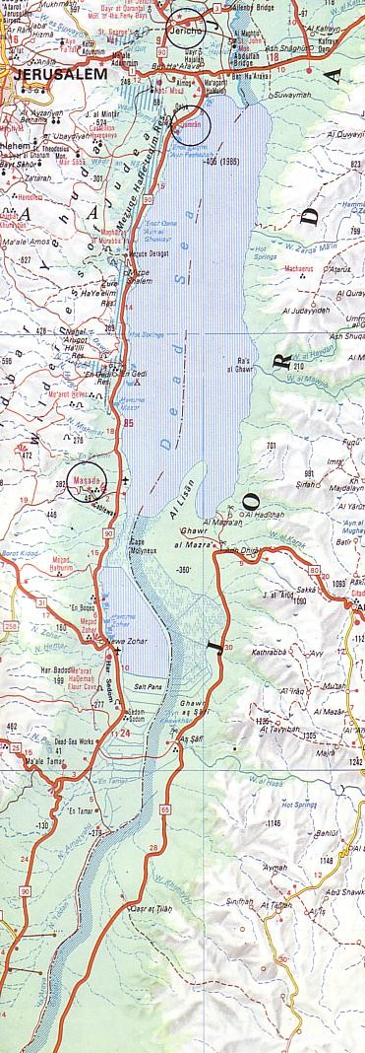
Zealots
123
Jerusalem
They originated in the time of Herod the Great ca. 6 BC. but ceased to exist in AD 73 after leaving Jerusalem for their last stand at Masada.
They opposed payment of tribute for taxes to a pagan emperor, saying that allegiance was due only to God.
They held a fierce loyalty to the Jewish traditions.
They were opposed to the use of the Greek language in Palestine.
They prophesied the coming of the time of salvation.
Jewish Sects
Masada
Bible Visual Resource Book, 185

Slide 34
Black

Slide 35
Life of Christ link at BibleStudyDownloads.org
Get this presentation for free!
Notes:
Life of Christ (lc)

