Slide 1
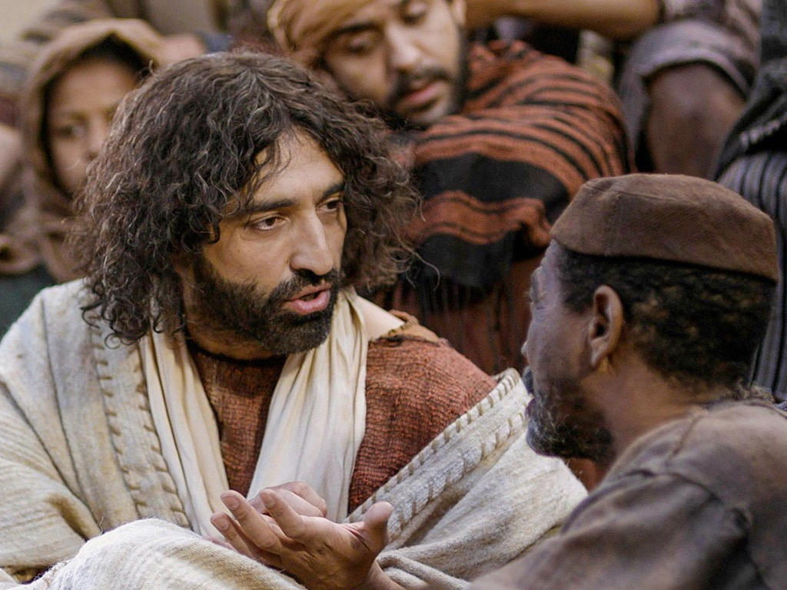
Life of Christ Syllabus
Dr. Rick Griffith • Jordan Evangelical Theological Seminary • BibleStudyDownloads.org
Notes:
Intro: Fact or Fiction...

Slide 2

Introduce Yourself!
Name
Country
Program
Family
Church
Ministry Goal

Slide 3

Notes Options
The Life of Christ
Digital at BibleStudyDownloads Life of Christ link
(Free)
Printed
($10 each)

Slide 4
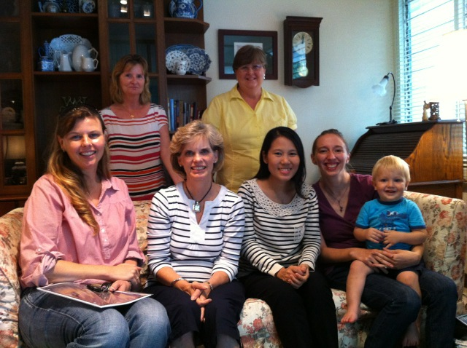

Our People
Susan teaches church women
Notes:
I also lead the woman's Precept Bible study at our church

Slide 5
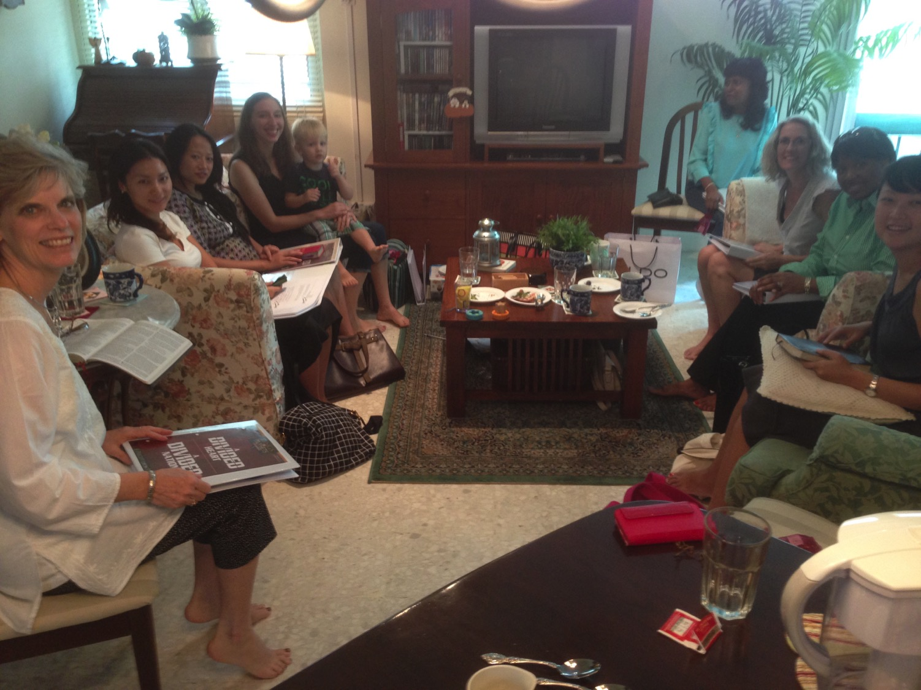
LADIES BIBLE STUDY ON
1-2 THESS
USA • Singapore • New Zealand • Holland

Slide 6

Thailand • Mongolia • Myanmar • Indonesia
Notes:
INTERVIEWER: And Susan, what ministries has the Lord granted you?
SUSAN: I have been teaching the wives of leaders at SBC. These 5 women come from 5 different nations!
SUSAN: I also lead the woman's Bible study at our church

Slide 7
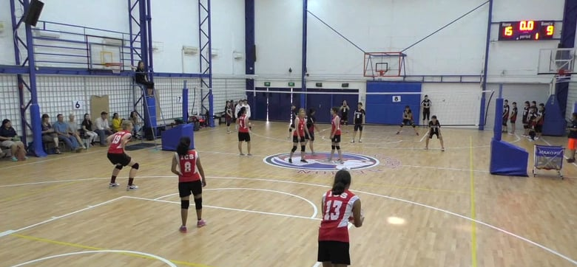
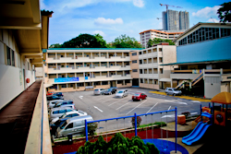
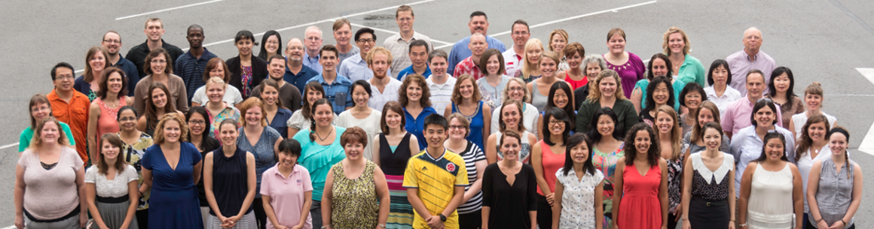
International Community School
(est. 1993)

Slide 8




ICS now has almost 400 students!
UK
SWEDEN
KOREA
SWITZERLAND
JAPAN
ITALY
USA
THAILAND
INDIA
MEXICO
ICS
VENUZELA
INDONESIA
BRAZIL
SOUTH AFRICA
AUSTRALIAN

Slide 9

Our Three Sons

Slide 10
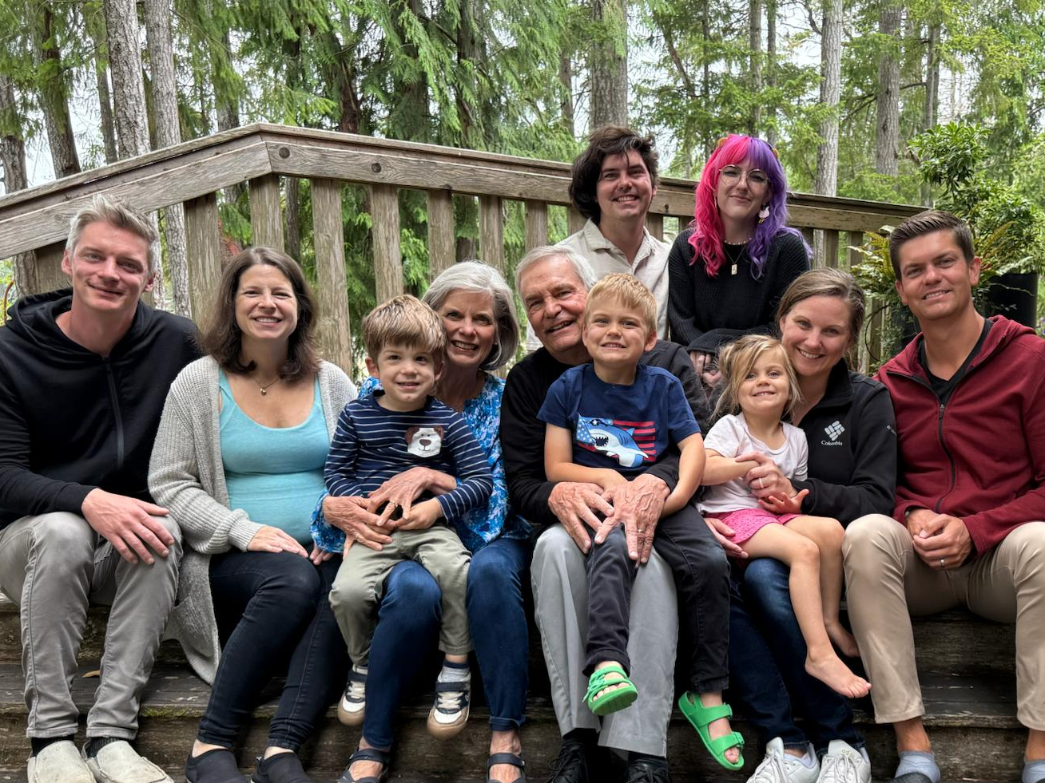
The Griffiths
28 Nov 2019
2025
John
& Chloe
(32)
Kurt
& Cara (38)
Stephen & Katie (35)
Rick & Susan

Slide 11
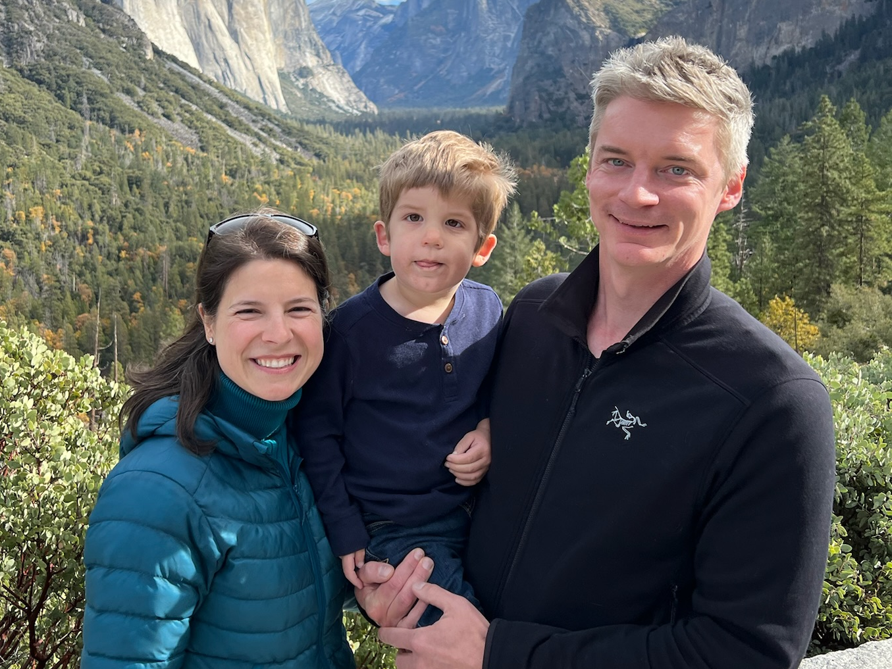
Kurt (38) & Cara own their HR consulting business near Seattle
(Kadon born Jan 2023)
Notes:
Kurt and his wife Cara are in Seattle

Slide 12

2-year-old grandson Kadon

Slide 13
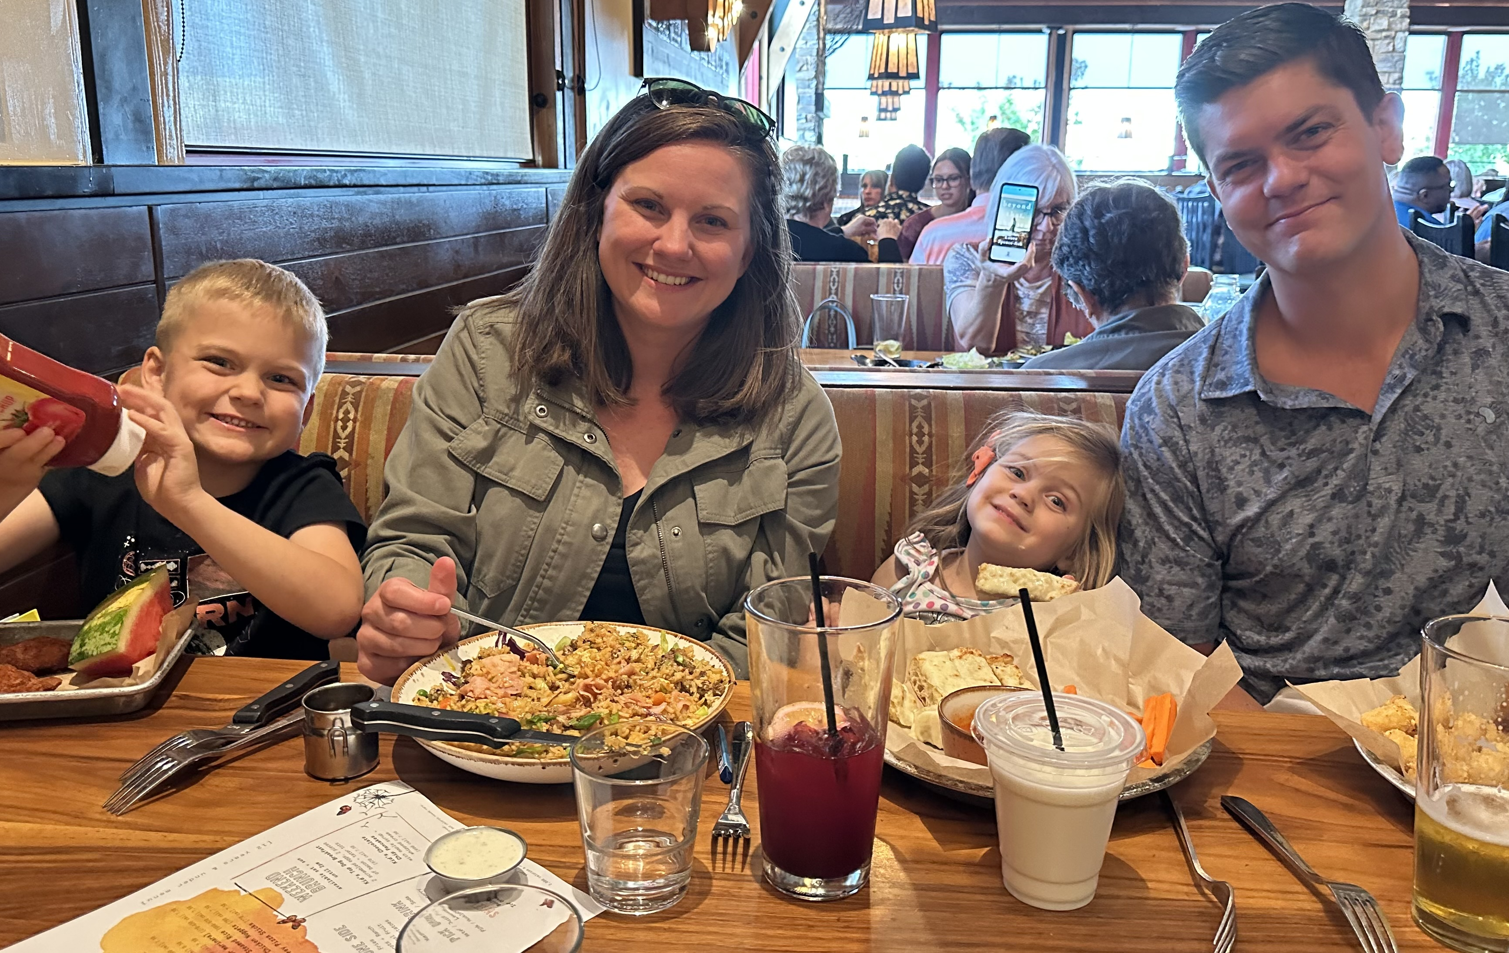
Stephen, Katie, Jesse & Norah in Denver

Slide 14

6-year-old grandson Jesse

Slide 15
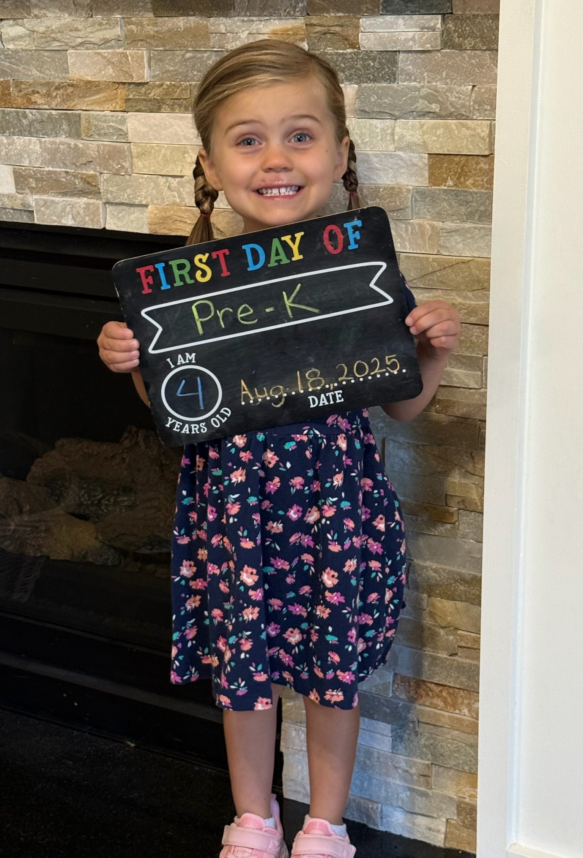

4-year-old granddaughter Norah

Slide 16
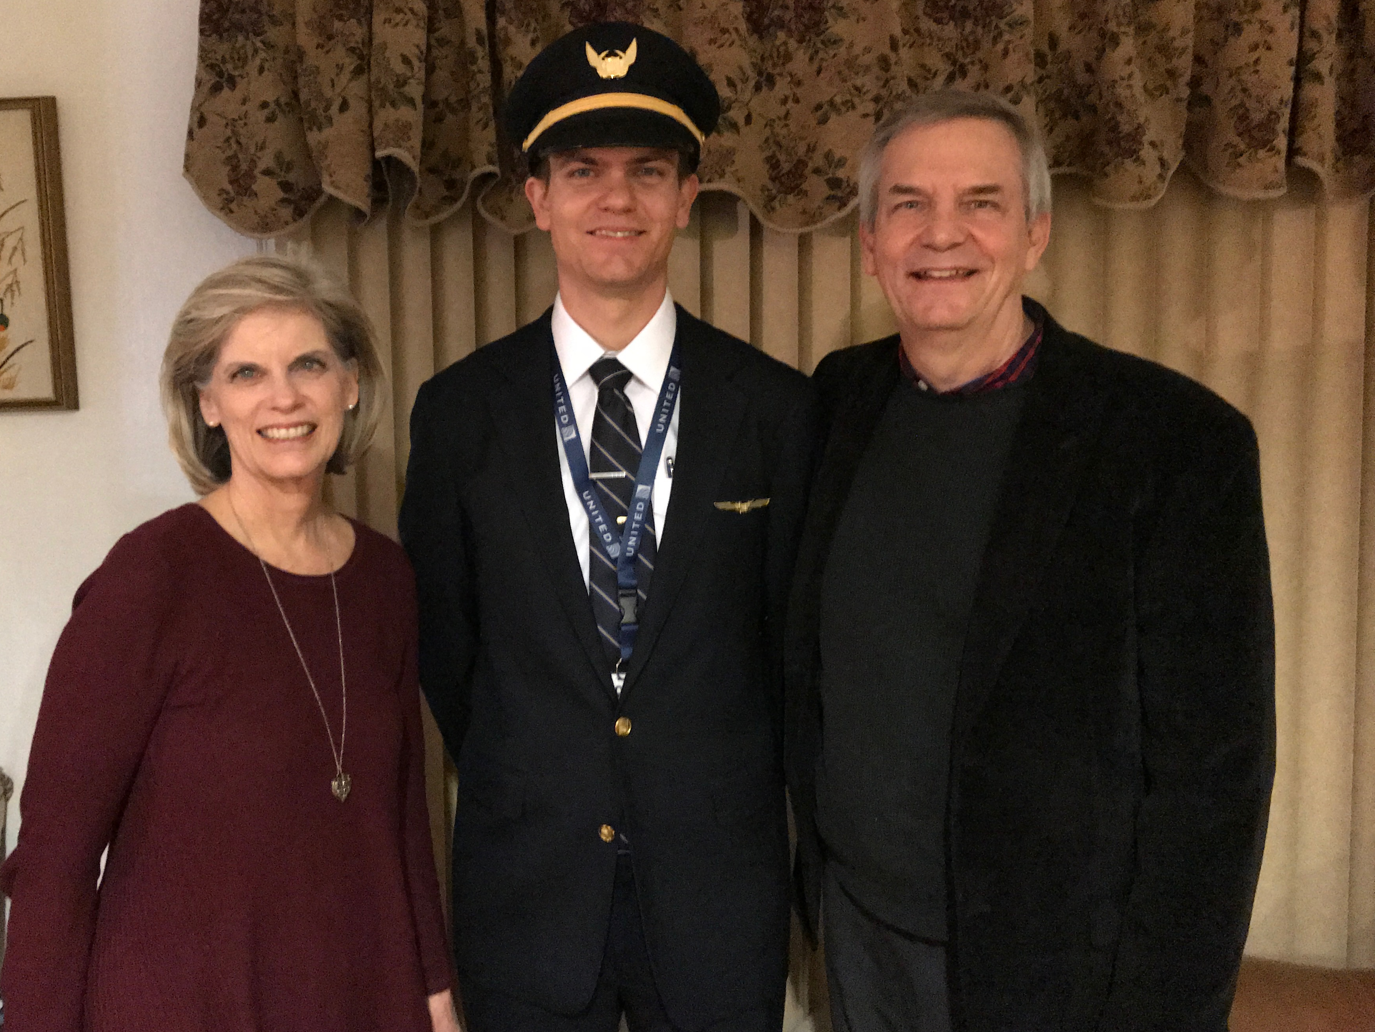

Stephen (35) trains United B777 pilots in Denver
6
Notes:
Stephen also takes an international trip monthly.
__________
Common-69

Slide 17
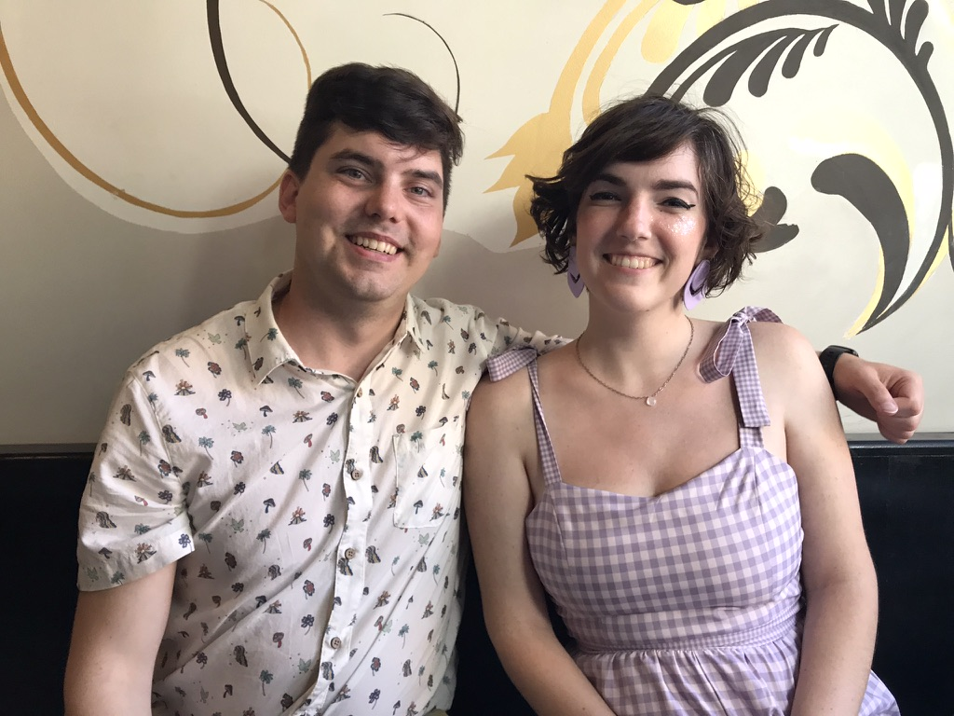
John (32) & Chloe in Pasadena, California
8
Notes:
John does graphics and Chloe does web design for digital software companies.
___________
Common-70

Slide 18
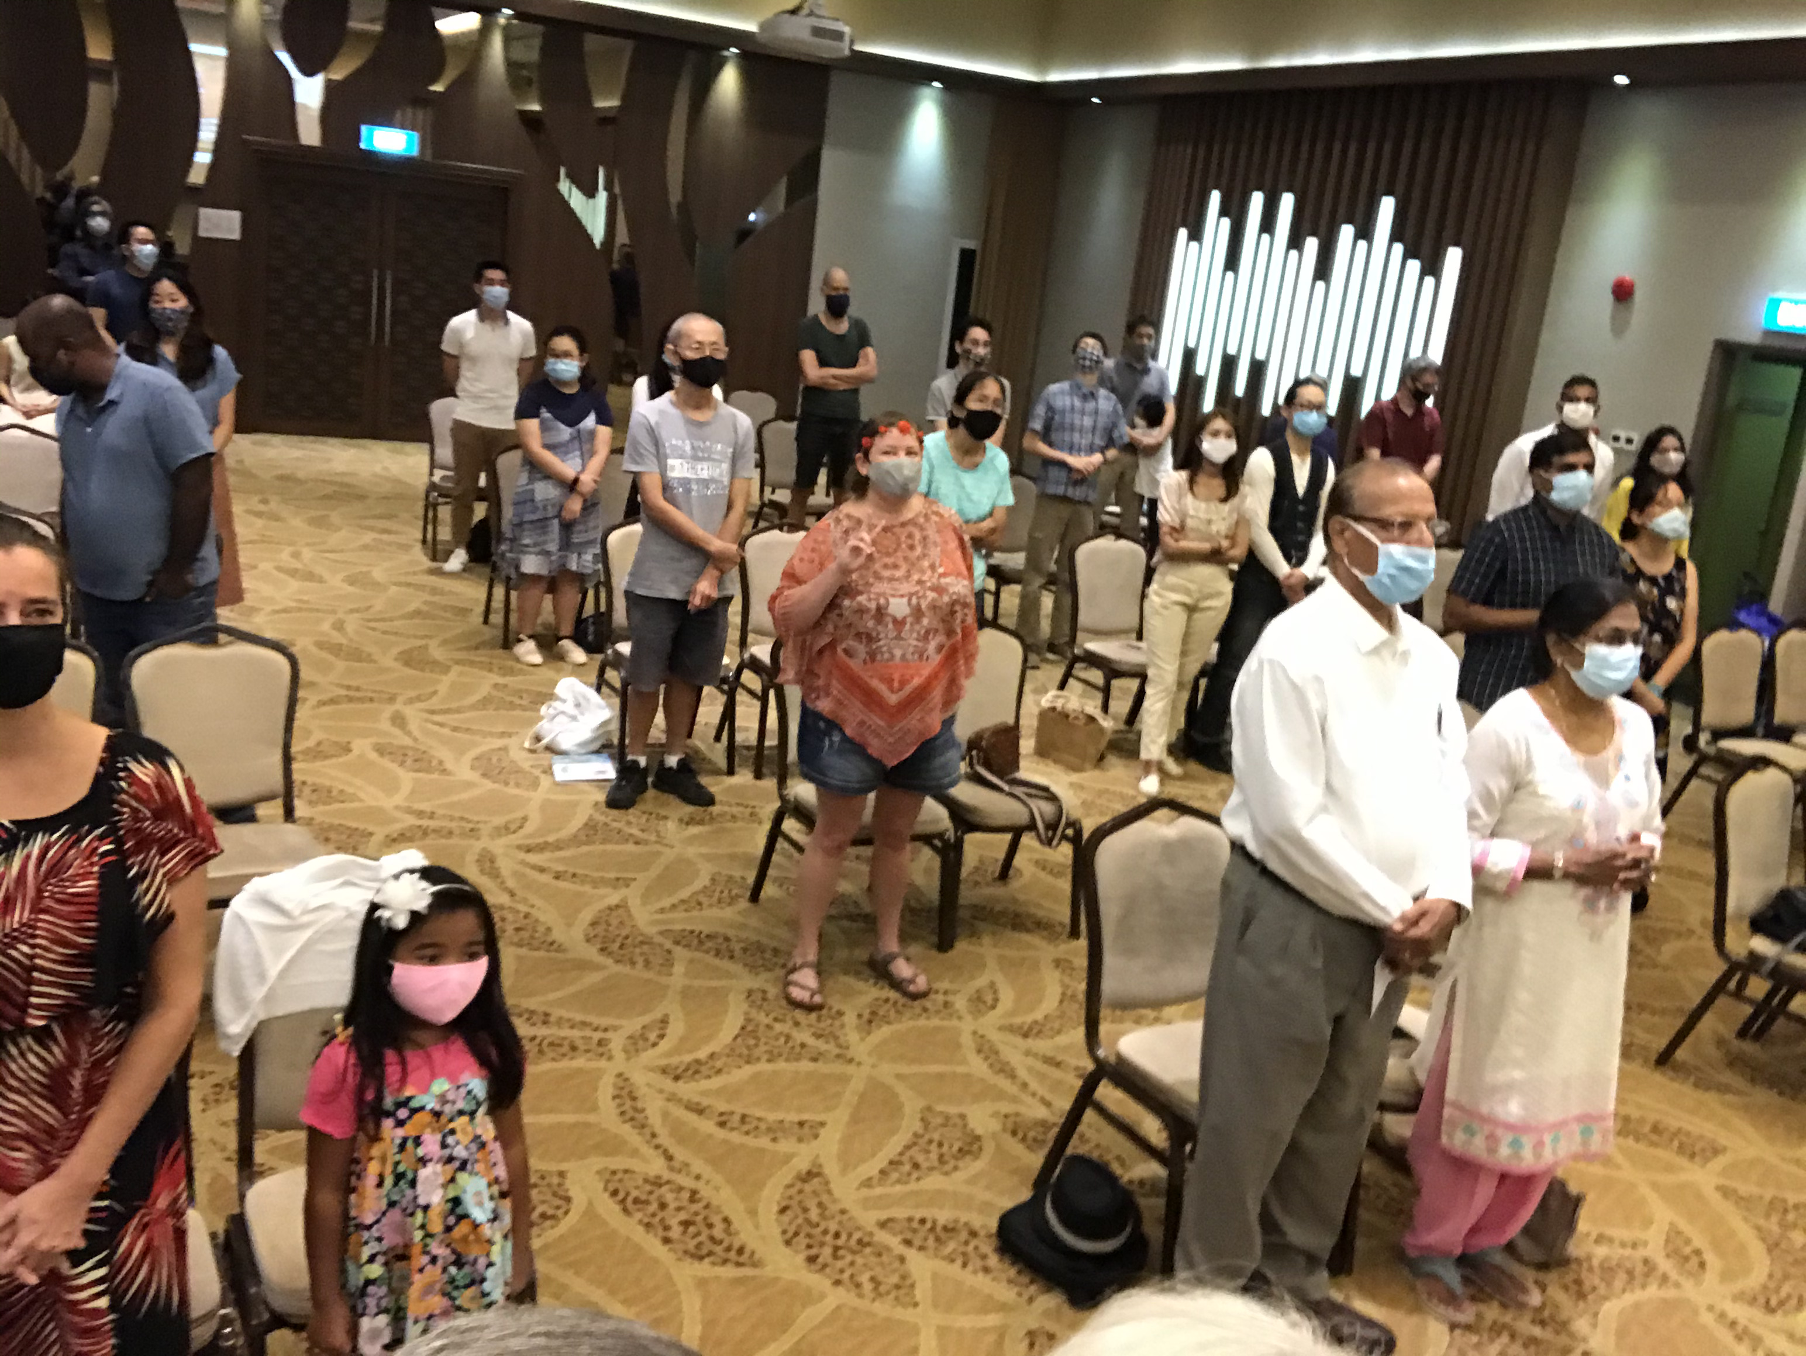
Our People
9
June 2021
90 people from 16 nations
Notes:
From 2006-2021, for 15 years we pastored this congregation in Singapore until we turned the church over to new leadership to move to the Middle East.
___________
Common-77

Slide 19
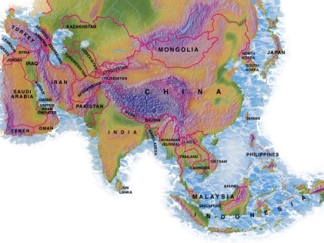

Crossroads People • June 2021
UK
UNITED KINGDOM
RUSSIA
NETHERLANDS
MONGOLIA
ITALY
FRANCE
KOREA
HONG KONG
LEBANON
EGYPT
JAPAN
CHINA
MYANMAR
GERMANY
TAIWAN
CANADA
INDIA
USA
THAILAND
ETHIOPIA
MALAYSIA
ZIMBABWE
SOUTH AFRICA
PHILIPPINES
SINGAPORE
INDONESIA
CIC
AUSTRALIA
NEW ZEALAND
KENYA
Notes:
We actually had about 20% Indian at CIC, thanks to St. Thomas, who overcame his initial reluctance to witness for Jesus in India.
Our June 2021 church of 90 people stem from 16 different countries around the world: Australia (David & Fiona), China (Jianji), Egypt (Tamara), France (Valentin), Korea (Grace Kim), India (Cynthia), Indonesia (Rena), Kenya (Jacqueline Ngare), Nepal (Joshua Limbu), Netherlands (Toes), Singapore (Albina), South Africa (Melody Hertenberger), Taiwan (Maple), Thailand (Mae), UK (James & Gabi), USA (Jim & Jacqui).
This does not include people who have recently attended only once:
Nor does it include missionaries living back in their countries but still are members of CIC: Maple (Taiwan), Budmaa (Mongolia)
Previous: Canada (Gloria Lee), Ethiopia (Lele), Malaysia (Aston, Naomi), Netherlands (Dies & Desiree), Philippines (Micah), South Africa (Melody),
_____________
Common-78

Slide 20
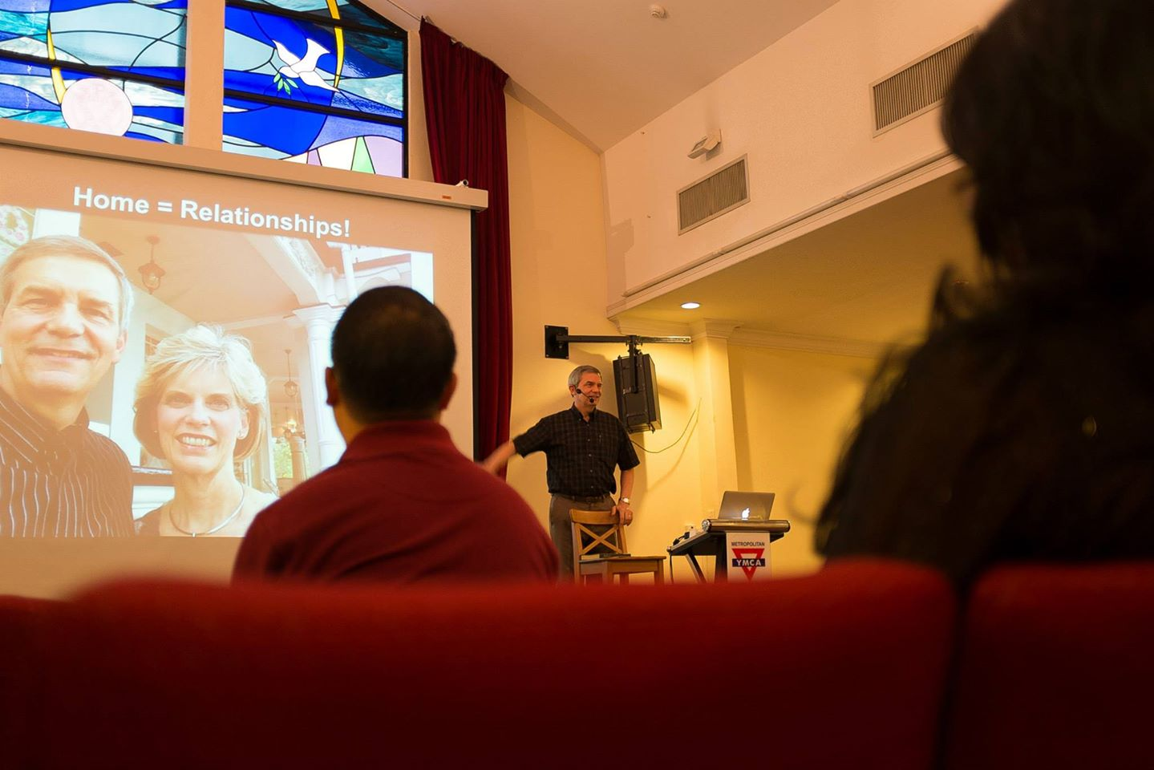
Our People
9
Preaching through Scripture
Notes:
RICK: Yes, we helped start Crossroads International Church in 2006 and I serve as the pastor-teacher.

Slide 21
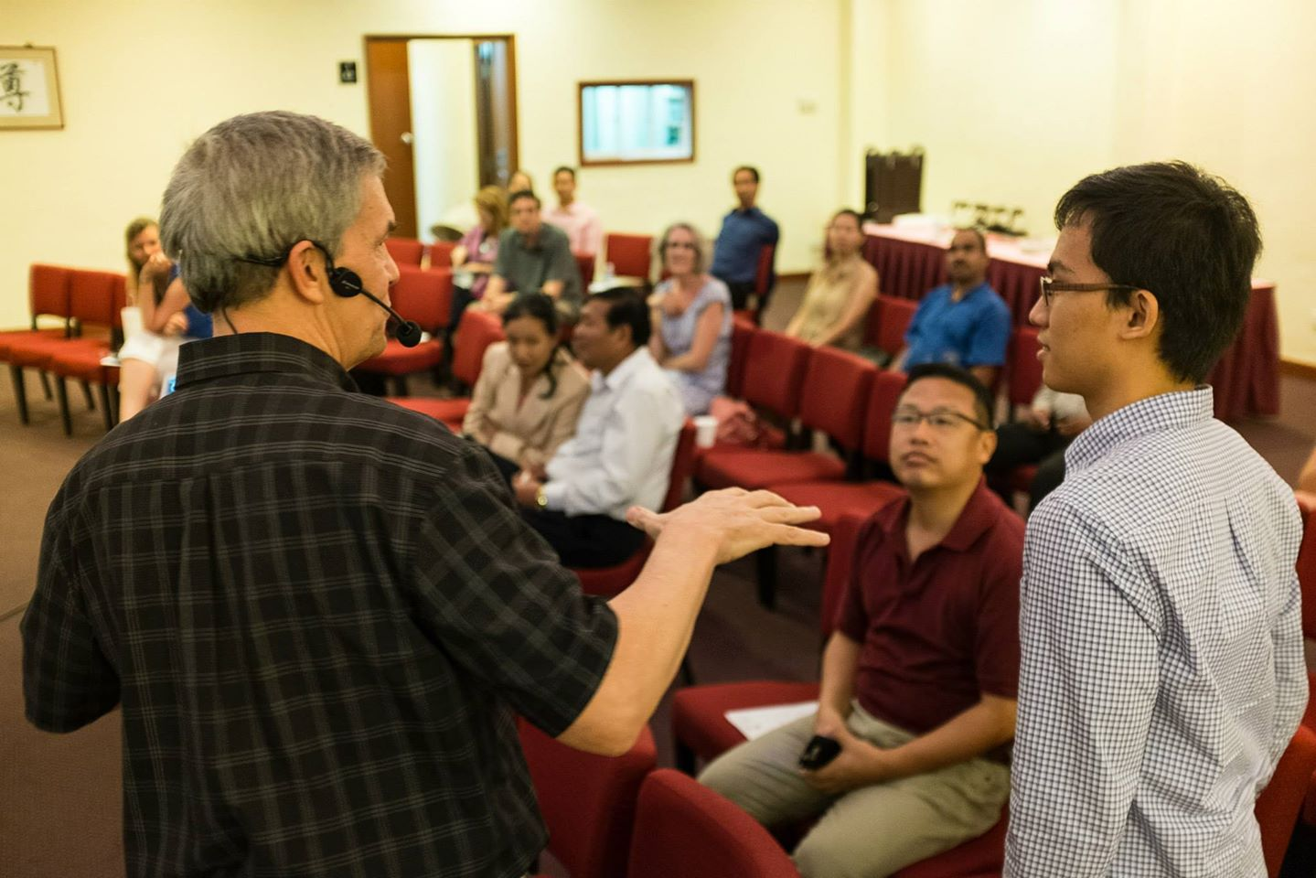
Our People
9
SBC students serve at church
Notes:
We also helped start Crossroads International Church in 2006 where I served as the pastor-teacher.

Slide 22
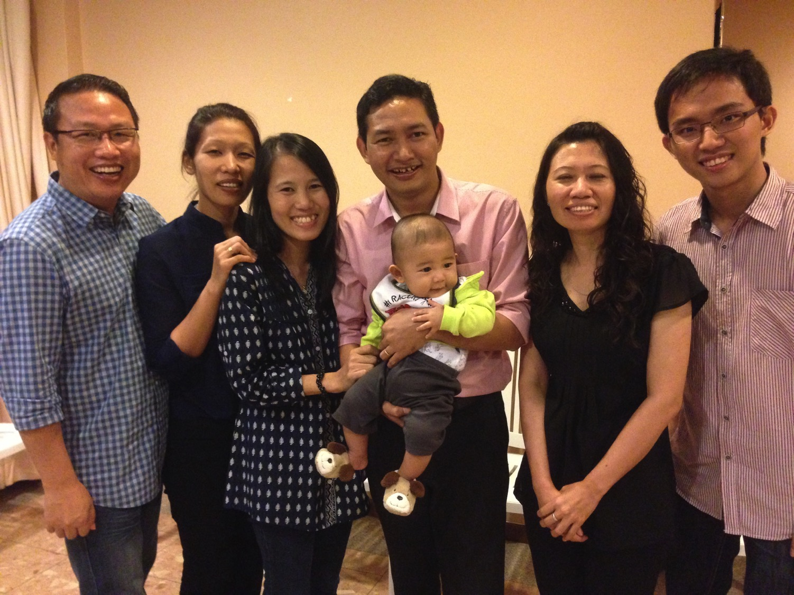
Our People
9
SBC students serve at church
Notes:
One special joy is mentoring my students who serve with us at church and led ministries to youth, children, home groups, and the worship team.

Slide 23
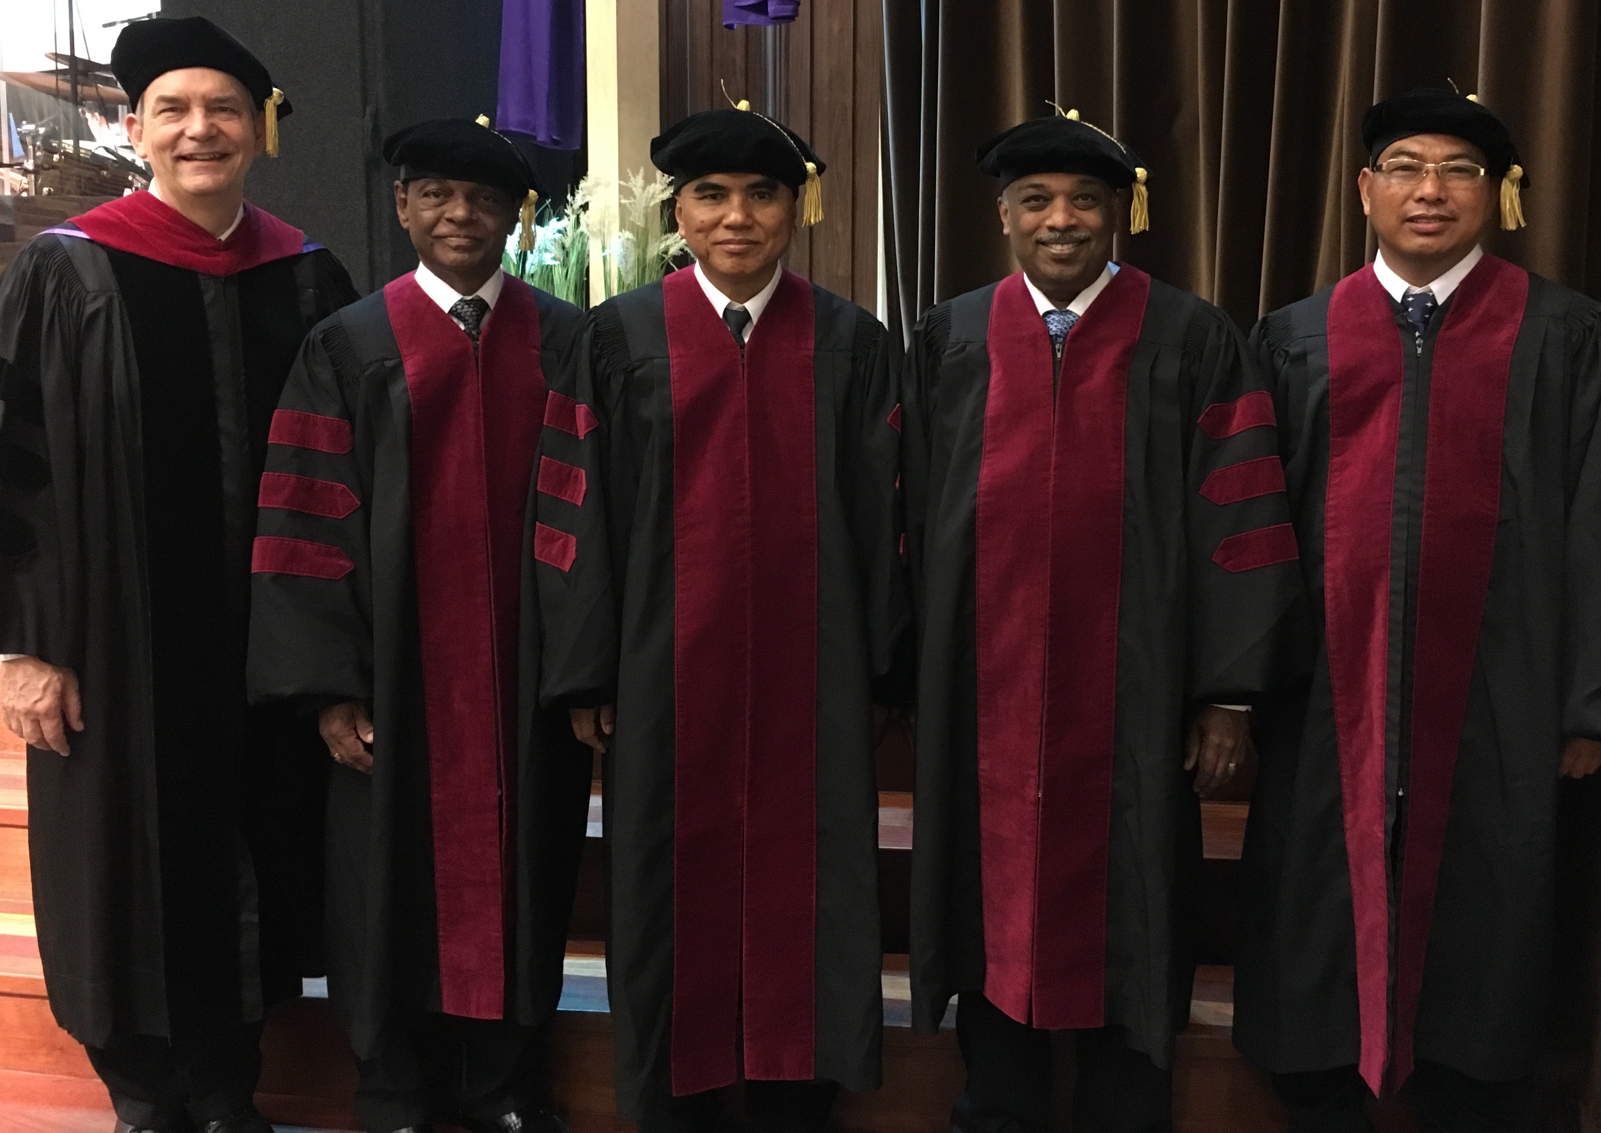
I directed the SBC Doctor of Ministry studies (DMin) from 2012-2021
Notes:
SBC trains about 50 seminary professors and pastors throughout Asia in English and Chinese. Generally each year about 5 of them received their Doctor of Ministry degree.

Slide 24
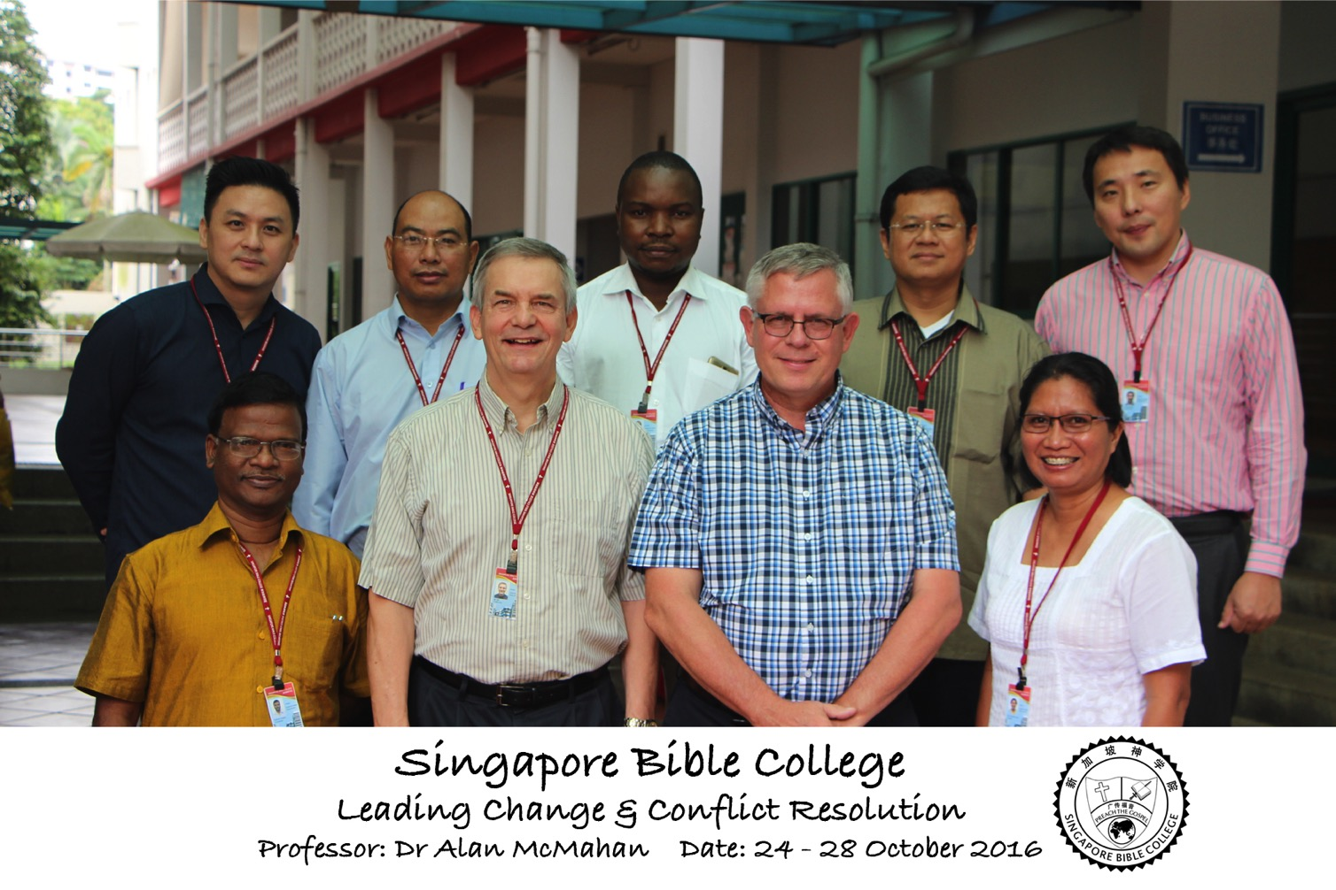
Leading Change & Conflict Resolution
(Dr. Alan McMahan Oct 2016)

Slide 25
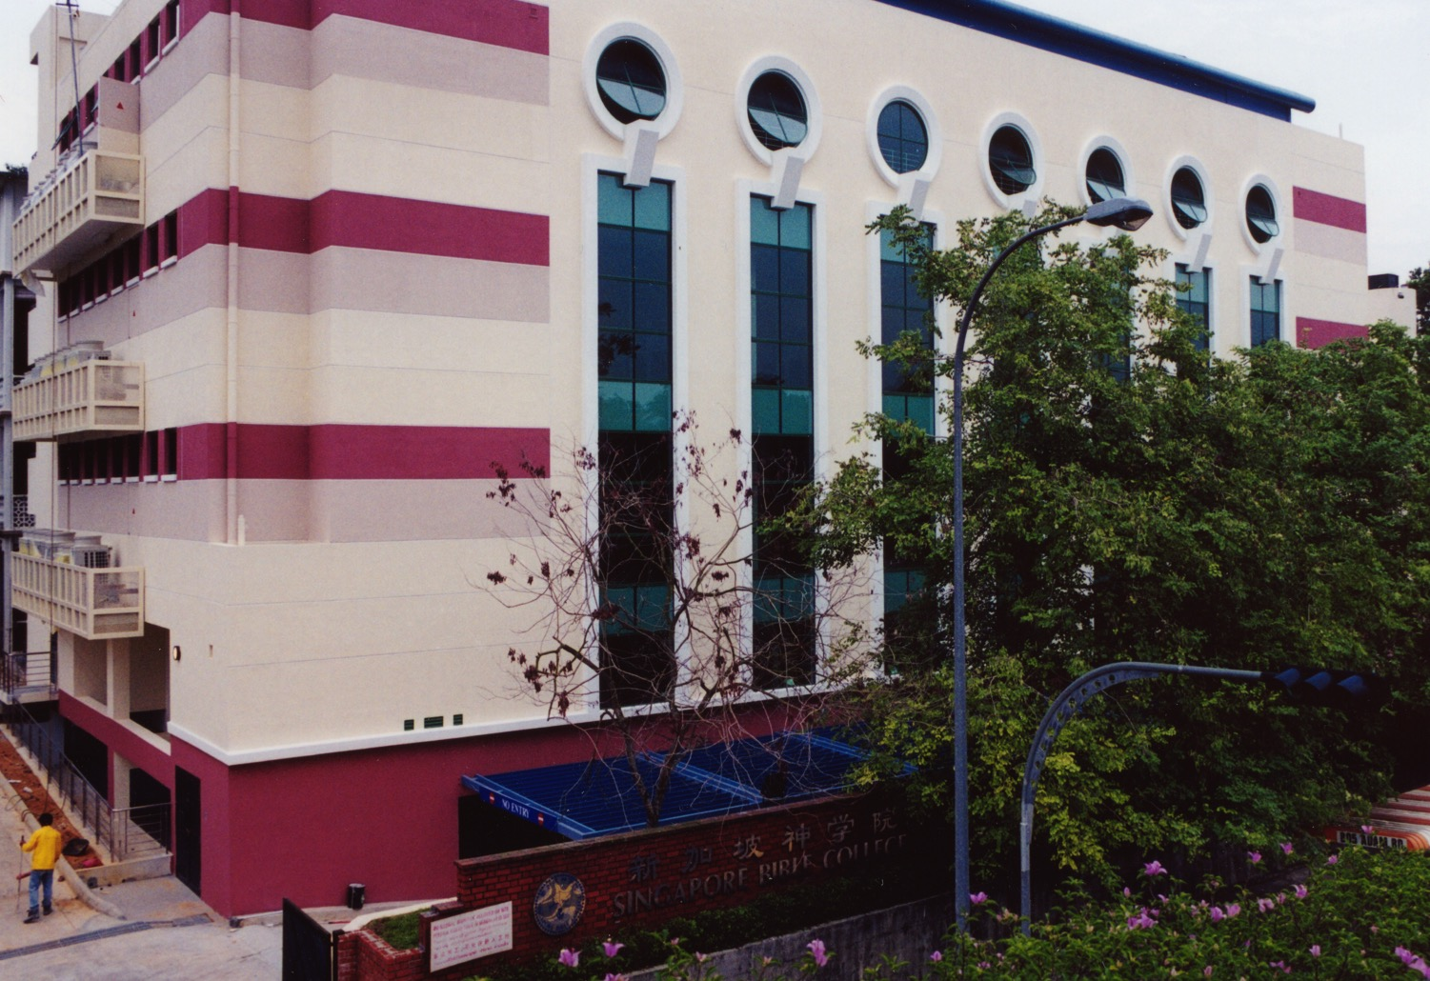
SINGAPORE BIBLE COLLEGE
9
Notes:
I've served as a seminary professor with 30 other faculty at Singapore's largest training school: Singapore Bible College

Slide 26

Singapore Bible College Students
USA
MONGOLIA
JAPAN
KOREA
CHINA
HONG KONG
MYANMAR
INDIA
THAILAND
VIETNAM
PHILIPPINES
MALAYSIA
SINGAPORE
SBC
INDONESIA
Notes:
These faithful leaders are from about 25 countries who come to us in Singapore for masters and doctoral-level training. We train them to build into others back in their home countries.

Slide 27
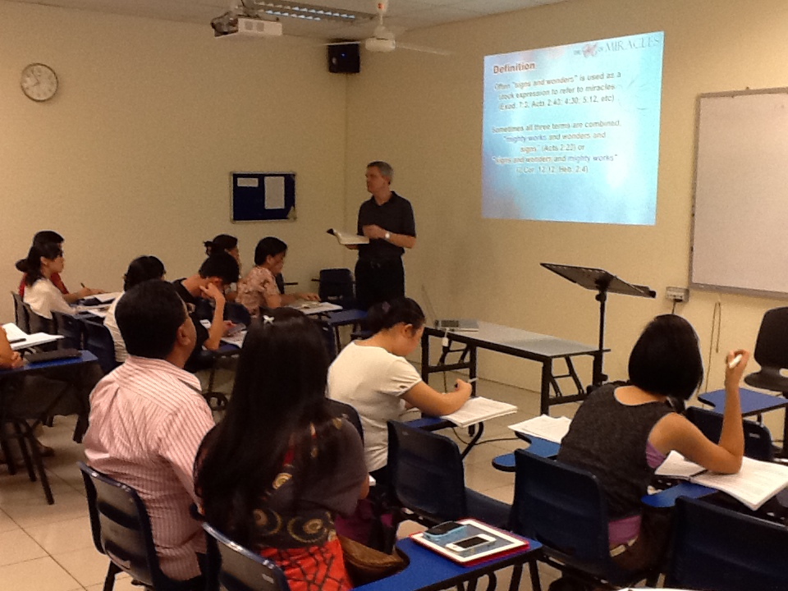
Singapore Bible College Students
9
Notes:
Most of these students are first-generation Christians eager to share the gospel with their own people!

Slide 28

Our Singapore Bible College Apt.
9
Notes:
Our Wednesday pattern to set up the table for our Pastoral Care Group that comes up to our apartment on campus.

Slide 29
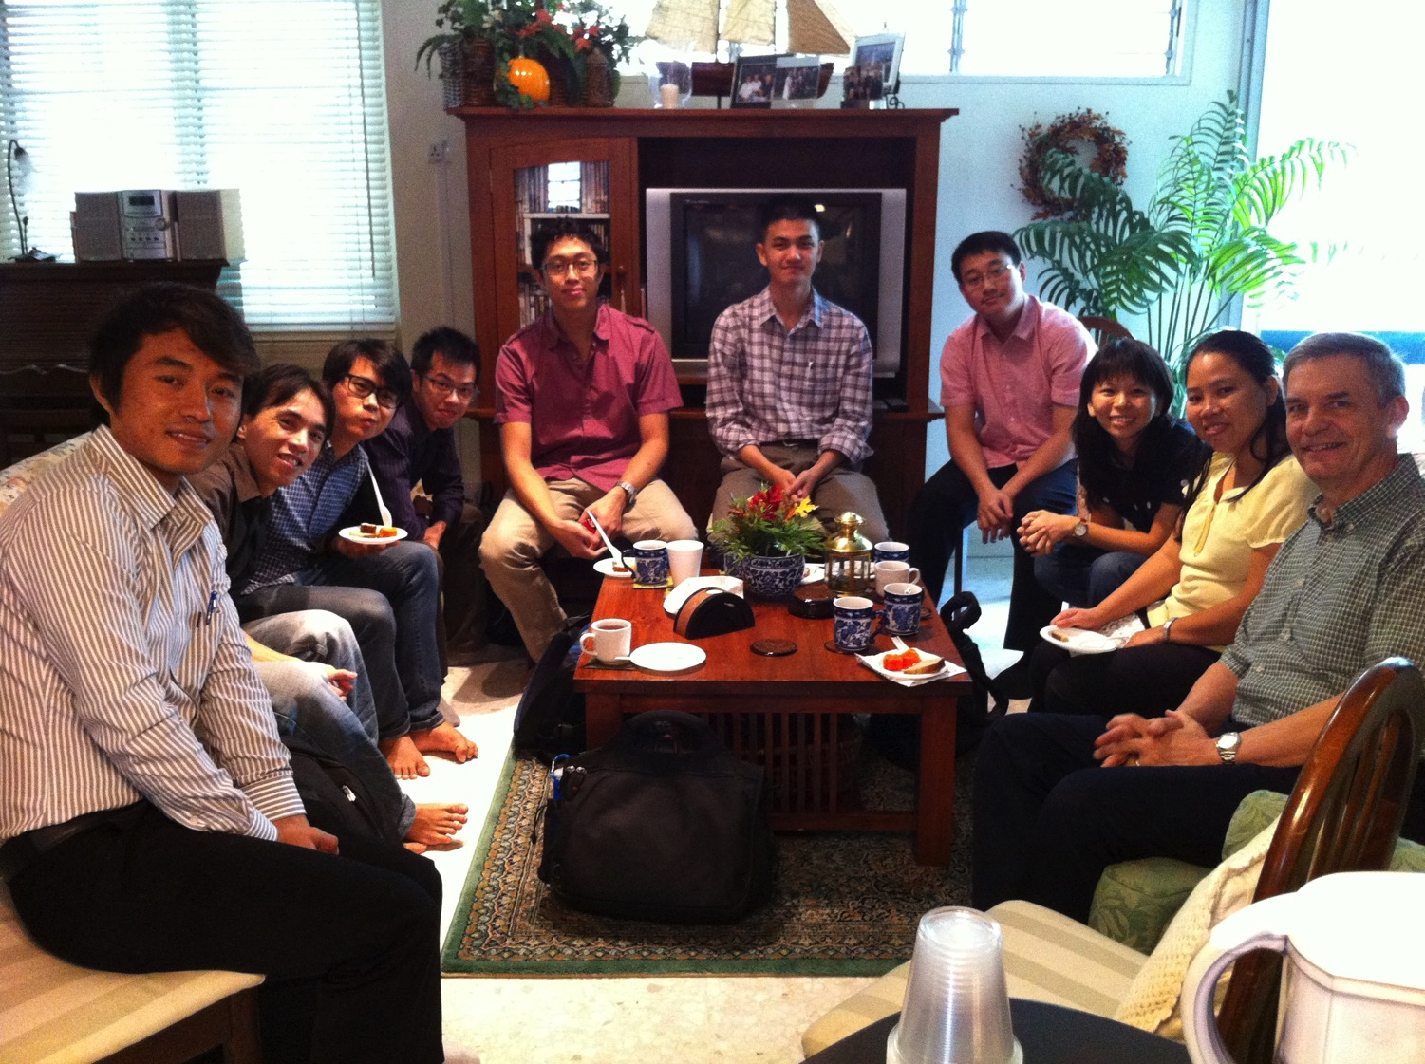
SBC Pastoral Care Group
9
Notes:
Our Pastoral Care Group has 9 students from Myanmar, Vietnam, Singapore, and Hong Kong.

Slide 30
Courses Taught Since 1991
(English • Indonesian • Chinese)
Survey • The Bible…Basically
OT NT Bible Study
Backgrounds • Research & Writing
OT NT Geography
Theology • Creation • Jesus
Church • Spirit • Salvation • Future
Preaching
Homiletics 1 Homiletics 2
Notes:
I get to teach these leaders every book of the Bible in survey courses, plus backgrounds to both the OT and NT, three areas of theology, and how to preach.

Slide 31

Our Mission Organization…

Slide 32
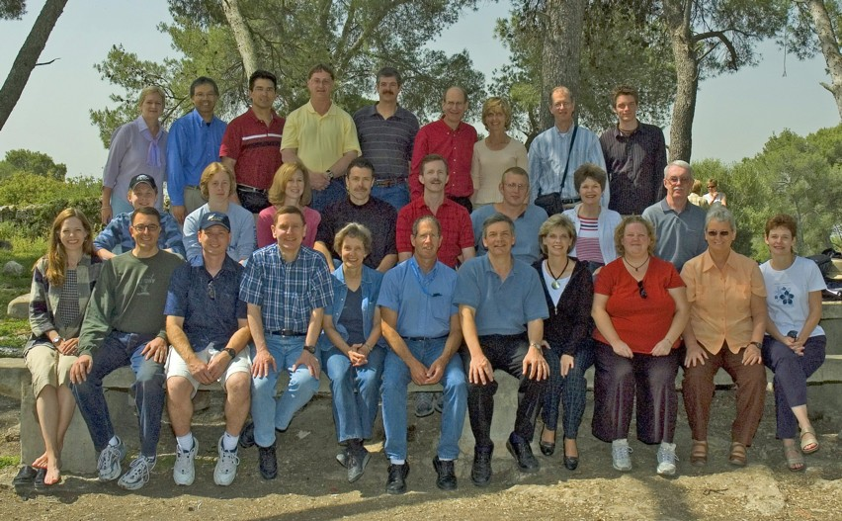
WorldVenture Seminary Professors in Israel

Slide 33
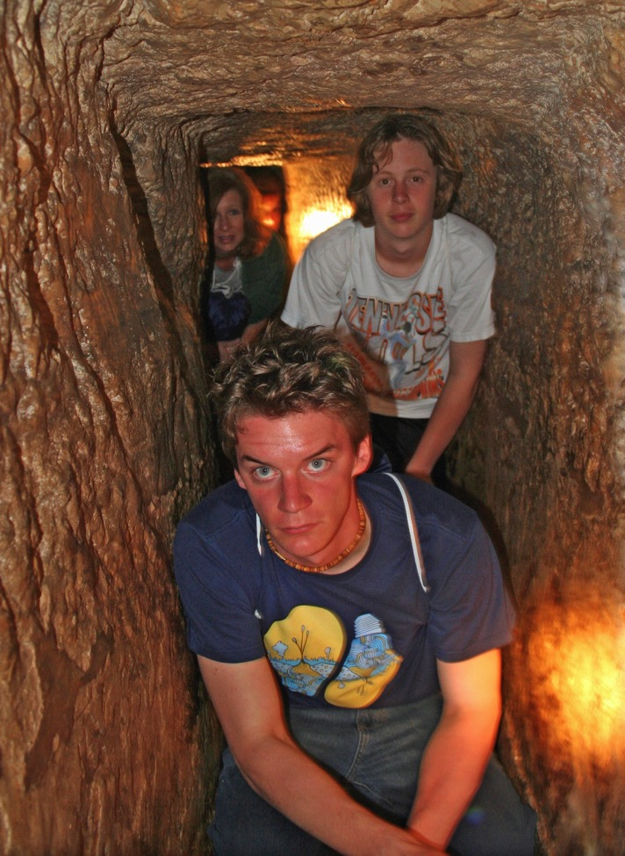
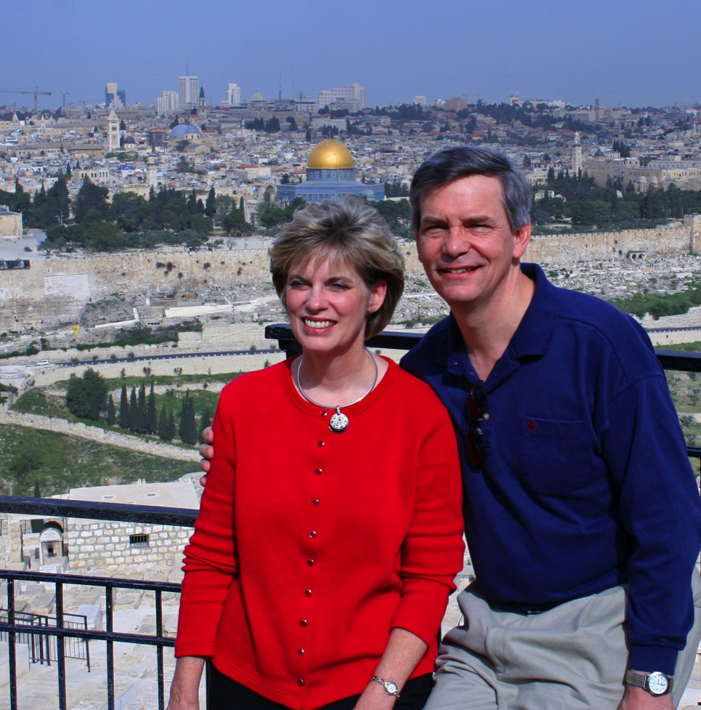
Susan & Rick at Mount of Olives
Kurt in
Hezekiah's Tunnel

Slide 34
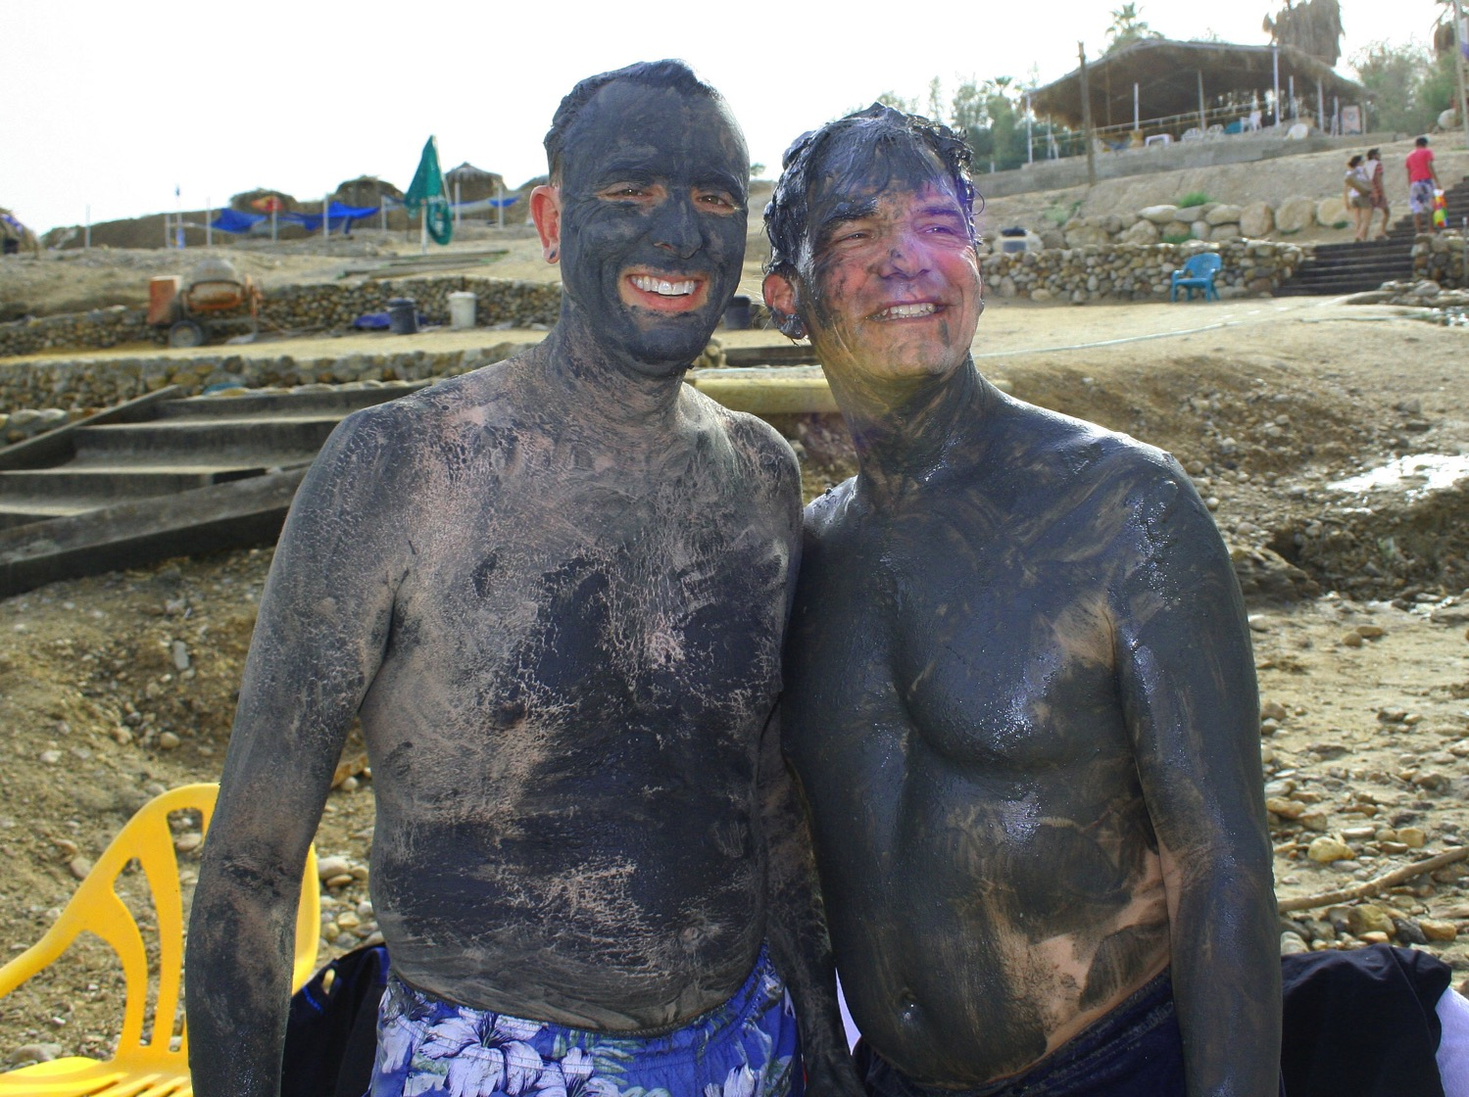
Dead Sea Mud

Slide 35
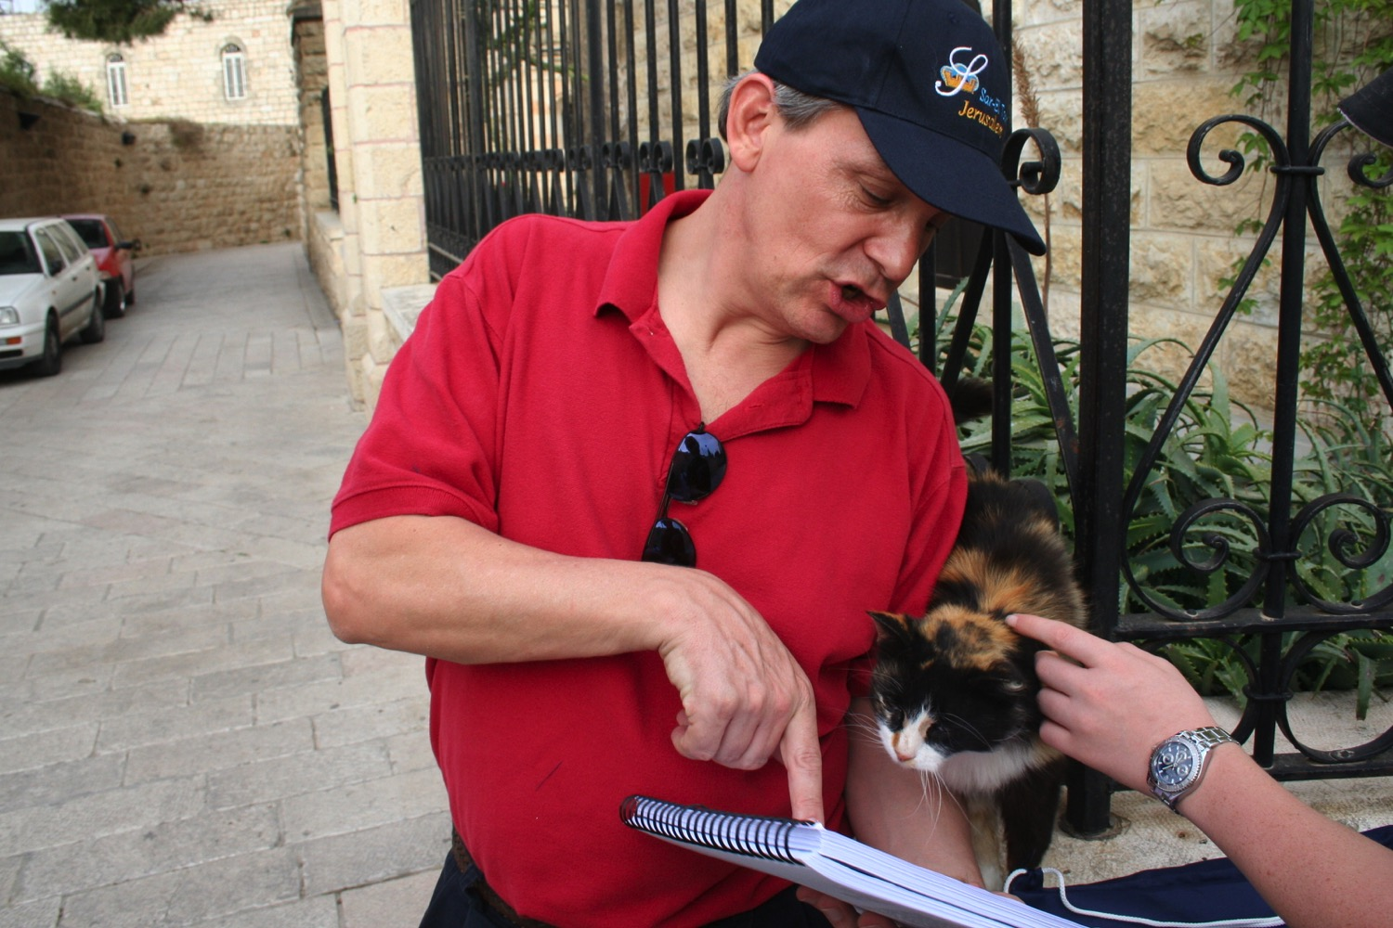
"Preach to every creature" (Mark 16:15)

Slide 36
Ministries God Gave Us
WorldVenture Singapore field leader
Singapore Bible College professor
Biblical Education by Extension teacher

Slide 37

Assignment File System

Slide 38
LC Sign Up List
Name | HP | Email | Reading |  | Project & Language
 |  |  | A: IBS | B: Book | 1: NTS | 2: TBB | 3: Teach | 4: Paper
X | X | X | X
X | X | X |  | X | X
X | X | X |  | X |  | X
X | X | X |  | X |  |  | X
X | X | X |  | X |  |  |  | X
Name | Email | Degree | Project

Slide 39


NT Survey link at BibleStudyDownloads.org
Get this presentation for free!
Notes:
Student translation since 2003 with 700 translators has resulted in Bible teaching and study materials—mostly PowerPoint—in 49 languages! All a teacher needs to do is to click on a file and it downloads for free to teach any book of the Bible and many other subjects.
NT Survey (ns)

Slide 40
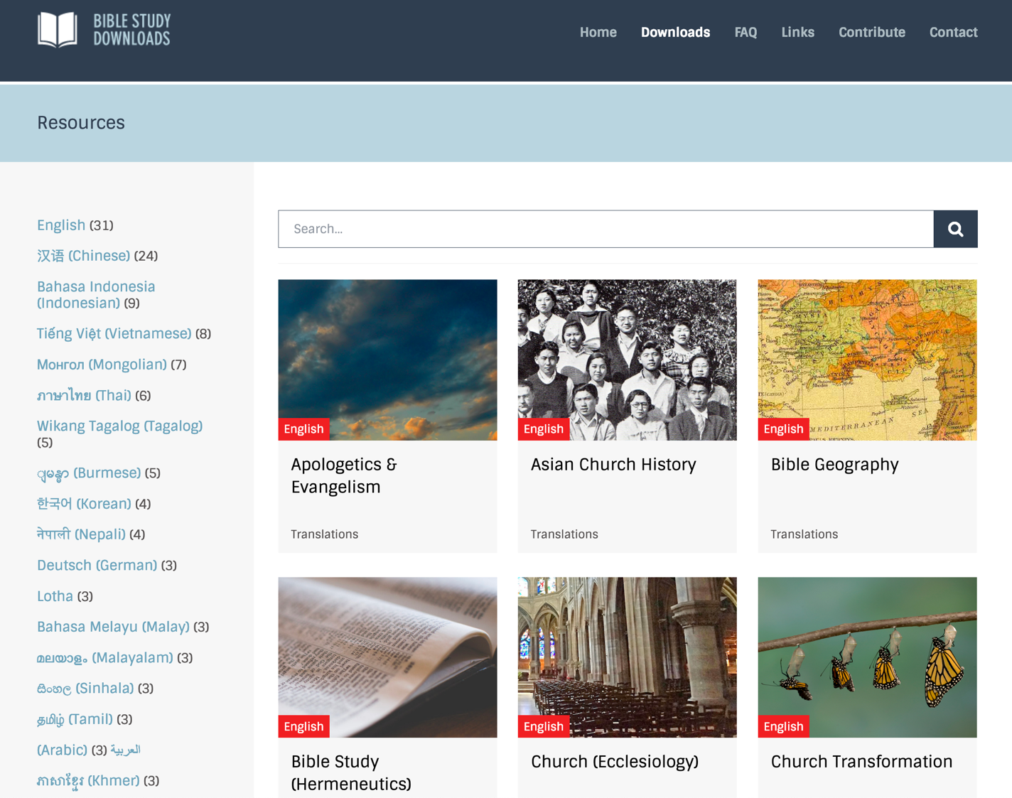
BibleStudyDownloads.org
7
Notes:
My SBC teaching has resulted in Bible teaching and study materials—mostly PowerPoint—in 49 languages! All a teacher needs to do is to click on a file and it downloads for free to teach any book of the Bible and many other subjects.

Slide 41
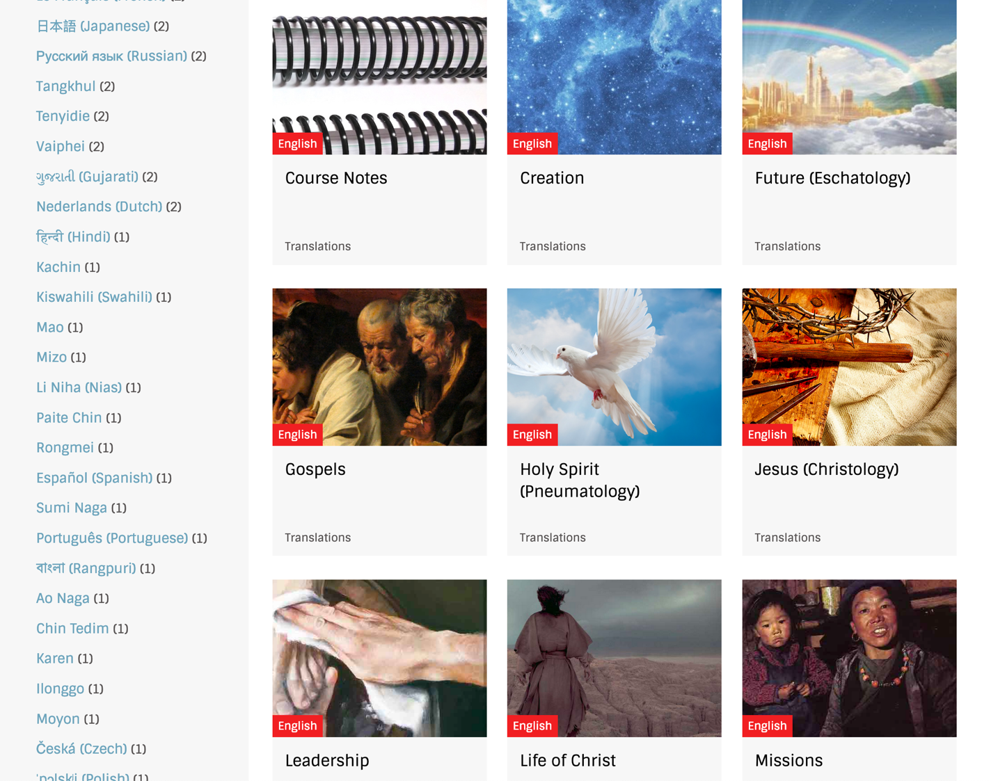
BibleStudyDownloads.org
7
Notes:
My SBC teaching has resulted in Bible teaching and study materials—mostly PowerPoint—in 49 languages! All a teacher needs to do is to click on a file and it downloads for free to teach any book of the Bible and many other subjects.

Slide 42
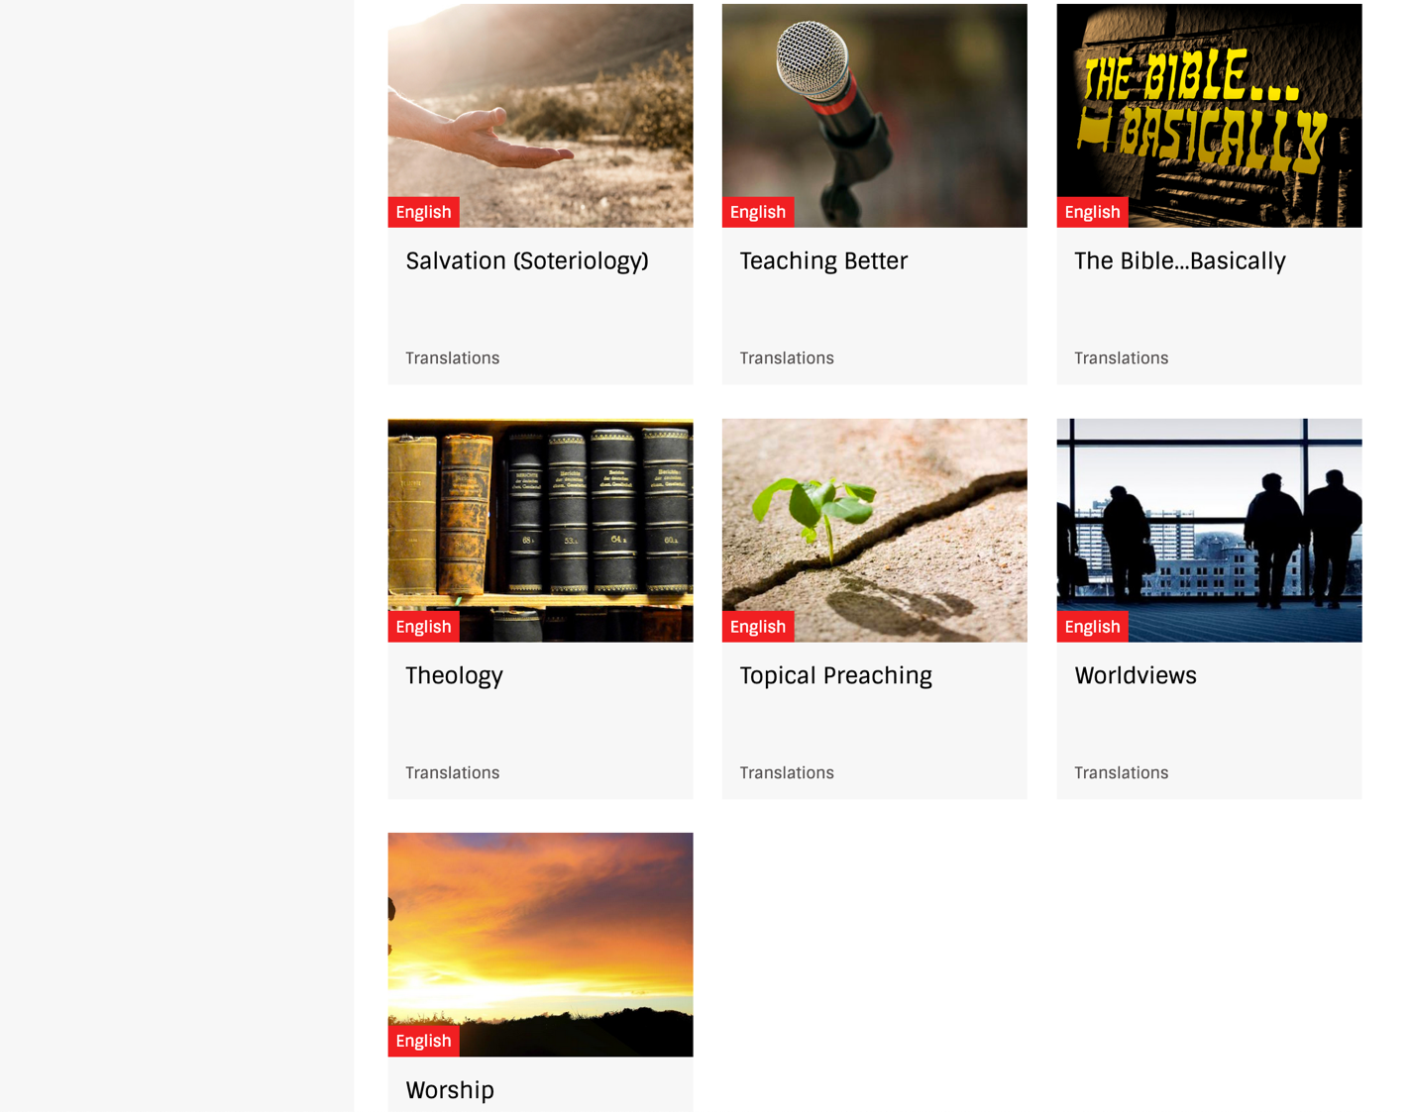
BibleStudyDownloads.org
7
Notes:
My SBC teaching has resulted in Bible teaching and study materials—mostly PowerPoint—in 49 languages! All a teacher needs to do is to click on a file and it downloads for free to teach any book of the Bible and many other subjects.

Slide 43
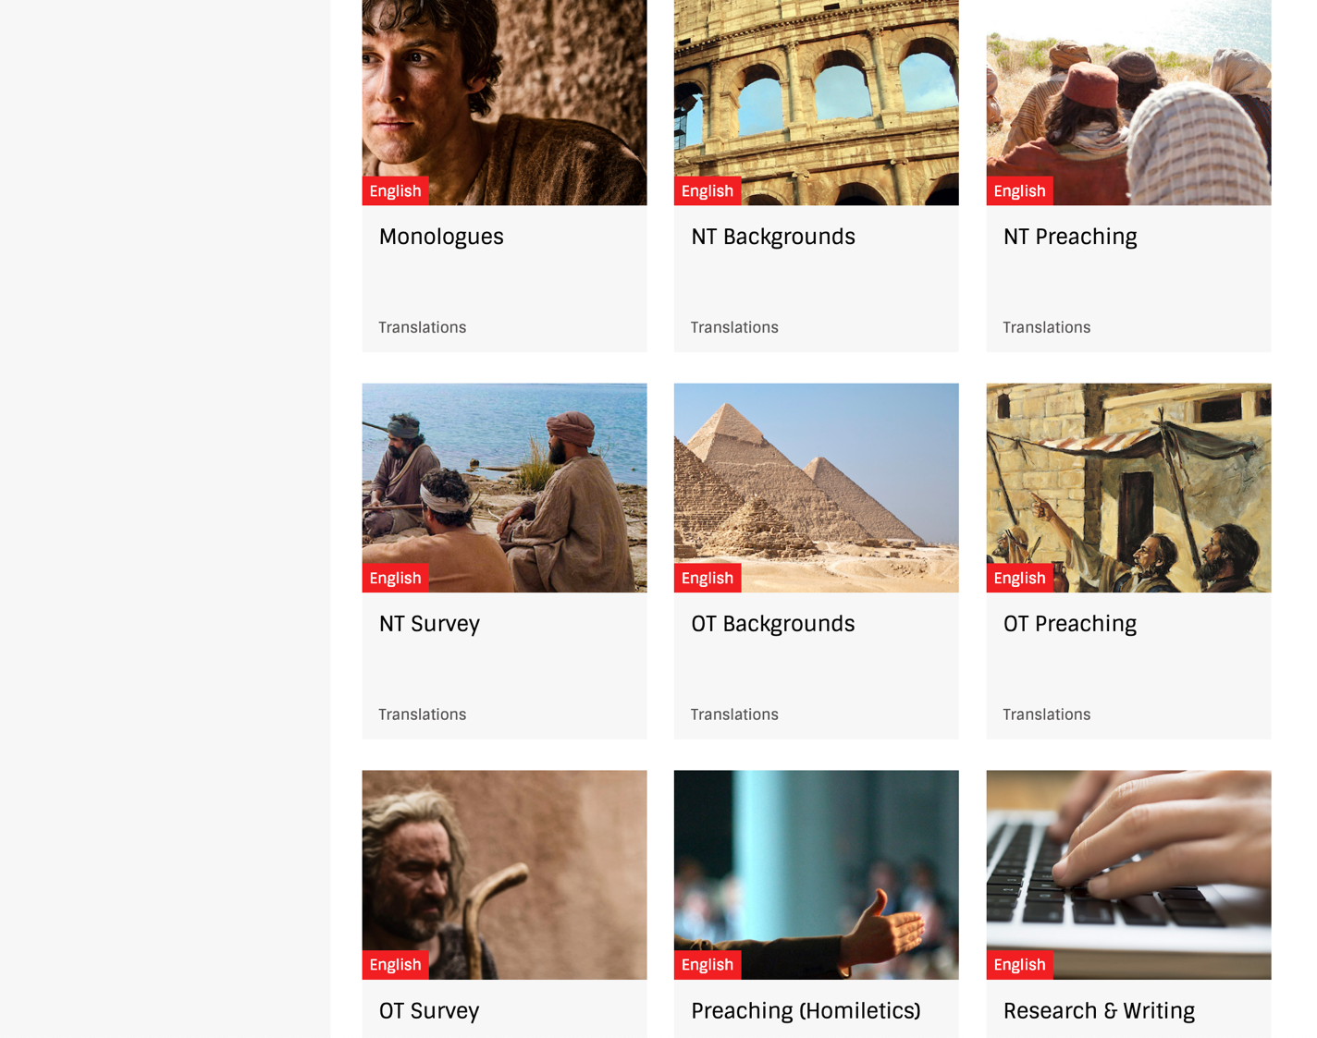
BibleStudyDownloads.org
7
Notes:
My SBC teaching has resulted in Bible teaching and study materials—mostly PowerPoint—in 49 languages! All a teacher needs to do is to click on a file and it downloads for free to teach any book of the Bible and many other subjects.

Slide 44
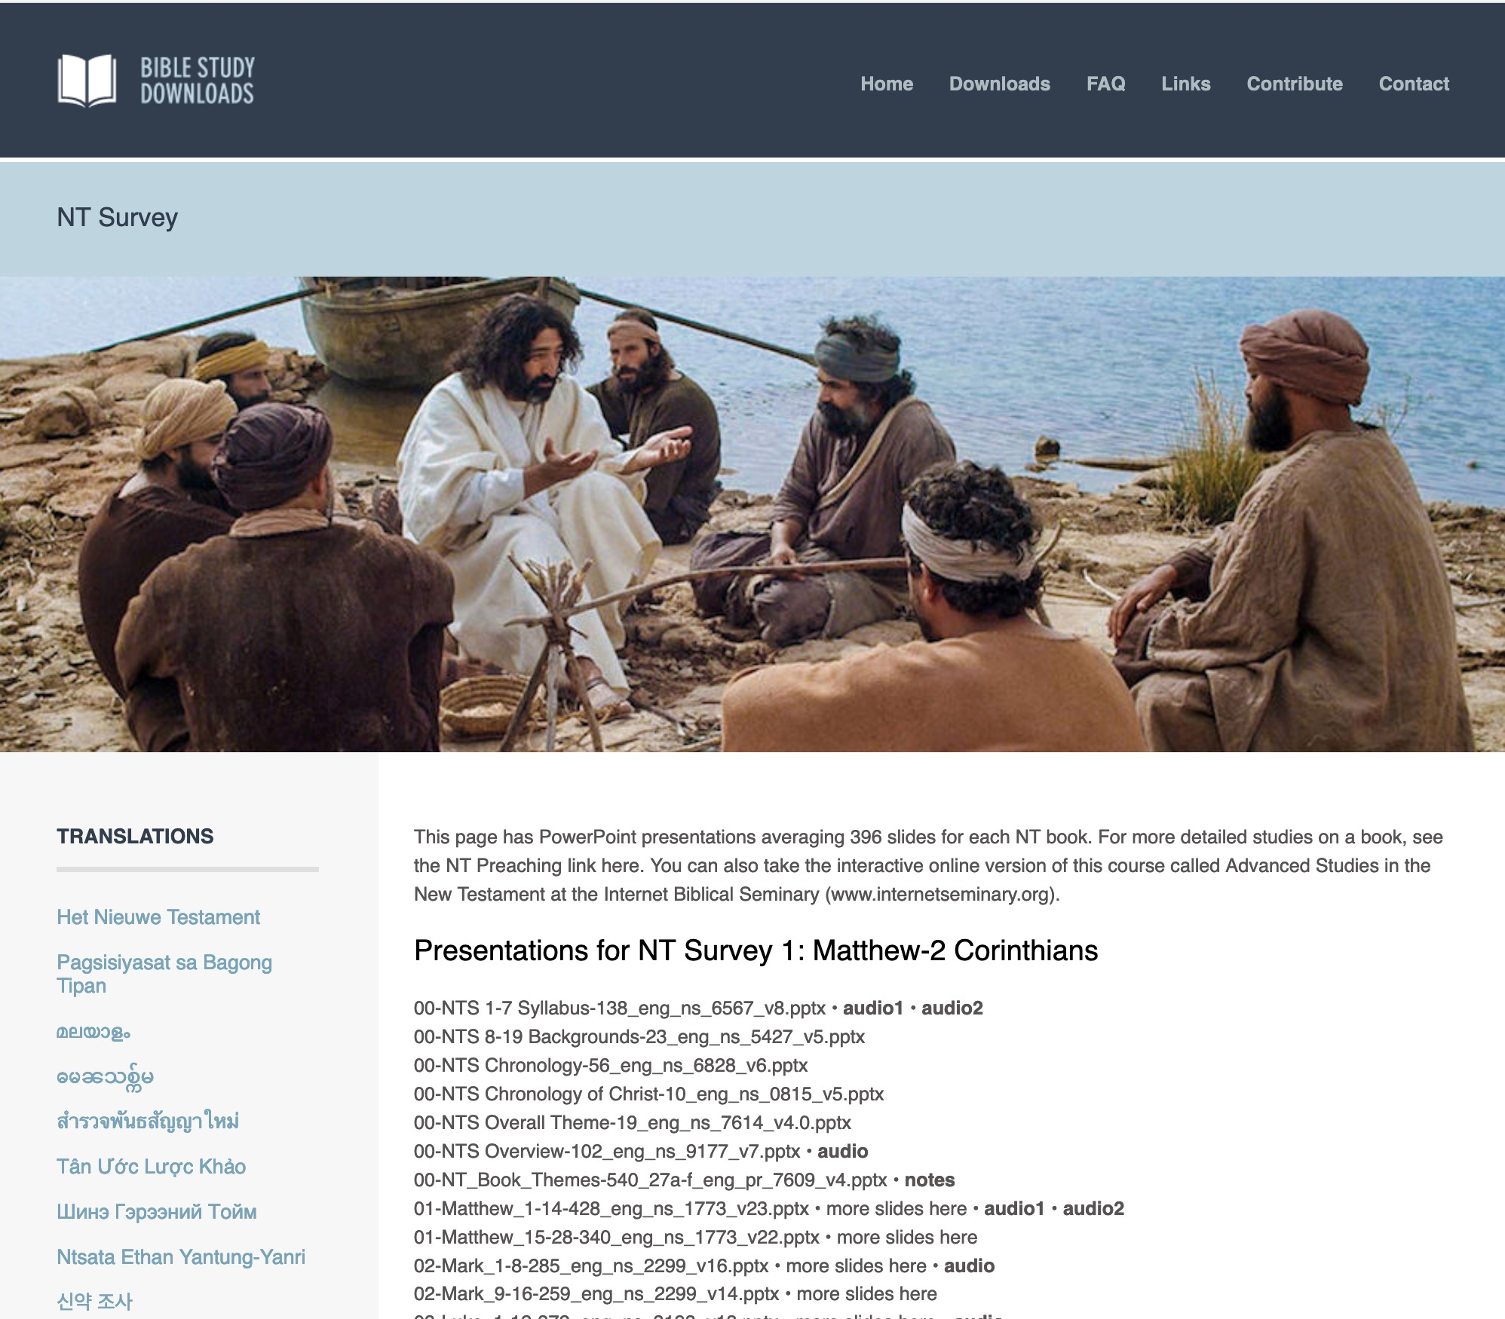
BibleStudyDownloads.org
7
English
Notes:
My SBC teaching has resulted in Bible teaching and study materials—mostly PowerPoint—in 49 languages! All a teacher needs to do is to click on a file and it downloads for free to teach any book of the Bible and many other subjects.

Slide 45
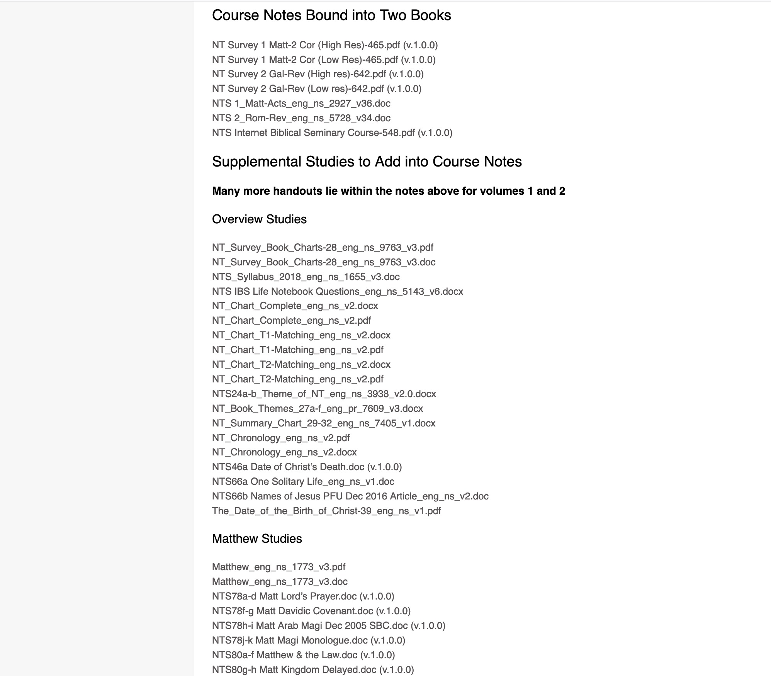
BibleStudyDownloads.org
7
NT Survey
Class Notes
Notes:
My SBC teaching has resulted in Bible teaching and study materials—mostly PowerPoint—in 49 languages! All a teacher needs to do is to click on a file and it downloads for free to teach any book of the Bible and many other subjects.

Slide 46
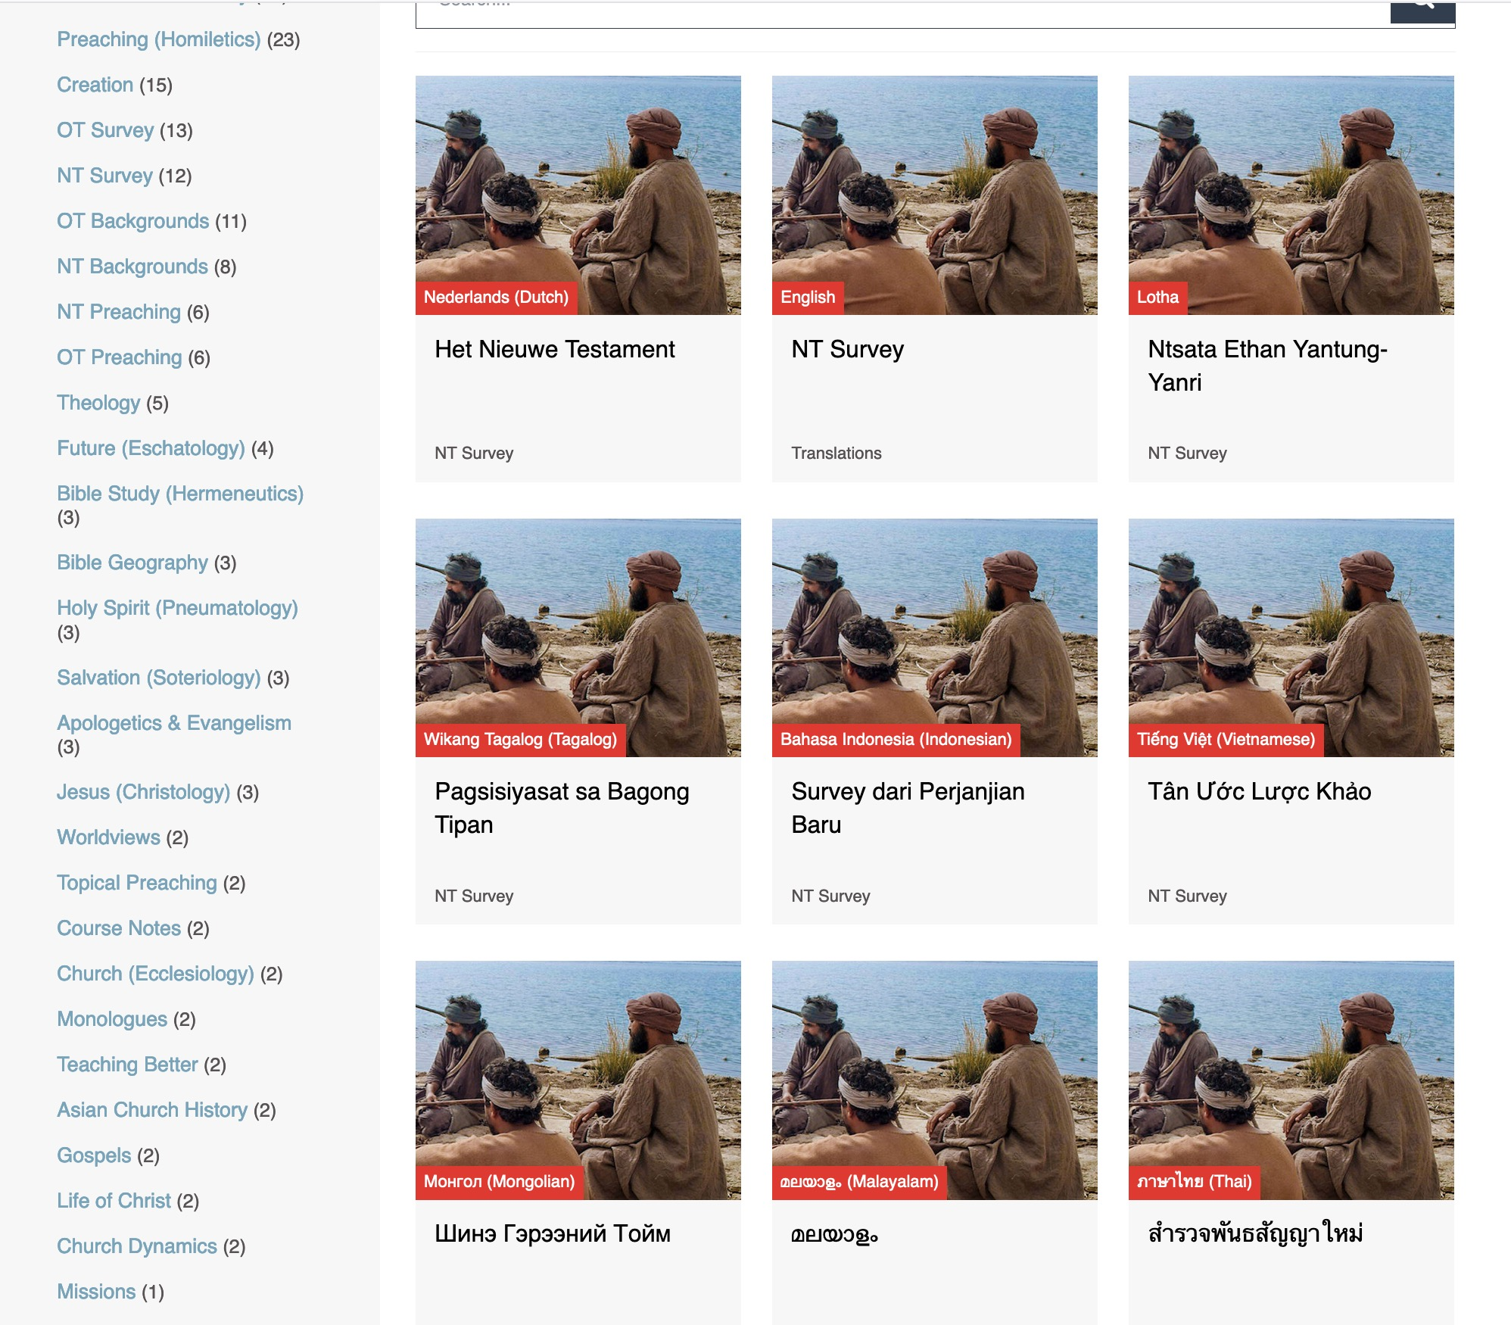
BibleStudyDownloads.org
7
Translations
Notes:
Here are 9 languages featured.

Slide 47
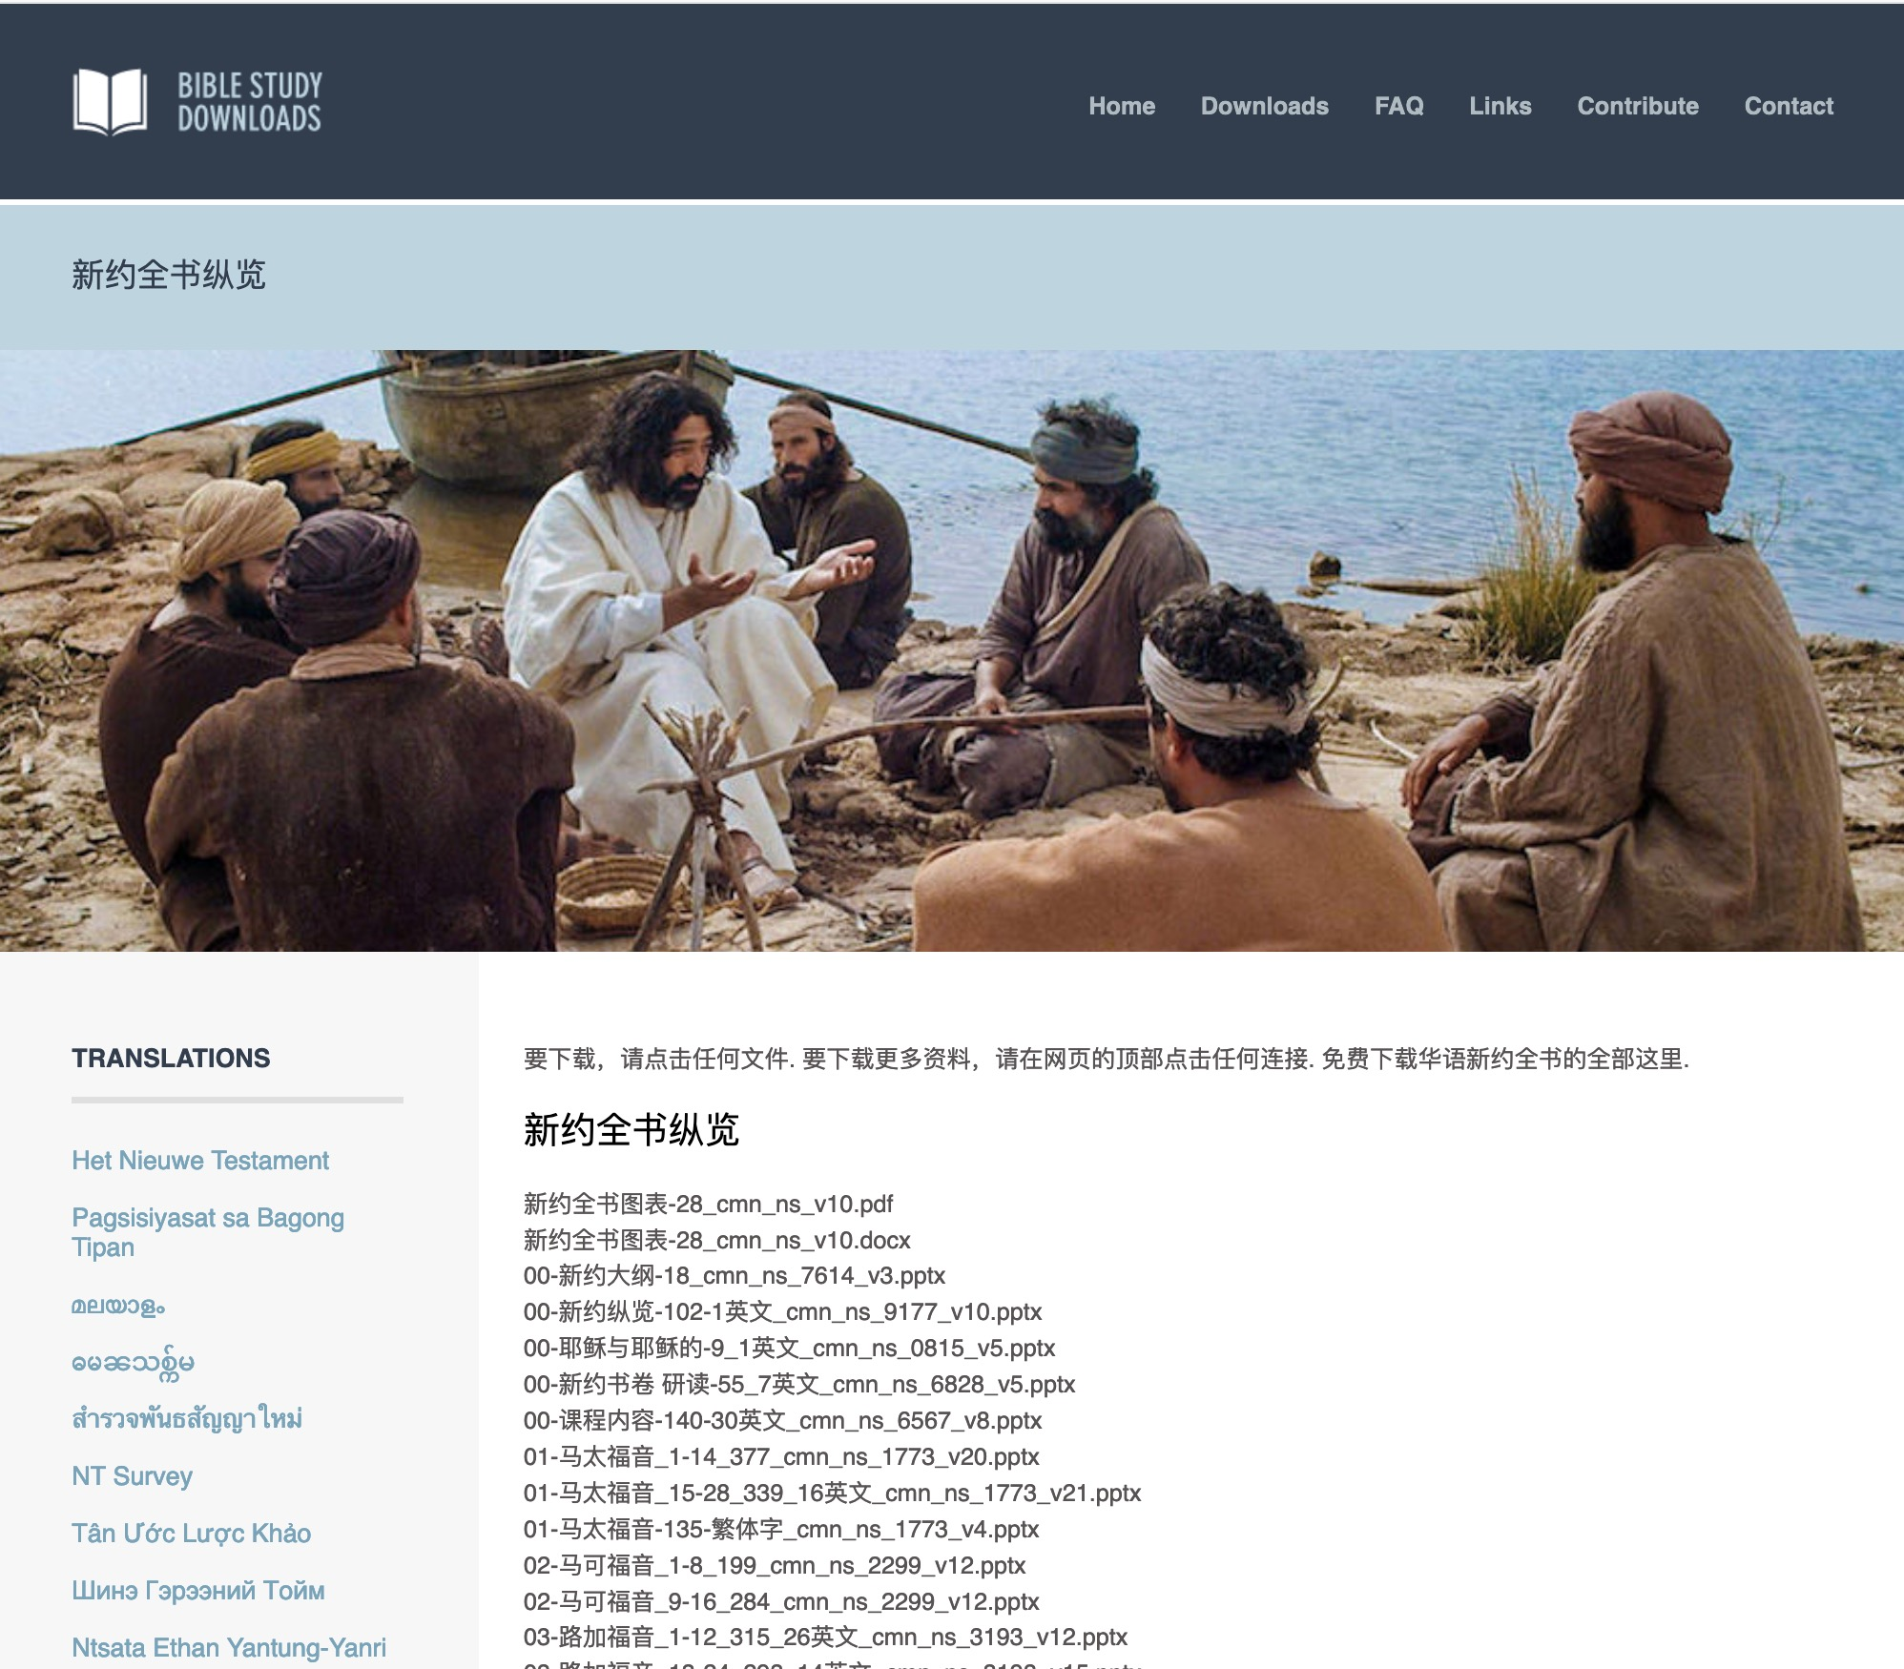
Chinese
7
01-马太福音_1-14_377_cmn_ns_1773_v20.pptx
Notes:
Chinese downloads include more than 37,000 slides as of Jan 2020.

Slide 48
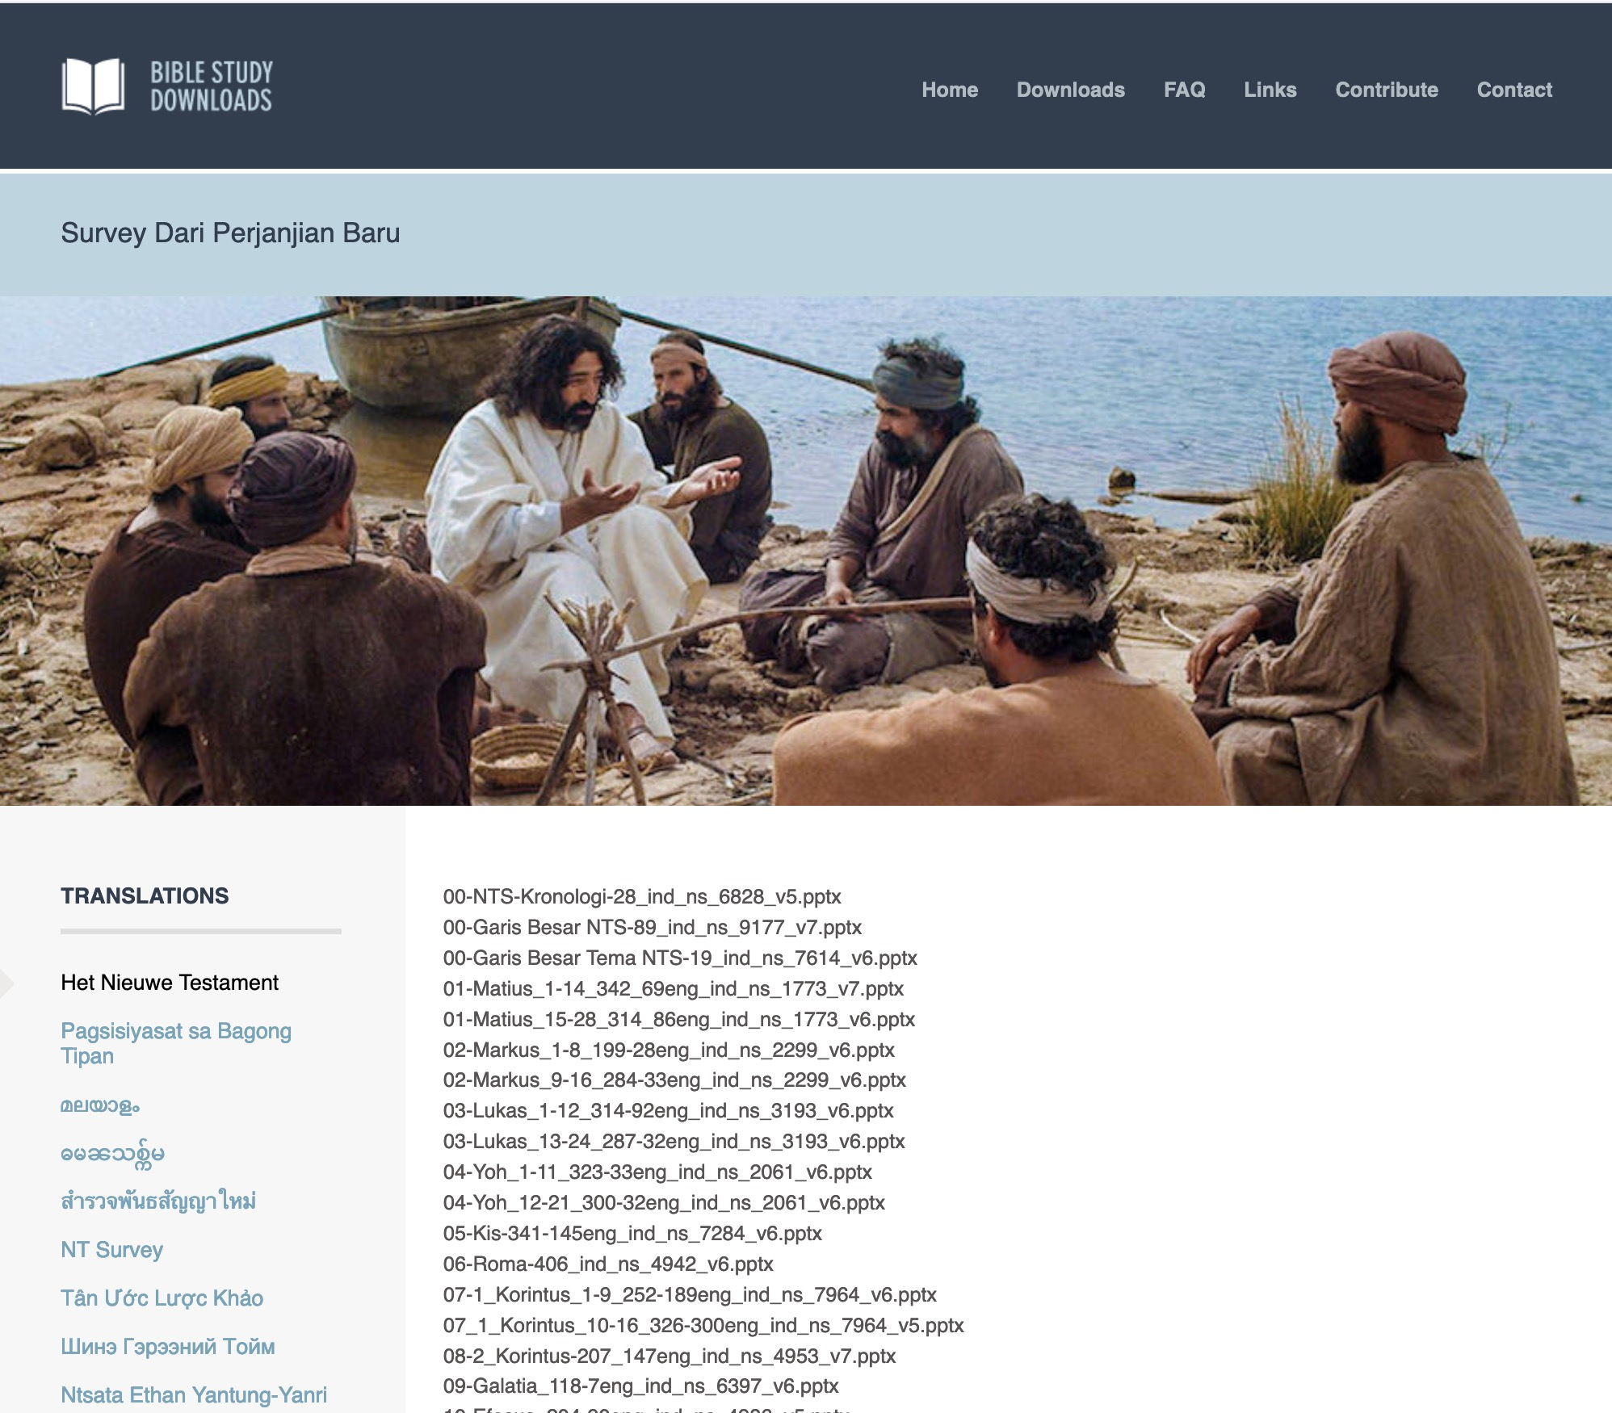
Indonesian
7
Notes:
Indonesian downloads include more than 14,000 slides as of Jan 2020.

Slide 49
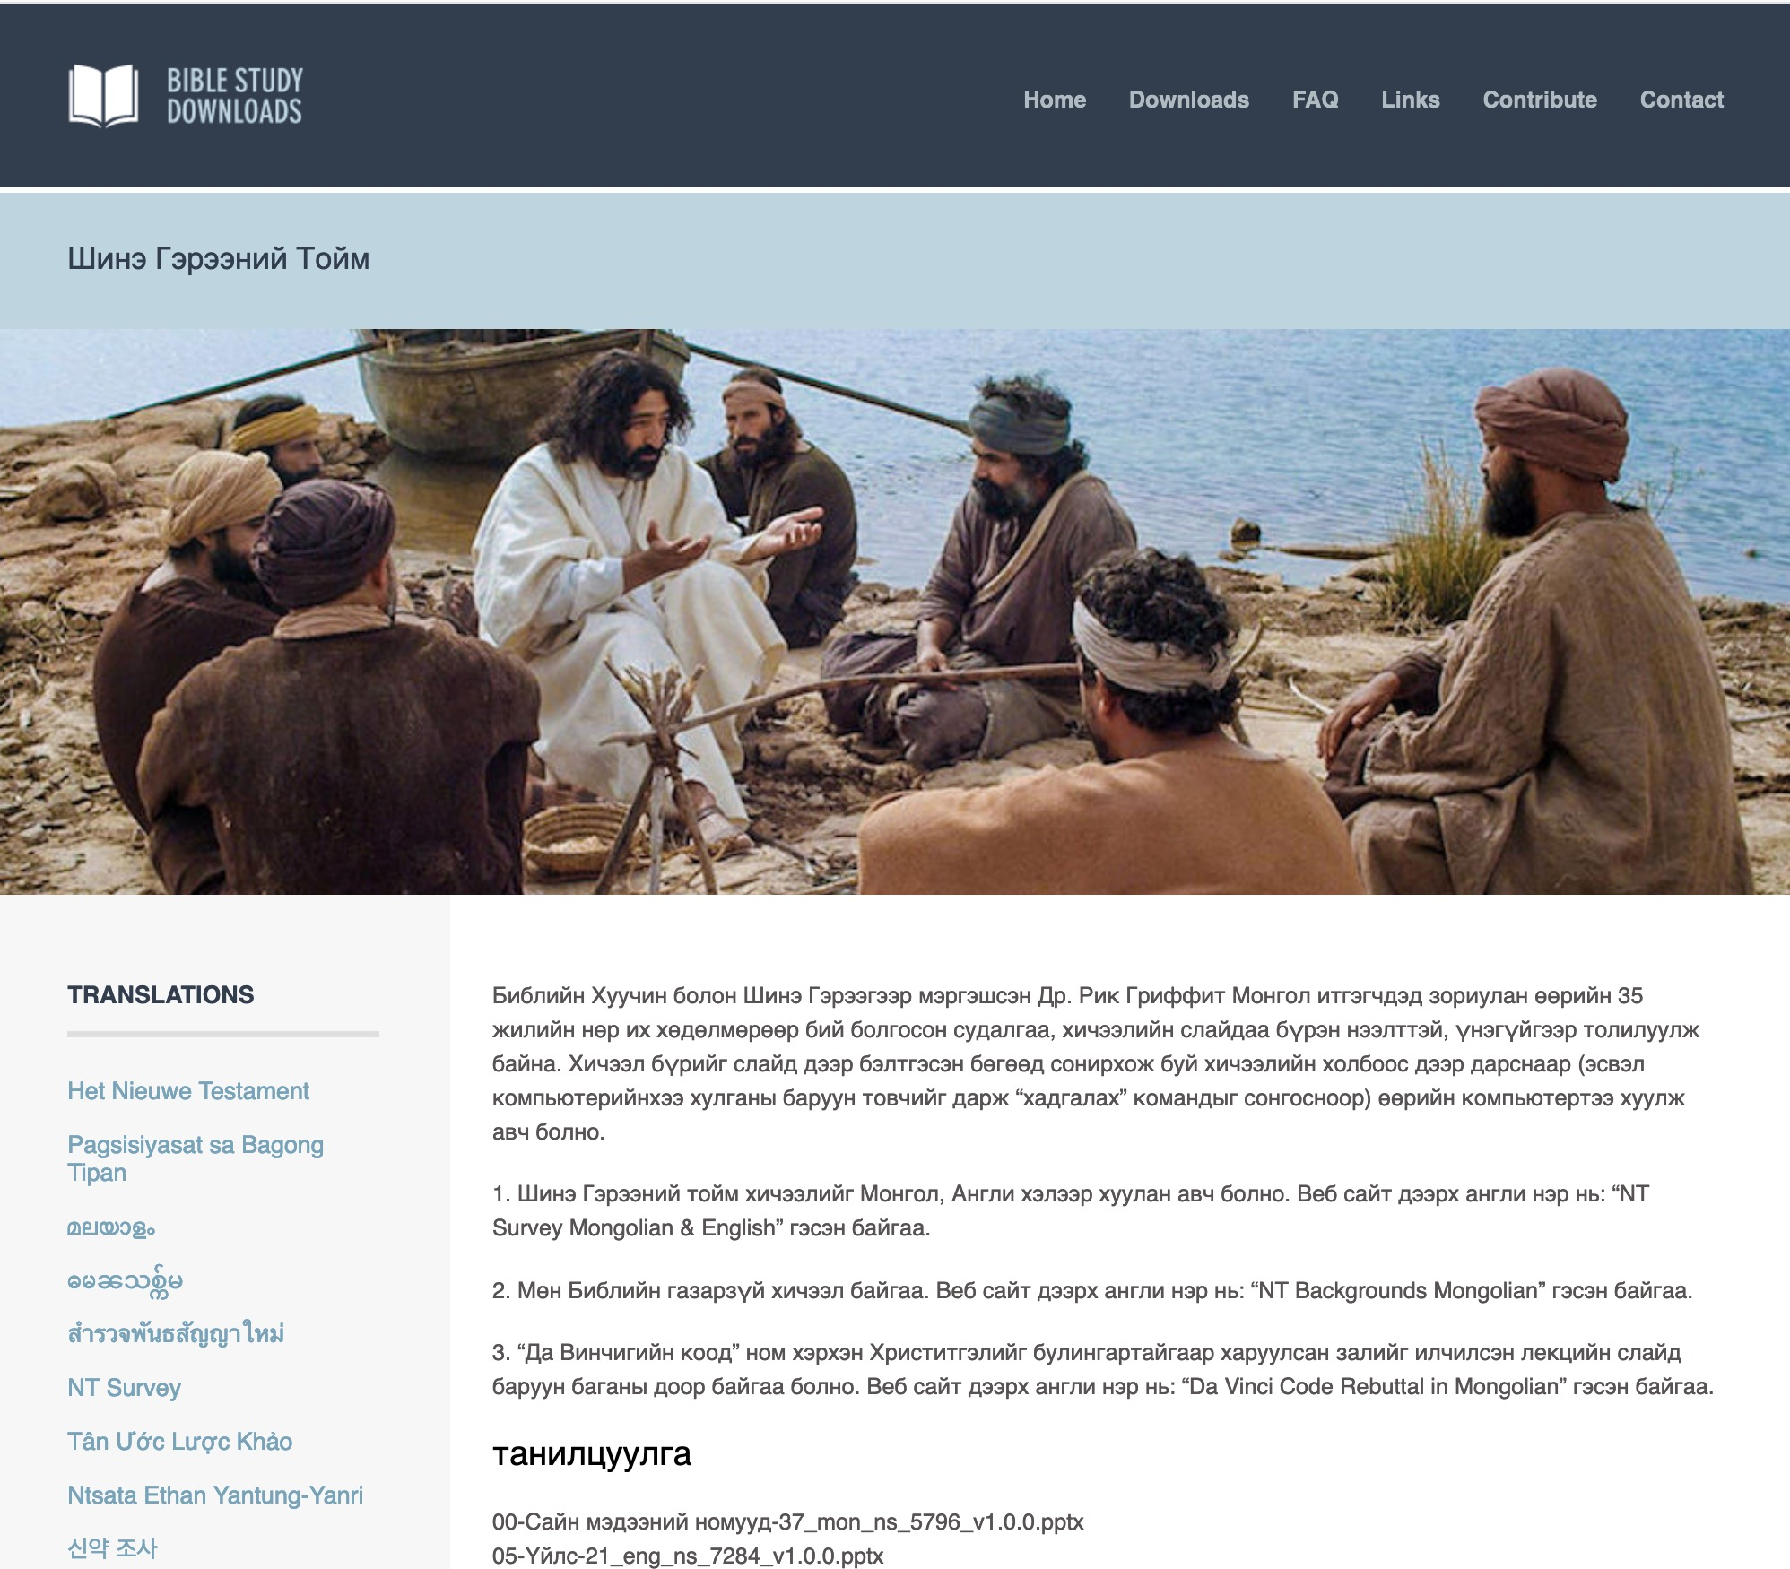
Mongolian
7
Notes:
Mongolian downloads include more than 3,000 slides as of Jan 2020.

Slide 50
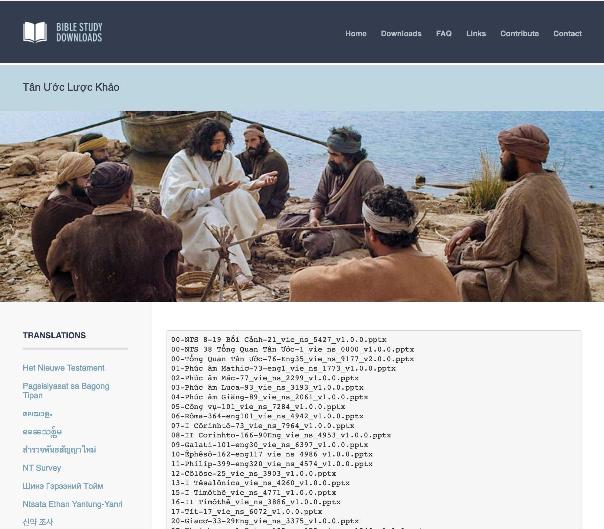
Vietnamese
7
Notes:
Vietnamese downloads include more than 8,000 slides as of Jan 2020.

Slide 51
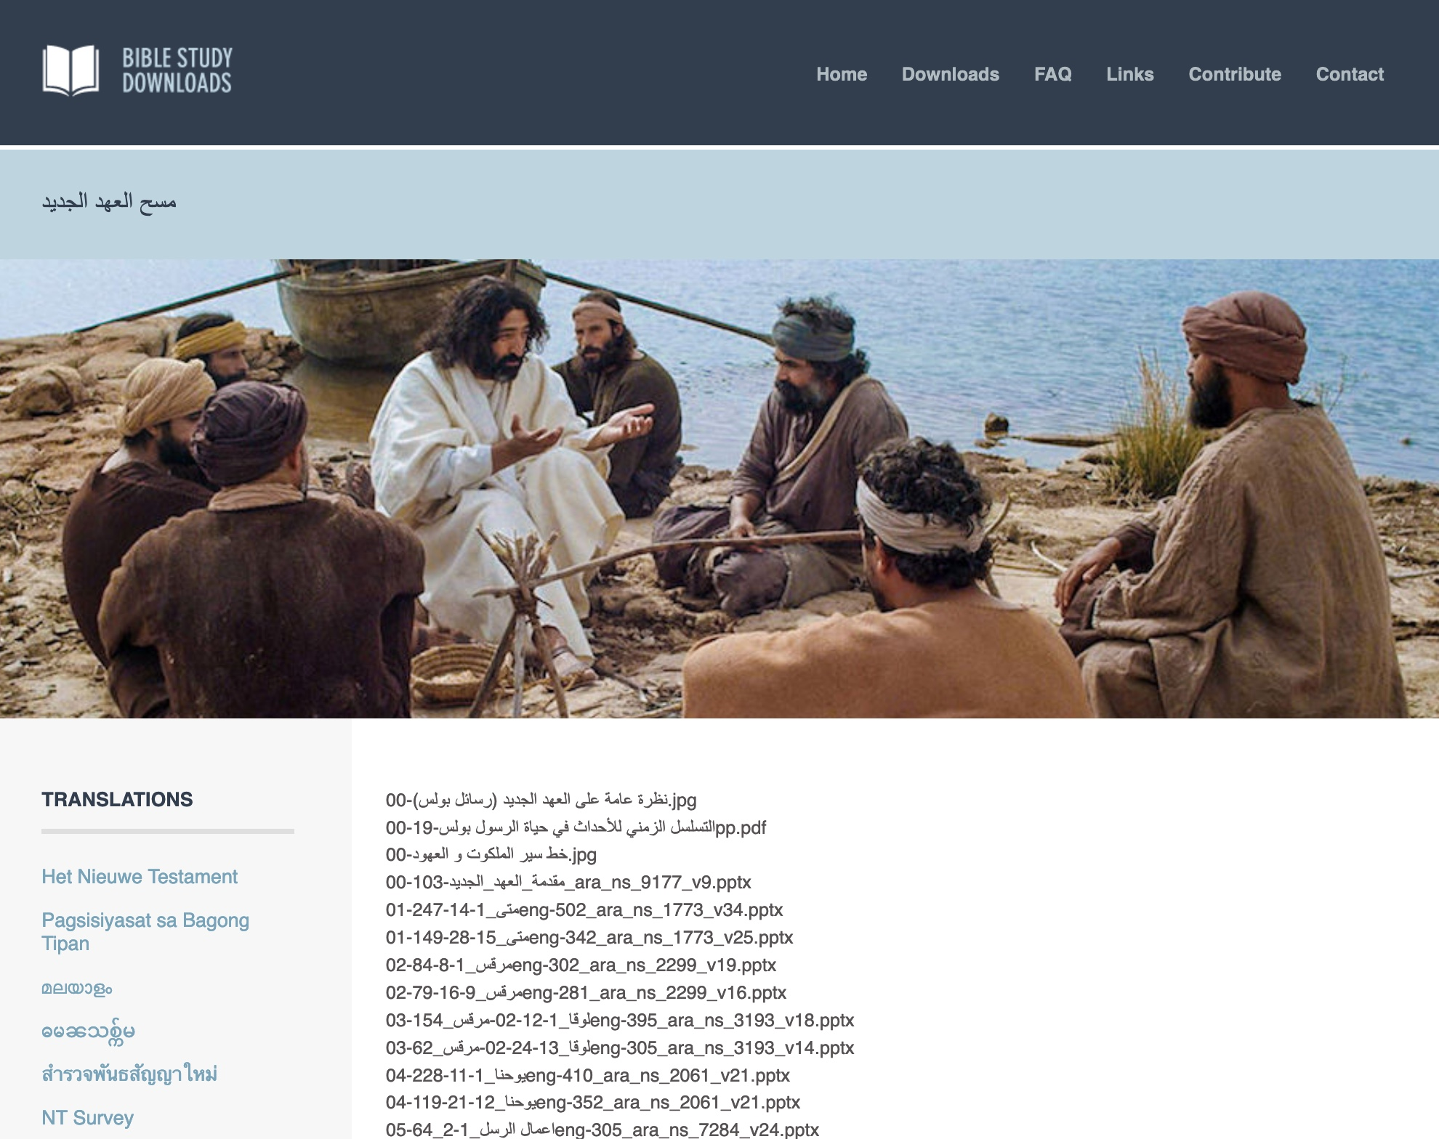
Arabic العربية
7
مسح العهد الجديد
01-متى_1-14-247eng-502_ara_ns_1773_v34.pptx
Notes:
Arabic downloads include more than 1100 slides as of August 2021.

Slide 52
Ministries God Gave Us
WorldVenture Singapore field leader
Singapore Bible College Bible & preaching professor
Singapore Bible College Doctor of Ministry director
Adjunct Professor teaching in 12 nations
The Bible…Basically translation director
BibleStudyDownloads.org web author
Crossroads International Church pastor-teacher
Jordan Evangelical Theological Seminary professor

Slide 53
Teaching 1997-2021
MONGOLIA
JORDAN
KOREA
CHINA
NEPAL
MYANMAR
INDIA
THAILAND
VIETNAM
MALAYSIA
SRI LANKA
SINGAPORE
SBC
INDONESIA
Notes:
From 1997-Dec 2020 God has seen fit to grant me the privilege to train pastors in 12 other countries on 73 trips. Often pastors in the US team-teach with me on these trips. To help the poor, I avoid the wealthy countries where listeners can pay an honorarium but instead raise the funds to pay my own way and then teach for free.

Slide 54
JETS Course Description
1
This is a study of the four Gospels, with attention given to developing a chronological survey of the life of Christ. Emphasis will be given to understanding their historical, cultural, and literary message, the trustworthiness of their witness, and important issues for the contemporary church (3 hours).

Slide 55
Course Description
1
A survey of the life of Jesus Christ in ten movements
An understanding of how a harmony of the gospels can aid our understanding of each respective gospel

Slide 56
Course Objectives
1
By the end of this course, the student will be able to…
A. Know the ten movements of the Life of Christ
B. See the value of harmonizing the gospels.
C. Teach the basic content of the course in Arabic and teach it.
D. Know from experience the value of Internet learning to know how to learn from the net.

Slide 57


All Quizzes and Exams are Closed Book!
Quizzes are over the reading.
Exams are over the notes.
Notes:
Quizzes are over the reading.
Exams are over the course notes.

Slide 58

Course Text
Section summaries based on J. Dwight Pentecost,
A Harmony of the Words and Works of Jesus Christ (Grand Rapids: Zondervan, 1981)
Notes:
The original 1981 title was The Words and Works of Jesus Christ.
The 1998 edition add the harmony idea with the new title A Harmony of the Words and Works of Jesus Christ.

Slide 59

BTh Student Grading
4
Average of
3 grades (paper or project)
Readings
Paper
Project
2 Exams

Slide 60
Other Matters
7
Copying Class Notes
Contacting Me
Mobile number: +962 7 9725 6061
My office hours are after chapel
Email: drrickgriffith@gmail.com
Let's have lunch too!

Slide 61
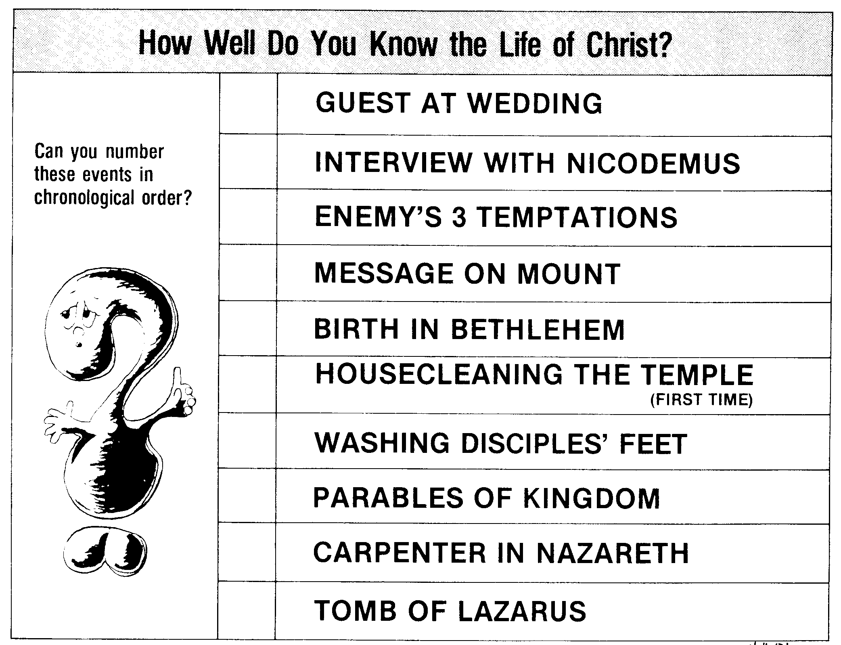
How Well Do You Know the Life of Christ?
How Well Do You Know the Life of Christ?
53
4
Guest at Wedding
Can you number these events in chronological order?
6
Interview with Nicodemus
3
Enemy's 3 Temptations
7
Message on Mount
1
Birth in Bethlehem
5
Housecleaning the Temple (1st time)
10
Washing Disciples' Feet
8
Parables of Kingdom
2
Carpenter in Nazareth
9
Tomb of Lazarus
Terry Hall, Bible Panorama, 121

Slide 62
AN ALPHABETIZED LIFE OF JESUS
54
AN ALPHABETIZED LIFE OF JESUS (Adapted from Terry Hall, Bible Panorama, 139)
Angels | Luke 1:5-38; Matthew 1:18-25 | Nazareth, Jerusalem
Birth | Luke 2:1-20; Matthew 2:1-12 | Bethlehem
Carpenter | Matthew 2:19-23; Luke 2:39-52 | Nazareth
Dove | Matthew 3:11-17; Luke 3:15-23 | Jordan River
Enemy | Matthew 4:1-11; Luke 4:1-13 | Wilderness, northeast Judea
Followers | John 1:19-51; Mark 3:14-19 | Perea, Galilee
Guest | John 2:1-11 | Cana
Housecleaning | John 2:13-22 | Jerusalem
Interview | John 3:1-21 | Jerusalem
Jacob's well | John 4:5-42 | Samaria
Kin | Luke 4:16-31 | Nazareth
Location | Matthew 4:13-22 | Capernaum
Message | Matthew 5–7 | Capernaum area
Nature | Luke 7:1-35 | Capernaum area, Galilea
Opposition | Matthew 12:22-50 | Capernaum
Parables | Matthew 13:1-53; Mark 4:1-34 | Capernaum area
Question | Matthew 16:13-28; Luke 9:22-36 | Caesarea Philippi
Revelation | Matthew 17:1-13 | Iturea, Mt. Hermon
Stoning | John 10:22-39 | Jerusalem
Tomb | John 11:1-54 | Bethany near Jerusalem
Upset | Matthew 21–23 | Jerusalem
Vision | Matthew 24–25 | Jerusalem, Mt. Olivet
Washing | John 13 | Jerusalem, Upper Room
Xecution | Matthew 26:30–27:56 | Jerusalem
Yes! | Matthew 28; Luke 24:1-49 | Jerusalem, Judea, Galilea
Zion | Luke 24:50-53; Acts 1:1-12 | Jerusalem, Mt. Olivet

Slide 63
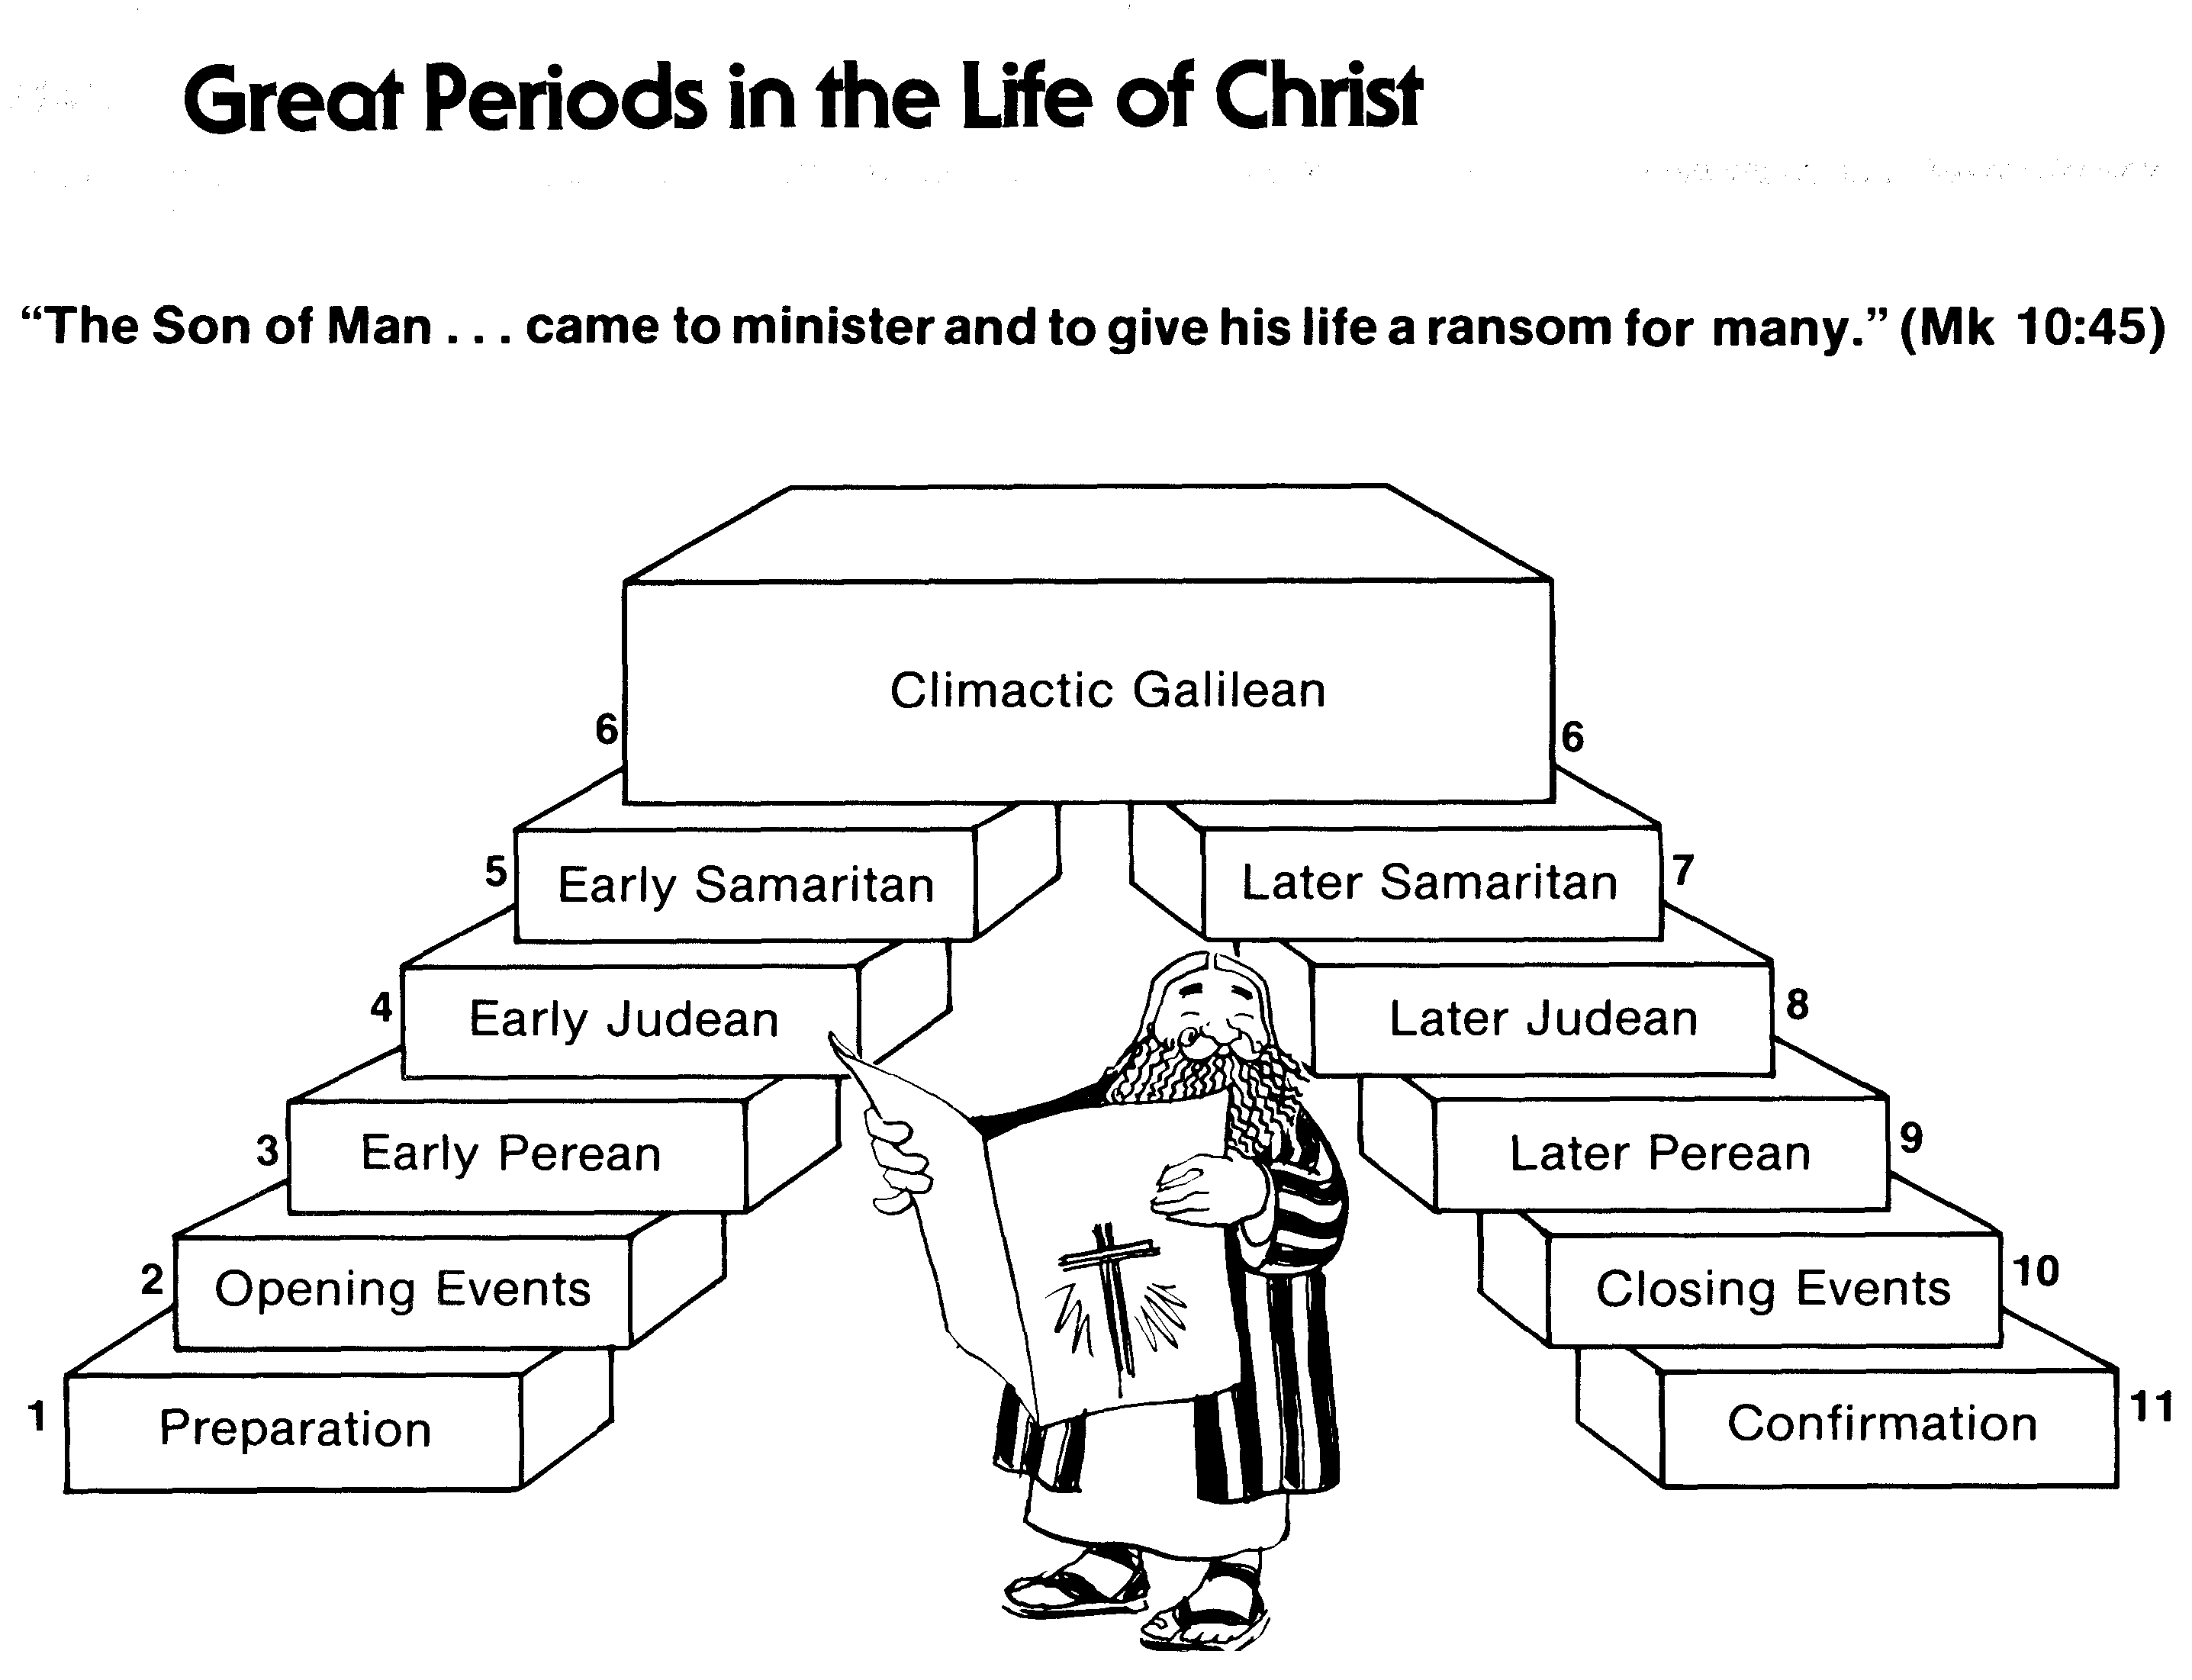
Great Periods in the Life of Christ
55
“The Son of Man… came to minister and to give his life a ransom for many” (Mark 10:45)
Climactic Galilean
Early Samaritan
Later Samaritan
Early Judean
Later Judean
Early Perean
Later Perean
Opening Events
Closing Events
Preparation
Confirmation
Walk Thru the New Testament seminar (used with permission)
Notes:
The Walk Thru outline of the life of Christ forms a chiasm or literary arrangement with repeating elements in the opposite order. This structure makes Confirmation parallel to Preparation, Closing Events parallel to Opening Events, etc. until the only event without parallel becomes the focus: Climatic Galilean. Such an arrangement of material was common in ancient antiquity and is seen in both the OT (e.g., Zephaniah) and the NT (1 Thess) where the central teaching appears in the middle of each writing.
_______
LC-00-Syllabus-63
LC-01-Introduction-265
LC-05-Opposition-4

Slide 64
MAIN IDEA OF MATTHEW
Serve the Lord Jesus Christ
GOD
Lord
KING
Jesus
Christ
SAVIOR
Notes:
Serve Jesus as Savior, God, and King of your life! This is the essential message and application of the entire gospel of Matthew.

Slide 65
Pentecost Outline
Introduction of the King
Authentication of the King
Controversy over the King
Instruction of the Twelve by the King
Opposition to the King
Preparation of the Disciples by the King
Official Presentation of the King
Preparation for the Death of the King
Rejection of the King
Resurrection of the King

Slide 66

THE WORD IN PICTURES
Pictures of Jesus from…
Free
Bible
images

Slide 67

Used with Permission
THE
GOSPEL
——OF—— MATTHEW
THE
GOSPEL
——OF—— MARK
THE
GOSPEL
——OF—— LUKE
THE
GOSPEL
——OF—— JOHN
Due to the Lumo Project producing its own publishing material we regret to inform you that we cannot license our photos to other clients outside of freebibleimages.org.
These images are not licensed for reuse in video, epublishing or other media. Downloaded pictures and files cannot be redistributed through any other website than freebibleimages.org or used in any context where the accompanying message is undermining of the Christian faith and gospel.
Photos can only be used on educational presentations, blogs and social media, all of which should be accompanied with reference to www.LumoProject.com.
Picture courtesy of BBM
© All Rights Reserved.
www.bigbookmedia.com

Slide 68
Black

Slide 69
Life of Christ link at BibleStudyDownloads.org
Get this presentation for free!
Notes:
NT Survey (ns)

