Slide 1
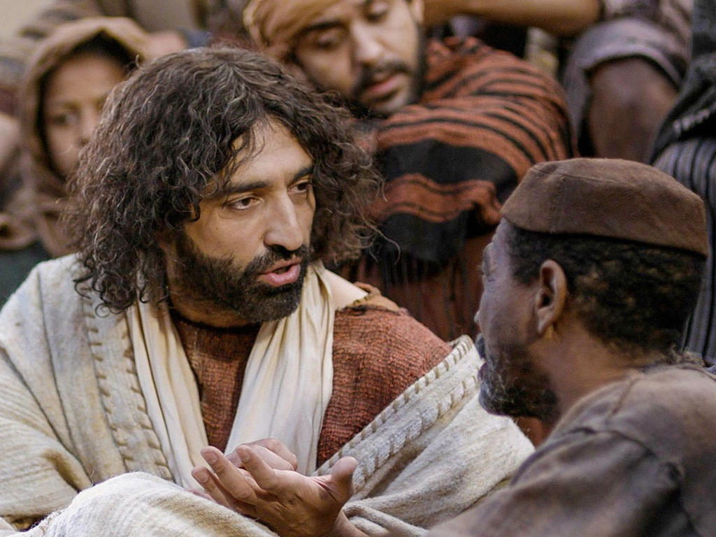
Life of Christ Syllabus
Dr. Rick Griffith • Jordan Evangelical Theological Seminary • BibleStudyDownloads.org
Notes:
Intro: Fact or Fiction...

Slide 2

Introduce Yourself!
Name
Country
Programme
Family
Church
Ministry Goal

Slide 3

Notes Options
The Life of Christ
Digital at BibleStudyDownloads Life of Christ link
(Free)
Printed
($10 each)

Slide 4


Our People
Susan teaches church women
Notes:
I also lead the woman's Precept Bible study at our church

Slide 5

LADIES BIBLE STUDY ON
1-2 THESS
USA • Singapore • New Zealand • Holland

Slide 6

Thailand • Mongolia • Myanmar • Indonesia
Notes:
INTERVIEWER: And Susan, what ministries has the Lord granted you?
SUSAN: I have been teaching the wives of leaders at SBC. These 5 women come from 5 different nations!
SUSAN: I also lead the woman's Bible study at our church

Slide 7
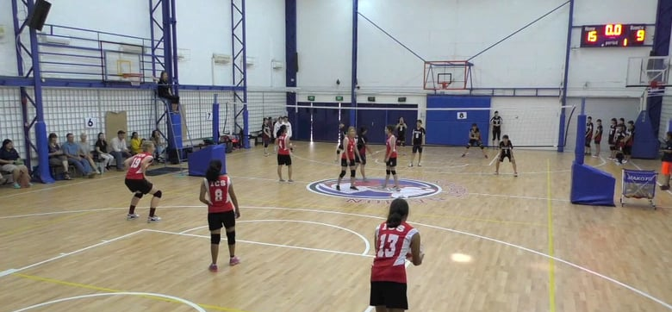

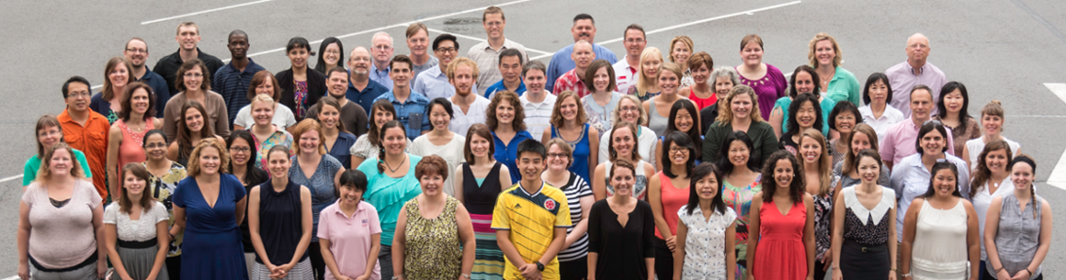
International Community School
(est. 1993)

Slide 8




ICS now has almost 400 students!
UK
SWEDEN
KOREA
SWITZERLAND
JAPAN
ITALY
USA
THAILAND
INDIA
MEXICO
ICS
VENUZELA
INDONESIA
BRAZIL
SOUTH AFRICA
AUSTRALIAN

Slide 9

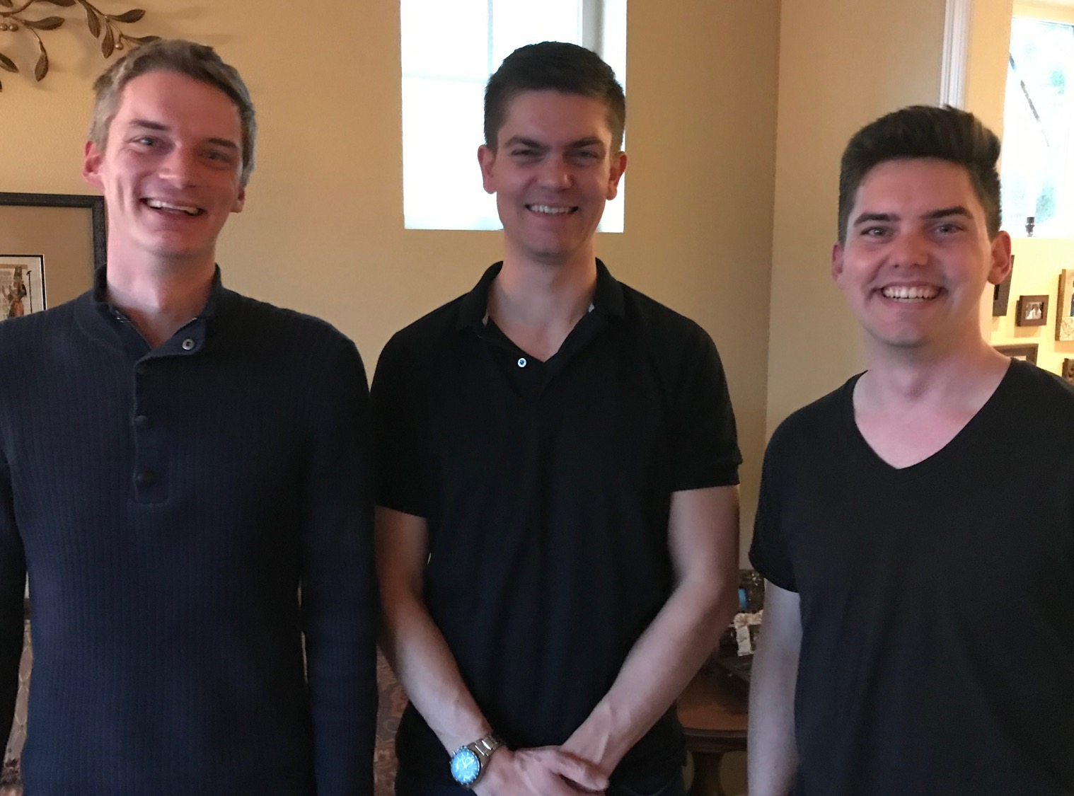
Our Three Sons

Slide 10

The Griffiths
28 Nov 2019
2022
Rick & Susan
John
& Chloe
(30)
Kurt
& Cara (36)
Stephen & Katie (33)

Slide 11
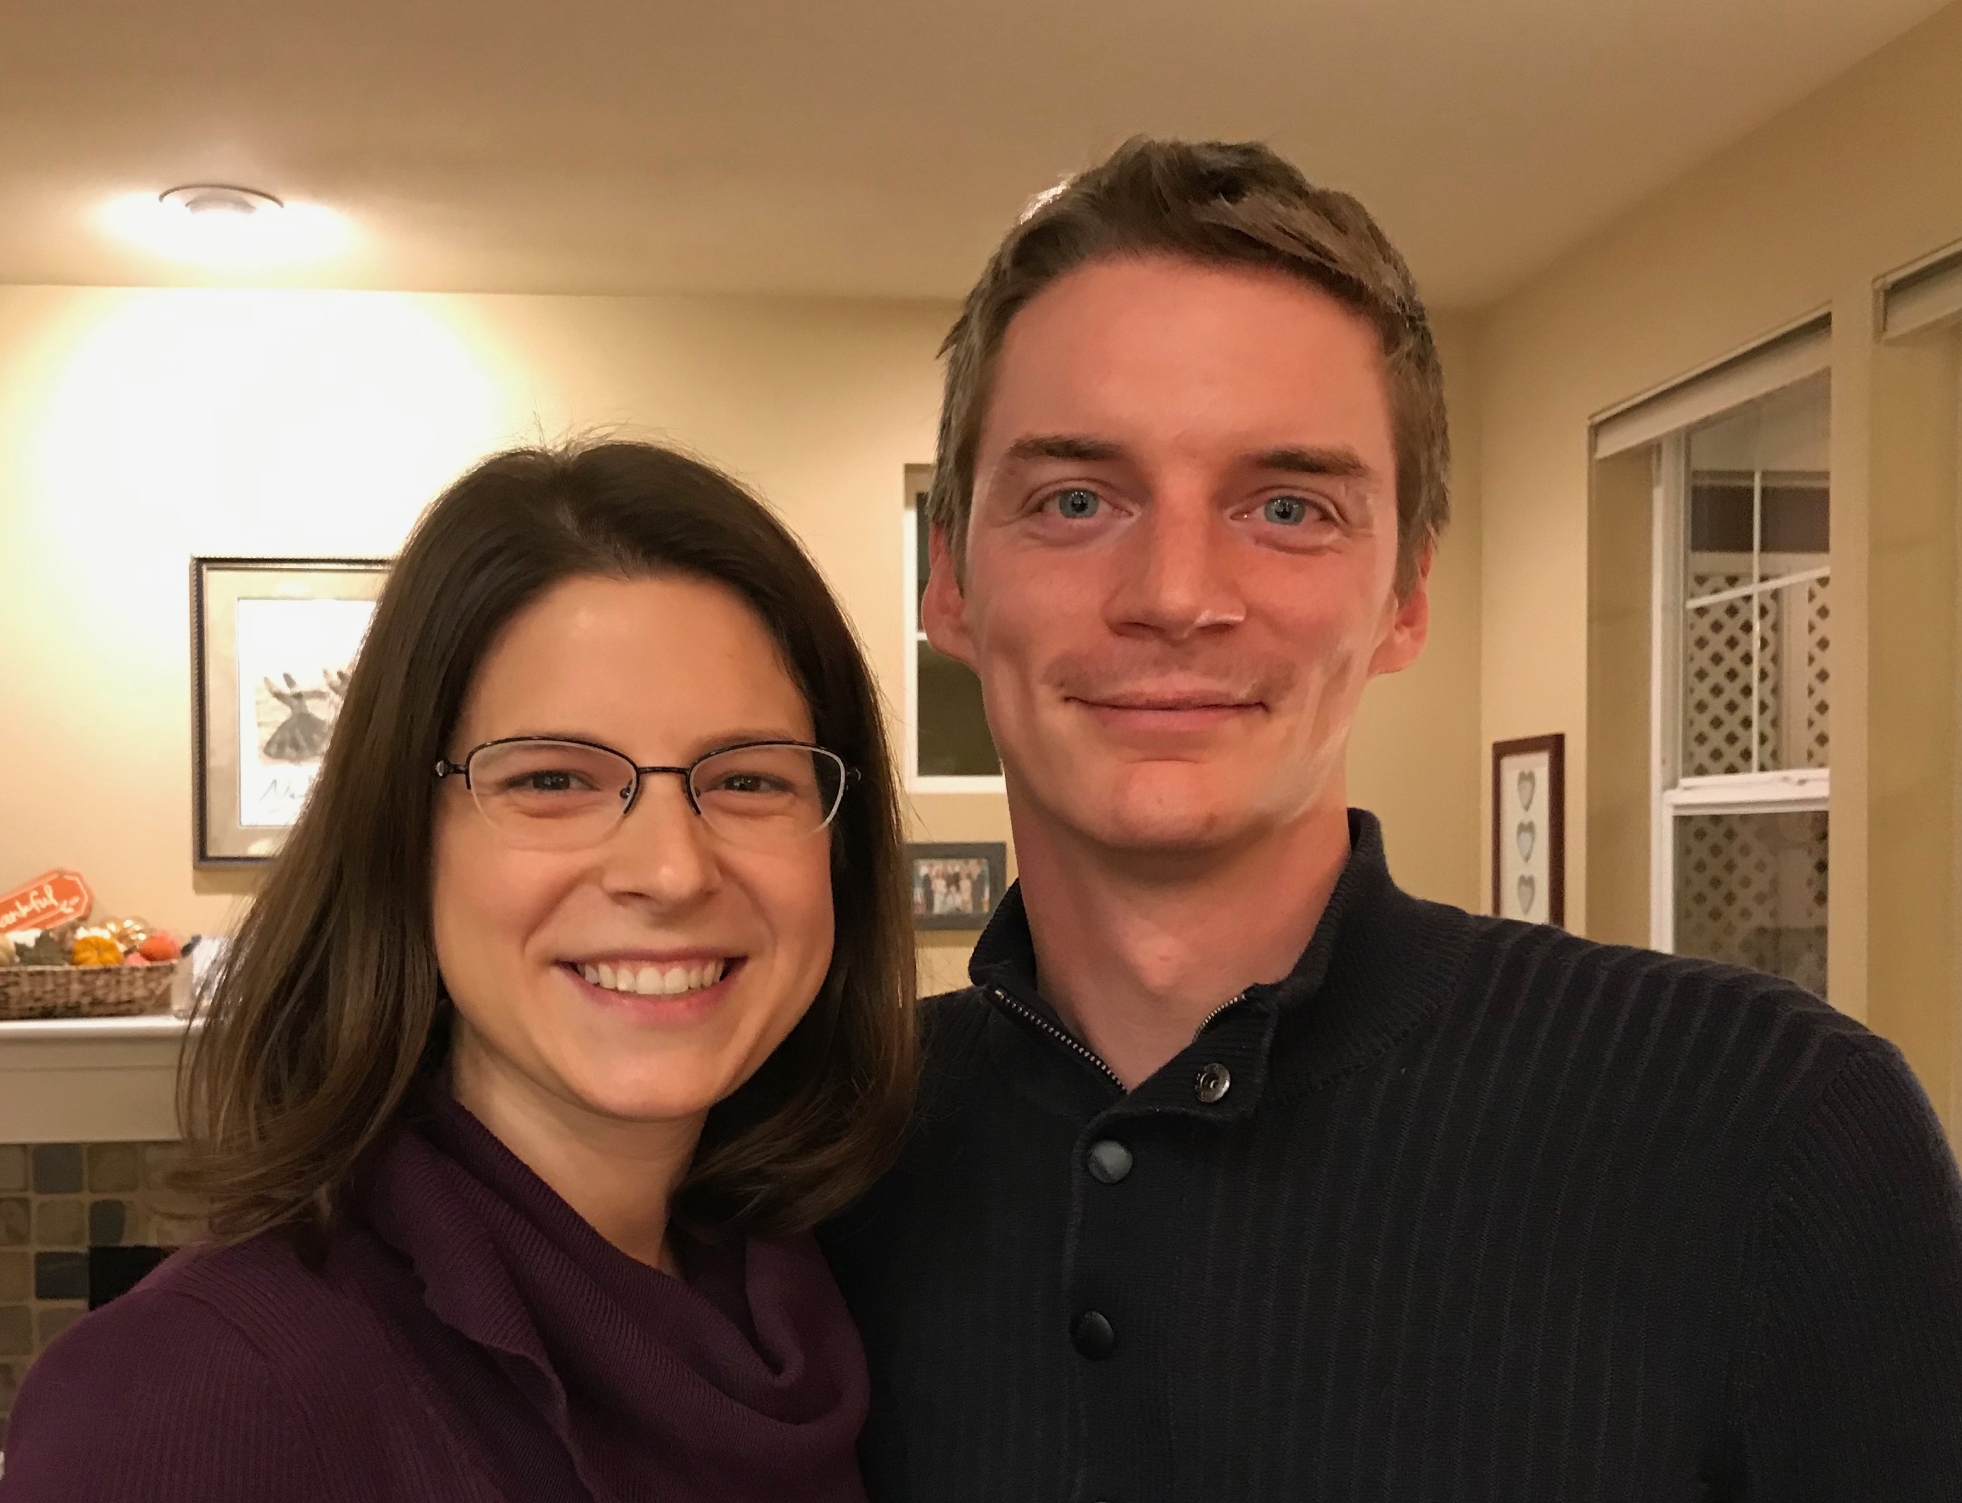
Kurt (37) & Cara own their HR consulting business near Seattle
Notes:
Kurt and his wife Cara are in Seattle.
__________
Common-65

Slide 12

1-year-old grandson Kadon

Slide 13

Stephen, Katie, Jesse & Norah in Denver
Notes:
Our granddaughter joined the family on 31 July 2021 but why would God take us now? I don’t know.

Slide 14

4-year-old grandson Jesse

Slide 15

2-year-old granddaughter Norah

Slide 16
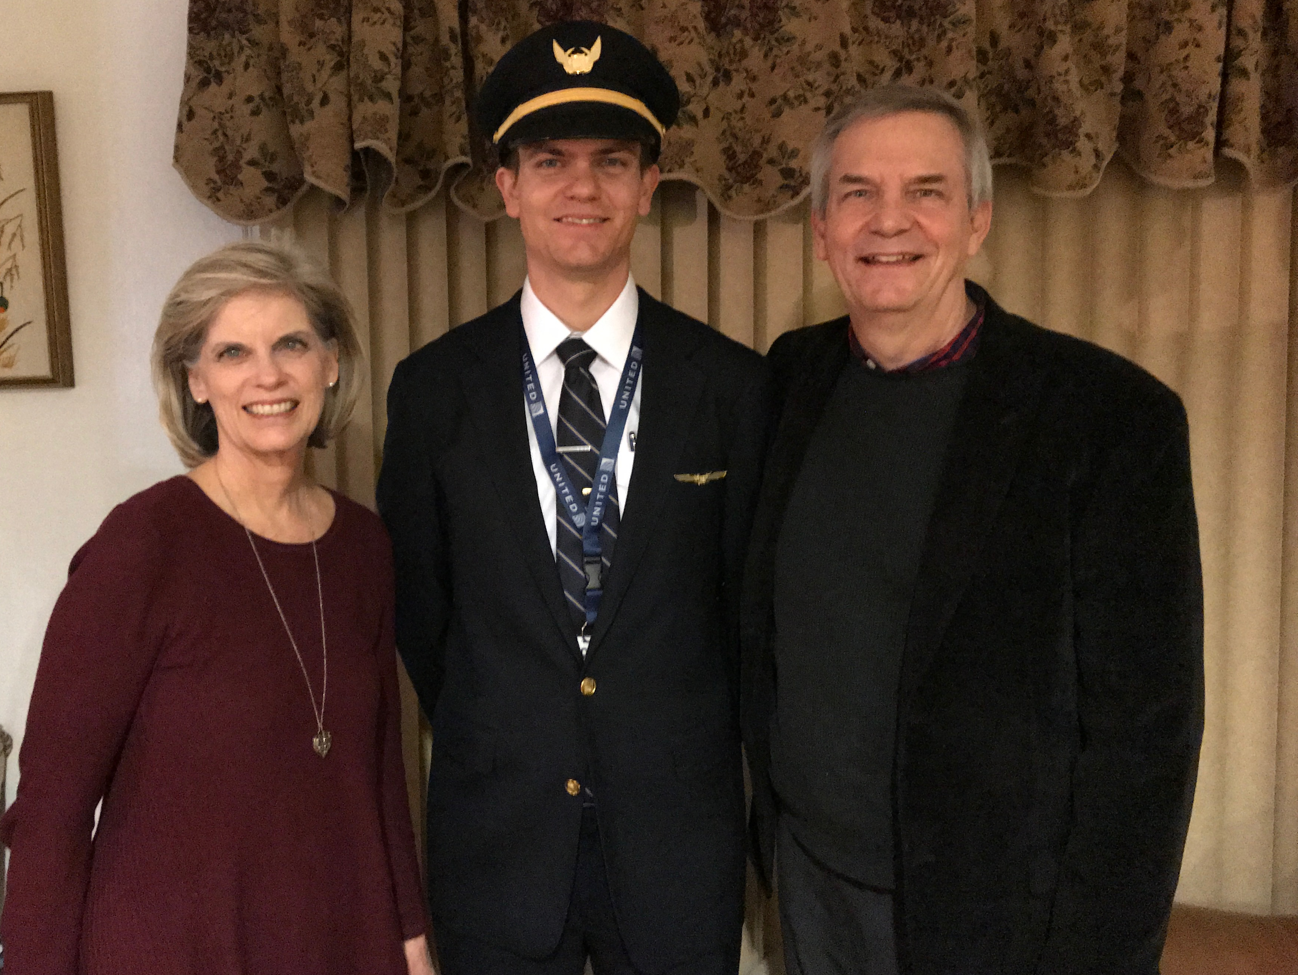
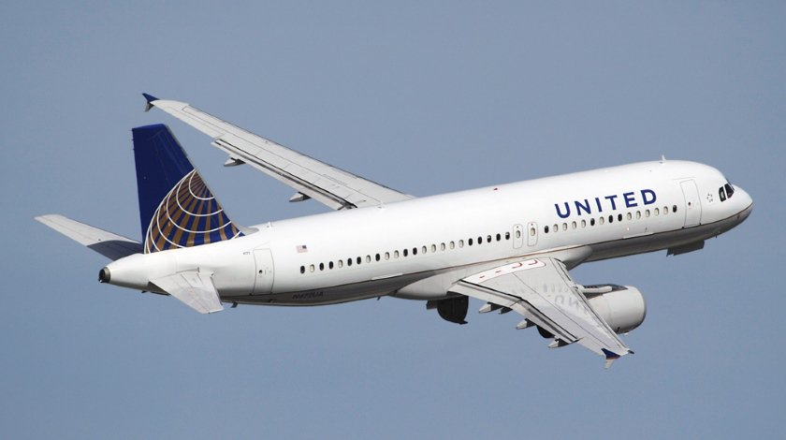
Stephen (35) trains United B777 pilots in Denver
6
Notes:
Stephen also takes an international trip monthly.
__________
Common-69

Slide 17

John (31) married Chloe in Pasadena, California in 2022
8
Notes:
John does graphics and Chloe does web design for digital software companies.
___________
Common-70

Slide 18
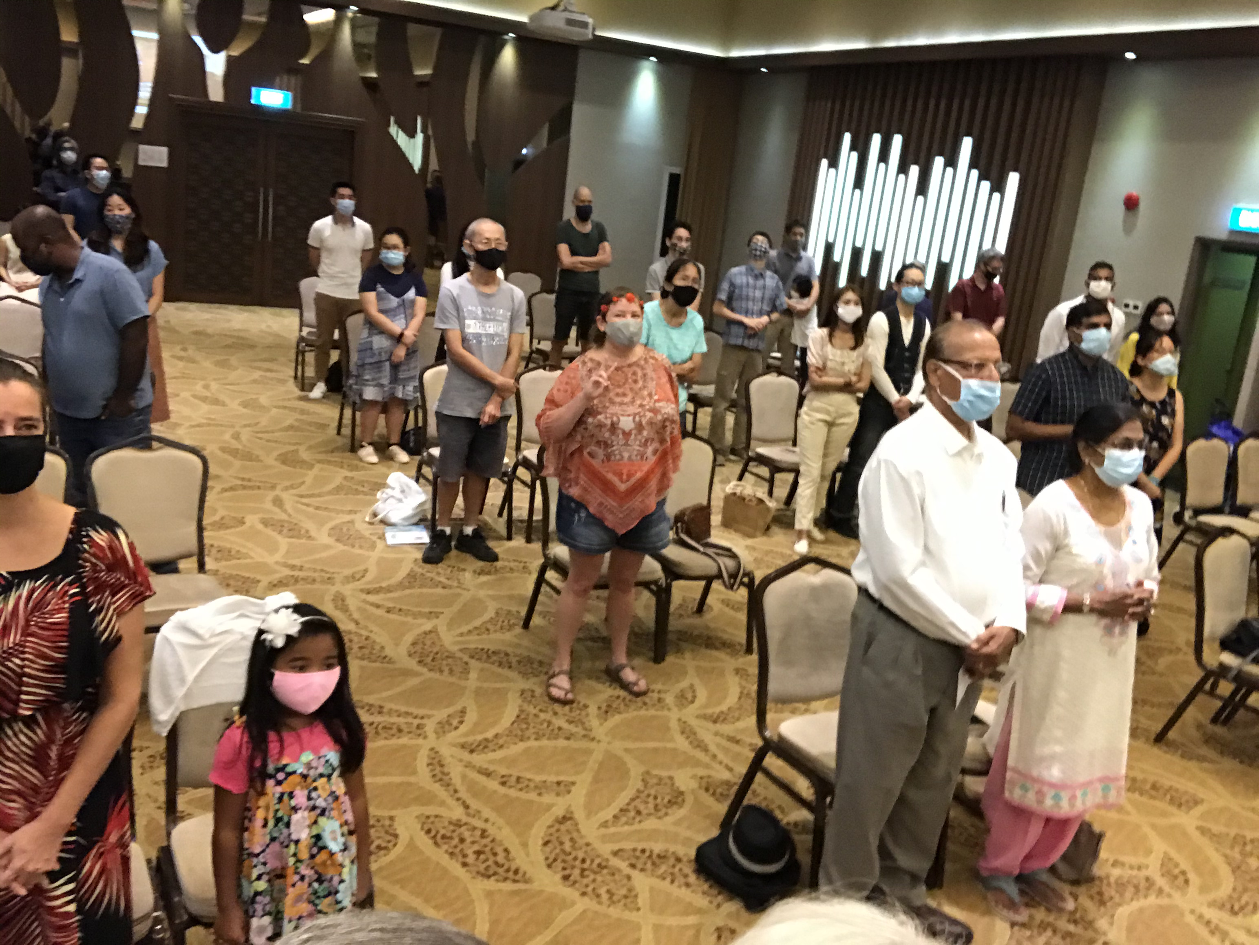
Our People
9
June 2021
90 people from 16 nations
Notes:
From 2006-2021, for 15 years we pastored this congregation in Singapore until we turned the church over to new leadership to move to the Middle East.
___________
Common-77

Slide 19


Crossroads People • June 2021
UK
UNITED KINGDOM
RUSSIA
NETHERLANDS
MONGOLIA
ITALY
FRANCE
KOREA
HONG KONG
LEBANON
EGYPT
JAPAN
CHINA
MYANMAR
GERMANY
TAIWAN
CANADA
INDIA
USA
THAILAND
ETHIOPIA
MALAYSIA
ZIMBABWE
SOUTH AFRICA
PHILIPPINES
SINGAPORE
INDONESIA
CIC
AUSTRALIA
NEW ZEALAND
KENYA
Notes:
We actually had about 20% Indian at CIC, thanks to St. Thomas, who overcame his initial reluctance to witness for Jesus in India.
Our June 2021 church of 90 people stem from 16 different countries around the world: Australia (David & Fiona), China (Jianji), Egypt (Tamara), France (Valentin), Korea (Grace Kim), India (Cynthia), Indonesia (Rena), Kenya (Jacqueline Ngare), Nepal (Joshua Limbu), Netherlands (Toes), Singapore (Albina), South Africa (Melody Hertenberger), Taiwan (Maple), Thailand (Mae), UK (James & Gabi), USA (Jim & Jacqui).
This does not include people who have recently attended only once:
Nor does it include missionaries living back in their countries but still are members of CIC: Maple (Taiwan), Budmaa (Mongolia)
Previous: Canada (Gloria Lee), Ethiopia (Lele), Malaysia (Aston, Naomi), Netherlands (Dies & Desiree), Philippines (Micah), South Africa (Melody),
_____________
Common-78

Slide 20

Our People
9
Preaching through Scripture
Notes:
RICK: Yes, we helped start Crossroads International Church in 2006 and I serve as the pastor-teacher.

Slide 21
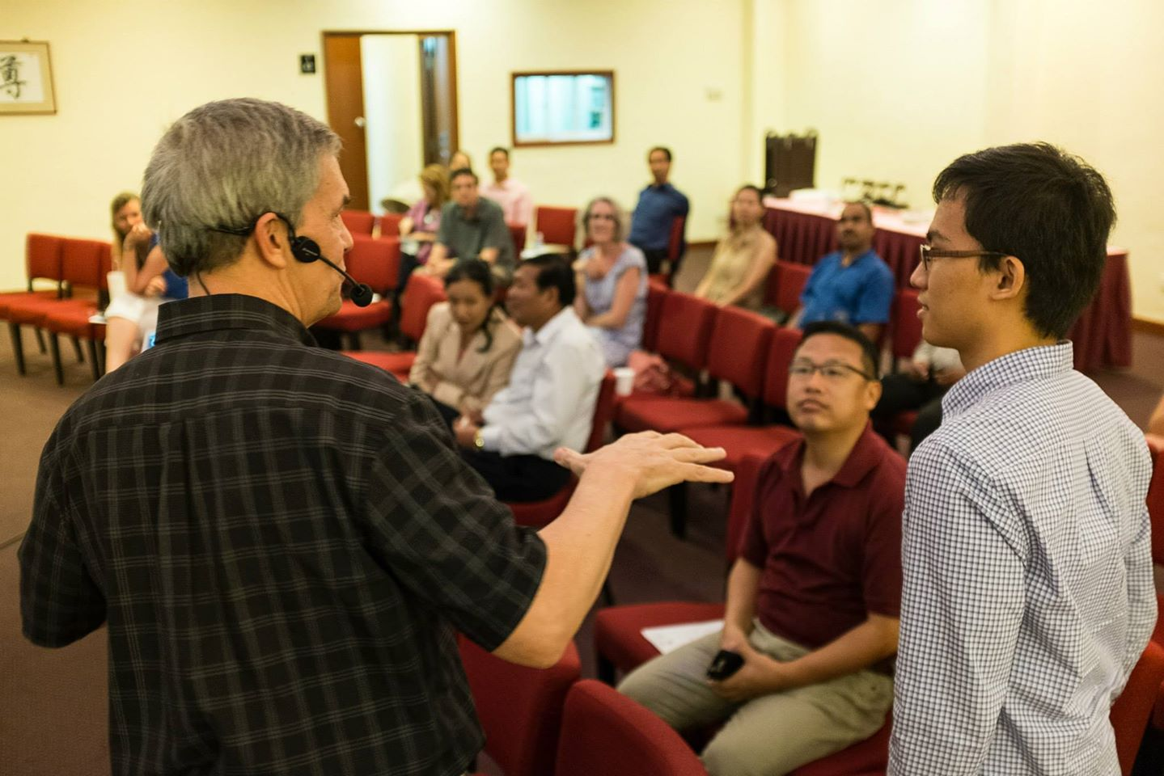
Our People
9
SBC students serve at church
Notes:
We also helped start Crossroads International Church in 2006 where I served as the pastor-teacher.

Slide 22

Our People
9
SBC students serve at church
Notes:
One special joy is mentoring my students who serve with us at church and led ministries to youth, children, home groups, and the worship team.

Slide 23
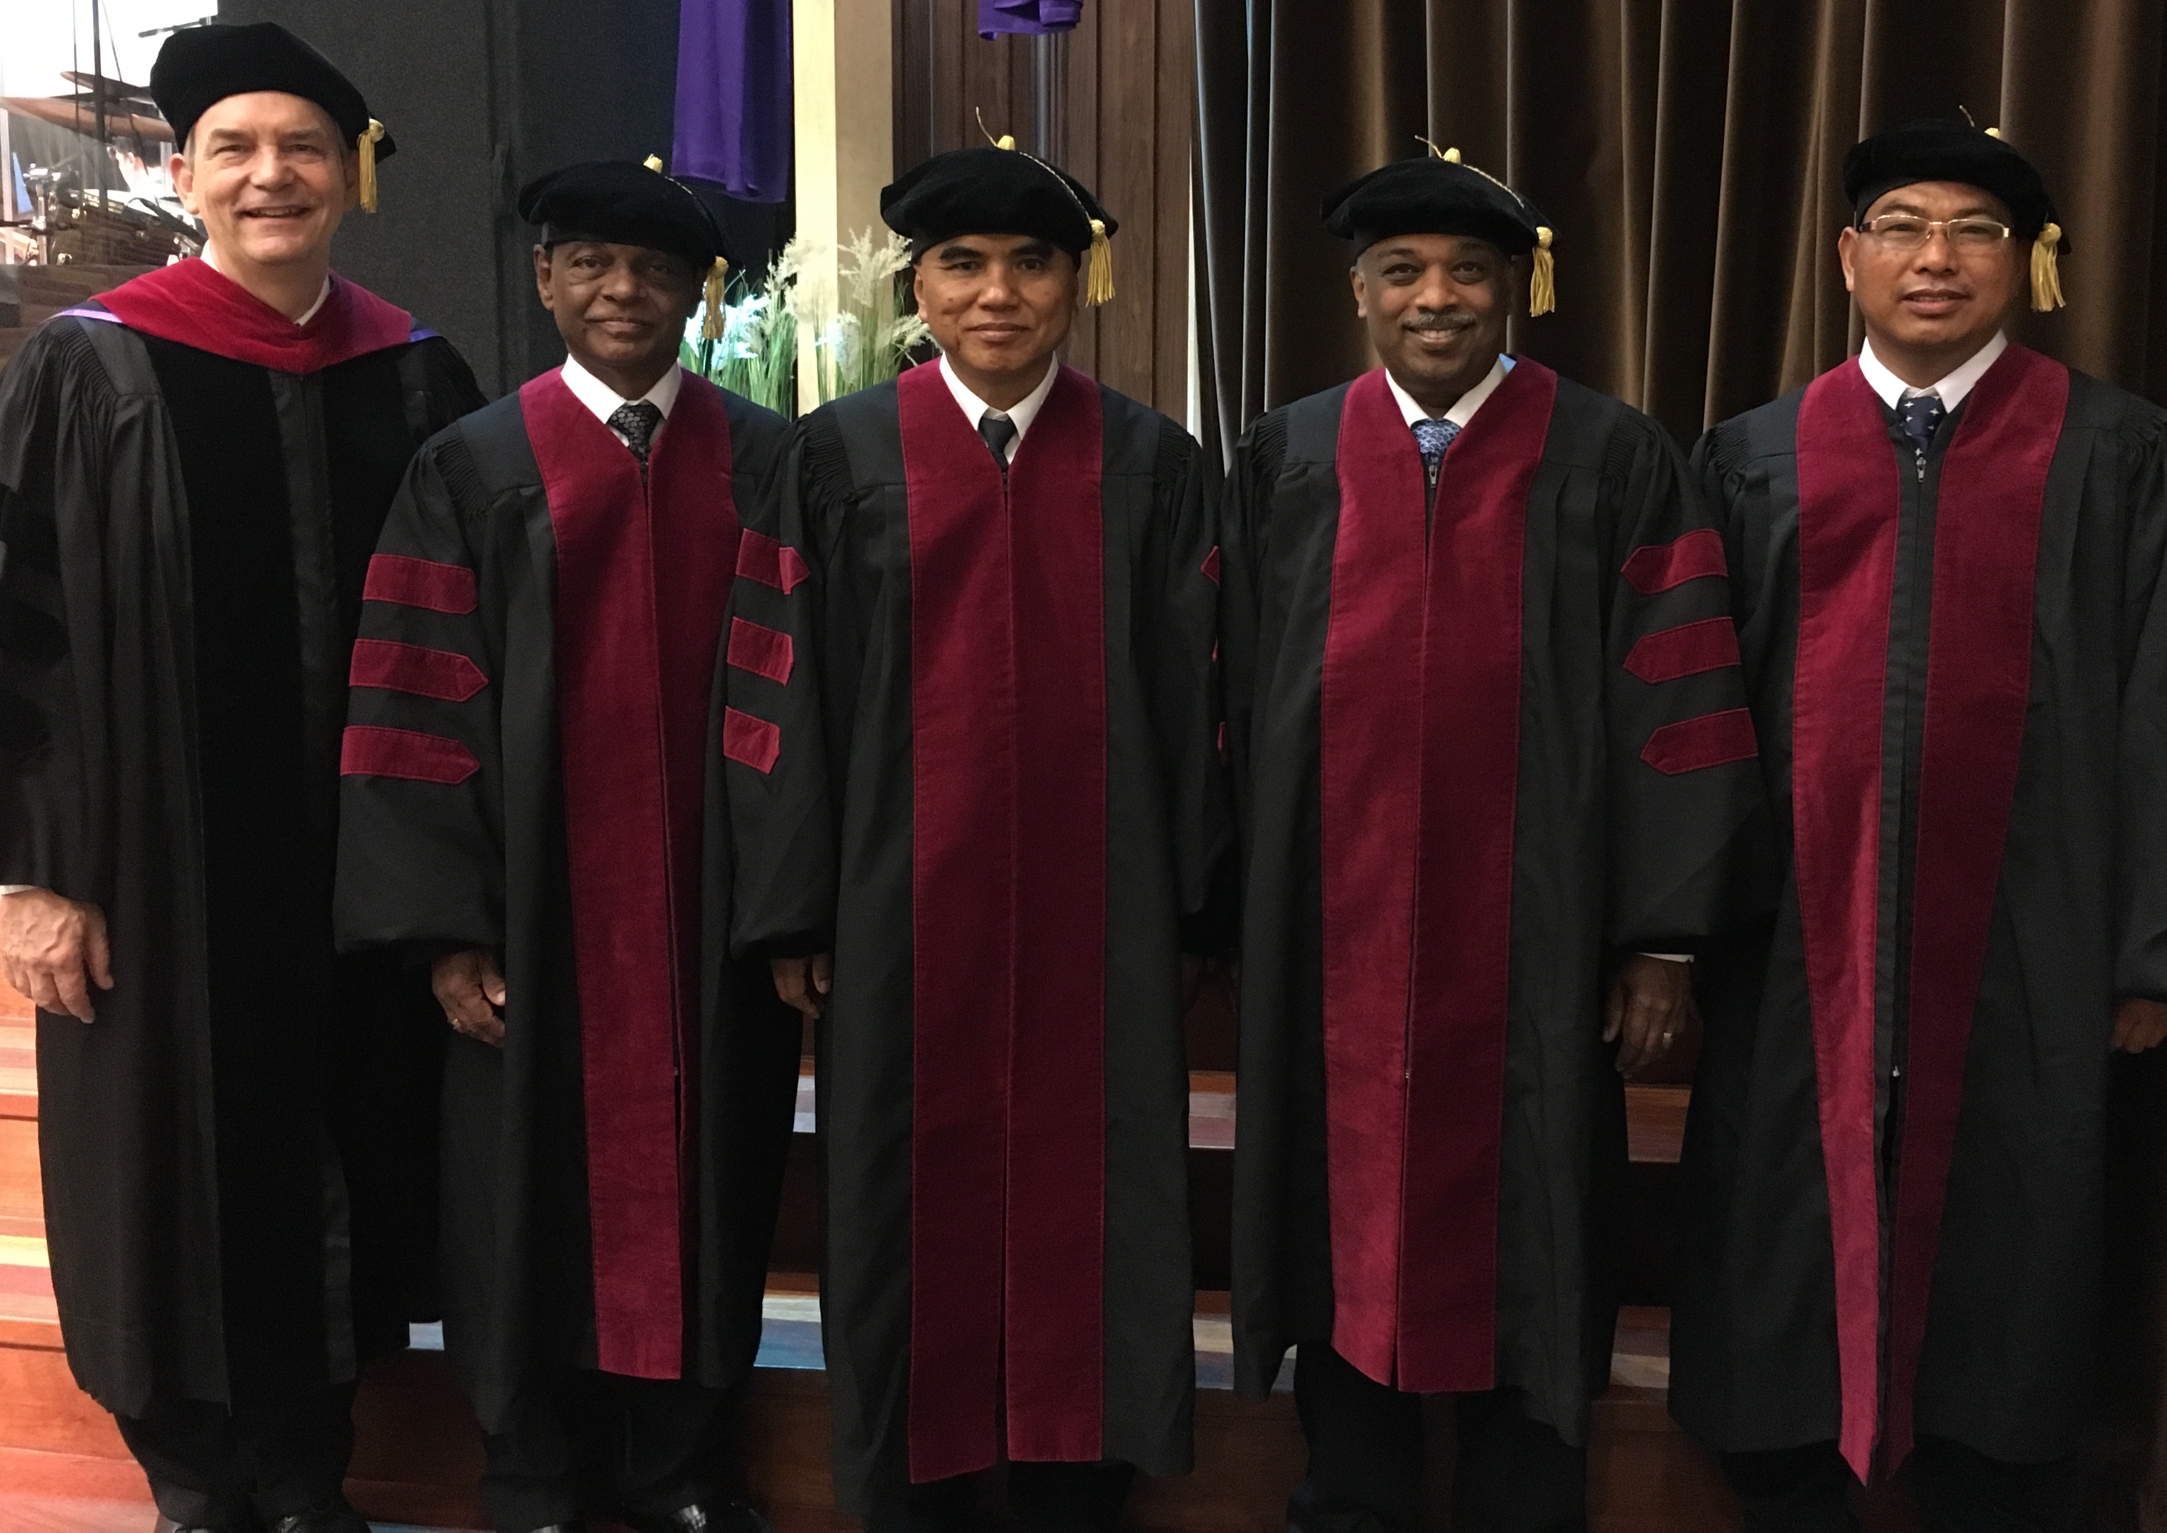
I directed the SBC Doctor of Ministry studies (DMin) from 2012-2021
Notes:
SBC trains about 50 seminary professors and pastors throughout Asia in English and Chinese. Generally each year about 5 of them received their Doctor of Ministry degree.

Slide 24
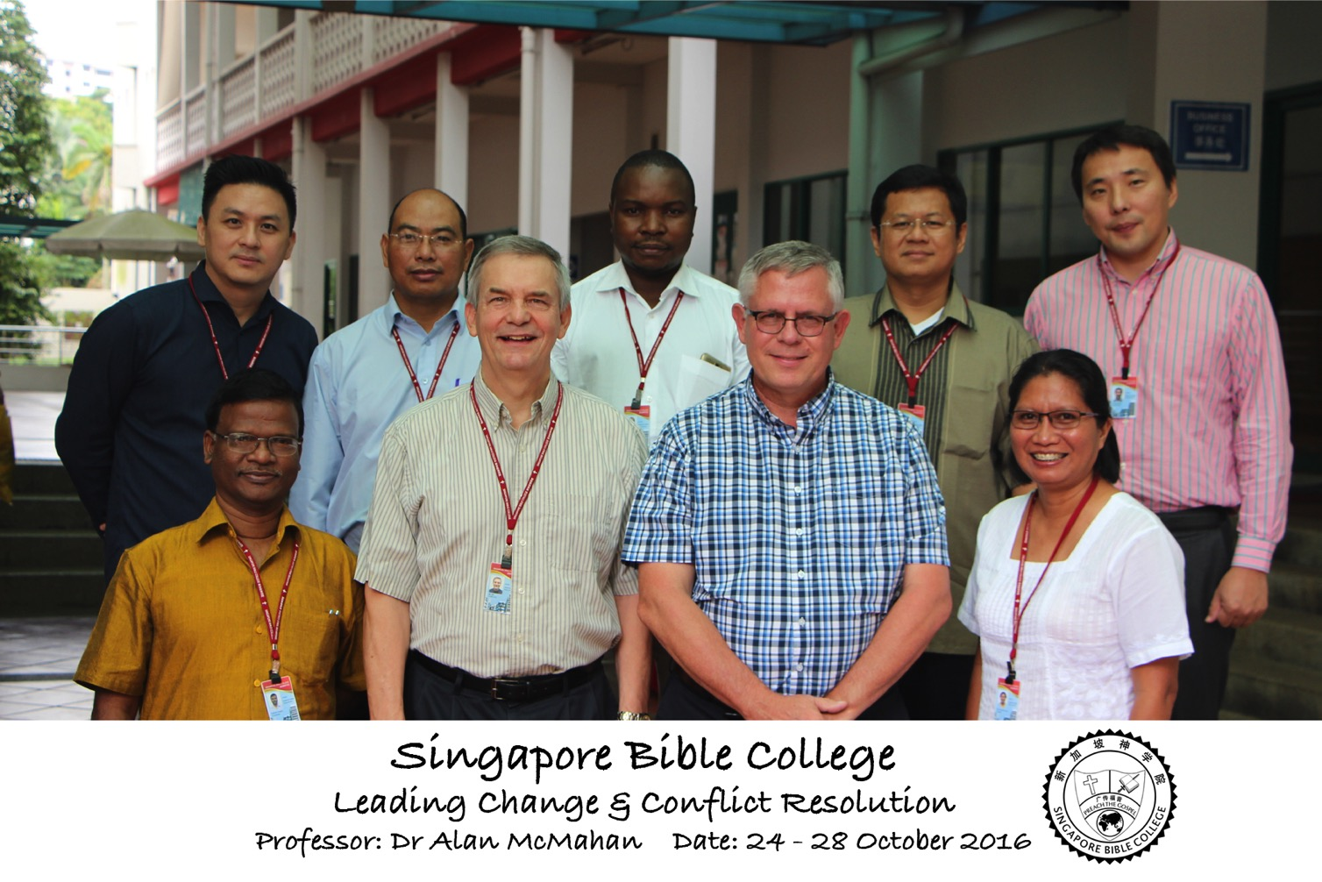
Leading Change & Conflict Resolution
(Dr. Alan McMahan Oct 2016)

Slide 25

SINGAPORE BIBLE COLLEGE
9
Notes:
I've served as a seminary professor with 30 other faculty at Singapore's largest training school: Singapore Bible College

Slide 26

Singapore Bible College Students
USA
MONGOLIA
JAPAN
KOREA
CHINA
HONG KONG
MYANMAR
INDIA
THAILAND
VIETNAM
PHILIPPINES
MALAYSIA
SINGAPORE
SBC
INDONESIA
Notes:
These faithful leaders are from about 25 countries who come to us in Singapore for masters and doctoral-level training. We train them to build into others back in their home countries.

Slide 27
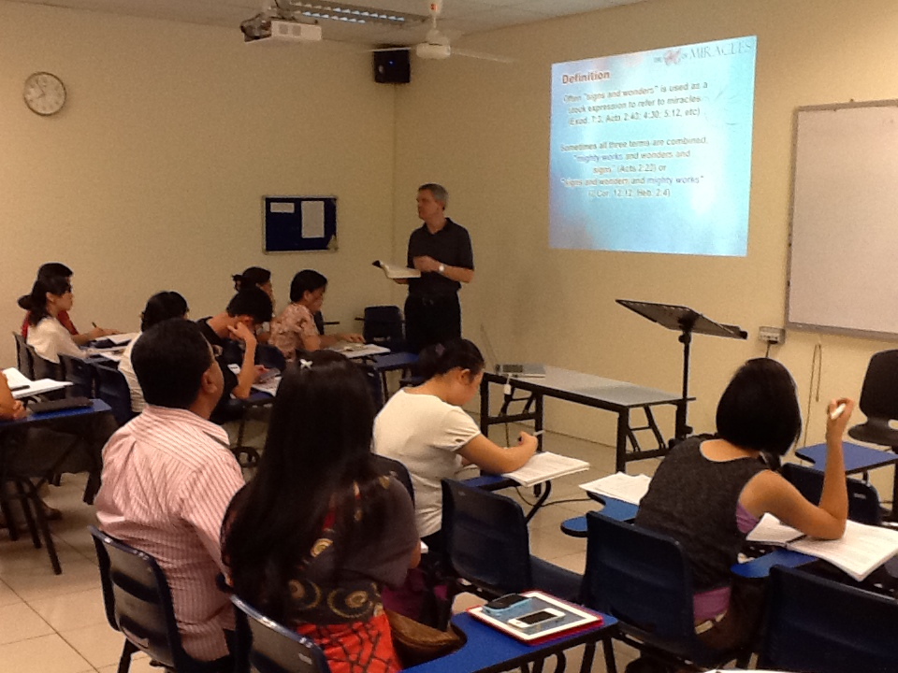
Singapore Bible College Students
9
Notes:
Most of these students are first-generation Christians eager to share the gospel with their own people!

Slide 28

Our Singapore Bible College Apt.
9
Notes:
Our Wednesday pattern to set up the table for our Pastoral Care Group that comes up to our apartment on campus.

Slide 29
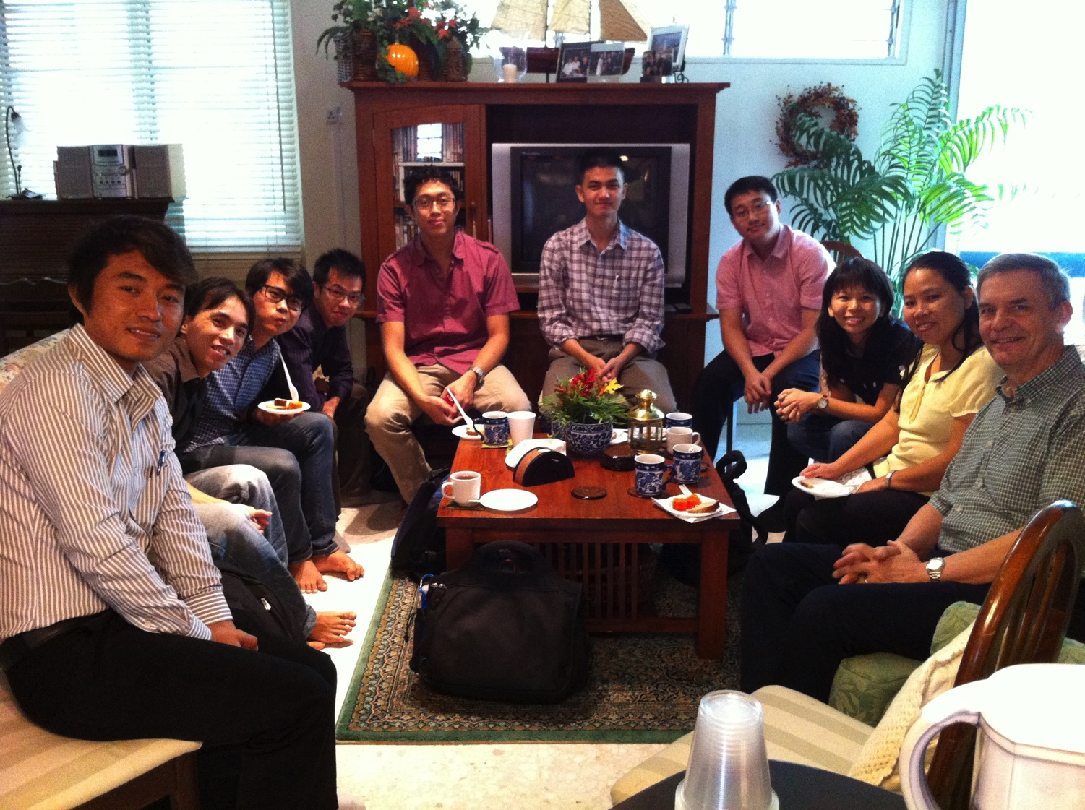
SBC Pastoral Care Group
9
Notes:
Our Pastoral Care Group has 9 students from Myanmar, Vietnam, Singapore, and Hong Kong.

Slide 30
Courses Taught Since 1991
(English • Indonesian • Chinese)
Survey • The Bible…Basically
OT NT Bible Study
Backgrounds • Research & Writing
OT NT Geography
Theology • Creation • Jesus
Church • Spirit • Salvation • Future
Preaching
Homiletics 1 Homiletics 2
Notes:
I get to teach these leaders every book of the Bible in survey courses, plus backgrounds to both the OT and NT, three areas of theology, and how to preach.

Slide 31

Our Mission Organization…

Slide 32
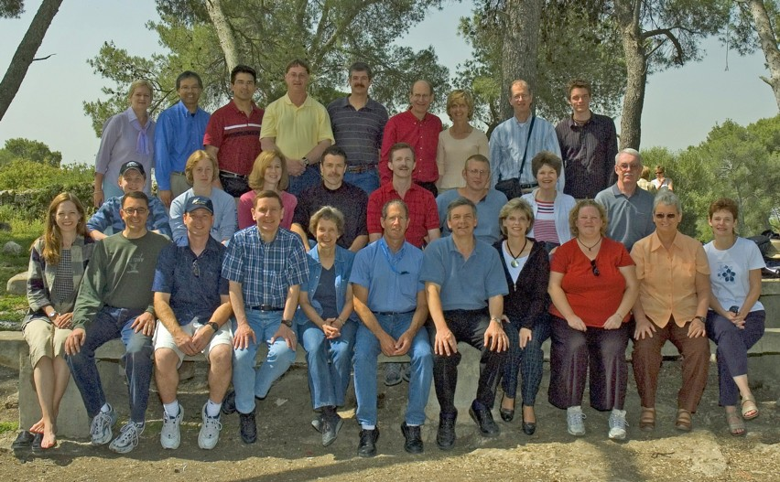
WorldVenture Seminary Professors in Israel

Slide 33
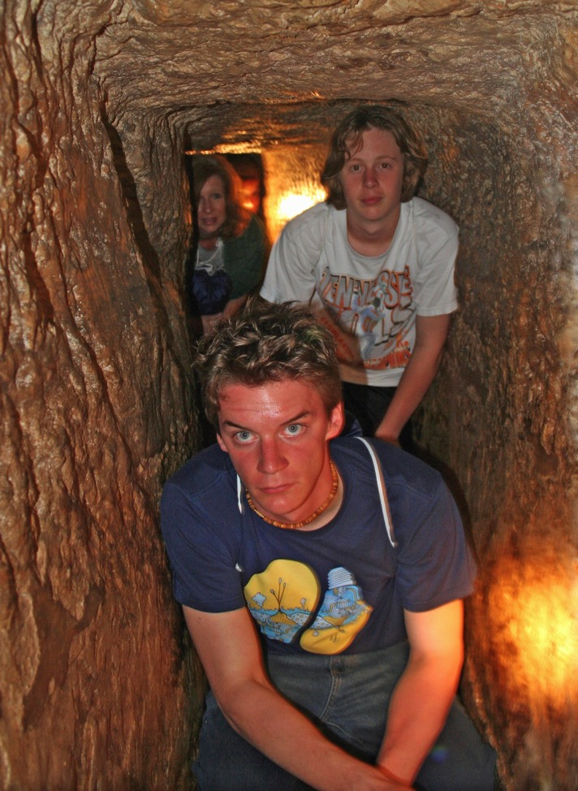
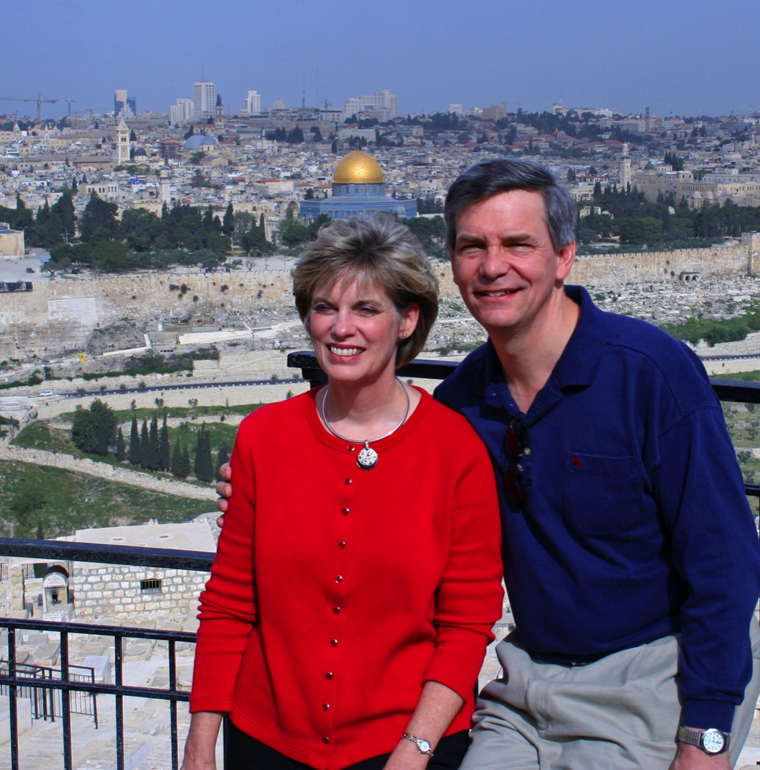
Susan & Rick at Mount of Olives
Kurt in
Hezekiah's Tunnel

Slide 34
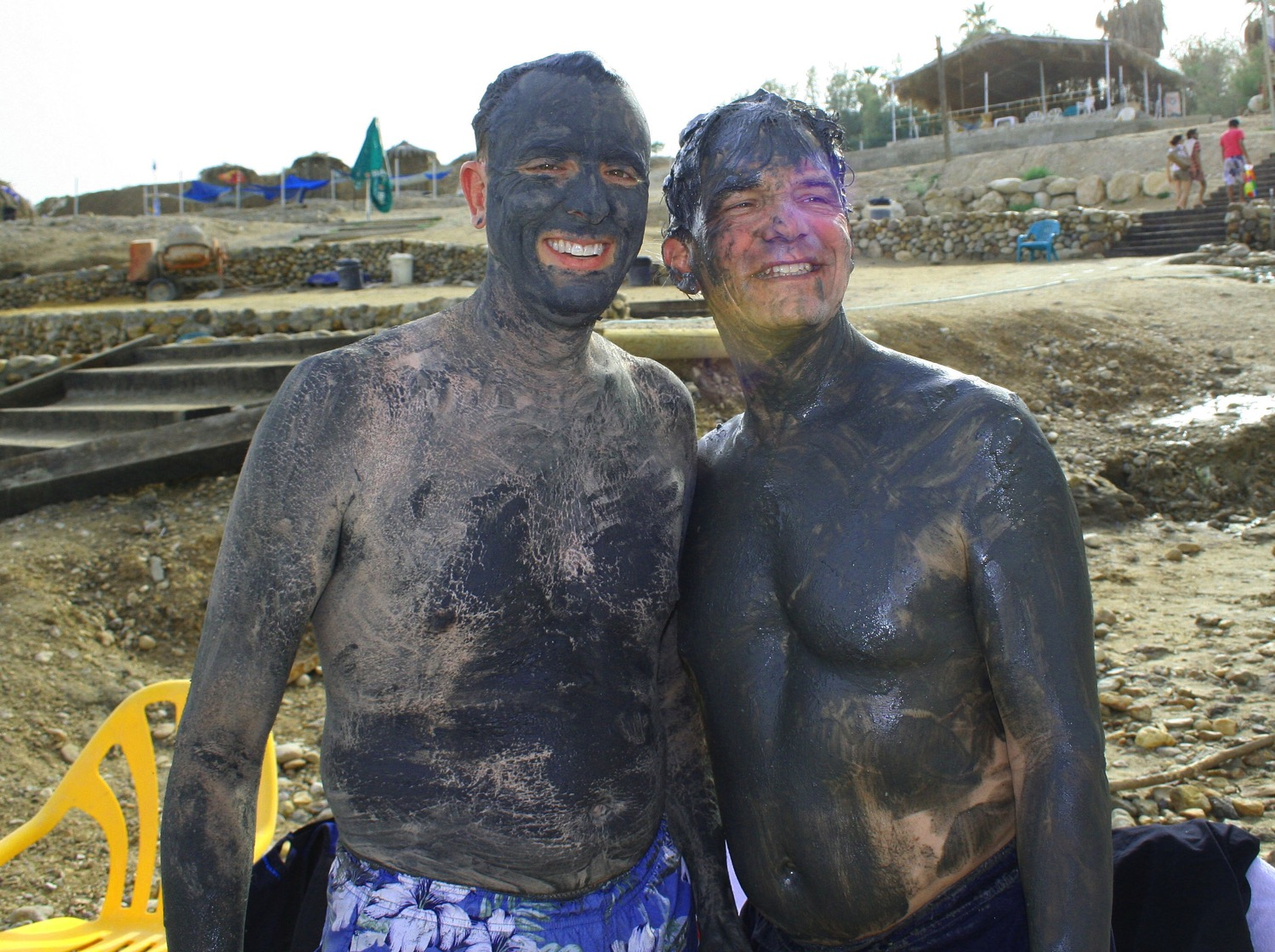
Dead Sea Mud

Slide 35
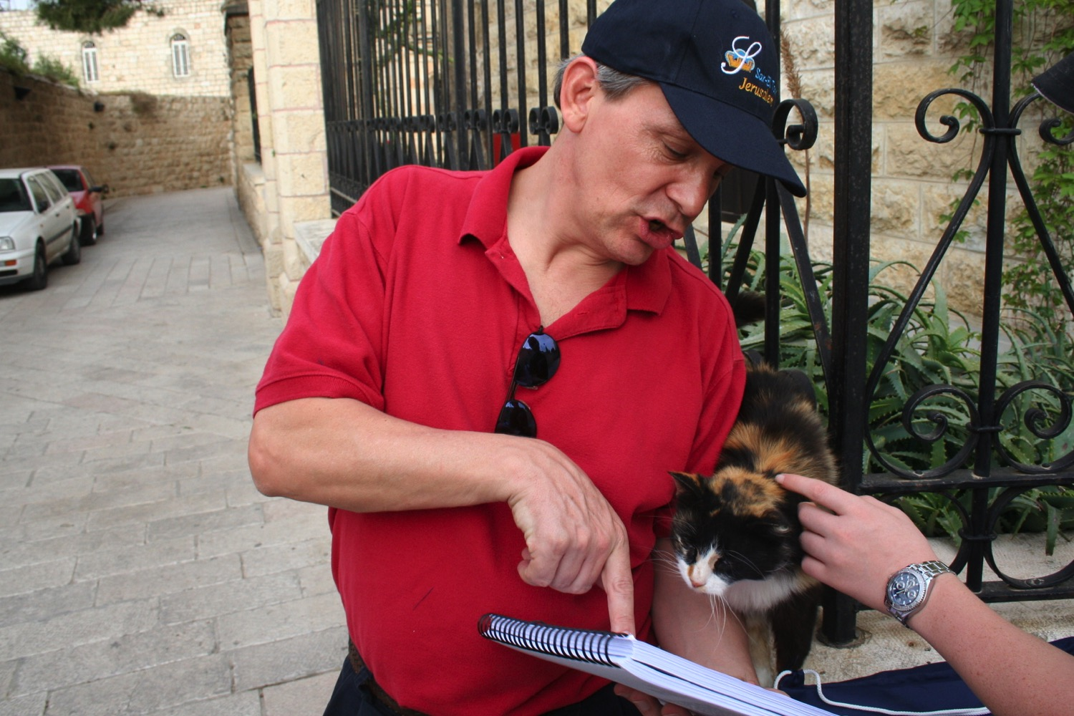
"Preach to every creature" (Mark 16:15)

Slide 36
Ministries God Gave Us
WorldVenture Singapore field leader
Singapore Bible College professor
Biblical Education by Extension teacher

Slide 37

Assignment File System

Slide 38
LC Sign Up List
Name | HP | Email | Reading |  | Project & Language
 |  |  | A: IBS | B: Book | 1: NTS | 2: TBB | 3: Teach | 4: Paper
X | X | X | X
X | X | X |  | X | X
X | X | X |  | X |  | X
X | X | X |  | X |  |  | X
X | X | X |  | X |  |  |  | X
Name | Email | Degree | Project

Slide 39


NT Survey link at BibleStudyDownloads.org
Get this presentation for free!
Notes:
Student translation since 2003 with 700 translators has resulted in Bible teaching and study materials—mostly PowerPoint—in 49 languages! All a teacher needs to do is to click on a file and it downloads for free to teach any book of the Bible and many other subjects.
NT Survey (ns)

Slide 40

BibleStudyDownloads.org
7
Notes:
My SBC teaching has resulted in Bible teaching and study materials—mostly PowerPoint—in 49 languages! All a teacher needs to do is to click on a file and it downloads for free to teach any book of the Bible and many other subjects.

Slide 41
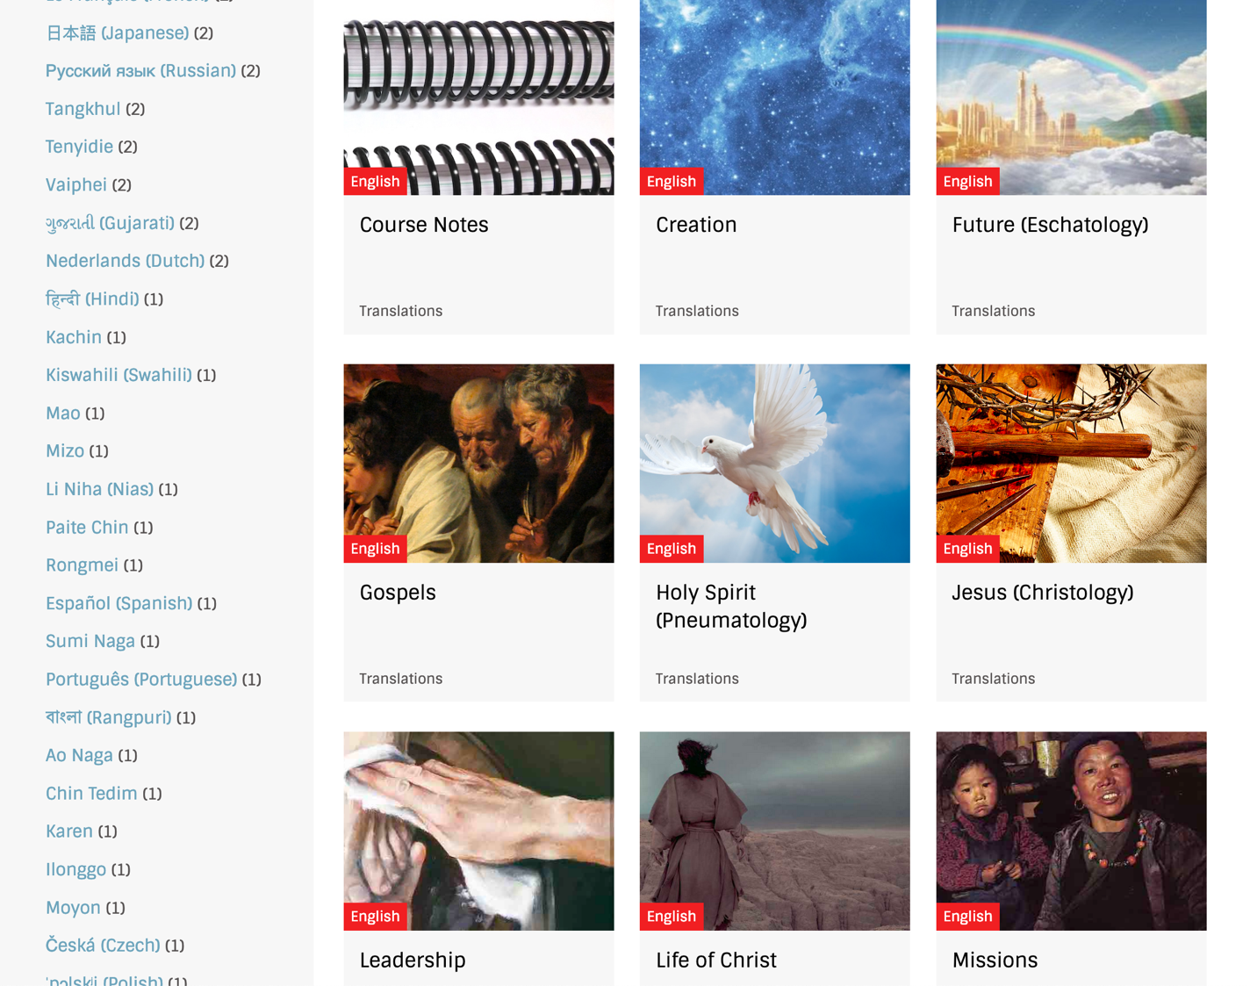
BibleStudyDownloads.org
7
Notes:
My SBC teaching has resulted in Bible teaching and study materials—mostly PowerPoint—in 49 languages! All a teacher needs to do is to click on a file and it downloads for free to teach any book of the Bible and many other subjects.

Slide 42
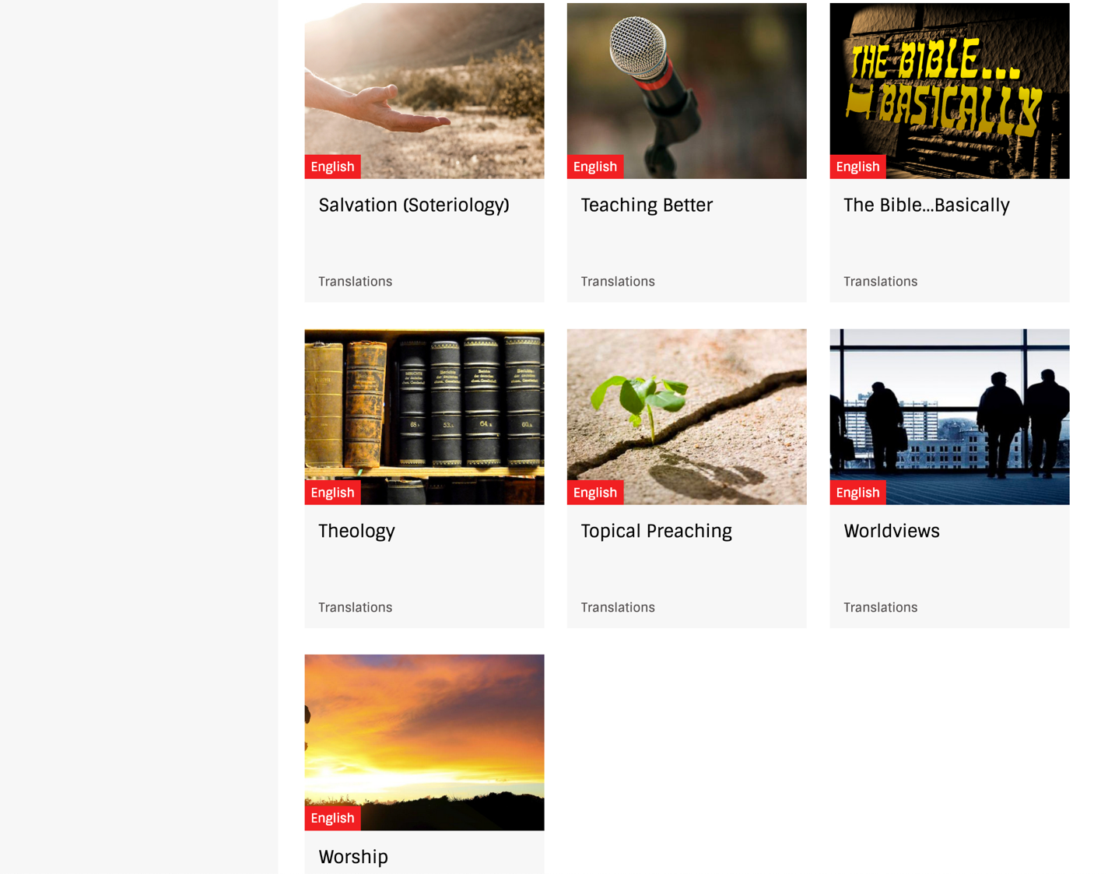
BibleStudyDownloads.org
7
Notes:
My SBC teaching has resulted in Bible teaching and study materials—mostly PowerPoint—in 49 languages! All a teacher needs to do is to click on a file and it downloads for free to teach any book of the Bible and many other subjects.

Slide 43
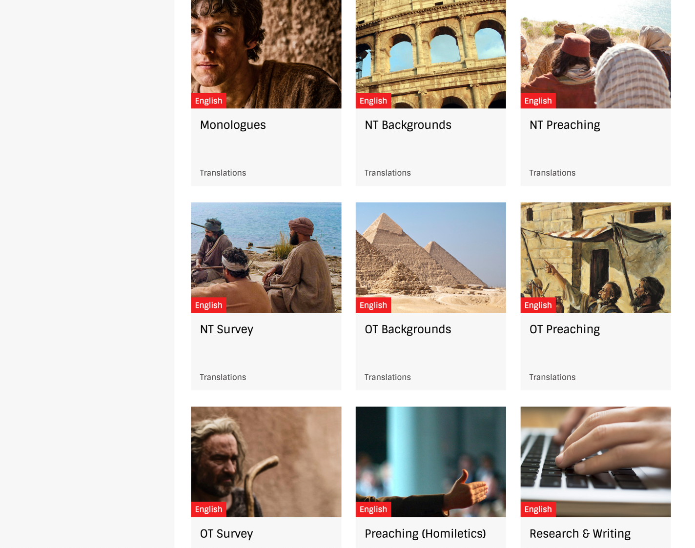
BibleStudyDownloads.org
7
Notes:
My SBC teaching has resulted in Bible teaching and study materials—mostly PowerPoint—in 49 languages! All a teacher needs to do is to click on a file and it downloads for free to teach any book of the Bible and many other subjects.

Slide 44
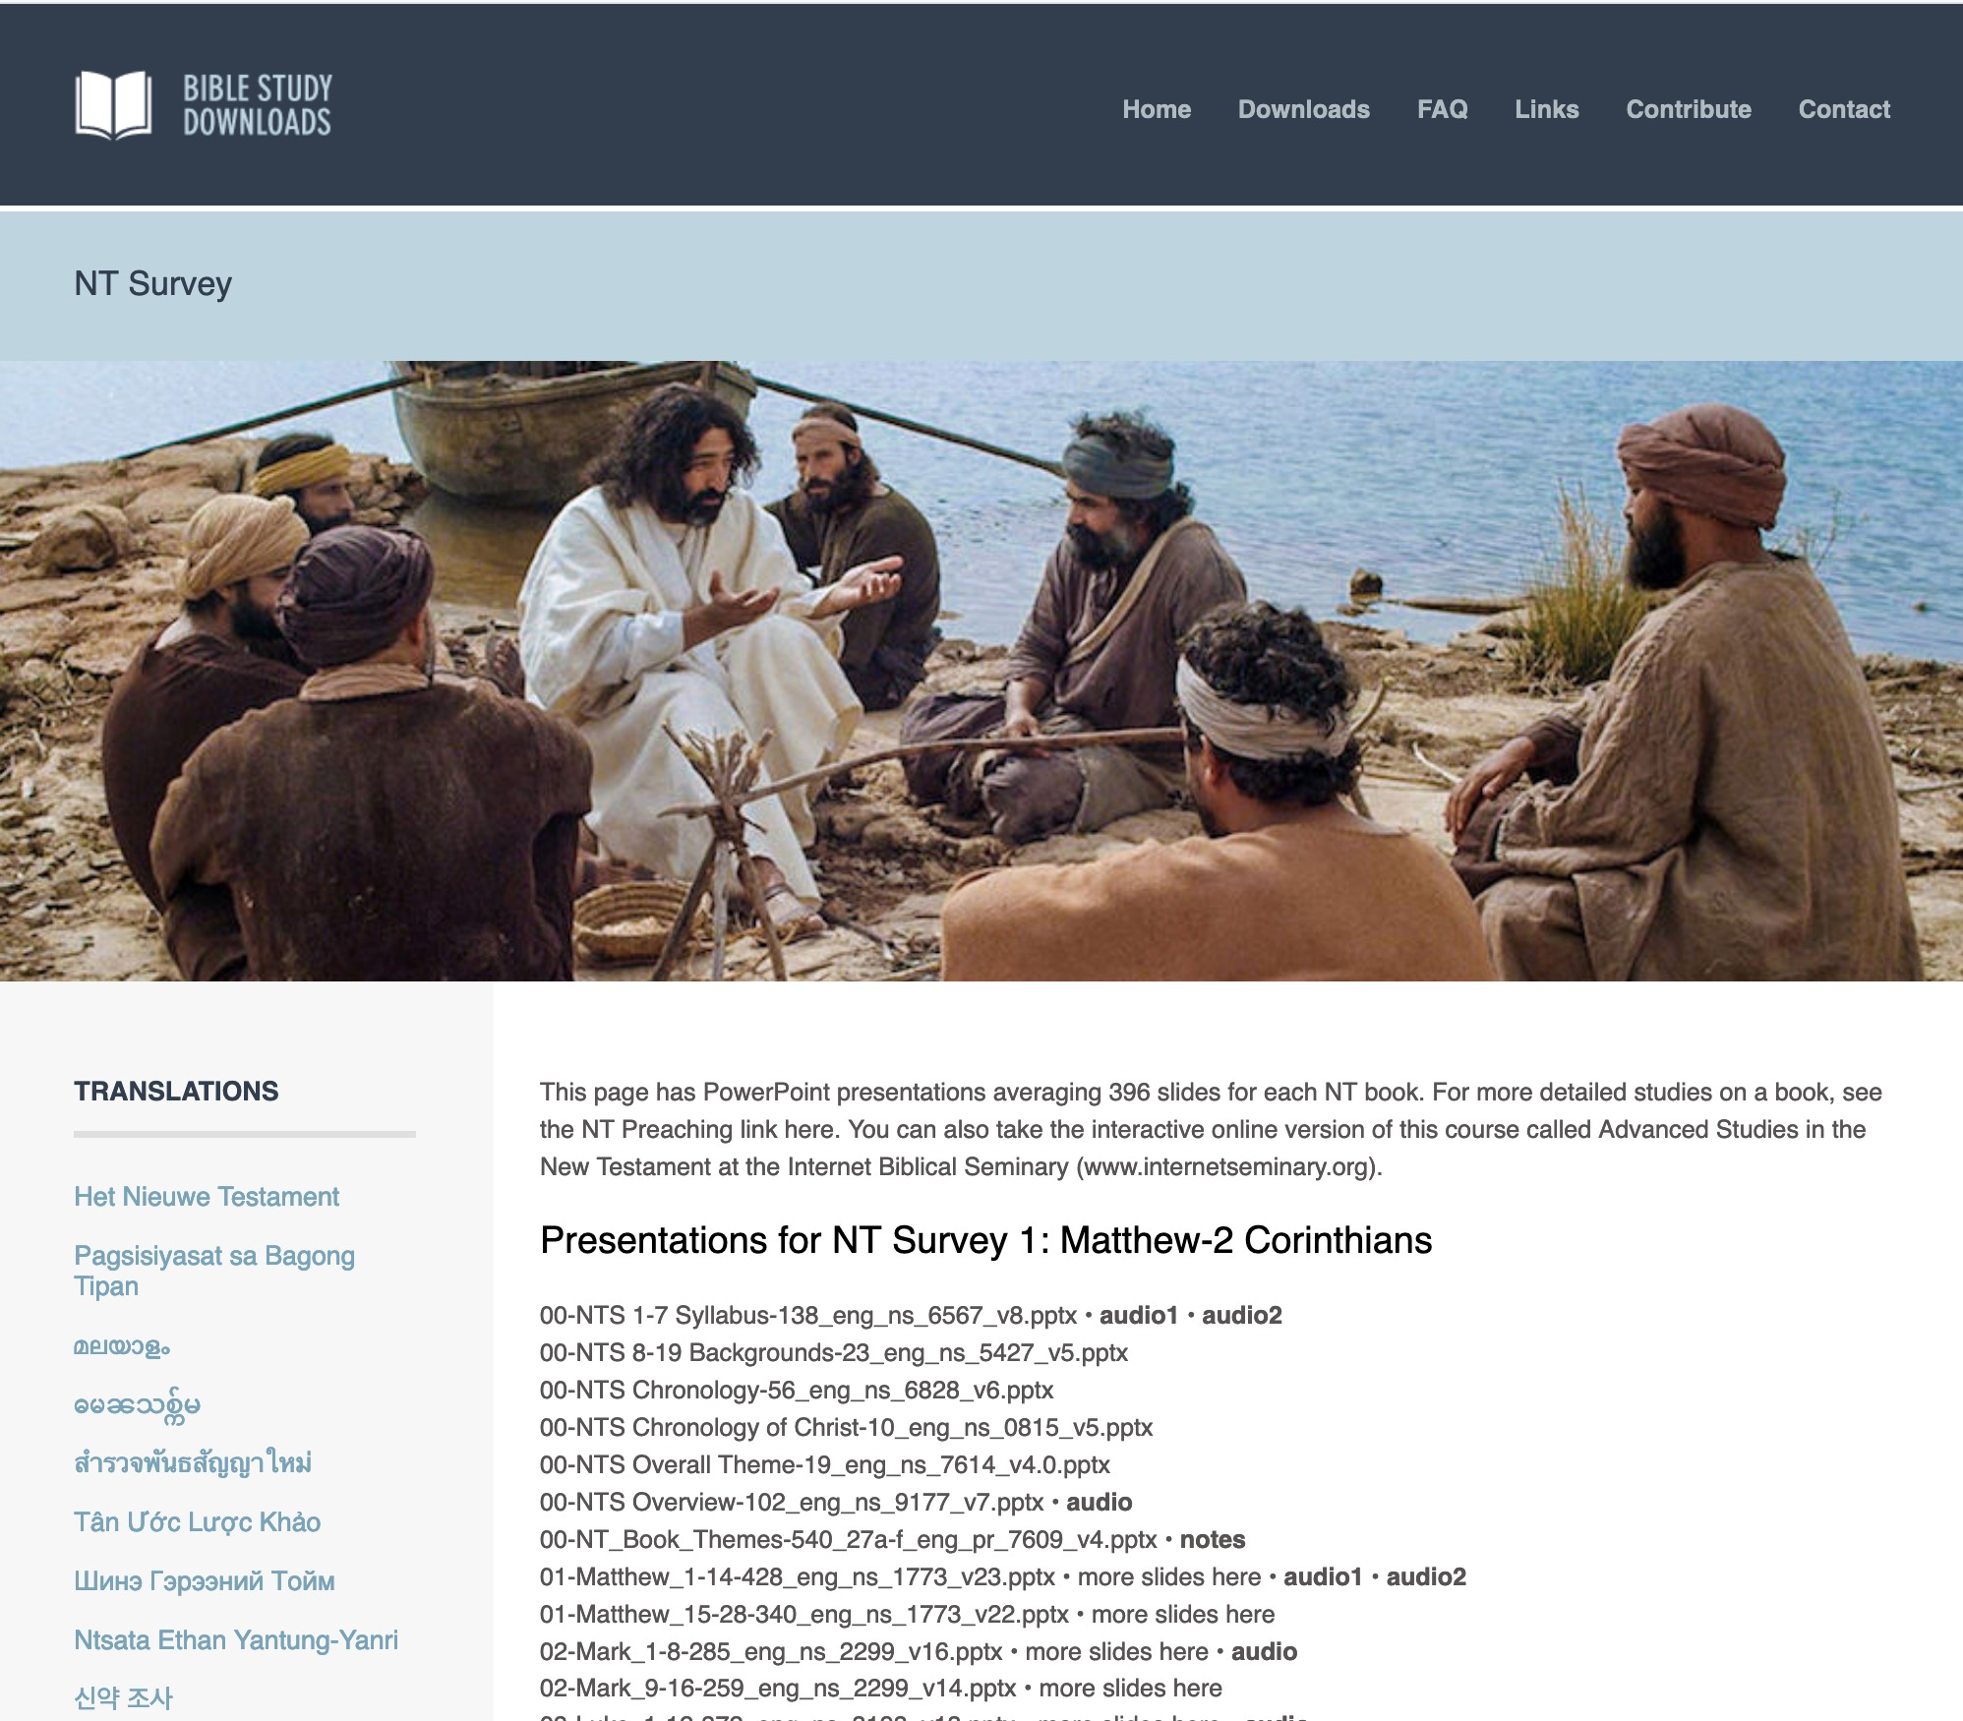
BibleStudyDownloads.org
7
English
Notes:
My SBC teaching has resulted in Bible teaching and study materials—mostly PowerPoint—in 49 languages! All a teacher needs to do is to click on a file and it downloads for free to teach any book of the Bible and many other subjects.

Slide 45
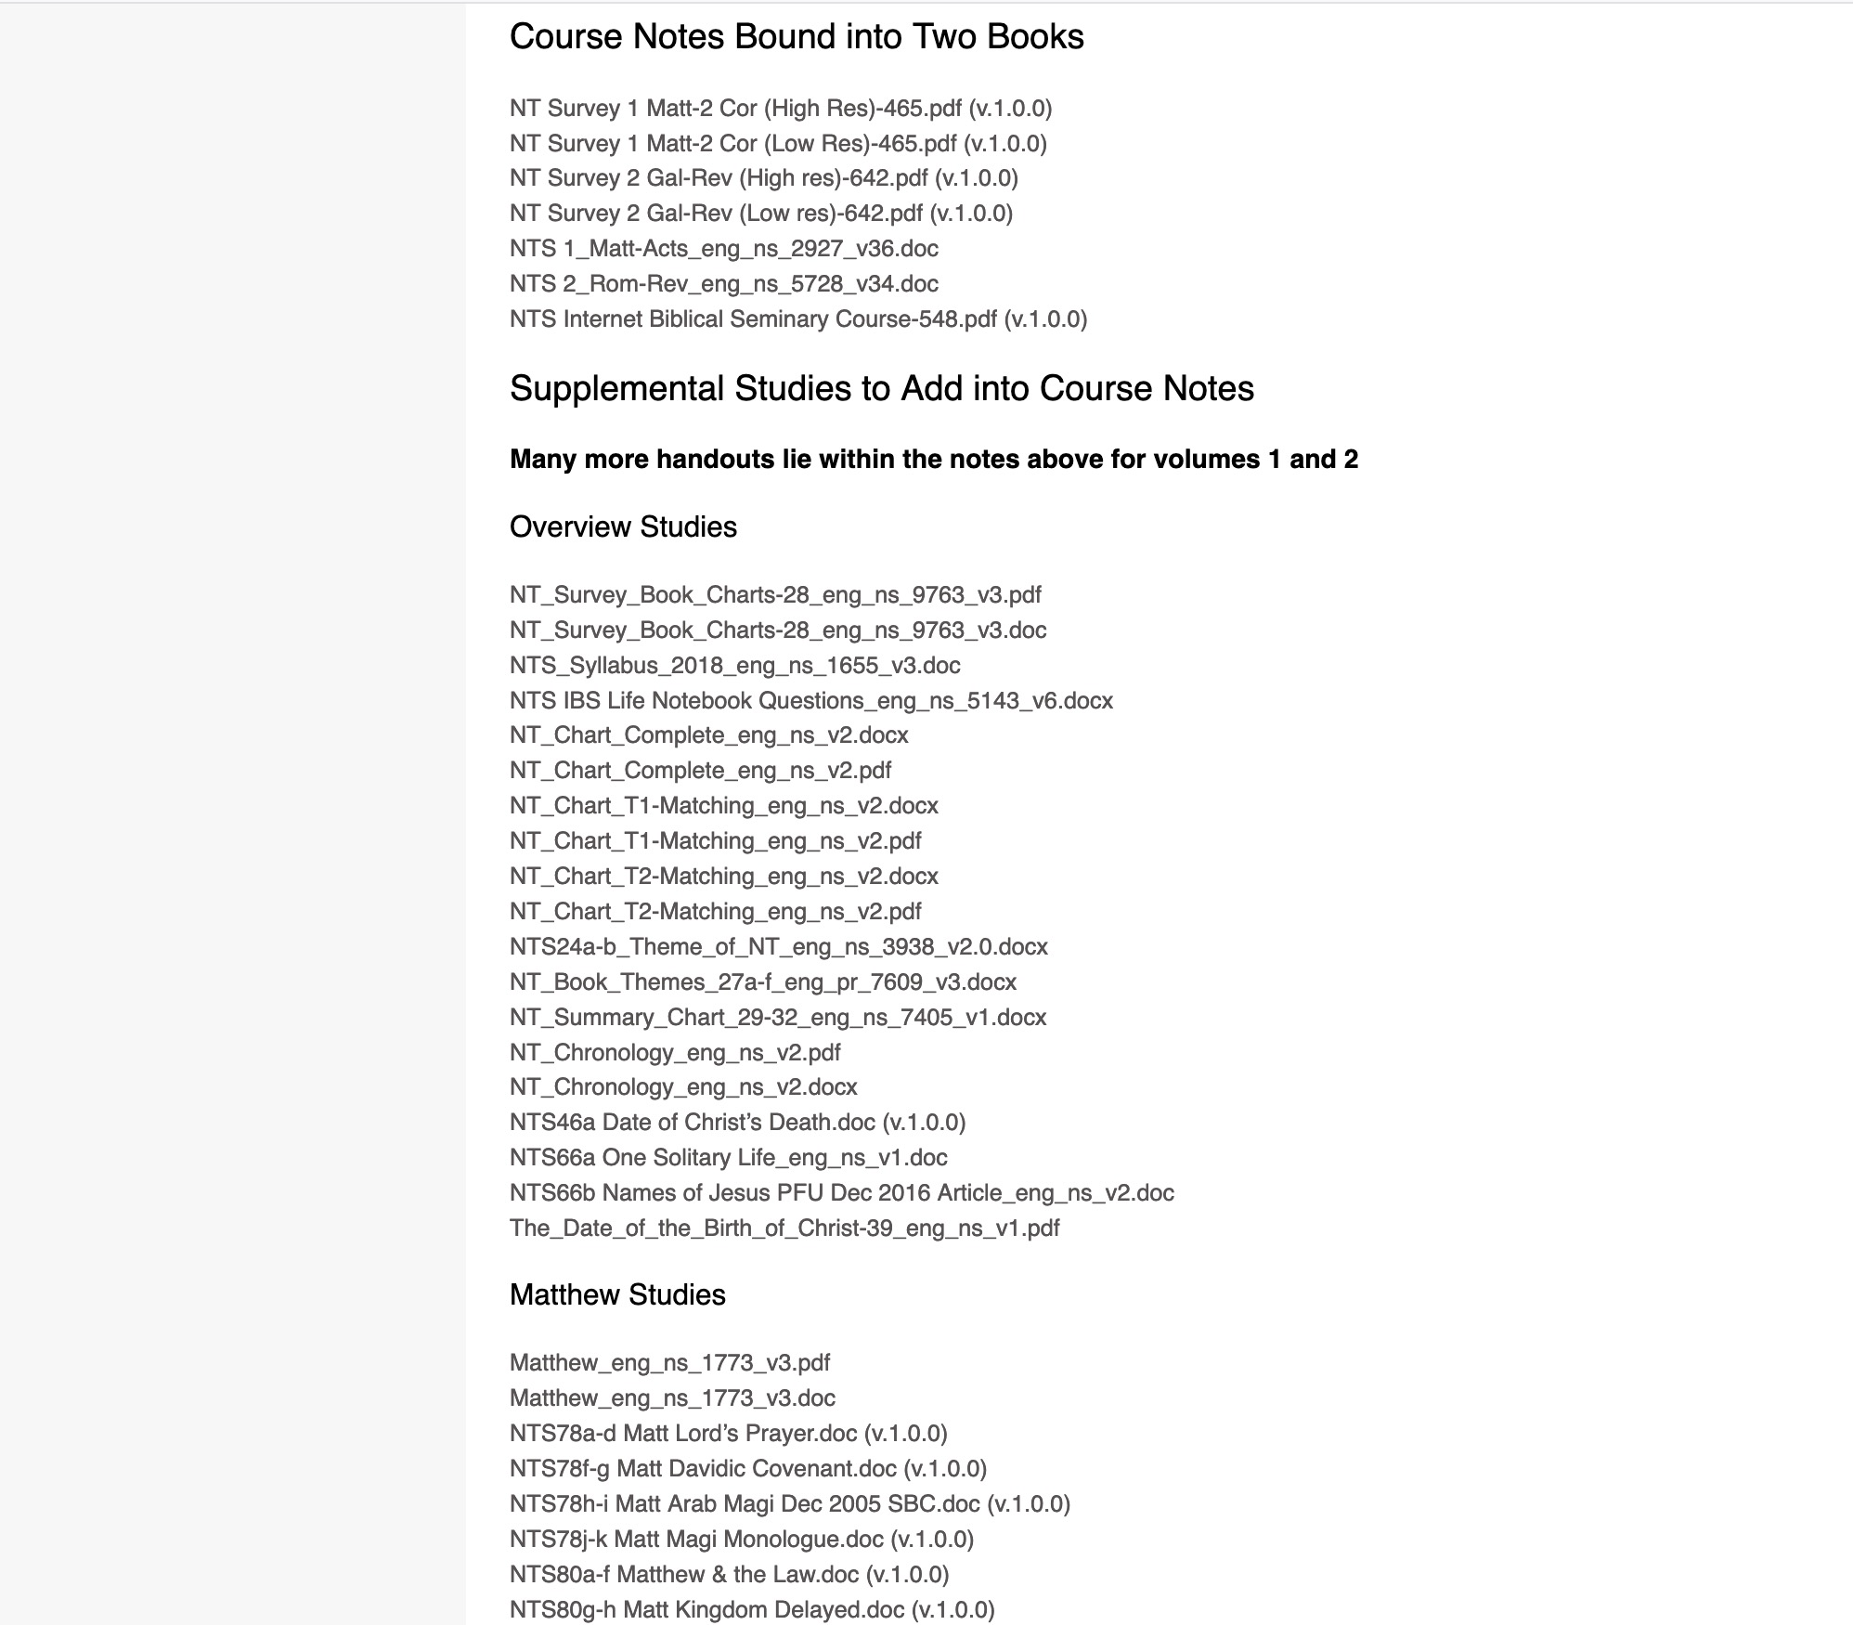
BibleStudyDownloads.org
7
NT Survey
Class Notes
Notes:
My SBC teaching has resulted in Bible teaching and study materials—mostly PowerPoint—in 49 languages! All a teacher needs to do is to click on a file and it downloads for free to teach any book of the Bible and many other subjects.

Slide 46
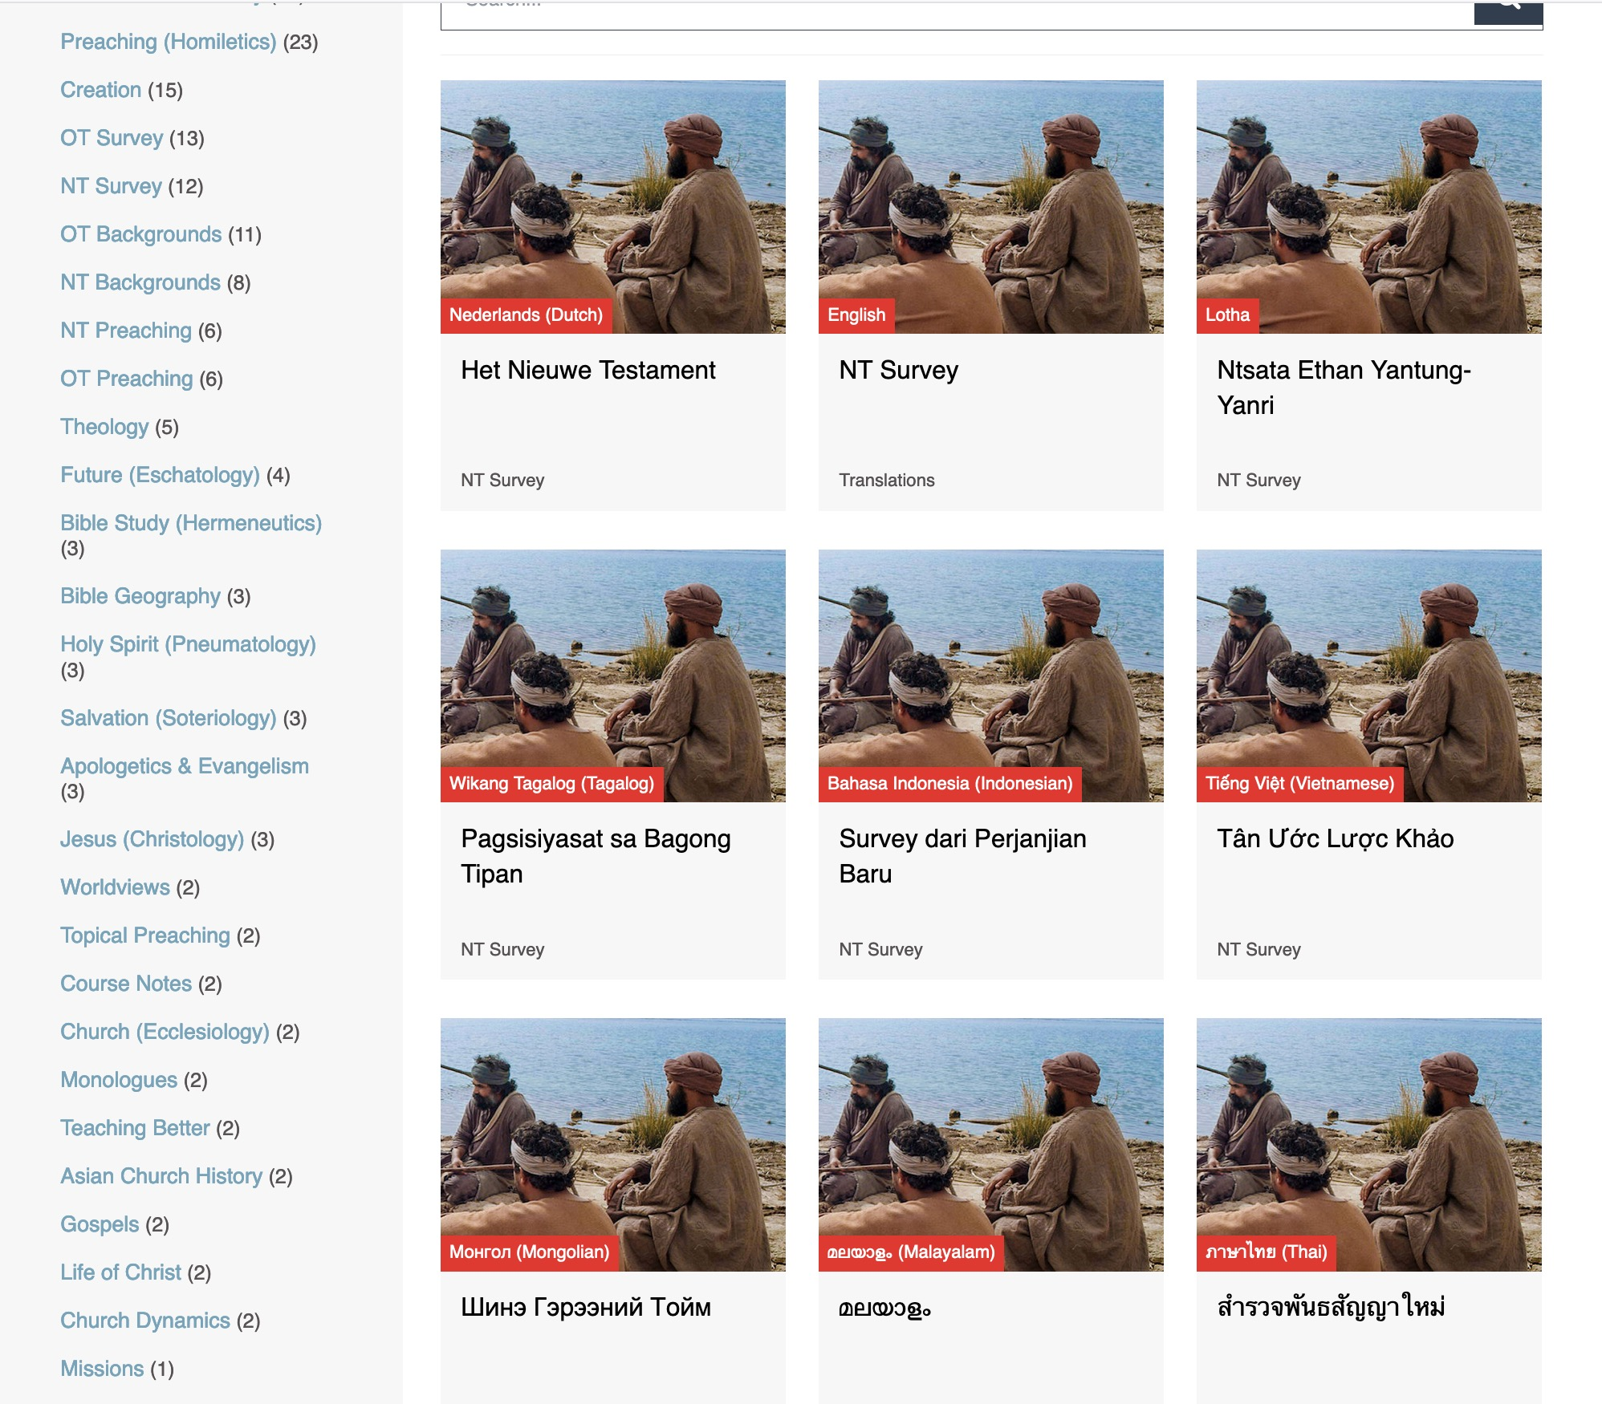
BibleStudyDownloads.org
7
Translations
Notes:
Here are 9 languages featured.

Slide 47
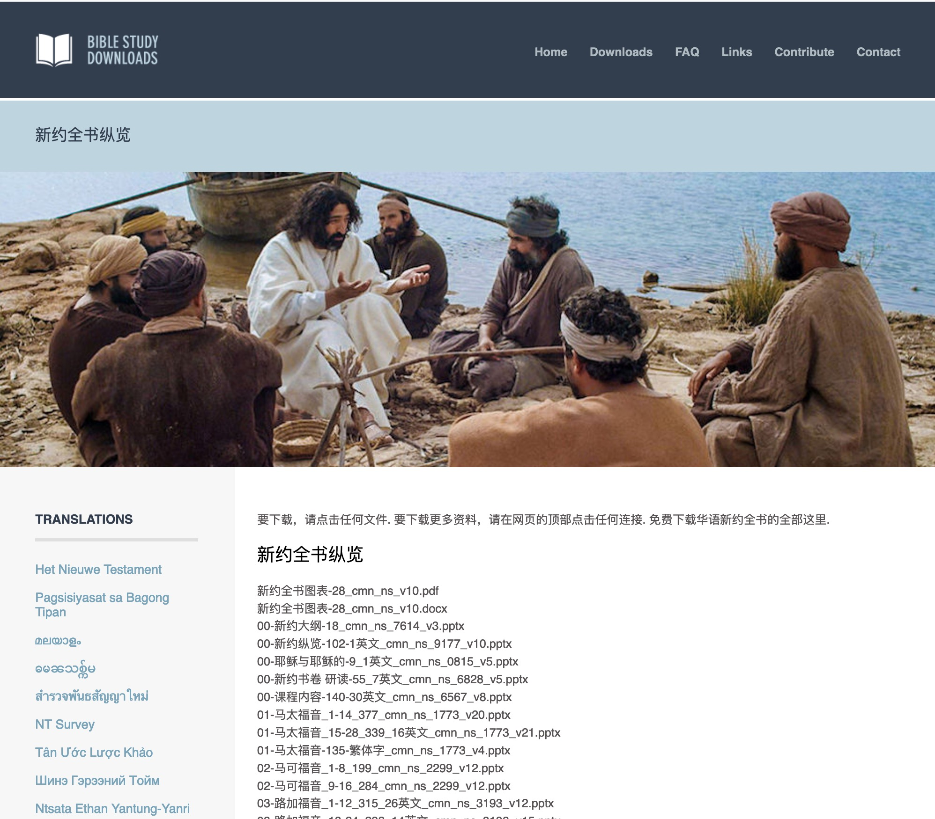
Chinese
7
01-马太福音_1-14_377_cmn_ns_1773_v20.pptx
Notes:
Chinese downloads include more than 37,000 slides as of Jan 2020.

Slide 48
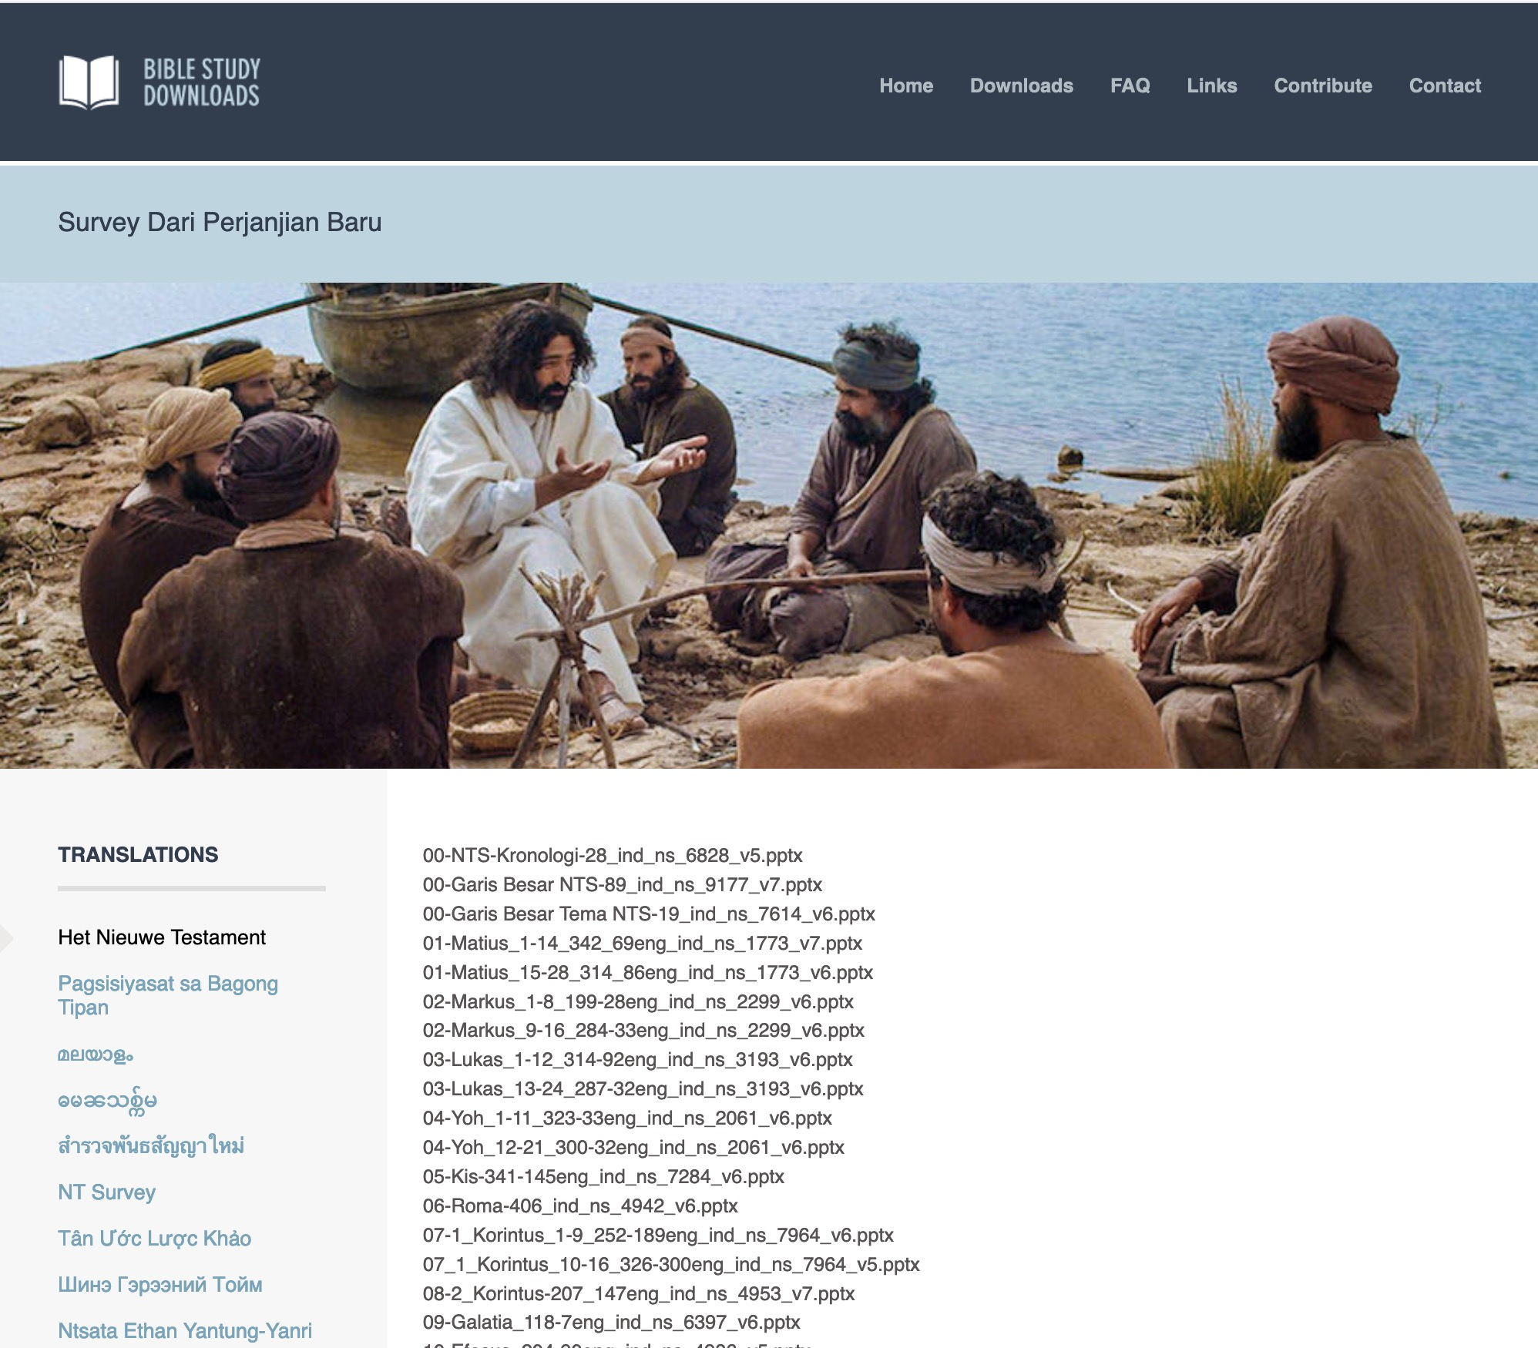
Indonesian
7
Notes:
Indonesian downloads include more than 14,000 slides as of Jan 2020.

Slide 49
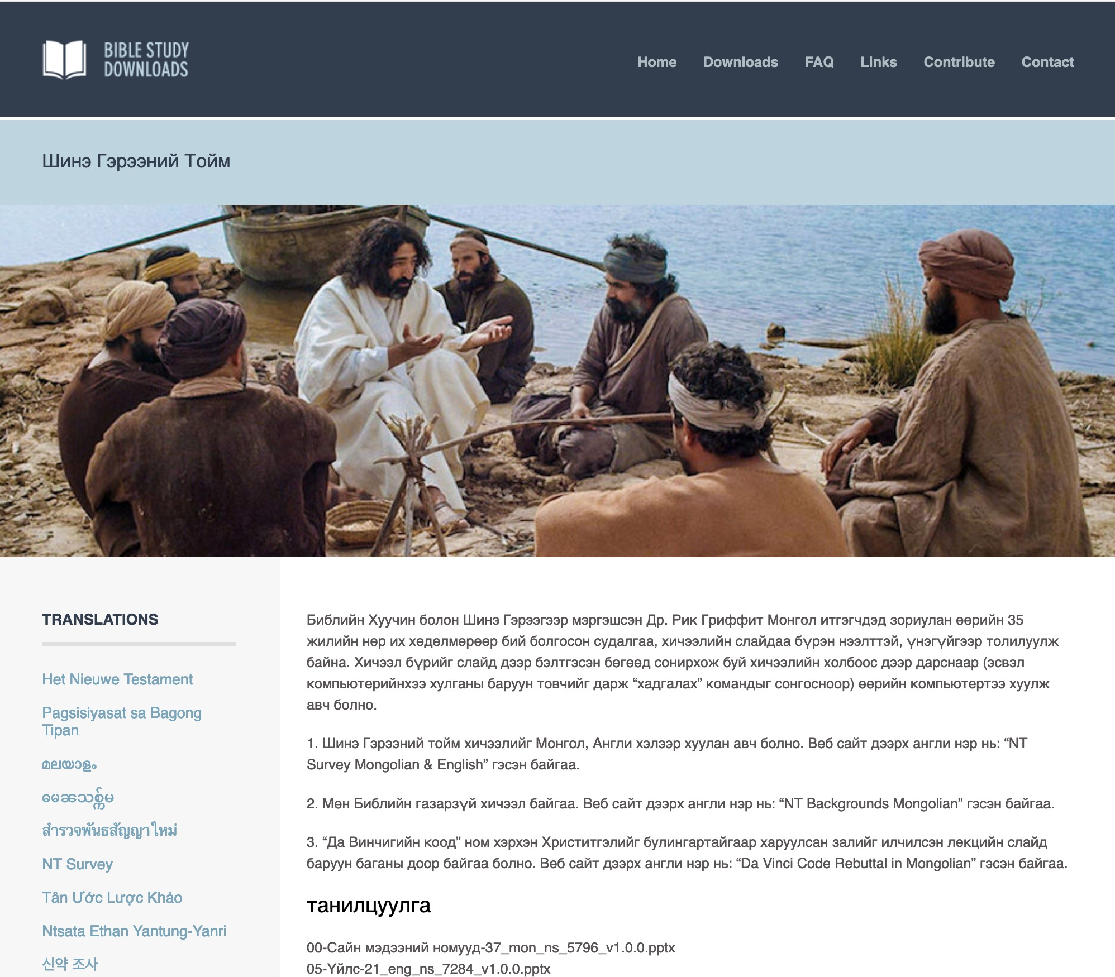
Mongolian
7
Notes:
Mongolian downloads include more than 3,000 slides as of Jan 2020.

Slide 50
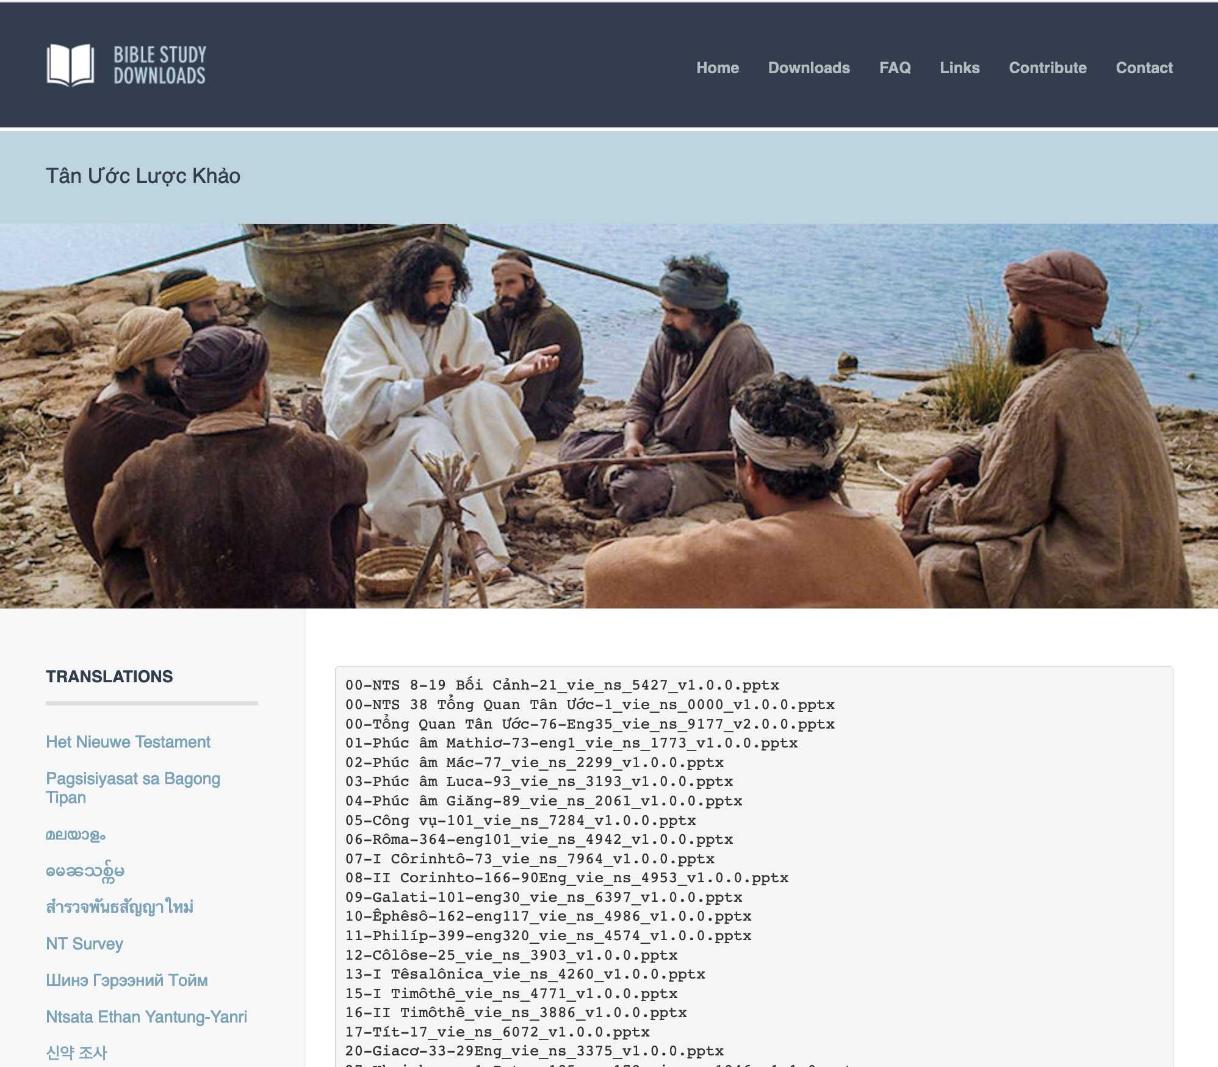
Vietnamese
7
Notes:
Vietnamese downloads include more than 8,000 slides as of Jan 2020.

Slide 51
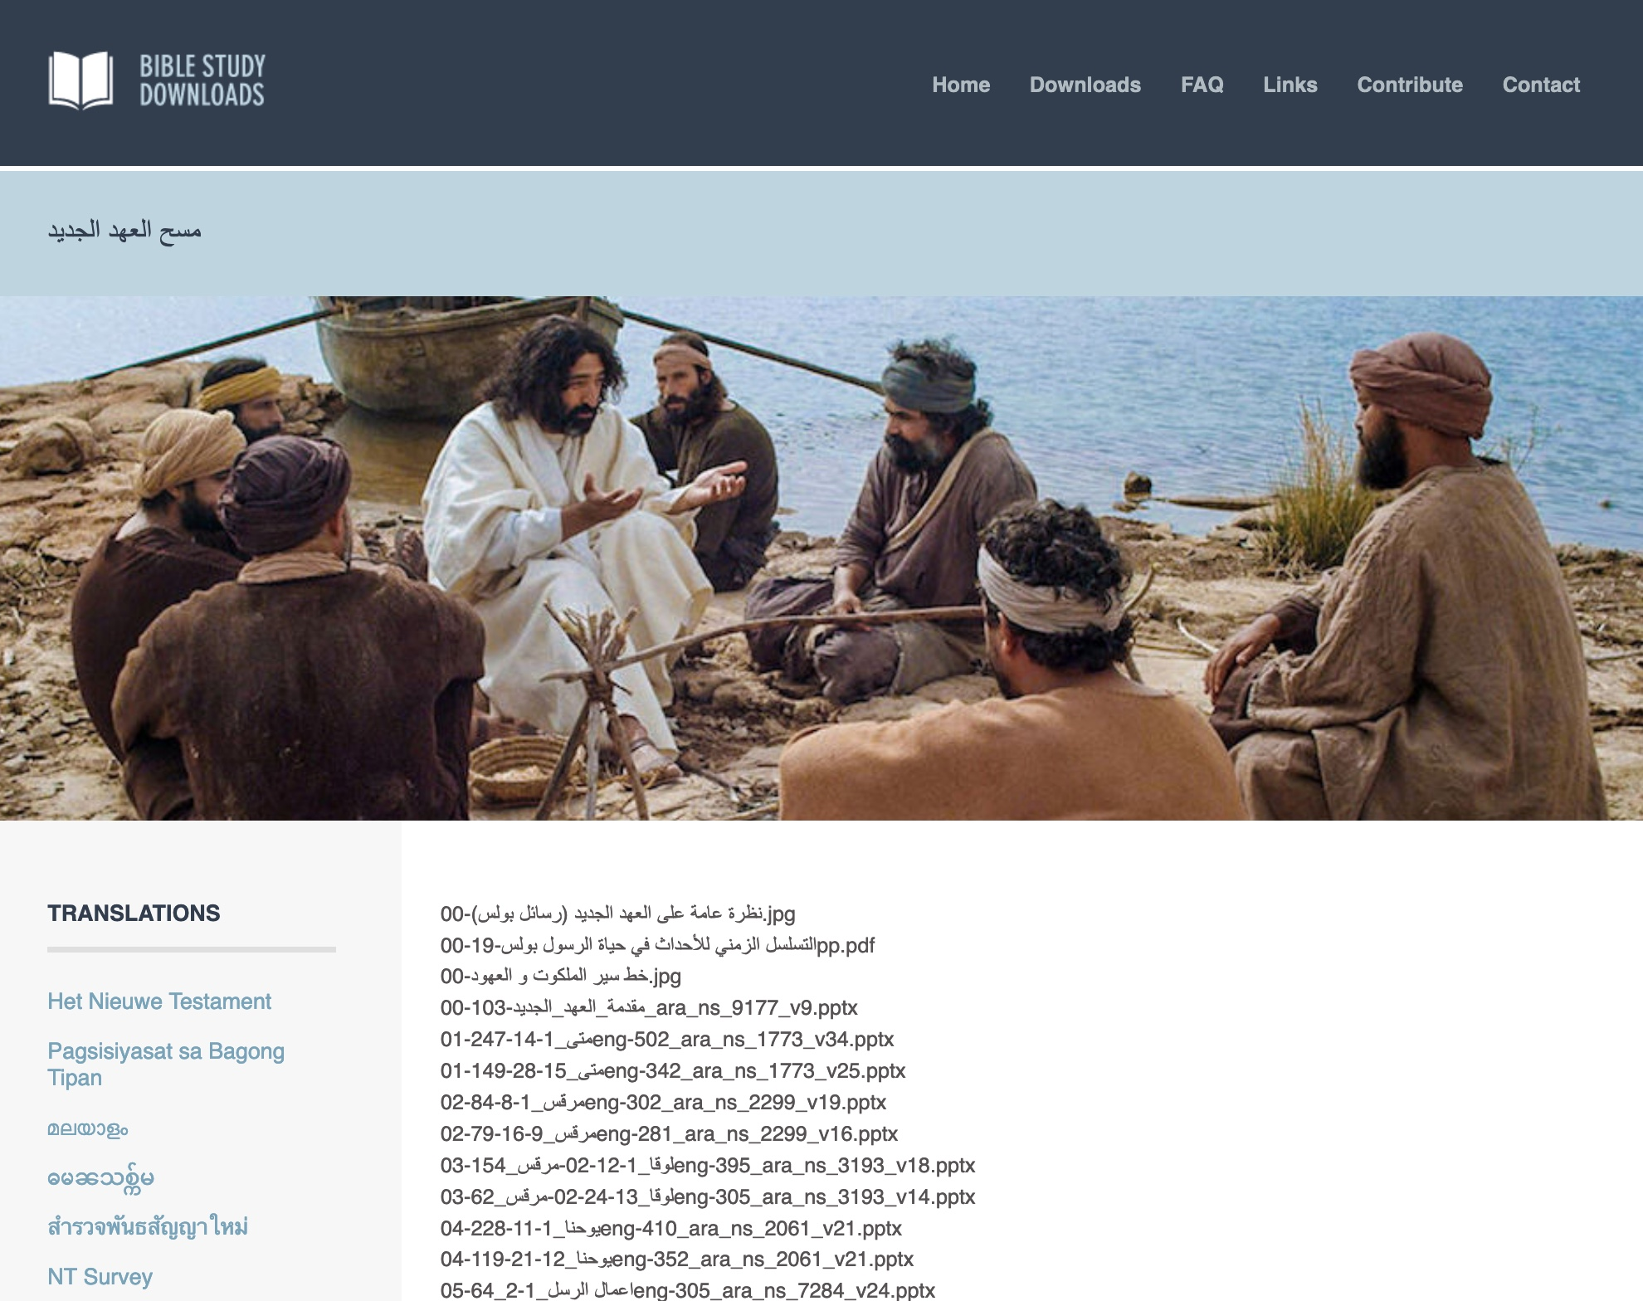
Arabic العربية
7
مسح العهد الجديد
01-متى_1-14-247eng-502_ara_ns_1773_v34.pptx
Notes:
Arabic downloads include more than 1100 slides as of August 2021.

Slide 52
Ministries God Gave Us
WorldVenture Singapore field leader
Singapore Bible College Bible & preaching professor
Singapore Bible College Doctor of Ministry director
Adjunct Professor teaching in 12 nations
The Bible…Basically translation director
BibleStudyDownloads.org web author
Crossroads International Church pastor-teacher
Jordan Evangelical Theological Seminary professor

Slide 53
Teaching 1997-2021
MONGOLIA
JORDAN
KOREA
CHINA
NEPAL
MYANMAR
INDIA
THAILAND
VIETNAM
MALAYSIA
SRI LANKA
SINGAPORE
SBC
INDONESIA
Notes:
From 1997-Dec 2020 God has seen fit to grant me the privilege to train pastors in 12 other countries on 73 trips. Often pastors in the US team-teach with me on these trips. To help the poor, I avoid the wealthy countries where listeners can pay an honorarium but instead raise the funds to pay my own way and then teach for free.

Slide 54
JETS Course Description
1
This is a study of the four Gospels, with attention given to developing a chronological survey of the life of Christ. Emphasis will be given to understanding their historical, cultural, and literary message, the trustworthiness of their witness, and important issues for the contemporary church (3 hours).

Slide 55
Course Description
1
A survey of the life of Jesus Christ in ten movements
An understanding of how a harmony of the gospels can aid our understanding of each respective gospel

Slide 56
Course Objectives
1
By the end of this course, the student will be able to…
A. Know the ten movements of the Life of Christ
B. See the value of harmonizing the gospels.
C. Teach the basic content of the course in Arabic and teach it.
D. Know from experience the value of Internet learning to know how to learn from the net.

Slide 57


All Quizzes and Exams are Closed Book!
Quizzes are over the reading.
Exams are over the notes.
Notes:
Quizzes are over the reading.
Exams are over the course notes.

Slide 58

Course Text
Section summaries based on J. Dwight Pentecost,
A Harmony of the Words and Works of Jesus Christ (Grand Rapids: Zondervan, 1981)
Notes:
The original 1981 title was The Words and Works of Jesus Christ.
The 1998 edition add the harmony idea with the new title A Harmony of the Words and Works of Jesus Christ.

Slide 59

BTh Student Grading
4
Average of
3 grades (paper or project)
Readings
Paper
Project
2 Exams

Slide 60
Other Matters
7
Copying Class Notes
Contacting Me
Mobile number: +962 7 9725 6061
My office hours are after chapel
Email: drrickgriffith@gmail.com
Let's have lunch too!

Slide 61

How Well Do You Know the Life of Christ?
How Well Do You Know the Life of Christ?
53
4
Guest at Wedding
Can you number these events in chronological order?
6
Interview with Nicodemus
3
Enemy's 3 Temptations
7
Message on Mount
1
Birth in Bethlehem
5
Housecleaning the Temple (1st time)
10
Washing Disciples' Feet
8
Parables of Kingdom
2
Carpenter in Nazareth
9
Tomb of Lazarus
Terry Hall, Bible Panorama, 121

Slide 62
AN ALPHABETIZED LIFE OF JESUS
54
AN ALPHABETIZED LIFE OF JESUS (Adapted from Terry Hall, Bible Panorama, 139)
Angels | Luke 1:5-38; Matthew 1:18-25 | Nazareth, Jerusalem
Birth | Luke 2:1-20; Matthew 2:1-12 | Bethlehem
Carpenter | Matthew 2:19-23; Luke 2:39-52 | Nazareth
Dove | Matthew 3:11-17; Luke 3:15-23 | Jordan River
Enemy | Matthew 4:1-11; Luke 4:1-13 | Wilderness, northeast Judea
Followers | John 1:19-51; Mark 3:14-19 | Perea, Galilee
Guest | John 2:1-11 | Cana
Housecleaning | John 2:13-22 | Jerusalem
Interview | John 3:1-21 | Jerusalem
Jacob's well | John 4:5-42 | Samaria
Kin | Luke 4:16-31 | Nazareth
Location | Matthew 4:13-22 | Capernaum
Message | Matthew 5–7 | Capernaum area
Nature | Luke 7:1-35 | Capernaum area, Galilea
Opposition | Matthew 12:22-50 | Capernaum
Parables | Matthew 13:1-53; Mark 4:1-34 | Capernaum area
Question | Matthew 16:13-28; Luke 9:22-36 | Caesarea Philippi
Revelation | Matthew 17:1-13 | Iturea, Mt. Hermon
Stoning | John 10:22-39 | Jerusalem
Tomb | John 11:1-54 | Bethany near Jerusalem
Upset | Matthew 21–23 | Jerusalem
Vision | Matthew 24–25 | Jerusalem, Mt. Olivet
Washing | John 13 | Jerusalem, Upper Room
Xecution | Matthew 26:30–27:56 | Jerusalem
Yes! | Matthew 28; Luke 24:1-49 | Jerusalem, Judea, Galilea
Zion | Luke 24:50-53; Acts 1:1-12 | Jerusalem, Mt. Olivet

Slide 63

Great Periods in the Life of Christ
55
“The Son of Man… came to minister and to give his life a ransom for many” (Mark 10:45)
Climactic Galilean
Early Samaritan
Later Samaritan
Early Judean
Later Judean
Early Perean
Later Perean
Opening Events
Closing Events
Preparation
Confirmation
Walk Thru the New Testament seminar (used with permission)
Notes:
The Walk Thru outline of the life of Christ forms a chiasm or literary arrangement with repeating elements in the opposite order. This structure makes Confirmation parallel to Preparation, Closing Events parallel to Opening Events, etc. until the only event without parallel becomes the focus: Climatic Galilean. Such an arrangement of material was common in ancient antiquity and is seen in both the OT (e.g., Zephaniah) and the NT (1 Thess) where the central teaching appears in the middle of each writing.
_______
LC-00-Syllabus-63
LC-01-Introduction-265
LC-05-Opposition-4

Slide 64
MAIN IDEA OF MATTHEW
Serve the Lord Jesus Christ
GOD
Lord
KING
Jesus
Christ
SAVIOR
Notes:
Serve Jesus as Savior, God, and King of your life! This is the essential message and application of the entire gospel of Matthew.

Slide 65
Pentecost Outline
Introduction of the King
Authentication of the King
Controversy over the King
Instruction of the Twelve by the King
Opposition to the King
Preparation of the Disciples by the King
Official Presentation of the King
Preparation for the Death of the King
Rejection of the King
Resurrection of the King

Slide 66
Introduction
§§ 1-2
The Gospel writers introduce the Person of Christ by emphasizing their sources and his deity to establish the validity of their claims

Slide 67
A. The Source of Knowledge
§ 1
Luke 1:1-4
Luke introduces his account as carefully researched and authoritative to assure his readers of the certainty of what they had been taught

Slide 68
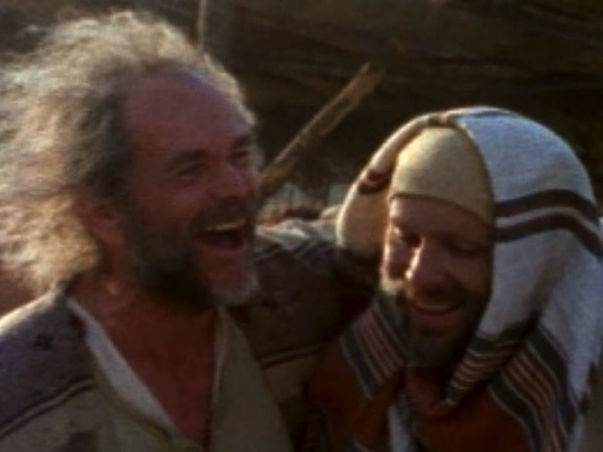
Who was Luke?
Medical doctor
Traveling companion of Paul
Articulate historian & writer

Slide 69
Authorship
94
External Evidence
Church Fathers of the latter half of the 2nd century agreed that Luke, "the beloved physician" (Col. 4:14), wrote this Gospel which bears his name:
The earliest evidence
for Lukan authorship – Muratorian Canon and
the Anti-Marcionite Prologue.
Further citations to Lukan authorship are given by Irenaeus, Tertullian, Clement of Alexandria,
Origen, Eusebius, and Jerome.
Internal Evidence
1. Several factors signify that Luke and Acts had the same author.
2. The "we sections" in Acts
3. Use of more technical medical terms is compatible with authorship by a doctor

Slide 70
NT Overview (History)
38
124
39-41
"To the remotest part of the earth" (Acts 1:8)
Acts 9 13 14 15 16 18 21 27 28
Apr 48-
Sep 49
1
Galatia
Apr 50-
Sep 52
2
Aegean
Spr 53-
May 57
3
Asia
Feb 60-
Mar 62
1
Rome
Spr 62-
Fall 67
4
Spain
Aut 67-
Spr 68
2
Rome
Summer 35-
37
Damascus
Antioch
May 57-
Aug 59
Trials
Fall 49
The
Council
Spring 68
Expansion of Church
35 48 49 50 52 53 57 60 62 67 68 95
Matt
Luke
Date
The Book of Acts ends with Paul's two year imprisonment,
ending in AD 62, and Luke was written before Acts. The best estimate is probably that Luke wrote his account during Paul's two-year imprisonment at Caesarea (Jun 57-Aug 59).
Gospels & Acts
1234
Journeys
Rome
Imprisonments
Gospels & Acts
Notes:
By this time, the Jews had the gospel of Matthew that was directed towards Jewish readers. Matthew gave evidences for Jesus as the long-awaited Messiah, or ruler promised in the OT. But now after the East was reached was the time for Luke to present Jesus to the westerners. Paul was awaiting trial for two years in Israel. Luke was with him and in the perfect time and place to write a history of Jesus for Gentiles.

Slide 71
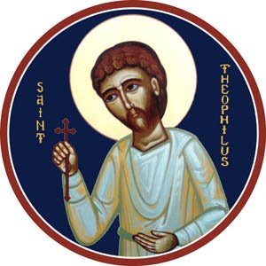
Who was Theophilus?
“Lover of God”
Believer in Jesus
Probably Wealthy Benefactor

Slide 72
Circumstances
94
Origin/Recipients
Assuming the dating presented
is correct, Luke wrote from Caesarea. He clearly wrote to Theophilus.
The title of "most excellent" for Theophilus probably indicates that he was an official. As a man of high social standing, he may have assumed responsibility for publishing Luke and Acts.

Slide 73
Circumstances
94
In line with writing to Gentiles, Luke:
Translates Aramaic terms
Traces Christ's genealogy to Adam
Refers to Roman rulers for dating
Avoids noting fulfilled prophecies
Quotes the Septuagint
Explains Jewish customs, and
Explains Israel’s geography.

Slide 74
Occasion
94
Undoubtedly Theophilus considered Luke a tremendous source to provide an orderly account of the life of Christ.
Luke wrote to strengthen the wealthy Christian's faith by showing that his faith rested on firm historical facts.
Perhaps even more significantly, Luke sought to explain to his wider Gentile audience how Christ died for the entire world after being rejected by Israel.

Slide 75
Purpose
95
Kingdom
Ecclesiastical
Instructional / Edification
Narration of History
Soteriological / Evangelistic
Conciliation
Apologetic

Slide 76
Characteristics
96
Glory
Superb Style
Joy
Prayer
Humanity of Christ
Universal
Money
Septuagint
Forgiveness
Temple
Redemptive Mission
Gentile
Holy Spirit
Abrahamic & Davidic Covenants
Secular History
Individual
Comprehensive
Emphasis on Women

Slide 77
Argument
96
Luke's Gospel is written from a Gentile mind to the Gentile mind to confirm Theophilus' faith but also to answer how the Jewish Savior could be a Savior for Gentiles. Luke performs this task masterfully by tracing the divinely directed kingdom message from Jews to Gentiles. Since Israel has rejected its Messiah, all men can receive salvation by simple faith. This message is continued in Luke's Book of Acts, which chronicles the kingdom message from its reception by Jerusalem Jews to Gentiles in the uttermost part of the Roman Empire.

Slide 78
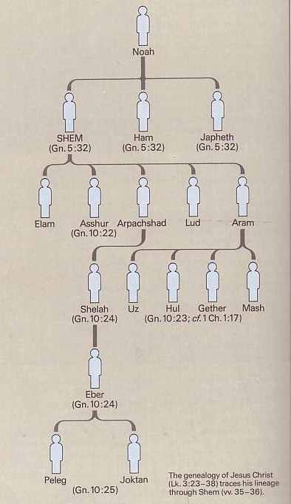
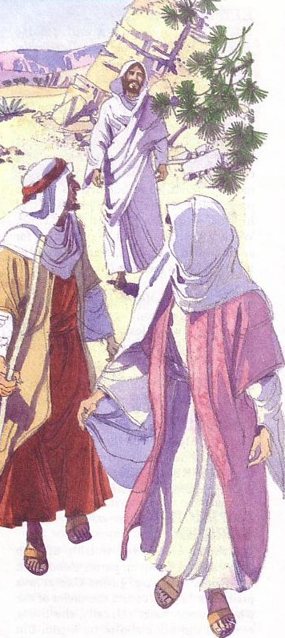
Synthesis
97
1:1-4 Sources
1:5–4:13 Pre-public Life
Nuh
SEM
(Kej 5:32)
HAM
(Kej 5:32)
YAFET
(Kej 5:32)
4:14–21:38 Ministry
Elam
Asyur
(Kej10:22)
Arpakhsad
Lud
Aram
22–23 Passion
Selah
(Kej10:24)
Us
Hul Geter
(Kej10:23;1Taw1:17)
Mas
24 Final Events
Eber
(Kej10:24)
Geneologi Yesus Kritus (Luk 3:23-38) mengesani keturunan melalui Sem (w.35-36)
Peleg Yoktan
(Kej10:25)

Slide 79
B. The Preexistence of Christ
§ 2
John 1:1-18
John introduces his account with Christ's relationships to the Father, creation, men, and John the Baptist to establish his deity as the revealer of the Father by being made man and the redeemer to those who believe, although he was rejected as Messiah by Israel
Notes:
Intro: Fact or Fiction...

Slide 80
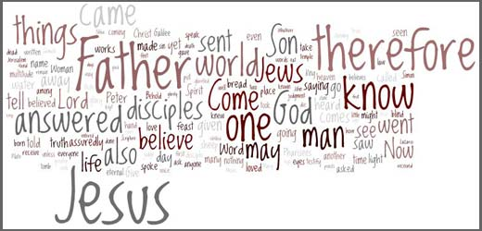
How Does God Speak to Us?
God has spoken in written & oral language

Slide 81
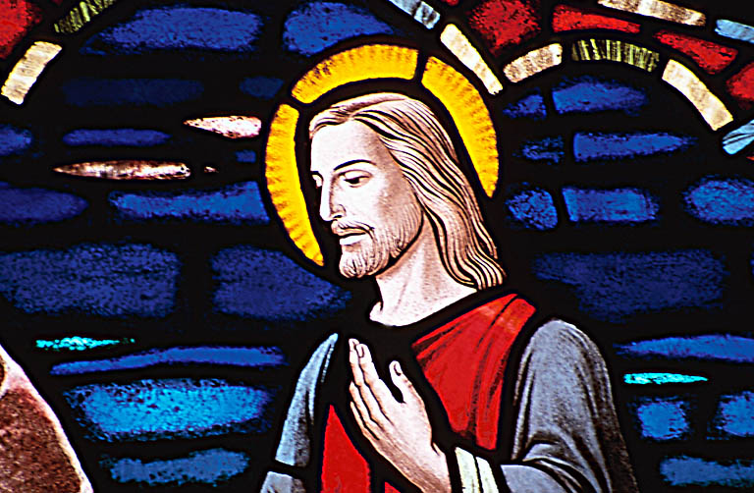
How Does God Speak to Us?
But has especially spoken through a person—Jesus Christ!
Jesus is the logos (word)
This means Jesus fully reveals who God is.
He is the Perfect Revelation.

Slide 82
LOGOS
Greek Philosophy:
"Reason"
Philo: "unity with God but distinct; creator, sustainer, & revealer"
OT: "that which lies behind"
Notes:
The background of logos is threefold:
Greek Philosophy: "The term was used technically in the Greek philosophy of this period, particularly by the Stoics, to denote the controlling Reason of the universe, the all-
pervasive Mind which ruled and gave meaning to all things. LOGOS was one of the purest and most general concepts of that ultimate Intelligence, Reason, or Will that is called God" (Merrill C. Tenney, The Gospel of John [Grand Rapids: Eerdmans, 1948; reprint 1975], 62).
OT: "In the LXX Logos is used to translate Heb. dāḇār. The root of this signifies 'that which lies behind', and so when translated as 'word' it, too, means meaningful sound; it may also mean 'thing.'" Some say it is the OT Wisdom literature whereas others say it refers to the Torah.
Philo: Philo was a Jewish philosopher in the first century AD down in Alexandria, Egypt. He combined Jewish and Greek ideas to try to evangelize Greeks to Judaism. The New Bible Dictionary notes that only Philo's "Logos-teaching provides a clear theological scheme in which the Word possesses a like unity with God and a like distinction from him, and in which both creative and sustaining activity in the universe and revelatory activity towards man is ascribed to it."

Slide 83


Exact Beginnings
"In the beginning
was the Word"
(John 1:1)
"In the beginning God created the heavens and the earth"
(Genesis 1:1)
Notes:
This does NOT say that Jesus' existence began with Gen 1:1. "The word 'was' (imperfect tense) implies timelessness. Jesus existed before Gen 1:1. He has a beginning of no beginning" [Jeffrey Khoo, The Story of Jesus, www.febc.edu.sg]

Slide 84

Jesus has always been God
"In the beginning
was the Word,
and the Word was with God,
and the Word was God"
(John 1:1)
Notes:
Scripture is very clear that Jesus is God. Christians have always believed this key doctrine called the deity of Christ.

Slide 85
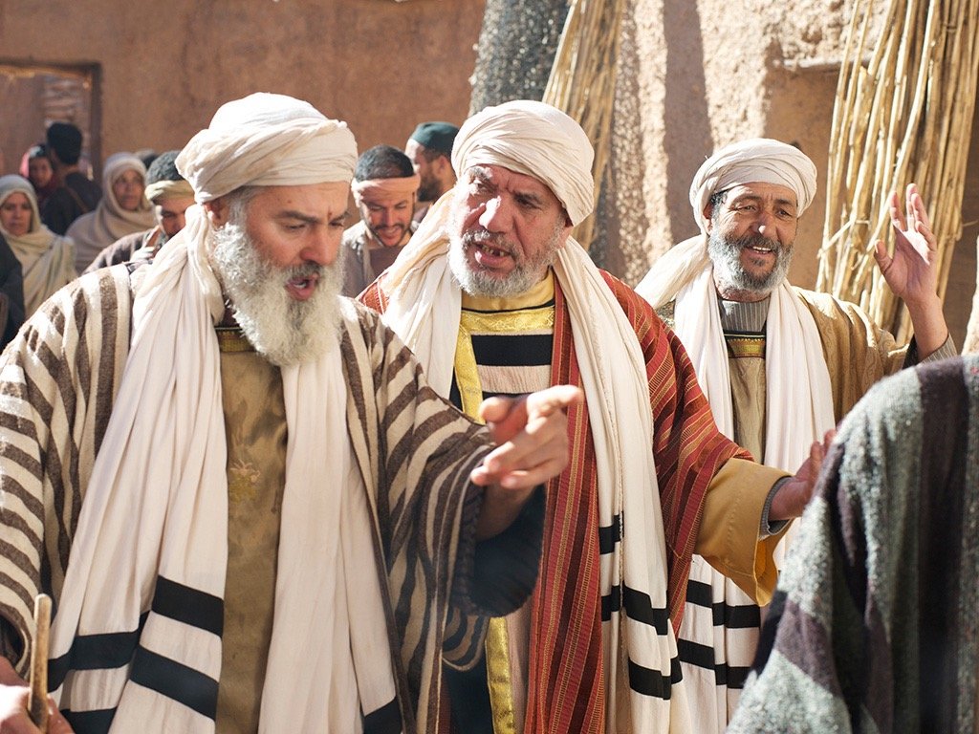
Jews rejected Christ even though he was Jewish (1:11)
"He came to that which was his own,
but his own did not receive [Gr. 'welcome alongside'] him" (NIV).

Slide 86

You become a child of God by believing that Jesus is God:
"But to all who believed him and accepted him, he gave the right to become children of God"
(John 1:12 NLT)

Slide 87

God became man in Jesus
"So the Word became human and lived here on earth among us. He was full of unfailing love and faithfulness. And we have seen his glory, the glory of the only Son of the Father" (John 1:14 NLT)

Slide 88
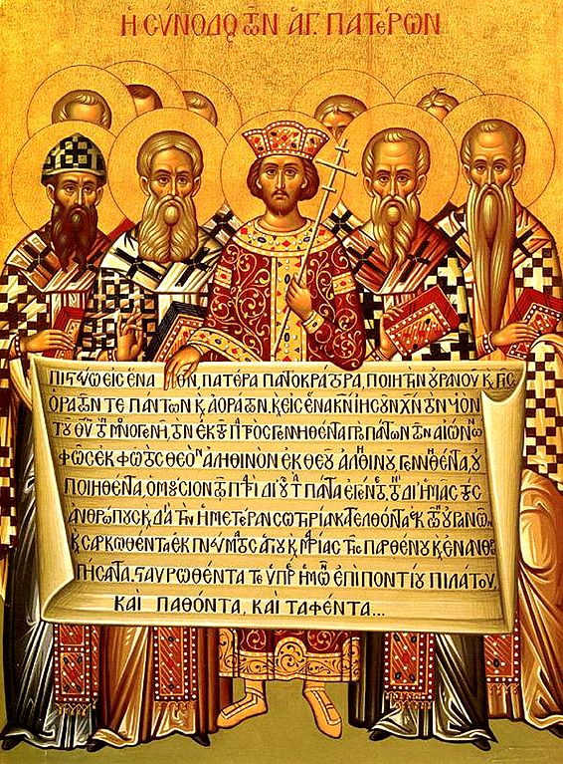
The Nicene Creed
(AD 325)
153e
Dr. Rick Griffith, Crossroads International Church Singapore
CICFamily.com & BibleStudyDownloads.org
Notes:
The Nicene Creed (AD 325) was the second oldest creedal statement of the Early Church, preceded only by The Apostle’s Creed of 1^{st to} 3rd centuries. But why do we have it in the first place?
___________
LC-00-Syllabus-88
NS-04-John1-12-slide 163
TH-03-Nicene Creed-1

Slide 89
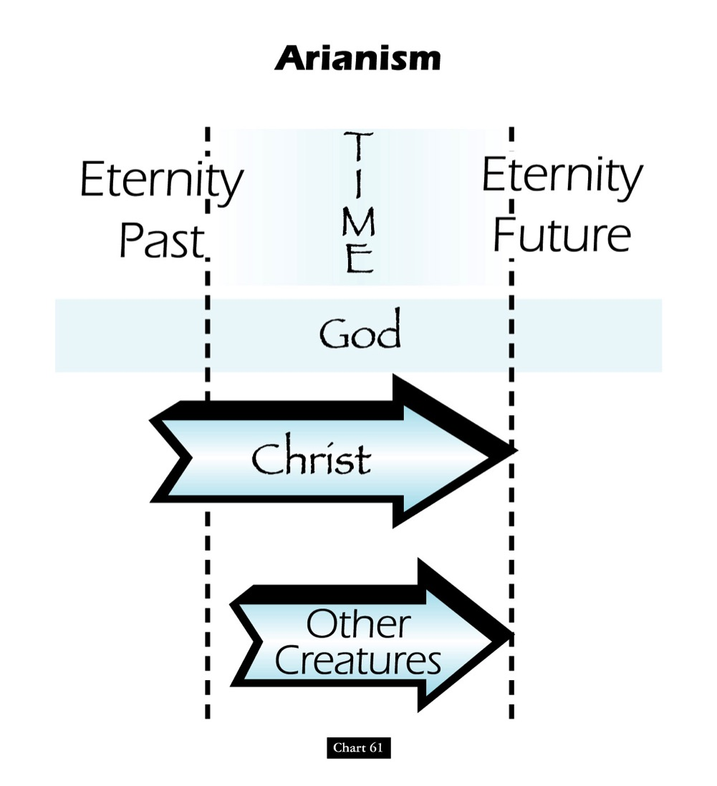
Teachings of the Heretic Arius
Eternity
Past
Eternity
Future
TIME
God
Christ
Other
Creatures
John D. Hannah, Charts of Ancient & Medieval Church History (Grand Rapids: Zondervan, 2001)
Notes:
One of the early heretical leaders was named Arius. He denied that Christ was "co-eternal" with the Father. Arius taught that Christ had a beginning point in eternity past.

Slide 90
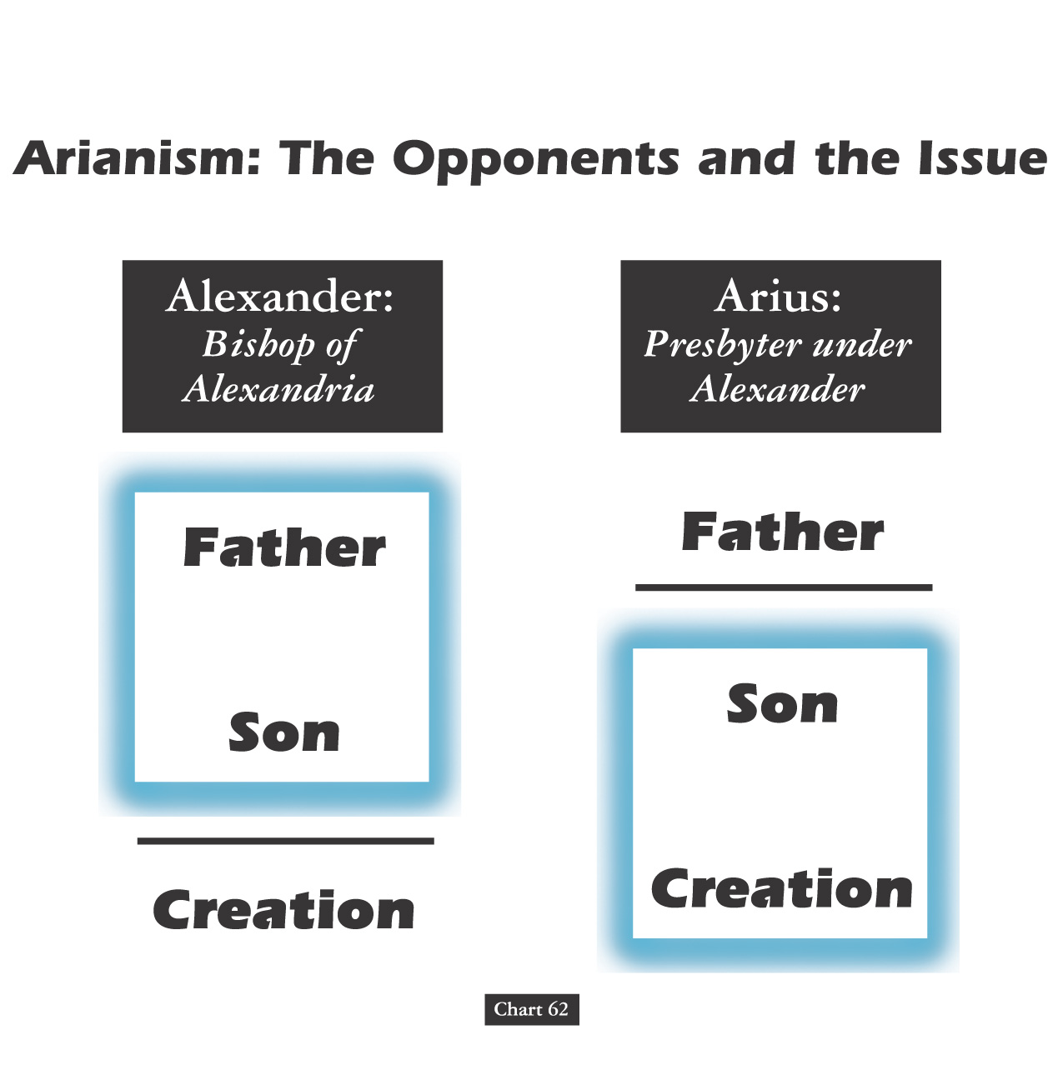
Alexander versus the Heretic Arius
Alexander:
Bishop of Alexandria
Arius:
Presbyter under Alexander
Father
Father
Son
Son
Creation
Creation
John D. Hannah, Charts of Ancient & Medieval Church History (Grand Rapids: Zondervan, 2001)
Notes:
We have come today to worship Jesus Christ. But why do we believe what we do about Jesus? It’s because the NT says so—but how we interpret it came through seeing what heretics taught too. For example, two hundred years after Christ, Alexander was a key leader who held to the orthodox view that the Father and Son stood apart from creation.
• However, Alexander was the “boss” of the pastor Arius in his city. Arius believed only the Father to be separate from creation. Arius taught that the Father created Jesus, then Jesus created the world after this.

Slide 91
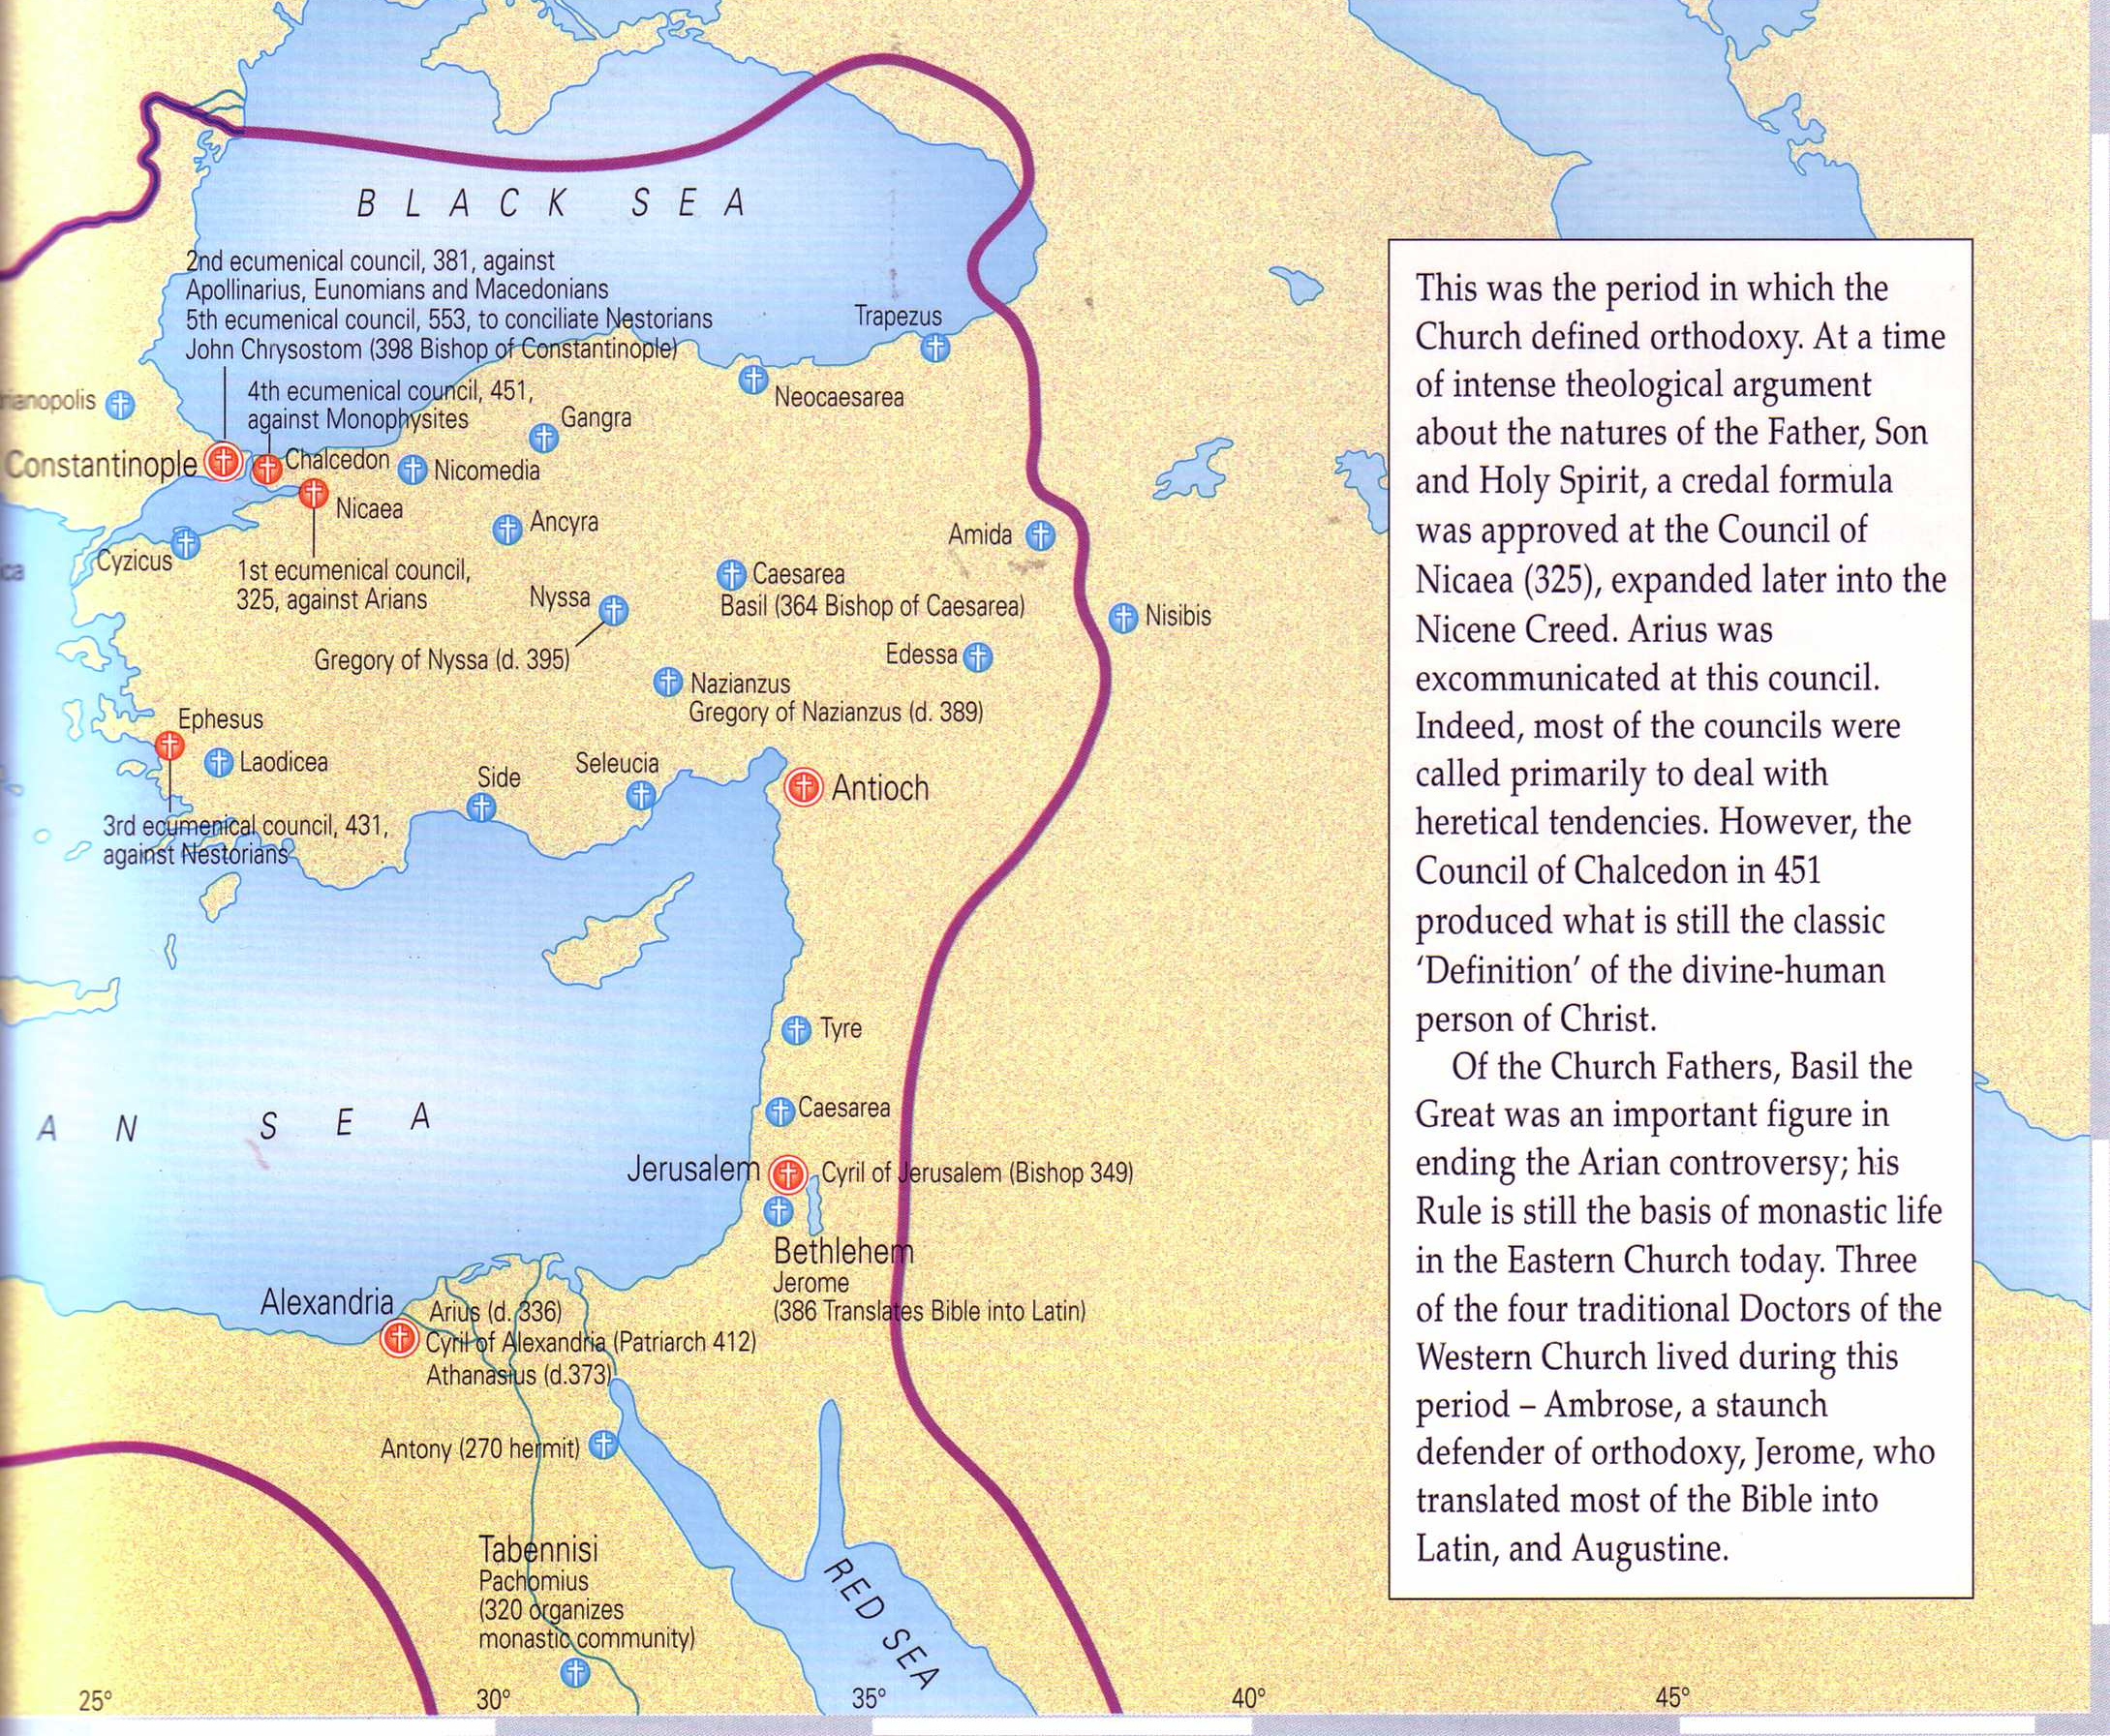

What About Nicea
(AD 325)?
Nicea
Bishops throughout the Eastern Empire gathered & excommunicated Arius of Alexandria
Alexander
Arius
The Atlas of the Bible and the History of Christianity, ed. Tim Dowley (London: Three’s Company, 1997), 77
Notes:
Nicea was a city in what is modern NW Turkey. It was the place where the controversy was resolved and a creed developed.
• The conflict was between Alexander and Arius in Alexandria, Egypt.
• However, to affirm the biblical teaching, 300 church leaders gathered together in the city of Nicea. Here by a vote of 300 to 3 the bishops rejected Arius.

Slide 92
What About Nicaea?
300 votes
Fiction
Fact
3 votes
Arians:
"Jesus Not God"
Orthodox:
"Jesus is God"
Arians:
"Jesus Not God"
Orthodox:
"Jesus is God"
AD 325
Council of Nicaea
Notes:
Brown claims (without support) that the Nicaea vote on whether Jesus was co-eternal with God was very close. The truth is that the vote of the 302 leaders present was 300 to 3. Along with Arius, "The two dissenting bishops were Secundus of Ptolemais and Theonas of Mamarica, both Libyan bishops associated with Arius. All three went into exile after the Council of Nicea" (Paul L. Maier in The Da Vinci Code: Fact or Fiction? with Hank Hanegraaff [Wheaton: Tyndale, 2004], 15, n. 6, on p. 73).

Slide 93
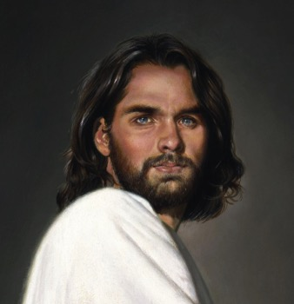
1st century belief in Deity
Paul:
"Christ, who is God over all"
Rom. 9:5
Peter:
"God and Savior Jesus Christ"
2 Pet. 1:1
The Father:
"About the Son He says, 'Your throne, O God…'" Heb. 1:8
Jesus:
"I and the Father are one"
John 10:30
Notes:
There is NO doubt that the earliest Christians believed that Jesus was God! Hebrews 1:8 gives us the witness of the Father himself, and where can one find a more reliable witness than God himself?

Slide 94
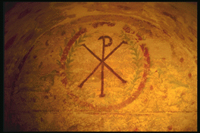
Belief in Christ's Deity Before Nicaea
Ignatius: "God Himself was manifest in human form" (AD 105)
Clement: "It is fitting that you should think of Jesus Christ as of God" (AD 150)
Irenaeus: "He is God, for the name Emmanuel indicates this" (AD 180)
Tertullian: "… Christ our God" (AD 200)
Origen: "No one should be offended that the Savior is also God" (AD 225)
Lactantius: "We believe Him to be God"
(AD 304)
Bercot, 93-100 in Garlow & Jones, 94
Notes:
Over and over the early church fathers affirmed that Jesus was God--all long BEFORE Nicaea!

Slide 95
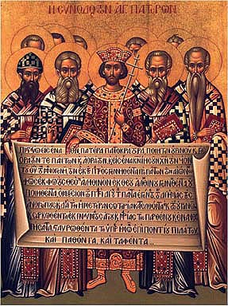
The Nicene Creed (AD 325)
We believe in one God,
the Father All Governing,
Creator of all things
visible and invisible;
And in one Lord Jesus Christ,
the Son of God,
Light from Light,
true God from true God
Notes:
The orthodox view won out and was expressed in the Nicene Creed. Let’s remind ourselves of this important teaching as we affirm aloud this great summary of Christian teaching. Reading together…(recite text)

Slide 96
The Nicene Creed (AD 325)
begotten not created,
of the same essence
as the Father,
through whom all things
came into being,
both in heaven and on earth;
Who for us men and for our salvation
came down and was incarnate,
becoming human.

Slide 97
The Nicene Creed (AD 325)
He suffered
and the third day he rose,
and ascended
into the heavens.
And he will come to judge
both the living and the dead.
And we believe in the Holy Spirit.

Slide 98
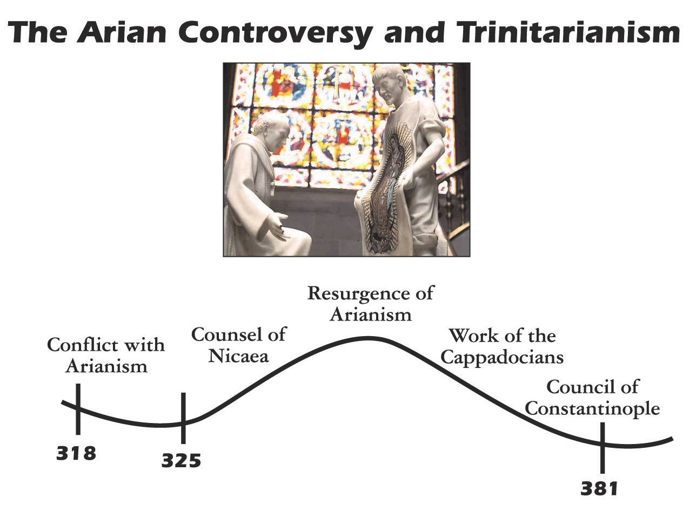

The Arian Controversy and Trinitarianism
Resurgence of Arianism
Work of the Cappadocians
Conflict with Arianism
Council of Nicaea
Council of Constantinople
Initial Rejection of Arianism
Final Rejection of Arianism
John D. Hannah, Charts of Ancient & Medieval Church History (Grand Rapids: Zondervan, 2001)
Notes:
Unfortunately, Nicea did not end the Arian controversy, which later resurged until its final rejection almost 60 years later.

Slide 99
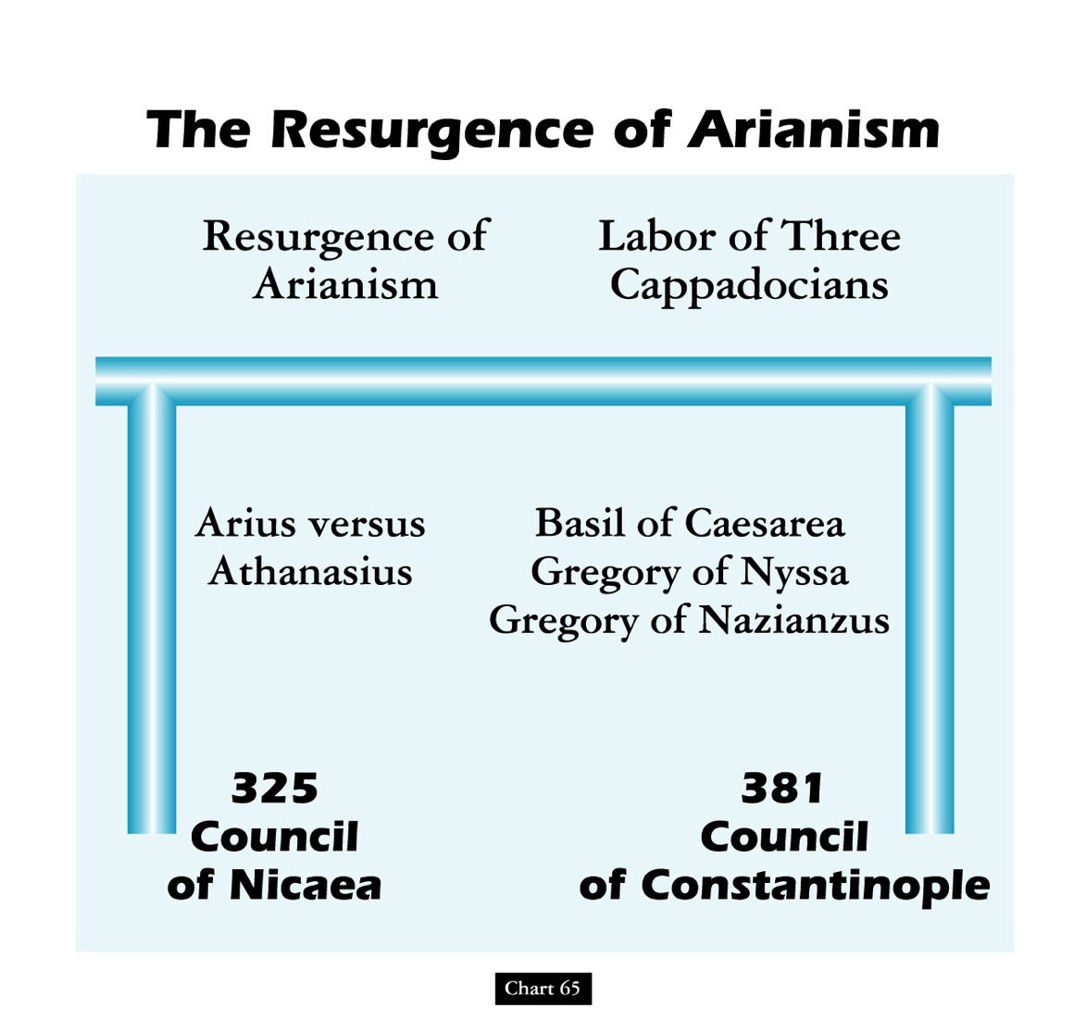
The Resurgence of Arianism
Resurgence of Arianism
Labor of Three Cappadocians
Arius versus
Athanasius
Basil of Caesarea
Gregory of Nyssa
Gregory of Nazianzus
325
Council
of Nicaea
381
Council
of Constantinople
John D. Hannah, Charts of Ancient & Medieval Church History (Grand Rapids: Zondervan, 2001)
Notes:
God raised up Basil and the "Two Gregorys" to finally nail the coffin in Arianism. (However, this same heresy came back in the 1800s in a cult called Jehovah's Witnesses which teaches that Jesus was created by the Father.)

Slide 100
Christ Alone is the Light
John (1:6-9)
Came to the world (6)
Came into existence (6)
A Man (6)
Testified of the Light (7-8)
Jesus (1:1-5)
Made the world (3)
Was in the beginning (1a)
The Word, or God (1c)
Was the Light Himself (9)

Slide 101

THE WORD IN PICTURES
Pictures of Jesus from…
Free
Bible
images

Slide 102

Used with Permission
THE
GOSPEL
——OF—— MATTHEW
THE
GOSPEL
——OF—— MARK
THE
GOSPEL
——OF—— LUKE
THE
GOSPEL
——OF—— JOHN
Due to the Lumo Project producing its own publishing material we regret to inform you that we cannot license our photos to other clients outside of freebibleimages.org.
These images are not licensed for reuse in video, epublishing or other media. Downloaded pictures and files cannot be redistributed through any other website than freebibleimages.org or used in any context where the accompanying message is undermining of the Christian faith and gospel.
Photos can only be used on educational presentations, blogs and social media, all of which should be accompanied with reference to www.LumoProject.com.
Picture courtesy of BBM
© All Rights Reserved.
www.bigbookmedia.com

Slide 103
Black

Slide 104
Life of Christ link at BibleStudyDownloads.org
Get this presentation for free!
Notes:
NT Survey (ns)

