Slide 1
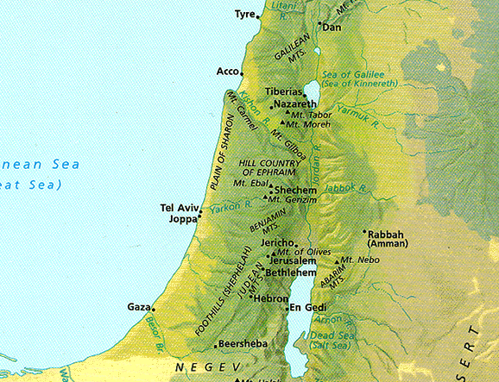
Geography of Israel's Regions & Travel
Dr. Rick Griffith • Jordan Evangelical Theological Seminary • BibleStudyDownloads.org

Slide 2
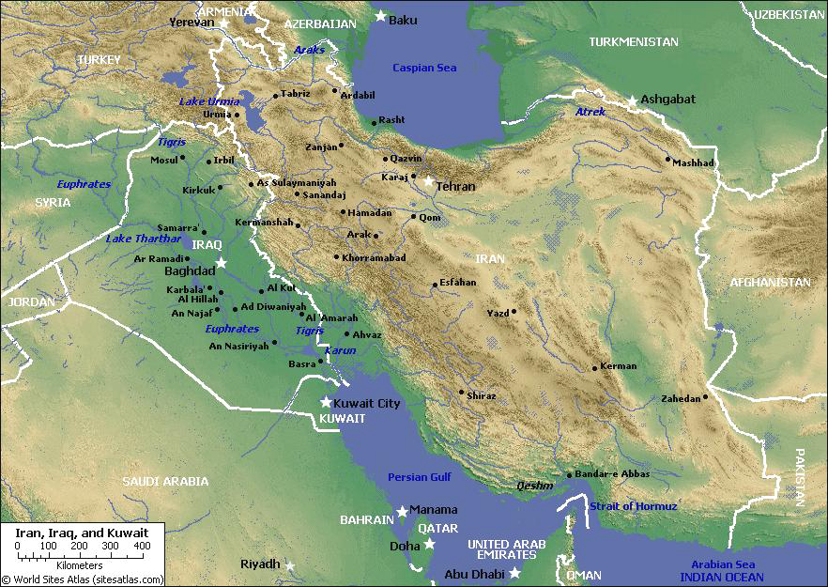
Mesopotamia
9
Tigris
Assyria
Euphrates
Babylon
Persia
Chaldea
Persian Gulf

Slide 3
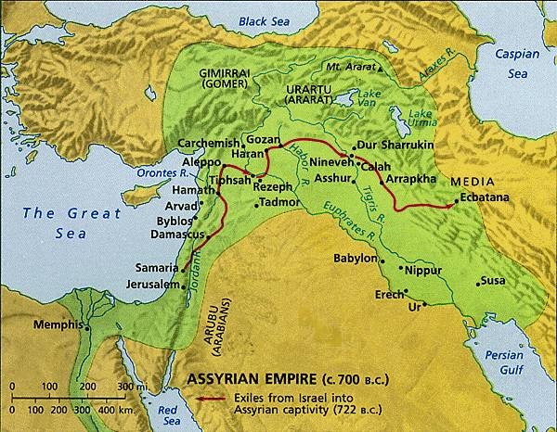
The Ancient Near East
9
Fertile Crescent

Slide 4



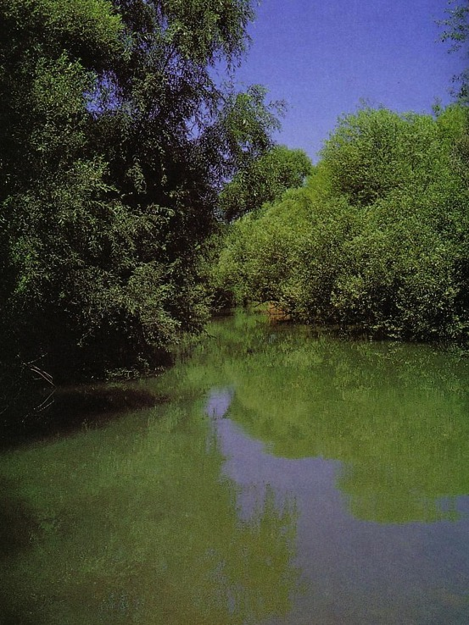
Bodies of Water in Israel
n.m. lyre -- lyre, stringed instrument used for popular as well as sacred music (B4604)
10
NT: Sea of Galilee
OT: Sea of Chinnereth
105 km. (65 mi.)
The Great Sea
215 km. (135 mi.)
Jordan River
Salt Sea
Nahal Senir, one of the sources of the Jordan River
Notes:
______________
BG-02-Eden& ANE-37
BG-05-Israel NT Regions-4

Slide 5
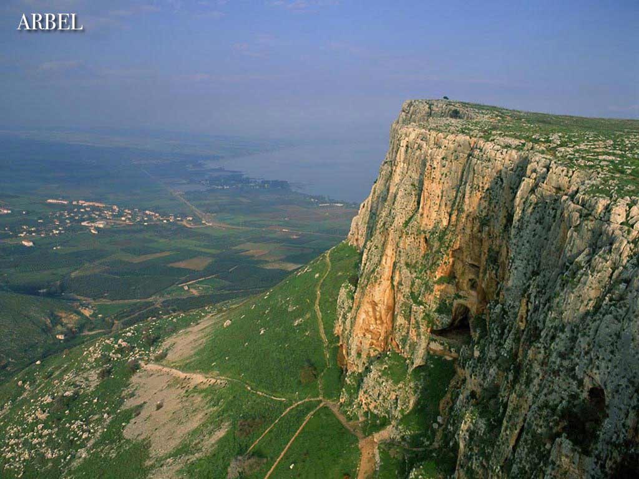
The Sea of Galilee
Arbel
(North shore looking east)

Slide 6
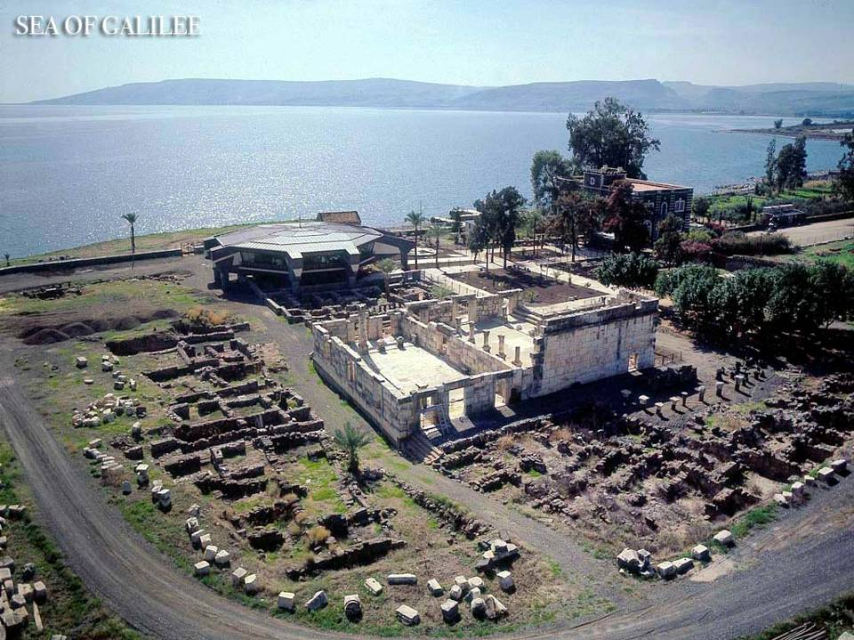
Sea of Galilee

Slide 7
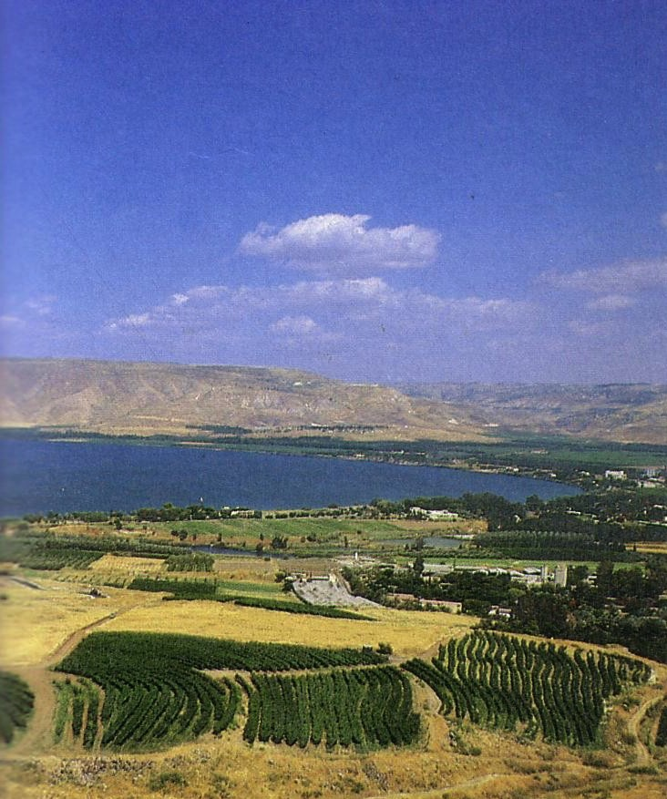
The Sea of Galilee
(South shore looking east)

Slide 8
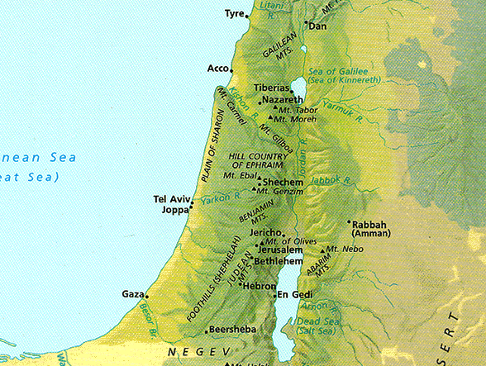
Mountains in Israel
10
Hermon
Carmel
Tabor
Gilboa
Zion
Olives
Nebo
Hor

Slide 9
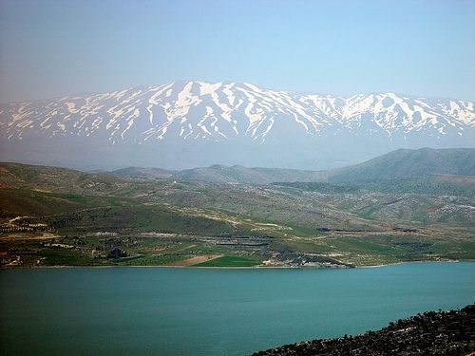
Mount Hermon

Slide 10
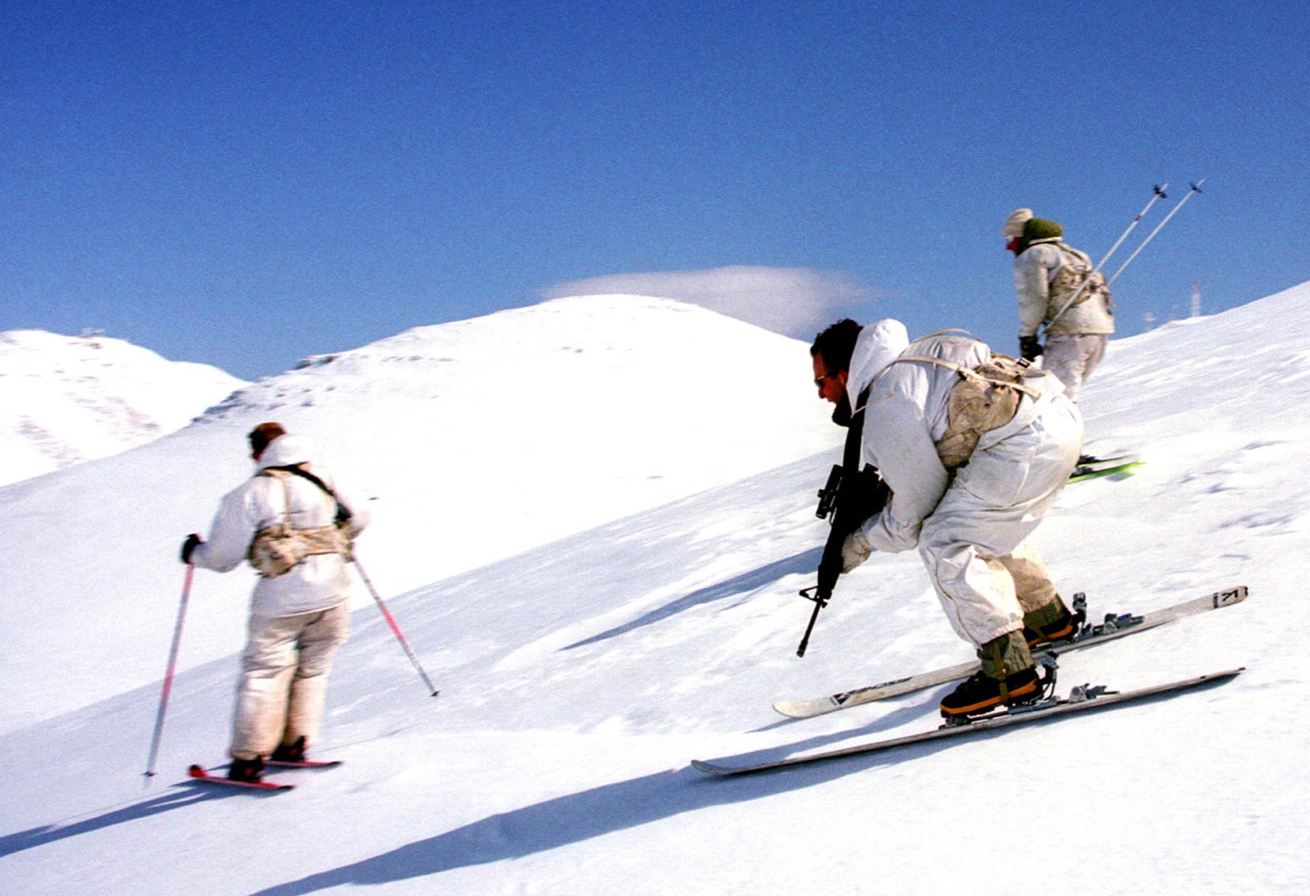
Mount Hermon

Slide 11
Regions of Israel (OT)
10
Bashan
Galilee
Israel
G
Gilead
Ammon
A
Judah
M
Moab
E
Edom

Slide 12
Regions of Israel (NT)
Syria
10
Batanea
Galilee
Samaria
Some Area
Decapolis
Perea
Judea
Idumea
Arabia
Notes:
_______________
BG-00-NT Regions-12
LC-00-NT Regions-12
LC-01-Introduction-4

Slide 13
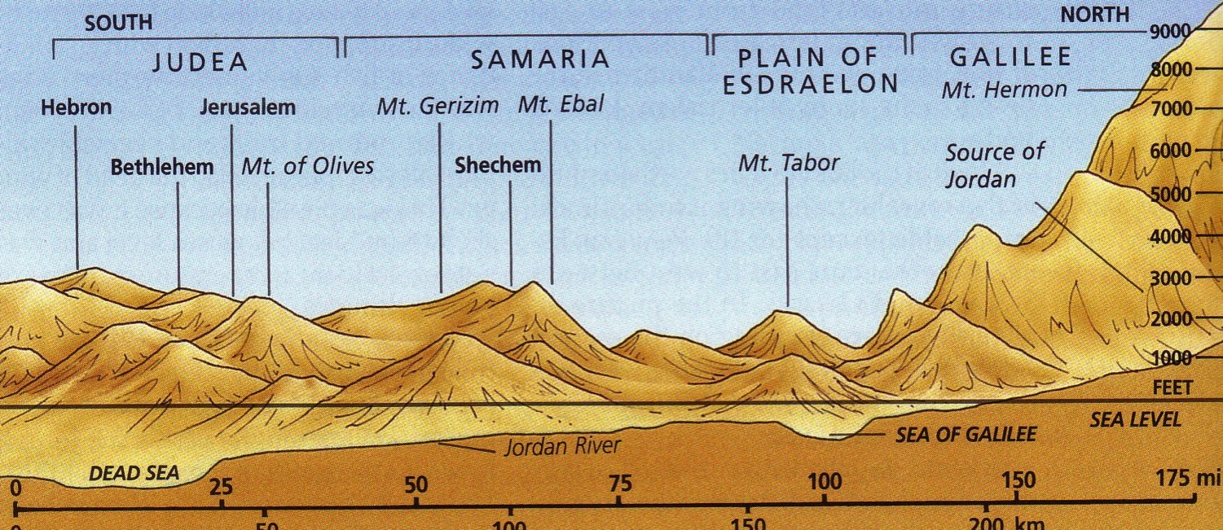
Elevations
10

Slide 14
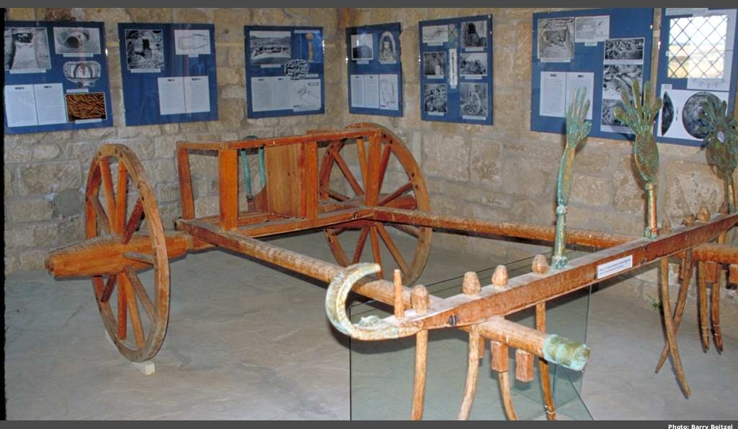
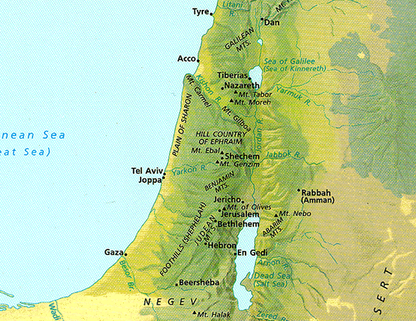
Elevations in North-South Divisions
10
Coastal Plain

Slide 15
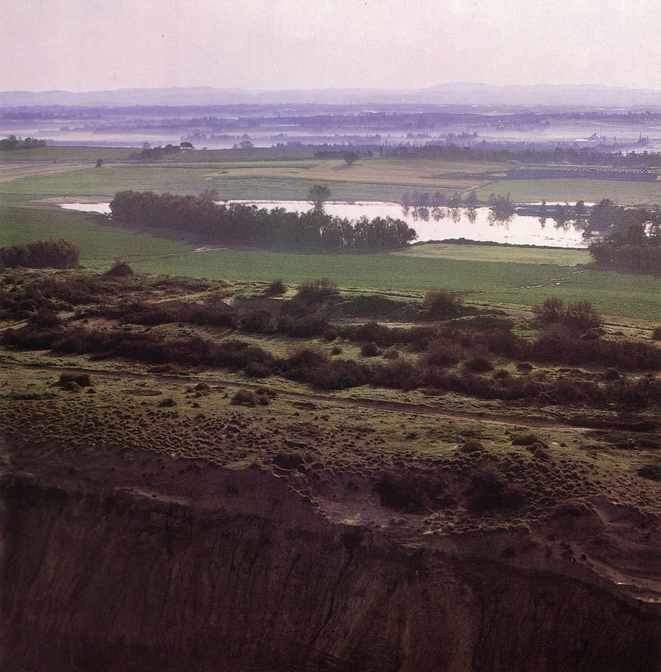
Coastal Plain
10
Kurkar (sandstone) ridges in the foreground while looking east to the foothills
Notes:
These ridges provide a natural barrier from water running westward to the Great Sea.

Slide 16
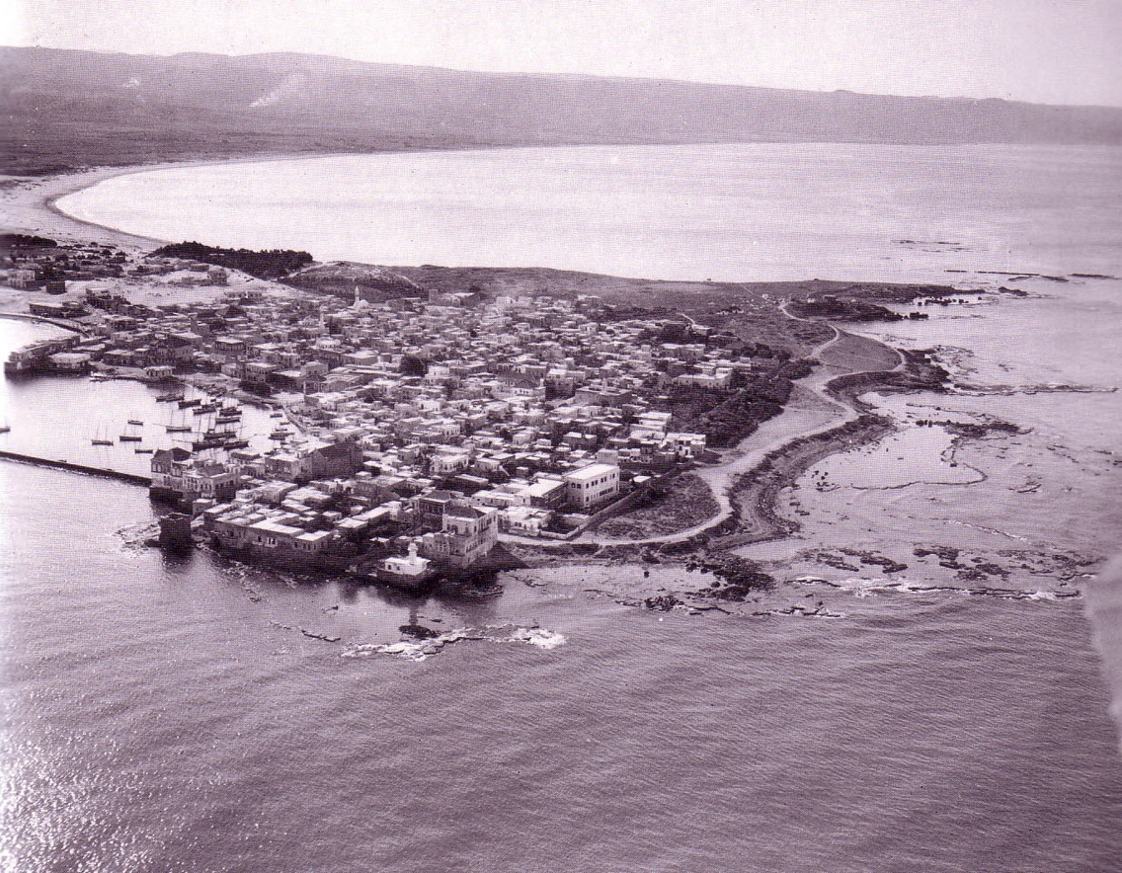
Coastal Plain
10
Tyre

Slide 17
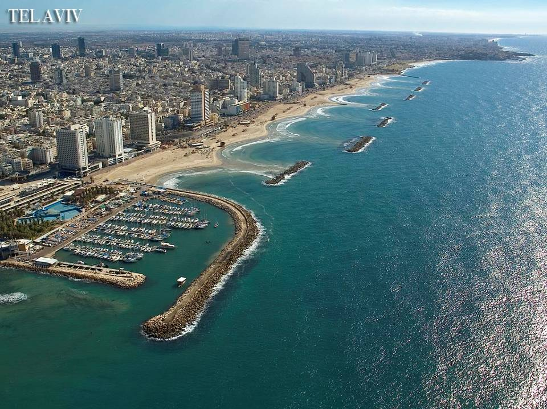
Tel Aviv

Slide 18
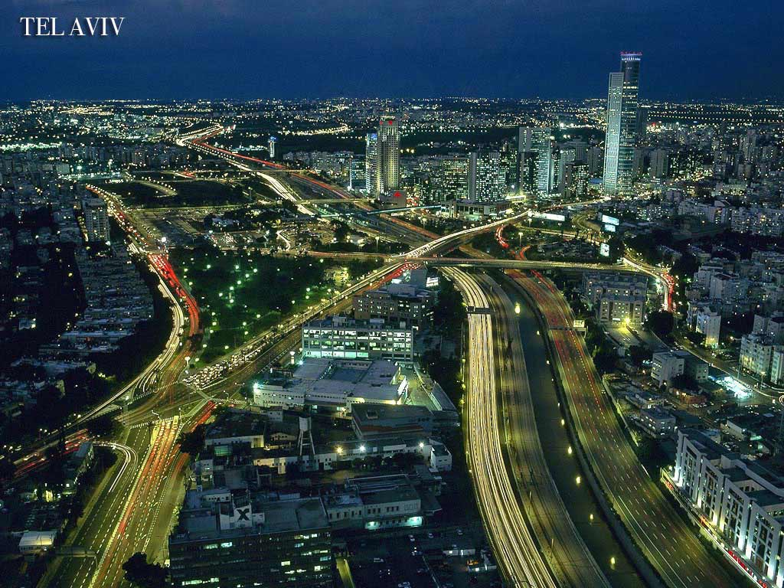
Tel Aviv

Slide 19
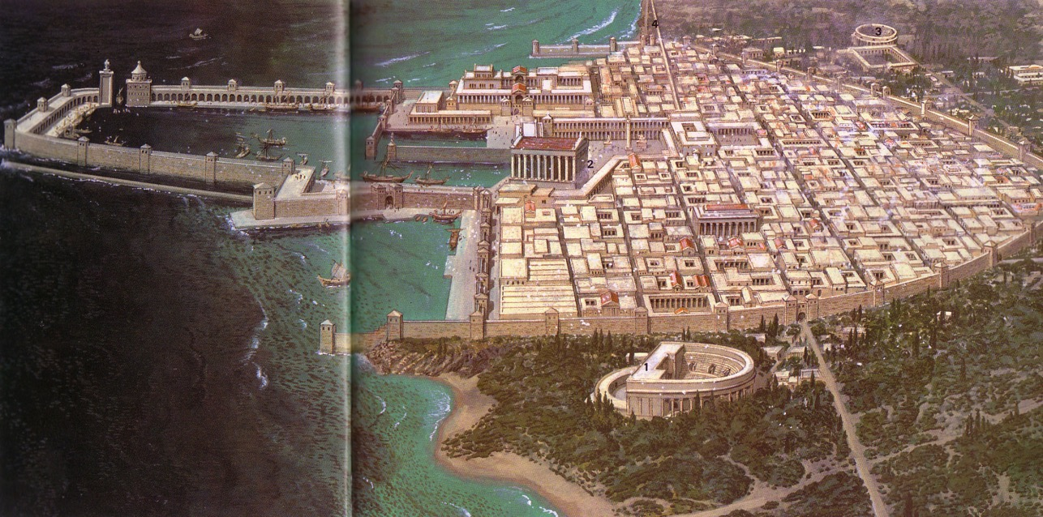
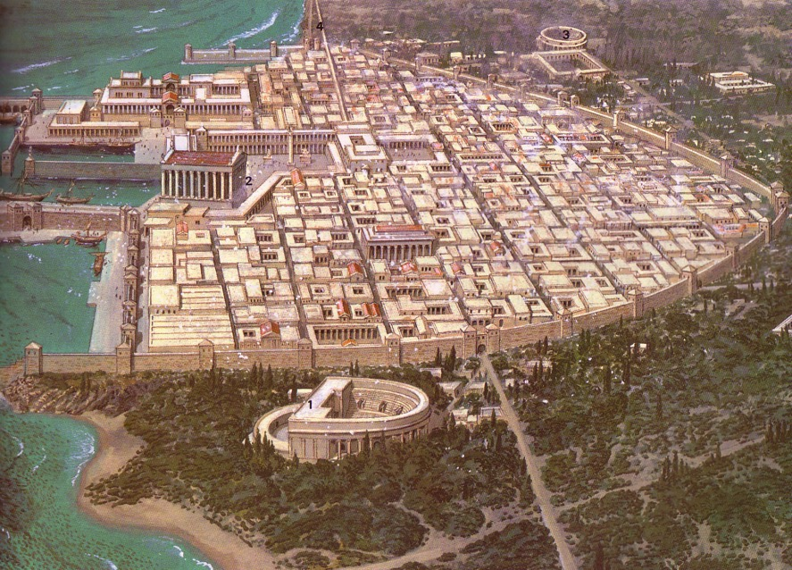
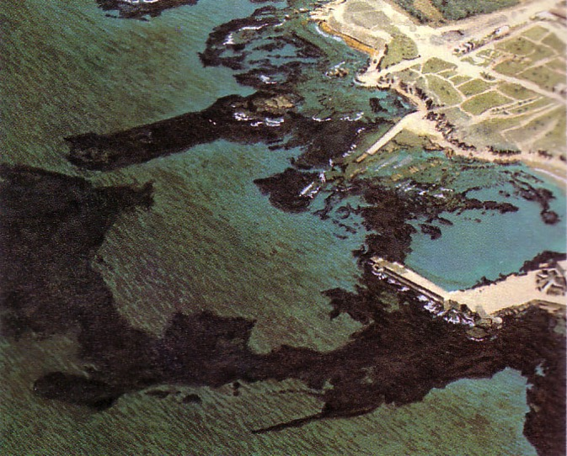
Coastal Plain
10
Caesarea

Slide 20
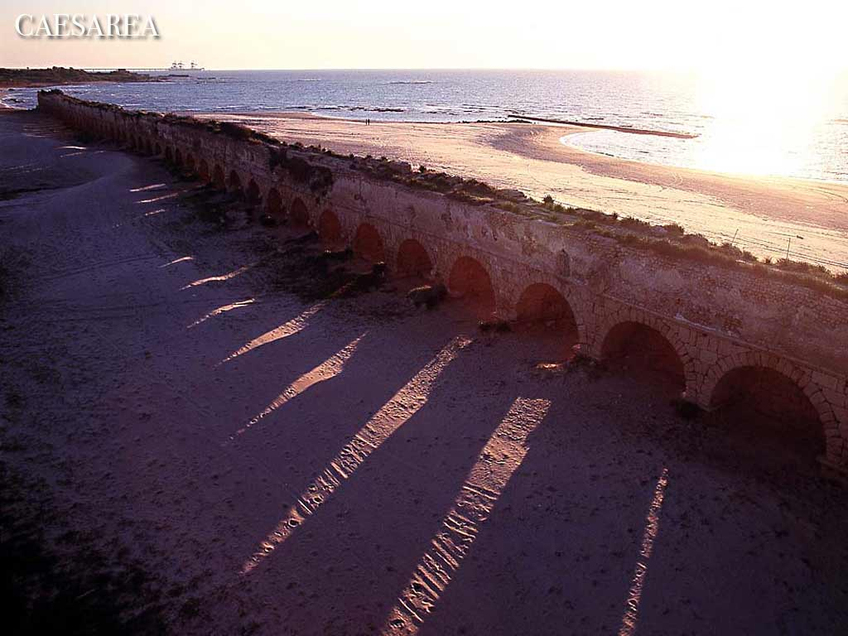
Caesarea

Slide 21
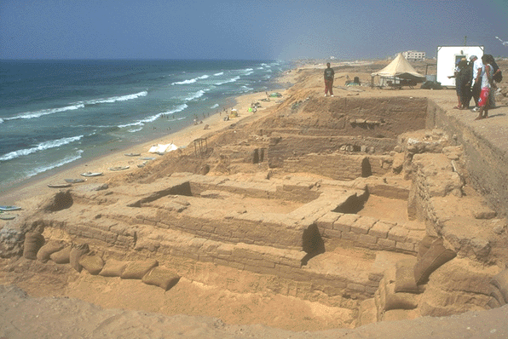
Coastal Plain
10
Gaza

Slide 22
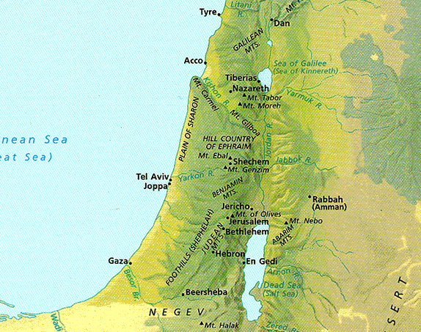
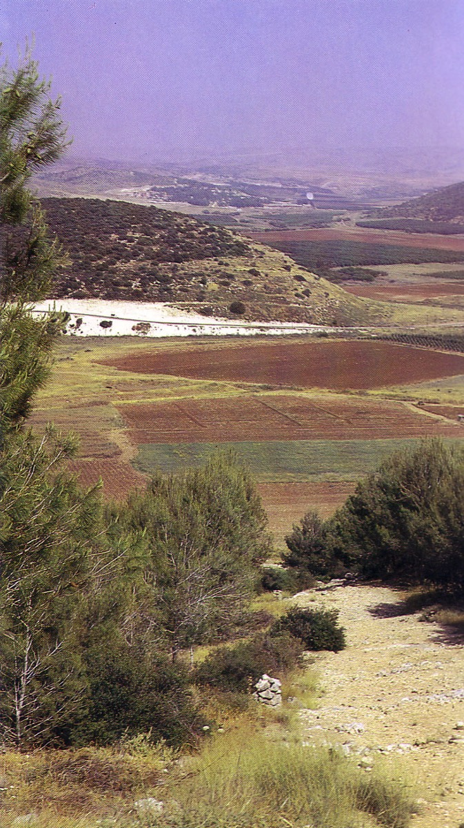
Elevations in North-South Divisions
10
Shephelah
Valleys and Hills

Slide 23
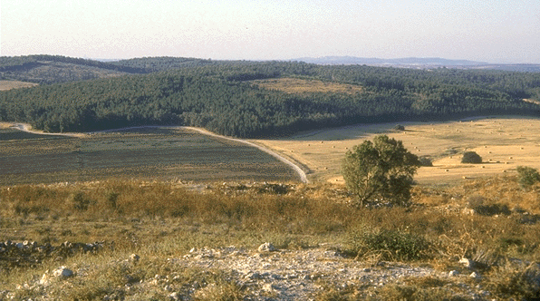
Shephelah
10
Farmland

Slide 24
Elevations in North-South Divisions
10
Central Mountain Range

Slide 25
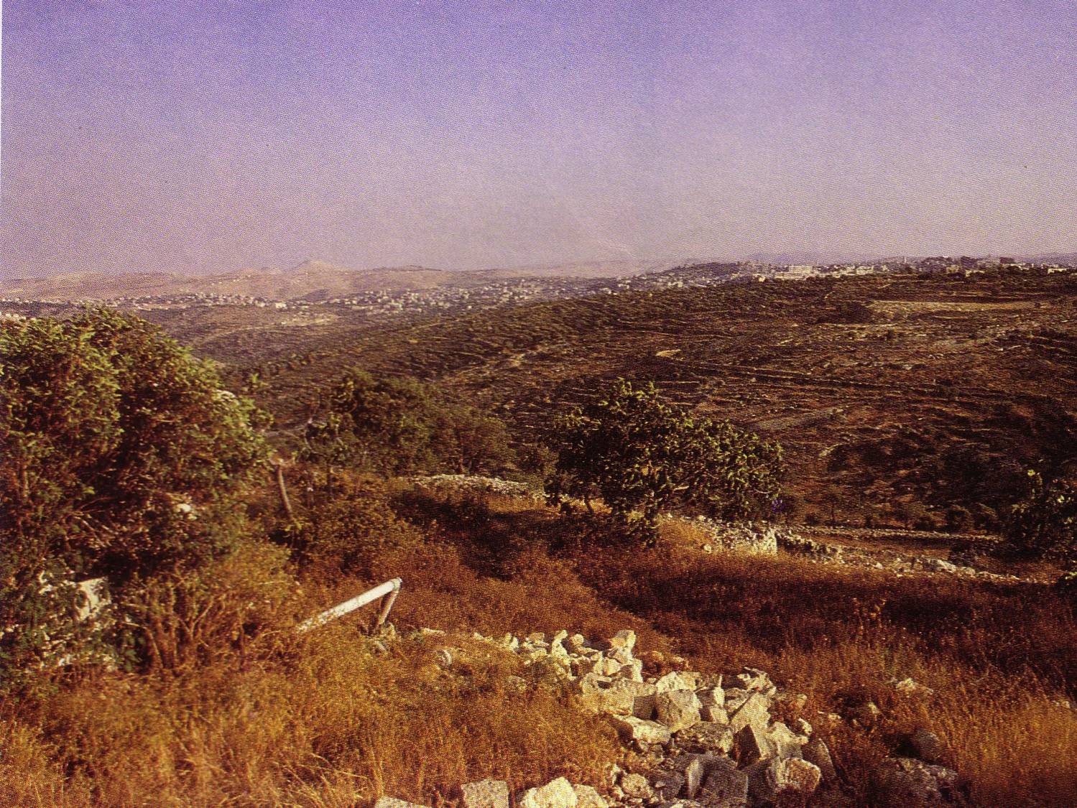
Judean Hills
10

Slide 26
Elevations in North-South Divisions
10
Also Called:
Plain of Megiddo
Jezreel Valley
Central Mountain Range

Slide 27
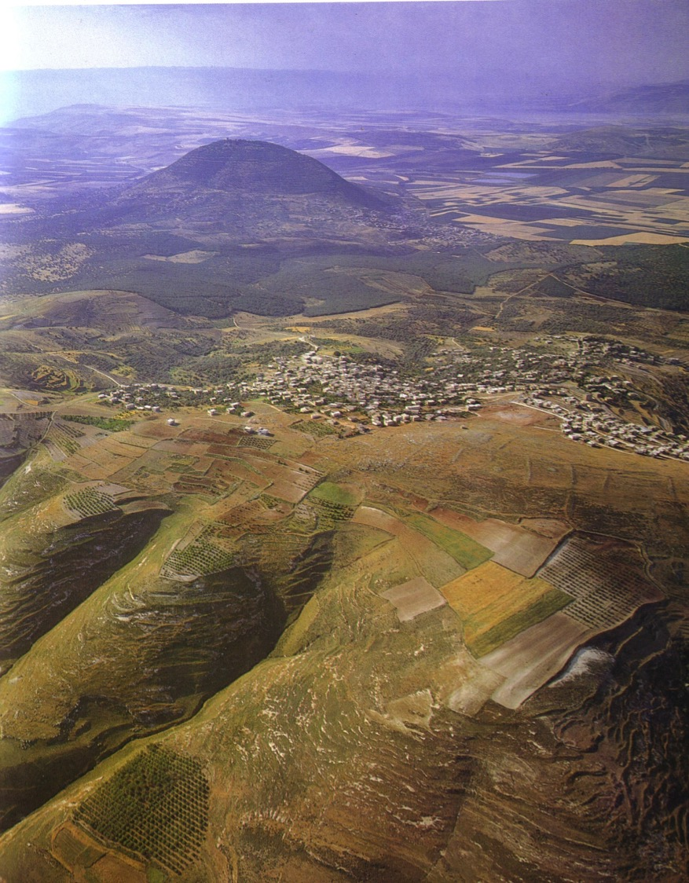
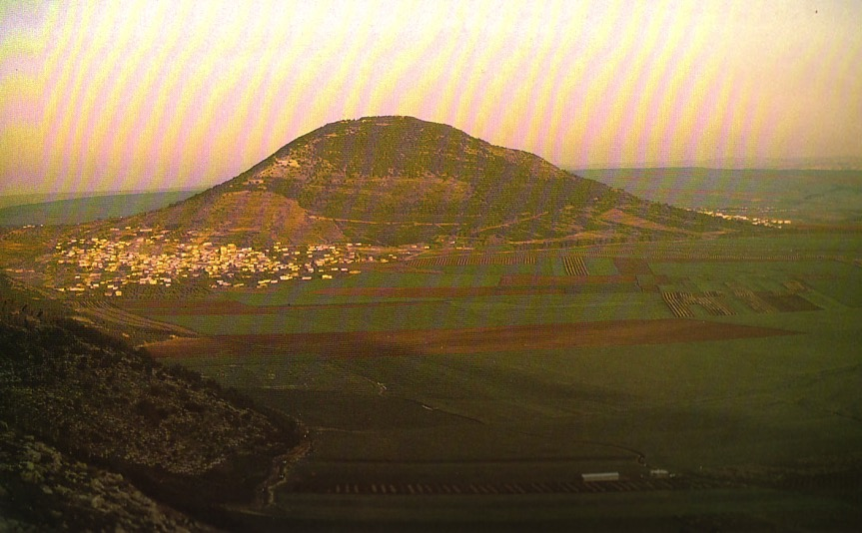
Mount Tabor in the Jezreel Valley
10

Slide 28
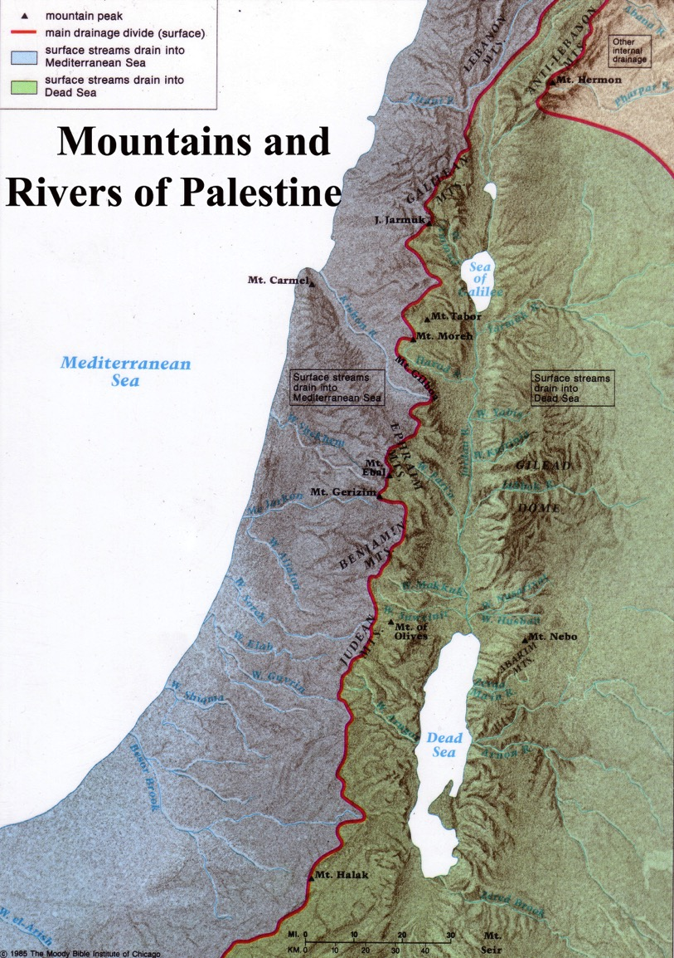
Central Mountain Range
10
A ridge causes water to flow east or west
The higher elevation is in the south

Slide 29
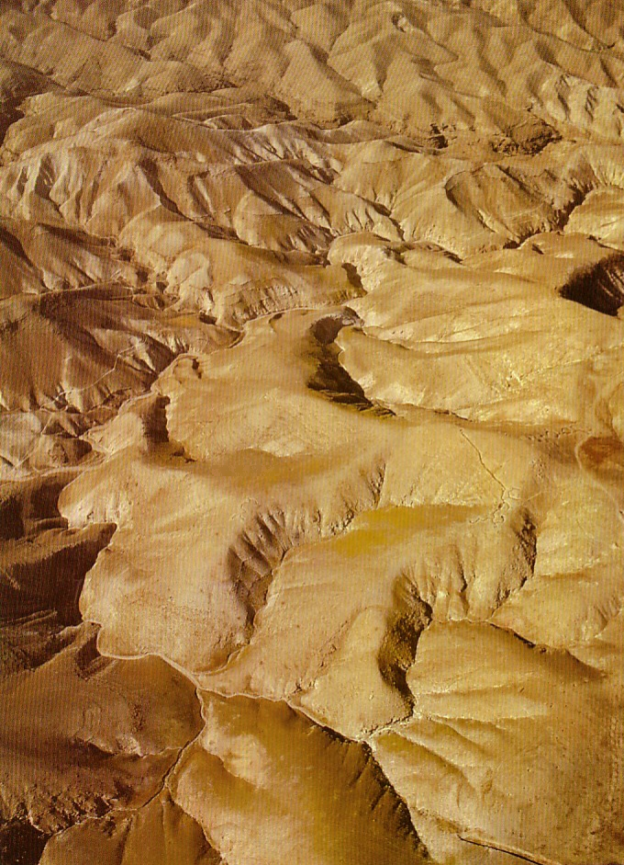
The Wilderness of Judea
10

Slide 30
Elevations in North-South Divisions
10
Jordan Rift

Slide 31
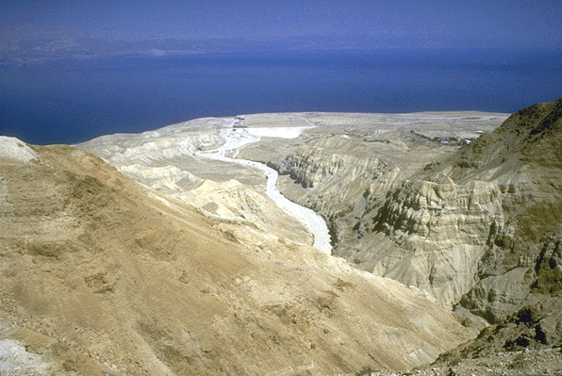
Jordan Rift
10
Deep Depression
From the Wilderness of Judea looking east to the Salt Sea below

Slide 32
Elevations in North-South Divisions
10
Transjordan Plateau

Slide 33
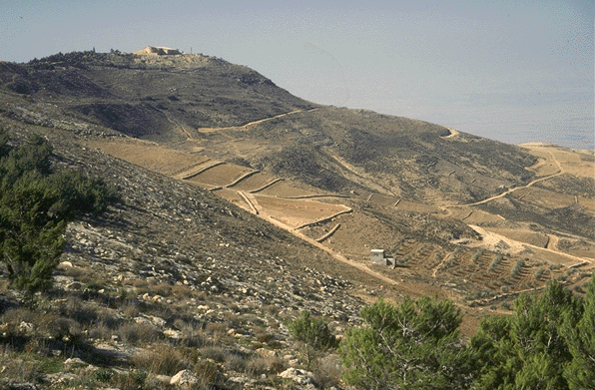
Transjordan Plateau
10
Mt. Nebo

Slide 34
Elevations in North-South Divisions
10

Slide 35
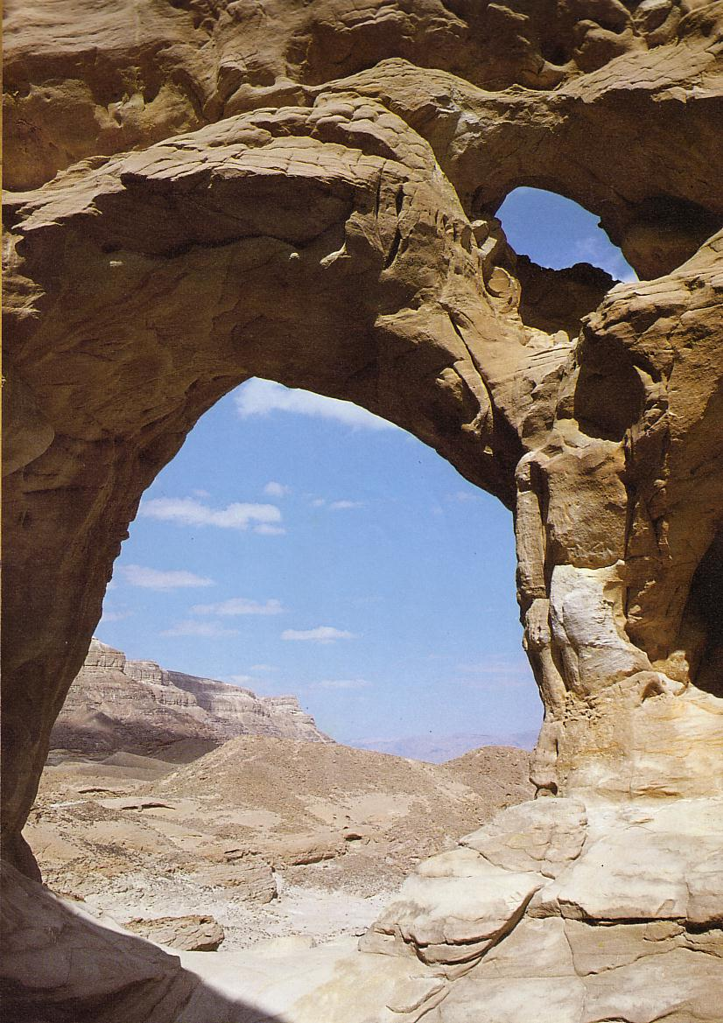
The Negev
10

Slide 36
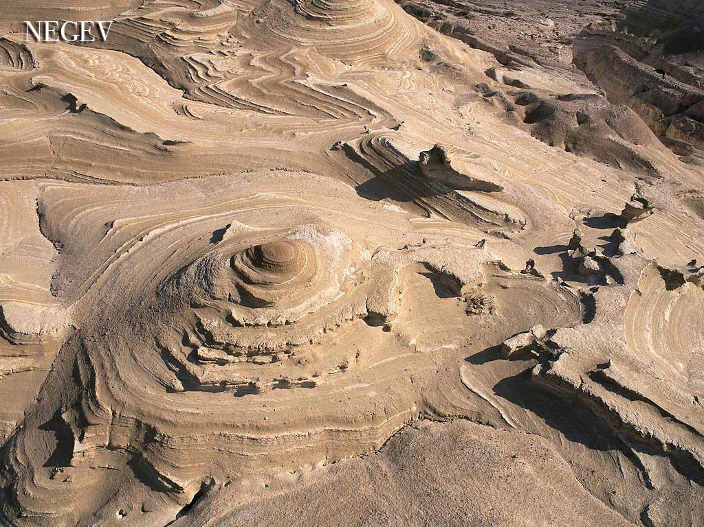
The Negev

Slide 37
Left Stage
12
Travel in Ancient Israel
Right Stage
West & North
East & South

Slide 38

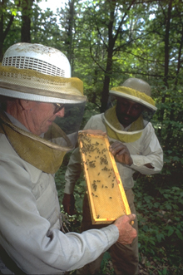
Left Stage
12
Life in
Ancient Israel
Right Stage
Farmers
Land of Honey
Herdsmen
Land of Milk

Slide 39
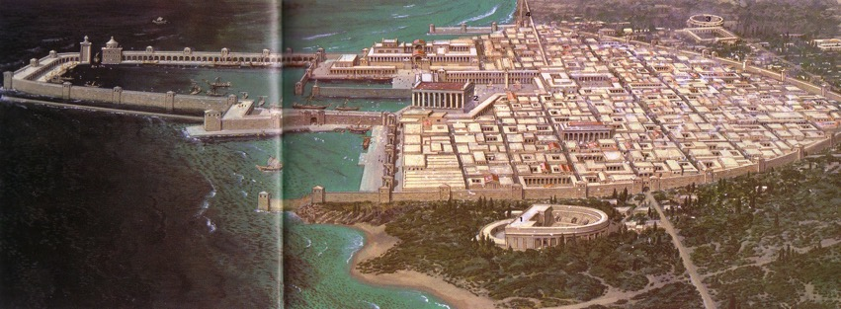
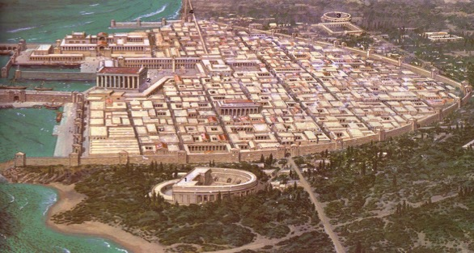
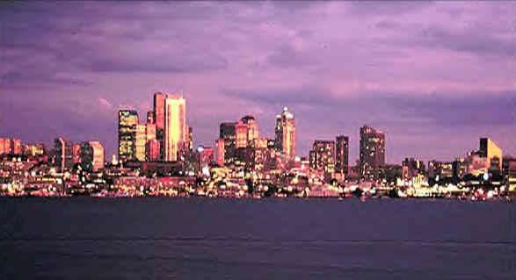
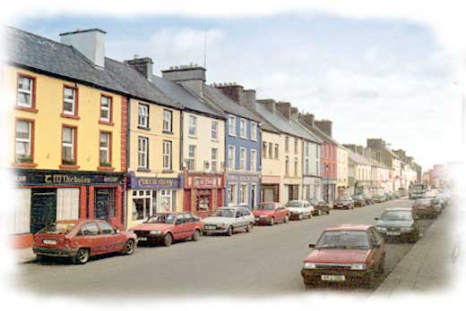
Left Stage
12
Life in
Ancient Israel
Right Stage
40 Large Cities
310 Small Towns

Slide 40

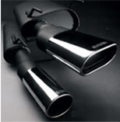
Left Stage
12
Life in
Ancient Israel
Right Stage
Easy,
Predictable
Exhausting,
Unpredictable

Slide 41
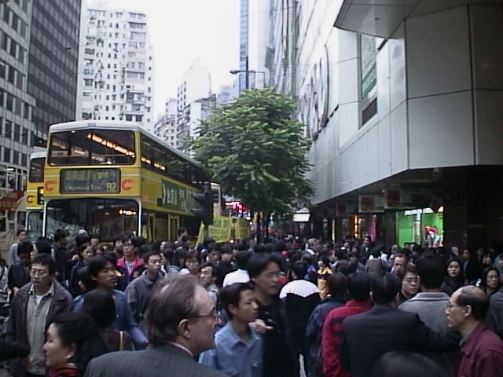
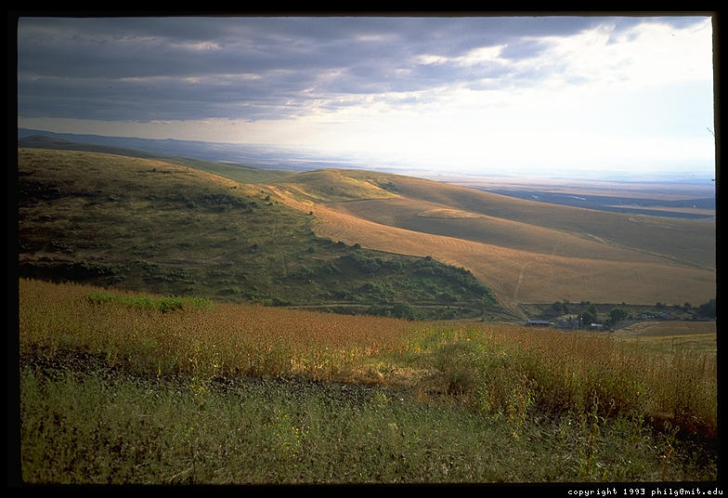
Left Stage
Life in
Ancient Israel
Right Stage
12
Trade, Noisy,
International
Isolation, Quiet,
Nationalism

Slide 42

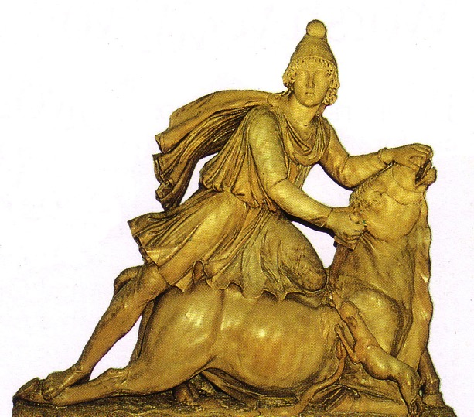
Left Stage
12
Life in
Ancient Israel
Right Stage
Syncretism,
Paganism
Religious Purity,
Monotheism

Slide 43
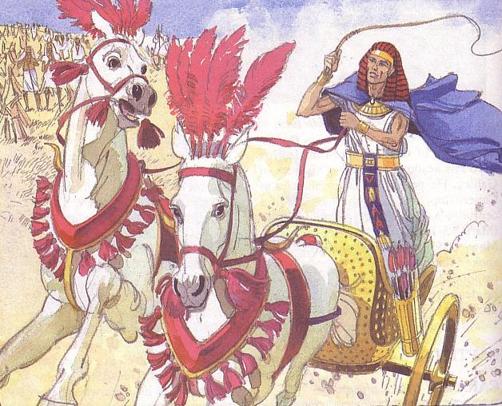
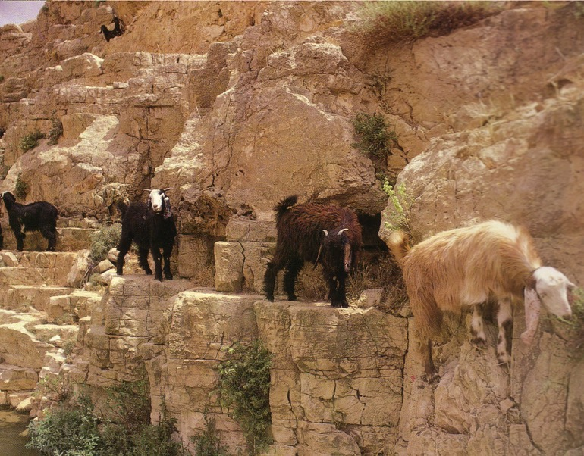
Left Stage
12
Life in
Ancient Israel
Right Stage
Controlled
By Israel only
150 years
Controlled
By Israel
1650 years

Slide 44
Left Stage
Phoenicians
Syrians
12
Life in
Ancient Israel
Right Stage
Romans
Sea Peoples,
The “ians” (mostly)
Desert Peoples,
The “ites”
Ammonites
Babylonians
Assyrians
Israelites
Philistines
Moabites
Edomites
Egyptians

Slide 45
Left Stage
12
Travel in Ancient Israel
Right Stage
West & North
East & South
Notes:
These two regions of Israel produced two cultures with their various benefits and challenges.
_______________
BG-05-Israel-NT_Regions_and_Travel-45
BG-08-Jerusalem_Geography-2

Slide 46
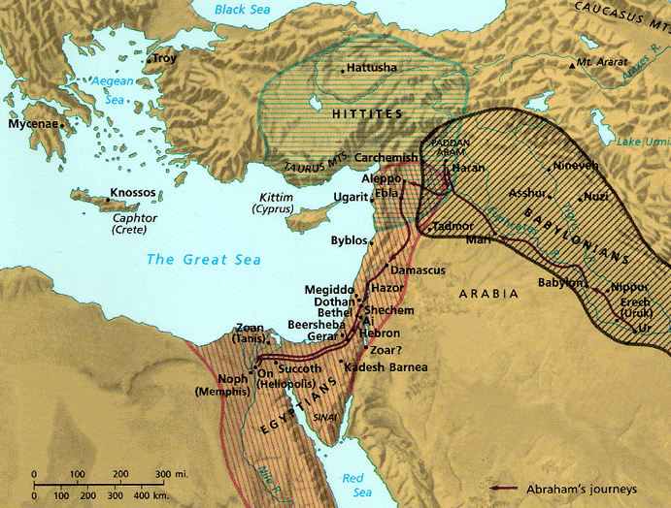
Israel's Strategic Location
46
Thought Question:
How has God placed you in a strategic place for His purposes?
“Thus says the LORD God: This is Jerusalem;
I have set her in the center of the nations, with countries round about her”
Ezekiel 5:5

Slide 47
Black

Slide 48


Bible Geography link at BibleStudyDownloads.org
Get this presentation for free!
Notes:
Bible Geograhpy (bg)

