Slide 1
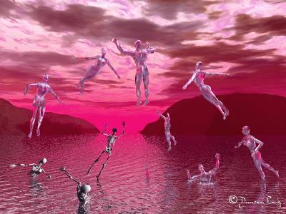
The Return of Christ
Christology: The Person & Work of Jesus
Dr. Rick Griffith • Jordan Evangelical Theological Seminary • BibleStudyDownloads.org

Slide 2


Slide 3
Amillennialism
27
155-159
Second Coming
Spiritual reign of Christ
Tribulations
Church Age
Eternal Kingdom
Judgment
Notes:
The amil view of the millennium is that it takes place between Christ’s first and second comings—thus it is in a box above. The Second Coming in this view appears as a single event where saints rise to meet Christ in the air and then immediately enter the eternal state without ever returning to the present earth. They only enter the new heaven and the new earth instead.

Slide 4
Critiques of Covenant Theology
Spiritualizing approach (83-84)
See dispensations but insist on one covenant of grace (8)
Biblical covenants have elements besides redemption (85)
Goal of history not broad enough—excludes purposes for Israel, church, angels, universe (85-86)
Older views not necessarily right (the issue is scriptural)
“Covenant of grace” and “covenant of works” are never found in the Bible (82)
Passages cited (Deut. 6:5, 10-12; 30:15-20) = life in the Promised Land (not heaven) (Ryrie, 189)
Use of deductive (not inductive) interpretation rather than clear statements (Ryrie, 189-90)
Reads the NT back into the OT (Ryrie, 191-93)
Abrahamic Covenant conditional
Paul N. Benware, Understanding End Times Prophecy, 83-86; cf. Ryrie, Dispensationalism, 189, 193

Slide 5
Postmillennialism
27
150-153
Second Coming
Golden Age of the Gospel
Tribulations
Church Age
Eternal Kingdom
Judgment
Notes:
The postmil view of the millennium is that it gradually comes to the earth over a long period of time—so far over 2000 years. Thus it is diagrammed as a polygon that gets larger and larger over time. Finally after the millennium arrives, Christ then comes to the earth. Like the amil view, the Second Coming in this postmil view appears as a single event where saints rise to meet Christ in the air and then immediately enter the eternal state without ever returning to the earth. They only enter the new heaven and the new earth instead.

Slide 6
Premillennialism
27
Second Coming
Second
=
Advent
Tribulation
Millennium
Church Age
Eternal Kingdom
7 years
1000 years
ALL 5 RAPTURE VIEWS ARE PREMILLENNIAL
Judgment

Slide 7
Dispensationalism
28
123-148
Second Coming
Israel
Tribulation
Millennium
Church Age
Eternal Kingdom
7 years
1000 years
Judgment

Slide 8
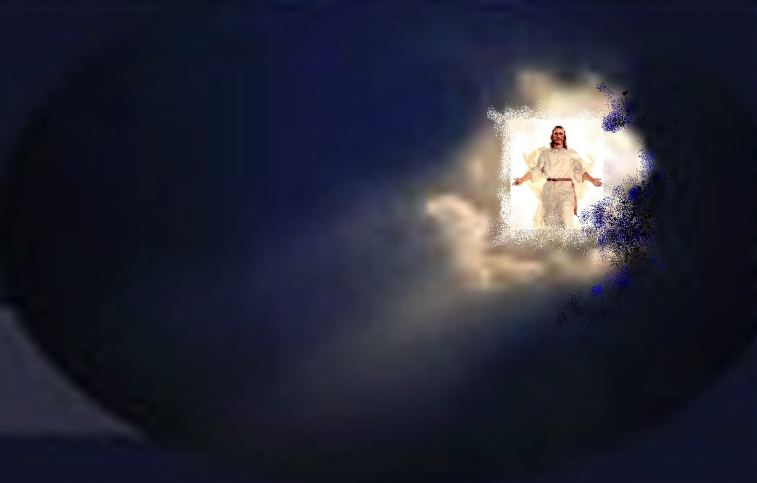
When will the Rapture occur?

Slide 9
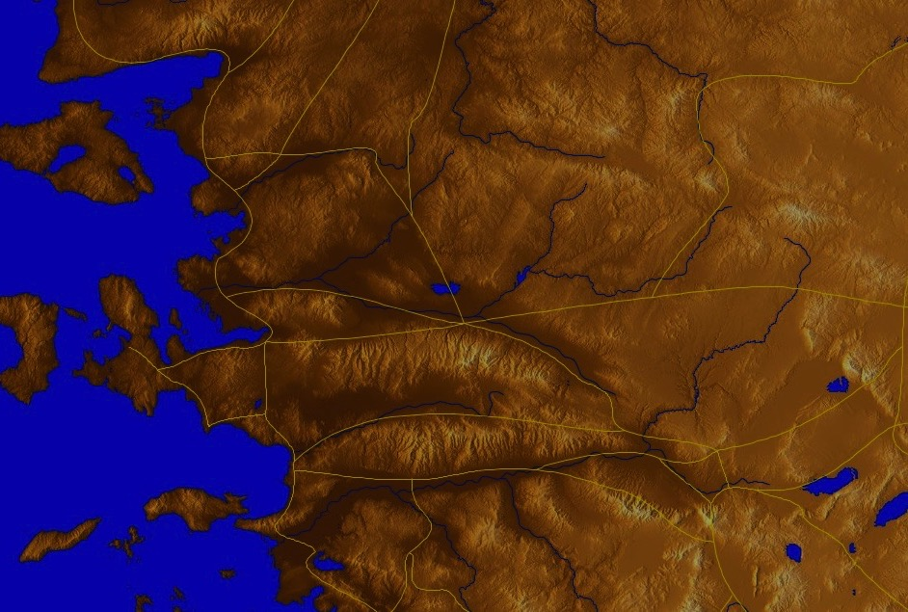
Philadelphia (Rev. 3:7-13)
57
Promise
Christ promised Philadelphia believers benefits for their perseverance (3:9-13)
Warning
None
Pergamum
Thyatira
Exhortation
Hold on to what you have
Rebuke
None!
Commendation:
Deeds, keeps Christ's word and does not deny His name, endures patiently
Christ:
Holy and true, holds the key of David
Smyrna
Sardis
Ephesus
Philadelphia
Laodicea

Slide 10
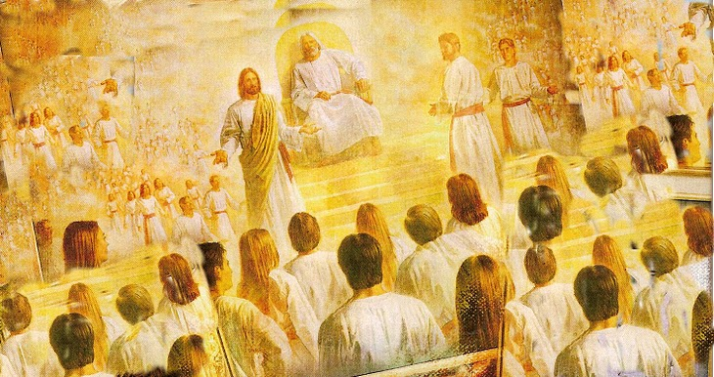
Christ promises honor before enemies (3:9).
"I have given you an open door that no one can shut" (3:8)
"Look, I will force those who belong to Satan’s synagogue—those liars who say they are Jews but are not—to come and bow down at your feet. They will acknowledge that you are the ones I love."

Slide 11
Deliverance from the Tribulation
57
Second Coming
Israel
Church Age
Tribulation
Millennium
Eternal Kingdom
7 years
1000 years
Judgment

Slide 12
Greek Prepositions
58
"from, out of, away from"
ek
peri
dia
"around"
"through"
eis
"into"
Notes:
"Frequently, but not always, ek means from within, while apo means from in a more general way (e.g., from the outside of, from the vicinity of)" (Eugene Van Ness Goetchius, The Language of the New Testament [New York: Charles Schribner's Sons, 1965], 151).

Slide 13
Premillennialism
56
Second Coming
Second
=
Advent
Tribulation
Millennium
Church Age
Eternal Kingdom
7 years
1000 years
ALL 5 RAPTURE VIEWS ARE PREMILLENNIAL
Judgment

Slide 14
"Pre-Trib" Rapture
57
Second Coming
Rapture
Tribulation
Millennium
Church Age
Eternal Kingdom
7 years
1000 years
Judgment

Slide 15
Why Am I Pretrib?
57
Believers will be kept from (ek) this "hour," or time period (Rev. 3:10)

Slide 16
"Pre-Trib" Rapture
57
Second Coming
1. "I will keep you from (ek) the hour of testing that will come upon the whole world, to test those who dwell upon the earth"
(Rev. 3:10)
Rapture
Tribulation
Millennium
Church Age
Eternal Kingdom
7 years
1000 years
Judgment

Slide 17
"Pre-Trib" Rapture
57
Rapture
Second Coming
1. "I will keep you from (ek) the hour of testing that will come upon the whole world, to test those who dwell upon the earth"
(Rev. 3:10)
"from, out of, away from"
ek
Tribulation
Millennium
dia
Church Age
"through"
Eternal Kingdom
7 years
1000 years
eis
"into"
Judgment
Notes:
"Frequently, but not always, e,k means from within, while e,k means from in a more general way (e.g., from he outside of, form the vicinity of)" (Eugene Van Ness Goetchius, The Language of the New Testament [New York: Charles Schribner's Sons, 1965], 151).

Slide 18
The Only Other NT Occurrence of "Keep From" (tereo ek)
58
The idea of being taken out of the world relates to being removed from the world
1. "I do not ask you to take them out of (ek) the world, but to keep them from (ek) the evil one"
(John 17:15)
sphere of "the evil one"
ek
"from, out of, away from"
Not kept in Satan's sphere
parallels
not kept in Tribulation Period
Notes:
"Frequently, but not always, e,k means from within, while e,k means from in a more general way (e.g., from he outside of, form the vicinity of)" (Eugene Van Ness Goetchius, The Language of the New Testament [New York: Charles Schribner's Sons, 1965], 151).

Slide 19
"Pre-Trib" Rapture
58
Second Coming
2. "I will keep you from (ek) the hour of testing that will come upon the whole world, to test those who dwell upon the earth"
(Rev. 3:10)
Rapture
Tribulation
Millennium
Church Age
Eternal Kingdom
7 years
1000 years
Each time this "phrase occurs… the enemies of the church are always in mind"
- Mounce, 120
Judgment

Slide 20
Why Am I Pretrib?
58
1. Believers will be kept from (evk) this "hour," or time period (Rev. 3:10)
The Tribulation tests unbelievers (Rev. 3:10)
Believers are not under God's wrath (Rev. 6:16-17)

Slide 21
"Pre-Trib" Rapture
58
Second Coming
3. The Church will never come under God's wrath:
• John 5:24
• Rom. 5:9; 8:1
• 1 Thess. 1:10; 5:9
• Rev. 6:15-17
• Rev. 11:18
• Rev. 14:10, 19
Rapture
Tribulation
Millennium
Church Age
Eternal Kingdom
7 years
1000 years
Judgment

Slide 22



Why Am I Pretrib?
58
1. Believers will be kept from (evk) this "hour," or time period (Rev. 3:10)
The Tribulation tests unbelievers (3:10)
Believers are not under God's wrath (6:16-17)
4. The Holy Spirit's work of restraining evil will be absent (2 Thess. 2:6-7).
to. kate,con ( "what restrains" = neuter, 2:6 = gospel preaching)
o` kate,cwn ( ”he who restrains" = masculine, 2:7 = a person)
pnue/ma ( "Spirit" = neuter noun but used of a person)

Slide 23
Why Am I Pretrib?
58
5. The church is never mentioned in the Tribulation chapters (Rev. 4–19) except as the "tabernacle of God" in heaven (13:6; cf. Eph. 2:21-22)

Slide 24
Why Am I Pretrib?
58
6. The Rapture is imminent ("can happen at any time"), so it must also be pretribulational:
e. "…the day of the Lord will come like a thief in the night" (1 Thess. 5:2)
f. "I will come back and take you to be with me" (John 14:3) = "I am coming" in immediate future without signs
g. James 5:8-9; Tit. 2:13; Heb. 9:28; 1 Pet. 1:6-7; 1 John 2:28; 3:2-3; Rev. 22:10, 12
Notes:
24

Slide 25
Stages of the Second Coming
60
 | The Rapture | The Revelation
1 | Pretribulational (Rev. 3:10) | Posttribulational (Rev. 19:11-21)
2 | Christ will come in the air (1 Thess. 4:16) | Christ will come to the earth, His feet touching the Mt. of Olives (Zech 14:4)
3 | A coming for the saints (John 14:1-2; 1 Thess. 4:15-17) | A coming with the saints (Matt. 25:31; 1 Thess. 3:13; Rev. 19:14)
4 | Saints (dead and alive) will be caught up ("raptured") from the earth to meet the Lord in the air and taken to heaven (1 Thess. 4:16-17) | Saints already on earth will remain on the earth (no Rapture) to be ushered into the Millennium (Acts 15:16; Rev. 5:10; cf. Matt. 6:10; chap. 24)
5 | Produces comfort and hope (1 Thess. 4:18) | Produces fear and judgment (Matt. 24:27-31; Luke 21:20-28; Rev. 6:15-17)

Slide 26
Stages of the Second Coming
60
 | The Rapture | The Revelation
6 | Mystery truth revealed only in the New Testament age (1 Cor. 15:51) | Central in OT prophecy but clarified in the NT (Jer. 30:7; Zech 14:1-3; Matt. 24:30; Col. 3:4)
7 | Bodies of church saints glorified (1 Cor. 15:51-58; Phil. 3:20-21) and brought to heaven for seven years (1 Thess. 4:17) | Bodies of tribulation saints left in mortal state to continue to live on the earth in the millennium (Matt. 25:31-34)
8 | Imminent, no signs needed (1 Thess. 4:16) | Not imminent but preceded by spectacular signs in the heavens and on the earth (Matt. 24:29-31; Luke 21:25-28; Acts 2:19-21; Rev. 1:7; chs. 6-19)
9 | Primary purpose is deliverance of the saints from this world (1 Thess. 1:10) | Primary purpose is judgment of unbelieving (Matt. 25:31-46)

Slide 27
Stages of the Second Coming
60
 | The Rapture | The Revelation
10 | Invisible and private as only believers see Christ and since God sends a powerful delusion through the Antichrist (2 Thess. 2:11) | Visible and public since "every eye shall see Him" (Rev. 1:7)
11 | Fulfills a promise to the Church where Jew-Gentile distinctions do not exist (1 Thess. 4:15; cf. John 14:1-3; Eph. 2:11-16) | Fulfills promises to Israel of covenants made in the Old Testament (Gen. 12:1-3; Ps. 89; Isa. 11:11-14; cf. Rom. 11:26-27)
12 | Evil begins to increase (2 Thess. 2:1-12) | Evil is suppressed (2 Thess. 1:7; Ps. 37:9-10)
13 | Church removed (1 Thess. 4:13-18) | Satan removed (Rev. 20:1-3)

Slide 28
Stages of the Second Coming
60
 | The Rapture | The Revelation
14 | Christ shown as Head of the Church and all things (Eph. 1:10, 22; 4:15; Col. 1:18; 2:10) | Christ vindicated as Messiah to Israel (Zech. 14:3-4; cf. Acts 1:6 with v. 11)
15 | Judgment seat of Christ for believers (2 Cor. 5:10; 1 Cor. 3:13) | Judgment of Israel and Gentiles (Ezek. 20:34-38; Matt. 25; Zech. 14:4; cf. p. 160)
16 | The Lord is at hand (Phil. 4:5) | The kingdom is at hand (Matt. 24:14)
17 | Nature subsequently ruined (Rev. 6–16) | Nature subsequently restored (Rom. 8:19-22; Isa. 11:6-9; 35:9; 65:25)

Slide 29
"Mid-Trib" Rapture
66
Second Coming
Rapture
Tribulation
Millennium
Church Age
Eternal Kingdom
7 years
1000 years
Time interval needed for:
Judgment
• Rewards
• Marriage Supper
• Mortal bodies

Slide 30
"Post-Trib" Rapture
70
Second Coming
Rapture
Tribulation
Millennium
Church Age
Eternal Kingdom
7 years
1000 years
Judgment

Slide 31
Critiques of “Post-Trib” Rapture
70
1 Historical: a doctrine being new does not make it invalid, J.N. Darby was not first “pre-tribber” anyway (245-48)
2 Nature of the Tribulation period is a time of God’s wrath, beginning in Rev. 6 (248-52)
3 Nature of the Church as distinct from Israel, to whom the Tribulation is directed (253-56)
4 Dissimilarity between Rapture & Second Coming texts, despite similar terminology (256-57)
5 Time needed between Rapture & Second Coming for rewards, marriage supper and mortal bodies (257-58)
6 Imminency denied: nothing had to be fulfilled by the time Peter grew old (John 21:18-19; cf. 1 Pet 4:7)
7 Olivet Discourse concerns Israel and lacks a resurrection or glorifying of the church (259-60)
8 Need for non-glorified bodies in the millennium and presence of “sheep” at “sheep and goat” judgment (260)
Paul Benware, Understanding End Times Prophecy, 245-261, summed up in 260-61

Slide 32
Why Am I Not Posttrib?
65a
8. If posttrib, then sheep would already be separated from goats (Matt. 25:31-46).
9. Some people in the millennium will die (Isa. 65:20), but a posttrib rapture gives a glorified body to all believers; therefore, some people must trust Christ in the Tribulation and enter the Millennium in their mortal bodies.

Slide 33
"Partial" Rapture
68
Second Coming
Raptures
Tribulation
Millennium
Church Age
Eternal Kingdom
7 years
1000 years
Judgment

Slide 34

"Prewrath" Rapture
72
Pre-Wrath
Rapture
Second Coming
God's
Wrath
(Day of the Lord)
Begin-ning of Sor-rows
Great
Tribu-lation
Millennium
Church Age
Eternal Kingdom
“Because you have kept my word of patience”
“I will keep you from the hour”
(here)
Rapture & Day of Lord follow testing
1000 years
Judgment
7 years
Notes:
34

Slide 35

Pretribulational Premillennialism
57
Rapture
2nd Advent
Great
White
Throne
Church Age
Tribulation
Millennium
Battle of
Armageddon
Battle of
Gog and Magog
"How awful that day will be! None will be like it. It will be a time of Jacob's trouble but he will be saved out of it"
(Jer. 30:7)
Notes:
35

Slide 36

“We will rise to meet Him”
(1 Thess. 4:16)

Slide 37
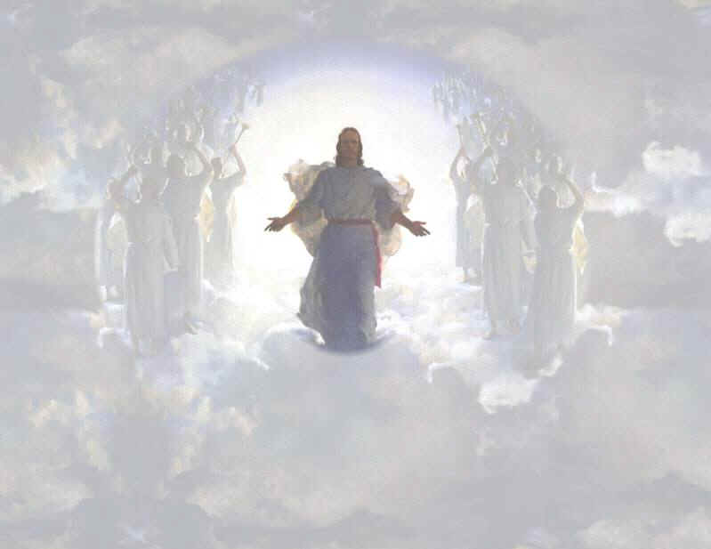
We will join him in the clouds

Slide 38
“We Shall Behold Him”
Sung by Sandi Patti
Notes:
38

Slide 39
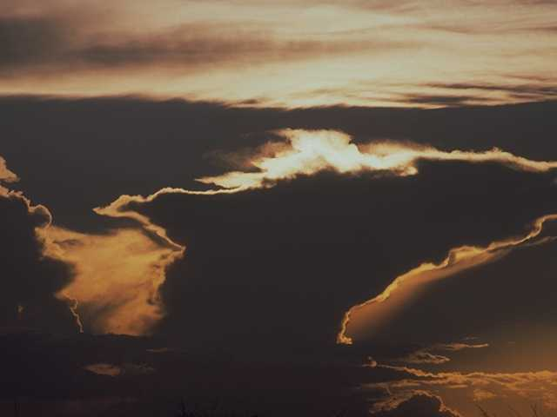
The sky shall unfold…
Notes:
39

Slide 40
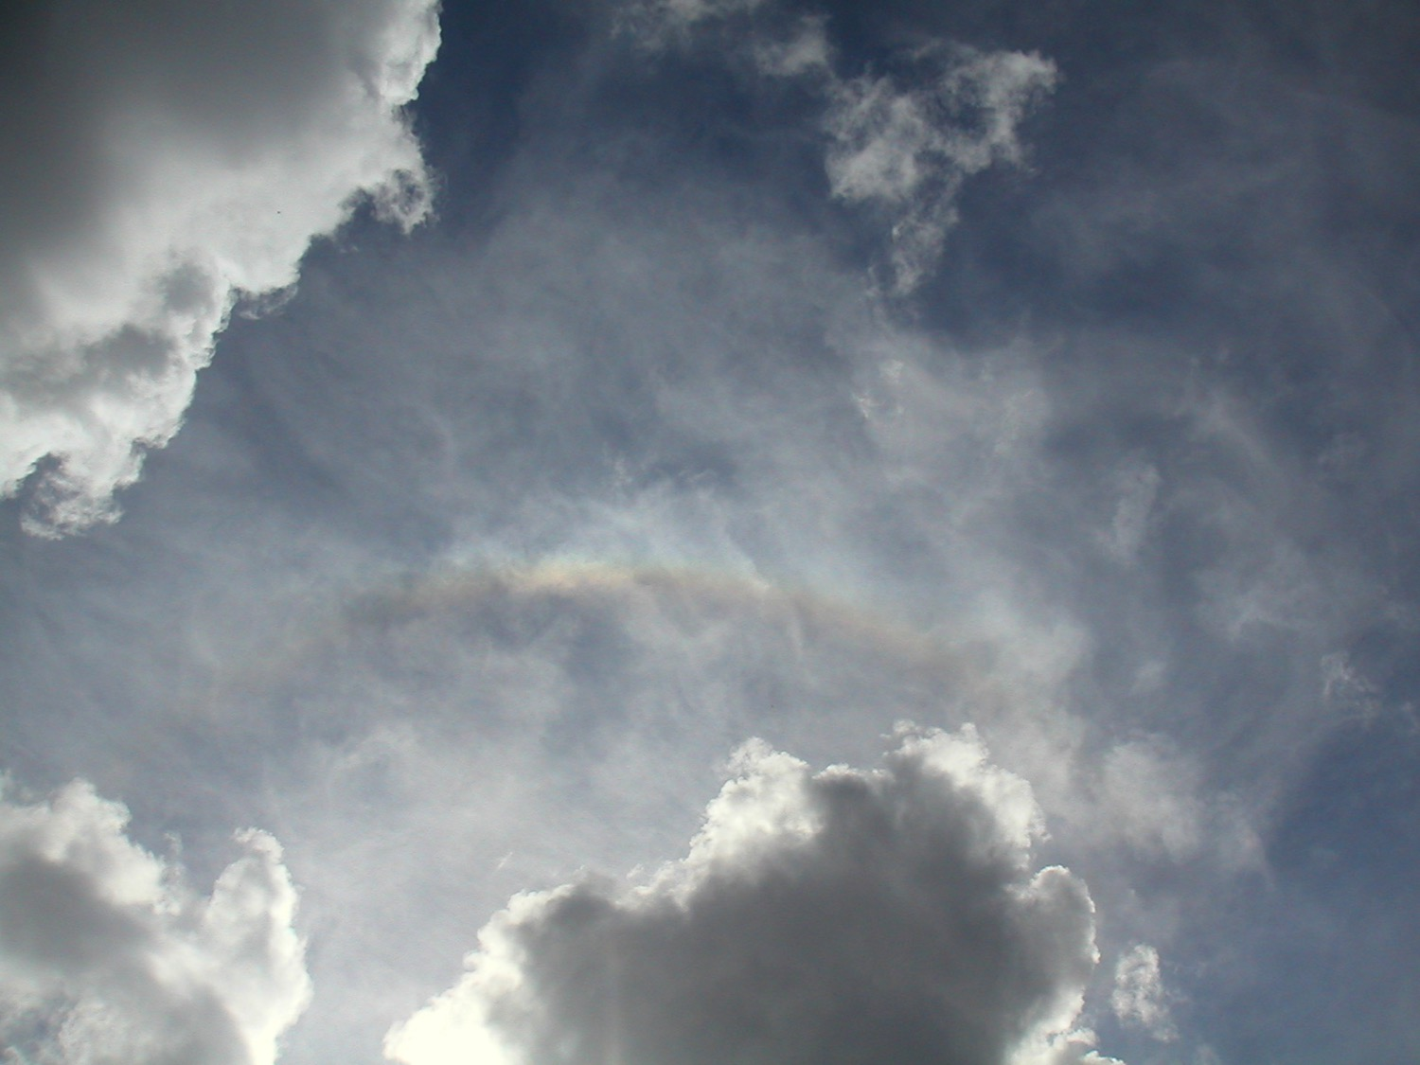
…preparing His entrance
Notes:
40

Slide 41

The stars shall applaud Him with thunders of praise
Notes:
41

Slide 42
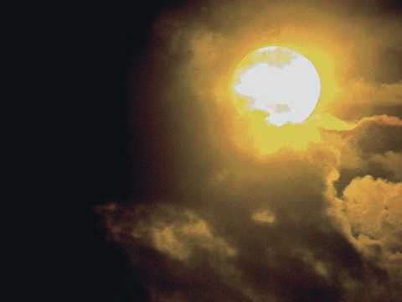
The sweet light in His eyes shall enhance those awaiting
Notes:
42

Slide 43
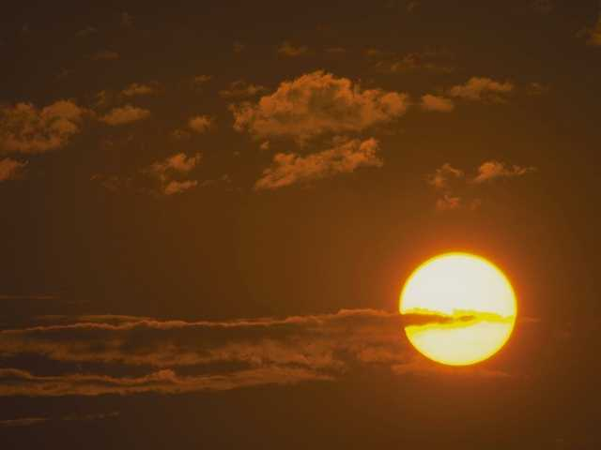
And we shall behold Him then face to face
Notes:
43

Slide 44
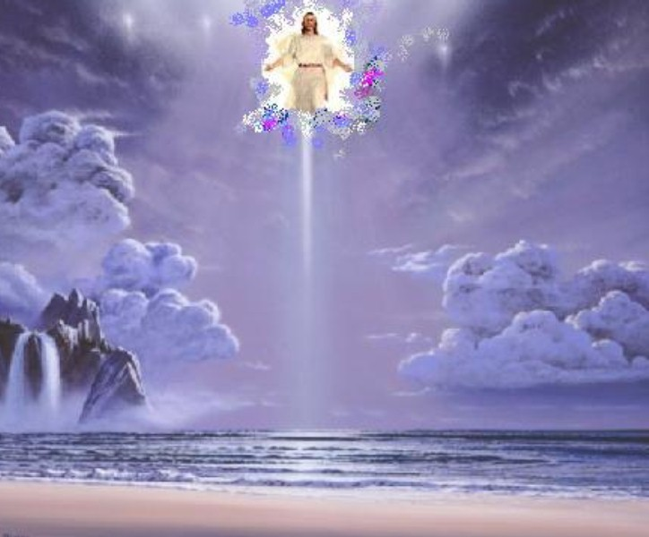
We shall behold Him
We shall behold Him
Notes:
44

Slide 45
…face to face in all of His glory
Notes:
45

Slide 46

We shall behold Him
We shall behold Him
Notes:
46

Slide 47
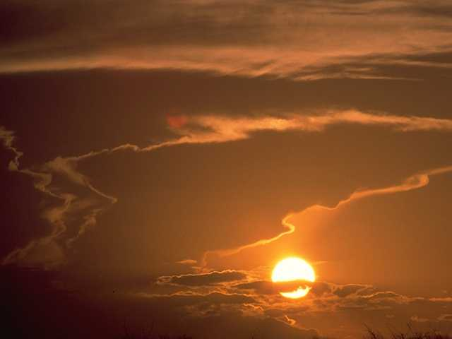
…face to face, our Savior and Lord
Notes:
47

Slide 48
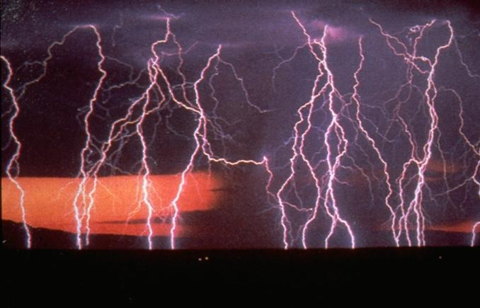
The angels shall sound the shout of His coming
Notes:
48

Slide 49
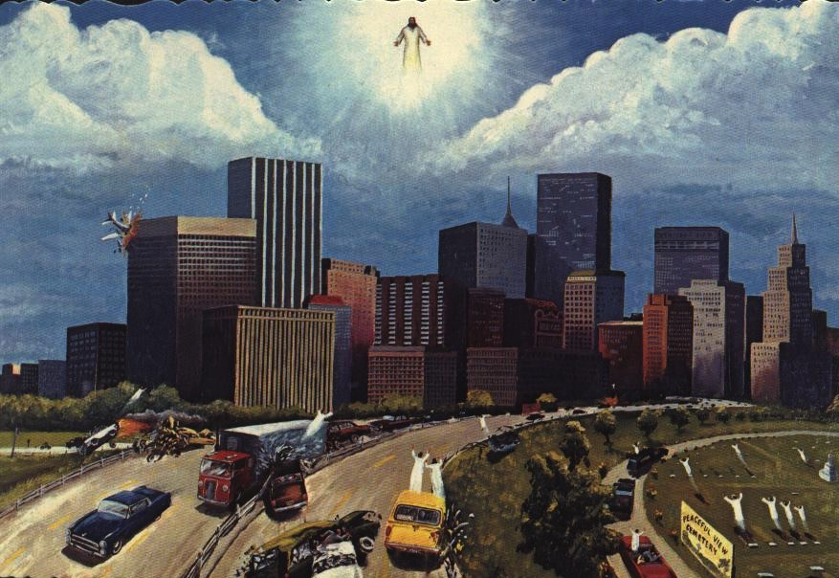
The sleeping shall rise from their slumbering place
Notes:
49

Slide 50

And those who remain shall be changed in a moment
Notes:
50

Slide 51
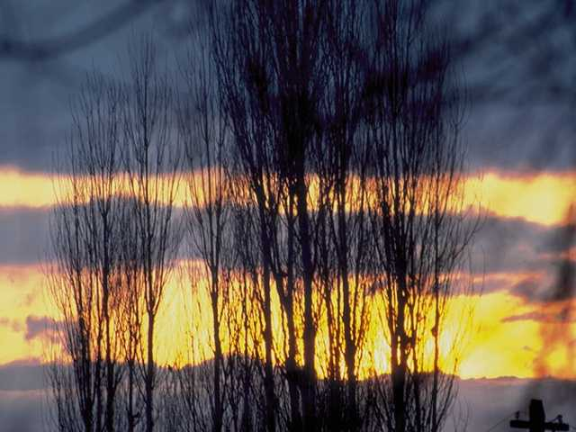
And we shall behold Him then face to face
Notes:
51

Slide 52
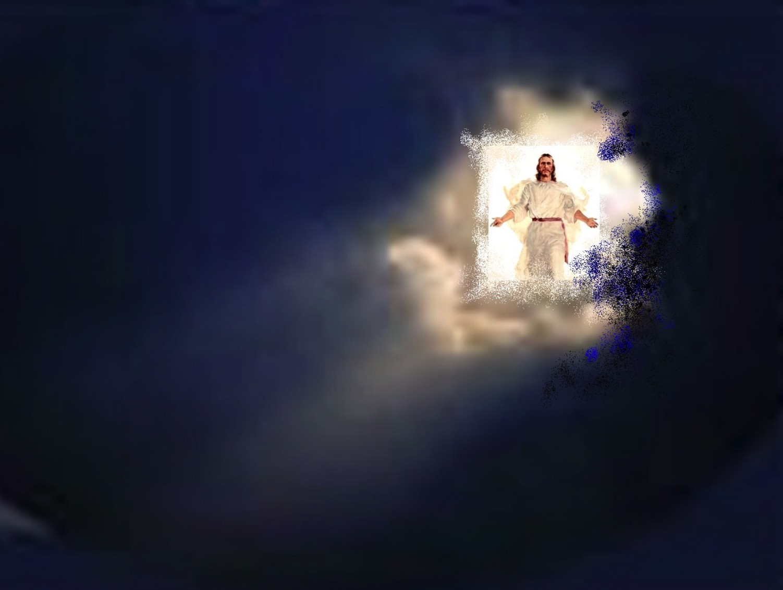
We shall behold Him
We shall behold Him
Notes:
52

Slide 53
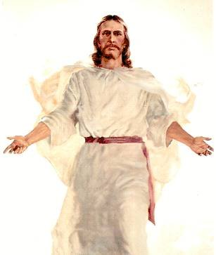
…face to face in all of His glory
Notes:
53

Slide 54
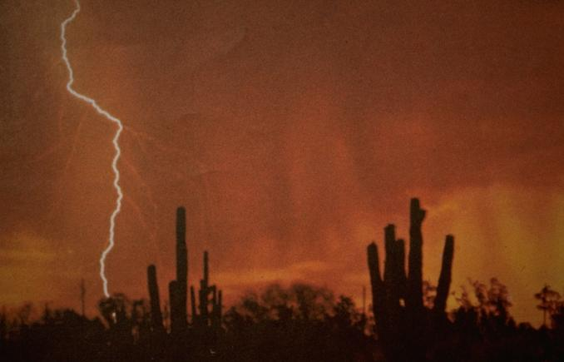
We shall behold Him
We shall behold Him
Notes:
54

Slide 55
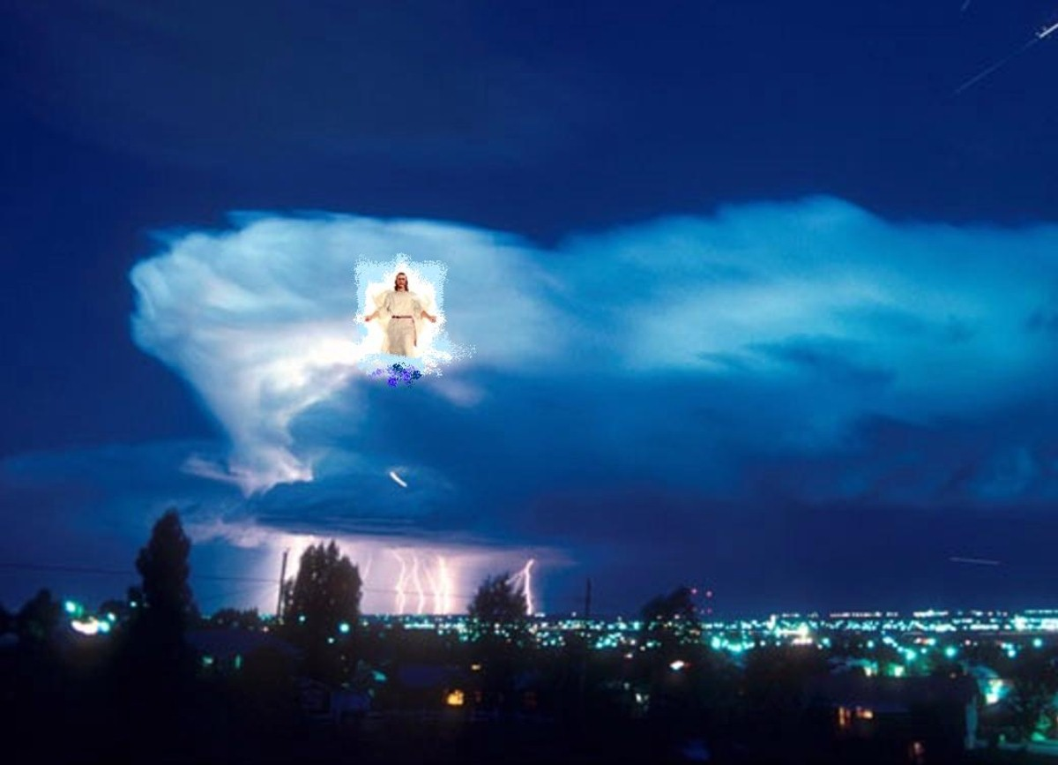
…face to face, our Savior and Lord
Notes:
55

Slide 56
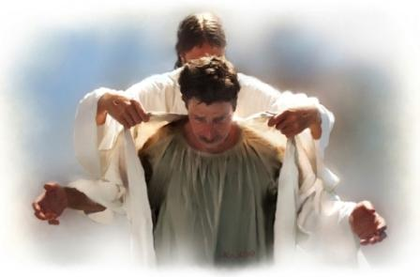
We shall behold Him, our Savior and Lord!
Notes:
56

Slide 57
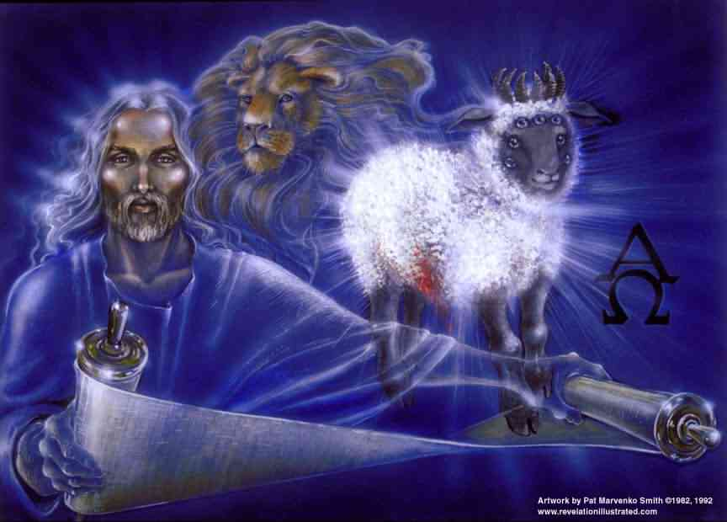
We shall behold Him, our Savior and Lord!
Notes:
57

Slide 58
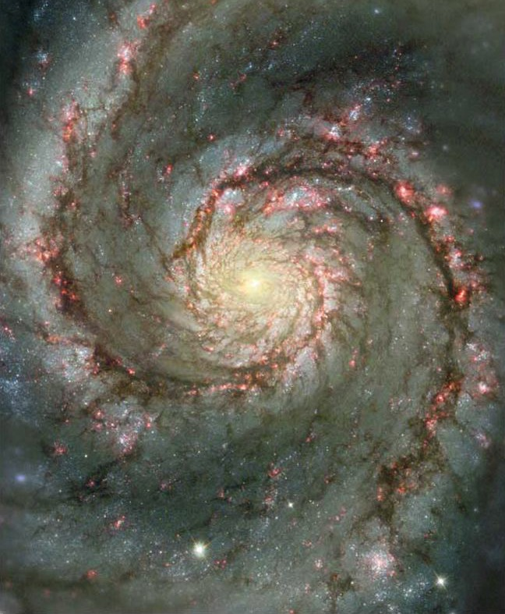
We will live forever with the One who flung stars into space!

Slide 59
Black

Slide 60


Christology link at BibleStudyDownloads.org
Get this presentation for free!
Notes:
Creation (cr)

