Slide 1
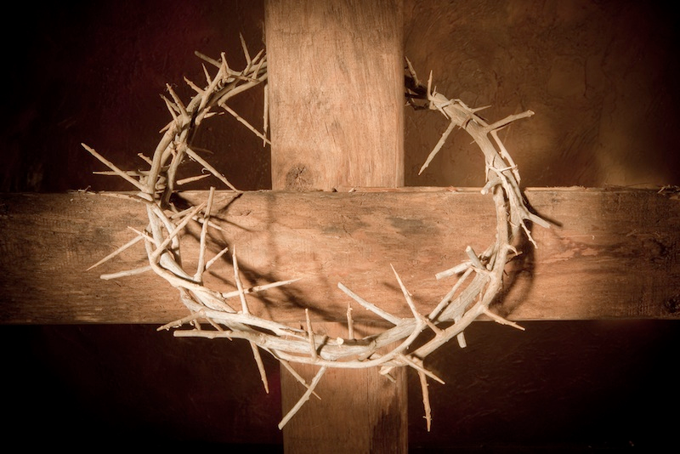
Theories of the Atonement
49
Christology: The Person & Work of Jesus
Dr. Rick Griffith • Jordan Evangelical Theological Seminary • BibleStudyDownloads.org

Slide 2
What is "Atonement"?
"The word atonement comes from 16th-century English and literally means at-one-ment.
Atonement is the process of reconciliation between God and human beings (either on a communal or individual basis) with the goal of righting a wrong or injury, i.e. sin."
http://hackingchristianity.net/2013/03/primer-on-atonement-theories.html

Slide 3
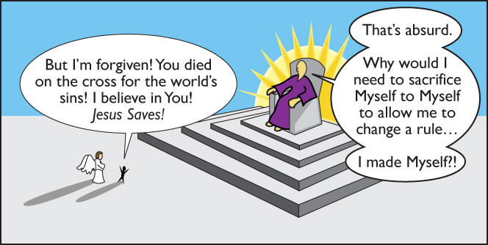
A Skeptic Muses…
http://www.jcnot4me.com/page32.html

Slide 4
What did the death of Jesus do?
Mark Driscoll, Doctrine: What Christians Should Believe

Slide 5
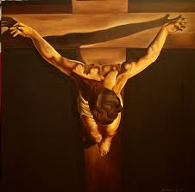
Three Main Atonement Theories
49
PUNISHMENT
Views Owing to God's Justice & Substitution
SATAN
Views Relating Christ's Death to Satan
EXEMPLARY
Views Seeing Christ's Death an Example to Influence

Slide 6
Three Main Atonement Theories
49
PUNISHMENT
SATISFACTION FOR HUMAN SIN
SATAN
BATTLE AGAINST SATAN
EXEMPLARY
ILLUSTRATION OF GOD'S LOVE

Slide 7
Three Main Atonement Theories
49
SATAN
Views Relating Christ's Death to Satan

Slide 8
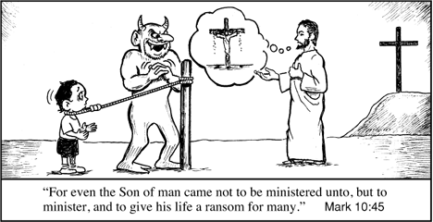
The Ransom to Satan View
49
"For even the Son of man came not to be served, but to serve, and to give his life a ransom for many" (Mark 10:45)
First Proposed by Origen (185-254)
Recently by Jack Chick of Chick's Tracts
Notes:
Fred Butler, Chick Tracts Get You In Trouble!
Posted on April 16, 2007
Accessed on 16 May 2016
https://hipandthigh.wordpress.com/2007/04/
2. Chick's Theology: Chick promotes the typical man-centered, fundamentalist gospel in his tracts and comics. Salvation is not a work solely done in the hearts of rebellious sinners by the divine act of a gracious God, but its a product of "decisional" regeneration on the part of the person making the "right choice" about Jesus.
The newest tract published by Chick called Set Free keynotes the ransom view of the atonement (See Phil Johnson's article on the nature of the atonement). This was a view developed by early church father, Origen, that suggests Christ's death, rather than appeasing the wrath of God against sinners, actually paid a ransom to the devil. Christ is pictured as a weak, powerless savior with no ability to defeat the devil's enslavement of humanity UNLESS the person enslaved chooses to follow Jesus. Our Lord is reduced to a pleading beggar and the devil is elevated to being on equal authority as Christ. Additionally, panels in the tract depicting enslaved humanity, suggest men are not born sinners and are only sinners because the devil so enslaves them. What bit of the biblical doctrine of original sin even presented in the tract is utterly warped. Read a full review of it at Scott McClare's blog.

Slide 9
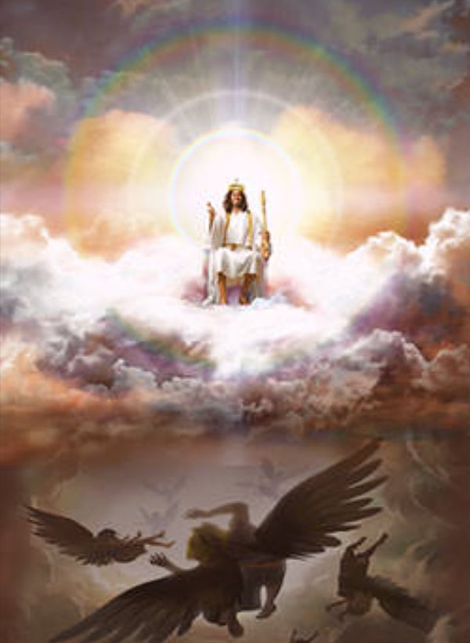
Dramatic (Aulen, 1879-1978)
49
"Christ in His death gained victory over the powers of evil."
—Ryrie, Basic Theology, 356

Slide 10
Three Main Atonement Theories
49
SATAN
Views Relating Christ's Death to Satan
EXEMPLARY
Views Seeing Christ's Death an Example to Influence

Slide 11
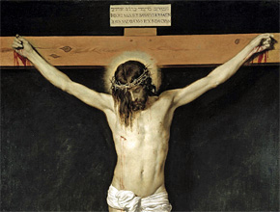
Moral Influence (Peter Abelard, 1079-1142)
49
The "death of Christ was not an expiation for sin but a suffering with His creatures to manifest God's love. This suffering love should awaken a responsive love in the sinner and bring an ethical change in him. This, then liberates from the power of sin."
—Ryrie, Basic Theology, 356

Slide 12
Governmental (Grotius, 1583-1645)
49
"God's government demanded the death of Christ to show His displeasure with sin. Christ also did not suffer the penalty of the Law, but God accepted His suffering as a substitute for that penalty."
—Ryrie, Basic Theology, 356

Slide 13
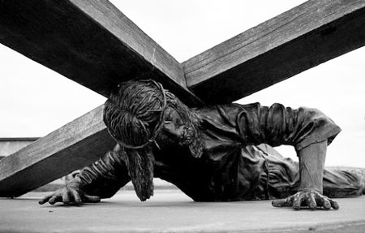
Example (Socinus, 1539-1604)
49
"Christ's death did not atone for sin, but revealed faith and obedience as the way to eternal life and inspiring people to lead a similar life."
—Ryrie, Basic Theology, 356

Slide 14
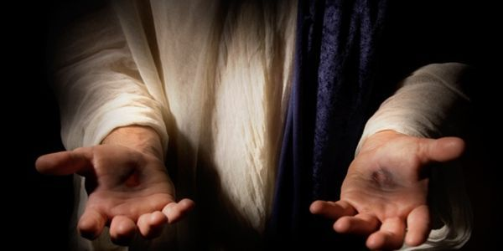
Barthian (Karl Barth, 1886-1968)
49
"Christ's death was principally a revelation of God's love and His hatred of sin."
—Ryrie, Basic Theology, 356

Slide 15
Three Main Atonement Theories
49
PUNISHMENT
Views Owing to God's Justice & Substitution
SATAN
Views Relating Christ's Death to Satan
EXEMPLARY
Views Seeing Christ's Death an Example to Influence

Slide 16
Life Stages

Slide 17
Recapitulation (Irenaeus, 130-202)
50
"Christ recapitulated in Himself all the stages of life including what belonged to us as sinners. His obedience substituted for Adam's disobedience, and this should effect a transformation in our lives."
—Ryrie, Basic Theology, 355

Slide 18
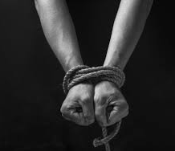
Satisfaction (Anselm, 1033-1109)
50
"Sinful man robbed God of His honor. God rewarded the death of Christ by viewing it as a work of supererogation so that He can pass on its stored-up merits to us. Faith is necessary to appropriate this."
—Ryrie, Basic Theology, 355

Slide 19
JESUS PAID IT ALL
50

Slide 20
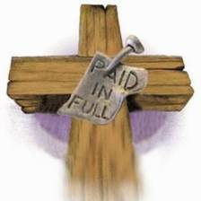
Penal Substitution View
50
"Christ the sinless One took on Himself the penalty that should have been borne by man and others"
—Ryrie, Basic Theology, 356

Slide 21
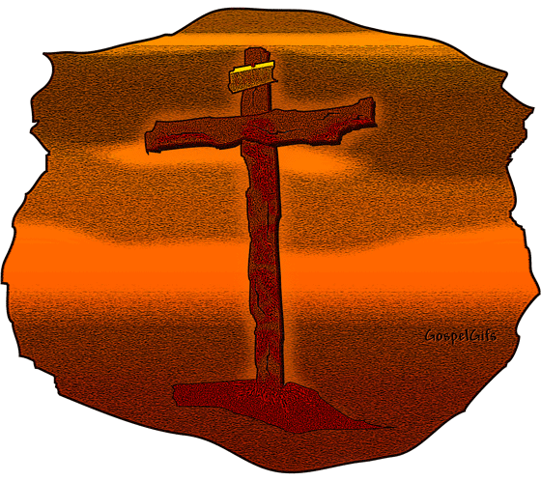
Conclusion
50
"While there may be truth in views that do not include penal substitution, it is important to remember that such truth, if there be some, cannot save eternally. Only the substitutionary death of Christ can provide that which God's justice demands and thereby become the basis for the gift of eternal life to those who believe."
—Ryrie, Basic Theology, 355

Slide 22
Black

Slide 23
Christology link at BibleStudyDownloads.org
Get this presentation for free!
Notes:
Creation (cr)

