Slide 1
The Extent of Christ's Atonement
Christology: The Person & Work of Jesus
Dr. Rick Griffith • Jordan Evangelical Theological Seminary • BibleStudyDownloads.org

Slide 2
The Question
57
Did Jesus die for all people?

Slide 3
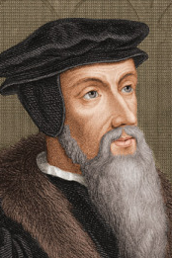
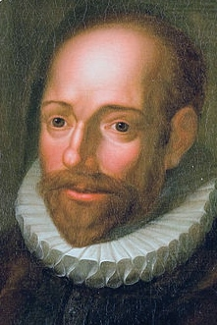
The Views
57
John Calvin
Jacob Arminius
Limited Atonement
Unlimited Atonement

Slide 4
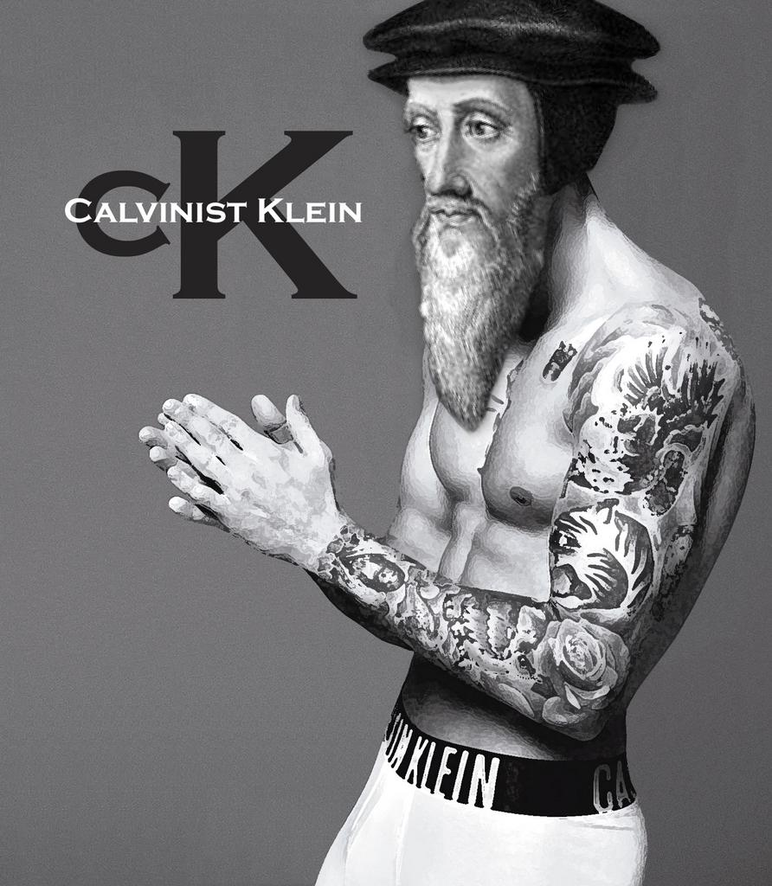
Clothes

Slide 5
The Acronym

Slide 6
ARMINIANISM
When God's Providence and Security are Just Not Enough

Slide 7
The Acronym

Slide 8
Four Important Affirmations
57
Unlimited redemptionists are not universalists.
All people are lost, including the elect.
Anyone who will be saved must believe.
Some Scriptures do relate the Atonement particularly to the elect (e.g., John 10:15; Ephesians 5:25).
—Charles Ryrie, Basic Theology, 375—

Slide 9
Exegetical Considerations
57

Slide 10
"But there were also false prophets in Israel, just as there will be false teachers among you. They will cleverly teach destructive heresies and even deny the Master who bought them. In this way, they will bring sudden destruction on themselves" (2 Peter 2:1 NLT).
57

Slide 11
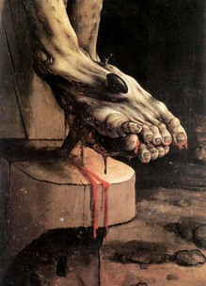
"[Jesus] himself is the sacrifice that atones for our sins—and not only our sins but the sins of all the world" (1 John 2:2 NLT).
58

Slide 12
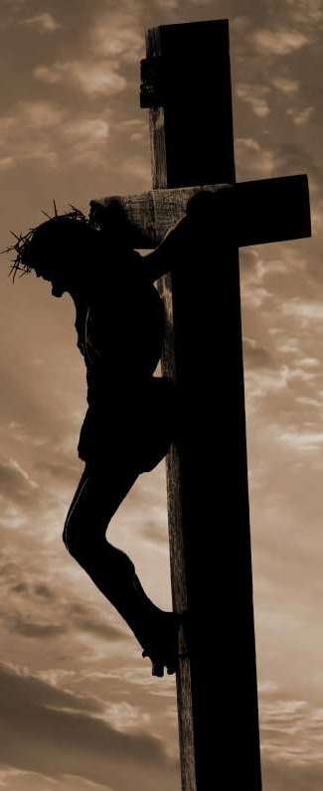
"[God] wants everyone to be saved and to understand the truth. ⁵For there is only one God and one Mediator who can reconcile God and humanity—the man Christ Jesus. ⁶He gave his life to purchase freedom for everyone. This is the message God gave to the world at just the right time" (1 Timothy 2:4-6 NLT).
58

Slide 13
"This is why we work hard and continue to struggle, for our hope is in the living God, who is the Savior of all people and particularly of all believers" (1 Timothy 4:10 NLT).
58

Slide 14
(Hebrews 2:9 NLT)
58
"What we do see is Jesus, who was given a position 'a little lower than the angels'; and because he suffered death for us, he is now 'crowned with glory and honor.' Yes, by God's grace, Jesus tasted death for everyone."
Notes:
This future rule of the world will go to a man (2:6-8a).
This future rule of the world will go to Jesus via His atoning death as our "brother" (2:8b-13).

Slide 15
Life or Death
"For God so loved the world that he gave his one and only Son, that whoever believes in him
shall not perish
but have eternal life.
¹⁷For God did not send his Son into the world to condemn the world,
but to save the world through him. ¹⁸Whoever believes in him is not condemned,
but whoever does not believe stands condemned already because he has not believed in the name of God's one and only Son"
(John 3:16-18 NLT)

Slide 16
"God overlooked people's ignorance about these things in earlier times, but now he commands everyone everywhere to repent of their sins and turn to him" (Acts 17:30 NLT).
58

Slide 17
The Limited Says to the Unlimited…
John Calvin
Jacob Arminius
Limited Atonement
Unlimited Atonement

Slide 18
Limited Atonement

Slide 19
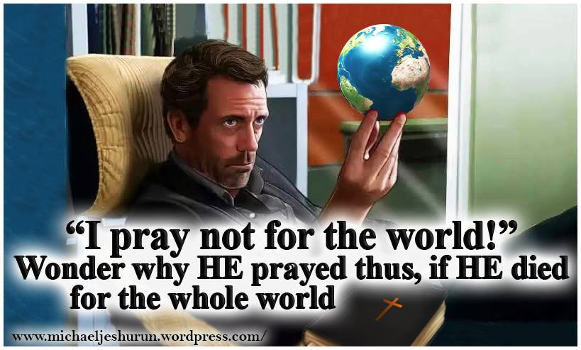
Limited Atonement

Slide 20
CALVINISM: A TOTALLY DEPRAVED THEOLOGY
"I'm sorry, Sally. I have predestined you, your mother and your father all to a fiery eternal torment and there's nothing you can do about it. Have fun suffering in horrible, unending anguish."

Slide 21
Which Pill Will You Swallow?

Slide 22
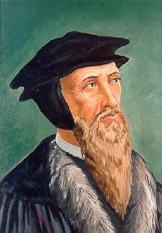
Theological Considerations
58

Slide 23
a) Universal Gospel Preaching
58
"In order for one to preach the Gospel to all…"
"Christ had to die for all."
—Ryrie, Basic Theology, 377

Slide 24
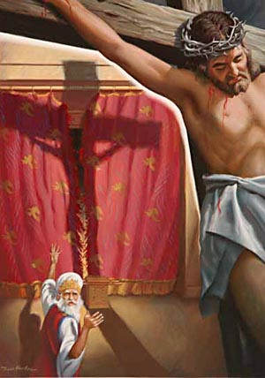
a) The Value of Christ's Death
58
Jesus "made the whole world savable, in addition to the saving value for those who do believe…"
—Ryrie, Basic Theology, 377

Slide 25
kar-ma
58
YOU GET WHAT YOU DESERVE
Chris-ti-an-i-ty
JESUS GOT WHAT YOU DESERVE

Slide 26
c) Do the Nonelect Have Their Sins Paid for Twice?
58
No. They are like a student who has a scholarship check that he never cashes in.
—Ryrie, Basic Theology, 378

Slide 27
If Christ truly died for all, what should we do?
58

Slide 28
Black

Slide 29
Christology link at BibleStudyDownloads.org
Get this presentation for free!
Notes:
Creation (cr)

