Slide 1
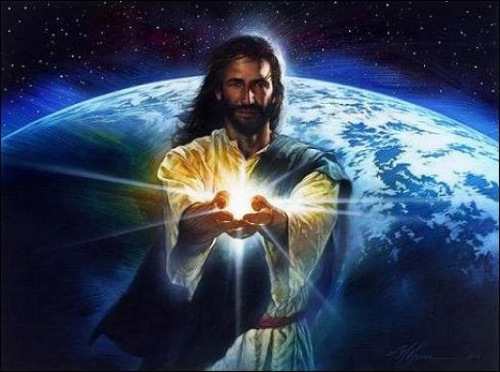
The Deity of Christ
Christology: The Person & Work of Jesus
Dr. Rick Griffith • Jordan Evangelical Theological Seminary • BibleStudyDownloads.org

Slide 2
The Trinity Diagrammed
vii
Father
is
is not
is not
GOD
is
is
Son
Spirit
is not

Slide 3
Jesus is Creator!
Notes:
If you are just getting to know about Jesus, you may be surprised to learn that the Bible says that Jesus is Creator God! Really!

Slide 4


John 1:3
JOHN: SUMMING UP THE MESSAGE
CHAPTER 1: 6 GREAT TRUTHS OF
JESUS CHRIST!
VERSE 1: The Pre-existent One
A Distinct Person
He Was and IS God
VERSE 2: Eternally Co-existent
"Through him all things were made; without him nothing was made that has been made."
VERSE 3: Creator of the Universe
25
1
Notes:
Verse 3: He is the Creator of the Universe…
//// "Through him all things were made; without him nothing was made that has been made."

Slide 5
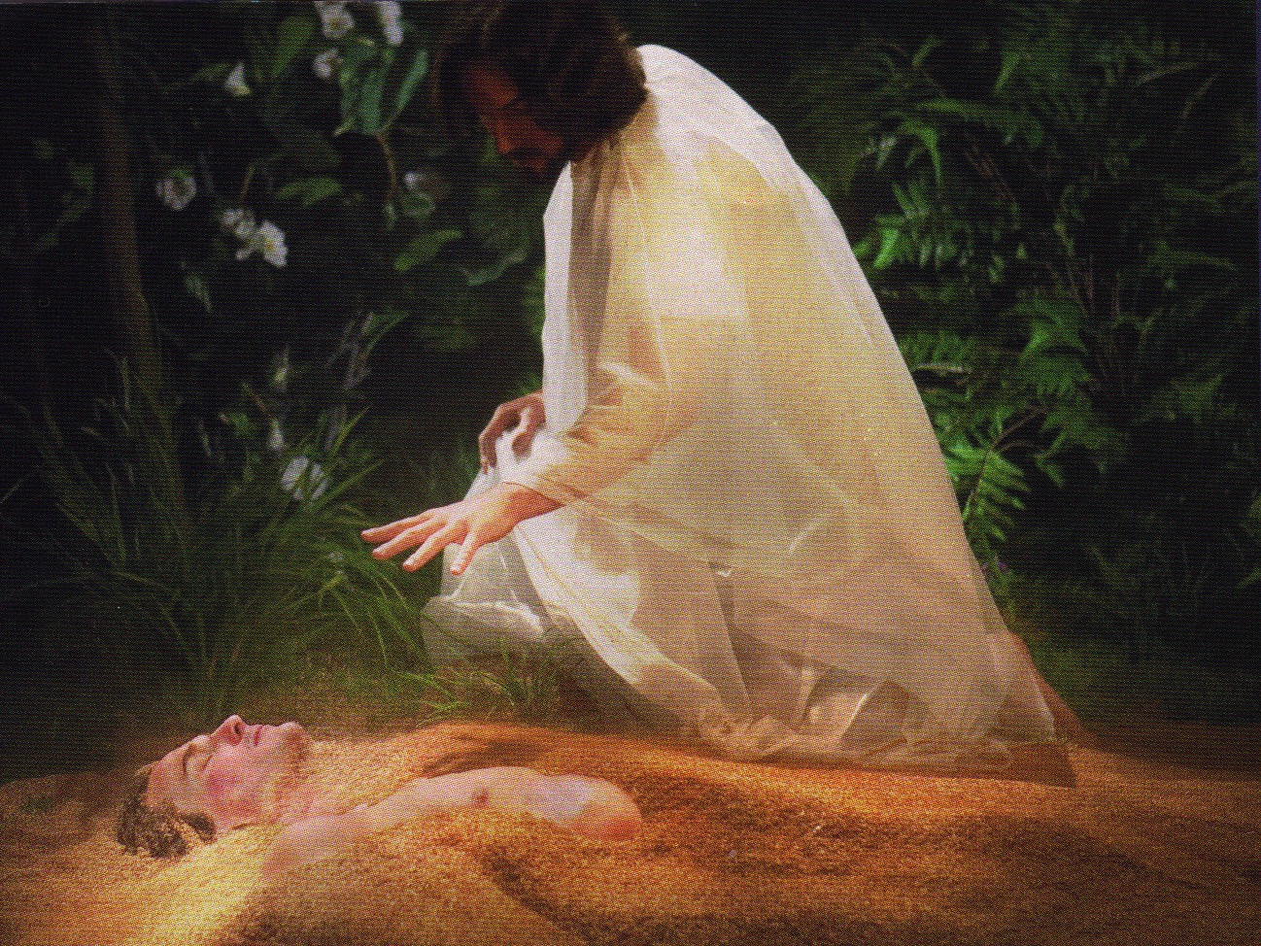
Jesus formed Adam from the dust (John 1:3; Gen. 2:7).

Slide 6
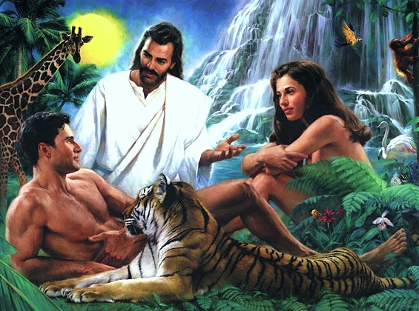
Jesus Created Adam and Eve (John 1:3; Gen. 2:21-23)

Slide 7
John 1:18 NLT
No one has ever seen God. But the unique One,
who is himself God,
is near to the Father’s heart. He has revealed God to us.

Slide 8
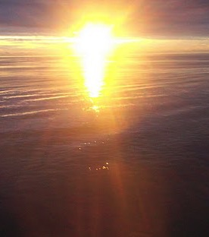

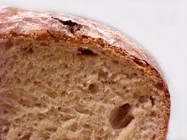
John 6–8
Bread
6
Water
7
Light
8

Slide 9
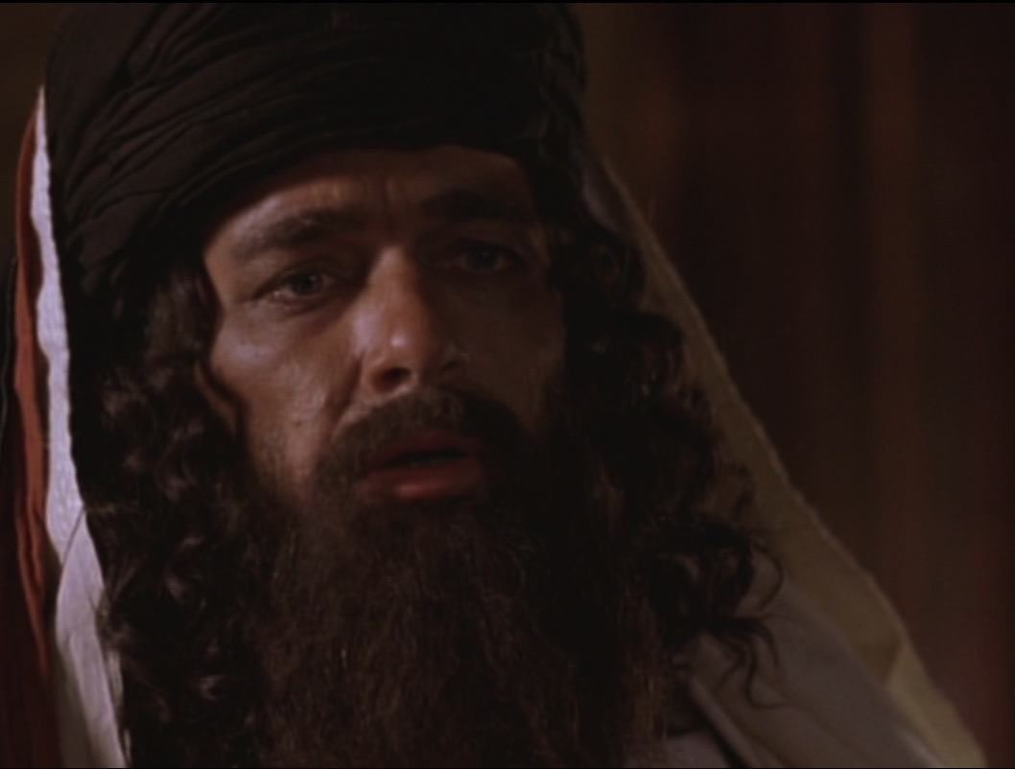
Who are you?!
John 8:25

Slide 10
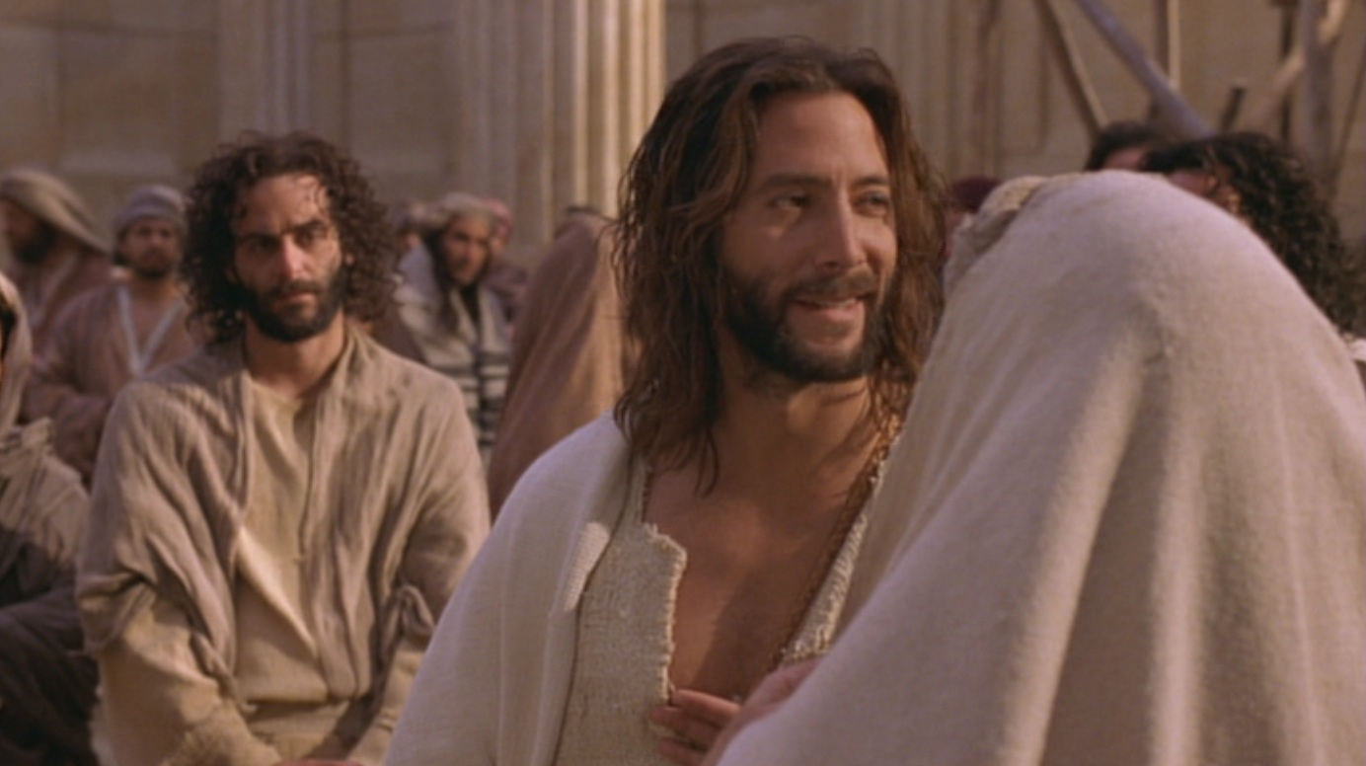
"My identity? I am God!"
(John 8:25-30)
Above
Eternal life
Below
Die in sins
Jesus continued, "You are from below; I am from above. You belong to this world; I do not. ²⁴ That is why I said that you will die in your sins; for unless you believe that I Am who I claim to be, you will die in your sins" (John 8:23-24).

Slide 11
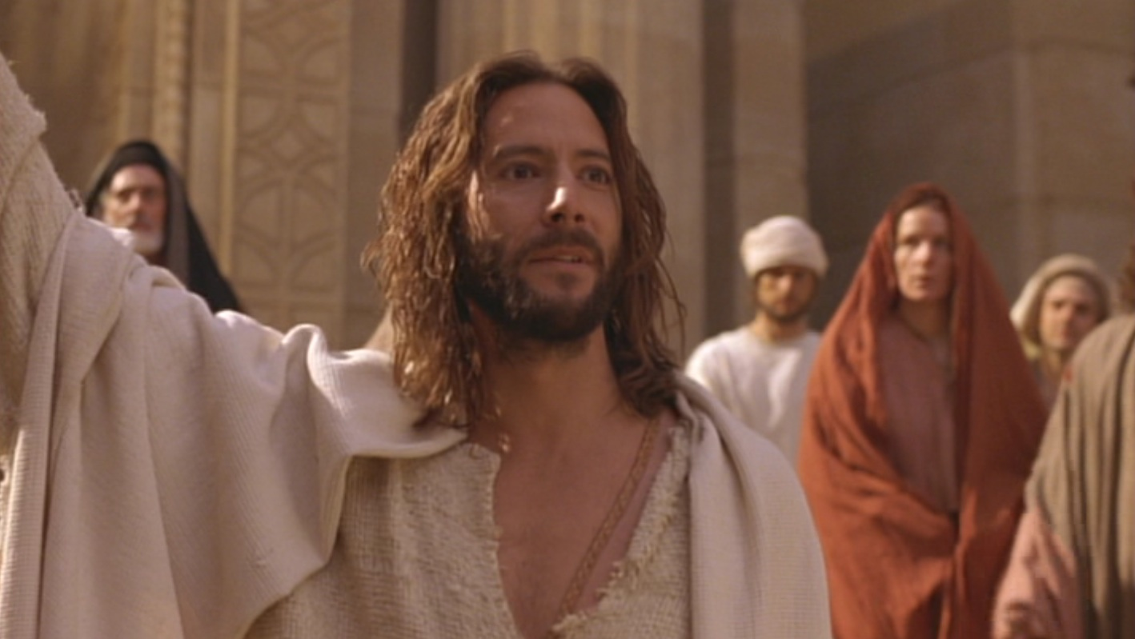
"Before Abraham was born, I Am!"
John 8:58

Slide 12
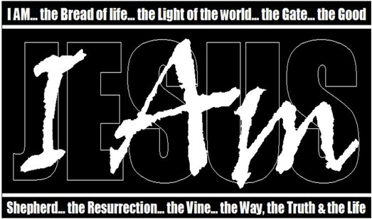
Christ's "I am…" Claims in John's Gospel
"Light of the World"
"Before Abraham"
"Good Shepherd"
"Door"
"I & Father are one"
"Resurrection & Life"
"Way, Truth, & Life"
"True Vine"

Slide 13
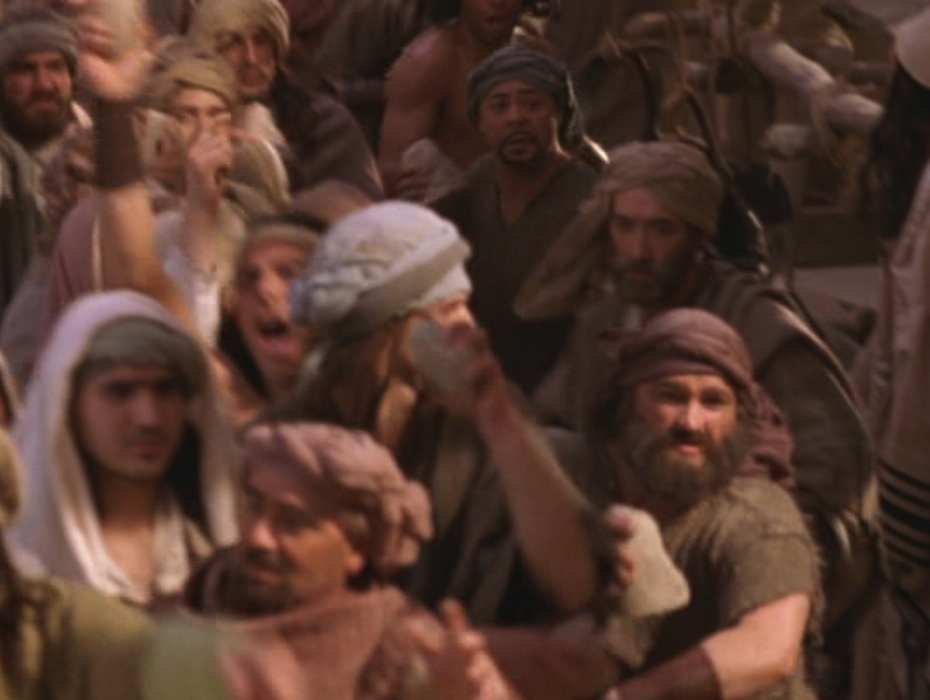
"They picked up stones to throw at him"
John 8:59

Slide 14
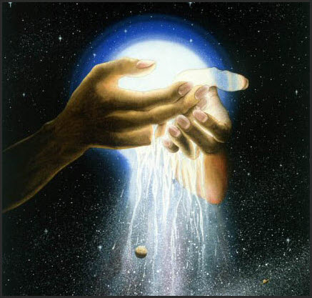
Colossians 1:15
"Christ is the visible image of the invisible God. He existed before anything was created and is supreme over all creation."
Colossians 1:15 (NLT)

Slide 15
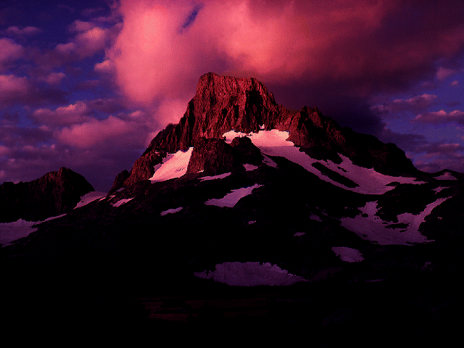
Colossians 1:16-18
"For by Him all things were created: things in heaven and on earth, visible and invisible, whether thrones or powers or rulers or authorities; all things were created by Him and for Him. He is before all things, and in Him all things hold together. And He is the head of the body, the church; He is the beginning and the firstborn from the dead, so that in everything He might have the supremacy."
Colossians 1:16-18 (NIV)

Slide 16
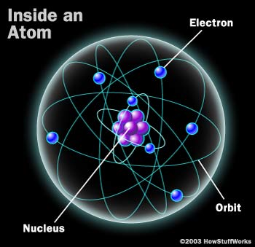
Inside an Atom
Electron (negative)
"…in Him all things hold together" (2:17)
Orbit
Proton Nucleus
(positive)
Notes:
“Electric charge is the physical property of matter that causes it to experience a force when placed in an electromagnetic field. There are two types of electric charges: positive and negative.” (wikipedia on “electric charge”).
One of the basic laws of physics is that opposite charges attract one another. So how does the negatively-charged electron continue to circle around the positively-charged nucleus? Why doesn’t the electron just fly into the nucleus? Verse 17 says, “In [Christ] all things hold together.”
Another law says that like charges repel one another. Good enough, but why doesn’t this apply in each atom? Why don’t all these positively-charged protons repel one another and fly into space? Verse 17 says, “In [Christ] all things hold together.”

Slide 17
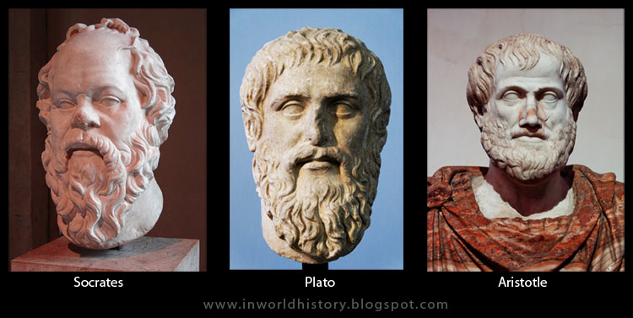
Greek Philosophy
Socrates
Plato
Aristotle

Slide 18
Greek Philosophy
"Good people do not need laws to tell them to act responsibly, while bad people will find a way around the laws"
—Plato
423-348 BC
Socrates
Plato
Aristotle

Slide 19
Greek Philosophy
Don't let anyone capture you with empty philosophies and high-sounding nonsense that come from human thinking and from the spiritual powers of this world, rather than from Christ
(2:8 NLT)
"Good people do not need laws to tell them to act responsibly, while bad people will find a way around the laws"
—Plato
423-348 BC
Socrates
Plato
Aristotle

Slide 20
Greek Philosophy
Don't let anyone capture you with empty philosophies and high-sounding nonsense that come from human thinking and from the spiritual powers of this world, rather than from Christ
(2:8 NLT)
"Good people do not need laws to tell them to act responsibly, while bad people will find a way around the laws"
—Plato
423-348 BC
Socrates
Plato
Aristotle

Slide 21
Key Verse
187
"For in Christ all the fullness of the Deity lives in bodily form"
(Colossians 2:9).
Colossians

Slide 22
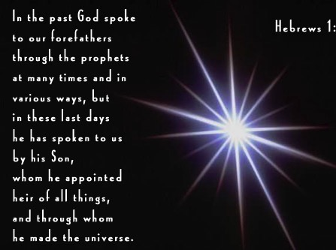
Hebrews 1:1-2 NLT
"Long ago God spoke many times and in many ways to our ancestors through the prophets. ²And now in these final days, he has spoken to us through his Son. God promised everything to the Son as an inheritance, and through the Son he created the universe."
Notes:
Long ago God spoke many times and in many ways to our ancestors through the prophets. ² And now in these final days, he has spoken to us through his Son. God promised everything to the Son as an inheritance, and through the Son he created the universe. ³ The Son radiates God's own glory and expresses the very character of God, and he sustains everything by the mighty power of his command. When he had cleansed us from our sins, he sat down in the place of honor at the right hand of the majestic God in heaven. ⁴ This shows that the Son is far greater than the angels, just as the name God gave him is greater than their names.

Slide 23
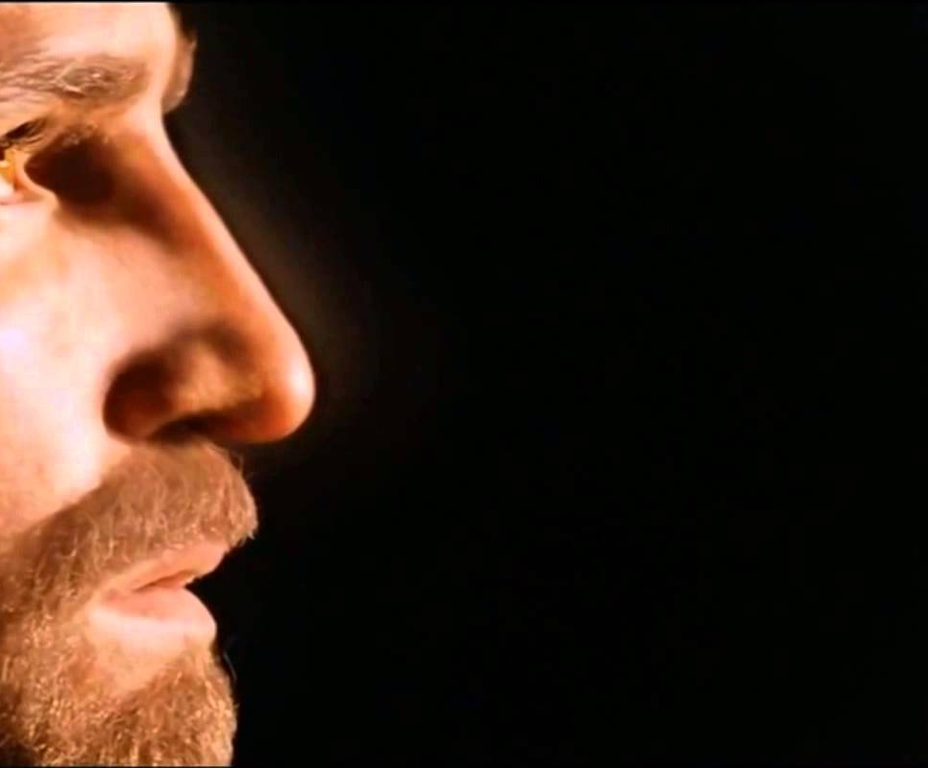
1. God gives you the same faith as the apostles due to Christ's deity.
You're complete in Christ as God (2 Pet 1:1-4)

Slide 24
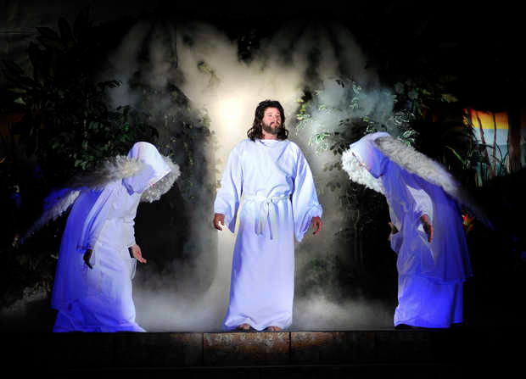
Angels worship Jesus
Notes:
Angels eternally worship Christ as God (1:6-7)

Slide 25
"And when he brought his supreme Son into the world, God said,
'Let all of God's angels worship him.'"
(Hebrews 1:6 NLT).
Notes:
If angels worship Jesus, then he must be higher, right?

Slide 26
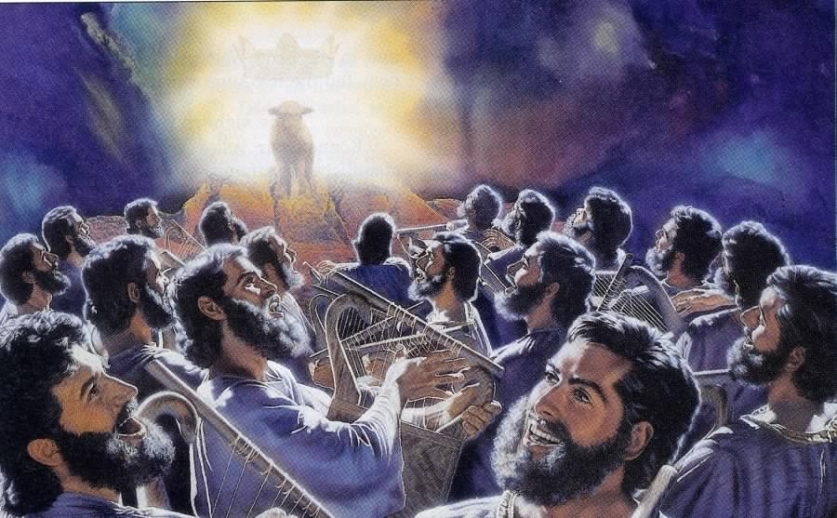
"You are worthy to take the scroll and open its seals…" (Rev 5:9)
369
Notes:
Revelation 5 shows angels worshipping the Lamb

Slide 27
"Regarding the angels, he says,
'He sends his angels like the winds, his servants like flames of fire.'"
(Hebrews 1:7 NLT).
Notes:
Angels are amazingly fast—like winds of fire!

Slide 28
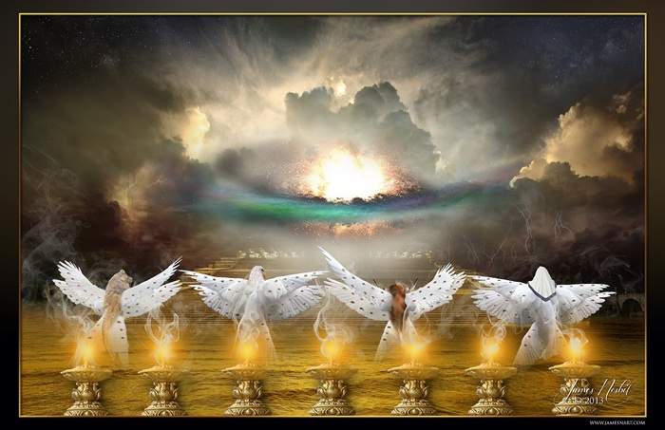
Four Living Creatures
(Rev. 4)
Notes:
Yet they still worship Christ!

Slide 29
"But to the Son he says,
'Your throne, O God,
endures forever and ever.
You rule with a scepter of justice.
⁹You love justice and hate evil.
Therefore, O God, your God has anointed you, pouring out the oil of joy on you more than on anyone else.'"
(Hebrews 1:8-9 NLT)
Notes:
The Father calls Jesus "God" in verses 8-9!

Slide 30
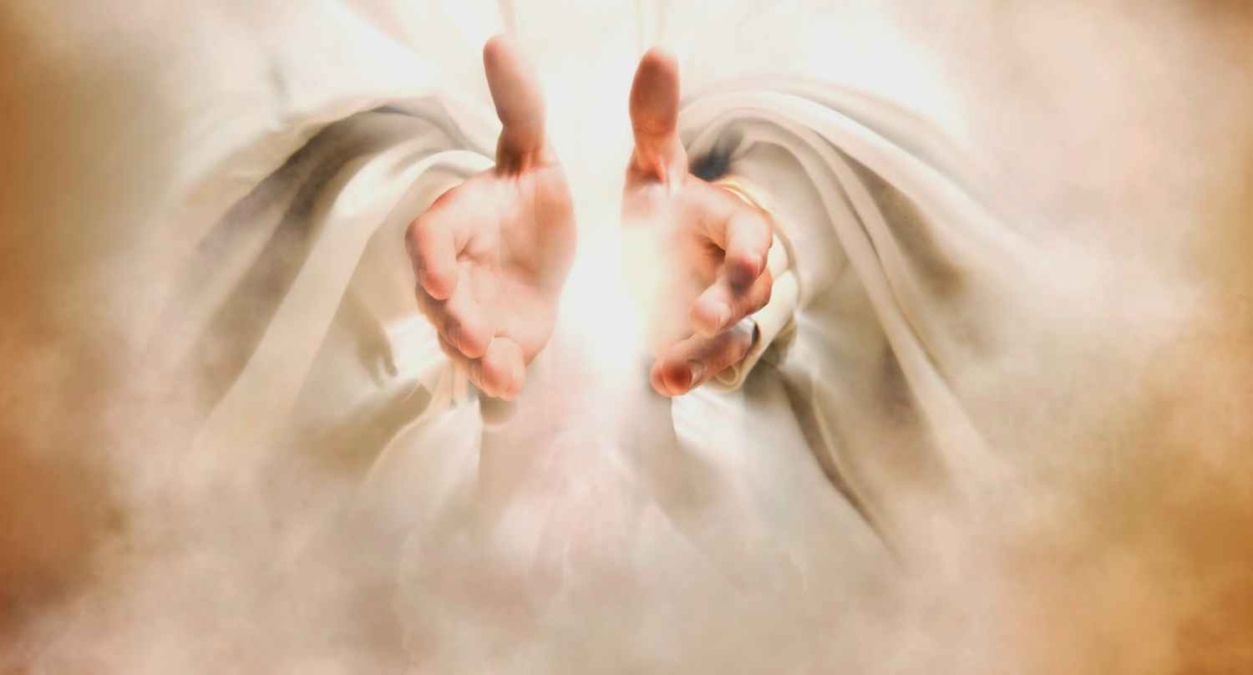
The Father calls Jesus "God"!
Notes:
What better witness to Christ’s identity do you need than the Father?

Slide 31
"He also says to the Son,
'In the beginning, Lord, you laid the foundation of the earth and made the heavens with your hands. ¹¹They will perish, but you remain forever. They will wear out like old clothing.'"
(Hebrews 1:10-11 NLT)
Notes:
The Father calls Jesus "Lord" and "Creator" in verses 10-11

Slide 32
"He also says to the Son…
'You will fold them [the earth and the heavens] up like a cloak
and discard them like old clothing.
But you are always the same;
you will live forever.'"
(Hebrews 1:10a, 12 NLT)
Notes:
Only God is unchanging. Since Jesus is unchanging, he must also be God.

Slide 33

"This letter is from Simon Peter, a slave and apostle of Jesus Christ. I am writing to you who share the same precious faith we have. This faith was given to you because of the justice and fairness of Jesus Christ, our God and Savior"
(2 Peter 1:1 NLT).
Notes:
Peter notes that his readers had the same faith as "ours" (1a).
There is a great sense of humility here where the great apostle puts himself on the same level as his meek readers.
In this pre-Gnostic world, teachers prided themselves with their privileged, so-called "secret knowledge."
Yet Peter says the righteousness provided by Jesus Christ gives us all the "same faith"! Wow!
The phrase "our God and Savior" also teaches Christ's deity (1b).
"The grammar here clearly indicates that 'God and Savior' are one Person, not two (i.e., there is one Gr. article with two substantives). This passage ranks with the great Christological passages of the New Testament which plainly teach that Jesus Christ is coequal in nature with God the Father" (Gangel, BKC, 2:863-64).
We need to understand that our faith is in Jesus as God, not just some teacher of knowledge.

Slide 34
1. God gives you the same faith as the apostles due to Christ's deity.
You're complete in Christ as God (2 Pet 1:1-4)
2. God shows us Christ's person for grace and peace.

Slide 35
"May God give you more and more grace and peace as you grow in your knowledge of God and Jesus our Lord"
(2 Peter 1:2 NLT).
Notes:
God shows us Christ's person for grace and peace (2).
The word for "knowledge" here implies an intimate, personal relationship.
We need to know that grace is in Christ (2a).
We need to know that Christ alone gives us peace (2b).

Slide 36
Lord
Lord Jesus Christ
God
Deity
Master
Jesus
Christ
King
Savior
Messiah
Joshua
Lion
Lamb

Slide 37
Black
Notes:
37

Slide 38


Christology link at BibleStudyDownloads.org
Get this presentation for free!
Notes:
Creation (cr)

