Slide 1
The Trinity Diagrammed
vii
Father
is
is not
is not
GOD
is
is
Son
Spirit
is not
Dr. Rick Griffith • Jordan Evangelical Theological Seminary • BibleStudyDownloads.org

Slide 2

Biblical Evidence for the Trinity
iii
Christology: The Person & Work of Jesus
How can you prove this important doctrine?

Slide 3

How to Prove the Trinity
iii
Start only with the Bible
Show the Bible teaches only one God

Slide 4

One God
iii

Slide 5

There is Only One God
iii
“This is what the LORD says—Israel’s King and Redeemer, the LORD of Heaven’s Armies: “I am the First and the Last; there is no other God”
(Isaiah 44:6)

Slide 6

There is Only One God
iii
“…Understand that I alone am God. There is no other God—there never has been, and there never will be”
(Isaiah 43:10 NLT)

Slide 7
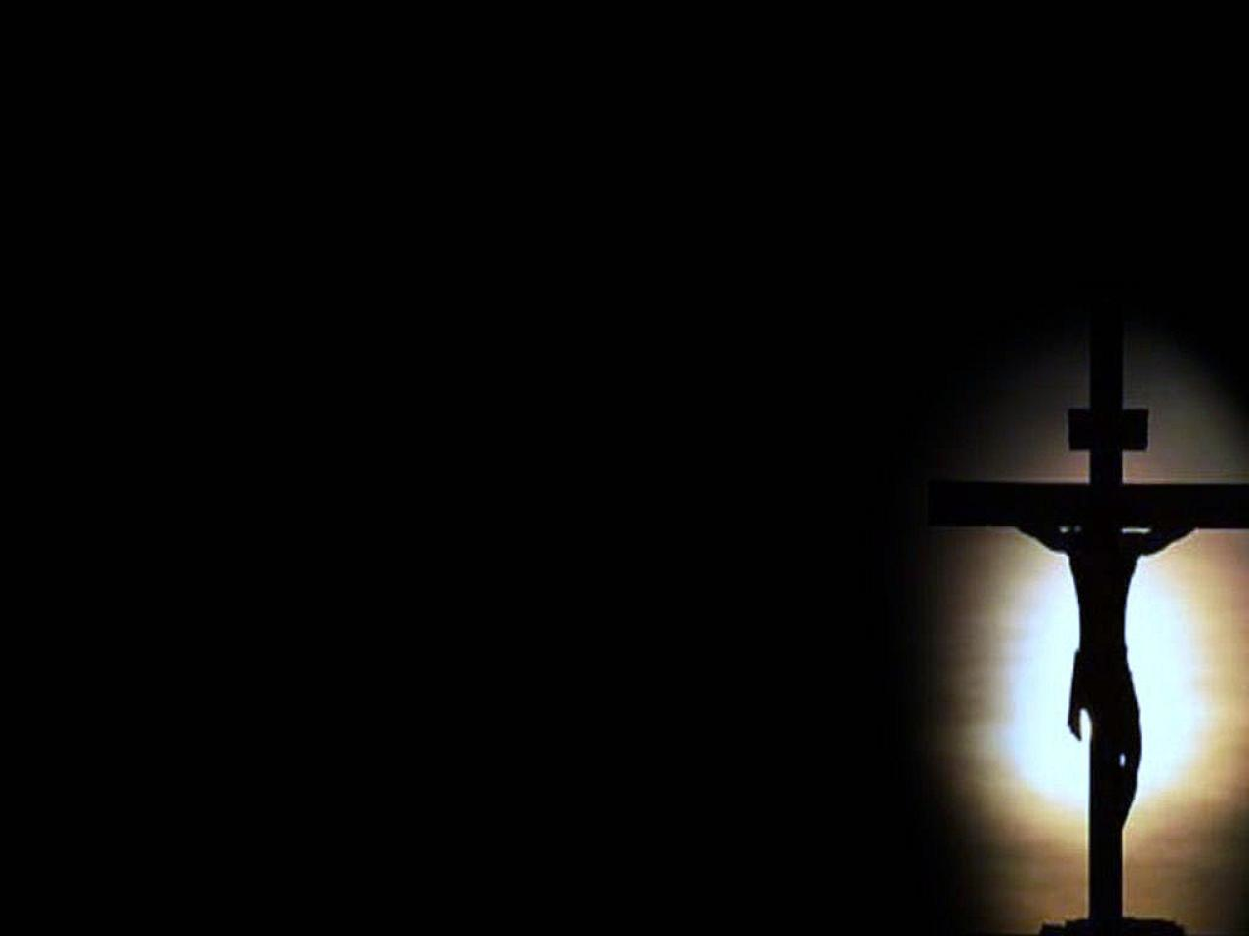
There is Only One God
iii
“There is but one God, and one mediator between God and man, Christ Jesus”
(1 Tim. 2:5)

Slide 8
3. Correctly Define the Trinity
iii
“Within the nature of the one, true God exists three Person(age)s:
the Father, the Son and the Holy Spirit, who share the same attributes,
are the same substance (nature, essence or reality)
and are in effect the one, true God.”
Ask, “Do you agree with this definition?”

Slide 9

The Illustration of Light
iii
A single beam of white light…
…breaks into three beams of red, yellow, and blue
Notes:
http://www.message4muslims.org.uk/apologetics/the-holy-spirit/

Slide 10
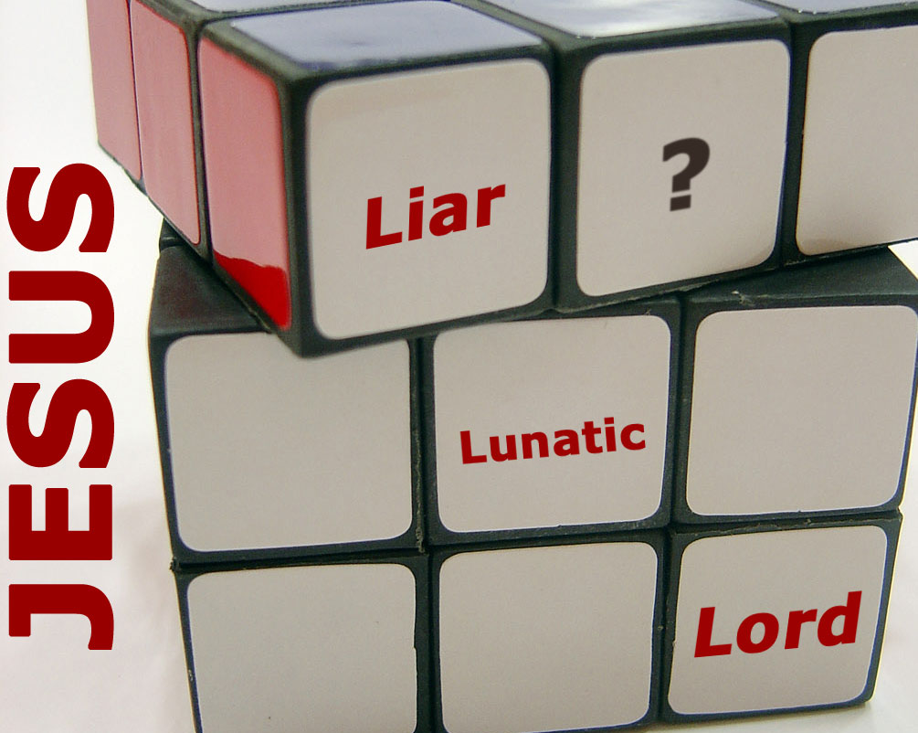
4. Decide who Jesus is
iii

Slide 11
5. Show the reasonableness of this proposition:
iii
If three biblical Persons are all called God and share the same attributes of God, but there exists only one God, they are in effect the one, true God. (If this can be demonstrated then the Trinity is true.)
Ask, “If I can prove this to you,
then will you believe in the Trinity?”
If the person says “no,” then he or she has an authority other than the Bible!

Slide 12
6. The Bible conclusively proves the above proposition in the following passages that identify the same attributes/titles with the Father, the Son, and the Holy Spirit:
iii
Father
is
is not
is not
GOD
is
is
Son
Spirit
is not

Slide 13
Proving the Trinity
Biblical Evidence for the Doctrine of the Trinity
iii
Attribute/Title
Father
Son
Holy Spirit
Called "God" (deity)
2 Pet. 1:17
Heb. 1:6-8
Acts 5:3-4
Worshipped as God
Matt. 4:10
John 20:28
Indwells believers
1 Cor. 3:16a
Col. 1:27
1 Cor. 3:16b
Is the truth
John 3:33
John 14:6
1 John 5:6
Raised Christ
Acts 3:26
John 10:17
Rom. 8:11
Omniscient
Ps. 139:1-5
John 16:3
1 Cor. 2:10-11
Omnipotent
Matt. 19:26
Phil. 4:13
Zech. 4:6
Omnipresent
Jer. 23:24
Matt. 18:20
Ps. 139:7-12
Has personhood
John 3:16
John 1:9-18
John 14:17
Helper (Paraclete)
2 Cor. 1:3-6
1 John 2:1
John 14:26
Forgives sin
Isa. 45:25
1 John 2:12
Forgets sin
Jer. 31:34
Heb. 8:12
Heb. 10:17
Immutable
Mal. 3:6
Heb. 13:8
Eternal
Exod. 15:18
John 1:1-2
"I Am"
Exod. 3:14
John 8:58
"Alpha and Omega"
Rev. 1:8
Rev. 22:13, 16
"First and the Last"
Isa. 44:6
Rev. 1:17
Holy
Isa. 6:3
Mark 1:24
Luke 11:13
Note: Underlined verses are translated correctly in the Jehovah Witness New World Translation.

Slide 14
6. The Father, Son, & Spirit are all God:
iii
Attribute or Title | Father | Son | Holy Spirit
Called “God” (deity) | 2 Pet. 1:17 when he received honor and glory from God the Father. The voice from the majestic glory of God said to him, “This is my dearly loved Son, who brings me great joy.” | Heb. 1:6, 8 And when he brought his supreme Son into the world, God said, “Let all of God’s angels worship him”… ⁸But to the Son he says, “Your throne, O God, endures forever and ever. You rule with a scepter of justice.” | Acts 5:3 Then Peter said, “Ananias, why have you let Satan fill your heart? You lied to the Holy Spirit…You weren’t lying to us but to God!”

Slide 15
6. The Father, Son, & Spirit are all God:
iii
Attribute or Title | Father | Son | Holy Spirit
Indwells believers | 1 Cor. 3:16a Don’t you realize that all of you together are the temple of God and that the Spirit of God lives in you? | Col. 1:27 For God wanted them to know that the riches and glory of Christ are for you Gentiles, too. And this is the secret: Christ lives in you. This gives you assurance of sharing his glory. | 1 Cor. 3:16b Don’t you realize that all of you together are the temple of God and that the Spirit of God lives in you?

Slide 16
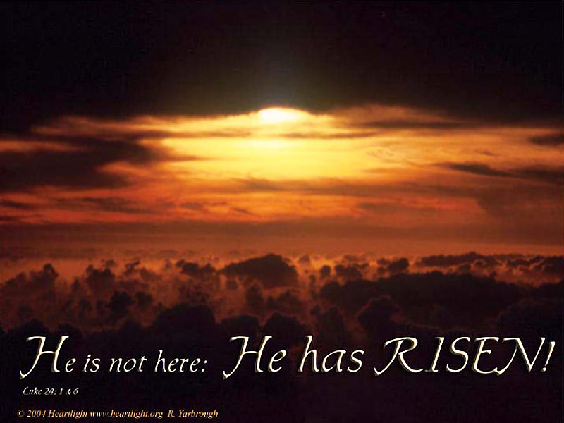

Truth
Father, Son & Spirit are All Called Truth

Slide 17
6. The Father, Son, & Spirit are all God:
iii
Attribute or Title | Father | Son | Holy Spirit
Holy | Isa. 6:3 They were calling out to each other, “Holy, holy, holy is the LORD of Heaven’s Armies! The whole earth is filled with his glory!” | Mark 1:24 “Why are you interfering with us, Jesus of Nazareth? Have you come to destroy us? I know who you are—the Holy One of God!” | Luke 11:13 So if you sinful people know how to give good gifts to your children, how much more will your heavenly Father give the Holy Spirit to those who ask him.”

Slide 18

Holy, Holy, Holy 1/4
Holy, Holy, Holy!

Slide 19
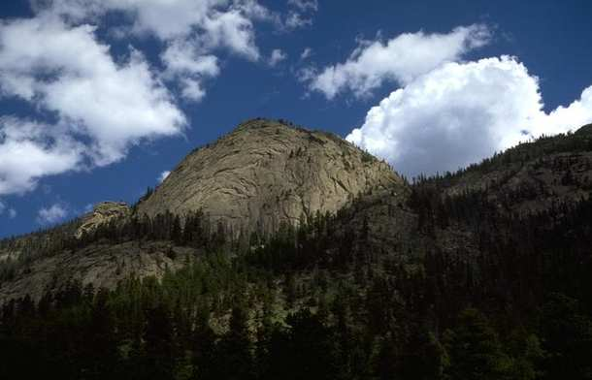
Holy, Holy, Holy 1/4
Holy, holy, holy! Lord God Almighty!
Early in the morning
our song shall rise to Thee;
Holy, holy, holy! merciful and mighty!
God in three Persons,
blessed Trinity!

Slide 20
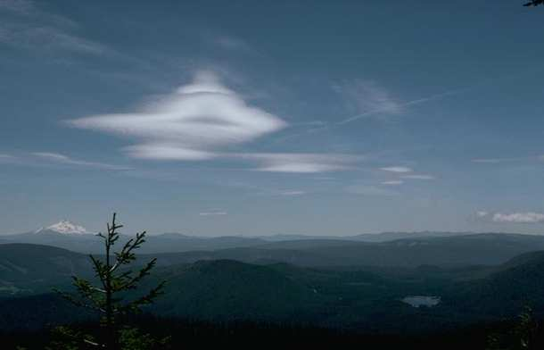
Holy, Holy, Holy 2/4
Holy, holy, holy!
All the saints adore Thee,
casting down their golden crowns
around the glassy sea;
Cherubim and seraphim
falling down before Thee,
which wert, and art,
and evermore shall be.

Slide 21
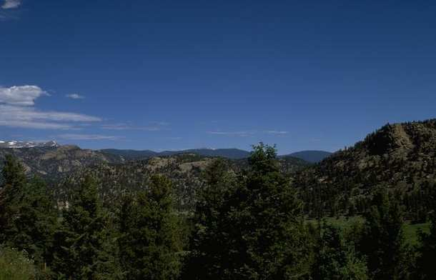
Holy, Holy, Holy 3/4
Holy, holy, holy!
though the darkness hide Thee,
though the eye of sinful man
Thy glory may not see;
only Thou art holy-
there is none beside Thee
perfect in power,
in love and purity.

Slide 22
Holy, Holy, Holy 4/4
Holy, holy, holy! Lord God Almighty!
All Thy works shall praise Thy name
in earth and sky and sea;
Holy, holy, holy! merciful and mighty!
God in three Persons,
blessed Trinity!

Slide 23
Ephesians 4:4
one Father
above all through all in all
one body
one Spirit
one Lord
one
faith
one hope
one
baptism
Marva Dawn, The Unnecessary Pastor, 237

Slide 24
Ephesians 4:5
one Father
above all through all in all
one body
one Spirit
one Lord
one
faith
one hope
one
baptism
Marva Dawn, The Unnecessary Pastor, 237

Slide 25
Ephesians 4:6
one Father
above all through all in all
one body
one Spirit
one Lord
one
faith
one hope
one
baptism
Marva Dawn, The Unnecessary Pastor, 237

Slide 26
Ephesians 4:4-6
one Father
above all through all in all
one body
one Spirit
one Lord
one
faith
one hope
one
baptism
Marva Dawn, The Unnecessary Pastor, p. 237

Slide 27
Ephesians 4:4-6
one God and Father
above all
through all
in all
v. 6
one body
one Spirit
one Lord
one
faith
v. 4
v. 5
one
hope
one
baptism
Marva Dawn, The Unnecessary Pastor, p. 237

Slide 28
As soon as Jesus was baptized,
he went up out of the water.
At that moment heaven was opened,
and he saw the Spirit of God descending like a dove and lighting on him.
And a voice from heaven said,
“This is my Son, whom I love;
with him I am well pleased.”
Matthew 3:16-17 (NIV)

Slide 29
Therefore go and make disciples of all nations, baptizing them in the name
of the Father
and of the Son
and of the Holy Spirit
Matthew 28:19 (NIV)

Slide 30
There are different kinds of gifts,
but the same Spirit.
There are different kinds of service,
but the same Lord.
There are different kinds of working,
but the same God
works all of them in all men.
1 Corinthians 12:4-6 (NIV)

Slide 31
May the grace
of the Lord Jesus Christ,
and the love
of God,
and the fellowship
of the Holy Spirit
be with you all.
2 Corinthians 13:14 (NIV)

Slide 32
who have been chosen
according to the foreknowledge
of God the Father,
through the sanctifying work
of the Spirit,
for obedience
to Jesus Christ
and sprinkling by his blood:
1 Peter 1:2 (NIV)

Slide 33
But you, dear friends,
build yourselves up
in your most holy faith
and pray in the Holy Spirit.
Keep yourselves in God’s love
as you wait for the mercy
of our Lord Jesus Christ
to bring you to eternal life.
Jude 20-21 (NIV)

Slide 34
Ephesians 4:4-6
one God and Father
above all
through all
in all
v. 6
one body
one Spirit
one Lord
one
faith
v. 4
v. 5
one
hope
one
baptism
Marva Dawn, The Unnecessary Pastor, p. 237

Slide 35
Misunderstandings of the Trinity
iv
1. Tritheism: three persons who are three gods
2. Modalism: one person who manifests himself in three different ways
3. Unitarianism: one person who is the only God
4. Nonsense: one person who is at the same time three persons

Slide 36
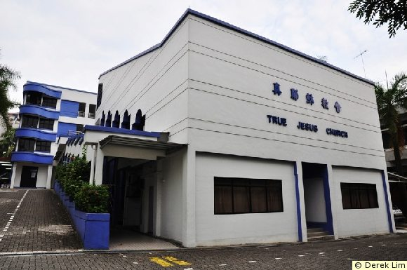
True Jesus Church, Adam Road
200
“Jesus is the heavenly Father” !! ??
= Modalism

Slide 37

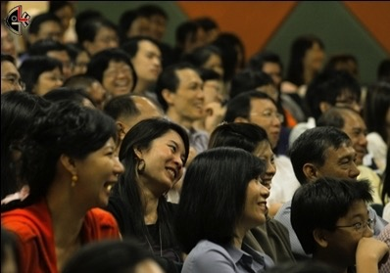
What Does the True Jesus Church Believe?
Identification with TJC
200
+
Baptism in TJC (Head Bowed)
+
Footwashing by TJC Minister
+
Communion (Transubstantiation)
+
Reception of the Holy Spirit
+
Speaking in Tongues
+
(Faith in Christ? No!)
=
Salvation ! ? ! ?

Slide 38
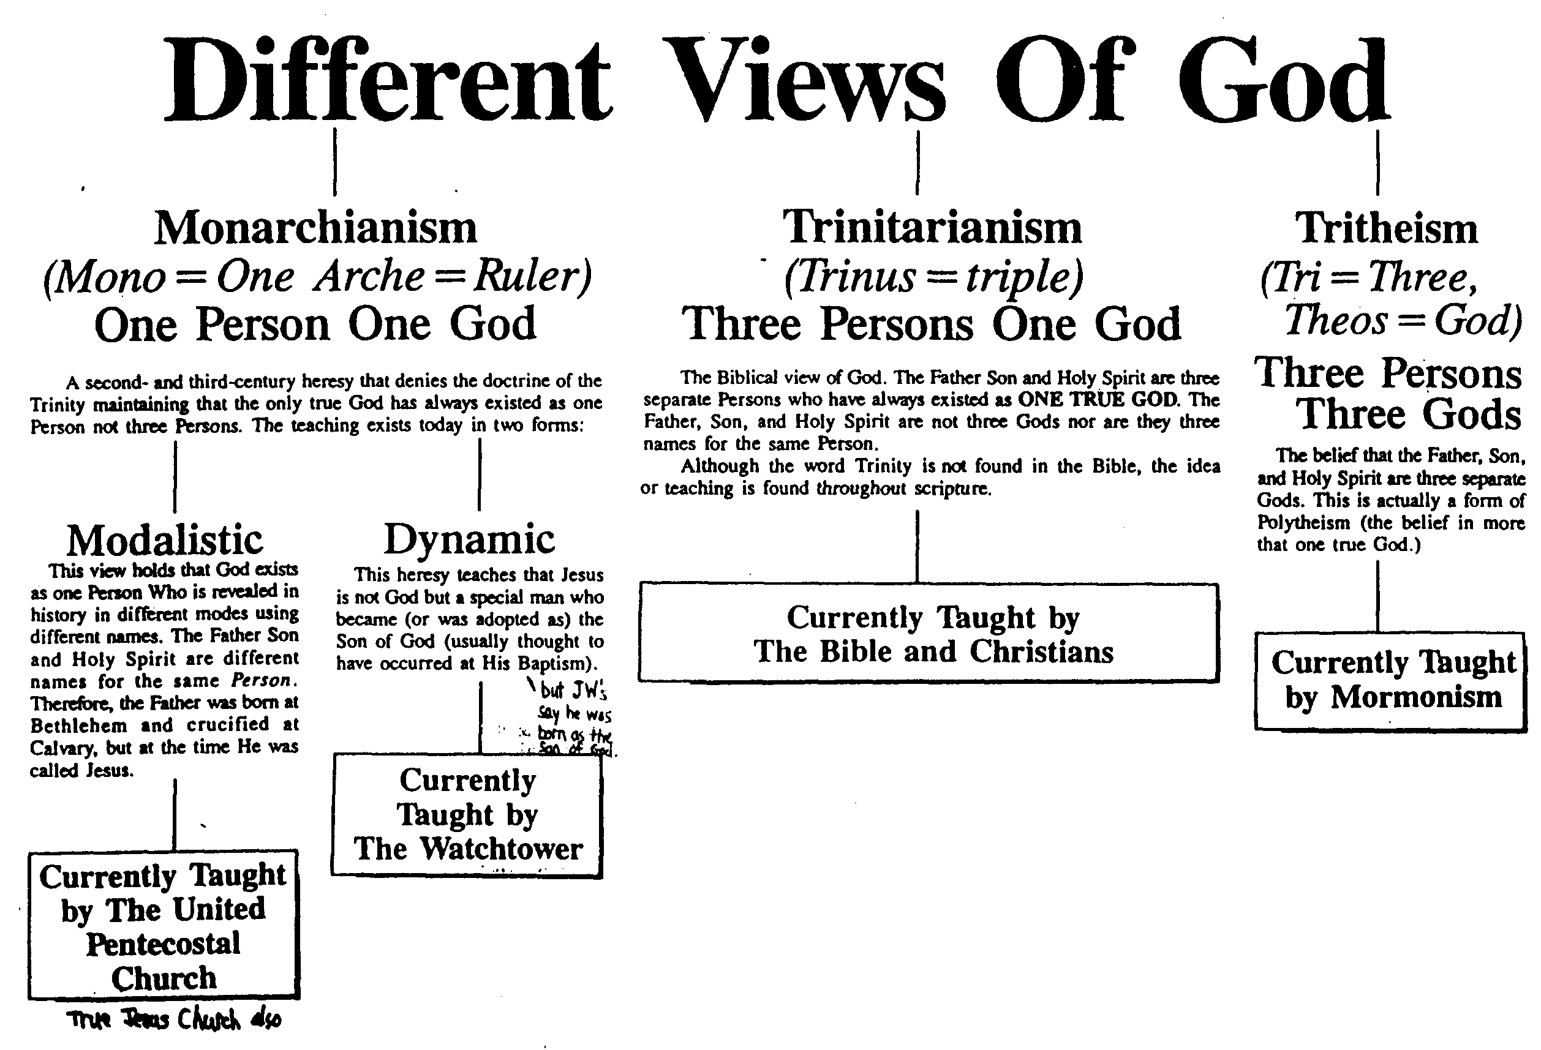
Different Views of God
vi

Slide 39
The Trinity Diagrammed
vii
Father
is
is not
is not
GOD
is
is
Son
Spirit
is not

Slide 40
Black

Slide 41


Jesus (Christology) link at BibleStudyDownloads.org
Get this presentation and script for free!

