Slide 1
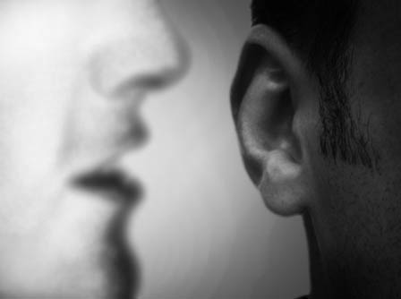
How the Spirit Leads Us
Dr. Rick Griffith • Jordan Evangelical Theological Seminary • BibleStudyDownloads.org
Notes:
How the Spirit Leads Us
A Singaporean friend gave me a booklet in 1981 that has had a profound impact on me. George Mueller was a German missionary to England in the mid-1800s, with whom many Christians are acquainted. He founded several orphanages for the Lord and saw God answer over 50,000 prayers recorded in his lifetime (he kept a meticulous journal of his requests and God’s answers). I know of no other human source that can help us seize the will of God more than Mueller. Here are his steps on how the Spirit guided him during his lifetime, which spanned over 92 years (1805-1898).

Slide 2

George Mueller's Step #1 to Find the Will of God
xxiv
"I get my heart into such a state that it has no will of its own in regard to the given matter."
Notes:
1. I SEEK AT THE BEGINNING to get my heart into such a state that it has no will of its own regarding a given matter. Nine-tenths of the trouble with people is just here. Nine-tenths of the difficulties are overcome when our hearts are ready to do the Lord's will, whatever it may be. When one is truly in this state, it is usually but a little way to the knowledge of what His will is.

Slide 3
How the Spirit Leads Us
xxiv
"No will of my own"
Discern feelings
Word of God
Providential circumstances
Ask God in prayer
Decide, look for peace, pray 2-3 more times, & act
Notes:
1. I SEEK AT THE BEGINNING to get my heart into such a state that it has no will of its own regarding a given matter. Nine-tenths of the trouble with people is just here. Nine-tenths of the difficulties are overcome when our hearts are ready to do the Lord's will, whatever it may be. When one is truly in this state, it is usually but a little way to the knowledge of what His will is.
2. HAVING DONE THIS, I do not leave the result to feeling or simple impression. If I do so, I make myself liable to great delusions.
3. I SEEK THE WILL of the Spirit of God through, or in connection with, the Word of God. The Spirit and the Word must be combined. If I look to the Spirit alone without the Word, I lay myself open to great delusions also. If the Holy Ghost guides us at all, He will do it according to the Scriptures and never contrary to them.
4. NEXT, I TAKE into account providential circumstances. These often plainly indicate God's will in connection with His Word and Spirit.
5. I ASK GOD in prayer to reveal His will to me aright.
6. THUS, THROUGH PRAYER to God, the study of the Word, and reflection, I come to a deliberate judgment according to the best of my ability and knowledge, and if my mind is thus at peace, and continues so after two or three more petitions, I proceed accordingly.
In trivial matters and in transactions involving the most important issues, I have found this method always effective.
Source: George Mueller, “How I Ascertain the Will of God,” from “An Hour with George Mueller: The Man of Faith to Whom God Gave Millions” ed. A. Sims (Warren Myers, P.O. Box 125: Singapore), ca. 1981.
______
We tend to want to jump right to step 5, don't we?
Step 1 is the hardest, but it's also the most important.

Slide 4
Black

Slide 5
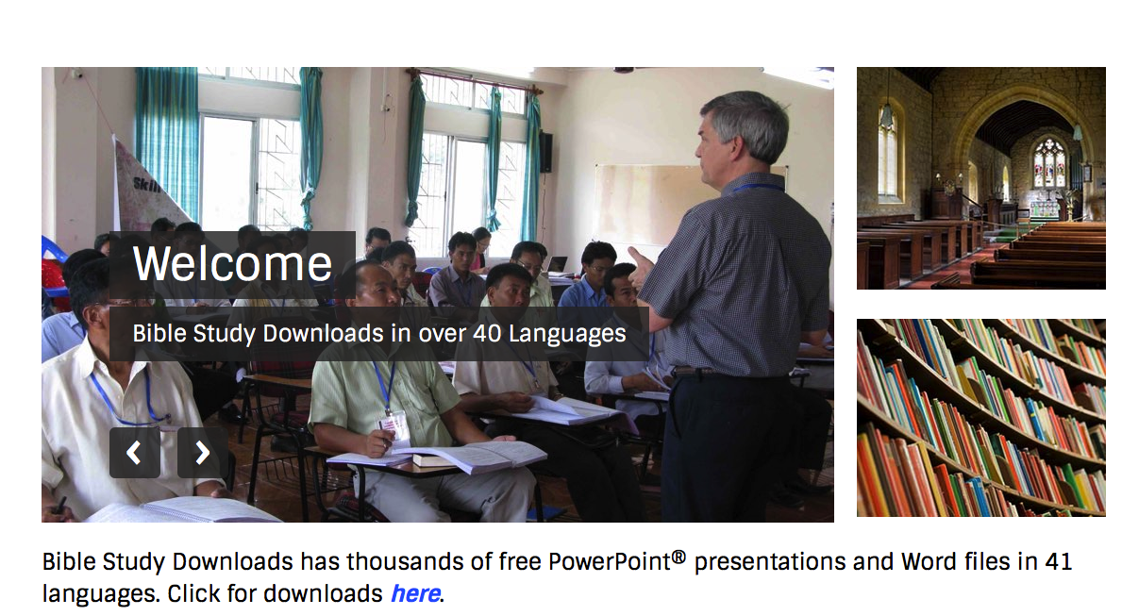
Holy Spirit PPT link at BibleStudyDownloads.org
Get this presentation for free!

