Slide 1

The Holy Spirit & Spiritual Gifts
Welcome to our course for this term!
Dr. Rick Griffith • Jordan Evangelical Theological Seminary • BibleStudyDownloads.org
A 2-Part Course for January-April 2016

Slide 2


Who Am I? (Family Roots)
Born in Tokyo as a MK (1958)
Moved to California (SF area) at 18 mos.
Parents divorced (age 4)
Mom remarried & divorced (ages 8-10)
Born again (age 13)
Mom married third time (age 14)

Slide 3
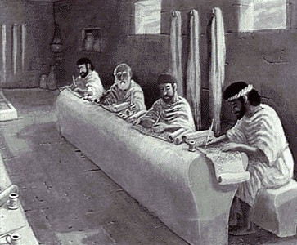
Who Am I? (Education Roots)
BS, Business Marketing (Hay U, 1980)
ThM, Pastoral Ministries (Dallas, 1987)
PhD, Bible Exposition (Dallas, 1990)

Slide 4
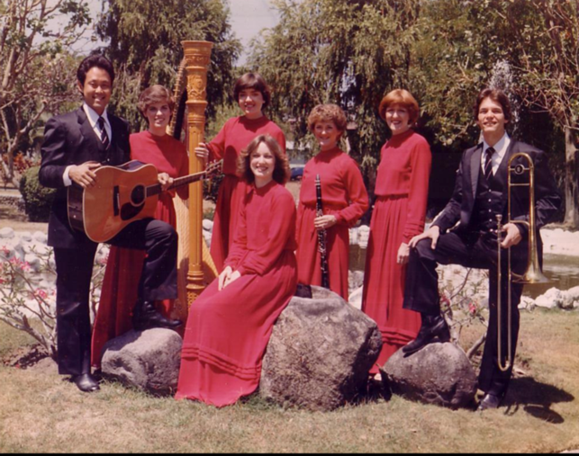
Who Am I? (My Passions)
My God
My Family

Slide 5


Our People
Susan teaches church women
Notes:
I also lead the woman's Precept Bible study at our church

Slide 6

LADIES BIBLE STUDY ON
1-2 THESS
USA • Singapore • New Zealand • Holland

Slide 7

Thailand • Mongolia • Myanmar • Indonesia
Notes:
INTERVIEWER: And Susan, what ministries has the Lord granted you?
SUSAN: I have been teaching the wives of leaders at SBC. These 5 women come from 5 different nations!
SUSAN: I also lead the woman's Bible study at our church

Slide 8
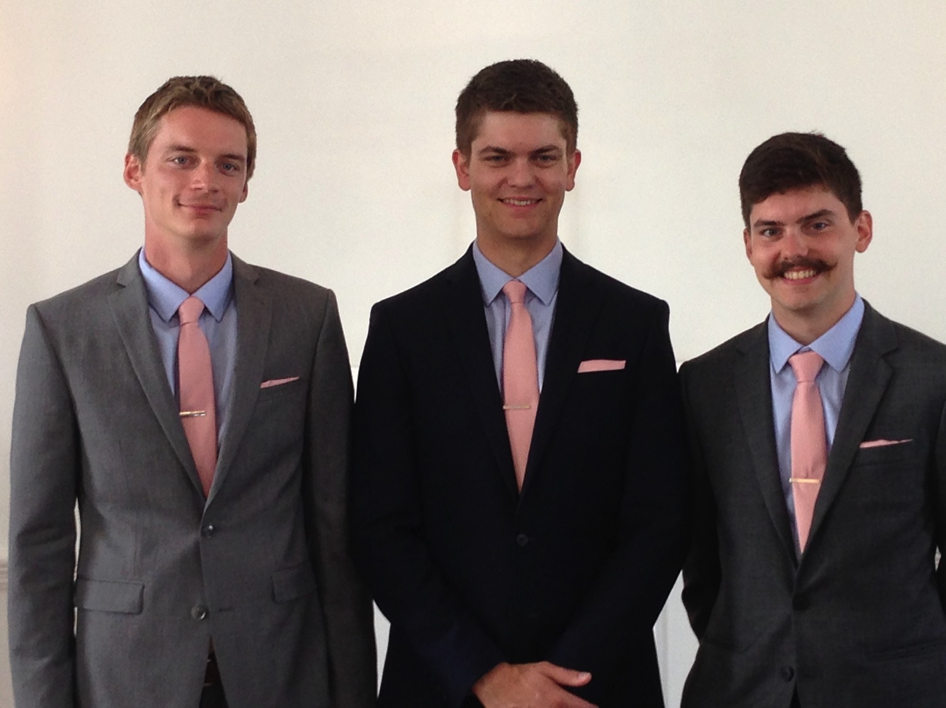
Our Three Sons

Slide 9
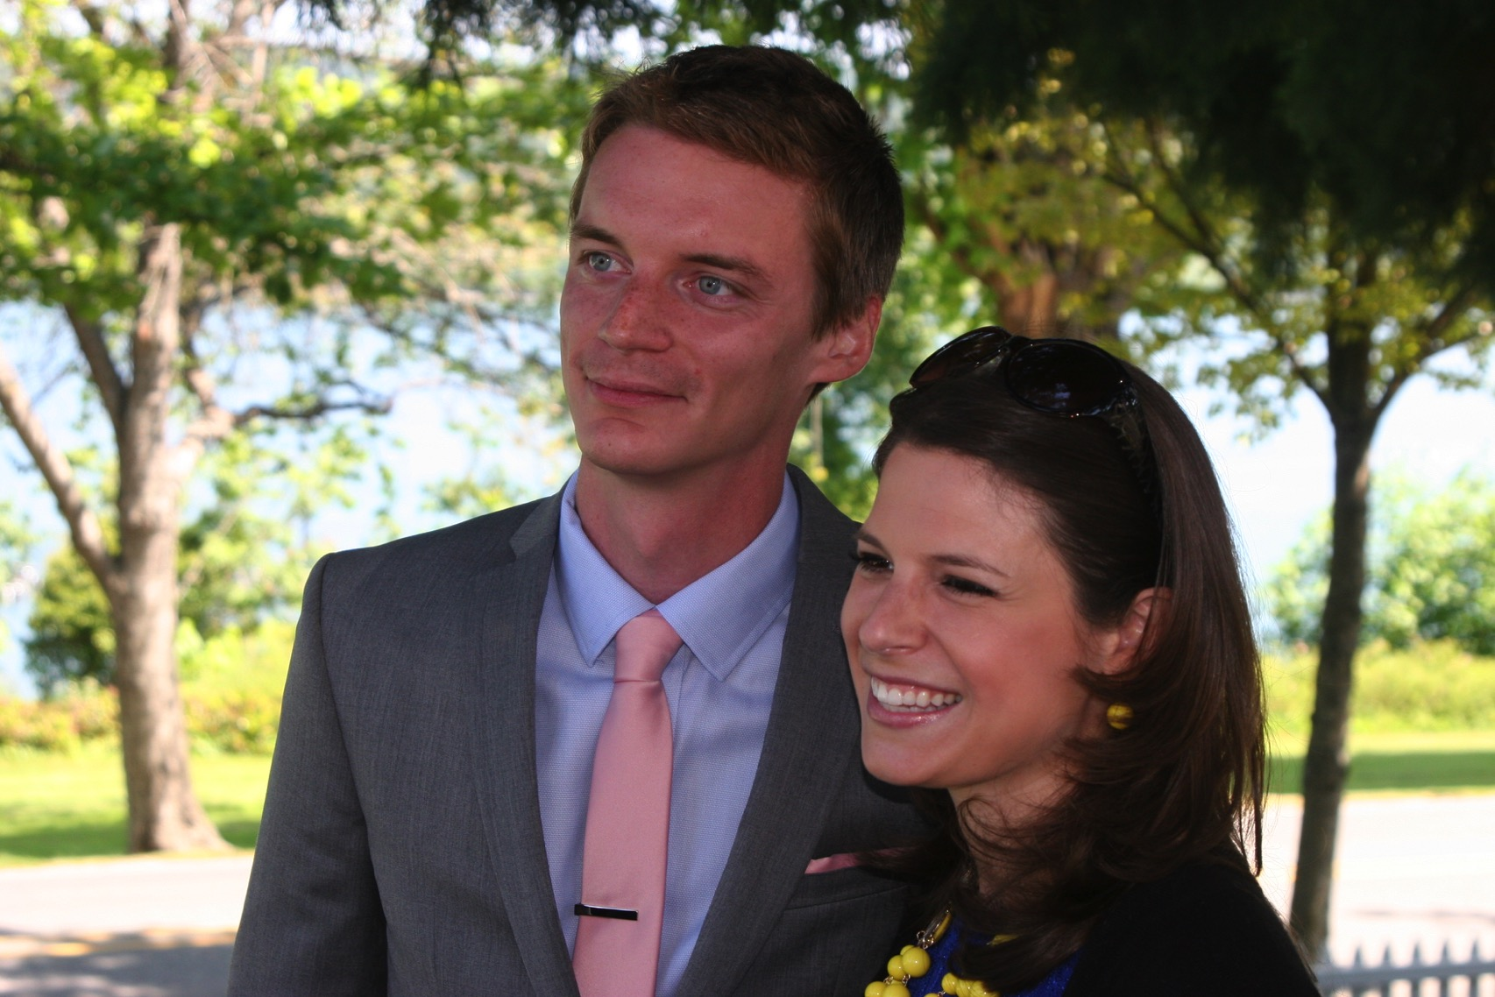
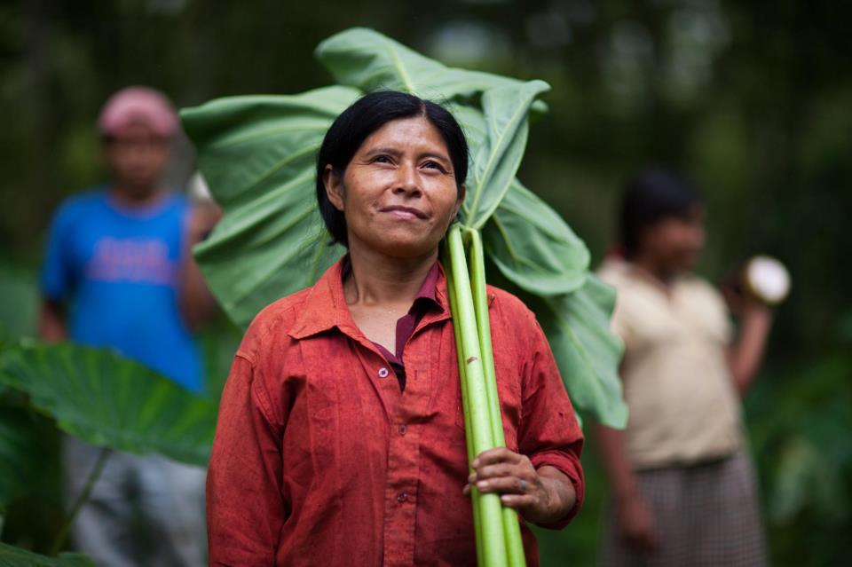

Kurt works in IT
9g

Slide 10
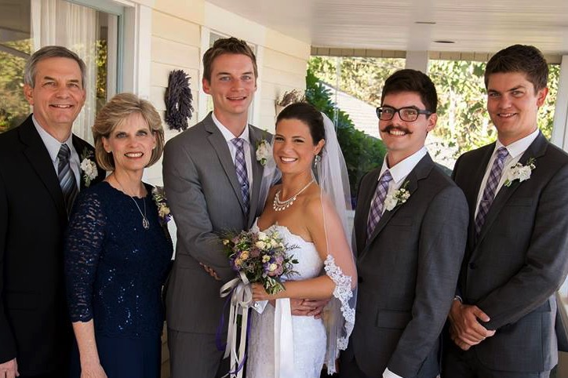
The Griffith Family
Sept 2014
2014
Rick
Stephen
25
Susan
John
22
Kurt & Cara
28

Slide 11
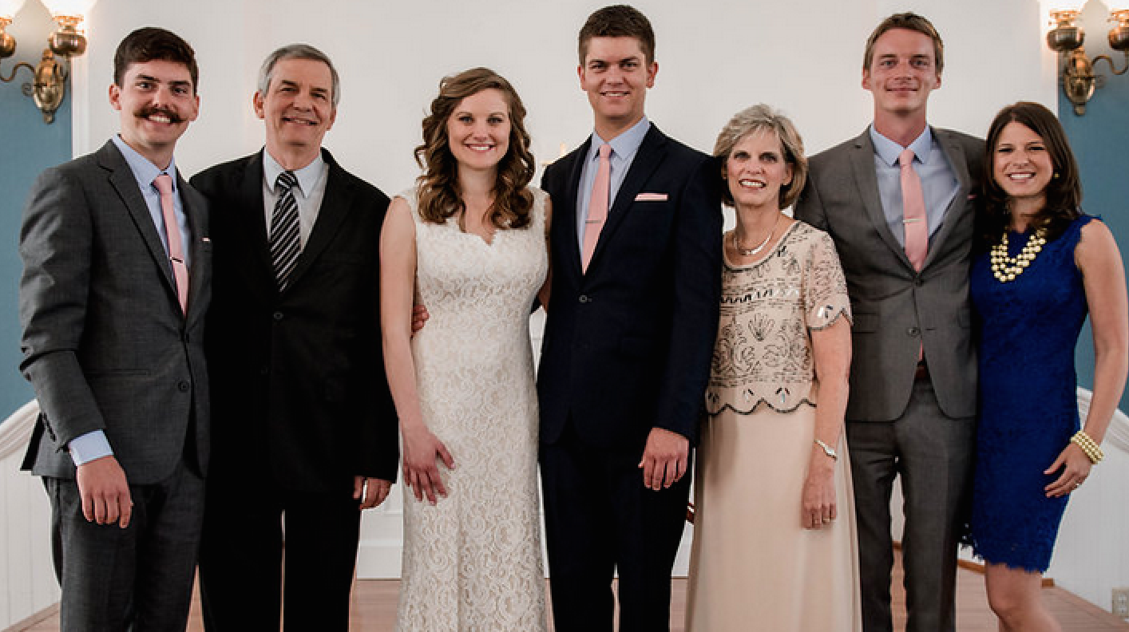
The Griffiths
May 2015
2015
Kurt & Cara (28)
John
(22)
Rick
Susan
Stephen & Katie (25)

Slide 12
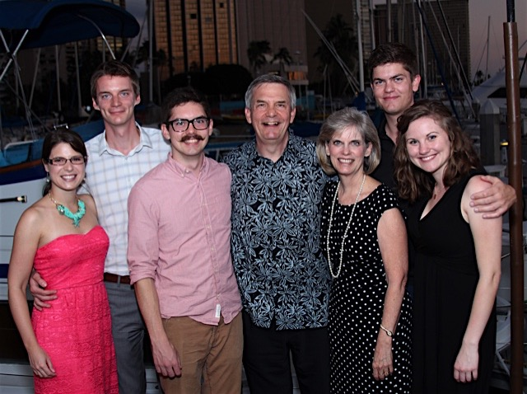
The Griffiths
9 Jan 2016
2016
John
(23)
Rick & Susan
Kurt & Cara (29)
Stephen & Katie (26)

Slide 13
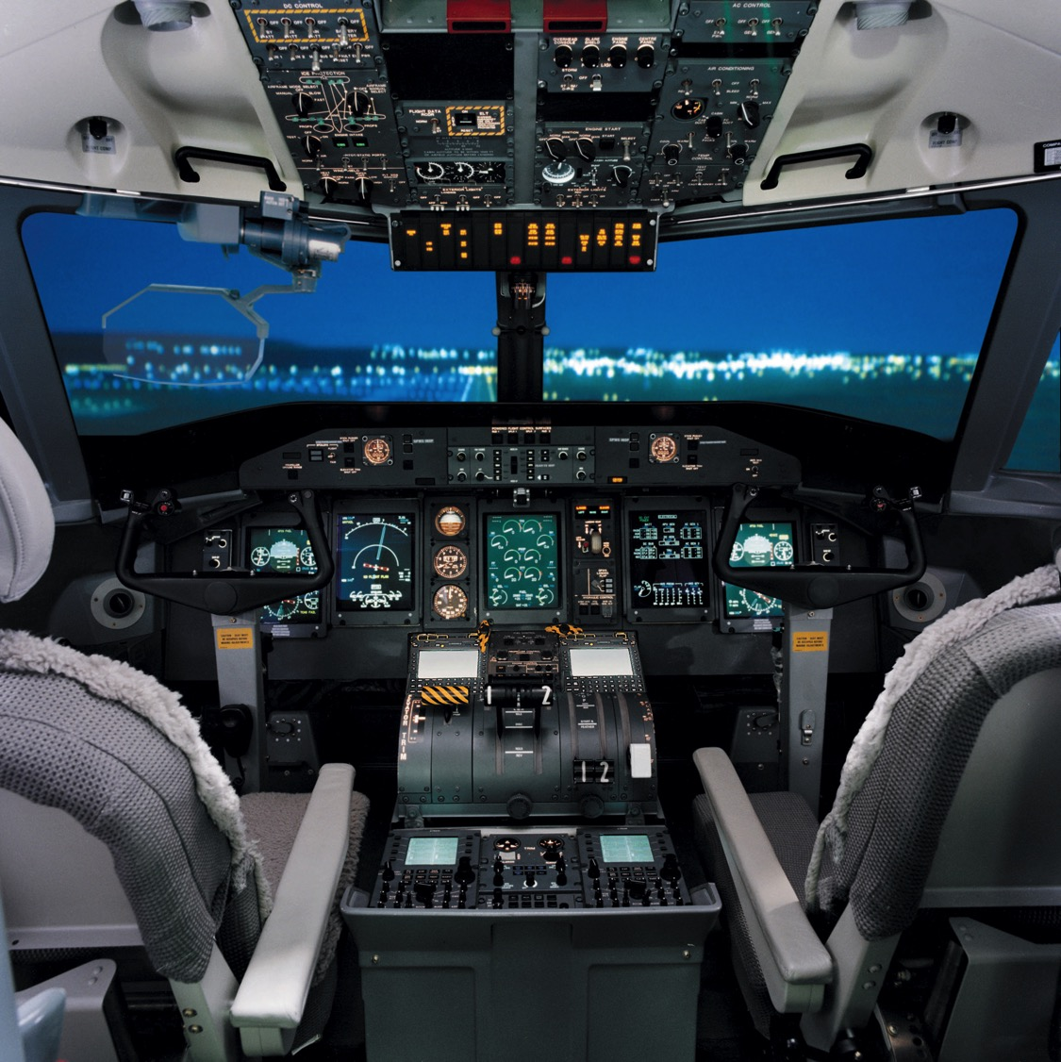
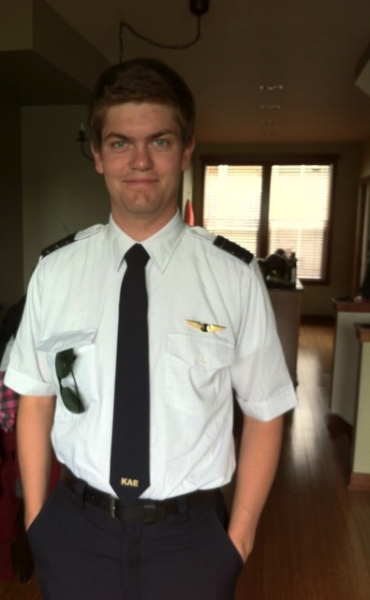
Stephen is a pilot with Horizon Air, Boise, Idaho
6

Slide 14
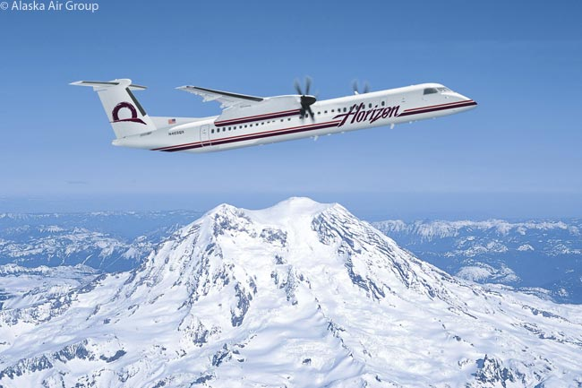
Above Seattle
9g

Slide 15
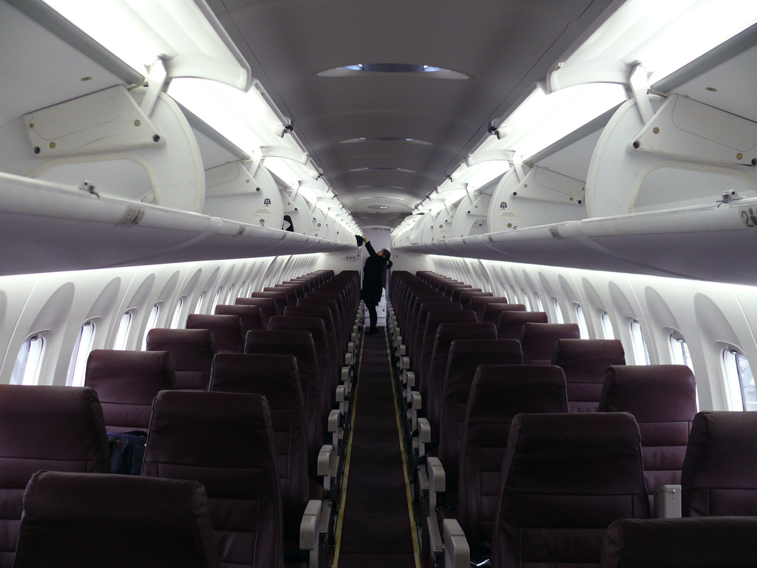
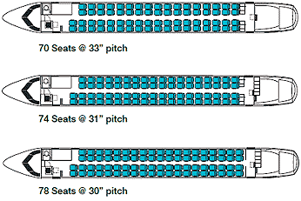
Stephen flies 76 passengers
6

Slide 16
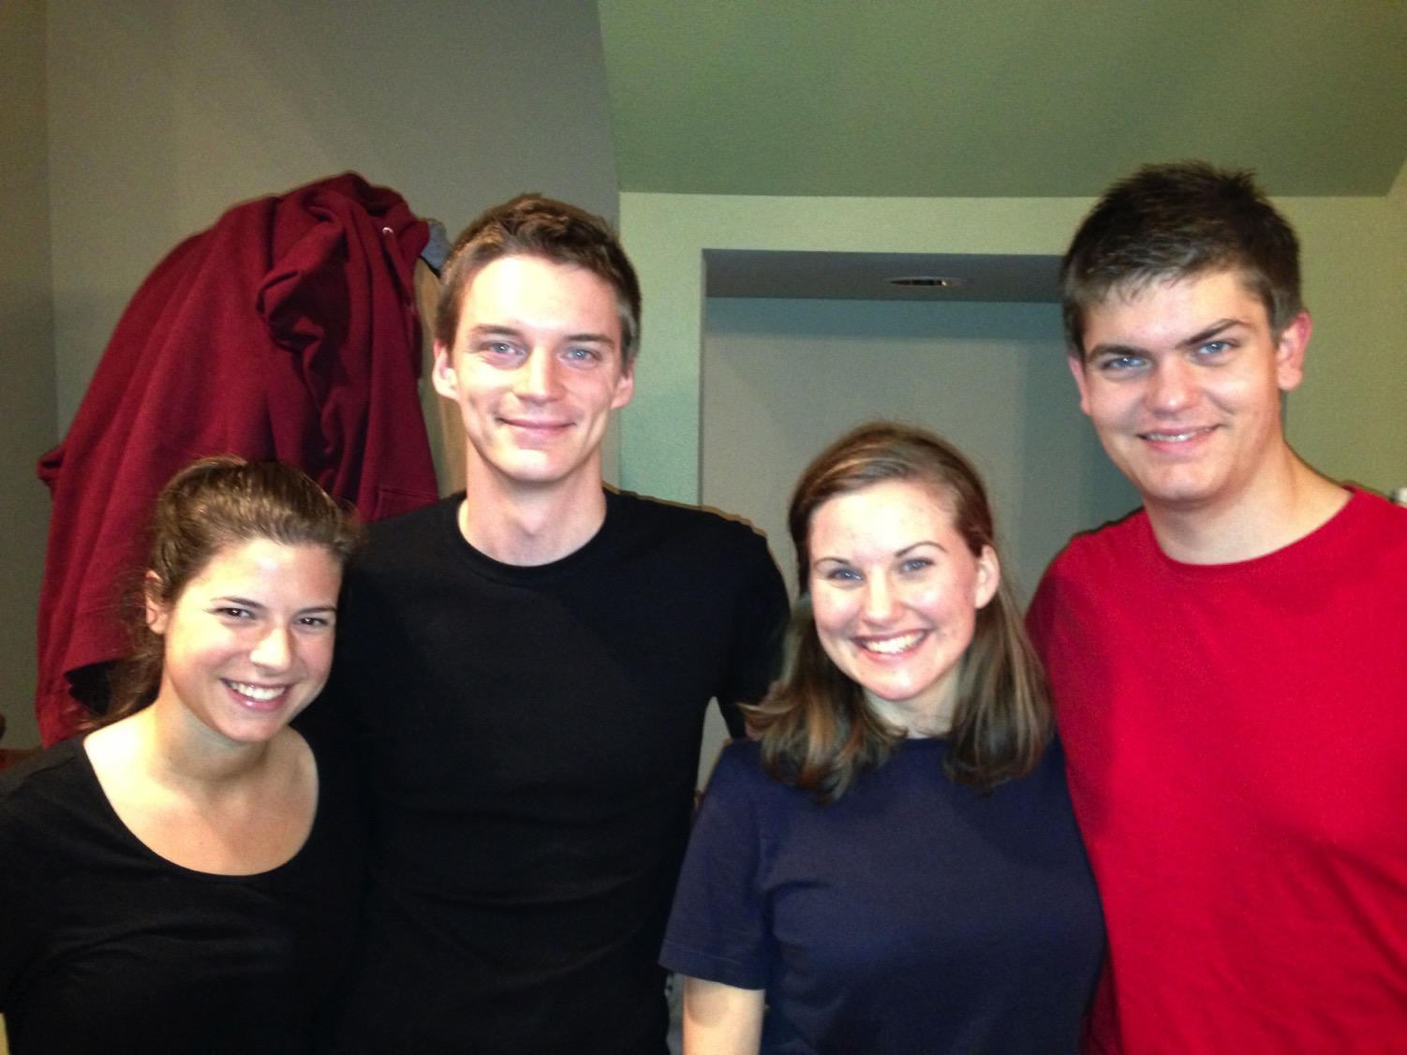
Cara & Kurt • Katie & Stephen

Slide 17
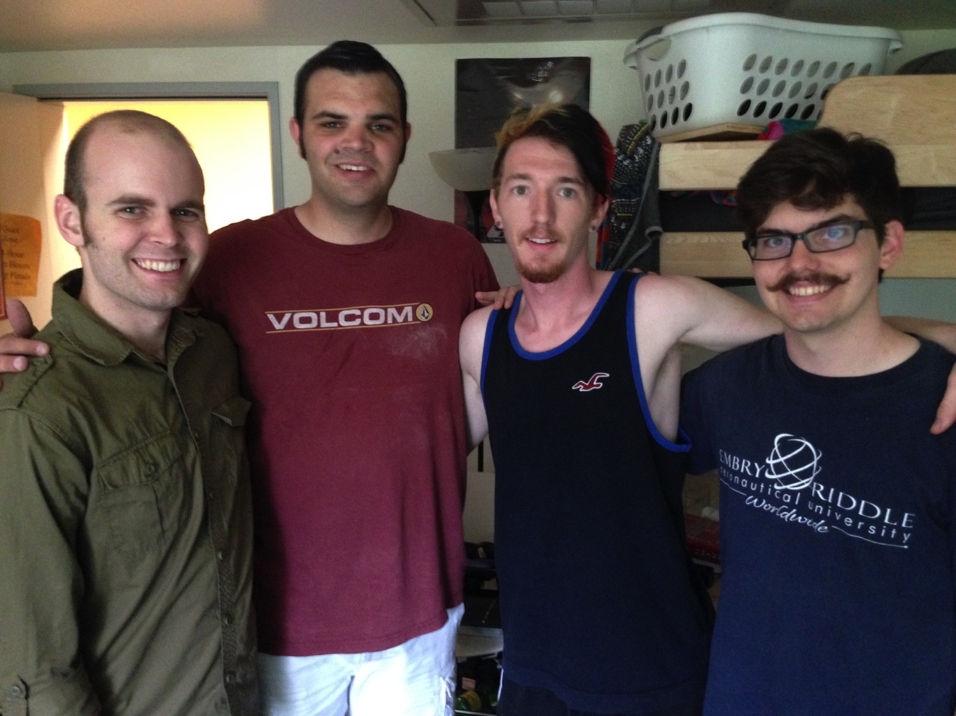
John at Biola University

Slide 18
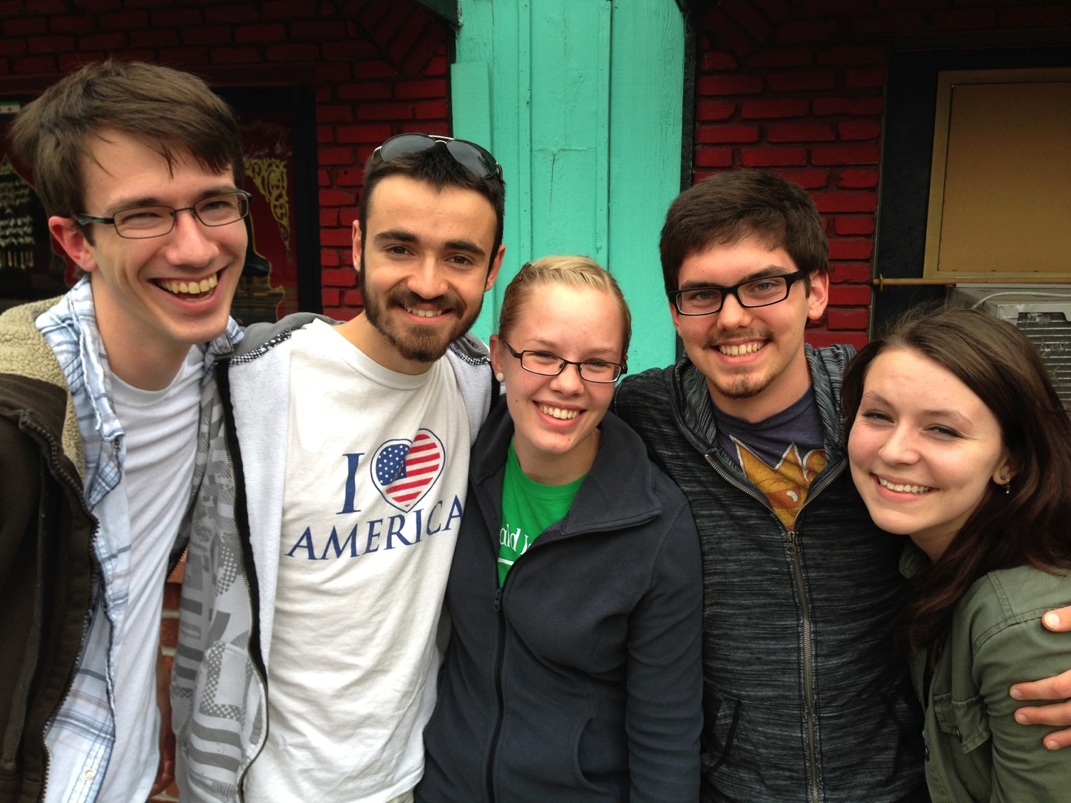
Caleb • Brennen • Holly • John • Kelsey
Taiwan • Slovania • Turkey • Singapore • Indonesia
WorldVenture Interns June- August 2013

Slide 19
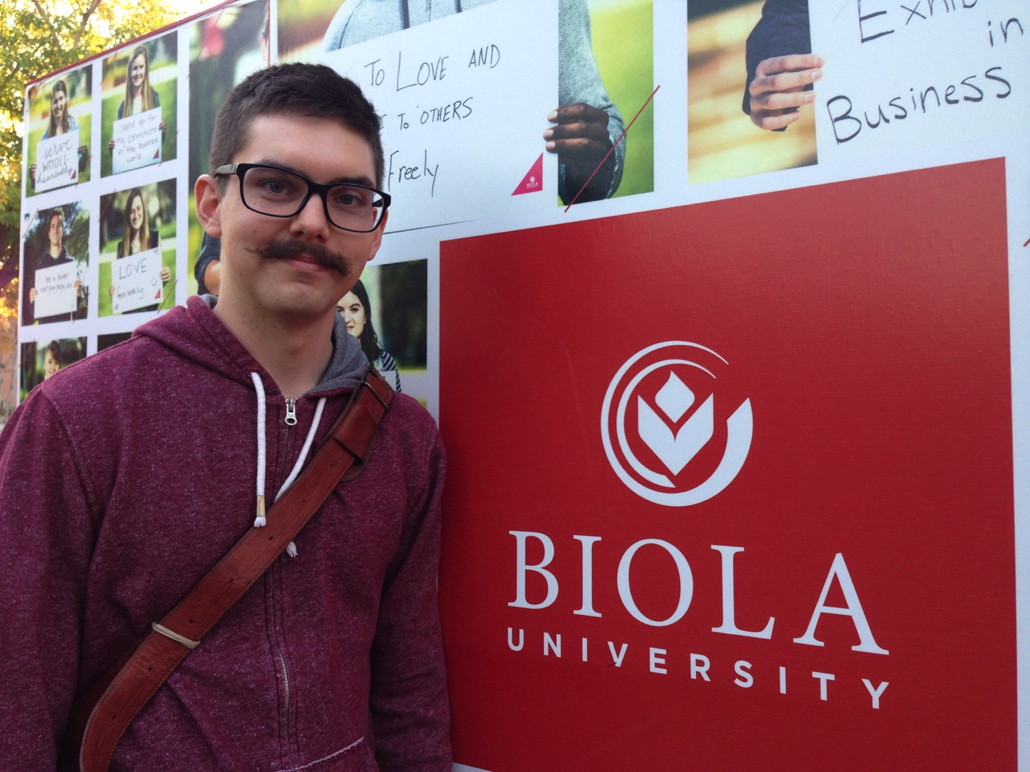
John at Biola University

Slide 20
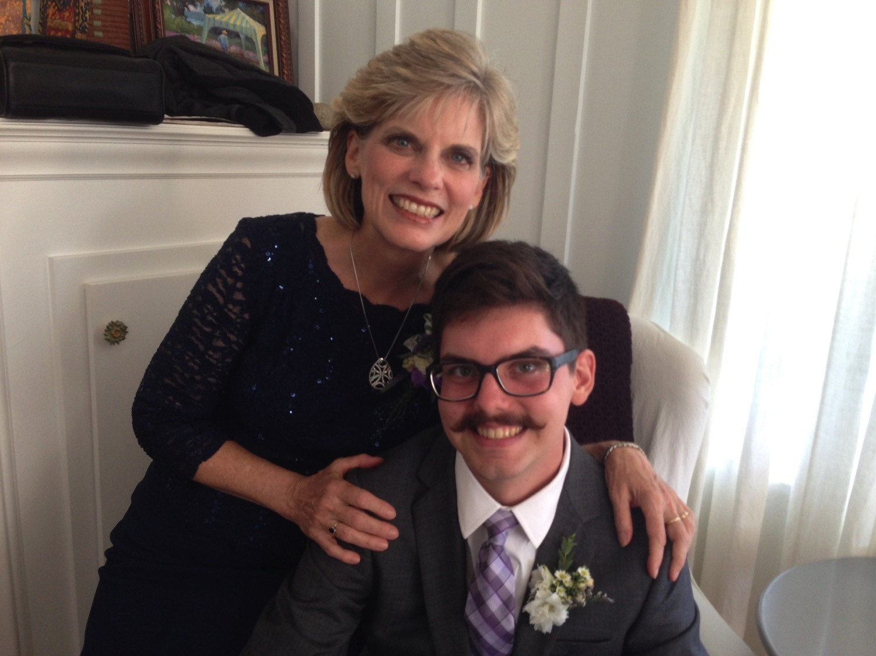

Our Youngest, John (23)

Slide 21
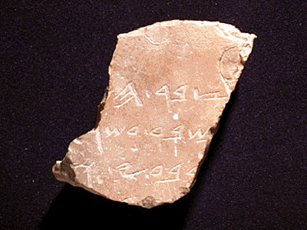
Who Am I? (My Passions)
My God
My Family
My Ministries

Slide 22
Ministries God Gave Us
WorldVenture Singapore field leader
Singapore Bible College Bible & preaching professor
Singapore Bible College Doctor of Ministry director
Adjunct Professor teaching in 12 nations
The Bible…Basically translation director
Biblestudydownloads.org web author
Crossroads International Church pastor-teacher

Slide 23

IBS Advantages
Internet Advantages
Cost efficient
Better content retention
Reaches where we cannot go
Easily multiplied
Better to reach youth

Slide 24
SBC Courses I Teach
Survey
OT NT
Backgrounds
WOT WNT Geography
Theology
Church Spirit Future
Preaching
Homiletics 1 Homiletics 2

Slide 25
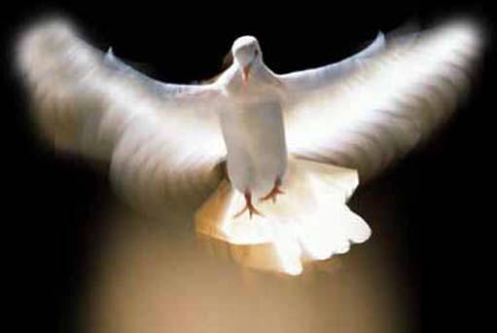
What's this course about?
1
Two Parts:
Holy Spirit in Part 1 (weeks 1-6)
Spiritual Gifts in Part 2 (weeks 7-12)
Dr. Rick Griffith • Singapore Bible College • biblestudydownloads.org

Slide 26
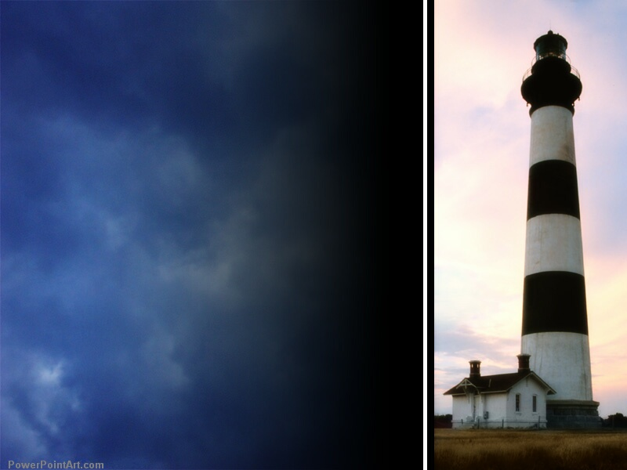
Course Description
A
Non-Christians often blame tragedies on God. Likewise, Christians often blame excesses on the Holy Spirit. Who is He and what does He really do in our world? This two-part course explores what the Bible says about the person and work of the Spirit.

Slide 27
Course Description
A
Part 1 addresses His deity and ministries relating to the believer (e.g., baptism, filling, sealing, indwelling, sanctifying, fruit) and the unbeliever (e.g., calling, conviction, regenerating).

Slide 28
Course Description
A
Part 2 covers His gifting the saints with special abilities to serve Christ, including the controversial gifts of prophecy, tongues, miracles, and healing.

Slide 29
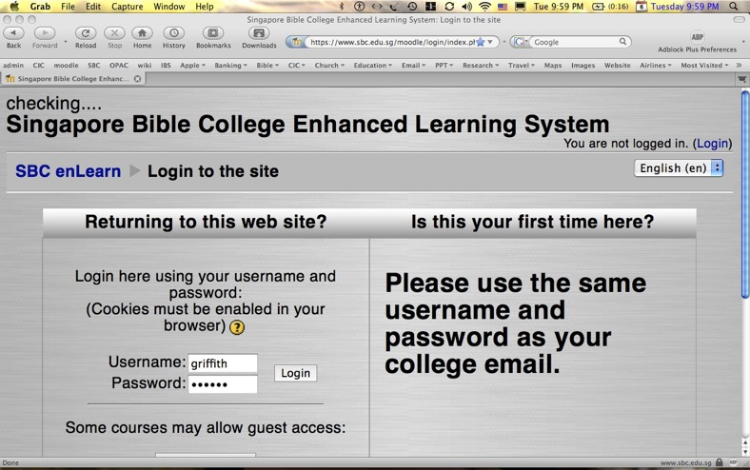
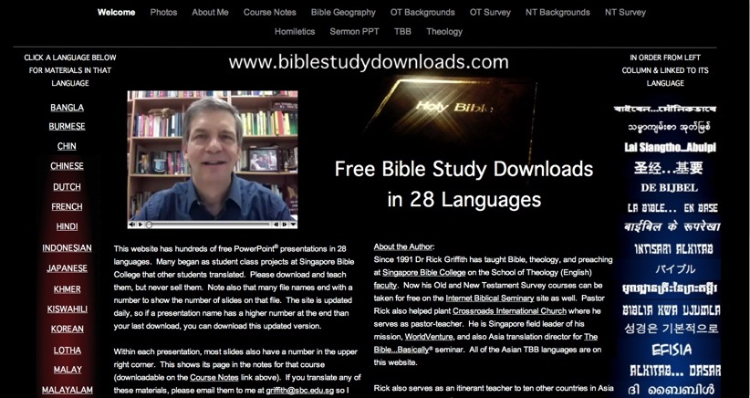
Our Two Websites
SBC Moodle
(Quizzes)
Biblestudydownloads.org
(Downloads)

Slide 30
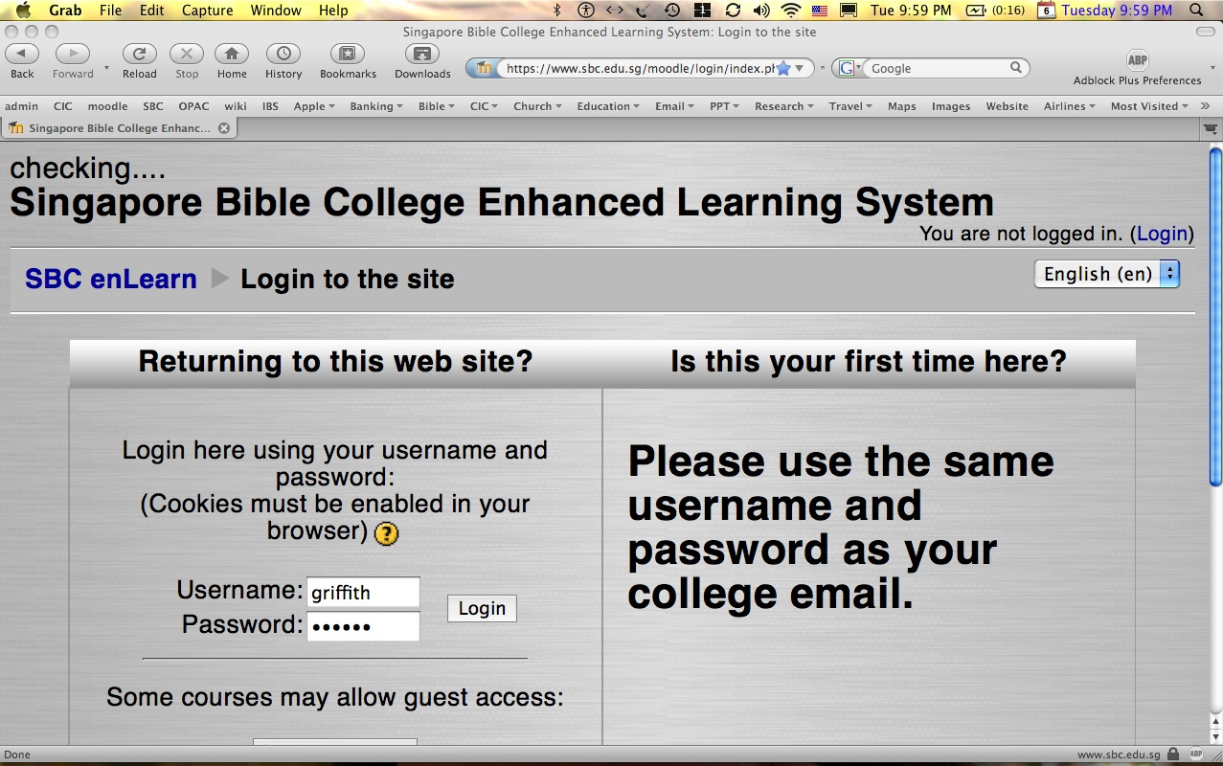
How to Get on Moodle…
A
Log on at sbc.edu.sg/moodle/login/index.php
Type your SBC email address
Type normal SBC password
Click on the CCTE Holy Spirit course
Take your quiz or post a message

Slide 31


All Quizzes are Closed Book!

Slide 32
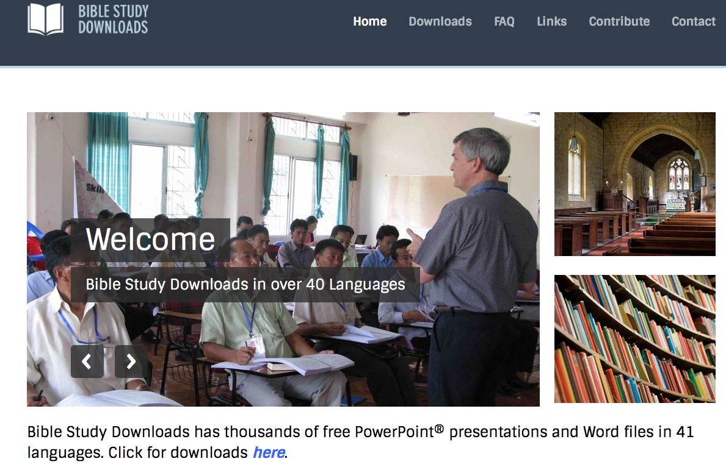
BibleStudyDownloads.org
7
Notes:
This has resulted in Bible teaching and study materials—mostly PowerPoint—in 42 languages! All a teacher needs to do is to click on a file and it downloads for free to teach any book of the Bible and many other subjects.

Slide 33
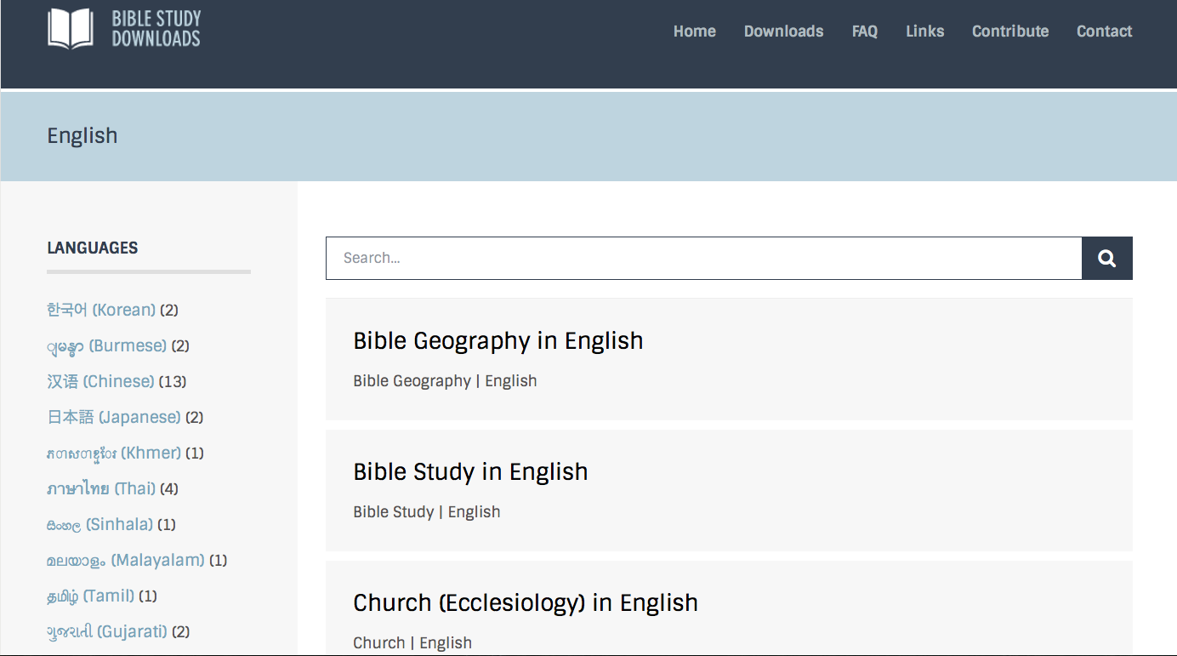
BibleStudyDownloads.org
7
Notes:
This has resulted in Bible teaching and study materials—mostly PowerPoint—in 42 languages! All a teacher needs to do is to click on a file and it downloads for free to teach any book of the Bible and many other subjects.

Slide 34
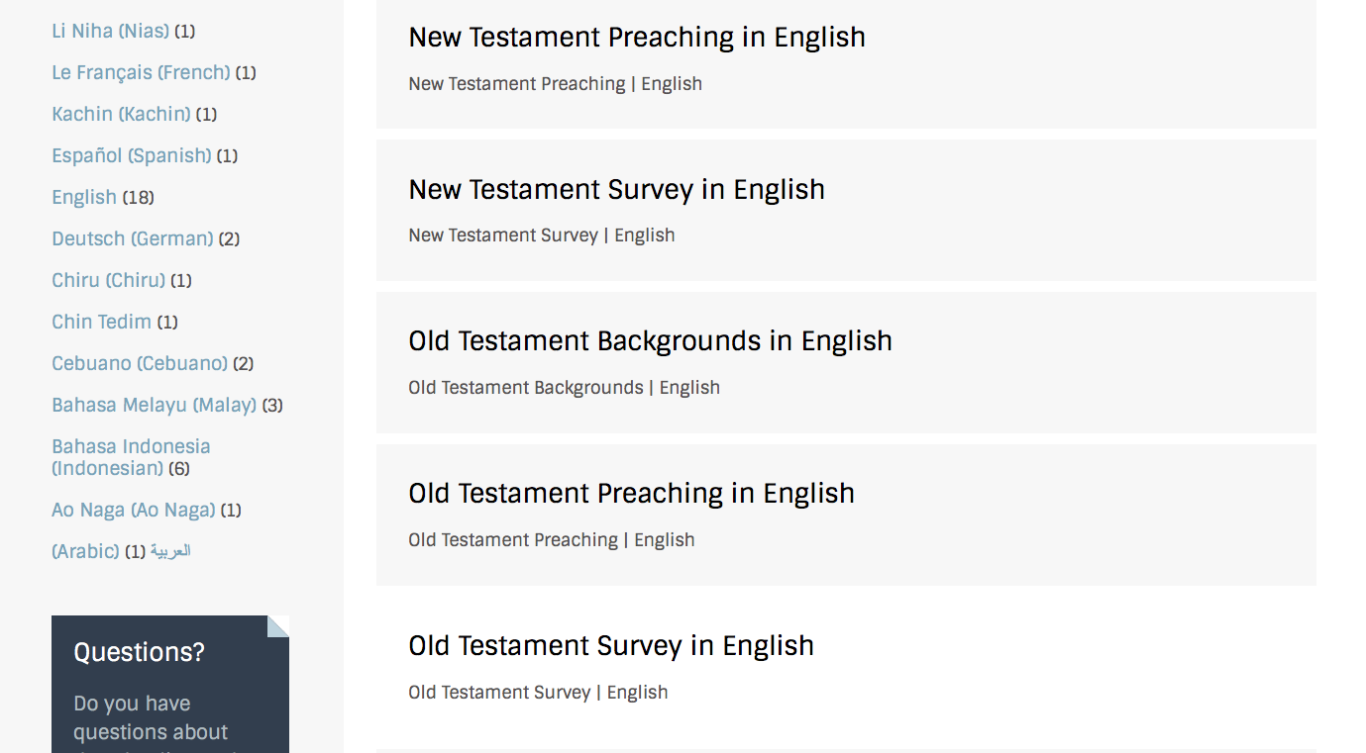
BibleStudyDownloads.org
7
Notes:
This has resulted in Bible teaching and study materials—mostly PowerPoint—in 42 languages! All a teacher needs to do is to click on a file and it downloads for free to teach any book of the Bible and many other subjects.

Slide 35
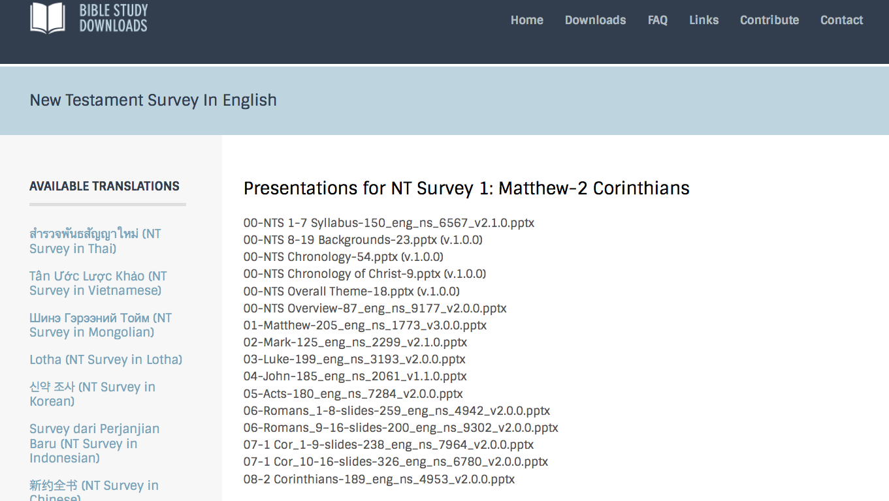
BibleStudyDownloads.org
7
Notes:
This has resulted in Bible teaching and study materials—mostly PowerPoint—in 42 languages! All a teacher needs to do is to click on a file and it downloads for free to teach any book of the Bible and many other subjects.

Slide 36
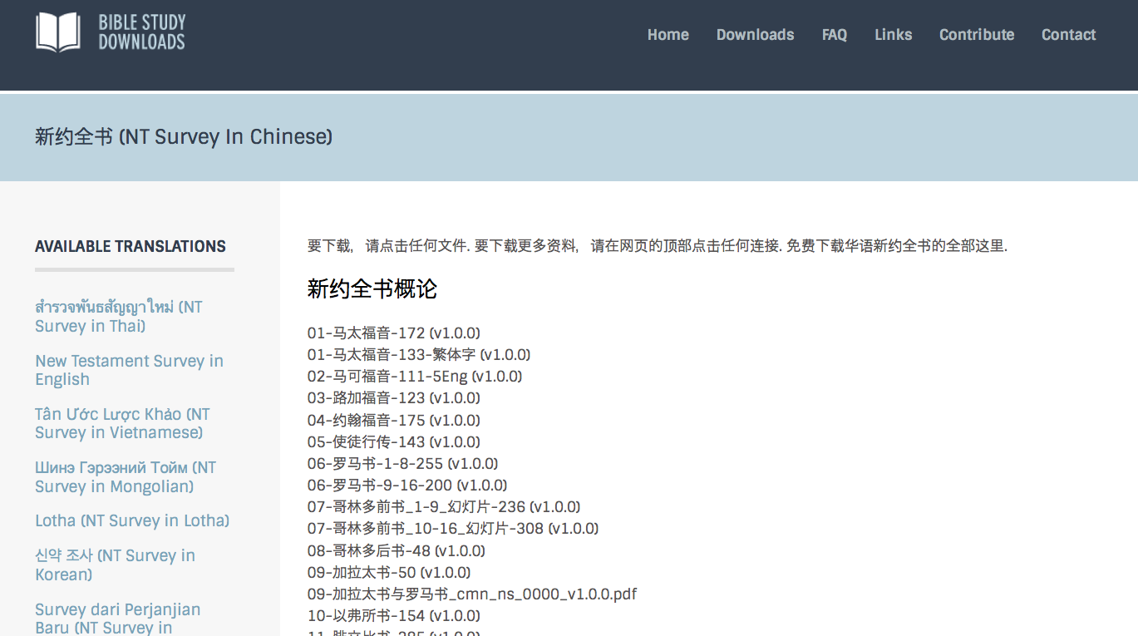
BibleStudyDownloads.org
7
Notes:
This has resulted in Bible teaching and study materials—mostly PowerPoint—in 42 languages! All a teacher needs to do is to click on a file and it downloads for free to teach any book of the Bible and many other subjects.

Slide 37
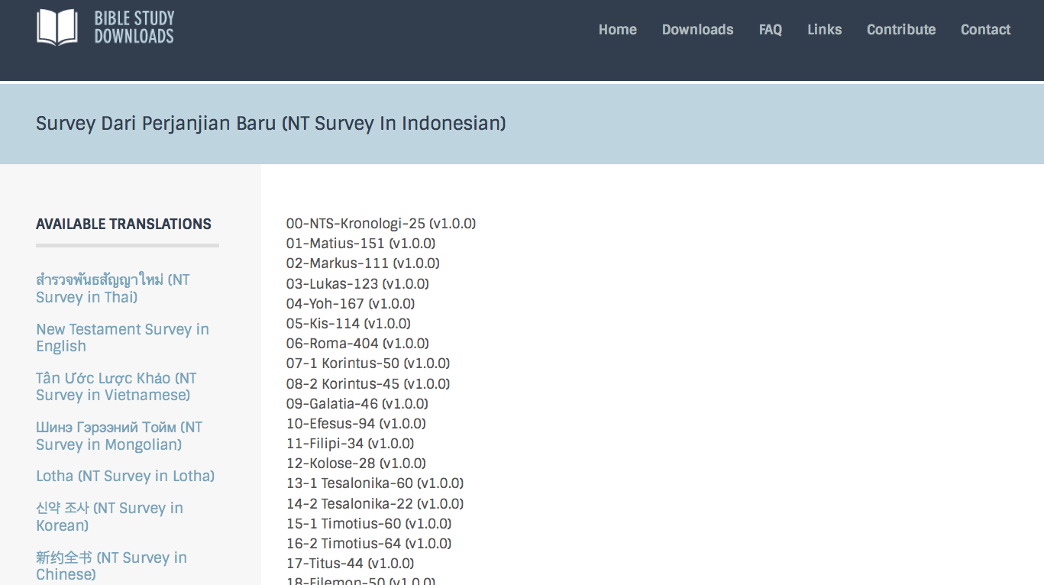
BibleStudyDownloads.org
7
Notes:
This has resulted in Bible teaching and study materials—mostly PowerPoint—in 42 languages! All a teacher needs to do is to click on a file and it downloads for free to teach any book of the Bible and many other subjects.

Slide 38
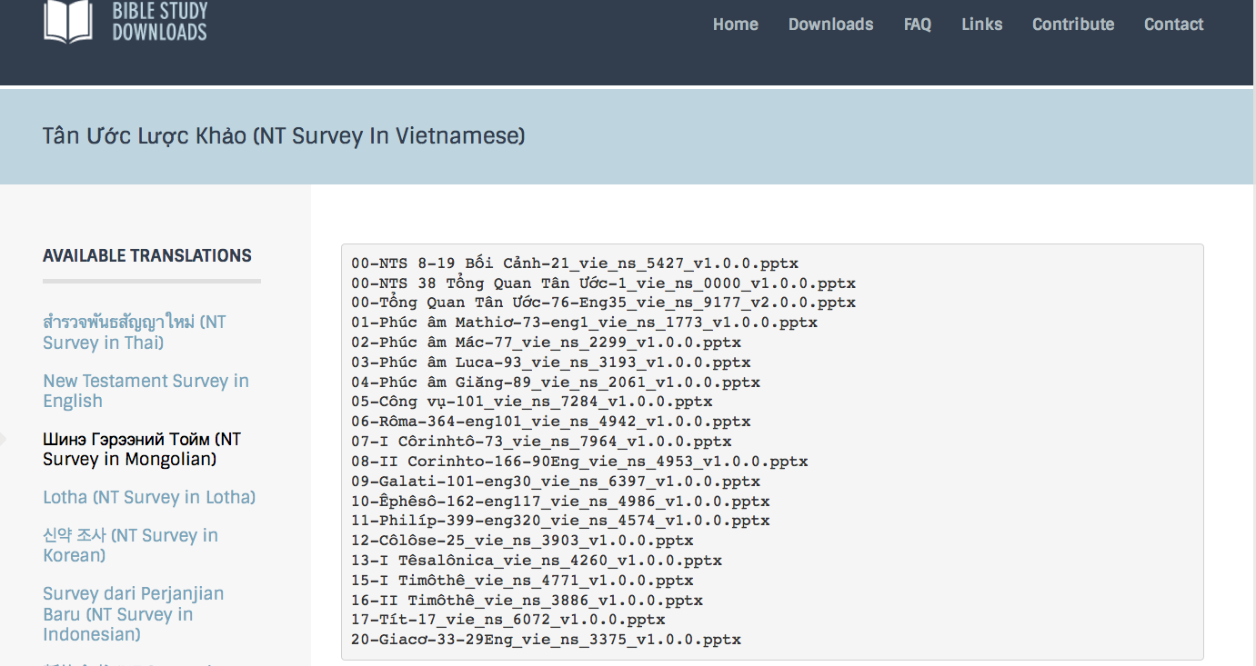
BibleStudyDownloads.org
7
Notes:
This has resulted in Bible teaching and study materials—mostly PowerPoint—in 42 languages! All a teacher needs to do is to click on a file and it downloads for free to teach any book of the Bible and many other subjects.

Slide 39
BibleStudyDownloads.org
7
Notes:
This has resulted in Bible teaching and study materials—mostly PowerPoint—in 42 languages! All a teacher needs to do is to click on a file and it downloads for free to teach any book of the Bible and many other subjects.

Slide 40
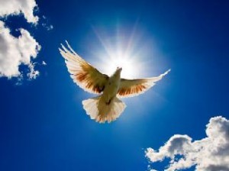
Readings:
B
Notes

Slide 41

Course Requirements
B
Average of
5 grades
Reading
(5 Weeks)
page F
Assessments
(5 Quizzes)

Slide 42

Grading
B
 | CCTE
Readings | 50%
Quizzes | 50%
NO Paper | –
NO Project | –
NO Final Exam | –
Total | 100%
Attendance | 70+% (5 of 6 sessions)

Slide 43

Contacting Me
F
Some options
griffith@sbc.edu.sg
Mobile 65-9113-7090
Office: 65-6559-1513
SBC mailbox L19

Slide 44

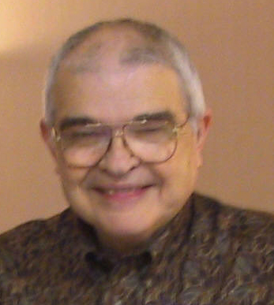
Dr John Fryman
Dr. John Fryman
Author of The Bible…Basically 10-Hour Seminar
Fort Worth, Texas
www.biblebasically.com
©2004 TBBMI
8.0.01.
04

Slide 45

English

Slide 46

Burmese
Lai S
iangtho…Abulpi
A Presentation of The Bible…Basically Ministries International Inc. Fort Worth, Texas
www.biblebasically.com
©2004 TBBMI
8.0.01.
04

Slide 47


French
LA BIBLE…
EN BASE
Une Présentation du Ministère Internationale de La Bible… En Base Inc. Fort Worth, Texas
www.biblebasically.com
©2006 TBBMI
8.0.01.
04
©2004 TBBMI
9.6.01.

Slide 48
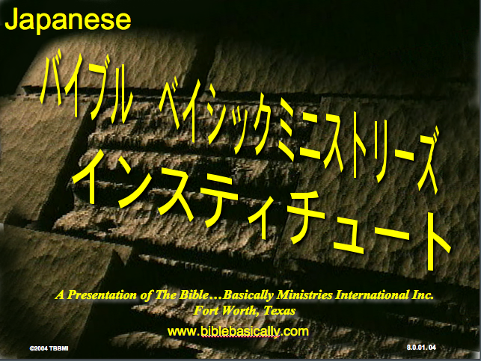
Japanese
バイブル ベイシックミニストリーズ
インスティチュート
A Presentation of The Bible…Basically Ministries International Inc. Fort Worth, Texas
www.biblebasically.com
©2004 TBBMI
8.0.01.
04
Notes:
Japanese title slide

Slide 49

Khmer (Cambodian)
mUldæanRKwH>>>
énRBHKm<IIr
karbgðaj[sÁal;nUvRBHKm<Ir>>> EdlCamUldæanRKw³ kñúg B½n§kic©shKmnGnþrCati GayGinsIu.
Fort Worth, Texas
www.biblebasically.com
©2004 TBBMI
8.0.01.
04

Slide 50
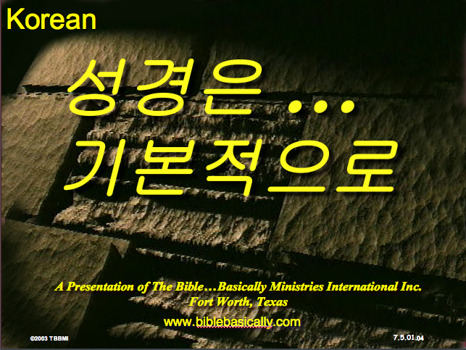
Korean
성경은 …
기본적으로
A Presentation of The Bible…Basically Ministries International Inc. Fort Worth, Texas
www.biblebasically.com
7.5.01.
©2003 TBBMI
04

Slide 51

Malay
Alkitab…
Dasar
Presentasi dari The Bible…Basically Ministries International Inc. Fort Worth, Texas
www.biblebasically.com
©2004 TBBMI
8.0.01.
04

Slide 52

Mao (India)
Bible…
Amolo Leino
Bible…Ngashankakhuina Ministries International Inc. pashina semkashok Fort Worth, Texas
www.biblebasically.com
©2004 TBBMI
8.0.01.
04

Slide 53
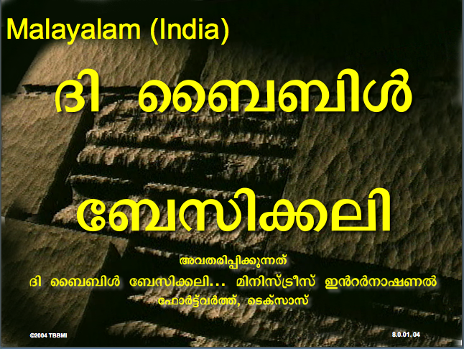
Malayalam (India)
Æß èÌÌßZ
çÌØßAÜß
¥ÕÄøßMßAáKÄí Æß èÌÌßZ çÌØßAÜß… ÎßÈßØíd¿àØí §aVÈÞ×ÃW çËÞVGíÕVJí, æ¿µíØÞØí
©2004 TBBMI
8.0.01.
04

Slide 54
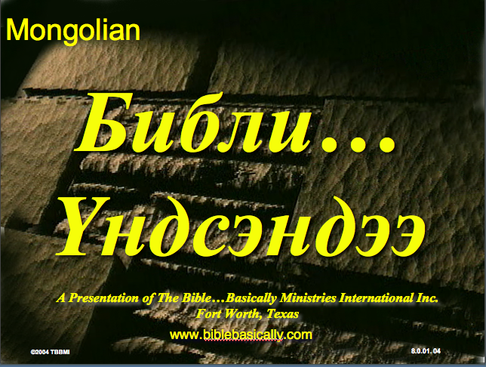
Mongolian
Библи…
Үндсэндээ
A Presentation of The Bible…Basically Ministries International Inc. Fort Worth, Texas
www.biblebasically.com
©2004 TBBMI
8.0.01.
04

Slide 55

Nepali
afOan======
cfwf/e[\t
A Presentation of The Bible…Basically Ministries International Inc. Fort Worth, Texas
www.biblebasically.com
8.0.01.
©2004 TBBMI
04

Slide 56
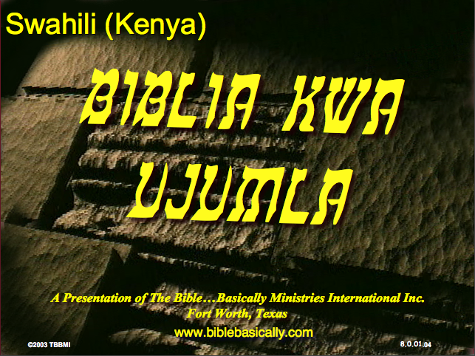
Swahili (Kenya)
biblia kwa ujumla
A Presentation of The Bible…Basically Ministries International Inc. Fort Worth, Texas
www.biblebasically.com
8.0.01.
©2003 TBBMI
04

Slide 57

Tagalog (Philippines)
Ang Biblia . . . Pinasimple
A Presentation of The Bible…Basically Ministries International Inc. Fort Worth, Texas
www.biblebasically.com
©2004 TBBMI
8.0.01.
04
Notes:
PLEASE PUT THE TITLE AND SUBTITLES INTO YOUR NATIONAL LANGUAGE AND LEAVE THE WEBSITE UNCHANGED

Slide 58

Tangkhul (India)
Bible…
Ngashankakhui
Bible…Ngashankakhuina Ministries International Inc. pashina semkashok Fort Worth, Texas
www.biblebasically.com
©2004 TBBMI
8.0.01.
04

Slide 59

Tamil (Sri Lanka/India)
jpUkiwapd;…
mbg;gil
A Presentation of The Bible…Basically Ministries International Inc. Fort Worth, Texas
www.biblebasically.com
©2004 TBBMI
8.0.01.
04

Slide 60
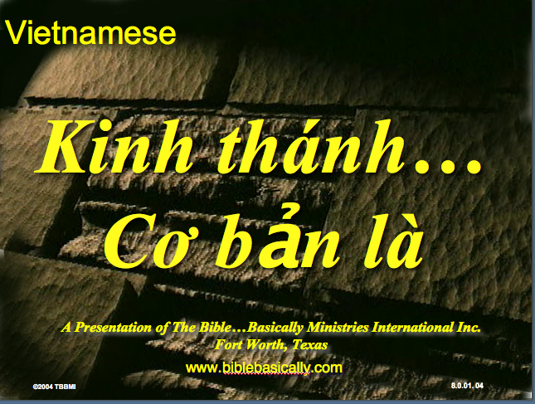
Vietnamese
Kinh thánh…
Cơ bản là
A Presentation of The Bible…Basically Ministries International Inc. Fort Worth, Texas
www.biblebasically.com
©2004 TBBMI
8.0.01.
04

Slide 61


Bahasa Indonesia
Presentasi dari The Bible…Basically Ministries International Inc. Fort Worth, Texas
www.biblebasically.com
7.5.01.
©2003 TBBMI
04

Slide 62
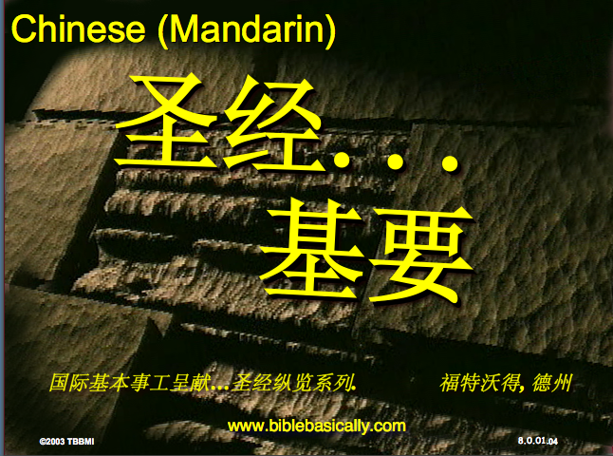
Chinese (Mandarin)
圣经...
基要
国际基本事工呈献…圣经纵览系列. 福特沃得, 德州
www.biblebasically.com
8.0.01.
©2003 TBBMI
04

Slide 63
PowerPoint (945 slides)
Student Workbook (80 pages)
Teacher Script (400 pages)
TBB Materials
Completed in
English • Bahasa • Chinese • Malay • Korean • Mongolian • Russian
A Presentation of The Bible…Basically Ministries International Inc. Fort Worth, Texas
www.biblebasically.com
©2004 TBBMI
8.0.01.
04

Slide 64

7
YOUR BIBLE FILE
Handbook pg. 8-14
37
Notes:
Now let's think again about a filing cabinet. This will be YOUR BIBLE FILE! Here is a look ahead to where we are going in this study.

Slide 65
7
1
2
3
4
5
6
7
8
9
10
Handbook pg. 8-14
39
Notes:
As a starting point, begin thinking about 10 file folders in a filing cabinet.
You are going to organize your own Bible File into a collection of these ten mental file folders.
Very soon you'll be applying labels to each of those 10 file folders. So…now to begin…and…

Slide 66
7
Opening Up
“Your Bible File”
7
7
7
7
7
7
7
C
7
J
C
S
J
C
S
J
C
S
J
S
Handbook pg. 8-14
4
40
Notes:
We begin right here...with the single number…. 7.
That's our mental anchor point. Simply the number 7 with that all-important dash through the stem.
//// Next step...surround that number with three alphabet letters. Set them firmly in place in your mind:
C 7 S J
Repeat the letter group aloud several times as you embed it in your mind... Because this is the very core of the Bible's organization and time-line flow:
//// “C 7 S J....
//// C 7 S J....
//// C 7 S J...etc.”

Slide 67
Opening Up
“Your Bible File”
7
7
= 4+3
Handbook pg. 8-14
2
41
Notes:
Now...about that European style '7'.
//// You'll remember that it has a dash through its stem... That's an important reminder — a mind clue. Keep it mentally handy. That small dash divides the length of the 7's stem into two parts. So, ask yourself the question: "What two numbers does 7 easily split into?"
//// One possible answer…and the right one…is: 4 and 3.

Slide 68
7
Opening Up
“Your Bible File”
C 4 3 S J
C 4 3 S J
Handbook pg. 8-14
1
42
Notes:
So, in the C 7 S J formula, by changing the 7 to a 4 and a 3, we have
C 4 3 S J.
As before, repeat that changed sequence aloud several times to help it hold tightly in your mind for easy recall.
//// C 4 3 S J.

Slide 69
5 Key Words or Phrases:
7
C = CREATION
4 = PEOPLE
3 = SOCIETIES
S = SILENCE
J = JESUS
Handbook pg. 8-14
5
43
Notes:
Now, based on C 4 3 S J, we enlarge that idea into five key words or phrases. They will become the foundation of your mental Bible File. Here they are…say them aloud…
//// C = CREATION
//// 4 = 4 PEOPLE
//// 3 = 3 SOCIETIES
//// S = SILENCE
//// J = JESUS.
And that's an organizational plan for the entire Bible! Those five words and phrases create an abbreviated outline map of the entire Bible's basic design.

Slide 70
5 Key Words or Phrases:
7
C = CREATION
4 = PEOPLE
3 = SOCIETIES
S = SILENCE
J = JESUS
Handbook pg. 8-14
6
44
Notes:
Once again...aloud…
//// C = CREATION
//// 4 = 4 PEOPLE
//// 3 = 3 SOCIETIES
//// S = SILENCE
//// J = JESUS.
We will now go back through the phrases, expanding them still farther.
//// CREATION,
of course, remains at the top of the list naturally…because the Bible story itself begins right there.

Slide 71
5 Key Words or Phrases:
7
C = CREATION
4 = PEOPLE
3 = SOCIETIES
S = SILENCE
J = JESUS
Handbook pg. 8-14
45
Notes:
We then take the next phrase from the list:
4 PEOPLE.

Slide 72
THE 4 PEOPLE ARE:
7
A BRAHAM
J OSEPH
M OSES
J OSHUA
Handbook pg. 8-14
5
46
Notes:
Let's break apart “4 PEOPLE” into 4 specific people, in this order:
//// ABRAHAM
//// JOSEPH
//// MOSES
//// JOSHUA
It's helpful to remember the word order by repeating several times the first-letter order of the words:
//// "A-J-M-J ... A-J-M-J ... etc."

Slide 73
7
A
JUDGE
MUST
JUDGE!
Handbook pg. 8-14
47
Notes:
How can you remember the order of those letters and the names:
This simple sentence..."A JUDGE MUST JUDGE." The first letters of each word: AJMJ and then you have it.

Slide 74
THE 4 PEOPLE ARE:
7
J OSEPH
A BRAHAM
A
M OSES
JUDGE
J OSHUA
MUST
JUDGE
Handbook pg. 8-14
8
48
Notes:
Just remember to repeat the four names aloud to yourself several times until you feel the rhythm of the words:
//// "ABRAHAM,
//// JOSEPH,
//// MOSES and
//// JOSHUA."
And here again is that mental tool…
//// A
//// JUDGE
//// MUST
//// JUDGE.

Slide 75
7
CREATION
ABRAHAM
JOSEPH
MOSES
JOSHUA
Handbook pg. 8-14
5
49
Notes:
So, from the top of the list we now can say:
//// CREATION
//// ABRAHAM
//// JOSEPH
//// MOSES
//// JOSHUA
This step completes the main FOUR PEOPLE of your new Bible File. Of course, there are dozens of other Biblical characters, but these are the only ones we are using to build the Bible File right now. Repeat the four names aloud several times until they are firmly set mentally.

Slide 76
5 Key Words or Phrases:
7
C = CREATION
4 = PEOPLE
3 = SOCIETIES
S = SILENCE
J = JESUS
Handbook pg. 8-14
50
Notes:
The next phrase of that beginning list is:
3 SOCIETIES.

Slide 77
7
A R C
Handbook pg. 8-14
2
51
Notes:
Another memory tool now…what do you call
//// that red section of the perimeter of a circle?
//// It's called an “arc,” spelled A-R-C. Those letters, then, remind you of the first letters of 3 KINDS OF SOCIETIES.

Slide 78
THE 3 SOCIETIES ARE:
7
A NARCHY
R OYALTY
C APTIVITY
Handbook pg. 8-14
6
52
Notes:
The three societies are…
//// ANARCHY
//// ROYALTY
//// CAPTIVITY.
As before, please repeat that word order several times.
ANARCHY, ROYALTY, CAPTIVITY...
ANARCHY, ROYALTY, CAPTIVITY.
And the mental tool here:
//// A
//// R
//// C.

Slide 79
CREATION
ABRAHAM
JOSEPH
MOSES
JOSHUA
ANARCHY
ROYALTY
CAPTIVITY
7
Handbook pg. 8-14
53
Notes:
Now we add the 3 SOCIETIES group to the others, and we have:
CREATION
ABRAHAM
JOSEPH
MOSES
JOSHUA
ANARCHY
ROYALTY
CAPTIVITY

Slide 80
7
7
TO REVIEW...
C 7 S J
C 4 3 S J
Handbook pg. 8-14
3
54
Notes:
To review the entire sequence so far…
Beginning with the single number
//// 7....
leading to…
//// C 7 S J...
which becomes...
//// C 4 3 S J.
These numbers and letters are then used to develop a mental list of TEN WORDS that will form a dependable mental outline of the entirety of Scripture.

Slide 81
CREATION
4 PEOPLE
3 SOCIETIES
SILENCE
JESUS
7
Handbook pg. 8-14
55
Notes:
C 4 3 S J is then expanded into:
CREATION
4 PEOPLE
3 SOCIETIES
SILENCE
JESUS.

Slide 82
7
CREATION
ABRAHAM
JOSEPH
MOSES
JOSHUA
ANARCHY
ROYALTY
CAPTIVITY
SILENCE
JESUS
Handbook pg. 8-14
2
56
Notes:
Then further expanded into:
CREATION
ABRAHAM
JOSEPH
MOSES
JOSHUA
ANARCHY
ROYALTY
CAPTIVITY.
Finally, now, we add: //// SILENCEand//// JESUS.

Slide 83
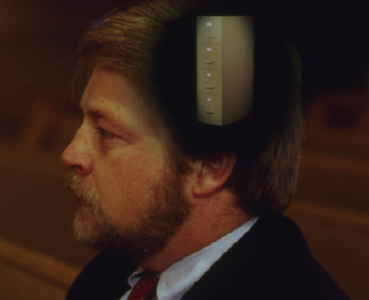
Your New Mental “Bible File”
CREATION
CREATION
ABRAHAM
ABRAHAM
ABRAHAM
ABRAHAM
JOSEPH
ABRAHAM
MOSES
JOSEPH
JOSHUA
ANARCHY
MOSES
ROYALTY
CAPTIVITY
JOSHUA
SILENCE
JESUS
ANARCHY
ROYALTY
CAPTIVITY
SILENCE
JESUS
Handbook pg. 8-14
57
11
Notes:
Now it's time mentally to apply those ten words as labels to ten mental folders in your new Bible File –
//// right up there in your head. That mental picture might look something like this. And there they are...
//// CREATION//// ABRAHAM//// JOSEPH//// MOSES//// JOSHUA//// ANARCHY//// ROYALTY//// CAPTIVITY//// SILENCE…and…//// JESUS.
Now it's organized in a neat and orderly package in your mind --- ready for recall and use as you need it. Now just a few more
examples to drive home the point...

Slide 84
Membuka
“Arsip Alkitab Anda”
7
7
7
7
7
7
C S Y
C S Y
C S Y
C S Y
Buku Panduan hlm. 8-14
40
4

Slide 85
Membuka
“Arsip Alkitab Anda”
7
7
= 4+3
Buku Panduan hlm. 8-14
41
2

Slide 86
Membuka
“Arsip Alkitab Anda”
7
C 4 3 S Y
C 4 3 S Y
Buku Panduan hlm. 8-14
42
1

Slide 87
5 Kata Kunci atau Ungkapan:
7
C = CIPTAAN
4 = TOKOH
3 = KOMUNITAS
S = SENYAP
Y = YESUS
Buku Panduan hlm. 8-14
43
5

Slide 88
5 Kata Kunci atau Ungkapan:
7
C = CIPTAAN
4 = TOKOH
3 = KOMUNITAS
S = SENYAP
Y = YESUS
Buku Panduan hlm. 8-14
45

Slide 89
4 TOKOH tsb adalah:
7
A BRAHAM
Y USUF
M USA
Y OSUA
Buku Panduan hlm. 8-14
46
5

Slide 90
AYMY
7
ANUGERAH
YANG
MENAKJUBKAN
YA !
Buku Panduan hlm. 8-14
47

Slide 91
5 Kata Kunci atau Ungkapan:
7
C = CIPTAAN
4 = ORANG
3 = KOMUNITAS
S = SENYAP
Y = YESUS
Buku Panduan hlm. 8-14
50

Slide 92
AKP
7
A K P
Buku Panduan hlm. 8-14
51
2

Slide 93
KE 3 KOMUNITAS ADALAH:
7
A NARKI
K ERAJAAN
P EMBUANGAN
Buku Panduan hlm. 8-14
52
6

Slide 94
SBC Courses I Teach
(English • Bahasa • Chinese)
Survey
OT NT
Backgrounds
WOT WNT
Theology
Church Spirit Future
Preaching
Homiletics 1 Homiletics 2
Notes:
I get to teach these leaders every book of the Bible in survey courses, plus backgrounds to both the OT and NT, three areas of theology, and how to preach.

Slide 95

“in the beginning”
Gen. 1:1
An Introduction to Genesis

Slide 96
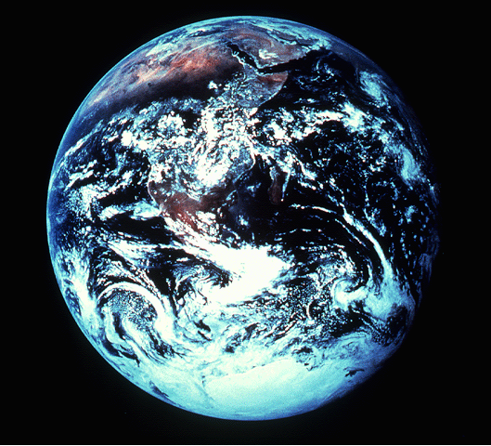
“pada mulanya”
Gen. 1:1
Pengenalan kitab Kejadian

Slide 97
“起初”
Gen. 1:1
创世记导论

Slide 98

Days of Creation
33
Void
Formless
Forming
Filling
Day 4: Sun, moon & stars arranged
Day 1: Light
Day 2: Water & air separated
Day 5: Fish & fowl
Day 3: Land & sea separated
Day 6: Animals & man
Genesis 1:3-31

Slide 99
Hari-hari penciptaan
64
Kosong
Tidak berbentuk
Dibentuk
Diisi
Hari 4: Matahari, bulan & bintang diatur
Hari 1: Terang
Hari 2: Air & udara dipisahkan
Day 5: Ikan & unggas
Day 3: Darat & laut dipisahkan
Day 6: Binatang & manusia
Kejadian 1:3-31

Slide 100
六天的创造
空虚
64
充满
混沌
形成
第四天: 太阳，月亮与众星摆列在天
第一天: 光
第二天:
水与空气分开
第五天: 鱼与雀鸟
第三天:
旱地与海分开
第五天: 动物与人
创世记 1:3-31

Slide 101
Would you like to translate 50-70 PPT slides from this course instead of doing the reading and taking the quizzes? Talk to me!
G

Slide 102
What Do You Think of the Holy Spirit?
i
Please complete the 24 items on page “i” in the next few minutes. Do it quickly. If you do not immediately Agree or Disagree, then indicate Unsure.

Slide 103
“In the beginning God created the heavens and the earth” (Gen. 1:1)
Gen. 1:1

Slide 104
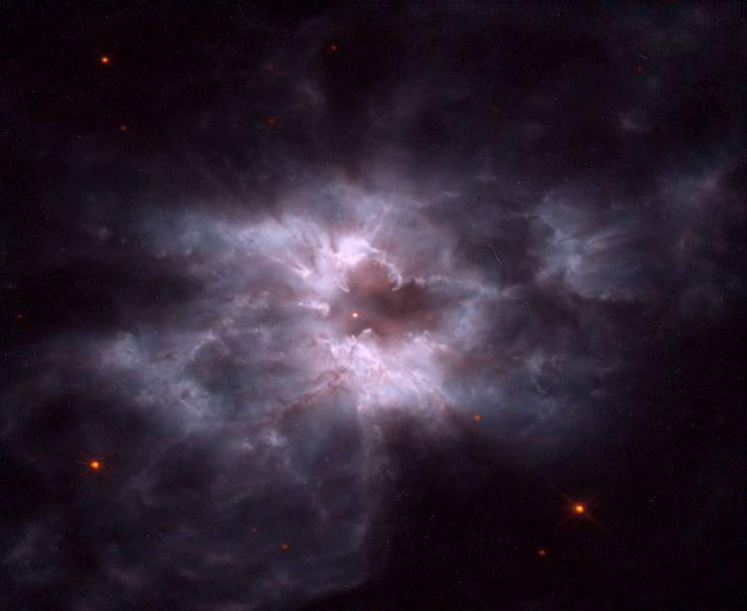
Light
God's Creation…Day 1
Then God said,
“Let there be light”; and there was light. God saw that the light was good, and he separated the light from the darkness (Gen. 1:4).

Slide 105
Light
God's Creation…Day 1
Then Jesus said,
“Let there be light”; and there was light. Jesus saw that the light was good, and he separated the light from the darkness (Gen. 1:3-4).

Slide 106
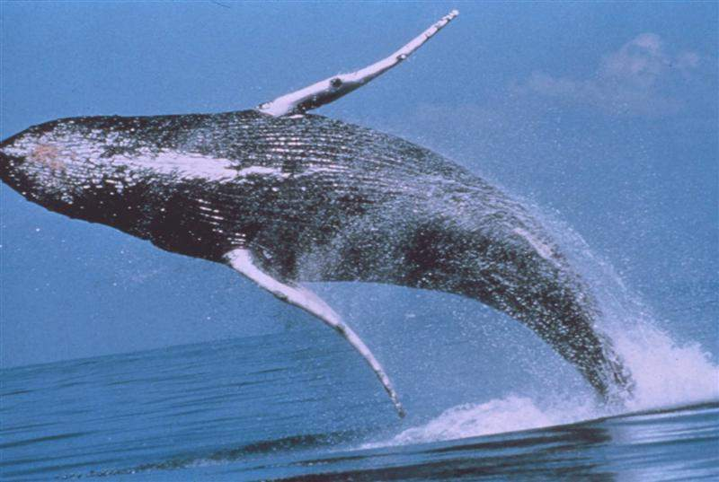
Whales
God's Creation…Day 5
God created the great sea monsters and every living creature that moves, with which the waters swarmed after their kind (Gen. 1:21a)…

Slide 107
Whales
God's Creation…Day 5
Jesus created the great sea monsters and every living creature that moves, with which the waters swarmed after their kind (Gen. 1:21a)…

Slide 108
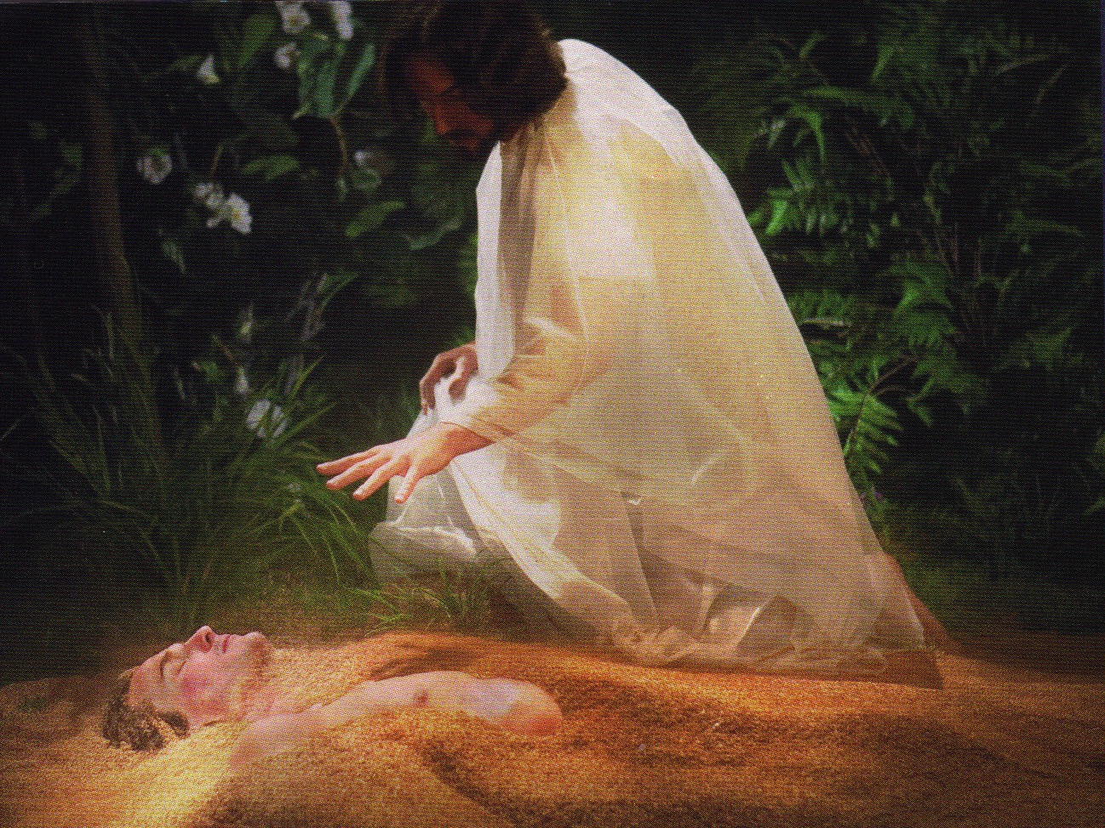
Jesus formed Adam from the dust (John 1:3; Gen. 2:7).

Slide 109
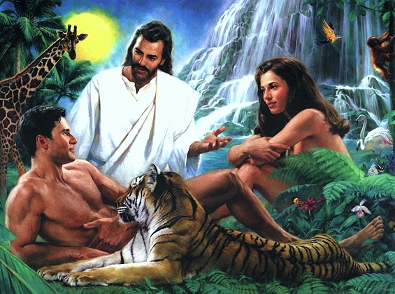
Jesus Created Adam and Eve (John 1:3; Gen. 2:21-23)

Slide 110
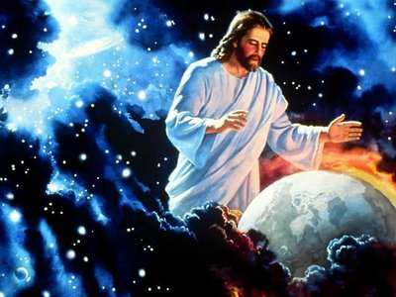
Jesus also sustains his creation

Slide 111
"Now the earth was formless and empty, darkness was over the the surface of the deep…"
"…and the Spirit of God was hovering over the waters."
Genesis 1:2 NIV

Slide 112
"Earth was a soup of nothingness, a bottomless emptiness, an inky blackness…"
"…God's Spirit brooded like a bird above the watery abyss."
Genesis 1:2 The Message

Slide 113

The Spirit as dove
"…God's Spirit brooded like a bird above the watery abyss."
Genesis 1:2 The Message

Slide 114
“From the very beginning of creation we have an indication that the Holy Spirit's work is to complete and sustain what God the Father has planned and what God the Son has begun, for in Genesis 1:2, 'the Spirit of God was moving over the face of the waters.'”
Wayne Grudem, Systematic Theology, 635

Slide 115

The Tabernacle
7
God sets up a place for Him to dwell as King
MOSES
Exodus
Sinai
M - C - C
Kadesh Barnea
40
The Tabernacle in the Wilderness
Handbook pg. 26-29
2
16

Slide 116
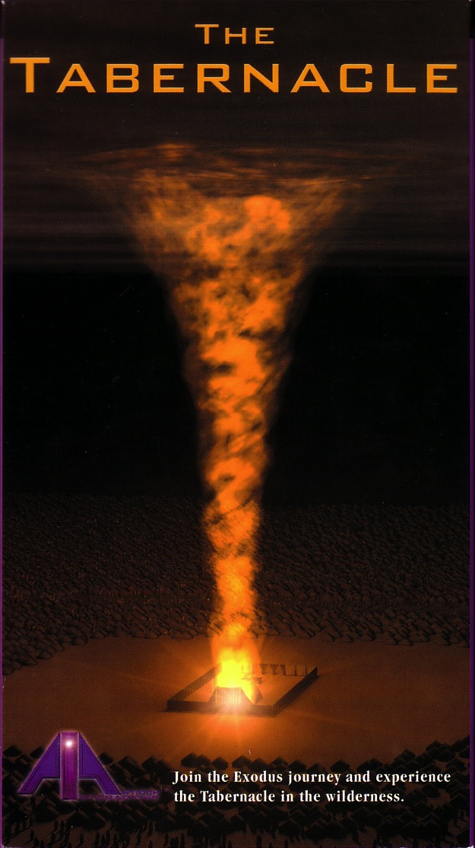

God's presence filled his new palace!
Then the cloud covered the tent of meeting, and the glory of the LORD filled the tabernacle.
Exodus 40:34 ESV

Slide 117
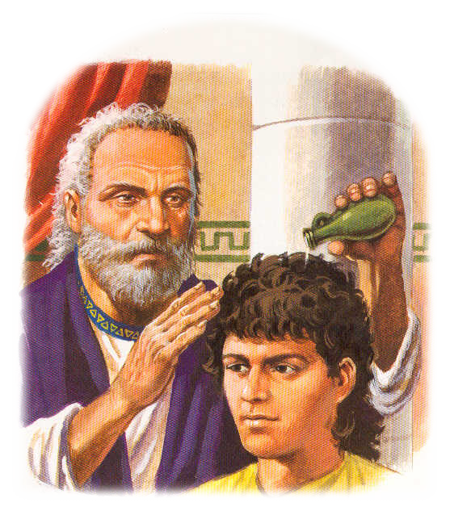
The Spirit also came upon judges, prophets, and kings in the Old Testament

Slide 118

God's Presence Indwelt Solomon's Temple

Slide 119
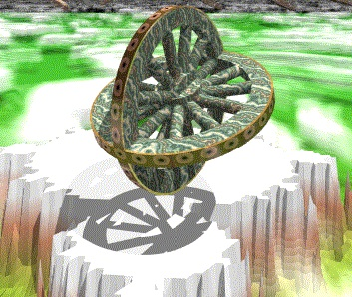

Ezekiel 1:15-16
As I looked at these beings, I saw four wheels touching the ground beside them, one wheel belonging to each. ¹⁶The wheels sparkled as if made of beryl. All four wheels looked alike and were made the same; each wheel had a second wheel turning crosswise within it (NLT).

Slide 120

Ezekiel 1

Slide 121

The Valley of Dry Bones (Ezek. 37)

Slide 122

The Valley of Dry Bones (Ezek. 37)

Slide 123




The Valley of Dry Bones (Ezek. 37)
Stage 1:
Return in Unbelief
Stage 2:
Trust in Messiah

Slide 124

A Hebrew Play on Words
"Prophesy to the
breath" (37:5, 9)
"Prophesy to the
Spirit" (37:14)
=
Hebrew insert
"breath, wind, Spirit"
Gen. 2:7
Greek insert
"breath, wind, Spirit"
John 3:5, 8; 2 Thess. 2:8
=

Slide 125
Pneumatology
Greek insert
"breath, wind, Spirit, spirit"
John 3:5, 8; 2 Thess. 2:8

Slide 126

Restoration of the Lord's Honor
Regathering of Israel from surrounding nations
Removing of impurities & idolatries
Replacing of a new heart/spirit upon Israel
Residing of the Spirit guarantees obedience
Reenacting covenant promise to Israel
Returning great productivity in Israel
Remembering & loathing of sins by Israel
Ezekiel 37

Slide 127
Please login tomorrow to check your access then do your reading and quiz for next week by midnight before class!

Slide 128
Black

Slide 129

Holy Spirit PPT link at BibleStudyDownloads.org
Get this presentation for free!

