Slide 1
John Supplement
Dr. Rick Griffith • Jordan Evangelical Theological Seminary • BibleStudyDownloads.org

Slide 2
THE SYNOPTICS: “TO SEE TOGETHER”
1
MATTHEW
2
MARK
TO:
JEWS
TO:
ROMANS
AS:
KING
AS:
SERVANT
WHAT
HE:
SAID
WHAT
HE:
DID
∑
3
LUKE
4
JOHN
TO:
GREEKS
TO:
CHURCH
AS:
GOD/MAN
AS:
GOD
WHAT
HE:
FELT
WHAT
HE:
MEANT
21
1

Slide 3
JOHN: SUMMING UP THE MESSAGE
1
MATTHEW
2
MARK
TO:
JEWS
TO:
ROMANS
AS:
KING
AS:
SERVANT
WHAT
HE:
SAID
∑
WHAT
HE:
DID
3
LUKE
4
JOHN
TO:
GREEKS
TO:
CHURCH
AS:
GOD/MAN
AS:
GOD
WHAT
HE:
FELT
WHAT
HE:
MEANT
22

Slide 4
John 1:1
STUDY HELP #22
JOHN: SUMMING UP THE MESSAGE
CHAPTER 1: 6 GREAT TRUTHS OF
VERSE I: The Pre-existent One
A Person Distinct
He Was and IS God
JESUS CHRIST!
“In the beginning was the Word, and the Word was with God, and the Word was God.”
23
3

Slide 5
John 1:2
JOHN: SUMMING UP THE MESSAGE
CHAPTER 1: 6 GREAT TRUTHS OF
VERSE I: The Pre-existent One
A Person Distinct
He Was and IS God
JESUS CHRIST!
VERSE 2: Eternally Co-existent
“He was with God in the beginning.”
24
1

Slide 6
John 1:3
JOHN: SUMMING UP THE MESSAGE
CHAPTER 1: 6 GREAT TRUTHS OF
VERSE I: The Pre-existent One
A Person Distinct
He Was and IS God
JESUS CHRIST!
VERSE 2: Eternally Co-existent
“Through him all things were made; without him nothing was made that has been made.”
VERSE 3: Creator of the Universe
25
1

Slide 7
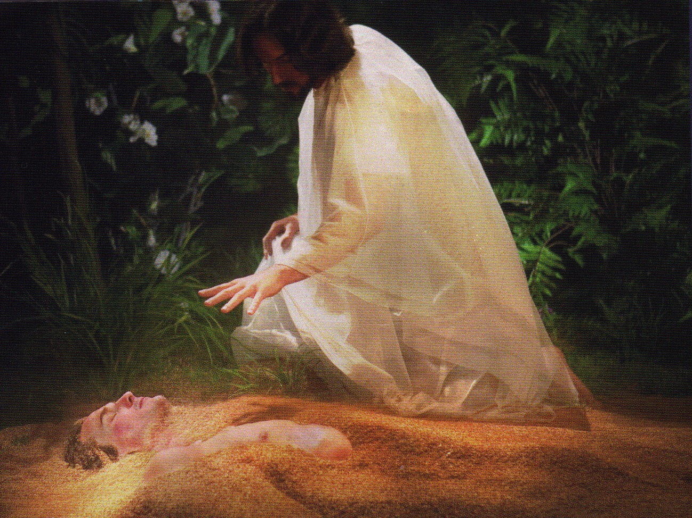
Jesus formed Adam from the dust (John 1:3; Gen. 2:7).

Slide 8
John 1:4, 5, 9
JOHN: SUMMING UP THE MESSAGE
CHAPTER 1: 6 GREAT TRUTHS OF
VERSE I: The Pre-existent One
A Person Distinct
He Was and IS God
JESUS CHRIST!
VERSE 2: Eternally Co-existent
“In him was life, and that life was the light of men. The light shines in the darkness, but the darkness has not understood it….The true light that gives light to every man was coming into the world.”
VERSE 3: Creator of the Universe
VERSES 4, 5, 9: Source of all Light and Life
26
1

Slide 9
…AND THE DATES OF WRITING?
1
MATTHEW
2
MARK
The A.D.40s
A.D. 64-68
TO:
JEWS
TO:
ROMANS
AS:
KING
AS:
SERVANT
WHAT
HE:
WHAT
HE:
SAID
DID
3
LUKE
4
JOHN
A.D. 57-59
A.D. 69 AFTER THE SYNOPTICS
TO:
GREEKS
TO:
CHURCH
AS:
GOD/MAN
AS:
GOD
WHAT
HE:
WHAT
HE:
FELT
MEANT
27
4

Slide 10
Date Options
109
Authorship is easier to determine than when John wrote. Three periods have been proposed for the date of the Gospel:
Late First Century
Second Century
Before AD 70
33
Christ's Death
70
Temple Destroyed
95
John's Death

Slide 11
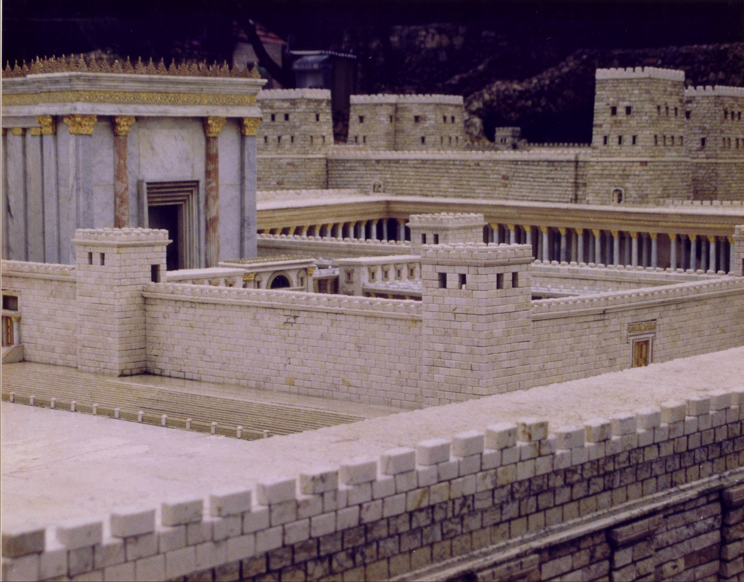
The Temple Stood Until AD 70

Slide 12
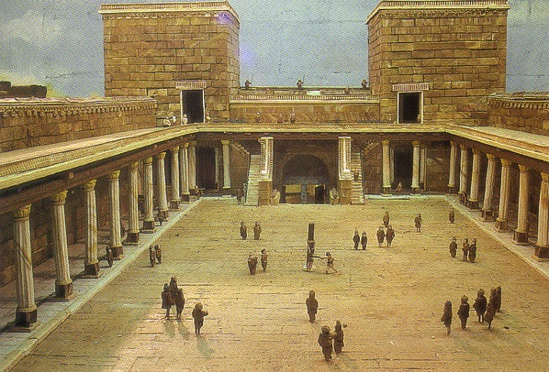
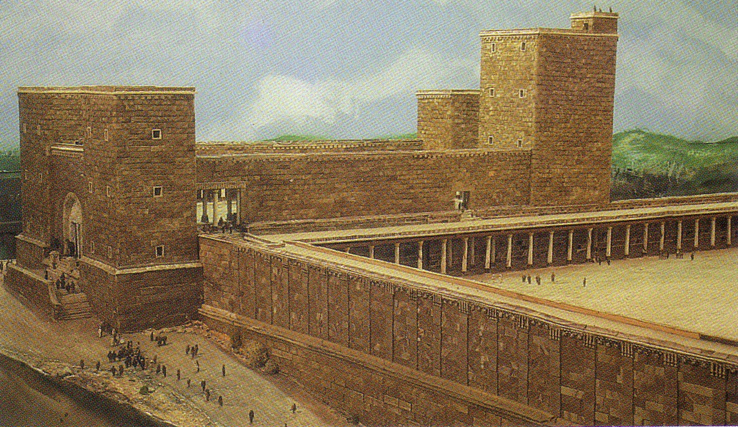
Antonia Fortress

Slide 13
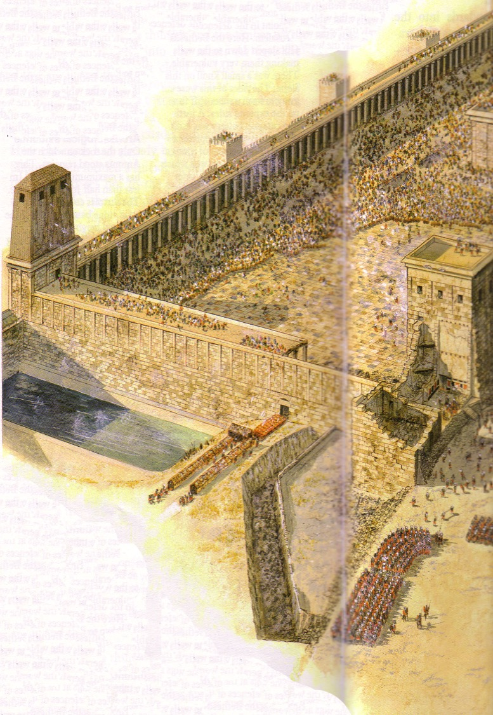
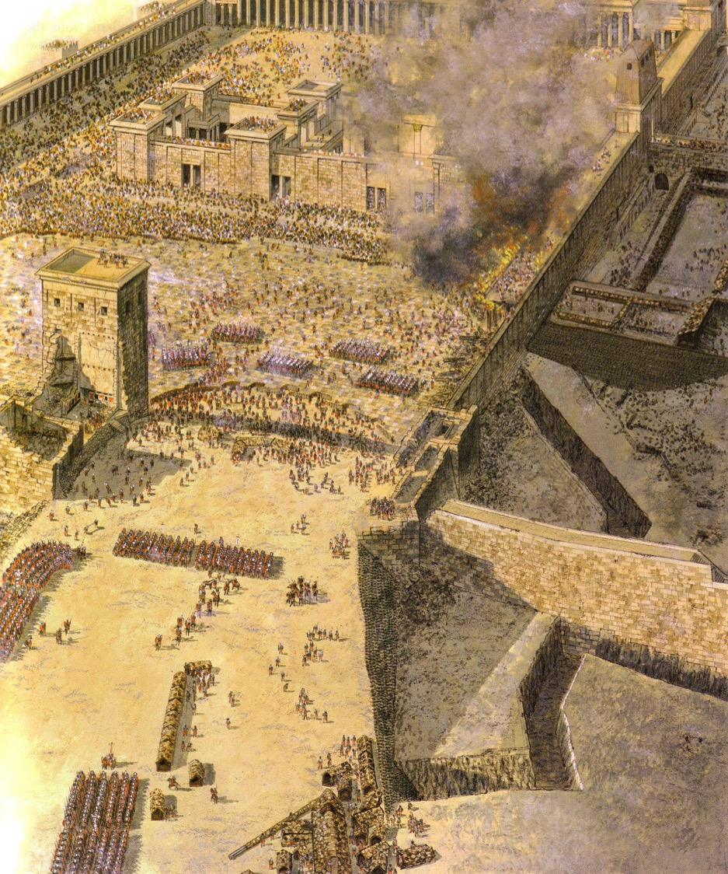
Temple Assault Sept AD 70
Sheep Pool

Slide 14
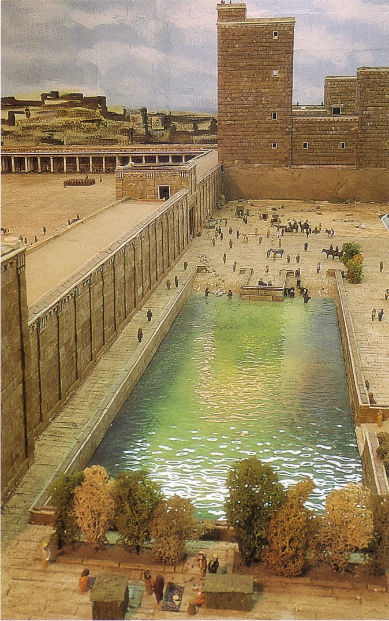
The Pool of Israel (Sheep Pool south of Pool of Bethesda)

Slide 15
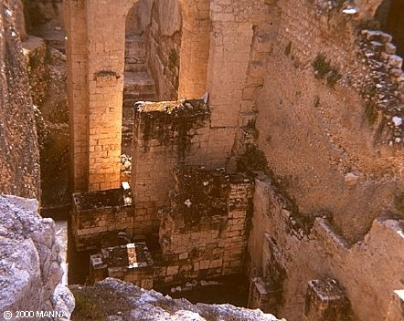
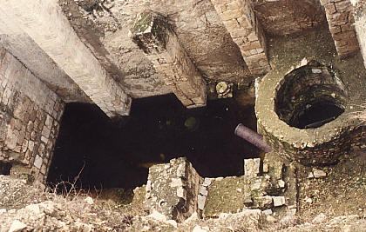
Pool of Bethesda
“Now there is in Jerusalem near the Sheep Gate a pool…”
John 5:2

Slide 16
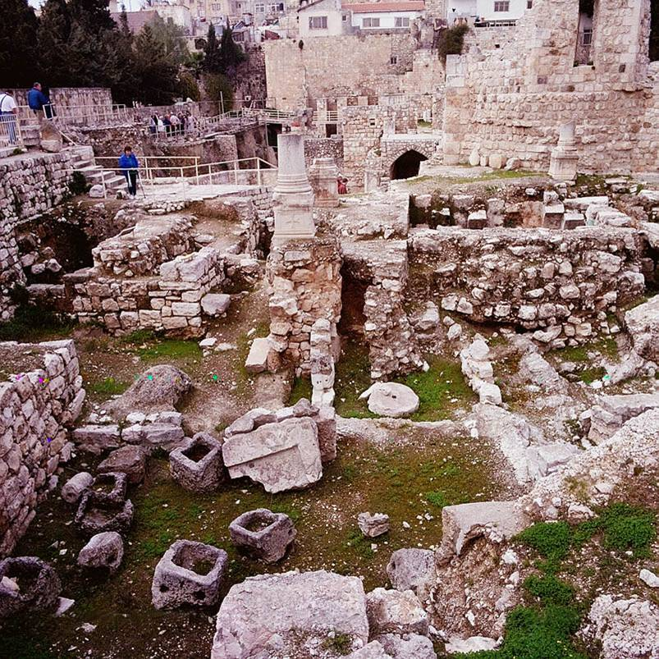
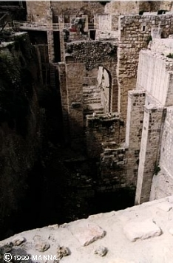
Pool of Bethesda Ruins

Slide 17
Pool of Bethesda
"Now there is in Jerusalem near the Sheep Gate a pool… called Bethesda…"
John 5:2

Slide 18
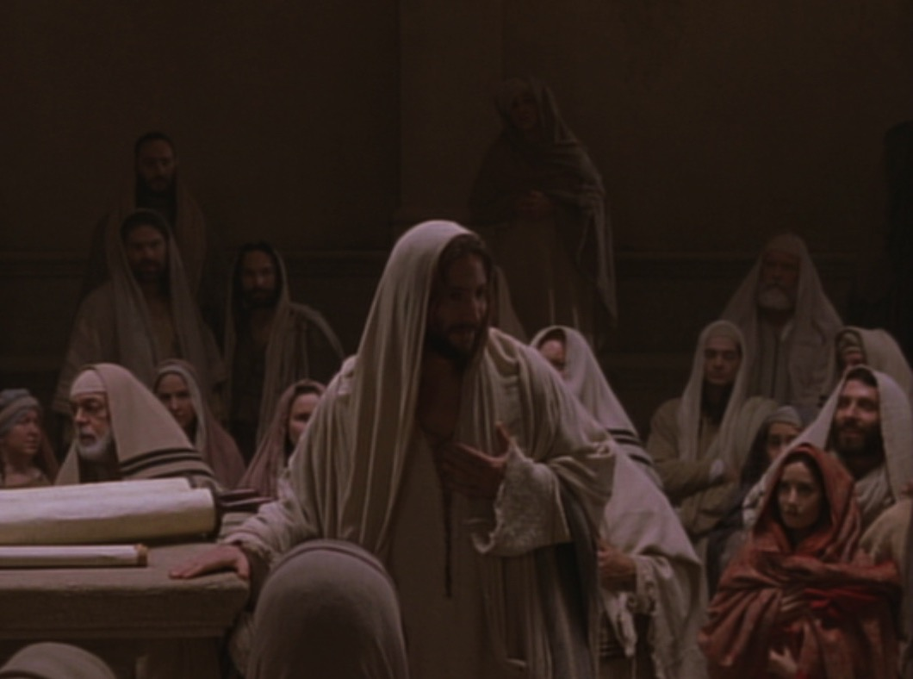
Key Word Believe
John
107
Key Verse
"Jesus did many other miraculous signs in the presence of his disciples, which are not recorded in this book. But these are written that you may believe that Jesus is the Christ, the Son of God, and that by believing you may have life in his name" (20:30-31).

Slide 19
The Duration of Christ's Ministry
56
Autumn AD 29 – 3 April AD 33 (3.5 Years)
John alone notes three Passovers
Commencement of Christ's Ministry
Passover #1 April 7, AD 30
Passover #2
Passover #3 April 25, AD 32
Passover #4 April 3, AD 33
Autumn AD 29
John 2:13, 23
Unstated by John Mark 2:23-28 Luke 6:1-5 Matthew 12:1-8
John 6:4
John 11:55–12:1
Harold W. Hoehner, Chronological Aspects of the Life of Christ (Zondervan, 1977), 114
Notes:
Christ's 3½ year ministry spanned four Passovers. However, the Synoptics mention only one Passover (#2 on this timeline), which could give the impression of only a year-old ministry. John fills in the details, though, by showing three other Passovers not mentioned by Matthew, Mark, or Luke.

Slide 20
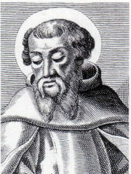
Irenaeus AD 180
Internal Indicator: Matthew Wrote to Jews
78a
"Matthew also issued a written Gospel among the Hebrews in their own dialect, while Peter and Paul were preaching at Rome [AD 60-68], and laying the foundations of the Church. After their departure [post AD 68], Mark, the disciple and interpreter of Peter, did also hand down to us in writing what had been preached by Peter. Luke also, the companion of Paul, recorded in a book the Gospel preached by him [no date given]. Afterwards [post 68], John, the disciple of the Lord, who also had leaned upon His breast, did himself publish a Gospel during his residence at Ephesus in Asia."
Against Heresies 3.1
Notes:
http://www.ccel.org/fathers2/ANF-01/anf01-60.htm#P7477_2003920

Slide 21
Black

Slide 22
Gospels link at BibleStudyDownloads.org
Get this presentation for free!
Notes:
NT Survey (ns)

