Slide 1
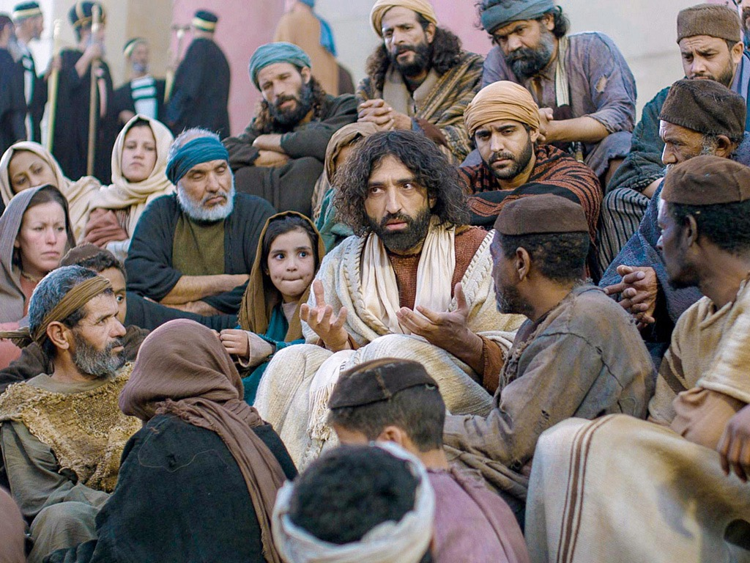
Luke Title Slide
Luke 13–24
Dr. Rick Griffith • Jordan Evangelical Theological Seminary • BibleStudyDownloads.org

Slide 2
Slides on
Luke 13

Slide 3
Slides on
Luke 14

Slide 4
Slides on
Luke 15

Slide 5
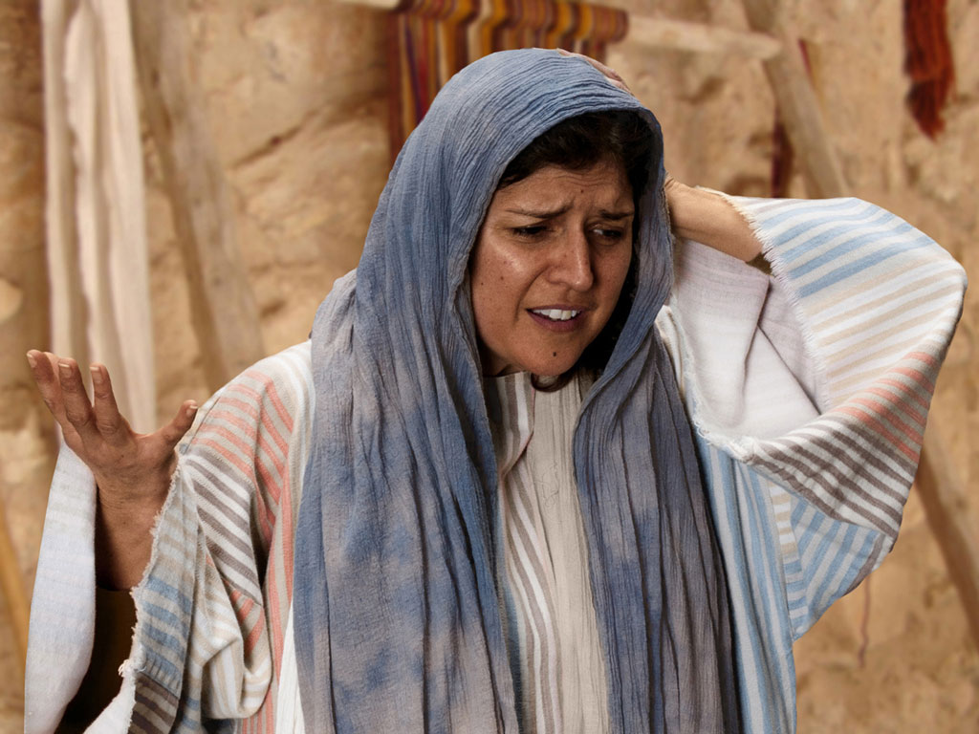

Free
Bible
images
THE PARABLE OF THE LOST COIN
Luke 15:8-10
Notes:
Luke's gospel is known for its many parables by Jesus.

Slide 6
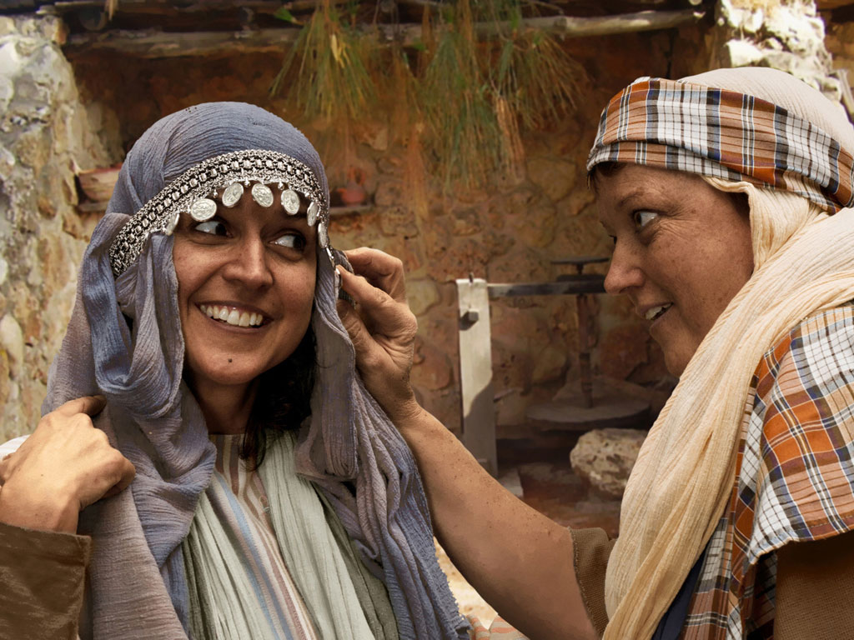
Notes:
Luke 15:8 Woman with 10 silver coins.
Most think that the silver coin (drachma) the woman lost was from the adornment of coins that women wore around her head and would have been her dowry. If so it was poor woman's dowry as a drachma was a day's salary for a peasant working for someone else. In the culture of the time, loss of a coin from a dowry could represent unfaithfulness and this would bring real shame and disgrace to her family and husband.

Slide 7
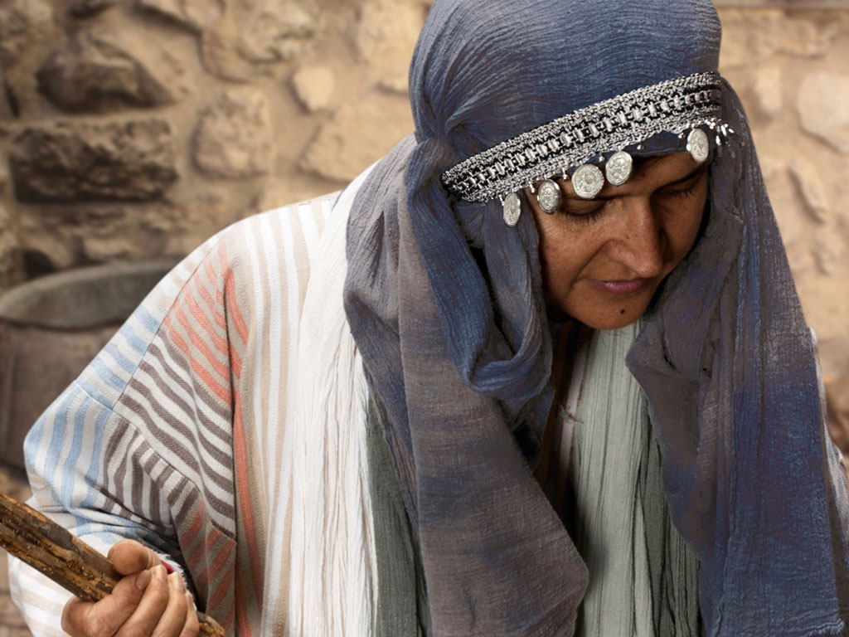
Notes:
Luke 15 v 8: Woman shown with coin missing.

Slide 8
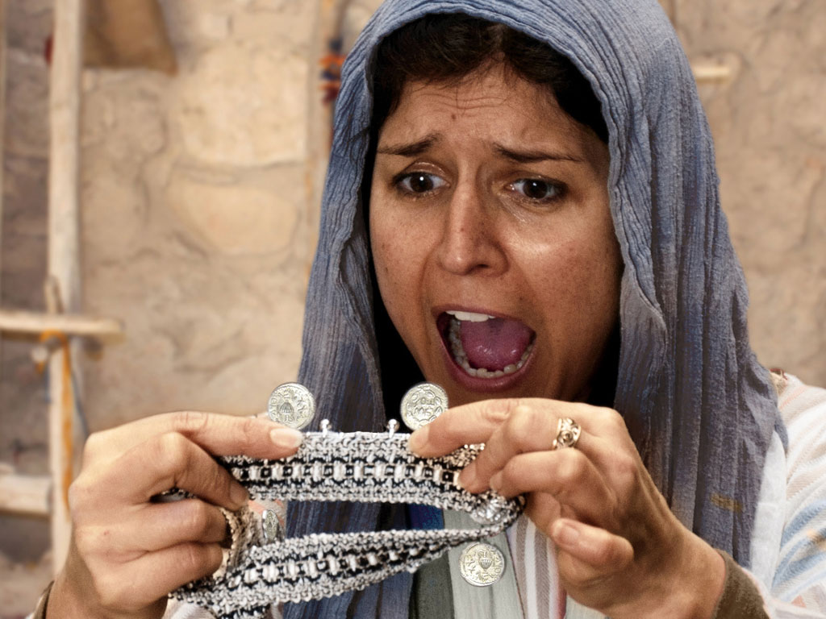
Notes:
Luke 15 v 8: Woman discovers a silver coin is missing.

Slide 9
Notes:
Luke 15 v 8: Woman wonders where she may have lost it.

Slide 10
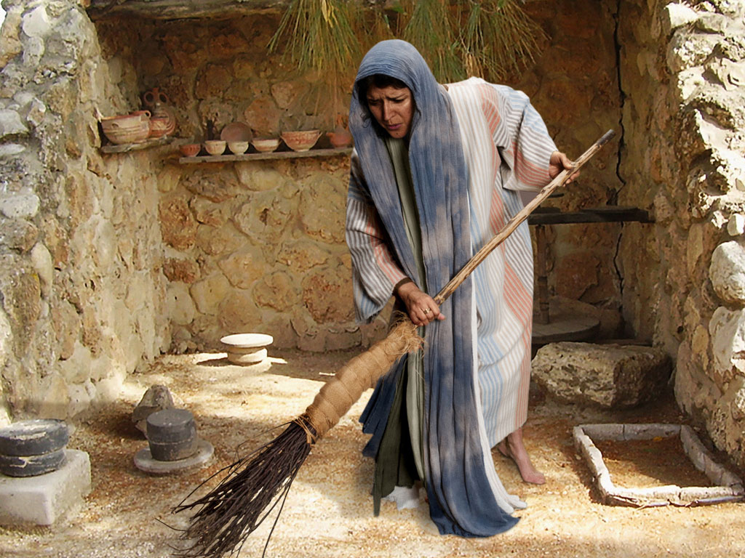
Notes:
Luke 15 v 8: Woman searches using broom.

Slide 11
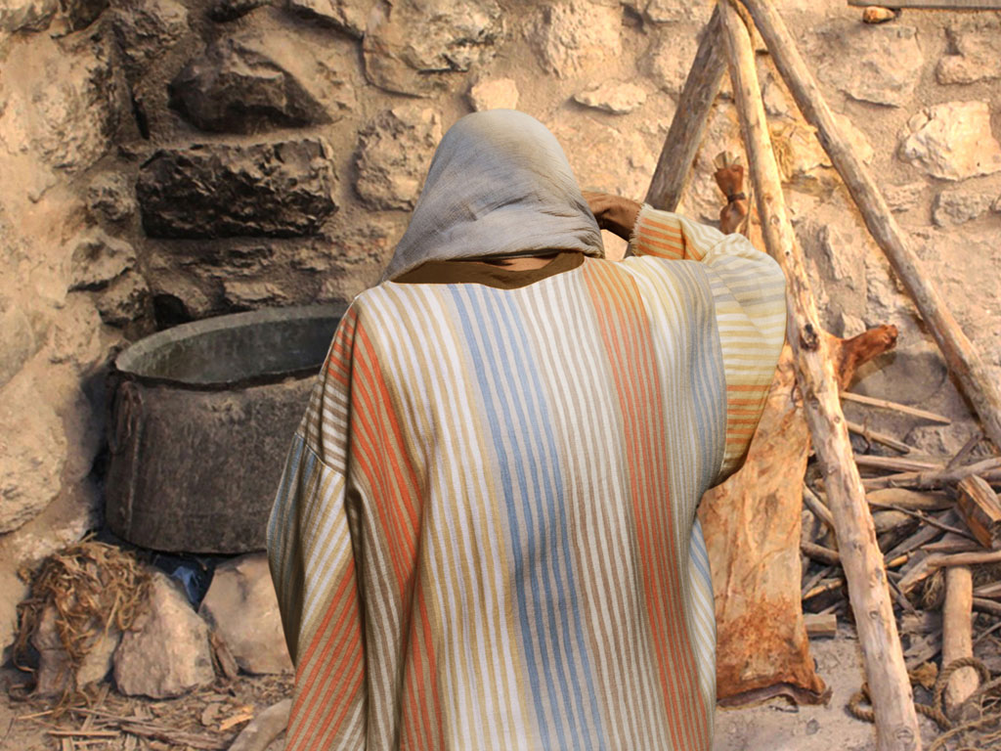
Notes:
Luke 15 v 8: Woman searches in courtyard.

Slide 12
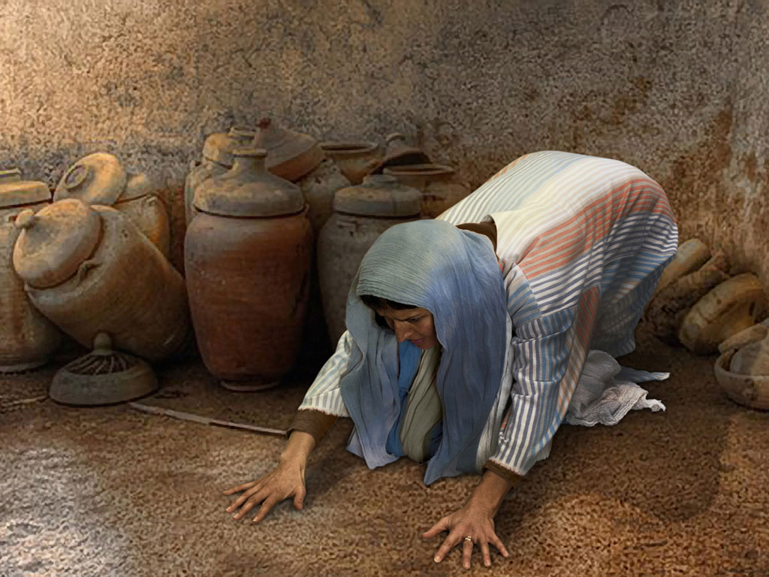
Notes:
Luke 15 v 8: Woman searches floor.

Slide 13
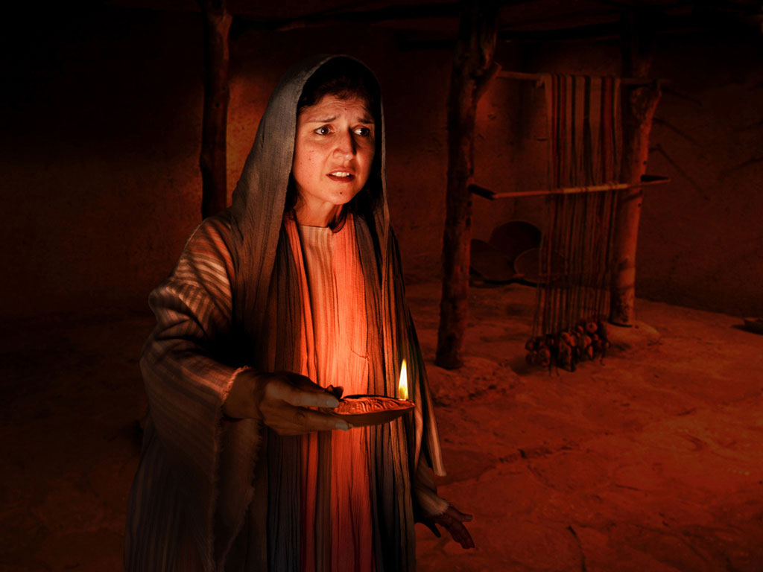
Notes:
Luke 15 v 8: Woman lights lamp and searches house. Many poor homes had very small windows and rooms were dark.

Slide 14
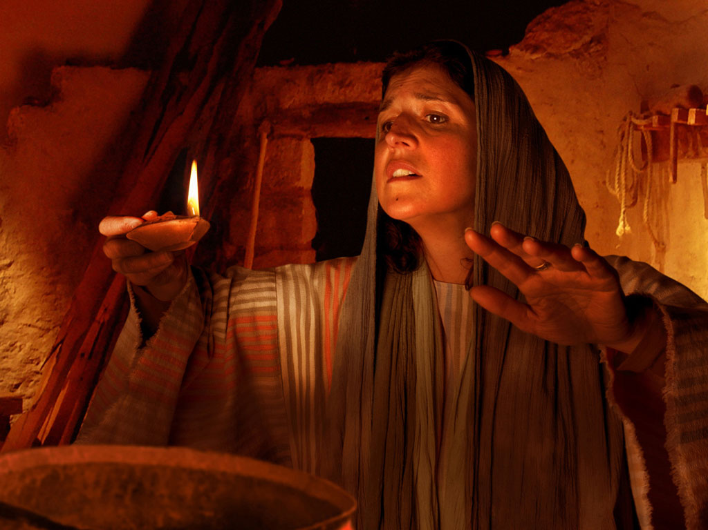
Notes:
Luke 15 v 8: Woman searches house by lamp light.

Slide 15
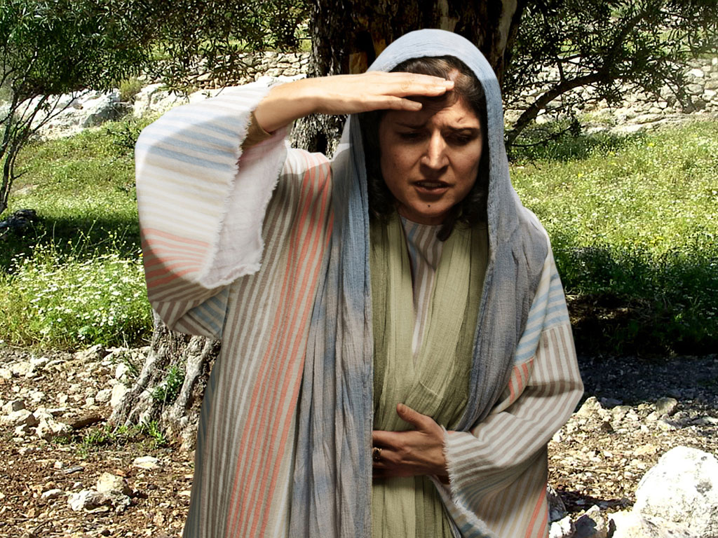
Notes:
Luke 15 v 8: Woman continues search.

Slide 16
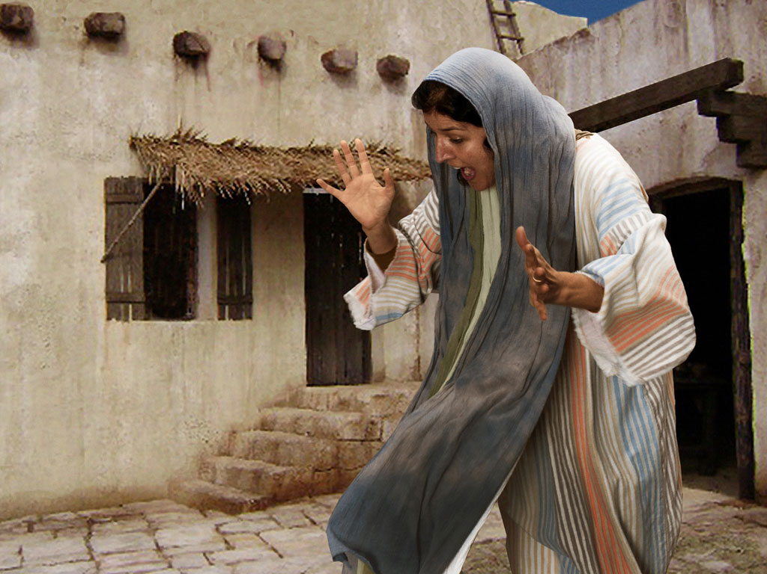
Notes:
Luke 15 v 9: Woman search is rewarded as she sees silver coin.

Slide 17
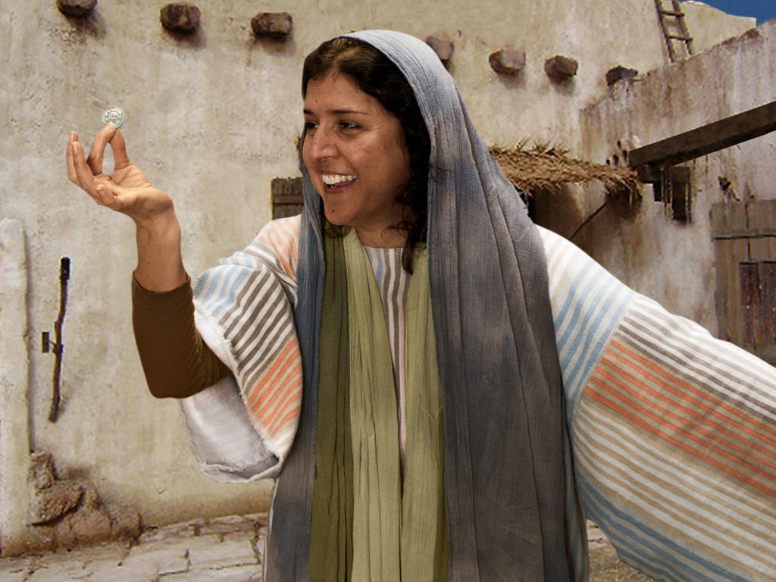
Notes:
Luke 15 v 9: Woman is full of joy as she finds coin.

Slide 18
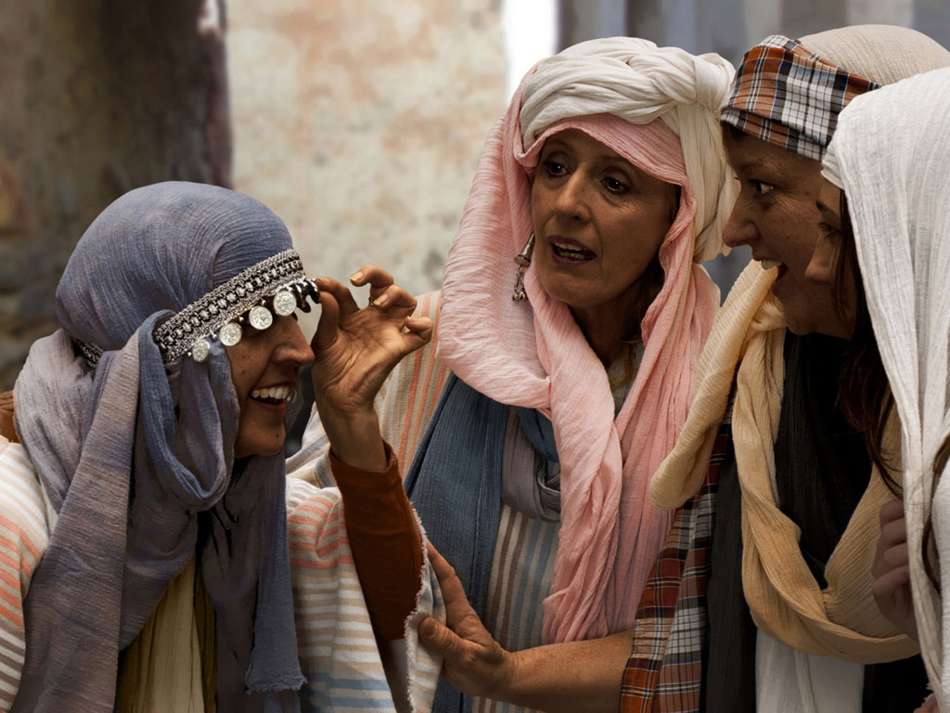
Notes:
Luke 15 v 9: Woman shares her good news with neighbours and friends.

Slide 19
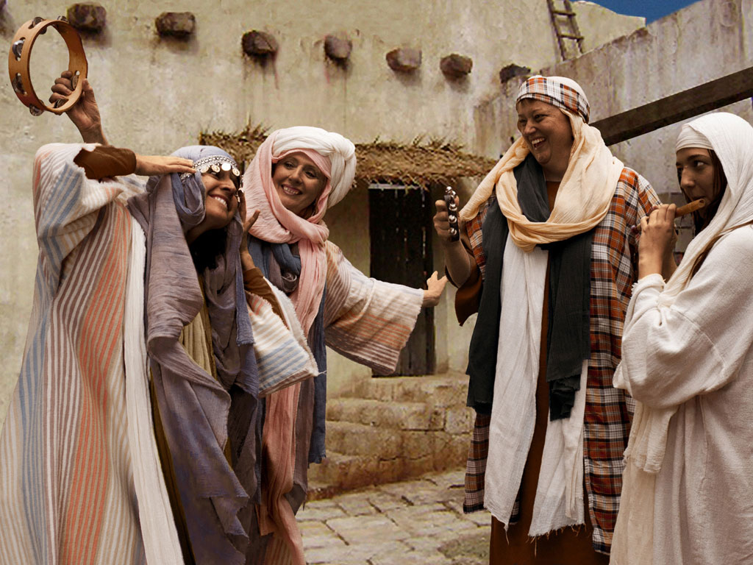
Notes:
Luke 15 v 9: Woman celebrates her good news with neighbours and friends. 'Rejoice with me; I have found my lost coin.'

Slide 20
THE WORD IN PICTURES
Free
Bible
images

Slide 21

FreeBibleimages would like to thank Peter Hutley and Wintershall Players for the use of their cast, costumes and facilities in creating these images.

Slide 22
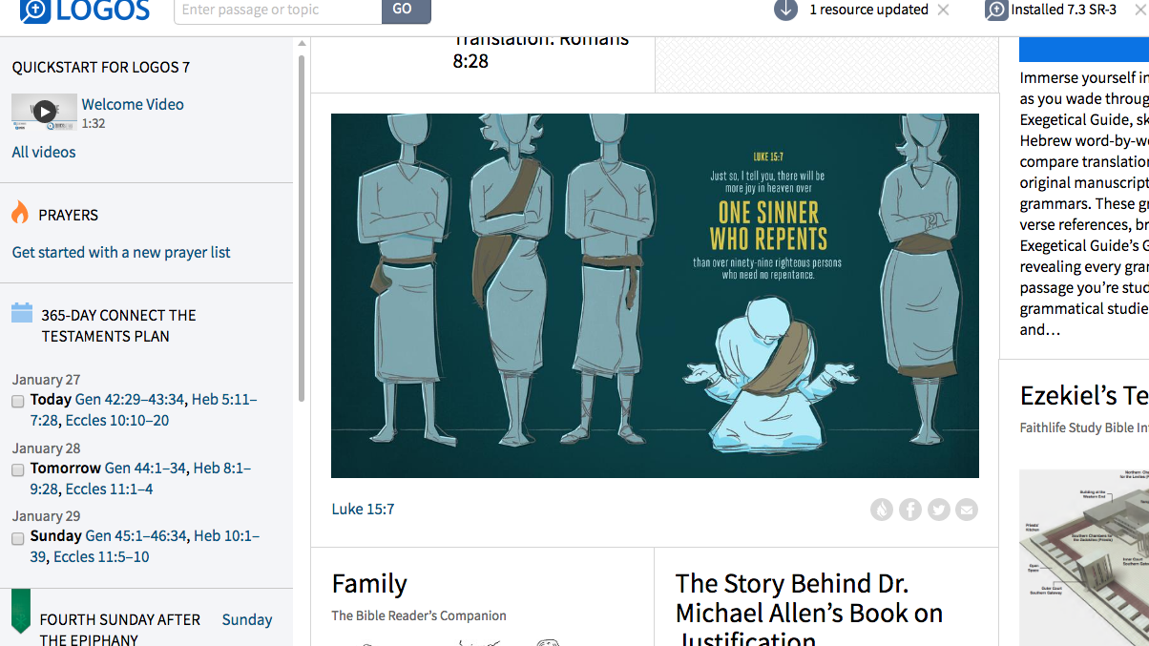
Luke 15:7
Just so, I tell you, there will be more joy in heaven over
ONE SINNER WHO REPENTS
than over 99 righteous persons who need no repentance.
Adapted from Logos Bible Software

Slide 23
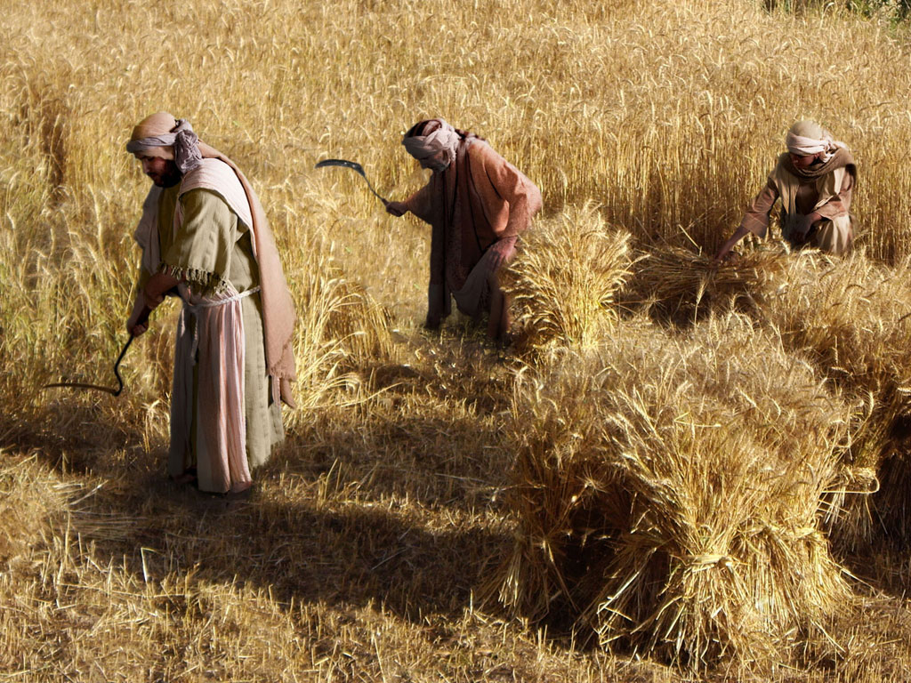
THE PARABLE OF THE TWO SONS (Prodigal Son)
Free
Bible
images
Luke 15:11-32

Slide 25
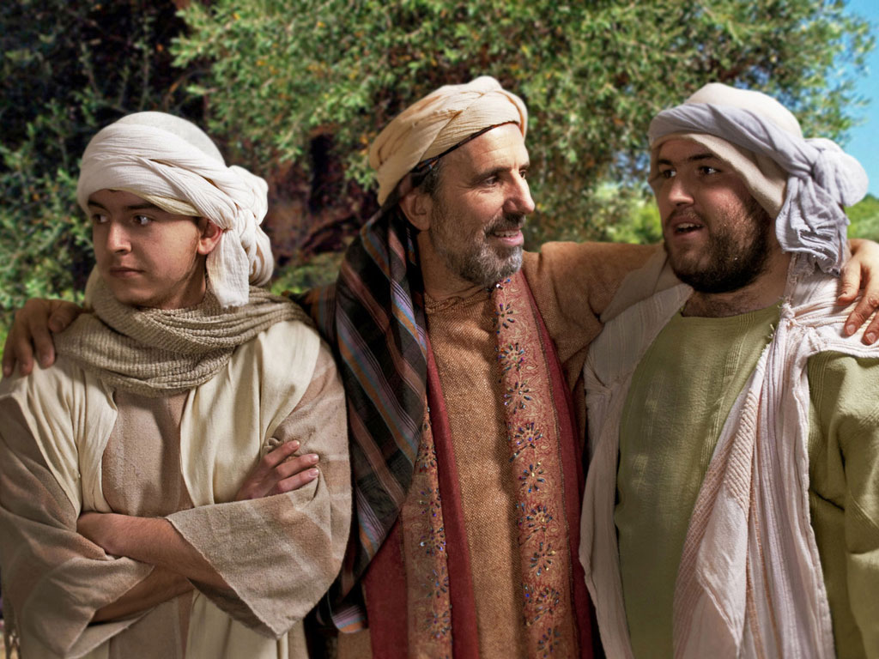

Slide 26
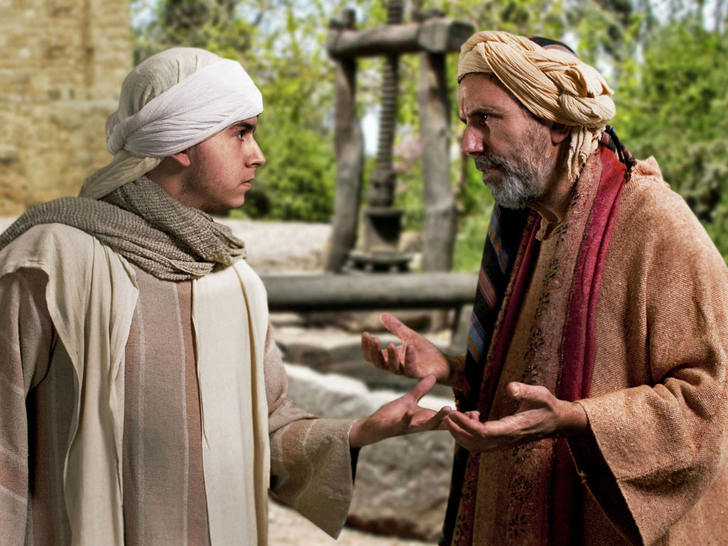

Slide 27
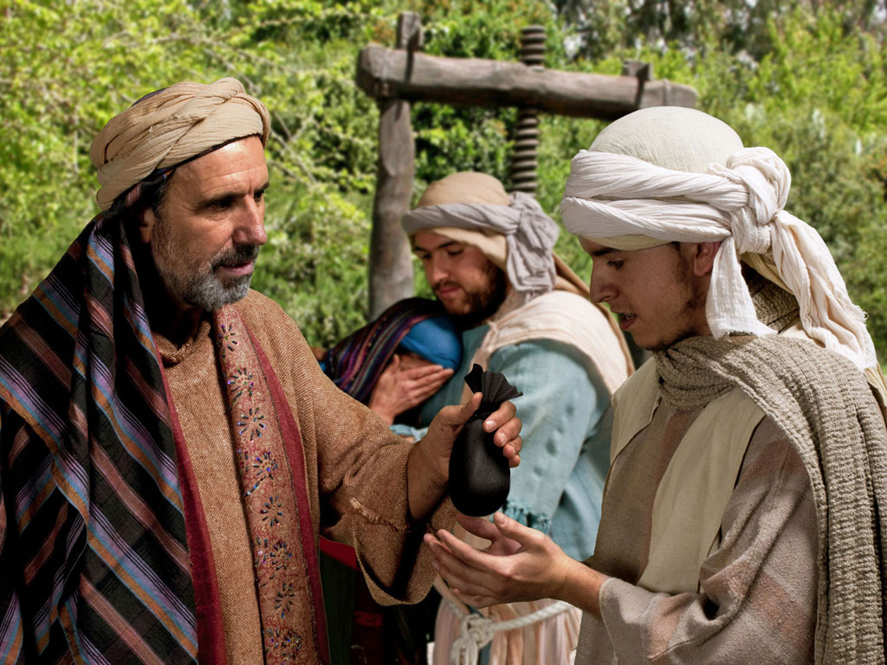

Slide 28
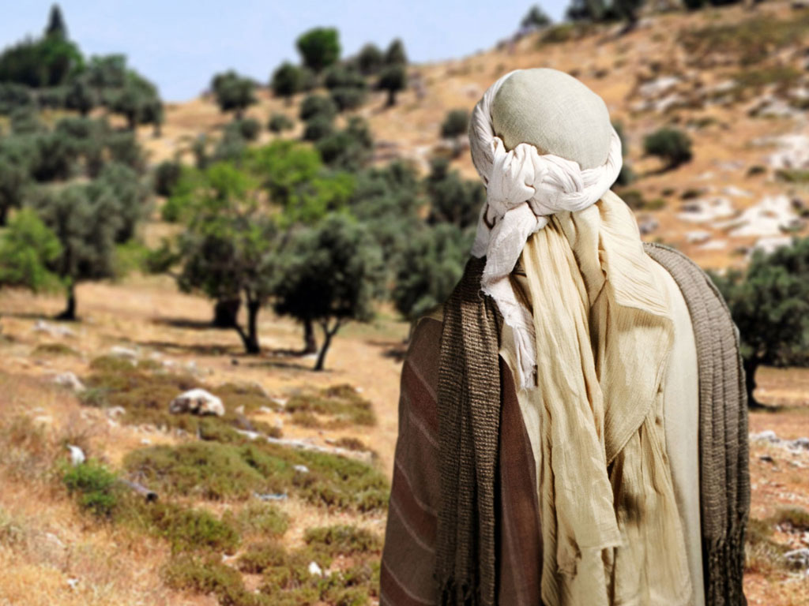

Slide 29
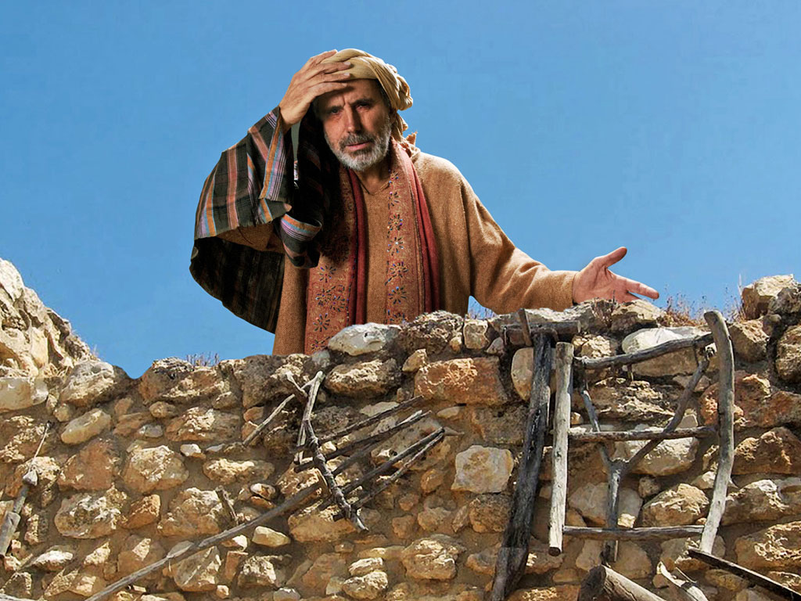

Slide 30
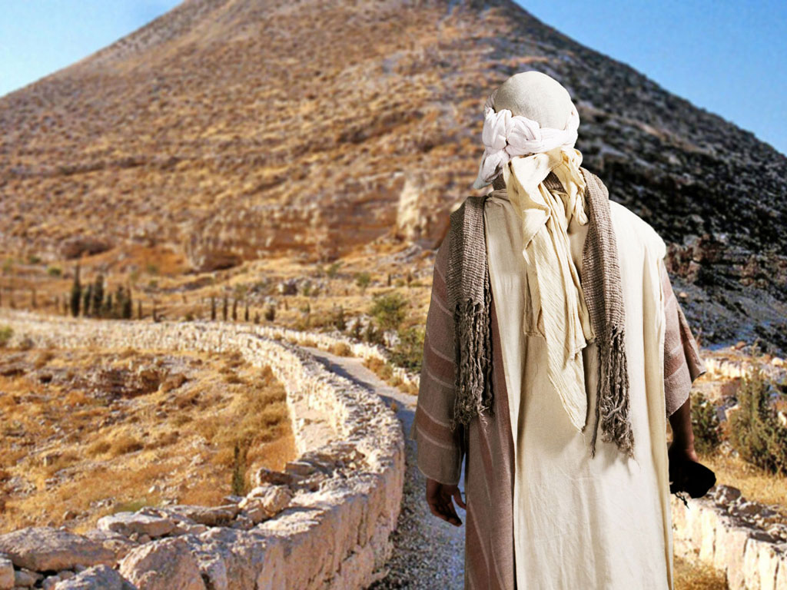

Slide 31
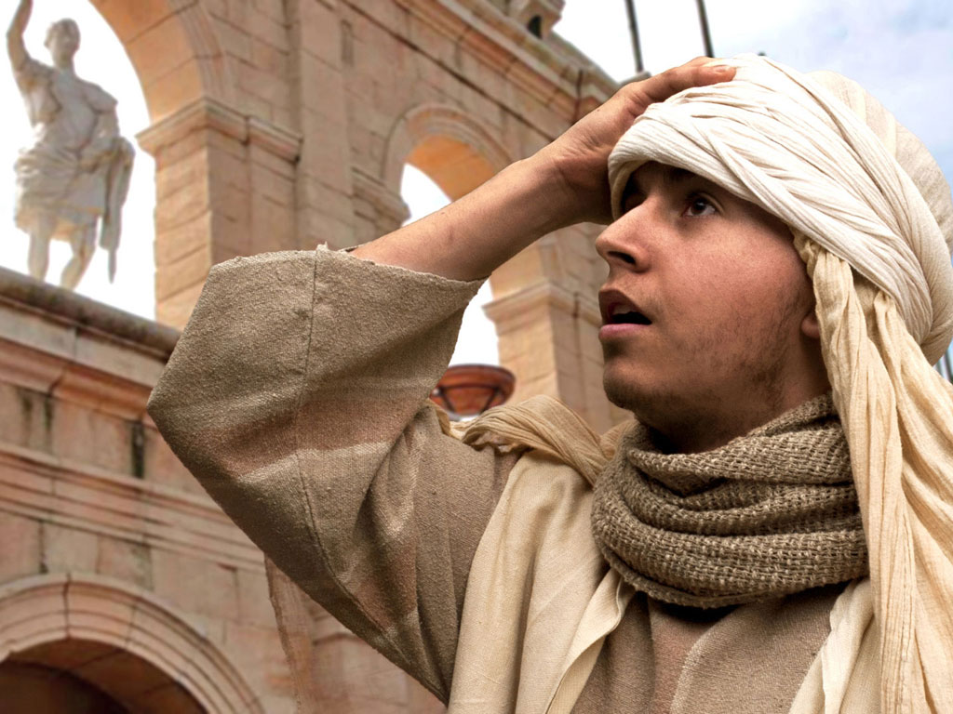

Slide 32
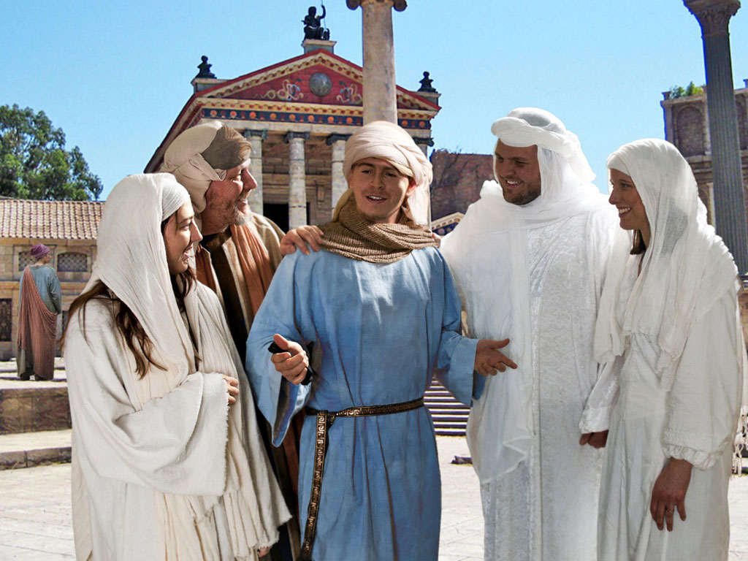

Slide 33
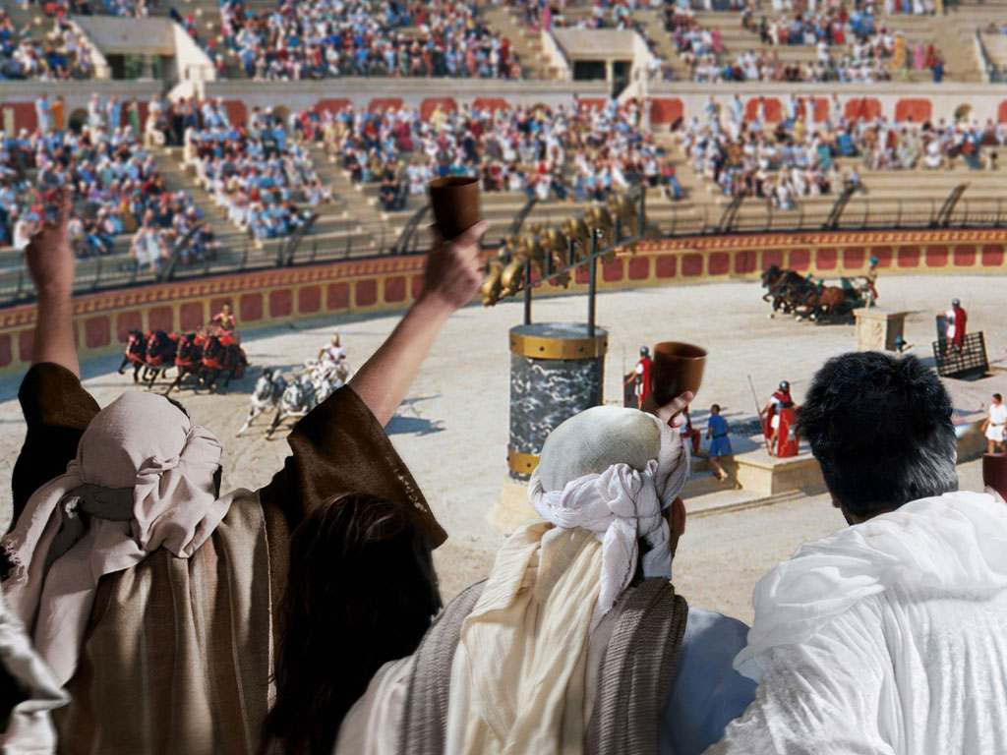

Slide 34
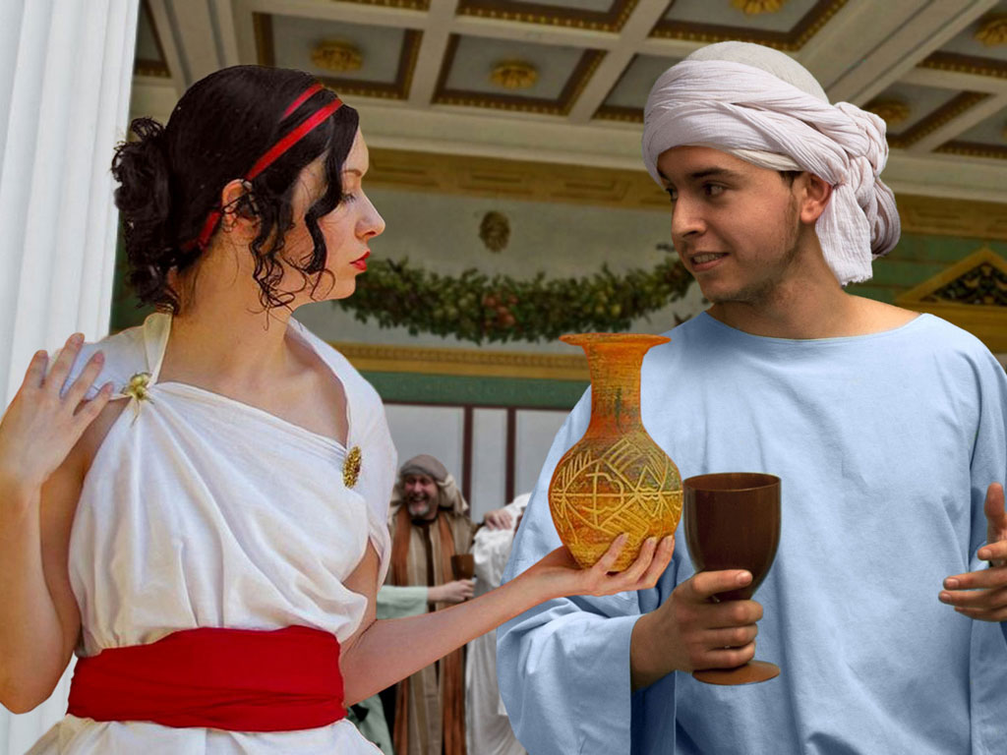

Slide 35
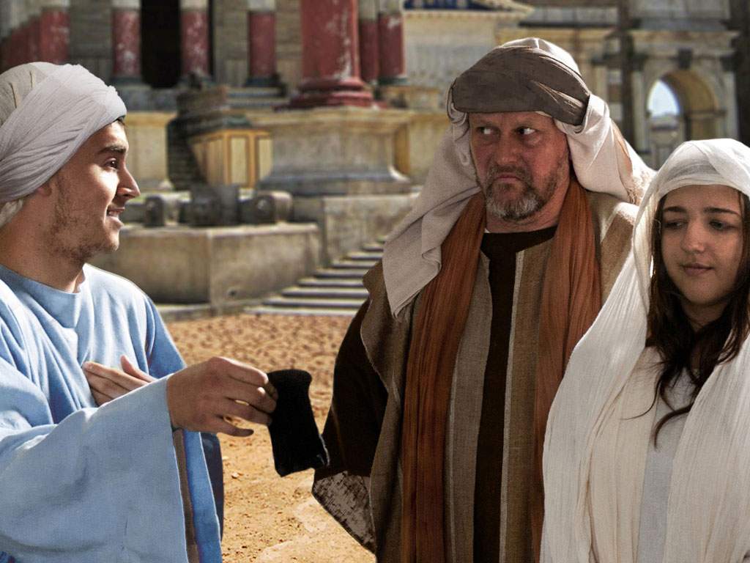

Slide 36
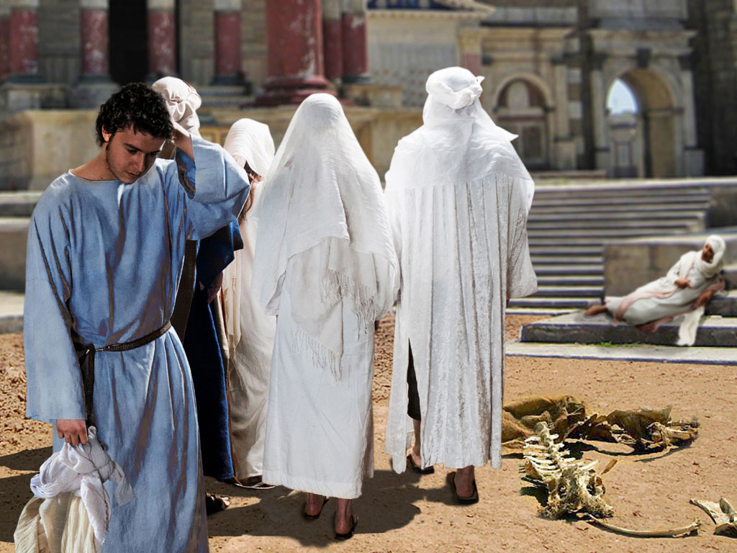

Slide 37
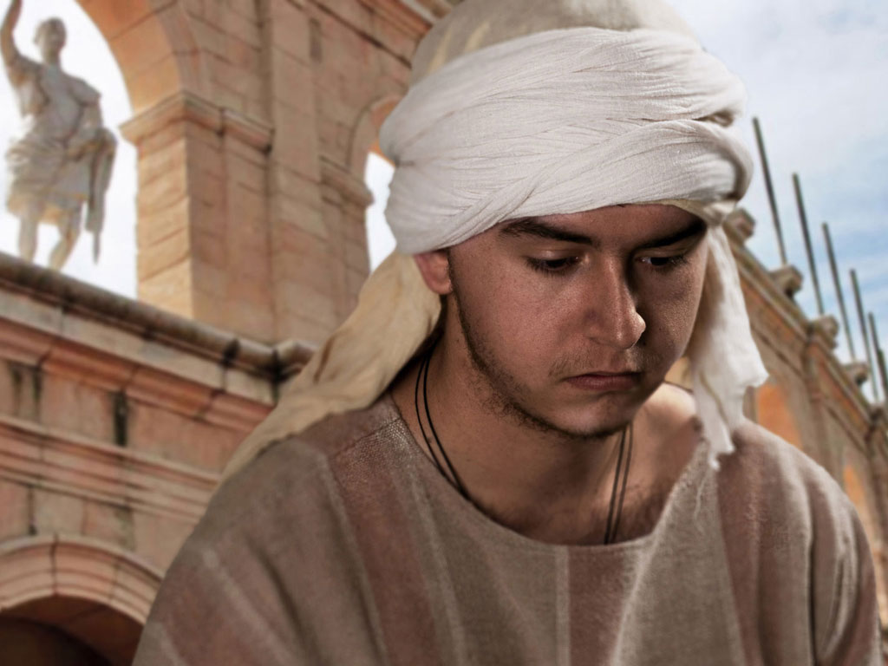

Slide 38
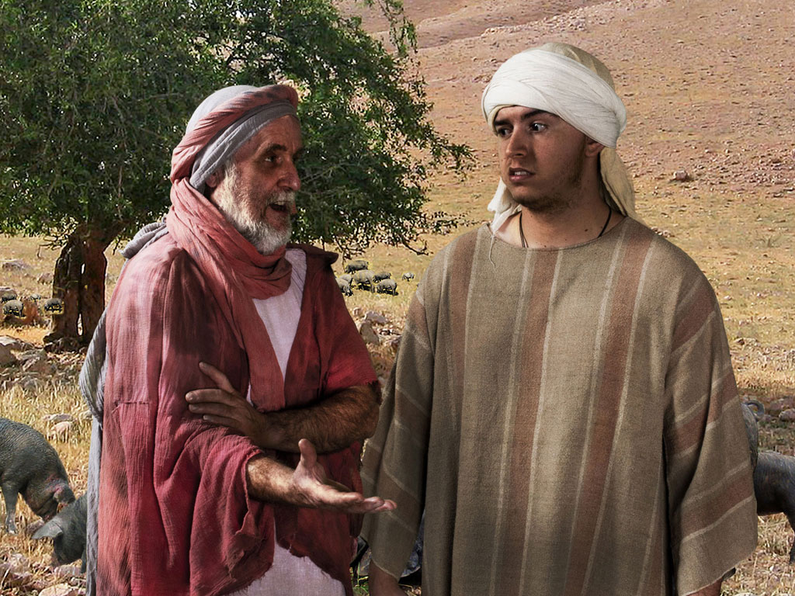

Slide 39
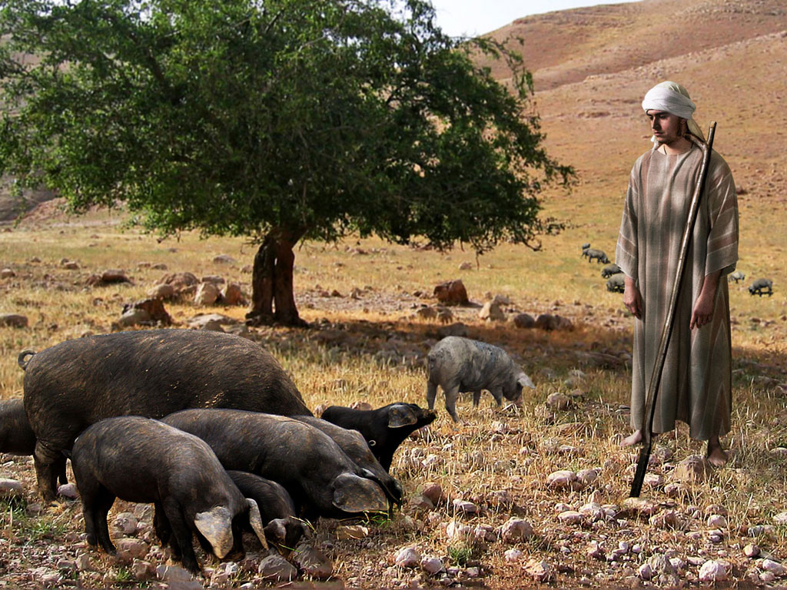

Slide 40
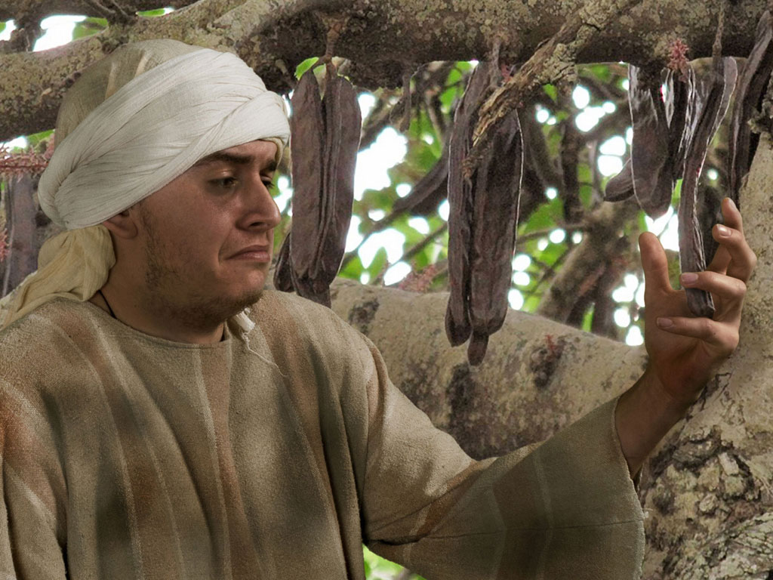

Slide 41
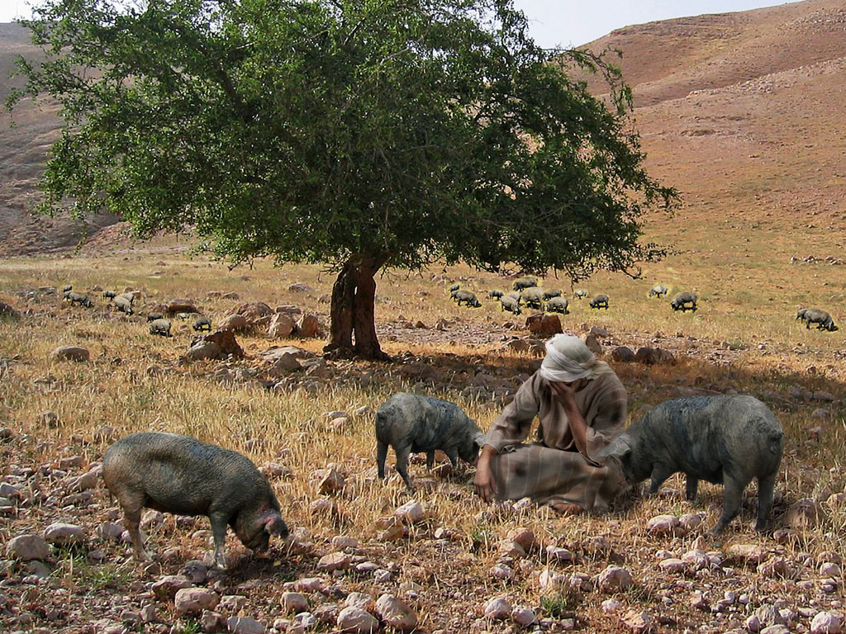

Slide 42
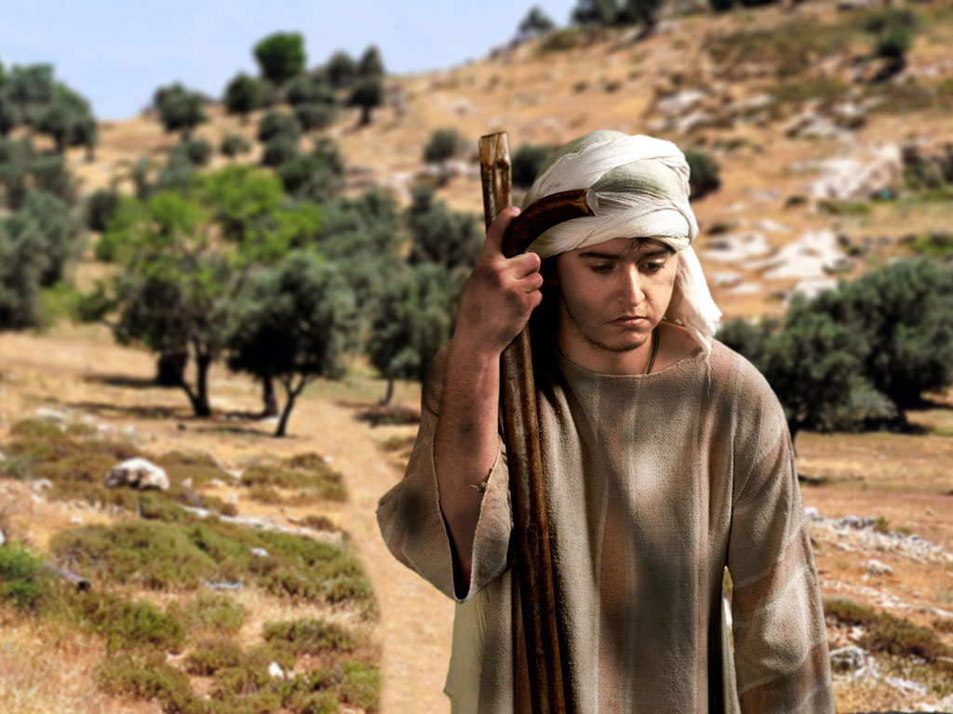

Slide 43
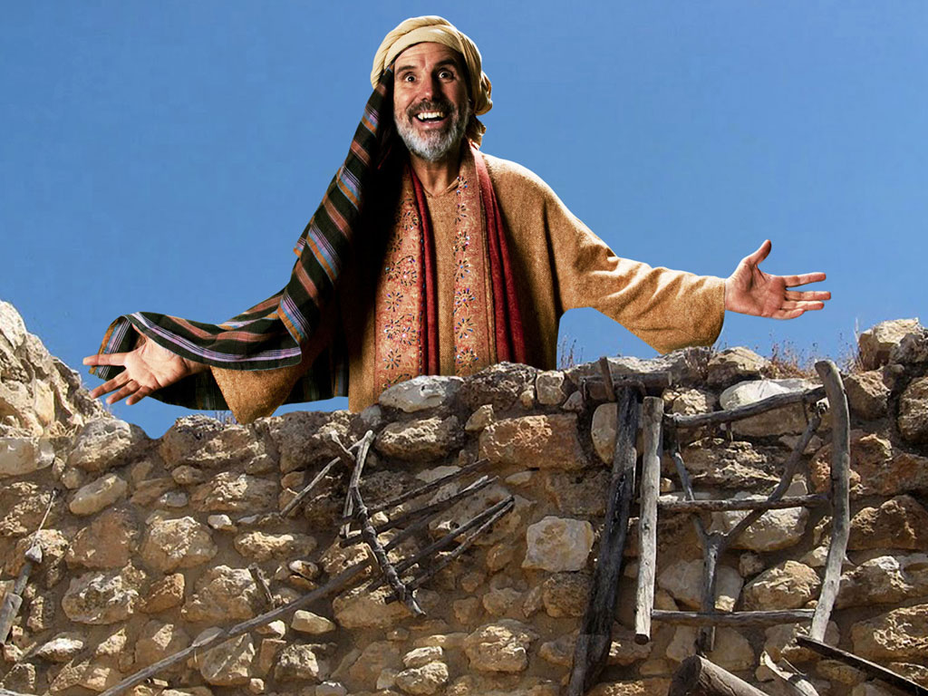

Slide 44
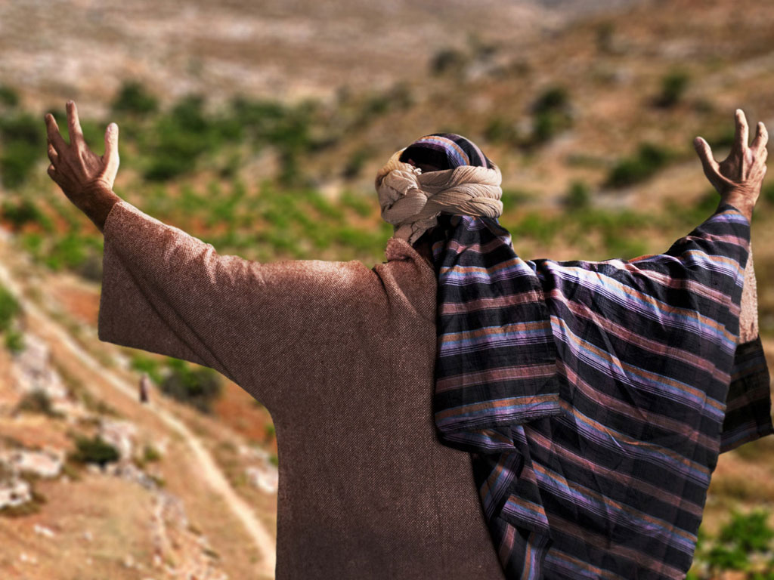

Slide 45
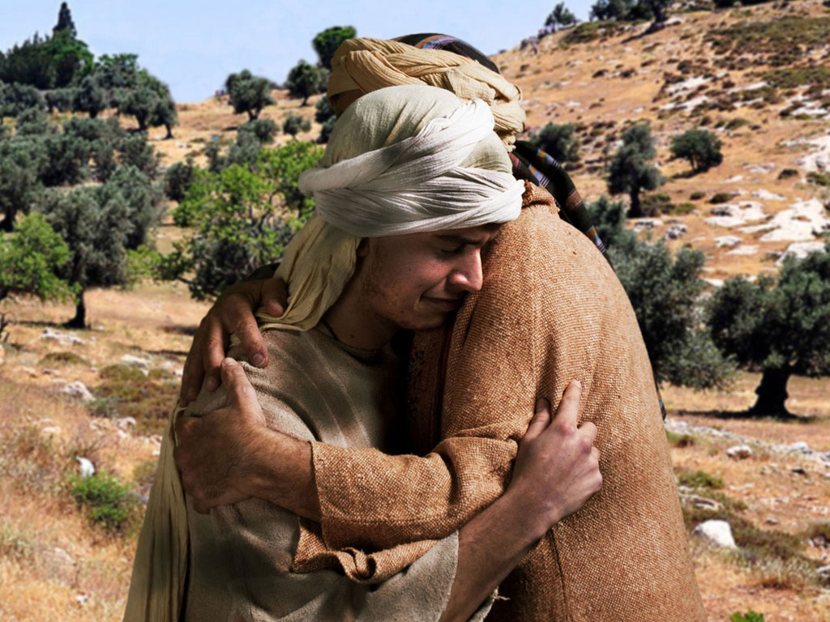

Slide 46
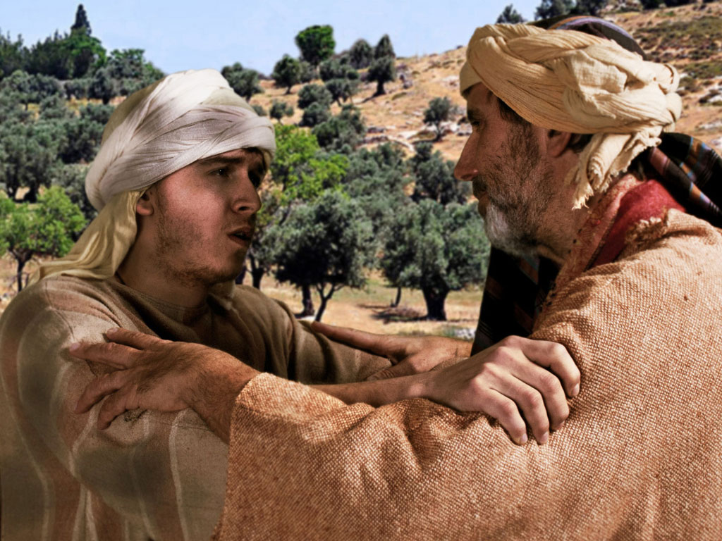

Slide 47
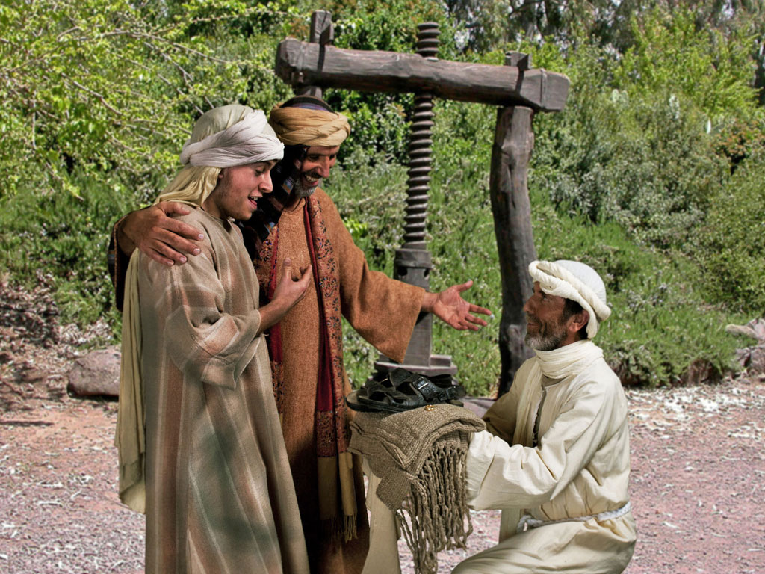

Slide 48
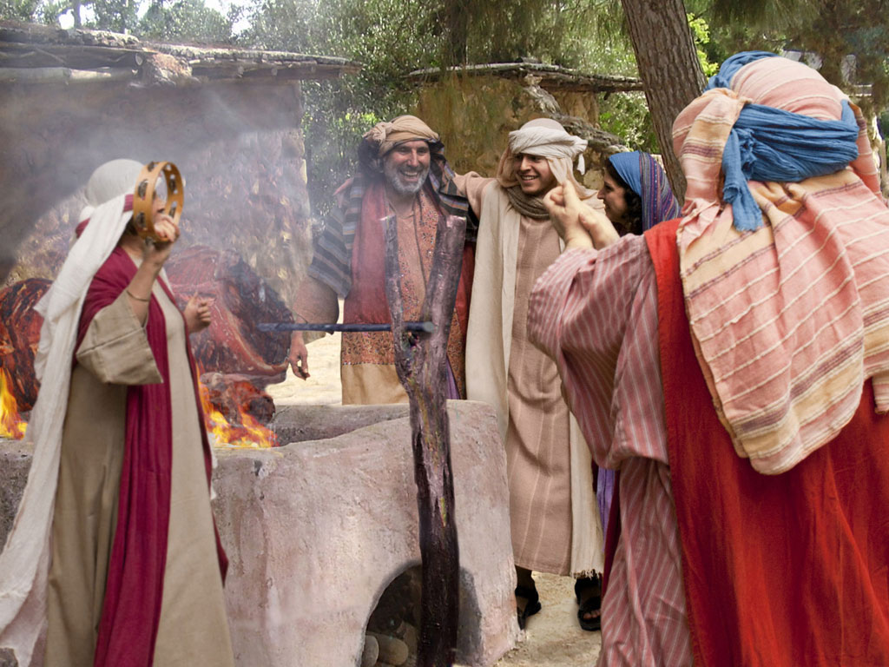

Slide 49
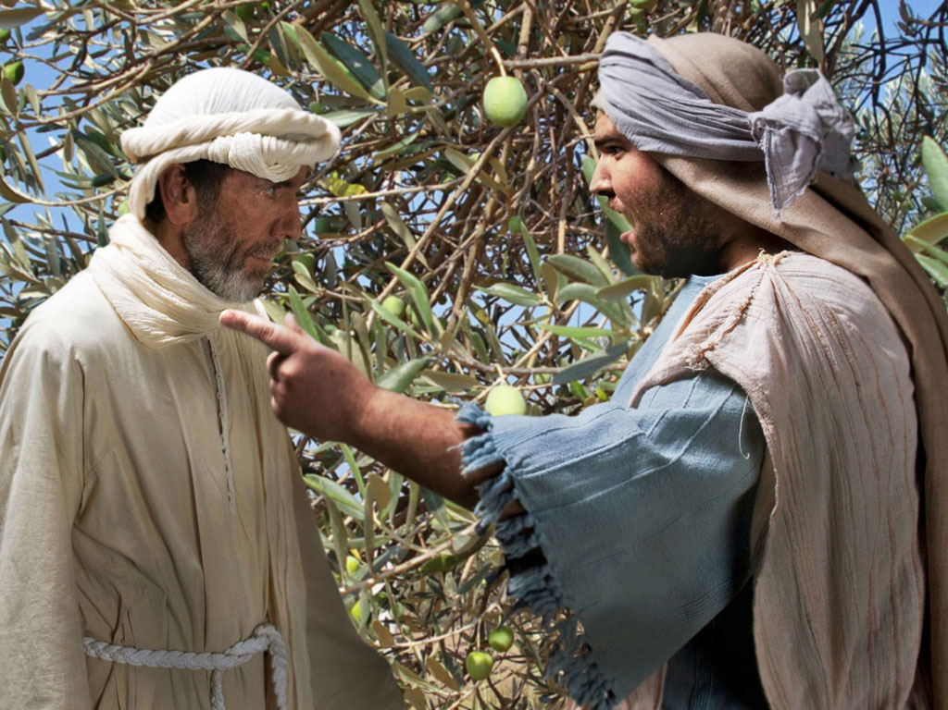

Slide 50
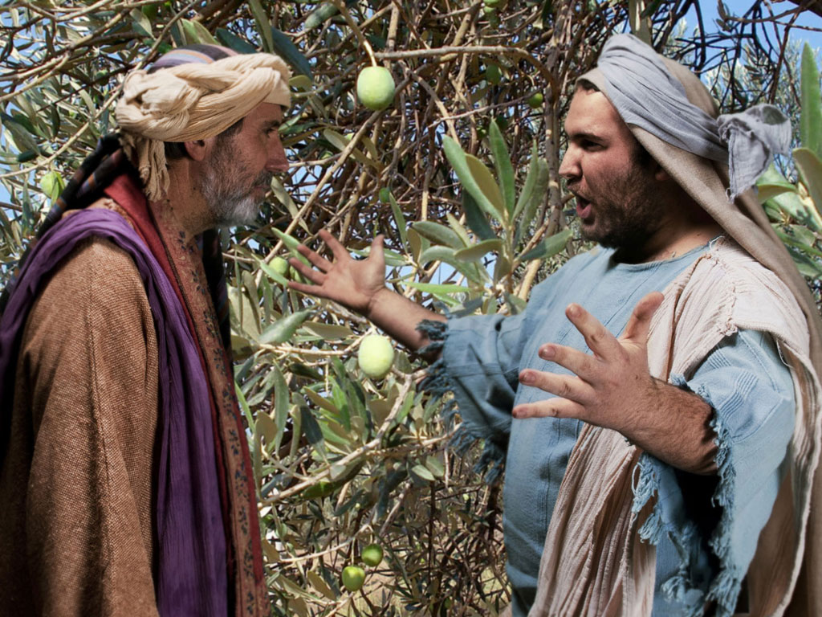

Slide 51
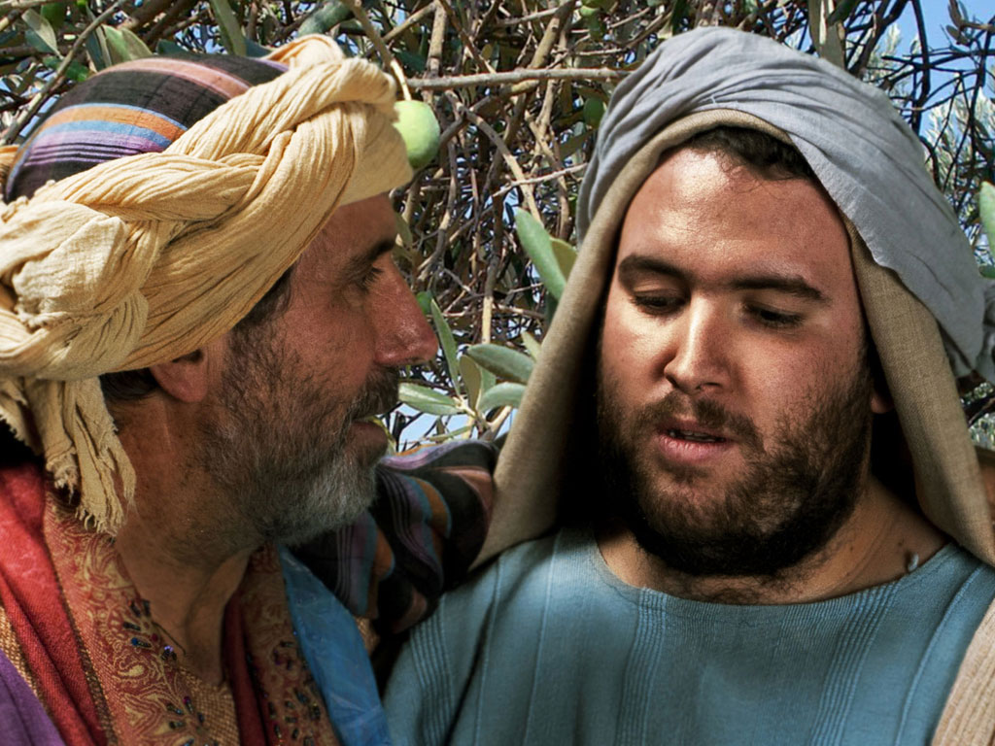

Slide 52
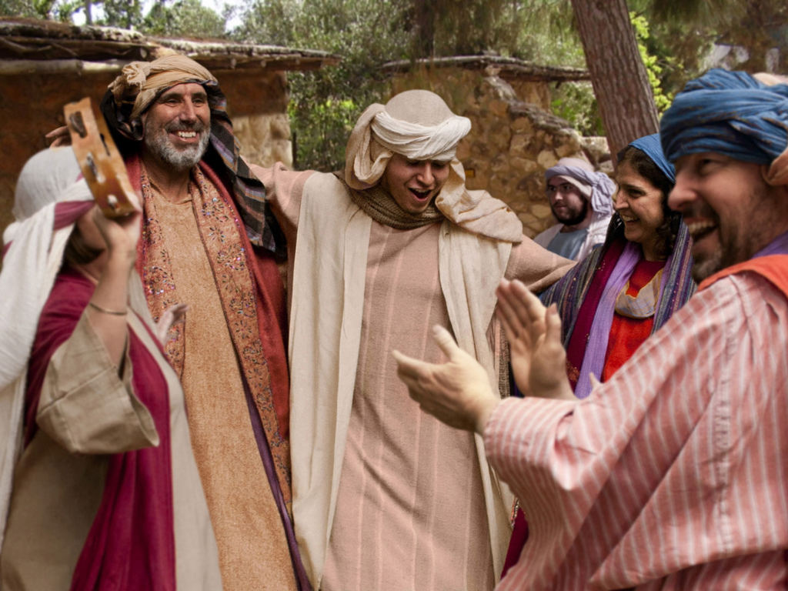

Slide 53
THE WORD IN PICTURES
Free
Bible
images

Slide 54
FreeBibleimages would like to thank Peter Hutley and Wintershall Players for the use of their cast, costumes and facilities in creating these images.

Slide 55
Slides on
Luke 16

Slide 56
Slides on
Luke 17

Slide 57
Slides on
Luke 18

Slide 58

Free
Bible
images
A RICH YOUNG MAN QUESTIONS JESUS
Matthew 19:16-30; Mark 10:17-31; Luke 18:18-30

Slide 59


Slide 60


Slide 61


Slide 62


Slide 63


Slide 65


Slide 66


Slide 67


Slide 68


Slide 69

Used with Permission
THE
GOSPEL
——OF—— MATTHEW
THE
GOSPEL
——OF—— MARK
THE
GOSPEL
——OF—— LUKE
THE
GOSPEL
——OF—— JOHN
Due to the Lumo Project producing its own publishing material we regret to inform you that we cannot license our photos to other clients outside of freebibleimages.org.
These images are not licensed for reuse in video, epublishing or other media. Downloaded pictures and files cannot be redistributed through any other website than freebibleimages.org or used in any context where the accompanying message is undermining of the Christian faith and gospel.
Photos can only be used on educational presentations, blogs and social media, all of which should be accompanied with reference to www.LumoProject.com.
Picture courtesy of BBM
© All Rights Reserved.
www.bigbookmedia.com

Slide 70
Slides on
Luke 19

Slide 71
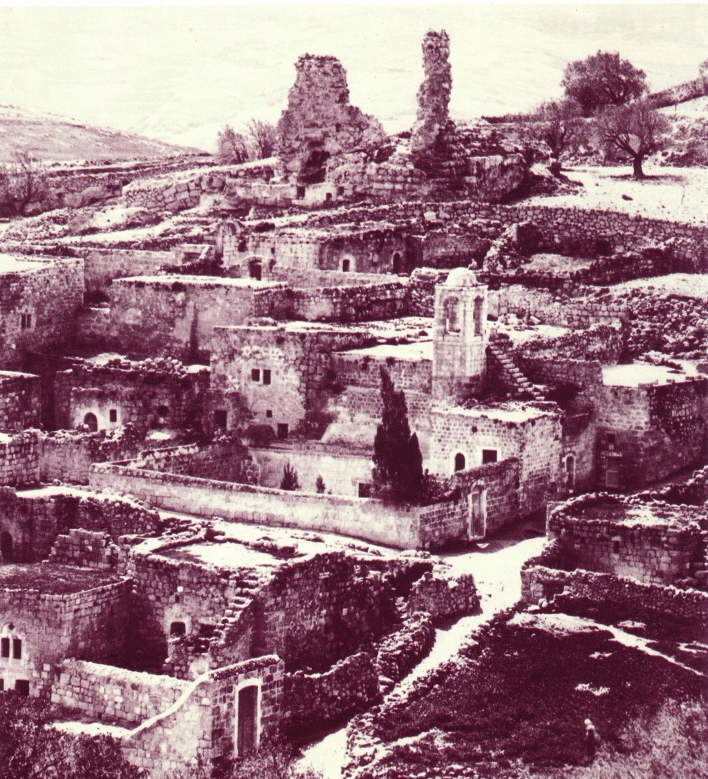
Bethany Ruins

Slide 72


Matthew 21:1-11
Mark 11:1-11
Luke 19:28-44
John 12:12-19
THE EASTER STORY
TRIUMPHAL ENTRY (Palm Sunday)

Slide 73

Mark 11:1-11
As Jesus and his disciples approached Jerusalem, they came to the towns of Bethphage and Bethany on the Mount of Olives.

Slide 74

Jesus sent two of them on ahead. ² “Go into that village over there,” he told them.

Slide 75

“As soon as you enter it, you will see a young donkey tied there that no one has ever ridden. Untie it and bring it here.
³ If anyone asks, ‘What are you doing?’ just say, ‘The Lord needs it and will return it soon.’”

Slide 76

⁴ The two disciples left and found the colt standing in the street, tied outside the front door.

Slide 77

⁵ As they were untying it, some bystanders demanded…

Slide 78

“What are you doing, untying that colt?” ⁶ They said what Jesus had told them to say, and they were permitted to take it.

Slide 79

⁷ Then they brought the colt to Jesus...

Slide 80

…and threw their garments over it, and he sat on it.

Slide 81

⁸ Many in the crowd spread their garments on the road ahead of him, and others spread leafy branches they had cut in the fields.

Slide 82
⁹ Jesus was in the center of the procession, and the people all around him were shouting…

Slide 83

“Praise God!
Blessings on the one who comes in the name of the LORD!

Slide 84

¹⁰ Blessings on the coming Kingdom of our ancestor David!

Slide 85

"Praise God in highest heaven!"

Slide 86

Luke 19:39
But some of the Pharisees among the crowd said, “Teacher, rebuke your followers for saying things like that!”

Slide 87

Luke 19:40
He replied, “If they kept quiet, the stones along the road would burst into cheers!”

Slide 88

Luke 19:41
But as he came closer to Jerusalem and saw the city ahead…

Slide 89

Luke 19:41-42
…he began to weep. ⁴² “How I wish today that you of all people would understand the way to peace. But now it is too late, and peace is hidden from your eyes.

Slide 90

Luke 19:43
Before long your enemies will build ramparts against your walls and encircle you and close in on you from every side.

Slide 91

Luke 19:44
They will crush you into the ground, and your children with you. Your enemies will not leave a single stone in place, because you did not recognize it when God visited you.”

Slide 92
THE WORD IN PICTURES
Free
Bible
images

Slide 93
Used with Permission
THE
GOSPEL
——OF—— MATTHEW
THE
GOSPEL
——OF—— MARK
THE
GOSPEL
——OF—— LUKE
THE
GOSPEL
——OF—— JOHN
Due to the Lumo Project producing its own publishing material we regret to inform you that we cannot license our photos to other clients outside of freebibleimages.org.
These images are not licensed for reuse in video, epublishing or other media. Downloaded pictures and files cannot be redistributed through any other website than freebibleimages.org or used in any context where the accompanying message is undermining of the Christian faith and gospel.
Photos can only be used on educational presentations, blogs and social media, all of which should be accompanied with reference to www.LumoProject.com.
Picture courtesy of BBM
© All Rights Reserved.
www.bigbookmedia.com

Slide 94

Palm Sunday
Notes:
Palm Sunday is an interesting name for the day, isn't it?

Slide 95


Palm Sunday
Notes:
We know that today recalls the palm branches waved at Jesus as he entered Jerusalem at the beginning of his last week of his life. Yet the focus really isn't the tree palms, but the hand palms of Jesus that would stretch out on a cross but a few days later.

Slide 96

Palms to Cross
Notes:
Tree palms were but a prelude to the cross.

Slide 97


Triumphant Entry
Matthew 21:9
Notes:
Even the alternate name—Triumphant Entry—is also perplexing.

Slide 98

Triumphal Entry
Notes:
True, Jesus rode into Jesus and the crowds cheered his arrival.

Slide 99

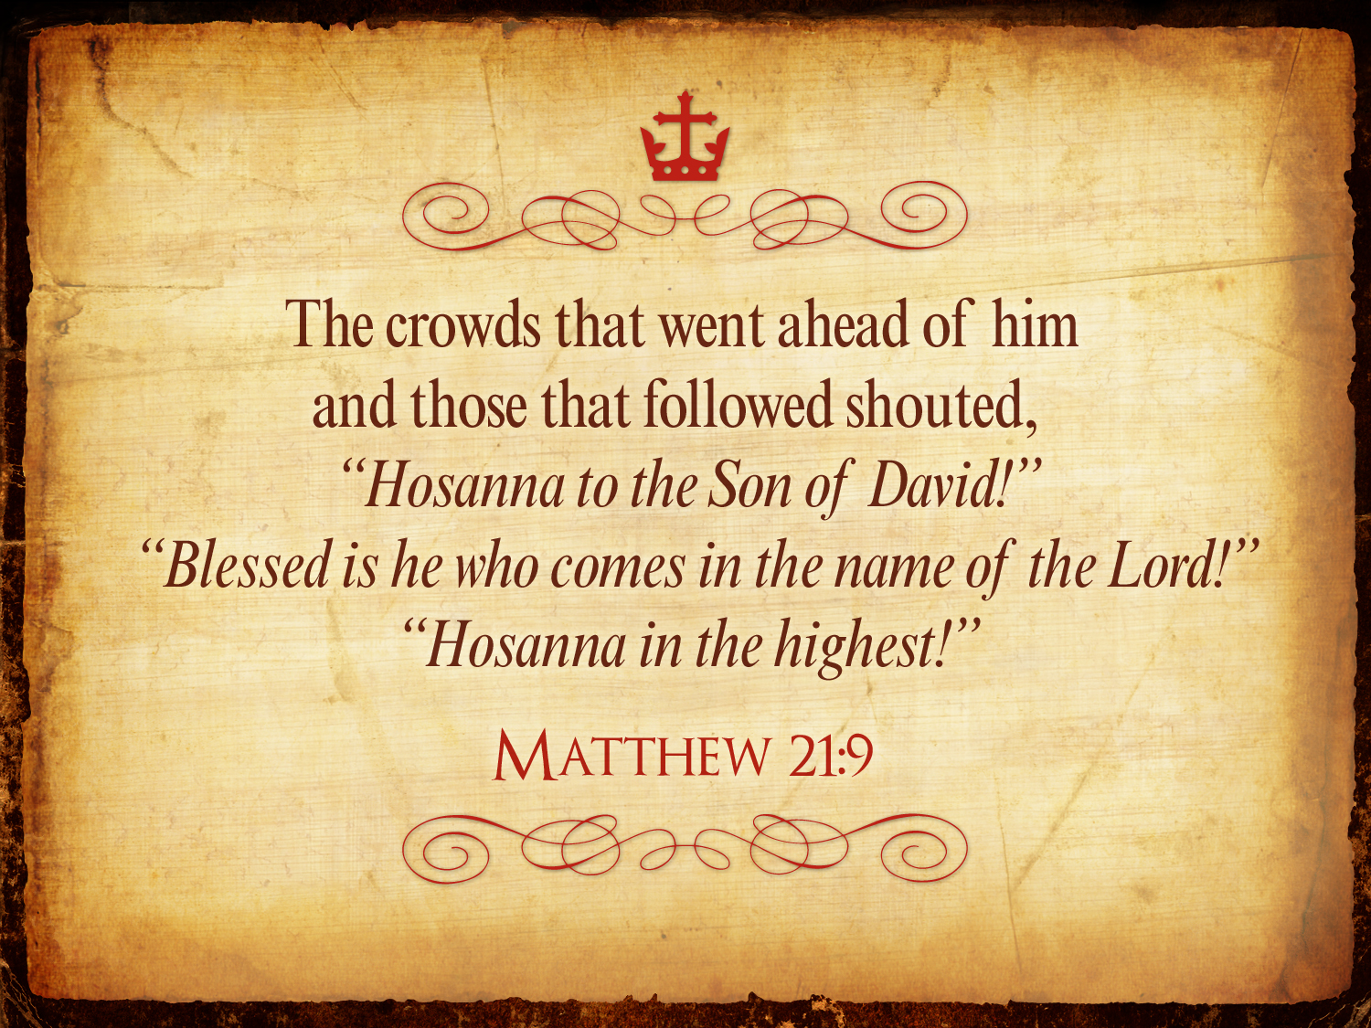
Triumphant Entry
Matthew 21:9
Notes:
Matthew 21:9 says the crowds that went ahead of him and those that followed shouted, "Hosanna to the Song of David!" "Blessed is he who comes in the name of the Lord!" "Hosanna in the highest!"

Slide 100

Palms to Palms
Notes:
Normally a king rode into the city as the victor over his enemies, while that very week would culminate in Jesus' death on Friday, which we call Good Friday.

Slide 101

What's so good about Good Friday?
Notes:
But that name is equally puzzling. Why is Good Friday called "good"?
Our leader died on that day, so it seems strange to call the day "good." No other religion refers to the death of their leader as "good."
We believe that his death was good. How was that?

Slide 102

How is Christ's death better than any sacrifice?

Slide 103

Was Mary Magdalene the Woman with the Alabaster Jar?
The WOMAN
with the
ALABASTER JAR
Mary Magdalen and the Holy
Grail
No. In Luke she is not named but in the other gospels she is clearly Mary of Bethany
As featured in The
Da Vinci Code

Slide 104

John 12 Events
64
656
Unbelief Summary
12:37-50
Predicts Death
12:21-36
Triumphal Entry
12:12-20
Anointing at Bethany
12:1-11

Slide 105

Luke 7:36-50
Jesus and the Sinful Woman

Slide 106

Anointings of Jesus
Common to all four gospel accounts:
Unannounced visit by woman
Anointed Jesus' head and/or feet
Wiped his feet with her hair
Complaint of waste by disciples/Judas
Disciples rebuked by Jesus
In a home
Alabaster jar (except in John)
Home owned by man called Simon

Slide 107

The Two Anointings of Jesus
Luke 7:36-50
Early in Ministry
Weeping
For worship, woman's
sins forgiven (Luke 7:48)
By unnamed harlot at
home of Simon the
Pharisee (Luke 7:40) in
an unknown town
Matt. 26:6-13
Mark 14:3-9
John 12:1-11
During Passion Week
No weeping noted
For burial, woman needed
no forgiveness
By Lazarus' sister Mary at home of Simon the Leper
(Matt. 26:6; Mark 14:3) in Lazarus' hometown of Bethany (John 12:1)

Slide 108


Luke 19:29-40
Blessed is He Who Comes in the Name of the
LORD

Slide 109
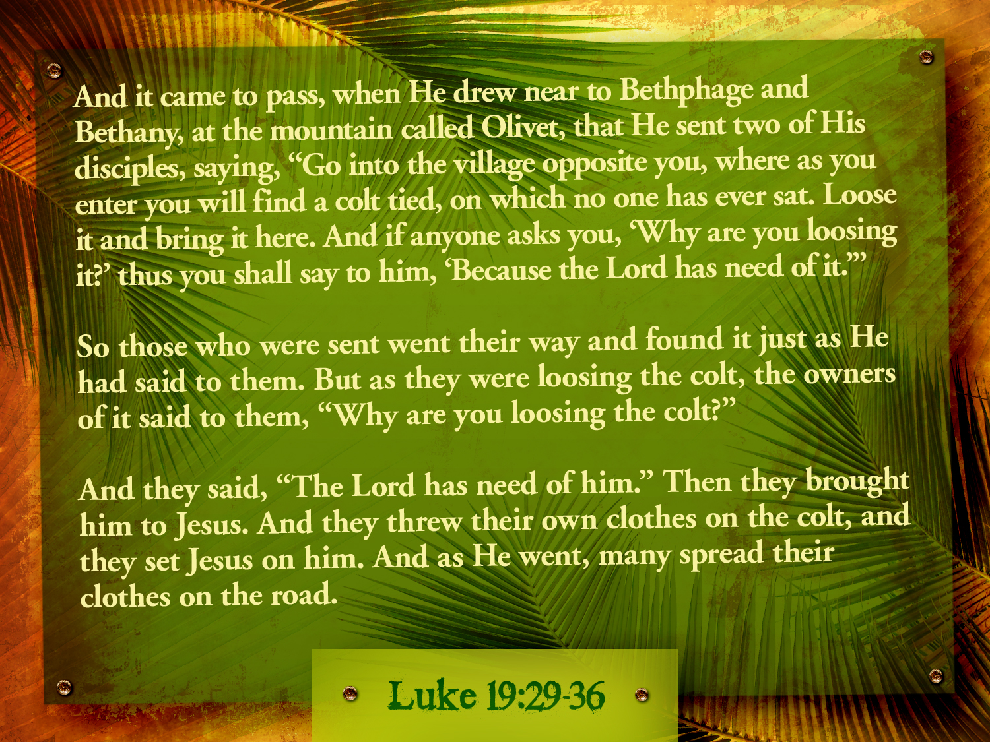

Luke 19:29- 36

Slide 110
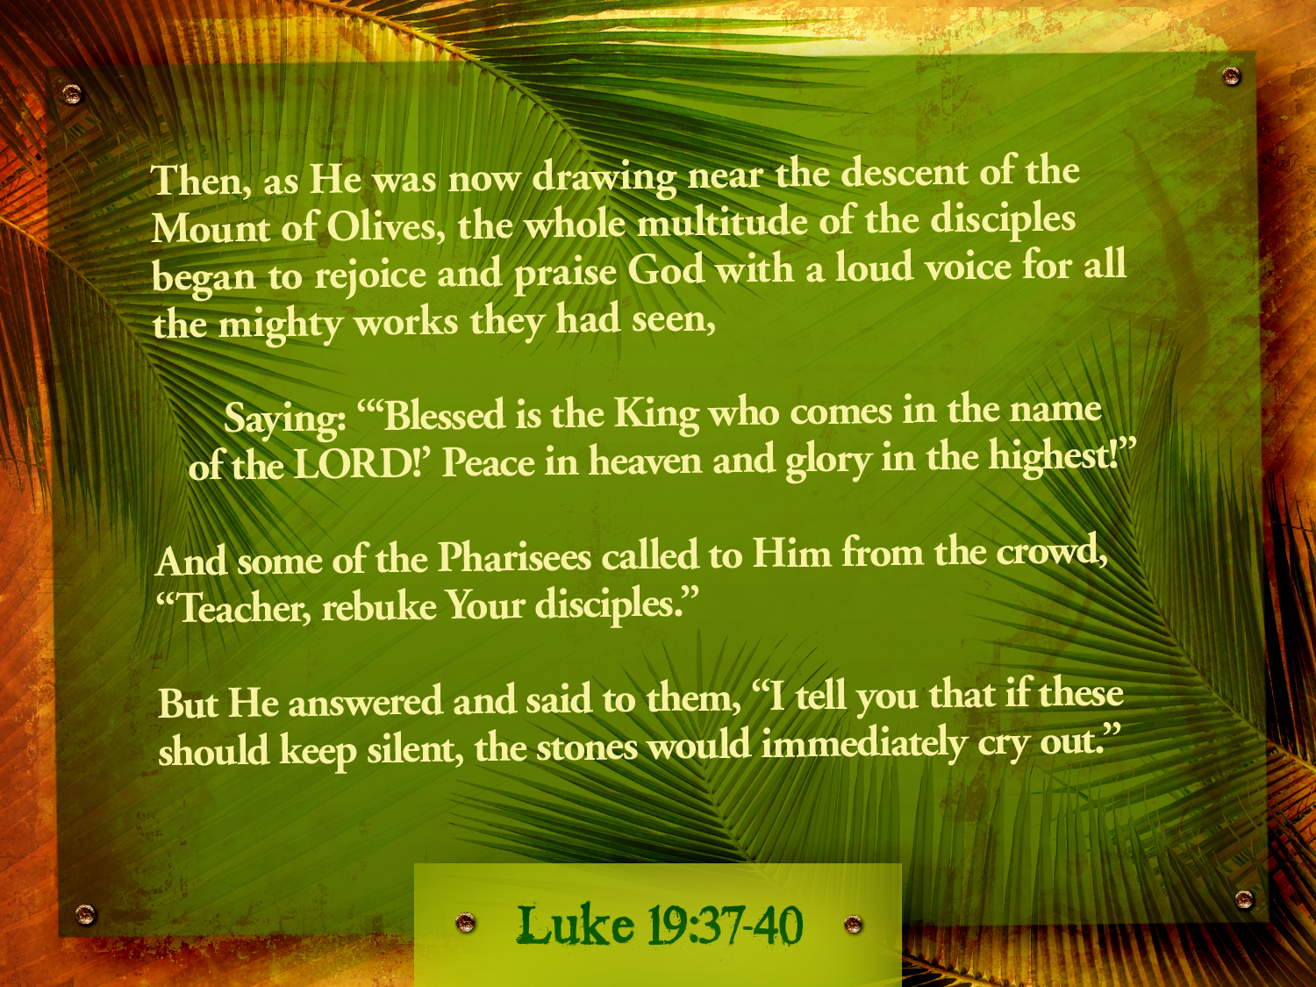
Luke 19:37-40

Slide 111






The Spirit Leaves & Returns
Mt. of Olives
656
Ezek. 8:4; 9:3; 10:4; 10:18-19; 11:23
Luke 19:37; 24:50; Acts 1:10
Acts 1:11; Zech. 14:4; Ezek. 43:1-5
Notes:
The Mount of Olives plays a significant role in history. It is the last place the Spirit is present in Ezekiel 11:23, the last place Christ was honored as king in Luke 19:37, the last place Christ was seen by his disciples in Acts 1:10, and the NEXT place Christ will appear on earth to fulfill Acts 1:11!
The Kidron Valley below the mount is likely the Valley of Jehoshaphat where Jesus will judge the nations (Joel 3).
_____________
Common Slides English-193
OS-26-Ezek1-39-slide 178
OS-38-Zechariah-179
LC-06-Official Presentation-33
NS-01-Matt15-28-slide 112
NS-03-Luke13-24-slide 111
NS-Acts1-2-slide 215

Slide 112
An Ominous Day:
Luke 19:41-42 NAU
"When He approached Jerusalem, He saw the city and wept over it, ⁴²saying, 'If you had known in this day, even you, the things which make for peace! But now they have been hidden from your eyes.'"

Slide 113
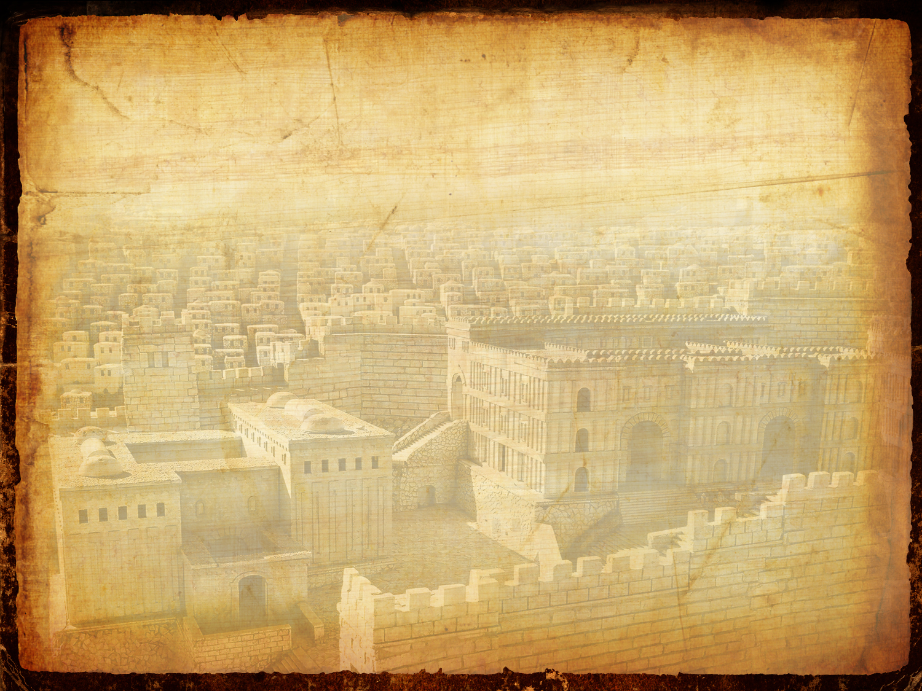
An Ominous Day:
Luke 19:43-44 NAU
"For the days will come upon you when your enemies will throw up a barricade against you, and surround you and hem you in on every side, ⁴⁴and they will level you to the ground and your children within you, and they will not leave in you one stone upon another, because you did not recognize the time of your visitation."

Slide 114

The Church and Kingdom (Luke 19:41-44)
106
CHURCH
THE CHURCH IS THE KINGDOM OF REGENERATED BELIEVERS "CALLED OUT" OF THE WORLD – Col. 1:13, 1 Thess. 2:12, 1 Cor.12:13, Eph. 4:4, Rom. 12:5
KINGDOM OF GOD
BEGAN AT PENTECOST
Acts 2:1, 41, 47
"THEN THE RIGHTEOUS WILL SHINE FORTH AS THE SUN IN THE KINGDOM OF THE FATHER"
Matt. 13:43
1 Cor. 13:24
Luke 13:29
THE LAW AND THE PROPHETS WERE UNTIL JOHN
Luke 16:16
"THE KINGDOM OF HEAVEN SUFFERS VIOLENCE"
Matt. 11:12
Matt. 13:25
John 6:15
"I WILL BUILD MY CHURCH"
Matt. 16:18.21
"THIS GOSPEL OF THE KINGDOM WILL BE PREACHED THROUGHOUT THE WHOLE WORLD AS A TESTIMONY TO ALL NATIONS, AND THEN THE END WILL COME" – Matt. 24:14
AD 70
Matt. 20:26
Mark 10:45
John 12:27
John 18:36-37
RAPTURE
"THE TIME OF YOUR VISITATION"
Matt. 21:4-5
Matt. 23:37-39
Luke 19:41-44
Matt. 21:43
JOHN THE BAPTIST
Matt. 3:2
Matt. 4:17
Matt. 10:7
THE SON OF MAN COMING IN HIS KINGDOM
Luke 21:27,31
Matt. 13:41
A STUDY OF
THE CHURCH AND KINGDOM
IN THE NEW TESTAMENT
Adapted from Raymond Ludwigson, A Survey of Bible Prophecy (Grand Rapids: Zondervan, 1975), 83

Slide 115

Matthew 21:12-17
Mark 11:15-19
Luke 19:45-48
John 2:13-24
THE EASTER STORY
CLEANSING THE TEMPLE
Free
Bible
images

Slide 116


Slide 117


Slide 118


Slide 119


Slide 120


Slide 122


Slide 123


Slide 124


Slide 125


Slide 126


Slide 127


Slide 128


Slide 129


Slide 130


Slide 131


Slide 132
THE WORD IN PICTURES
Free
Bible
images

Slide 133
Used with Permission
THE
GOSPEL
——OF—— MATTHEW
THE
GOSPEL
——OF—— MARK
THE
GOSPEL
——OF—— LUKE
THE
GOSPEL
——OF—— JOHN
Due to the Lumo Project producing its own publishing material we regret to inform you that we cannot license our photos to other clients outside of freebibleimages.org.
These images are not licensed for reuse in video, epublishing or other media. Downloaded pictures and files cannot be redistributed through any other website than freebibleimages.org or used in any context where the accompanying message is undermining of the Christian faith and gospel.
Photos can only be used on educational presentations, blogs and social media, all of which should be accompanied with reference to www.LumoProject.com.
Picture courtesy of BBM
© All Rights Reserved.
www.bigbookmedia.com

Slide 134
Slides on
Luke 20

Slide 135
Slides on
Luke 21

Slide 136
Olivet Discourse Overview
27
First Fall of Jerusalem
586 BC
Second Fall of Jerusalem
AD 70
Rapture
1 Thessalonians
4:14-17
Third Fall of Jerusalem
Second Coming with the Saints
Matt. 23:39; 24:30
Israel
Church Age
Tribulation
Millennium
The Great Tribulation
Daniel 9:27
Matt. 24:15
Israel Scattered Luke 21:24
Return to the Land
606 BC
Times of the Gentiles Luke 21:24
Judgment
of the Gentile Nations
Matt. 25:31-46
Adapted from Salem Kirban
Charts on Revelation (1979), 48

Slide 137
Times of the Gentiles (Luke 21:24)
106
"TIMES OF THE GENTILES"
Luke 21:24
KINGDOM OF JUDAH
THE RESTORATION PERIOD
THE 4 CENTURIES BETWEEN THE TESTAMENTS
CHURCH PERIOD
Acts 15:14-18
Rom. 11:25
"The Throne of the LORD"
Jer. 3:17
Isa. 62:6-7
586 BC
AD 70
BABYLON
PERSIA
GREECE
ROME
538 BC
333 BC
63 BC
"AMONG MANY NATIONS"
"Her sun is gone down while it was yet day" Jer. 15:9
"Because they have forsaken the covenant of the Lord" Jer. 22:8-9
2 Kings 25:8-12
Jer. 15:4, 22:29-30, 30:24
Ezek. 10:4, 28. 11:22-25, 14:22-23
Ezekiel 6:8
Hosea 3:4-5
Hosea 8:8
Amos 9:8-9
Jer. 31:35-37
Jer. 46: 27-28
Jer. 51:5
"I will perform the good thing that I have promised to the house of Israel and to the house of Judah"
Jer. 33:7-14
Isa. 4:2-6
Ezek. 43:1-9
Zech. 2:10-13
Zech. 8:1-8
Adapted from Raymond Ludwigson, A Survey of Bible Prophecy (Grand Rapids: Zondervan, 1975), 181
Notes:
Jesus alone referred to "the times of the Gentiles" in Luke 21:24. But the entire book of Daniel refers to this period of Gentile rule over Israel that interrupts the nation's rule by a son of David, though not by this phrase.
______
OS-27-Daniel-21
NS-03-Luke 13-24-slide 137

Slide 138
Slides on
Luke 22

Slide 139

How to be confirmed…
…in our belief in Jesus
No one killed Christ because he willingly offered his life for us all (Luke 22–23).
God’s plan included Jewish rejection of Jesus to offer salvation to Gentiles (4:14–21:38).
God sent Jesus to be both Jewish and the universal Saviour (1:5–4:13).
Sources about Christ’s life are reliable (1:1-4).
Notes:
The passion narrative shows Christ submitted to the Father as the innocent Passover Lamb whose death offers forgiveness and eternal life to all who believe.

Slide 140

Free
Bible
images
Matthew 26:17-35
Mark 14:12-31
Luke 22:7-38
John 13:18-38
THE EASTER STORY
THE LAST SUPPER

Slide 141


Slide 142


Slide 143


Slide 144


Slide 145


Slide 146


Slide 147


Slide 148


Slide 150


Slide 151


Slide 152


Slide 153


Slide 154


Slide 155


Slide 156
THE WORD IN PICTURES
Free
Bible
images

Slide 157
Used with Permission
THE
GOSPEL
——OF—— MATTHEW
THE
GOSPEL
——OF—— MARK
THE
GOSPEL
——OF—— LUKE
THE
GOSPEL
——OF—— JOHN
Due to the Lumo Project producing its own publishing material we regret to inform you that we cannot license our photos to other clients outside of freebibleimages.org.
These images are not licensed for reuse in video, epublishing or other media. Downloaded pictures and files cannot be redistributed through any other website than freebibleimages.org or used in any context where the accompanying message is undermining of the Christian faith and gospel.
Photos can only be used on educational presentations, blogs and social media, all of which should be accompanied with reference to www.LumoProject.com.
Picture courtesy of BBM
© All Rights Reserved.
www.bigbookmedia.com

Slide 158


PESACH
The Passover Meal
Notes:
Translators, do NOT translate PESACH as this is Hebrew but translate “The Passover Meal”

Slide 159
The Four Cups (Exod. 6:6-7)
145
"Therefore, say to the Israelites:
'I am the Lord, and I will bring you out from under the yoke of the Egyptians.
Sanctification
Plagues
I will free you from being slaves to them,
and I will redeem you with an outstretched arm and with mighty acts of judgment.
Redemption

Slide 160


… This is my body
GIVEN FOR YOU do this in
REMEMBRANCE of me.
LUKE 22:19

Slide 161
… This cup is the
NEW COVENANT in my blood, which is POURED OUT for you.
The cup (not baptism) is the new covenant sign
LUKE 22:20

Slide 162

"This cup is the new covenant in my blood" (Luke 22:20)
Refers back to Jeremiah 31:31-34
The new covenant replaces the old
The church participates in the covenant promised to Israel
Never does Scripture say that the church replaces Israel since God has not rejected the nation (Rom. 11:1; cf. Jer. 31:35-37)

Slide 163

Free
Bible
images
Matthew 26:36-56
Mark 14:32-52
Luke 22:39-53
John 18:1-12
THE EASTER STORY
JESUS PRAYS IN GETHSEMANE

Slide 164


Slide 165


Slide 166


Slide 167


Slide 168


Slide 170


Slide 171


Slide 172


Slide 173


Slide 174


Slide 175


Slide 176


Slide 177


Slide 178


Slide 179


Slide 180


Slide 181


Slide 182


Slide 183


Slide 184
THE WORD IN PICTURES
Free
Bible
images

Slide 185
Used with Permission
THE
GOSPEL
——OF—— MATTHEW
THE
GOSPEL
——OF—— MARK
THE
GOSPEL
——OF—— LUKE
THE
GOSPEL
——OF—— JOHN
Due to the Lumo Project producing its own publishing material we regret to inform you that we cannot license our photos to other clients outside of freebibleimages.org.
These images are not licensed for reuse in video, epublishing or other media. Downloaded pictures and files cannot be redistributed through any other website than freebibleimages.org or used in any context where the accompanying message is undermining of the Christian faith and gospel.
Photos can only be used on educational presentations, blogs and social media, all of which should be accompanied with reference to www.LumoProject.com.
Picture courtesy of BBM
© All Rights Reserved.
www.bigbookmedia.com

Slide 186


Free
Bible
images
Matthew 26:69-75
Mark 14:66-72
Luke 22:54-62
John 18:15-27
THE EASTER STORY
PETER DENIES JESUS

Slide 187


Slide 188


Slide 189


Slide 190


Slide 191


Slide 192


Slide 193


Slide 194


Slide 195


Slide 197

Used with permission

Slide 198
THE WORD IN PICTURES
Free
Bible
images

Slide 199

Free
Bible
images
Matthew 26:57-67
Mark 14:53-65
Luke 22:66-71
John 18:15-27
THE EASTER STORY
JESUS BEFORE
THE SANHEDRIN
Notes:
Jesus’ arrest and trials repeatedly show him innocent of all charges leveled at him to confirm his sacrifice for the sins of the world—not his own sins (22:47–23:25).

Slide 200


Slide 201


Slide 202


Slide 204


Slide 205


Slide 206


Slide 207


Slide 208
THE WORD IN PICTURES
Free
Bible
images

Slide 209
Used with Permission
THE
GOSPEL
——OF—— MATTHEW
THE
GOSPEL
——OF—— MARK
THE
GOSPEL
——OF—— LUKE
THE
GOSPEL
——OF—— JOHN
Due to the Lumo Project producing its own publishing material we regret to inform you that we cannot license our photos to other clients outside of freebibleimages.org.
These images are not licensed for reuse in video, epublishing or other media. Downloaded pictures and files cannot be redistributed through any other website than freebibleimages.org or used in any context where the accompanying message is undermining of the Christian faith and gospel.
Photos can only be used on educational presentations, blogs and social media, all of which should be accompanied with reference to www.LumoProject.com.
Picture courtesy of BBM
© All Rights Reserved.
www.bigbookmedia.com

Slide 210
Slides on
Luke 23

Slide 211

Passion Week
Mon
Tues
Wed
64
Fri
Thurs
Sun
Fri
Sat
Sat
Sun

Slide 212

Free
Bible
images
Matthew 27:27-37
Mark 15:16-25
Luke 23:26-34
John 19:16-27
THE EASTER STORY
JESUS IS CRUCIFIED

Slide 213


Slide 214


Slide 215


Slide 216


Slide 217


Slide 218


Slide 219


Slide 220


Slide 221


Slide 222


Slide 223


Slide 224


Slide 225


Slide 226


Slide 227


Slide 228


Slide 229
THE WORD IN PICTURES
Free
Bible
images

Slide 230
Used with Permission
THE
GOSPEL
——OF—— MATTHEW
THE
GOSPEL
——OF—— MARK
THE
GOSPEL
——OF—— LUKE
THE
GOSPEL
——OF—— JOHN
Due to the Lumo Project producing its own publishing material we regret to inform you that we cannot license our photos to other clients outside of freebibleimages.org.
These images are not licensed for reuse in video, epublishing or other media. Downloaded pictures and files cannot be redistributed through any other website than freebibleimages.org or used in any context where the accompanying message is undermining of the Christian faith and gospel.
Photos can only be used on educational presentations, blogs and social media, all of which should be accompanied with reference to www.LumoProject.com.
Picture courtesy of BBM
© All Rights Reserved.
www.bigbookmedia.com

Slide 231

Free
Bible
images
Matthew 27:38-66
Mark 15:25-47
Luke 23:35-56
John 19:28-42
THE EASTER STORY
JESUS DIES ON THE CROSS

Slide 232


Slide 233


Slide 234


Slide 235


Slide 236


Slide 237


Slide 238


Slide 240


Slide 241


Slide 243


Slide 244


Slide 245


Slide 246


Slide 247


Slide 248


Slide 249


Slide 250
THE WORD IN PICTURES
Free
Bible
images

Slide 251
Used with Permission
THE
GOSPEL
——OF—— MATTHEW
THE
GOSPEL
——OF—— MARK
THE
GOSPEL
——OF—— LUKE
THE
GOSPEL
——OF—— JOHN
Due to the Lumo Project producing its own publishing material we regret to inform you that we cannot license our photos to other clients outside of freebibleimages.org.
These images are not licensed for reuse in video, epublishing or other media. Downloaded pictures and files cannot be redistributed through any other website than freebibleimages.org or used in any context where the accompanying message is undermining of the Christian faith and gospel.
Photos can only be used on educational presentations, blogs and social media, all of which should be accompanied with reference to www.LumoProject.com.
Picture courtesy of BBM
© All Rights Reserved.
www.bigbookmedia.com

Slide 252
Slides on
Luke 24

Slide 253
How to be confirmed…
…in our belief in Jesus
We can proclaim a risen Saviour to the world (Luke 24).
No one killed Christ because he willingly offered his life for us all (Luke 22–23).
God’s plan included Jewish rejection of Jesus to offer salvation to Gentiles (4:14–21:38).
God sent Jesus to be both Jewish and the universal Saviour (1:5–4:13).
Sources about Christ’s life are reliable (1:1-4).
Notes:
Christ's resurrection, commission, and ascension authenticate his ministry and atoning death as worthy of bringing to the nations.

Slide 254

Matthew 28:1-15
Mark 16:1-20
Luke 24:1-47
John 20:1-29
Free
Bible
images
THE EASTER STORY
JESUS IS ALIVE

Slide 255


Slide 257


Slide 258


Slide 259


Slide 260


Slide 261


Slide 262


Slide 263


Slide 264


Slide 265


Slide 266


Slide 267


Slide 268


Slide 269


Slide 270


Slide 271


Slide 272


Slide 273
THE WORD IN PICTURES
Free
Bible
images

Slide 274
Used with Permission
THE
GOSPEL
——OF—— MATTHEW
THE
GOSPEL
——OF—— MARK
THE
GOSPEL
——OF—— LUKE
THE
GOSPEL
——OF—— JOHN
Due to the Lumo Project producing its own publishing material we regret to inform you that we cannot license our photos to other clients outside of freebibleimages.org.
These images are not licensed for reuse in video, epublishing or other media. Downloaded pictures and files cannot be redistributed through any other website than freebibleimages.org or used in any context where the accompanying message is undermining of the Christian faith and gospel.
Photos can only be used on educational presentations, blogs and social media, all of which should be accompanied with reference to www.LumoProject.com.
Picture courtesy of BBM
© All Rights Reserved.
www.bigbookmedia.com

Slide 275

Could mortals and those in glorified bodies really live together?
435
Jesus did this on the Emmaus Road
(Luke 24)

Slide 276

Could mortals and those in glorified bodies really live together?
435
Remember when Jesus glowed?

Slide 277

Could mortals and those in glorified bodies really live together?
435
No, he looked like the rest of us!

Slide 278

Only at dinner did they recognize Jesus
435

Slide 279
Could mortals and those in glorified bodies really live together?
"And beginning with Moses and all the Prophets, he explained to them what was said in all the Scriptures concerning himself"
(Luke 24:27 NIV)

Slide 280

Free
Bible
images
THE EASTER STORY
JESUS APPEARS TO THE DISCIPLES
Luke 24:36-49
John 20:19-23

Slide 281


Slide 282


Slide 284


Slide 285


Slide 286


Slide 287


Slide 288


Slide 289


Slide 290
THE WORD IN PICTURES
Free
Bible
images

Slide 291
Used with Permission
THE
GOSPEL
——OF—— MATTHEW
THE
GOSPEL
——OF—— MARK
THE
GOSPEL
——OF—— LUKE
THE
GOSPEL
——OF—— JOHN
Due to the Lumo Project producing its own publishing material we regret to inform you that we cannot license our photos to other clients outside of freebibleimages.org.
These images are not licensed for reuse in video, epublishing or other media. Downloaded pictures and files cannot be redistributed through any other website than freebibleimages.org or used in any context where the accompanying message is undermining of the Christian faith and gospel.
Photos can only be used on educational presentations, blogs and social media, all of which should be accompanied with reference to www.LumoProject.com.
Picture courtesy of BBM
© All Rights Reserved.
www.bigbookmedia.com

Slide 292

A Prophetic Weekend
NTS 39
Thursday
Friday
Saturday
Sunday
Galilean
Passover
Unleavened Bread
Firstfruits
Judean
Passover
Unleavened Bread
Firstfruits
Last Supper
Crucifixion
Resurrection
2 April 33
3 April 33
5 April 33
Notes:
OB-25-Feasts-35; NB11-Feasts-35; NS-Mt15-28-S313; NS-Mk9-16-S274; NS-Lk13-24-S290; NS-Jn12-21-S260
Leviticus 23 gives the order of three key feasts of Israel: • Passover, • Unleavened Bread, and • Firstfruits.
• But how could Jesus have Passover Thursday night but then die at 3 PM the next day on Friday when the Passover lambs were being slaughtered? And why did the Jewish leaders want the bodies off the cross quickly as Passover was approaching when Jesus had already celebrated Passover the night before?
• The answer is that Galilean Jews celebrated Passover the day before • Judean Jews. Since his disciples were Galileans, Jesus naturally celebrated on their timetable.
• The Feast of Unleavened Bread always began the day after Passover (Lev 23:5-6).
• Then Firstfruits followed sometime later on the first Sabbath after the first crops began to ripen (Lev 23:11). It indicated that millions of additional sheaves would follow until the entire harvest came in at Pentecost. In AD 33, these three celebrations occurred one after another on three consecutive days!
The significance is astonishing. • Christ predicted his death at the Last Supper Thursday night. • Then Jesus died on the Judean Passover • so that believers can live a life without yeast (Unleavened Bread), • which immediately followed with his resurrection on Firstfruits as he is the first and only human ever to obtain a glorified body as an installment for millions more to follow (1 Cor 15:20)!
We know these dates to be • 2 April 33 for the Thursday night Passover, • 3 April 33 was the day of his crucifixion, and • Jesus rose from the dead on the Feast of Firstfruits on 5 April 33.

Slide 293

Resurrection Appearances
105

Slide 294
How to be confirmed…
…in our belief in Jesus
We can proclaim a risen Saviour to the world (Luke 24).
No one killed Christ because he willingly offered his life for us all (Luke 22–23).
Jesus is Jewish but also the Universal Saviour (Main Idea).
God’s plan included Jewish rejection of Jesus to offer salvation to Gentiles (4:14–21:38).
God sent Jesus to be both Jewish and the universal Saviour (1:5–4:13).
Sources about Christ’s life are reliable (1:1-4).
Notes:
Christ's resurrection, commission, and ascension authenticate his ministry and atoning death as worthy of bringing to the nations.

Slide 295


The Half Life of Facts
Notes:
David McRaney, “The Half-Life of Facts,” BoingBoing, 27 Aug 2017, https://boingboing.net/2017/08/21/the-half-life-of-facts.html?utm_medium=referral&utm_source=idealmedia&utm_campaign=boingboing.net&utm_term=68704&utm_content=2143287

Slide 296
The Half Life of Facts
“In medical school, they tell you half of what you are about to learn won’t be true when you graduate — they just don’t know which half.
“In every field of knowledge, half of what is true today will one day be updated with better information, and it turns out that we actually know when that day will come for many academic pursuits."
David McRaney, “The Half-Life of Facts,” BoingBoing, 27 Aug 2017, https://boingboing.net/2017/08/21/the-half-life-of-facts.html?utm_medium=referral&utm_source=idealmedia&utm_campaign=boingboing.net&utm_term=68704&utm_content=2143287

Slide 297
The Half Life of Facts
“This is what author Sam Arbesman calls ‘the half-life of facts.’ The premise is that for every domain, silo, discipline, and school of knowledge, the facts contained within are slowly being overturned, augmented, replaced, and refined — and in medicine, for example, the rate of that overturning is high enough that if you never really complete your education. Medical school, in other words, never ends.”
David McRaney, “The Half-Life of Facts,” BoingBoing, 27 Aug 2017, https://boingboing.net/2017/08/21/the-half-life-of-facts.html?utm_medium=referral&utm_source=idealmedia&utm_campaign=boingboing.net&utm_term=68704&utm_content=2143287

Slide 298
The Half Life of Facts
“... For instance, in physics, about half of all research findings will be disconfirmed within 13 years. In psychology, it’s every seven. In other words, if you graduated with a degree in psychology seven years ago, half of the information in all your textbook is now inaccurate.”
David McRaney, “The Half-Life of Facts,” BoingBoing, 27 Aug 2017, https://boingboing.net/2017/08/21/the-half-life-of-facts.html?utm_medium=referral&utm_source=idealmedia&utm_campaign=boingboing.net&utm_term=68704&utm_content=2143287

Slide 299

The Unchanging Bible
Jesus is the Universal Saviour—but do you need to be confirmed that he is your Saviour?
Notes:
By contrast, the Bible claims to be the very “Word of God.” The fact that millions of people the world over have found that claim to be credible for 3500 years proves that the truths that matter the most are not nullified by the passing of time or rendered passé by better information. There is no half-life to the truth that God loves us or that Jesus came into this world to die for the sins of mankind. These truths are grounded in God’s unfailing nature and will never be overturned or replaced.
• Jesus is the Universal Saviour—but do you need to be confirmed that he is your Saviour?

Slide 300
The Unchanging Bible
“The grass withers and the flowers fall, but the word of our God endures forever” (Isaiah 40:8).
___________
“For I tell you truly, until heaven and earth pass away, not a single jot, not a stroke of a pen, will disappear from the Law until everything is accomplished” (Matthew 5:18).

Slide 301
Black

Slide 302


NT Preaching • BibleStudyDownloads.org
Get this presentation and script for free!

Slide 303

Capernaum Synagogue
105

Slide 304
Black

Slide 305

NT Survey link at biblestudydownloads.org
Get this presentation for free!

