Slide 1

Marcan Priority
Matthew
Mark
Luke
Adapted from a 2006 Class Presentation by Lee Sang Oh for
Dr. Rick Griffith • Singapore Bible College • BibleStudyDownloads.org

Slide 2

Marcan Priority
Evaluating the Majority View

Slide 3

The Synoptic Problem
49
Matthew, Mark & Luke in a nutshell:
How do we explain their similarities?
How do we explain their differences?

Slide 4
Marcan Priority Diagrammed
51
51
Mark
661
1068
1149
500
350
Matthew
Luke
Numbers indicate the verses in each proposed source
235
333
Q
564
M
L

Slide 5

Dating the Synoptic Gospels
49
Adapted from the NIV Study Bible, 1431
MARK
MATTHEW
LUKE
MARK
MATTHEW
LUKE
ASSUMPTION A:
ASSUMPTION B:
Matthew and Luke used Mark as a source
Matthew and Luke did not use Mark as a source
View #1
View #1
Mark written in the 50s or early 60s
Mark could have been written anytime between 50 and 70
(1) Matthew written in late 50s or the 60s
View #2
(2) Luke written 59-63
Mark written 65-70
View #2
(1) Matthew written early 50s (see Matthew notes)
Mark written 65-70
(1) Matthew written in the 70s
(2) Luke written 59-63 (see Luke notes)
(2) Luke written in the 70s
Taught in this class

Slide 6
Reasons Mark is Seen as First
Explain and respond in your small group…
Details are most vivid
Grammar and style roughest
Embarrassing or misleading details
Shortest
Little material not in Matthew or Luke
Text order same in Matthew & Luke
High incidence of Aramaic words
Omits all material common to Matthew & Luke
Consistent theology of Matthew & Luke
Blomberg, Jesus and the Gospels, 87-90

Slide 7

The Gospel of Mark
Adapted from Student Lee Sang Oh • Singapore Bible College 2006

Slide 8
Mark’s View of Jesus
Why does half of Mark focus on his mighty deeds
and half on his suffering and death?
Weeden – “divine man”
Gundry – “powerful Jesus”
Martin – “balances an emphasis on Jesus’
divinity with his humanity”
Jesus’
divinity and humanity
Blomberg, Jesus and the Gospels, 118

Slide 9
Mark’s View of Jesus
“Son of God” – Mark’s headline to the Gospel
“Christ” – This title is not common
Messianic secret – not to tell anyone about his
identity
“Suffering Messiah” – Jesus’ road to the cross
“Suffering Servant” – Mark never uses this term
as it highlights the human side of Jesus’ nature
and mission
Blomberg, Jesus and the Gospels, 118

Slide 10
Other Distinctive Themes
☞ Disciples and Discipleship
☞ Imminent eschatology
☞ The message is Good news
Blomberg, Jesus and the Gospels, 118

Slide 11
Mark 1:14-15
After John was put in prison, Jesus
went into Galilee, proclaiming the good news of God.
“The time has come,” he said. “The
kingdom of God is near. Repent and
believe the good news!”

Slide 12

Jesus we enthrone you
Jesus we enthrone you.
We proclaim you are King.
Standing here in the midst of us.
We raise you up with our praise.
And as we worship build your throne.
And as we worship build your throne.
And as we worship build your throne.
Come Lord Jesus and take your place.

Slide 13
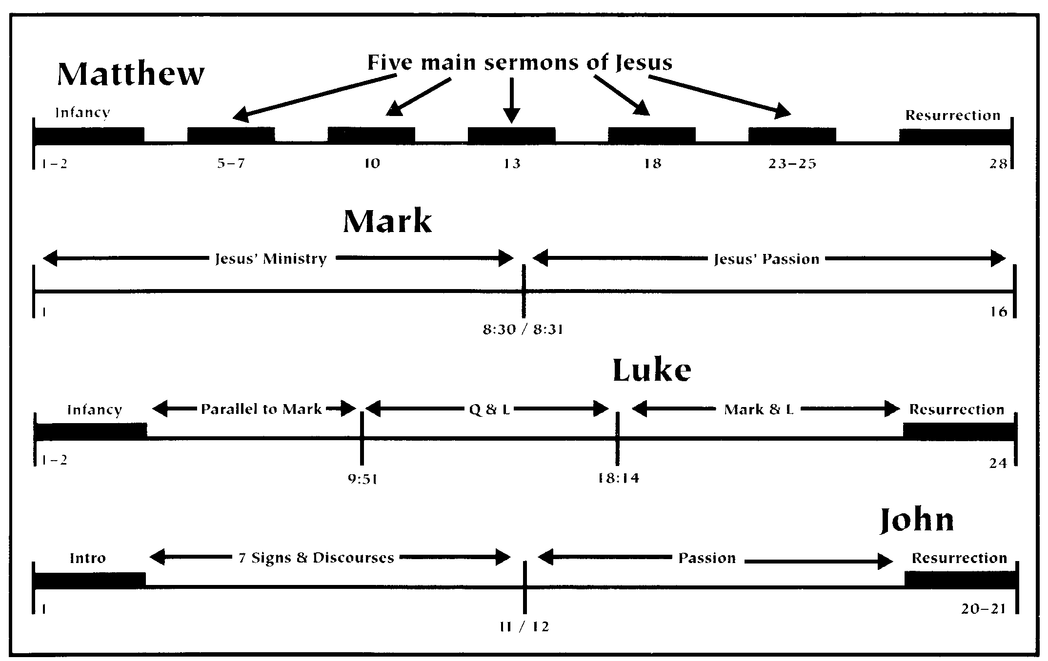
Contrasting Gospel Charts
Blomberg, Jesus and the Gospels, 127

Slide 14
Black

Slide 15


Gospels link at BibleStudyDownloads.org
Get this presentation for free!
Notes:
NT Survey (ns)

