Slide 1
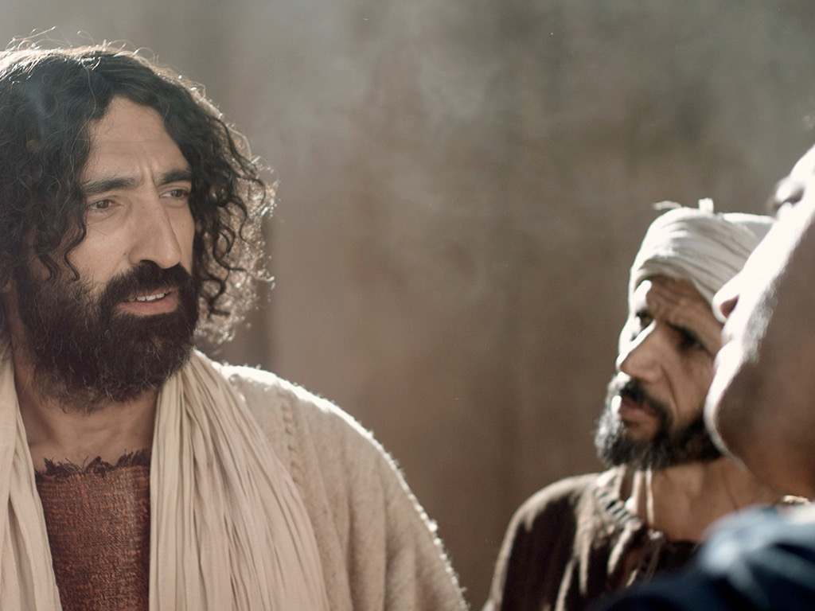
Matthew 15–28
Dr. Rick Griffith • Jordan Evangelical Theological Seminary • BibleStudyDownloads.org

Slide 2
Why serve Jesus?

Slide 3
Amazing Names
Lord
Jesus
Christ
Notes:
We need to understand what it means for our Jesus to be the Lord Jesus Christ.
Do you agree that the name of Jesus is the most dishonored in the world? Few people swear by the name of any other religious or political or other leader.
Even Christians don't often think much about the three main names of Jesus noted 60 times in the NT.

Slide 4
Amazing Names
Jesus is the highest ruler in the world (Matt 1–10).
Christ
Notes:
[Jesus met every prophecy we should expect for him to prove he is King.]
[Christ means Messiah-Ruler, for he fulfilled each part of his job description.]
—What more would Christ need to do for you to trust him with your life?
—Have you been the victim of Christ’s first mistake? How?
—Do you see how statistically unlikely it was for Jesus to be the Messiah?

Slide 5
Amazing Names
Jesus is the highest authority in the Church (Matt 11–27).
Lord
Christ
Notes:
[As Master, he is the boss of every believer’s life.]
As a Christian, do you recognize Christ’s authority over you?
—Why do you do what you do in terms of your life work?
—How did you make that decision?
—What area of your life right now should you submit to his authority?

Slide 6
Slides on
Matthew 15

Slide 7
Slides on
Matthew 16

Slide 8


¹³ When Jesus came to the region of Caesarea Philippi, he asked his disciples, “Who do people say the Son of Man is?”
¹⁴ They replied, “Some say John the Baptist; others say Elijah; and still others, Jeremiah or one of the prophets.”
¹⁵ “But what about you?” he asked. “Who do you say I am?”
¹⁶ Simon Peter answered, “You are the Messiah, the Son of the living God.”
Matthew 16:13-20 (NLT)

Slide 9
¹⁷ Jesus replied, “Blessed are you, Simon son of Jonah, for this was not revealed to you by flesh and blood, but by my Father in heaven.
¹⁸ And I tell you that you are Peter, and on this rock I will build my church, and the gates of Hades will not overcome it.
¹⁹ I will give you the keys of the kingdom of heaven; whatever you bind on earth will be bound in heaven, and whatever you loose on earth will be loosed in heaven.”
²⁰ Then he ordered his disciples not to tell anyone that he was the Messiah.
Matthew 16:13-20 (NLT)

Slide 10
16:13–20:34
Outline
73
IV. (11:1–16:12) Christ is rejected as Messiah in anticipation of the final crucifixion rejection, so He introduces the Interadvent Age before His future reception and ministers to Gentiles to teach the postponement of the kingdom.
V. (16:13–20:34) Christ prepares His disciples regarding His Person and program in order that His Messianic authority might be delegated to them after His death.

Slide 11
Slides on
Matthew 17

Slide 12
Slides on
Matthew 18

Slide 13
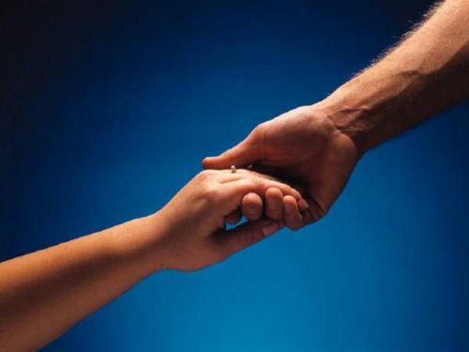

How to Restore Relationships
Matthew 18:15-20
Dr. Rick Griffith
Singapore Bible College
BibleStudyDownloads.org
10 December 2006
6 March 2011

Slide 14

I. (15-17) The manner in which the church should correctly restore a sinning Christian is by keeping the matter as private as possible.
34c
  (15) A private sin should be dealt with only between those directly involved so as to make restoration of the offender easier.
  (16) Unrepentant sin after a private confrontation should be exposed only to one or two more persons in order to facilitate restoring the sinner.
  (17a) Unrepentant sin after a small group attempt at restoration should be brought before the entire church body as a deterrent to continued sin.
  (17b) Unrepentant sin after exposure to the church should result in requiring each church member to relate to the sinner as an unbeliever (this includes removal from membership).
Notes:
PR 09.33
BS 20.33; 25.09
NS Mt 15.8

Slide 15
II. (18-20) The reason the church can restore or continue to seek to restore errant believers is because it extends the authority of God Himself.
34c
  (18-19) Churches that prayerfully restore or continue to seek to restore sinful believers act in the place of the Father.
    (18) The church must announce guilt or innocence based upon what God has already determined.
    (19) Church leaders who prayerfully make a judgment can have confidence that they have acted according to God's will.
  (20) Churches that restore or continue to seek to restore sinful believers act in the presence of Jesus.
Notes:
PR 09.34
BS 20.34; 25.10
NS Mt 15.9

Slide 16

Exegetical Idea: The reason the church should restore a sinning Christian correctly is because it extends God's authority.
34c
  (15-17) The manner in which the church should correctly restore a sinning Christian is by keeping the matter as private as possible.
  (18-20) The reason the church can restore or continue to seek to restore errant believers is because it extends the authority of God Himself.
Matthew 18:15-20
Notes:
PR 07.15. 09.35; 11.25; 12.16; 16:11 HO subject only
BS 18.43; 20.31; 25.11
NS Mt 15.10

Slide 17
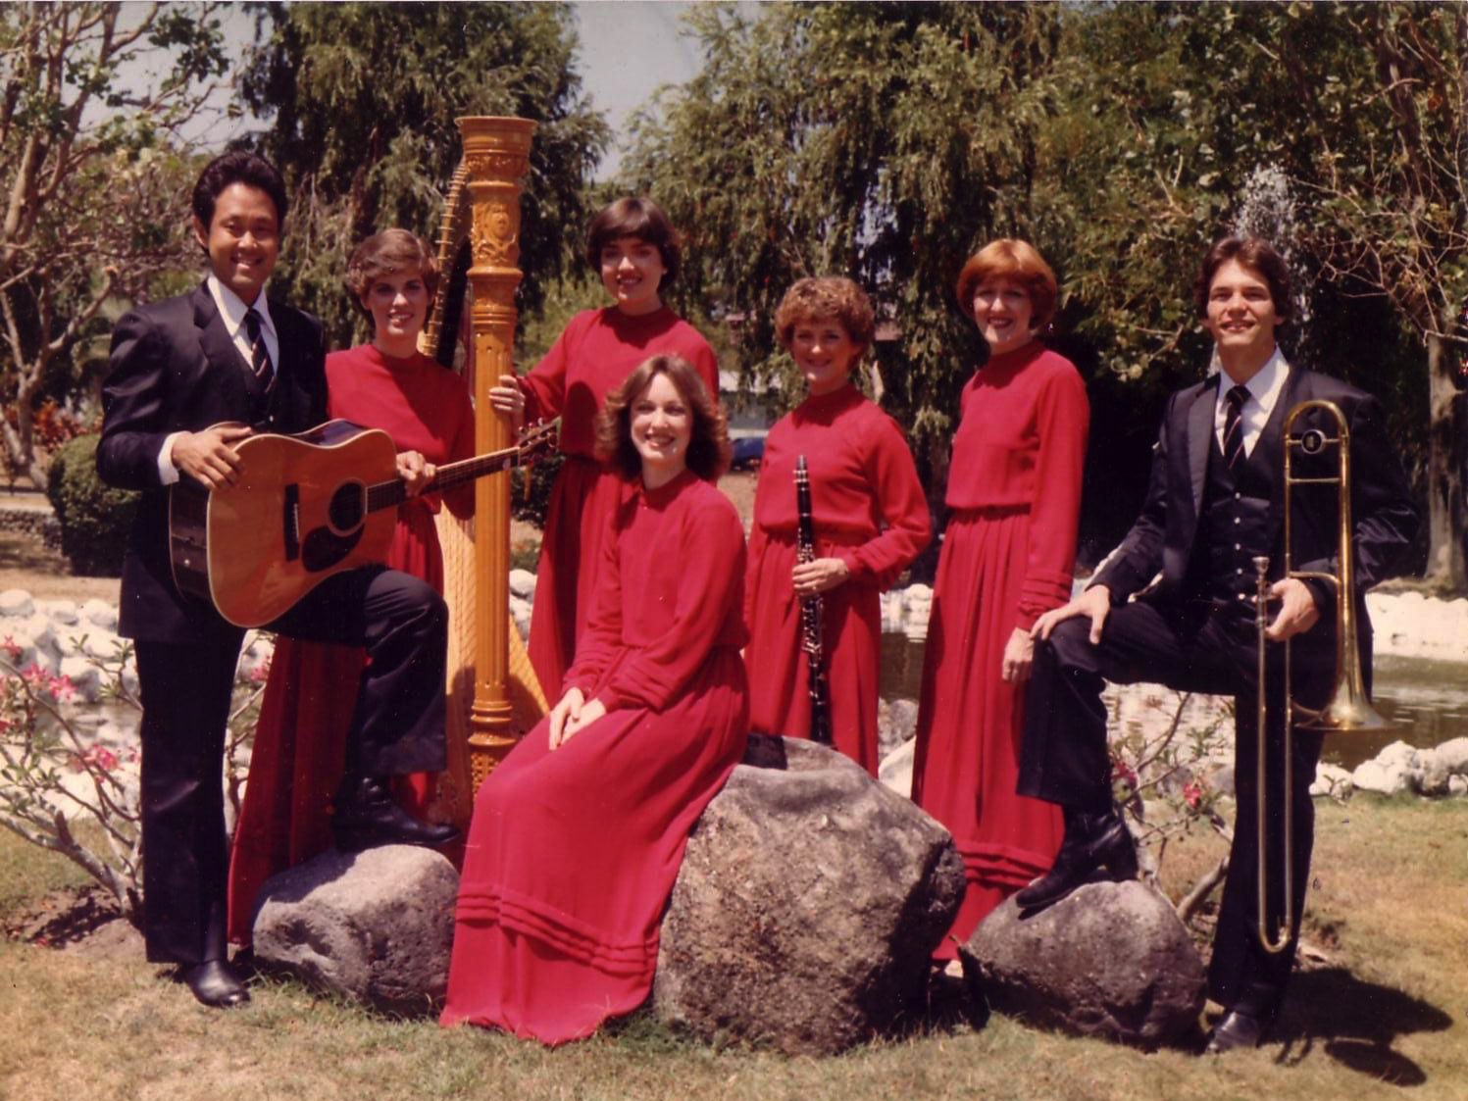
The Crossroads (1981-83)
Notes:
Some 35 years ago I sang on a music team of seven musicians called Crossroads. If you can't tell, I am the guy who is not Japanese.

Slide 18
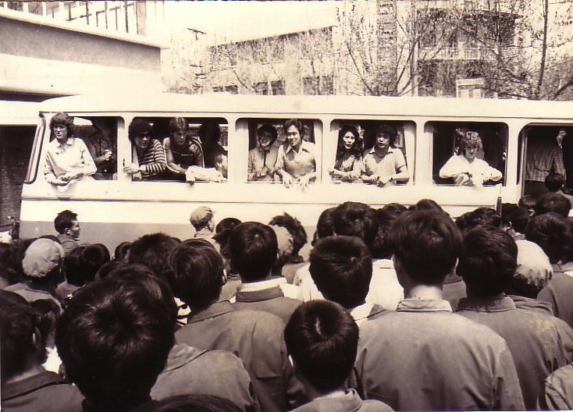
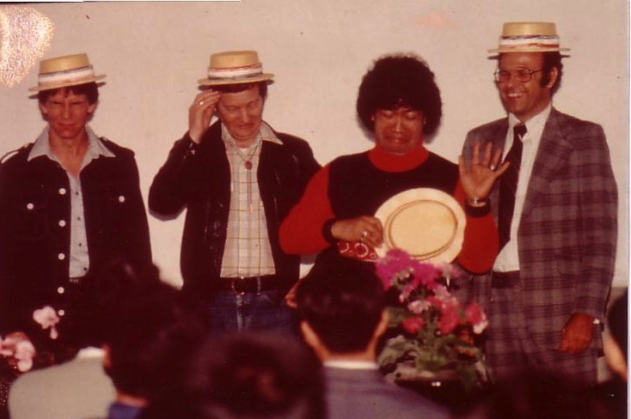
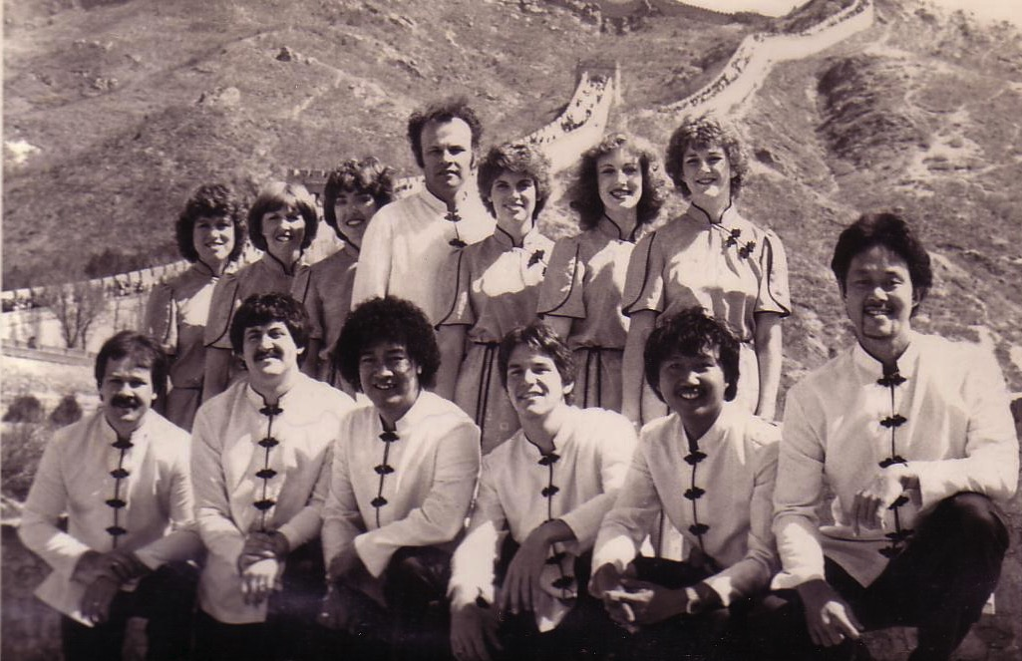
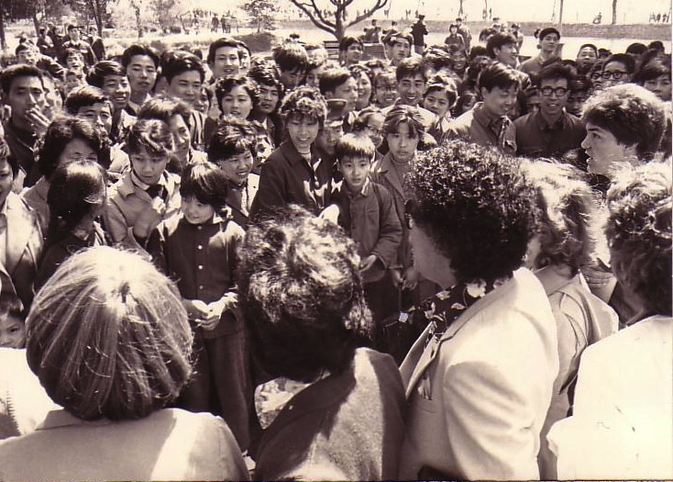
China, 1981
Notes:
We shared the gospel in China and—praise God—we reached over 600 people per concert!

Slide 19
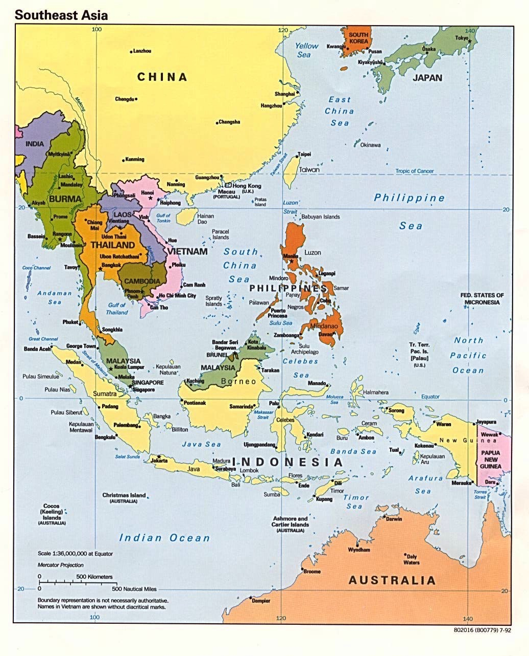
Crossroads Ministry
Korea
China
Japan
Hong Kong
Taiwan
Macau
Thailand
Philippines
Malaysia
Singapore
Indonesia
Notes:
The Crossroads team shared the gospel in 11 Asian nations and saw over 10,000 people trust Christ as indicated in comment cards at our 269 concerts.

Slide 20
This is war.
Notes:
If you know anything about spiritual warfare, it is that the enemy of our souls concentrates his efforts on believers who are having an impact for Christ.
In our team, the opposition came from within—relationships that were a challenge. On that team was one particular woman named Kay. She was a godly woman but we didn't see eye-to-eye at all. In fact, many times she felt that I just a "mister-know-it-all.” She didn't like my mannerisms, my clothes, or my insights in our group Bible studies. She avoided being around me and it seemed that I could do nothing right! She saw me as really arrogant.
So what do you do when you are forced into a working relationship with someone who just plain does not like you? I found that I couldn't really avoid Kay. After all, every day we had four hours of music practice with the team. I had to sing in harmony with her—literally! But discord often reigned. Then we had a concert to give and had to work together.

Slide 21

Relational Pillars
Relational Pillars
for believers
Notes:
God ministered to me then through two texts in Matthew that became "relational pillars" that I want to share with you today. These texts literally changed my life.

Slide 22

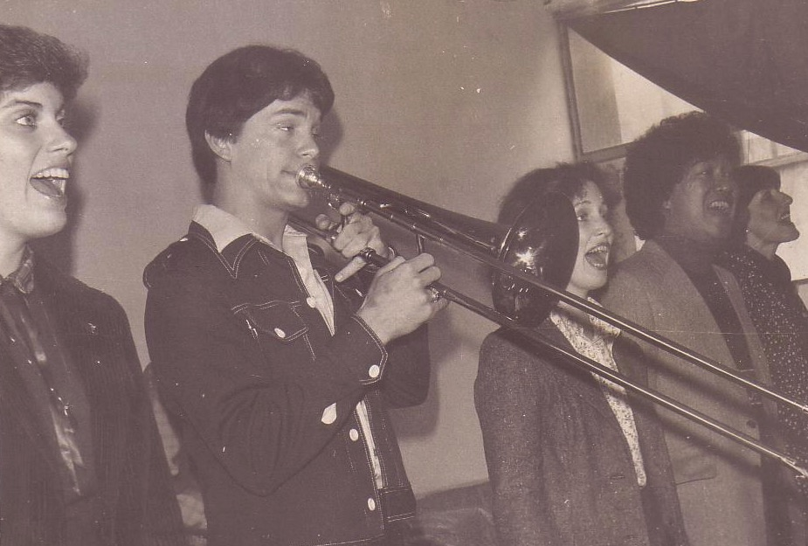
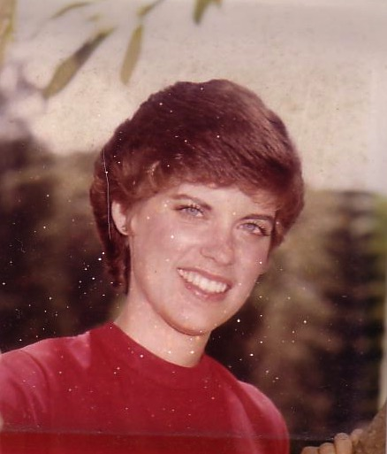
Romance, 1982
Notes:
They enabled Kay and me to reconcile our differences—so much so that three years after our initial differences Kay actually said "yes" to marrying me!

Slide 23
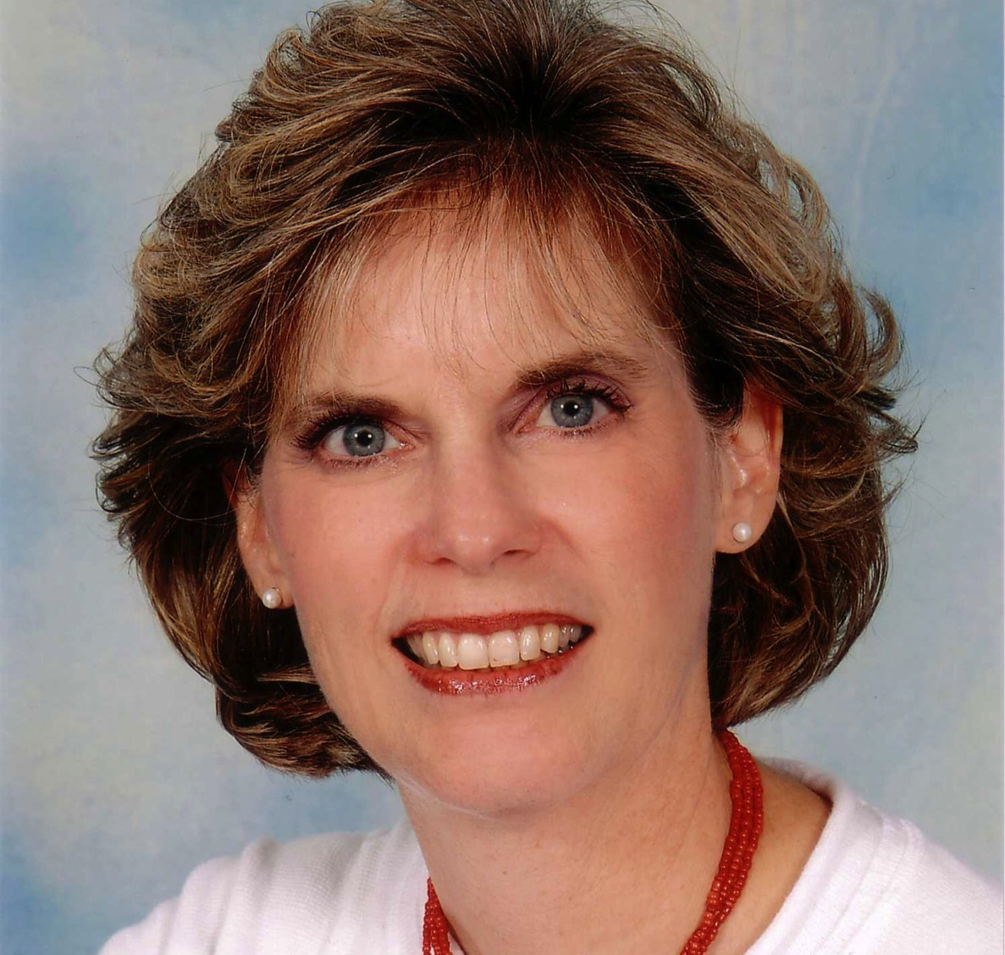
Susan Kay Griffith
Notes:
Yes, Kay is her middle name. Her full name is now Susan Kay Griffith.

Slide 24

Matthew's Relational Pillars
Matthew's Relational Pillars
5:23-24
You are:
Offender
Issue:
General
Notes:
Have you ever had a problem with another believer? (If you say "no," then I wonder which planet you have been living on!) Are you in fellowship with every Christian that you know now—your family members, your work colleagues, your neighbors and friends? If you're not in harmony, what should you do?
• If you hurt the other person, Matthew 5 tells you what to do in any general issue dividing you.

Slide 25


Matthew 5:23-24
Notes:
Let's read it.
God places the responsibility to reconcile on you if you are the offender.

Slide 26
Matthew 5:23-24
?
"Therefore if you are presenting your offering at the altar, and there remember that your brother has something against you, leave your offering there before the altar and go; first be reconciled to your brother, and then come and present your offering."
Notes:
The last I checked, believers weren't offering up sacrifices at the altar. So what does the "altar" refer to today?

Slide 27
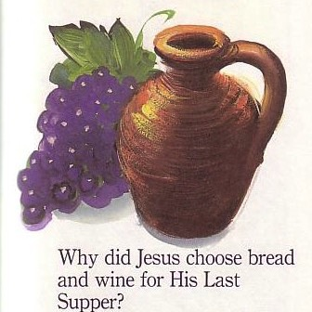
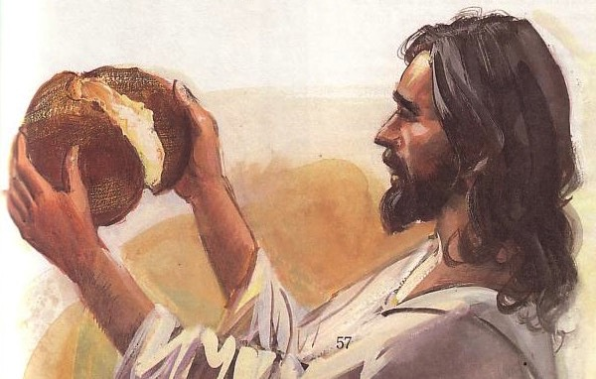
The Lord's Supper
Notes:
At the very least, it refers to the Lord's table—a sign of our fellowship & unity—so don't take the Supper when in conflict with another believer.

Slide 28
Matthew's Relational Pillars
Matthew's Relational Pillars
5:23-24
18:15-17
You are:
Offender
Offended
Issue:
General
Sin
Notes:
However, in some situations, you are the offended. The other person is guilty of sin. Every church eventually encounters problems with believers living in sin. In these cases a loving body will restore them to God's holiness.

Slide 29



How do we restore sinning Christians properly?
Our First Question Today (for vv. 15-17)
Notes:
So how do we restore sinning Christians properly? When someone goes astray from God's will, what process do we use to bring that person back?

Slide 30



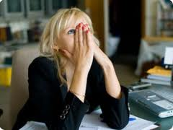
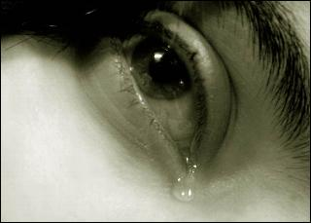
Other Relationships
Notes:
This doesn't just refer to marriage, nor to serious sins—it's any kind of sin that can hurt any relationship among believers.

Slide 31
Black
Notes:
Why I am talking about resolving relational problems now?
I just know that issues surface in every relationship, including ours. At some point, I am going to offend you and you will offend me. So what should we do?

Slide 32
Matthew 18
The Value of
One
1
1
Child (1-9)
1
Sheep
(10-14)
1
Sinner
(15-20)
1
Debtor
(21-35)
Notes:
So our key text today is Matthew 18. The context of Matthew 18 is the value of one—
• one child (1-9), one sheep (10-14), one sinner (15-20), one debtor (21-35).
• At the heart of this chapter is verses 15-20…

Slide 33
Matthew 18:15-20
If your brother sins against you, go and show him his fault, just between the two of you. If he listens to you, you have won your brother over. ¹⁶But if he will not listen, take one or two others along, so that 'every matter may be established by the testimony of two or three witnesses.' ¹⁷If he refuses to listen to them, tell it to the church; and if he refuses to listen even to the church, treat him as you would a pagan or a tax collector.
¹⁸I tell you the truth, whatever you bind on earth will be bound in heaven, and whatever you loose on earth will be loosed in heaven. ¹⁹Again, I tell you that if two of you on earth agree about anything you ask for, it will be done for you by my Father in heaven. ²⁰For where two or three come together in my name, there am I with them.
How to Restore
15-17
Why to Restore
18-20
Notes:
In Matthew 18:15-20 Jesus provides God's plan for loving church discipline. Let's read it together [read 15-20.] This text has two main teachings on restoring Christians in sin.
• Verses 15-17 give how to restore them and…
• Verses 18-20 give why to restore them.
Let's first see how to restore relationships. God's way to restore believers in sin is to…

Slide 34

The Point of Verses 15-17
I. Keep the matter as private as possible (15-17).
Notes:
God's strategy to bring sinning Christians back is to involve as few people as you can.

Slide 35
Our Goal:
Our Goal:
Restoration!
Notes:
The desired end is restoration, not punishment or excommunication.
The goal of discipline is behavior change to bring the wayward one back. Unfortunately, too many churches "excommunicate" to punish rather than restore).
Restoration is God's goal for a wandering saint in the sheep image of verses 10-14.
Restoration is the explicit teaching of this text in verse 15b.
Restoration is the goal of church discipline in other passages like Galatians 6:1.

Slide 36


Restore People in Sin
Restore People in Sin
"Brothers, if someone is caught in a sin, you who are spiritual should restore him gently."
Galatians 6:1

Slide 37
God's 4-step restoring process…
4
3
2
1
…reveals the issue to more people each step
Notes:
God's restoring process has four steps that progressively tell more and more people about the sin (15-17).

Slide 38
Step 1 to Restoration
Talk to the person by yourself
M
M
M
M
M
M
M
M
M
M
M
M
M
M
M
M
S
M
M
M
M
M
M
M
M
M
M
M
S = Sinner
M = Member
Notes:
What's our human tendency here?
• It is to tell others about the problem instead of the one involved.
• God commands us to keep the issue as private as possible.

Slide 39
Matthew's Relational Pillars
Matthew's Relational Pillars
5:23-24
18:15-17
You are:
Offender
Offended
Issue:
General
Sin
Notes:
This differs from Matthew 5 in that you're not an offender, but the offended.
Note also that in Matthew 5 sin may not be in the picture, but Matthew 18 deals specifically with a believer living in sin. This does not refer simply to differences of opinion on debatable matters.

Slide 40
Matthew's Relational Pillars
Matthew's Relational Pillars
5:23-24
18:15-17
You are:
Offender
Offended
Issue:
General
Sin
Initiative:
You!
You!
Notes:
Earlier we saw from Matthew 5:23-24 that God places the responsibility to reconcile on you if you are the offender. Now whose job is it to initiate if you are the offended?
• Yes, again it is your responsibility again! You say, "That's not fair! Why is it my job in both situations? Whether I am the offender or the offended I still have to make the first move?" Well, if relationships are not resolved between believers, it has to be through the fault of both—as both have the command of God to resolve it!

Slide 41
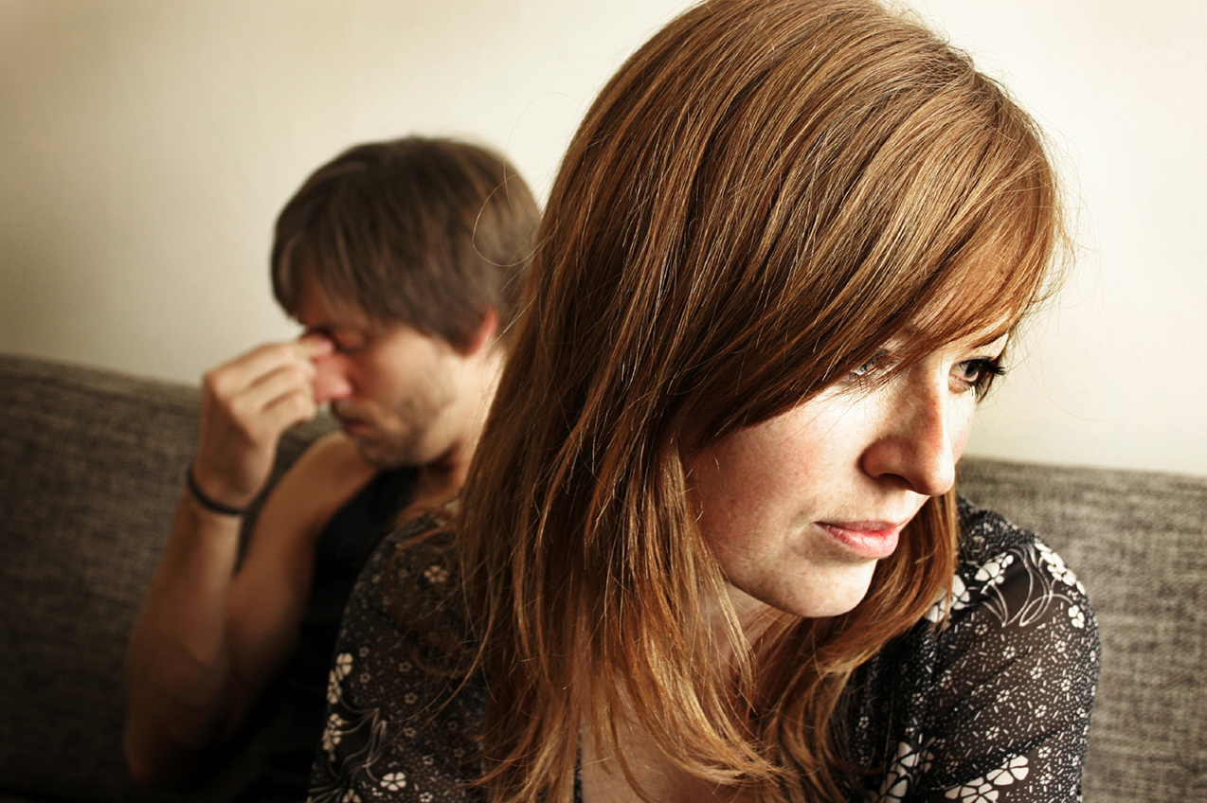
Go in Person
Not:
• email
• SMS
• letter
• phone
Notes:
While letter writing was very popular in the time of Christ, our Lord specifically says to deal with these sensitive matters face-to-face. Today this means confrontation should never be handled via email, SMS, letter, or phone calls. It also prohibits the cowardice of anonymous communication.

Slide 42
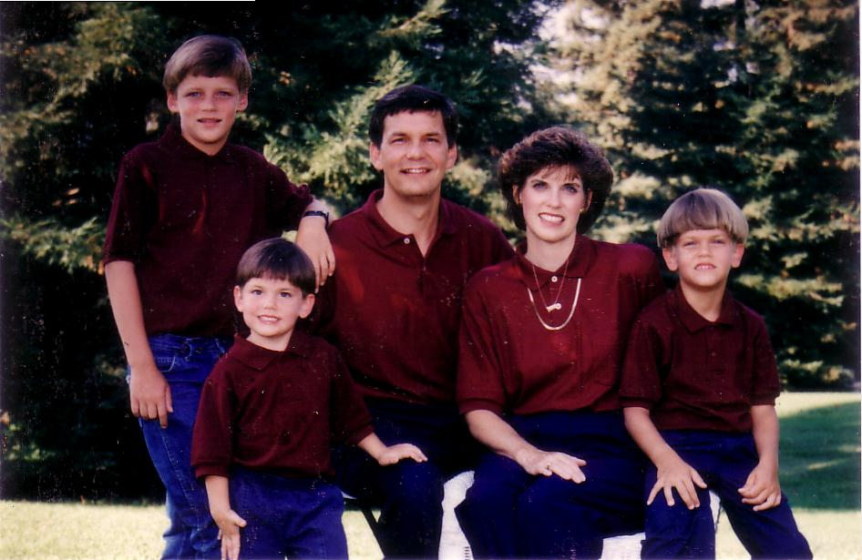
1996
Notes:
Our family has tried to do this since our three sons were young—not to let them do the "Mom! Dad! So-and-so did such-and-such to me!" We just told him, "Matthew 18, bud. If you can't solve it, we'll be step 2…" They rarely came back to us!

Slide 43
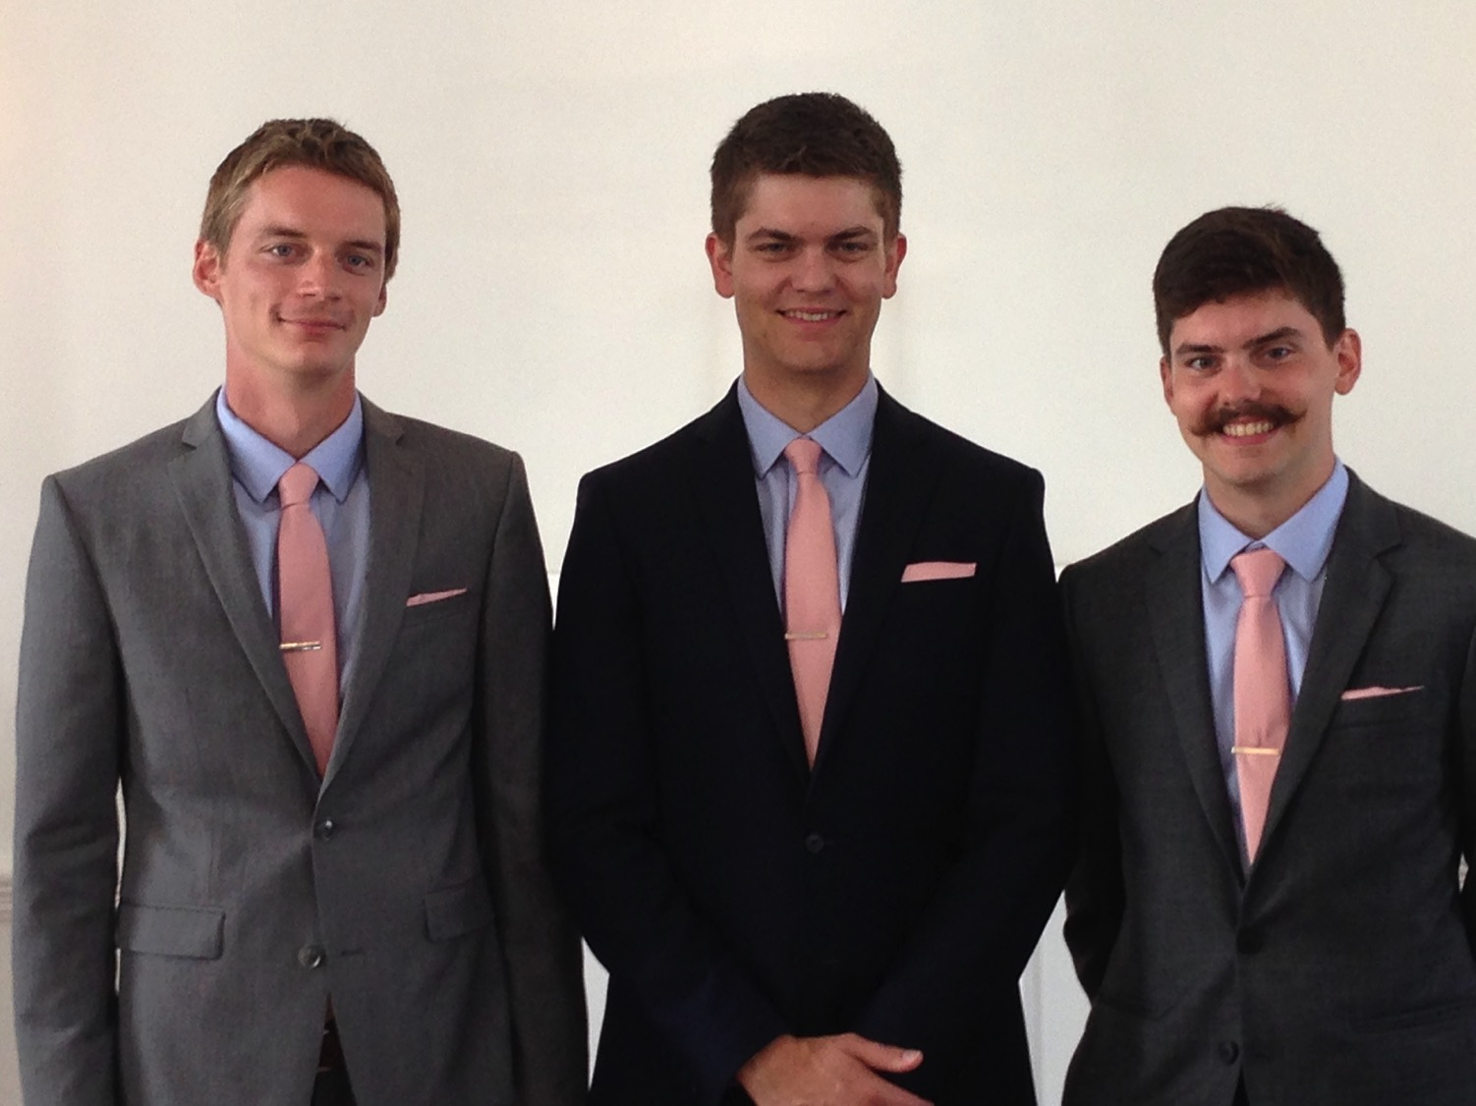
Brothers…
Notes:
Now that they are older, they solve the problems among themselves without our intervention. Some friends were amazed that Kurt and Stephen moved to the US for college and decided to stay as roommates—for 7 years until they married!

Slide 44

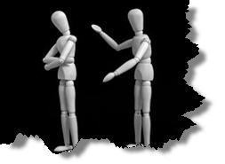
Why don't we confront others?
Ignorance
Doubt
Failure
Fear
Excuses
Impurity
Unsocial
Notes:
However, most of the time believers don't keep issues private—or we don't address them at all. Why do you think don't we confront others? Tell the person next to you why! (Small groups for 1 min.) Why not?
• ignorance of what God commands here?
• doubt that it will work?
• failure of past confrontations that didn't work?
• fear that we might look bad?
• excuses that we can't get together?
• impurity in our own life?
• unsocial in that we just don't care enough to risk it?

Slide 45
Step 1 to Restoration
Talk to the person by yourself
M
M
M
M
M
M
M
M
M
M
M
M
M
M
M
M
S
M
M
M
M
M
M
M
M
M
M
M
S = Sinner
M = Member
Notes:
So… you should talk to the person by yourself—even though our tendency is to tell others instead. But what if the offender does not repent? We need step 2 where we…

Slide 46
Step 2 to Restoration
Take 1-2 others along
M
M
M
M
M
M
M
M
M
M
M
M
M
M
M
M
S
M
M
M
M
M
M
M
M
M
M
M
S = Sinner
M = Member
Notes:
Take one or two others along (16).

Slide 47

Questions on Step 2
Who should these people be?
Why take 1-2 others?
Notes:
Who should these 1-2 others be? These persons should be individuals whom the offender respects as they will best help restore him/her. They should not go instead of the offended believer, but along with this person.
• Why take 1-2 others along?

Slide 48
Deut. 19:15
"One witness is not enough to convict a man accused of any crime or offense he may have committed. A matter must be established by the testimony of two or three witnesses."
Notes:
The OT law prohibited conviction of crimes based on only one person's testimony (read Deut. 19:15). The NT teaching is the same, protecting the offender from an easily offended or lying accuser.
What if the offender still does not repent? Go to step 3…

Slide 49
Step 3 to Restoration
Expose the sin to the entire church
M
M
M
M
M
M
M
M
M
M
M
M
M
M
M
M
S
M
M
M
M
M
M
M
M
M
M
M
S = Sinner
M = Member
Notes:
The church leadership certainly must be involved at this point before the matter is brought to the congregation. They also must see the issue isn't just a difference of opinion between two parties; the biblical basis for the offender living in sin must be clearly shown with specific passages.

Slide 50
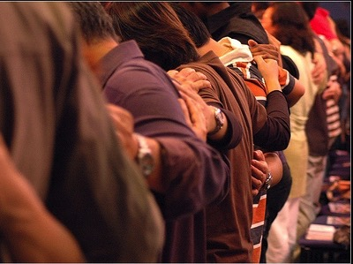
Why tell the whole church?
Notes:
Bringing the matter to the entire church is vital, since without it the sinning person will be able to find fellowship in other smaller groups within the larger church who do not know of his/her sin. Such gossip situations inevitably bring disunity, which lead to factions that can split the body.
What, then, should the entire church do once discipline has been determined? Step 4…

Slide 51
Step 4 to Restoration
Treat the person as an unbeliever
M
M
M
M
M
M
M
M
M
M
M
M
M
M
M
M
S
M
M
M
M
M
M
M
M
M
M
M
S = Sinner
M = Member
S

Slide 52

Sins Worthy of Discipline
How NOT to Discipline
EXCOMMUNICATE !
Notes:
Sometimes this step has been misinterpreted to mean "excommunication" where the errant person is never contacted again.

Slide 53

Sins Worthy of Discipline
How to Discipline Him/Her
Don't refer to him/her as a Christian.
Evangelize this person.
Don't let him/her take the Lord's Supper.
Remove the person from membership.
Remove this person from church roles.
Unbeliever
"Deliver over to Satan" one in sex sin
(1 Cor. 5:5).
Don't eat with him/her (1 Cor. 5:11).
Prohibit him/her from attending church?
Worse
Notes:
But Jesus said to "treat him as you would a pagan or a tax collector." Jesus treated pagans with love and kindness, but he didn't ask them to evangelize the lost as part of his team. You shouldn't be ugly or ungodly, but…
• Don't refer to him/her as a Christian. (ILL: I have done this with my former brother-in-law who divorced my sister to marry another woman.)
• Evangelize this person.
• Don't let him/her take the Lord's Supper.
• Remove the person from membership.
• Remove this person from church roles (ILL: My friend Paula was asked to leave her church kitchen ministry once her adultery was discovered.)
But in other ways it is more serious than how we treat unbelievers:
• "Deliver over to Satan" one in sex sin (1 Cor. 5:5). Years ago a friend named John left his wife and two small boys for another woman. My church disciplined him, but an elder kept up with him to restore him. After five years, he showed up at church—but he looked 20 years older!
• Don't eat with him/her (1 Cor. 5:11).
• Should we prohibit the person from attending church? Some say they, like unbelievers, should be welcomed in services without taking the Lord's Supper; but in most discipline cases this is not even an issue as few disciplined believers seek to return to the assembly until repentant.

Slide 54
The Point of Verses 15-17
I. Keep the matter as private as possible (15-17).
Notes:
So that's God's 4-step process—to keep the matter as private as possible.

Slide 55
God's 4-step restoring process…
4
3
2
1
…reveals the issue to more people each step
Notes:
This is the intent in each of the four steps with the goal of restoration.

Slide 56

Our 2nd question is answered in verses 18-20:
Why do we restore sinning Christians properly?
Notes:
But why must we do all this? What right do we have to discipline our members? Why must we restore sinning Christians properly? Because…

Slide 57

The Point of Verses 18-20
II. Our church extends the authority of God Himself!
Notes:
God's right to judge is actually delegated to us!

Slide 58
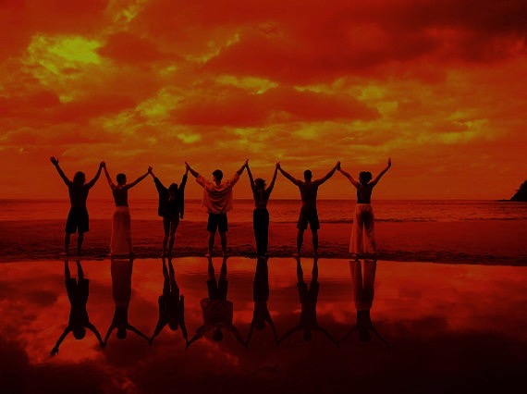
Why discipline?
When we seek to restore someone…
We act in the place
of the Father
(18-19)
Notes:
We act in the place of the Father when we seek to restore someone (18-19).

Slide 59
A Better Translation…
NAU is a Better Translation…
NIV "I tell you the truth, whatever you bind on earth
will be {or have been} bound in heaven, and whatever you loose on earth will be {or have been} loosed in heaven."
NAU "Truly I say to you, whatever you bind on earth shall have been bound in heaven; and whatever you loose on earth shall have been loosed in heaven."
Notes:
Too often today's churches act as if they have no authority under God, and yet "binding" here refers to disciplining (a guilty verdict) while "loosing" refers to releasing from discipline (an innocent verdict).

Slide 60

Matthew 18:19
"Again, I tell you that if two of you on earth agree about anything you ask for, it will be done for you by my Father in heaven"
(NIV).
Notes:
We should trust that our prayerful judgments are God's will.

Slide 61
Psalm 82:1, 6
(to Israel's rulers/gods)
"I said, 'You are "gods"; you are all sons of the Most High…
but you will die like men…"
Notes:
Ps. 82:6 has a similar idea where Israel's rulers are called "gods" in that they rule others.
Why should we trust this process in discipline situations? Verse 20 says that…

Slide 62
Why discipline?
When we seek to restore someone…
We act in the place
of the Father
(18-19)
We act in the presence & authority of Christ
(20)
Notes:
When we seek to restore someone, we act in the presence and authority of Christ (20).

Slide 63
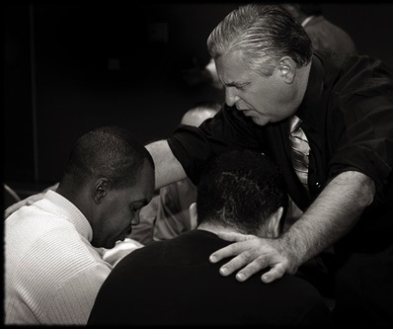
Matthew 18:20
"For where
two or three come together in my name, there I am with them" (NIV).
Notes:
The "two or three" refers to the witnesses whose testimony enacted discipline (v. 16).
The point of Christ being "in their midst" is that local church discipline acts with the presence and authority of Christ Himself.

Slide 64
Why do we restore sinning Christians properly?
Notes:
So how can we sum up this passage in one sentence? I'd say it this way…

Slide 65

Main Idea:
We must restore sinning members properly since we act on God's behalf
Notes:
When sheep stray, we shepherd them back as loving hands of God's grace.

Slide 66
Matthew's Relational Pillars
Matthew's Relational Pillars
5:23-24
18:15-17
You are:
Offender
Offended
Issue:
General
Sin
Initiative:
You!
You!
Notes:
God expects each of us to take the initiative—

Slide 67
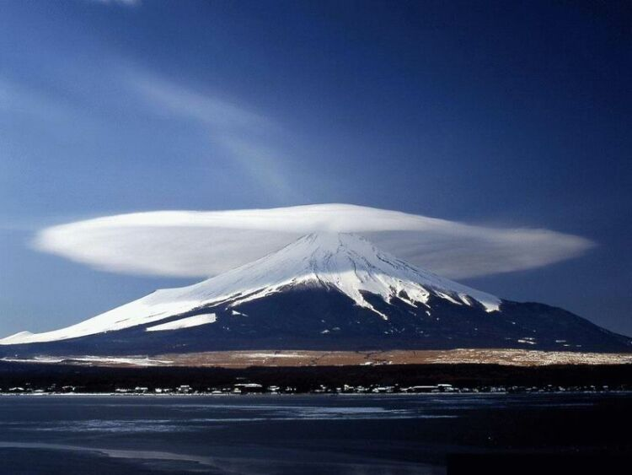
The Overall Principle
"If possible, as far as it depends on you, be at peace with all men"
Romans 12:18
Notes:
—and to do so as far as possible, as Romans 12:18 says [read]. This verse is a great encouragement to do all we can even if others are not responsive.

Slide 68
Matthew's Relational Pillars
Matthew's Relational Pillars
5:23-24
18:15-17
The Overall Principle: Romans 12:18
You are:
Offender
Offended
Issue:
General
Sin
Initiative:
You!
You!
Notes:
This verse is a great overall principle in relationships.

Slide 69
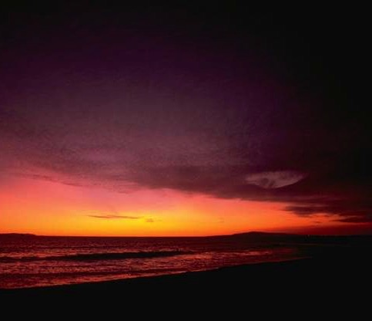
Make us one 3/3
Make us one, Lord,
make us one,
Holy Spirit, make us one.
Let Your love flow
so the world will know
we are one in You.
Notes:
God desires us to truly live out the chorus "Make Us One, Lord"

Slide 70
What's God Saying to You?
a. The Church Body
M
M
M
M
M
M
M
M
M
M
M
M
b. Your Own Life
M
M
M
M
S
M
M
M
M
M
M
M
M
c. Helping Others
M
M
M
Notes:
Matthew 18 relates to us in at least three ways:
• To be in this assembly you must submit to its authority under God. This means that we will lovingly seek to restore you should you fall.
• Is there sin in you worthy of discipline? Clean it up now to avoid pain for us all!
• Do you know anyone who needs a private confrontation? Romans 12:18 encourages you to do everything possible to be at peace with all people, so do it!

Slide 71
Slides on
Matthew 19

Slide 72


Free
Bible
images
A RICH YOUNG MAN QUESTIONS JESUS
Matthew 19:16-30; Mark 10:17-31; Luke 18:18-30

Slide 73


Slide 74


Slide 75


Slide 76


Slide 77


Slide 79


Slide 81
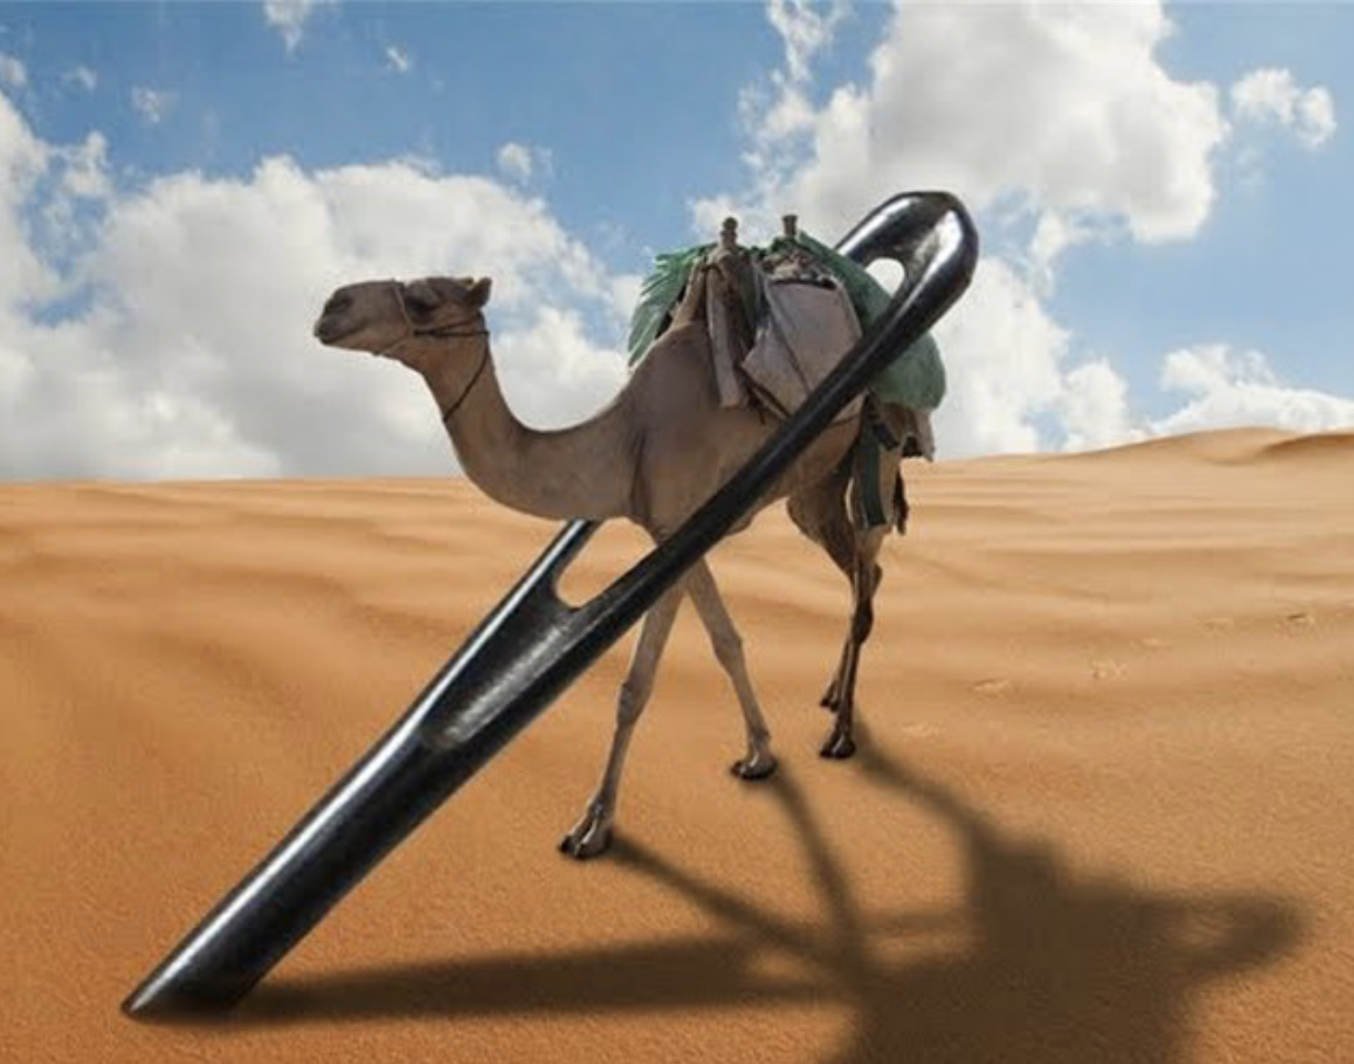
Camel through a needle (Matt 19:24)

Slide 82


Slide 83


Slide 84

Used with Permission
THE
GOSPEL
——OF—— MATTHEW
THE
GOSPEL
——OF—— MARK
THE
GOSPEL
——OF—— LUKE
THE
GOSPEL
——OF—— JOHN
Due to the Lumo Project producing its own publishing material we regret to inform you that we cannot license our photos to other clients outside of freebibleimages.org.
These images are not licensed for reuse in video, epublishing or other media. Downloaded pictures and files cannot be redistributed through any other website than freebibleimages.org or used in any context where the accompanying message is undermining of the Christian faith and gospel.
Photos can only be used on educational presentations, blogs and social media, all of which should be accompanied with reference to www.LumoProject.com.
Picture courtesy of BBM
© All Rights Reserved.
www.bigbookmedia.com

Slide 85

A Literal, Political Kingdom
"Jesus replied,
'I assure you that when the world is made new and the Son of Man sits upon his glorious throne, you who have been my followers will also sit on twelve thrones, judging the twelve tribes of Israel'"
(Matt. 19:28 NLT)
Notes:
NS-01-Matt1-14-slide 113
NS-01-Matt15-28-slide 85
NS-05-Acts1-2-slide 191

Slide 86
Slides on
Matthew 20

Slide 87
Slides on
Matthew 21

Slide 88
Chs. 21–27
Outline
73
IV. (11:1–16:12) Christ is rejected as Messiah in anticipation of the final crucifixion rejection, so He introduces the Interadvent Age before His future reception and ministers to Gentiles to teach the postponement of the kingdom.
V. (16:13–20:34) Christ prepares His disciples regarding His Person and program in order that His Messianic authority might be delegated to them after His death.
VI. (Chs. 21–27) Christ's official presentation and rejection as Israel's King in His vicarious crucifixion show why the kingdom is postponed until His return.

Slide 89
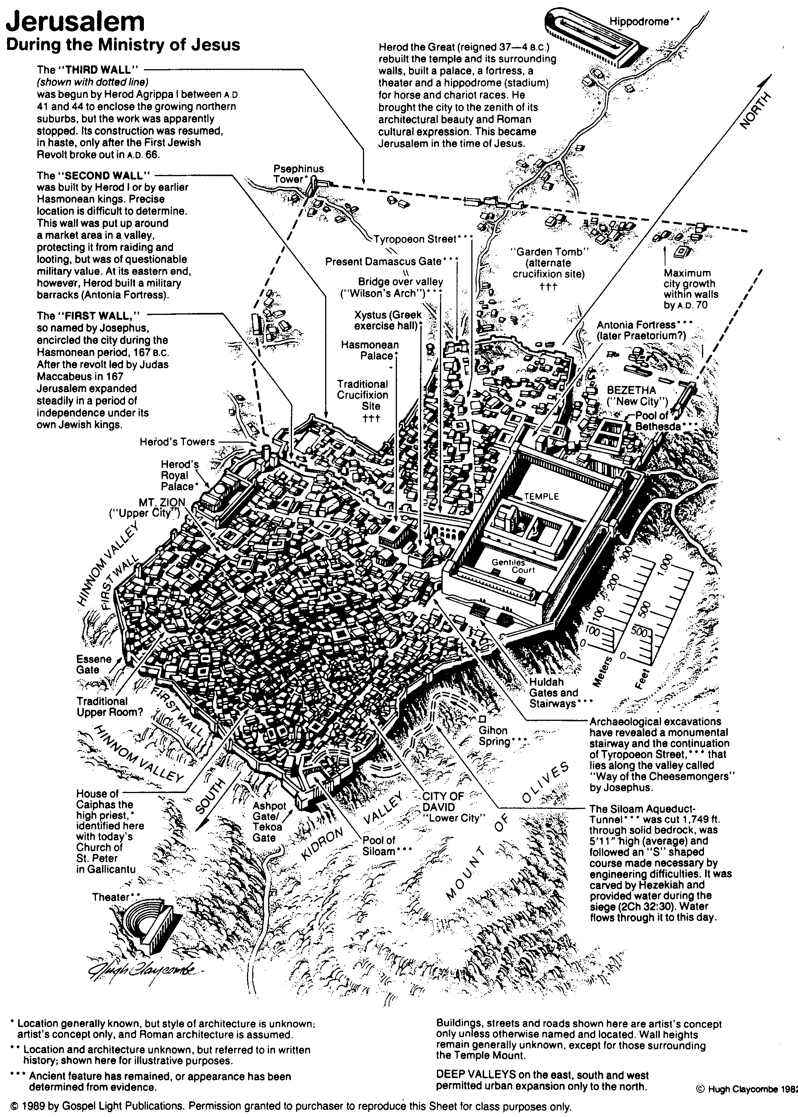
Jerusalem During the Ministry of Jesus
80

Slide 90


Matthew 21:1-11
Mark 11:1-11
Luke 19:28-44
John 12:12-19
THE EASTER STORY
TRIUMPHAL ENTRY (Palm Sunday)

Slide 91

Mark 11:1-11
As Jesus and his disciples approached Jerusalem, they came to the towns of Bethphage and Bethany on the Mount of Olives.

Slide 92

Jesus sent two of them on ahead. ² “Go into that village over there,” he told them.

Slide 93

“As soon as you enter it, you will see a young donkey tied there that no one has ever ridden. Untie it and bring it here.
³ If anyone asks, ‘What are you doing?’ just say, ‘The Lord needs it and will return it soon.’”

Slide 94

⁴ The two disciples left and found the colt standing in the street, tied outside the front door.

Slide 95

⁵ As they were untying it, some bystanders demanded…

Slide 96

“What are you doing, untying that colt?” ⁶ They said what Jesus had told them to say, and they were permitted to take it.

Slide 97

⁷ Then they brought the colt to Jesus...

Slide 98

…and threw their garments over it, and he sat on it.

Slide 99

⁸ Many in the crowd spread their garments on the road ahead of him, and others spread leafy branches they had cut in the fields.

Slide 100
⁹ Jesus was in the center of the procession, and the people all around him were shouting…

Slide 101

“Praise God!
Blessings on the one who comes in the name of the LORD!

Slide 102

¹⁰ Blessings on the coming Kingdom of our ancestor David!

Slide 103

"Praise God in highest heaven!"

Slide 104

Luke 19:39
But some of the Pharisees among the crowd said, “Teacher, rebuke your followers for saying things like that!”

Slide 105

Luke 19:40
He replied, “If they kept quiet, the stones along the road would burst into cheers!”

Slide 106

Luke 19:41
But as he came closer to Jerusalem and saw the city ahead…

Slide 107

Luke 19:41-42
…he began to weep. ⁴² “How I wish today that you of all people would understand the way to peace. But now it is too late, and peace is hidden from your eyes.

Slide 108

Luke 19:43
Before long your enemies will build ramparts against your walls and encircle you and close in on you from every side.

Slide 109

Luke 19:44
They will crush you into the ground, and your children with you. Your enemies will not leave a single stone in place, because you did not recognize it when God visited you.”

Slide 110
THE WORD IN PICTURES
Free
Bible
images

Slide 111
Used with Permission
THE
GOSPEL
——OF—— MATTHEW
THE
GOSPEL
——OF—— MARK
THE
GOSPEL
——OF—— LUKE
THE
GOSPEL
——OF—— JOHN
Due to the Lumo Project producing its own publishing material we regret to inform you that we cannot license our photos to other clients outside of freebibleimages.org.
These images are not licensed for reuse in video, epublishing or other media. Downloaded pictures and files cannot be redistributed through any other website than freebibleimages.org or used in any context where the accompanying message is undermining of the Christian faith and gospel.
Photos can only be used on educational presentations, blogs and social media, all of which should be accompanied with reference to www.LumoProject.com.
Picture courtesy of BBM
© All Rights Reserved.
www.bigbookmedia.com

Slide 112






The Spirit Leaves & Returns
Mt. of Olives
656
Ezek. 8:4; 9:3; 10:4; 10:18-19; 11:23
Luke 19:37; 24:50; Acts 1:10
Acts 1:11; Zech. 14:4; Ezek. 43:1-5
Notes:
The Mount of Olives plays a significant role in history. It is the last place the Spirit is present in Ezekiel 11:23, the last place Christ was honored as king in Luke 19:37, the last place Christ was seen by his disciples in Acts 1:10, and the NEXT place Christ will appear on earth to fulfill Acts 1:11!
The Kidron Valley below the mount is likely the Valley of Jehoshaphat where Jesus will judge the nations (Joel 3).
_____________
Common Slides English-193
OS-26-Ezek1-39-slide 178
OS-38-Zechariah-179
LC-06-Official Presentation-33
NS-01-Matt15-28-slide 112
NS-03-Luke13-24-slide 111
NS-Acts1-2-slide 215

Slide 113

Matthew 21:12-17
Mark 11:15-19
Luke 19:45-48
John 2:13-24
THE EASTER STORY
CLEANSING THE TEMPLE
Free
Bible
images

Slide 114

It was nearly time for the Jewish Passover celebration, so Jesus went to Jerusalem.

Slide 115

In the Temple area he saw merchants selling cattle, sheep, and doves for sacrifices.

Slide 116

He also saw dealers at tables exchanging foreign money.

Slide 117


Slide 118

Jesus made a whip from some ropes and chased them all out of the Temple.

Slide 119
He drove out the sheep and cattle, scattered the money changers’ coins over the floor

Slide 120

and turned over their tables.

Slide 121

Then, going over to the people who sold doves, he told them...

Slide 122

“Get these things out of here. Stop turning my Father’s house into a marketplace!”

Slide 123

Then his disciples remembered this prophecy from the Scriptures: “Passion for God’s house will consume me.”

Slide 124


Slide 125

But the Jewish leaders demanded, “What are you doing? If God gave you authority to do this, show us a miraculous sign to prove it.”

Slide 126

“All right,” Jesus replied. “Destroy this temple, and in three days I will raise it up.”

Slide 127

“What!” they exclaimed. “It has taken forty-six years to build this Temple, and you can rebuild it in three days?”

Slide 128

But when Jesus said “this temple,” he meant his own body.

Slide 129

After he was raised from the dead, his disciples remembered he had said this, and they believed both the Scriptures and what Jesus had said.

Slide 130
THE WORD IN PICTURES
Free
Bible
images

Slide 131

Palm Sunday
Notes:
Palm Sunday is an interesting name for the day, isn't it?

Slide 132


Palm Sunday
Notes:
We know that today recalls the palm branches waved at Jesus as he entered Jerusalem at the beginning of his last week of his life. Yet the focus really isn't the tree palms, but the hand palms of Jesus that would stretch out on a cross but a few days later.

Slide 133

Palms to Cross
Notes:
Tree palms were but a prelude to the cross.

Slide 134


Triumphant Entry
Matthew 21:9
Notes:
Even the alternate name—Triumphant Entry—is also perplexing.

Slide 135

Triumphal Entry
Notes:
True, Jesus rode into Jesus and the crowds cheered his arrival.

Slide 136

Triumphant Entry
Jesus was in the center of the procession, and the people all around him were shouting,
“Praise God for the Son of David!
Blessings on the one who comes in the name of the LORD!
Praise God in highest heaven!”
Matthew 21:9
Notes:
Matthew 21:9 says the crowds that went ahead of him and those that followed shouted, "Hosanna to the Song of David!" "Blessed is he who comes in the name of the Lord!" "Hosanna in the highest!"

Slide 137

Palms to Palms
Notes:
Normally a king rode into the city as the victor over his enemies, while that very week would culminate in Jesus' death on Friday, which we call Good Friday.

Slide 138

What's so good about Good Friday?
Notes:
But that name is equally puzzling. Why is Good Friday called "good"?
Our leader died on that day, so it seems strange to call the day "good." No other religion refers to the death of their leader as "good."
We believe that his death was good. How was that?

Slide 139

How is Christ's death better than any sacrifice?

Slide 140
Slides on
Matthew 22

Slide 141

Passion Week
Mon
Tues
Wed
64
Fri
Thurs
Sun
Fri
Sat
Sat
Sun

Slide 142
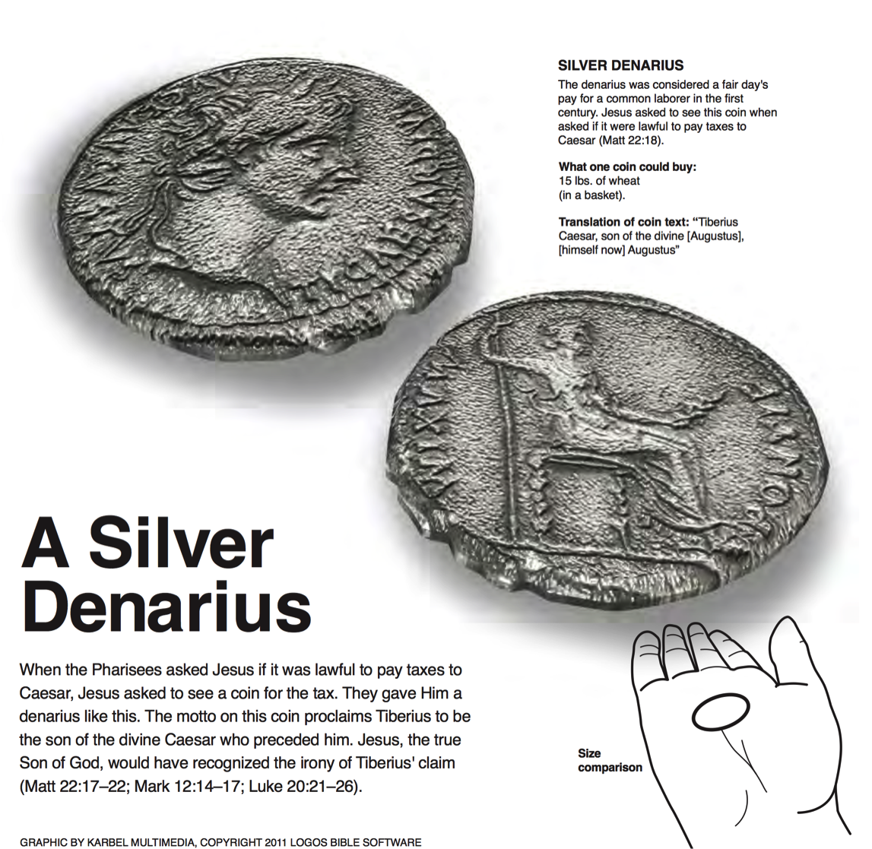
A Silver Denarius
SILVER DENARIUS
The denarius was considered a fair day's pay for a common labor in the first century. Jesus asked to see this coin when asked if it were lawful to pay taxes to Caesar (Matt 22:18).
What one coin could buy:
15 lbs. of wheat (in a basket)
Translation of coin text: "Tiberius Caesar, son of the divine [Augustus], [himself now] Augustus"
When the Pharisees asked Jesus if it was lawful to pay taxes to Caesar, Jesus asked to see a coin for the tax. They gave him a denarius like this. The motto on this coin proclaims Tiberius to be the son of the divine Caesar who preceded him. Jesus, the true Son of God, would have recognized the irony of Tiberius's claim (Matt 22:17-22; Mark 12:14-17; Luke 20:21-26).
Logos Bible Software

Slide 143
Slides on
Matthew 23

Slide 144
Slides on
Matthew 24

Slide 145
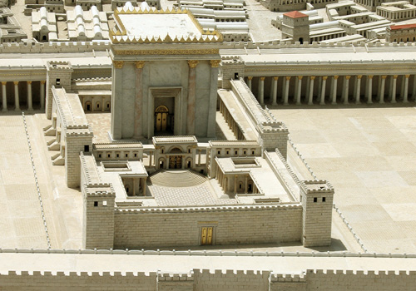
Disciples: What a fantastic temple! (24:1)
Jesus: "Not one stone here will be left on another" (24:2)
Disciples: When? What sign? (24:3)

Slide 146
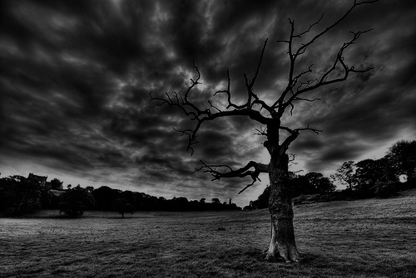
The Olivet Discourse (Matthew 24–25)
77
Adapted from Mark L. Bailey, DTS class notes, 1986
Second Coming (27-31):
Signs in the Heavens (29-30)
Coming of the Son of Man (27, 30)
Bird Supper (28)
Salvation of Elect (31)
Abomination of Desolation
(15-20)
False Christs
& Prophets
(23-26)
Beginning of Birth Pangs
(4-8)
Great Tribulation
(9-14, 21-22)
Judgment of the Nations
Sheep
Goats
Correlation with Revelation
12:7-12
13:14
12:8-17
8:1–19:10
(Matt. 25:31-46)
6:1–8:5
19:11-21

Slide 147
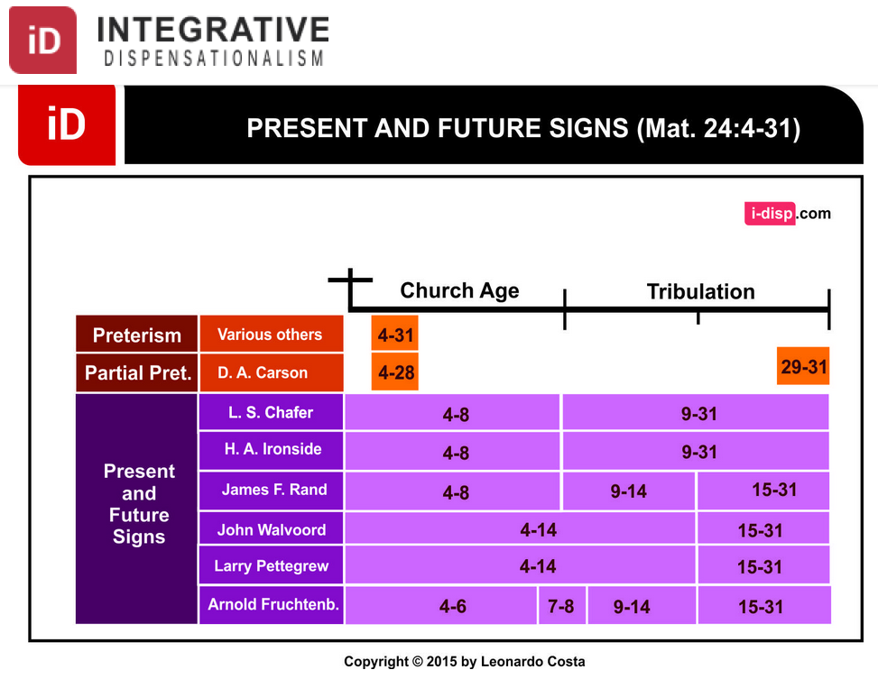
Dispensational Views on Matthew 24
INTEGRATIVE
DISPENSATIONISM
PRESENT & FUTURE SIGNS（Matt 24:4-31）
Church Age
Tribulation
Preterism
Various Others
Partial Pret.
Present
& Future Signs
Notes:
Leonardo Costa, "The Fulfillment of Matthew 24:4-31 in Dispensational Tradition," Integrative Dispensationalism website
http://i-disp.com/the-fulfillment-of-matthew-244-31-in-dispensational-tradition/ accessed 24 July 2015

Slide 148
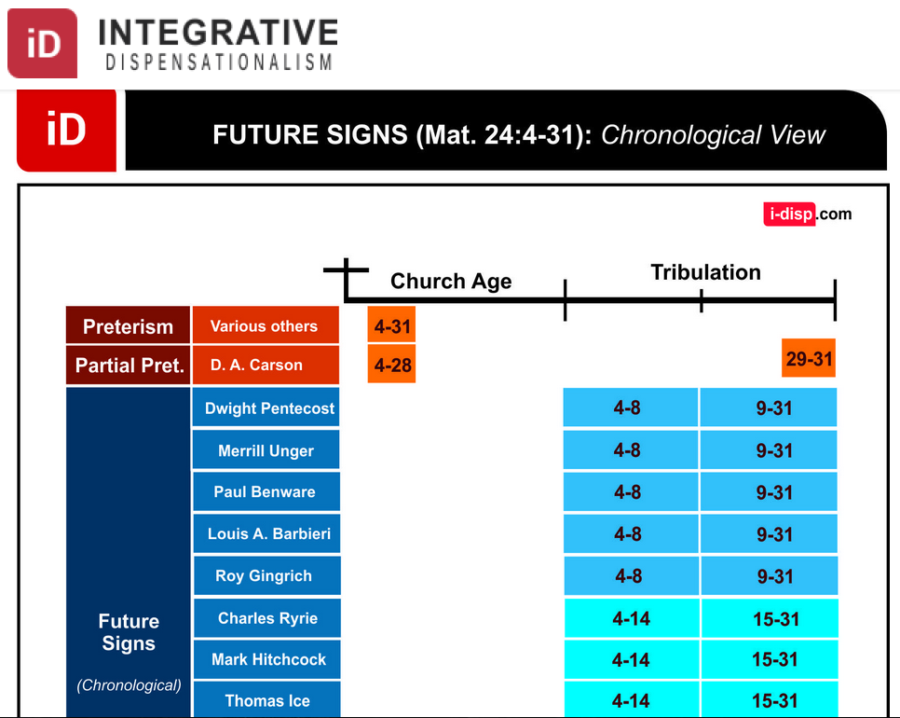
Dispensational Views on Matthew 24
INTEGRATIVE
DISPENSATIONISM
FUTURE SIGNS（Matt 24:4-31): Chronological View
Church Age
Tribulation
Preterism
Various Others
Partial Pret.
未来的年代
Future Signs
(Chronological)
Notes:
Leonardo Costa, "The Fulfillment of Matthew 24:4-31 in Dispensational Tradition," Integrative Dispensationalism website
http://i-disp.com/the-fulfillment-of-matthew-244-31-in-dispensational-tradition/ accessed 24 July 2015

Slide 149
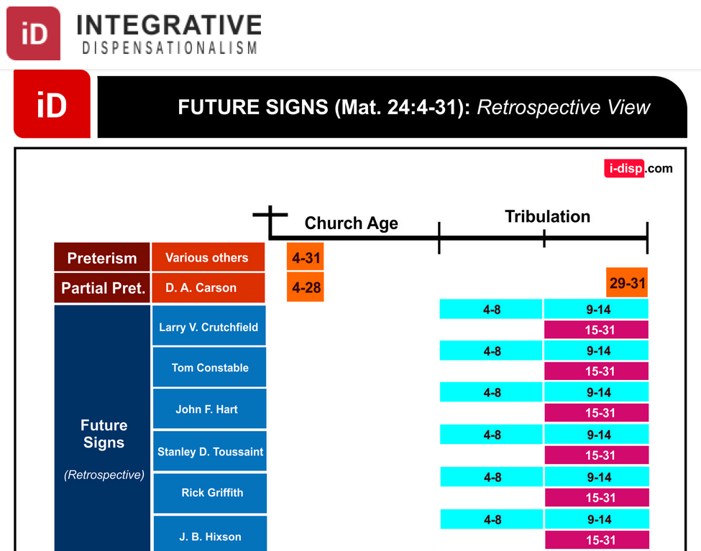
Dispensational Views on Matthew 24
INTEGRATIVE
DISPENSATIONISM
FUTURE SIGNS（Matt 24:4-31): Retrospective View
Church Age
Tribulation
Preterism
Various Others
Partial Pret.
Future Signs
(Retrospective)
Notes:
Leonardo Costa, "The Fulfillment of Matthew 24:4-31 in Dispensational Tradition," Integrative Dispensationalism website
http://i-disp.com/the-fulfillment-of-matthew-244-31-in-dispensational-tradition/ accessed 24 July 2015

Slide 150
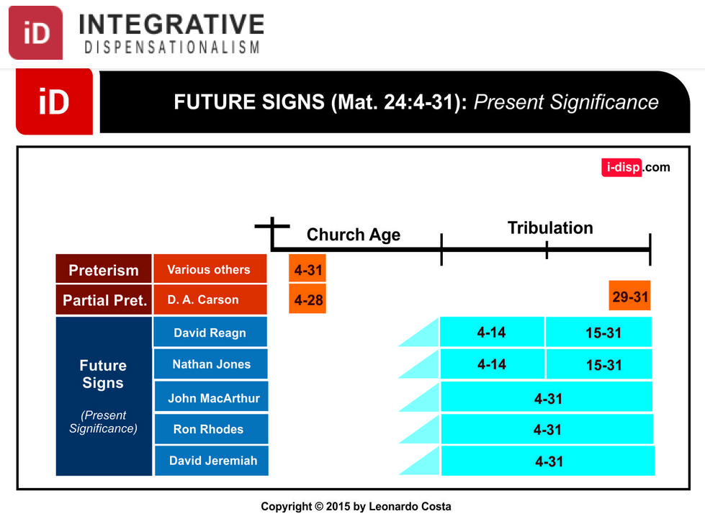
Dispensational Views on Matthew 24
综合
时代主义
INTEGRATIVE
DISPENSATIONISM
FUTURE SIGNS（Matt 24:4-31): Present Significance
Church Age
Tribulation
Preterism
Various Others
Partial Pret.
Future Signs
(Present Significance)
Notes:
Leonardo Costa, "The Fulfillment of Matthew 24:4-31 in Dispensational Tradition," Integrative Dispensationalism website
http://i-disp.com/the-fulfillment-of-matthew-244-31-in-dispensational-tradition/ accessed 24 July 2015

Slide 151

MATTHEW 24:14
AND THIS GOSPEL OF THE KINGDOM WILL BE PREACHED IN THE WHOLE WORLD AS A TESTIMONY TO ALL NATIONS,
AND THEN THE END WILL COME

Slide 152
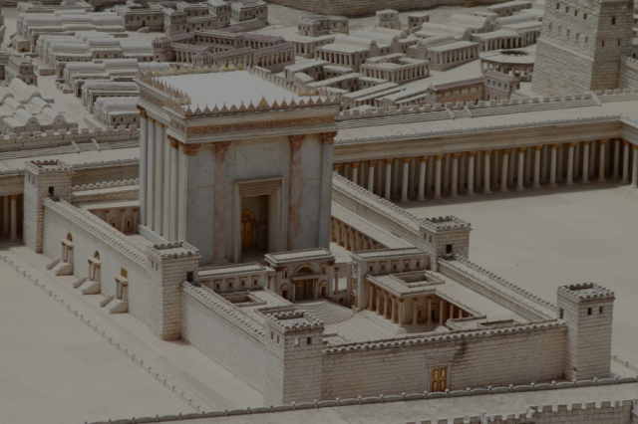
Matthew 24:15 (NLT)
"'The day is coming when you will see what Daniel the prophet spoke about—the sacrilegious object that causes desecration standing in the Holy Place.' (Reader, pay attention!)."
Jesus says that Daniel 9:27 was written by Daniel
Notes:
Some critics say Antiochus IV fulfilled Dan 9:27 in 167 BC when he desecrated the temple by offering a pig on the altar. Yet Jesus noted that the fulfillment was still future. I will take the word of Jesus over the critics.

Slide 153
Slides on
Matthew 25

Slide 154
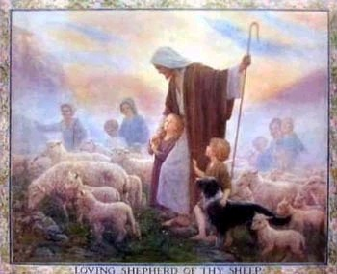
Judgment of the the Nations
(Sheep & Goats)
160
NLT Matthew 25:31 "But when the Son of Man comes in his glory, and all the angels with him, then he will sit upon his glorious throne. ³²All the nations will be gathered in his presence, and he will separate them as a shepherd separates the sheep from the goats. ³³He will place the sheep at his right hand and the goats at his left. ³⁴Then the King will say to those on the right, 'Come, you who are blessed by my Father, inherit the Kingdom prepared for you from the foundation of the world.'"

Slide 155
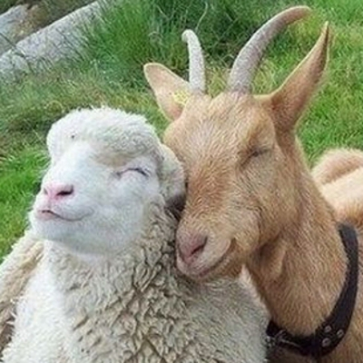
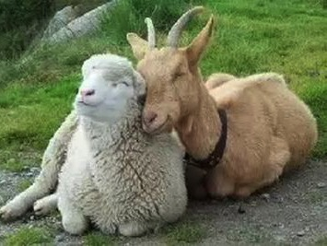
Aren't Sheep & Goats the Same?

Slide 156
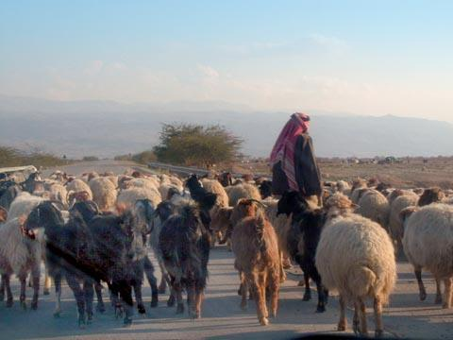
Judgment of the Nations
"All the nations will be gathered in his presence, and he will separate the people as a shepherd separates the sheep from the goats. ³³He will place the sheep at his right hand and the goats at his left"
(Matt. 25:31-32).

Slide 157

Judgment of Living Gentiles
³¹ "But when the Son of Man comes in his glory, and all the angels with him, then he will sit upon his glorious throne.
³² All the nations will be gathered in his presence, and he will separate the people as a shepherd separates the sheep from the goats. ³³ He will place the sheep at his right hand and the goats at his left.
³⁴ "Then the King will say to those on his right, 'Come, you who are blessed by my Father, inherit the Kingdom prepared for you from the creation of the world" (Matt. 25:31-34 NLT).

Slide 158
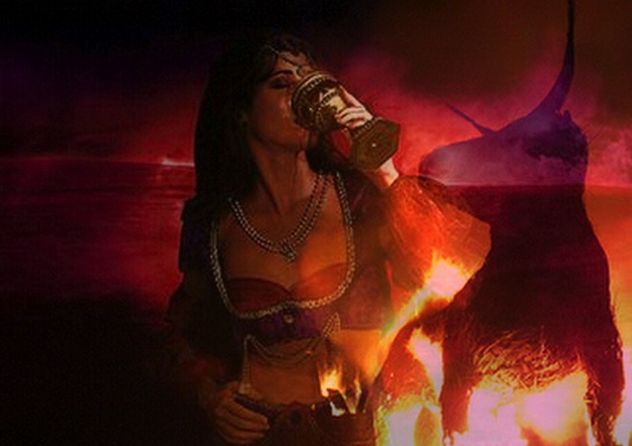
Judgment of Living Gentiles
⁴¹ "Then the King will turn to those on the left and say, 'Away with you, you cursed ones, into the eternal fire prepared for the devil and his demons. ⁴² For I was hungry, and you didn't feed me. I was thirsty, and you didn't give me a drink.
⁴³ I was a stranger, and you didn't invite me into your home. I was naked, and you didn't give me clothing. I was sick and in prison, and you didn't visit me.'
⁴⁴ "Then they will reply, 'Lord, when did we ever see you hungry or thirsty or a stranger or naked or sick or in prison, and not help you?'
⁴⁵ "And he will answer, 'I tell you the truth, when you refused to help the least of these my brothers and sisters, you were refusing to help me.' ⁴⁶ "And they will go away into eternal punishment, but the righteous will go into eternal life" (Matt. 25:41-46 NLT).

Slide 159
Olivet Discourse Overview
(Matt. 24–25)
27
First
Fall of Jerusalem
586 BC
Second
Fall of Jerusalem
AD 70
Rapture
1 Thess.
4:14-17
Third
Fall of Jerusalem
Second Coming with the Saints
Matt. 23:39; 24:30
Israel
Church Age
Tribulation
Millennium
The Great Tribulation
Dan. 9:27
Matt. 24:15
Judgment
of the Gentile Nations
Matt. 25:31-46
Israel Scattered Luke 21:24
Return to the Land
606 B.C.
Times of the Gentiles
Luke 21:24
Adapted from Salem Kirban
Charts on Revelation (1979), 48

Slide 160
Outline Finished
73
IV. (11:1–16:12) Christ is rejected as Messiah in anticipation of the final crucifixion rejection, so He introduces the Interadvent Age before His future reception and ministers to Gentiles to teach the postponement of the kingdom.
V. (16:13–20:34) Christ prepares His disciples regarding His Person and program in order that His Messianic authority might be delegated to them after His death.
VI. (Chs. 21–27) Christ's official presentation and rejection as Israel's King in His vicarious crucifixion show why the kingdom is postponed until His return.

Slide 161
Slides on
Matthew 26

Slide 162
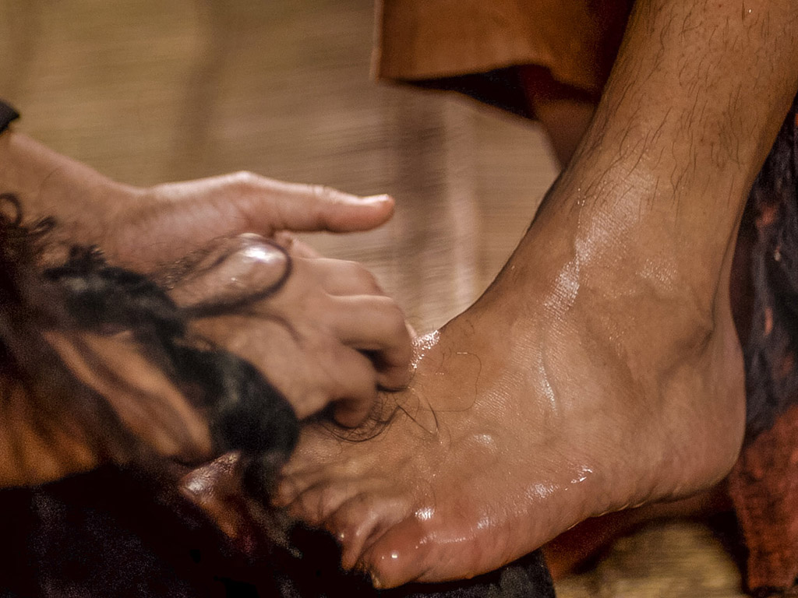
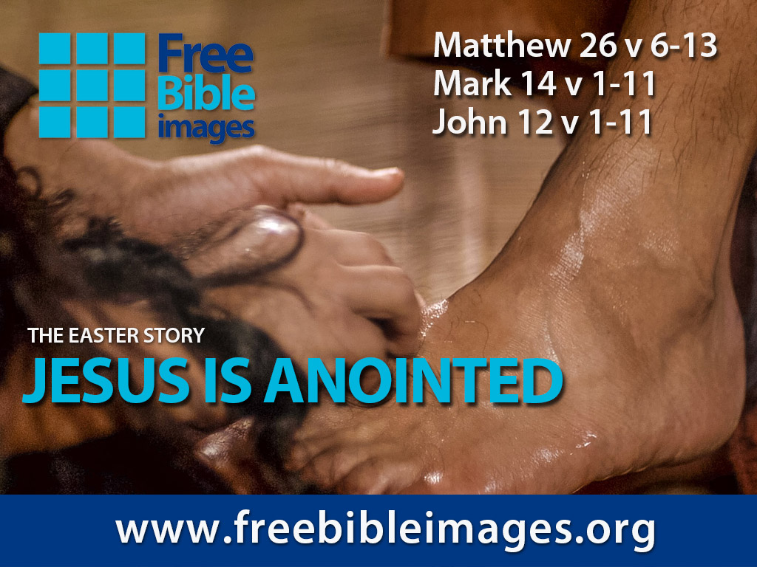
Broken & Spilled Out
Matthew 26:6-13
Mark 14:1-11
John 12:1-11
Free
Bible
images
Performed By Steve Green
JESUS IS ANOINTED

Slide 163
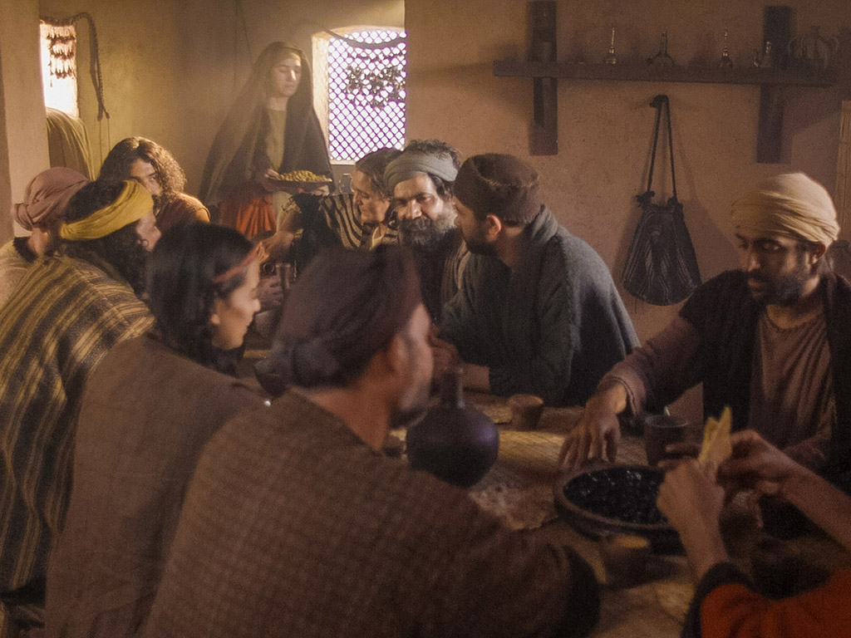
Notes:
Music background 1 of 2

Slide 164

Notes:
Music background 1 of 2

Slide 165

One day a plain village woman, driven by love for her Lord

Slide 166
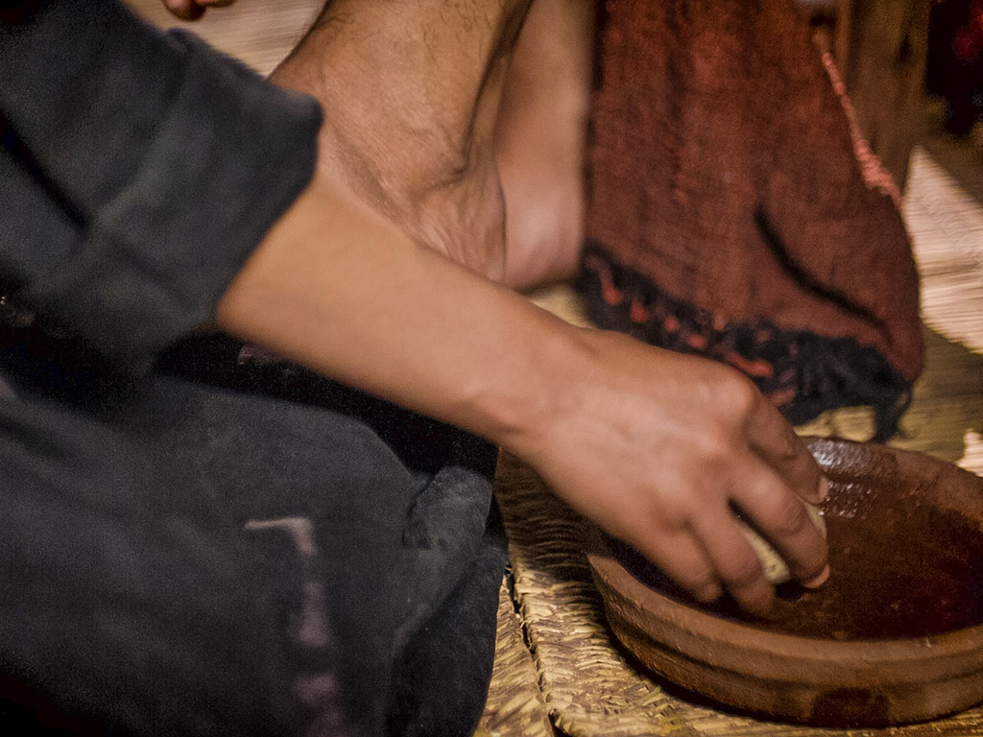
Recklessly poured out a valuable essence, disregarding the scorn

Slide 167
And once it was broken and spilled out
A fragrance filled all the room.
Like a prisoner released from his shackles
Like a spirit set free from the tomb

Slide 168
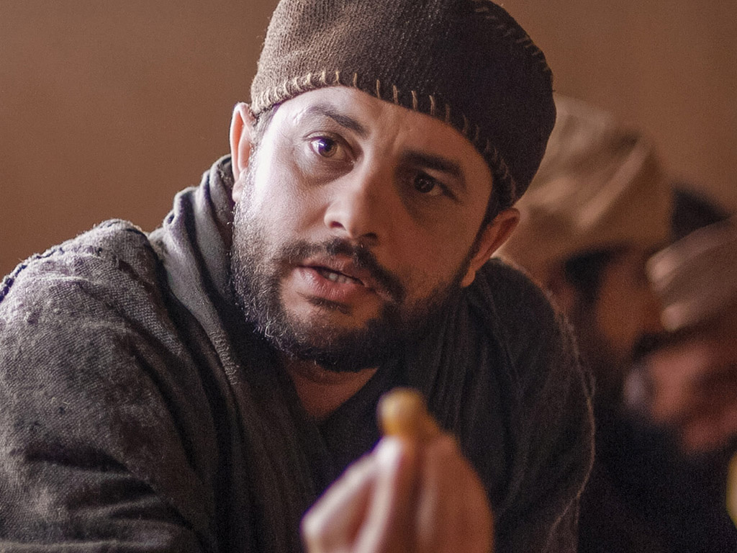
Broken and spilled out, just for love of you, Jesus
Life's most precious treasure, lavished on Thee

Slide 169
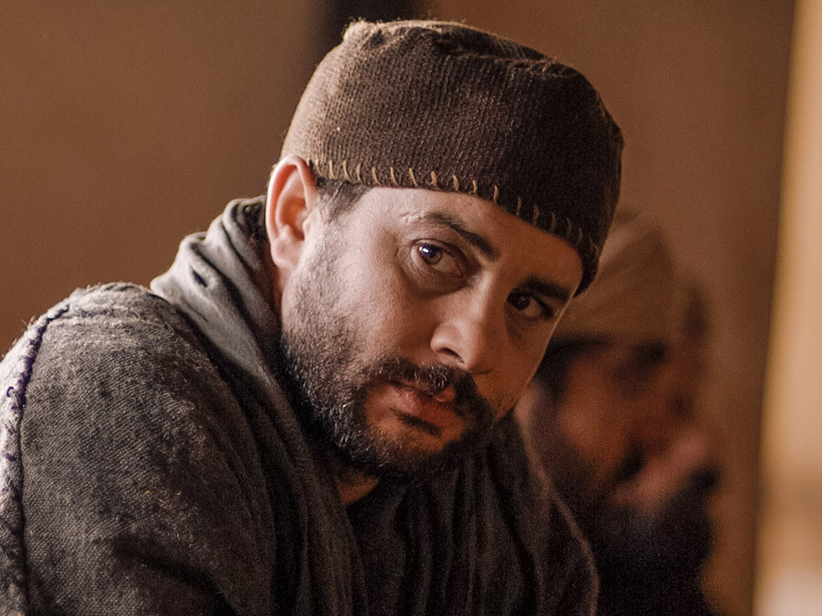
Broken and spilled out, and poured at Your feet
In sweet abandon
let me be spilled out
and used up for Thee

Slide 170
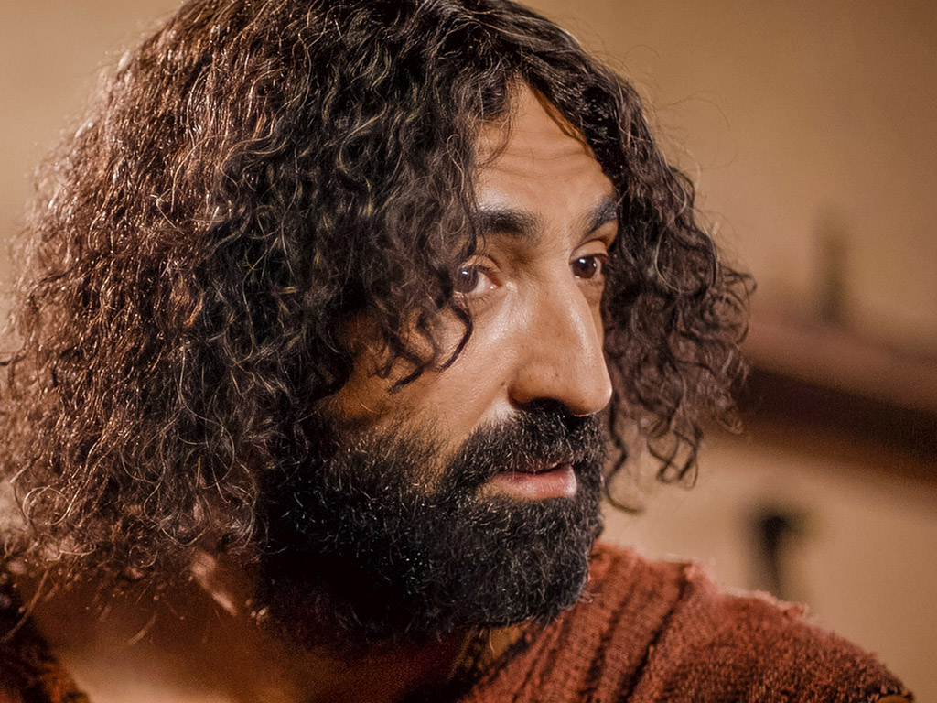
Lord, You were God's precious treasure,
His loved and His own perfect Son
Sent here to show me
the love of the Father,
just for love it was done

Slide 171
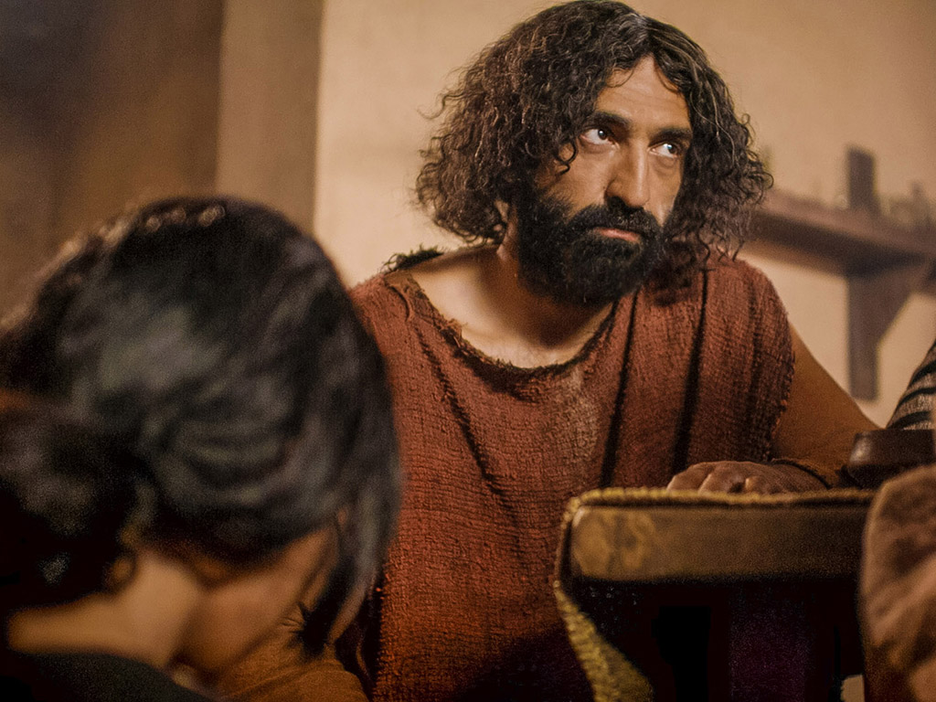
And though You were perfect and holy
You gave up Yourself willingly
You spared no expense for my pardon
You were used up and wasted for me

Slide 172
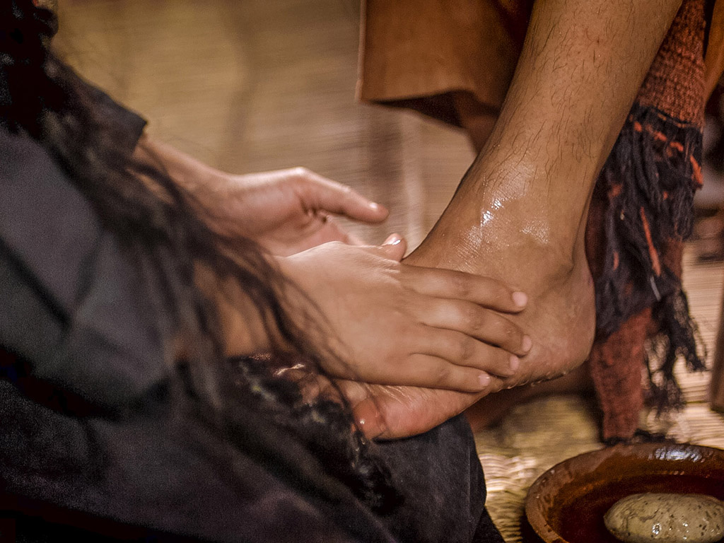
Broken and spilled out
Just for love of me, Jesus––
God's most precious treasure lavished on me

Slide 173
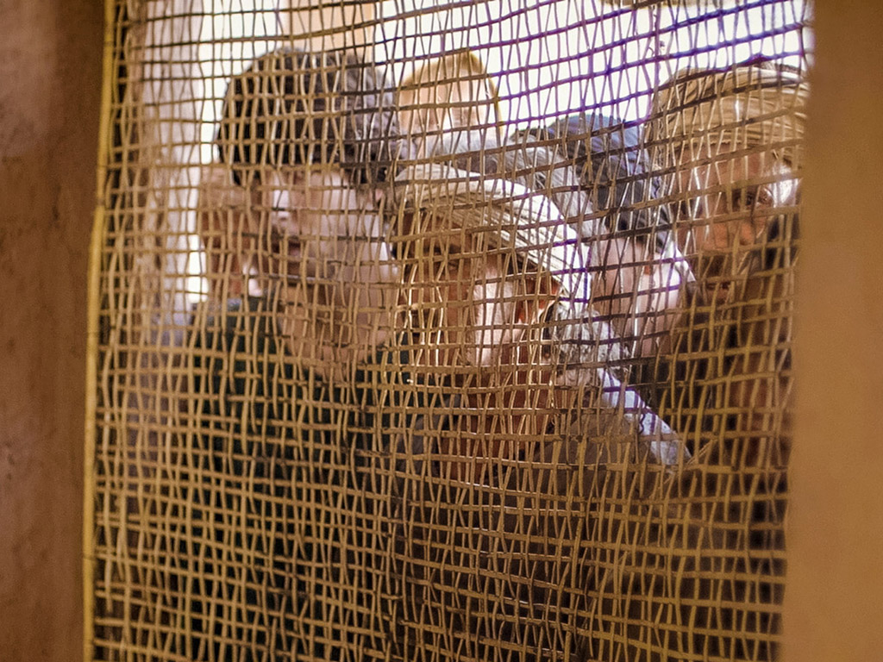
Broken and spilled out and poured at my feet.
In sweet abandon,
Lord, You were spilled out
and used up for me

Slide 174
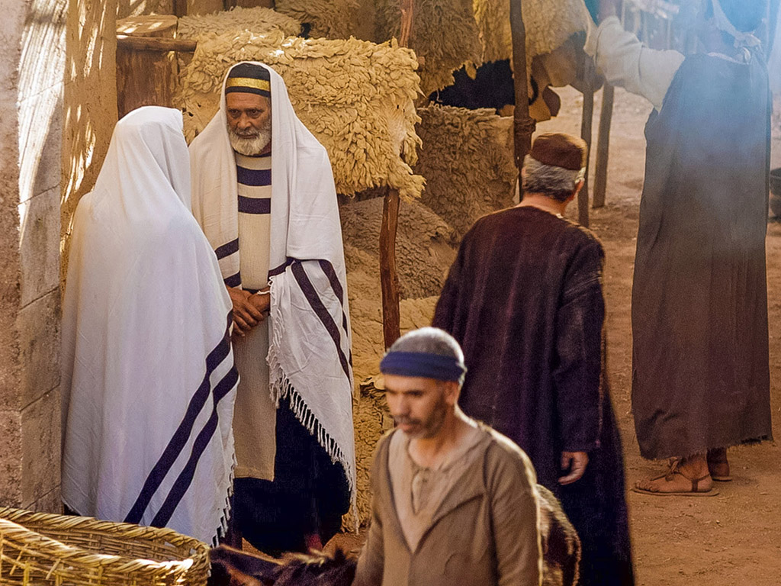
In sweet abandon, let me be spilled out and used up for Thee

Slide 175

Pictures courtesy of Big Book Media
© All Rights Reserved.
Used with permission
BIG BOOK MEDIA

Slide 176
THE WORD IN PICTURES
Free
Bible
images

Slide 177


Was Mary Magdalene the Woman with the Alabaster Jar?
The WOMAN
with the
ALABASTER JAR
Mary Magdalen and the Holy
Grail
No. In Luke she is not named but in the other gospels she is clearly Mary of Bethany
As featured in The
Da Vinci Code

Slide 178

John 12 Events
64
656
Unbelief Summary
12:37-50
Predicts Death
12:21-36
Triumphal Entry
12:12-20
Anointing at Bethany
12:1-11

Slide 179

Luke 7:36-50
Jesus and the Sinful Woman

Slide 180

Anointings of Jesus
Common to all four gospel accounts:
Unannounced visit by woman
Anointed Jesus' head and/or feet
Wiped his feet with her hair
Complaint of waste by disciples/Judas
Disciples rebuked by Jesus
In a home
Alabaster jar (except in John)
Home owned by man called Simon

Slide 181

The Two Anointings of Jesus
Luke 7:36-50
Early in Ministry
Weeping
For worship, woman's
sins forgiven (Luke 7:48)
By unnamed harlot at
home of Simon the
Pharisee (Luke 7:40) in
an unknown town
Matt. 26:6-13
Mark 14:3-9
John 12:1-11
During Passion Week
No weeping noted
For burial, woman needed
no forgiveness
By Lazarus' sister Mary at home of Simon the Leper
(Matt. 26:6; Mark 14:3) in Lazarus' hometown of Bethany (John 12:1)

Slide 182

Free
Bible
images
Matthew 26:17-35
Mark 14:12-31
Luke 22:7-38
John 13:18-38
THE EASTER STORY
THE LAST SUPPER

Slide 183


Slide 184


Slide 185


Slide 186


Slide 187


Slide 188


Slide 189


Slide 190


Slide 192


Slide 193


Slide 194


Slide 195


Slide 196


Slide 197


Slide 198
THE WORD IN PICTURES
Free
Bible
images

Slide 199

Free
Bible
images
Matthew 26:36-56
Mark 14:32-52
Luke 22:39-53
John 18:1-12
THE EASTER STORY
JESUS PRAYS IN GETHSEMANE

Slide 200


Slide 201


Slide 202


Slide 203


Slide 204


Slide 206


Slide 207


Slide 208


Slide 209


Slide 210


Slide 211


Slide 212


Slide 213


Slide 214


Slide 215


Slide 216


Slide 217


Slide 218


Slide 219


Slide 220
THE WORD IN PICTURES
Free
Bible
images

Slide 221
Used with Permission
THE
GOSPEL
——OF—— MATTHEW
THE
GOSPEL
——OF—— MARK
THE
GOSPEL
——OF—— LUKE
THE
GOSPEL
——OF—— JOHN
Due to the Lumo Project producing its own publishing material we regret to inform you that we cannot license our photos to other clients outside of freebibleimages.org.
These images are not licensed for reuse in video, epublishing or other media. Downloaded pictures and files cannot be redistributed through any other website than freebibleimages.org or used in any context where the accompanying message is undermining of the Christian faith and gospel.
Photos can only be used on educational presentations, blogs and social media, all of which should be accompanied with reference to www.LumoProject.com.
Picture courtesy of BBM
© All Rights Reserved.
www.bigbookmedia.com

Slide 222

Free
Bible
images
Matthew 26:57-67
Mark 14:53-65
Luke 22:66-71
John 18:15-27
THE EASTER STORY
JESUS BEFORE
THE SANHEDRIN

Slide 223


Slide 224


Slide 225


Slide 227


Slide 228


Slide 229


Slide 230


Slide 231
THE WORD IN PICTURES
Free
Bible
images

Slide 232
Used with Permission
THE
GOSPEL
——OF—— MATTHEW
THE
GOSPEL
——OF—— MARK
THE
GOSPEL
——OF—— LUKE
THE
GOSPEL
——OF—— JOHN
Due to the Lumo Project producing its own publishing material we regret to inform you that we cannot license our photos to other clients outside of freebibleimages.org.
These images are not licensed for reuse in video, epublishing or other media. Downloaded pictures and files cannot be redistributed through any other website than freebibleimages.org or used in any context where the accompanying message is undermining of the Christian faith and gospel.
Photos can only be used on educational presentations, blogs and social media, all of which should be accompanied with reference to www.LumoProject.com.
Picture courtesy of BBM
© All Rights Reserved.
www.bigbookmedia.com

Slide 233


Free
Bible
images
Matthew 26:69-75
Mark 14:66-72
Luke 22:54-62
John 18:15-27
THE EASTER STORY
PETER DENIES JESUS

Slide 234


Slide 235


Slide 236


Slide 237


Slide 238


Slide 239


Slide 240


Slide 241


Slide 242


Slide 244
Pictures courtesy of Big Book Media
© All Rights Reserved.
Used with permission
BIG BOOK MEDIA

Slide 245
THE WORD IN PICTURES
Free
Bible
images

Slide 246
Slides on
Matthew 27

Slide 247

Free
Bible
images
Matthew 27:27-37
Mark 15:16-25
Luke 23:26-34
John 19:16-27
THE EASTER STORY
JESUS IS CRUCIFIED

Slide 248


Slide 249


Slide 250


Slide 251


Slide 252


Slide 253


Slide 254


Slide 255


Slide 256


Slide 257


Slide 258


Slide 259


Slide 260


Slide 261


Slide 262


Slide 263


Slide 264
THE WORD IN PICTURES
Free
Bible
images

Slide 265
Used with Permission
THE
GOSPEL
——OF—— MATTHEW
THE
GOSPEL
——OF—— MARK
THE
GOSPEL
——OF—— LUKE
THE
GOSPEL
——OF—— JOHN
Due to the Lumo Project producing its own publishing material we regret to inform you that we cannot license our photos to other clients outside of freebibleimages.org.
These images are not licensed for reuse in video, epublishing or other media. Downloaded pictures and files cannot be redistributed through any other website than freebibleimages.org or used in any context where the accompanying message is undermining of the Christian faith and gospel.
Photos can only be used on educational presentations, blogs and social media, all of which should be accompanied with reference to www.LumoProject.com.
Picture courtesy of BBM
© All Rights Reserved.
www.bigbookmedia.com

Slide 266

Free
Bible
images
Matthew 27:38-66
Mark 15:25-47
Luke 23:35-56
John 19:28-42
THE EASTER STORY
JESUS DIES ON THE CROSS

Slide 267


Slide 268


Slide 269


Slide 270


Slide 271


Slide 272


Slide 273


Slide 275


Slide 276


Slide 278


Slide 279


Slide 280


Slide 281


Slide 282


Slide 283


Slide 284


Slide 285
THE WORD IN PICTURES
Free
Bible
images

Slide 286
Used with Permission
THE
GOSPEL
——OF—— MATTHEW
THE
GOSPEL
——OF—— MARK
THE
GOSPEL
——OF—— LUKE
THE
GOSPEL
——OF—— JOHN
Due to the Lumo Project producing its own publishing material we regret to inform you that we cannot license our photos to other clients outside of freebibleimages.org.
These images are not licensed for reuse in video, epublishing or other media. Downloaded pictures and files cannot be redistributed through any other website than freebibleimages.org or used in any context where the accompanying message is undermining of the Christian faith and gospel.
Photos can only be used on educational presentations, blogs and social media, all of which should be accompanied with reference to www.LumoProject.com.
Picture courtesy of BBM
© All Rights Reserved.
www.bigbookmedia.com

Slide 287

The Temple Veil

Slide 288

The Temple Veil Torn (27:51)

Slide 289
Why serve Jesus?

Slide 290
Amazing Names
Lord
Jesus
Christ
Notes:
We need to understand what it means for our Jesus to be the Lord Jesus Christ.
Do you agree that the name of Jesus is the most dishonored in the world? Few people swear by the name of any other religious or political or other leader.
Even Christians don't often think much about the three main names of Jesus noted 60 times in the NT.

Slide 291
Amazing Names
Jesus is the highest ruler in the world (Matt 1–10).
Christ
Notes:
[Jesus met every prophecy we should expect for him to prove he is King.]
[Christ means Messiah-Ruler, for he fulfilled each part of his job description.]
—What more would Christ need to do for you to trust him with your life?
—Have you been the victim of Christ’s first mistake? How?
—Do you see how statistically unlikely it was for Jesus to be the Messiah?

Slide 292
Amazing Names
Jesus is the highest authority in the Church (Matt 11–27).
Lord
Christ
Notes:
[As Master, he is the boss of every believer’s life.]
As a Christian, do you recognize Christ’s authority over you?
—Why do you do what you do in terms of your life work?
—How did you make that decision?
—What area of your life right now should you submit to his authority?

Slide 293
Amazing Names
Lord
Jesus
Christ
Jesus provided salvation by conquering death (Matt 28).
Notes:
[He lived up to his name and proved he could save us by rising from the grave.]
What impact does Christ’s resurrection have on you personally?
—Do you believe Jesus really came back from the dead?
—Have you ever sincerely studied the resurrection?
—Are you one of those disciples noted in Matthew 28:19?
—How can you better make disciples? Who should you disciple?

Slide 294
Slides on
Matthew 28

Slide 295
Outline Finished
73
IV. (11:1–16:12) Christ is rejected as Messiah in anticipation of the final crucifixion rejection, so He introduces the Interadvent Age before His future reception and ministers to Gentiles to teach the postponement of the kingdom.
V. (16:13–20:34) Christ prepares His disciples regarding His Person and program in order that His Messianic authority might be delegated to them after His death.
VI. (Chs. 21–27) Christ's official presentation and rejection as Israel's King in His vicarious crucifixion show why the kingdom is postponed until His return.
VII. (Ch. 28) Christ's victory over death confirms Him as the Messiah who should be believed by all throughout the entire world.

Slide 296

Matthew 28:1-15
Mark 16:1-20
Luke 24:1-47
John 20:1-29
Free
Bible
images
THE EASTER STORY
JESUS IS ALIVE

Slide 297


Slide 299


Slide 300


Slide 301


Slide 302


Slide 303


Slide 304


Slide 305


Slide 306


Slide 307


Slide 308


Slide 309


Slide 310


Slide 311


Slide 312


Slide 313


Slide 314


Slide 315
THE WORD IN PICTURES
Free
Bible
images

Slide 316
Used with Permission
THE
GOSPEL
——OF—— MATTHEW
THE
GOSPEL
——OF—— MARK
THE
GOSPEL
——OF—— LUKE
THE
GOSPEL
——OF—— JOHN
Due to the Lumo Project producing its own publishing material we regret to inform you that we cannot license our photos to other clients outside of freebibleimages.org.
These images are not licensed for reuse in video, epublishing or other media. Downloaded pictures and files cannot be redistributed through any other website than freebibleimages.org or used in any context where the accompanying message is undermining of the Christian faith and gospel.
Photos can only be used on educational presentations, blogs and social media, all of which should be accompanied with reference to www.LumoProject.com.
Picture courtesy of BBM
© All Rights Reserved.
www.bigbookmedia.com

Slide 317

A Prophetic Weekend
NTS 39
Thursday
Friday
Saturday
Sunday
Galilean
Passover
Unleavened Bread
Firstfruits
Judean
Passover
Unleavened Bread
Firstfruits
Last Supper
Crucifixion
Resurrection
2 April 33
3 April 33
5 April 33
Notes:
OB-25-Feasts-35; NB11-Feasts-35; NS-Mt15-28-S313; NS-Mk9-16-S274; NS-Lk13-24-S290; NS-Jn12-21-S260
Leviticus 23 gives the order of three key feasts of Israel: • Passover, • Unleavened Bread, and • Firstfruits.
• But how could Jesus have Passover Thursday night but then die at 3 PM the next day on Friday when the Passover lambs were being slaughtered? And why did the Jewish leaders want the bodies off the cross quickly as Passover was approaching when Jesus had already celebrated Passover the night before?
• The answer is that Galilean Jews celebrated Passover the day before • Judean Jews. Since his disciples were Galileans, Jesus naturally celebrated on their timetable.
• The Feast of Unleavened Bread always began the day after Passover (Lev 23:5-6).
• Then Firstfruits followed sometime later on the first Sabbath after the first crops began to ripen (Lev 23:11). It indicated that millions of additional sheaves would follow until the entire harvest came in at Pentecost. In AD 33, these three celebrations occurred one after another on three consecutive days!
The significance is astonishing. • Christ predicted his death at the Last Supper Thursday night. • Then Jesus died on the Judean Passover • so that believers can live a life without yeast (Unleavened Bread), • which immediately followed with his resurrection on Firstfruits as he is the first and only human ever to obtain a glorified body as an installment for millions more to follow (1 Cor 15:20)!
We know these dates to be • 2 April 33 for the Thursday night Passover, • 3 April 33 was the day of his crucifixion, and • Jesus rose from the dead on the Feast of Firstfruits on 5 April 33.

Slide 318


Guards Bribed (28:12)

Slide 319

Matthew 28:18-20 NLT
"Jesus came and told his disciples, 'I have been given all authority in heaven and on earth. ¹⁹Therefore, go and make disciples of all the nations, baptizing them in the name of the Father and the Son and the Holy Spirit. ²⁰Teach these new disciples to obey all the commands I have given you. And be sure of this: I am with you always, even to the end of the age.'"

Slide 320


The Great Commission
Matthew 28:18-20
¹⁸Then Jesus came to them and said, "All authority in heaven and on earth has been given to me. ¹⁹Therefore go and make disciples of all nations, baptizing them in the name of…, ²⁰and teaching them to obey everything I have commanded you. And surely I am with you always, to the very end of the age."
Notes:
Christ has all authority but he extends some of it to us as people under his authority. It may appear that there are four commands here, but "make disciples" is the only command here. This happens by us also obeying the three participles: going, baptizing, and teaching.

Slide 321
The Great Commission
Make Disciples
Going
Baptizing
Teaching
Salvation
Identification
Sanctification
Evangelism
Assimilation
Education
Believing
Bonding
Maturing
Find Them
Keep Them
Build Them
Adapted from Dr. Gary McIntosh, Church Growth Network 2014
Notes:
Most churches emphasize the third column and think only of teaching as discipleship; However, it includes going, baptizing, and teaching.
List the ministries in your church under their appropriate column. If it can't be listed under one of these, then eliminate that ministry.
Which of the three columns is weakest in your church? What can you do to strengthen this weak area?

Slide 322
Why serve Jesus?

Slide 323
Amazing Names
Lord
Jesus
Christ
Notes:
We need to understand what it means for our Jesus to be the Lord Jesus Christ.
Do you agree that the name of Jesus is the most dishonored in the world? Few people swear by the name of any other religious or political or other leader.
Even Christians don't often think much about the three main names of Jesus noted 60 times in the NT.

Slide 324
Amazing Names
Jesus is the highest ruler in the world (Matt 1–10).
Christ
Notes:
[Jesus met every prophecy we should expect for him to prove he is King.]
[Christ means Messiah-Ruler, for he fulfilled each part of his job description.]
—What more would Christ need to do for you to trust him with your life?
—Have you been the victim of Christ’s first mistake? How?
—Do you see how statistically unlikely it was for Jesus to be the Messiah?

Slide 325
Amazing Names
Jesus is the highest authority in the Church (Matt 11–27).
Lord
Christ
Notes:
[As Master, he is the boss of every believer’s life.]
As a Christian, do you recognize Christ’s authority over you?
—Why do you do what you do in terms of your life work?
—How did you make that decision?
—What area of your life right now should you submit to his authority?

Slide 326
Amazing Names
Lord
Jesus
Christ
Jesus provided salvation by conquering death (Matt 28).
Notes:
[He lived up to his name and proved he could save us by rising from the grave.]
What impact does Christ’s resurrection have on you personally?
—Do you believe Jesus really came back from the dead?
—Have you ever sincerely studied the resurrection?
—Are you one of those disciples noted in Matthew 28:19?
—How can you better make disciples? Who should you disciple?

Slide 327
MAIN IDEA OF MATTHEW
Serve the Lord Jesus Christ
Lord
Jesus
Christ
Notes:
Serve Jesus as Savior, God, and King of your life!

Slide 328
Amazing Names
Jesus is the highest authority in the Church (Matt 11–27).
Lord
Jesus is the highest ruler in the world (Matt 1–10).
Jesus
Christ
Jesus provided salvation by conquering death (Matt 28).

Slide 329
MAIN IDEA OF MATTHEW
Serve the Lord Jesus Christ
GOD
Lord
KING
Jesus
Christ
SAVIOR
Notes:
Serve Jesus as Savior, God, and King of your life!

Slide 330


Do you trust the King right now?
Before we can pray, "Lord, Thy kingdom come," we must be willing to pray, "My kingdom go."

Slide 331
Black

Slide 332


NT Preaching • BibleStudyDownloads.org
Get this presentation and script for free!

Slide 333

Since Jesus is king, then believers will rule with him!

Slide 334


Believers will rule the earth
(Rev. 5:10 NLT).
"And you have caused them to become a Kingdom of priests for our God. And they will reign on the earth."

Slide 335


Revelation 20:4-6 Diagrammed
424
^{4b}and they came to life and reigned with Christ for a thousand years.
^{4a}Then I saw thrones, and they sat on them, and judgment was given to them. And I saw the souls of those who had been beheaded because of their testimony of Jesus and because of the word of God, and those who had not worshiped the beast or his image, and had not received the mark on their forehead and on their hand…
1000 years
^{5b}This is the first resurrection. ^{6a}Blessed and holy is the one who has a part in the first resurrection; over these the second death has no power…
^{6b}but they will be priests of God and of Christ and will reign with Him for a thousand years.
^{5a}The rest of the dead did not come to life until the thousand years were completed.

Slide 336

Since Jesus fulfilled all the requirements to be Israel's king, we will rule with him!
Main Idea

Slide 337

Will you stand?

Slide 338

Jesus is both Lamb and Lion
Jesus Christ
Lamb of
God
Lion of
Judah

Slide 339

"I trust in your death for me."

Slide 340

Are you ready to rule?

Slide 341

Be faithful NOW

Slide 342

NT Survey link at biblestudydownloads.org
Get this presentation for free!

Slide 343
Black

