Slide 1
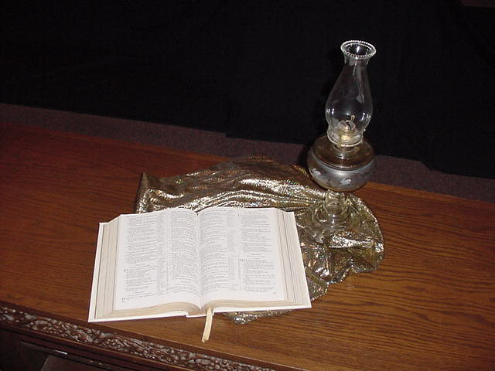
Exposition of the Gospels
Syllabus
Dr. Rick Griffith • Jordan Evangelical Theological Seminary • BibleStudyDownloads.org

Slide 2
Course Description
1
A study of Matthew, Mark, and John, emphasizing skills and principles for interpreting the Gospels and using them in preaching and teaching (3 hours)

Slide 3
Course Objectives
1
By the end of this course the student will be able to…
Give a walk through Matthew, Mark, and John by section.
Solve supposed discrepancies between the gospels to answer the Synoptic Problem.
Accurately interpret gospel genres such as parable, narrative, etc.
Explain from the gospels the nature and implications of the gospel message.
Summarize the key movements in the life of Christ and their significance.

Slide 4
Course Objectives
1
By the end of this course the student will be able to…
Write accurate exegetical outlines from gospel narratives with their relevant homiletical outlines.
Show the contribution of the gospels to the kingdom theme of Scripture.
Defend his/her view on the kingdom of God after studying alternate views.
Grow in loving adoration of Christ as Savior and Lord.

Slide 5
Course Requirements
1
Readings (10%)
Four Passage Outlines (40%)
Two Class Presentations (50%)

Slide 6
Course Design
5
Introduction
Presentations on Matthew & Mark
Presentations on John

Slide 7
Other Matters
7
Copying Class Notes
Contacting Me
At SBC box L19 or phone (6559-1513).
Home address
Home phone number is 6458-6158
E-mail: Griffith@sbc.edu.sg
My office hours are…
Let’s have lunch too!

Slide 8
The New Testament Bookshelf
22
The Gospels
History
Matthew
Mark
Luke
John
Acts
Letters by Paul
1 Thessalonians
2 Thessalonians
1 Corinthians
2 Corinthians
Philippians
Ephesians
Colossians
1 Timothy
Romans
Galatians
2 Timothy
Philemon
Titus
General Letters
Prophecy
Hebrews
1 Peter
2 Peter
1 John
2 John
3 John
James
Jude
Revelation
Notes:
What overall observations can you make in your small group for the NT?
• There are 5 parts to the NT (grouped by category)
• 4 versions of Christ's life but only one of the church
• Most the NT are letters (especially by Paul)
• 6 of Paul's 13 letters are to people he wrote twice (follow-up for Cor., Thess., & Tim.)
• 2 groupings (general epistles & gospels) named after their authors while Paul's after their recipients

Slide 9
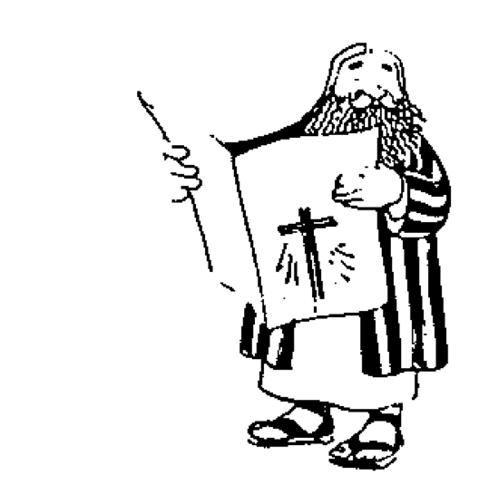
The New Testament “Building”
21
Paul's Letters to Pastors
 | 1 Timothy | 2 Timothy | Titus |  | Philemon
Paul's Letters to Churches | 2 Thessalonians |  |  |  | Revelation | General Letters
 | 1 Thessalonians |  |  |  | Jude
 | Colossians |  |  |  | 3 John
 | Philippians |  |  |  | 2 John
 | Ephesians |  |  |  | 1 John
 | Galatians |  |  |  | 2 Peter
 | 2 Corinthians |  |  |  | 1 Peter
 | 1 Corinthians |  |  |  | James
 | Romans |  |  |  | Hebrews
 | Acts
 | Matthew | Mark |  | Luke | John
Historical Books
Adapted from Walk Thru the Bible
Notes:
What overall observations on the NT can you make from this diagram?
Gospels and Acts form the primary and secondary foundations of the NT.
On the historical foundation are two pillars of 9 books each.
Paul's letters to churches in the left pillar all fit into Acts.
Paul didn't write any inspired letters to churches after Acts.
Pauline letters are named after recipients while General after authors (except Hebrews)
The four gospels are named after their authors.
Every book that ends in "ns" is Pauline
All Pastoral Epistles begin with "T”
______
General Epistles came after Acts (except James).
Each of the 2 pillars begin with a foundational book: Romans & Hebrews (also their longest).
Both pillars also end up in books that primarily deal with eschatology: 2 Thess and Revelation.
Instruction to the leaders comprise only 4 books (i.e., the NT addresses the average Christian).
Only 4 NT books are written to an individual (i.e., the NT is corporate, not individualistic).
Each 1st of multiple letters (1-2 Cor., 1-2 Thess., etc.) is longer & more theologically significant.
The “building” is chronologically clockwise.
________
Three sections all have 9 books: 9 Historical/Pastoral + 9 Pauline + 9 General.
Audiences of the Pauline column had more Jews than the Gentile readers of the General column.
Pauline letters addressed early Christians when eyewitnesses to Jesus lived but General letters mostly addressed second generation believers.
The NT foundation rests on books about the life of Christ, as Jesus is the focus of the NT.

Slide 10
The Fours Gospels Compared
52
 | Matthew | Mark | Luke | John
Job before Saved | Tax Collector | None (Youth) | Medical Doctor | Fisherman
Race | Jew | Jew | Gentile | Jew
Office and / or Spiritual Gift | Apostle | Service or Pastoring | Service or Teaching | Apostle
Readers:
Ethnically | Jews | Roman | Gentile (Greek) | World
Interest | Signs (1 Cor. 1:22) |  | Wisdom (1 Cor. 1:22)
Spiritually | Unbelievers | Believers | Unbelievers | Unbelievers
Primary Need | Messiahship and Kingdom Offer | Model in Suffering (exhorts discipleship) | Universality (and kingdom expansion) | Deity

Slide 11
The Four Gospels Compared
52
 | Matthew | Mark | Luke | John
Date Written | 40s | 64-68 | 57-59 | late 60s
Place Written | Antioch or Syria | Rome | Caesarea or Rome | Ephesus
Place Sent | Palestine | Rome | To Theophilus | Asia, etc.
Jesus is… | King of Israel (Messiah) | Suffering Servant (Deity) | Ideal Man (Messiah) | Son of God (Deity)
Key Verse | 21:5 | 10:45 | 19:10 | 20:31
Themes | Law | Power | Grace | Glory
Literary Emphasis | Sermons | Miracles | Parables | Allegories
Arrangement | Topical | Chronological | Chronological | Topical
Genealogy | Abraham to Joseph | None | Adam to Mary | None

Slide 12
The Four Gospels Compared
52
 | Matthew | Mark | Luke | John
Scope | Birth to Resurrection | Ministry to Resurrection | Ministry to Resurrection | Ministry to Resurrection
Tone | Prophetic | Pastoral | Historical | Spiritual
Christ's Words | 60% | 42% | 50% | 50%
Chapters | 28 | 16 | 24 | 21
Verses | 1068 | 661 | 1149 | 878
Verses per Chap. | 38 | 41 | 48 | 42
OT Quotations | 53 | 36 | 25 | 20
OT Allusions | 76 | 27 | 42 | 105
OT References | 129 | 63 | 67 | 125
Unique Material | 42% | 7% | 59% | 92%
Broad Division | ------------------- Synoptic Gospels ------------------- |  |  | Supplemental Gospel

Slide 13
NT Overview
38 124 39-41
"To the remotest part of the earth" (Acts 1:8)
Acts 9 13 14 15 16 18 21 27 28
Apr 48- Sep 49
1 Galatia
Apr 50- Sep 52
2 Aegean
Spr 53- May 57
3 Asia
Feb 60- Mar 62
1 Rome
Spr 62- Fall 67
4 Spain
Aut 67- Spr 68
2 Rome
Summer 35- 37
Damascus Antioch
May 57- Aug 59
Trials
Fall 49
The
Council
Spring 68
Expansion of Church
35 48 49 50 52 53 57 60 62 67 68 95
Matt
Luke
Acts
Mark
John
Gal
1 Thess
1 Cor
Eph
1 Tim
2 Tim
Jude
James
2 Thess
2 Cor
Col
Titus
Heb
1 John
Romans
Philem
1 Pet
2 John
Gospels & Acts
Phil
2 Pet
3 John
Pauline Epistles
1234
Journeys
Rev
General Epistles
Rome
Imprisonments
No Animations

Slide 14
NT Book Key Words
24
Date | Book | Key Word | Paul's Life | Key Doctrine
40s | Matthew | Kingdom |  | Ecclesiology
44-47 | James | Works |  | Soteriology
49 | Galatians | Justification | 1st journey | Soteriology
51 | 1 Thessalonians | Rapture | 2nd journey | Eschatology
51 | 2 Thessalonians | Tribulation | 2nd journey | Eschatology
56 | 1 Corinthians | Sanctification | 3rd journey | Ecclesiology
56 | 2 Corinthians | Apostleship | 3rd journey | Ecclesiology
56-57 | Romans | Righteousness | 3rd journey | Soteriology
57-59 | Luke | Sovereignty I |  | Missiology

Slide 15
NT Book Key Words
24
Date | Book | Key Word | Paul's Life | Key Doctrine
60 | Ephesians | Unity | 1st imprisonment | Christology (Head)
61 | Colossians | Deity | 1st imprisonment | Christology (God)
61 | Philemon | Forgiveness | 1st imprisonment | Christology (Reconciler)
62 | Philippians | Attitude | 1st imprisonment | Christology (Example)
62 | Acts | Sovereignty II |  | Missiology
62 | 1 Timothy | Order | 4th journey | Ecclesiology
64 | 1 Peter | Suffering |  | Eschatology
64 | 2 Peter | Knowledge |  | Eschatology
64-68 | Mark | Discipleship |  | Eschatology

Slide 16
NT Book Key Words
24
Date | Book | Key Word | Paul's Life | Key Doctrine
66 | Titus | Conduct | 4th journey | Ecclesiology
67 | 2 Timothy | Doctrine | 2nd imprisonment | Ecclesiology
67-68 | Hebrews | Superiority |  | Christology
c. 69 | John | Belief |  | Soteriology
75 | Jude | Pretenders |  | Eschatology
85-95 | 1 John | Love |  | Soteriology
85-95 | 2 John | Limits |  | Missiology
85-95 | 3 John | Missionaries |  | Missiology
95-96 | Revelation | Triumph |  | Eschatology

Slide 17
Black

Slide 18
Gospels link at BibleStudyDownloads.org
Get this presentation for free!
Notes:
NT Survey (ns)

