Slide 1
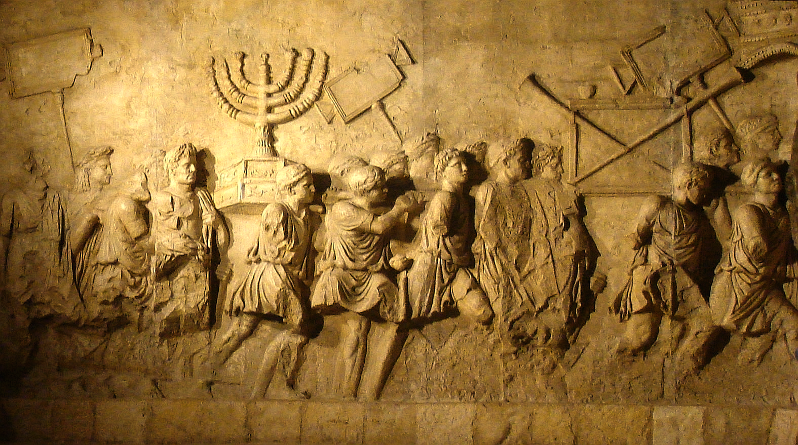
How the Nations Treat Israel
Hating Jews Through the Centuries
Dr. Rick Griffith • Jordan Evangelical Theological Seminary
BibleStudyDownloads.org

Slide 2
What is Antisemitism?

Slide 3
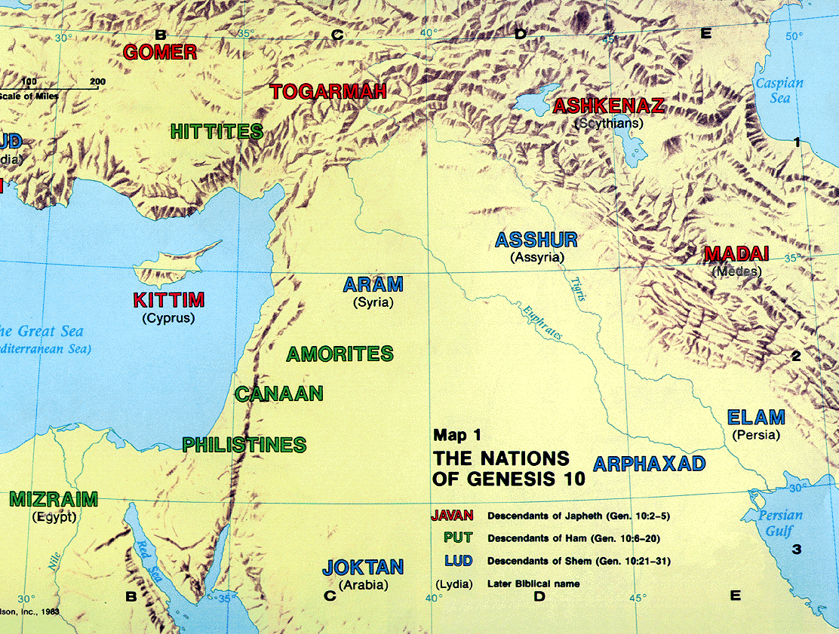
The Table of Nations
92
NOAH
Sino
Japheth
HAM
SHEM
Sin
Caucasians
Canaanites
Semites
Sinai
Europeans &
East Indians
Africans &
Asians
Jews &
Arabs
Genesis 10
Notes:
Noah’s three sons became three divisions of humanity in three major areas.
Asians stem from Canaanites in the city of Sin—not those who migrated south to the Sinai but those who migrated east to China. Here is why we have these terms of Sinai and East Asians called Sino.
_____________
ES-29-How the Nations Treat Israel-4
BG-03-Table of Nations-3
OS-01-Gen4-20-slide 149
OS-13-1Chron-74
4, 149, 150
Sura 37.99-113 claims that Abraham offered Ishmael.
The Bible promises blessing to both Ishmael and Isaac, but only Isaac is promised to BE a blessing.

Slide 4
How has the world treated the Jews?

Slide 5
How has the world treated the Jews?
Pharaohs
Philistia
Assyrians
Babylonians
Persians
Greeks
Romans
Catholics
Terrorism
Crusaders
Spaniards
Lutherans
Germans
Europeans
MENA
The UN
Neighbors
Land ownership
Canadians
US Left Wing
The World

Slide 6
Pharaohs
Persecutors of Jews…

Slide 7
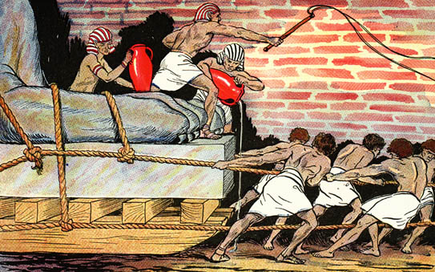
Egyptians Ruthlessly Oppressed Israel

Slide 8
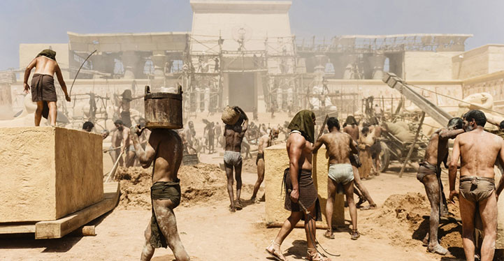
"For you will break the yoke of their slavery and lift the heavy burden from their shoulders" (Isa. 9:4a NLT).

Slide 9
Philistia
Persecutors of Jews…

Slide 10
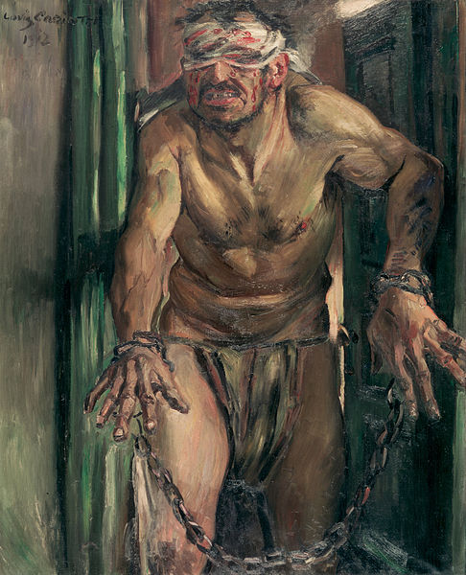
Samson's Haircut

Slide 11
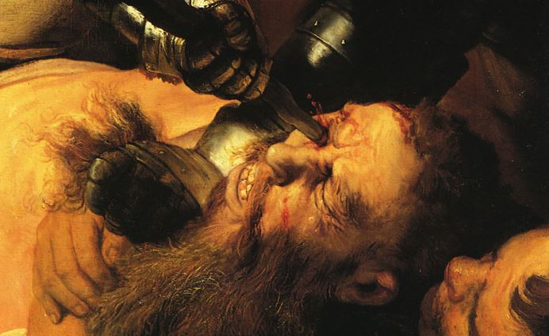
Samson's Eyes Cut

Slide 12
Assyrians
Persecutors of Jews…

Slide 13
The Assyrian Threat
454
Assyrian Expansion
Nineveh
Mediterranean
Sea
Aram
Israel
Judah
Isaiah 7
Persian
Gulf
Egypt
Notes:
13
The Assyrian Empire—like most empires—developed in stages. Theirs was a westward expansion that conquered many areas, some of which are noted in Isaiah 7 such as Israel and Syria. A total of 12 nations allied to fight Assyria, but Isaiah 13-23 lists their alliance as a futile attempt since God destined the Assyrians to destroy them all.
Nineveh repented 100 years earlier than Nahum under Jonah but then went back to its sin.
Assyrians invaded Israel 60 years earlier than Nahum during Isaiah's day and scattered the people.
Then they destroyed 46 towns of Judah—all but Jerusalem in 701 BC!
———————
Common-322
BG-03-Table of Nations & OT Peoples-37
OS-23-Isaiah1-12-slide 107
OS-34-Nahum-38

Slide 14
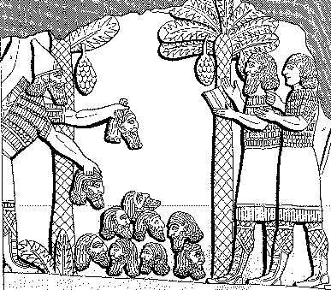
Assyrian Brutality
Assyrian
614
Brutality
"A pyramid of heads I reared in front of his city. Their youths and their maidens I burnt up in the flames."
Shalmaneser, 859-824 BC = 80 years before Jonah, in
Luckenbill, Ancient Records of Assyria and Babylonia, 1:213

Slide 15
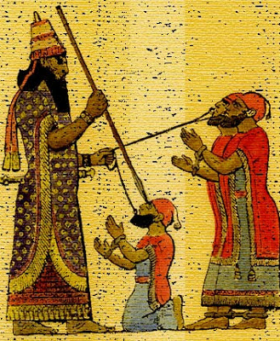
Treatment of Captured Kings
614
"Assyrian execution might involve tortures such as flaying…pulling out the lying tongue, burning, or…"
"I pierced his chin with my keen hand dagger. Through his jaw… I passed a rope, put a dog chain upon him and made him occupy a kennel."
Ashurbanipal, 669-626 BC = 100 years after Jonah, in
Luckenbill, Ancient Records of Assyria & Babylonia, 2:319

Slide 16
Assyrian Developments
And the king of Assyria transported groups of people from Babylon, Cuthah, Avva, Hamath, and Sepharvaim and resettled them in the towns of Samaria, replacing the people of Israel. So the Assyrians took over Samaria and the other towns of Israel
(2 Kings 17:24).
Finally, in the ninth year of King Hoshea's reign, Samaria fell, and the people of Israel were exiled to Assyria. They were settled in colonies in Halah, along the banks of the Habor River in Gozan, and among the cities of the Medes
(2 Kings 17:6).
48
Fall of Samaria
Rise of Samaritans
Beitzel, Moody Atlas of Bible Lands, 1st ed., 139
Notes:
• Fall of Samaria: Assyria conquered in all directions, but especially westward, including Israel when Samaria fell in 722 BC.
• "Finally..." (17:6): Most of the people were deported to other lands, but a few remained.
• Rise of Samaritans: Assyrians brought other conquered peoples into Israel’s territory.
• "And the king..." (17:24): Intermarriage between the few remaining Jews and these pagan peoples brought about a mixed race of half-Jews and half-Gentiles. They were named after the former capital and thus called Samaritans. Full-blooded Jews despised them.
______________
Common-415
OS-12-2 Kings-250
OS-14-2 Chron-346
OS-23-Isaiah13-23—slide 71
OS-24-Jeremiah-242
OS-32-Jonah-39
NB-05 Politics 2 Ptolemies to 63 BC (Pompey)-4

Slide 17
Babylonians
Persecutors of Jews…

Slide 18
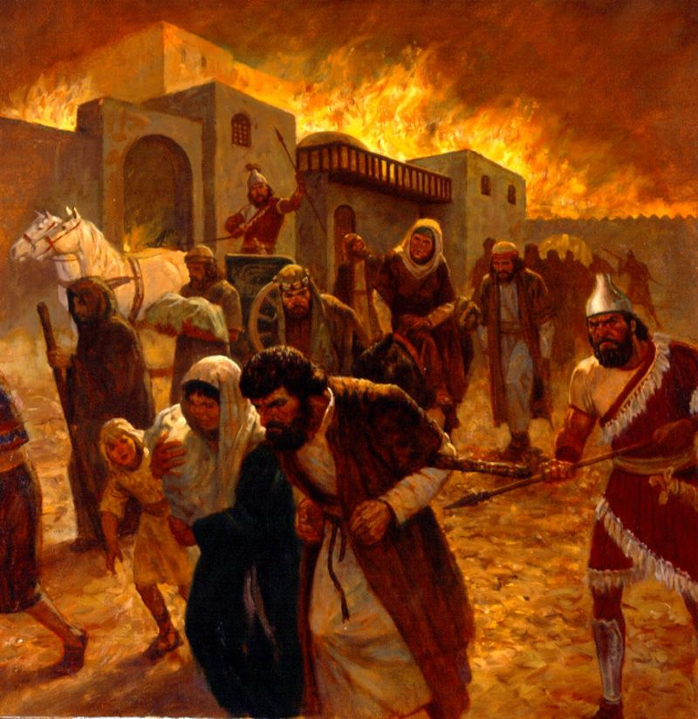
The Exile
Notes:
Babylonians drove Jews outside their land for 70 years.
__________
ES-29-Antisemitism-18
OS-26-Ezek1-3-slide 144
OS-27-Daniel-188

Slide 19
Babylonian Rule over Israel
56
Deportations
Developments
Separation
Synagogue
No more idolatry
Beitzel, Moody Atlas of Bible Lands, 1st ed., 145
Notes:
• Babylonians deported those left in Jerusalem to Babylon (cf. Dan 1).
• Jews in Babylon resulted in the term “Judaism,” with three key developments:
• They resisted intermarriage with the pagan peoples.
• They established local places of teaching (but no sacrifices) called synagogues (=“together marketplace”)
• Despite living in the most idolatrous city ever, they were cured of idol worship!
• Babylonians deported those left in Jerusalem to Babylon (cf. Dan 1).
• Jews in Babylon resulted in the term “Judaism,” with three key developments:
• They resisted intermarriage with the pagan peoples.
• They established local places of teaching (but no sacrifices) called synagogues (=“together marketplace”)
• Despite living in the most idolatrous city ever, they were cured of idol worship!
But the people and temple exiles were not permanent. God promised to restore them because the exiles would last only 70 years, and the time and opportunity to return had come to return home. Remember centuries earlier when Israel entered Canaan and had 600,000 soldiers? Now, only 50,000 men of Judah had trusted the LORD to bring them back to Israel.
In some sense, you can’t blame them for not many of them wanting to return. They had separated from idolatry, developed the synagogue, and been cured of idolatry. Besides these, they were making good money in Babylon—so who would want to return to a ruined country? No money, no homes, no friends—just enemies occupying their country now. But they still came, and they trusted God’s leading. They eagerly rebuilt the temple foundation and altar in 536 BC.
______________
Common-416
BE-35-Haggai-10
OS-12-2 Kings-241
OS-14-2 Chron-317
OS-25-Jeremiah-237
NB-05 Politics 2 Ptolemies to 63 BC (Pompey)-5

Slide 20
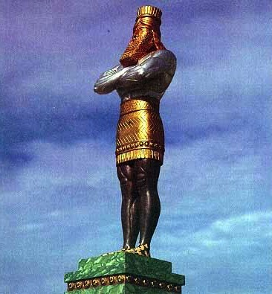
The Image of Daniel 2 is Apocalyptic too
Gold
Babylon
Silver
Persia
Bronze
Greece
Iron
Rome
Iron & Clay
Antichrist
Stone
Kingdom
Notes:
\While Babylon was depicted by gold, even Babylon would fall to Christ’s kingdom!

Slide 21
Persians
Persecutors of Jews…

Slide 22
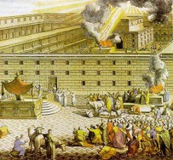
The Postexilic Era
295 296 560
The Postexilic Era
Temple work
Prophets:
Haggai
Zechariah
Malachi
605
586
539
536
520
516
483-473
444-425
72 years
Others:
Zerubbabel
Esther
Ezra
Nehemiah
Persian Kings:
Cyrus
Darius
Xerxes
Artaxerxes
Notes:
The Post-Exilic Era involved three separate periods: (1) Temple rebuilding led by Zerubbabel, Haggai, and Zechariah in two parts under Cyrus and Darius,
(2) The saving of the nation from destruction by Esther about 30 years later under Xerxes, and
(3) The restoration of Jerusalem’s walls and gates by Nehemiah another 72 years after that under Artaxerxes.
_________
Common-321
BE-37-Haggai-15
BE-39-Malachi-21
OS-12-Kings & Prophets Charts-24
OS-15-Ezra-36
OS-16-Nehemiah-94, 156
OS-17-Esther-16, 75
OS-26-Ezek33-39—slide 85
OS-27-Daniel-340
OS-37-Haggai-25, 43
OS-38-Zechariah-46, 121
OS-39-Malachi-13, 56

Slide 23
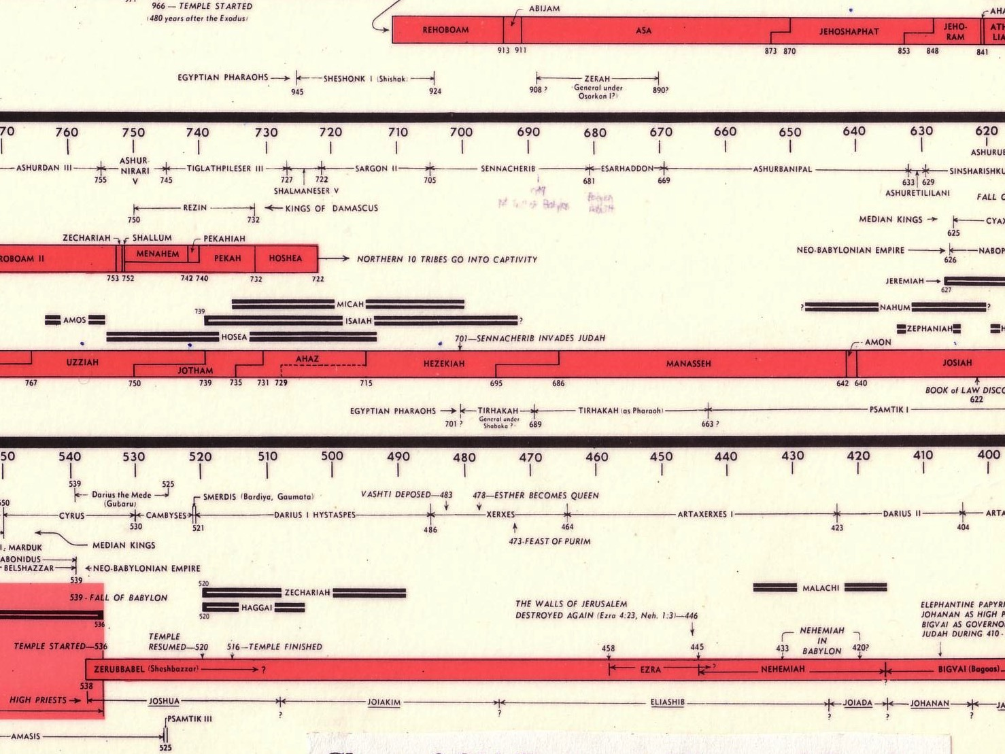
Opposition Timeline (Ezra 4; Esther 1; Neh 13)
232 342
Zerubbabel Under Cyrus 536-520 BC
Esther Under Xerxes 486 BC
Ezra Under Artaxerxes ±460 BC
Nehemiah Under Darius (internal) ±430 BC
Chart of Old Testament Kings & Prophets
John C. Whitcomb, 4th ed. (Winona Lake, IN: BMH Books, 1968), 2
Notes:
"﻿The terminology in the biblical copies of letters to and from the Persian court is directly comparable with what we find in the external, firsthand documents. Inferiors call themselves the “servant(s)” of superiors and kings; the idiom for issuing decrees (sam t’e’em) is the same; the body of the typical Official Aramaic letter begins with the phrase “Peace (sh-l-m) and much well-being I send you,” which is what is presupposed in Ezra 4:17 (lit. “Peace, etc.”), where the formula is abbreviated for brevity’s sake.39 And so on, we may also say, on this topic. The form or stage of language of Aramaic used in Ezra and Daniel is precisely that used in the Neo-Babylonian and Persian period (sixth to fourth centuries), and is currently termed Official Aramaic. In the Old Testament the sole difference is that the spelling has been consistently modernized, to bring it into line with the Aramaic otherwise in popular use among the Jews by the third century.”
K. A. Kitchen, On the Reliability of the Old Testament. Grand Rapids, MI: Eerdmans, Kindle Edition. Loc 1892 of 14432.
________
Common English-168
OS-37-Ezra-87
OS-38-Nehemiah-407
OS-39-Esther-54

Slide 24
Haman the Agagite (Esther 3:1-2)
Notes:
"Some time later King Xerxes promoted Haman son of Hammedatha the Agagite over all the other nobles, making him the most powerful official in the empire. ² All the king’s officials would bow down before Haman to show him respect whenever he passed by, for so the king had commanded. But Mordecai refused to bow down or show him respect" (3:1-2 NLT).
"Because Haman was an Agagite, some have supposed that he was descended from Agag, king of the Amalekites (1 Sam. 15:8). However, it seems unlikely that a high-ranking Persian official would be related to a west Semite who lived 600 years earlier. Archeologists have uncovered an inscription which indicates that Agag was also the name of a province in the Persian Empire. This probably explains why Haman was called an Agagite" (John A. Martin, "Esther," Bible Knowledge Commentary, 1:705).

Slide 25
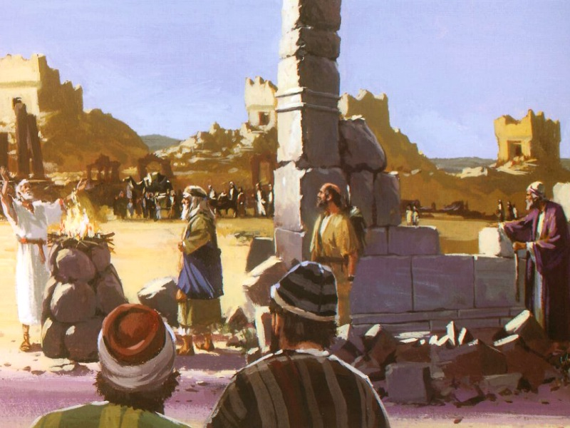
God's work was opposed (Ezra 4:1-2)

Slide 26
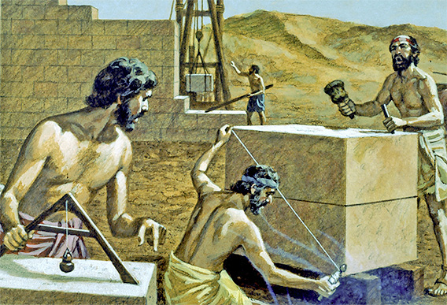
God's work is always opposed

Slide 27
Greeks
Persecutors of Jews…

Slide 28
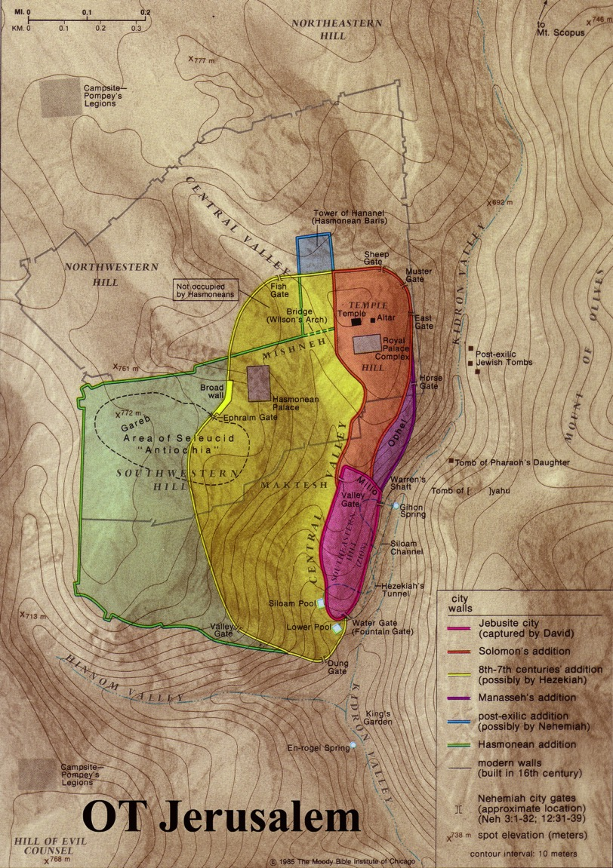
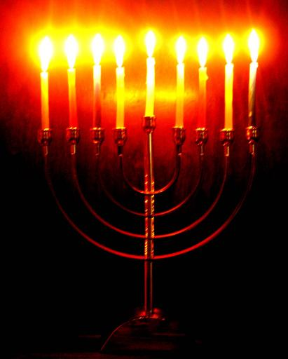
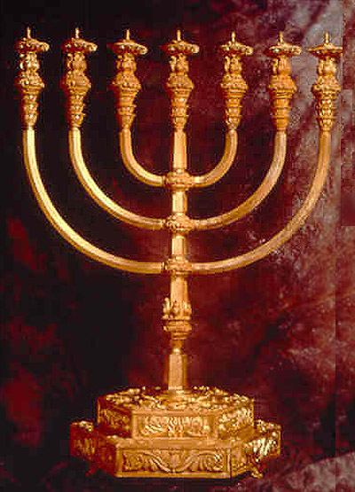
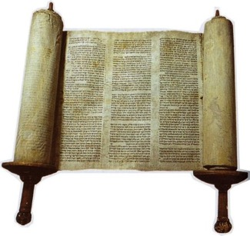
Jerusalem Hellenization
65
Dec 167- Dec 164
Hanukkiah
Menorah
The Feast of Lights (Dedication)
Notes:
Greek rule over Israel came to a height when Antiochus IV vented his anger at being defeated by Rome upon the Jews of Jerusalem.
• Jews had long considered the Torah sacred...
• But Antiochus prohibited Scripture readings.
• He even sacrificed a pig on the Jerusalem altar to desecrate it.
• For three years, the temple became a pagan altar (Dec 167-Dec 164).
• Finally, Jews took back the temple when the one-day supply of lampstand oil miraculously lasted 8 days!
• This led to victory over the Greeks and the commemoration of their victory with 8 lampstand arms (hanukkiah) instead of the normal 7-branched menorah.
• Each December, Jews celebrate their victory at the Feast of Lights or Dedication (or Rededication) to remember their oppression by the Greeks.
_______________
ES-29-Antisemitism-28
NB-05-Politics2 Ptolemies to 63 BC (Pompei)-23

Slide 29
Romans
Persecutors of Jews…

Slide 30
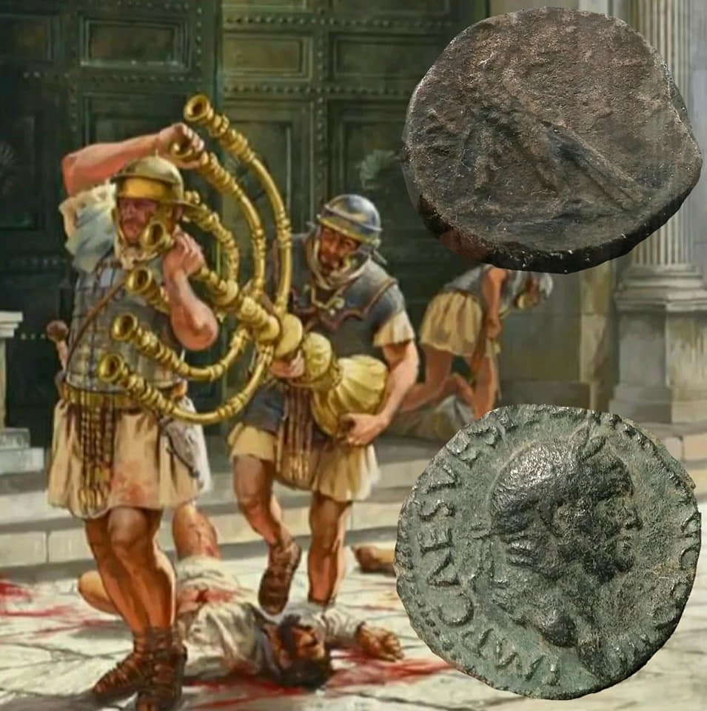
Romans destroyed the Jewish temple in AD 70 and made Jerusalem pagan in AD 132
Rome even renamed Israel as Palestina after the Philistines who came from the Aegean Sea to seek to erase any Jewish claim to the city!

Slide 31
Catholics
Persecutors of Jews…

Slide 32
Catholic Theology & Practice
Said "The Church is the New Israel"
Replaced Israel
Disdained Jews
Oppressed Jews

Slide 33
Terrorism
Persecutors of Jews…

Slide 34
thereligionofpeace.com
9 Nov 2023
Daily Updates of Islamic Terror Against Jews, Christians, etc.

Slide 35
Crusaders
Persecutors of Jews…

Slide 36
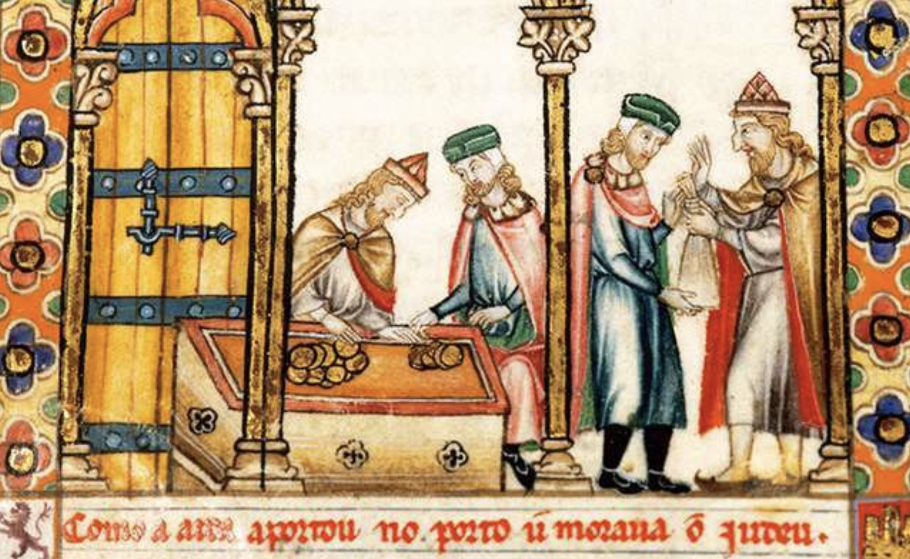
Jews were brought from France to lend money to build England's castles
Notes:
https://www.english-heritage.org.uk/visit/places/cliffords-tower-york/history-and-stories/massacre-of-the-jews/
The Massacre at Clifford’s Tower
England’s Jewish Population
After the Norman Conquest of 1066, a number of Jews came to England from Rouen in France. The early Norman kings needed to borrow money to build castles and secure their kingdom, but money-lending was forbidden to Christians. It was, however, permitted to Jews. These French-speaking Jews were protected by the Crown, and in time established communities in most of the principal cities of England. In the later 12th century, members of the Jewish community in Lincoln settled in York. However, there was growing hostility towards the Jewish population in England. This was in part due to public disagreements in theology between Jewish scholars and Christian churchmen. In the mid-12th century several vicious stories were spread accusing Jews of murdering Christian children. Such slanders, now known as the ‘Blood Libel’, strengthened anti-Semitic sentiment in England.
___________
An anti-Semitic portrayal of Jewish money-lenders from a 13th-century manuscript. William I brought Jewish merchants to England in the 11th century as they were able to lend money to the Crown, whereas Christians were forbidden to do so © Getty Images/Universal Images Group/Hulton Fine Art

Slide 37
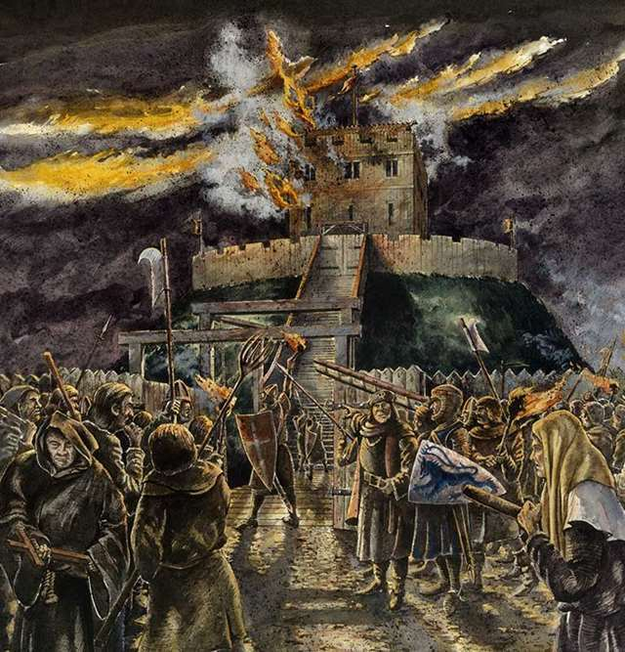
Jews Burned in Clifford's Tower, England
Notes:
https://www.english-heritage.org.uk/visit/places/cliffords-tower-york/history-and-stories/massacre-of-the-jews/
The Massacre at Clifford’s Tower
One of the worst anti-Semitic massacres of the Middle Ages took place in York in 1190. The city’s entire Jewish community was trapped by an angry mob inside the tower of York Castle. Many members of the community chose to commit suicide rather than be murdered or forcibly baptised by the attackers.

Slide 38
Spaniards
Persecutors of Jews…

Slide 39
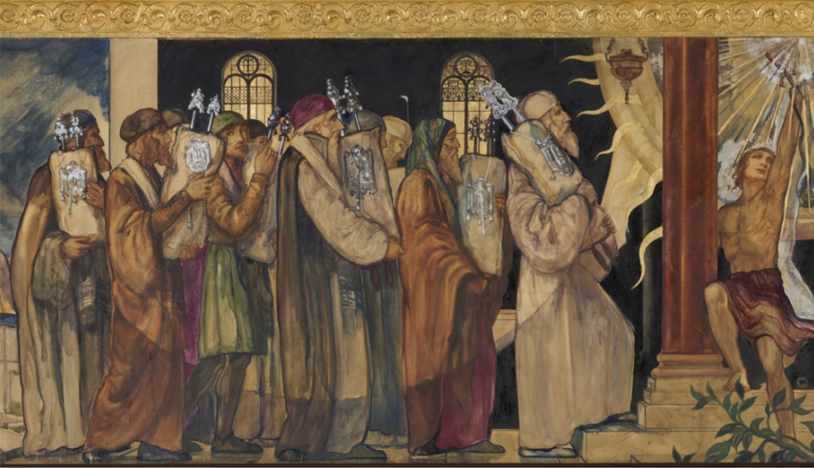
Spain Expelled All Jews
A mural depicting the movement of Torah scrolls following the expulsion from Spain. From Wilshire Boulevard Temple, Los Angeles.
Notes:
What the Jews of the Iberian Peninsula can teach us about political power & minority status
https://jewishstudies.washington.edu/jewish-history-and-thought/political-power-minority-status-jews-iberian-peninsula/

Slide 40
Lutherans
Persecutors of Jews…

Slide 41
Luther to His Followers
"My advice, therefore, is to deal kindly with the Jews and to instruct them in the Scriptures so that they may come over to us . . . We must welcome them in our midst, permit them to work and trade among us. They will then have an opportunity to witness Christian life and doctrine. Should, however, some of them still remain stubborn, what of it? Not every one of us is a good Christian."

Slide 42
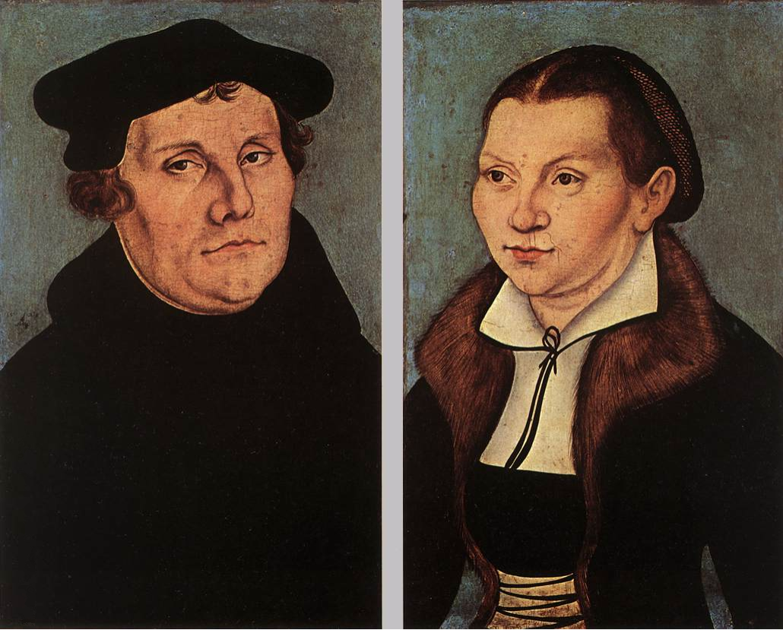
After Jews Rejected the Gospel…
"Set their synagogues on fire, and whatever does not burn up should be covered or spread over with dirt so that no one may be able to see a cinder or stone of it... Their homes should likewise be broken down and destroyed… They should be put under one roof or in a stable, like gypsies, in order that they may realize that they are not masters in our land, as they boast, but miserable captives, as they complain of us incessantly before God with bitter wailing."

Slide 43
Germans
Persecutors of Jews…

Slide 44
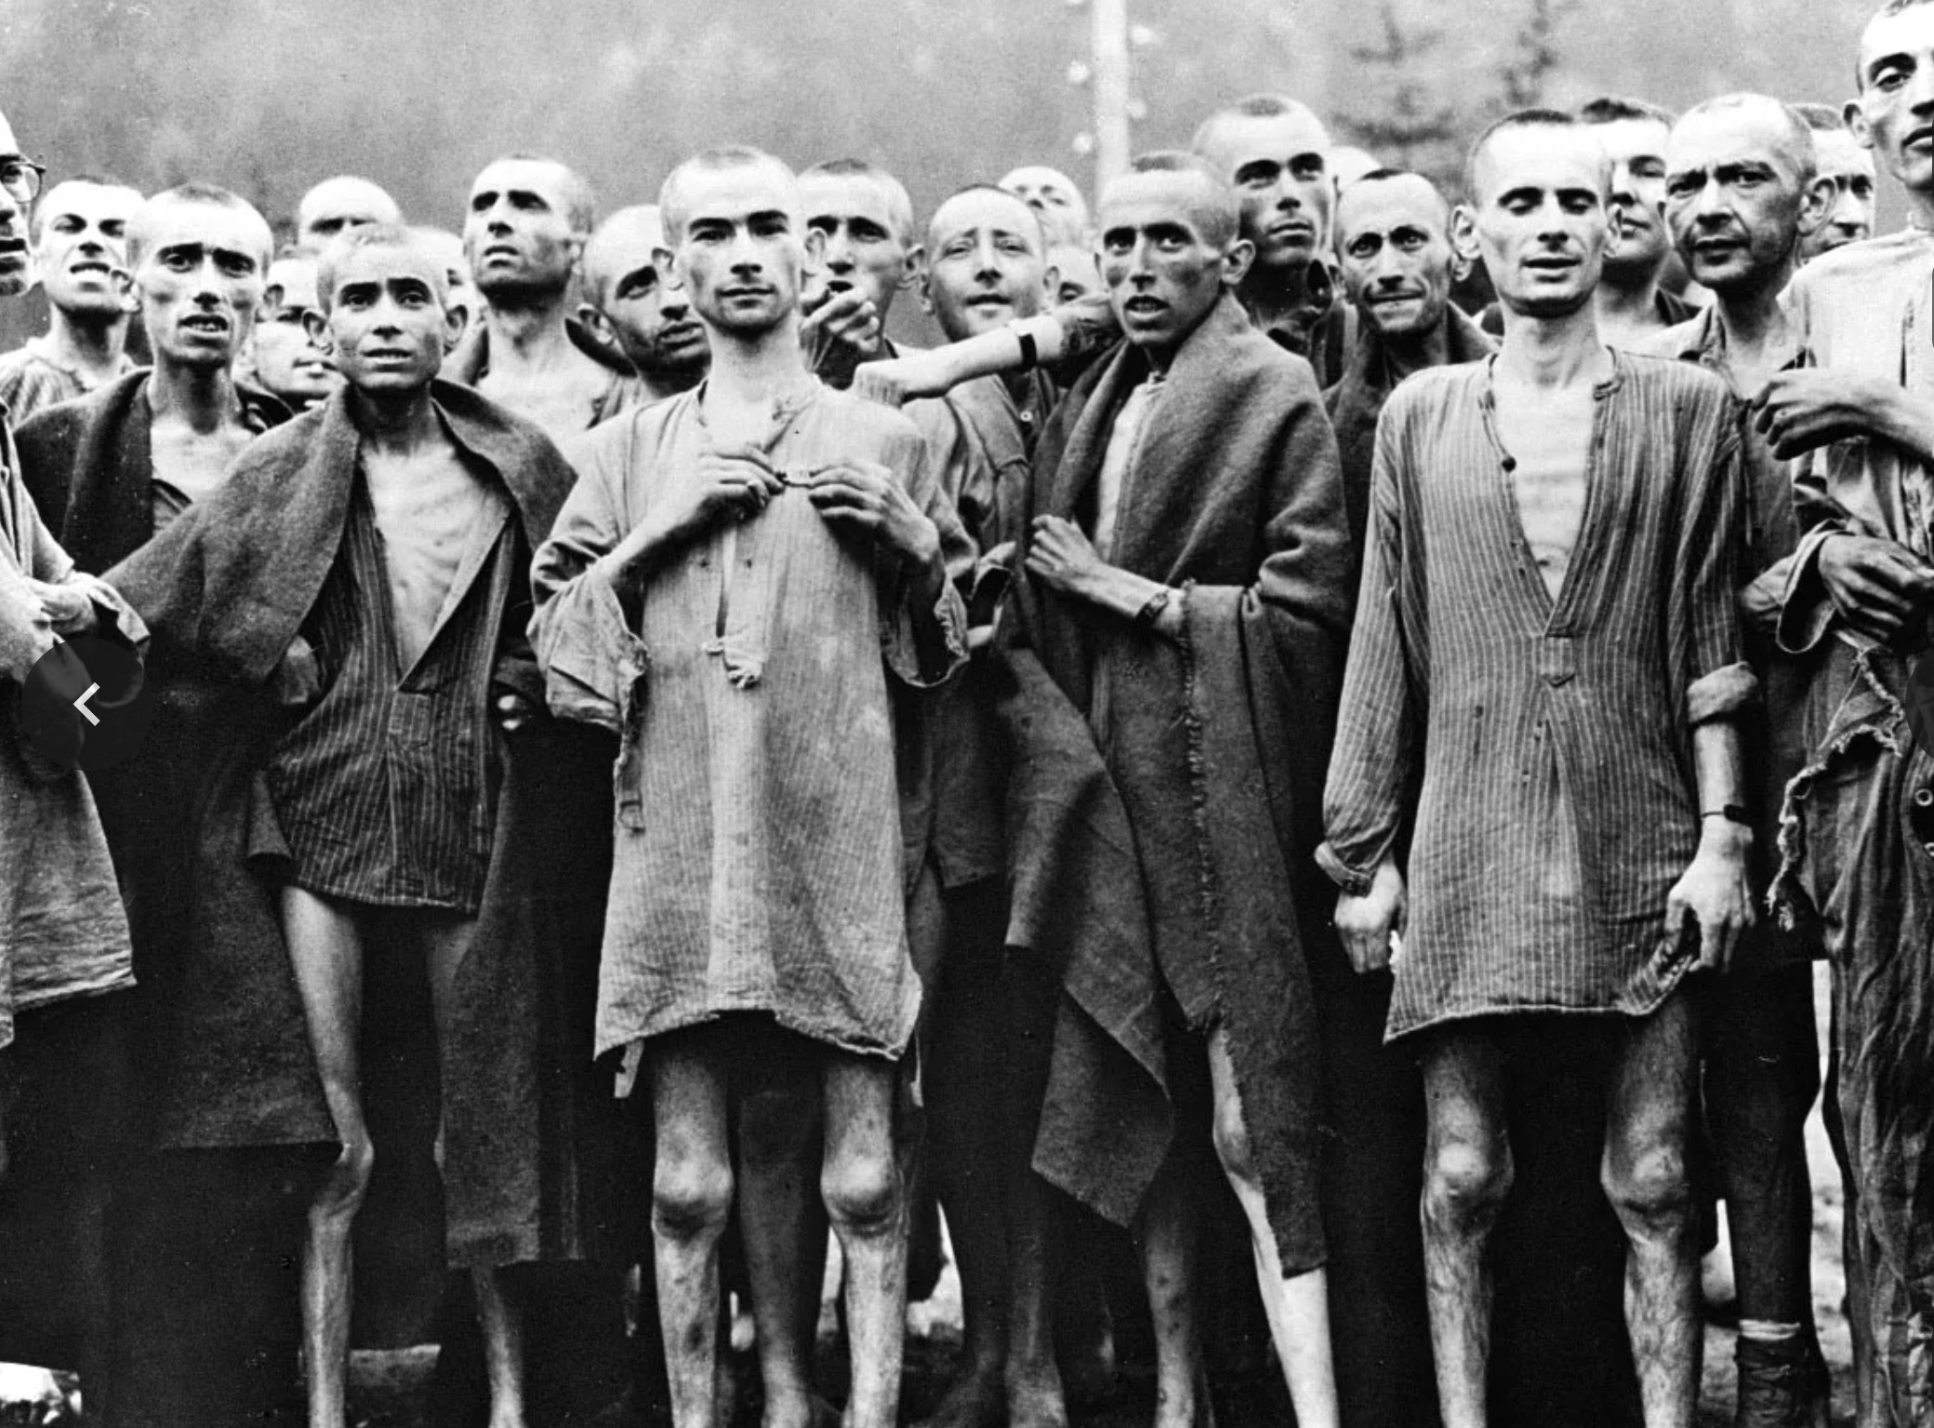
Liberated Jewish prisoners at the Nazi concentration camp in Ebensee, Austria
Notes:
https://www.britannica.com/event/Holocaust/Artistic-responses-to-the-Holocaust

Slide 45
Hitler motivated the Jews to go to their homeland!
Notes:
The very opposite happened to what Hitler tried to do. He sought to kill the Jews and pushed them out of his land.

Slide 46
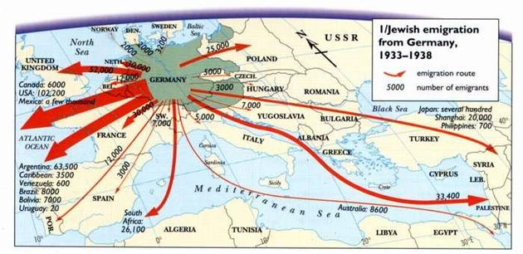
Hitler motivated the Jews to go to their homeland!
Jewish emigration from Germany 1933-1938
Route
GERMANY
Number
Notes:
Hitler sought to eradicate the Jews, but God sought to eradicate Hitler. He committed suicide in 1945 and three years later the Jews established their homeland in Israel! God told Abraham, "I will bless those who bless you and curse those who curse you" (Gen 12:3). Hitler's attempt to curse the Jews led to him being cursed.

Slide 47
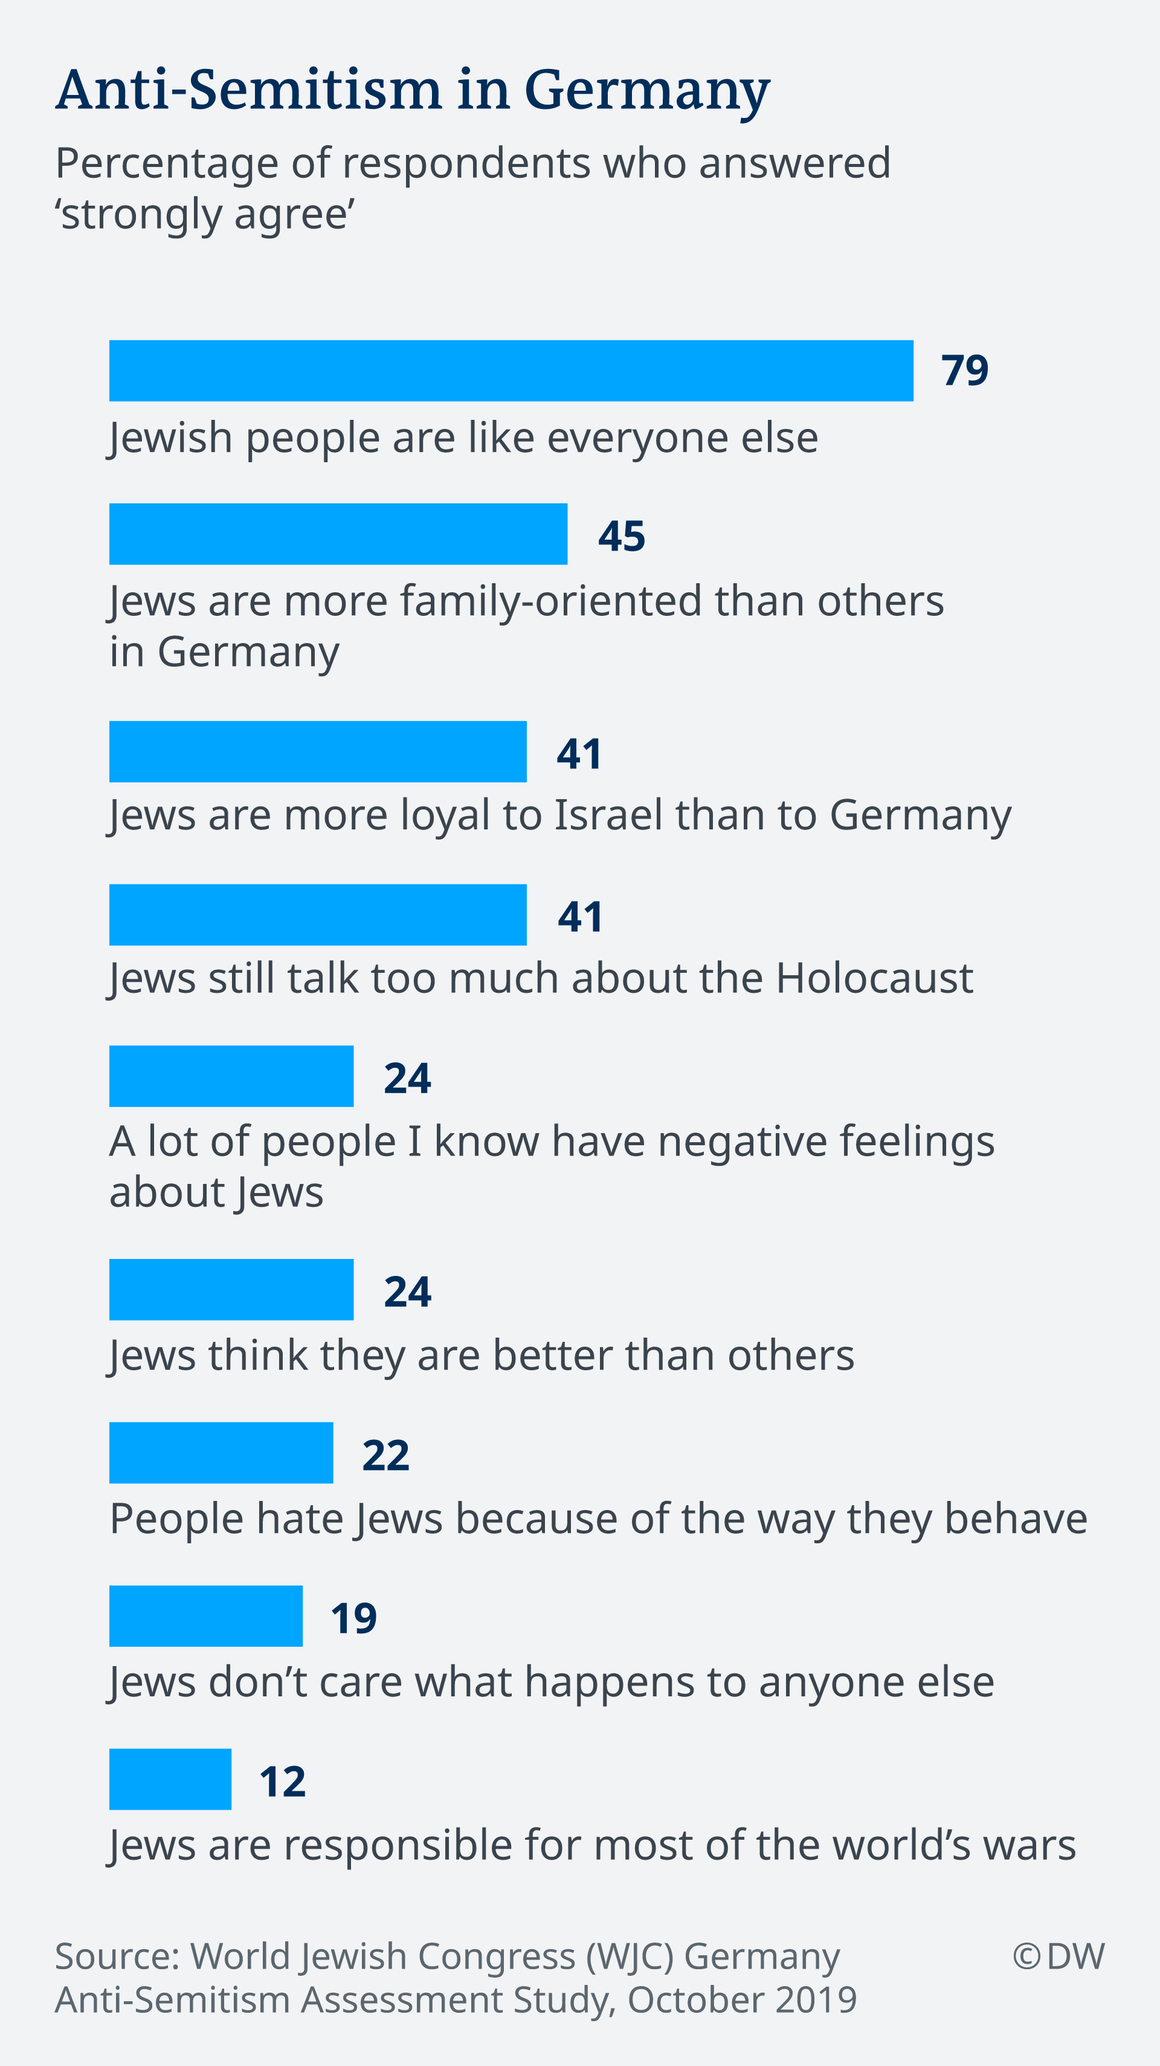
A Quarter of Germans Say Jews Think They are Superior (2019)
Anti-Semitism in Germany
Percentage of respondents who answered "strongly agree"
Jewish people are like everyone else
Jews are more family-oriented than others in Germany
Jews are more loyal to Israel than to Germany
Jews still talk too much about the Holocaust
A lot of people I know have negative feelings about Jews
Jews think they are better than others
People hate Jews because of the way they behave
Jews don't care what happens to anyone else
Jews are responsible for most of the world's wars
https://www.dw.com/en/one-in-four-germans-hold-anti-semitic-beliefs-study-finds/a-50958589
Source: World Jewish Congress (WJC) Germany Anti-Semitism Assessment Study, October 2019
Notes:
Study: One in four Germans harbor anti-Semitic thoughts
Rebecca Staudenmaier
October 24, 2019
https://www.dw.com/en/one-in-four-germans-hold-anti-semitic-beliefs-study-finds/a-50958589
More than a quarter of Germans surveyed said they agreed with anti-Semitic statements, including that Jews have "too much power over the economy." Over 40% said they thought Jews "talk about the Holocaust too much."
Anti-Semitism is gaining a stronger foothold in German society, the Süddeutsche Zeitung newspaper reported on Wednesday, citing a new study from the World Jewish Congress (WJC).
Out of the 1,300 Germans who took part in the representative survey, 27% agreed with a range of anti-Semitic statements and stereotypes about Jewish people.
Some 41% said they agreed with the statement that "Jews talk about the Holocaust too much." The same portion said they believed "Jews are more loyal to Israel than to Germany."
Over 20% of respondents said they agreed that Jewish people have "too much power" over the economy, international financial markets and the media. Another 22% agreed that "people hate Jews due to the way they behave."
"These are cliches, stereotypes, envy but there is also some truth to it. Jews are successful. What's the problem with that?" Cologne Rabbi Yechiel Brukner told DW. "Why are Germans not envious that, as a percentage of the population, Jews have many more Nobel Prize winners? Why doesn't that bother anyone? What does it always concern the aspect of 'money'? Judaism places an emphasis on intellectual intelligence and that has meant that Jews are often very successful. They also work hard, but why does someone not like them for that?
"Think about this: There are still living Holocaust survivors and Germans already dare to entertain anti-Semitic thoughts — and even to take action based on them. That's incredible," Brukner added.
The survey was carried out two months ago, prior to the anti-Semitic attack targeting a synagogue in the eastern German city of Halle.
Hostility towards Jews growing among 'elites'
Anti-Semitism is also growing among the wealthy and well-educated, according to the study.
The WJC found that 18% of "elites" — respondents with at least one university degree who make at least €100,000 ($111,300) per year — agreed with anti-Semitic sentiments.
Within that group, over a quarter said they believed Jewish people have "too much power over world politics" and the economy.
Read more: German groups combating far-right extremism face uncertain future

Slide 48
Europeans
Persecutors of Jews…

Slide 49
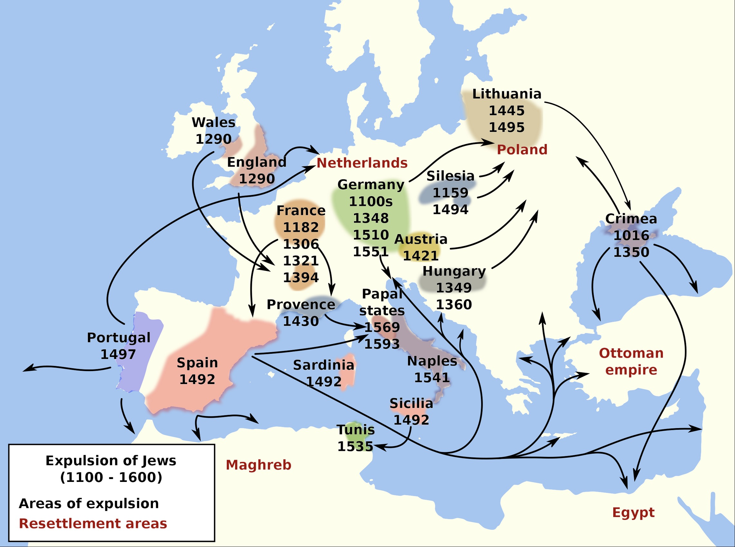
Expulsion of Jews from Europe (1100-1600)
https://en.wikipedia.org/wiki/Antisemitism#/media/File:Expulsion_judios-en.svg

Slide 50
MENA (Middle East & North Africa)
Persecutors of Jews…

Slide 51
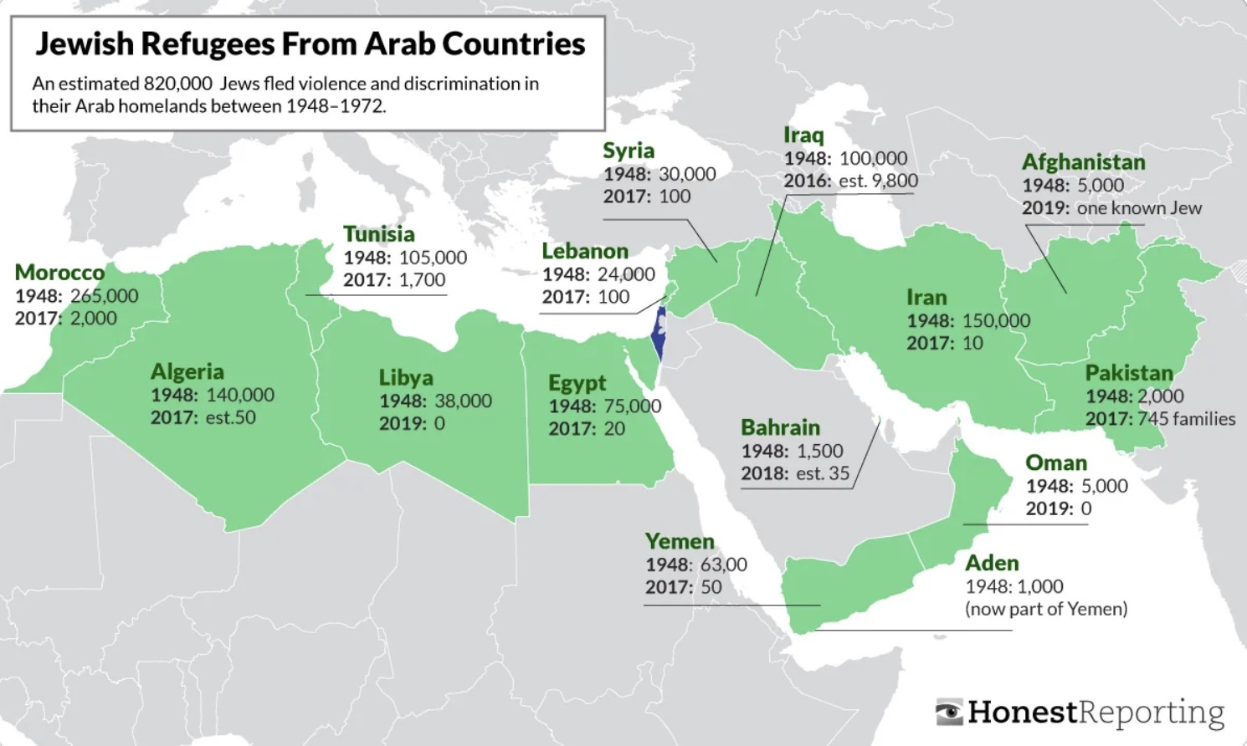
Jewish refugees from MENA countries (1948-2019)
https://www.reddit.com/r/MapPorn/comments/wzfk94/jewish_refugees_from_muslim_countries/?rdt=37455

Slide 52
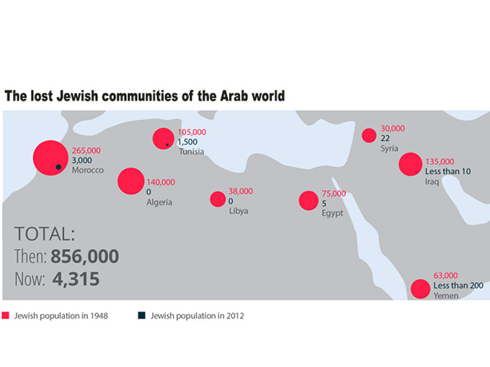
Migration of Jews from MENA countries (1948-2021)
https://www.gov.il/en/departments/news/jewish-refugees-expelled-from-arab-lands-and-from-iran-30-november-2021
Notes:
Jewish refugees expelled from Arab lands and from Iran
Subject Foreign Policy
Secondary topic Behind the Headlines
Publish Date 30.11.2021
This Memorial Day commemorates the tragedy of people who were forced to flee their homes, part from their host cultures and leave the countries where they had lived for centuries, solely because of their Jewish identity.
On November 30th, Israel and the Jewish world remember the fate of more than 850,000 Jews who were expelled and forced out of Arab lands and Iran in the 20th century. This Memorial Day commemorates the tragedy of people who were forced to flee their homes, part from their host cultures and leave the countries where they had lived for centuries, solely because of their Jewish identity.
Thousands of Jews were forced to leave behind their properties, businesses and possessions. Jews in Iraq, Libya, Yemen and more, were compelled to leave behind their heritage, ancestors, and legacies. Many even suffered from violence, brutality and persecution.
The expulsion of countless Jewish communities from Arab countries and Iran dramatically changed the demographic composition of the Middle East and North Africa. The stories of these Jews and their communities are an integral part of modern Jewish history. Their expulsion profoundly affected the Jewish nation as a whole. It is incumbent that these stories are told.
Upon arrival to Israel, these Jewish immigrants who were forced to leave their homes overcame personal and communal tragedy and not only persevered, but thrived; many rose to important positions in the national government and in the public and private sectors. They have made an invaluable contribution to the fabric of Israeli society, and their vibrant cultures are an integral part of the colorful mosaic of the Jewish people in the Land of Israel. It is time for the world to hear their story.

Slide 53
The UN
Persecutors of Jews…

Slide 54
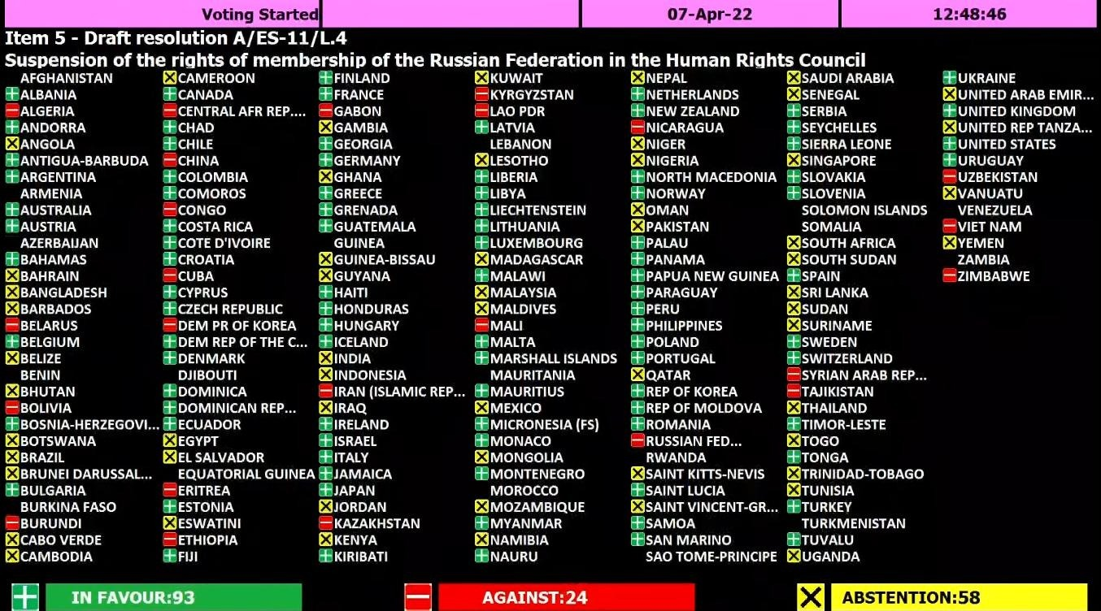
UN Voting for Israel by Nation (1947)
https://ishr.ch/wp-content/uploads/2022/04/Russia_vote_UNGA.jpeg

Slide 55
6th Grade Map Test (Curriculum of UN Rights Watch Association, 2021)
Notes:
Notice how the word "Israel" does not even appear on this UN Map test.

Slide 56
Canadians
Persecutors of Jews…

Slide 57
Anti-Semitism in Toronto (2022)
of the reported hate crimes in Toronto in 2021 targeted the Jewish community, which makes up less than 4% of the population
14 of 32 reported multi-bias hate crimes targeted diverse Jews (7 of which target Black Jews) in 2021 in Toronto
targeted group for the 6th consecutive year
https://www.toronto.ca/community-people/get-involved/community/toronto-for-all/confronting-antisemitism/
Notes:
Confronting Antisemitism
https://www.toronto.ca/community-people/get-involved/community/toronto-for-all/confronting-antisemitism/
The Confronting Antisemitism educational campaign was completed in 2022.
Antisemitism has been the most reported hate crime in Toronto for more than five years in a row, according to the Toronto Police Service Hate Crime Unit. What’s more, antisemitism is experienced daily by Jewish Torontonians.
This Toronto for All campaign brings attention to antisemitism in Toronto and calls on Torontonians to take action to confront it and eliminate it.

Slide 58
The USA Left
Persecutors of Jews…

Slide 59
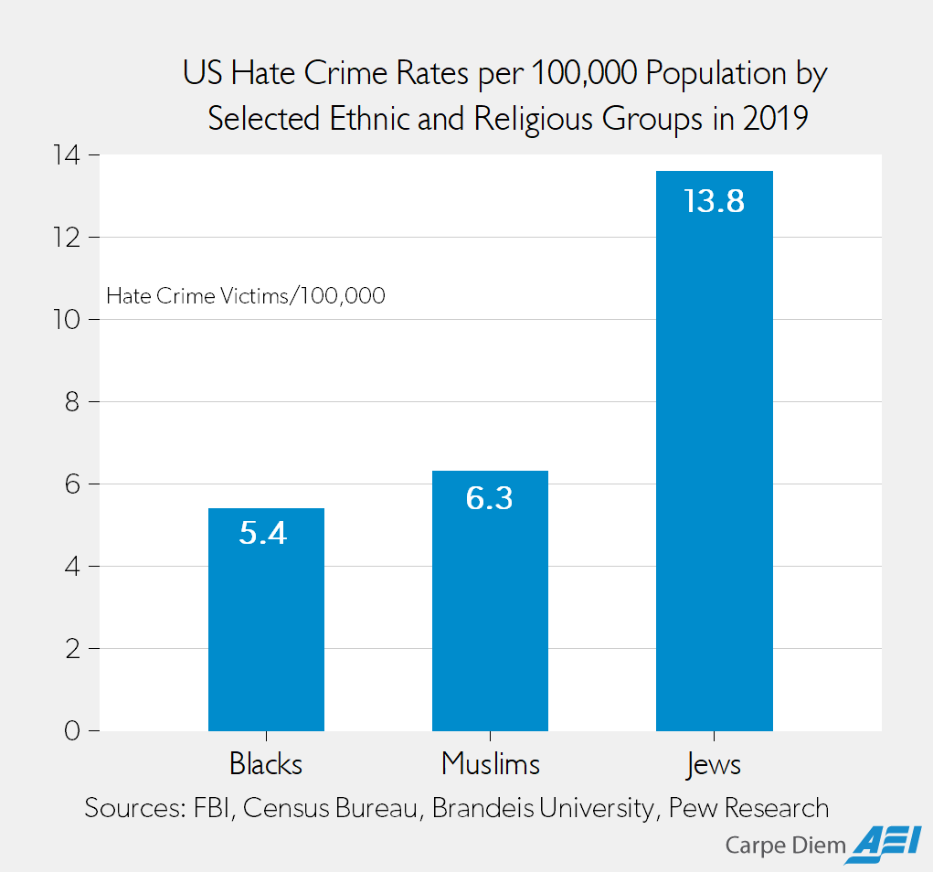
US Hate Crime Rates per 100,000 Population by Selected Ethnic and Religious Groups in 2019
Blacks
Muslims
Jews
https://www.aei.org/carpe-diem/based-on-2019-fbi-data-jews-were-2-6x-more-likely-than-blacks-and-2-2x-more-likely-than-muslims-to-be-victims-of-hate-crimes/
Notes:
Based on 2019 FBI Data, Jews Were 2.6X More Likely Than Blacks and 2.2X More Likely Than Muslims to Be Victims of Hate Crimes
By Mark J. Perry
July 06, 2021
Members of which of these groups were most likely to be a victim of a hate crime in 2019: Muslims, Blacks, or Jews? Based on media coverage, you would probably say Muslims or Blacks. According to a Google news search for the term “hate crimes” along with the name of each of those three groups, there are 291,000 results for “hate crimes” + black, 89,600 results for “hate crimes” + Muslim, and only 67,000 results for “hate crimes” + Jew. Based on news reports, you might think that blacks were much more likely than Jews to be the victim of a hate crime and that Muslims were somewhat more likely to be hate crime victims compared to Jews.
Hate crime data released last November by the FBI for 2019 reveal that there were 2,391 black/African-American victims of hate crimes, 1,032 Jewish victims, and 227 Muslim victims. Adjusting for the population of each group in 2019 (43.98 million blacks, 7.5 million Jews, and 3.61 million Muslims) the hate crime victimization rates per 100,000 population of each group were 13.8 for Jews, 6.3 for Muslims, and 5.4 for blacks (see chart above). Therefore, adjusted for population by group, American Jews were 2.6 times more likely than blacks to be a victim of a hate crime in 2019, and 2.2 times more likely than a Muslim to be a hate crime victim.
The FBI data for 2019 on anti-religion hate crimes also reveal that of the 1,715 victims of anti-religious hate crimes in the US, 1,032 were Jews (60.2% of the total) and 227 victims were Muslims (13.2% of the total). Obviously, since more than half (60.2%) of the anti-religious hate crimes in 2019 were against Jews, there were more anti-religious hate crimes against Jews (1,032) than incidents of hate crimes against all other religious groups combined (683). The FBI data also show that there were more Jewish hate crime victims in 2019 (1,032) than the number of gay men (863) and lesbians (143) who were victims of hate crimes.
Without any adjustments for population, there 4.5 times more Jewish hate crime victims (1,032) in 2019 than Muslim victims (227). And yet there are 33.7% more media reports on hate crimes against Muslims than news reports on hate crimes against Jews.
Question: Based on hate crime victimization rates and the fact that Jews are so disproportionately targeted in hate crimes compared to blacks and Muslims, is it fair to say that hate crimes against Jews are routinely under-reported by the media relative to the reporting of hate crimes against blacks and Muslims?
https://www.aei.org/carpe-diem/based-on-2019-fbi-data-jews-were-2-6x-more-likely-than-blacks-and-2-2x-more-likely-than-muslims-to-be-victims-of-hate-crimes/
Accessed 8 Nov 2023

Slide 60
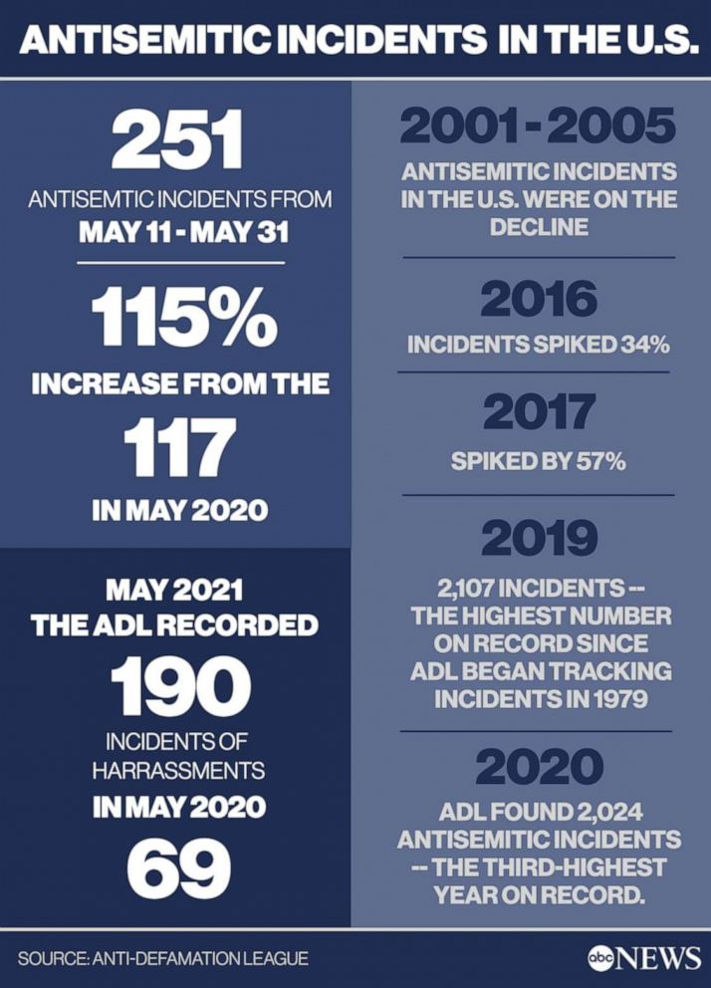
Antisemitism in the USA (2001-2020)
https://abcnews.go.com/US/antisemitism-surged-us-gaza-conflict-part-multi-year/story?id=78092408
Notes:
Antisemitism surged across US during Gaza conflict, part of multi-year rise: Advocates
Antisemitic incidents more than doubled during the Hamas conflict.
ByEmily Shapiro
June 10, 2021, 1:00 PM
https://abcnews.go.com/US/antisemitism-surged-us-gaza-conflict-part-multi-year/story?id=78092408
Joseph Borgen, a 29-year-old accountant in New York City, was on his way to a protest after work when he was jumped near Times Square.
"Out of the corner of my eye I saw someone chasing me, with their fist raised back, looking to punch me in the face. Before I could even react … I was surrounded by a whole group," Borgen told ABC News.
The attackers punched, kicked, pepper-sprayed him and beat him with crutches, the New York Police Department said, leaving him with a concussion and bruising.
"I grabbed my head and neck and my face area and just held onto those areas as tight as I could," Borgen said of the May 20 attack. "I was getting constantly kicked, punched and hit all over my body. But I was just holding onto my face and head, holding on for dear life, hoping I would survive."

Slide 61
Antisemitism in the USA (7-25 October 2023)
US antisemitic incidents up about 400% since Israel-Hamas war began, report says

Slide 62
Antisemitism in US Colleges (Nov 2023)
Anti-Semitism goes to school
https://wng.org/podcasts/antisemitism-goes-to-school-1699312731
Notes:
Anti-Semitism goes to school: Jewish university students in New York are troubled by incidents of anti-Semitism and doxing
World Magazine
Date 11/07/2023
Hosted By Mary Muncy
https://wng.org/podcasts/antisemitism-goes-to-school-1699312731
A Star of David necklace and a blue ribbon worn during a discussion on antisemitism on college campuses. Associated Press/Photo by Julia Nikhinson
MARY REICHARD, HOST: It’s Tuesday, the 7th of November, 2023. This is WORLD Radio. Thanks for joining us and good morning. I’m Mary Reichard.
NICK EICHER, HOST: And I’m Nick Eicher. First up on The World and Everything in It: rising anti-semitism in higher education.
On Saturday, tens of thousands of people in Washington D.C. protested in support of Palestinians with a chant that means the elimination of the state of Israel.
CROWD CHANTING: From the river to the sea, Palestine will be free.
REICHARD: Meanwhile, university administrators are being pulled into unwinnable situations. Pro-Palestinian professors and students demand the right to protest Israel’s war to root out Hamas in Gaza …while Jewish alumni and donors threaten to pull their funding if schools continue to tolerate antisemitism.
EICHER: At Columbia University, school officials have created task forces to respond to allegations of antisemitism on campus and doxing of students. Doxing is the practice of publishing private or identifying information about specific people with the intent to intimidate.
REICHARD: WORLD Radio Reporter Mary Muncy visited the Ivy League school in New York City to see what’s happening.
BARNARD FRESHMAN: I don't wear my Star of David around my neck anymore because I'm scared someone will attack me.
MARY MUNCY, REPORTER: This Jewish freshman is standing in Columbia University’s courtyard… at a vigil for people kidnapped by Hamas. For security reasons, she and other students at the vigil didn’t give me their names.
BARNARD FRESHMAN: I don't walk around Columbia's campus without being with someone else, or being on the phone with someone.
She keeps thinking about a Jewish student attacked on her campus last month. That student was placing posters of people kidnapped by Hamas when another student yelled and hit the student with a stick. Police arrested the student on charges of assault and harassment… and classified the incident as a hate crime.
But this freshman decided to show her support at the Columbia vigil.
She and about 20 other students stand around a display of roses representing the 242 people Hamas has kidnapped in the war.
Nearby, a Jewish upperclassman says she is here for more than a vigil.
BARNARD SENIOR: I guess I'm here just just for some, some support just to be around people who can sort of understand what I'm going through.
SOUND: [Protest]
About three weeks ago, students gathered in the courtyard and held Columbia’s first large pro-Palestinian demonstration. Columbia closed the campus to outsiders during the event for safety concerns. That’s really unusual. People from outside the school had been joining protests, and they have joined several other protests on campus since then.
Two weeks later, a group of more than 100 professors at Columbia signed a statement supporting the students’ right to express their views.
I contacted the pro-Palestinian groups on Columbia’s campus and more than 15 professors who signed the statement. None agreed to speak with me.
But Jewish students from campuses across the country did want to talk.
PNINA: My name is Pnina. I'm a freshman at Tulane.
SOFFER: I'm a junior at the George Washington University...
DAVID FRISCH: My name is David Frisch. I'm in my first year at Harvard Law School.
These students watched with alarm as pro-Palestinian student organizations started releasing statements.
At Harvard, 36 separate student groups signed a statement blaming Israel for the terrorist attacks of October 7. Almost all of them have since removed themselves from that list.
Other campuses have seen violence related to the unrest—everything from protests that turn violent, to students harassed individually. Cornell even canceled classes on Friday due to death threats against Jewish students.
Meanwhile, the conservative media group Accuracy in Media has been revealing the identities of pro-Palestinian students at Harvard and Columbia, a practice called doxxing.
WCVB: The names and faces of Harvard students are displayed under the title “Harvard’s leading antisemites.”
WCVB: This billboard truck was here on Mass Ave just outside campus for about two and a half hours.
NEWSNATION: This has gotten insane, and these are students.
But those are just the loud things, the ones that grab media attention, and that journalists have open access to.
While the Jewish vigil was taking place in the courtyard at Columbia last week, some law students were attending informational sessions on the conflict hosted by the group Columbia Law Students for Palestine.
The event organizers refused to let me attend, and declined to share recordings of the events with me. That said, one of the event speakers was Peter Beinart. Here he is in an interview with MSNBC from October 10th.
BEINART: If Palestinians don’t have basic rights, new Palestinians organizations will grow up, and they may do terrible things too because brutalized people do brutal things sometimes.
A few days later, Beinart wrote in a New York Times column that the Oct. 7 murder of 1,700 civilians, including women and children, was a natural reaction to not being able to peacefully protest and resist Israeli oppression.
At George Washington University, Jewish student Sabrina Soffer says a few days after the war began, The Elliot School of International Affairs put together a panel on the conflict with five or six people.
SOFFER: So students are coming in here looking at five different people thinking that this is a balanced panel. But none of them supported Israel.
Soffer went to the panel and said the speakers used what she called catchy, intellectual language like what students would hear in class.
SOFFER: This is, I think, actually the most subtle and dangerous and almost, I would call it insidious, way of-of molding the minds of young people.
But this isn’t just an intellectual issue.
SOUND: [VIGIL]
Every Jewish student I talked to knew someone in Israel, and many of them are scared to wear outward signs of their faith in public.
The question of how administrations will respond is still largely unanswered. so for now, this Columbia upperclassman says she’ll keep going as always:
BARNARD SENIOR: We're all just people who are just trying to get through our days and like, keep up with school and with work.
She’s grieving her friends who died in the first attacks and hoping conversations about Hamas’s actions change for the better.
BARNARD SENIOR: I don't want to have to be fighting for like, to try and convince people that their death isn't justified.
Reporting for WORLD, I’m Mary Muncy at Columbia University in New York.
——————————
WORLD Radio transcripts are created on a rush deadline. This text may not be in its final form and may be updated or revised in the future. Accuracy and availability may vary. The authoritative record of WORLD Radio programming is the audio record.

Slide 63
Neighbors
Persecutors of Jews…

Slide 64
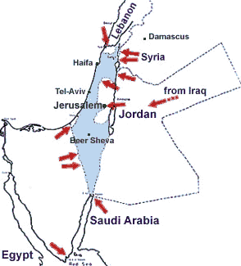
Israel's many neighbors amassed armies on every side (1967)
Notes:
https://www.jewishvirtuallibrary.org/map-of-the-overview-of-the-six-day-war-1967
Six-Day War Maps: Overview of the War
(1967)

Slide 65
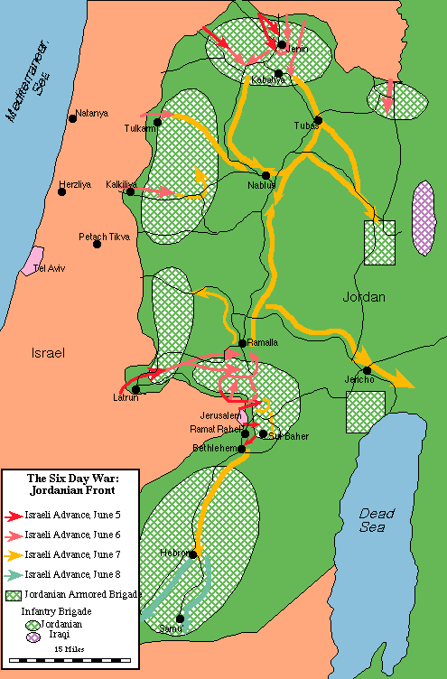
Jews made a pre-emptive attack against threatening armies at Israel's borders (1967)
Notes:
https://www.jewishvirtuallibrary.org/map-of-the-the-jordanian-front-june-1967

Slide 66
Ethnic Cleansing
THIS IS ETHNIC CLEANSING
JEWISH POPULATION 1948 vs. 2023
EGYPT
SYRIA
IRAN
IRAQ
LEBANON
MOROCCO
YEMEN
ALGERIA
LIBYA
TUNISIA
GAZA
THIS IS NOT
ARAB POPULATION 1948 vs. 2023
ARABS IN ISRAEL ARABS IN GAZA
Notes:
https://twitter.com/asifbhandari/status/1727436357327593801

Slide 67
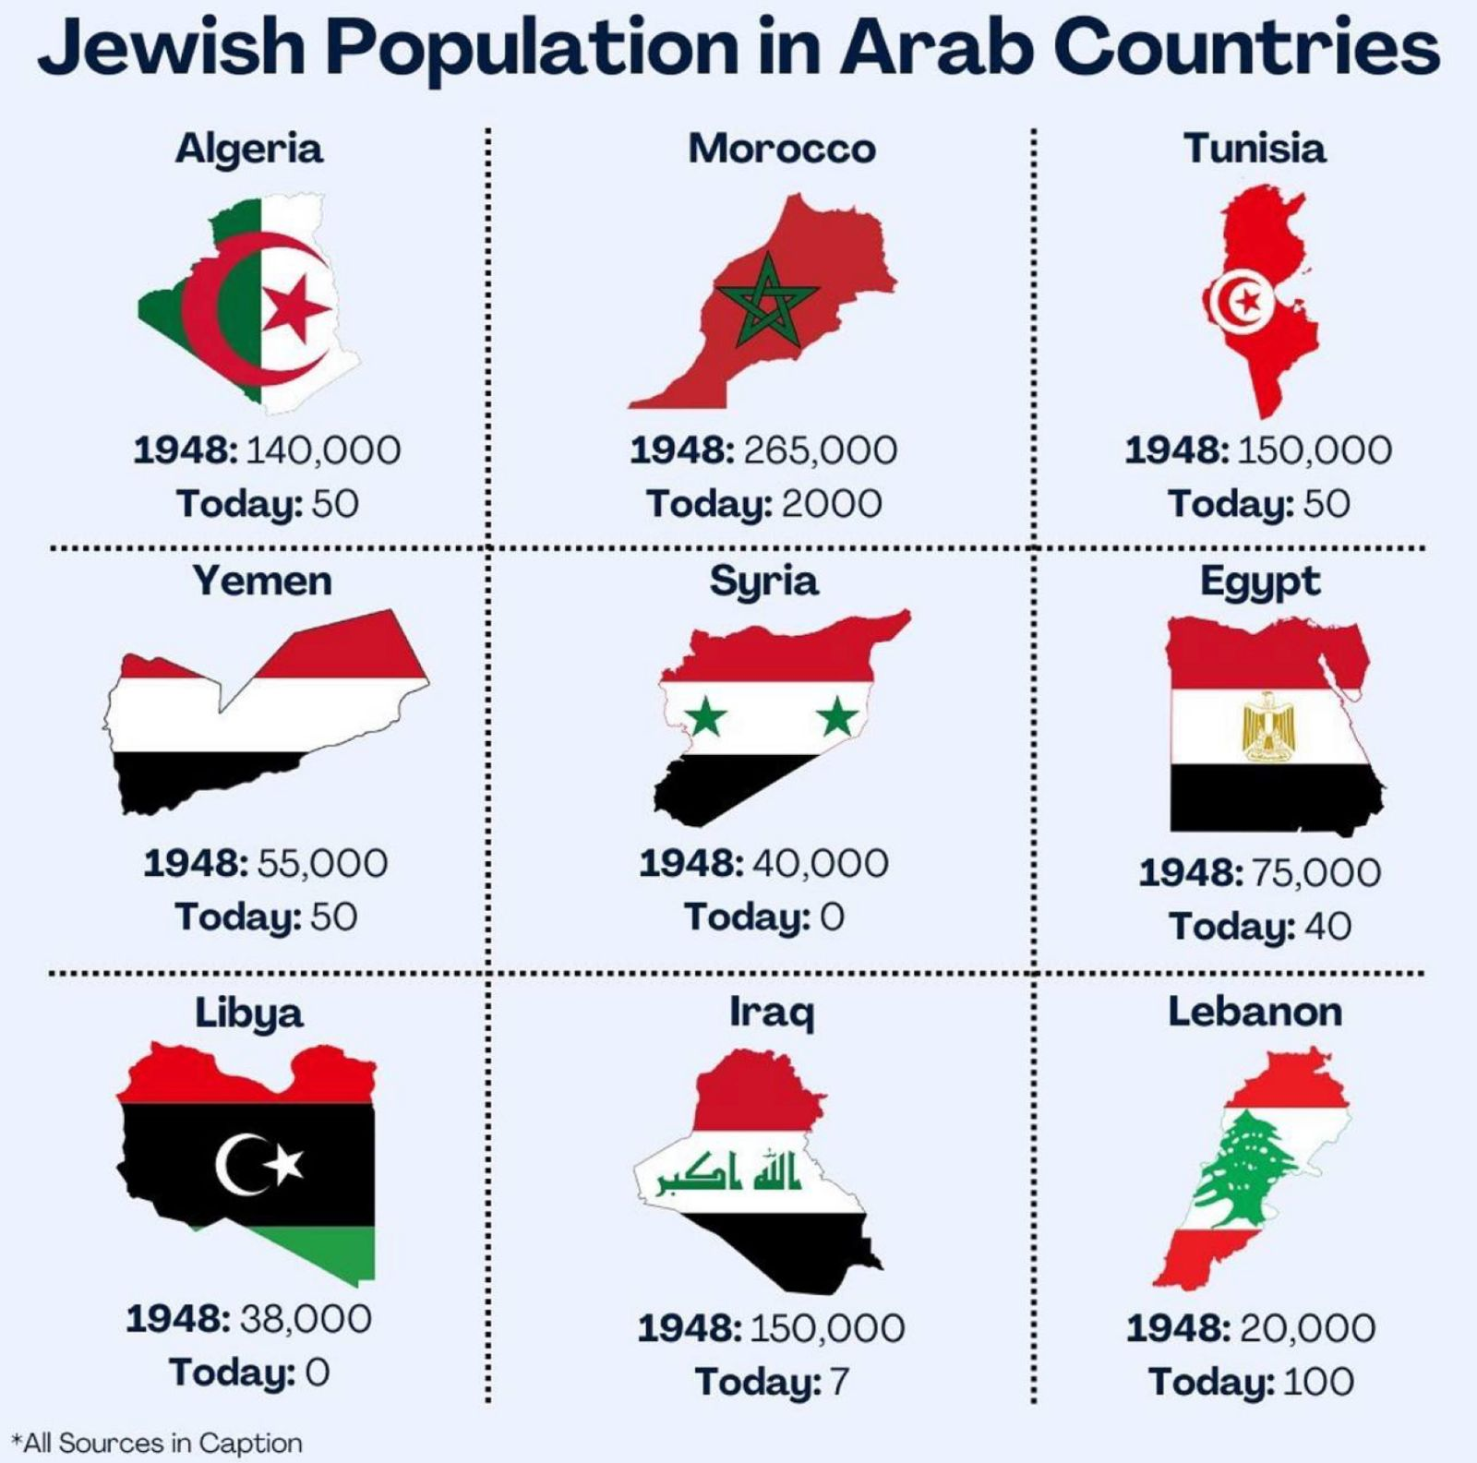
Jewish Population in Arab Countries (1948 vs. 2018)
Notes:
"The Jews of the Middle East and North Africa
in Modern Times". Michael Menachem Laskier
'Jewish Refugees from Arab Countries". https://
www.jewishvirtuallibrary.org/jewish-refugees-
from-arab-countries

Slide 68
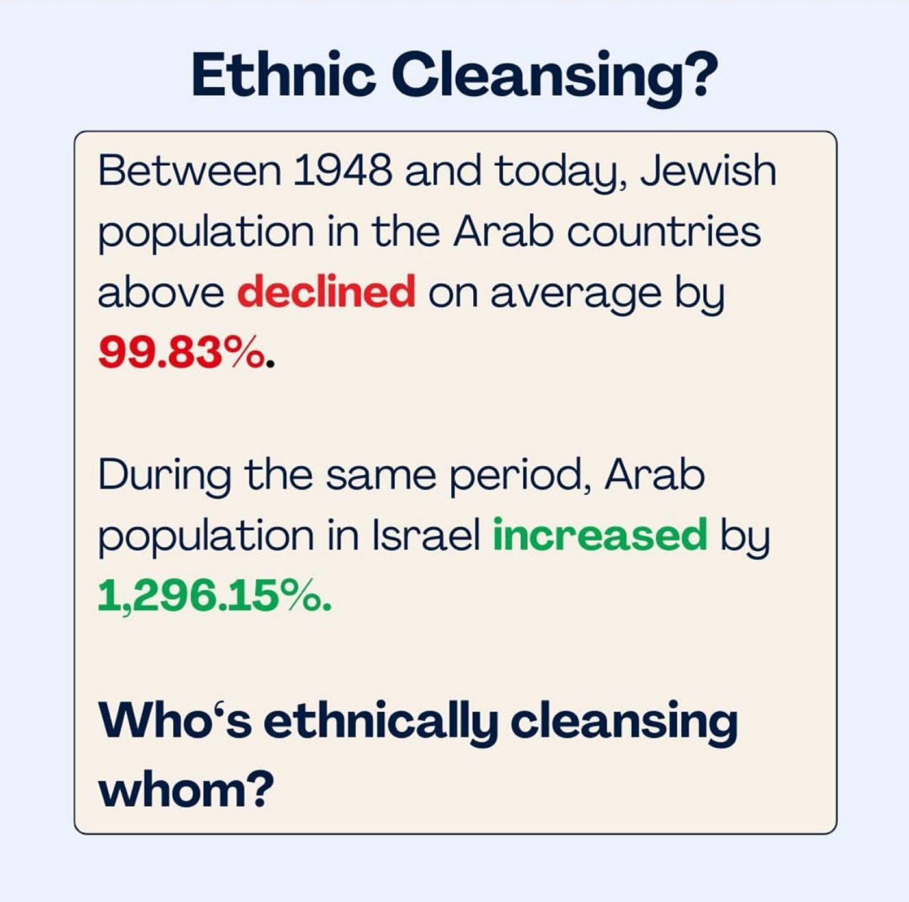
Ethnic Cleansing
Ethnic Cleansing?
Between 1948 and 2018, Jewish population in the Arab countries of the previous slide declined on average by 99.83%.
During the same period, Arab population in Israel increased by 1,296.15%.
Who's ethnically cleansing whom?
Notes:
* "The Forgotten Refugees: the causes of the
post-1948 Jewish Exodus from Arab Countries".
Philip Mendes.

Slide 69
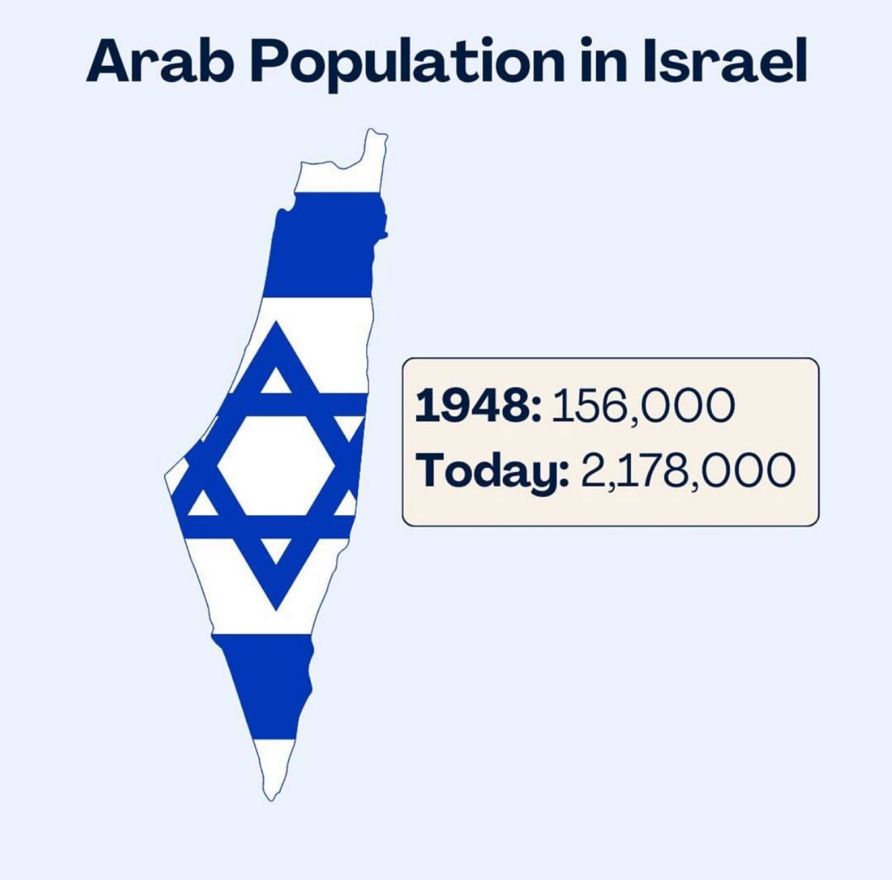
Arab Population in Israel
Notes:
* "Census
Israel Central Bureau of Statistics".
https://www.cbs.gov.il/he/mediarelease/DocLib/
2023/133/11_23_133e.pdf

Slide 70
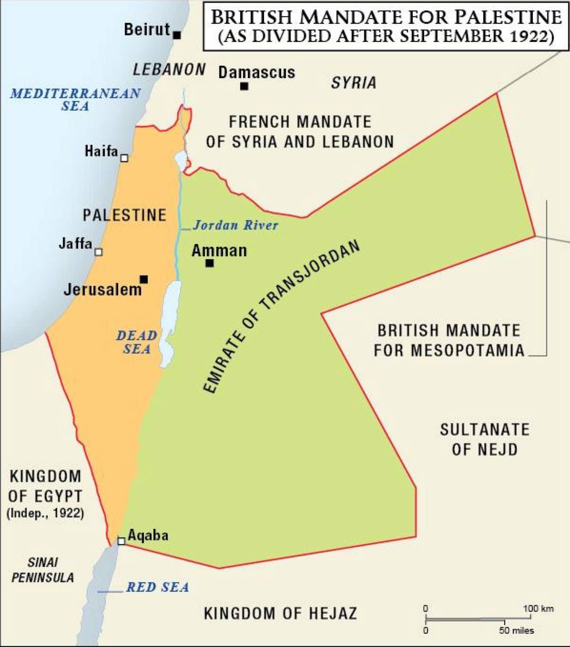
Ethnic Cleansing
BRITISH MANDATE FOR PALESTINE (AS DIVIDED AFTER SEPTEMBER 1922)
Notes:
* "The Jews 01 Arab Lands: A History and Source Book". Norman A. Stillman

Slide 71
The World
Persecutors of Jews…

Slide 72
The Global War on the Jews
Anti-Semitism surges, even in the West, which shows why Israel exists
Hate Crimes Against Jews:
2022: +36% for the year
2023: +400% for 3 weeks after Oct 7

Slide 73
RECOGNITION OF ISRAEL (JUNE 1981)
https://www.reddit.com/media?url=https%3A%2F%2Fi.redd.it%2F2g65d04x0v291.jpg

Slide 74
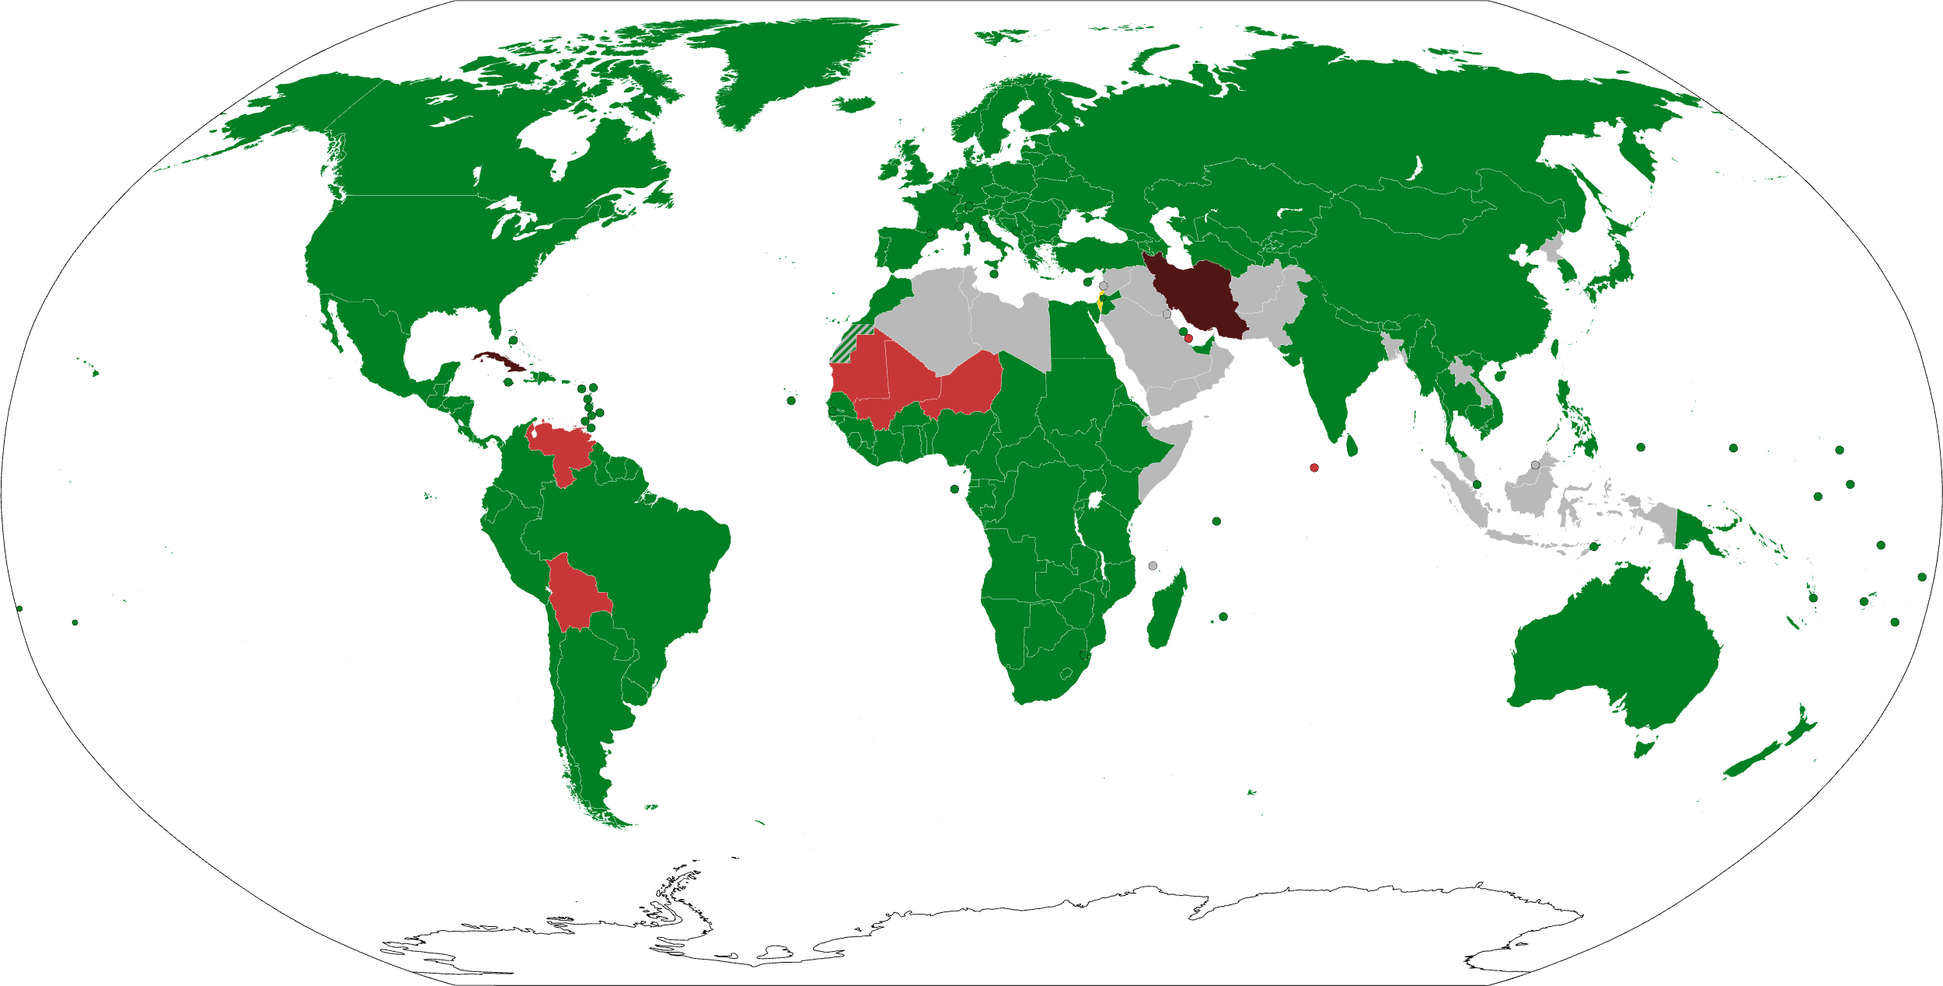
165 Nations Recognize Israel (2023)
This is 85% of the 193 total UN member states
State of Israel Countries that recognize Israel Countries that have withdrawn their recognition of Israel Countries that have suspended/cut bilateral ties with Israel Countries that have never recognized Israel
https://en.wikipedia.org/wiki/International_recognition_of_Israel (accessed 13 Nov 2023)
Notes:
The State of Israel was formally established by the Israeli Declaration of Independence on 14 May 1948, and was admitted to the United Nations (UN) as a full member state on 11 May 1949.^{[1][2]} As of December 2020, it has received diplomatic recognition from 165 (or 85%) of the 193 total UN member states, and also maintains bilateral ties with all of the Permanent Five. 28^{[a]} member states have either never recognized Israel or have withdrawn their recognition; others have severed diplomatic relations without explicitly withdrawing their recognition. Additionally, many non-recognizing countries have challenged Israel's existence—predominantly those in the Muslim world—due to significant animosity stemming from the Israeli–Palestinian conflict and the Arab–Israeli conflict.^{[3]}
Also from Summary Chart at https://en.wikipedia.org/wiki/International_recognition_of_Israel:
IRAN (purple): Established relations in 1950 but voted against UN Partition Plan and voted against admission of Israel to membership of UN. Iranian government refrained from recognizing Israel de jure despite de facto recognition.^{[107]} Relations severed on 18 February 1979.^{[108]} Does not accept Israeli passports,^{[22]} and the holders of Iranian passports are "not entitled to travel to the occupied Palestine"
WESTERN HEMISPHERE (north to south in red):
Cuba recognized Israel in 1949 but severed relations in September 1973,^{[78]} and the most recent government does not recognize it.
Venezuela recognized Israel on 27 June 1948^{[85]} but severed relations in January 2009.
Bolivia recognized Israel in 1949 but severed relations in January 2009,^{[58]} restored them in November 2019.^{[59]} and severed again during the 2023 Gaza–Israel War.
NORTH-WESTERN SUB-SAHARA AFRICA (west to east in red):
Mauritania: 28 October 1999 established diplomatic relations but suspended on 6 March 2009,^{[131]} and severed on 21 March 2010^{[132]}
Mali: Diplomatic relations severed on 5 January 1973
Niger: Relations severed on 4 January 1973
MENA (Middle East/North Africa in green):
Egypt began relations in 1979 and Signatory to the Khartoum Resolution.^{[33]} Later became the first Arab state to recognize Israel, with the Egypt–Israel peace treaty.
Jordan gave recognition in 1994 and Signatory to the Khartoum Resolution.^{[33]} Recognized Israel in the Israel–Jordan peace treaty.
United Arab Emirates: On 15 September 2020, an agreement was signed to normalize relations.
State of Palestine recognized Israel in 1993 as signatory to the Khartoum Resolution.^{[33]} Recognized Israel as part of the Oslo I Accord.
MENA (Middle East/North Africa in gray):
All other Arab nations do not recognize the legitimacy of the State of Israel.
OTHER MUSLIM NATIONS (in gray as they do not recognize Israel):
Bangladesh does not accept Israeli passports, and Bangladeshi passports are not valid for travel to Israel
Malaysia does not admit Israeli passport holders without written permission from the government. Malaysian passports not valid for travel to Israel without permission from the government.
Maldives started relations in 1965 but diplomatic relations were suspended in 1974.^{[124]} Cooperation agreements began in 2009 did not develop into full diplomatic relations^{[125][126][127]} and were terminated in 2014.^{[128]}
Indonesia: Israelis can only travel to Indonesia with an invitation from the Department of Immigration of Indonesia. Can only enter Indonesia through airports in Denpasar, Jakarta and Surabaya.
NORTH KOREA (gray) and Israel held talks in 1993, but the talks were halted under pressure from the United States.^{[147]} See Israel-North Korea relations for more details.

Slide 75
RECOGNITION OF PALESTINE IN 2017
https://www.aljazeera.com/wp-content/uploads/2017/02/8e739a3d3734465d88c4731cd2d30aaf_6.jpeg

Slide 76
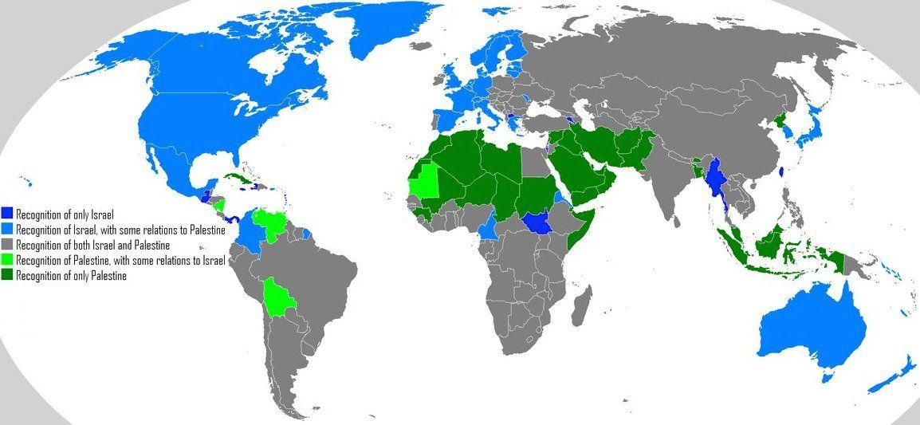
Recognition of Israel & Palestine (2023)
https://i.pinimg.com/originals/62/f0/57/62f05714dd327425947b776b9399375f.jpg
Notes:
This map combines both of the previous two maps to show widespread opposition to Israel in MEAN and other countries.
In Central and North America, only Guatemala, Panama, and Puerto Rico recognize only Israel (dark blue above) while
Nicaragua, Venezuela, and Bolivia side with Palestine with some relations to Israel (light green).
The other most pro-Israel nations that only recognize Israel remain South Sudan, Myanmar, and Taiwan, plus two small countries on opposite sides of Turkey (dark blue)

Slide 77
Land Ownership
Persecutors of Jews…

Slide 78
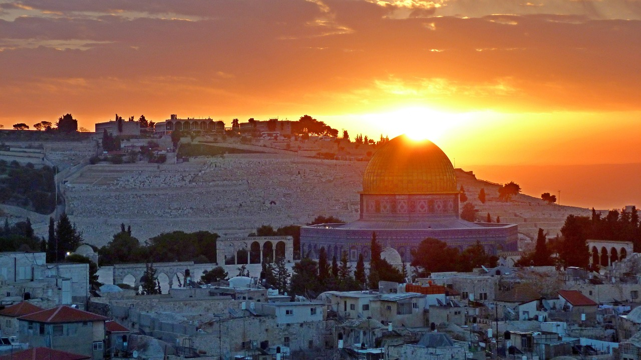
Whose land is this?

Slide 79
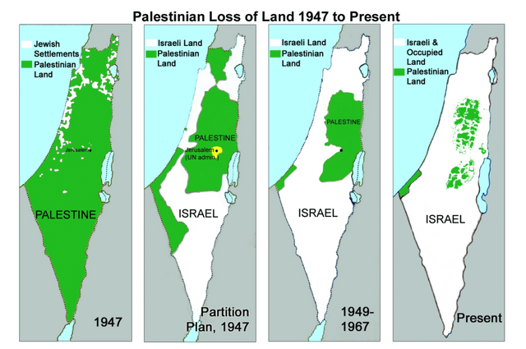
ARAB DECREASED PRESENCE 1947-now
https://www.reddit.com/r/MapPorn/comments/172jcvk/palestinian_loss_of_land_1947_to_2023_1300x1900/
Notes:
The popular depiction of the so-called loss of Palestinian land has many problems.

Slide 80
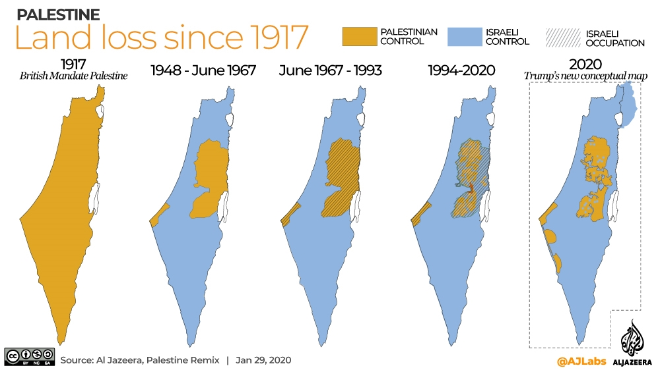
ANOTHER MAP CLAIM…
https://www.aljazeera.com/news/2020/1/29/what-does-trumps-plan-propose-for-palestinian-territories
Notes:
Here is an Arab response to President Trump's land proposal in 2020 as reported in the official Arab newspaper, Al-Jazeera…
What does Trump’s plan propose for Palestinian territories?
Israeli annexation of parts of occupied West Bank envisioned in US president’s deal.
29 Jan 2020
With Israeli Prime Minister Benjamin Netanyahu standing by his side, US President Donald Trump on Tuesday unveiled his long-delayed Middle East plan, claiming that it would lay the foundations for a “realistic two-state solution” in the long-running Israeli-Palestinian conflict.
Palestinian leaders had rejected the plan even before its release and were absent during its unveiling. Following the announcement at the White House, Palestinians denounced the proposal as utterly biased in favour of Israel and insisted that “Jerusalem is not for sale”.
Trump called his plan an “historic opportunity” for Palestinians to achieve an independent state of their own by doubling the territory currently under their control. But under the proposal, the United States said Jerusalem would remain the “undivided capital” of Israel and it would recognise Israeli sovereignty over parts of the occupied West Bank. The Palestinians want both occupied East Jerusalem and the West Bank to be part of a future state.
As many Palestinians used social media to express anger and, at times, mock the proposal, others warned that it would lead to “apartheid” within a single state.
Here are some of the key points included in Trump’s proposal:
Borders
According to the plan, Israel would annex “the vast majority” of illegal Israeli settlements in the West Bank which would be connected to the rest of Israel with their own access roads and a transportation system.
Ninety-seven percent of Israelis living in the West Bank would be incorporated into Israeli territory.
The Jordan Valley would also be under Israeli sovereignty, giving Israel a permanent eastern border along the Jordan River.
The Gaza Strip would be connected to the West Bank with a high-speed transportation link, crossing over or under Israel.
The plan also lays out the possibility that Israel’s current borders could be redrawn.
The so-called “Triangle Communities” consisting of 10 Palestinian towns in Israel: Kafr Qara, Ar’ara, Baha al-Gharbiyye, Umm al Fahm, Qalansawe, Tayibe, Kafr Qasim, Tira, Kafr Bara and Jaljulia could possibly be transferred to the State of Palestine.
According to Edo Konrad, editor-in-chief of Israeli news website 972 Magazine, 257,000 Palestinian citizens of Israel could find themselves outside the borders of Israel.
Jerusalem
Jerusalem would be the capital of Israel and “Al Quds (or another name selected by the State of Palestine)” should be internationally recognised for the State of Palestine, according to Trump’s plan.
The separation barrier would serve as a border between the two capitals.
The Palestinian state would not include any part of Jerusalem inside the current separation barrier which includes the holy Al-Aqsa Mosque located in the Old City and areas where most East Jerusalemites live.
The capital of Palestine will be in East Jerusalem, located in areas which Israel previously cut off with its separation barrier including Kafr Aqab, the eastern part of Shuafat and Abu Dis.
Demilitarised state
The plan calls for the demilitarisation of all of Palestine and the disarmament of Palestinian factions in Gaza such as Hamas and the Islamic Jihad.
Security
Israel would control security at all international crossings into Palestine.
It would also continue to carry out surveillance of Palestinians within their own territory. Israel would rely on blimps, drones and similar aerial equipment “to reduce the Israeli security footprint” within the State of Palestine.
Refugees
There would be no right of return of any Palestinian refugees or their descendants into Israel. According to the plan: “Their Arab brothers have the moral responsibility to integrate them into their countries as the Jews were integrated into the State of Israel.”
Upon the signing of an agreement as proposed under Trump’s Middle East plan, Palestinian refugee status would cease to exist and the United Nations‘s agency for Palestinian refugees would be terminated.
Prerequisites for a Palestinian State
Israel and the US would review the Palestinian school curriculum as a prerequisite for the creation of a Palestinian state.
“The Palestinians shall have ended all programs, including school curricula and textbooks, that serve to incite or promote hatred or antagonism towards its neighbours, or which compensate or incentivize criminal or violent activity,” the plan said.
Source: Al Jazeera
____________
See also:
Palestine’s Legal and Legitimate Bid to Statehood and UN Membership
Commentary by Shereen Dbouk – 18 August 2011
https://arabsthink.com/2011/08/18/palestine%E2%80%99s-legal-and-legitimate-bid-to-statehood-and-un-membership/

Slide 81
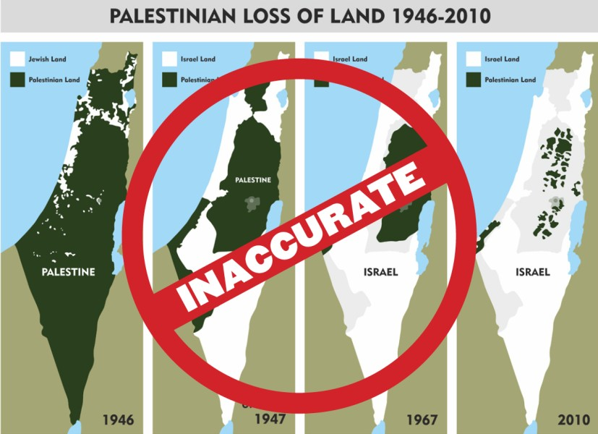
ARAB DECREASED PRESENCE 1947-2020
https://www.linkedin.com/pulse/palestinian-loss-land-myth-4-maps-adir-duchan-ההוא-/
Notes:
This map depiction is rebutted at:
Palestinian Loss of Land: The Myth of the 4 Maps
Adir Duchan (🤓 ההוא מהזה)
Senior Software Engineer at Roundforest ⭐ | I make code, videos & cookies 🍪🎬
https://www.linkedin.com/pulse/palestinian-loss-land-myth-4-maps-adir-duchan-ההוא-/
October 17, 2023
Ladies and gentlemen, what we're about to unravel here is nothing short of a masterclass in visual deception.
These four maps, often brandished as a testament to Palestinian loss of land, may have dazzled you, but we're about to break them down, one fallacy at a time.
Warning
The points here are not meant to argue that Palestinians do not deserve self determination nor that they have no real history or connection to the land. They have and they do. I do not accept claims that they are made up people, unrelated to the land, they are here they were here and they will stay here.
However. One doesn't get to twist history in pursuit of self determination.
Terminology
Before we start, a quick word about terminology: "Palestinian," as applied to the Arab population in this region, was a term coined by Yasser Arafat in 1964, a quick narrative hack to create a connection between the Arabs living there to the area.
There's never been a Palestinian state, nor Palestinian lands. Instead, this territory was part of the British Mandate for Palestine, a geographical region that the British administered post-Ottoman Empire collapse after the First World War.
Wait so where did the name "Palestine" come from?
Though the definite origins of the word “Palestine” have been debated for years and are still not known for sure, the name is believed to be derived from the Egyptian and Hebrew word "peleshet", which appears in the Bible no fewer than 250 times. Roughly translated to mean "rolling", "migratory", "invade", the term was used to describe the inhabitants of the land to the northeast of Egypt – the Philistines.
The Philistines were an Aegean people – more closely related to the Greeks and with no connection ethnically, linguistically, or historically with Arabia – who conquered the Mediterranean coastal plain that is now Israel.
Before the 60's the 'new-age-palestinians' were simply known as 'Arabs.' In the 1947 UN Partition Plan, you won't find the term 'Palestinians.' It's the 'Jewish population' and the 'Arab population.'
So who are the indigenous people to the land?
TBH? I don't know, depends on the exact point in time you put the needle on. The entire world passed through here at some point, from crusaders to muslim conquerors.
A more pragmatic answer to the new age that does not include Bible testimonies, is that the "Native" people, are a mix of Jews (Tzabar), Arabs and Christians who lived in the area during Ottoman rule and early British mandate.
Bearing this in mind, let's deep dive to the maps.
_______________
Also see another response at:
“Disappearing Palestine” – the Maps that Lie
Jul 7, 2020 | Judy Maynard
https://aijac.org.au/fresh-air/disappearing-palestine-the-maps-that-lie/

Slide 82
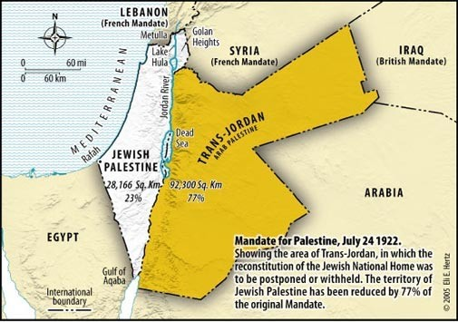
A Jewish Response…
Fake History
Real History
Notes:
Map 1: "Palestine" in 1946
The first map showcases "Palestine" in 1946... The vast green expanses on this map supposedly represent a million Arabs living there, while the white spots are home to half a million Jewish inhabitants.
• But here's the twist: it conveniently omits the portion of the Mandate that was handed to the local Arab population in 1923, creating what we now know as Jordan. Jordan, today a Muslim Arab state with a population boasting 70% Arab Palestinian descendants. By not showing the entirety of the British Mandate, they present it as a quarter of its actual size, masquerading it as "Palestinian land."
From:
https://www.linkedin.com/pulse/palestinian-loss-land-myth-4-maps-adir-duchan-ההוא-/
Palestinian Loss of Land: The Myth of the 4 Maps
Adir Duchan (🤓 ההוא מהזה)
Senior Software Engineer at Roundforest ⭐ | I make code, videos & cookies 🍪🎬
October 17, 2023

Slide 83
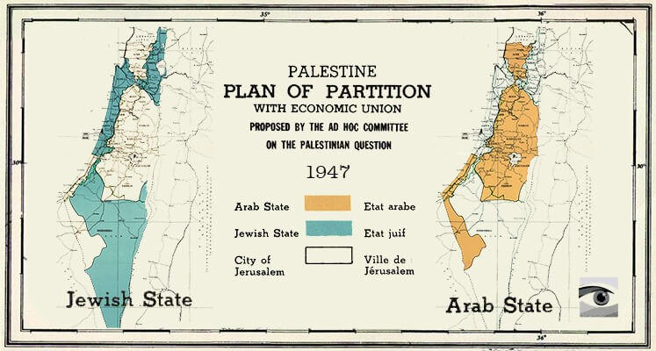
A Jewish Response…
Fake History
Real History
Notes:
Map 2: UN Partition Plan
Now, onto the second act, featuring the UN Partition Plan, which supposedly drew the lines for Jewish and Palestinian lands. Sounds straightforward, right? Reality is bit more nuanced -- the Partition Plan indeed called for a Jewish state and one for the 'local Arab population.' But the Arabs shrugged it off, rejecting the existence of a Jewish state. As a result, that second state for the local Arab population (following Jordan which is 70% Palestinian) never saw the light of day.
• Instead, in 1948, seven Arab countries swiftly launched an attack on Israel, trying to erase it from the map.
From:
https://www.linkedin.com/pulse/palestinian-loss-land-myth-4-maps-adir-duchan-ההוא-/
Palestinian Loss of Land: The Myth of the 4 Maps
Adir Duchan (🤓 ההוא מהזה)
Senior Software Engineer at Roundforest ⭐ | I make code, videos & cookies 🍪🎬
October 17, 2023

Slide 84
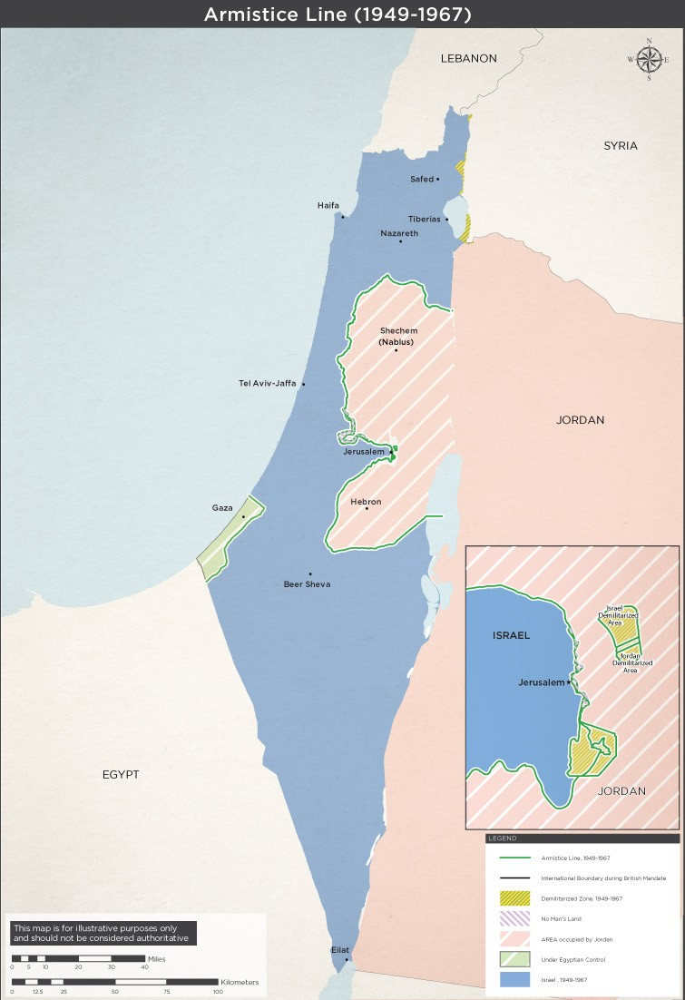
A Jewish Response…
Fake History
Real History
Notes:
Map 3: The '67 Borders
Now, the third map, often mislabeled as the '67 borders. But hold onto your seats; these are neither borders nor a '67 creation.
• These are 1949 armistice lines that simply tell us who controlled what when the fighting stopped. The map portrays Gaza and the West Bank as Palestinian land, yet this is another falsehood. The West Bank was occupied by Jordan from 1948-1967, and it was ethnically cleansed of Jews. Gaza, on the other hand, was in the iron grip of Egypt from 1949 to 1967. Even today, Egypt clings to parts of the Strip from Rafah to the south. Attempting to paint all this green shading as Palestinian land is, in no uncertain terms, a categorical falsehood.
From:
https://www.linkedin.com/pulse/palestinian-loss-land-myth-4-maps-adir-duchan-ההוא-/
Palestinian Loss of Land: The Myth of the 4 Maps
Adir Duchan (🤓 ההוא מהזה)
Senior Software Engineer at Roundforest ⭐ | I make code, videos & cookies 🍪🎬
October 17, 2023

Slide 85
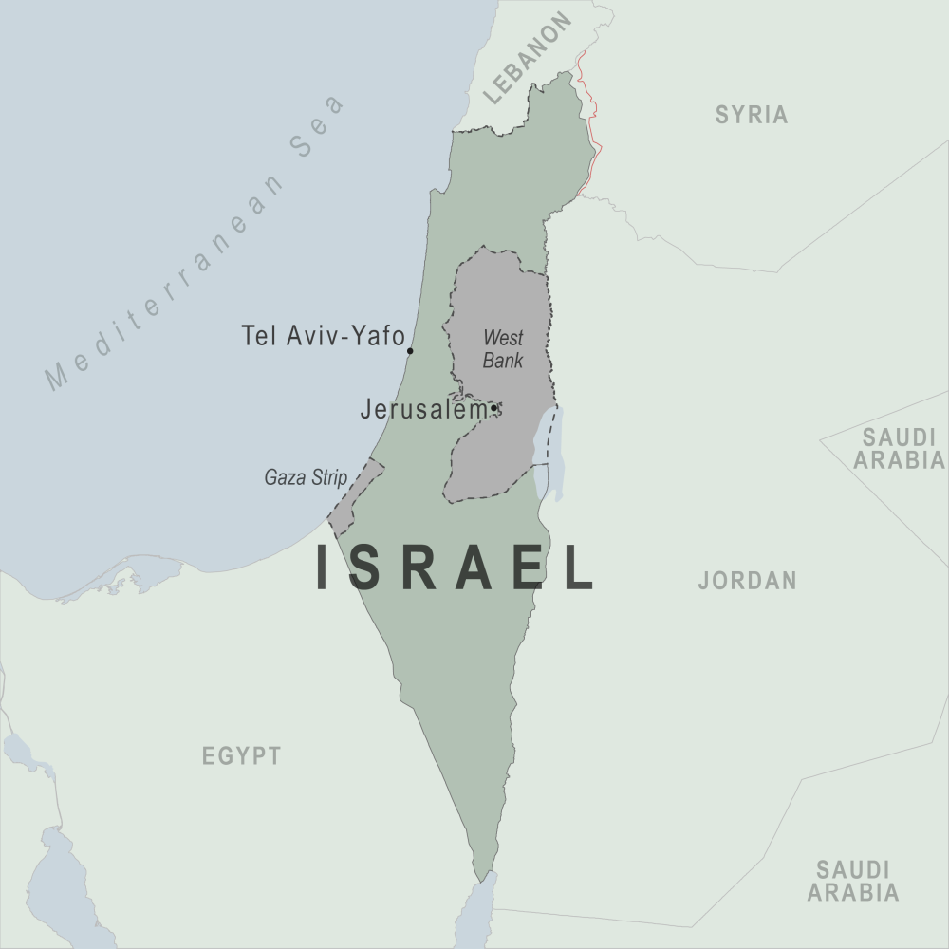
A Jewish Response…
Fake History
Real History
Notes:
Map 4: Present-Day "Palestinian Land"
And now, the grand finale, the fourth map suggests it's what remains of a once-mighty territory. But hold your frowns; this isn't "what's left." It's all the land Palestinians have ever controlled. The prior maps are areas PROPOSED to the Arabs to live alongside Israel, to all of which, they refused, and decided to rage yet another war in hopes to conquer the entire land, eventually losing more land.
But wait, there's more! What about the green depiction of 1 million Arabs in 1946 on the first map? Where are they in the last map? The illusionists behind these maps want you to believe they were ethnically cleansed.
• In reality, today, these numbers have swelled from 100k to nearly 7 million, Israelis are really bad at ethnic cleansing huh? The Israeli Arab population grew from 50k to 2 million, citizens living across Israel equally, judges, doctors, engineers, some even serving in the Israeli military, completely assimilated. Yet, there's no green shading outside the West Bank and Gaza - another blatant falsehood.
From:
https://www.linkedin.com/pulse/palestinian-loss-land-myth-4-maps-adir-duchan-ההוא-/
Palestinian Loss of Land: The Myth of the 4 Maps
Adir Duchan (🤓 ההוא מהזה)
Senior Software Engineer at Roundforest ⭐ | I make code, videos & cookies 🍪🎬
October 17, 2023

Slide 86
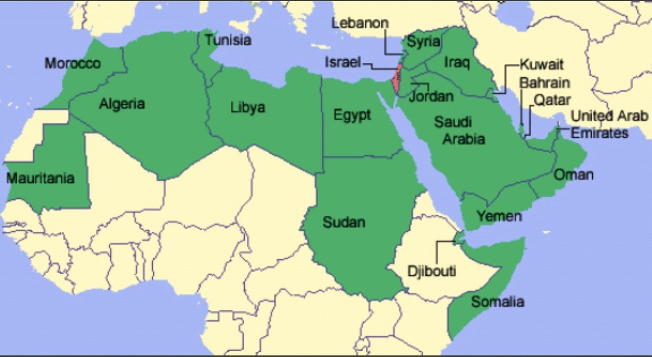
A Jewish Response…
Real History
Notes:
The Jewish Loss of Land - A different perspective
Israel's history is replete with conflicts initiated by its neighbors, all seeking its destruction. These hostilities date back to 1948 and continued through 1956, 1967, and 1973. As a result of these conflicts, Israel expanded its territories.
While critics often highlight Israel's territorial gains, it is important to recognize Israel's consistent efforts to pursue peace, including significant territorial withdrawals.
Oslo Accords - Israel ceded control of green areas within the West Bank to the PLO in hopes of achieving lasting peace. Unfortunately, this deal soured as suicide bombings targeting Israeli civilians, funded and endorsed by the PLO, persisted. This example is just one facet of a broader narrative regarding Israel's efforts for peace, a narrative that encompasses the withdrawal from Gaza, the return of the Sinai Peninsula to Egypt, and the pullout from Lebanon.
Withdrawal from the Gaza Strip - In 2005, Israel unilaterally disengaged from Gaza, uprooting settlements and relinquishing control. The aim was to establish conditions for a peaceful coexistence between Israelis and Palestinians. However, the subsequent rise of Hamas and the continued violence in the region illustrate the complexities of such initiatives.
Return of the entire Sinai Peninsula to Egypt - The Sinai had been occupied by Israel since the Six-Day War in 1967. The 1979 Egypt-Israel Peace Treaty marked a historic turning point when Israel, in exchange for peace, returned the Sinai to Egyptian sovereignty. This remains one of the most substantial territorial concessions in the quest for regional stability.
Lebanon withdrawal - in May 2000 Israel left Lebanon ending an 18-year occupation in an attempt to disentangle from the Lebanese quagmire and promote peace along its northern border.
Now let's play a quick game, zoom out, and put things in perspective. Can you find Waldo? The red dot is Israel.
Closing Remarks
The idea of "Palestinian Land Loss" must be scrutinized.
Rather than accepting one-sided narratives, we should acknowledge the complexity of the land's historical context.
To achieve a more balanced understanding of these maps, it is essential to consider Israel's history in its entirety. This broader perspective includes the wars initiated by neighboring countries, the pursuit of peace through territorial withdrawals
Misrepresentations like these maps are inaccurate, and can perpetuate conflicts and hinder progress toward reconciliation, the misinformation they propagate encourage the continues Palestinian rejectionism and violence, which have always left the Palestinians with less than they had before.
These misconceptions have permeated various platforms, affecting not only public opinion but also respected journalism and academia. A simple Google image search would show you the amount of footprint this map has on the internet, and it's time to dispel these inaccuracies.
Please share this exposé and contribute to a more nuanced understanding of the complexities surrounding Israel's land changes.
Sincerly, Adir.
From:
https://www.linkedin.com/pulse/palestinian-loss-land-myth-4-maps-adir-duchan-ההוא-/
Palestinian Loss of Land: The Myth of the 4 Maps
Adir Duchan (🤓 ההוא מהזה)
Senior Software Engineer at Roundforest ⭐ | I make code, videos & cookies 🍪🎬
October 17, 2023

Slide 87
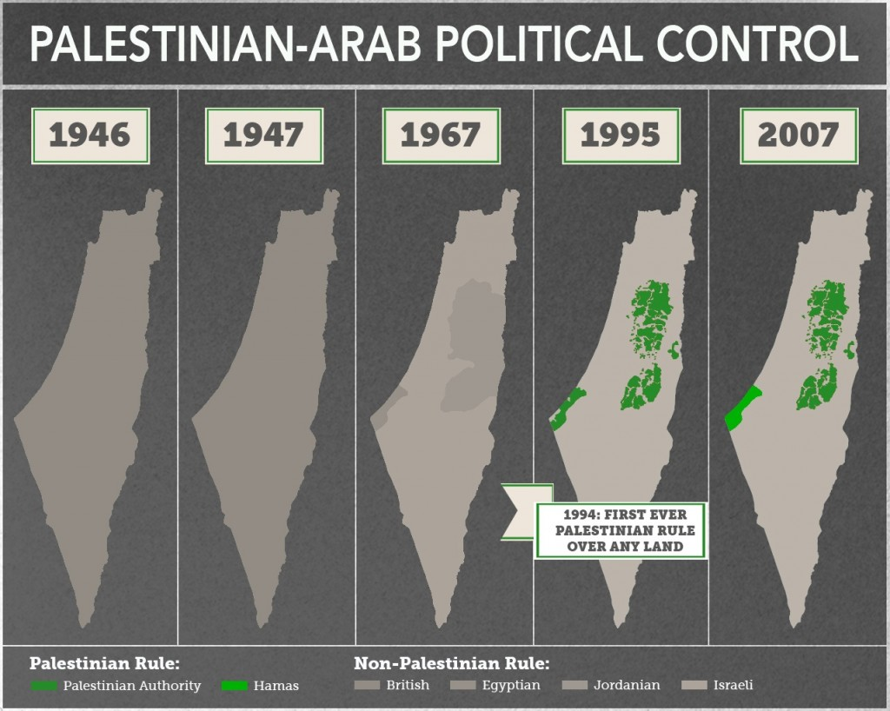
Real History by Shany Mor
Notes:
The Mendacious Maps of Palestinian “Loss”
The Tower Issue 22
January 2015
Shany Mor
Writer based in Paris; former director for foreign policy, Israeli National Security Council
click for full bio >>
https://www.thetower.org/article/the-mendacious-maps-of-palestinian-loss/
Anti-Israel activists often use doctored maps to show Israel’s supposed malfeasance over the past century. Such claims are made by people who, in the best case, have no knowledge of the facts, and in the worst case, have no moral compass.
You can’t walk very far on an American or European university campus these days without encountering some version of the “Palestinian Land Loss” maps. This series of four—occasionally five—maps purports to show how rapacious Zionists have steadily encroached upon Palestinian land. Postcards of it can be purchased for distribution, and it has featured in paid advertisements on the sides of buses in Vancouver as well as train stations in New York. Anti-Israel bloggers Andrew Sullivan and Juan Cole have both posted versions of it, and it occasionally creeps into supposedly reputable media sources, like Al Jazeera English.
Indeed, it recently appeared as a “Chart of the Day” in the UK’s respected magazine New Statesman. Beneath it was a tiny line of text listing its sources as the UN Office for the Coordination of Humanitarian Affairs and a CIA atlas from 1973. Given that the maps included information far more recent than 1973, the source struck me as slightly dubious. I contacted the staff writer who created the feature and asked him about it. He was very reluctant to admit that he had lifted it from anti-Israel propaganda sources, so he directed me to the 1973 CIA atlas. Unfortunately, nothing like the series appears in the CIA World Factbook and nothing like it could have appeared in an atlas published decades before several of the events it claims to portray. The writer then apologized for not being able to track down his sources any further and explained that he no longer works at New Statesman. He has moved on to The Guardian, and given that particular publication’s attitude toward Israel, he should have no trouble fitting in.
There is a reason why those who make use of these maps avoid examining their provenance or proving their accuracy: The maps are egregiously, almost childishly dishonest. But they have become so ubiquitous that it is worth taking the time to examine them, and what their dishonesty can teach us about the Palestinian cause and its supporters.
In whatever form they take, the “Land Loss” maps show very little variation. The standard version looks something like this:
Sometimes, a fifth map is added, this one dated 1920, showing the entirety of what was once British Mandatory Palestine in a single solid color, labeled “Palestinian.” This accomplishes the seemingly impossible and makes the series of maps even more dishonest than before.
Whether made up of four or five maps, the message of the series is clear: The Jews of Palestine have been assiduously gobbling up more and more “Palestinian land,” spreading like some sort of fungal infection that eventually devours its host.
There are some outright lies in these maps, to be sure. But the most egregious falsehoods transcend mere lies. They emerge from a more general and quite deliberate refusal to differentiate between private property and sovereign land, as well as a total erasure of any political context.
This final point is especially crucial. It goes to the question of whether the Palestinians actually “lost” this land and the context of that alleged “loss.” We could quite easily, for example, make a panel of maps showing German “land loss” in the first half of the 20th century. It would be geographically accurate but, without the political context, it would tell a completely misleading story amounting to a flat-out lie. And that is precisely what these maps are: A lie.
Taking each map in turn, it is easy to demonstrate that the first one is by far the most dishonest of the lot. As far as I have been able to determine, it is based on a map of Jewish National Fund (JNF) land purchases dating roughly from the 1920s. The JNF was founded to purchase land for Jewish residents and immigrants in then-Palestine, and was partly funded through charity boxes that were once found in almost every Jewish school and organization in the West. Ironically, this map often adorned those ubiquitous boxes.
These maps have become so ubiquitous that it is worth taking the time to examine them, and what their dishonesty can teach us about the Palestinians and their supporters.
The dishonesty of using an out-of-date map for pre-1948 Jewish land purchases is actually relatively minor. So is not omitting the political context: After 1939, Jews were forbidden from making any further land purchases by British authorities, a measure taken as a sop to Arab terrorism. Even the deceptive use of JNF land and only JNF land as a proxy for the entire Palestinian Jewish presence is but a trifle compared to the epic lie represented by this map: It deliberately conflates private property with political control.
They are not at all the same thing. The simple fact is that none of pre-1948 Palestine was under the political authority of Arabs or Jews. It was ruled by the British Mandatory government, established by the League of Nations for the express purpose of creating a “Jewish National Home.” It was also—contrary to the claims of innumerable pro-Palestinian activists—the first time a discrete political entity called “Palestine” existed in modern history. And this entity was established in order to fulfill a goal that was essentially Zionist in nature.
But this lie is compounded by another that is even more epic in scope: Labeling every single patch of land not owned by the JNF as Arab or Palestinian. This was quite simply not the case. We have incomplete data on land ownership in modern Palestine, and even less on Arab property than Jewish property, partly due to the very complicated nature of property law in Ottoman times. But anyone’s map of private property in Mandatory Palestine from this period would be mostly empty—half the country is, after all, desert. It would show small patches of private Jewish land—as this map does—alongside small patches of private Arab land, as this map shamelessly does not.
The next map is labeled 1947. This is inaccurate, as any other date would be, because the map does not represent the situation on the ground in 1947 or at any other time. Instead, it represents the partition plan adopted by the United Nations General Assembly in 1947 as UN Resolution 181. It called for two independent states to be formed after the end of the British Mandate, one Jewish and one Arab.
Needless to say, the resolution was never implemented. It was rejected by a Palestinian Arab leadership that just two years before had still been allied with Nazi Germany. The day after its passage, Arab rioting began against Jewish businesses, followed by deadly Arab attacks against Jewish civilians. Events quickly escalated into all-out war, with Arabs laying siege to major Jewish population centers—cutting off all supplies, including food and water. In some places, the siege worked, but for the most part, it was resisted successfully.
The maps emerge from a more general and quite deliberate refusal to differentiate between private property and sovereign land, as well as a total erasure of any political context.
At this point, with partition rejected by the Arabs and no help from the international community in sight, the Jews declared independence and formed what would become the Israel Defense Forces. The Arab states promptly launched a full-scale invasion, whose aims—depending on which Arab leader you choose to quote—ranged from expulsion to outright genocide. And the Arabs lost. At war’s end in 1949, the situation looked roughly like the third map in the series—the first of the lot that even comes close to describing the political reality on the ground.
I say “close” because it too is remarkably dishonest. It is only because one’s standards of dishonesty have been stretched so far by its predecessors that it almost seems true. But, alas, it is not. The map is dated 1967. What it shows are the so-called “armistice lines,” i.e., the borders where the Israeli and Arab armies stopped fighting in 1949. These lines held more or less until 1967. As far as Israel’s borders are concerned, then, the map accurately presents the situation over those 19 years.
But what lies on the other side of the line, in the territories that are today called the West Bank and the Gaza Strip, is again presented in radically dishonest fashion. These lands were not—not before, during, or after 1967—“Palestinian” in the sense of being controlled by a Palestinian Arab political entity. Both territories were occupied by invading Arab armies when the armistice was declared in 1949, the Gaza Strip by Egypt and the West Bank by Jordan. The latter was soon annexed, while the former remained under Egyptian military administration. This status quo lasted until 1967, when both were captured by Israel.
In the 1967 Six Day War, which was marked by Arab rhetoric that was sometimes even more genocidal than 1948, Israel also took the Golan Heights from Syria and the Sinai Peninsula from Egypt, more than trebling the amount of land under its control. Israel has since withdrawn from more than 90 percent of the land it occupied—mostly in the Sinai withdrawal that led to peace with Egypt. Unsurprisingly, there are no heartfelt “Israeli Land Loss” maps representing this.
The first three maps, then, confuse ethnic and national categories (Jewish and Israeli, Arab and Palestinian), property and sovereignty, and the Palestinian national movement with Arab states that ruled over occupied territory for a generation. They are a masterpiece of shameless deception.
Shameless deception is the only thing that remains consistent in this series.
As we move to the fourth map, shameless deception is the only thing that remains consistent. This map, usually labeled either 2005 or “present,” purports to show the distribution of political control following the Oslo process and the Israeli withdrawal from Gaza. The patches of Palestinian land in the West Bank are areas handed over to the Palestinian Authority in the 1990s, mostly under the 1995 Oslo II agreement. Expanding upon the autonomy put in place after previous agreements in the Oslo process since 1993, this agreement created a complex patchwork of administrative and security zones, splitting the West Bank into areas of exclusive Palestinian control, joint control, and Israeli control. It was meant as a five-year interim arrangement, after which a final status agreement would be negotiated.
Final status talks did indeed take place. But no agreement was reached. As in 1947, the principal reason was Palestinian rejectionism. This time, the Palestinian leadership rejected a state on over 90 percent of the West Bank and 100 percent of the Gaza Strip. They then broke their pledge not to return to the “armed struggle” and embarked on a campaign of suicide bombings and other terrorist atrocities that were not only morally indefensible but lost them the trappings of sovereignty they had gained over the previous decade.
After tamping down the worst of the violence, Israel decided to leave the areas of the Gaza Strip it had not evacuated a decade before. The withdrawal took place in 2005. Two years later, the Islamist group Hamas took over the Strip in a violent coup d’etat. Since then, there have been two Palestinian governments—the Hamas regime in Gaza and the Fatah-led regime in the West Bank.
Both of these regimes are marked with the same color on this fourth map, thus failing to acknowledge the split between the two regimes, though it is the first map in the series to correctly label areas under Palestinian Arab political control. Nonetheless, it does not distinguish between the sovereign territory of the State of Israel—or, in the case of East Jerusalem, territory that Israel claims as sovereign without international recognition—and territories in the West Bank that, according to agreements endorsed by both sides, are under Israeli control until a final status agreement.
Taken together, what we have is not four maps in a chronological series, but four different categories of territorial control presented with varying degrees of inaccuracy. Those categories are private property (“1946”), political control (“1967” and “2005”), and international partition plans (“1947”). They are presented in a fashion that is either tendentiously inaccurate (“2005”), essentially mendacious (“1947” and “1967”), or radically untrue (“1946”).
An honest approach would look very different. It would take each of these categories and depict how they developed over time. For example, basing ourselves on the most blatantly deceitful map, 1946, we might want to show the chronological development of private property distribution. But we’d first have to adjust the original series’ 1946 map by labeling only Arab property as Arab, rather than simply filling in the entire country with the desired color. It would be a lot of data to collect, and then we’d then have to repeat the effort for other years appropriate to the discussion: Perhaps 1950, after Israel and Jordan both instituted Absentee Property Laws; 1993, just before Palestinian self-rule began; or 2005, just after the disengagement from Gaza and the northern West Bank. The maps would have to be consistent as well, showing Arab property inside Israel as well as Jewish property in the West Bank and Gaza. I don’t know if anyone has bothered to collect all this data, and I’m not sure what it would show in any case. What argument would it advance? That Jews and Arabs should be forbidden to buy land from each other?
On the other hand, the categories of political control and international partition plans are quite easy to map out over time. Since the concern of those publicizing the maps above is Palestinian control of land, we can illustrate this with a more honest series of maps showing areas of political control, using the same years as the original—adding one for clarity.
As seen above, 1946 has exactly zero land under Palestinian Arab control—not autonomous, not sovereign, not anything—as it was all under British authority. We could go further back in time, to the Ottoman era, for example, and the map wouldn’t change in the slightest. 1947 sees no changes to the map, as Palestine was still under British control. Before the war in June 1967, control is divided between three states, and none of them is Palestinian. The 2005 map would be exactly as it is presented in the original series, showing the very first lands ever be ruled by Palestinian Arabs qua Palestinian Arabs. To clarify this a bit more, I have added a map from 1995, showing the withdrawals undertaken during the first two years of the Oslo process, just up to but not including the 1997 Hebron Protocol.
In fact, if we zoomed in a bit more, we would see how the peace process of the 1990s resulted in the first time a Palestinian Arab regime ruled over any piece of land. This occurred in 1994 with the establishment of the Palestinian Authority in Gaza and Jericho. That control steadily expanded over more and more land during the years leading up to the failed final status talks. Much of it was then lost during the second intifada, but eventually regained as violence died down, and the Gaza disengagement even expanded it slightly. All of these Palestinian land gains have taken place in the last 20 years and every square meter of it came not from Turkey or Britain or Jordan or Egypt, but from Israel alone; and nearly all of it through peace negotiations.
It is true that this is a smaller amount of land than that controlled by Israel—which is nonetheless an extremely small country by global standards. More importantly, however, it is small compared to what could have been ruled by a Palestinian state had the Palestinians not rejected partition and peace in 1947 and again in 2000. That is, had the Palestinians been motivated by the interests of their own people rather than the wish to destroy another people.
One could very easily create a theoretical series of maps that would begin in 1947 and show the distribution of political control, not as it existed, but as it could have existed. In contrast to the previous series charting political control over the years, this series would map out the international proposals to partition the country. It would begin with the Peel Commission’s 1937 partition plan, through the United Nations Special Committee on Palestine (UNSCOP) partition resolution, and end with the Clinton Parameters of 2000—which were very close to the rejected offers made by Israeli Prime Ministers Ehud Barak earlier that same year at Camp David and Ehud Olmert eight years later. But these international efforts to partition the land would be incomplete without a word or two about each side’s reaction to the proposal… (continued on the next slide)

Slide 88
Real History by Shany Mor
Notes:
The Mendacious Maps of Palestinian “Loss”
The Tower Issue 22
January 2015
Shany Mor
Writer based in Paris; former director for foreign policy, Israeli National Security Council
click for full bio >>
https://www.thetower.org/article/the-mendacious-maps-of-palestinian-loss/
(continued from the previous slide)…Here too there is a continuing trend of losses for the Palestinian side. Not loss of land, but loss of potential. Each successive rejection left the Palestinians with less and less to bargain with. Surely, there is a lesson in this. But it seems that, if the Palestinians are ever to learn it, it will not be with the help of their Western supporters.
We could also make a set of maps that would present a story of Jewish “land loss.” It would begin with the first iteration of the British Mandate, before Transjordan was split off and Jewish land purchases and immigration banned. We are forever being reminded that the Palestinians have supposedly conceded 77 percent of their historic claims already, implicitly saying that all of Israel proper somehow belongs to them. But territorial maximalists on the Israeli side are not wrong when they use the same standards to claim that they have given up 73 percent of what was promised to them, including Transjordan. It is the business of pro-Palestinian activists to privilege one of these claims over the other; but in fact, both are equally wrong: The idea that the Israeli “concession” of Transjordan entitles Israel to 100 percent of the West Bank is as absurd as the Palestinians’ claim that their “concession” of Haifa entitles them to the same.
A series of actual Israeli withdrawals, however, could fill a rather long series of maps. It would include the 1957 withdrawal from Sinai, the Disengagement of Forces agreements in 1974 and 1975, the staged withdrawals stemming from the Israeli-Egyptian peace treaty in 1979 and 1982, the withdrawal from most of Lebanon in 1985, the staged withdrawals undertaken according to the Oslo Accords from 1994 to 1997, the unilateral withdrawal from southern Lebanon in 2000, and the complete withdrawal from Gaza in 2005. These maps, unlike those used by pro-Palestinian activists, have the benefit of being accurate, but I am not sure the case for “Israeli Land Loss” would convince anyone but the most partisan and ignorant of Israel’s supporters.
Perhaps the best way to illustrate the bankruptcy of the “Palestinian Land Loss” myth is to compare it to a similar situation elsewhere.
An equally absurd set of maps could be drawn up of the Indian subcontinent before and after the end of British rule. It could start with a 1946 map of the entire subcontinent, labeling any private property owned by Hindus as “Indian” and the rest as “Pakistani.” Hindus, after all, are 80 percent of India’s population today, just as Jews are 80 percent of Israel’s. It is absurd to consider anything not privately owned by Hindus under British rule as “Pakistani” when the state of Pakistan did not yet exist, but that is roughly the same as labeling anything not privately owned by Jews under the Mandate as “Palestinian.”
We could then put up a partition map from 1947, with West and East Pakistan next to a much larger India; as well as a post-partition map—perhaps from 1955—showing the land losses along the Radcliffe Line. Finally, we could draw a map from 1971 with East Pakistan shorn off into Bangladesh. A fervently dishonest person might call this series “Pakistani Land Loss,” but it would be such an obvious piece of fiction that no one could possibly take it seriously.
And no thinking person can take “Palestinian Land Loss” seriously. It is just as absurd and just as much a fiction. But it is also, in its own way, extremely destructive. Because these maps and the lies they propagate only encourage Palestinian rejectionism and violence; and as illustrated above, these have always left the Palestinians with less than they had before.

Slide 89
"Arab Decreased Presence Over Time"
But why start with 1917?
https://www.uccpin.org/land-loss-timeline
Notes:
This map has a bit more detail but bringing the maps back to 1917 and adding in the 1967 borders after the 6-Day War.

Slide 90
Jordan took the land from the British (1949) who had taken it from the Ottoman Turks (1918)
Why start with 1888?
https://www.reddit.com/r/telaviv/comments/1762f8y/1888_2023_evolution_of_israel_palestine_borders/

Slide 91
Ottoman Turks took the land from the Muslims (1517)
Why start with 1517?
https://www.worldatlas.com/articles/why-did-the-ottoman-empire-fall.html

Slide 92
Middle Ages Battles
MUSLIM CONQUEST BATTLES
CRUSADE BATTLES
Notes:
There is much talk of the injustices of the Crusades against the Muslims. The reality is that there were far fewer battles to retake the Holy Land than there were in the preceding centuries by the Muslim forces.
https://www.facebook.com/DSouzaDinesh/photos/why-the-crusades-the-muslims-conquered-the-christian-near-east-parts-of-italy-an/1059025257457462/?paipv=0&eav=AfaEuJ5Ynlv9I8J6ZfgdaQVZTCwF0UBipvTCKp3Mh5r56YrWWb9nN_IaM6fmA1uetCY&_rdr

Slide 93
Muslims took the land from the Christians (AD 640)
Why start with 640?
https://theconversation.com/did-the-crusades-lead-to-islamic-state-54478
Notes:
Did the Crusades lead to Islamic State?
Published: February 22, 2016 7.05pm GMT
https://theconversation.com/did-the-crusades-lead-to-islamic-state-54478
How do we account for forces and events that paved the way for the emergence of Islamic State? Our series on the jihadist group’s origins tries to address this question by looking at the interplay of historical and social forces that led to its advent.
Today, professor of religious studies Carole Cusack considers the Crusades: can we really understand anything about Islamic State by looking at its rise as the latest incarnation of a centuries-old struggle between Islam and Christianity?
In 1996, late US political scientist Samuel P. Huntington published the book The Clash of Civilizations and the Remaking of World Order. Following the collapse of communism in 1989, he argued, conflicts would increasingly involve religion.
Islam, which Huntington claimed had been the opponent of Christianity since the seventh century, would increasingly feature in geopolitical conflict.
So, it wasn’t particularly shocking when, after the September 11 attacks on the World Trade Centre and the Pentagon, the then-US president, George W. Bush, used the term “crusade” to describe the American military response.
Framing the subsequent “war on terror” as a crusade acted as a red flag to journalists and political commentators, who could treat the events as simply the most recent stoush in a centuries-old conflict.
The actual Crusades (1096-1487) themselves evoke a romantic image of medieval knights, chivalry, romance and religious high-mindedness. But representing them as wars between Christians and Muslims is a gross oversimplification and a misreading of history.
Early Islamic conquests
That there were wars between Muslims and Christians is certainly true. After the death of Abu Bakr (573-634), the Prophet Muhammad’s father-in-law and first caliph, the second Caliph Umar (583-644) sent the Islamic armies in three divisions to conquer and spread the religion of Islam.
Whole regions that were Christian fell to Islam. The Holy Land, which comprised modern-day Palestinian territories, Israel, Lebanon, Syria and Jordan, for instance, was defeated. And Egypt was conquered without even a battle in 640.
The ancient and vast Persian Empire, officially Zoroastrian in religion, had been conquered by 642. Weakened by war with the Christian Byzantine Empire, Persia was no match for the Muslim forces.
Muslim armies marched across north Africa and crossed the Straits of Gibraltar into modern Spain, eventually securing a large territory in the Iberian Peninsula, which was known as Al-Andalus (also known as Muslim Spain or Islamic Iberia).
They also marched across the Pyrenees and into France in 732, the centenary of Muhammad’s death. But they were decisively defeated at the Battle of Poitiers (also known as Battle of Tours and, by Arab sources, as Battle of the Palace of the Martyrs) by the Frankish general, Charles Martel (686-741), grandfather of the great Emperor Charlemagne.
This was seen as a Christian victory and, after Poitiers, there were no further attacks on Western Europe. The Crusades came much later.
The causes of the Crusades
The proximate causes of the First Crusade (1096-1099) include the defeat of the Byzantine Emperor Alexius Comnenus (1056-1118), who was crowned in 1081 and ruled until his death. His armies met the Muslim Seljuk Turks at the Battle of Manzikert in 1071 and were defeated.
This placed the city of Constantinople at risk of conquest. So, the emperor requested that the West send knights to assist him – and he was prepared to pay.
Pope Urban II (1044-1099) preached the Crusade at the Council of Clermont in 1095. He argued that the Turks and Arabs attacked Christian territories and had “killed and captured many, and have destroyed the churches and devastated the empire”.
He also promised his audience:
All who die by the way, whether by land or by sea, or in battle against the pagans, shall have immediate remission of sins. This I grant them through the power of God with which I am invested.
This was recorded by a monk called Fulcher of Chartres, who wrote a chronicle of the First Crusade.
The four leaders of the First Crusade. Alphonse-Marie-Adolphe de Neuville via Wikimedia Commons Thousands answered the pope’s call and the First Crusade conquered Jerusalem in 1099. But the Crusaders’ presence in the Middle East was short-lived and the port city of Ruad, the last Christian possession, was lost in 1302/3.
Many later conflicts that were called Crusades were not actions against Muslim armies at all. The Fourth Crusade (1202-1204), for instance, was a Venetian Catholic army, which besieged Constantinople. Catholic Christians attacked Orthodox Christians, then looted the city, taking its treasures back to Venice.
Islam was not a factor in the Albigensian Crusade of 1209-1229, either. In that instance, Pope Innocent III (1160/1-1216) used the language of war against the infidel (literally “unfaithful”, meaning those without true religion) against heretics in the south of France. So, “right-thinking” Christians killed “deviant” Christians.
The end of the Middle Ages
It wasn’t all intermittent fighting. There were also periods of peace and productive relationships between Christian and Muslim rulers in the Middle Ages.
For instance, Charlemagne (742-814) (also know as Charles the Great or Charles I), who united most of Western Europe during the early part of the Middle Ages, sent gifts to Harun al-Rashid (763-809), the Caliph of Baghdad. In return, he received diplomatic presents such as a chess set, an elaborate clepsydra (water clock) and an elephant.
In Spain, the culture from the early eighth century to the late 15th was known as “la Convicencia” (the co-existence), as Jews, Christians and Muslims lived in relative peace (though the level of harmony has been exaggerated). And there was an exchange of ideas in fields including mathematics, medicine and philosophy.
The Christian kingdoms of the north gradually reconquered Al-Andalus. And, in 1492, King Ferdinand (1452-1516) and Queen Isabella (1451-1504) reclaimed Granada and expelled the Jews and Muslims from Spain, or forced them to convert to Christianity.
A clumsy view
Clearly, to speak of an “us versus them” mentality, or to frame current geopolitical conflicts as “crusades” of Christians against Muslims, or vice versa, is to misunderstand – and misuse – history.
Not all blood and guts: the Caliph of Baghdad Harun al-Rashid receives a delegation from Charlemagne. Julius Köckert via Wikimedia Commons Modern Westerners would find medieval Crusader knights as unappealing as they do Islamic State.
And it’s impossible to miss the fact that the immediate entry into heaven Pope Urban promised to Christian soldiers who died in battle against the infidel Muslims is conceptually identical to the martyrdom ideology of contemporary jihadists.
Reality is more complex – and more interesting – than the simple continuation of a historical struggle against the same enemy. Muslims conquered Christian territories, yes, but Christians engaged in reconquest.
There were forced conversions to both Islam and Christianity, and – very importantly – actual governments and monarchs were involved. It’s a simplistic thing to say that “Islamic State is neither Islamic nor a state”, but there’s an element of truth in it.
The most important reason we should resist the lure of the crusade tag to any fight against jihadists is that groups like Islamic State want the West to think like that.
It justified the Paris bomb attacks of November 2015 as attacks against “the Crusader nation of France”. Osama bin Laden used the same reasoning after the September 11 attacks.
By adopting the role of Crusaders, Western nations play into Islamic State’s hands. It’s how these jihadists want the West to understand itself – as implacably opposed to Islam. But it’s not, and it never has been.
This is the sixth article in our series on the historical roots of Islamic State. Download our special report collating the whole the series.

Slide 94
Byzantine Christians gained the land after the Roman Emperor Constantine's Conversion (AD 313)
The Cardo (Jerusalem Main Street) in the Byzantine Era
Why start with AD 313?
https://www.worldhistory.org/article/1166/pilgrimage-in-the-byzantine-empire/
Notes:
Pilgrimage in the Byzantine Empire
World History Encyclopedia
by Mark Cartwright published on 08 January 2018
https://www.worldhistory.org/article/1166/pilgrimage-in-the-byzantine-empire/
The Holy Land
Pilgrimage developed in the Byzantine period to such an extent that whole itineraries were made which spanned across the eastern part of the empire. The Holy Land was, of course, the most important and popular destination for pilgrims. Jerusalem was considered by Christians to be the centre of the world. The earliest surviving account of a Christian pilgrimage to Jerusalem is by a pilgrim from Bordeaux who recorded his travels in 333 CE. The city really took off as a destination for pilgrims following Constantine I's 4th-century CE sacred building programme there. The emperor set up lavish shrines at the Holy Sepulchre on Golgotha, where Christ was crucified and then entombed, the Mount of Olives, where the Ascension took place, and the nativity cave in Bethlehem.
Other sites of interest in Jerusalem included the site of the Resurrection, Gethsemane, where Christ prayed on the eve of his death, the church of Holy Wisdom, where Christ was condemned, the birthplace of Saint Mary and her tomb, the cave of the Last Supper, and the tombs of Simeon and James. By the 4th century CE alone there were some 34 sites to be visited in the city and its environs, and these only grew over the centuries with more and more churches, especially, being built. Besides Bethlehem, other sites outside the city included the tomb of Lazarus in Bethany. There were also relics to be seen such as the very jugs which Jesus had used to turn water into wine at Cana and the notebook he had used as a child in Nazareth.

Slide 95
Romans had conquered the land from the Hasmoneans (63 BC)
Why start with 63 BC?
https://medium.com/@ancient.rome/how-did-the-romans-take-over-judea-335e4b858947
Notes:
How did the Romans take over Judea?
Medium
SPQR | Ancient Rome and the Ancient World
Apr 13 (no year given, but accessed in 2023)
Judea is a small but terribly uncomfortable country. It had been a bone in Rome’s throat for over two hundred years, and much blood was spilled on both sides in the process of its conquest.
In 63 B.C., the Romans invaded Palestine for the first time. At that time, the kingdom of Hasmonean controlled this territory. The kingdom was in turmoil. Two brothers, two pretenders to the throne, Hyrcanus II and Aristobulus II, could not divide the throne. In order to provide international aid to the brotherly nation, the general Gnaeus Pompey went to Jerusalem with his troops. The kingdom went to Hyrcanus, but he ceased to be king after that. The Romans gave him the title of ethnarch, “national leader,” in modern parlance. His state retained its self-government but lost its independence. Antipater, a Roman protégé, became the de facto ruler.
See also the site where the above picture was taken:
Little Known Fact: The Romans were Invited to Invade Judea
Ward Sanford
Original: May 2, 2021
Updated: Oct 12, 2022
https://www.cryforjerusalem.com/post/romans-invited-judea
Wait—Seriously? Did the Jews invite the Romans to invade their country? Well—yes—sort of. The Jewish nation did not. But its rulers did. And that led to General Pompey besieging Jerusalem in 63 BCE. What were they thinking?
It all started four years earlier when the Queen of Judea, Salome Alexandra, died. She was the wife of former ruler Alexander Jannaeus, who was part of the Hasmonean Dynasty that had ruled Judea since the Maccabees had expelled the Greeks. Salome and Alexander had had two sons: Hyrcanus II and Aristobulus II, each the namesake of a former Hasmonean ruler. Hyrcanus was the elder and inherited the throne upon his mother’s death. But Aristobulus was superior to his older brother in power and magnanimity and could not resist trying to claim the throne for himself. Thus, the country descended into civil war. Aristobulus quickly overpowered Hyrcanus and captured Jerusalem. He allowed his brother Hyrcanus to live in peace once he had renounced the kingship and high priesthood. But Hyrcanus grew suspicious that Aristobulus was going to have him killed eventually, so he took refuge with the Nabateans in their capital at Petra in present day Jordan. There Hyrcanus eventually convinced the Nabatean king to send an army of 50,000 toward Jerusalem to restore his kingship.
Meanwhile Rome had been expanding its empire. General Pompey had been making advancements east into Asia, including the assimilation of the Greek Seleucid kingdom. The Seleucids had originally ruled over a great eastern territory that had been conquered by the Alexander the Great. By this time, however, it had been diminished to the area of modern-day Syria. With Judea on the verge of civil war again, both Aristobulus and Hyrcanus sent gifts to General Pompey in Damascus, requesting he send military troops to aide them in establishing their sole kingship of Judea while expelling their brother. Rome saw the weaker of the two brothers, Hyrcanus, as a more subservient ruler under future Roman authority, and so backed him against Aristobulus. The result was Pompey besieging Jerusalem and the removal of Aristobulus, a seeming victory for Hyrcanus. But Hyrcanus was only given the high priesthood and not the kingship. Instead, the governing administration was given to a powerful Roman ally in the Jewish court, Antipater the Idumean. Antipater was a convert to Judaism from the Edomites (descendants of Esau). He was also the father of Herod the Great, who succeeded him as founder of the new Herodian dynasty. The die now had been cast. In seeking Roman intervention for their short-term ambition of making themselves the ruler of Judea, the brothers had invited in the Roman military, who had no intention of handing the ruling authority back over to the Jews. They had put their own self-interest above that of their nation.
Cry For Jerusalem is a series of historical fiction books covering the seven years leading up to the burning of Herod’s Temple and the Siege of Jerusalem in 70 CE.

Slide 96
Hasmoneans Conquered the Greeks (164 BC)
69
Why start with 164 BC?
?
?
Beitzel, Moody Atlas of Bible Lands, 1st ed., 155

Slide 97
Greek Rule over Israel (331-164 BC)
60
Why start with 331 BC?
Alexander
Struggle for Supremacy
Hellenistic Empire Developments

Slide 98
Persians Conquered the Land from the Babylonians (539 BC)
57, 59
Why start with 539 BC?
Temple
People
Walls
Barry Beitzel, Moody Atlas of Bible Lands, 1st ed., 150
Notes:
Babylon had three major deportations, but Persia did the opposite with three major returns to the land.
______________
OS-12-2 Kings-242
OS-14-2 Chron-318
NB-05 Politics 2 Ptolemies to 63 BC (Pompey)-6

Slide 99
The Babylonian Threat
Babylonian Expansion
Mediterranean
Sea
Syria
Babylon
Israel
Judah
586 BC
Why start with 586 BC?
Persian
Gulf
Egypt
Notes:
The Babylonians had conquered the world north of Judah—and then in 586 BC, they destroyed Jerusalem, which is addressed in Jeremiah and Lamentations.
Daniel served the very confident superpower, Babylon, that had conquered its way across the Ancient Near East.
———————
Common-323
BG-03-Table of Nations & OT Peoples-53
OS-25-Lamentations-116
BE-27-Daniel-5
OS-27-Daniel-159

Slide 100
Assyrian Expansion
607
Why start with 722 BC?
Barry Beitzel, Moody Atlas of Bible Lands, 1st ed., 139

Slide 101
Israel Conquered the Land from the Canaanites (1405 BC) and Possessed it 800 Years (until 586 BC)
Israel’s Claims to Its Land is Based on:
War
God Gave the Jews this Land
International Agreement
Long-Time Residence
But why start with 1405 BC?
https://jewishjournal.com/commentary/opinion/364623/israels-claims-to-its-land/
Notes:
Israel’s Claims to Its Land
There are four grounds that nations use in their self-understanding of why they rightfully occupy their land. I will give some examples from around the world, and then I will apply it to Israel.
Rabbi Elliot N. Dorff
November 1, 2023
yorkfoto/Getty Images
In these weeks when Jews all over the world are worried about the future existence of the State of Israel, let alone its safety and flourishing, and when some claim that Israel is a colonial power that is usurping the right of Palestinians to their land, the philosopher in me wants to zoom out to ask this question: How does any nation have a right to its land?
I am going to suggest that there are four grounds that nations use in their self-understanding of why they rightfully occupy their land, grounds that other nations recognize as well in respecting each nation’s sovereignty over its land. For each of these grounds, I will give some examples from around the world, and then I will apply it to Israel. Interestingly, in some form all four of these grounds are illustrated in the stories in Genesis we are reading in the synagogue at this time of year.
War
The American Revolution and the revolutions of South American countries against their Spanish and Portuguese rulers are some examples of how nations establish sovereignty over their land. This is mirrored in Genesis 14, in which Abram has to wage war to defend his hold on the land. Interestingly, in doing so he redeems Lot from captivity, an especially poignant part of the story for the current Israel-Gaza conflict.
Israel has unfortunately had a surfeit of experience of having to establish or reenforce its claim to its land through war, from its War of Independence in 1948 to the current conflict.
God gave the Jews this land
This gift to Abram and his descendants, Isaac and Jacob, is first announced in Genesis 12 and repeated many times thereafter. In similar fashion, the Japanese believe that the gods granted them the land that they occupy.
This is a powerful justification for Jews to live on the Land of Israel for religious Jews and for many Christians, especially Evangelical Christians. When I first began formulating this essay, I thought that Muslims would disagree, based on the Koran. I Googled “the Land of Israel in the Koran,” however, and found a talk by Sheikh Dr Muhammad Al-Hussaini in London, in which he points to Sura 5:20-21:
“Give heed, O believers! For Moses said to his people: O my people! Remember with reverence the grace of God upon you when He appointed prophets among you and made you sovereign over yourselves. Moreover, He gave to you what He has not given to anyone else. O my people! Enter the Holy Land that God has decreed for you to enter, and do not turn away from this battle in retreat, for then you shall turn back from the faith itself as losers of an everlasting Paradise.”
Sheikh Al-Hussaini then asserts “that the traditional commentators from the eighth and ninth century onwards have uniformly interpreted the Koran to say explicitly that Eretz Yisrael has been given by God to the Jewish people as a perpetual covenant. There is no Islamic counterclaim to the Land anywhere in the traditional corpus of commentary” (https://www.thejc.com/judaism/all/what-the-koran-says-about-the-land-of-israel-1.8278). Mohammed many times urges his followers to fight for Mecca (Makka in many translations), but never for Jerusalem or Israel. The only way in which Hamas and other Muslims can justify taking it away from Jews is to claim that they are evil sinners who must be punished, but for the Koran and its official interpreters, God gave the Land of Israel to the Jews.
International agreement
This is how Canada gained its independence — through the Constitution Acts from 1867 to 1982 — and it is how many nations gained independence after World War II, when colonial powers handed over sovereignty to the local communities in India, Pakistan, and many countries in Africa. In the same way, the British abandoned their rule of Israel and its neighbors in 1948, turning it over to what, according to the United Nations resolution of November 1947, was supposed to be two independent Jewish and Arab states between the Mediterranean the Jordan River. In at least somewhat similar ways, the Torah records in Genesis 13 the division of the land between Abram and Lot to settle the conflict between their shepherds and, in Genesis 21:22ff, the agreement between Abraham and Abimelech to settle the conflict of their clans over their wells of water.
Long-time Residence
This is the self-understanding of the Japanese, Chinese, Russians, and many African tribes as to why they rightfully occupy their land: It has been theirs from ancient ancestors to now. This is the claim that especially secular Israeli Jews use, and so it is no accident that they (and some religious Jews too) are keenly interested in archaeology to prove the claim of the ancient Israelites on the Land of Israel, and it is also the reason that the biblical stories of the conquest of the land in the Torah and in the books of the Former Prophets are taught in secular Israeli high schools. It is also the motivation of the claim that even though Jews did not rule that land for many centuries, there were always Jews living there, and Jews prayed three times daily for their return to the land of their ancestors.
In sum, the claim of Jews to the Land of Israel is grounded in all four of these factors. That said, as Americans, Central and South Americans, Australians, and New Zealanders must deal morally with the claims of those native to those lands before the current majority arrived there, and for cogent humanitarian, political, security, economic, and other pragmatic reasons, contemporary Israelis must find a way to negotiate peace with the Muslims who lived there before the modern Jewish return to the land and their descendants, as difficult as it has been to find a partner for peace among successive Palestinian representatives. We all hope and pray that there be peace there, and may it be soon.
Rabbi Elliot Dorff, Ph.D. is the Rector and Distinguished Service Professor of Philosophy at American Jewish University.

Slide 102
Whose Land?
A Biblical View

Slide 103
What is the real beginning of the Jewish connection to the Land?

Slide 104
God gave the Land to Abraham and His Descendants (2000 BC)

Slide 105
The Romans hated the Jews and renamed the land as “Palestine” in 132 A.D. after name of Philistia in order to erase and Jewish connection.

Slide 106
The Three Basic Elements
7
Genesis 12
The Lord had said to Abram,
"Leave your country, your people and your father's household, and go to the land I will show you.
1
A LAND
A SEED
"I will make you into a great nation
and I will bless you;
I will make your name great,
and you will be a blessing.
2
ABRAHAM
The CALL
I will bless those who bless you,
and whoever curses you I will curse;
and all peoples on earth
will be blessed through you."
L - S - B
3
A BLESSING
Handbook pg. 19-24
14
2
Notes:
The order of those covenant promises is an important key to Biblical order itself:
//// First is the promise of a LAND…then…
//// a SEED
//// followed by a BLESSING, represented by "L-S-B" on the ABRAHAM file folder.
_________
God appeared to Abram with a threefold promise:
God told this nomad who grew up in the city of Ur that he would provide for him and his descendants a land to live,
God promised this 75-year-old man with a barren wife of decades that he would father an entire nation to come from that barren wife Sarah, and
God assured that the nation that came from him would bless all peoples—especially fulfilled through Jesus, who came 2000 years later to die for the whole world.
_________
Common-163
BB-3B-Abraham-Joseph-18
ES-29-Antisemitism-108
OS-01-Gen4-20-slide 215
OS-10-2Samuel-90

Slide 107
Borders of the Land Promised to Abraham
61
531e
Syria
Lebanon
Israel
Jordan
Genesis 15:18
"On that day the LORD made a covenant with Abram, saying, 'To your offspring I give this land, from the river of Egypt to the great river, the river Euphrates'" (ESV)
India
Egypt
Notes:
God’s promised land stretched northward from the small wadi of Egypt south in the Sinai to the large Euphrates River in the far north—a HUGE piece of real estate! When today’s boundaries are placed over this land, we can see the struggle modern Israel has to claim land from Egypt, Lebanon, Syria and possibly even Jordan on the other side of the Jordan River.
"The promise of the land to Abraham and the patriarchs of Israel is widely attested (Gen 12:1; 15:18–21; 17:8; 26:3; 28:4, 13; 35:12; 48:6, 16, 21–22; Exod 3:8, 17; 6:8; 13:5; 23:23, 28–33; 33:1–3; 34:11; Num 34:29; Deut 1:7–8; 3:21; 7:16, 19; 9:1–3; 11:23–25; 31:3–8; Josh 1:2–5)."
Mark F. Rooker, “The Book of Joshua,” in The World and the Word: An Introduction to the Old Testament (Nashville, TN: B&H Academic, 2011), 284–285.
______________
Common Arabic-136
Common English-95
BE-31-Obadiah-83
BG-13-Present & Future-6
OS-01-Gen4-20 (Gen 12)-221
OS-04-Numbers-235
OS-06-Joshua-21
OS-17-Esther-16
OS-31-Obadiah-159

Slide 108
Eternal Land for Abraham’s Descendants
Genesis 17:7-8 (NIV)
"I will establish my covenant as an everlasting covenant between me and you and your descendants after you for the generations to come, to be your God and the God of your descendants after you. ⁸The whole land of Canaan, where you are now an alien, I will give as an everlasting possession to you and your descendants after you; and I will be their God."
Israel
Notes:
God's promise here answers the question, "For how long did God give this land to Abraham and his descendants?" The LORD clearly shows the land to be the eternal possession of Israel, that will come from Abraham

Slide 109
“The LORD did not set his heart on you and choose you because you were more numerous than other nations, for you were the smallest of all nations! ⁸ Rather, it was simply that the LORD loves you, and he was keeping the oath he had sworn to your ancestors. That is why the LORD rescued you with such a strong hand from your slavery and from the oppressive hand of Pharaoh, king of Egypt." —Deuteronomy 7:7-8 NLT—

Slide 110
Deuteronomy 30:1-4
44
7
EXILE & RETURN PROMISED
¹ When all these blessings and curses I have set before you come upon you and you take them to heart wherever the Lord your God disperses you among the nations, ²and when you and your children return to the Lord your God and obey him with all your heart and with all your soul according to everything I command you today, ³then the Lord your God will restore your fortunes and have compassion on you and gather you again from all the nations where he scattered you. ⁴Even if you have been banished to the most distant land under the heavens, from there the Lord your God will gather you and bring you back (NIV).
27
Notes:
Chapter 30 says that Israel will be dispersed but then Israel will return to the LORD, so he will restore them from the nations and bring them back to the Land.
_________
Common-164
OS-05-Deuteronomy-278

Slide 111
The Qur'an Claims that God gave the Land to Jews
"Give heed, O believers! For Moses said to his people: 'O my people! Remember with reverence the grace of God upon you when He appointed prophets among you and made you sovereign over yourselves. Moreover, He gave to you what He has not given to anyone else. O, my people! Enter the Holy Land that God has decreed for you to enter, and do not turn away from this battle in retreat, for then you shall turn back from the faith itself as losers of an everlasting Paradise'" (Sura 5:20-21).
Notes:
Israel’s Claims to Its Land
There are four grounds that nations use in their self-understanding of why they rightfully occupy their land. I will give some examples from around the world, and then I will apply it to Israel.
Rabbi Elliot N. Dorff
November 1, 2023
This is a powerful justification for Jews to live on the Land of Israel for religious Jews and for many Christians, especially Evangelical Christians. When I first began formulating this essay, I thought that Muslims would disagree, based on the Koran. I Googled “the Land of Israel in the Koran,” however, and found a talk by Sheikh Dr Muhammad Al-Hussaini in London, in which he points to Sura 5:20-21:
“Give heed, O believers! For Moses said to his people: O my people! Remember with reverence the grace of God upon you when He appointed prophets among you and made you sovereign over yourselves. Moreover, He gave to you what He has not given to anyone else. O my people! Enter the Holy Land that God has decreed for you to enter, and do not turn away from this battle in retreat, for then you shall turn back from the faith itself as losers of an everlasting Paradise.”
Sheikh Al-Hussaini then asserts “that the traditional commentators from the eighth and ninth century onwards have uniformly interpreted the Koran to say explicitly that Eretz Yisrael [the land of Israel] has been given by God to the Jewish people as a perpetual covenant. There is no Islamic counterclaim to the Land anywhere in the traditional corpus of commentary” (https://www.thejc.com/judaism/all/what-the-koran-says-about-the-land-of-israel-1.8278). Mohammed many times urges his followers to fight for Mecca (Makka in many translations), but never for Jerusalem or Israel. The only way in which Hamas and other Muslims can justify taking it away from Jews is to claim that they are evil sinners who must be punished, but for the Koran and its official interpreters, God gave the Land of Israel to the Jews.

Slide 112
The Qur'an Claims that God gave the Land to Jews
“You will find very clearly, that the traditional commentators from the eighth and ninth century onwards have uniformly interpreted the Koran to say explicitly that Eretz Yisrael [the land of Israel] has been given by God to the Jewish people as a perpetual covenant. There is no Islamic counterclaim to the Land anywhere in the traditional corpus of commentary.”
Sheikh Dr Muhammad Al-Husseini
Notes:
What the Koran says about the land of Israel
Islamic scripture actually recognises the Jewish link to Israel, says a British imam
BY The JC
March 19, 2009 11:55
https://www.thejc.com/judaism/all/what-the-koran-says-about-the-land-of-israel-1.8278
According to the Hamas charter, Palestine is an Islamic endowment “for all generations of Muslims until the Day of Resurrection” which no one may renounce. The Arab-Israeli conflict is seen as not just a political dispute but an implacably religious one.
But there are Muslim scholars who will tell you that this claim has no basis in the Koran: not only that, but the foundation text of Islam, in fact, recognises the special link between the Jewish people and the Land of Israel. “You will find very clearly,” says Sheikh Dr Muhammad Al-Husseini, “that the traditional commentators from the eighth and ninth century onwards have uniformly interpreted the Koran to say explicitly that Eretz Yisrael has been given by God to the Jewish people as a perpetual covenant. There is no Islamic counterclaim to the Land anywhere in the traditional corpus of commentary.”
Dr Al-Husseini is a British imam who teaches a course on the Koran as part of interfaith studies at the Leo Baeck College, the Progressive rabbinic college in Finchley, north London. One of the texts he has taught is the following verse in the Koran (5:21), “O my people! Enter the Holy Land which God has decreed for you, and turn back on your heels otherwise you will be overturned as losers.”
He examines this passage through the eyes of one classic commentator of the Koran, Muhammad ibn Jarir al-Tabari (838-923), who says the remark is “a narrative from God… concerning the saying of Moses… to his community from among the children of Israel and his order to them according to the order of God to him, ordering them to enter the holy land.”
Al-Tabari, Dr Al-Husseni says, is “our Rashi”, the founder of tafsir, “the science of exegesis” — the Arabic word is similar to pesher, Hebrew for interpretation. “One of the key rules of Islamic exegesis by which Islamic scholarship is bound is that the authority to interpret lies in the hands of the Prophet and of the Prophets’ Companions alone,” he says, “Nobody can go to the text and just freely interpret the text for their own purposes. This is really important… because if the Prophet, or one of his Companions, has given an interpretation, then we are bound by it.”
Just as you find in the Talmud that one rabbi quotes a saying in the name of one of his teachers, so al-Tabari will cite the interpretations of earlier, oral commentators in a chain going back to one of the Prophet Muhammad’s Companions, the ultimate source of authority for that interpretation.
The Muslim commentators may differ over exactly where “the Holy Land” is — one says the area around Mount Sinai, another the Levant. But what is significant, Dr Al-Husseini, is that “they are pointing to the same area — it is not Egypt, Saudi or Iraq.”
The Arabic for “the holy land”, al-ard al-muqaddasa, is close to the Hebrew, eretz kodesh and refers to this piece of land rather than other sites sacred to Muslims. “During the life of the Prophet, there was an enormous territorial ambition to get Makka back from the Makkans,” he says. “There was no territorial ambition to claim Jerusalem, Palestine.
“What happens during his lifetime is what God wants to happen for the Muslim community. His prophecy and his objective was the reclamation of the Islamic holy site which is Makka. If God had decreed that His Prophet should have Jerusalem, then it would have been something that he would have been preoccupied with during his lifetime and he conquered the whole of the Arabian peninsula.
“It was never the case during the early period of Islam…that there was any kind of sacerdotal attachment to Jerusalem as a territorial claim. Jerusalem is holy but Mount Sinai is more holy. Sinai is mentioned far more often, and Jerusalem isn’t actually mentioned by name.” (Jerusalem is alluded to in the phrase “the further mosque”).
Al-Tabari’s commentary also notes that the word “decreed” — kataba in Arabic, related to katav, “written”, in Hebrew — has the connotations of “ordered”: in other words, settling the land was regarded as a mitzvah for the children of Israel. Al-Tabari also observes that the decree is confirmed in al-lawh al-mahfuz, the eternally preserved tablet” — a reference to the Islamic idea that in heaven exists a sacred blueprint from which the Muslim, Christian and Jewish scriptures emanate, hence the covenant with the Jewish people over Israel is everlasting.
Dr Al-Husseini— who stresses his support for a two-state solution to the Israeli-Palestinian conflict — points out that other contemporary Muslim scholars draw attention to this tradition, such as Professor Khaleel Mohammed in San Diego (see: www-rohan.sdsu.edu/~khaleel/) and Sheikh Abdul Hadi Palazzi in Rome (http://jmm.aaa.net.au/articles/1002.htm).
But he also observes that many Muslims are unfamiliar with al-Tabari’s work because it is mostly untranslated and accessible only to an educated elite who understand Arabic. By contrast, the teachings of 20th-century radicals linked to political groups such as the Muslim Brotherhood are often widely available in English. Since the militants cannot contradict the Koranic precedent for Jewish attachment to the Land of Israel, they adopt another tactic, Dr Al-Husseini says: they argue that Jews are a wicked people who “must be punished” — hence the spread of antisemitism within the Muslim world. “But no fundamentalist, no matter how hard they try,” he says, “can overrule the existing tradition to say there is, in fact, an Islamic counterclaim to Eretz Yisrael.”
Studying Islam in a Jewish setting
Leo Baeck College, the Progressive rabbinic academy, has long been at the forefront of dialogue between Jews and members of other religions. Interfaith dialogue forms part of its rabbinic training.
Last autumn it launched a weekly, 10-part introduction to the classical study of the Koran, open not only to serving and trainee rabbis but also to Jewish community leaders. It is taught by Shiekh Dr Muhammad Al-Husseini, a Cairo-trained British imam who grew up in Hertfordshire with many Jewish schoolfriends — “I’ve been to more Jewish than Muslim weddings!” he said.
Committed to challenging antisemitism within the Muslim community, he is keen to demonstrate “the common DNA that exists between Judaism and Islam”.
His course is part of a larger Leo Baeck project, Scriptures in Dialogue, to encourage the comparative academic study of Jewish, Muslim and Christian texts. You can download his lecture and other resources from www. scripturesindialogue.org

Slide 113
The New Covenant
Jeremiah 31:31-34
³¹"The time is coming," declares the LORD, "when I will make a new covenant with the house of Israel and with the house of Judah.
³²It will not be like the covenant I made with their forefathers when I took them by the hand to lead them out of Egypt, because they broke my covenant, though I was a husband to them," declares the LORD.
³³"This is the covenant I will make with the house of Israel after that time," declares the LORD.
Notes:
Jeremiah anticipates a time when the divided nation is once again united (31:33) and also believes in the Lord (31:34). This has not happened since Jeremiah's time. The people did return to the land in 538 BC, but they certainly did not "all know me" (31:33) nor did they receive forgiveness as a nation when they rejected Messiah Jesus. While some new covenant elements are being fulfilled now since the cup of the Lord's supper celebrates forgiveness for those who believe (Luke 22:20-22), the ultimate fulfillment of this promise awaits Israel's trust in Jesus in the future at his return.
__________
Common-386
BE-24-Jeremiah-60
FU-05-Biblical Covenants-29
OS-24-Jeremiah-166
NS-08-2 Corinthians-81
NS-19-Hebrews-335

Slide 114
The New Covenant
Jeremiah 31:31-34
^{33b} "I will put my law within them, and I will write it on their hearts. And I will be their God, and they shall be my people. ³⁴ And no longer shall each one teach his neighbor and each his brother, saying, 'Know the LORD,' for they shall all know me, from the least of them to the greatest, declares the LORD. For I will forgive their iniquity, and I will remember their sin no more."
Notes:
Verse 34 looks forward to a time when everyone in Israel is saved (all know me) and forgiven. Zechariah repeatedly promises this to happen in a single day!
Zech. 3:9 Now look at the jewel I have set before Jeshua, a single stone with seven facets. I will engrave an inscription on it, says the LORD of Heaven’s Armies, and I will remove the sins of this land in a single day.
Zech. 12:6 “On that day I will make the clans of Judah like a flame that sets a woodpile ablaze or like a burning torch among sheaves of grain. They will burn up all the neighboring nations right and left, while the people living in Jerusalem remain secure.
Zech. 12:11 The sorrow and mourning in Jerusalem on that day will be like the great mourning for Hadad-Rimmon in the valley of Megiddo.
Zech. 14:4 On that day his feet will stand on the Mount of Olives, east of Jerusalem. And the Mount of Olives will split apart, making a wide valley running from east to west. Half the mountain will move toward the north and half toward the south.
Zech. 14:6 On that day the sources of light will no longer shine, ⁷ yet there will be continuous day! Only the LORD knows how this could happen. There will be no normal day and night, for at evening time it will still be light.
__________
Common-387
BE-24-Jeremiah-61
FU-05-Biblical Covenants-30
OS-24-Jeremiah-167
NS-08-2 Corinthians-82
NS-19-Hebrews-33

Slide 115
"How to Get Rid of the Jews"
³⁵ This is what the LORD says,
he who appoints the sun
to shine by day,
who decrees the moon and stars
to shine by night,
who stirs up the sea
so that its waves roar—
the LORD Almighty is his name:
³⁶ "Only if these decrees vanish from my sight," declares the LORD,
"will the descendants of Israel ever cease
to be a nation before me."
³⁷ This is what the LORD says:
"Only if the heavens above can be measured
and the foundations of the earth below be searched out
will I reject all the descendants of Israel
because of all they have done,"
declares the LORD (Jer. 31:35-37 NIV).
Notes:
A pastor once announced to his congregation, • "Next week I will speak on the topic of 'How to Get Rid of the Jews.'" The news spread throughout the small town to the extent that on the next Sunday, after the doors had closed and just before a packed service began, the doors opened again and into the church walked the city's chief rabbi, followed by two of his lawyers! They walked down the center aisle all the way to the front, then took seats in the very front row.
The service continued with songs, prayers, offering and finally the pastor stood at the pulpit. "I am thrilled to see so many at church today, including our distinguished rabbi and his friends. My topic today is 'How to Get Rid of the Jews.' The text is from Jeremiah, chapter 31. Please turn in your Bibles to Jeremiah 31, verse 35.'" [Animate slide and read vv. 35-37]
At this point, the rabbi smiled, the pastor winked, the congregation sighed in relief, and the lawyers realized that their job was over.
God was clear to Jeremiah that his covenant with the Jews is an eternal covenant, not dependent on them. He promised a New Covenant that assures that at some future point the nation will again trust in him by believing in Messiah, after which God will forgive their sins.
A pastor once announced to his congregation, • "Next week I will speak on the topic of 'How to Get Rid of the Jews.'" The news spread throughout the small town to the extent that on the next Sunday, after the doors had closed and just before a packed service began, the doors opened again and into the church walked the city's chief rabbi, followed by two of his lawyers! They walked down the center aisle all the way to the front, then took seats in the very front row.
The service continued with songs, prayers, offering and finally the pastor stood at the pulpit. "I am thrilled to see so many at church today, including our distinguished rabbi and his friends. My topic today is 'How to Get Rid of the Jews.' The text is from Jeremiah, chapter 31. Please turn in your Bibles to Jeremiah 31, verse 35.'" [Animate slide and read vv. 35-37]
At this point, the rabbi smiled, the pastor winked, the congregation sighed in relief, and the lawyers realized that their job was over.
God was clear to Jeremiah that his covenant with the Jews is an eternal covenant, not dependent on them. He promised a New Covenant that assures that at some future point the nation will again trust in him by believing in Messiah, after which God will forgive their sins.
That God will never abandon Israel is also taught elsewhere:
Jer. 33:23 The LORD gave another message to Jeremiah. He said, ²⁴ “Have you noticed what people are saying?—‘The LORD chose Judah and Israel and then abandoned them!’ They are sneering and saying that Israel is not worthy to be counted as a nation. ²⁵ But this is what the LORD says: I would no more reject my people than I would change my laws that govern night and day, earth and sky. ²⁶ I will never abandon the descendants of Jacob or David, my servant, or change the plan that David’s descendants will rule the descendants of Abraham, Isaac, and Jacob. Instead, I will restore them to their land and have mercy on them.”
Lev. 26:40 “But at last my people will confess their sins and the sins of their ancestors for betraying me and being hostile toward me. ⁴¹ When I have turned their hostility back on them and brought them to the land of their enemies, then at last their stubborn hearts will be humbled, and they will pay for their sins. ⁴² Then I will remember my covenant with Jacob and my covenant with Isaac and my covenant with Abraham, and I will remember the land. ⁴³ For the land must be abandoned to enjoy its years of Sabbath rest as it lies deserted. At last the people will pay for their sins, for they have continually rejected my regulations and despised my decrees.
Lev. 26:44 “But despite all this, I will not utterly reject or despise them while they are in exile in the land of their enemies. I will not cancel my covenant with them by wiping them out, for I am the LORD their God. ⁴⁵ For their sakes I will remember my ancient covenant with their ancestors, whom I brought out of the land of Egypt in the sight of all the nations, that I might be their God. I am the LORD.”
See also The Restoration of Israel PPT file at https://biblestudydownloads.org/resource/future/
____________
Common-381
OS-24-Jeremiah-49, 162

Slide 116
A Great Question (Acts 1:6)
So when they met together, they asked him, “Lord, are you at this time going to restore the kingdom to Israel?”
Notes:
We should witness to everyone until Israel is restored (1:6-8).

Slide 117
Will you at this time restore the kingdom to yourself?
Acts 1:6
Notes:
Why do the disciples ask about a kingdom restored to Israel (6)?
They knew from many OT texts that Messiah would rule over Israel—and they knew that Jesus was that Messiah—so they reasoned that the now resurrected Jesus would restore that kingdom.
One scholar notes, “In the disciples’ minds the outpouring of the Holy Spirit and the coming of the promised kingdom were closely associated. And well they should be, because the Old Testament frequently joined the two (cf. Isa. 32:15–20; 44:3–5; Ezek. 39:28–29; Joel 2:28–3:1; Zech. 12:8–10). When Christ told the disciples of the soon-coming Spirit baptism, they immediately concluded that the restoration of Israel’s kingdom was near in time.”
_______
Stanley D. Toussaint, “Acts,” in The Bible Knowledge Commentary: An Exposition of the Scriptures, ed. J. F. Walvoord and R. B. Zuck, vol. 2 (Wheaton, IL: Victor Books, 1985), 354.

Slide 118
A Great Answer (Acts 1:7)
He said to them: “It is not for you to know the times or dates the Father has set by his own authority.”
Notes:
How does Jesus correct their understanding of Israel’s restoration (7)?
Does Jesus say that they had the wrong idea about the kingdom?
Does Jesus say, “Oh, you stiff-necked and dull disciples? When are you going to see that my kingdom is not a political one. It’s spiritual only!”
But he doesn’t say that it is only spiritual. He affirms their understanding of what the kingdom is. He just corrects the timing of that kingdom. It wasn’t going to happen then but only when the Father determines. They just needed to wait.
But in verse 8 he tells them what to do until the kingdom for Israel arrives: WITNESS!

Slide 119
“…you shall be my witnesses”
"But you shall receive power when the Holy Spirit has come upon you, and you shall be My witnesses both in Jerusalem, and in all Judea and Samaria, and even to the remotest part of the earth."
—Acts 1:8—
Notes:
So what was the commission for the disciples (8)?
They were NOT to preach.
They were NOT to teach.
They were simply to WITNESS what they experienced. Isn’t that freeing?

Slide 120
A Literal, Political Kingdom
"Jesus replied, 'I assure you that when the world is made new and the Son of Man sits upon his glorious throne, you who have been my followers will also sit on twelve thrones, judging the twelve tribes of Israel'" (Matt. 19:28 NLT)
Notes:
It will be ruled by Messiah where Israel will have prominence over the entire world that will follow the Lord.

Slide 121
Kingdom & Covenants Timeline
9g
CH-34a
OS1-22
OS2-337
NS-9g
SA-19
34a
Dr. Rick Griffith • BibleStudyDownloads.org
22
Kingdom Teaching...
Adam rules with God (Gen. 1:26, 28; 2:19)
Satan begins rule as god of this world (Gen. 3:15;
2 Cor. 4:4)
God covenants with Abraham to reestablish man's rule via Israel as a "kingdom of priests" (Gen. 12:1-3; Exod. 19:6)
Israel's failure to witness to nations as a kingdom of priests is judged via exile under foreign rule
Israel rejects Messiah's offer of kingdom (Matt. 12:41-42; 23:37-39)
Jesus extends His kingdom in mystery form to the Church (Matt. 13)
Christ subdues Israel's enemies and nation believes (Rom. 11:26-27)
Christ rules over everything with saints (Eph. 1:9-10; Rev. 20:1-6; 22:5b)
337
9g
Fall of Man (Gen. 3)
Noahic Covenant
19
Genesis 6:18; 9:8-17
Land Covenant
ISRAEL
CHURCH
MESSIANIC KINGDOM
(National Focus)
The "New Man" (Eph. 2:15)
Millennial Eternal
land
Genesis 15:18 (cf. Deut. 30:1-10) promises:
Land from Wadi of Egypt to Euphrates River (Isa. 27:12)
Eternal possession of land (Gen. 17:8) after exile/restoration
Whole world blessed via the land (Isa. 14:1-2)
Israel judged for rejecting Messiah by dispersion away from land for 19 centuries
(AD 70–AD 1948) but now partially restored (Ezek. 37:1-7)
Full restoration (Ezek. 37:8-28) Jerusalem world capital
(Isa. 2:1-5)
New Jerusalem
(Rev. 21–22)
Davidic Covenant
Christ is Head over His Church, which is a spiritual temple (Eph. 2:19-22; 2 Cor. 6:16)
Christ reigns over the world
(Isa. 11)
with saints (Rev. 5:10; 20:4-6)
Christ hands kingdom over to Father (1
Cor. 15:24)
Genesis 12:1-3
2 Samuel 7:12-16 promises:
Sons ("house" never wiped out)
Kingdom (political dynasty)
Throne (right to rule by descendants)
Temple (son to build it)
"Why, then, was the law given? It was given alongside the promise to show people their sins. But the law was designed to last only until the coming of the child who was promised" (Galatians 3:19 NLT).
seed
Abrahamic Covenant
New Covenant
All
things made new!
(Rev. 21:5)
All 5 elements fulfilled in national restoration (Zech. 8)
Jeremiah 31:31-34 promises:
Forgiveness
Indwelling Spirit
New heart, nature, mind
Reunification of Israel and Judah
No need for evangelism
Mosaic Law replaced with first three elements of the New Covenant (Luke 22:20; 2 Cor. 3:6)
blessing
Mosaic Covenant
Law abolished, fulfilled, and replaced at the cross (Rom. 7:1-6; 1 Cor. 9:19-21; Heb. 8:13)
10th Edition
10 Nov 2020
Temporary (Gal. 3:19) and conditional (Deut. 28) to reveal sin (Rom. 7:7) and regulate Israel (Gal. 3:23-25)
Scripture has a dual kingdom-covenant theme. Israel's role from Abraham to Christ expands to include the Church (continuity) yet the Church never replaces the nation as the "new Israel" (discontinuity). Israel will enjoy world prominence after trusting Christ at His second coming.
Notes:
Salvation was by faith 430 years before the Law led to faith by revealing sin (3:15-29).
Galatians 3:17 notes that the promise to Abraham came 430 years before the Mosaic Covenant.
All agree that a partial fulfillment of the covenant to Abraham exists now to the Church in the indwelling Holy Spirit and forgiveness of sins (Jer 31:31-34)—and the ultimate fulfillment will be in the eternal state.
The main area of disagreement relates to the time period from now to eternity. Will there be a literal land, throne, and worldwide blessing to national (ethnic) Israel before the eternal kingdom? This chart shows verses giving a resounding YES to that question in a present partial fulfillment and a future full fulfillment in the normal sense of language in the verses cited. But the messianic kingdom will be in two stages—first in a millennial fulfillment to last 1000 years, but then, after that, the eternal stage in the new Jerusalem after the destruction of our present heavens and earth (Rev 21–22). What an amazing future remains for those who trust Jesus!
____________
Common English-7
CH-02-Nature-103-p34a
OS-02-Exodus-267-p22
OS-05-Deut-248-p22
OS-10-2Sam-96-p22
OS-24-Jeremiah-174-p337
OS-23-Isaiah-97-p337
NS-09-Gal-143-p9g
NS-19-Hebrews-319-p9g
SA-08-Mosaic Law-19-p38a

Slide 122
"Israel" always means ethnic seed of Jacob (9:1-5)
155v
"For not all who are descended from Israel are Israel" (9:6)
≠ "Israel" refers to believing Gentiles?!?!
= Not all Jews believe
Notes:
Though parallels exist between them, not one place in the Bible does it ever call the Gentiles "Israel."
______________
OS-Isaiah49-59—slide 153
NS-06-Rom9-16—slide 6

Slide 123
"All Israel will be saved" (Rom. 11:25-27)
NTS 155w
²⁵I do not want you to be ignorant of this mystery, brothers, so that you may not be conceited: Israel has experienced a hardening in part until the full number of the Gentiles has come in.
²⁶And so all Israel will be saved, as it is written:
"The deliverer will come from Zion; he will turn godlessness away from Jacob.
²⁷And this is my covenant with them when I take away their sins."
Notes:
Does this mean that all Jews throughout history will be saved? That would contradict John 3:16 and many other verses that show salvation only in Christ (John 14:6l Acts 4:12). It also cannot mean Gentiles as they are never called the church. But Zechariah 3:9 says that Israel will believe in Jesus as Messiah in a single day at the end of the Tribulation. At that time, "All Israel will be saved" (Rom 11:25-26) for only then will the redeemer come from Jerusalem to save the nation since Paul quotes Isaiah 59:20 whose context is Israel under the new covenant (cf. Jer 31:31-34).
___________________
Common-449
OS-23-Isaiah49-59—slide 154
OS-23-Isaiah60-66-slide 154
OS-38-Zechariah-86, 134
NS-06-Rom9-16-slide 53
NS-22-Rev13-19-slide 53

Slide 124
Why must salvation be by faith alone?
Paul gives 3 reasons
Galatians
Notes:
What reasons can we give that simple trust in Christ alone puts us in a right relationship with God?

Slide 125
I. Jesus called Paul to teach salvation by faith (Chapters 1–2).
Galatians
Notes:
[Jesus himself appointed Paul to proclaim justification by faith as his defining doctrinal truth.]
[Personal: Paul defends his apostolic call to counter Judaizer teaching that Paul invented justification by faith.]

Slide 126
II. Salvation has always been by faith (Chapters 3–4).
The Centrality of the Cross
B.C.
Faith looked forward to the Cross of Christ
A.D.
Faith looks back at the Cross of Christ
Galatians
Notes:
[Whether Old Testament or new, we have always been put in a right relationship with God by simple trust.]
[Practical: Paul applies salvation by faith in Spirit-led living by exhorting balance and others-orientation.]
The grounds of salvation has always been the death of Christ—for believers before and after the cross.
We must see the centrality of the cross—how people before Jesus believed by looking toward the cross while those of us after Jesus look back at the cross. In other words, the foundation of salvation has always been the death of Christ—for believers before and after the cross.
____________________
Common-198
BE-03-Leviticus-73
OB-37-Sacrifices-19
OB-38-Salvation-4
OS-03-Leviticus-193
NS-09-Galatians-16, 49, 118
NS-20-James-32
SA-03-Biblical Terminology-10
SA-15-Inheritance-26
TP-01-Our Inheritance OT Summary-29

Slide 127
III. Salvation by faith alone changes us inside (Chap. 5–6).
Galatians
Notes:
[Whether Old Testament or new, we have always been put in a right relationship with God by simple trust.]
[Practical: Paul applies salvation by faith in Spirit-led living by exhorting balance and others-orientation.]

Slide 128
Main Idea
Salvation by faith frees us from the Law to give freedom in Christ.
Galatians
Notes:
We are justified before God simply by trusting Jesus—not by good works—resulting in true internal change.

Slide 129
Galatians 3:13-14 ESV
¹³ Christ redeemed us from the curse of the law by becoming a curse for us—for it is written, “Cursed is everyone who is hanged on a tree”—¹⁴ so that in Christ Jesus the blessing of Abraham might come to the Gentiles so that we might receive the promised Spirit through faith.

Slide 130
Galatians 3:26-27 NLT
06/08/13
"For you are all children of God through faith in Christ Jesus. ²⁷And all who have been united with Christ in baptism have put on Christ, like putting on new clothes."

Slide 131
Galatians 3:28 NLT
"There is no longer Jew or Gentile, slave or free, male and female. For you are all one in Christ Jesus."

Slide 132
Galatians 3:29 NIV
"If you belong to Christ, then you are Abraham’s seed, and heirs according to the promise."

Slide 133
"Think of it this way. If a father dies and leaves an inheritance for his young children, those children are not much better off than slaves until they grow up, even though they actually own everything their father had" (Galatians 4:1 NLT).

Slide 134
"They have to obey their guardians until they reach whatever age their father set. ³And that’s the way it was with us before Christ came. We were like children; we were slaves to the basic spiritual principles of this world" (Gal 4:2-3 NLT).
Notes:
“4:3. Paul applied the illustration in order to show the contrast between the believers’ former position and what they now enjoyed. Formerly, in their state of spiritual immaturity (when we were children, nh/pioi), they were like slaves. The scope of that slavery was described as being under the basic principles (stoicei√a, “elements”) of the world. Though often interpreted as a reference to the Mosaic Law, this view does not fit the Galatians, most of whom were Gentile pagans before conversion and were never under the Law. It seems better to understand the “basic principles” to refer to the elementary stages of religious experience, whether of Jews under the Law or Gentiles in bondage to heathen religions (cf. “weak and miserable principles” in v. 9, and “basic principles of this world” in Col. 2:20) Thus all were enslaved until Christ emancipated them” (Donald K. Campbell, “Galatians,” in The Bible Knowledge Commentary, 2:601).

Slide 135
Infant | Grown Son
Under guardian (Law) | Enjoys son-with-father relationship (redeemed)
Status: like a slave with rights of sonship not realized | Status: son and heir with full rights given
Under bondage: external authority of the Law | Free: internal authority of the Spirit of God
Immature: in elementary school of the Law with external motivation | Mature: in secondary school of the Spirit with internal motivation
173c
Ceremonial vs. True Religion (Gal. 4:1-7)
Paul A. Pomerville, Galatians & Romans (Brussels: ICI, 1976), 95
Notes:
A son’s privileges over a slave’s shows a believer's faith over the Law (4:1-11).
In infancy, the son looks like a slave because he has to follow many of the same rules—don’t throw food, don’t talk back, etc.
However, when the infant son grows us, his relationship with the father no longer looks like that of the grown slave. The son owns the estate!

Slide 136
Covenant Contrasts in Galatians 4:21-31
174a
Covenant | Law (24-25) | Abrahamic (28b; cf.3:16-18)
Son | Ishmael (not specifically named | Isaac (28)
Mother | Hagar（24-25) | Sarah (not specifically named)
Freedom | Slave (22a, 24b, 31a) | Free (22b, 26a, 31a)
Birth | Ordinary (23a) | Of Promise (23b)
Mount | Sinai in Arabia (24) | Calvary (implied?)
Jerusalem | Present Earthly (25b) | Future (?), Heavenly, Mother (26)
Followers | Children Not Under Promise (implied) | Children of Promise (28b)
Persecution | Persecutor (29a) | Persecuted (29b)
Teachers | Judaizers | Paul & True Evangelists
Salvation by | Works | Faith in Christ
Result | Unsaved | Saved
Notes:
Isaac (=Abrahamic Covenant)—not Ishmael (=Mosaic Covenant)—shows faith (4:21-31).

Slide 137
Jews are a hated people.

Slide 138
People
Muslim Middle East
Notes:
https://i.pinimg.com/originals/dd/c4/ed/ddc4ed300ae94e7dc6d764fd43b66de1.jpg

Slide 139
Why have Jews been hated throughout history?

Slide 140
The Battle
Is there a battle between human armies?

Slide 141
Our Real Enemy
Put on all of God’s armor so that you will be able to stand firm against all strategies of the devil. ¹²For we are not fighting against flesh-and-blood enemies, but against evil rulers and authorities of the unseen world, against mighty powers in this dark world, and against evil spirits in the heavenly places.
—Ephesians 6:11-12 NLT—

Slide 142
Satan: • hates what God loves • loves what God hates
A joint 2016 prayer session was held in Gush Etzion, after the Duma arson attack
(photo credit: MARC ISRAEL SELLEM/THE JERUSALEM POST)
https://www.jpost.com/israel-news/for-jewish-agency-israeli-arabs-an-increasing-priority-445642
Notes:
God loves all people, so Satan hates all people for whom Christ died.
Picture from:
For Jewish Agency, Israeli Arabs an increasing priority
Branded as the Agency's “Global Tikkun Olam initiative,” project Ten sends Jewish youth to work in vulnerable communities around the world and in Israel.
By SAM SOKOL FEBRUARY 21, 2016 20:51 Updated: FEBRUARY 22, 2016 02:09
https://www.jpost.com/israel-news/for-jewish-agency-israeli-arabs-an-increasing-priority-445642
The Jewish Agency is seriously interested in increasing its involvement in the Israeli-Arab community and in working with Druse and Beduin, the agency’s board of governors was told during the opening of their triennial gathering in Tel Aviv on Sunday.As recently as five years ago, the agency did not employ any Druse or Arabs, while today there are 75 on the payroll and around NIS 10 million is allocated to programs among the non-Jewish minority groups in Israel, agency representatives said.“As a Zionist I believe that this is important for the future of our democracy,” agency chairman Natan Sharansky announced, addressing board members during a session on the subject.

Slide 143
What is the future of antisemitism?

Slide 144
Joel 2:28-29 in Acts 2:16-21
579
"This is that which was spoken by the prophet Joel…" (Acts 2:16)
Notes:
In the day of the LORD, God will send the indwelling of the Spirit upon all Jews and celestial signs [when the Jewish nation repents at the return of Christ] (2:28-32).

Slide 145
Joel 2:28-29; Acts 2:17-18 NLT
"Then, after doing all those things, I will pour out my Spirit upon all people. Your sons and daughters will prophesy. Your old men will dream dreams, and your young men will see visions.
²⁹In those days I will pour out my Spirit even on servants—men and women alike."
579

Slide 146
Joel 2:30-31; Acts 2:19-20 NLT
"And I will cause wonders in the heavens and on the earth—blood and fire and columns of smoke.
³¹The sun will become dark, and the moon will turn blood red before that great and terrible day of the LORD arrives."
579
Notes:
God notes these phenomena in the skies which were NOT at Pentecost in Acts 2. This clues us in that only the first part of the prophecy was fulfilled then in the outpouring of the Spirit. The rest will be fulfilled when Christ returns and the “terrible day of the LORD arrives.”

Slide 147
Joel 2:32; Acts 2:21 NLT
"But everyone who calls on the name of the LORD will be saved, for some on Mount Zion in Jerusalem will escape, just as the LORD has said. These will be among the survivors whom the LORD has called."
579

Slide 148
"'At the time of those events,' says the LORD, 'when I restore the prosperity of Judah and Jerusalem, ²I will gather the armies of the world into the valley of Jehoshaphat'" (Joel 3:1-2a NLT).

Slide 149
"There I will judge them for harming my people, my special possession, for scattering my people among the nations, and for dividing up my land" (Joel 3:2b NLT).
Haifa
Tel Aviv
PALESTINE
I S R A E L
Jerusalem
PALESTINE
EGYPT
Negev Desert
JORDAN
Notes:
This verse teaches that, at the return of Christ when the prosperity of Israel is restored and the nations judged (Joel 3:1-2a), Gentile armies will be judged for three crimes:
Harming Israel
Scattering Jews among the nations, and
Dividing Israel into various parts.
The 2020 peace accords between Israel and Bahrain and between Israel and UAE were accomplished on the condition that Israel keep the land divided among Israel and the Palestinians.

Slide 150
The Restoration of Judah
"But I will bring them back from all the places to which you sold them, and I will pay you back for everything you have done. ⁸I will sell your sons and daughters to the people of Judah, and they will sell them to the people of Arabia, a nation far away. I, the LORD, have spoken!" (Joel 3:7-8 NLT).
219
Greeks
Sidon
Tyre
Judah
Arabia

Slide 151
Gentiles Blessed (Isaiah 56:3-5 NLT)
“Don’t let foreigners who commit themselves to the LORD say,
‘The LORD will never let me be part of his people.’
And don’t let the eunuchs say,
‘I’m a dried-up tree with no children and no future.’
⁴ For this is what the LORD says:
I will bless those eunuchs
who keep my Sabbath days holy
and who choose to do what pleases me
and commit their lives to me.
⁵ I will give them—within the walls of my house—
a memorial and a name
far greater than sons and daughters could give.
For the name I give them is an everlasting one.
It will never disappear!

Slide 152
Gentiles Join Sabbath Worship with Israel in Millennium (Isaiah 56:6-8 NLT)
“I will also bless the foreigners who commit themselves to the LORD,
who serve him and love his name,
who worship him and do not desecrate the Sabbath day of rest,
and who hold fast to my covenant.
⁷ I will bring them to my holy mountain of Jerusalem
and will fill them with joy in my house of prayer.
I will accept their burnt offerings and sacrifices,
because my Temple will be called a house of prayer for all nations.
⁸ For the Sovereign LORD,
who brings back the outcasts of Israel, says:
I will bring others, too,
besides my people Israel.”

Slide 153
Shared Land with Jews & Gentiles
“’You are to distribute this land among yourselves according to the tribes of Israel. ²²You are to allot it as an inheritance for yourselves and for the aliens who have settled among you and who have children. You are to consider them as native-born Israelites; along with you they are to be allotted an inheritance among the tribes of Israel. ²³In whatever tribe the alien settles, there you are to give him his inheritance,’ declares the Sovereign LORD” (Ezekiel 47:21-23 NLT).
Notes:
This is millennial and not today. No one argues for distributing the land to the twelve tribes today, but they only say that the land should be shared with Gentiles today.
_____________
OS-23-Isaiah49-59—slide 79
OS-26-Ezek44-48—slide 80

Slide 154
The New Jerusalem over present Jerusalem
190
Notes:
Revelation 21:16 NLT:
"When he measured it, he found it was a square, as wide as it was long. In fact, its length and width and height were each 1,400 miles."
4, 149, 150

Slide 155
What do we do with this teaching about antisemitism?

Slide 156
There is only one race
—the human race.

Slide 157
God accepts all ethnicities. So should we.

Slide 158
Pray for the Middle East

Slide 159
Black

Slide 160
Future (Eschatology) link at BibleStudyDownloads.org
Get this presentation for free!

