Slide 1
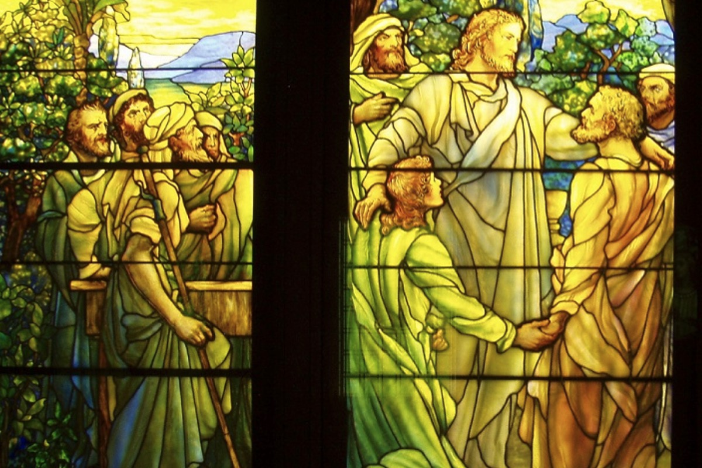
The Eschatological Significance of the Sabbath
Dissertation by Dr. Rick Griffith

Slide 2
The Eschatological Significance of the Sabbath
23
A visual summary of the ThD dissertation by Richard James Griffith, Dallas Theological Seminary, 1990
OS 23
529
Christ’s Second Coming in 2 Phases
Pre-Fall
Pre-Mosaic
Mosaic
Church
Tribulation
Millennial Kingdom
Eternity
Creation
Fall of Man
Mount Sinai
Death of Christ
Rapture
Revelation
Rev 20:1-6
Eternity
NS266k
6 Days
(Work)
Gen 1
7th Day
(Rest)
Gen 2:1-3
Law Instituted
Exod 20
Law Abolished
Rom 7:1-6
Gal 3:19, 23-29
1 Cor 9:20
2 Cor 3:6-11
Daniel’s 70th Week of 70-Week Prophecy
Dan 9:27
Some Aspects of Law Reinstituted
Ezek 40–48
God’s Work
Work of Creation
Gen 1
Work of Sustaining
John 5:17
Work of Recreation
Rev 21–22
Israel Repeatedly Rejected God’s Offer of the Promised Land Rest…
God’s Rest
Not Resting
Rests from Creative Activity
Gen 2:2-3
Rest Stops by Sin
Rest Linked to Canaan
Gen 12; 1-3; 15:18;
Deut 30:1-10
Rejected in Wilderness
Gen 14:23;
Heb 3:9
Rejected in David’s Time
Ps 95:7b-11
Rejected in Messiah
Matt 23:37-39
Rejected in Peter’s Sermon
Acts 3:19-20
Rest Accepted & Reinstituted
Heb 3:7–4:11
Israel’s Sabbath
No Sabbath for Mankind
Israel’s Sabbath Anticipated
Gen 2:3
Sabbath Instituted
Exod 16
Neh 9:13-14
Sign of Mosaic Covenant
Exod 31:13, 17;
Ezek 20:12, 20
Sabbath Abolished
Col 2:16-17
Gal 4:9-10
Rom 14:5
Hos 2:11
Lord’s Day Instituted
Acts 20:7
1 Cor 16:1-2
Rev 1:10
Sabbath Reinstituted
Matt 24:20
Sabbath Reinstituted
Ezek 46:1
Isa 66:23
Transition Begins
Transition Completed
Israel’s National History
Nation Established at Mt Sinai
Exod 19
69 Weeks
（483 years）
444 BC-AD 33
Dan 9:25
Nation Set Aside in
Church Age Gap: “Times of the Gentiles”
Dan 9:26
Luke 21:24
1 Week
(7 Years)
AD ??
Dan 9:27
Nation Repents, Believes in Messiah, Re-established
Ezek 36–39
Kingdom Typology
Kingdom Language
Gen 1
Abrahamic & Land Covenants
Gen 12:1-3; 15:18
Deut 30:1-10
Sabbath Looks Back at Creation & Redemption
Exod 20:8-11
Deut 5:12-15
Sabbath Looks Forward & Typifies Kingdom
Heb 4:9
Lev 23:1-3
Sabbath Typifies in a Dual Sense
Notes:
OS-00-Intro-26
OS-02-Exodus-320
NS-19-Hebrews-175
FU-07-Premillennialism-02

Slide 3
Black

Slide 4


Future (Eschatology) at BibleStudyDownloads.org
Get this presentation for free!
Notes:
Future (fu)
Eschatology

