Slide 1
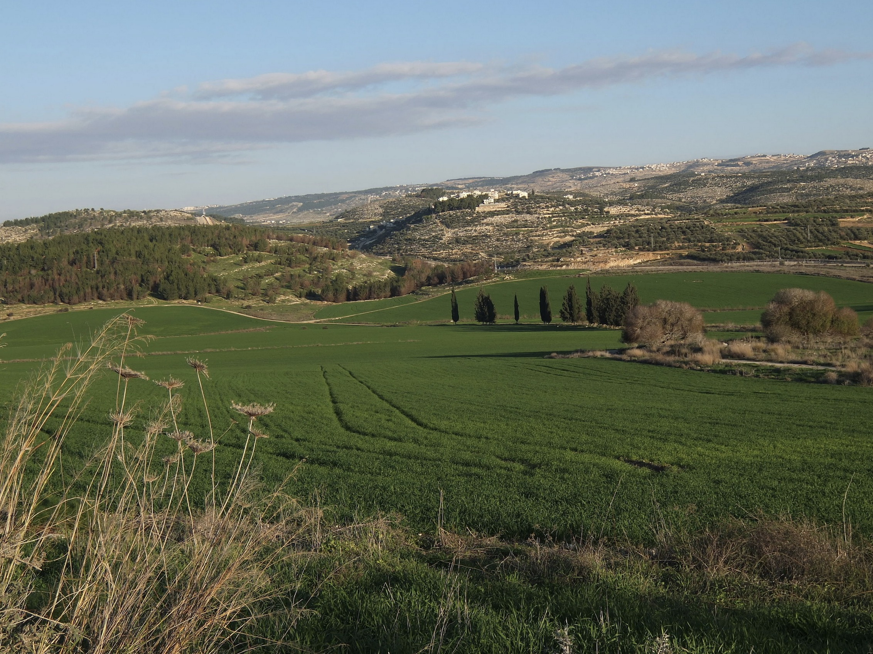
Towards a Shared Land Theology
A Response to the Presentation by Rev Dr Munther Isaac
Dr. Rick Griffith • Jordan Evangelical Theological Seminary • BibleStudyDownloads.org

Slide 2
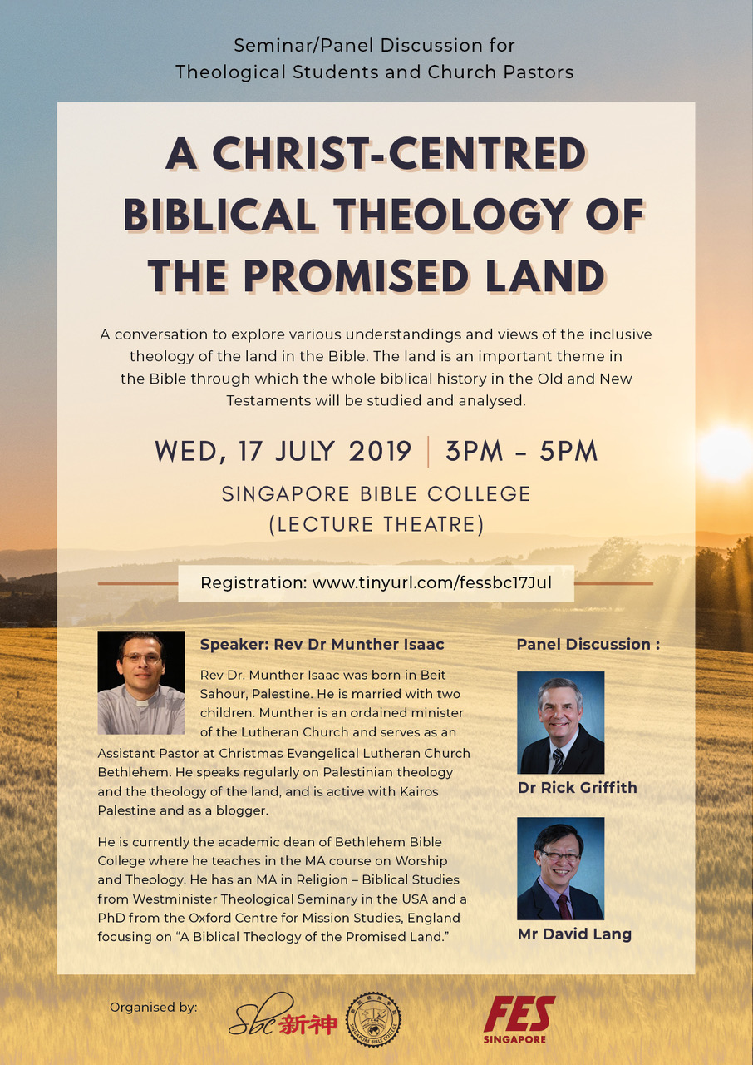
Singapore Bible College Conference
Jointly organized with FES Singapore (17 July 2019)

Slide 3

BibleStudyDownloads.org
Use this QR Code to Link to Resources
Notes:
Links to the Resource page at BSD
______________
Common-09

Slide 4
Definitions:
“Christian Zionist”
“Palestinian”

Slide 5
1. The Land Belongs to God.

Slide 6
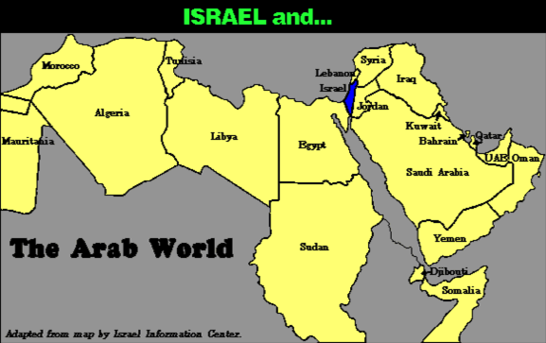
7
COMPARE THE GEOGRAPHY…
Israel and…
ABRAHAM
The CALL
L - S - B
The Arab World
I - I
Handbook pg. 19-24
34
Notes:
Practically speaking…just compare the geography…today's Israel versus the rest of the Arab world!

Slide 7
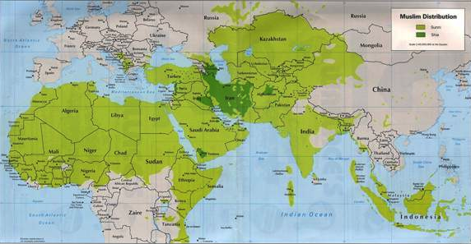
7
COMPARE THE GEOGRAPHY…
ABRAHAM
The CALL
L - S - B
I - I
MOHAMMED VERSUS ISAAC!
Handbook pg. 19-24
35
Notes:
But there is something else at work here. Compare the Middle Eastern influence of Ishmael's descendant, Mohammed, founder of Islam…with that of Isaac, the great Israelite patriarch, and the brother of Ishmael!

Slide 8
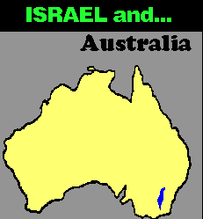
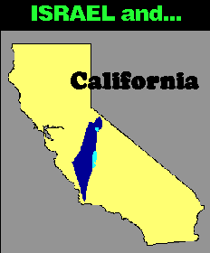
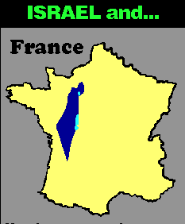
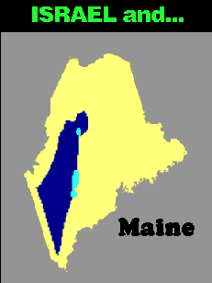


7
COMPARE THE GEOGRAPHY…
ISRAEL and…
ISRAEL and…
Australia
ISRAEL and…
France
California
ISRAEL and…
ISRAEL and…
Singapore
ABRAHAM
The CALL
L - S - B
I - I
Maine
Maps drawn to same scale with Israel in blue
Handbook, pages 19-24
4
36
9.65.03b.
Notes:
In today's geopolitical world…compare the size of tiny Israel with
Australia…
//// Israel with France…
//// Israel and the United States' state of Maine…or
//// Israel and California.
//// The width of Singapore and Israel are about the same.

Slide 9
2. What Were the Boundaries of the Promised Land?

Slide 10

Borders of the Land Promised to Abraham
531e
Syria
Lebanon
Israel
Jordan
Genesis 15:18
"On that day the LORD made a covenant with Abram, saying, 'To your offspring I give this land, from the river of Egypt to the great river, the river Euphrates'" (ESV)
India
Egypt
Notes:
God’s promised land stretched northward from the small wadi of Egypt south in the Sinai to the large Euphrates River in the far north—a HUGE piece of real estate! When today’s boundaries are placed over this land we can see the struggle modern Israel has to claim land from Egypt, Lebanon, Syria and possibly even Jordan on the other side of the Jordan River.

Slide 11
3. The Land Has Demands.

Slide 12
Eternal Land for Abraham’s Descendants
Genesis 17:7-8 (NIV)
"I will establish my covenant as an everlasting covenant between me and you and your descendants after you for the generations to come, to be your God and the God of your descendants after you. ⁸The whole land of Canaan, where you are now an alien, I will give as an everlasting possession to you and your descendants after you; and I will be their God."
Israel
Notes:
God’s promised land stretched northward from the small wadi of Egypt south in the Sinai to the large Euphrates River in the far north—a HUGE piece of real estate! When today’s boundaries are placed over this land we can see the struggle modern Israel has to claim land from Egypt, Lebanon, Syria and possibly even Jordan on the other side of the Jordan River.

Slide 13
4. Inheritance—Forever?

Slide 14
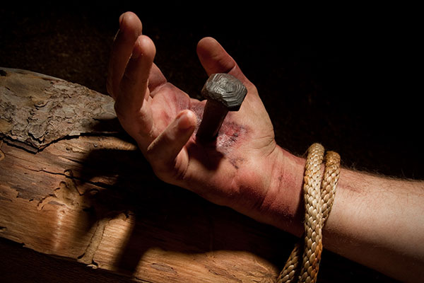
The Repentance of Israel
"Then I will pour out a spirit of grace and prayer on the family of David and on the people of Jerusalem. They will look on me whom they have pierced and mourn for him as for an only son. They will grieve bitterly for him as for a firstborn son who has died"
(Zech. 12:10 NLT).

Slide 15
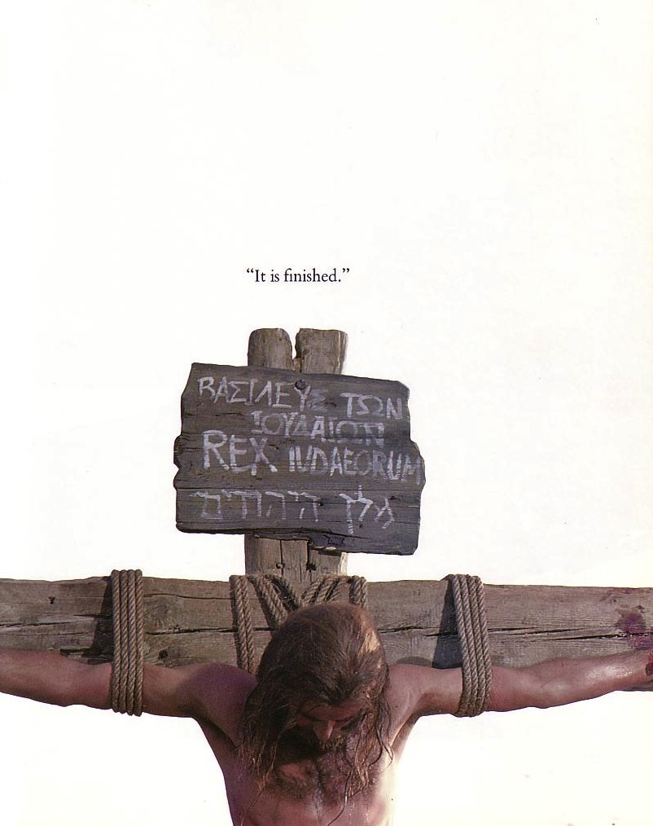
Tribulation Results
"They will look on the one they have pierced…"
(Zech. 12:1-10; esp. v. 10)
"The Redeemer will come to Zion, to those in Jacob who repent of their sins" (Isa. 59:20)
"The deliverer will come from Zion; he will turn godlessness away from David"
(Rom. 11:26b)
"And so all Israel will be saved" (Rom. 11:26a)

Slide 16
A Dispensational Timeline
OT Survey page 437
Rapture
(1 Thess 4:13-18)
2nd Advent
(Zech 14:3-5)
Great White Throne
(Rev 20:11-14)
Day of the LORD
Church Age
Tribulation
(Zech 14:1-2)
Millennium
(Zech 14:6-21)
Gog & Magog
(Armageddon)
(Ezek 38–39)
Gog and Magog
Revisited
(Rev 20:7-10)
"How awful that day will be! None will be like it. It will be a time of Jacob's trouble, but he will be saved out of it"
(Jer 30:7)
Notes:
16
The next event on God's prophetic calendar is for the church age to end with the Rapture. Shortly after this, the Day of the Lord will begin with the Antichrist signing a covenant with Israel (Dan 9:27; 2 Thess 2:1-12). Jeremiah 30:7 called this "Day" or period the "time of Jacob's trouble" or era of great persecution of Jews. Yet the second coming will bring in phase 2 of the "Day of the Lord" where all Israel at that time will be saved (Rom 11:26-27). This 1000 years of blessing on earth will be preceded and followed by two major battles and ending in the Great White Throne Judgment.
So how does this give you hope?
Does it affect how you use your money? Do you “lay up for yourself treasures in heaven” as a result?
How does it impact your use of time? Do you say, “That movie isn’t necessarily wrong, but I could use my time much better by investing God’s Word into others!”?
______
Common-342
ES-25-Shared Land Theology-18
ES-26-Restoration of Israel-126, 334, 346, 362
JE-09-Return of Christ-36
JE-10-Christ's Rule-40
OS-23-Isaiah 1-12-Slide 87
OS-24-Jeremiah-161
OS-26-Ezekiel 1-39-Slide 247
OS-26-Ezekiel_33-39—slide 102
OS-26-Ezekiel 40-43-Slide 24
OS-29-Joel-87
OS-31-Obadiah-154
OS-36-Zephaniah-86
OS-39-Zechariah-158, 167, 184
NS-22-Rev4-6-slide 117
NS-22-Rev20-22-slide 137

Slide 17
5. Who is Israel in the Bible?

Slide 18

Is God's election fair?

Slide 19
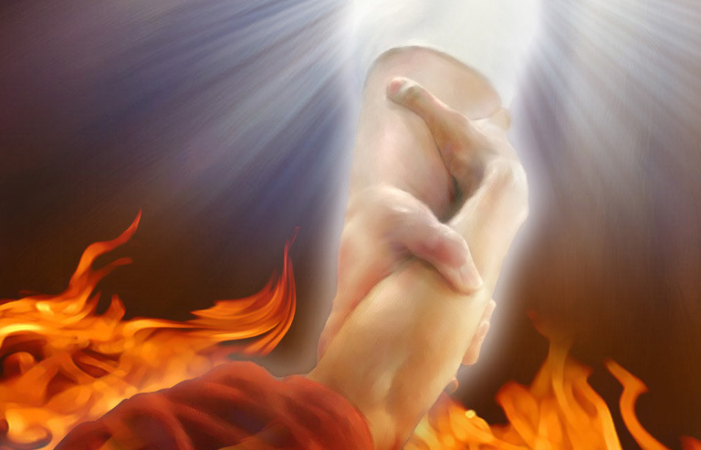
"Are we saying, then, that God was unfair? Of course not! ¹⁵For God said to Moses, 'I will show mercy to anyone I choose, and I will show compassion to anyone I choose.'
¹⁶So it is God who decides to show mercy. We can neither choose it nor work for it"
(Romans 9:14-16 NLT).

Slide 20
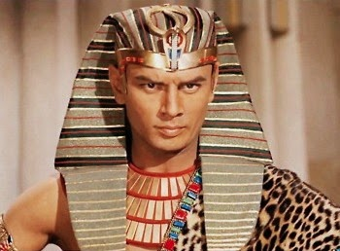
"For the Scriptures say that God told Pharaoh,
'I have appointed you for the very purpose of displaying my power in you and to spread my fame throughout the earth.'
¹⁸So you see, God chooses to show mercy to some, and he chooses to harden the hearts of others so they refuse to listen”
(Romans 9:17-18 NLT).

Slide 21
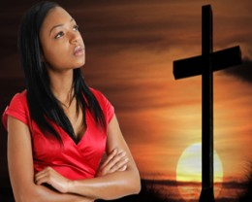
"Well then, you might say, 'Why does God blame people for not responding? Haven't they simply done what he makes them do?
²⁰No, don't say that. Who are you, a mere human being, to argue with God? Should the thing that was created say to the one who created it, 'Why have you made me like this?'"
(Romans 9:19-20 NLT).

Slide 22
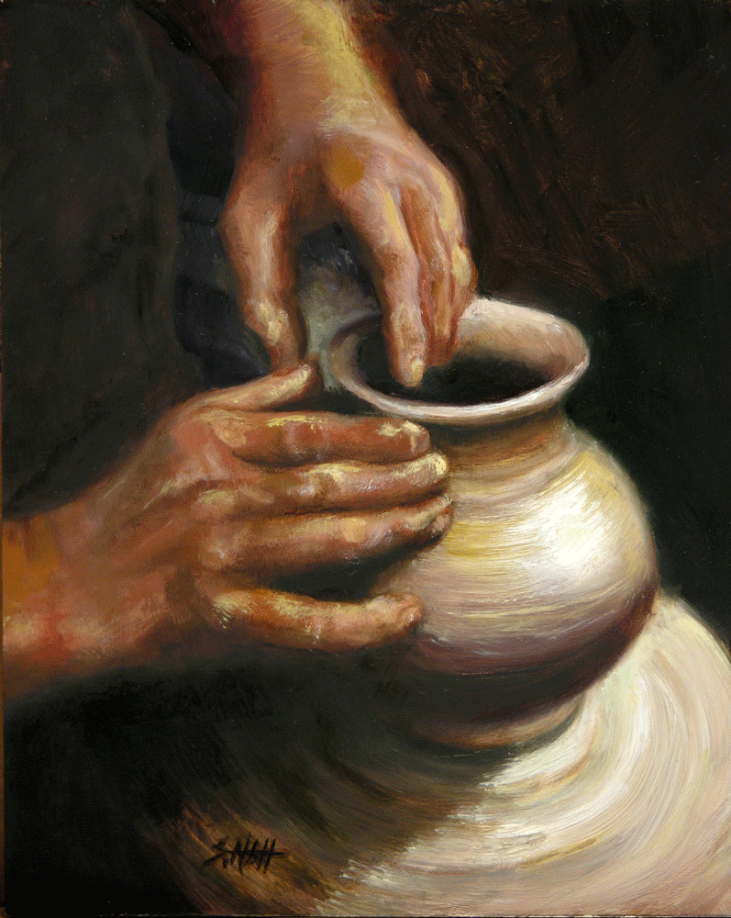
"When a potter makes jars out of clay, doesn't he have a right to use the same lump of clay to make one jar for decoration and another to throw garbage into?"
(Romans 9:21 NLT).

Slide 23
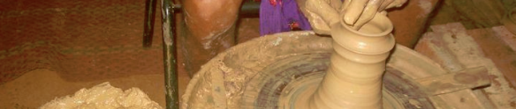
"In the same way, even though God has the right to show his anger and his power, he is very patient with those on whom his anger falls, who are destined for destruction. ²³He does this to make the riches of his glory shine even brighter on those to whom he shows mercy, who were prepared in advance for glory. ²⁴And we are among those whom he selected, both from the Jews and from the Gentiles” (Romans 9:22-24 NLT).

Slide 24
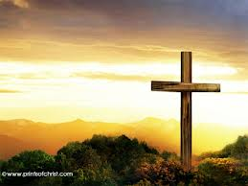
Galatians 3:26-27 NLT
06/08/13
"For you are all children of God through faith in Christ Jesus. ²⁷And all who have been united with Christ in baptism have put on Christ, like putting on new clothes."

Slide 25

Galatians 3:28 NLT
"There is no longer Jew or Gentile, slave or free, male and female. For you are all one in Christ Jesus."

Slide 26
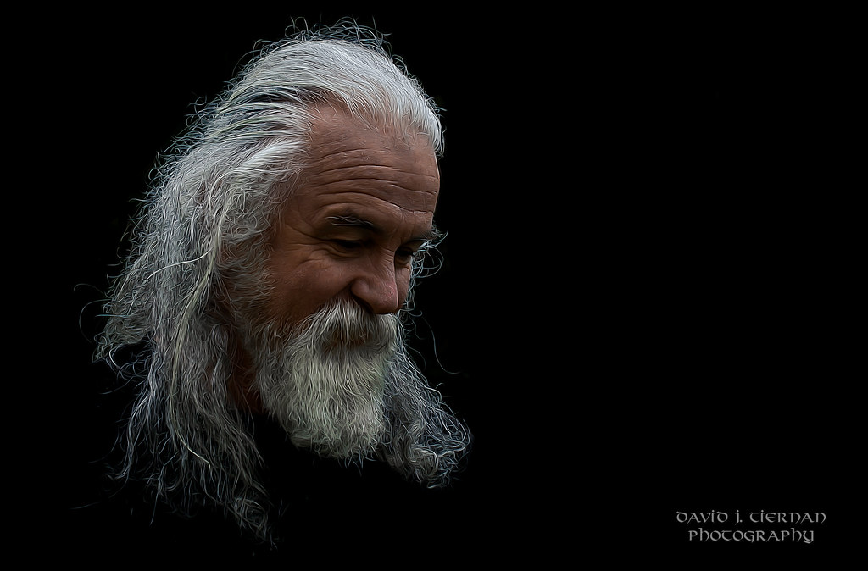
Galatians 3:29 NIV
"If you belong to Christ, then you are Abraham’s seed, and heirs according to the promise."

Slide 27

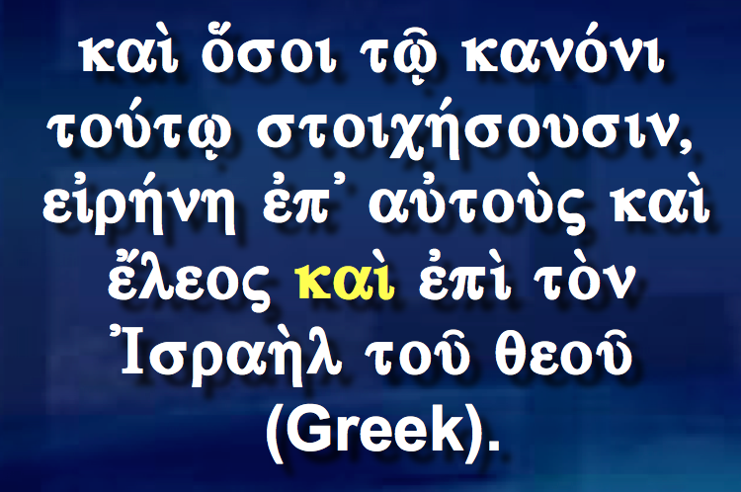
Who is "the Israel of God" (Gal. 6:16)?
"Peace and mercy to all who follow this rule, even to the Israel of God" (NIV).
kai« o¢soi twˆ◊ kano/ni tou/twˆ stoich/sousin, ei˙rh/nh e˙p∆ aujtou\ß kai« e¶leoß kai« e˙pi« to\n ∆Israh\l touv qeouv (Greek).
"May God’s peace and mercy be upon all who live by this principle; they are the new people of God" (NLT).
"And those who will walk by this rule, peace and mercy be upon them, and upon the Israel of God" (NAU).
Notes:
______________
ES-25-Shared Land Theology-24
ES-26-Restoration of Israel-449
NS-09-Galatians-200

Slide 28
"…and (kai) upon the Israel of God" (Gal. 6:16)
"…even to the Israel of God" (NIV)
"…and upon the Israel of God" (NAU)
Unusual
use of kai
Normal
use of kai
= All Christians
= Jewish Christians
Church = Israel
Church ≠ Israel

Slide 29
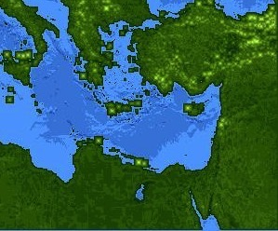
Jews at Pentecost––Acts 2:9-11
132
Rome (13)
PONTUS (7)
CAPPADOCIA (6)
ASIA (8)
PHRYGIA (9)
Parthia (1)
PAMPHILIA (10)
Mesopotamia (4)
CRETE (14)
Media (2)
Elam (3)
Jerusalem
CYRENE (12)
JUDEA (5)
ASIA––Roman Empire Provinces
Media––Parthian Empire Provinces
EGYPT (11)
Rome––Cities
CRETE––Islands
ARABIA (15)
Miles
0
200
400
600
800
1000
(1) (2) (3) etc. indicate sequence in Acts 2:9-11
Kms
0
300
600
900
1200
1500
Notes:
Jews numbered 40,000 in Rome during the reign of Augustus (30 BC to AD 14), so this was a sizable minority. We do not know for sure who actually started the church at Rome, but it likely was some of these Jews who returned to Rome after receiving the Spirit at Pentecost in Jerusalem. They, in turn, led Gentiles in Rome to faith as well.
_______________
ES-25-Shared Land Theology—27
NS-05-Acts1-2—257

Slide 30

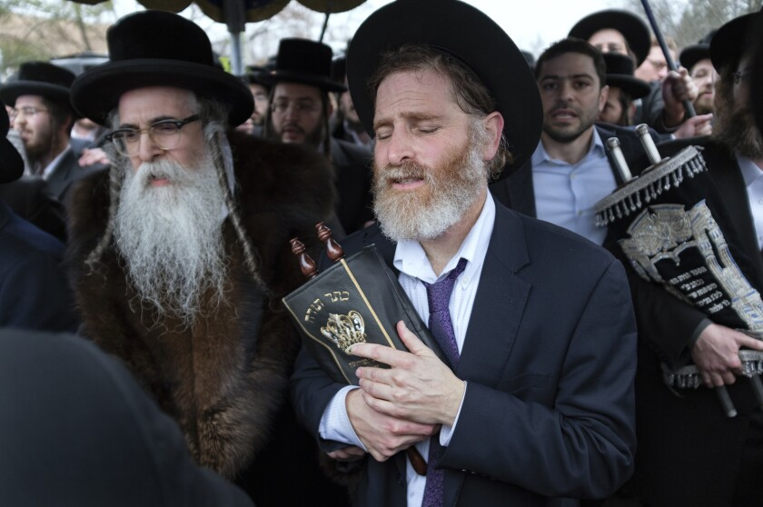
Is There a Future for Ethnic Jews?
155q
Notes:
About 27% of the Bible related to the future when it was written, and half of these prophecies have already been fulfilled. But should we expect more fulfillments to come for the descendants of Jacob?
_________
Common-347
BE-45-Rom-slide 70
ES-Shared Land Theology-28
OS-02-Exodus-444
OS-31-Obadiah-145
NS-06-Rom9-16-slide 26

Slide 31
Leviticus 26:44-45
"Yet in spite of this, when they are in the land of their enemies, I will not reject them, nor will I so abhor them as to destroy them, breaking My covenant with them; for I am the Lord their God. But I will remember for them the covenant with their ancestors, whom I brought out of the land of Egypt in the sight of the nations, that I might be their God. I am the Lord."

Slide 32
Deuteronomy 30:3-5a
"Then the Lord your God will restore you from captivity, and have compassion on you, and will gather you again from all the peoples where the Lord your God has scattered you. If your outcasts are at the ends of the earth, from there the Lord your God will gather you, and from there He will bring you back. And the Lord; your God will bring you into the land which your fathers possessed, and you shall possess it..."

Slide 33
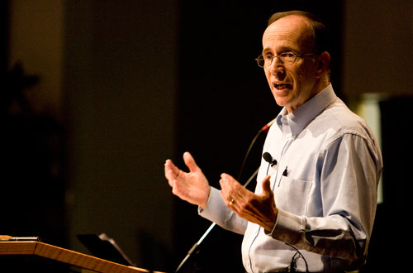
"How to Get Rid of the Jews"
³⁵ This is what the LORD says,
he who appoints the sun
to shine by day,
who decrees the moon and stars
to shine by night,
who stirs up the sea
so that its waves roar—
the LORD Almighty is his name:
³⁶ "Only if these decrees vanish
from my sight," declares the LORD,
"will the descendants of Israel ever cease
to be a nation before me."
³⁷ This is what the LORD says:
"Only if the heavens above can be measured
and the foundations of the earth below be searched out
will I reject all the descendants of Israel
because of all they have done,"
declares the LORD (Jer. 31:35-37 NIV).
Notes:
A pastor once announced to his congregation, • "Next week I will speak on the topic of 'How to Get Rid of the Jews.'" The news spread throughout the small town to the extent that on the next Sunday, after the doors had closed and just before a packed service began, the doors opened again and into the church walked the city's chief rabbi, followed by two of his lawyers! They walked down the center aisle all the way to the front, then took seats in the very front row.
The service continued with songs, prayers, offering and finally the pastor stood at the pulpit. "I am thrilled to see so many at church today, including our distinguished rabbi and his friends. My topic today is 'How to Get Rid of the Jews.' The text is from Jeremiah, chapter 31. Please turn in your Bibles to Jeremiah 31, verse 35.'" [Animate slide and read vv. 35-37]
At this point, the rabbi smiled, the pastor winked, the congregation sighed in relief, and the lawyers realized that their job was over.
God was clear to Jeremiah that his covenant with the Jews is an eternal covenant, not dependent on them. He promised a New Covenant that assures that at some future point the nation will again trust in him by believing in Messiah, after which God will forgive their sins.
A pastor once announced to his congregation, • "Next week I will speak on the topic of 'How to Get Rid of the Jews.'" The news spread throughout the small town to the extent that on the next Sunday, after the doors had closed and just before a packed service began, the doors opened again and into the church walked the city's chief rabbi, followed by two of his lawyers! They walked down the center aisle all the way to the front, then took seats in the very front row.
The service continued with songs, prayers, offering and finally the pastor stood at the pulpit. "I am thrilled to see so many at church today, including our distinguished rabbi and his friends. My topic today is 'How to Get Rid of the Jews.' The text is from Jeremiah, chapter 31. Please turn in your Bibles to Jeremiah 31, verse 35.'" [Animate slide and read vv. 35-37]
At this point, the rabbi smiled, the pastor winked, the congregation sighed in relief, and the lawyers realized that their job was over.
God was clear to Jeremiah that his covenant with the Jews is an eternal covenant, not dependent on them. He promised a New Covenant that assures that at some future point the nation will again trust in him by believing in Messiah, after which God will forgive their sins.
That God will never abandon Israel is also taught elsewhere:
Jer. 33:23 The LORD gave another message to Jeremiah. He said, ²⁴ “Have you noticed what people are saying?—‘The LORD chose Judah and Israel and then abandoned them!’ They are sneering and saying that Israel is not worthy to be counted as a nation. ²⁵ But this is what the LORD says: I would no more reject my people than I would change my laws that govern night and day, earth and sky. ²⁶ I will never abandon the descendants of Jacob or David, my servant, or change the plan that David’s descendants will rule the descendants of Abraham, Isaac, and Jacob. Instead, I will restore them to their land and have mercy on them.”
Lev. 26:40 “But at last my people will confess their sins and the sins of their ancestors for betraying me and being hostile toward me. ⁴¹ When I have turned their hostility back on them and brought them to the land of their enemies, then at last their stubborn hearts will be humbled, and they will pay for their sins. ⁴² Then I will remember my covenant with Jacob and my covenant with Isaac and my covenant with Abraham, and I will remember the land. ⁴³ For the land must be abandoned to enjoy its years of Sabbath rest as it lies deserted. At last the people will pay for their sins, for they have continually rejected my regulations and despised my decrees.
Lev. 26:44 “But despite all this, I will not utterly reject or despise them while they are in exile in the land of their enemies. I will not cancel my covenant with them by wiping them out, for I am the LORD their God. ⁴⁵ For their sakes I will remember my ancient covenant with their ancestors, whom I brought out of the land of Egypt in the sight of all the nations, that I might be their God. I am the LORD.”
See also The Restoration of Israel PPT file at https://biblestudydownloads.org/resource/future/
____________
Common-383
ES-25-Shared Land Theology-31
OS-24-Jeremiah-49, 162

Slide 34
God will restore Israel to the land twice
“In that day the Root of Jesse will stand as a banner for the peoples; the nations will rally to him, and his place of rest will be glorious. ¹¹In that day the LORD will reach out his hand a second time to reclaim the remnant that is left of his people from Assyria, from Lower Egypt, from Upper Egypt, from Cush, from Elam, from Babylonia, from Hamath and from the islands of the sea” (Isa 11:11-12 NIV).

Slide 35
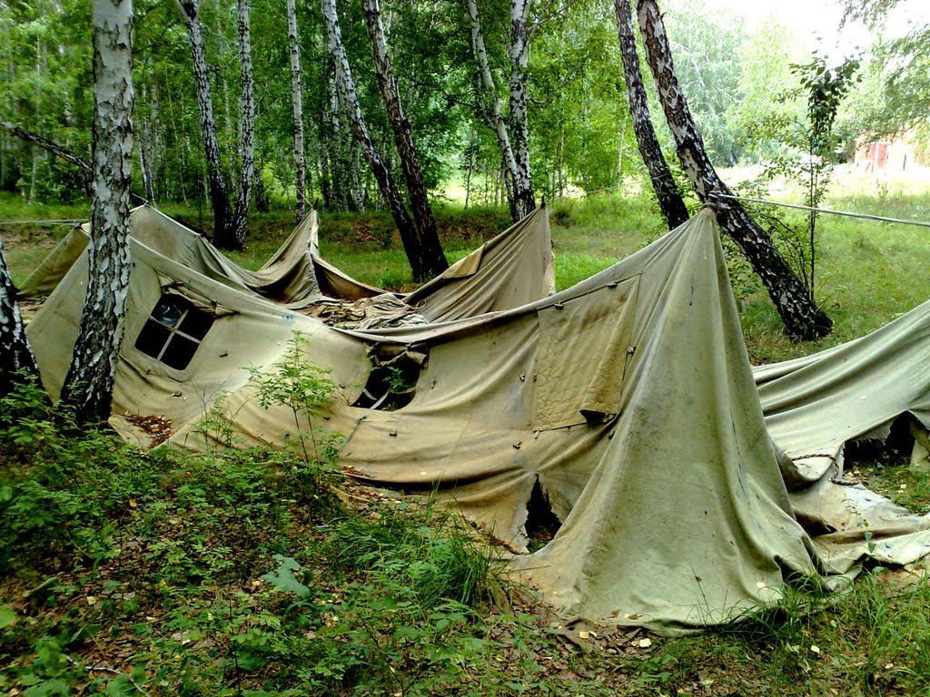
Can you restore a fallen tent?
593
God can.

Slide 36

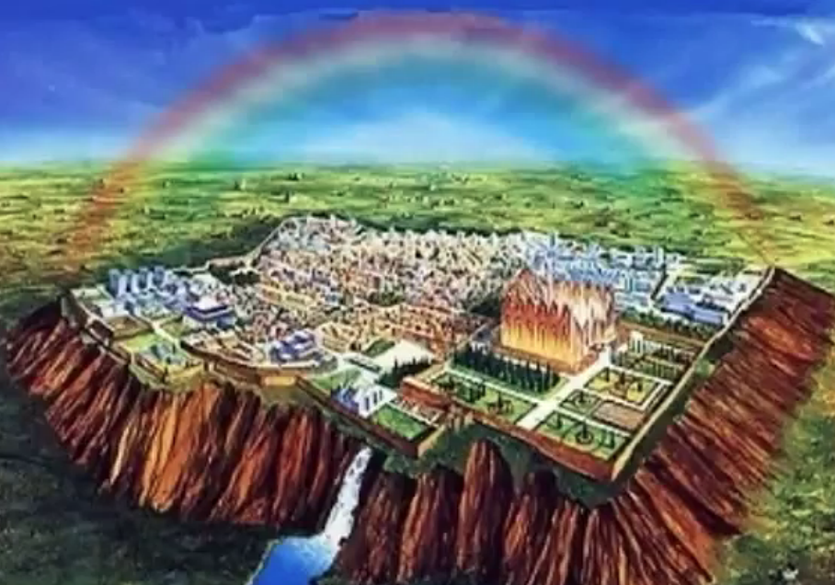
Amos 9:11 (NIV)
593
"'In that day I will restore David's fallen tent. I will repair its broken places, restore its ruins, and build it as it used to be."

Slide 37


Amos 9:11 (NIV)
593
"'In that day I will restore David's fallen tent. I will repair its broken places, restore its ruins, and build it as it used to be."
Zedekiah Deposed
586 BC
Jesus
Rules
AD ??

Slide 38
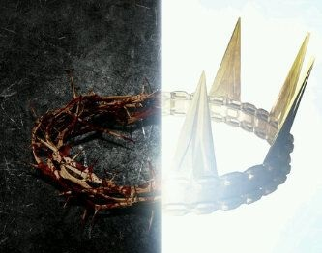
Amos
Christ's crown of thorns will be replaced with a crown of rule

Slide 39

Amos 9:11-12 (NIV)
593
"In that day I will restore David's fallen tent. I will repair its broken places, restore its ruins, and build it as it used to be, ¹²so that they may possess the remnant of Edom and all the nations that bear my name,' declares the LORD, who will do these things."
Judah
Edom
Notes:
"B. National purpose (9:12)
9:12. The united kingdom under its Davidic King will then become the source of blessing to all Gentiles. Edom, a nation perpetually hostile toward God’s people (cf. Num. 20:14-21; Ps. 137:7; Obad. 1; see comments on Amos 1:11-12), and therefore representative of all Israel’s enemies, will become a sharer in the promises to David: Israel will possess the remnant of Edom (cf. Obad. 19). In fact, all ... nations will be brought under the dominion of the Davidic King, for they too bear God’s name. To “bear someone’s name” meant to be under the suzerainty and protection of that individual (cf. Deut. 28:9-10; 2 Sam. 12:26-28; 1 Kings 8:43; Isa. 4:1; 63:19; Jer. 15:16; Dan. 9:18-19). All nations belong to God (cf. Amos 1:3-2:16; 3:9; 9:4, 7) and therefore will be included in the blessings of the future kingdom.
From the beginning, God’s plan has been to provide salvation for the Gentile nations. His promise to Abraham was that through his descendants “all peoples on earth” will be blessed (Gen. 12:3; cf. Gen. 18:18; 22:17-18; 26:3-4; 28:13-14). Through Isaiah God continually affirmed that a united Israel under its Davidic King, the Messiah, will bring light, justice, and full knowledge of the LORD to all nations on the earth (Isa. 9:1-7; 11:1-13; 42:1-7; 45:22-25; 49:5-7; 55:1-5). When God restores the kingdom (the Millennium) under David’s Son, both Jews and Gentiles will bear the name of the Lord.
At the Jerusalem Council, James cited Amos 9:11-12 as proof that the Gentiles of his day need not be circumcised and live as Jews in order to be saved (Acts. 15:1-20). James was aware that Israel’s judgments were not yet over (cf. the Lord’s statements regarding the coming destruction of the temple and renewed persecution and death, Matt. 24:1-22; Luke 21:5-24, and that the restoration had not yet begun; cf. Acts 1:6-7). But James also knew from Amos’ succinct statement and from extended passages in other prophets (cf. “prophets” in Acts 15:15; also note Isa. 42:6; 60:3; Mal. 1:11) that when the promised kingdom would come, the Gentiles will share in it as Gentiles and not as quasi-Jews. Since this was God’s millennial purpose, James concluded that the church should not require Gentiles to relinquish their identity and live as Jews. James was not saying the church fulfills the promises to Israel in Amos 9:11-12. He was saying that since Gentiles will be saved in the yet-to-come Millennium, they need not become Jews in the Church Age (see extended comments on Acts 15:15-18)."
Donald R. Sunukjian, Amos (The Bible Knowledge Commentary; ed. John F. Walvoord and Roy B. Zuck; Accordance electronic ed. 2 vols.; Wheaton: Victor Books, 1985), 1:1451.

Slide 40
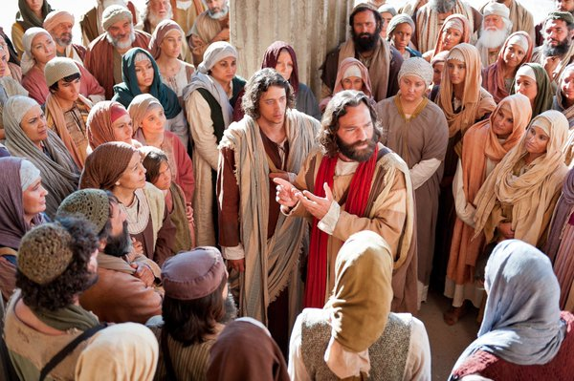
Peter Led 3000 to Christ at Pentecost
"Those who accepted his message were baptized, and about three thousand were added to their number that day."
Acts 2:41 NIV

Slide 41
Amos 9:11-12 (NIV)
593
Acts 15:16-18 (NIV)
"In that day I will restore David's fallen tent. I will repair its broken places, restore its ruins, and build it as it used to be, ¹²so that they may possess the remnant of Edom and all the nations that bear my name,' declares the LORD, who will do these things."
"'After this I will return and rebuild David's fallen tent. Its ruins I will rebuild, and I will restore it, ¹⁷that the remnant of men may seek the Lord, and all the Gentiles who bear my name, says the Lord, who does these things.'"
Notes:
The final verses of Amos’ prophecy (9:11-12) provide hope for restoration to Israel after discipline by the LORD. In fact, reference is made to both a restoration of the Davidic reign and expansion of the nation’s borders to include land as far southeast as Edom.
James used this text from Amos at the Jerusalem Council of Acts 15:16-17 to argue for the inclusion of Gentiles in the church without the need for circumcision. Yet notable differences remain between the two, as James does not quote Amos exactly. See the differences above.
“Edom” (consonants EDM) is from the Hebrew (Masoretic) Text with vowel pointing that was not added until the eighth century AD. Yet in Amos’ time without the vowels, the same word could be read either as “Edom” or “mankind” (also consonants EDM). In Acts 15 James quoted it as “mankind.” A similar problem occurs between “possess” (consonants YRS) and “seek” (consonants DRS) which are only different by one consonant.
For interpretive problems such as the claim that the church is being referred to here, see the supplement to the book of Acts in my New Testament Survey. Also, note the following from Donald R. Sunukjian, “Amos,” in The Bible Knowledge Commentary, 1:1451
"V. The Restoration after Judgment (9:11-15)
After all God’s judgments are past, when the nation has received full punishment for her sins, the Lord will move in [Vol. 1, p. 1451] mercy to renew and refresh His people. God will restore David’s kingdom over both the North and the South, and through it He will bless all nations of the earth. He will reverse the covenant curses and bring unprecedented prosperity to the land. Dispersed Israel will be returned to her land, there to dwell securely and enjoy its goodness. Then He who has always claimed them as “My people” (7:8, 15; 8:2; 9:10, 14; cf. Hosea 2:23; Zech. 8:8; 13:9) will once again take the title “your God” (Amos 9:15).
A. Political renewal (9:11)
9:11. In that day (cf. Isa. 4:2; Micah 4:6; 5:10) God will restore David’s fallen tent. Previous references in Amos to “that day” had spoken of it as a day of darkness and destruction (Amos 2:16; 3:14; 5:18-20; 8:3, 9, 11, 13). But when Israel’s ordeal is finally over, “that day” will also become the day of her renewal.
God will reestablish David’s “tent” over both the Northern and Southern Kingdoms. A “tent” (lit., “booth”) or awning was made by setting up a simple frame and spreading branches over it. Its primary purpose was to shelter those under it, whether troops in the field (2 Sam. 11:11; 1 Kings 20:12-16), a watchman at post (Jonah 4:5), or pilgrims at the Feast of Booths (also called the Feast of Tabernacles, Lev. 23:33-42). David’s dynasty, which had been a protective canopy over all the people of Israel, had “fallen” with the great schism of the 10 Northern tribes from the 2 Southern tribes (1 Kings 12). This booth had been broken in two. But God promised to unite the two kingdoms once again under Davidic rule (cf. Jer. 30:3-10; Ezek. 37:15-28; Hosea 3:4-5). He will restore the sheltering tent, repair its broken places, building it as it used to be. God will carry out His good promise to David that He would raise up a Descendant after him and establish His rule forever (2 Sam. 7:11-16, 25-29)."

Slide 42
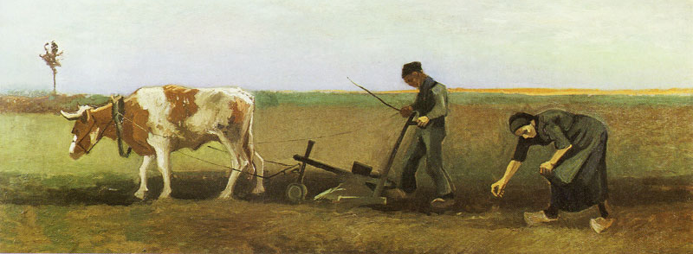
Amos 9:13a (NIV)
593
"'The days are coming,' declares the LORD, 'when the reaper will be overtaken by the plowman and the planter by the one treading grapes."

Slide 43
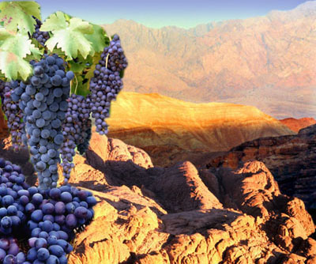
Amos 9:13b (NIV)
593
"New wine will drip from the mountains and flow from all the hills."

Slide 44
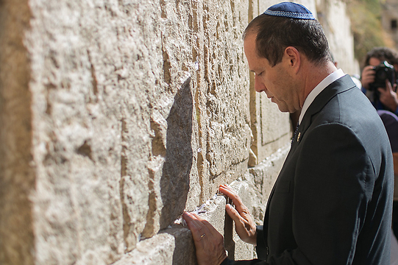
Amos 9:14-15 (NIV)
593
"'I will bring back my exiled people Israel;
they will rebuild the ruined cities and live in them. They will plant vineyards and drink their wine; they will make gardens and eat their fruit.
¹⁵I will plant Israel in their own land, never again to be uprooted from the land I have given them,' says the LORD your God."

Slide 45
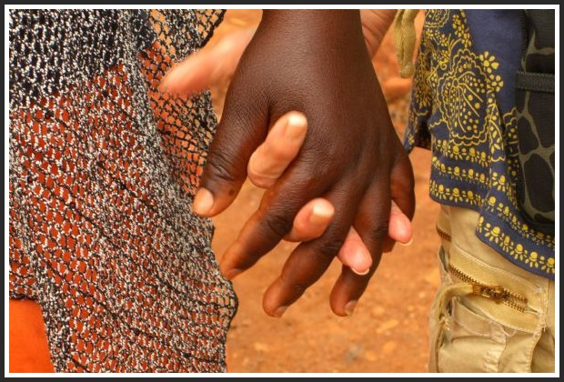
Millennial Worship
"In the end, the enemies of Jerusalem who survive the plague will go up to Jerusalem each year to worship the King... and to celebrate the Festival of Shelters. ¹⁷Any nation in the world that refuses to come to Jerusalem to worship the King... will have no rain. ¹⁸If the people of Egypt refuse to attend the festival, the LORD will punish them with the same plague that he sends on the other nations who refuse to go. ¹⁹Egypt and the other nations will all be punished if they don't go to celebrate the Festival of Shelters"
(Zechariah 14:16-19 NLT).

Slide 46

"And you have caused them to become a Kingdom of priests for our God. And they will reign on the earth" (Rev 5:10 NLT).
369

Slide 47

461b
Millennial Jerusalem
"The law will go out from Zion,
the word of the LORD from Jerusalem"
--Isaiah 2:3
Notes:
47

Slide 48
Millennial Jerusalem (Micah)
106
"For out of Zion shall go forth the law, and the word of the LORD from Jerusalem"
––Micah 4:2

Slide 49
Who copied whom?
ESV Isaiah 2:2 It shall come to pass in the latter days that the mountain of the house of the LORD shall be established as the highest of the mountains, and shall be lifted up above the hills; and all the nations shall flow to it,
ESV Micah 4:1 It shall come to pass in the latter days that the mountain of the house of the LORD shall be established as the highest of the mountains, and it shall be lifted up above the hills; and peoples shall flow to it,
Notes:
49

Slide 50
Who copied whom?
ESV Isaiah 2:3 and many peoples shall come, and say: "Come, let us go up to the mountain of the LORD, to the house of the God of Jacob, that he may teach us his ways and that we may walk in his paths." For out of Zion shall go the law, and the word of the LORD from Jerusalem.
ESV Micah 4:2 and many nations shall come, and say: "Come, let us go up to the mountain of the LORD, to the house of the God of Jacob, that he may teach us his ways and that we may walk in his paths." For out of Zion shall go forth the law, and the word of the LORD from Jerusalem.
Notes:
50

Slide 51
Who copied whom?
ESV Isaiah 2:4 He shall judge between the nations, and shall decide disputes for many peoples; and they shall beat their swords into plowshares, and their spears into pruning hooks; nation shall not lift up sword against nation, neither shall they learn war anymore.
ESV Micah 4:3 He shall judge between many peoples, and shall decide for strong nations afar off; and they shall beat their swords into plowshares, and their spears into pruning hooks; nation shall not lift up sword against nation, neither shall they learn war anymore
Notes:
51

Slide 52
6. The Prophecies and the Realities Today

Slide 53
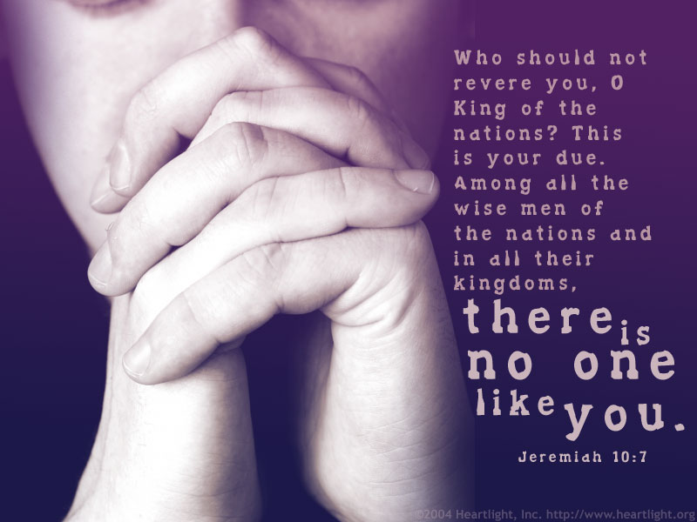
But can God restore Israel as a nation?
508
Notes:
Jeremiah also notes that Israel will be restored as a nation even after many centuries:
Jer. 30:20 Their children will prosper as they did long ago.
I will establish them as a nation before me,
and I will punish anyone who hurts them.

Slide 54
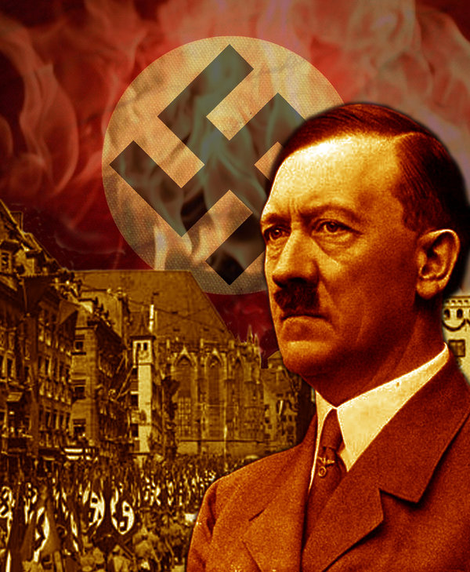
Hitler motivated the Jews to go to their homeland!
Notes:
The very opposite happened to what Hitler tried to do. He sought to kill the Jews and pushed them out of his land.

Slide 55
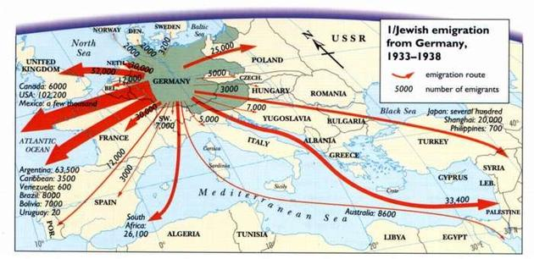
Hitler motivated the Jews to go to their homeland!
Jewish emigration from Germany
1933-1938
Route
GERMANY
Number
Notes:
Hitler sought to eradicate the Jews, but God sought to eradicate Hitler. He committed suicide in 1945 and three years later the Jews established their homeland in Israel! God told Abraham, "I will bless those who bless you and curse those who curse you" (Gen 12:3). Hitler's attempt to curse the Jews led to him being cursed.

Slide 56

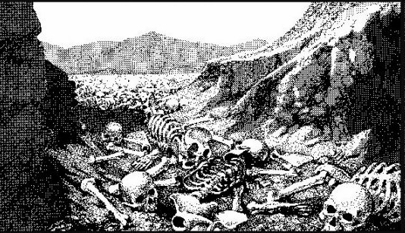
The Dry Bones of Ezekiel 37
508
What do they mean?
When is the fulfillment?
Notes:
Ezekiel 37 has one of the most amazing depictions in Scripture with bones coming to life.

Slide 57
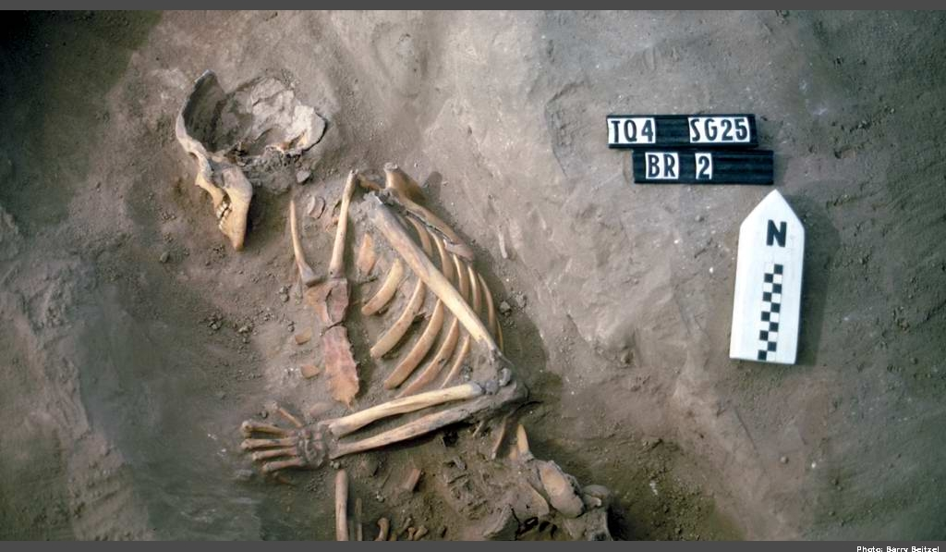
The Valley of Dry Bones (Ezekiel 37)
Notes:
Imagine a skeleton standing up on its own, growing flesh, and then coming alive.

Slide 58
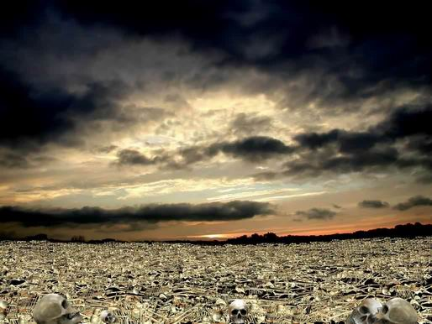
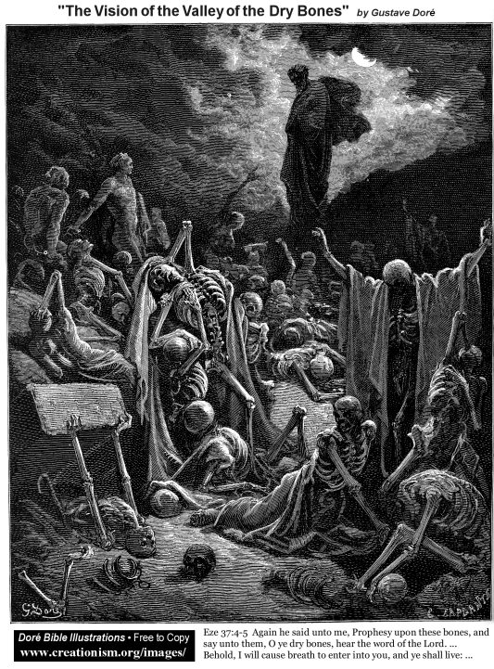
The Valley of Dry Bones (Ezek. 37)
Stage 1:
Return in Unbelief
Notes:
God predicted a two-stage return to the land—first in unbelief…

Slide 59
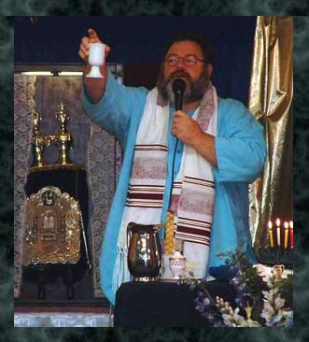
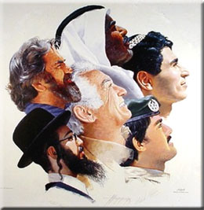
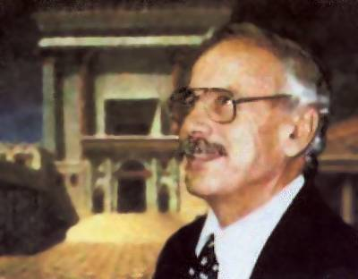
The Valley of Dry Bones (Ezek. 37)
Stage 1:
Return in Unbelief
Stage 2:
Trust in Messiah
Notes:
God predicted a two-stage return to the land—first in unbelief…
• but then later they will believe in a single day (Zech 3:9; 9:16).

Slide 60
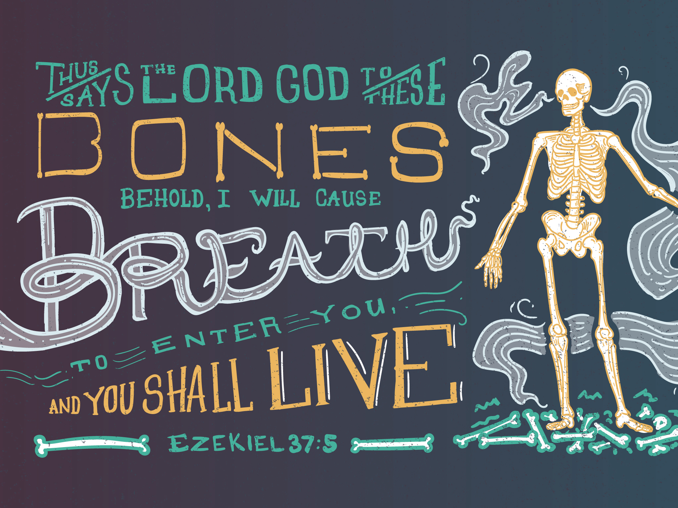
Ezekiel 37:5
* Don't try that on the final exam
Notes:
God will breathe life into Israel!

Slide 61

A Hebrew Play on Words
"Prophesy to the
breath" (37:5, 9)
"Prophesy to the
Spirit" (37:14)
=
Hebrew insert
"breath, wind, Spirit"
Gen. 2:7
Greek insert
"breath, wind, Spirit"
John 3:5, 8; 2 Thess 2:8
=
Notes:
Amazingly, the same three meanings of the Hebrew ruah are replicated in the Greek pneuma.
This probably is not true of any other Hebrew and Greek words.
So the angel told Ezekiel twice to prophesy to the ruah, but it is correct to translate it as "Spirit" the second time.
The point, of course, is that the Spirit gives life and breath to individuals—and will do so to Israel also in the last days.

Slide 62

Exiles & Returns
508
Exile
to
Babylon
by
King
Nebuchad-nezzar
(586 BC)
Exile
to
Nations
by
Roman
General
Titus
(AD 70)
Return
to
Israel
by
King
Cyrus
(516 BC)
Return
to
Israel
by
Zionists
(AD 1948)
Ezekiel's Time (597 BC)
But how do we know Ezekiel 37 relates to this second exile and return?
Notes:
Israel returned to the land TWO times since Ezekiel lived. (Isaiah served even a century earlier.)
• The people were exiled to Babylon in 586 BC.
• And the first return was 516 BC at the end of our OT.
• But they were exiled a second time in AD 70 and went to many nations of the world.
• And their second return culminated in the State of Israel in 1948.
Now, which return was Ezekiel predicting? I say the second one.
But how do we know Ezekiel 37 relates to this second exile and return?
———————————
OS-23-Isaiah1-12—slide 354
OS-23-Ezek 33-38—slide 62

Slide 63


Interpreting Ezekiel's Prophecy
508
Vision |  | Meaning
bones | = | house of Israel
dried bones | = | hope gone, cut off
bones together | = | Jews return to Israel
breath in them | = | God's Spirit in Israel
Adapted from www.bibleweb.org/ MEastStudies/Sem3.htm

Slide 64
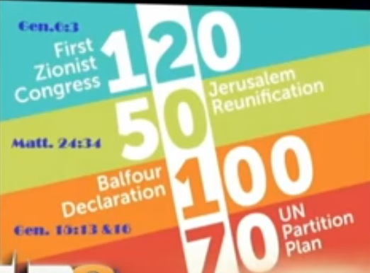
The year 2017 was significant for Israel
Gen 6:3
120
First
Zionist
Congress
Jerusalem
Reunification
50
Matt 24:34
100
Balfour
Declaration
UN
Partition
Plan
Gen 15:13, 16
70
Notes:
See https://www.youtube.com/watch?v=_JF9cWmjgEc for PM Benjamin Netanyahu UN speech speech on these dates at 18:00 minutes:
1897 First Zionist Congress under Theodore Hertzel started bringing Jews back to Israel exactly 120 years ago (Gen 6:3 gave 120 years limit to man relating to the Flood)
1967 Six-Day War captured Jerusalem 50-year generation 50 years ago (Matt 24:34 says "this generation will not pass away until all these things have happened")
1917 Balfour Declaration of UK divided Middle East into present countries one 100-year generation ago to prepare for Jewish state 100 years ago (Gen 15:13 notes a 400-year slavery, which Gen 15:17 identifies as 4 generations of 100 years each)
1947 UN Partition Plan granted minimal boundaries for modern Israel 70 years ago, similar to the 70-year exile from the land from 605-536 BC
These four key modern events lead us to the year 2017 as paramount for Israel.
________
The above image and article below is reproduced from:
Reformation and Jubilees?
Posted on July 10, 2017 by Richard A. Volunteer
Accessed 20 Oct 2017
"Blow the Shofar in Zion, and sound an alarm on My Holy Mountain! Let all the inhabitants of the land tremble, For the day of the LORD, is coming; Surely it is near… (Joel 2:1)
The Feast of Trumpets falls on Sept 21, 2017, and Yom Kippur is 10 days later….
The U.N. declared International Day of Peace “just happens” to be September 21, 2017. The Theme this year “just happens” to be peace and safety.
It is 70 years from 1947 which was the rebirth of Israel. – On 29 November 1947, the UN General Assembly adopted the Plan as Resolution 181
It is the 50th anniversary or year of Jubilee for Jerusalem. It was liberated in 1967 when Jerusalem was recaptured by Israel from the Jordanians. Fifty years earlier Jerusalem was liberated by Allenby in 1917 and 400 years earlier in the Turks conquered Jerusalem in 1517.
It is the 70th anniversary of the Dead Sea Scrolls – early 1947
It is the 100th anniversary of the Balfour declaration – On November 2, 1917, Foreign Secretary Arthur James Balfour writes a letter expressing the British government’s support for a Jewish homeland in Palestine.
It is the 120th anniversary of the First Zionist Congress – “In Basel, I founded the Jewish state,” Zionist visionary Theodor Herzl said in 1897 of the First Zionist Congress.
It is the 500th anniversary of the Reformation – Catholics and Lutherans will celebrate Reformation Day Oct 31st, 2017 in Jerusalem. They will begin to set aside differences that started with Luther actions on Oct 31, 1517, in Wittenberg Germany.
It is 120 Jubilees from Adam.
It is 40 Jubilees since Christ’s death.
It is 70 Jubilees since Exodus (1483 B.C).
It marks year 5777 on the Jewish calendar.
So we pay attention and we note the time….for God moves in time and with design and order.
No – I make no attempt to interpret the mind of God and His inscrutable plans. I do know that ‘coincidence” is not a Kosher word….We only pray to be part of whatever He plans to do among His people and we prepare spiritually."

Slide 65
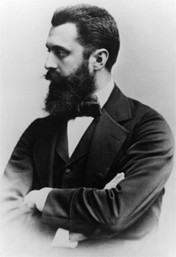
Theodore Herzl
First Zionist Congress
1897
Notes:
That 1948 return actually began with the First Zionist Congress by Theodore Herzl in 1897.

Slide 66
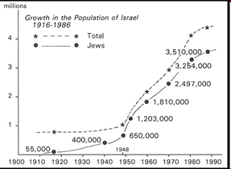
Jews Return in the 20th Century
195b
www.bibleweb.org/ MEastStudies/Sem3.htm
millions
Growth in the Population of Israel
1916-1986
Total
Jews
Notes:
www.bibleweb.org/ MEastStudies/Sem3.htm

Slide 67
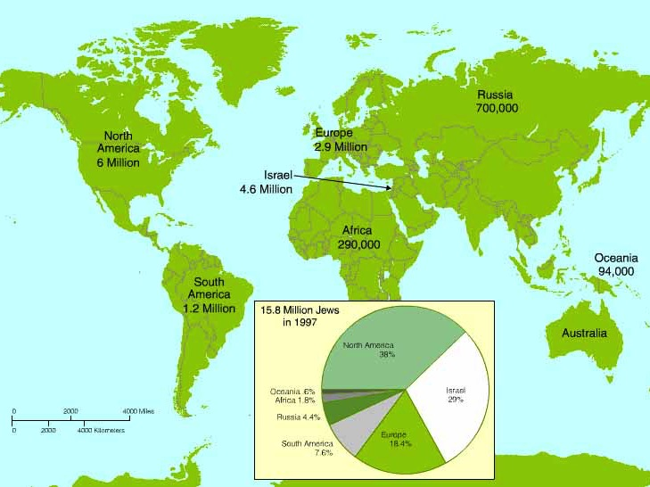
Worldwide Jewish Population in 1997
Note that most Jews still haven't returned to Israel
15.8 Million Jews in 1997
North America
38%
Oceania .8%
Israel
29%
Africa 1.8%
Russia 4.4%
Europe
18.4%
South America 7.6%

Slide 68
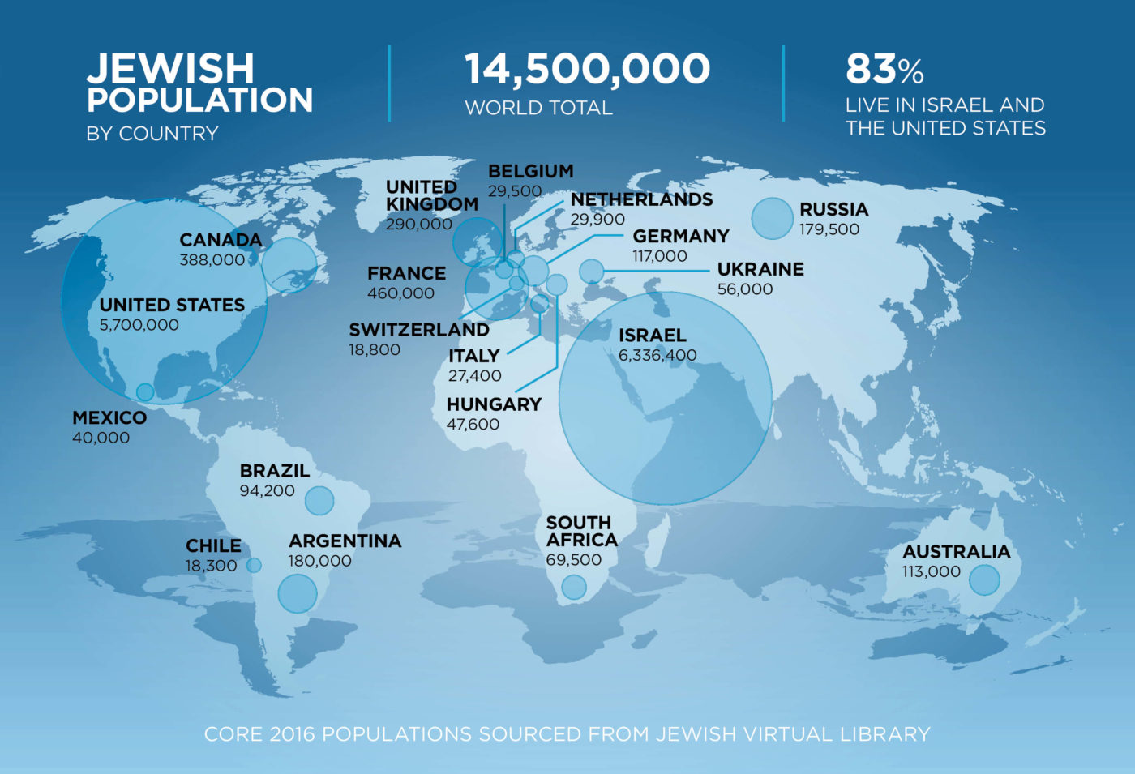
Worldwide Jewish Population in 2016
JEWISH
POPULATION
BY COUNTRY
14,500,000
WORLD TOTAL
83%
LIVE IN ISRAEL AND
THE UNITED STATES
Note that most Jews still haven't returned to Israel

Slide 69
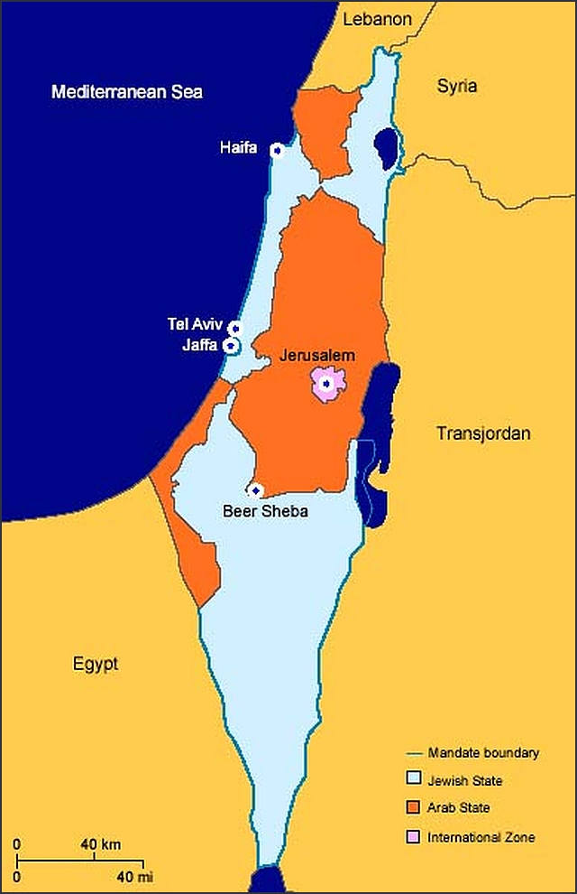
To return to the land of Israel, Jews had to become a nation once again (1948)

Slide 70
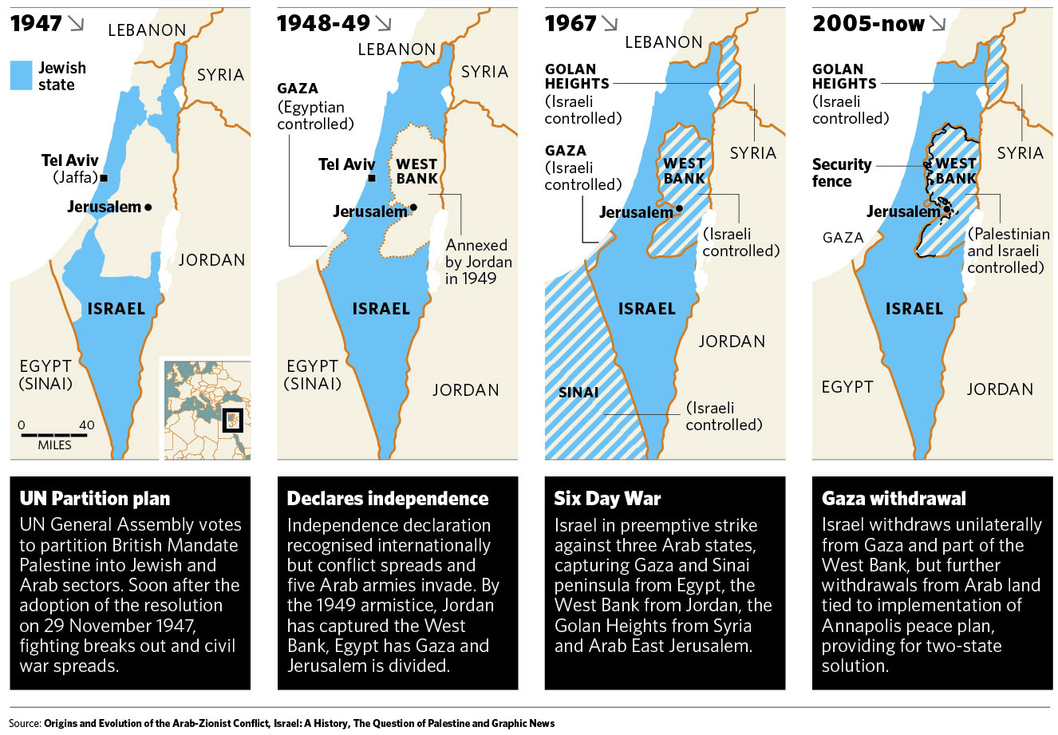
Israel regained ancient borders in stages (1947-2005)
http://kmhouseindia.blogspot.com/2012/11/palestinian-statehood-bid.html

Slide 71
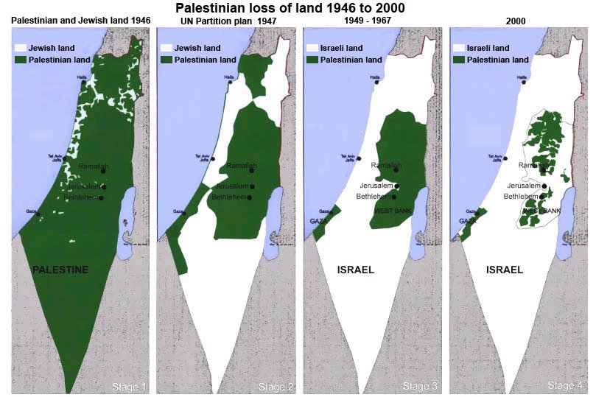
Israel regained ancient borders in stages (1946-2000)
http://tema1tema.blogspot.com/2011/05/stop-israeli-war-crimes-yells-woman-at.html

Slide 72
Jews also needed to regain Jerusalem, which they did in the
Six-Day War (1967)
Foundation for Middle East Peace
(March 2002)

Slide 73
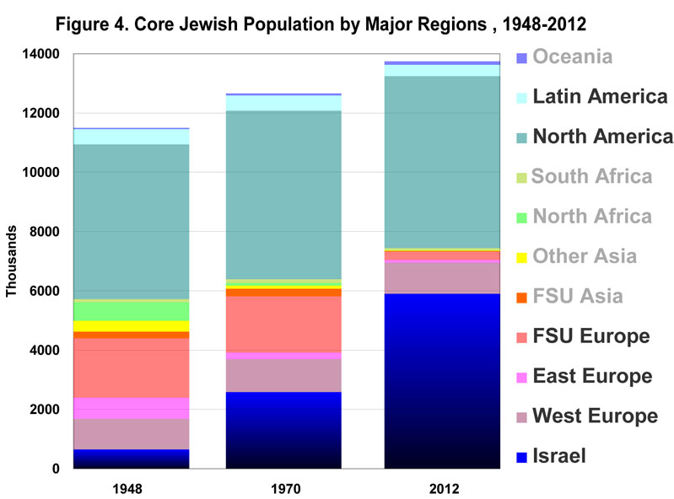
Jewish Population by Major Regions (1948-2012)
14
Oceania
7 million outside Israel
Latin America
12
North America
10
10 million outside Israel
South Africa
11 million outside Israel
8
North Africa
Millions
Other Asia
6
FSU Asia
God is bringing His people back!
4
FSU Europe
East Europe
2
West Europe
0
Israel
1948
1970
2012
––Jews for Jesus
Notes:
David Brickner, "Israel's Salvation" (Jews for Jesus Publication, 8 July 2013) at http://www.jewsforjesus.org/images/population-israel-800w.jpg accessed 17 July 2013

Slide 74

Why does Ezekiel depict the second return?
33-34
Israel will trust in her Messiah (37:14)
Reunification of Israel & Judah (37:15-23)
The Messiah will lead them (37:24)
The Messiah will rule "forever" (37:25)
Permanent temple (37:26b, 28)
Postexilic prophecy (Zech. 10:9-10)
Second re-gathering (Isa. 11:11)

Slide 75
7. The Land: Inclusive and Universal

Slide 76


Tribal Redistribution
Dan
531d
531e
Asher
After Conquest
(Josh. 13)
Millennial Israel
(Ezekiel
47-48)
Naphtali
Manasseh
Ephraim
Reuben
Judah
Leaders & Temple
Benjamin
Simeon
Issachar
Zebulun
Gad
Notes:
The millennial tribes will be the same as in Joshua's time, but all allotments will lie west of the Jordan River and in equal divisions. Ezekiel 47–48 shows that, in the millennium, the 12 tribal allotments under Joshua will all lie on the west side of the Jordan River. Among them also will live Gentiles with equal privileges. As there exist no distinctions between Jews and Gentiles today in the Church (Galatians 3:28), so the same will be true in the land shared between these groups in the Millennium. God's plan has no second-class citizens:
"You are to distribute this land among yourselves according to the tribes of Israel. ²²You are to allot it as an inheritance for yourselves and for the aliens who have settled among you and who have children. You are to consider them as native-born Israelites; along with you, they are to be allotted an inheritance among the tribes of Israel. ²³In whatever tribe the alien settles, there you are to give him his inheritance,’ declares the Sovereign LORD"
(Ezekiel 47:21-23 NLT).
______________
ES-26-Restoration of Israel-202
OS-06-Joshua-184
OS-26-Ezek44-48-slide 80

Slide 77
Shared Land with Jews & Gentiles
“’You are to distribute this land among yourselves according to the tribes of Israel. ²²You are to allot it as an inheritance for yourselves and for the aliens who have settled among you and who have children. You are to consider them as native-born Israelites; along with you they are to be allotted an inheritance among the tribes of Israel. ²³In whatever tribe the alien settles, there you are to give him his inheritance,’ declares the Sovereign LORD”
(Ezekiel 47:21-23 NLT).

Slide 78
8. The New Testament and the Land

Slide 79
461b
Millennial Jerusalem
"The law will go out from Zion,
the word of the LORD from Jerusalem"
--Isaiah 2:3
Notes:
79

Slide 80

I am the Vine
You are the branches
15
Those who remain in me, and I in them, will produce much fruit. For apart from me you can do nothing.
John 15:5 NLT

Slide 81
9. Jesus, the Kingdom and the Land

Slide 82
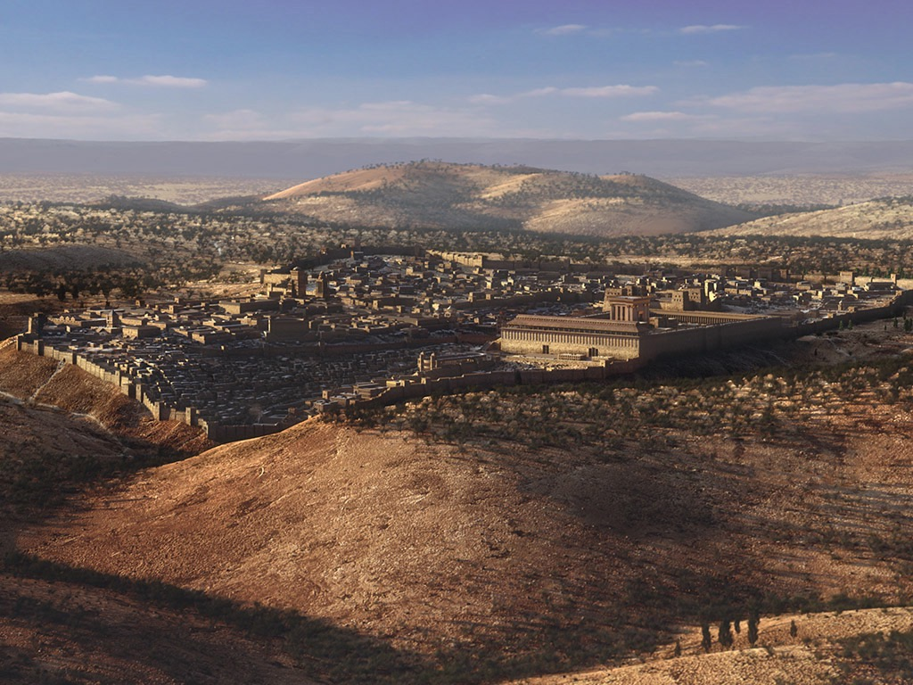
A Great Question (Acts 1:6)
So when they met together, they asked him, “Lord, are you at this time going to restore the kingdom to Israel?”
Notes:
We should witness to everyone until Israel is restored (1:6-8).

Slide 83

A Great Answer (Acts 1:7)
He said to them: “It is not for you to know the times or dates the Father has set by his own authority.”
Notes:
How does Jesus correct their understanding of Israel’s restoration (7)?
Does Jesus say that they had the wrong idea about the kingdom?
Does Jesus say, “Oh, you stiff-necked and dull disciples? When are you going to see that my kingdom is not a political one. It’s spiritual only!”
But he doesn’t say that it is only spiritual. He affirms their understanding of what the kingdom is. He just corrects the timing of that kingdom. It wasn’t going to happen then but only when the Father determines. They just needed to wait.
But in verse 8 he tells them what to do until the kingdom for Israel arrives: WITNESS!

Slide 84

Acts 1:8 NAU
"remotest part"
"But you shall receive power when the Holy Spirit has come upon you; and you shall be My witnesses both in Jerusalem, and in all Judea and Samaria, and even to the remotest part of the earth."
Samaria
Jerusalem
Judea
Notes:
What is the significance of the threefold regions (8)?
Geographically, they go from the near to the far.
By size, it begins with a city, goes to regions and then beyond regions.
Culturally, they begin with the familiar and stretch to the unfamiliar.
Chronologically, it begins in AD 33 and finishes in AD 62—as well as to today.

Slide 85

A Literal, Political Kingdom
"Jesus replied, 'I assure you that when the world is made new and the Son of Man sits upon his glorious throne, you who have been my followers will also sit on twelve thrones, judging the twelve tribes of Israel'"
(Matt. 19:28 NLT)
Notes:
It will be ruled by Messiah where Israel will have prominence over the entire world that will follow the Lord.

Slide 86
10. Paul and the Abrahamic Inheritance

Slide 87
“’The promises were spoken to Abraham and to his seed. The Scripture does not say “and to seeds,’ meaning many people, but ‘and to your seed,’ meaning one person, who is Christ" (Gal 3:16 NIV).
“The stress on seed (cf. Gen. 12:7; 13:15; 24:7), not seeds, was made simply to remind the readers that the faithful in Israel had always recognized that blessing would ultimately come through a single individual, the Messiah (cf. Gal. 3:19).”
—Campbell, BKC, 2:598
Notes:
The context does not relate to the land but to the one who will fulfill the Abrahamic covenant.

Slide 88

Righteousness in Romans
145
Theme | Needed | Provided | Imparted | Proved | Applied | Dissem-inated
Intro 1:1-17 | Condem-nation 1:18– 3:20 | Justifi-cation 3:21– 5:21 | Sanctifi-cation 6–8 | Election 9–11 | Trans-form-ation 12:1– 15:13 | Propa-gation 15:14– 16:27
Start | Sin | Salva-tion | Set Apart | Sove-reignty | Service | Send

Slide 89

"Israel" always means ethnic seed of Jacob (9:1-5)
155v
"For not all who are descended from Israel are Israel" (9:6)
≠ "Israel" refers to believing Gentiles?!?!
= Not all Jews believe
Notes:
Though parallels exist between them, not one place in the Bible does it ever call the Gentiles "Israel."
______________
OS-Isaiah49-59—slide 153
NS-06-Rom9-16—slide 6

Slide 90


Gentile Engrafting
131b
Branches (11:17-21)
a. Natural: Ethnic Israel (9:4-5)
1) Remaining/Grafted = Believing (11:23-24)
2) Cut off = Unbelieving (11:19-21)
b. Wild: Gentile humanity
1) Grafted = Believing (11:17b, 22)
2) Cut off = Unbelieving (11:21b)
Trunk (11:24)
Sap (11:17b)
Root (11:16-18)
Notes:
Paul illustrates salvation for both Jews and Gentiles with the metaphors of two trees. Note that the original, cultivated olive tree does NOT represent Israel. It is also NOT cut down and replaced with the Gentiles. In other words, the Church does not replace Israel in Paul's theology.
Rather, the first tree represents the Abrahamic Covenant, through which Jews and Gentiles are saved. Those NOT saved are branches of that tree, whether Jew or Gentile.
__________________
CH-02-Nature-89
ES-07-Dispenstionalism& Premillennialism-85
OS-02-Exodus-445
NS-06-Rom9-16-slide 52

Slide 91
Distinctions Between
Israel and the Church
155u
Discontinuity (155u)
Continuity (155v)
Problem Passages (155w-y)

Slide 92

Israel & the Church: Discontinuity
117
Israel
Church
Identity
Physical seed of Abraham (Gal. 6:12-16)
Spiritual seed of Abraham (Gal. 3:7, 29)
Land Covenant
Still outstanding (Deut. 30:1-10) but partly fulfilled since 1948 (Ezek. 37:1-7)
No land promise (Palestinian Covenant) can be claimed by present believers
Law
Required to obey the law (Exod. 19–20)
Freedom from the law (Rom. 7; Gal. 3)
Duration
Abraham (Gen. 12:1-3) to eternity (Jer. 31:35-37)
Pentecost (Acts 2) to Rapture (1 Thess. 4:13-18) or even later (?)
Wrath
Experienced in Tribulation (Jer. 30:7)
Free from wrath (1 Thess. 5:9; Rev. 3:10)
Notes:
Several differences exist between Israel and the Church that show they are not the same entity. Thus, it is a bit misleading to claim that the Church is "the new Israel."
__________
Common-348
CH-02-Nature-89
OS-02-Exodus-434
NS-06-Rom9-16-slide 28

Slide 93
Israel & the Church: Discontinuity
117
Israel
Church
Faith
Shown in offering sacrifices
Shown in trusting Christ's sacrifice
Priesthood
Has one: a special class by heredity
Is one: all are priests (1 Pet. 2:5)
Activity
Set aside between 69th & 70th "Weeks" (Dan. 9:24-27)–a part of the "times of the Gentiles" (Luke 21:24)
Between 69th & 70th "Weeks" the church is a mystery unforeseen in the OT (Eph. 3:1-9; Col. 1:26)
Qualifi-cation
Ethnic–descendants of Abraham or Gentile proselytes who became Jews via circumcision as blessing is via Israel (1 Kings 8:41-43; Isa. 2:2-3; 19:19-25; 49:6; 51:4; 56:6-8; Zech. 14:16-19)
Nonethnic–"Neither Jew nor Gentile" (Gal. 3:28) means a combination of Jews and Gentiles without need to become Jewish proselytes (Acts 15; Eph. 3:3, 6)
Notes:
CH-02-Nature-89
OS-02-Exodus-434
NS-06-Rom9-16-slide 28

Slide 94
Israel & the Church: Continuity
118
Israel
Church
Abrahamic Covenant
Origin in Abraham as the father of the nation (Gen. 12:1-3)
Believers today are grafted into this same covenant (Rom. 11:17-21; cf. Gal. 3:29)
Davidic Covenant
Promise of a literal temple (2 Sam. 7:13) fulfilled by Solomon (1 Kings)
Functions now as a spiritual temple (Eph. 2:19-22; 1 Pet. 2:4-10)
New Covenant
Forgiveness of sins, indwelling Spirit, new heart, reunification of Israel and Judah, & knowledge of God everywhere (Jer. 31:31-34)
The first 3 aspects (forgiveness of sins, indwelling Spirit, new heart) true today in a progressive covenant fulfillment (Luke 22:20)
Law
Required to obey the Mosaic law (Exod. 19–20)
Required to obey the "law of Christ" (Gal 6:2) or "law that gives freedom" (Jas 1:25; 2:12)
Notes:
CH-02-Nature-89
OS-02-Exodus-434
NS-06-Rom9-16-slide 28

Slide 95
Israel & the Church: Continuity
118
Israel
Church
Salvation by
God's grace through faith (Gen. 15:6)
God's grace through faith (Rom. 4:3)
Basis of Salvation
Sacrificial lamb
Sacrificial Lamb
Spirit
Filling on leaders
Indwelling of all believers (Rom. 8:9)
Prophets
Provided revelation of God's word
Foundation of the church (Eph. 2:20)
Notes:
CH-02-Nature-89
OS-02-Exodus-434
NS-06-Rom9-16-slide 28

Slide 96
Israel & the Church: Continuity
118
Israel
Church
Election
Based on grace (Mal. 1:2)
Based on grace (Eph. 1:4-6, 11)
Disobedience
Led to God's discipline
Leads to God's discipline
(1 Cor. 11:30)
Leadership
Elders (Exod. 3:16, 18; 4:29, 31;12:21; Num. 11:16-17; Josh. 24:31; 1 Sam. 15:30; 2 Sam. 17:4, 15; 1 Kings 21:8, 11 and many other texts)
Elders (Acts 11:30; 14:23-24; 15:1-6; 16:4; 20:17-38; 21:17-26; 1 Thess. 5:12-13; Phil. 1:1; 1 Tim. 3:1-7; 4:14; 5:17-25; Tit. 1:5-9; Jas. 5:14; 1 Pet. 5:1-5; Heb. 13:17)
Witness
"light for the Gentiles" (Is. 49:3-6)
"kingdom of priests" (Exod. 19:6)
"holy nation" (Exod. 19:6)
"light of the world" (Matt. 5:14-16)
"royal priesthood" (1 Pet 2:5, 9)
"holy nation" (1 Pet. 5:9)
Notes:
CH-02-Nature-89
OS-02-Exodus-434
NS-06-Rom9-16-slide 28

Slide 97
Is there a future for ethnic believing Israel?
154e
Dispensational
Premillennialism
Amillennialism &
Postmillennialism
Church & Israel distinct
Israel has a future
Church is new Israel
Israel has no future
Covenant
Premillennialism

Slide 98
Summary of Romans 9–11
NT Survey,
page 154e
9:1-29 | 9:30–10:21 | 11:1-36
Israel's past | Israel's present | Israel's future
God elected Israel | Israel rejects God | God will reject Israel only partially and temporarily
Israel's failure is not due to God's unfaithfulness | Israel's failure is due to rejecting her Messiah | Israel's failure will be neither total in scope nor final
A Jewish remnant has been preserved by God | Only a small Jewish remnant accepts Him now | Yet this remnant will grow into an entire believing nation
Gentiles have also become elect of God in Christ | Gentiles are now becoming saved by faith in Christ | Gentiles should not be proud over blessings that Jews reject
Divine side | Human side | Divine results
God's election | Man's responsibility | God's mercy
Human unbelief cannot eradicate God's promises because they are based on the principle of sovereign election | However, God's election in sovereign grace to fulfill His Word does not eradicate human responsibility for unbelief | Ultimately, God's election will be justified in the salvation of the Jewish nation alive when Christ returns (11:26-27)

Slide 99
11. Incorporation Theology

Slide 100
“…when you were pagans"
(1 Cor 12:2 NAU, NIV, NLT).
Notes:
Munther Isaac notes on page 18 of his paper,
Richard Hays uses the term “incorporation” to describe the theology of Paul with
regards [sic] to Gentiles: Gentiles have been “incorporated” into Israel as a result of their faith in Christ.20 He also observes how in 1 Cor. 10:1, Paul calls the
attention of the Corinthians to the experience of “our fathers”,21 and in 1 Cor. 12:2
Paul says to the Gentiles that they “were Gentiles”: these phrases indicate that
Paul “thinks of the Corinthian Christians as Gentiles no longer”.22
20 R.B. Hays, 1989, Echoes of Scripture in the Letters of Paul, Yale University Press, New Haven, p. 96
21 Ibid., p. 95.
22 Ibid., p. 96.
——————
But does Paul mean that the Corinthians were no longer Gentiles? The NAU, NIV, and NLT (among other translations) catch Paul's real meaning here that they were no longer "pagans." They certainly remained Gentiles. Jews will be Jews into eternity, as will Gentiles, even as our sexuality and physical characteristics will last into eternity, for these traits define our individuality. What Jesus has done is to make his Church composed of Jews and Gentiles, men and women, slave and free, etc. not to eradicate these distinctions.

Slide 101
"Therefore, remember that formerly you who are Gentiles by birth and called “uncircumcised” by those who call themselves “the circumcision” (that done in the body by the hands of men)— ¹²remember that at that time you were separate from Christ, excluded from citizenship in Israel and foreigners to the covenants of the promise, without hope and without God in the world. ¹³But now in Christ Jesus you who once were far away have been brought near through the blood of Christ" (Ephesians 2:11-13 NLT).
Still Gentiles

Slide 102
12. Israel Today

Slide 103

"'At the time of those events,' says the LORD,
'when I restore the prosperity of Judah and Jerusalem,
²I will gather the armies of the world into the valley of Jehoshaphat'"
(Joel 3:1-2a NLT).

Slide 104

"There I will judge them for harming my people, my special possession, for scattering my people among the nations, and for dividing up my land"
(Joel 3:2b NLT).

Slide 105

The Restoration of Judah
"But I will bring them back from all the places to which you sold them, and I will pay you back for everything you have done. ⁸I will sell your sons and daughters to the people of Judah, and they will sell them to the people of Arabia, a nation far away. I, the LORD, have spoken!"
(Joel 3:7-8 NLT).
219
Greeks
Sidon
Tyre
Judah
Arabia

Slide 106
13. Justice Matters

Slide 107
14. The Land and the Political Reality

Slide 108
Millennial Israel Will Bless Nations
531e
Mountains
Assyria
"In that day, Israel, your cities will be rebuilt, and your borders will be extended. ¹²People from many lands will come and honor you— from Assyria all the way to the towns of Egypt, from Egypt all the way to the Euphrates River, and from distant seas and mountains”
(Micah 7:11-12 NLT)
Seas
Israel
Jordan
Egypt
Notes:
God’s promised land stretched northeard from the small wadi of Egypt south in the Sinai to the large Euphrates River in the far north—a HUGE piece of real estate! When today’s boundaries are placed over this land we can see the struggle modern Israel has to claim land from Egypt, Lebanon, Syria and possibly even Jordan on the other side of the Jordan River.

Slide 109
15. Sharing the Land: The Land of Peace, Justice, and Reconciliation

Slide 110

Gaza Rocket Attacks on Israel

Slide 111
Conclusion

Slide 112
Q&A

Slide 113

"Then another message came to me from the LORD of Heaven's Armies: 'This is what the LORD of Heaven's Armies says: My love for Mount Zion is passionate and strong; I am consumed with passion for Jerusalem!"
(Zech 8:1-2 NLT).

Slide 114
Key Verse
649
"This is what the LORD says, 'I will return to Zion and dwell in Jerusalem. Then Jerusalem will be called The City of Truth, and the mountain of the LORD Almighty will be called The Holy Mountain'" (Zechariah 8:3).
Zechariah

Slide 115

“And He will lift up a standard for the nations, and will assemble the banished ones of Israel, and will gather the dispersed of Judah from the four corners of the earth.” —Isaiah 11:12
“Thus says the LORD of hosts, ‘Behold, I am going to save My people from the land of the east and from the land of the west; and I will bring them back, and they will live in the midst of Jerusalem, and they will be My people and I will be their God in truth and righteousness.’” —Zechariah 8:7–8
Notes:
This is not the return from the 70-year exile for at least two reasons:
1—The dispersed Jews will not return from Babylon but from the "four corners of the earth" (Isa 11:12b)
2—Zechariah claims that they will come from the "east and the west," but Babylon was considered the "land of the north" (Zech 2:6; 6:8).
______________________________
ES-26-Restoration of Israel-303
OS-23-Isaiah1-12-slide 345
OS-23-Isaiah49-59-slide 35
OS-38-Zechariah-129

Slide 116
Jews will be sought out
649
"This is what the LORD of Heaven's Armies says: In those days ten men from different nations and languages of the world will clutch at the sleeve of one Jew. And they will say, 'Please let us walk with you, for we have heard that God is with you'" (Zech. 8:23 NLT).

Slide 117

"Now look at the jewel I have set before Jeshua, a single stone with seven facets. I will engrave an inscription on it, says the LORD of Heaven’s Armies, and
I will remove the sins of this land in a single day"
(Zechariah 3:9 NLT).

Slide 118

"All Israel will be saved" (Rom. 11:25-27)
NTS 155w
²⁵I do not want you to be ignorant of this mystery, brothers, so that you may not be conceited: Israel has experienced a hardening in part until the full number of the Gentiles has come in.
²⁶And so all Israel will be saved, as it is written:
"The deliverer will come from Zion; he will turn godlessness away from Jacob.
²⁷And this is my covenant with them when I take away their sins."
Notes:
Does this mean that all Jews throughout history will be saved? That would contradict John 3:16 and many other verses that show salvation only in Christ (John 14:6l Acts 4:12). It also cannot mean Gentiles as they are never called the church. But Zechariah 3:9 says that Israel will believe in Jesus as Messiah in a single day at the end of the Tribulation. At that time, "All Israel will be saved" (Rom 11:25-26) for only then will the redeemer come from Jerusalem to save the nation since Paul quotes Isaiah 59:20 whose context is Israel under the new covenant (cf. Jer 31:31-34).
___________________
Common-449
OS-23-Isaiah60-66-slide 154
OS-38-Zechariah-86, 134
NS-06-Rom9-16-slide 53
NS-22-Rev13-19-slide 53

Slide 119

Jerusalem Population (2002)
East = Arabs
West = Jews

Slide 120

Jerusalem (2002)
Foundation for Middle East Peace
(March 2002)

Slide 121

The Old City Today

Slide 122



Modern Jerusalem: "Many will live outside the city walls" (Zech. 2:4)

Slide 123

The Wall of Fire (Zech. 2:3-5 NLT)
649
"Then the angel who was with me went to meet a second angel who was coming toward him. ⁴The other angel said, 'Hurry, and say to that young man, 'Jerusalem will someday be so full of people and livestock that there won't be room enough for everyone! Many will live outside the city walls. ⁵Then I, myself, will be a protective wall of fire around Jerusalem, says the LORD. And I will be the glory inside the city!'"

Slide 124
The Repentance of Israel
"Then I will pour out a spirit of grace and prayer on the family of David and on the people of Jerusalem. They will look on me whom they have pierced and mourn for him as for an only son. They will grieve bitterly for him as for a firstborn son who has died"
(Zech. 12:10 NLT).
Notes:
"I will pour out on the house of David and on the inhabitants of Jerusalem, the Spirit of
grace and of supplication, so that they will look on Me whom they have pierced, and they will
mourn for Him, as one mourns for an only son, and they will weep bitterly over Him like the
bitter weeping over a firstborn. Zech. 12:10 Some Jewish interpreters see this verse as a
reference to Gentile nations who will look to God for forgiveness for having “pierced” Him by
their inflicting suffering on the Jewish people. But the subject of each of the verbs in this
sentence is clearly the people of Israel. So the most natural way to understand this verse is to see
it as a reference to the Holy Spirit’s moving on the nation Israel to see the One they had pierced
as though He was their own firstborn son, and to seek God’s gracious forgiveness and cleansing.
What is striking about this verse is that the One whom they had pierced, and for whom they will
mourn is the Lord Himself—a not too subtle reference to the deity of Christ."
—Rick Rood email 5 December 2023

Slide 125
Tribulation Results
"They will look on the one they have pierced…"
(Zech. 12:1-10; esp. v. 10)
"The Redeemer will come to Zion, to those in Jacob who repent of their sins" (Isa. 59:20)
"The deliverer will come from Zion; he will turn godlessness away from David"
(Rom. 11:26b)
"And so all Israel will be saved" (Rom. 11:26a)

Slide 126

"Look!
He comes with the clouds of heaven.
And everyone will see him— even those who pierced him.
And all the nations of the world will mourn for him. Yes! Amen!"
Rev. 1:7 NLT
cf. Zech. 12:10

Slide 127

"The sorrow and mourning in Jerusalem on that day will be like the great mourning for Hadad-rimmon in the valley of Megiddo"
(Zech 12:11 NLT).

Slide 128
"All Israel will mourn, each clan by itself, and with the husbands separate from their wives. The clan of David will mourn alone, as will the clan of Nathan,
¹³ the clan of Levi, and the clan of Shimei. ¹⁴ Each of the surviving clans from Judah will mourn separately, and with the husbands separate from their wives" (Zech 12:12-14 NLT).

Slide 129

The Second Coming
"On that day, his feet will stand on the Mount of Olives east of Jerusalem…"
(Zech. 14:4a).

Slide 130

The Second Coming
"…And the Mount of Olives will split apart, making a wide valley running from east to west. Half the mountain will move toward the north and half toward the south"
(Zech. 14:4b NLT).

Slide 131
The Second Coming
"You will flee through this valley, for it will reach across to Azal. Yes, you will flee as you did from the earthquake in the days of King Uzziah of Judah. Then the LORD my God will come, and all his holy ones with him"
(Zech. 14:5 NLT).

Slide 132

The Second Coming
"On that day the sources of light will no longer shine, ⁷yet there will be continuous day! Only the LORD knows how this could happen. There will be no normal day and night, for at evening time it will still be light" (Zech. 14:6-7 NLT).

Slide 133

Living Water!
"On that day life-giving waters will flow out from Jerusalem, half toward the Dead Sea and half toward the Mediterranean, flowing continuously in both summer and winter" (Zech. 14:8 NLT).

Slide 134
Black

Slide 135


Eschatology link at BibleStudyDownloads.org
Get this presentation for free!
Notes:
OT Survey (os)

