Slide 1
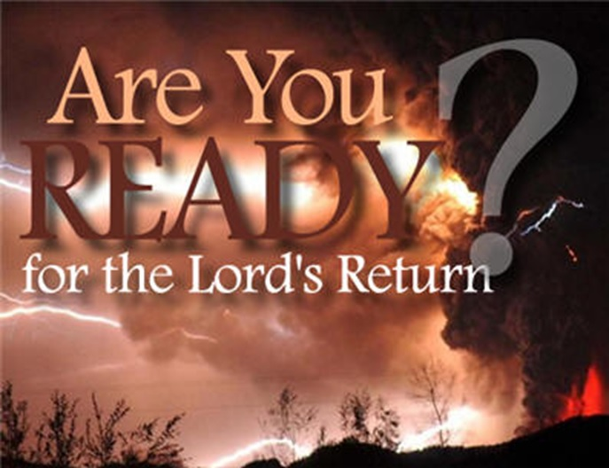
Are You Ready for the Lord’s Return?
1 Thessalonians 4:13-18
Dr. Rick Griffith • Jordan Evangelical Theological Seminary • BibleStudyDownloads.org

Slide 2
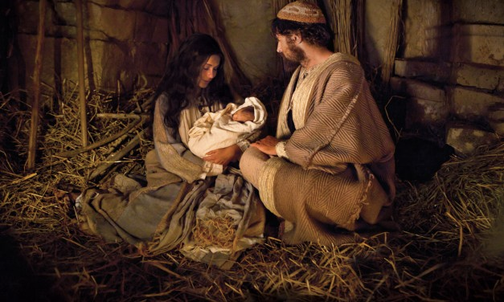
Christ's First Coming
Notes:
Last Christmas we focused on the first coming of our Savior in Bethlehem.

Slide 3
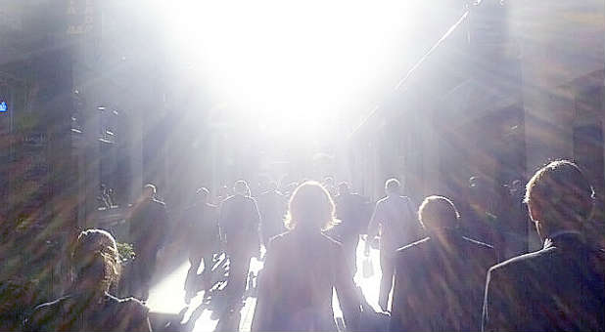
Are you ready for his return?
Notes:
But our focus today is "Are You Ready For the Lord's Return?"

Slide 4
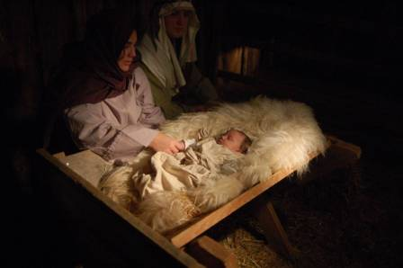
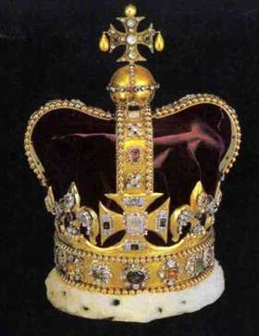
Christ's Two Comings
420
FIRST COMING | (CHURCH AGE) | SECOND COMING
Laid in a manger |  | Lands on a mountain
Came as a lamb |  | Comes as the Lord
Lowly and poor |  | Lavish and powerful
Died for His enemies |  | Death to His enemies
Tempted by Satan |  | Traps Satan in bottomless pit
Lived in a world of unrighteousness |  | Leads the world in righteousness
Died for sins and rose again |  | Directs and reigns
Ruth & Larry Moody; cited by Terry Hall, Bible Panorama, 117
Notes:
Today in our new year I believe the Scripture has some words of encouragement for us about Christ's second coming to earth at the Rapture.

Slide 5
Amillennialism
433
Second Coming
Millennium is Church Age:
Spiritual reign of Christ
Tribulations Satan Bound
Eternal Kingdom
Judgment
Revelation 6–18
Revelation 20
19
21–22
Notes:
Amillennialism teaches both tribulations and the spiritual reign of Christ in our present age. This leaves no room for the nations to come to Jerusalem yearly after Messiah's return in Zechariah 14.
________
Common-331
ES-24-1Thess4Rapture-5
OS-23-Isaiah1-12-slide 48
OS-38-Zechariah-165

Slide 6
Postmillennialism
433
Second Coming
Millennium Gradually Comes as Golden Age of the Gospel
Tribulations
Satan Bound
Church Age
Eternal Kingdom
Judgment
Revelation 6–18
20
19
21–22
Notes:
Like the Amil view, the Postmil view also does not view the book of Revelation in chronological order. It puts chapter 20 BEFORE chapter 19 as it sees the Rev 20 millennium as the present church age that is followed by Christ's return in Rev 19. However, it has even more difficulties as it sees the judgments of Rev 6-18 during a millennium that supposedly gets better and better, while these chapters show the world getting progressively worse.
Posttribulationalism sees the Church bringing in the Millennium gradually. Once this glorious age arrives, then Jesus returns to a Christianized earth. It is by far the most optimistic view of the Millennium. It was the most popular millennial view around 1900
________
Common-332
ES-24-1Thess4Rapture-6
OS-23-Isaiah1-12-slide 48
OS-38-Zechariah-165

Slide 7
Premillennialism
433
Rapture
Second Coming
Second
=
Advent
signs
Tribulation
Millennium
Church Age (no signs)
Eternal Kingdom
7 years
1000 years Satan Bound Saints Reign
Judgment
Judgment
Revelation 6–18
19
20
21–22
Notes:
In my thinking, the Premil view is the most logical and biblical as it sees the chapters as a straightforward chronology. It also does not see the binding of Satan as simply applying to nations but to all people who comprise these nations.
_________
Common-330
ES-24-1Thess4Rapture-7

Slide 8

Eschatology
eschatos
+
ology
"last"
"study of"
= study of the last things (future)
Notes:
But first let's define three terms: eschatology, the Rapture, and the Revelation.

Slide 9
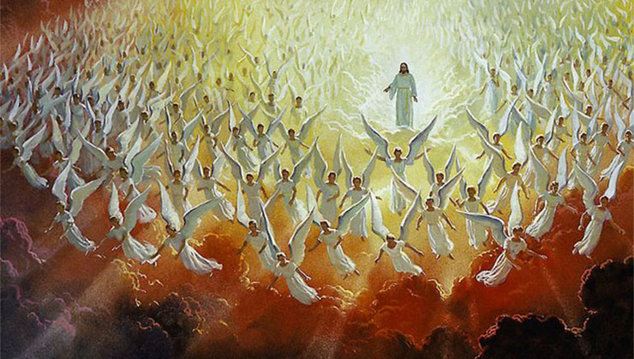
Two Stages of His Return
Notes:
Within that study, an important doctrine is Christ’s Second Coming but allow me to clarify what I mean by Christ's Second Coming. I am using this as an umbrella term that encompasses two events separated by seven years: the Rapture that is followed by the Revelation.

Slide 10
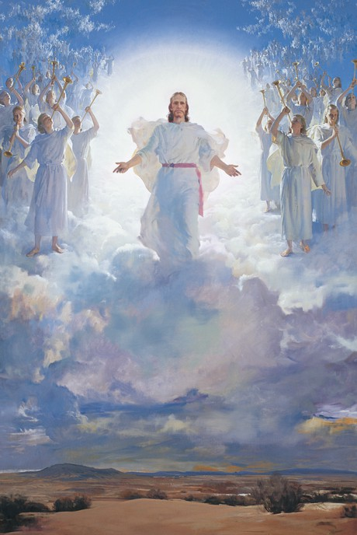
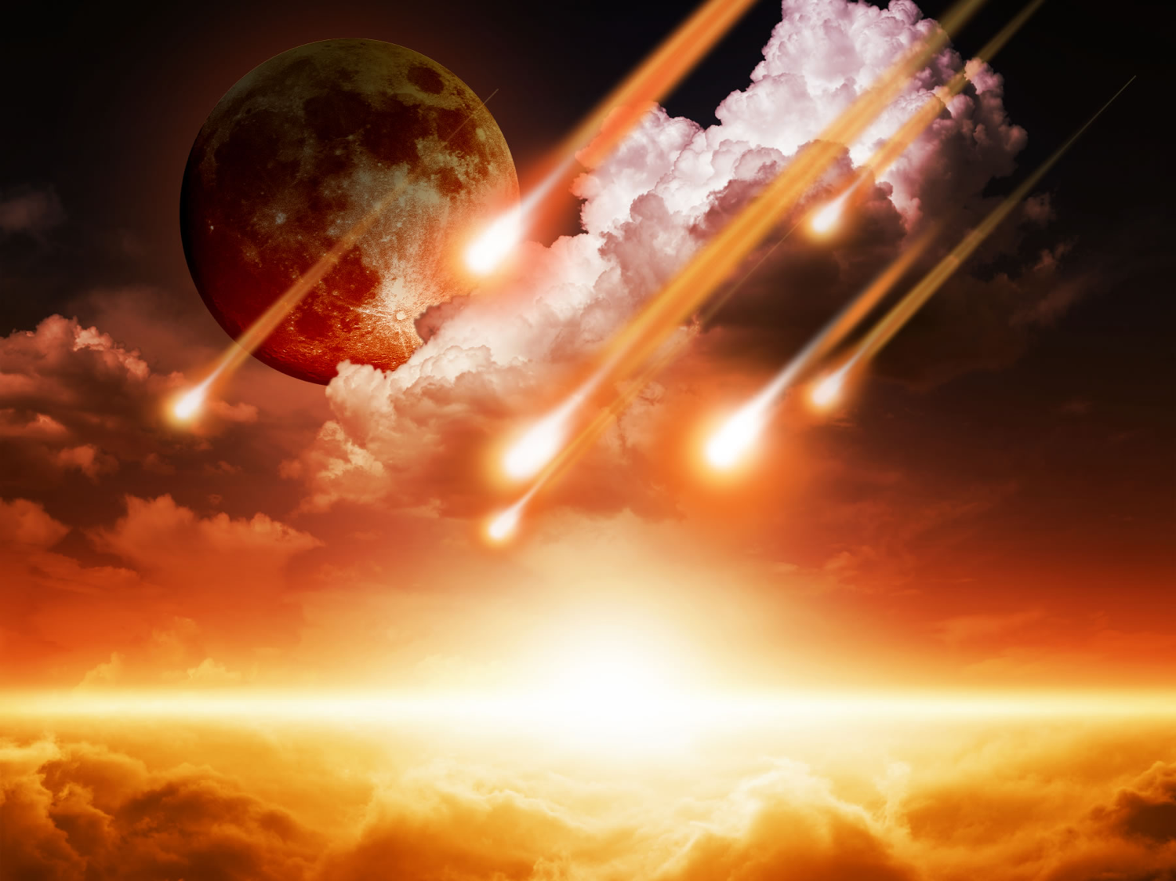
Two Stages of His Return
Literal
Christ
Future
"Coming"
Rapture
Revelation
Notes:
The Rapture (the coming of Christ for His own in the air to take the church from the earth prior to the Great Tribulation) differs from the Revelation (the coming of Christ with His own to judge unbelievers upon the earth after the Great Tribulation).
• Both events are literal returns. Never does the Scripture refer to these events as only allegorical returns for in both instances Christ will bodily return to the earth.
• Both events find Christ as their central figure. Although humanity is involved in both, Christ Himself is at the forefront.
• Both events are still future. They are yet to be seen on God's prophetic calendar.
• Both events are sometimes referred to by the same word (e.g., "coming" refers to the Rapture in 1 Thessalonians 4:15 and the Revelation in Matthew 24:27).

Slide 11
Premillennialism
208
433
Second Coming
Second
=
Advent
Tribulation
Millennium
Church Age
Eternal Kingdom
7 years
1000 years
ALL 5 RAPTURE VIEWS ARE PREMILLENNIAL
Judgment
Notes:
There exist five perspectives on when Jesus will come back concerning the Tribulation. All five see his return before the Millennium, so all five are Premillennial. But they differ in relating to the Tribulation.

Slide 12
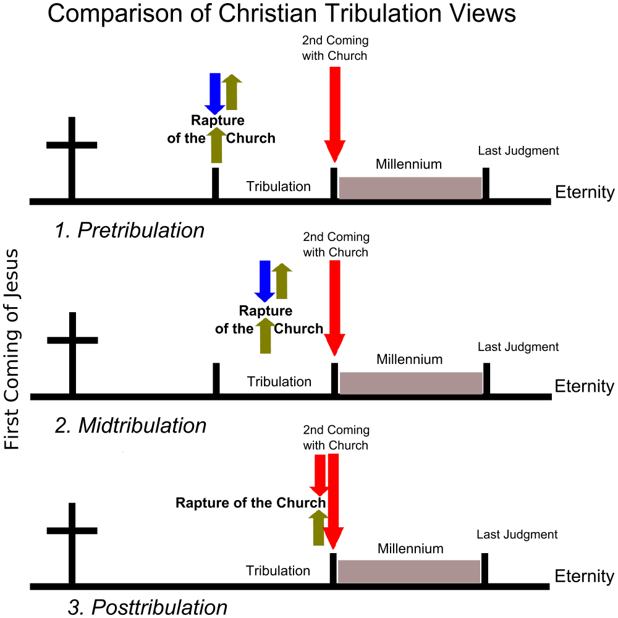
The Main Tribulation Views
Second Coming with Church
Rapture of the Church
Millennium
Last Judgment
Tribulation
Eternity
1. Pretribulation
Second Coming with Church
Rapture of the Church
First Coming of Jesus
Last Judgment
Millennium
Tribulation
Eternity
2. Midtribulation
Second Coming with Church
Rapture of the Church
Millennium
Last Judgment
Tribulation
Eternity
3. Posttribulation
Notes:
I know of 5 Rapture views, but these 3 of the most held.
Two views are not surveyed: the Partial Rapture and the Prewrath Rapture views. Neither one has convinced many people.

Slide 13
"Pre-Trib" Rapture
209 361
Second Coming
Rapture
Tribulation
Millennium
Church Age
Eternal Kingdom
7 years
1000 years
Judgment
Notes:
I believe that the Pre-Trib view has the best merit. One reason is that there are too many differences between the two phases of Christ's return as seen in the 17 distinctions in the next four slides.

Slide 14
Stages of the Second Coming
210
 | The Rapture | The Revelation
1 | Pretribulational (Rev. 3:10) | Posttribulational (Rev. 19:11-21)
2 | Christ will come in the air (1 Thess. 4:16) | Christ will come to the earth, His feet touching the Mt. of Olives (Zech 14:4)
3 | A coming for the saints (John 14:1-2; 1 Thess. 4:15-17) | A coming with the saints (Matt. 25:31; 1 Thess. 3:13; Rev. 19:14)
4 | Saints (dead and alive) will be caught up ("raptured") from the earth to meet the Lord in the air and taken to heaven (1 Thess. 4:16-17) | Saints already on earth will remain on the earth (no Rapture) to be ushered into the Millennium (Acts 15:16; Rev. 5:10; cf. Matt. 4:10; chap. 24)
5 | Produces comfort and hope (1 Thess. 4:18) | Produces fear and judgment (Matt. 24:27-31; Luke 21:20-28; Rev. 4:15-17)
Notes:
Despite their similarities, several contrasts exist between the Rapture and the Revelation (adapted and expanded from Charles F. Baker, A Dispensational Theology, 584-86).

Slide 15
Stages of the Second Coming
210
 | The Rapture | The Revelation
6 | Mystery truth revealed only in the New Testament age (1 Cor. 15:51) | Central in OT prophecy but clarified in the NT (Jer. 30:7; Zech 14:1-3; Matt. 24:30; Col. 3:4)
7 | Bodies of church saints glorified (1 Cor. 15:51-58; Phil. 3:20-21) and brought to heaven for seven years (1 Thess. 4:17) | Bodies of tribulation saints left in mortal state to continue to live on the earth in the millennium (Matt. 25:31-34)
8 | Imminent, no signs needed (1 Thess. 4:16) | Not imminent but preceded by spectacular signs in the heavens and on the earth (Matt. 24:29-31; Luke 21:25-28; Acts 2:19-21; Rev. 1:7; chs. 6-19)
9 | Primary purpose is deliverance of the saints from this world (1 Thess. 1:10) | Primary purpose is judgment of unbelieving (Matt. 25:31-46)

Slide 16
Stages of the Second Coming
210
 | The Rapture | The Revelation
10 | Invisible and private as only believers see Christ and since God sends a powerful delusion through the Antichrist (2 Thess. 2:11) | Visible and public since "every eye shall see Him" (Rev. 1:7)
11 | Fulfills a promise to the Church where Jew-Gentile distinctions do not exist (1 Thess. 4:15; cf. John 14:1-3; Eph. 2:11-16) | Fulfills promises to Israel of covenants made in the Old Testament (Gen. 12:1-3; Ps. 89; Isa. 11:11-14; cf. Rom. 11:26-27)
12 | Evil begins to increase (2 Thess. 2:1-12) | Evil is suppressed (2 Thess. 1:7; Ps. 37:9-10)
13 | Church removed (1 Thess. 4:13-18) | Satan removed (Rev. 20:1-3)

Slide 17
Stages of the Second Coming
210
 | The Rapture | The Revelation
14 | Christ shown as Head of the Church and all things (Eph. 1:10, 22; 4:15; Col. 1:18; 2:10) | Christ vindicated as Messiah to Israel (Zech. 14:3-4; cf. Acts 1:6 with v. 11)
15 | Judgment seat of Christ for believers (2 Cor. 5:10; 1 Cor. 3:13) | Judgment of Israel and Gentiles (Ezek. 20:34-38; Matt. 25; Zech. 14:4; cf. p. 160)
16 | The Lord is at hand (Phil. 4:5) | The kingdom is at hand (Matt. 24:14)
17 | Nature subsequently ruined (Rev. 6–16) | Nature subsequently restored (Rom. 8:19-22; Isa. 11:6-9; 35:9; 65:25)

Slide 18
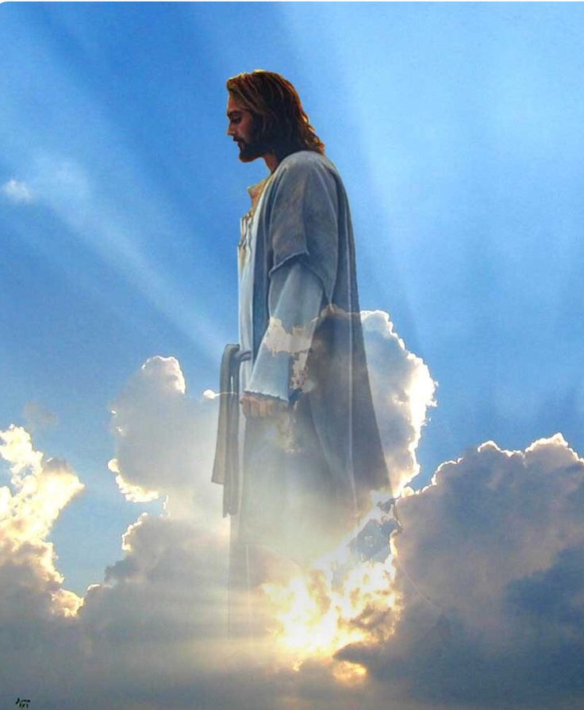
The Rapture
Notes:
Today we will focus on the first stage: The Rapture.

Slide 19
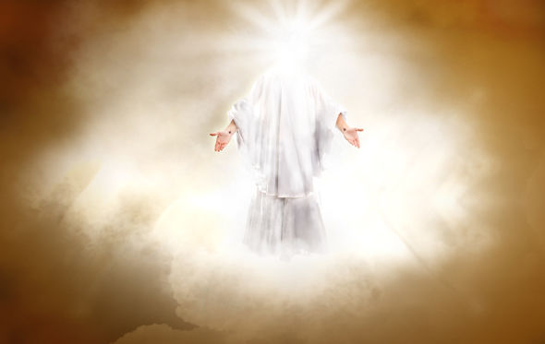
Why should we look forward to the Rapture with expectancy?
Notes:
Are you looking to Christ’s return at the Rapture?
What reasons can we give to anticipate Jesus coming back?
Paul gave them three reasons to have hope in the Lord’s return. So today we’ll see these three reasons to look forward to the Lord’s return at the Rapture.

Slide 20
Two Stages of His Return
Rapture
Revelation
Notes:
My comments today will focus on the first of these two events: the Rapture. We'll be looking at the key passage in all Scripture relating to this very important event in God's timetable of the ages. Believers at Thessalonica had died and those left were wondering when and if they would see them again.

Slide 21
Why should we look forward to the Rapture with expectancy?
1 Thessalonians 4:13-18
3 Reasons
Notes:
Paul gave them three reasons to have hope in the Lord’s return. So today we’ll see these three reasons to look forward to the Lord’s return at the Rapture.

Slide 22

I. The Rapture helps us grieve with hope (1 Thess 4:13-14).
Notes:
Knowing the destiny of Christians at death helps us to control our grief.

Slide 23
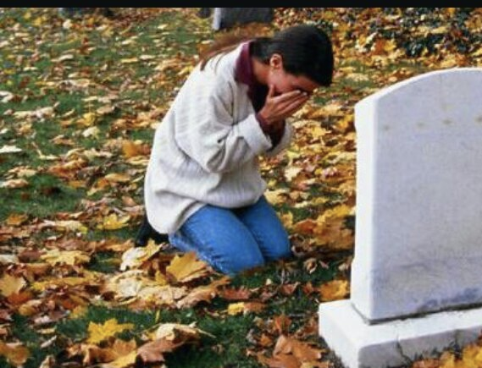
"And now, dear brothers and sisters, we want you to know what will happen to the believers who have died..." (4:13a NLT).
Notes:
Knowledge of what happens after death is one of the most important things to know.

Slide 24
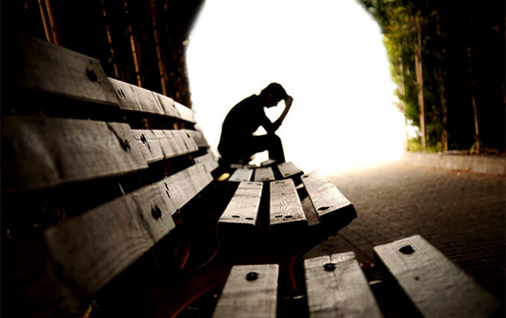
Know about the future destiny of believers who die (4:13a).
Notes:
Many people think that eschatology is unimportant.
This is seen in what some say about the time of the Rapture: I"'m not pretrib, midtrib, or posttrib. I am pantrib, because it will all pan out in the end!"

Slide 25
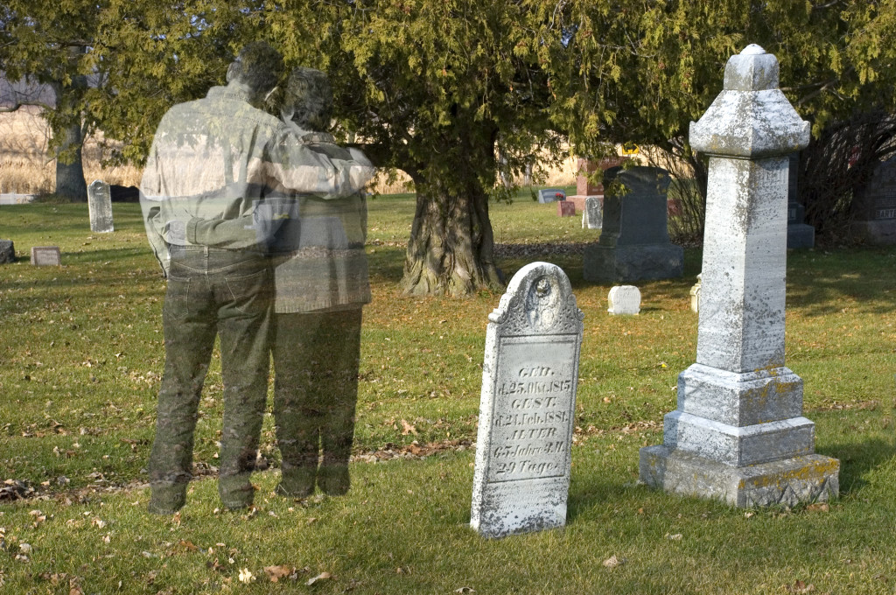
Grief is hard
Notes:
It is difficult to lose a loved one even when you know where that person is going after death.

Slide 26

"Grief is the price we pay for love." Queen Elizabeth II
Notes:
Why is it so important that we know about future things such as the destiny of believers? Paul saw eschatology as vital because it affects our hope. It's important because…

Slide 27

Being informed about believers who have died will prevent us from hopeless grief (4:13b).
Notes:
We all respond to life based on what we know.

Slide 28
"And now, dear brothers and sisters, we want you to know what will happen to the believers who have died so you will not grieve like people who have no hope" (4:13 NLT).
Notes:
Many people grieve with no hope of where their loved one went at death—but not believers!

Slide 29
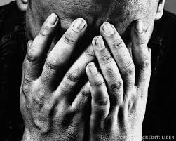
Should Christians grieve when a fellow believer dies?
Notes:
We still grieve, but we do so in hope.

Slide 30
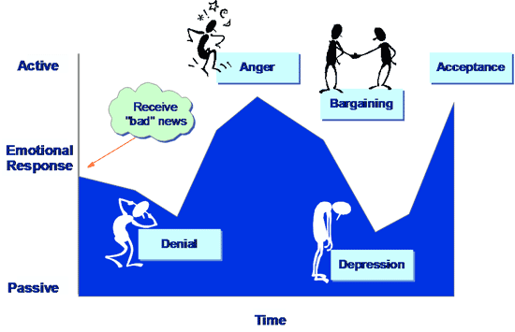
Five Stages of Grief
Active
Anger
Acceptance
Receive the "bad" news
Bargaining
Emotional Response
Denial
Depression
Passive
Time
Notes:
Recent studies claim that we go through these emotions but not necessarily in this order.

Slide 31
"And now, dear brothers and sisters, we want you to know what will happen to the believers who have died so you will not grieve like people who have no hope" (4:13 NLT).
Notes:
Notice what Paul is really saying in this verse.
He is not saying that Christians will not grieve.
He is only addressing the issue of how they should grieve. They should grieve in such a way that shows hope—like when Jesus grieved over Lazarus.

Slide 32

The Rapture
Notes:
Why did Paul say these things though? What problem was he addressing in the church?
Paul had already taught the believers about the Rapture when he was with them. He told them that when Christ comes all who have trusted Him will be removed from the earth.
The Thessalonians were confused regarding the destiny of believers who had died before the Rapture.
—Perhaps some thought these would miss the Rapture and had to wait until the Great White Throne Judgment.
—Perhaps some wondered whether they would be saved at all.

Slide 33
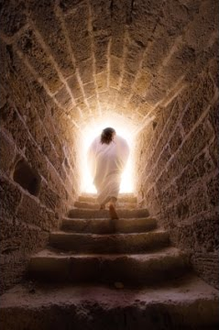
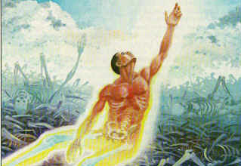
Christ's resurrection guarantees the believer's resurrection (4:14).
Notes:
As did Jesus, so do we.

Slide 34
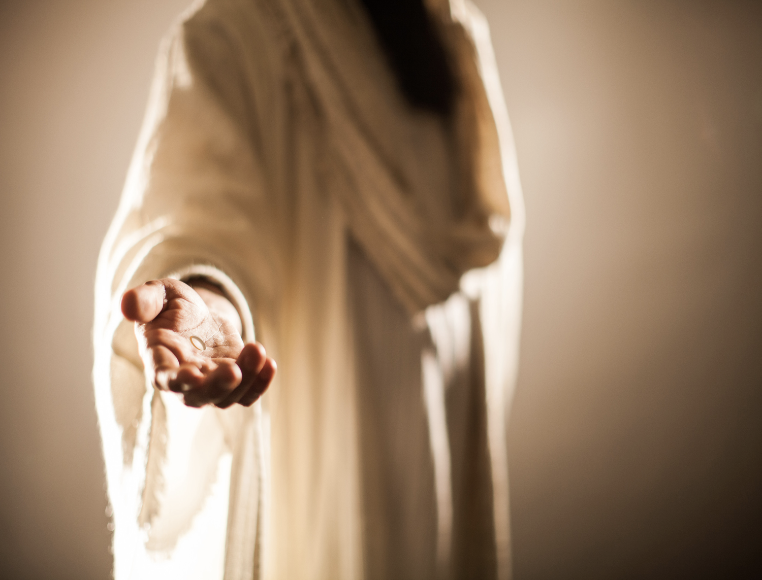
"For since we believe that Jesus died and was raised to life again, we also believe that when Jesus returns, God will bring back with him the believers who have died" (4:14 NLT).
Notes:
The "if" here (in the NASB & KJV) is better translated as "since" (as in the NIV & NLT) because of the Greek construction.
1) Therefore, it means "since we believe that Christ died…"
2) Paul did not doubt the validity of the resurrection.

Slide 35
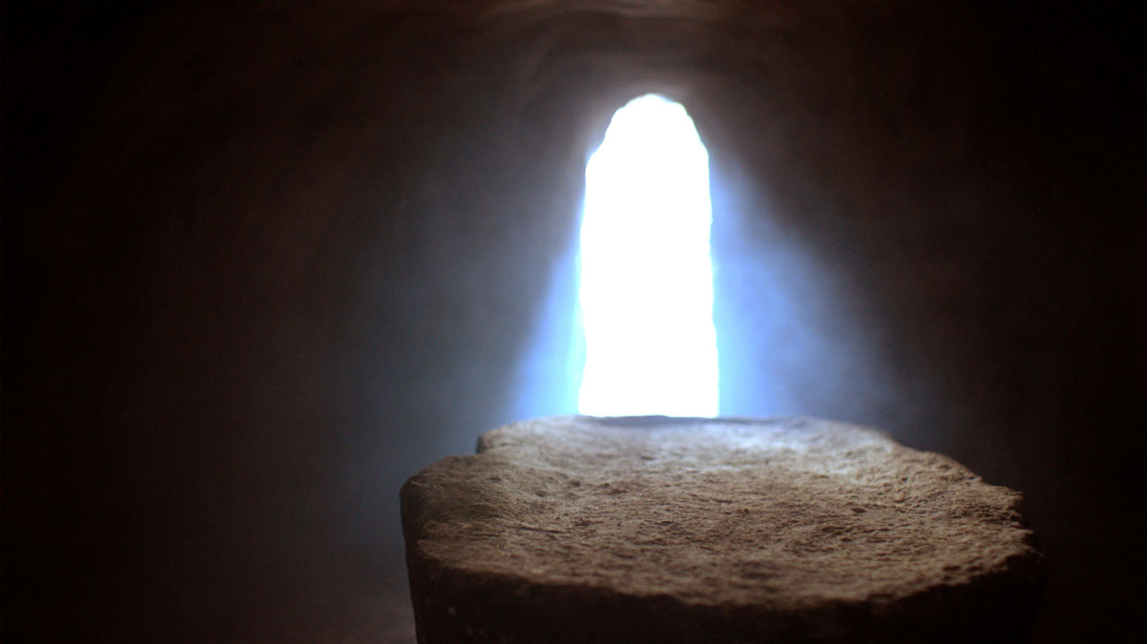
The Implictions
Notes:
This historical basis assures that the bodies of all Christians also will be raised (4:14b).
Paul declared that both Christ's resurrection and our resurrection stand or fall together.
This is taught in 1 Corinthians 15:12-20.

Slide 36
I. The Rapture helps us grieve with hope (1 Thess 4:13-14).
Notes:
Therefore, Paul has told us that when we undergo affliction to the point of death we shouldn't grieve hopelessly because all believers will be resurrected. But how will this come about when Christ comes to receive His church? Who will be the first to be bodily with the Lord—those who have died or those of us who are living? This leads us to the second reason to expect his return…

Slide 37
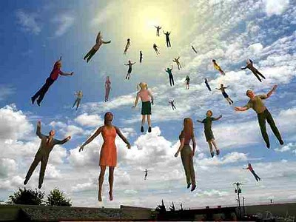
II. Christians who have died will meet Christ in the air before those living (4:15-17).
Notes:
We who are alive when the Rapture comes will be taken up only after the dead in Christ.
Now the living moving faster than the dead—but then the dead will move faster than the living!

Slide 38
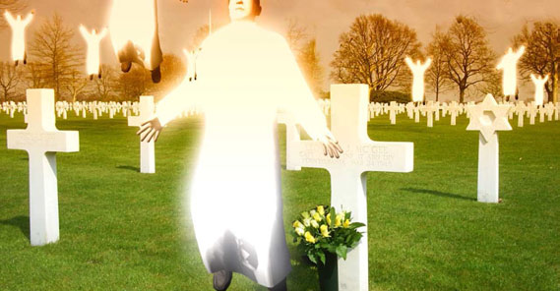
"We tell you this directly from the Lord: We who are still living when the Lord returns will not meet him ahead of those who have died" (1 Thess 4:15 NLT).
Notes:
1. Paul did not make this truth up. It was Christ's promise.
Perhaps this was an unrecorded statement of Christ (cf. Acts 20:35).
Maybe Paul received this word by direct revelation.
In either case, there was no need to worry since the dead will have a prominent place in the Rapture because they will rise even before the living.
2. Paul included himself among the living group and expected to be living when Christ returned.
Here we see more evidence for a pre-tribulation Rapture.
According to Paul, the next event on God's timetable was the return of Christ since it could happen at any moment.

Slide 39
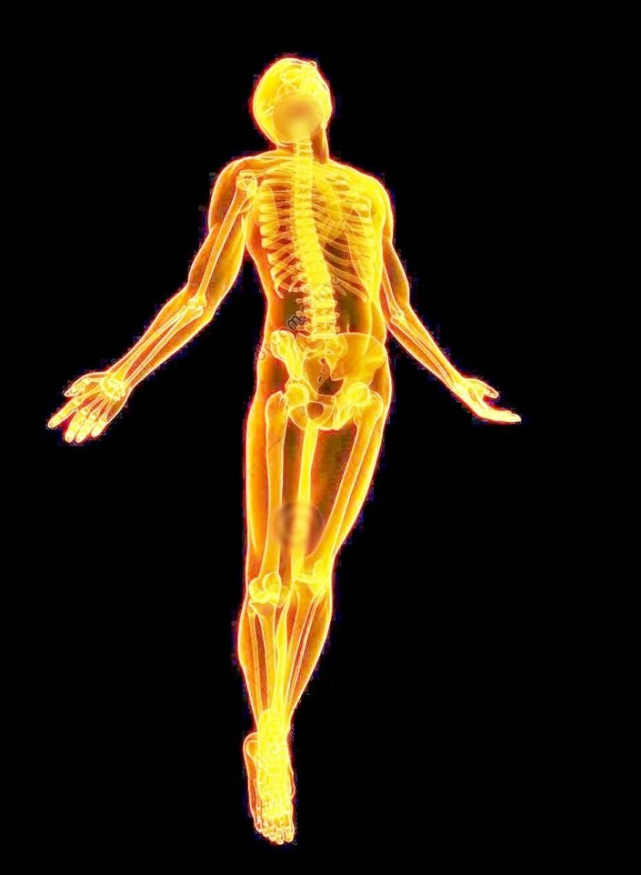
Some future day 4 amazing events will happen without a moment's notice (4:16-17)
Notes:
These four events will happen in the following order, each event beginning with the letter "R" (cf. Ryrie)…

Slide 40
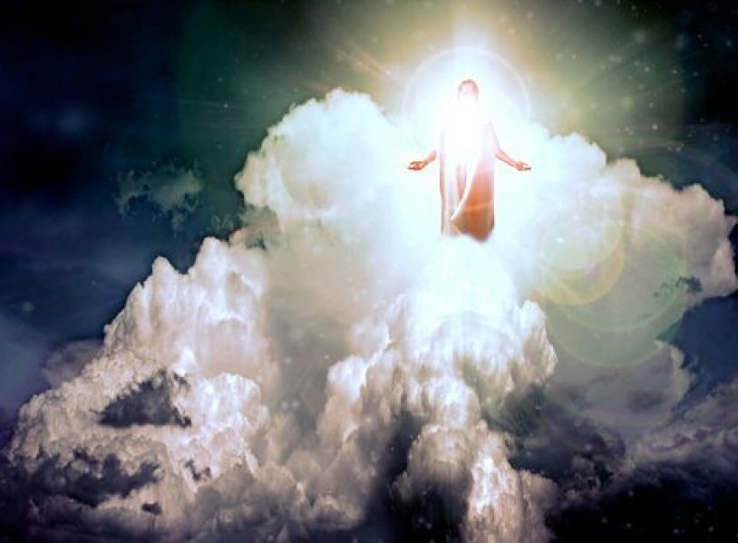
Return
"For the Lord himself will come down from heaven with a commanding shout, with the voice of the archangel, and with the trumpet call of God" (1 Thess 4:16a NLT).
Notes:
Where is Christ right now? In heaven seated at the right side of the Father.
Christ Himself (not an angel) will return for the church.
His return will be accompanied by three things:

Slide 41
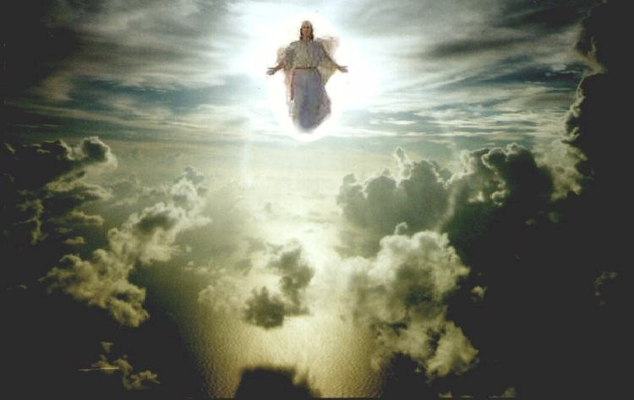
Christ's Commanding Shout
Notes:
Is this shout from Christ or an angel or Michael the archangel? The text isn't clear, but I like to think that it's from Christ.
The word for "loud command" or "shout" is "used of the cry of the charioteer to his horses or the hunter to his hounds; it is the shout of the ship's master to the rowers, or of the commander to his soldiers" (Morris).
What is the command? "Rise!" "Come forth!" "It's time!" ????
The word carries with it a ring of authority and urgency.

Slide 42
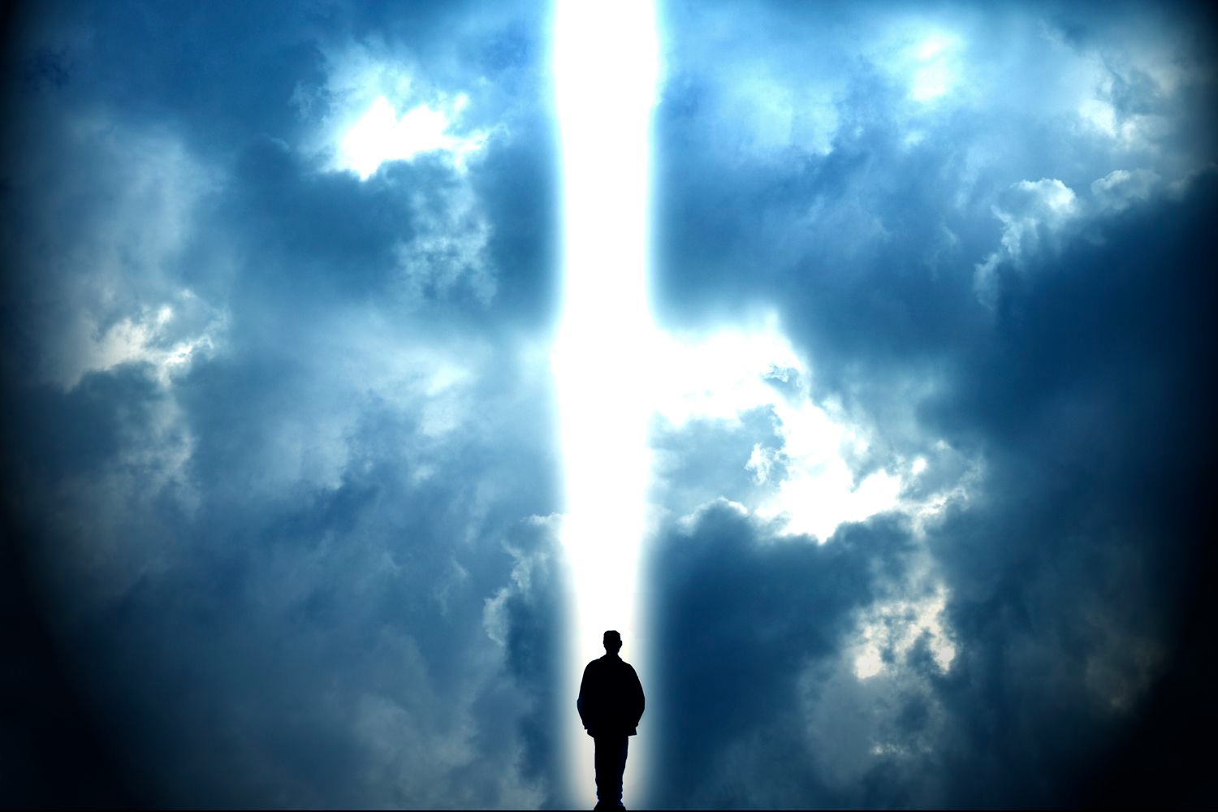
Voice of an Archangel
Notes:
The Jews listed seven chief angels, but which one is the archangel?
The identity of this angel is somewhat unclear since Michael is the only angel in Scripture specifically referred to as an archangel, but here the word appears without a definite article.
"Voice" also lacks the word "the" in the Greek.
However, a definite article is not necessary to be definite so this is probably Michael.

Slide 43
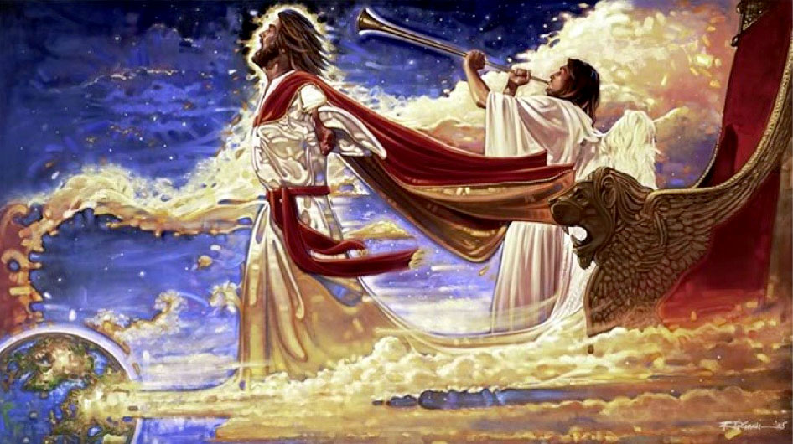
The Trumpet Call of God
Notes:
Trumpets are associated with God's activity in the Bible:
-Ex 19:16 has a trumpet at Mt. Sinai
-Isa 27:13 uses the trumpet to signal the return to the land from Assyria
-Joel 2:1 mentions the trumpet sounding in judgment
-Matt 24:31 has a trumpet sound when Christ returns after the Tribulation
By using the trumpet, God calls attention to this event as a majestic, dramatic, spectacular one worthy of Christ who is King of kings and Lord of lords.

Slide 44
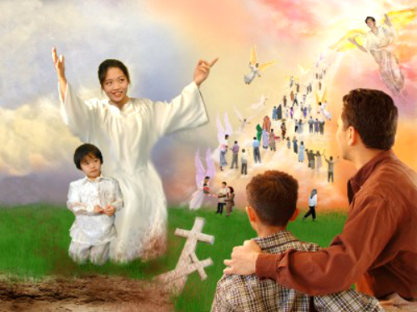
Resurrection
"First, the Christians who have died will rise from their graves" (1 Thess 4:16b NLT).
Notes:
Christians who have died during the Church Age will rise first.
The designation "in Christ" refers only to those who have died since Christ's death and resurrection in the Church Age.
So, the bodies of those who have died as Christians will be rejoined with their spirits which have already been with Christ.

Slide 45

“The dead in Christ will rise first” (1 Thess. 4:16b)
Notes:
But what happens to the bodies of these who have died? Are they changed? (RAPTURE transformation of the body = farmer's wife in an elevator).
For sure! Read 1 Corinthians 15:50-55.
Exactly how these bodies are reassembled and resurrected is not stated.

Slide 46

Rapture
"Then, together with them, we who are still alive and remain on the earth will be caught up in the clouds to meet the Lord in the air" (1 Thess 4:17a NLT).
"caught up"—not "disappear"
Notes:
Too many movies show Christians disappearing!!

Slide 47
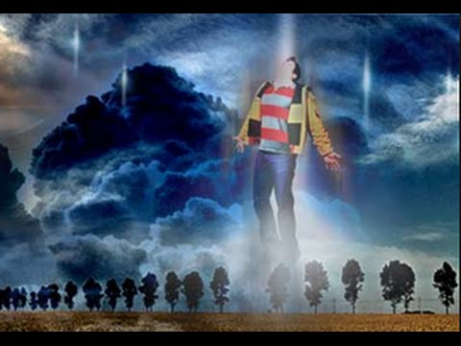
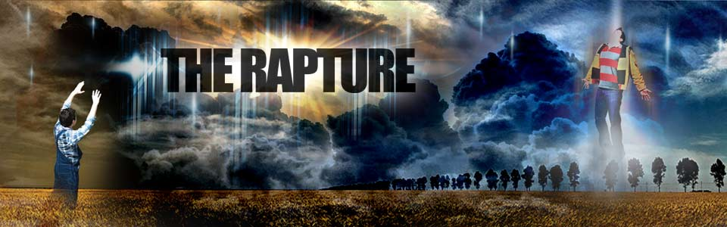
THE RAPTURE
From rapturo, "to catch up" (Latin)
Notes:
We get the English term "Rapture" from the Latin.

Slide 48

Notes:
This short Fed Ex commercial parallels the Rapture in certain aspects!

Slide 49

"Enoch walked with God, and he was not, for God took him"—Genesis 5:24
Enoch
Notes:
Enoch had what you might call an individual Rapture or catching up!

Slide 50
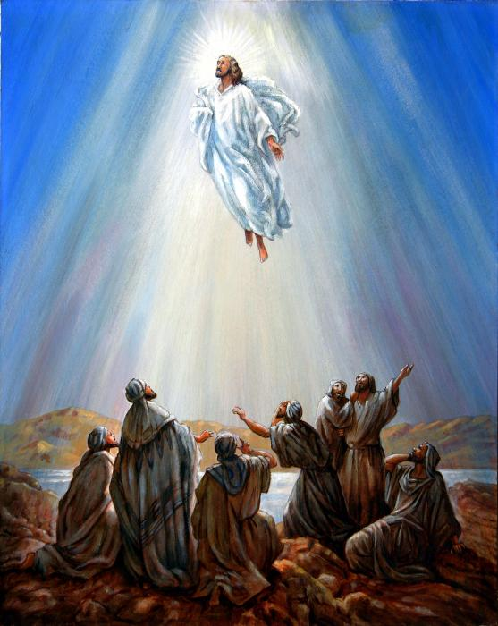
Christ Ascended
Notes:
Jesus also left the earth in the same way that we will follow him!

Slide 51
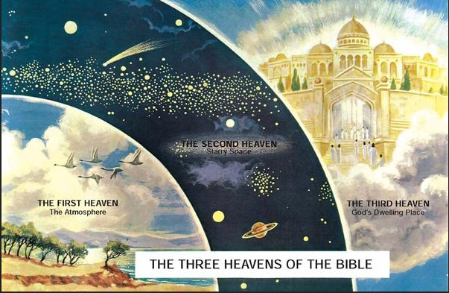
"I was caught up to the third heaven" (2 Cor 12:2 NLT)
THE SECOND HEAVEN
Starry Space
THE FIRST HEAVEN
The Atmosphere
THE THIRD HEAVEN
God's Dwelling Place
THE THREE HEAVENS OF THE BIBLE
Notes:
Paul already had a private "Rapture" to the “third heaven” in 2 Corinthians 12:2, 4

Slide 52

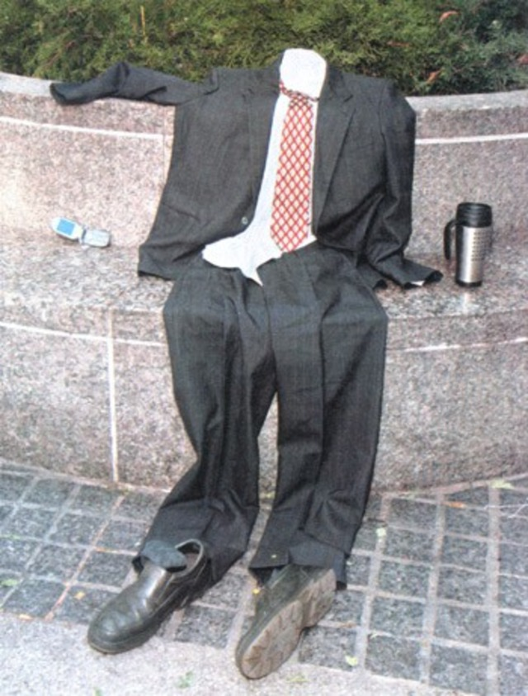
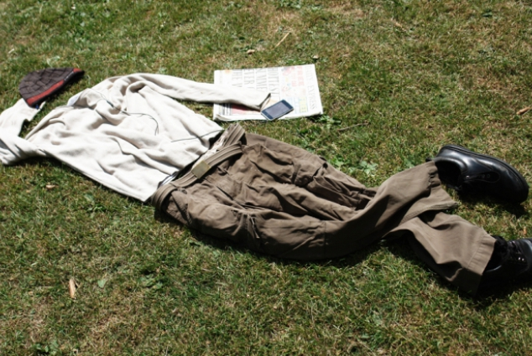
Rapture Chaos
Notes:
The Bible doesn’t say what will happen to our clothes—but certainly we won’t go naked. Maybe our clothes will be replaced with a robe!

Slide 53
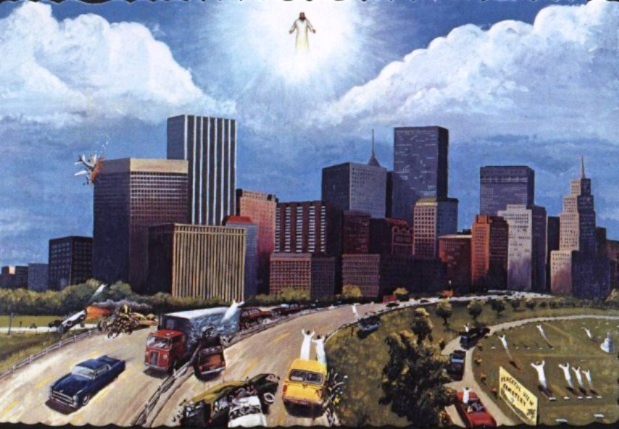
Rapture Chaos
Notes:
The Rapture will bring chaos for those left behind. Cars and planes will crash upon the sudden catching up of millions.

Slide 54
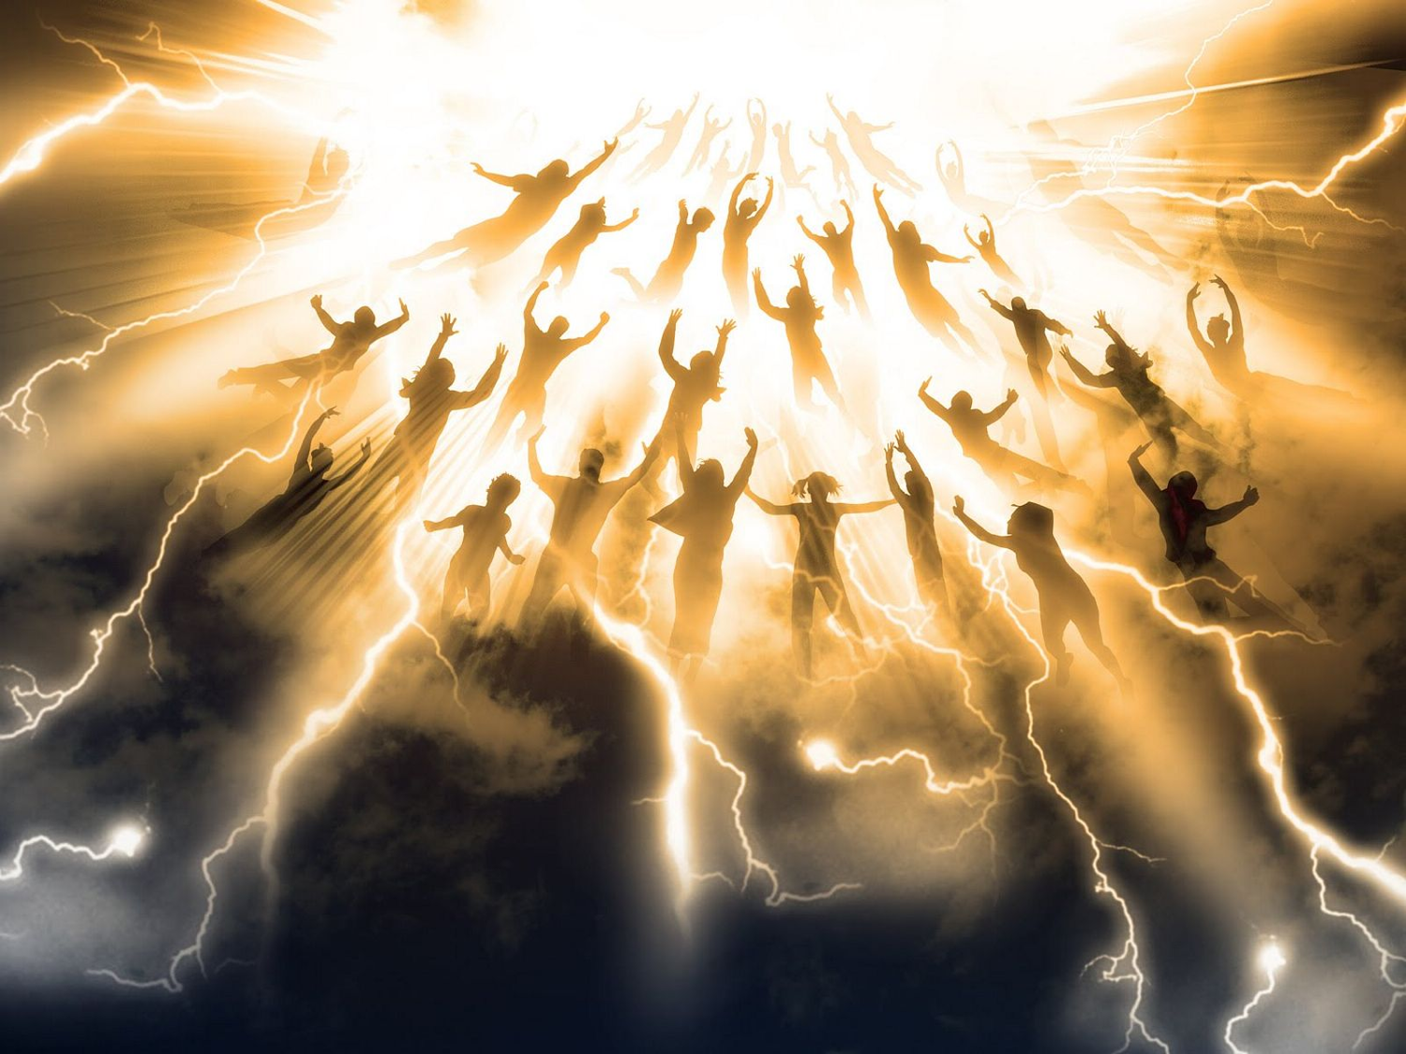
The Translation
Notes:
Some call this a "translation" to heaven.

Slide 55
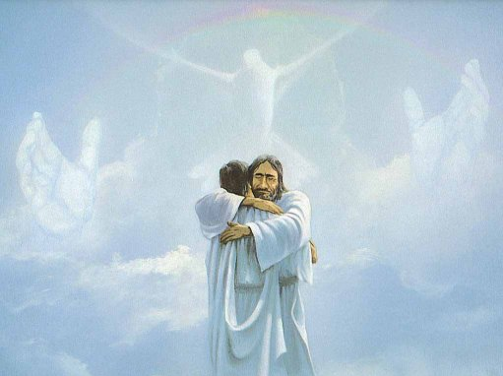
Reunion
"Then we will be with the Lord forever" (1 Thess 4:17b NLT).
Notes:
The result will be reunions with both Jesus and other believers.

Slide 56
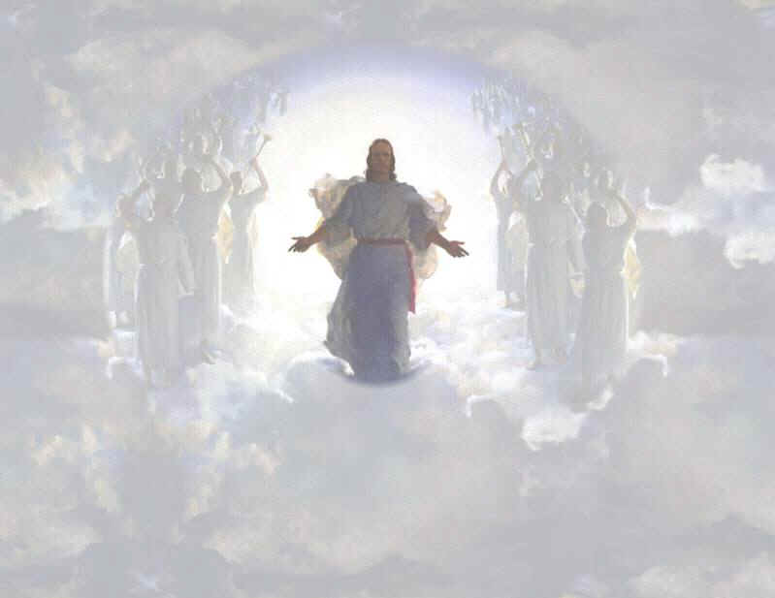
We will join him in the clouds
Notes:
It will be our first time to stand on clouds. But don't try that now!

Slide 57
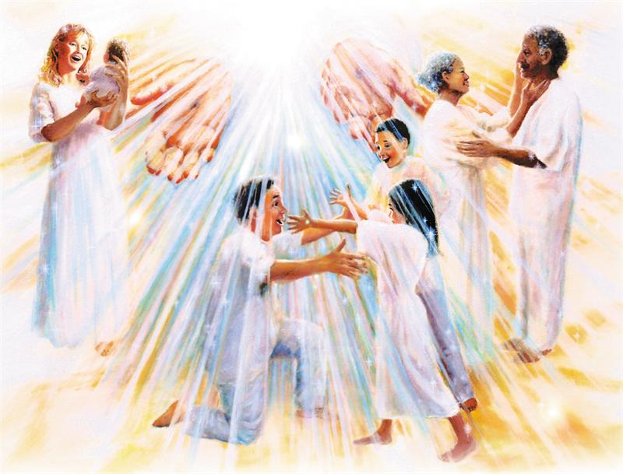
III. Christ’s return helps us encourage one another (4:18).
Notes:
The result for us now is in the final verse today.
The word for "comfort" (or "encourage") here means to "come alongside to help (Read Charles Swindoll, Contagious Christianity, 46-47).
We're also guaranteed escape from the coming wrath of the Tribulation, which is something to be encouraged about! (A post-tribulation rapture would be no comfort to anyone as all would have to go through seven years of hell on earth!)

Slide 58
Why should we look forward to the Rapture with expectancy?
Notes:
So, are you looking to Christ’s return at the Rapture?
What reasons can we give to anticipate Jesus coming back?

Slide 59
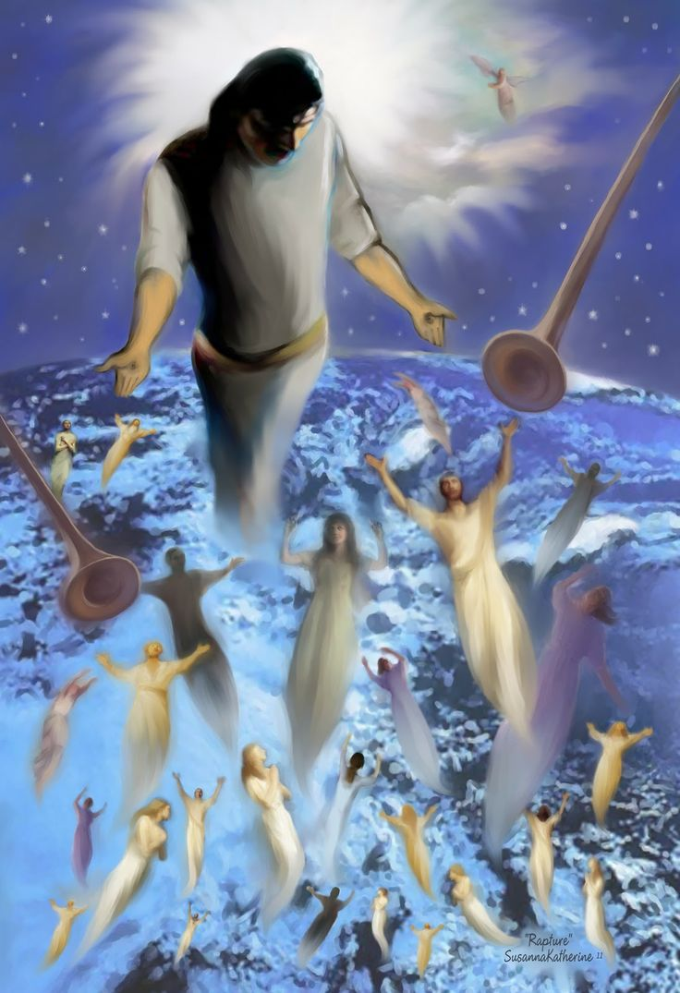
Main Idea
The Rapture gives hope and encouragement that he will come for you.
Notes:
The sure return of Jesus is not a stuffy doctrine but a reassuring personal promise!

Slide 60

"I've got time..."
Notes:
It is foolish to claim that we have time to live for ourselves.

Slide 61

Behold, I COME QUICKLY
Rev 3:11
Notes:
Jesus will come as suddenly as he came to the disciples in the upper room—and we will rise just as quickly!

Slide 62

1 Thessalonians 5:2
"like a thief in the night"
Notes:
You don't expect a thief to break into your house—but prepare for Jesus to return as much as you would prepare to know that a thief is coming.

Slide 63
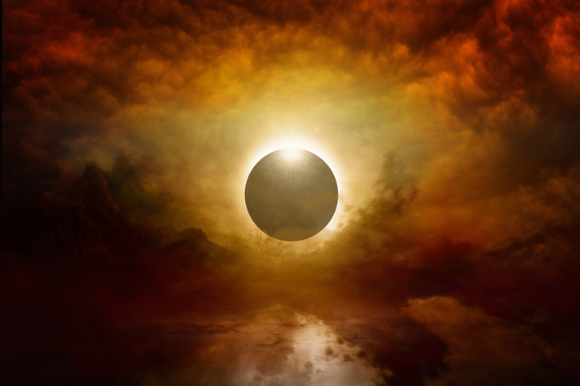
How to live?
Charles R. Swindoll, Contagious Christiantiy, 47
Notes:
How does the Rapture affect how we live?

Slide 64
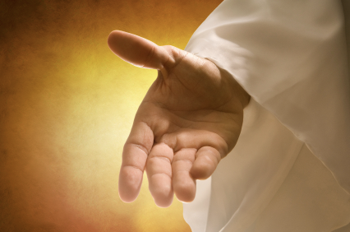
Make sure that you have received the salvation God freely offers you (Titus 2:11 NLT).
"For the grace of God has been revealed, bringing salvation to all people."
Charles R. Swindoll, Contagious Christiantiy, 47
Notes:
Swindoll gives three ways to be prepared for the Rapture based on Titus 2:11-13.

Slide 65
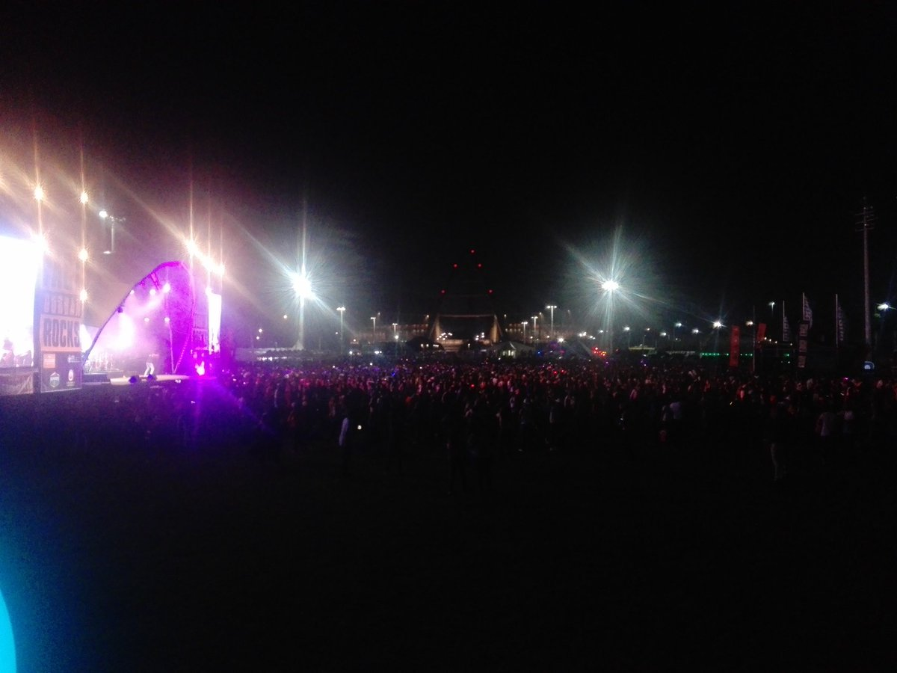
Continue to resist a corrupt lifestyle (Titus 2:12a NLT).
"And we are instructed to turn from godless living and sinful pleasures."
Charles R. Swindoll, Contagious Christiantiy, 47
Notes:
Don’t be caught doing something stupid when Jesus arrives—something shameful like looking at porn, being immoral, or gluttonous or drunken.

Slide 66

Live in a sensible, godly manner (Titus 2:12b-13 NLT).
"We should live in this evil world with wisdom, righteousness, and devotion to God, ¹³while we look forward with hope to that wonderful day when the glory of our great God and Savior, Jesus Christ, will be revealed."
Charles R. Swindoll, Contagious Christiantiy, 47
Notes:
Instead, focus on these three goals: wisdom, righteousness, and devotion. Be sober and holy.

Slide 67
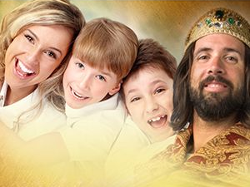
The faithful will reign with Christ
Notes:
Live as if you will reign with Christ—because the faithful believers will!

Slide 68
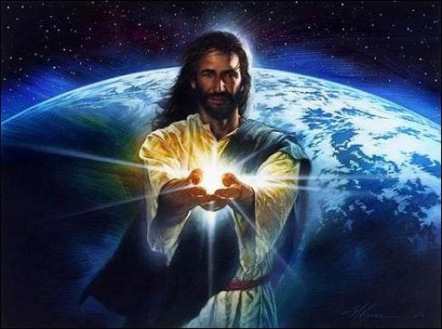
Black
Notes:
Jesus is preparing heaven now as your eternal home—and he invites you there now!
Respond in belief and discipleship.
Pray that you will be ready.

Slide 69
Black

Slide 70


Future (Eschatology) link at BibleStudyDownloads.org
Get this presentation and script for free!

