Slide 1

The New Heaven & New Earth
Dr. Rick Griffith • Jordan Evangelical Theological Seminary • BibleStudyDownloads.org

Slide 2
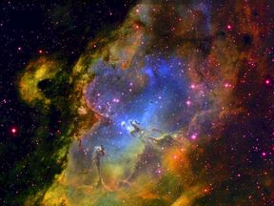
What is the greatest truth about your eternal home?
What do you long for most in heaven?

Slide 3
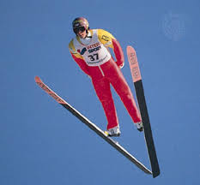
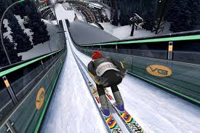
Imagine skiing where you can't get hurt!

Slide 4
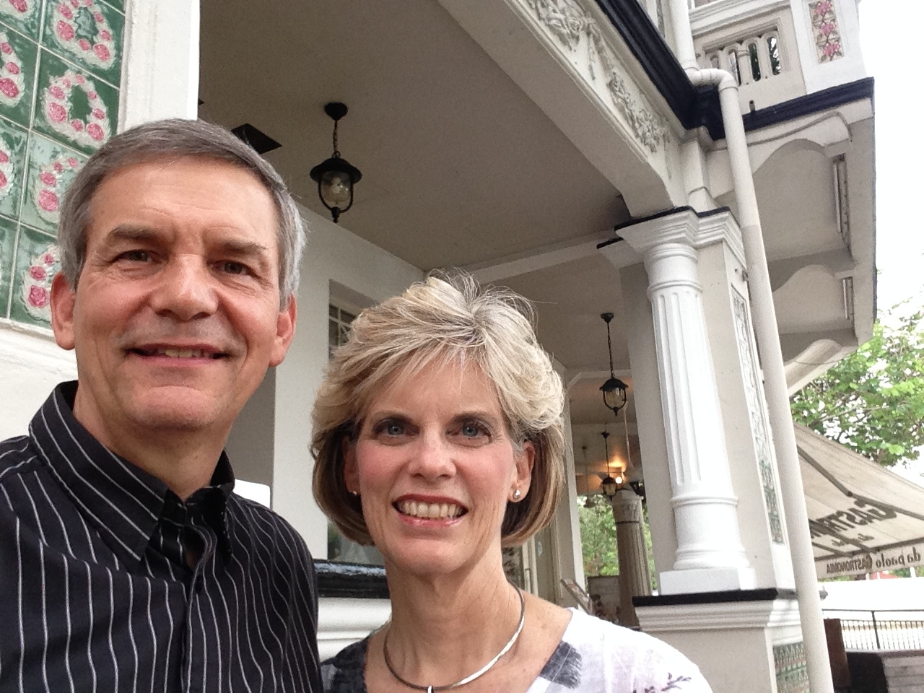
Home = Relationships!

Slide 5
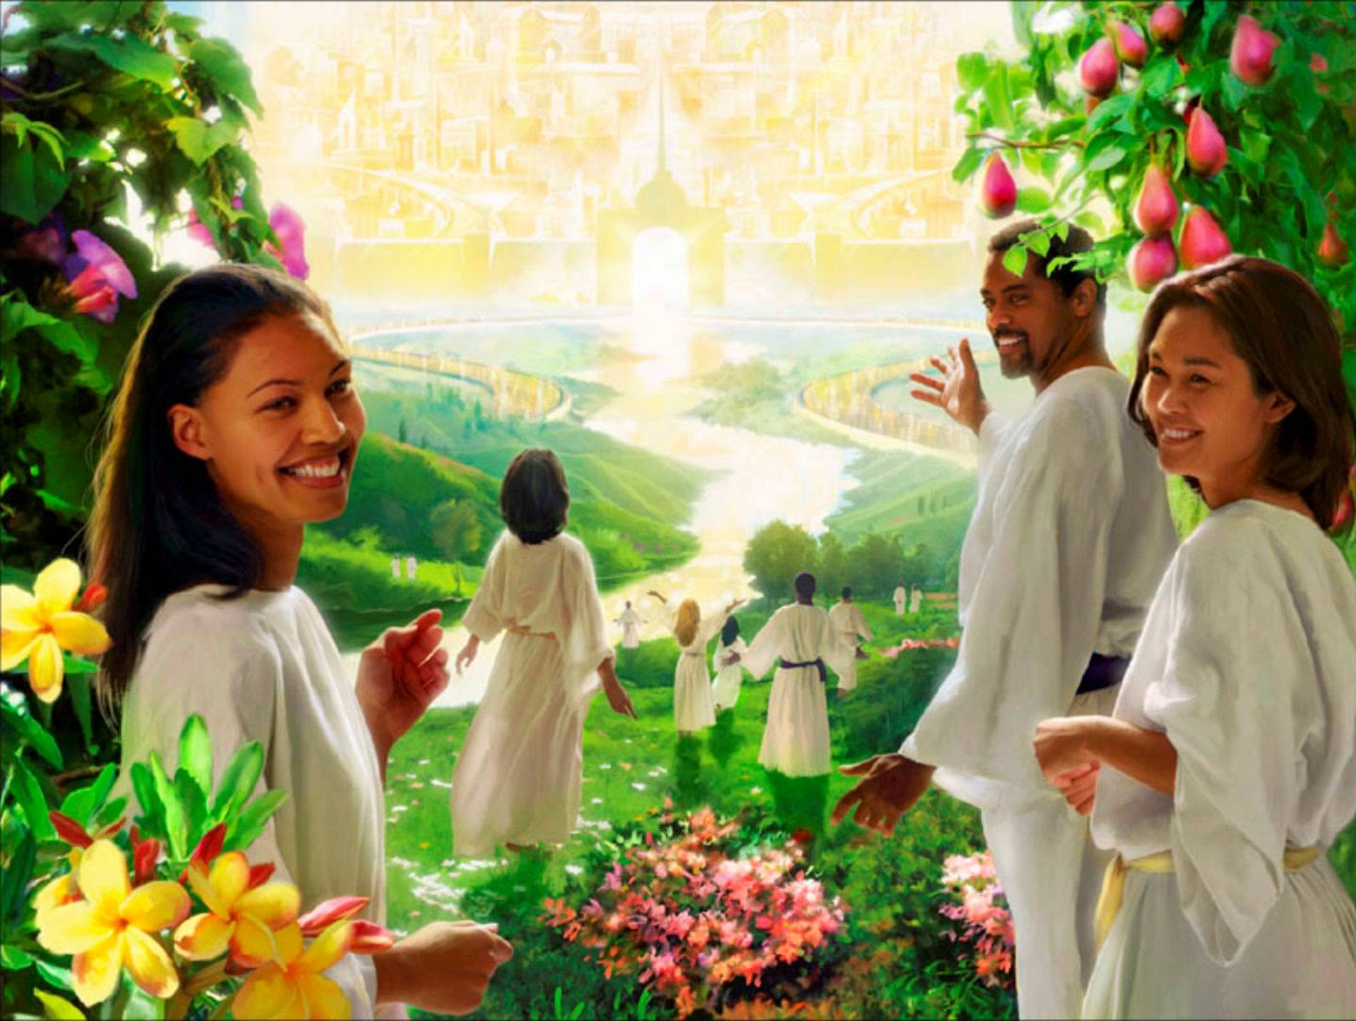
Heaven = Relationships!

Slide 6

Heaven is for Real
Notes:
"Heaven Is For Real" Movie Attendance Is For Real: Greg Kinnear's $12 Million Faith Based Film Beats Johnny Depp's $100 Million "Transcendence" On Easter Weekend
By Staff Writer | Apr 21, 2014 10:09 AM EDT at http://www.kdramastars.com/articles/20087/20140421/heaven-is-for-real-movie-kinnear.htm
"Heaven Is For Real," a faith-based movie, made big bucks this past weekend during the Easter holiday. The movie, which cost $12 million to make, earned a stellar $21.5 million from 2,417 theaters according to the Hollywood Reporter. "Heaven Is For Real" beat out Johnny Depp's huge budget sci-fic movie "Transcendence," which cost $100 million to make, opened to a weak $11.5 million from 3,455 locations this past weekend.
Like Us on Facebook
Meanwhile, "Captain America" continued to stay at No. 1 for its third consecutive weekend: the superhero movie grossed $26.6 million from 3,825 locations. After Easter weekend, the film hit the $200 million mark in the U.S. and $586.6 million worldwide. In second place, Fox's animated movie "Rio 2" grossed $22.5 million at 3,975 locations in its second weekend; it rung up a total of $75.4 million.
"Heaven Is for Real" is at third place and is another Christian film which greatly exceeded expectations. It's clear that the movie's release on Easter weekend was a big plus for the film. The movie is from Sony's TriStar label; it opened last Wednesday and earned an impressive $28.5 million in its first five days of release. The movie is produced by pastor T. D. Jakes and directed by Randall Wallace. "Heaven Is for Real" stars stars Greg Kinnear, Kelly Reilly, Jacob Vargas and Nancy Sorel. The movie earned an A rating by CinemaScore

Slide 7

Heaven is for Real
Notes:
"Heaven Is For Real" Movie Attendance Is For Real: Greg Kinnear's $12 Million Faith Based Film Beats Johnny Depp's $100 Million "Transcendence" On Easter Weekend
By Staff Writer | Apr 21, 2014 10:09 AM EDT at http://www.kdramastars.com/articles/20087/20140421/heaven-is-for-real-movie-kinnear.htm
"Heaven Is For Real," a faith-based movie, made big bucks this past weekend during the Easter holiday. The movie, which cost $12 million to make, earned a stellar $21.5 million from 2,417 theaters according to the Hollywood Reporter. "Heaven Is For Real" beat out Johnny Depp's huge budget sci-fic movie "Transcendence," which cost $100 million to make, opened to a weak $11.5 million from 3,455 locations this past weekend.
Like Us on Facebook
Meanwhile, "Captain America" continued to stay at No. 1 for its third consecutive weekend: the superhero movie grossed $26.6 million from 3,825 locations. After Easter weekend, the film hit the $200 million mark in the U.S. and $586.6 million worldwide. In second place, Fox's animated movie "Rio 2" grossed $22.5 million at 3,975 locations in its second weekend; it rung up a total of $75.4 million.
"Heaven Is for Real" is at third place and is another Christian film which greatly exceeded expectations. It's clear that the movie's release on Easter weekend was a big plus for the film. The movie is from Sony's TriStar label; it opened last Wednesday and earned an impressive $28.5 million in its first five days of release. The movie is produced by pastor T. D. Jakes and directed by Randall Wallace. "Heaven Is for Real" stars stars Greg Kinnear, Kelly Reilly, Jacob Vargas and Nancy Sorel. The movie earned an A rating by CinemaScore

Slide 8

Heaven is for Real
Notes:
'My Experience in Heaven is Very Vivid': New Movie Tells Story of Boy's Near-Death Experience
by Fox News Insider // Apr 07 2014 // 10:17pm http://foxnewsinsider.com/2014/04/07/new-movie-heaven-real-tells-story-boys-near-death-experience
As seen on The Kelly File
A new film tells the story of a 4-year-old boy's near-death experience, during which he says he visited heaven. Colton Burpo, who is now 14, was on "The Kelly File" tonight with his parents, Todd and Sonja Burpo.
When Colton was 4, his appendix burst, and during that time, he says he visited heaven.
Though 10 years have passed, Colton said, "My experience in heaven is very vivid." He said he even met a sister that his parents had lost in a miscarriage.
Todd said he knew what his son was saying was real when Colton was able to detail what Todd was doing while the little boy was in surgery.
The film, "Heaven Is For Real," is based on the hit book, which sold 8 million copies. It comes to theaters on April 16.
Watch the Burpo family's interview above.

Slide 9
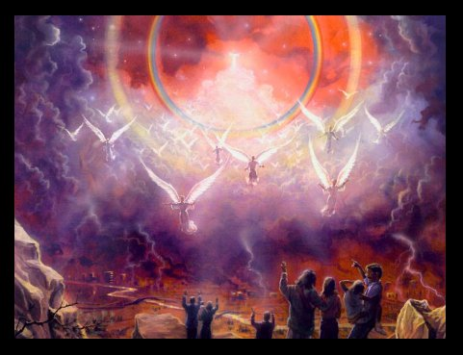
He will return!

Slide 10
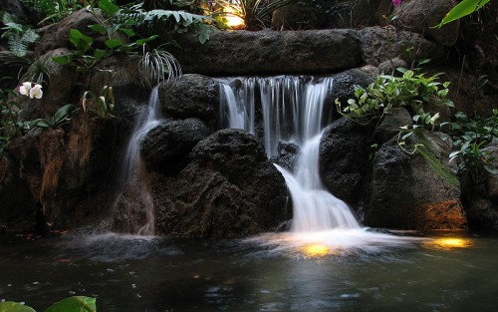
Come the water!

Slide 11

Be a Bride of Christ

Slide 12
Terminology for "Heaven(s)"
175
Atmosphere (Gen. 1:6-8)
Outer Space (Gen. 1:1, 14)
Abode of God & Saints (2 Cor. 12:2)
Millennium (Isa. 65:17; 66:22)

Slide 13
Slides on
Revelation 21

Slide 14
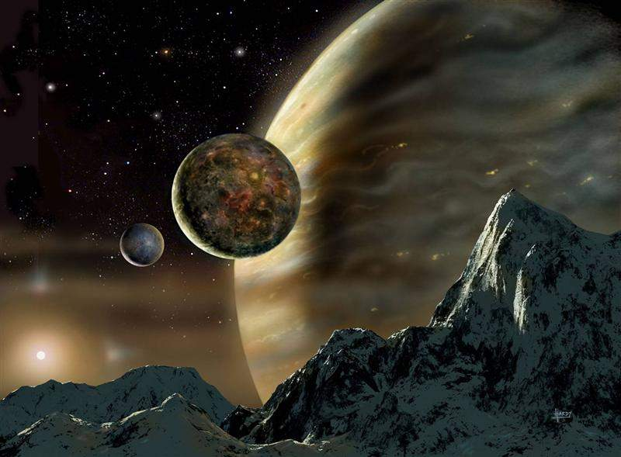
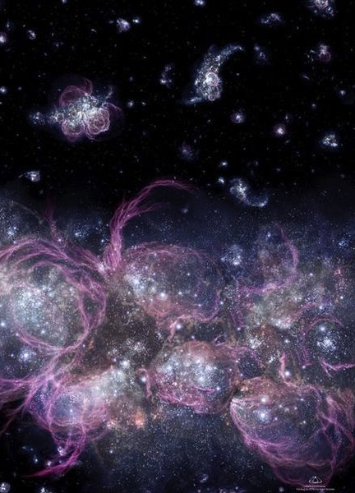
The Consummation of All Things
175
Genesis 1–3
Revelation 20–22
"In the beginning God created the heavens and the earth" (1:1)
"Then I saw a new heaven and a new earth" (21:1)
Notes:
The first three chapters of Scripture have many parallels in the last three chapters.

Slide 15
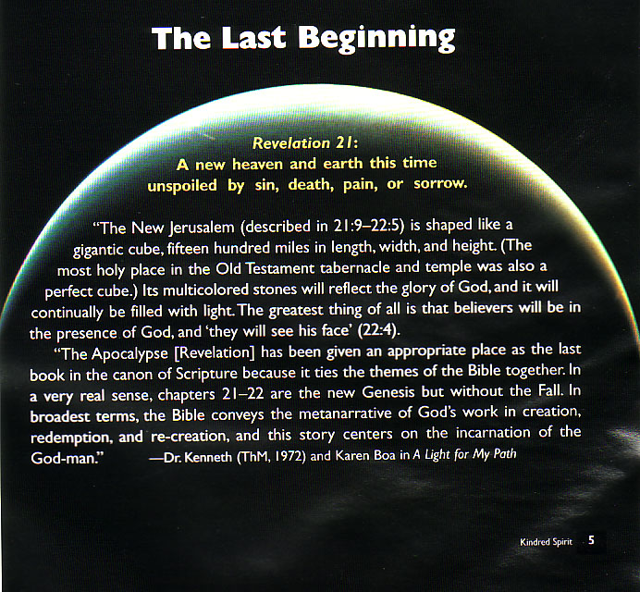
The Last Beginning
The Last Beginning
Revelation 21:
A new heaven and earth this time unspoiled by sin, death, pain or sorrow
(Translate from left)
Notes:
15
The last beginning=最后一个开始 , Revelation 21:9-22: 5=启示录21:9 -22:5

Slide 16

Days of Creation
3
Void
Formless
Forming
Filling
Day 4: Sun, moon & stars arranged
Day 1: Light
Day 2: Water & air separated
Day 5: Fish & fowl
Day 3: Land & sea separated
Day 6: Animals & man
Genesis 1:3-31

Slide 17

Man
God's Creation…Day 6
448
"Then God said, 'Let Us make man in Our image, according to Our likeness; and let them rule over the fish of the sea and over the birds of the sky and over the cattle and over all the earth, and over every creeping thing that creeps on the earth'" (Gen. 1:26).

Slide 18

Woman
God's Creation…Day 6
"So God created man in his own image
in the image of God he created him
male and female he created them" (Gen. 1:27).

Slide 19

Mandate
448
and over the birds of the air
"And God blessed them, and God said to them, 'Be fruitful and multiply, and fill the earth and subdue it;
and have dominion over the fish of the sea
and over every living thing that
moves upon the earth'" (Gen. 1:28 NLT).

Slide 20
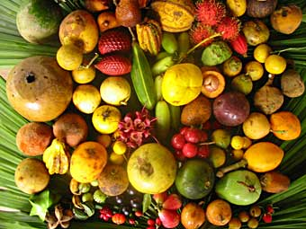
Food
Then God said, "Look, I have given you every green plant yielding seed that is on the surface of the all the earth, and every tree which has fruit yielding seed; it shall be food for you" (29)

Slide 21
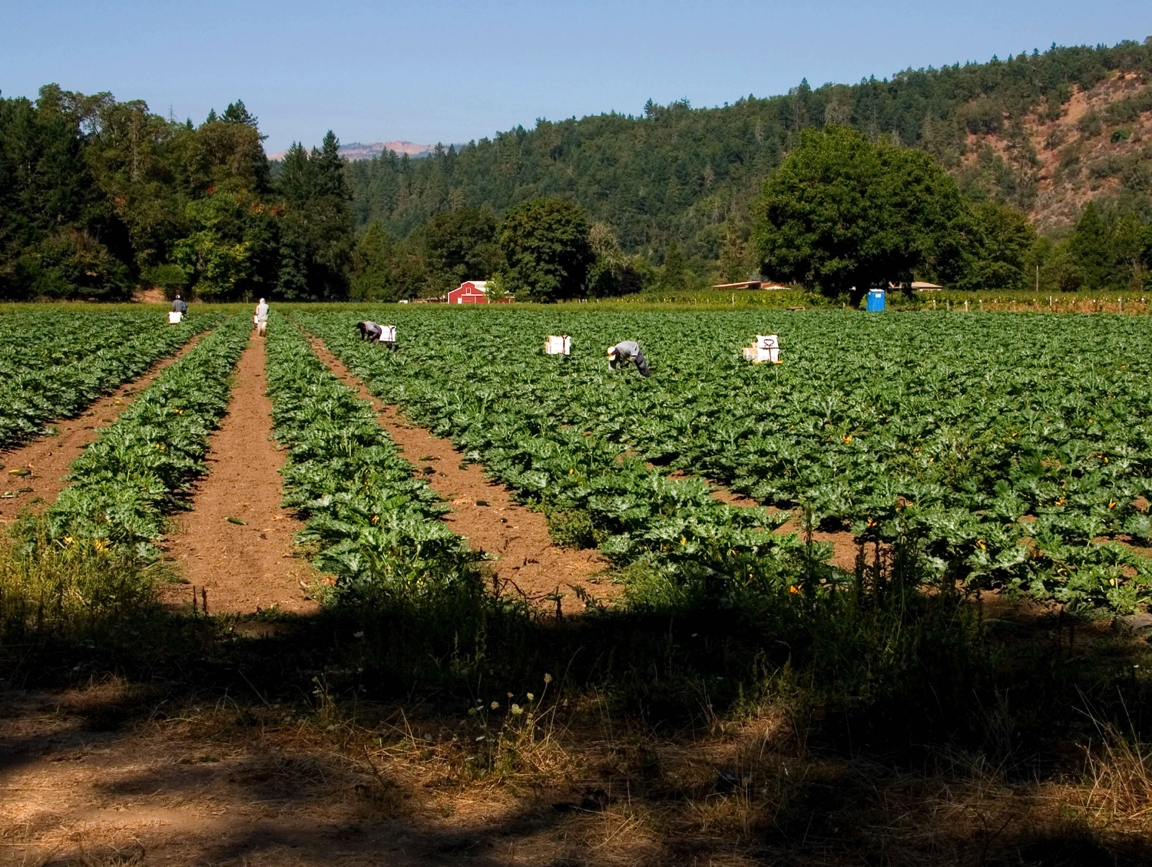
Food
"and to every beast of the earth and to every bird of the sky and to every thing that moves on the earth which has life, I have given every green plant for food"; and it was so (30).

Slide 22
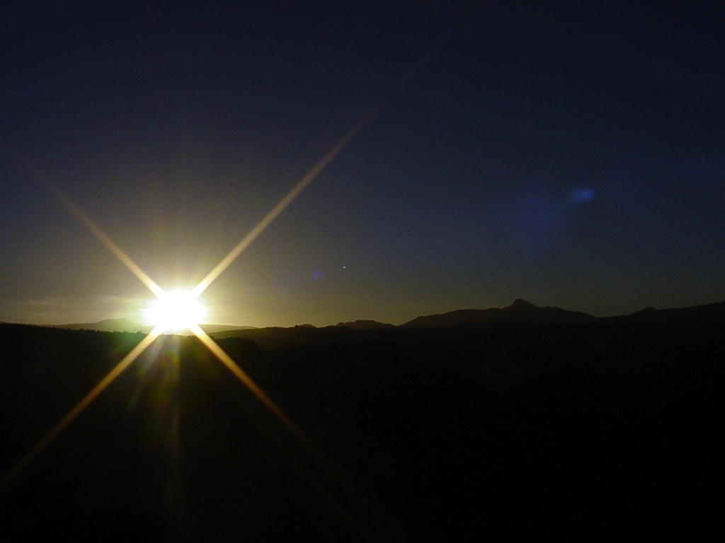
Sixth Day
God's Creation…Day 6
God saw all that He had made, and it was very good.
And there was evening and there was morning, the sixth day (31).

Slide 23
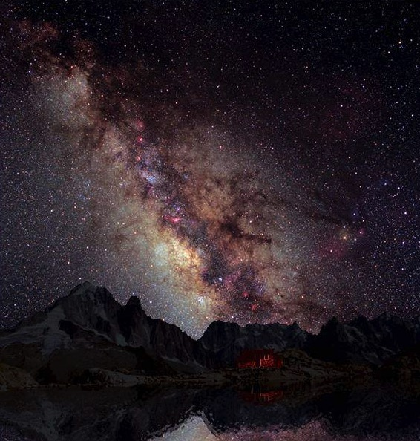
Summary
God's Creation…Day 7
Thus the heavens and the earth were completed,
and all their hosts (2:1)

Slide 24
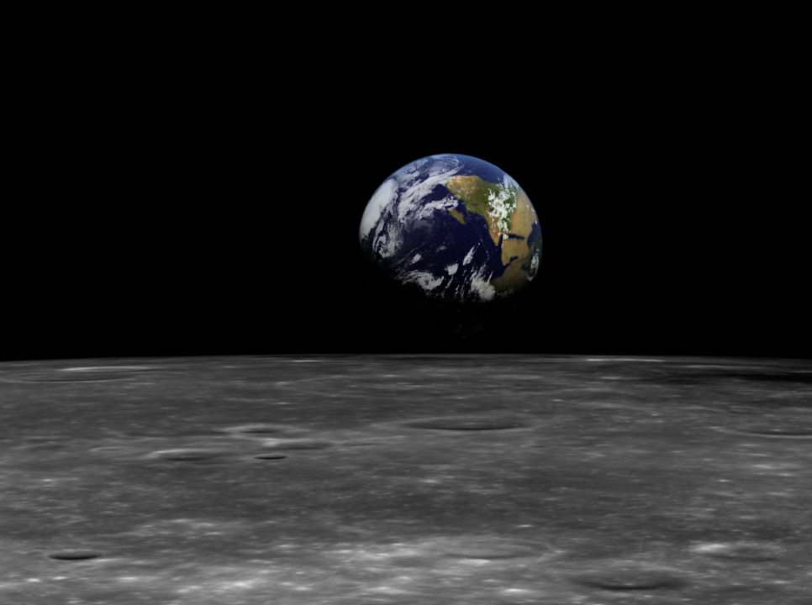
The Kingdom in Genesis 1
• Uncreated God (1:1)
• Creation by Word alone (1:4)
• Creation with ease
• Sun and moon [gods] created (1:16)
• Shared rule with man (1:26)

Slide 25
The Kingdom of God:
The Bible's All-Encompassing Theme
445
Genesis 1:26-28
"Then God said, 'Let us make man in our image, in our likeness, and let them rule over the fish … birds … livestock … all the earth, and over all the creatures that move along the ground…' God blessed them and said to them, 'Be fruitful and increase in number; fill the earth and subdue it. Rule over the fish of the sea and the birds of the air and over every living creature that moves on the ground.'"
Revelation 22:5
"There will be no more night. They will not need the light of a lamp or the light of the sun, for the Lord God will give them light. And they will reign for ever and ever."
The Bible's Theme: God extends His rule to man
Command
Covenants
Fulfillment

Slide 26
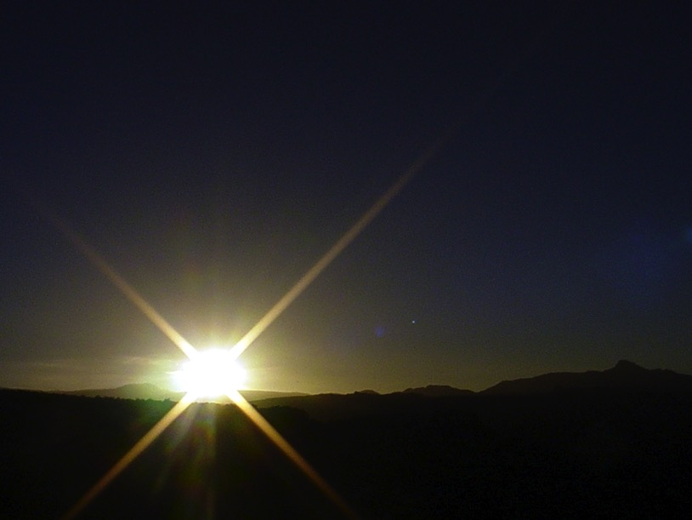

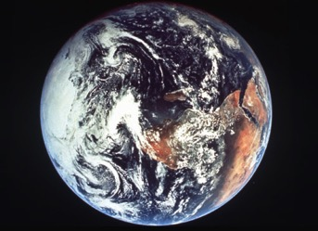
The Bible's Chiasm
Repeated Patterns in Reverse Order
Christ's Redemption
Christ's Rule
Man's Rule Lost at
Fall
Man's
Rule Restored at Millennium
Creation
New Creation
Notes:
Creation in Genesis 1–2 is repeated In the Restored, New Creation in Rev 21–22
Man was created to rule over the fish, birds, and land animals (Gen. 1:28) but he gave over his rule over to the god of this world, Satan (2 Cor. 4:4)
However, this rule is restored during the 1000-year reign of the saints (Rev. 20:4-6)
But Christ is the central Person of history: both as Lamb (Redeemer) and as Lion (Ruler of all creation in the line of David)

Slide 27
Kingdom & Covenants Timeline
9g
Kingdom Teaching...
Adam rules with God (Gen. 1:26, 28; 2:19)
Satan rules as god of this world (Gen. 3:15;
2 Cor. 4:4)
God covenants with Abraham to reestablish man's rule via Israel as a "kingdom of priests" (Gen. 12:1-3; Exod. 19:6)
Israel's failure to witness to nations as a kingdom of priests is judged via exile under foreign rule
Israel rejects Messiah's offer of kingdom (Matt. 12:41-42; 23:37-39)
Jesus extends His kingdom in mystery form to the Church (Matt. 13)
Christ subdues Israel's enemies and nation believes (Rom. 11:26-27)
Christ rules over everything with saints (Eph. 1:9-10; Rev. 20:1-6; 22:5b)
Fall of Man (Gen. 3)
Noahic Covenant
Genesis 6:18; 9:8-17
Land Covenant
ISRAEL
CHURCH
MESSIANIC KINGDOM
(National Focus)
The "New Man" (Eph. 2:15)
Millennial Eternal
land
Genesis 15:18 (cf. Deut. 30:1-10) promises:
Land from Wadi of Egypt to Euphrates River (Isa. 27:12)
Eternal possession of land (Gen. 17:8) after exile/restoration
Whole world blessed via the land (Isa. 14:1-2)
Israel judged for rejecting Messiah by dispersion away from land for 19 centuries
(AD 70–AD 1948) but now partially restored (Ezek. 37:1-7)
Full restoration (Ezek. 37:8-28) Jerusalem world capital
(Isa. 2:1-5)
New Jerusalem
(Rev. 21–22)
Davidic Covenant
Christ is Head over His Church, which is a spiritual temple (Eph. 2:19-22; 2 Cor. 6:16)
Christ reigns over the world
(Isa. 11)
with saints (Rev. 5:10; 20:4-6)
Christ hands kingdom over to Father (1
Cor. 15:24)
Abrahamic Covenant
2 Samuel 7:12-16 promises perpetual:
Sons ("house" never wiped out)
Kingdom (political dynasty)
Throne (right to rule by descendants)
Temple (son to build it)
Genesis 12:1-3
seed
New Covenant
All
things made new!
(Rev. 21:5)
All 5 elements fulfilled in national restoration (Zech. 8)
Jeremiah 31:31-34 promises:
Forgiveness
Indwelling Spirit
New heart, nature, mind
Reunification of Israel and Judah
No need for evangelism
Mosaic Law replaced with first three elements of the New Covenant (Luke 22:20; 2 Cor. 3:6)
blessing
Mosaic Covenant
Law abolished, fulfilled, and replaced at the cross (Rom. 7:1-6;1 Cor. 9:19-21; Heb. 8:13)
Fourth Edition
30 May 2011
Temporary (Gal. 3:19) and conditional (Deut. 28) to reveal sin (Rom. 7:7) and regulate Israel (Gal. 3:23-25)
Scripture contains a dual kingdom-covenant emphasis. Israel's role from Abraham to Christ is expanded to include the Church (continuity) yet the Church
never replaces the nation as the "new Israel" (discontinuity). Israel will again enjoy world prominence after trusting in Christ at His second coming.

Slide 28

My View of the Bible's Theme
The Bible narrates
God's restoring man to participate in His kingdom rule for His own glory
mandated in Eden but lost in the Fall
and accomplished by redeeming man
through Israel as a kingdom of priests
and ultimately through the Messiah,
who will reign as Saviour and King
to fulfill the Abrahamic Covenant

Slide 29
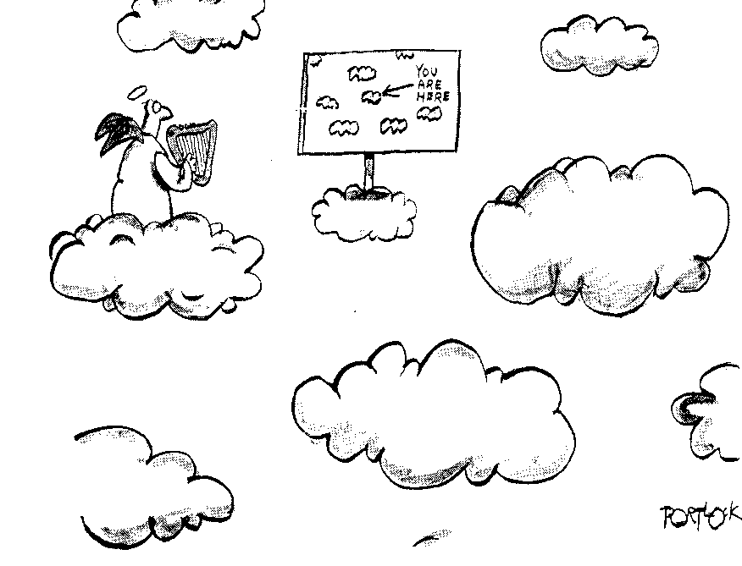
You are Here
174b

Slide 30



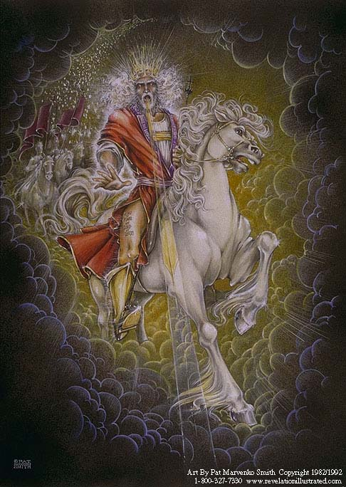
Future Benefits
(Rev. 19-20)
191
Heaven
(Rev. 21-22)
Millennium
(Rev. 20)
Return
(Rev. 19)

Slide 31
Differences Between the Millennium and Heaven
191
 | Millennium | Heaven
Duration | 1000 years (Rev. 20:1-6) | Eternal (Rev. 22:5)
Death | Possible (Isa. 65:20) | Impossible (Rev. 21:4)
Longevity of Life | "Never again will there be an infant who lives a few days. He who dies at a hundred will be thought a mere youth" (Isa. 65:20) | No aging (Rev. 21:4 implied)
Sin Nature | Active (Rev. 20:7-9) | Abolished (Rev. 21:27)
Inhabitants | Initially Christian, but later includes unbelievers––no living with angels? (Matt. 25:34; Rev. 20:7-9) | Saints and angels alone (Rev. 21:27)
Millennium
(Rev. 20)
vs.
Heaven
(Rev. 21-22)

Slide 32
Differences Between the Millennium and Heaven
191
 | Millennium | Heaven
Bodies | Mortal and immortal living together (Isa. 65:20; 1 Cor. 15:42-44) | Only immortal (glorified) (1 Cor. 15:42-44)
Satan | Bound, but then released after 1000 years (Rev. 20:3, 7) | In lake of burning sulfur, never to be released again (Rev. 20:10)
Political & Religious Centre | Jerusalem (Isa. 2:2-3; Micah 4:1-2, 7) | New Jerusalem (Rev. 21)
Place | Earth (Rev. 5:10) | New heavens and new earth (Rev. 21:1)
Key Passages | Psalm 72; Isaiah 2; 11; 65–66; Revelation 20:1-6 | Revelation 21–22
Millennium
(Rev. 20)
vs.
Heaven
(Rev. 21-22)

Slide 33
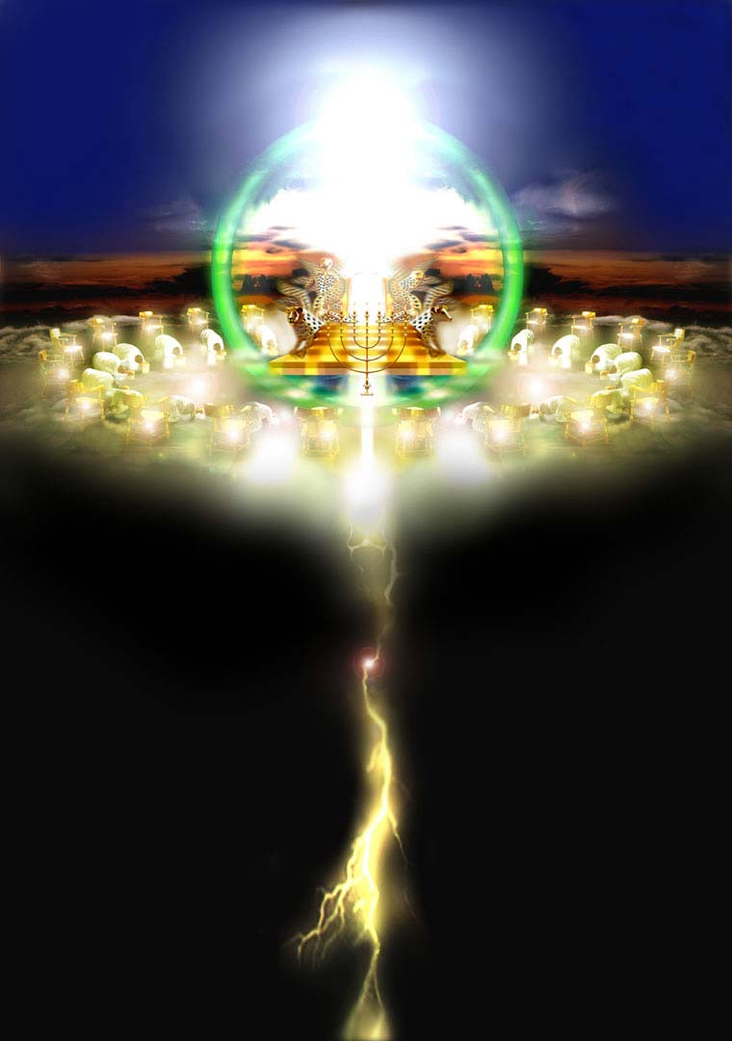
We already saw one glimpse of the throne of God (Rev. 4-5)

Slide 34
The Last Beginning

Slide 35
New Heaven
& New Earth
176
The Consummation of All Things
How are these "New"?
Annihilation
Renewal

Slide 36

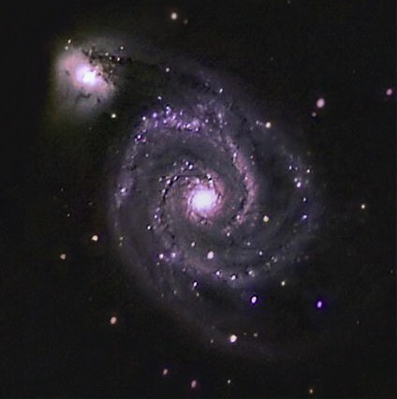
Explore!

Slide 37
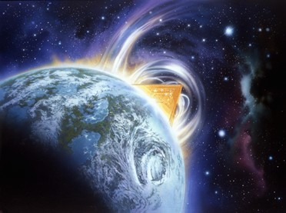
"Then I saw a new heaven and a new earth, for the old heaven and the old earth had disappeared"
(Rev 21:1a NLT).
449

Slide 38
Isaiah v. John on the
New Heaven(s) and New Earth
452
 | Isaiah's New Heavens and New Earth (Isa. 65:17; 66:22) | John's New Heaven and New Earth (Rev. 21:1)
English Term | Plural: "new heavens" | Singular: "new heaven"
Time Period | Millennium | Eternal State
Life span of Inhabitants | Extended yet not infinite life (65:20) | Eternal Life
Death | Possible, though dying at 100 years old is "young" (65:20; cf. 66:24)! | No death (Rev. 21:4) as death is abolished at the Great White Throne Judgment (Rev. 20:14)
Notes:
38

Slide 39
Isaiah v. John on the
New Heaven(s) and New Earth
452
 | Isaiah's New Heavens and New Earth (Isa. 65:17; 66:22) | John's New Heaven and New Earth (Rev. 21:1)
Marriage & Childbirth | Possible (65:23) | Impossible (Matt. 22:30)
Activity | Building of houses and planting of vineyards (65:21) | Christ claimed that he would prepare a place for us (John 14:1f.).
Animal Activity | Peaceful cohabitation of wild animals (65:25a) | No animals are noted by John or in any other text on heaven
Associated City | Protection of God in Jerusalem (65:25b) | Focus is the new Jerusalem (Rev. 20–21)
Notes:
39

Slide 40
Isaiah v. John on the
New Heaven(s) and New Earth
452
 | Isaiah's New Heavens and New Earth (Isa. 65:17; 66:22) | John's New Heaven and New Earth (Rev. 21:1)
Gathering of Nations | Brought to Jerusalem to see God's glory (66:18-20; cf. Zech. 14:16-19) | God's glory provides light for the nations (21:23-24)
Priesthood & Temple | Has a temple, priests, and Levites (66:20-21; cf. Ezek. 40—43) | Has no temple (21:22), so by implication no priests are needed
Celebrations | New Moon and the Sabbath (56:6-7a; 66:23) | No need for these since there will be no need for rest in eternity
Notes:
40

Slide 41
Isaiah v. John on the
New Heaven(s) and New Earth
452
 | Isaiah's New Heavens and New Earth (Isa. 65:17; 66:22) | John's New Heaven and New Earth (Rev. 21:1)
Time | Still existent | Abolished with night (Rev. 22:5), so rest every seven "days" is absurd.
Place of Worship | Jerusalem (65:23) | Throne of God (22:3-4)
Notes:
41

Slide 42
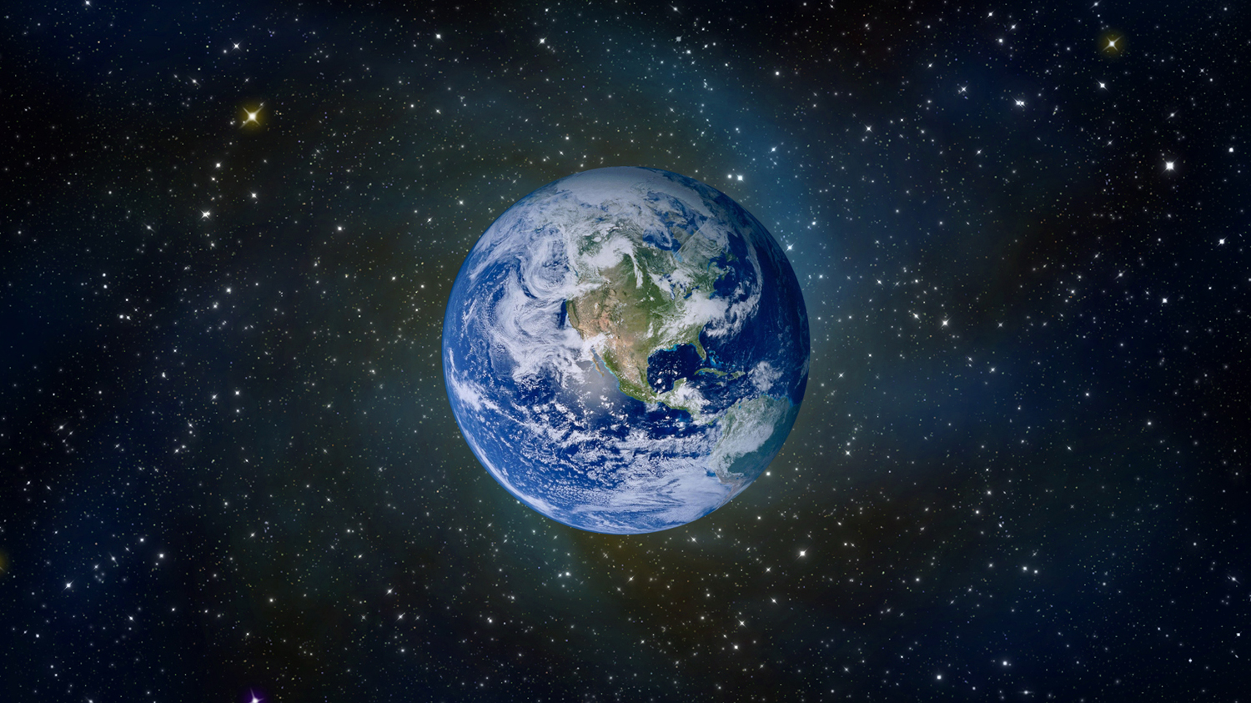
"Then I saw a new heaven and a new earth, for the old heaven and the old earth had disappeared" (21:1a NLT).
176
A renewed earth?

Slide 43
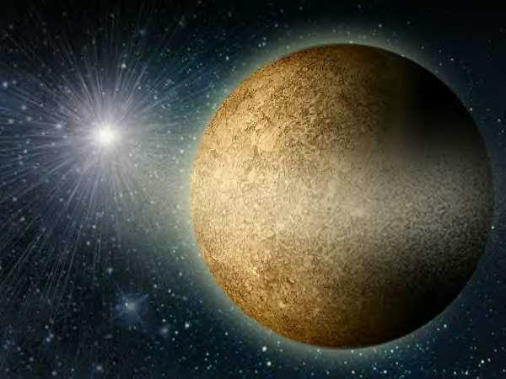

And the sea was also gone (21:1b NLT).
176

Slide 44
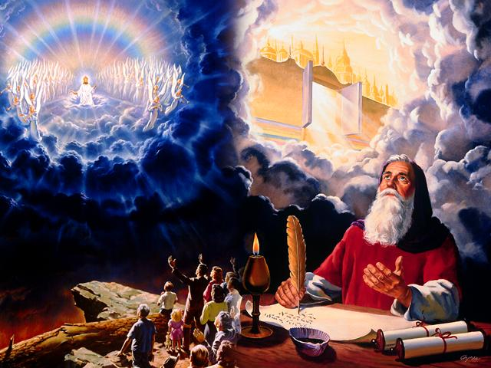
John sees the New Jerusalem
180

Slide 45
The Bible's Chiasm
446
Repeated Patterns in Reverse Order
Christ's Redemption
Christ's Rule
Man's Rule Lost at
Fall
Man's
Rule Restored at Millennium
Creation
New Creation
Notes:
We need to know who we are—more accurately, who God says we are—our future identity.
This is shown in the overall structure of the Bible in a chiasm—a literary pattern where earlier content is repeated in reverse order:
• Creation in Genesis 1–2 • is repeated In the Restored, New Creation in Rev 21–22
• Man was created to rule over the fish, birds, and land animals (Gen. 1:28) but he gave over his rule over to the god of this world, Satan (2 Cor. 4:4)
• But this rule will be restored during the 1000-year reign of the saints (Rev. 20:4-6)
• Christ is the central Person of history, • both as Lamb (Redeemer) • and as Lion (Ruler of all creation in the line of David)
________________
BE-17-Esther-76
ES-22-Heaven-45
OC-17-Genesis Authorship-14
OS-01-Genesis1-3-slide 243
OS-17-Esther-17, 145
NS-27-Rev20-22-slide 206

Slide 46

And the sea was also gone (21:1b NLT).
181

Slide 47

And the sea was also gone (21:1b NLT).
181

Slide 48
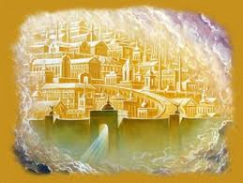
The New Jerusalem

Slide 49
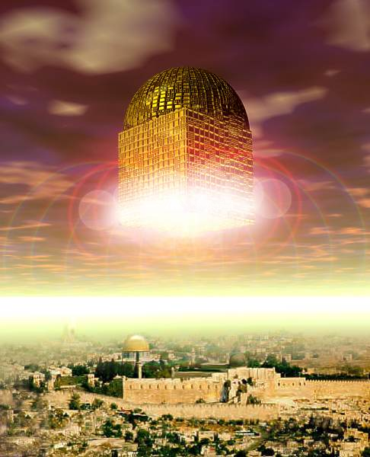
"And I saw the holy city, the new Jerusalem, coming down from God out of heaven like a bride beautifully dressed for her husband"
(21:2 NLT).
181

Slide 50

Why would the New Jerusalem come out of heaven (21:2)?
181

Slide 51
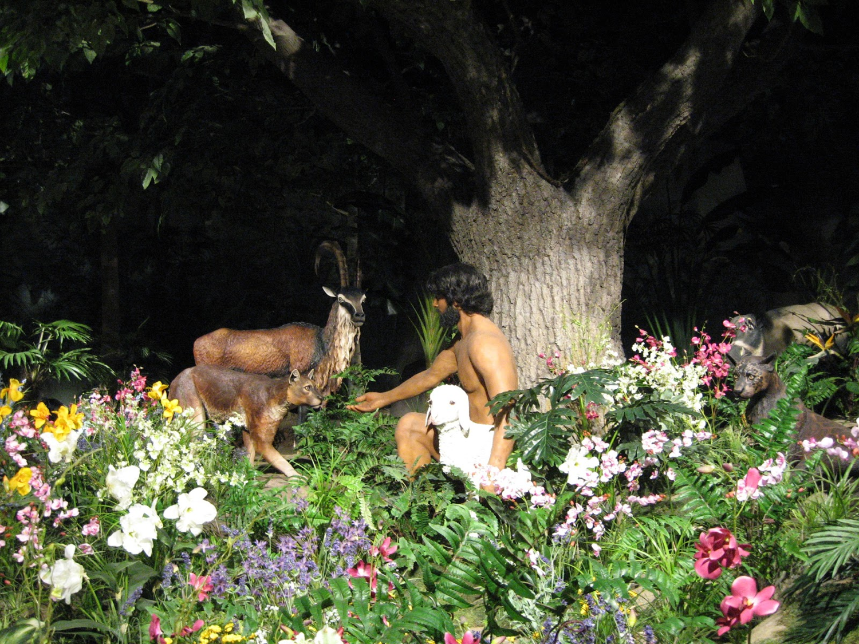
God's presence in Eden

Slide 52
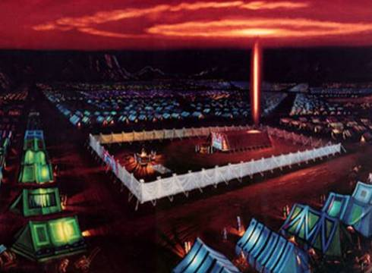
God's presence at the tabernacle

Slide 53
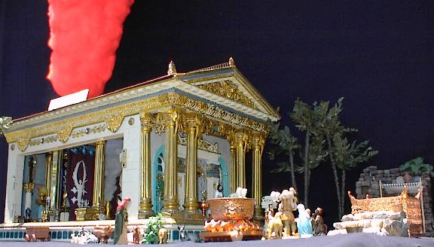
God's presence at the Temple

Slide 54


"…as a bride, beautifully dressed for her husband…"

Slide 55
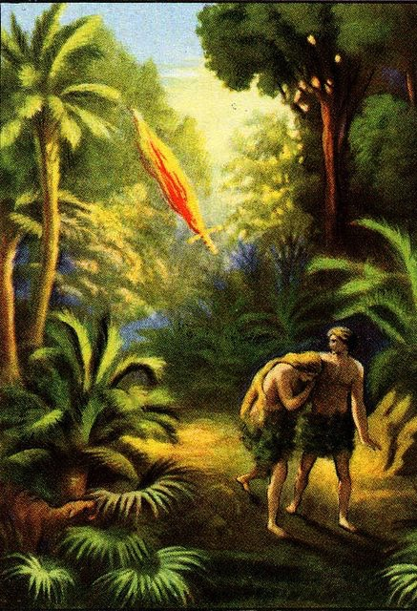

The Consummation of All Things
175
Genesis 1–3
Revelation 20–22
Fellowship with God broken
(3:8-10)
Fellowship with God resumed
(21:3)

Slide 56
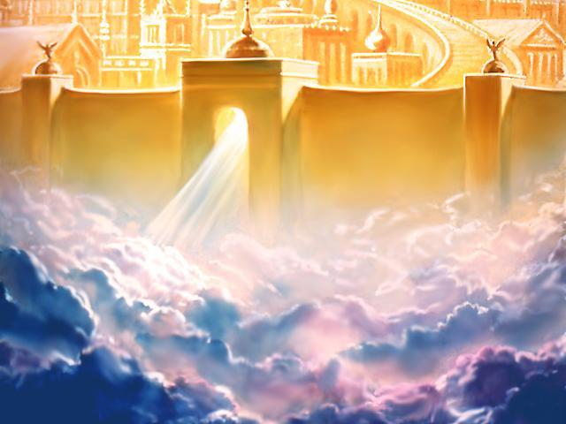
"I heard a loud shout from the throne, saying, 'Look, God's home is now among his people! He will live with them, and they will be his people. God himself will be with them'"
(21:3 NLT).
448

Slide 57

Not Earth to Heaven, but Heaven to Earth
174b

Slide 58
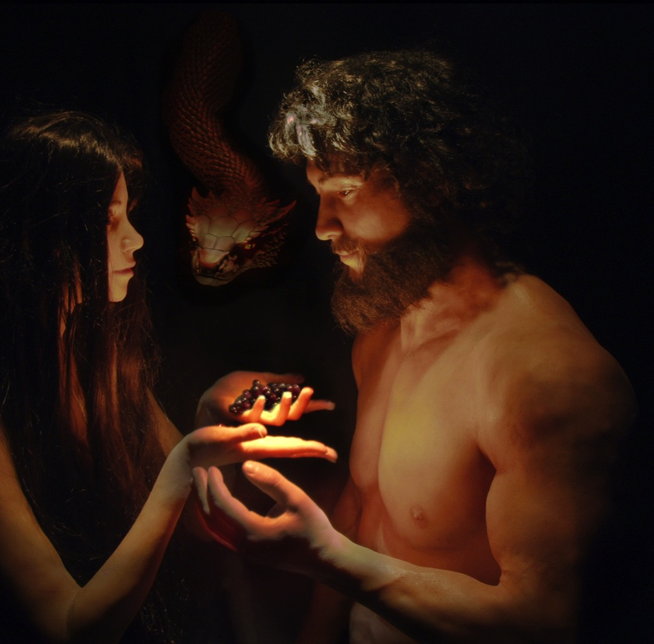

The Consummation of All Things
175
Genesis 1–3
Revelation 20–22
"In the day you eat of it you will surely die" (2:17)
"There will be no more death"
(21:4)
"I will greatly multiply your sorrow" (3:16)
"There will be no more... sorrow or crying or pain" (21:4)

Slide 59

We all experience death now

Slide 60

Sorrow is part of life now

Slide 61

The Consummation of All Things
175
Genesis 1–3
Revelation 20–22
"I will greatly multiply your sorrow" (3:16)
"There will be no more... sorrow or crying or pain" (21:4)

Slide 62
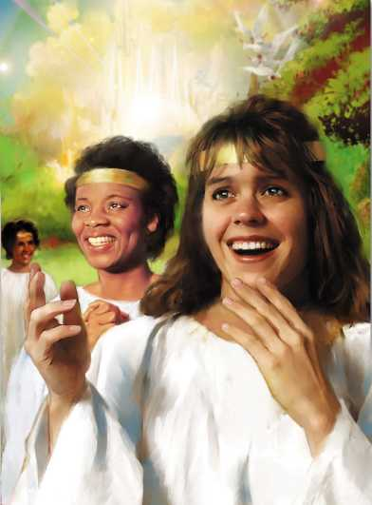
"He will wipe every tear from their eyes, and there will be no more death or sorrow or crying or pain. All these things are gone forever"
(21:4 NLT).
340
448

Slide 63
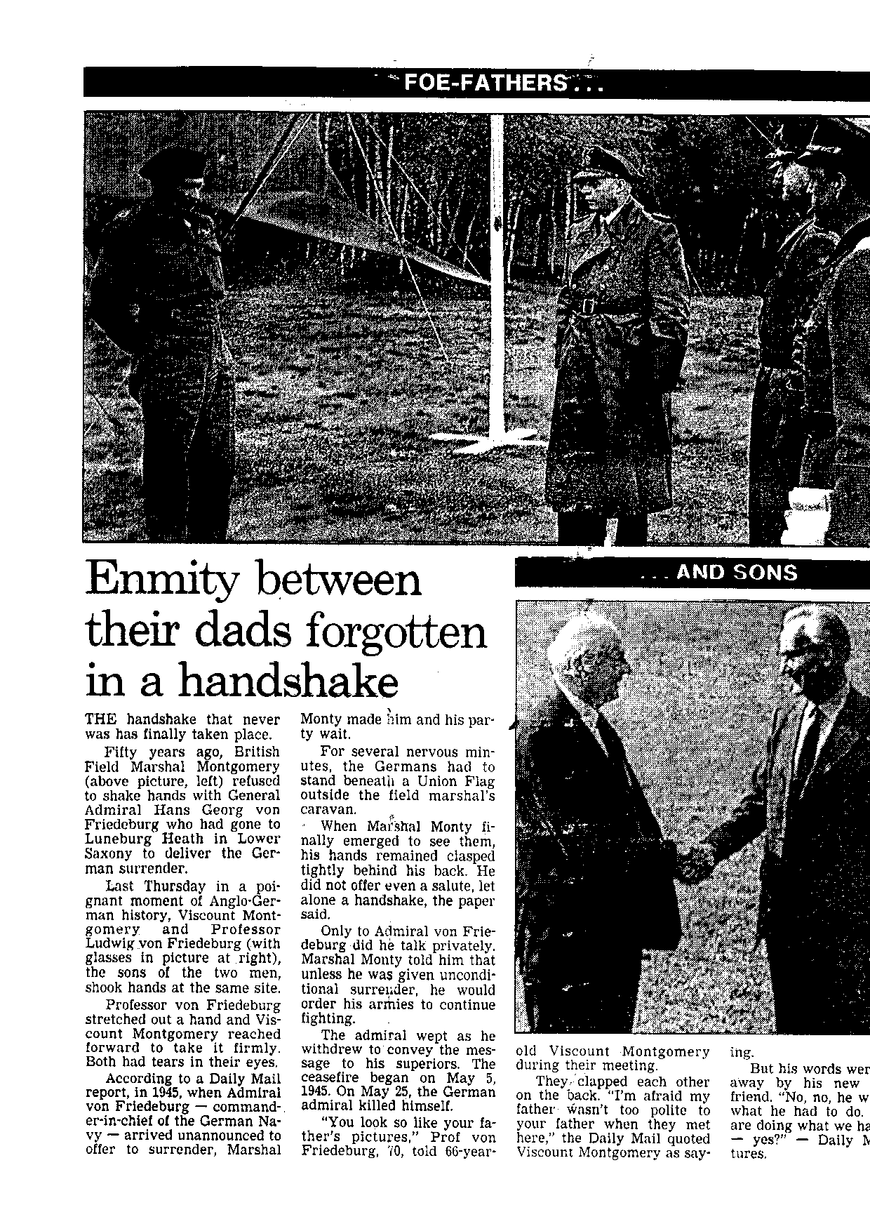
Heaven Will Have Sins Forgiven
FOE FATHERS (1945)

Slide 64
Heaven Will Have Sins Forgiven!
FOE FATHERS
Enmity between their dads forgotten in a handshake
… AND SONS (1995)

Slide 65
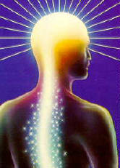
We will have glorified bodies!

Slide 66
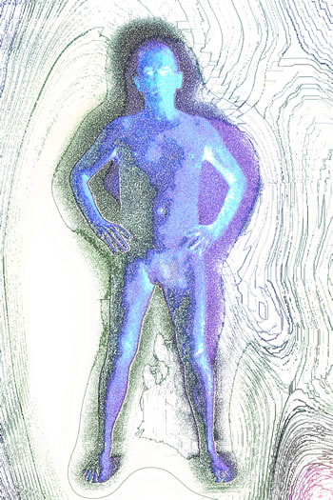
So what will our glorified bodies be like?
187

Slide 67
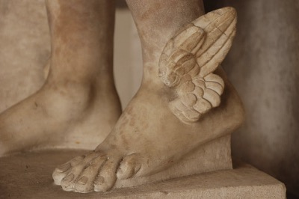
Greeks believed that Mercury could fly
187

Slide 68

Our bodies will be like Christ's body!
188

Slide 69
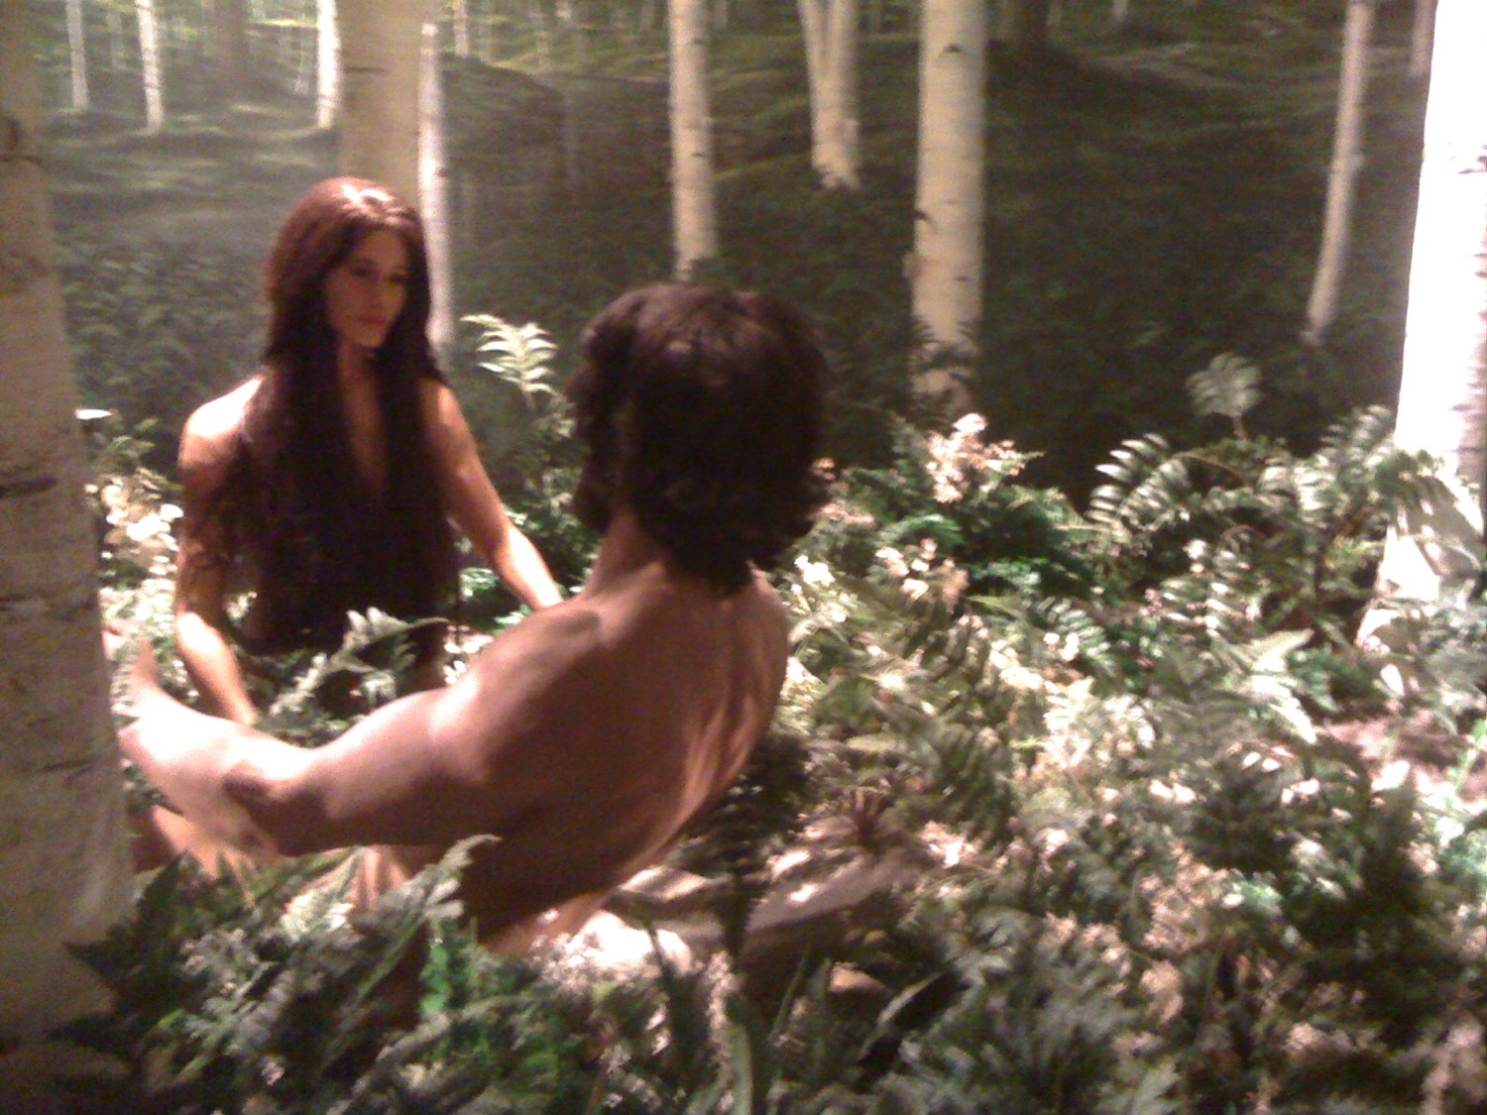
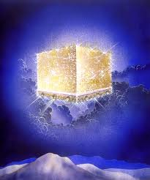
The Consummation of All Things
175
Genesis 1–3
Revelation 20–22
Husband and wife (2:18-25)
Lamb and bride (19:6-9; 21:9-10)

Slide 70
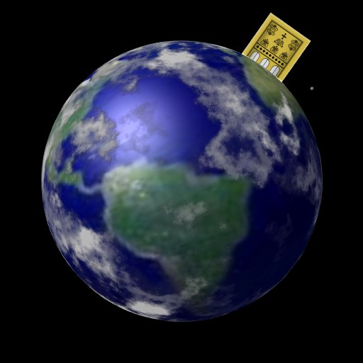
Sitting on the Earth?
184

Slide 71
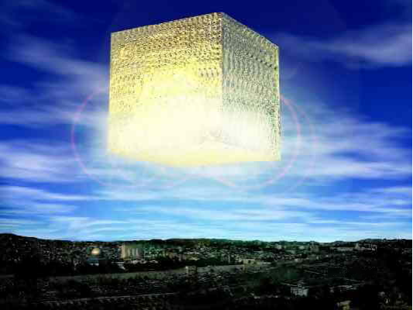
The Cubed City
184

Slide 72
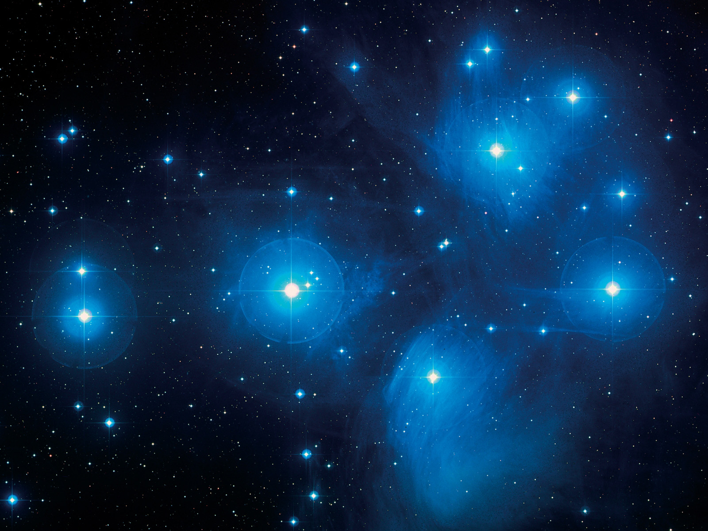
The New Jerusalem
460

Slide 73
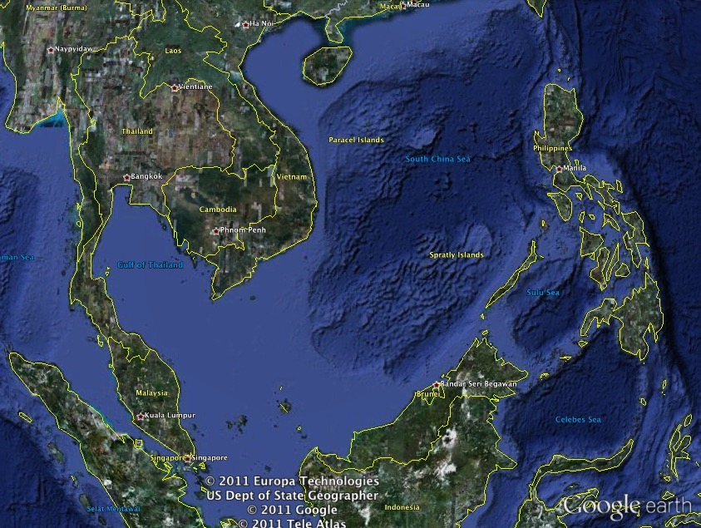
The New Jerusalem & SE Asia
460
2200 km
2200 km
2200 km
2200 km

Slide 74
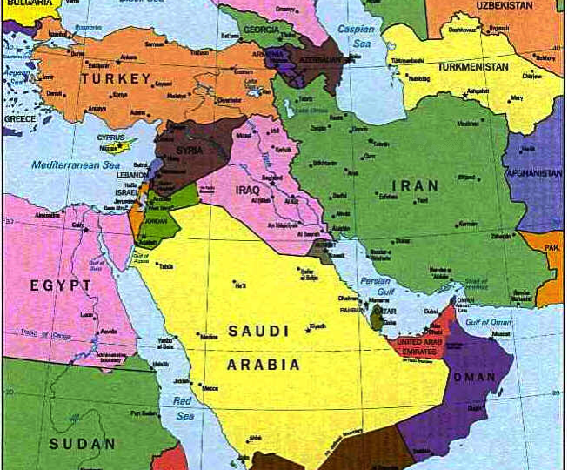
The New Jerusalem over present Jerusalem
190

Slide 75
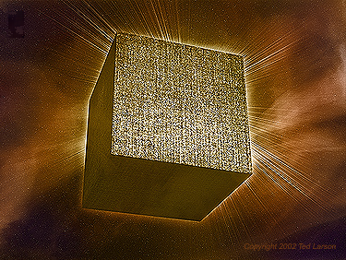
Figurative or Literal?
180

Slide 76
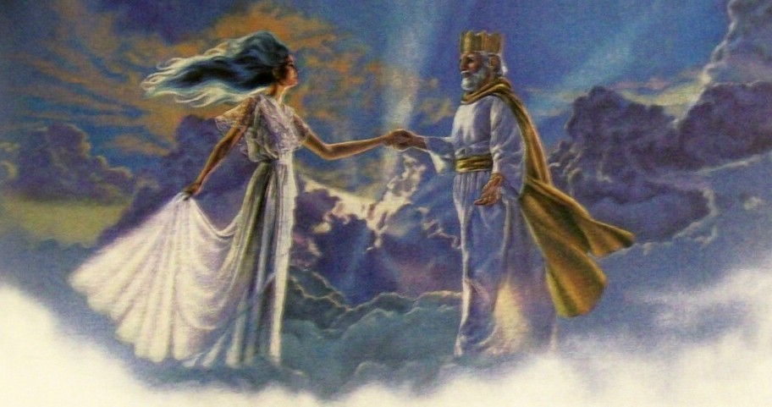
Is the New Jerusalem the Church?

Slide 77
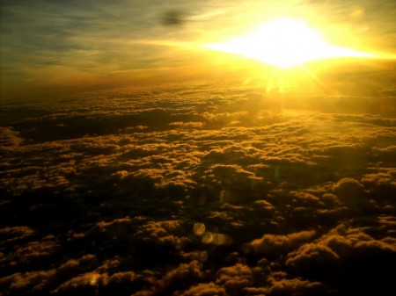
New Jerusalem = The Church?
The city is described as a "bride beautifully dressed for her husband" (21:2; see also vv. 9-10). Since the term "bride" often refers to the church (Isa. 54:5; Eph. 5:32; etc.), it would seem so here too (Hendriksen, 199).
"Even in the Old Testament the Church is represented under the symbolism of a city (Isa. 26:1; Ps. 48; etc.)" (Hendriksen, 199).

Slide 78
The New Jerusalem
The church is never called the bride of Christ in the NT.
Verses 9-10 denote the "bride" or "wife" as the new Jerusalem itself—not the church
180

Slide 79
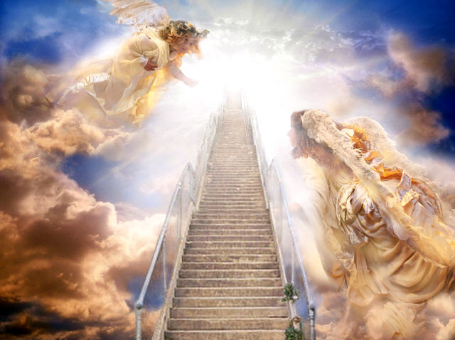
"Then one of the seven angels who held the seven bowls containing the seven last plagues came and said to me, 'Come with me! I will show you the bride, the wife of the Lamb'" (21:9 NLT).

Slide 80


The City Descending
(21:10-11 NLT)
"So he took me in the Spirit to a great, high mountain, and he showed me the holy city, Jerusalem, descending out of heaven from God. ¹¹It shone with the glory of God and sparkled like a precious stone—like jasper as clear as crystal."

Slide 81
The Consummation of All Things
175
Genesis 1–3
Revelation 20–22
Husband and wife (2:18-25)
Lamb and bride (19:6-9; 21:9-10)

Slide 82
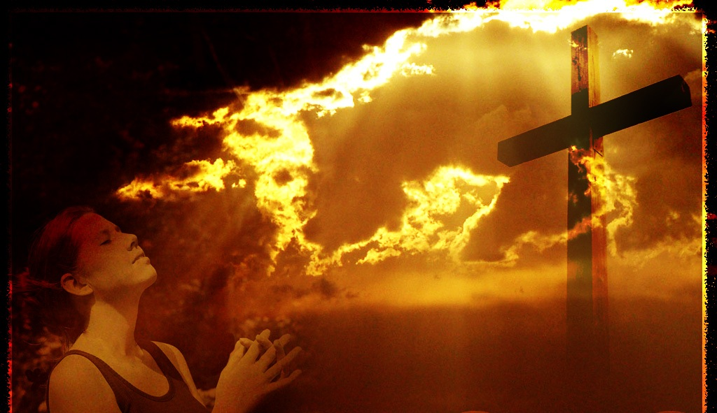
New Jerusalem Citizens
Hebrews 12:22-23 (NAU)
"But you have come to Mount Zion and to the city of the living God, the heavenly Jerusalem, and to
myriads of angels,
to the general assembly
and church of the firstborn who are enrolled in heaven,
and to God, the Judge of all,
and to the spirits of the righteous made perfect"

Slide 83

Everything New!
(21:5-7 NLT)
"And the one sitting on the throne said, 'Look, I am making everything new!' And then he said to me, 'Write this down, for what I tell you is trustworthy and true.' ⁶And he also said, 'It is finished! I am the Alpha and the Omega—the Beginning and the End. To all who are thirsty I will give freely from the springs of the water of life. ⁷All who are victorious will inherit all these blessings, and I will be their God, and they will be my children.'"

Slide 84

Those Excluded
(21:8 NLT)
"But cowards, unbelievers, the corrupt, murderers, the immoral, those who practice witchcraft, idol worshipers, and all liars—their fate is in the fiery lake of burning sulfur. This is the second death."

Slide 85
The 2200-kilometer cube will recall God's presence in the Holy of Holies (21:15-16).
190

Slide 86

The Holy of Holies in the tabernacle and temple was a perfect cube
190

Slide 87

Over the USA
190

Slide 88

It will be lit by the glory of God (21:22-27)!
"I saw no temple in the city, for the Lord God Almighty and the Lamb are its temple" (21:22 NLT).

Slide 89


The Consummation of All Things
175
Genesis 1–3
Revelation 20–22
"God made two great lights" (sun and moon; 1:16)
"The city does not need the sun or the moon" (21:23)

Slide 90

And the city has no need of sun or moon, for the glory of God illuminates the city, and the Lamb is its light
(21:23 NLT).
175

Slide 91


The Consummation of All Things
175
Genesis 1–3
Revelation 20–22
"The darkness He called night" (1:5)
"There will be
no night there"
(21:25; 22:5)

Slide 92

Foundations of the City
(21:12-21)
Used with permission

Slide 93












Foundation Stones (21:19-20)
185
Emerald
Beryl
Amethyst
Agate
Chrysolite
Jacinth
Sapphire
Carnelian
Chrysoprase
Jasper
Onyx
Topaz

Slide 94

High Priest Breastpiece
(Exod. 28:15-21 NIV)

Slide 95

High Priest Breastpiece
(Exod. 28:15-21 NIV)
¹⁵"Fashion a breastpiece for making decisions…¹⁷Then mount four rows of precious stones on it. The first row shall be carnelian, chrysolite and beryl; ¹⁸the second row shall be turquoise, lapis lazuli and emerald; ¹⁹the third row shall be jacinth, agate and amethyst; ²⁰the fourth row shall be topaz, onyx and jasper. Mount them in gold filigree settings. ²¹There are to be twelve stones, one for each of the names of the sons of Israel, each engraved like a seal with the name of one of the twelve tribes.

Slide 96












Foundation Stones (21:19-20)
185
NLT
Amethyst
NAU
Amethyst
Jacinth
Jacinth
Chrysoprase
Chrysoprase
Topaz
Topaz
Beryl
Beryl
Chrysolite
Chrysolite
Carnelian
Sardius
Onyx
Sardonyx
Emerald
Emerald
Agate
Chalcedony
Sapphire
Sapphire
Jasper
Jasper

Slide 97

Through the Gate (21:21)
185
Used with permission

Slide 98

Gates from a Single Pearl (21:21)!
185

Slide 99


The Consummation of All Things
175
Genesis 1–3
Revelation 20–22
Satan appears
as deceiver of mankind (3:1)
Satan disappears forever (20:10)
Initial triumph
of the serpent (3:13)
Ultimate triumph
of the Lamb
(20:10; 22:3)
Defilement enters the garden (3:6-7)
Defilement never enters the city (21:27)

Slide 100

No More Sin and Death!
"You sure you're supposed to be doing' that, Mitch?"

Slide 101

"Nothing evil will be allowed to enter, nor anyone who practices shameful idolatry and dishonesty—but only those whose names are written in the Lamb's Book of Life" (21:27 NLT).
175

Slide 102
Slides on
Revelation 22

Slide 103


The Consummation of All Things
175
Genesis 1–3
Revelation 20–22
Trees and rivers (2:8-14)
Tree and river
(22:1-2)

Slide 104

The Consummation of All Things
175
Genesis 1–3
Revelation 20–22
Prohibition from the tree of life (3:24)
Access to the
tree of life (22:14)

Slide 105

The Tree of Life (22:2, 14)

Slide 106


The Consummation of All Things
175
Genesis 1–3
Revelation 20–22
"Cursed is the ground because of you" (3:17)
"No longer will there be any curse" (22:3)

Slide 107


The Consummation of All Things
175
Genesis 1–3
Revelation 20–22
"They will see His face" (22:4)
Man driven from God's presence (3:24)

Slide 108


The Consummation of All Things
175
Genesis 1–3
Revelation 20–22
Man's dominion broken in the fall of the first man, Adam (3:19)
Man's dominion restored in the rule of the new man, Christ (22:5)

Slide 109


The Consummation of All Things
175
Genesis 1–3
Revelation 20–22
First paradise closed (3:23)
New paradise opened (21:25)

Slide 110

The Consummation of All Things
175
Genesis 1–3
Revelation 20–22
First rest for God (2:1-3)
Final rest for man (14:13)

Slide 111

"And there will be no night there—no need for lamps or sun—for the Lord God will shine on them. And they will reign forever and ever" (22:5 NLT).

Slide 112

The Consummation of All Things
175

Slide 113

Other Questions?

Slide 114

Lucy and Snoopy
HMM…
I DON'T THINK YOUR SUBJECT IS SERIOUS ENOUGH.
YOU SHOULD WRITE SOMETHING REALLY THOUGHT-PROVOKING.
WRITE ABOUT SOMETHING THAT HAS BEEN A PUZZLE SINCE THE WORLD BEGAN…
(THINKING)
ARE THERE DOGS IN HEAVEN?

Slide 115

Will there be animals in heaven?
Why not?
We will reign over creation, so why not over animals?
People will no longer need human rulers.

Slide 116

Are there animals in heaven?

Slide 117

Christ and his forces will return on horses (Rev. 19:11)

Slide 118

Heaven is Eternal!
"I think he's missing the whole point!"

Slide 119

Heaven Never Ends!
188

Slide 120

Christ encourages us to live as if he can come any moment (22:7-17).
Blessing!
"I am coming soon!" (22:7)
"Look, I am coming soon! Blessed are those who obey the words of prophecy written in this book" (NLT).

Slide 121

"We will rise to meet Him"
(1 Thess. 4:17)
tachus = "soon" (NLT)?
Imminency = "at any moment"
Notes:
121

Slide 122
Jesus Wins!
Series on Revelation
tachus = "quick, swift, speedy" (BADG; NAU)?

Slide 123
Christ encourages us to live as if he can come any moment (22:7-17).
Blessing!
"I am coming soon!" (22:7)
"I am coming soon!" (22:12)
Reward!

Slide 124

I'm Coming!
(22:12-13 NLT)
"Look, I am coming soon, bringing my reward with me to repay all people according to their deeds. ¹³I am the Alpha and the Omega, the First and the Last, the Beginning and the End."

Slide 125


How would you advertise for Heaven?
A Heavenly Advertisement
Free Beautiful Homes
To Be
Given Away
In a
Perfect City
with––
100% Pure Free Water
No Light Bulbs
Perpetual Lighting
Permanent Gold Pavement
Nothing Undesirable
Everything New
Perfect health
Immunity from Accidents
The Best of Society
Beautiful Music
Free Transportation
Secure a Contract Today—
For the New Jerusalem
188

Slide 126
Where is Heaven?

Slide 127

Where is heaven right now?

Slide 128

Where is heaven right now?

Slide 129

Where is heaven right now?

Slide 130

Heaven is closer than you think!

Slide 131

Traditional versus Biblical Views of Heaven
470

Slide 132

What's True About Heaven?
Tradition
Bible
Judgment
Blessing
We go to heaven
Heaven comes to us
We live with God
God dwells with us
"Heaven"
New heaven & earth
Country living
HDB living
Rest
Service

Slide 133

The Transfiguration

Slide 134

Who goes to heaven?
WELCOME TO HEAVEN. HAVE C.V. READY.
"CV"
means "Christ Victorious"
Hey, what are you trying to pull? This is a RESUME!
There IS a difference.

Slide 135

Will There Be Degrees of Reward in Heaven?
465

Slide 136

Heavenly Greenery
465

Slide 137

Heavenly Landscape?

Slide 138
City Life for Eternity?

Slide 139

A City of Gold

Slide 140

"'Yes! I am coming soon!'
Amen! Come, Lord Jesus!
The grace of the Lord Jesus be with God's people. Amen"
(22:20-21 NIV).

Slide 141

How can we sum up the
New Heaven,
New Earth &
New Jerusalem?

Slide 142

Main Idea:
Christ living with us
encourages us to live for Christ

Slide 143

Do you focus on God's presents or God's presence?

Slide 144

I. God will once again live with man (21:1–22:6).

Slide 145

II. Live in light of the end (22:7-21).

Slide 146


Come to the Water!
"The Spirit and the bride say, 'Come.' Let anyone who hears this say, 'Come.' Let anyone who is thirsty come. Let anyone who desires drink freely from the water of life"
(22:17).
Notes:
146
God the Spirit invites you.
The Church invites you.
Anyone who hears this also invites you.
Invites you to what?
Every one of us is invited to believe in Jesus Christ under the image of freely drinking from water that grants eternal life.
Do you want eternal life? Then come in belief.

Slide 147

Do you long for Christ's return?
Why or why not?

Slide 148
Black

Slide 149


Future (Eschatology) link at BibleStudyDownloads.org
Get this presentation for free!
Notes:
OT Survey (os)

