Slide 1

Hell
163
The Subject I'd Rather Not Teach
Dr. Rick Griffith • Jordan Evangelical Theological Seminary • BibleStudyDownloads.org

Slide 2

What Do You Think of…
162
Heaven?
and Hell?

Slide 3
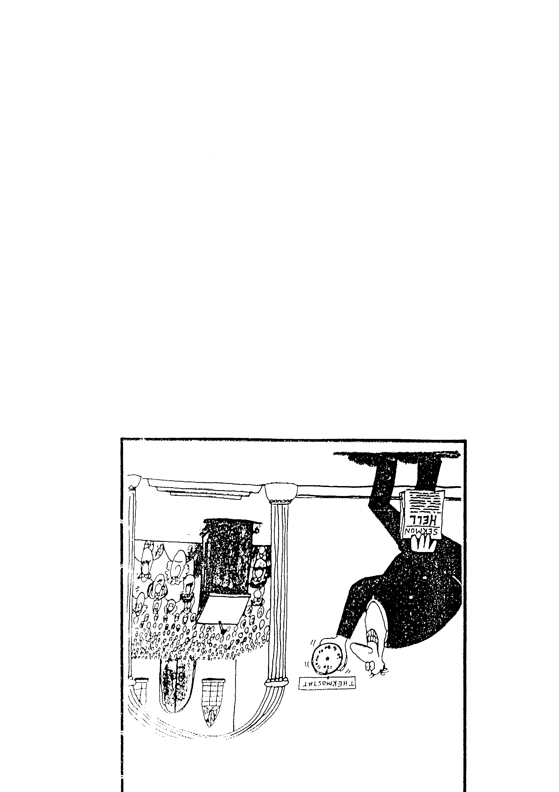
Sermon
THERMOSTAT
THERMOSTAT
SERMON:
HELL

Slide 4
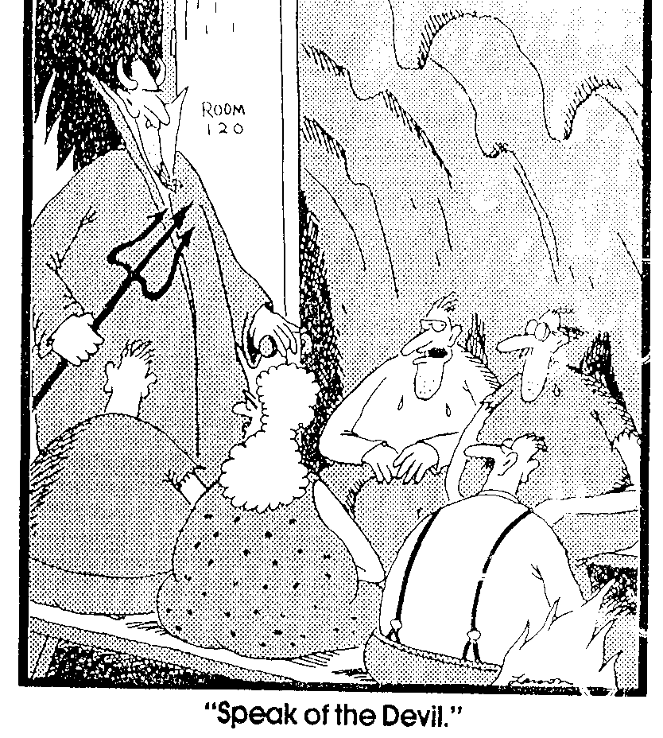
"Speak of the Devil."
Room
120

Slide 5
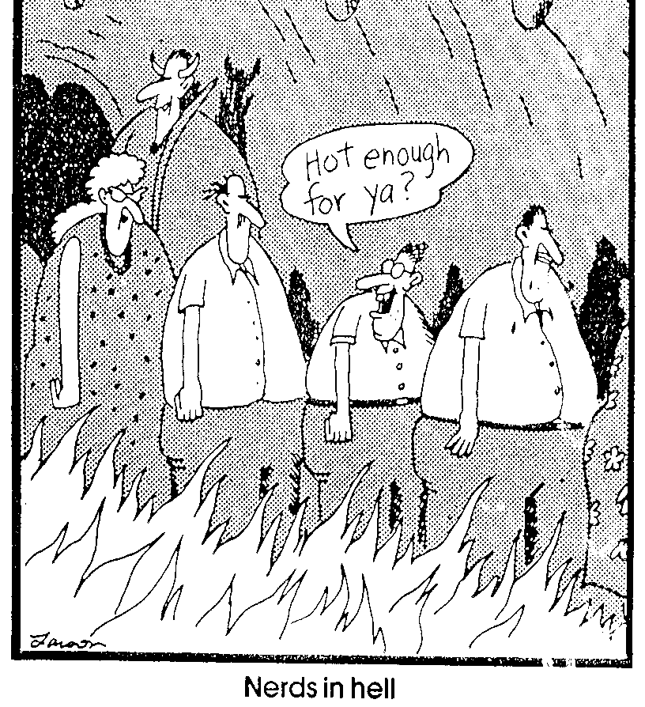
Nerds in Hell
Hot enough for ya?

Slide 6

S

Slide 7
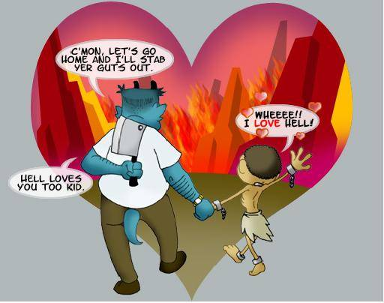
Some even love hell?
C’MON, LET’S GO HOME AND I’LL STAB YOUR GUTS OUT.
WHEEEE!!
I LOVE HELL!
HELL LOVES YOU TOO KID.
Notes:
Some even love hell?

Slide 8
Hell: What if it's Real?
Notes:
tomstyle.com/ archive/hell.jpg

Slide 9
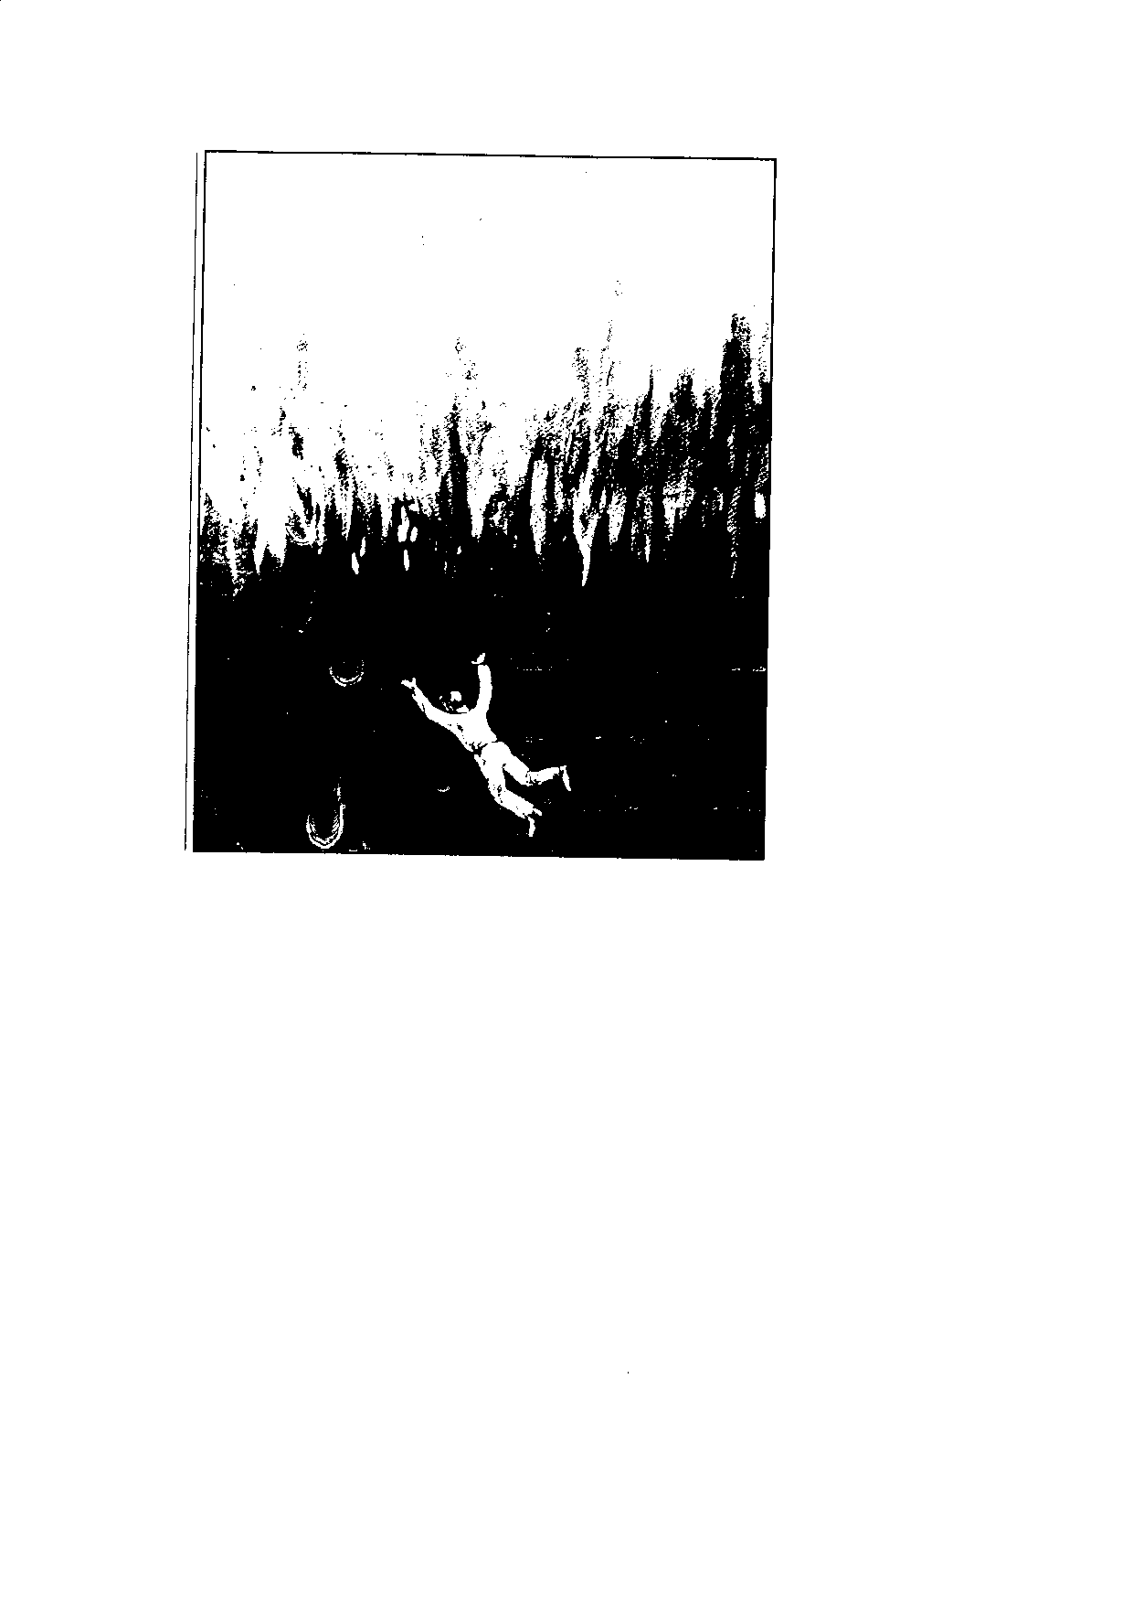
"If anyone's name was not found written in the book of life, that person was thrown into the lake of fire"
(Rev. 20:15 NET Bible)

Slide 10
Attacks on Hell
163
Universalism
Annihilationism
Purgatory

Slide 11
Universalism
163
What is it?
Arguments cited
Rebuttals

Slide 12


Recent Universalism
Notes:
http://www.cbn.com/cbnnews/us/2011/april/love-wins-pastor-caught-off-guard-by-controversy/
‘Love Wins’ Pastor Caught Off Guard by Controversy
By Crystal Woodall CBN News Internet Producer
Sunday, April 10, 2011
Print 35 Comment(s)
Ad Feedback
Evangelical megachurch pastor Rob Bell says he was caught off guard by the condemnation his new book has received from leaders in the Christian community.
Standing before an audience of about 1,600 at Nashville's Belmont University, Bell said the last several weeks had been the "most painful" of his life.
"It has taken me to a place of profound brokenness," said Bell, who pastors the 10,000-member Mars Hill Bible Church in Grand Rapids, Mich.
Love Wins: Heaven, Hell, and the Fate of Every Person Who Ever Lived, released March 29, challenges the traditional Christian belief that few will enter Heaven.
"Will only a few select people make it into Heaven and will billions of people burn forever in Hell?" Bell asks in a promotional video of his book, recently released by publisher HarperOne. "And if that's the case, how do you become one of the few?" Watch the video here.
Bell insists it was never his intent to stir controversy, but to bring focus back to a message he suggests has got lost in dogma -- the love of God.
"I kept meeting religious people who were incredibly dogmatic about heaven and hell when you die but didn't seem to care about the fact that 8 million people will go to bed hungry tonight," Bell explained.
Bell denies charges that his book promotes a universalist theology - the belief that everyone, regardless of belief, will be saved by God.
"No, if by universalist we mean there's a giant cosmic arm that swoops everybody in at some point whether you want to be there or not," he told The Christian Post.
"That violates the laws of love and love is about freedom," he explained. "It's about choice; it's about do you want to be there? Because that's what would make it heaven."
According to the Associated Press, Bell says hell is something freely chosen that already exists on earth.
"Apparently this is a pastor who has written a book who has grown uncomfortable contending for the faith," CBN chaplain and Regent University theology professor Joel Palser said. "He is no longer able to defend what the Bible says and has endeavored to make that more palatable to modern culture."
"It may be trendy and it might sell a lot of books, but in fact Jesus speaks very clearly about heaven and hell," Palser added.

Slide 13

Of his 10,000-member Grand Rapids Mars Hill Bible Church, 3000 left after the book, then Bell himself left for California to run a "faith-inflected talk show"
Notes:
http://www.cbn.com/cbnnews/us/2011/april/love-wins-pastor-caught-off-guard-by-controversy/
‘Love Wins’ Pastor Caught Off Guard by Controversy
By Crystal Woodall CBN News Internet Producer
Sunday, April 10, 2011
Print 35 Comment(s)
Ad Feedback
Evangelical megachurch pastor Rob Bell says he was caught off guard by the condemnation his new book has received from leaders in the Christian community.
Standing before an audience of about 1,600 at Nashville's Belmont University, Bell said the last several weeks had been the "most painful" of his life.
"It has taken me to a place of profound brokenness," said Bell, who pastors the 10,000-member Mars Hill Bible Church in Grand Rapids, Mich.
Love Wins: Heaven, Hell, and the Fate of Every Person Who Ever Lived, released March 29, challenges the traditional Christian belief that few will enter Heaven.
"Will only a few select people make it into Heaven and will billions of people burn forever in Hell?" Bell asks in a promotional video of his book, recently released by publisher HarperOne. "And if that's the case, how do you become one of the few?" Watch the video here.
Bell insists it was never his intent to stir controversy, but to bring focus back to a message he suggests has got lost in dogma -- the love of God.
"I kept meeting religious people who were incredibly dogmatic about heaven and hell when you die but didn't seem to care about the fact that 8 million people will go to bed hungry tonight," Bell explained.
Bell denies charges that his book promotes a universalist theology - the belief that everyone, regardless of belief, will be saved by God.
"No, if by universalist we mean there's a giant cosmic arm that swoops everybody in at some point whether you want to be there or not," he told The Christian Post.
"That violates the laws of love and love is about freedom," he explained. "It's about choice; it's about do you want to be there? Because that's what would make it heaven."
According to the Associated Press, Bell says hell is something freely chosen that already exists on earth.
"Apparently this is a pastor who has written a book who has grown uncomfortable contending for the faith," CBN chaplain and Regent University theology professor Joel Palser said. "He is no longer able to defend what the Bible says and has endeavored to make that more palatable to modern culture."
"It may be trendy and it might sell a lot of books, but in fact Jesus speaks very clearly about heaven and hell," Palser added.

Slide 14
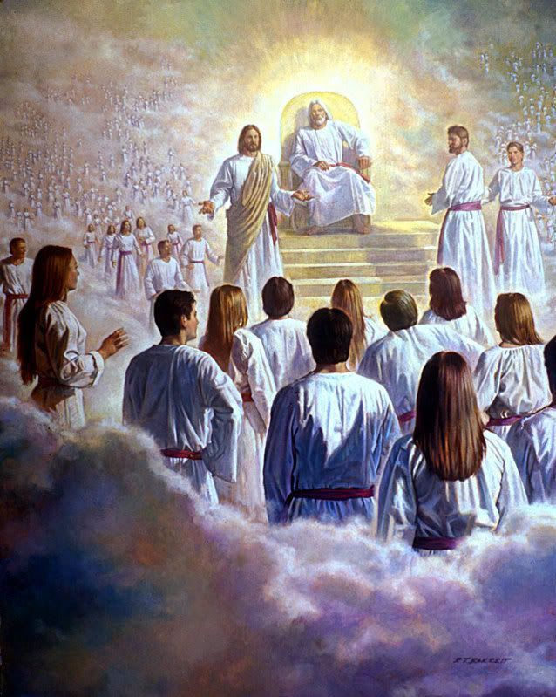
"Then I saw a great white throne…"
(20:11)

Slide 15
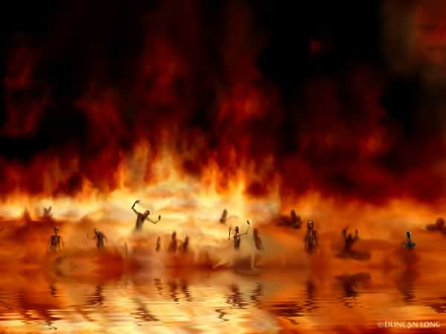
The Lake of Fire (20:14-15)

Slide 16

Annihilationism
164
What is it?
Arguments cited
Rebuttals

Slide 17

Annihilationist Groups
164
Seventh-Day Adventists
Jehovah's Witnesses
Some "Evangelicals"?

Slide 18

Annihilationist Arguments
164
Rebuttals
God is too nice to send people to eternal hell
God is absolutely just and holy
"Destruction" implies annihilation
"Destruction" refers to physical death

Slide 19
Church of England Report, January 1996
"Hell as ultimate non-being is the way in which we've put it. The horrible demons are the imaginations of inventors and medievalists."
Bishop John Taylor
One of the authors of the report

Slide 20

Purgatory
167
What is it?

Slide 21
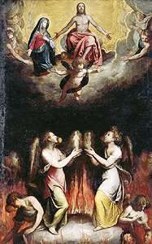
Arguments Cited for Purgatory
167
"Not good enough for heaven but not bad enough for hell"
2 Maccabees

Slide 22
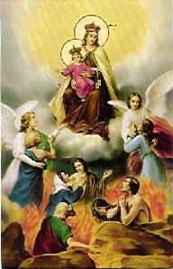
Rebuttals to Purgatory
167
Salvation by works
Apocrypha
No second chance

Slide 23
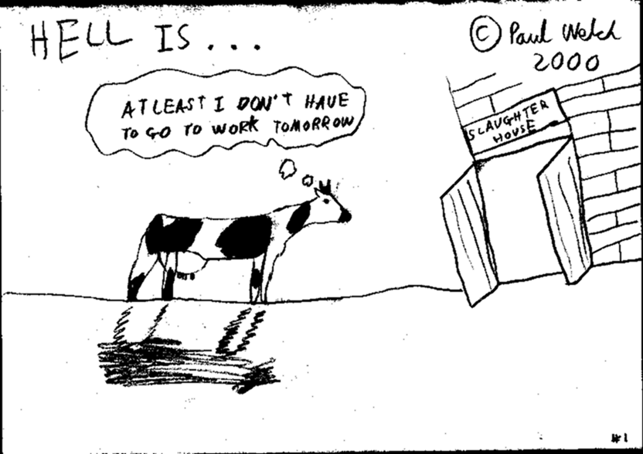
Purgatory?
Or Annihilationism?
HELL IS…
AT LEAST I DON’T HAVE TO GO TO WORK TOMORROW
SLAUGHTER HOUSE

Slide 24

Why study and teach about hell?
171

Slide 25
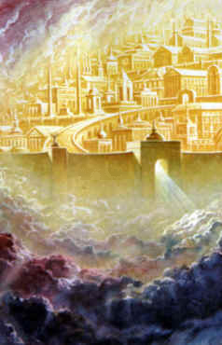

What's the Difference?
Grace
Mercy
…is God
giving us
what we
do not
deserve
…is God
not giving us
what we
do
deserve

Slide 26
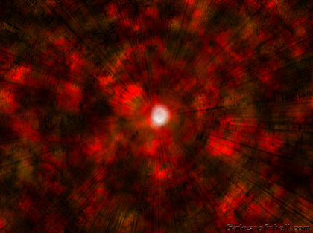
Where is Hell?

Slide 27

Gates of Hell
171

Slide 28
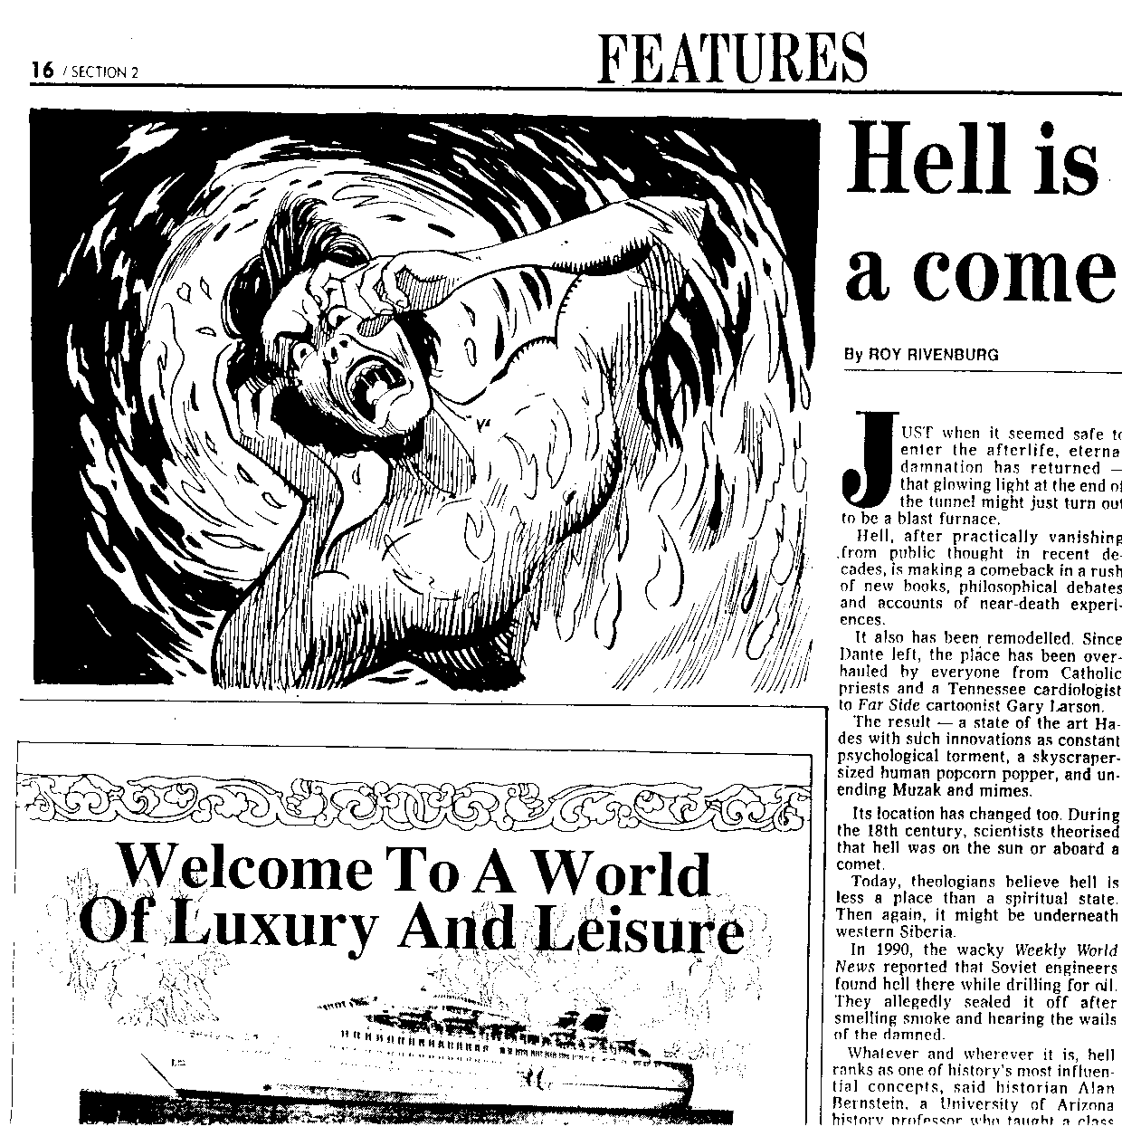
Hell is Making a Comeback
Monday January 24, 1994 THE STAR
"It exists but it's not a place," said Biola University philosophy professor J.P. Moreland, co-author of Immortality: The Other Side of Death. "It's like numbers. They're real, but no one knows where they are."
Notes:
Monday January 24, 1994 THE STAR
(Malaysia)

Slide 29
What is Hell Like?
171
Eternal (Matt. 25:46; 2 Thess. 1:8-9; 1 Cor. 1:18; 4:3; Heb. 2:3)
Eternal consumption by worms (Mark 9:47-48)
Total Separation from God's Presence
(2 Thess. 1:9)
Outer Darkness (Matt. 8:12; 25:30; 2 Peter 2:17; Jude 13; cf. 1 Enoch 102:8; Ps. Sol. 14:9)
Unquenchable fire (Matt. 5:22; 18:8-9; 25:41; Mark 9:47-48; Luke 16:24; James 3:6; Jude 7; Rev. 20:14-15; cf. Exod. 3:1-6; Sib. Or. 4:40-44)

Slide 30
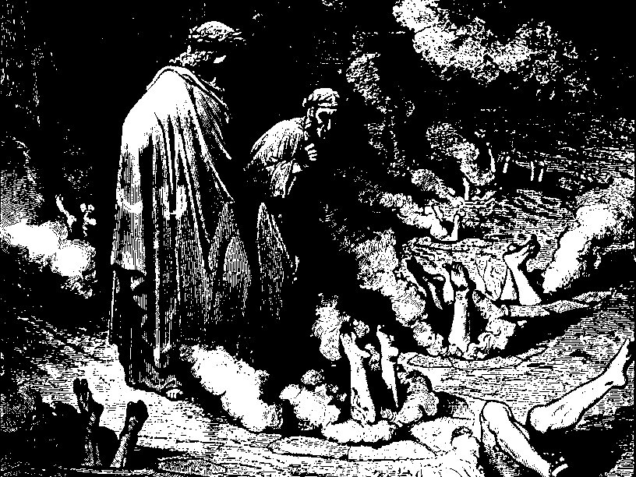
Classical View of Hell
Notes:
Paul Lee Tan, 194

Slide 31

There is no boss there!
172
Point c
Notes:
http://plaza.ufl.edu/bigjay/Vision%20of%20Hell.jpg

Slide 32

Literal or Figurative Fire?
172
Point e

Slide 33
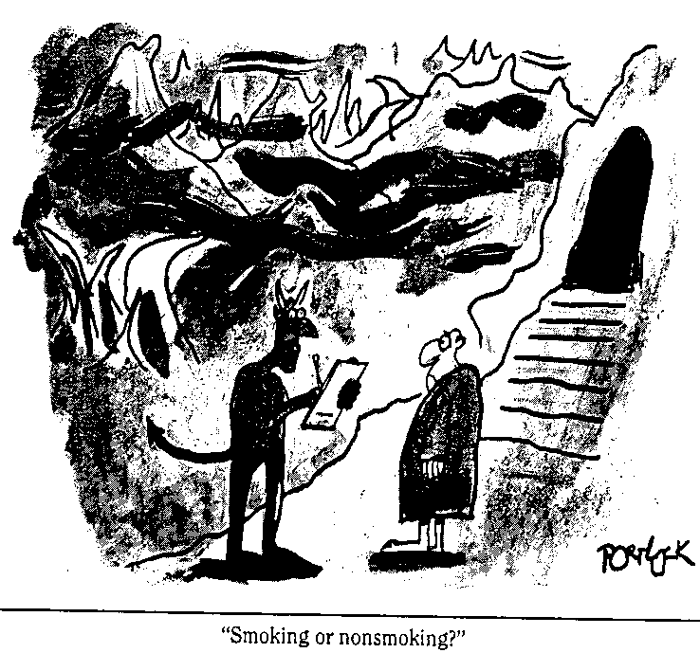
Degrees of Punishment in Hell?
172
Point f
"Smoking or non-smoking?"

Slide 34
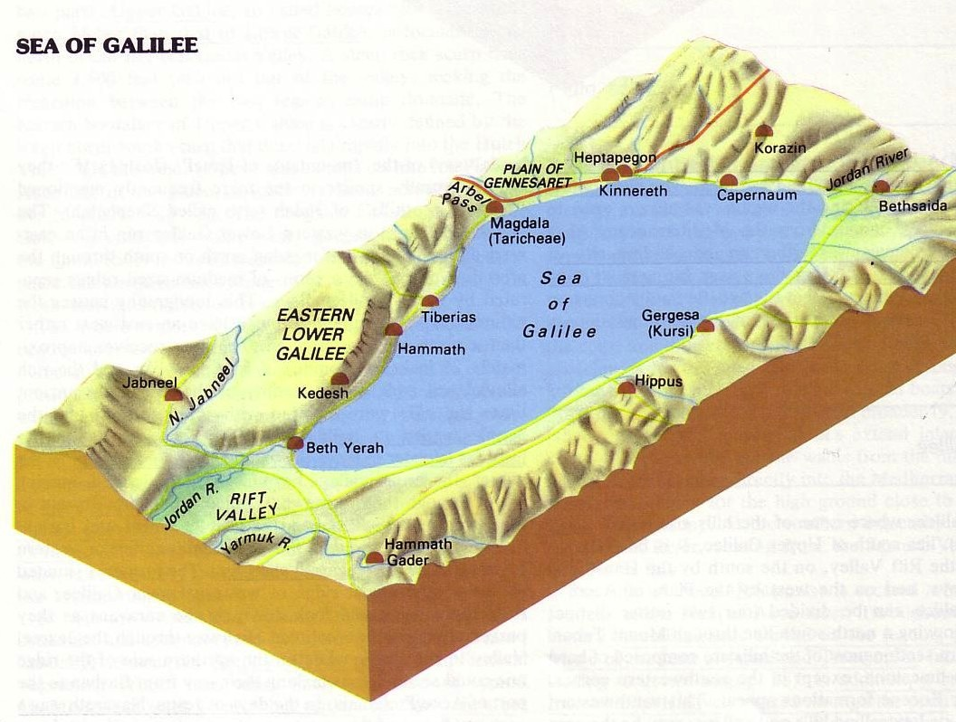

The Tri-City Area
172
Point f
Then Jesus began to denounce the cities in which most of his miracles had been performed, because they did not repent.
"Woe to you, Korazin! Woe to you Bethsaida!
If the miracles that were performed in you had been performed in Tyre and Sidon, they would have repented long ago in sackcloth and ashes. But I tell you, it will be more bearable for for Tyre and Sidon on the day of judgment than for you.
And you, Capernaum, will you be lifted up to the skies? … It will be more bearable for Sodom on the day of judgment than for you."
Matthew 11:20-24

Slide 35

One of the worst things about hell is a memory.
172
Point i

Slide 36
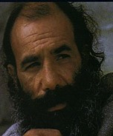
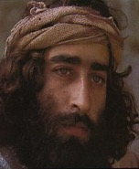
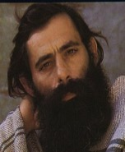

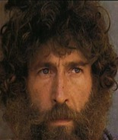
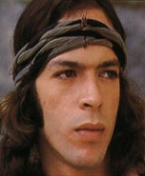
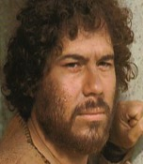
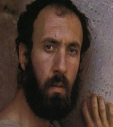
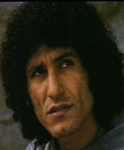

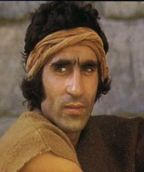
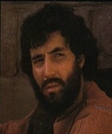












Who will go to hell?
Those who reject Christ
James
Thaddeus
John
Peter
Andrew
Judas
Bartholomew
James bar Alphaeus
Thomas
Matthew
Simon the Zealot
Philip

Slide 37

God's Wrath (Romans 1:18-20)
The Reality (18a)
The Reason (18b-20a)
The Result (20b)

Slide 38

Romans 1:20
173
Person who is Limitless
Person who is Supernatural
For since the creation of the world God's invisible qualities—his eternal power and divine nature—have been clearly seen, being understood from what has been made, so that men are without excuse (NIV).

Slide 39


Why God is Angry at Gentiles
(1:21-32)
Ignore God (21-23)
God gave them over
Impurity (24)
Idolatry (25)
God gave them over
Homosexuality (26-27)
God gave them over
Depravity (28-32)

Slide 40
Which Will We Believe?
174a
Tradition
Bible
Man dwells with the devil

Slide 41
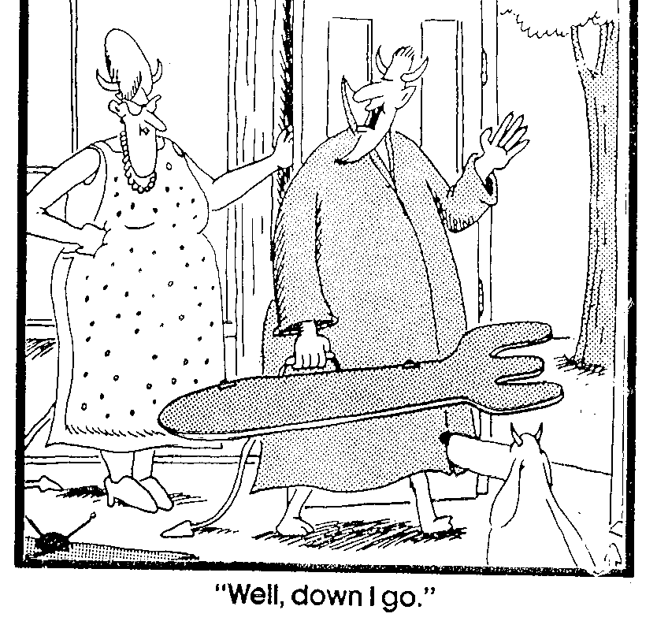
"Well, down I go."

Slide 42
Which Will We Believe?
174a
Tradition
Bible
Man dwells with the devil—the boss
Man is alone (Luke 13:28)
"At least my friends
will be there"
Yes, but you won't see them (Luke 13:28)
Bodies suffer mild discomfort
Bodies suffer from burning sulfur and consumption by worms (Mark 9:47-48; Rev. 21:8)

Slide 43
Which Will We Believe?
174a
Tradition
Bible
Satan is tormenter over all in Hell
Satan in torment with those tormented (Rev. 20:10)
A place of solid earth
A lake (Rev. 20:10)
People alone suffer
Demons too (2 Pet. 2:4)
Satan rules with pitchfork
Satan thrown into Hell with no emblems of dominion (Rev. 20:10)

Slide 44
Black

Slide 45


Future (Eschatology) at BibleStudyDownloads.org
Get this presentation for free!
Notes:
Future (fu)
Eschatology

