Slide 1
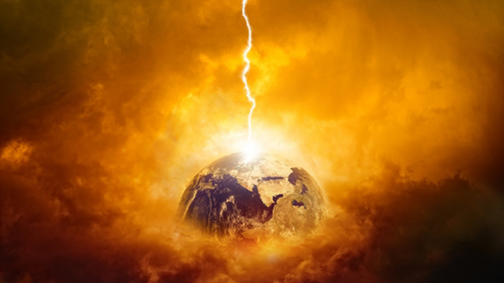
Resurrections & Judgments
160
Receiving new bodies
To be held accountable
Dr. Rick Griffith • Jordan Evangelical Theological Seminary • BibleStudyDownloads.org

Slide 2

Will there be only one?
160
"On that
Great
Judgment Day"

Slide 3
John 5:28-29 (NIV)
160
"Do not be amazed at this, for a time is coming when all who are in their graves will hear his voice ²⁹and come out-- those who have done good will rise to live, and those who have done evil will rise to be condemned."
But do these verses teach that these resurrections of both the righteous and wicked will occur at the same time?

Slide 4
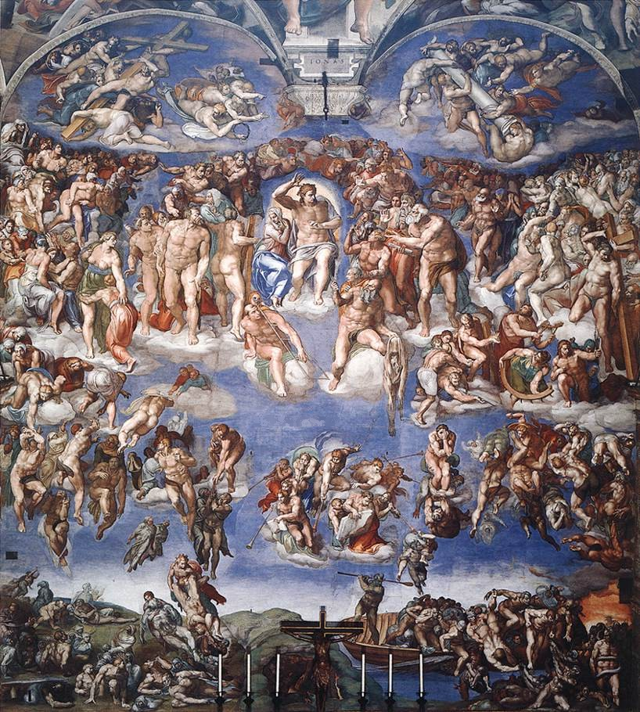
The Final Judgment
160
Is there one general judgment as depicted by Michelangelo?
Sistine Chapel, 1541

Slide 5
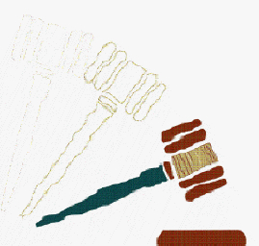
Yet Scripture prophesies seven more future judgments…
160
Sound strange?

Slide 6
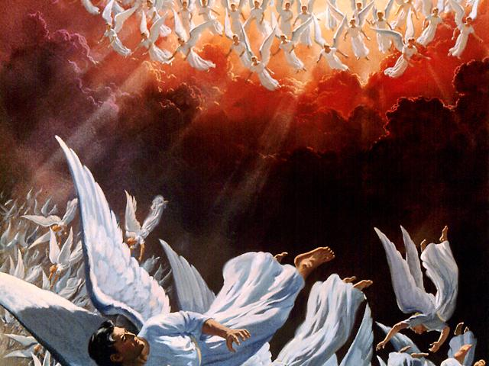
Lucifer & demons judged (2 Pet. 2:4; Jude 6)

Slide 7
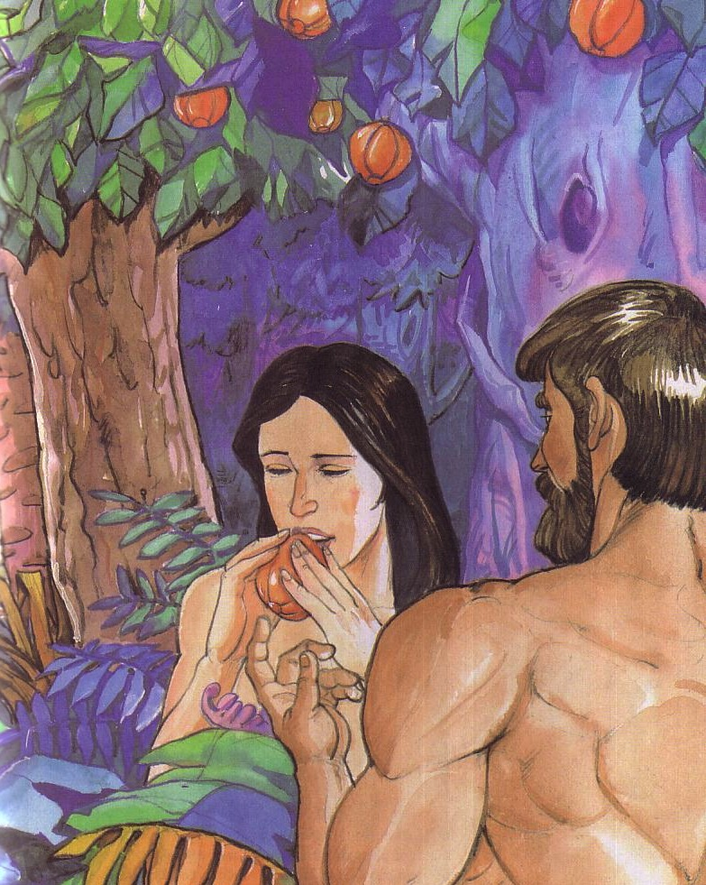
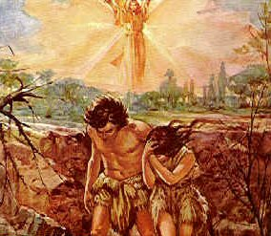
Sin in Eden
160
Genesis 3

Slide 8
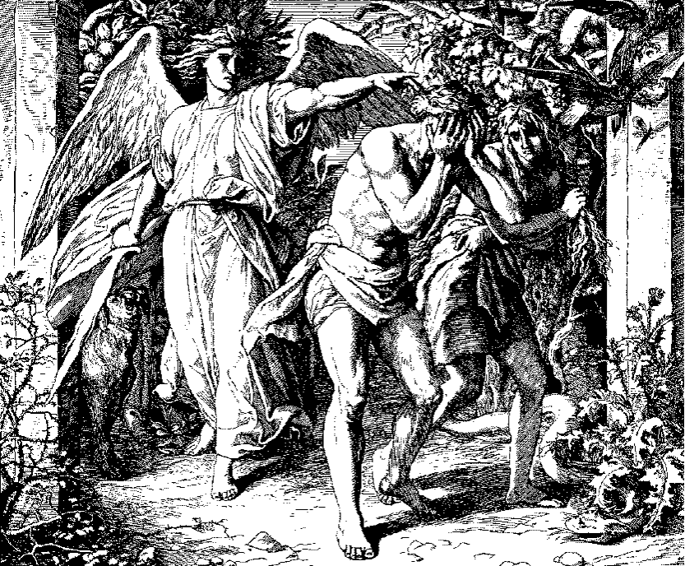
Expelled from Eden

Slide 9
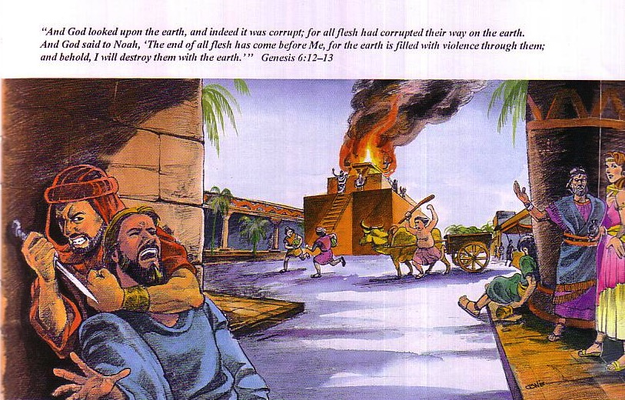
Judgment at the Flood
160
God saw how corrupt the earth had become, for all the people on earth had corrupted their ways. ¹³So God said to Noah, "I am going to put an end to all people, for the earth is filled with violence because of them. I am surely going to destroy both them and the earth" (Gen. 6:12-13).

Slide 10
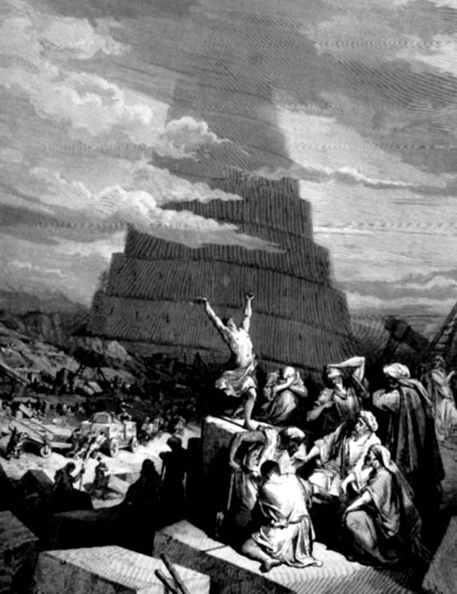
God again judged man's base heart at Babel
160
Genesis 11

Slide 11
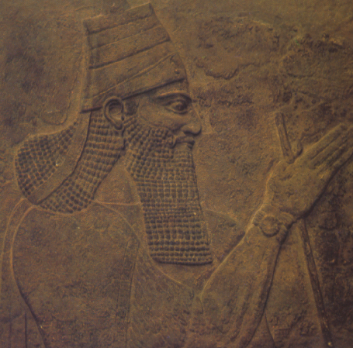
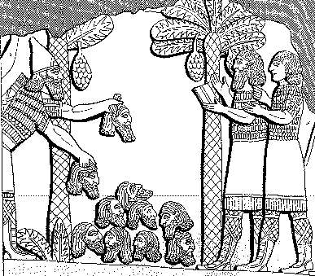
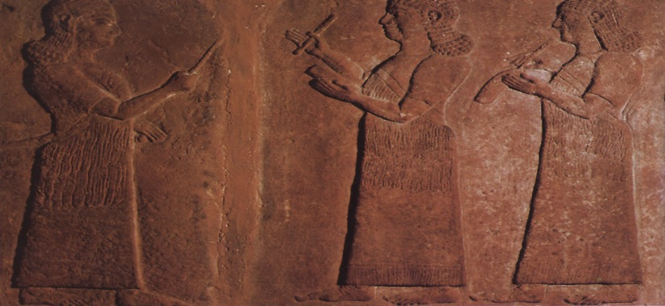
Downfall of Samaria
160
Downfall
of
Samaria

Slide 12
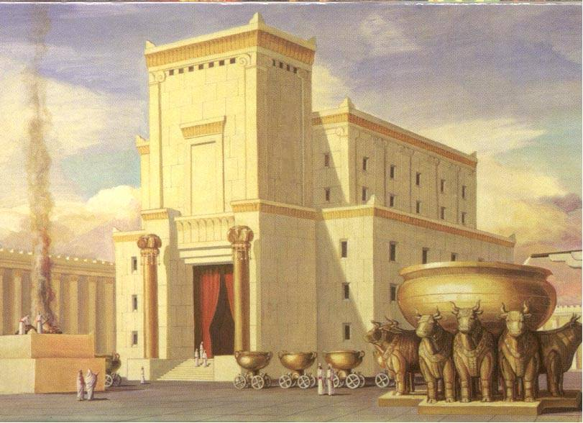
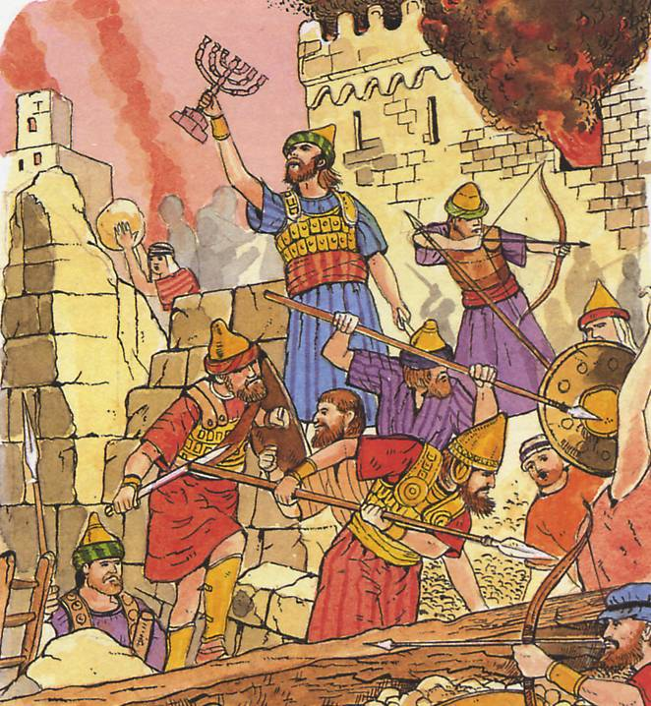
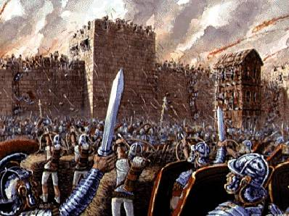
Downfall of Jerusalem
160
Downfall
of
Jerusalem

Slide 13

Terminator 2 Judgment Day
160

Slide 14
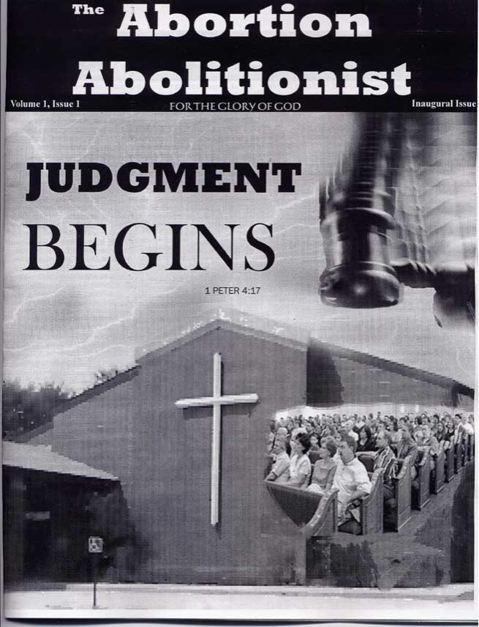
God already judges sin now
160
"For the wrath of God is revealed from heaven against all ungodliness and wickedness of men"
(Rom. 1:18)

Slide 15

Content of the Judgments
104
 | SEALS | TRUMPETS | BOWLS
1 | White: conqueror | Hail & fire: 1/3 vegetation | Sores
2 | Red: war | Fire: 1/3 sea creatures | Sea to blood
3 | Black: famine | Star: 1/3 fresh water | Fresh water to blood
4 | Pale: death | Dark: 1/3 sun, moon, stars | Sun burns men
 |  | (Trumpets 5-7 are woes)
5 | Martyrs reassured | Woe #1: locusts | Beast's kingdom dark
6 | Wrath: earthquake, signs | Woe #2: Euphrates prep | Euphrates dries up
 | (144,000 sealed) | (Trump #7 = mystery)
7 | 1/2 hour silence | Woe #3: victory imminent | Earthquake & hail
HORSES
WOES
Adapted from Robert Gromacki, NT Survey and Wayne House, Chronological & Background Charts of the NT, 19

Slide 16
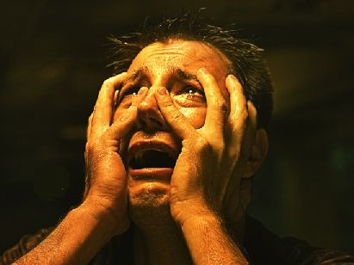
Now for the Seven Future Judgments…
160

Slide 17
Pretribulational Premillennialism
160
Rapture
2nd Advent
Great
White
Throne
Church Age
Tribulation
Millennium
Battle of
Armageddon
Battle of
Gog and Magog

Slide 18
Resurrections & Judgments
160
R = 4 Resurrected Groups
J = 7 Judged Groups
Rapture
2nd Advent
R
2R
R
Great
White
Throne
J
4J
2J
Church Age
Tribulation
Millennium
Battle of
Armageddon
Battle of
Gog and Magog

Slide 19

Judgment Seat of Christ
160
Believers Rewarded by Christ (2 Cor. 5:10)
At the Rapture
(1 Thess. 4:17)
Reward or loss of rewards (not salvation)

Slide 20

Christ's Second Coming
160

Slide 21
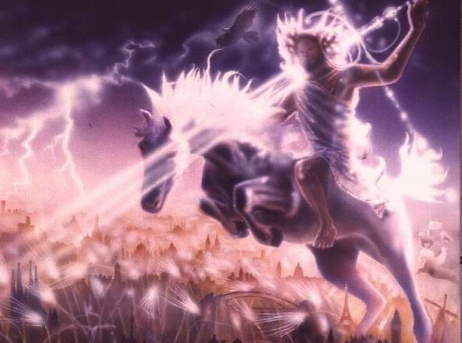
"Out of his mouth comes a sharp sword with which to strike down the nations"
(Rev. 19:15a)
Notes:
21

Slide 22
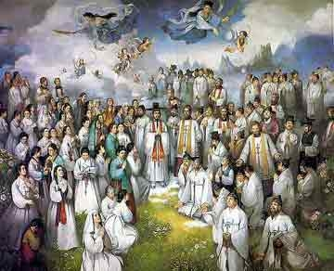
Judgment of Old Testament Saints
160
"Now at that time Michael, the great prince who stands guard over the sons of your people, will arise. And there will be a time of distress such as never occurred since there was a nation until that time; and at that time your people, everyone who is found written in the book, will be rescued. ²Many of those who sleep in the dust of the ground will awake, these to everlasting life, but the others to disgrace and everlasting contempt. ³"Those who have insight will shine brightly like the brightness of the expanse of heaven, and those who lead the many to righteousness, like the stars forever and ever"
(Dan. 12:1-3 NAU).

Slide 23
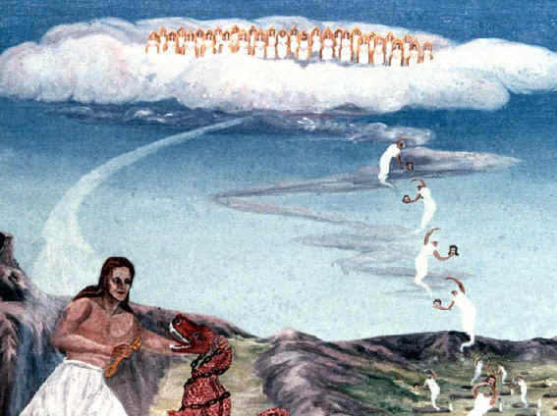
Judgment of Tribulation Saints
160
⁴Then I saw thrones, and they sat on them, and judgment was given to them. And I saw the souls of those who had been beheaded because of their testimony of Jesus and because of the word of God, and those who had not worshiped the beast or his image, and had not received the mark on their forehead and on their hand; and they came to life and reigned with Christ for a thousand years… they will be priests of God and of Christ and will reign with Him for a thousand years"
(Rev. 20:4, 6b).

Slide 24
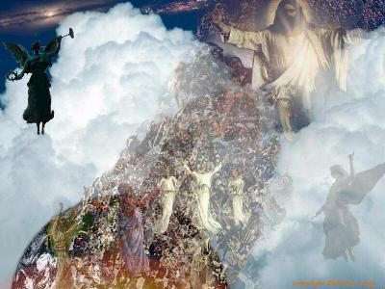
Judgment of Nation of Israel
160
"You say, 'We want to be like the nations all around us, who serve idols of wood and stone.' But what you have in mind will never happen… 34And in anger I will reach out with my strong hand and powerful arm, and I will bring you back from the lands where you are scattered. 35I will bring you into the wilderness of the nations, and there I will judge you face to face. 36I will judge you there just as I did your ancestors in the wilderness after bringing them out of Egypt, says the Sovereign Lord. 37I will examine you carefully and hold you to the terms of the covenant" (Ezek. 20:32, 34-37).
Notes:
³² "You say, 'We want to be like the nations all around us, who serve idols of wood and stone.' But what you have in mind will never happen. ³³ As surely as I live, says the Sovereign Lord, I will rule over you with an iron fist in great anger and with awesome power. ³⁴ And in anger I will reach out with my strong hand and powerful arm, and I will bring you back* from the lands where you are scattered. ³⁵ I will bring you into the wilderness of the nations, and there I will judge you face to face. ³⁶ I will judge you there just as I did your ancestors in the wilderness after bringing them out of Egypt, says the Sovereign Lord. ³⁷ I will examine you carefully and hold you to the terms of the covenant. ³⁸ I will purge you of all those who rebel and revolt against me. I will bring them out of the countries where they are in exile, but they will never enter the land of Israel. Then you will know that I am the Lord" (Eze 20:32-38 NLT).

Slide 25
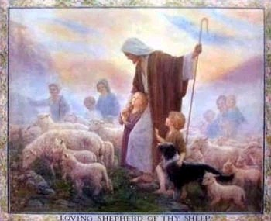
Judgment of the the Nations
(Sheep & Goats)
160
NLT Matthew 25:31 "But when the Son of Man comes in his glory, and all the angels with him, then he will sit upon his glorious throne. ³²All the nations will be gathered in his presence, and he will separate them as a shepherd separates the sheep from the goats. ³³He will place the sheep at his right hand and the goats at his left. ³⁴Then the King will say to those on the right, 'Come, you who are blessed by my Father, inherit the Kingdom prepared for you from the foundation of the world.'"

Slide 26
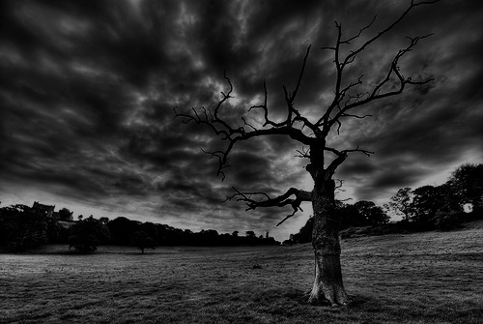
The Olivet Discourse (Matthew 24–25)
160
Adapted from Mark L. Bailey, DTS class notes, 1986
Second Coming (27-31):
Signs in the Heavens (29-30)
Coming of the Son of Man (27, 30)
Bird Supper (28)
Salvation of Elect (31)
Abomination of Desolation
(15-20)
False Christs
& Prophets
(23-26)
Beginning of Birth Pangs
(4-8)
Great Tribulation
(9-14, 21-22)
Judgment of the Nations
Sheep
Goats
Correlation with Revelation
12:7-12
13:14
12:8-17
8:1–19:10
(Matt. 25:31-46)
6:1–8:5
19:11-21

Slide 27
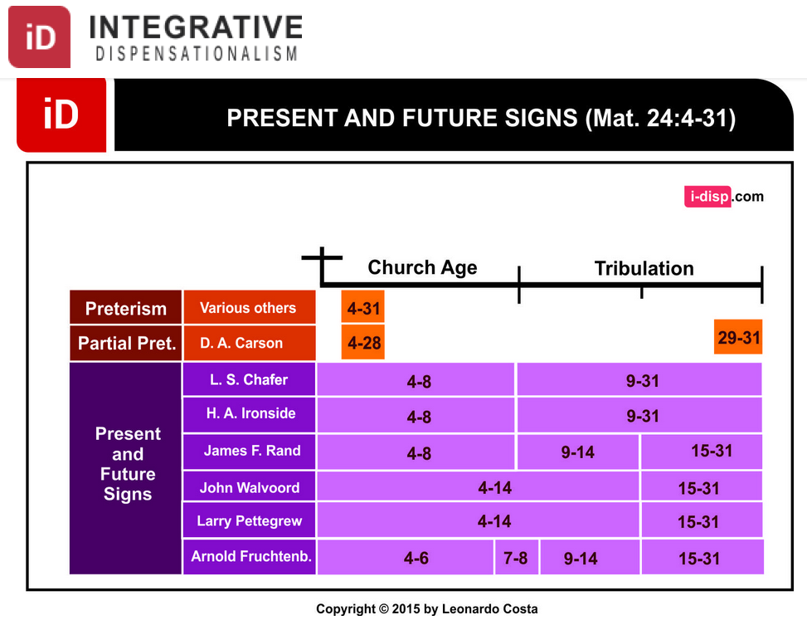
Dispensational Views on Matthew 24
INTEGRATIVE
DISPENSATIONISM
PRESENT & FUTURE SIGNS（Matt 24:4-31）
Church Age
Tribulation
Preterism
Various Others
Partial Pret.
Present
& Future Signs
Notes:
Leonardo Costa, "The Fulfillment of Matthew 24:4-31 in Dispensational Tradition," Integrative Dispensationalism website
http://i-disp.com/the-fulfillment-of-matthew-244-31-in-dispensational-tradition/ accessed 24 July 2015

Slide 28
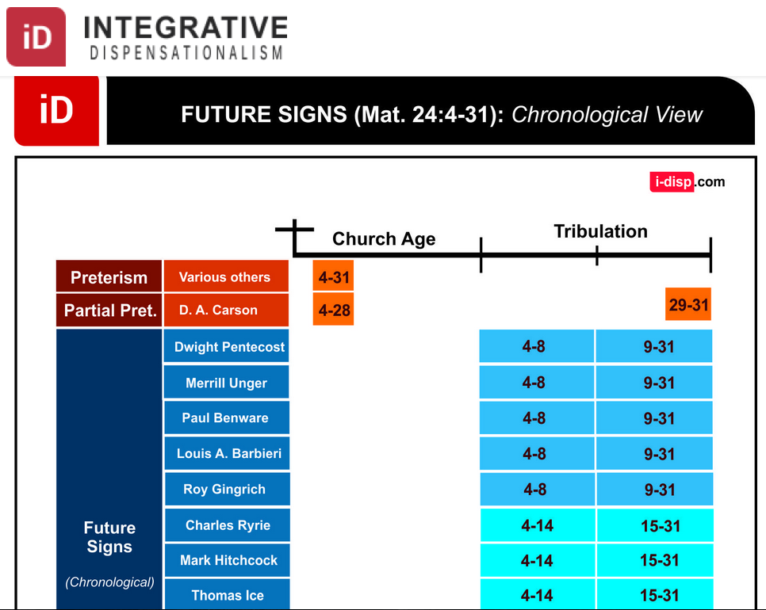
Dispensational Views on Matthew 24
INTEGRATIVE
DISPENSATIONISM
FUTURE SIGNS（Matt 24:4-31): Chronological View
Church Age
Tribulation
Preterism
Various Others
Partial Pret.
未来的年代
Future Signs
(Chronological)
Notes:
Leonardo Costa, "The Fulfillment of Matthew 24:4-31 in Dispensational Tradition," Integrative Dispensationalism website
http://i-disp.com/the-fulfillment-of-matthew-244-31-in-dispensational-tradition/ accessed 24 July 2015

Slide 29
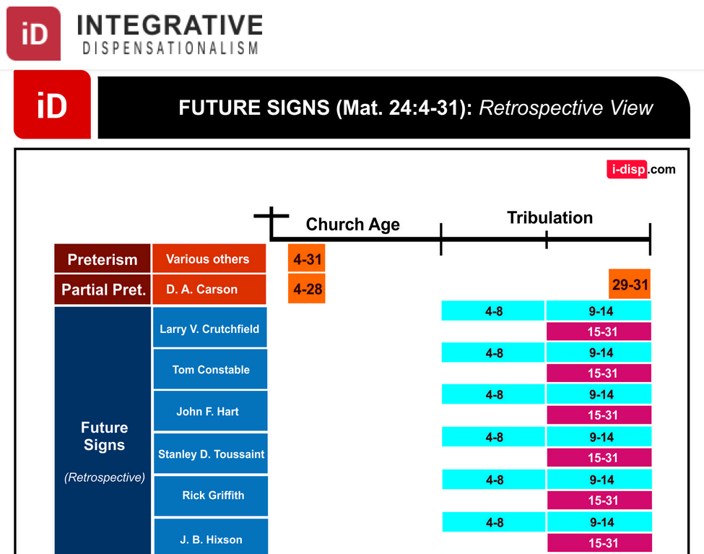
Dispensational Views on Matthew 24
INTEGRATIVE
DISPENSATIONISM
FUTURE SIGNS（Matt 24:4-31): Retrospective View
Church Age
Tribulation
Preterism
Various Others
Partial Pret.
Future Signs
(Retrospective)
Notes:
Leonardo Costa, "The Fulfillment of Matthew 24:4-31 in Dispensational Tradition," Integrative Dispensationalism website
http://i-disp.com/the-fulfillment-of-matthew-244-31-in-dispensational-tradition/ accessed 24 July 2015

Slide 30
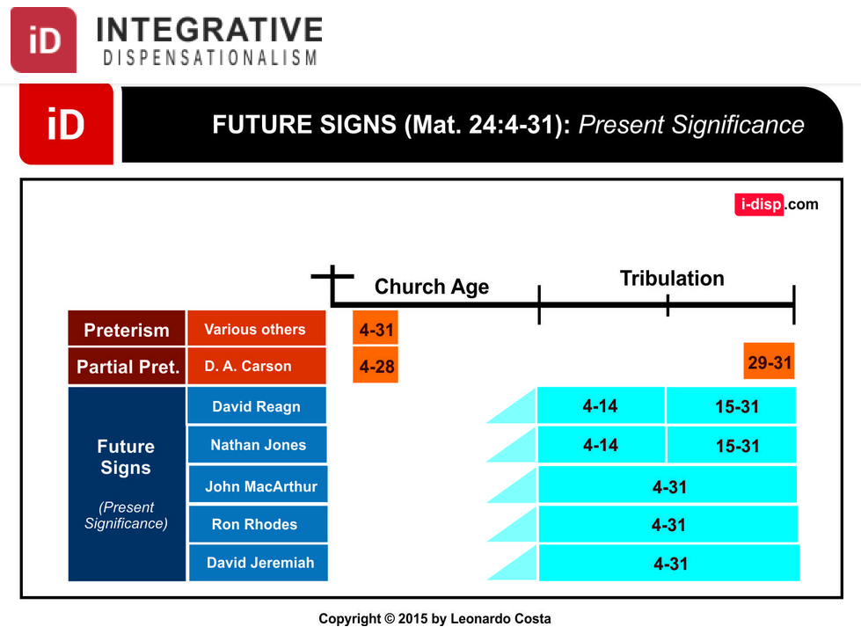
Dispensational Views on Matthew 24
综合
时代主义
INTEGRATIVE
DISPENSATIONISM
FUTURE SIGNS（Matt 24:4-31): Present Significance
Church Age
Tribulation
Preterism
Various Others
Partial Pret.
Future Signs
(Present Significance)
Notes:
Leonardo Costa, "The Fulfillment of Matthew 24:4-31 in Dispensational Tradition," Integrative Dispensationalism website
http://i-disp.com/the-fulfillment-of-matthew-244-31-in-dispensational-tradition/ accessed 24 July 2015

Slide 31
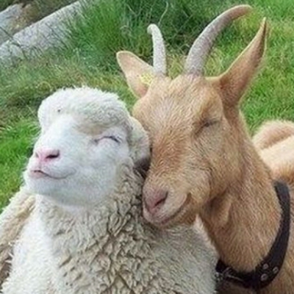
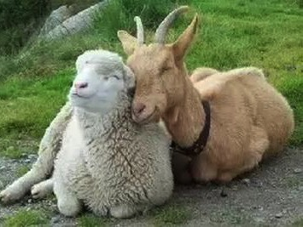
Aren't Sheep & Goats the Same?

Slide 32
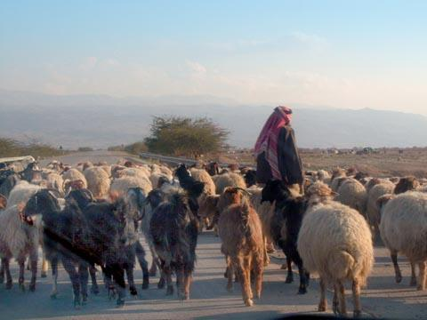
Judgment of the Nations
"All the nations will be gathered in his presence, and he will separate the people as a shepherd separates the sheep from the goats. ³³He will place the sheep at his right hand and the goats at his left"
(Matt. 25:31-32).

Slide 33

Judgment of Living Gentiles
160
³¹ "But when the Son of Man comes in his glory, and all the angels with him, then he will sit upon his glorious throne.
³² All the nations will be gathered in his presence, and he will separate the people as a shepherd separates the sheep from the goats. ³³ He will place the sheep at his right hand and the goats at his left.
³⁴ "Then the King will say to those on his right, 'Come, you who are blessed by my Father, inherit the Kingdom prepared for you from the creation of the world" (Matt. 25:31-34 NLT).

Slide 34
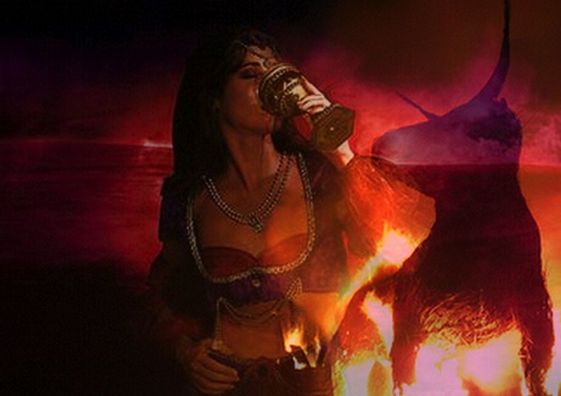
Judgment of Living Gentiles
160
⁴¹ "Then the King will turn to those on the left and say, 'Away with you, you cursed ones, into the eternal fire prepared for the devil and his demons. ⁴² For I was hungry, and you didn't feed me. I was thirsty, and you didn't give me a drink.
⁴³ I was a stranger, and you didn't invite me into your home. I was naked, and you didn't give me clothing. I was sick and in prison, and you didn't visit me.'
⁴⁴ "Then they will reply, 'Lord, when did we ever see you hungry or thirsty or a stranger or naked or sick or in prison, and not help you?'
⁴⁵ "And he will answer, 'I tell you the truth, when you refused to help the least of these my brothers and sisters, you were refusing to help me.' ⁴⁶ "And they will go away into eternal punishment, but the righteous will go into eternal life" (Matt. 25:41-46 NLT).

Slide 35
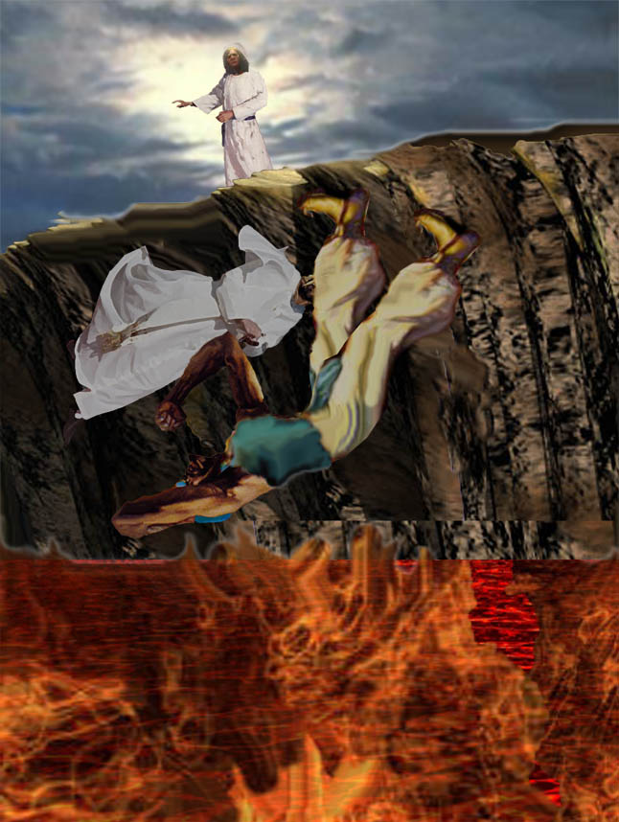
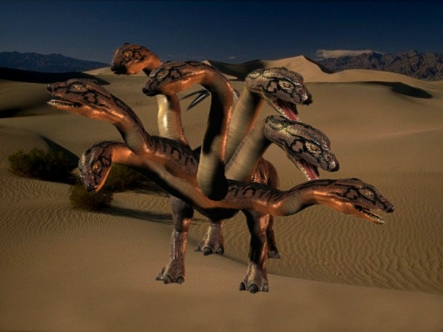
Beast & False Prophet cast into lake of burning sulfur
(19:20)

Slide 36
Revelation 20:4 (NAU)
160
⁴Then I saw thrones, and they sat on them, and judgment was given to them. And I saw the souls of those who had been beheaded because of their testimony of Jesus and because of the word of God, and those who had not worshiped the beast or his image, and had not received the mark on their forehead and on their hand; and they came to life and reigned with Christ for a thousand years.

Slide 37
Why Am I Not Posttrib?
1. If posttrib, then sheep would already be separated from goats (Matt. 25:31-46).
R = 4 Resurrections
J = 7 Judgments
Rapture
2nd Advent
R
2R
R
Great
White
Throne
J
4J
2J
Church Age
Tribulation
Millennium
Notes:
37

Slide 38
Why Am I Not Posttrib?
2. Some people in the millennium will die (Isa. 65:20), but a posttrib rapture gives a glorified body to all believers; therefore, some people must trust Christ in the Tribulation and enter the Millennium in their mortal bodies.
R = 4 Resurrections
J = 7 Judgments
Rapture
2nd Advent
R
2R
R
Great
White
Throne
J
4J
2J
Church Age
Tribulation
Millennium
Notes:
38

Slide 39
Revelation 20:5-6 (NAU)
160
⁵The rest of the dead did not come to life until the thousand years were completed. This is the first resurrection. ⁶Blessed and holy is the one who has a part in the first resurrection; over these the second death has no power, but they will be priests of God and of Christ and will reign with Him for a thousand years.

Slide 40


Revelation 20:4-6 Diagrammed
424
^{4b}and they came to life and reigned with Christ for a thousand years.
^{4a}Then I saw thrones, and they sat on them, and judgment was given to them. And I saw the souls of those who had been beheaded because of their testimony of Jesus and because of the word of God, and those who had not worshiped the beast or his image, and had not received the mark on their forehead and on their hand…
1000 years
^{5b}This is the first resurrection. ^{6a}Blessed and holy is the one who has a part in the first resurrection; over these the second death has no power…
^{6b}but they will be priests of God and of Christ and will reign with Him for a thousand years.
^{5a}The rest of the dead did not come to life until the thousand years were completed.
Notes:
The 1000 years are bracketed with two resurrections, contrary to the popular belief that there will exist one, general resurrection of everyone at the same time.
Sadly, many destroy this wonderful truth of the reign of the saints by seeing the first resurrection as "spiritual" (variously defined!) in verse 4 but the second resurrection as physical in the very next verse. But the word "resurrection" in the Bible always refers to the body, not the spirit.
In fact, Paul warns against such spiritualizing of the resurrection in 2Tim. 2:15-18 —— "Work hard so you can present yourself to God and receive his approval. Be a good worker, one who does not need to be ashamed and who correctly explains the word of truth. ¹⁶ Avoid worthless, foolish talk that only leads to more godless behavior. ¹⁷ This kind of talk spreads like cancer, as in the case of Hymenaeus and Philetus. ¹⁸ They have left the path of truth, claiming that the resurrection of the dead has already occurred; in this way, they have turned some people away from the faith."
___________
Common-476
ES-20-Resurrections&Judgements-20
OS-17-Esther-146
NS-27-Rev20-22-slide 33

Slide 41
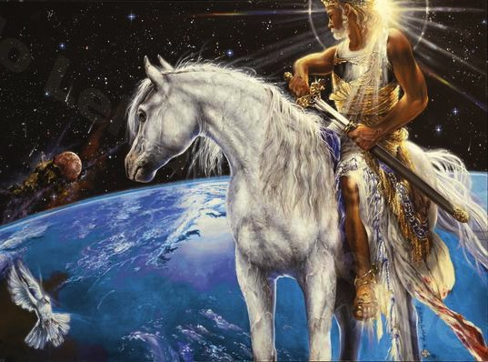
Christ will win this Last Battle

Slide 42
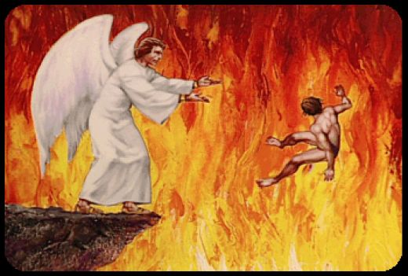
"And anyone whose name was not found recorded in the Book of Life was thrown into the lake of fire" (Rev. 20:15)

Slide 43
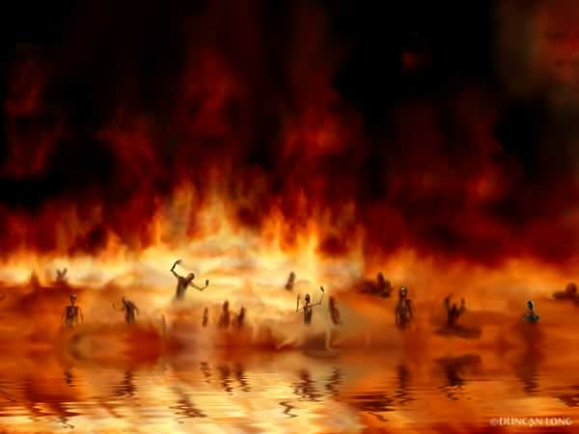
The Lake of Fire (Rev. 20:14-15)

Slide 44
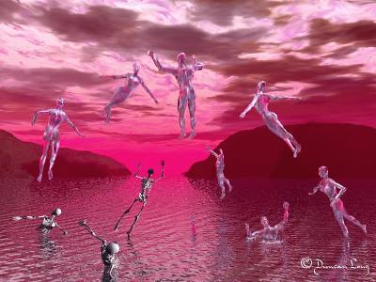
"The sea… and death and hades gave up their dead" (Rev. 20:13)
160

Slide 45
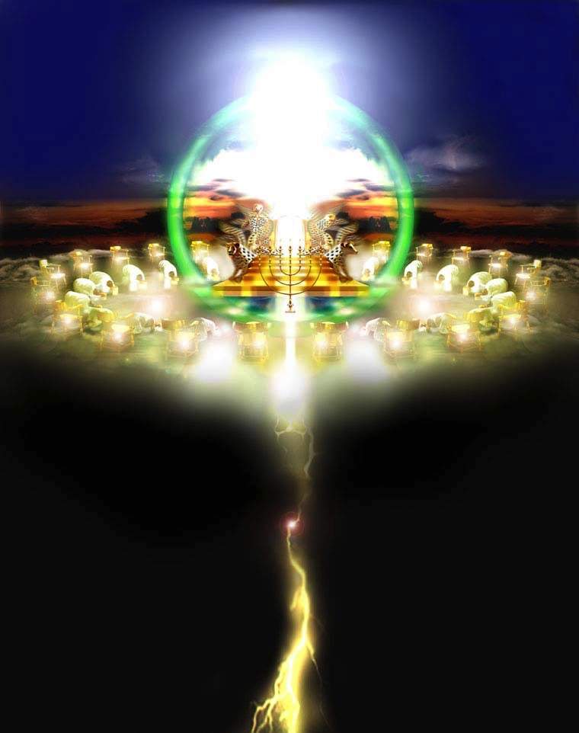
The Great White Throne
(Rev. 20:14-15)
160

Slide 46
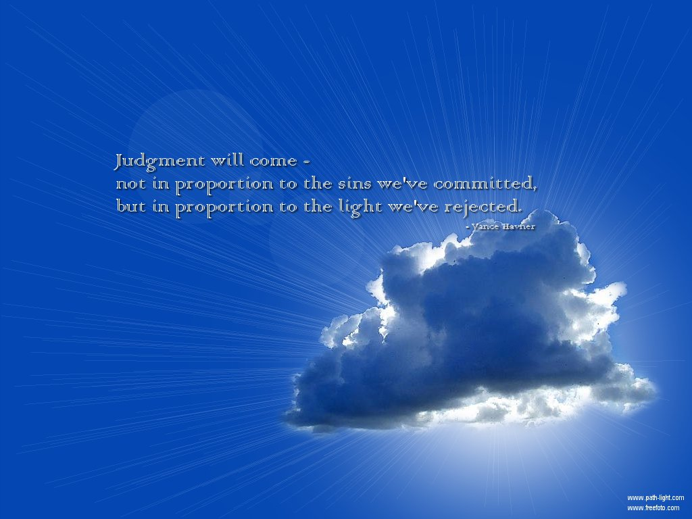
How much light?
160
"Judgment will—
Not in proportion to the sins we've committed,
but in proportion to the light we've rejected."
—Vance Havner

Slide 47
"To whom much has been given, much will be required."
Luke 12:48

Slide 48


Future (Eschatology) link at BibleStudyDownloads.org
Get this presentation for free!
Notes:
NT Survey (ns)

Slide 49
Black

