Slide 1
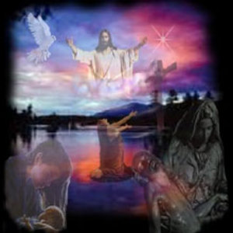
Postmillennialism
Dr. Rick Griffith • Jordan Evangelical Theological Seminary • BibleStudyDownloads.org

Slide 2
Is there a future for ethnic believing Israel?
Dispensational
Premillennialism
Amillennialism &
Postmillennialism
Church & Israel distinct
Israel has a future
Church is new Israel
Israel has no future
Covenant
Premillennialism

Slide 3
Two Key Millennial Questions
120
When? Will Christ return before or after the millennium?
What? All agree there will be a millennium, but what kind will it be?

Slide 4
Basic Comparisons
120
Amil
Postmil
Premil

Slide 5
"We've a Story to Tell"
"For the darkness shall turn to dawning, and the dawning to noonday bright, And Christ's great kingdom shall come on earth, the kingdom of love and light."

Slide 6
Jesus Shall Reign
Jesus shall reign where'er the sun
Doth his successive journeys run
His Kingdom stretch from shore to shore,
Till moons shall wax and wane no more.
To Him shall endless prayer be made.
And princes throng to crown His head,
His name like sweet perfume shall rise
With every morning sacrifice.
Notes:
http://www.lyricsondemand.com/miscellaneouslyrics/christianlyrics/jesusshallreignwhereerthesunlyrics.html

Slide 7
O Zion, Haste
Text: Mary A. Thompson, 1834-1923
Music: James Walch, 1837-1901
O Zion, haste, thy mission high fulfilling,
to tell to all the world that God is light,
that he who made all nations is not willing one soul should perish, lost in shades of night.
Refrain:
Publish glad tidings, tidings of peace; tidings of Jesus, redemption and release.

Slide 8
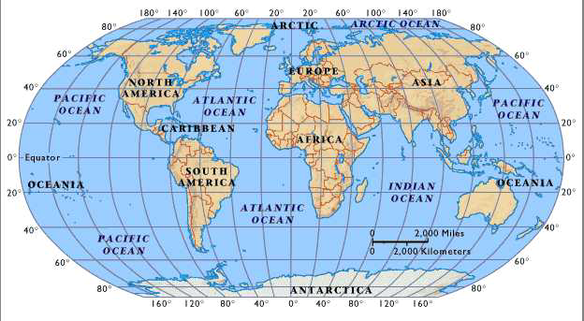
"Oh, Zion Haste"
106
"The law will go out from Zion,
the word of the LORD from Jerusalem"
--Isaiah 2:3

Slide 9
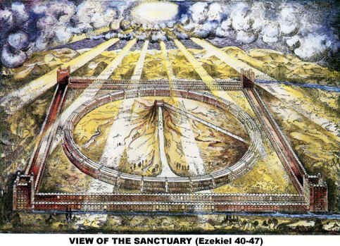
"Jesus Shall Reign"
Isaac Watts (dispensational theologian)
"Shall reign" indicates future millennium
"From east to west the princes come…"
"with ev'ry morning sacrifice"
Notes:
www.antipas.org/.../ezekiels_temple/ ezekiels_temple.html

Slide 10
Postmillennialism
The belief that the church will bring in the millennium so that Christ will return to a Christianized world

Slide 11
In Other Words…
150
Theonomy
Christian Reconstructionism
Dominion Theology

Slide 12
Millennial Advocates by Century
121
1
2
3
4
16
17
18
19
20
21
Premil
Amil
Postmil

Slide 13
Postmillennialism
27
Second Coming
Golden Age of the Gospel
Tribulations
Church Age
Eternal Kingdom
Judgment

Slide 14
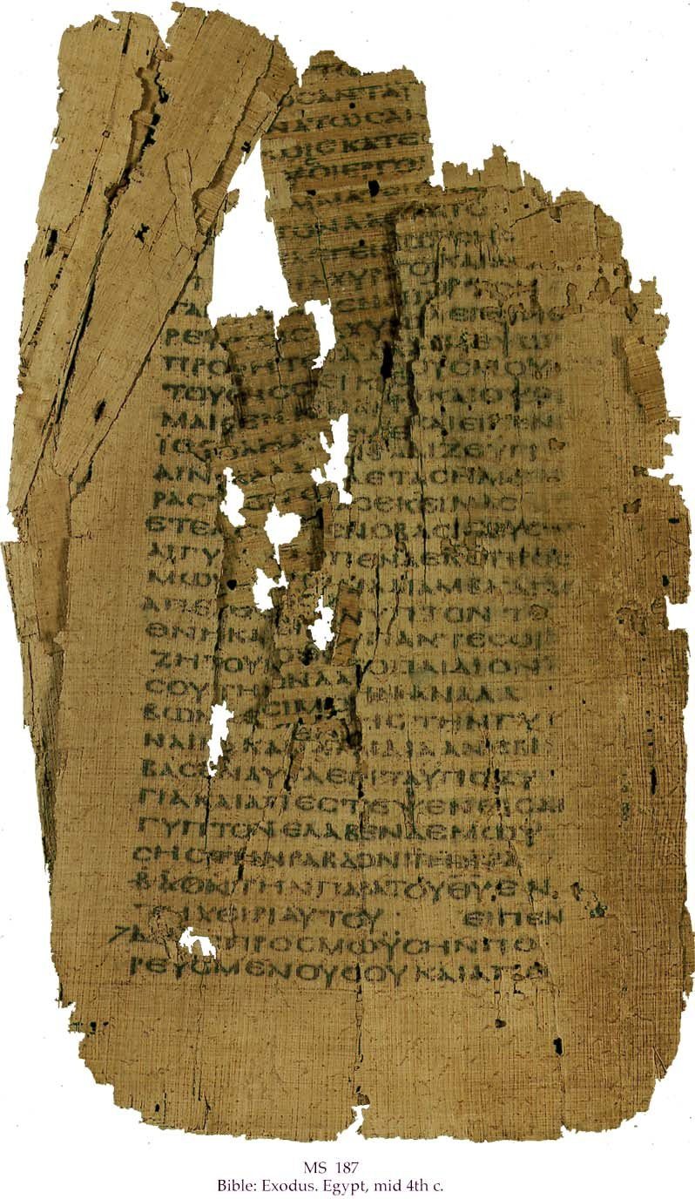
Postmillennial Support Cited
151
Argument
Response
No beginning
Brought by Christ
More saved than lost
"The gate is small"
World getting better
WWI, WWII, Luke 18:8
Premil ignores figures
Figures are for real things

Slide 15
Postmillennial Support Cited
151
Argument
Response
Mortals & immortals can't live together
It's already been done (Luke 24:31-32)
"Flesh and blood cannot inherit the kingdom of God" (1 Cor. 15:50)
Refers to the eternal state (15:24-25)

Slide 16
Kingdom Aspects
119d
----------The Universal Kingdom------------
----------The Spiritual Kingdom------------
Theocratic
Eternal
Millennial
Mt Sinai
Judges/ Kings
Church Age
Eternity
Tribulations

Slide 17
Black

Slide 18
Future (Eschatology) at BibleStudyDownloads.org
Get this presentation for free!
Notes:
Future (fu)
Eschatology

