Slide 1
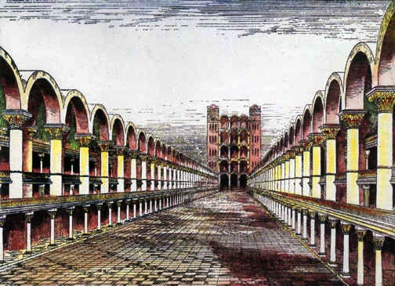
Ezekiel's Temple
& Topography
Dr. Rick Griffith • Jordan Evangelical Theological Seminary • BibleStudyDownloads.org

Slide 2

What's the Future for the Dome and World Geography in the Kingdom after Messiah Comes?

Slide 3

Jewish life then revolved around Solomon's temple for 400 years (959-586 BC)

Slide 4
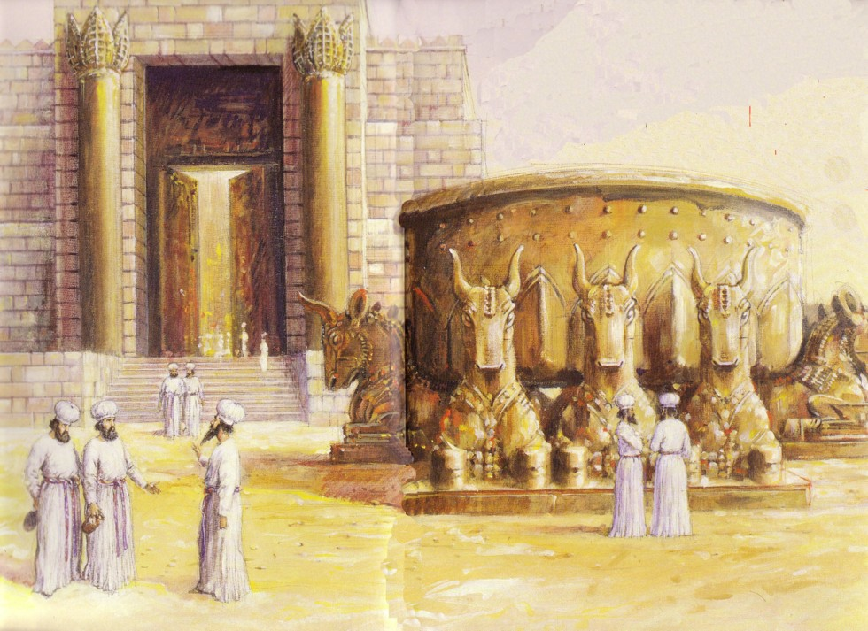
Jews Maintained Holiness at the Basin
586 BC: Temple Destroyed!

Slide 5


After temple rebuilding, in NT Passovers 100,000 Jews visited the Temple!
AD 70: Temple Destroyed Again!

Slide 6

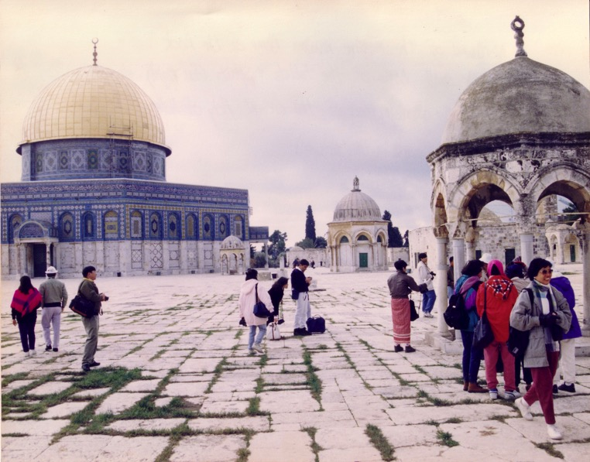

Muslim Control
47
Mosque of Omar
(Dome of the Rock)
Al-Aksa Mosque

Slide 7
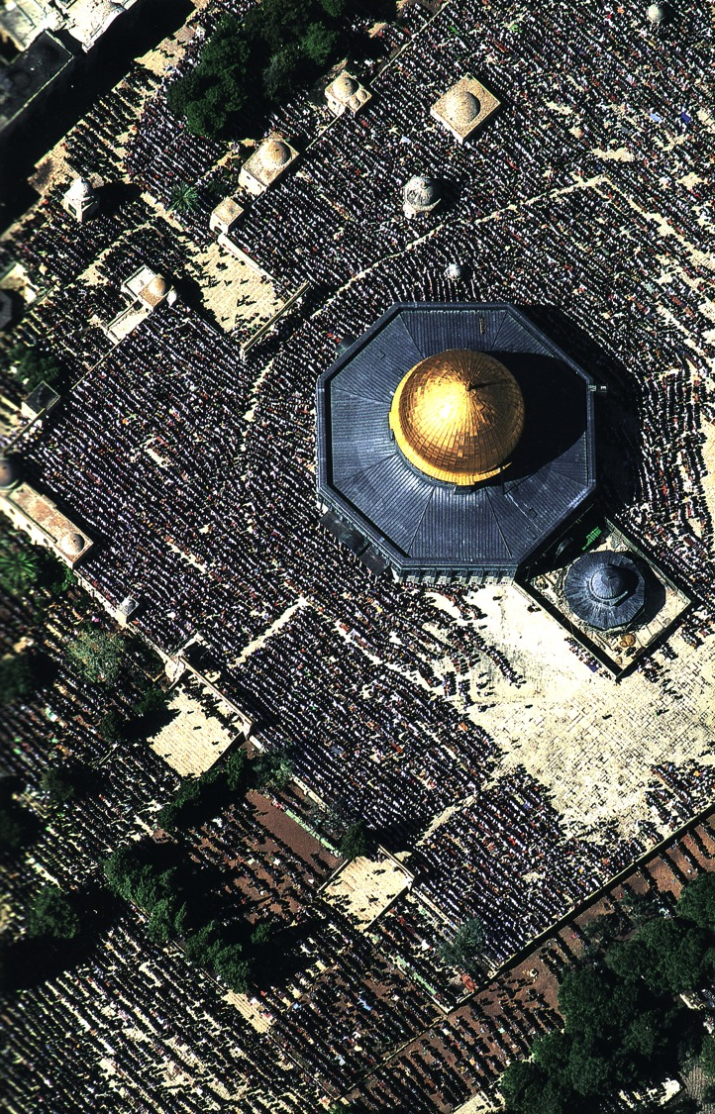
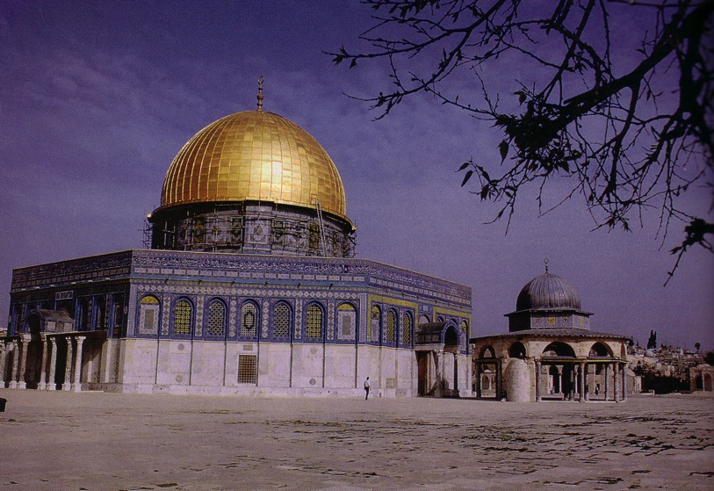
Muslim Prayers at the Dome
45

Slide 8
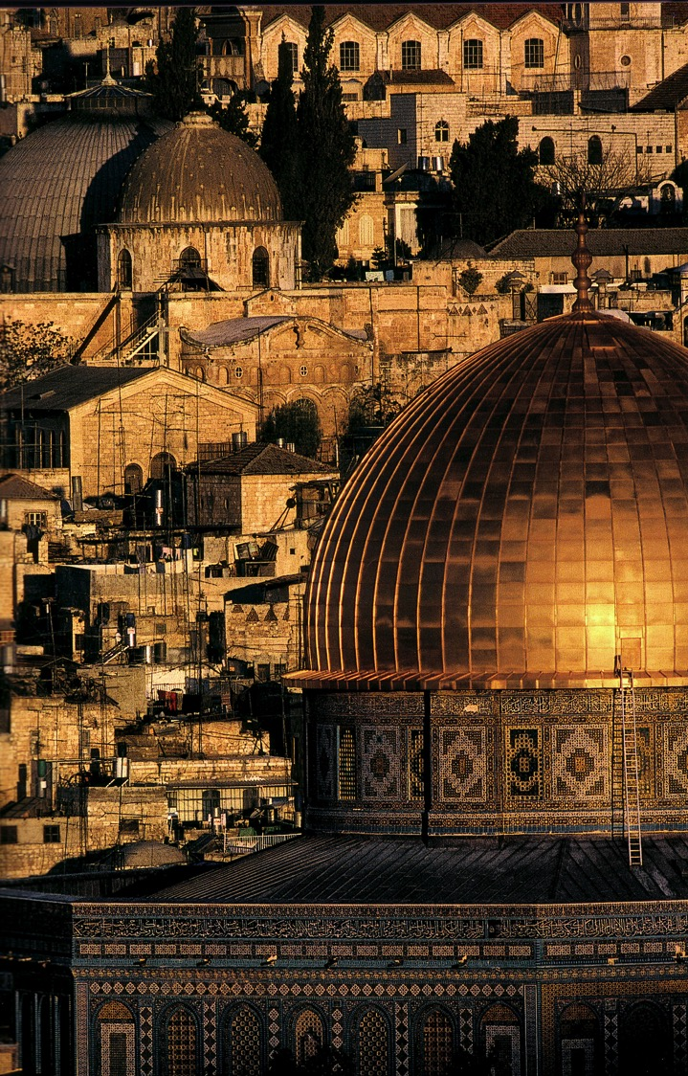
A Dome to Outshine the Dome

Slide 9
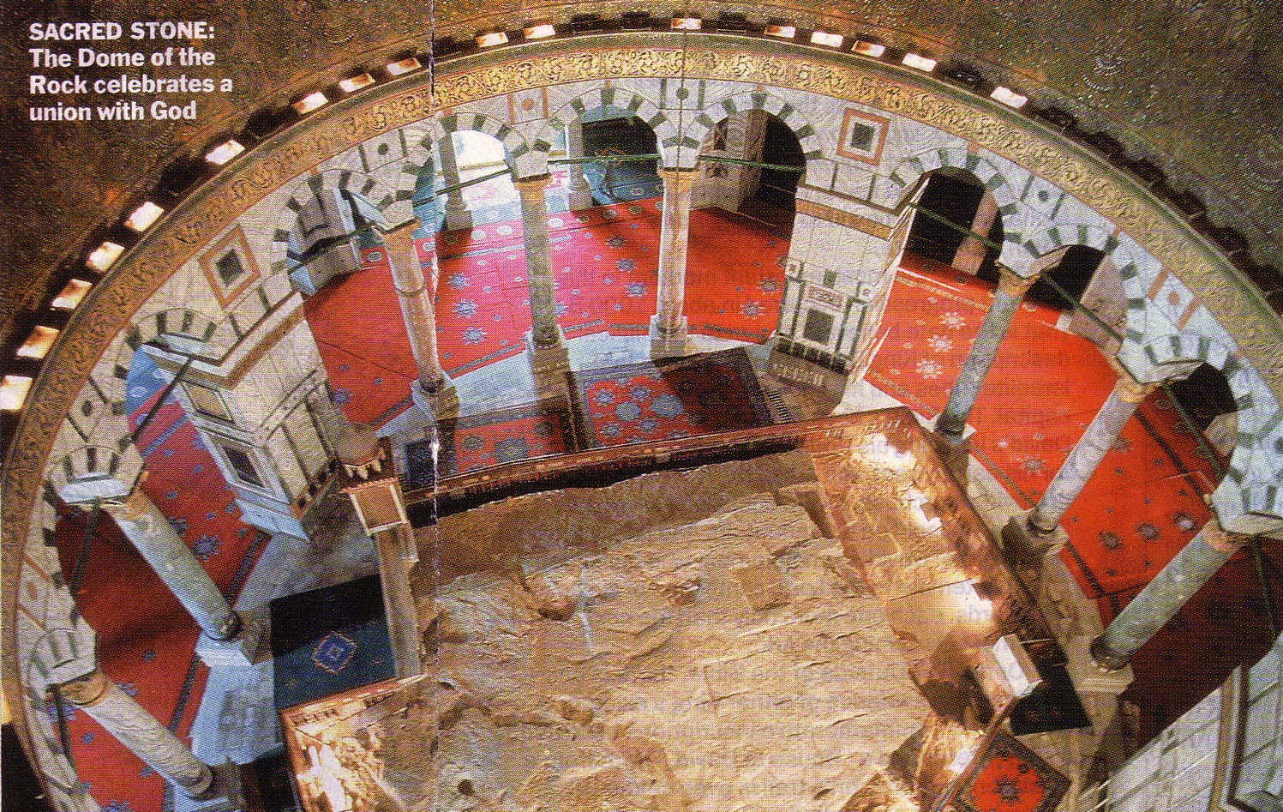
The Rock Inside

Slide 10
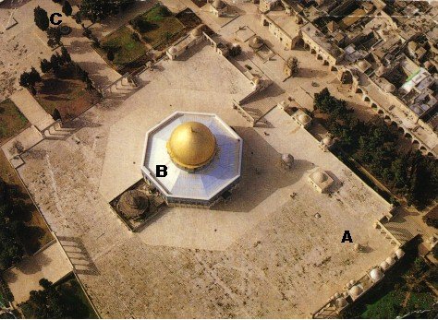
An Imposing Structure
47

Slide 11

Modern Temple Mount
49a

Slide 12


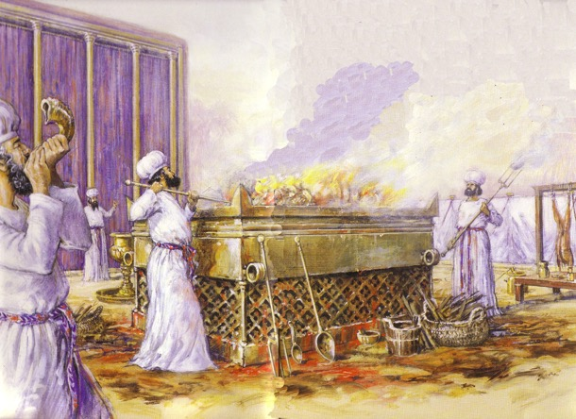
Jewish Western Wall
45

Slide 13
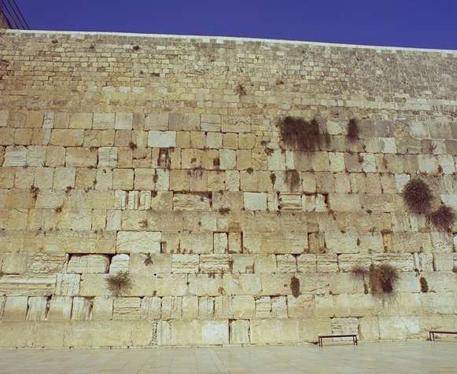
The Western Wall
45

Slide 14

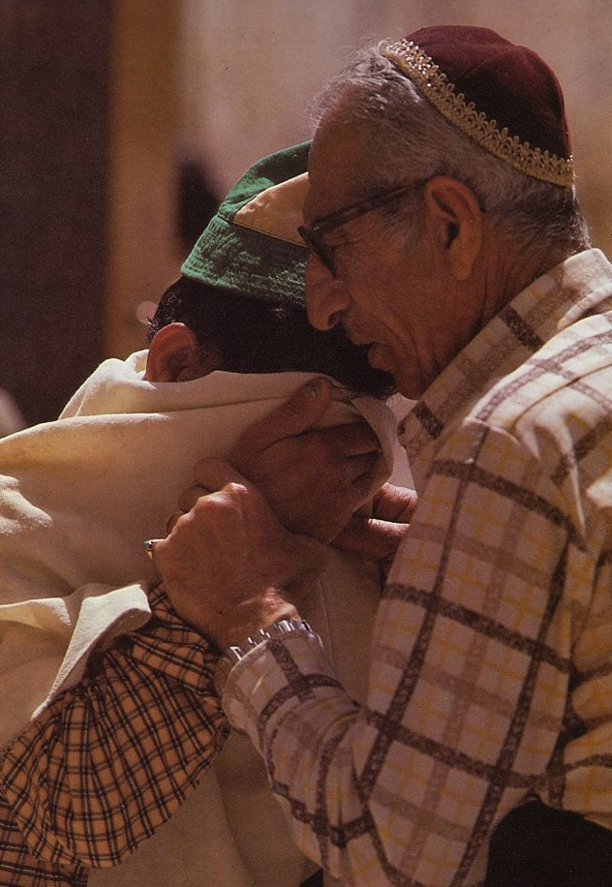
Prayers for the Third Temple

Slide 15
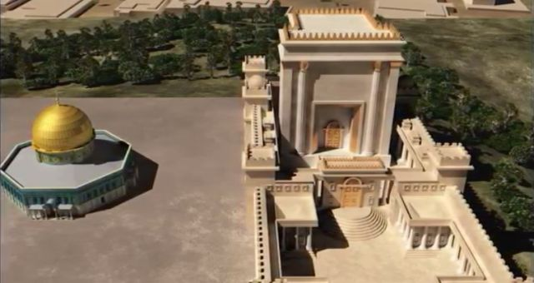
Antichrist will make a 7-year treaty with Israel
79 B
This will likely enable the rebuilding of the Jerusalem temple (Third Temple Era)
Artwork by Sunny Chandra

Slide 16
But the Tribulation Temple will be destroyed and replaced with Ezekiel’s Temple in the Millennium
(Fourth Temple Era)
Artwork by Sunny Chandra

Slide 17
Timeline to the Kingdom and Temple Described in Ezekiel 40–48
530a
Heaven
New Heaven
7+ Years
Resurrection & Catching Away of Church Believers
1 Thess 4：16-17
Return with Christ
Rev 9：11-21
Earth
Current Period
7-Year Tribulation Period
75 Days Resurrection of Tribulation & OT Believers
1000-Year Messianic Kingdom with Temple
Rev 20:4; Ezek 40–48
Final Rebellion Resurrection & Judgment of Unbelievers
New Earth
Rev 21：1-3
Ezekiel's temple will be built after Christ's return
Adapted from Wayne ODonnell • "Ezekiel 40 - 48: Tour of Ezekiel's Temple" http://bible.ag/en/enEzekieltranscript.htm
Notes:
"See Picture #1. Timeline to the Kingdom and Temple Described in Ezekiel 40-48.
As Picture #1 shows, we are currently in the bottom left part labeled "Current Period." A "7-Year Tribulation Period" is probably going to begin very soon. Before that time there will be a "Resurrection and Catching Away of Church Believers" who will wait out the tribulation in heaven and then "Return With Christ" at the end of the tribulation period.
Revelation 19:11-16 says, "Behold a white horse; and he that sat upon him," that's Yeshua, Jesus, "and the armies which were in heaven followed him," that's us, "clothed in fine linen, white and clean. And out of his mouth goeth a sharp sword, that with it he should smite the [Gentile] nations: and he shall rule them with a rod of iron." He will smite the Gentile nations when he returns to defend Israel (see my references to Zechariah 12-14 in my Matthew and Romans 9-11 surveys) at the end of the "7-Year Tribulation Period," and he will rule the nations with a rod of iron during the "1000-Year Messianic Kingdom." "And he hath on his vesture and on his thigh a name written, KING OF KINGS," because during the kingdom, there will be multiple nations, each with their own king, but Yeshua, ruling from Jerusalem, will be king over all kings.
Then, after the kingdom, there will be a "New Heaven" and "New Earth," as shown on the right side of the diagram. Revelation 21:1-3, "I saw a new heaven and a new earth, ... and ... new Jerusalem, coming down from God out of heaven." If new Jerusalem comes down from God out of heaven, it has to come to the earth, because there is only heaven and earth. "And I heard ... behold, the tabernacle of God is with men ...." God is going to come down and make his tabernacle with men; men are not going up to spend eternity in tabernacles in heaven. "And he will dwell with them." We are not going to dwell with him in heaven. He is going to dwell with us on the new earth forever. The place Jesus prepares for us in heaven (Jn14:2-3), may not come down to earth until after the kingdom in the New Jerusalem, but we will be on earth during the kingdom also (Mt19:28).
So get the idea out of your mind that you are going to be in heaven for eternity. We are in heaven for only a very brief time. Even the people who died a thousand years ago in the Lord, and their spirits are in heaven, their bodies are still with us here on earth. And after the resurrection it is a very brief layover in heaven before returning to earth with Christ and entering the Messianic Kingdom. So we could use a lot less songs about walking around heaven with Jesus, and a lot more songs about what it is going to be like in the kingdom.
Since we are going to be spending so much time in the kingdom, we should learn about it; and the new earth is going to have a lot of similarities to the kingdom, although there are some differences. I know God wants us to learn about the kingdom, because he has told us so much about it in Isaiah, Jeremiah, Ezekiel, the minor prophets, the psalms, and so forth. And the benefit of learning about the kingdom, is that it will help you persevere through trials, and help you labor more fervently.
God could have given us just an overview of the kingdom in these last 9 chapters of Ezekiel, but instead they focus a lot on one building, the temple, so that if we know this one building that will be at the center of the kingdom in a very detailed way, the entire kingdom will all be very real and solid to us, so that our sure hope of entering the kingdom in the future will help us in our trials and labors today.
Ezekiel 40:1-2. The Mountain
When Ezekiel first arrived in the future at the land of Israel, he saw a very high mountain. Now, there is no high mountain in Israel today, but there will be geological changes before the Messianic Kingdom. Isaiah 2:2 says, "It shall come to pass in the last days, that the mountain of the LORD'S house," meaning the mountain that will have the Lord's house, the temple, on it, "shall be established in the top of the mountains." That means it is going to be the highest mountain in the world. Ezekiel 20:40 says, "For in mine holy mountain, in the mountain of the height of Israel, saith the Lord GOD, there shall all the house of Israel, all of them in the land, serve me."
Zechariah 14:1-10 talks about the geological changes that will be necessary. "Behold, the day of the LORD cometh." 'Day of the Lord' is another name for the seven year tribulation period; and it is also called 'the time of Jacob's trouble' (Jer30:7). Verse 2, "I will gather all nations against Jerusalem to battle ... then shall the LORD go forth, and fight against those nations." The Messiah, Yeshua, returns with us and smites the armies of the Gentile nations, as we saw in Revelation 19.
"And his feet shall stand in that day upon the mount of Olives, which is before Jerusalem on the east." That is also where Yeshua, Jesus, left the earth from (Acts1:9-12). "And the mount of Olives shall cleave in the midst thereof toward the east and toward the west, and there shall be a very great valley," running east and west, "and half of the mountain shall remove toward the north, and half of it toward the south ... and the LORD my God shall come," in the person of Messiah at the end of the tribulation period, "and all the saints," that's us, returning with Christ.
"All the land shall be turned as a plain from Geba to Rimmon south of Jerusalem: and it [probably Jerusalem, not the plain] shall be lifted up, and inhabited in her place." So all the mountains around Jerusalem, and to the south of it in the land of Israel, will be lowered, and leveled into a plain, but Jerusalem will raised up higher than it is now, and other mountains around the world will be lowered, not to a plain, but until their peaks are lower than Jerusalem's mountain."
Wayne ODonnell, "Ezekiel 40–48: Tour of Ezekiel's Temple"
http://bible.ag/en/mr4web.html#EZanchor-anchor
Recorded December 30, 2007
Accessed 30 Aug 2016

Slide 18
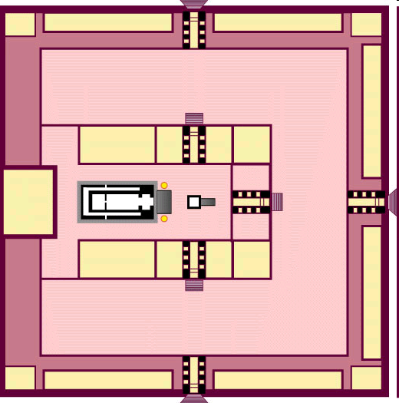
Ezekiel's Temple
143

Slide 19
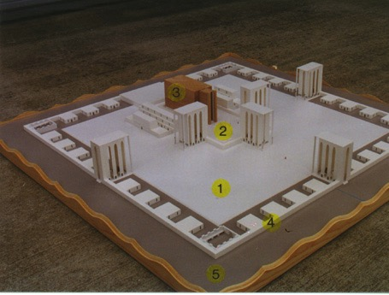
Ezekiel' Temple Model
143
1. Outer Court - 40:17-19
2. Inner Court - 40:44-47
3. The Temple or Sanctuary - 41:1-26
4. Wall around the outside of the temple - 40:5 (42:15-20, 45:2)
5. Fifty cubits of open space - 45:2
www.pauljab.net/temple/ TemplePictures.html

Slide 20
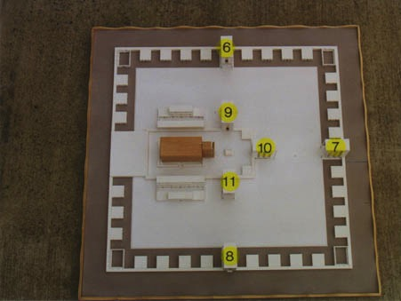
View from Above
143
6. Outer Court Northern Gateway - 40:20-23
7. Outer Court Eastern Gateway - 40:6-16
8. Outer Court Southern Gateway - 40:24-27
9. Inner Court Northern Gateway - 40:35-37
10. Inner Court Eastern Gateway - 40:32-34
11. Inner Court Southern Gateway - 40:28-31
www.pauljab.net/temple/ TemplePictures.html
Notes:
20

Slide 21
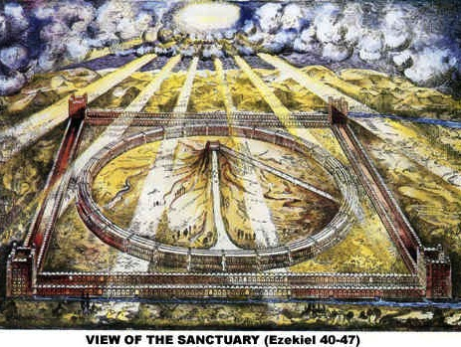
View of the Sanctuary (Ezekiel 40-48)
521
www.antipas.org/.../ezekiels_temple/ ezekiels_temple.html
Notes:
Ezekiel's depiction matches Isaiah 2…
Is. 2:2 In the last days, the mountain of the LORD’s house
will be the highest of all—
the most important place on earth.
It will be raised above the other hills,
and people from all over the world will stream there to worship.
³ People from many nations will come and say,
“Come, let us go up to the mountain of the LORD,
to the house of Jacob’s God.
There he will teach us his ways,
and we will walk in his paths.”
For the LORD’s teaching will go out from Zion;
his word will go out from Jerusalem.
⁴ The LORD will mediate between nations
and will settle international disputes.
They will hammer their swords into plowshares
and their spears into pruning hooks.
Nation will no longer fight against nation,
nor train for war anymore.

Slide 22
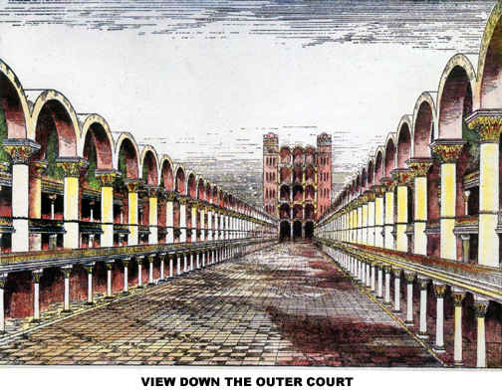
View Down the Outer Court
Notes:
If you think Solomon's temple was glorious, how much more so Ezekiel's!

Slide 23
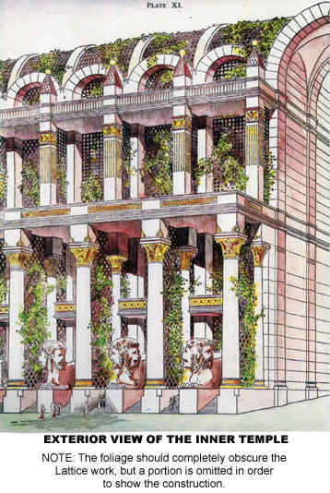
Exterior View of the Inner Temple

Slide 24


Solomon's & Ezekiel's Temples Contrasted
518
Notes:
24

Slide 25
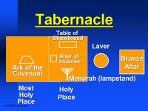
Comparing the Furniture
144a
Mosaic
Tabernacle
Solomon's
Temple
Ezekiel's
Temple
Altar of Burnt Offering
(Ezek. 43:13-27)
Ark of the Covenant
(Exod. 40:34)
Ark of the Covenant
(1 Kings 8:21)
Contrasting Centers of Worship:
Moved Millennial Furniture:
Altar of Burnt Offering: from the outer (Exod. 40:6) to inner court (Ezek 43:13)
Missing Millennial Furniture:
Ark of covenant (Exod. 25:22), veil, lampstand, table of showbread, & laver

Slide 26
View from Above
6. Outer Court Northern Gateway - 40:20-23
7. Outer Court Eastern Gateway - 40:6-16
8. Outer Court Southern Gateway - 40:24-27
9. Inner Court Northern Gateway - 40:35-37
10. Inner Court Eastern Gateway - 40:32-34
11. Inner Court Southern Gateway - 40:28-31
www.pauljab.net/temple/ TemplePictures.html
Notes:
26

Slide 27


Ezekiel's temple won't fit on the present Temple Mount!
www.pauljab.net/temple/ TemplePictures.html
Notes:
27

Slide 28
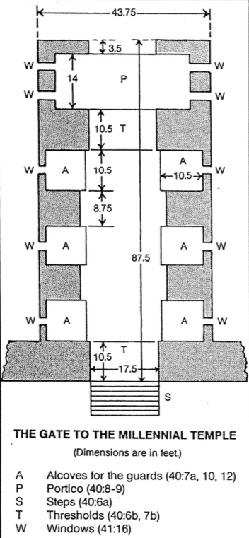
The Eastern Gate (40:7-16)
519
Charles Dyer, "حزقيال,"
in The Bible Knowledge Commentary, 1:1305

Slide 29
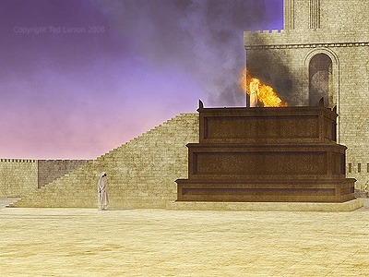
Altar (43:13-17)
519

Slide 30
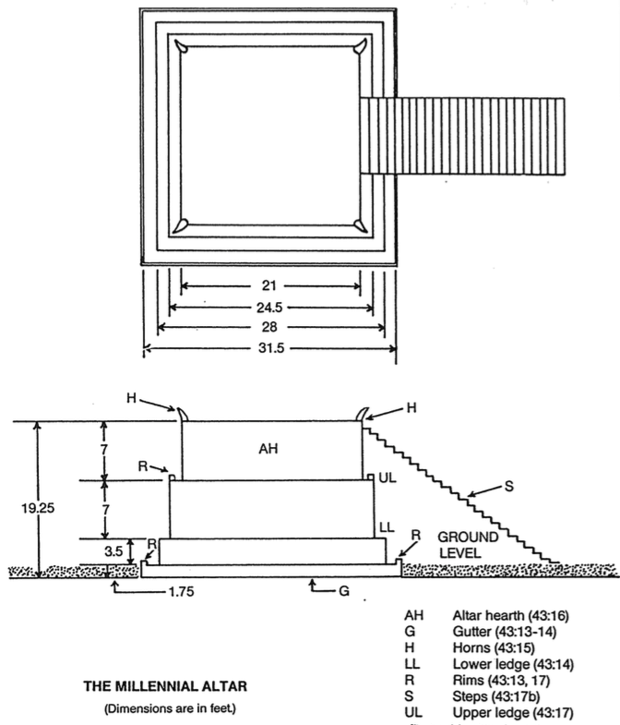
Altar (43:13-17)
519
Charles Dyer, "حزقيال,"
in The Bible Knowledge Commentary, 1:1307

Slide 31
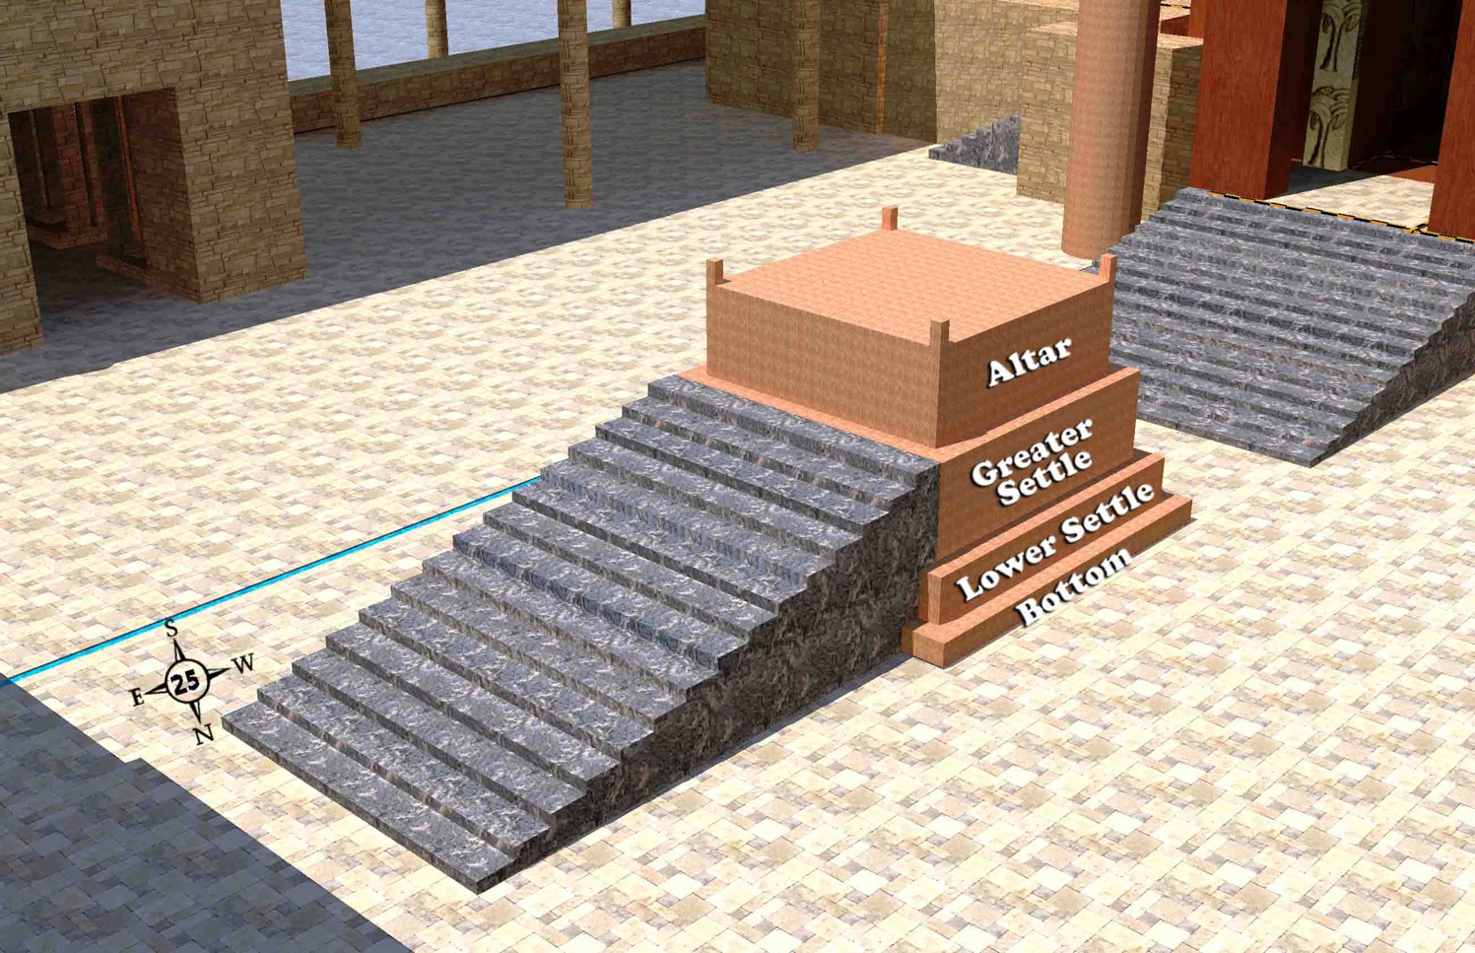
The Altar (43:13-17)
519
The large brass altar before the temple at the center of the inner court
Wayne ODonnell • "حزقيال 40–48: Tour of حزقيال's Temple" • http://bible.ag/en/enحزقيالtranscript.htm
Notes:
"See Picture #25. The large brass altar before the temple at the center of the inner court.
حزقيال 43:13-17, "And these are the measures of the altar ... the bottom shall be a cubit [high], and the breadth [of the bottom ledge] a cubit, and the border thereof by the edge thereof round about shall be a span: and this shall be the higher place of the altar. And from the bottom upon the ground even to the lower settle shall be two cubits [high], and the breadth [of the ledge] one cubit; and from the lesser [lower] settle even to the greater settle shall be four cubits [high], and the breadth [of the ledge] one cubit. So the altar shall be four cubits [high]; and from the altar and upward shall be four horns. And the altar shall be twelve cubits long, twelve broad, square in the four squares thereof. And the [lower] settle shall be fourteen cubits long and fourteen broad in the four squares thereof; and the border about it shall be half a cubit; and the bottom thereof shall be a cubit about; and his stairs shall look toward the east."
The stairs in the model should go all the way to the top of the altar, as a ramp reportedly did in the previous temples. This would be necessary because wood and large pieces of animals need to be carried to the top of the altar, which is very large for all the different work that needs to be performed there, and which cannot all be performed from the 2 foot wide topmost ledge."
Wayne ODonnell, "حزقيال 40–48: Tour of حزقيال's Temple"
http://bible.ag/en/mr4web.html#EZanchor-anchor
Recorded December 30, 2007
Accessed 30 Aug 2016

Slide 32
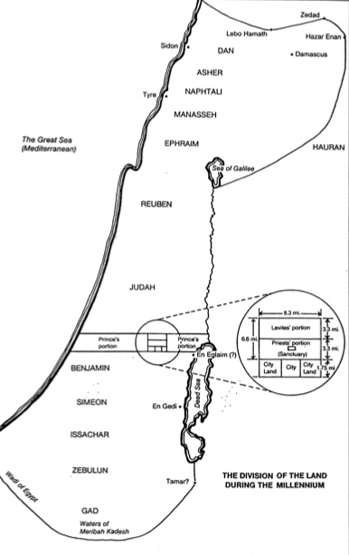
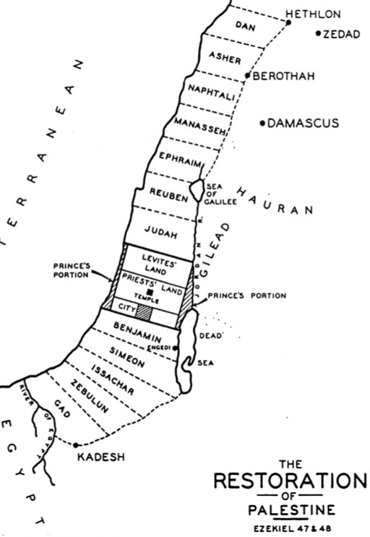
End Time Geography
146
147

Slide 33
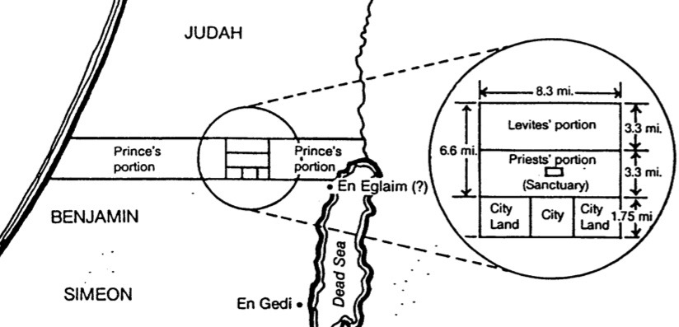
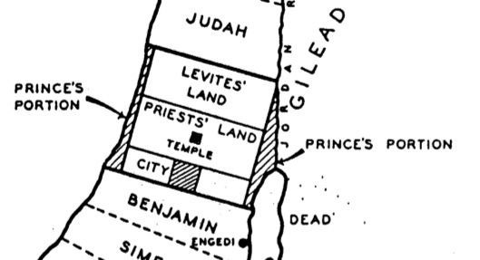
Priests, Levites & Prince Comparisons
146-147

Slide 34
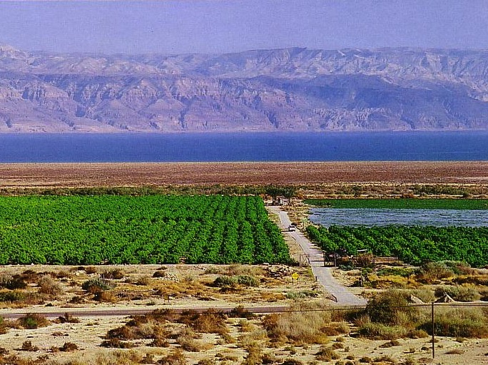
Crops from a Fresh Water Oasis
105
Ezekiel 47:10

Slide 35


Tribal Redistribution
Dan
531e
146
147
Asher
After Conquest
(Josh. 13)
Millennial Israel
(Ezek.
47–48)
Naphtali
Manasseh
Ephraim
Reuben
Judah
Leaders & Temple
Benjamin
Simeon
Issachar
Millennial Jerusalem in Ezekiel 47 retains its central location but is south (not north) of Judah
Zebulun
Gad

Slide 36
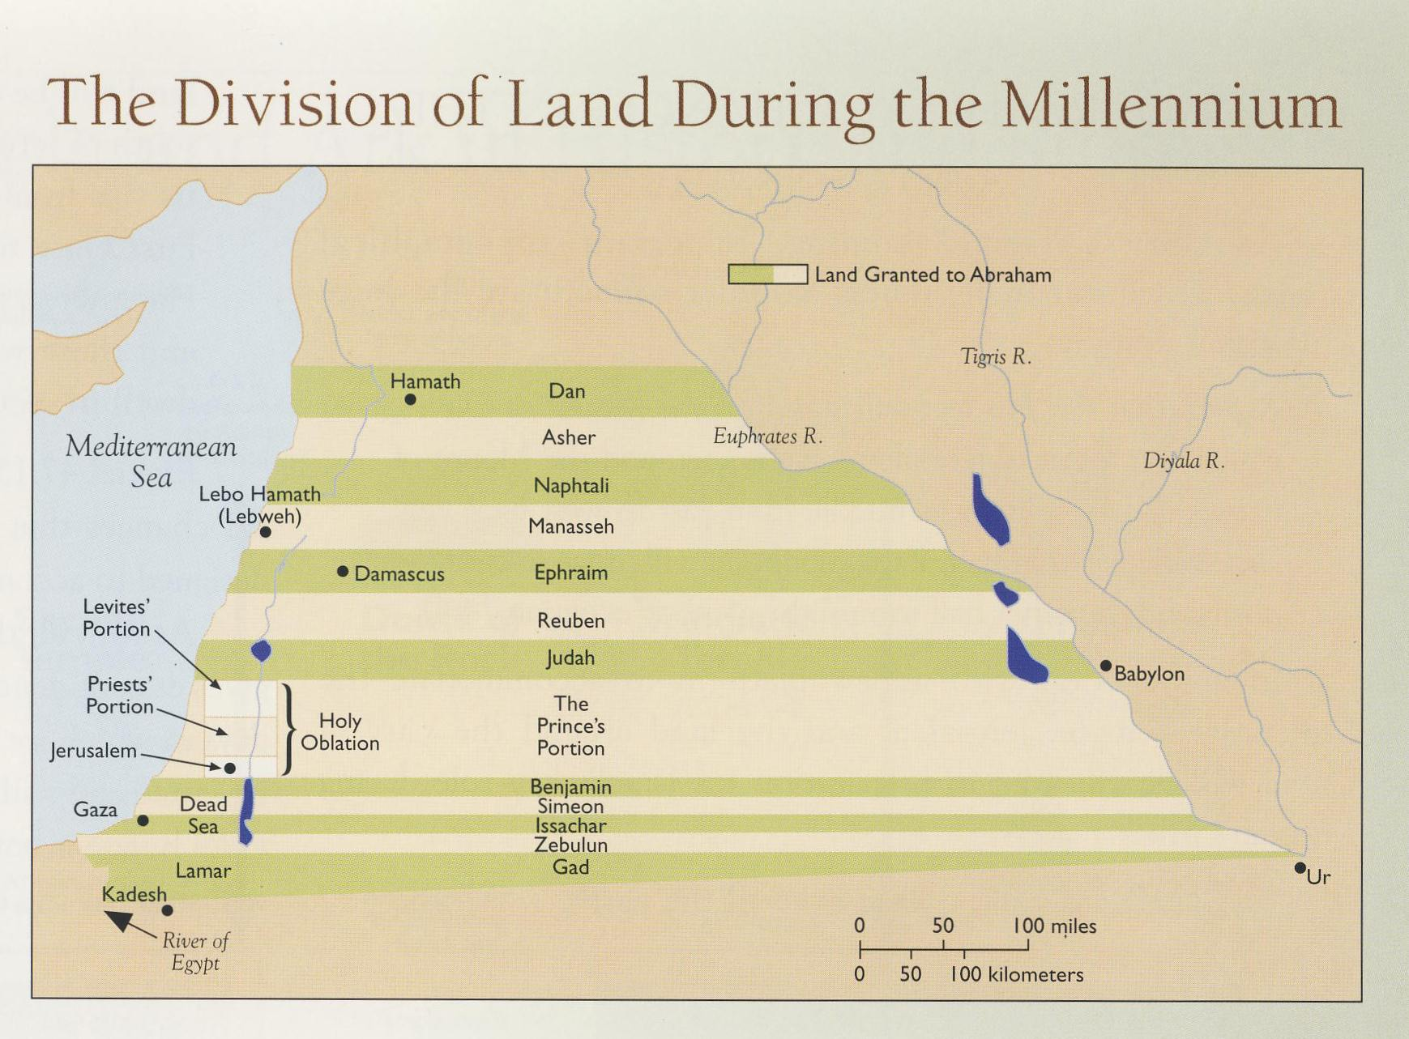
Another View of the Eastern Border
Tim LaHaye
This would bring the border all the way back to Abraham's original home at Ur

Slide 37
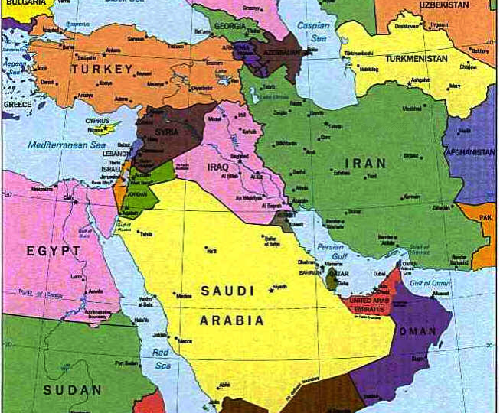
Will Israel's millennial border go all the way east to the Euphrates River?

Slide 38
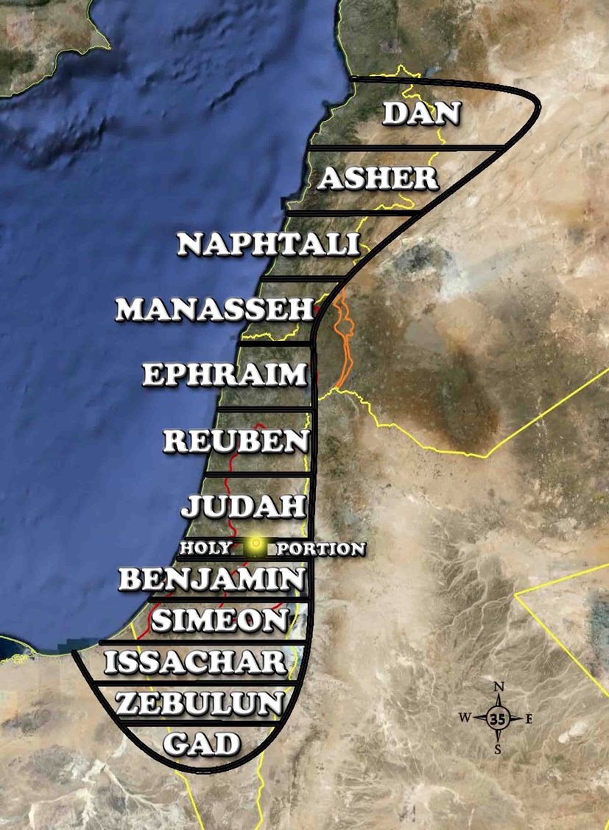
Land Portions (48:1-7)
531e
Portions of land for the tribes of Israel going straight across from east to west. I have not tried to present accurate boundaries, but rather to show the general arrangement of the tribal portions. For example, the Golan Heights will probably be within the borders of Israel, though the picture doesn't show it that way.
Wayne ODonnell • "Ezekiel 40 - 48: Tour of Ezekiel's Temple" • http://bible.ag/en/enezekieltranscript.htm
Notes:
"See Picture #35. Portions of land for the tribes of Israel going straight across from east to west. I have not tried to present accurate boundaries, but rather to show the general arrangement of the tribal portions. For example, the Golan Heights will probably be within the borders of Israel, though the picture doesn't show it that way.
Northern Boundaries. Ezekiel 48:1, "Now these are the names of the tribes. From the north end to the coast of the way of Hethlon, as one goeth to Hamath, Hazarenan, the border of Damascus northward, to the coast of Hamath." Hamath is present day Hama in Syria. The northern border of Israel during the Messianic Kingdom will extend to about the present northern border of Lebanon. Present day Lebanon will be part of millennial Israel.
Seven Northern Tribes. Ezekiel 48:2-7, "These are his sides east and west; a portion for Dan. And by the border of Dan, from the east side unto the west side, a portion for Asher. And by the border of Asher, from the east side even unto the west side, a portion for Naphtali. And by ... Naphtali, ... a portion for Manasseh. And by ... Manasseh, ... a portion for Ephraim. And by ... Ephraim, ... a portion for Reuben. And by ... Reuben, ... a portion for Judah." Each tribe's portion will extend completely across from the western boundaries, like the Jordan River, to the Mediterranean Sea.
Today most Jewish people don't know which tribe they are descended from, the exception being some descendants of priests and Levites who have family names like Cohen, the Hebrew word for priest, or Levi. But now we have genetic tests, and anyway the Lord knows the genealogy of everyone. Jewish tradition says that when Elijah returns before the Messianic Kingdom is set up, he will provide Jewish people with their tribal identities.
So although physical things like genealogies have no relevance in the church age or for spiritual salvation; in the future, genealogies will be important again, at least in determining how physically close to the shekinah glory a person will be able to live.
Some Gentiles, possibly proselytes, will dwell among the tribes in the land, "in what tribe the stranger sojourneth, there shall ye give him his inheritance," Ez47:23. And some Gentiles in their natural bodies during the kingdom will become servants to Israelites so they can live in the land. "Strangers shall stand and feed your flocks, and the sons of the alien shall be your plowmen and your vinedressers ... For your shame, ye shall have double [blessing, joy, inheritance, etc.]," Is60:1-61:7."
Wayne ODonnell, "Ezekiel 40 - 48: Tour of Ezekiel's Temple"
http://bible.ag/en/mr4web.html#EZanchor-anchor
Recorded December 30, 2007
Accessed 30 Aug 2016

Slide 39
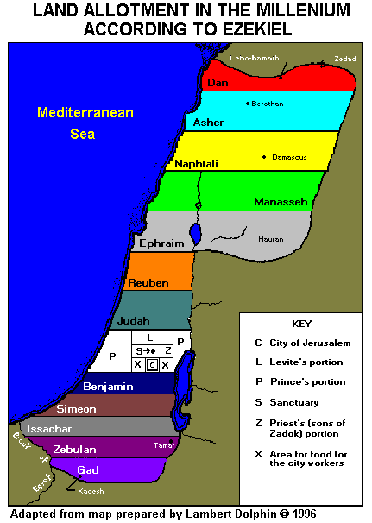
A Mediating View is Probably Most Accurate
Damascus
Hauren
Ezekiel 47:18 says, "The eastern border starts at a point between Hauran and Damascus and runs south along the Jordan River between Israel and Gilead, past the Dead Sea and as far south as Tamar. This will be the eastern border."
Gilead
Tamar

Slide 40

Millennial Jerusalem
106
“The law will go out from Zion,
the word of the LORD from Jerusalem”
—Isaiah 2:3

Slide 41
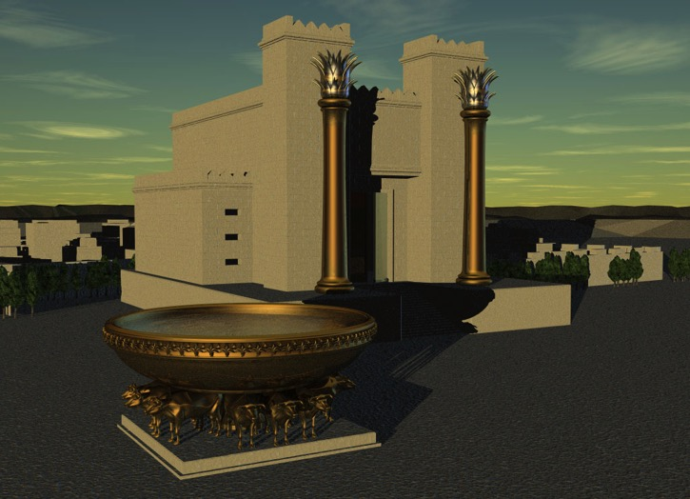
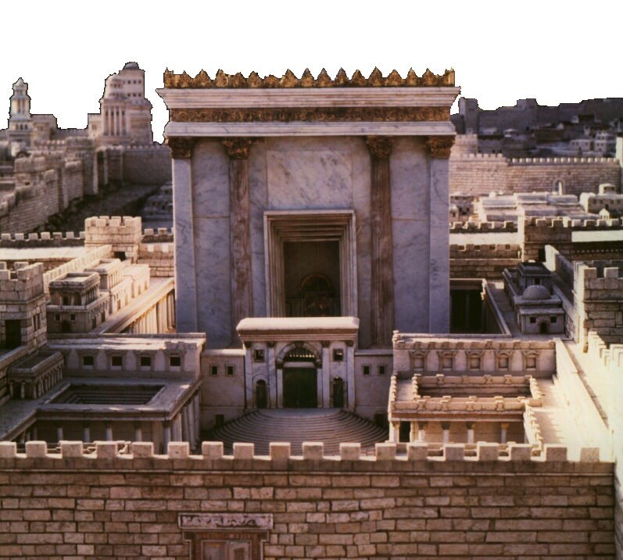
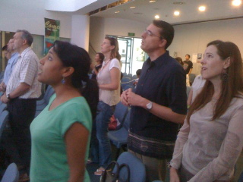
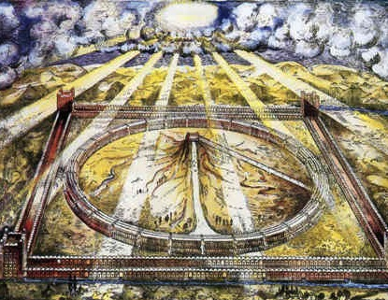
Which temple for Ezekiel?
133
Solomon
Zerubbabel/Herod
Three
Literal
Views
Conditional
Millennial
Church

Slide 42
Interpretations of 40–48
Literal/Historical: The First Temple
Literal/Historical: Zerubbabel's Temple
Literal/Historical: Herod's Temple
Symbolic/Present: The Church
Apocalyptic/Present: The Idealized Temple
Literal/Future: The Millennium Temple
Literal/Eternal: The Kingdom of God
Notes:
42

Slide 43
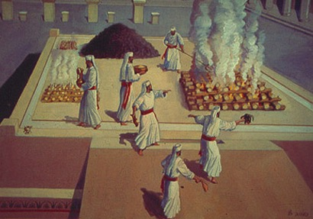
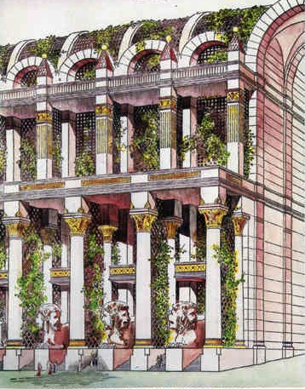
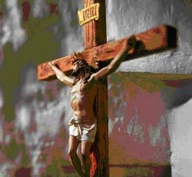
Problems Either Way!
138
Problems Either Way!
Premillennial:
Sacrifices for Sin
(40:39) in Light of Christ's Death
Amillennial:
Abandon Normal Hermeneutic for Ezekiel 40-48

Slide 44
Why Millennial Sacrifices?
Why Millennial Sacrifices?
139
Pre-Cross:
Looked toward Christ's Death
Post-Cross:
Look back on Christ's Death
Theocratic: like confession of sin (1 John 1:9)
Memorial: like Lord's Supper that looks back
Paul offered a temple sacrifice in AD 57 (Acts 21:26) without seeing a “digression problem”

Slide 45
Black

Slide 46


Future (Eschatology) at BibleStudyDownloads.org
Get this presentation for free!
Notes:
Future (fu)
Eschatology

