Slide 1

The Kingdom of God
What is it? When is it?
Dr. Rick Griffith • Jordan Evangelical Theological Seminary • BibleStudyDownloads.org

Slide 2

Kingdom Aspects
119d
----------The Universal Kingdom------------
----------The Spiritual Kingdom------------
Theocratic
Mystery Form
Millennial
Eternal
Mt Sinai
Judges/
Kings
Church Age
Millennium
Eternity
Tribulation

Slide 3

The Kingdom Diagrammed
Universal Kingdom
(everything inside and outside the circle)
119
Living Beings
All People
(saved and unsaved all in the box)
Spiritual
Kingdom
(saved
people)
Unsaved Before Christ
Saints prior to Moses
Theocracy & Monarchy
(OT Saints under Law in Israel)
Kingdom of Darkness
(shaded area of all ages with unsaved people and demons)
Present
Unbelievers
Church
Angels
& Animals
Tribulation
Unbelievers
Tribulation
Believers
Millennial
Unbelievers
Millennial
Believers
Second Death
(Hell)
Eternal Life
(Heaven)
Mystery Form
of the Kingdom
Millennial Kingdom

Slide 4
The Millennium
Part 2 of 2

Slide 5
Revelation 20:1-3 (NAU)
¹Then I saw an angel coming down from heaven, holding the key of the abyss and a great chain in his hand. ²And he laid hold of the dragon, the serpent of old, who is the devil and Satan, and bound him for a thousand years; ³and he threw him into the abyss, and shut it and sealed it over him, so that he would not deceive the nations any longer, until the thousand years were completed; after these things he must be released for a short time.

Slide 6
Revelation 20:4 (NAU)
⁴Then I saw thrones, and they sat on them, and judgment was given to them. And I saw the souls of those who had been beheaded because of their testimony of Jesus and because of the word of God, and those who had not worshiped the beast or his image, and had not received the mark on their forehead and on their hand; and they came to life and reigned with Christ for a thousand years.

Slide 7
Revelation 20:5-6 (NAU)
⁵The rest of the dead did not come to life until the thousand years were completed. This is the first resurrection. ⁶Blessed and holy is the one who has a part in the first resurrection; over these the second death has no power, but they will be priests of God and of Christ and will reign with Him for a thousand years.

Slide 8
Two Key Millennial Questions
120
When? Will Christ return before or after the millennium?
What? All agree there will be a millennium, but what kind will it be?

Slide 9
Basic Comparisons
120
 | Time When is the Millennium? Before/after Christ’s Return? How long is it? | Nature What kind of Millennium?
Amil | • Between 1st & 2nd advents • Before the Second Coming • Indefinite length | • Spiritual kingdom of Christ • The present age itself
Postmil | • No Specific Beginning Point • Before the Second Coming • Indefinite length (but a very few say it is a literal 1000 years, such as Boettner & Chilton) | • Literal rule of the Church on earth without Christ present • Similar to the present age (sin, marriage, birth & death present but greatly reduced)
Premil | • Future • After the Second Coming • Literal 1000 years | • Literal rule of Christ on earth • Similar to postmil except for Jewish elements, topographical changes, etc.

Slide 10
Millennial Advocates by Century
121
1
2
3
4
16
17
18
19
20
21
Premil
Amil
Postmil

Slide 11
Amillennialism
27
Second Coming
Spiritual reign of Christ
Tribulations
Church Age
Eternal Kingdom
Judgment
Notes:
11

Slide 12
27
Postmillennialism
Second Coming
Golden Age of the Gospel
Tribulations
Church Age
Eternal Kingdom
Judgment
Notes:
12

Slide 13
Premillennialism
27
Second Coming
Second Advent
=
Tribulation
Millennium
Church Age
Eternal Kingdom
7 years
1000 years
Judgment
Judgment
Notes:
13

Slide 14
Is there a future for ethnic believing Israel?
Dispensational
Premillennialism
Amillennialism &
Postmillennialism
Church & Israel distinct
Israel has a future
Church is new Israel
Israel has no future
Covenant
Premillennialism
Notes:
14
Covenant premillennialism seeks to bridge between dispensationalism and the amil/postmil views. Their advocates have largely convinced believers that it was the first view taught I the early church, so they are also called historic premil. But since the covenant premil view is posttrib in its view of the Tribulation, this would imply that the early church was posttrib. In reality, most of the early fathers believed in imminency that leads to a pretrib position, though none of these terms were yet coined.
In any event, both premil views believe in a prophetic future for ethnic Israel, though the covenant view does this inconsistently while seeking also to hold the opposite view that the Church is the “new Israel.”
__________
Common Arabic-260
Common English-230
ES-07-Premil/Dispensational-10
ES-16-Kingdom&Millennialism-14
NS-06-Romans9-11-slide

Slide 15
A Dispensational Timeline
473
Great
White
Throne
(Rev. 20:11-14)
Rapture
(1 Thess. 4:13-18)
2nd Advent
(Zech. 14:3-5)
Church Age
Tribulation
(Zech. 14:1-2)
Millennium
(Zech. 14:6-21)
Gog & Magog
(Armageddon)
(Ezek. 38–39)
Gog and Magog
Revisited
(Rev. 20:7-10)
Notes:
15

Slide 16
What's the Difference?
29
 | Dispensational | Non-Dispensational
Israel & the Church | Separate entities Israel ≠ Church | Same people of God Israel = Church (the “New Israel”)
Literal Interpretation | Consistently employed | Spiritualizing acceptable
Unifying Theme of Bible | Glory of God or Kingdom of God | Redemption of man or Kingdom of God

Slide 17
What's the Difference?
29
 | Dispensational | Non-Dispensational
Millennial View | Always premil | Pre-, Post-, or Amil
Tribulational View | Pretrib | Mid- or Posttrib
Recognizes Differing Economies | Yes–often 7 dispensations | Yes & No–Covenant of Grace but no sacrifices

Slide 18
What's the Difference?
29
 | Dispensational | Non-Dispensational
Biblical Covenants | Unconditional | Conditional or fulfilled
Future for Israel? | Yes | No (though covenant/ historic premil says yes)
Is the Church foreseen in the OT? | Generally No | Yes

Slide 19
What's the Difference?
29
 | Dispensational | Non-Dispensational
Distinguishes law & grace | More sharply | Not so sharp
Theological stance | Almost always conservative (few premil liberals!) | Conservative or liberal
Number of Adherents | Many–especially at lay level and at Bible colleges | Growing–especially at seminary level and Catholic Church

Slide 20
A Literal Kingdom for David's Line
22-23
Ordinary language for “kingdom” is used
Prophets interpreted the kingdom literally
Israel interpreted the kingdom literally
586 BC kingdom overthrown is the same kind
The Davidic Covenant relates only to Israel
David saw the covenant applying only to Israel
Portions have been fulfilled literally
David's throne is not related to Christ's present session in heaven
John, Jesus, the 12, and the 70 all offered Israel a literal kingdom (Matt. 3:11; 4:17; 10:7; Luke 10:1, 9)

Slide 21
Was the Kingdom Delayed?
131h
80g
Christ's kingdom will have the same political nature as promised by Isaiah (pp. 119b-d)
Christ is ruling on the throne of David right now
Matthew's reference to "Israel" today designates all Christians
God rejected Israel so the nation has no prophetic future remaining
God delayed the kingdom for ethnic Israel after the nation rejected Christ
A U D
A U D
A U D
A U D
A U D

Slide 22
A Literal, Political Kingdom
"Jesus replied, 'I assure you that when the world is made new and the Son of Man sits upon his glorious throne, you who have been my followers will also sit on twelve thrones, judging the twelve tribes of Israel'"
(Matt. 19:28 NLT)

Slide 23
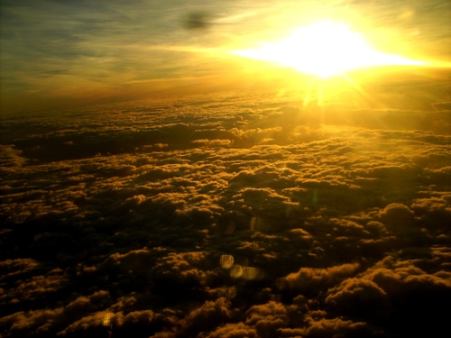
Christ's Future Rule in Jerusalem
Isaiah 2:1-5; 4:2-6
Dr. Rick Griffith • Crossroads International Church
BibleStudyDownloads.org

Slide 24
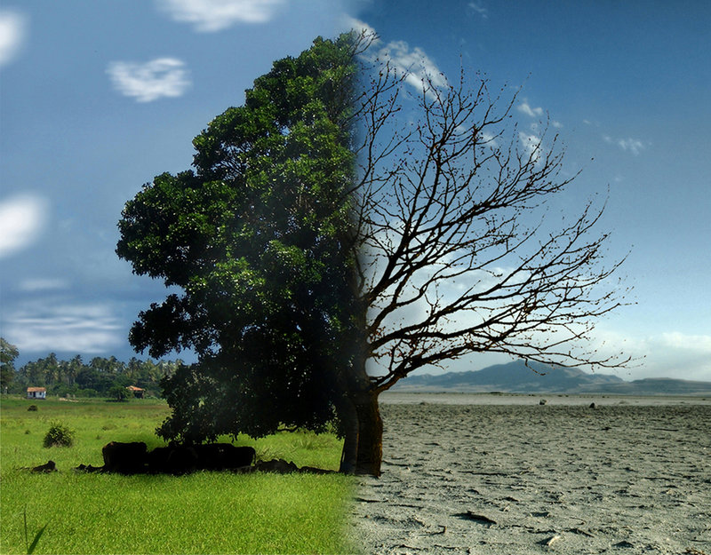
What in the world is happening?
Good
Bad
Notes:
Not too many people today feel that the world is getting better. Most say it is getting worse.
Financially the currencies are no longer backed by gold.
The family has fallen apart in most, if not all, countries.
Ethnic and religious conflicts abound.

Slide 25
What in the world is happening?
Do you have hope it will get better?
Good
Bad
Notes:
Do you think the next US president will turn the tide?
Do you think Singapore will be less crowded in the future?
Do you feel Singapore will become more affordable?
Have you ever heard a sermon on what the world will be life after Jesus returns?

Slide 26
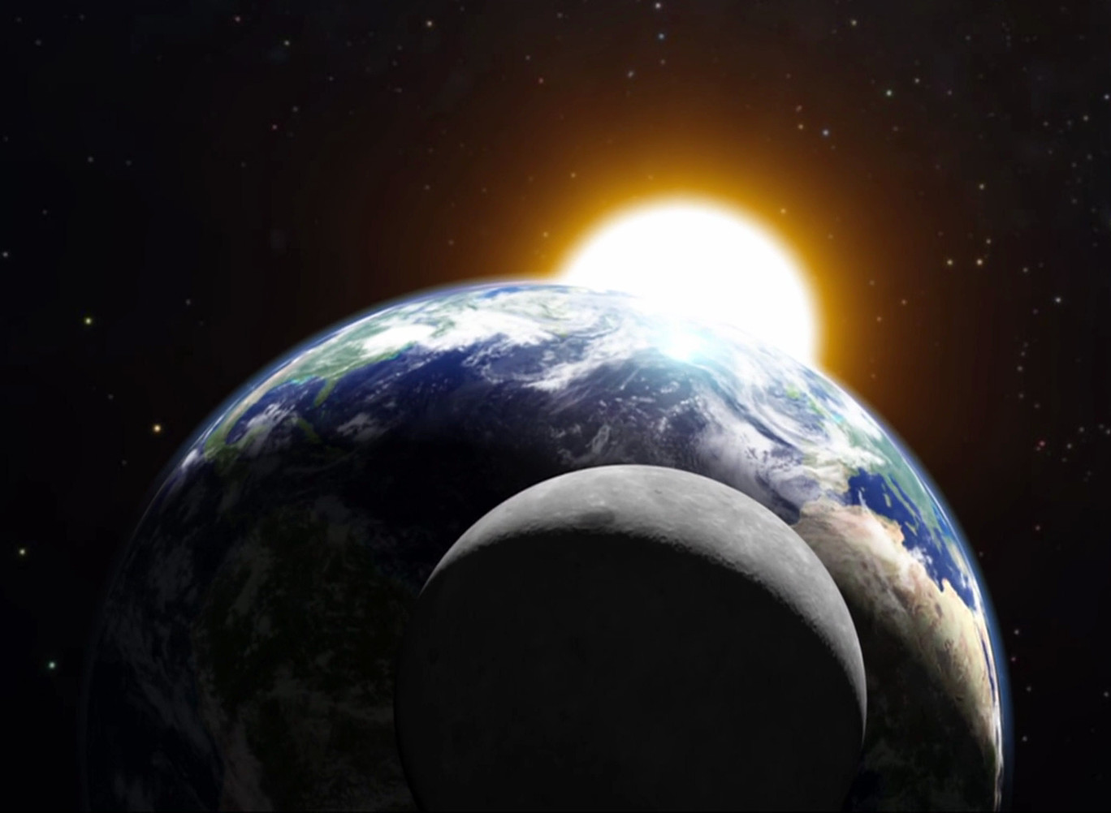
What will it be like when Christ rules this world?

Slide 27
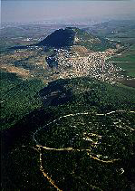
Life in Isaiah's Day
(735 BC)

Slide 28
The Assyrian Threat
454
Assyrian Expansion
Nineveh
Mediterranean
Sea
Aram
Israel
Judah
700s BC
Persian
Gulf
Egypt
Notes:
28

Slide 29

When Isaiah Wrote
453
End of the
Kings of Israel
Pekah
Hoshea
Kings of Judah
Uzziah
Jotham
Ahaz
Hezekiah
Isaiah's 60 Year Ministry
(740-680 BC)
Notes:
29

Slide 30

Isaiah 1
When God Takes His People to Court
Dr. Rick Griffith, Crossroads International Church, Singapore
www.biblestudydownloads.com

Slide 31

Court Procedure
Charge
Evidence
Verdict

Slide 32
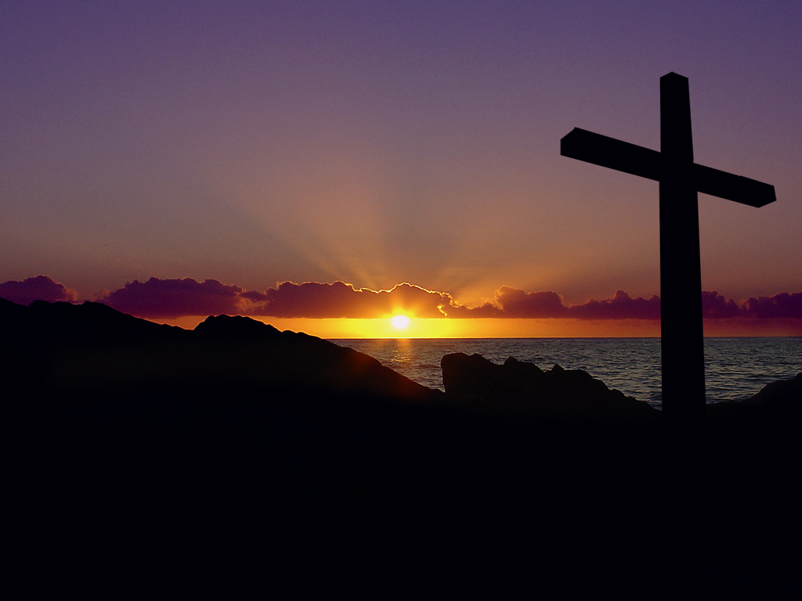
Isaiah 1 Main Idea
When rituals replace relationship, repent for restoration.
Notes:
Turn to God instead of religion—so don't be religious, be restored!
This comes through a change of mind (repentance) followed by the fruits of repentance (justice)

Slide 33
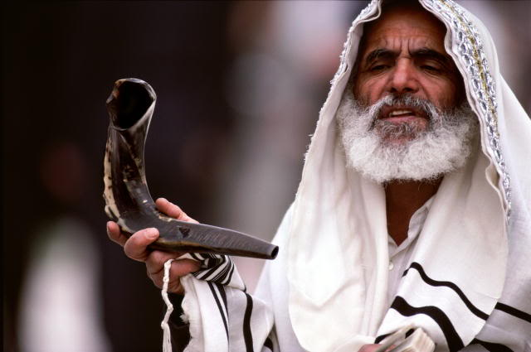
Two Key Texts:
Isaiah 2:1-5
Isaiah 4:2-6

Slide 34

I. Jesus will bring worldwide truth and peace (2:1-5).
Notes:
Christ will give us all God's values that will finally help us get along.

Slide 35
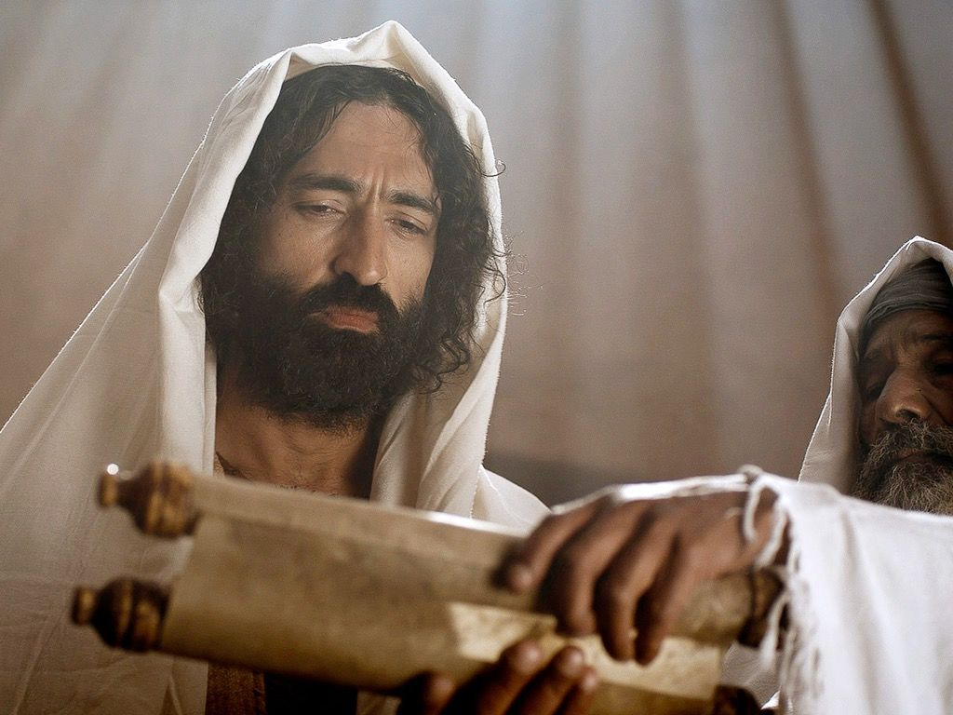
Christ will teach all people from Temple Mount (2:1-3)

Slide 36
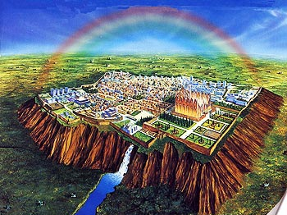
"In the last days,
the mountain of the LORD's house
will be the highest of all—
the most important place on earth.
It will be raised above the other hills,
and people from all over the world will stream there to worship"
(Isa. 2:2 NLT).

Slide 37

Solomon's Temple
502
Ezekiel 8:4

Slide 38
Solomon's Temple
502
Ezekiel 9:3

Slide 39
Solomon's Temple
502
Ezekiel 10:4

Slide 40
Solomon's Temple
502
Ezekiel 10:18-19

Slide 41

The Glory Leaving
502
Ezekiel 11:23

Slide 42
The Glory Returns
502
Ezekiel

Slide 43


Ezekiel's temple won't fit on the present Temple Mount!
Ezekiel 40–43
521
www.pauljab.net/temple/ TemplePictures.html

Slide 44
Who copied whom?
ESV Isaiah 2:2 It shall come to pass in the latter days that the mountain of the house of the LORD shall be established as the highest of the mountains, and shall be lifted up above the hills; and all the nations shall flow to it,
ESV Micah 4:1 It shall come to pass in the latter days that the mountain of the house of the LORD shall be established as the highest of the mountains, and it shall be lifted up above the hills; and peoples shall flow to it,
Notes:
44

Slide 45
Who copied whom?
ESV Isaiah 2:3 and many peoples shall come, and say: "Come, let us go up to the mountain of the LORD, to the house of the God of Jacob, that he may teach us his ways and that we may walk in his paths." For out of Zion shall go the law, and the word of the LORD from Jerusalem.
ESV Micah 4:2 and many nations shall come, and say: "Come, let us go up to the mountain of the LORD, to the house of the God of Jacob, that he may teach us his ways and that we may walk in his paths." For out of Zion shall go forth the law, and the word of the LORD from Jerusalem.
Notes:
45

Slide 46
Who copied whom?
ESV Isaiah 2:4 He shall judge between the nations, and shall decide disputes for many peoples; and they shall beat their swords into plowshares, and their spears into pruning hooks; nation shall not lift up sword against nation, neither shall they learn war anymore.
ESV Micah 4:3 He shall judge between many peoples, and shall decide for strong nations afar off; and they shall beat their swords into plowshares, and their spears into pruning hooks; nation shall not lift up sword against nation, neither shall they learn war anymore
Notes:
46

Slide 47

461b
Millennial Jerusalem
"The law will go out from Zion,
the word of the LORD from Jerusalem"
—Isaiah 2:3
Notes:
47

Slide 48

48 Levitical Cities
171a
6 Cities of Refuge

Slide 49

The Teacher

Slide 50
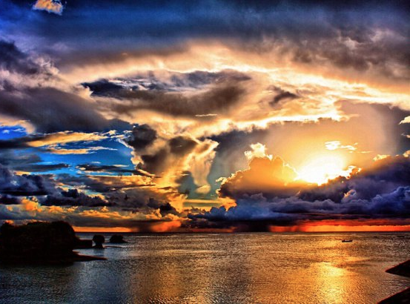
Christ will bring worldwide peace (2:4)
"He will judge between the nations and will settle disputes for many peoples" (4a).
Notes:
Christ will judge between countries at the worldwide court (2:4a).
What kind of disputes will Jesus settle among the nations (2:4a)? All arguments!
I think this means that the nations are going to stop arguing with each other as they have done for millennia.

Slide 51
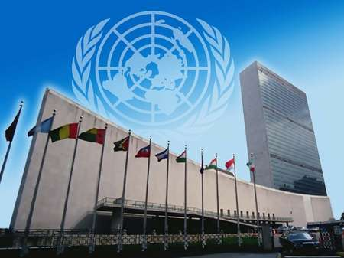
United Nations Building, New York

Slide 52
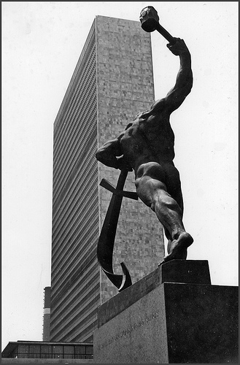
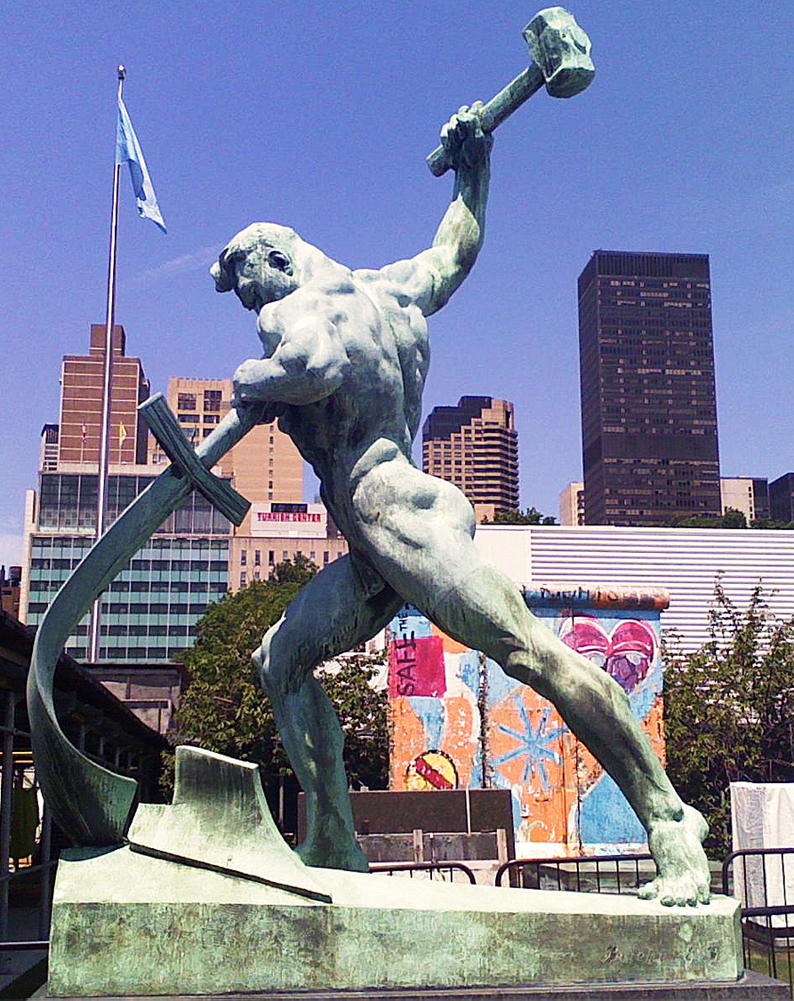
United Nations Building (New York)
Notes:
"Let Us Beat Swords into Plowshares
But first...
What is a plowshare?!
A plowshare is part of a plow. It is the leading edge that cuts
into the earth when turning over the dirt.
Let Us Beat Swords into Plowshares was sculpted
by Yevgeny Vuchetich. It was donated to the UN by the USSR in 1959.
The sculpture stands in the garden of the UN Headquarters."
https://sites.google.com/site/cdaunexploration/let-us-beat-swords-into-plowshares
Accessed 8 July 2015

Slide 53
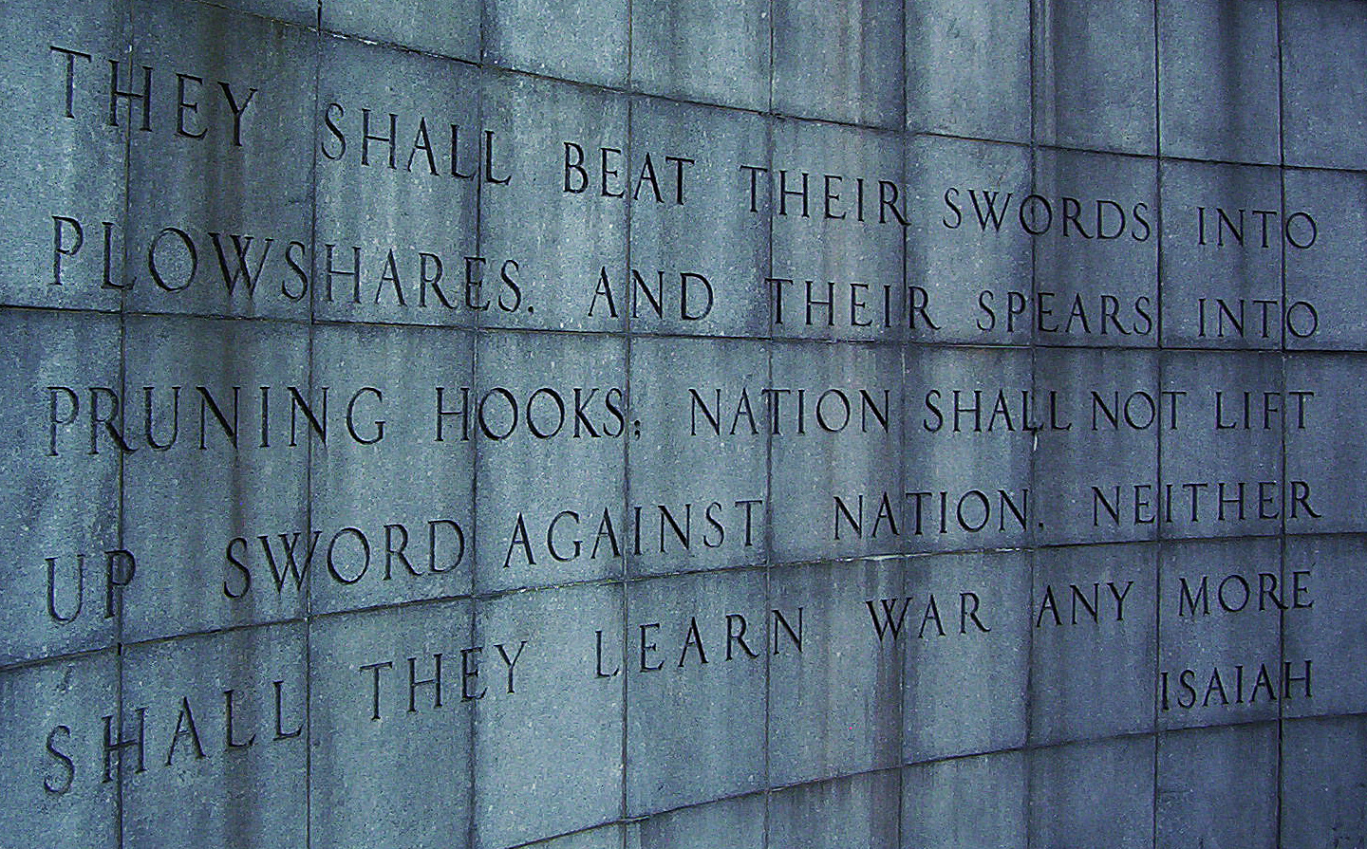
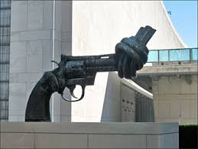
United Nations Building, New York

Slide 54
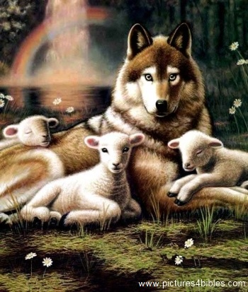
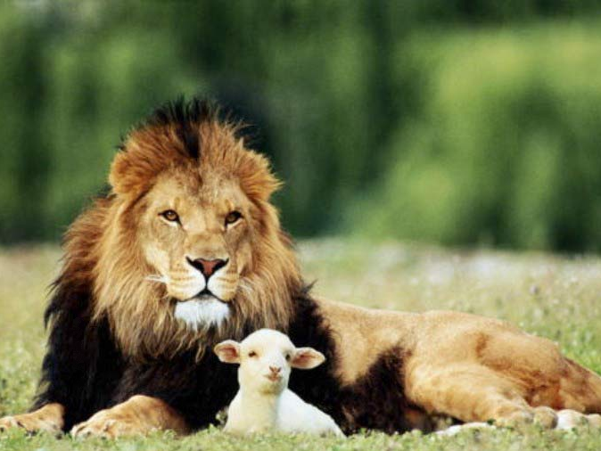
Isaiah 11:6-9
473a
⁶ And the wolf will dwell with the lamb, and the leopard will lie down with the young goat, and the calf and the young lion and the fatling together.
Notes:
54

Slide 55
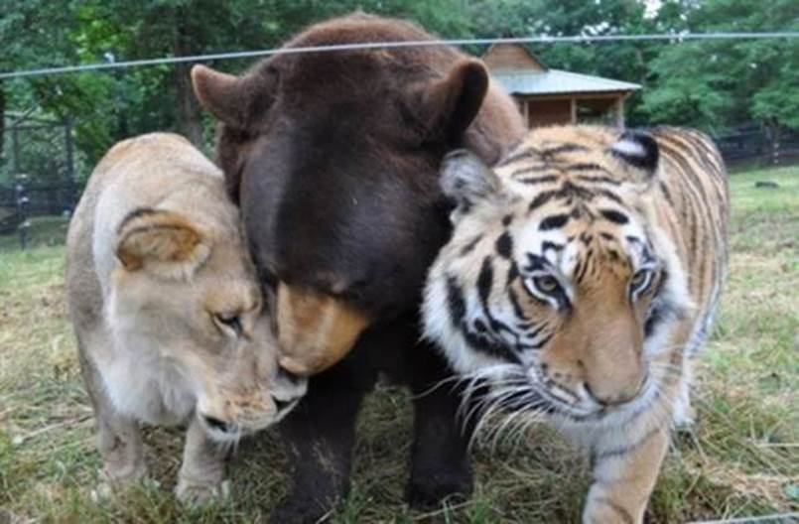
“Lions, Tigers & Bears! Oh, My!”
Notes:
In “The Wizard of Oz,” Dorothy exclaims with fear upon thinking that she would have to travel through the forest to get to Oz, “Lions, tigers and bears! Oh, My!” Yes, these are dangerous animals—most of the time!
• We may think that all carnivorous animals must kill to eat, but a peaceful environment even today can be instructive that peace in the animal kingdom doesn’t even have to wait until the millennium.
“An American black bear, a Bengal tiger and an African lion were the victims of animal cruelty....”
________________
How An Abused Lion, Tiger And Bear Became An Unlikely Family (PHOTOS)
The Huffington Post | By Alexandra Zaslow
Posted: 12/03/2013 12:28 pm EST Updated: 12/04/2013 11:57 am EST
http://www.huffingtonpost.com/2013/12/03/lion-tiger-bear-negligence_n_4374091.html
Accessed 30 Sep 2015

Slide 56
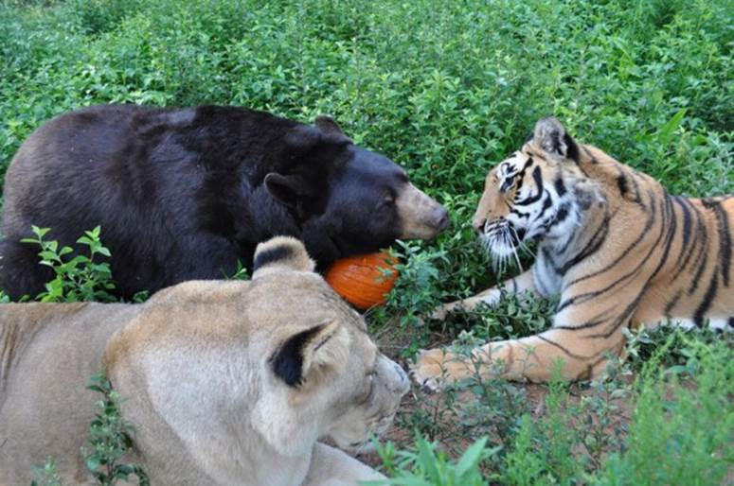
Baloo the Bear, Leo the Lion, and Shere Khan the Tiger (all three known as BLT)
Notes:
“Baloo the bear, Leo the lion, and Shere Khan the tiger (all three known as BLT) were brought together as 2-month-old cubs and have grown up as a family.”
_______________
How An Abused Lion, Tiger And Bear Became An Unlikely Family (PHOTOS)
The Huffington Post | By Alexandra Zaslow
Posted: 12/03/2013 12:28 pm EST Updated: 12/04/2013 11:57 am EST
http://www.huffingtonpost.com/2013/12/03/lion-tiger-bear-negligence_n_4374091.html
Accessed 30 Sep 2015

Slide 57
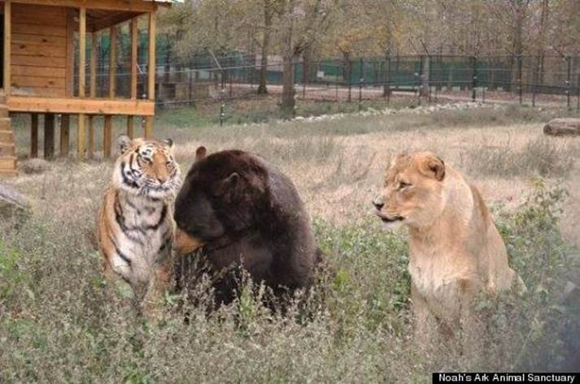
“Lions, Tigers & Bears! Oh, My!”
Notes:
“The trio was originally owned by a drug dealer who didn't properly care for them, leading to neglect, poor health and severe injuries.”
_______________
How An Abused Lion, Tiger And Bear Became An Unlikely Family (PHOTOS)
The Huffington Post | By Alexandra Zaslow
Posted: 12/03/2013 12:28 pm EST Updated: 12/04/2013 11:57 am EST
http://www.huffingtonpost.com/2013/12/03/lion-tiger-bear-negligence_n_4374091.html
Accessed 30 Sep 2015

Slide 58
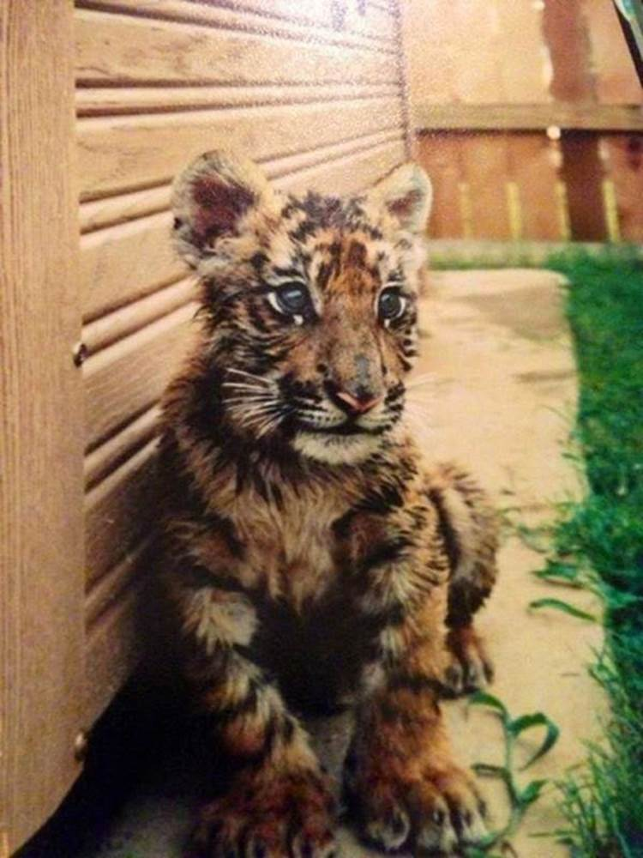
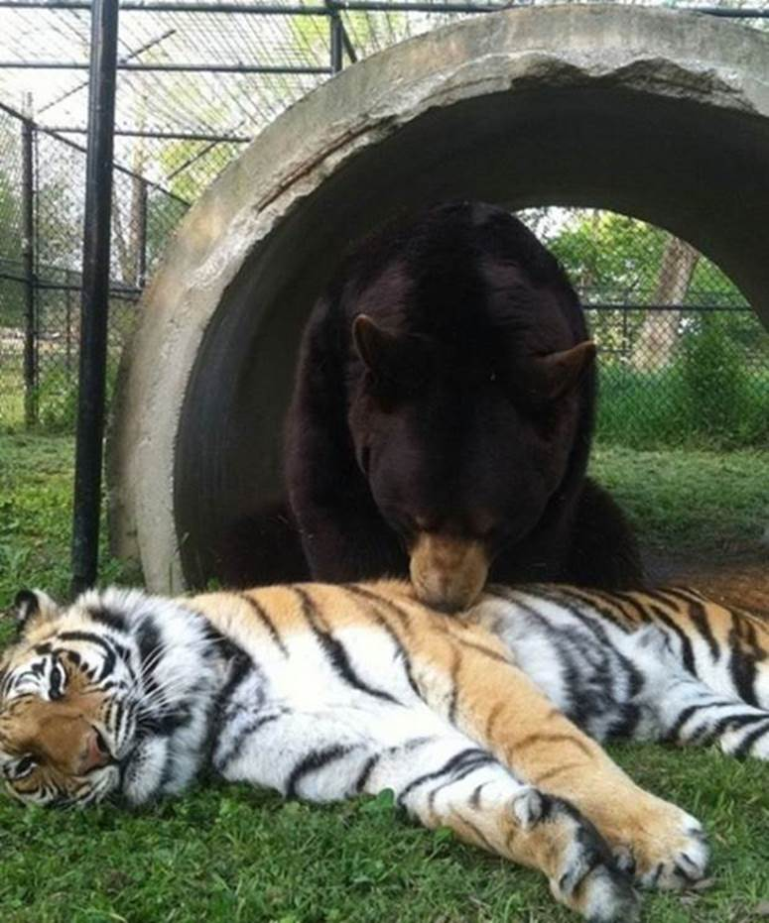
“Lions, Tigers & Bears! Oh, My!”
Notes:
“In 2001, Noah's Ark Animal Sanctuary, a nonprofit that cares for animals in need, came to the rescue, and took them to Locust Grove, Georgia, where they were treated for injuries.”
_______________
How An Abused Lion, Tiger And Bear Became An Unlikely Family (PHOTOS)
The Huffington Post | By Alexandra Zaslow
Posted: 12/03/2013 12:28 pm EST Updated: 12/04/2013 11:57 am EST
http://www.huffingtonpost.com/2013/12/03/lion-tiger-bear-negligence_n_4374091.html
Accessed 30 Sep 2015

Slide 59
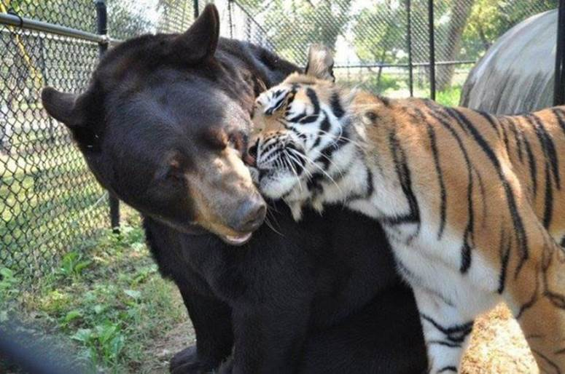
“Lions, Tigers & Bears! Oh, My!”
Notes:
“Baloo required greater care than his two friends -- his former owner had put a harness on him and didn't adjust it as he grew, leading to a deformity, Imgur reports.”
_______________
How An Abused Lion, Tiger And Bear Became An Unlikely Family (PHOTOS)
The Huffington Post | By Alexandra Zaslow
Posted: 12/03/2013 12:28 pm EST Updated: 12/04/2013 11:57 am EST
http://www.huffingtonpost.com/2013/12/03/lion-tiger-bear-negligence_n_4374091.html
Accessed 30 Sep 2015

Slide 60
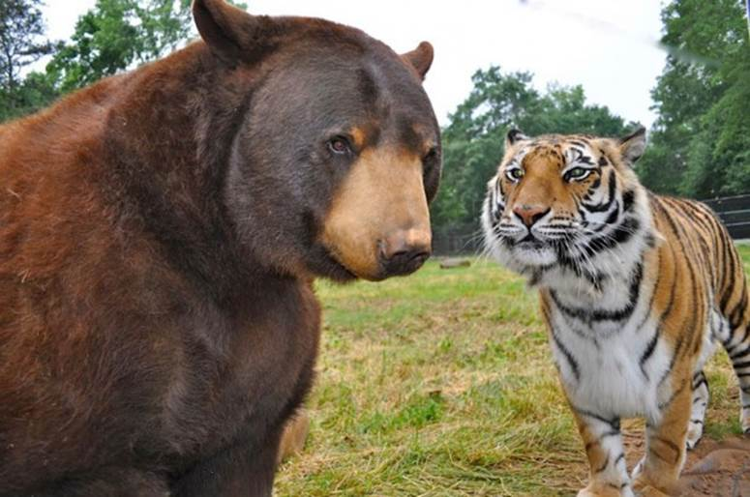
“Lions, Tigers & Bears! Oh, My!”
Notes:
“After arriving in Georgia, Baloo had the harness surgically removed.”
_______________
How An Abused Lion, Tiger And Bear Became An Unlikely Family (PHOTOS)
The Huffington Post | By Alexandra Zaslow
Posted: 12/03/2013 12:28 pm EST Updated: 12/04/2013 11:57 am EST
http://www.huffingtonpost.com/2013/12/03/lion-tiger-bear-negligence_n_4374091.html
Accessed 30 Sep 2015

Slide 61
“Lions, Tigers & Bears! Oh, My!”
Notes:
“Given that the trio had found comfort in each other during their years of mistreatment, The Sanctuary's staff realized that they couldn't be separated and fenced them in together.”
_______________
How An Abused Lion, Tiger And Bear Became An Unlikely Family (PHOTOS)
The Huffington Post | By Alexandra Zaslow
Posted: 12/03/2013 12:28 pm EST Updated: 12/04/2013 11:57 am EST
http://www.huffingtonpost.com/2013/12/03/lion-tiger-bear-negligence_n_4374091.html
Accessed 30 Sep 2015

Slide 62
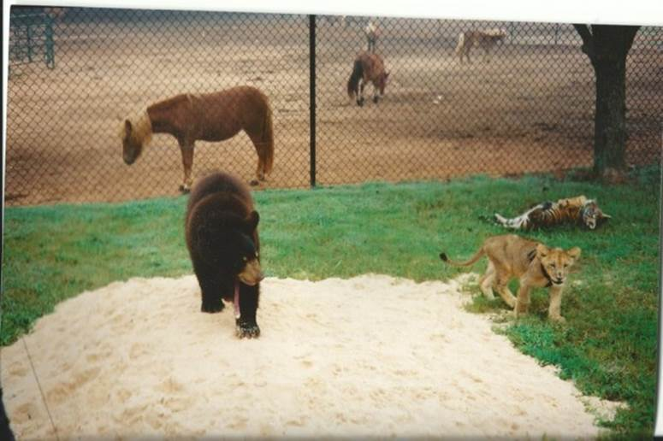
“Lions, Tigers & Bears! Oh, My!”
Notes:
“Unfortunately, the government passed new federal regulations requiring big cat enclosures to have 16 foot fences put up, which would take effect in October of this year. Baloo, Leo and Shere Khan's fence was only 8 feet high. If these regulations weren't met, the three animals would have to split up.
Rebuilding the fence would cost $489,000.”
_______________
How An Abused Lion, Tiger And Bear Became An Unlikely Family (PHOTOS)
The Huffington Post | By Alexandra Zaslow
Posted: 12/03/2013 12:28 pm EST Updated: 12/04/2013 11:57 am EST
http://www.huffingtonpost.com/2013/12/03/lion-tiger-bear-negligence_n_4374091.html
Accessed 30 Sep 2015

Slide 63
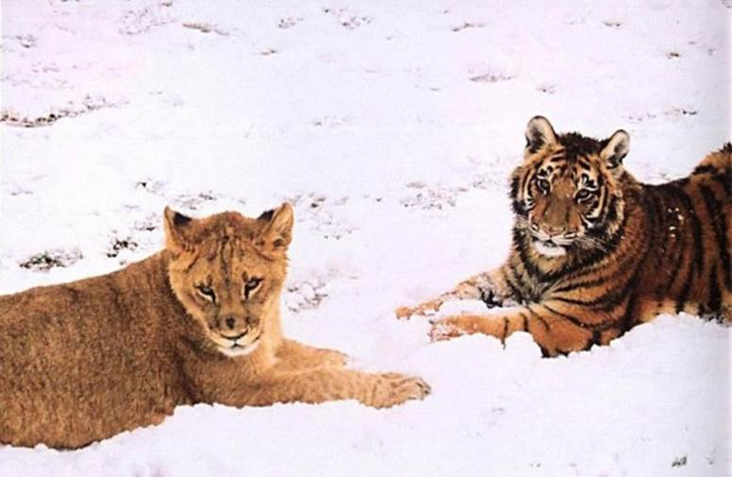
“Lions, Tigers & Bears! Oh, My!”
Notes:
“With October slowly approaching, The Sanctuary entered a contest to help raise money. On August 15, CrowdRise, an online fundraising site, teamed up with RYOT, a social news platform to announce a challenge called #STARTARYOT, according to ncronline.com. They offered $75,000 to the nonprofit that raised the most money in five weeks.”
_______________
How An Abused Lion, Tiger And Bear Became An Unlikely Family (PHOTOS)
The Huffington Post | By Alexandra Zaslow
Posted: 12/03/2013 12:28 pm EST Updated: 12/04/2013 11:57 am EST
http://www.huffingtonpost.com/2013/12/03/lion-tiger-bear-negligence_n_4374091.html
Accessed 30 Sep 2015

Slide 64
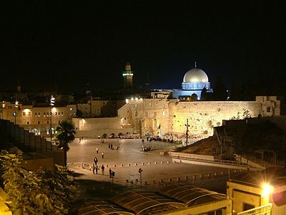
"The LORD has sworn to Jerusalem by his own strength: 'I will never again hand you over to your enemies. Never again will foreign warriors come and take away your grain and new wine'"
(Isa. 62:8 NLT).

Slide 65
I. Jesus will bring worldwide truth and peace (2:1-5).
Notes:
Christ will give us all God's values that will finally help us get along.

Slide 66
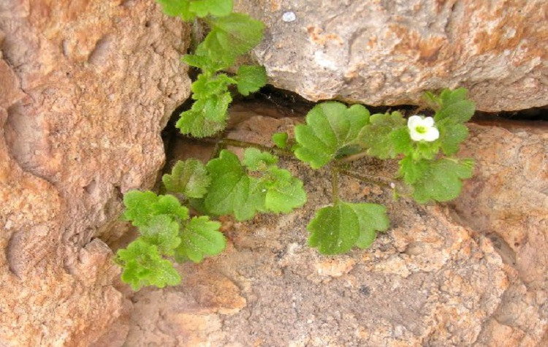
II. Jesus will bring worldwide prosperity, holiness and protection (4:2-6).
Notes:
Christ will give us all God's values that will finally help us get along.

Slide 67

"In that day the Branch of the LORD will be beautiful and glorious, and the fruit of the land will be the pride and glory of the survivors in Israel" (4:2 NIV).

Slide 68
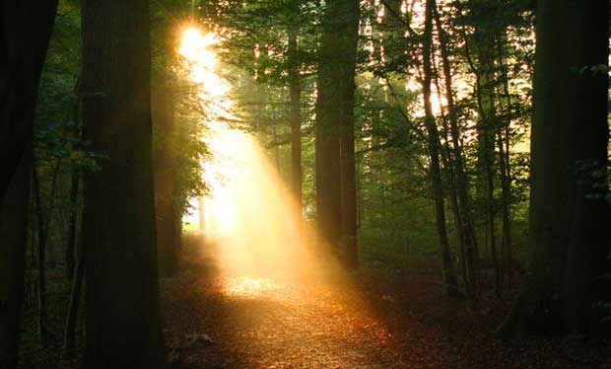
The Branch
"The prophet looked beyond the 'day of the Lord' to that time when the kingdom will be established on earth. 'Branch of the Lord' is a messianic title for Jesus Christ, who came as a 'shoot' from the seeming dead stump of David's dynasty (11:1; 53:2; see Jer. 23:5; 33:15; Zech. 3:8; 6:12). God will cleanse His people (Isa. 4:4; see Zech. 12:10–13:1), restore the fruitfulness of the land, and dwell with them as He did when He led them through the wilderness (Isa. 4:5–6; Ex. 13:21–22). Not just the temple, but every dwelling will be blessed by the presence of the Lord! Unlike in Isaiah's day, 'in that day' the people will be holy (set apart), and the land will be beautiful and glorious."
Warren W. Wiersbe, Be Comforted: Feeling Secure in the Arms of God, 33
Notes:
"The prophet looked beyond the 'day of the Lord' to that time when the kingdom will be established on earth. 'Branch of the Lord' is a messianic title for Jesus Christ, who came as a 'shoot' from the seeming dead stump of David's dynasty (11:1; 53:2; see Jer. 23:5; 33:15; Zech. 3:8; 6:12). God will cleanse His people (Isa. 4:4; see Zech. 12:10–13:1), restore the fruitfulness of the land, and dwell with them as He did when He led them through the wilderness (Isa. 4:5–6; Ex. 13:21–22). Not just the temple, but every dwelling will be blessed by the presence of the Lord! Unlike in Isaiah's day, 'in that day' the people will be holy (set apart), and the land will be beautiful and glorious" (Warren W. Wiersbe, Be Comforted: Feeling Secure in the Arms of God, 33).

Slide 69

"In that day the Branch of the LORD will be beautiful and glorious, and the fruit of the land will be the pride and glory of the survivors in Israel"
(4:2 NIV).

Slide 70
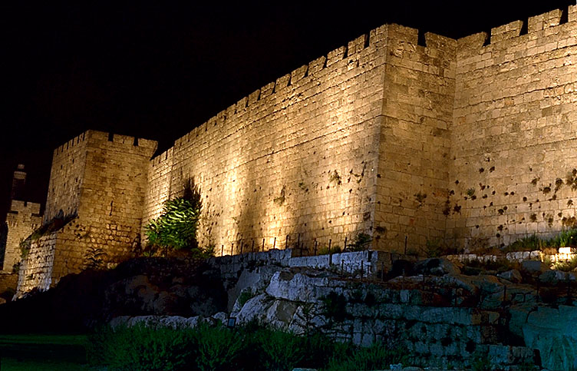
"O Jerusalem, I have posted watchmen on your walls; they will pray day and night, continually.
Take no rest, all you who pray to the LORD. ⁷Give the LORD no rest until he completes his work, until he makes Jerusalem the pride of the earth" (Isa. 62:6-7 NLT).

Slide 71

Christ will make holy Jerusalem's remnant in mortal bodies (4:3-4).

Slide 72
A Look at the Future
473
Great
White
Throne
(Rev. 20:11-14)
Rapture
(1 Thess. 4:13-18)
2nd Advent
(Zech. 14:3-5)
Church Age
Tribulation
(Zech. 14:1-2)
Millennium
(Zech. 14:6-21)
Gog & Magog
(Armageddon)
(Ezek. 38–39)
Gog and Magog
Revisited
(Rev. 20:7-10)
Notes:
72

Slide 73
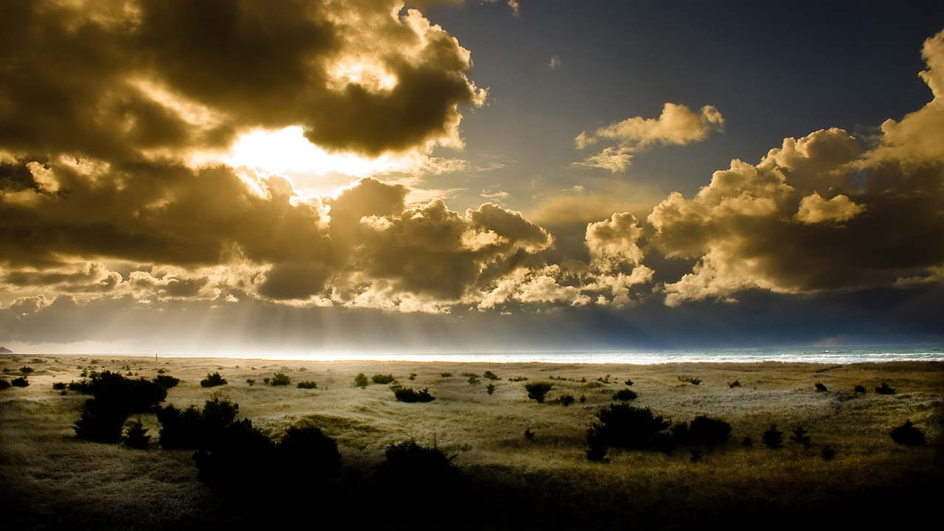
Christ will protect Jerusalem's citizens from the sun and rain (4:5-6).

Slide 74
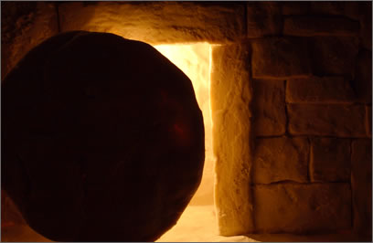
Main Idea
Jesus will bring worldwide truth, peace, prosperity, holiness and protection

Slide 75
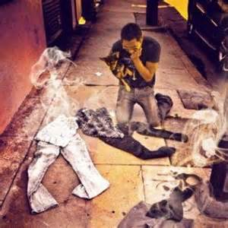
Main Idea

Slide 76


Revelation 20:4-6 Diagrammed
NTS 424
^{4b}and they came to life and reigned with Christ for a thousand years.
^{4a}Then I saw thrones, and they sat on them, and judgment was given to them. And I saw the souls of those who had been beheaded because of their testimony of Jesus and because of the word of God, and those who had not worshiped the beast or his image, and had not received the mark on their forehead and on their hand…
1000 years
^{5b}This is the first resurrection. ^{6a}Blessed and holy is the one who has a part in the first resurrection; over these the second death has no power…
^{6b}but they will be priests of God and of Christ and will reign with Him for a thousand years.
^{5a}The rest of the dead did not come to life until the thousand years were completed.

Slide 77
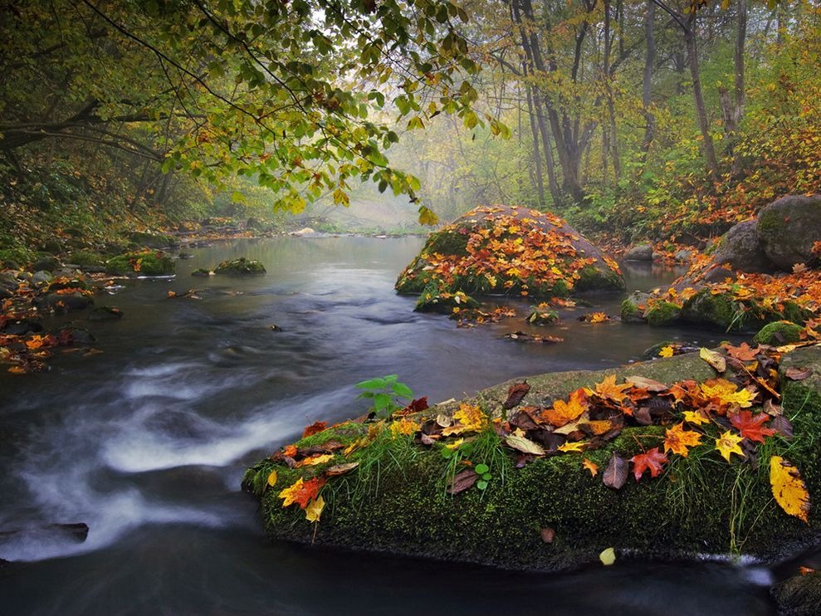
Purposes of the Millennium
NTS 424
Judge angels (1 Cor. 6:3)

Slide 78
"Don't you realize that someday we believers will judge the world? And since you are going to judge the world, can't you decide even these little things among yourselves? ³Don't you realize that we will judge angels? So you should surely be able to resolve ordinary disputes in this life"
(1 Cor. 6:2-3 NLT)

Slide 79
Purposes of the Millennium
NTS 424
Judge angels (1 Cor. 6:3)
Rule the earth (1 Cor. 6:2)

Slide 80
Purposes of the Millennium
NTS 424
Judge angels (1 Cor. 6:3)
Rule the earth (1 Cor. 6:2)
Restore world to pre-Flood era (long life of Isa. 65:20)

Slide 81
Incredibly Long Life (NIV)!
NTS 424
NIV Isaiah 65:20 "Never again will there be in [Jerusalem] an infant who lives but a few days, or an old man who does not live out his years; he who dies at a hundred will be thought a mere youth; he who fails to reach a hundred will be considered accursed."
Notes:
81

Slide 82
Purposes of the Millennium
NTS 424
Judge angels (1 Cor. 6:3)
Rule the earth (1 Cor. 6:2)
Restore world to pre-Flood era (long life of Isa. 65:20)
Show the human heart corrupt

Slide 83
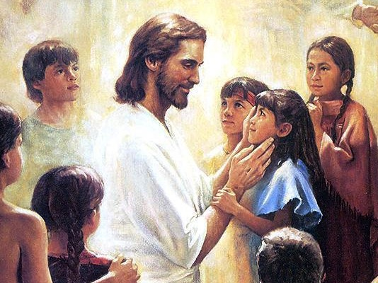
Christ will have a Spirit-led and righteous rule (11:1-5)
Christ will have a Spirit-led and righteous rule (Isa. 11:1-5)

Slide 84
Purposes of the Millennium
NTS 424
Judge angels (1 Cor. 6:3)
Rule the earth (1 Cor. 6:2)
Restore world to pre-Flood era (long life of Isa. 65:20)
Show the human heart corrupt
Fulfill Abrahamic Covenant

Slide 85


Abraham
Abraham
Heroes of the Faith
Notes:
In Genesis 12 the account switches directions from discussing all peoples to zeroing in on one man and his family—the man Abraham.

Slide 86
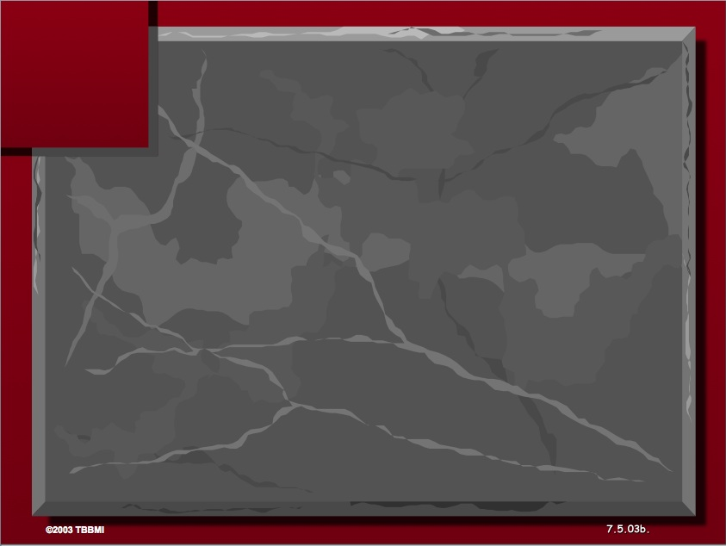
The Three Basic Elements
7
Genesis 12
The Lord had said to Abram,
"Leave your country, your people and your father's household, and go to the land I will show you.
1
A LAND
A SEED
"I will make you into a great nation
and I will bless you;
I will make your name great,
and you will be a blessing.
2
ABRAHAM
The CALL
I will bless those who bless you,
and whoever curses you I will curse;
and all peoples on earth
will be blessed through you."
L - S - B
3
A BLESSING
Handbook pg. 19-24
14
2

Slide 87
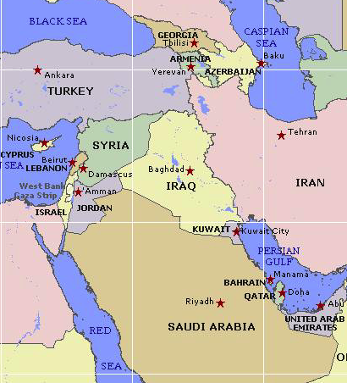

Borders of the Land Promised to Abraham
Genesis 15:18
"On that day the LORD made a covenant with Abram, saying, 'To your offspring I give this land, from the river of Egypt to the great river, the river Euphrates'" (ESV)

Slide 88
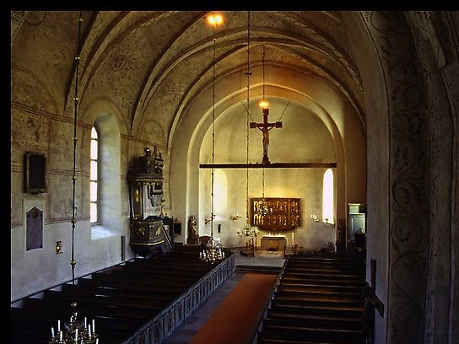
Covenants Fulfilled in the Millennium
60
Abrahamic
Land
Davidic
New
Land | Seed | Blessing
Physical | Political | Spiritual
Deut. 30 | 2 Sam. 7 | Jer. 31

Slide 89
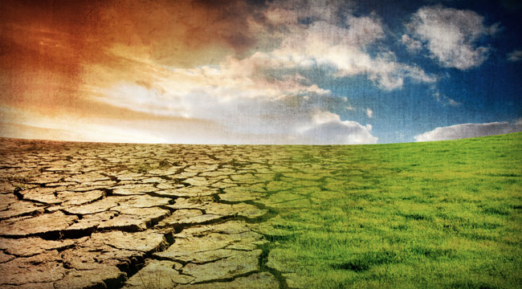
Isaiah's Key Idea
452
343
Judgment
Salvation
Notes:
In contrast to humanism, God says that he will judge the world, but then renew it—or restore it.

Slide 90
Key Word
452
343
Restoration
A Study of Isaiah

Slide 91
Since Jesus will reign, you should serve him now so your can rule with him later (Isaiah 2:5)!

Slide 92

Jesus Shall Reign
Words: Isaac Watts (1674-1748)
CCLI Song #11026168
Music: 2008 Van Ness Press, Inc.
(Admin. by Music Services, Inc.)
CIC CCLI Licence # 277507
Notes:
In the late 1600s and early 1700s, Isaac Watts was an English Christian minister, hymn writer, and theologian. He was a prolific and popular hymn writer and is credited with some 750 hymns. His theology showed that he believed in a literal millennium where Jesus would rule even with a renewed sacrificial system. This is evident in his 1719 hymn "Jesus Shall Reign." Note the future—that Jesus shall rule in the days ahead.
http://www.lyricsondemand.com/miscellaneouslyrics/christianlyrics/jesusshallreignwhereerthesunlyrics.html

Slide 93
Jesus Shall Reign
Jesus shall reign where'er the sun
Doth his successive journeys run
His Kingdom stretch from shore to shore,
Till moons shall wax and wane no more.
To Him shall endless prayer be made.
And princes throng to crown His head,
His name like sweet perfume shall rise
With every morning sacrifice.
Notes:
Watts understood that Christ's future rule would be over the entire earth and would be so until the moon no longer waxed and waned. Since the eternal state will have neither sun nor moon (Rev. 21:4), Watts was referring to the earthly reign of Christ in the future millennium after the Second Coming.
______________
http://www.lyricsondemand.com/miscellaneouslyrics/christianlyrics/jesusshallreignwhereerthesunlyrics.html

Slide 94
Jesus Shall Reign
People and realms of every tongue
Dwell on His love with sweetest song;
And infant voices shall proclaim
Their early blessings on His name.
Blessings abound where'er He reigns:
The prisoner leaps to lose his chains,
The weary find eternal rest,
And all the sons of want are blest.
Notes:
http://www.lyricsondemand.com/miscellaneouslyrics/christianlyrics/jesusshallreignwhereerthesunlyrics.html

Slide 95
Jesus Shall Reign
Where He displays His healing power
Death and the curse are known no more;
In Him the tribes of Adam boast
More blessings than their father lost.
Let every creature rise and bring
Peculiar honors to our King;
Angels descend with songs again,
And earth repeat the loud Amen.
Notes:
http://www.lyricsondemand.com/miscellaneouslyrics/christianlyrics/jesusshallreignwhereerthesunlyrics.html

Slide 96
Black

Slide 97


Future (Eschatology) at BibleStudyDownloads.org
Get this presentation for free!
Notes:
Future (fu)
Eschatology

