Slide 1

PRETERISM
474
Dr. Rick Griffith • Jordan Evangelical Theological Seminary • BibleStudyDownloads.org • Edited from a 2010 class presentation by Joshua Daniel Rungsung, Penny Quek & Joni Siau
Notes:
_________
NC-13-Preterism-1
NS-27-Rev20-22—slide 367

Slide 2
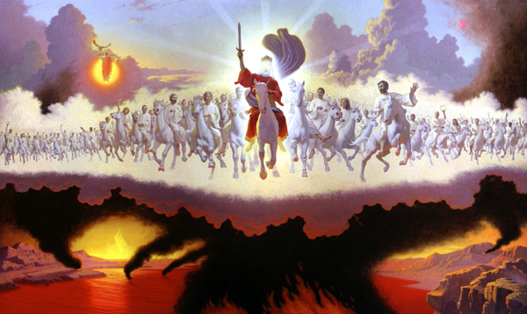
I. Introduction
475

Slide 3
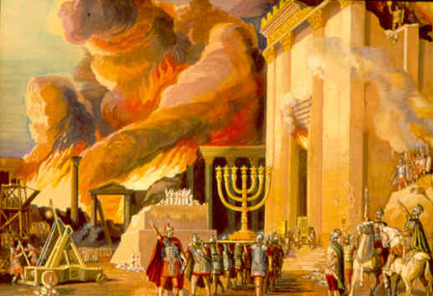
A.D. 70
475
Tribulation?
Notes:
What is meant by the term "Tribulation"? Is it the burning of Jerusalem's temple in AD 70?

Slide 4

Unable to find a parking space
475
Tribulation?
Notes:
Sometimes we use the term loosely even to describe not being able to find a parking space!

Slide 5

9/11
475
Tribulation?
Notes:
Certainly, 9/11 was a tribulation for the Americans.

Slide 6
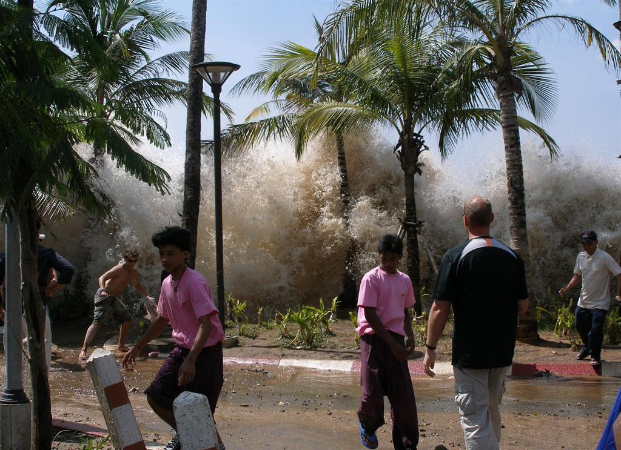
Tsunami
475
Tribulation?
Notes:
And the tsunami of 26 Dec 2004 was a great trial for those who endured it.

Slide 7
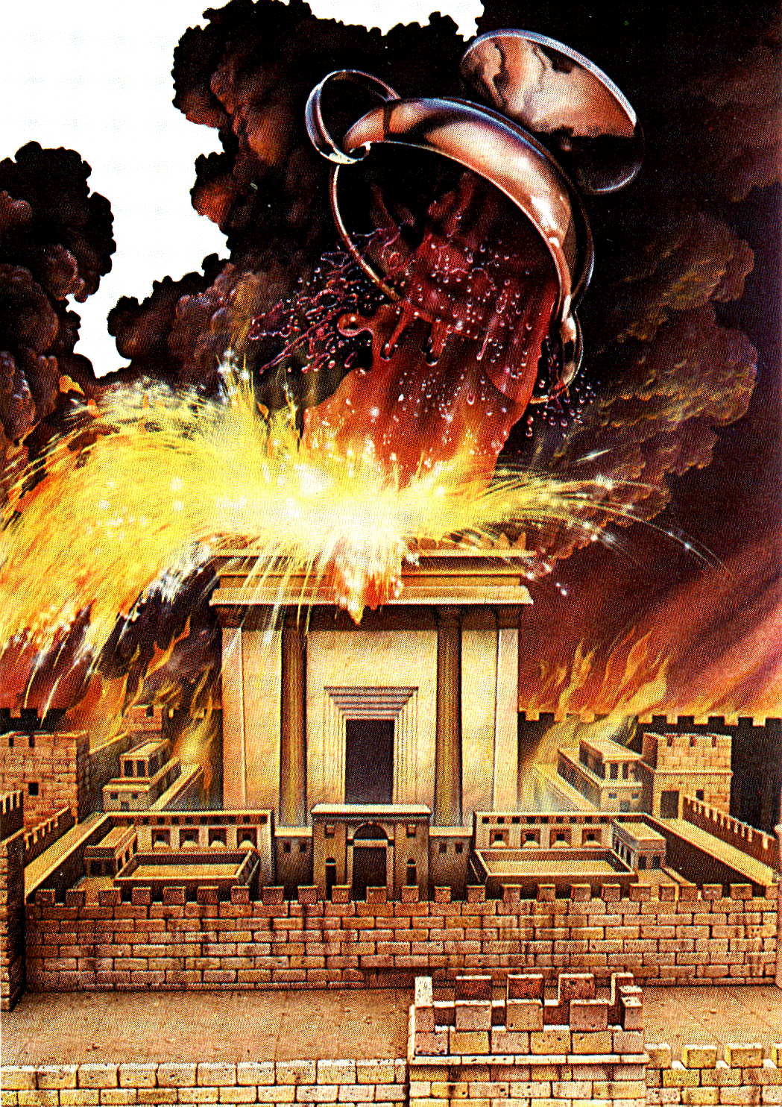
The Bowl Judgments
475
Tribulation?
Notes:
Whereas others will use the term only for the bowl judgments of Rev 6.

Slide 8

four major eschatological views
475
Preterism | Past
Historicism | Present
Futurism | Future
Idealism | Timeless
Notes:
When speaking about the biblical prophecies and the timing of tribulation in history, there are four possibilities to which time is being referred:
Preterism – the tribulation is “past”
Historicism – the tribulation is “present”
Futurism – the tribulation is “future”
Idealism – the tribulation is “timeless”
In a very brief way of summarizing these four views, the preterist (the Latin word, meaning “past”) believes that most, if not all, prophecy has already been fulfilled during the destruction of Jerusalem in A.D. 70. The historicist (remember we said this is “present”) sees much of the current church age as part of the tribulation period. In other words, the prophecies in the Bible are being fulfilled right now. This may overlap with the view of the idealist as well.
The futurist, on the other hand, usually believes that most of the prophetic events will take place in the future. To him, the tribulation of the seven years, the Second Coming of Christ, the 1000-year millennium as well as the eternal state are all future events. The idealist does not believe that the prophecies in the Bible have timing for the events nor does it believe that one can determine the timing of these prophecies. They see prophetic passages as teachings of great truth about God and are to be used as an application to our present lives.

Slide 9

Definition
475
An eschatological viewpoint that sees most or all of Bible prophecy as being fulfilled sometime in the past (1st century AD after the death of Christ, at the destruction of Jerusalem in A.D. 70)
Notes:
Preterism is an eschatological viewpoint that sees most or all of Bible prophecy as being fulfilled sometime in the past. In other words, preterism holds that some or all of the Bible prophecies concerning the end times were fulfilled in the 1st century AD after the death of Christ, at the destruction of Jerusalem in A.D. 70. Those who believe in Preterism are called Preterists.

Slide 10
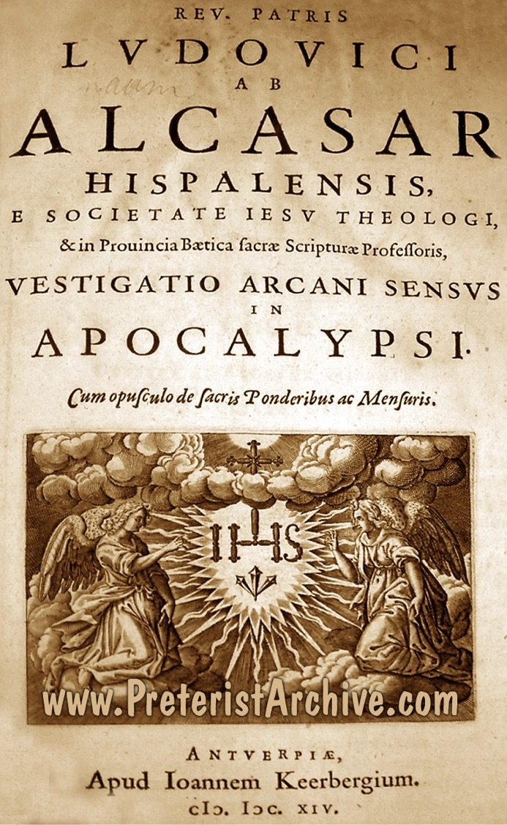
History
475
The first systematic preterist exposition of prophecy was written by Luis De Alcasar in 1614.
Johnson
Notes:
Historically, there is a general agreement that the first systematic Preterist exposition of prophecy was written in 1614 by the Spanish Jesuit named Luis De Alcasar.
—Alan Johnson, “Revelation.” In Expositors Bible Commentary, Vol. 12, Edited by Frank E. Gaebelein, 397-603 (Grand Rapids: Zondervan, 1981), 409.

Slide 11
Kenneth L. Gentry, Jr.
475
"The word 'preterist' is from Latin term praeteritus, which means 'gone by,' or past. Preterism holds that the tribulation prophecies (of Matthew and Revelation) occur in the first century."
Notes:
Kenneth Gentry, a modern preterist, has defined preterism as follows: “The word ‘preterist’ is based on the Latin term praeteritus, which means ‘gone by,’ or past. Preterism holds that the tribulation prophecies (of Matthew and Revelation) occurred in the first century, thus in our past.”
The view of the Preterist is not new to the prophetic debate. Proponents of Preterism argue that this position was the original eschatological understanding of the early Christian church. This claim, of course, is contested by the historicists and others as well. Some other Preterists, however, hold that the view was developed in the 17th century. This brings us to the variants of Preterism but this shall be introduced in just a short while.
Kenneth Gentry claimed that the preterist view had a powerful influence in the last few centuries and many writings by famous scholars such as John Calvin (1509-1564), Hugo Grotius (1583-1645), Henry Hammond (1605-1660), Thomas Scott (1747-1821), Moses Stuart (1780-1852) and Milton Terry (1840-1914) have been found.
Kenneth L. Gentry Jr. & Thomas Ice, The Great Tribulation: Past or Future? (Grand Rapids: Kregel, 1999), 13.
—Kenneth L. Gentry Jr. & Thomas Ice, The Great Tribulation: Past or Future? (Grand Rapids: Kregel, 1999), 13.

Slide 12
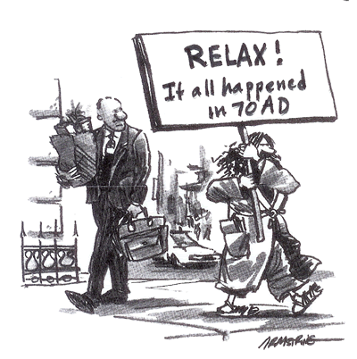
Types of Preterists
476
Extreme Preterists
(Radical/Full/Consistent
Preterists) see Tribulation,
Resurrection, 2nd Coming
& Judgments as past
Mild Preterists
God judged Jews (A.D. 70) & Rome (A.D. 313)
Still look forward for the 2nd Coming of Christ
Moderate Preterists
(Partial Preterists) – Almost all prophecies
fulfilled in A.D. 70, Future 2nd Coming
Notes:
Preterists can be classified into three broad categories. There are the Extreme Preterists, the Mild Preterists and the Moderate Preterists
Extreme Preterists: They are also known as Radical Preterists, Full Preterists or Consistent Preterists. They believe that all events predicted in the Scripture, including the Second Coming, the resurrection of the dead and the final judgments have already taken place. Sproul writes concerning them, “Radical Preterism sees all future prophecies of the New Testament as having already taken place.” The Moderate Preterists and the non-Preterists see Radical Preterists as outside of Christian orthodoxy.
Mild Preterists: The Mild Preterists believe that the tribulation was fulfilled within the first 300 years of Christianity when God judged His two enemies: (1) the Jews in A.D. 70 and (2) Rome by A.D. 313. However, these adherents still look towards the future Second Coming of Jesus Christ.
Moderate Preterists: They are also known as Partial Preterists. They teach that almost all prophecies have been fulfilled in the destruction of Jerusalem in A.D. 70, but they also hold to a future Second Coming and bodily resurrection. Some of the proponents of Moderate Preterists are R C Sproul, Kenneth Gentry, etc.
Alan Johnson responds to the presupposition of the Preterists that Revelation 4-22 are events contemporary to John’s time, “This approach identifies the book with the Jewish apocalyptic method of producing ‘tracts for the times’ to encourage faithfulness during intense persecution.” It needs to be noted that even if these prophecies were written to bring comfort and encouragement to those who are going through suffering, it does not rule out the fulfillment of the prophetic contents of God’s word in the near or distant future.
For the sake of our presentation today, we will discuss some of the key issues that go across the various views of Preterists by analyzing their arguments and our responses.
Paul N. Benware, Understanding End Times Prophecy: A Comprehensive Approach (Chicago: Moody Publishers, 1995, 2006), 156.
R.C. Sproul, The Last Days According to Jesus (Grand Rapids: Baker Books, 1998, 2000), 24.
Benware, Understanding End Times Prophecy, 157.
Johnson, Revelation, 409. Johnson affirms that liberal interpreters have taken this particular methodology. He gives a bibliography of the books written by the Preterists and for further studies on Preterism, one can look it up at page 412.

Slide 13
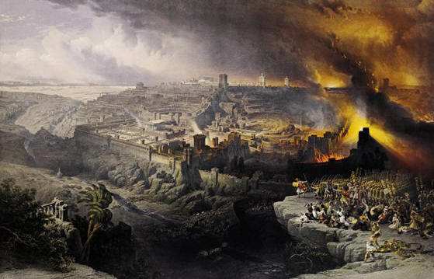
II. Arguments and Responses on Preterism
476
Notes:
This presentation cannot cover all the views for supporting the Preterists of various forms, but we will highlight a few critical areas that would be important for our discussion.

Slide 14
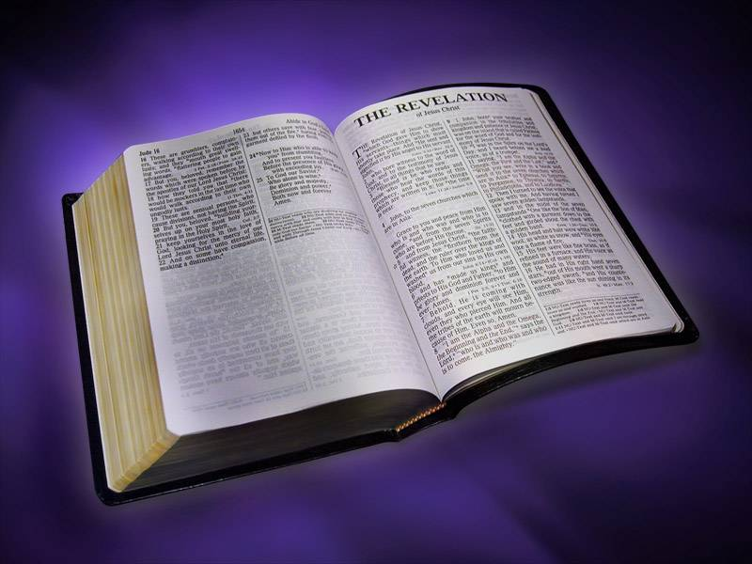
A. External Evidence
476
Critical to the position of the Radical Preterists is that they need to date Revelation before A.D. 70
Notes:
A. The dating of Revelation: External evidence
Critical to the position of the Radical Preterists is that they need to hold the dating of Revelation before A.D. 70 to affirm that all the prophecies of the book of Revelation and the Olivet Discourse of Matthew 23–24 have been fulfilled by A.D. 70. It is also important to note that Preterists believe that “when John wrote Revelation, it was prophecy.” Benware, Understanding End Times Prophecy, 164.

Slide 15

A Radical Claim:
476
"The dating of the book of Revelation by the Church Fathers is wrong."
David Chilton
Notes:
David Chilton supported an early dating of Revelation based on the conclusion that the “second-century church Father Irenaeus and most other ancient witnesses were wrong in dating the book.” Chilton further cites “Athanasius as proof of the canon’s completion by A.D. 70.” Thomas critiques Chilton’s view by writing, “Careful scrutiny of Athanasius’ quotation, his comment on Gabriel’s words in Daniel 9:24, reflects that Chilton’s interpretation of it is quite forced.”
——Robert L. Thomas, Revelation 1-7, Wycliff Exegetical Commentary, Vol.1 (Chicago: Moody, 1992), 21.
Ibid.

Slide 16
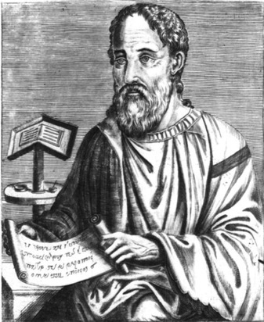
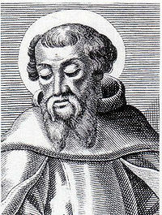
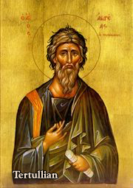
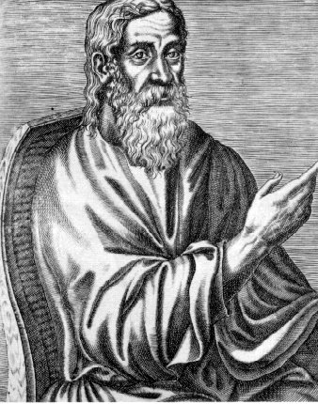
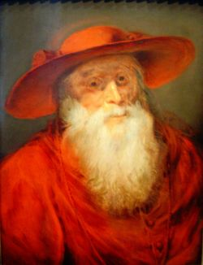
Church Fathers & Modern Scholars
Response
476
Church Fathers and most modern scholars concur with the date of A.D. 95/96.
The Tribulation of Revelation does not refer to A.D. 70.
Notes:
The traditional view of the dating of Revelation is around A.D. 95/96. Irenaeus states that the time when the apostle John wrote the book of Revelation was during the reign of the Roman Emperor Domitian. Eusebius quotes Irenaeus and confirms the same. Most of the early Church fathers agree with Eusebius and Irenaeus, such as Tertullian, Clement of Alexandria, Jerome and numerous others, also dating the book of Revelation in the reign of Domitian, the Roman Emperor. Beale affirms as well that “the difference of dating could alter the interpretation of the book, since the occasion prompting John to write might be different.” Thomas affirms the same that “most modern scholars concur” with the view that Revelation was written around A.D. 95/96.
With such a vast testimony to the dating of Revelation in the A.D. 90s, the Full Preterists’ basis of the argument that the tribulations of Rev. 6–19 (particularly the seal, trumpet, and bowl judgments as well as the “beast of the book of Revelation”) to have occurred during the time of Nero stands unjustified for the simple fact that Revelation was not yet written at that point of time.
The argument of the Full Preterists that the Second Coming, the resurrection of the dead, and the final judgment have taken place finds no scriptural support and most, if not all, of the other eschatological persuasions would deem the view held by them as unorthodox and unbiblical.
Eusebius, The History of the Church, trans. By G.A. Williamson (New York, Penguin, 1989), 81. Eusebius noted that “There is ample evidence that at that time the apostle and evangelist John was still alive.”
Benware, Understanding End Times Prophecy, 164.
G. K. Beale, The Book of Revelation: A Commentary on the Greek Text (Grand Rapids: Eerdmans, 1999), 4. Beale dated the book around 95 A.D. and affirmed that this is the current scholarly opinion. This view is held broadly across various eschatological views and there is a consensus on the same.
Thomas, Revelation 1-7, 21. He clarified that if Irenaeus had been wrong, later church fathers and witnesses would have corrected him. Aune also discussed the external evidence for the dating of Revelation in his introduction to his commentary on Revelation 1-5 and affirmed from early church fathers like Justin Martyr, Polycarp and others that the book has to be dated during the reign of Domitian. For further details see, David E. Aune, Revelation 1-5, Word Biblical Commentary, Vol.52 (Waco, Texas: Word Books, 1997), lviii-lx.

Slide 17
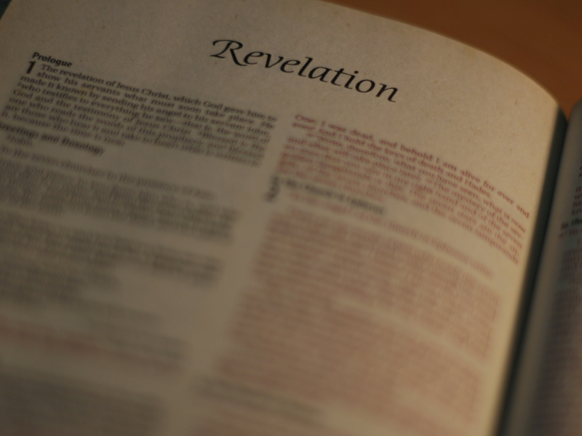
B. Internal evidence for dating Revelation before A.D. 70.
477

Slide 18
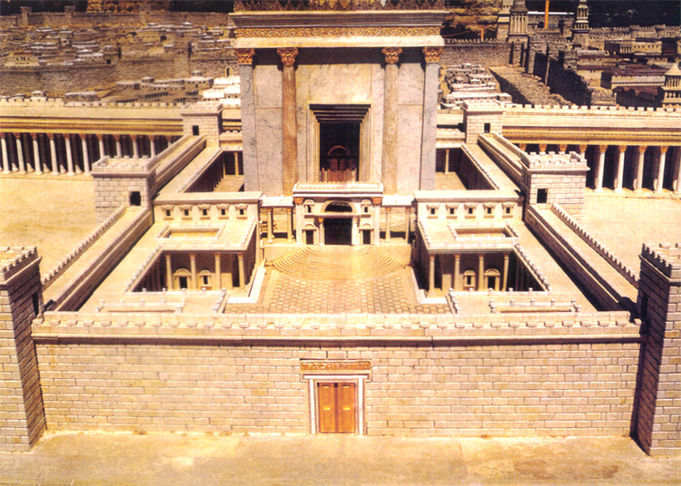
Preterists see the temple in
Rev. 11:1-2 as still standing
477
Notes:
In Revelation 11:1-2, according to the Preterists, John mentions the temple as standing when he was given the vision. So, in their view, if the temple was still standing when John recorded his vision, then the book of Revelation must have been written before the temple was destroyed in A.D. 70. Sproul, a moderate Preterist, does acknowledge that that “this is an argument from silence, but the silence is deafening.”
Kim Riddlebager, The Man of Sin: Uncovering the Truth about Antichrist (Grand Rapids: Baker Books, 2006), 181. Benware also advanced this as one of the three main arguments from the internal evidence that seems to favor the Preterist view of the dating of Revelation before A.D. 70. For further details, see Benware, Understanding End Times Prophecy, 167. Beale brilliantly covers the arguments and responds to the early dating based on internal evidence in his commentary (Beale, The Book of Revelation, 20-27). Beale responds based on his idealistic eschatological view that they were symbolic and that it does not refer to any literal temple, neither to Herod’s nor to any future temple.
R.C. Sproul, The Last Days According to Jesus (Grand Rapids: Baker Books, 1998), 147. Sproul admits that it would seem strange for the author of Revelation not to mention the destruction of Jerusalem had it been destroyed in A.D. 70 and the book was written in A.D. 96. This seems like a strong argument for the Preterists, but as we shall see, the internal evidence and the background setting of Revelation favors the dating of the 90s.

Slide 19
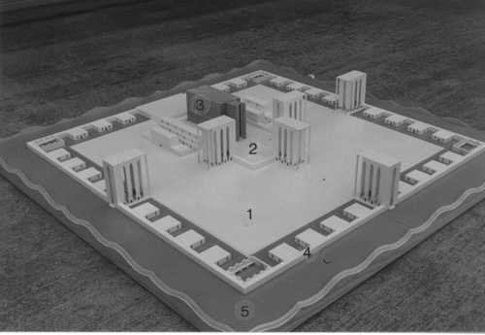
Response:
477
The vision of the Temple in Ezekiel 40-48 was given when the temple in Jerusalem was already destroyed. In the same way, it is not necessary for the temple to be standing for John.
Notes:
The presuppositions of various eschatological viewpoints greatly affect one’s interpretation of the book of Revelation. This affects whether we see the book of Revelation symbolically, allegorically, literally, historically or as a mixture of some of these hermeneutical presuppositions. It is therefore beneficial to study the fulfillment of the OT texts, especially those that pertain to prophecy and how they have been fulfilled literally. For example, a literal fulfillment would see that kings would come from Abraham’s loins (Gen. 17:6) and Micah’s prophecy tells where Jesus would be born (Micah 5:2). Since there is literal fulfillment of OT prophecies, it would seem reasonable to assume a literal fulfillment of prophecies in the New Testament as well.
The simple response formulated by Benware seems to be the most appropriate. When Ezekiel had the vision of the Temple in Ezekiel 40–48, the temple in Jerusalem was already destroyed in 586 B.C. In the same way, it is not necessary for the temple to be standing for John to measure it. Herod’s temple was destroyed in A.D. 70 and John received this prophetic vision during the reign of Domitian. Hitchcock, after analyzing in detail the temple passages from Ezekiel, Daniel, and Revelation, concludes that John was not measuring Herod’s temple anyway: “In light of Revelation 11:3-13 and the parallels in Daniel and Ezekiel it is best to view the temple in Revelation 11:1-2 as a future, reconstituted temple.”
—Mark L. Hitchcock, ‘A Critique of the Preterist view of the Temple in Revelation 11:1-2,’ Bibliotheca Sacra 164 (2007): 219-236 (236).

Slide 20
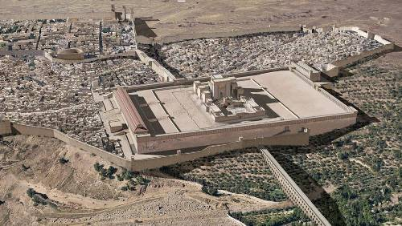
Was Jerusalem destroyed by this time?
320
Does 11:1-2 mean the temple still stood?
Then I was given a measuring stick, and I was told, "Go and measure the Temple of God and the altar and count the number of worshipers. ²But do not measure the outer courtyard…" (NLT)
No, this text refers to a literal future temple during the Tribulation.
This is a vision.
Also, the 7th bowl (16:17–21) does not picture "the great city" as entirely destroyed until after John's time, so it looked to a future destruction.
Notes:
_________
NC-13-Preterism-20
NS-27-Rev1 Intro-72

Slide 21

Rev. 13:18
478
Preterists see the number 666 in Rev. 13:18 as Nero, so Revelation must have been written during Nero's time
Notes:
A second line of defense for the Preterists is the number of the beast, which is 666 in Rev. 13:18. This number is said to be the numerical value of Nero’s name and hence, Revelation must have been written during Nero’s time.
Benware, Understanding End Times Prophecy, 168.

Slide 22

Response: Future Orientation
478
Rev. 1:1 and 4:1 state that John (the author) would be shown "what must soon take place" and "what must take place after this." This removes any doubt that the number of the beast must be future and not past or present.
Notes:
As discussed above, since Revelation was written in the A.D. 90s, this removes the possibility of linking the number of the beast back to Nero. Some eschatological groups that consider Revelation as history and not prophetic may also point it back to Nero as a possible point of argument. However, the statement in Rev. 1:1 and 4:1 which states that the author of Revelation would be shown “what must soon take place” or “what must take place after this,” shows that the number of the beast must be future and not past or present. This is one of the contextual arguments for Revelation 13:18 favoring a future view.
Secondly, as Benware points out, “nowhere in Scripture is any number given specific theological meaning.” The text surrounding Rev. 13 about the beast which exercises authority for “forty-two months” (Rev. 13:5) must be interpreted with other similar texts in Scripture. One must go to Daniel 9:24-27 and consider the context of that chapter. Nero did not exercise authority for just “forty-two months” and neither did any other Roman emperor in the first three centuries. Neither did “all inhabitants of the earth” worship Nero or other Roman emperors (Rev. 13:8). Hence Rev. 13:8 does not refer to Nero or any Roman emperor, but it has a future referent.
Benware, Understanding End Times Prophecy, 168. Benware, quoting John J. Davis, further explained that such methodologies of giving theological values is of Greek origin and finds its development primarily among the Gnostics, Neo-Pythagoreans, and Jewish allegorists. Furthermore, he also points to the inconsistency of the Preterists as to why they should take the number of the beasts literally whilst the other numbers and judgments in Revelation are taken symbolically or allegorically.

Slide 23
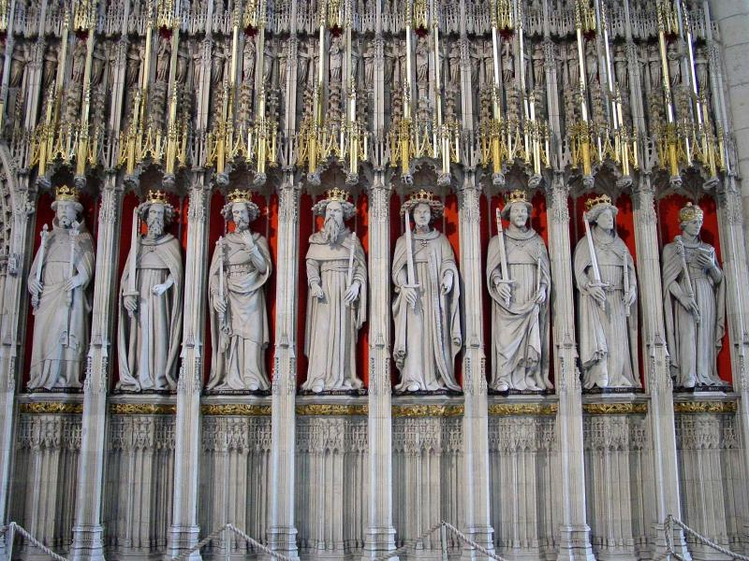
Rev. 17:10
478
Preterists see the "seven kings" as seven Roman kings from the first century. Then they argue that the sixth king is Nero.
Notes:
The third internal evidence for Preterists for dating Revelation before A.D. 70 is Rev. 17:10. Preterists see the “seven kings” as describing seven Roman kings from the first century. Then they argue that the sixth king is Nero.

Slide 24
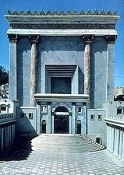

When Did John Write Revelation?
39-41, 320
Who was the Roman Emperor then?
Christ Crucified
AD 33
Jerusalem Destroyed
AD 70
Revelation Written
AD 95
Tiberius
14-37
Caligula
37-41
Claudius
41-54
Nero
54-68
Vespasian
69-79
Titus
79-81
Domitian
81-96
Most preterists place the book here
Supported by:
Irenaeus
Victorinus of Pettau Clement of Alexandria
Eusebius
Notes:
Emperors in black persecuted Christians
This course teaches that Revelation was written during the reign of Domitian at the end of the first century.
_______
NB-06-Politics3 Roman Emperors-40
NC-13-Preterism-24
NS-21-1 Peter-63
NS-27_Rev1-slide 94
NS-27-Rev4-6-slide 36

Slide 25
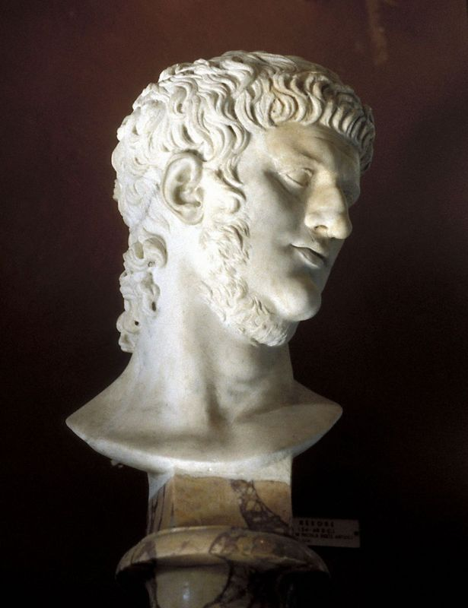
Response: Why can't Nero be the 666?
479
Nero exercised authority from AD 54-68, not for the required 42 months (Rev. 13:5).
All inhabitants of the earth did not worship Nero (Rev. 13:8).
Notes:
The Preterist exegesis and hermeneutics become creative here. “In order for Nero to be the sixth king, certain kings were not counted.” They also ignore other scriptural texts like the prophecies of Daniel, which form the basis for this prophecy. Some do not want to connect Daniel’s prophecy with the book of Revelation as it weakens their theological persuasion. Osborne has a warning for such an approach to the Scripture. He writes, “Do not impose your theological system upon the text.” He further notes, “Non-dispensationalists stress the symbolic more.” It will be important to note that OT prophets repeat similar judgments on the nations and Israel, and similar language like the “day of the Lord” is commonly used. It would be hermeneutical suicide to ignore other Scriptures that bear high similarity, especially those that pertain to end times.
__________
Benware, Understanding End Times Prophecy, 169.
Grant R. Osborne, The Hermeneutical Spiral: A Comprehensive Introduction to Biblical Interpretation (Downers Grove: InterVarsity, 1991), 219.

Slide 26

Correlation with Daniel
479
Daniel 7:1-8 | Revelation 13:1-2; 17:9-12
Four beasts (lion, bear, leopard, terrible beast with ten horns) | One beast that is like a leopard, bear, and lion (13:2) with ten horns (13:1; 17:3)
Seven heads representing four successive kingdoms | Seven heads representing seven successive kingdoms
Four kingdoms | Seven kingdoms
Ten horns (v. 7) | Ten horns (13:1; 17:3,12)
Mark L. Hitchcock, "A Critique of the Preterist View of Revelation 17:9-11 and Nero," Bibliotheca Sacra 164 (July-September 2007): 484
Notes:
Hitchcock draws a parallel between Daniel and Revelation, showing successive kingdoms rather than interpreting them symbolically.
_________
OS-27-Daniel-312
NC-13-Preterism-24
NS-27-Rev13-19—slide 118

Slide 27

Eight Successive Kingdoms (17:10-11)
479
Egypt (Pharaohs)
Assyria (Assyrian kings)
3. Neo-Babylonia (Nebuchadnezzar)
4. Medo-Persia (Cyrus)
5. Greece (Alexander the Great)
6. Rome (Caesars; "one is")
7. Reunited Roman Empire (ten kings; "not yet")
8. Final Gentile world kingdom (the Antichrist)
Mark L. Hitchcock, "A Critique of the Preterist View of Revelation 17:9-11 and Nero," Bibliotheca Sacra 164 (July-September 2007): 484

Slide 28
Support for Successive Kingdoms View
479-480
"The successive-kingdoms view avoids the nebulous nature of the symbolic view, is consistent with the Old Testament imagery from Daniel 7, and provides a consistent interpretation of the eight kings. For these reasons this is the preferred view. Therefore Revelation 17:9-11 offers no support for the early date of Revelation based on the idea that Nero is the sixth king."
Mark L. Hitchcock, "A Critique of the Preterist View of Revelation 17:9-11 and Nero," Bibliotheca Sacra 164 (July-September 2007): 484

Slide 29
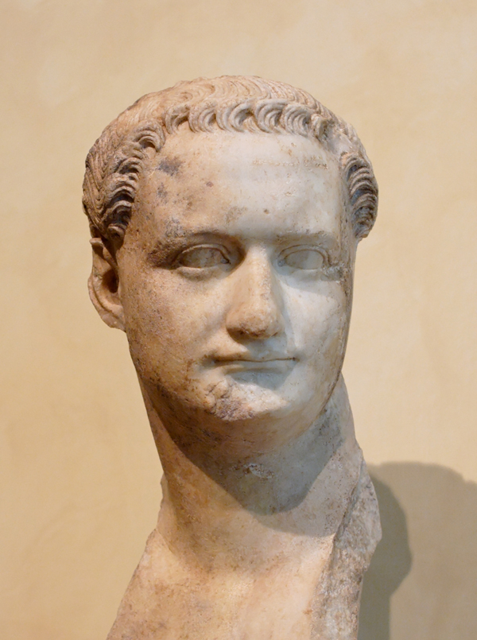
Rev. 17:10 has no reference to Nero or Domitian as Beale affirms.
480
Nero (A.D. 37-68)
Domitian (A.D. 81-96)
Notes:
Rev. 17:10 has no reference to Nero or Domitian as Beale affirms. It is best to see it considering the book of Daniel and Rev. 1:1 and 4:1 as in the future.
Beale, The Book of Revelation, 870-875.

Slide 30
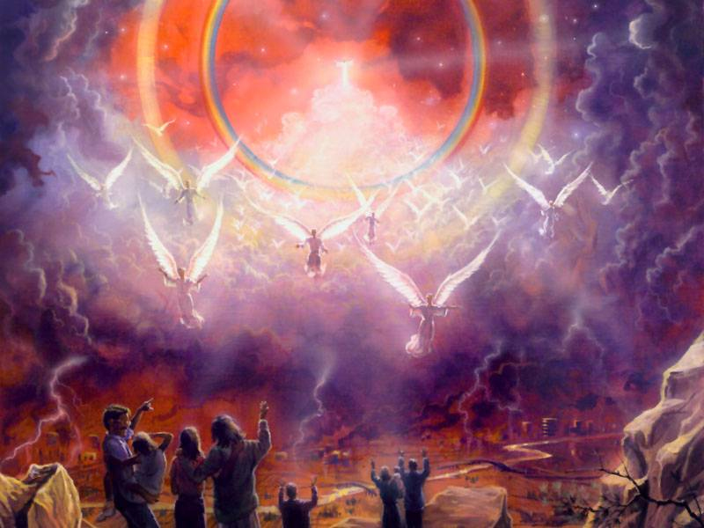
C. The timing of fulfillment of the prophecies in Revelation
480
Preterists say words like "shortly" or "soon" relate to a short time (Rev. 1:1)
Notes:
It is very important to Preterists who accept the A.D. 96 dating for the book of Revelation that the prophecies will be fulfilled very soon. Their support lies in the phrase “must shortly take place” (Rev. 1:1, etc.). Preterists will see the words like “shortly” or “soon” to be relating to a short time and will see the fulfillment of the many prophecies of Revelation as taking place during the first three centuries. This helps them to conclude the prophetic fulfillment of Revelation in the first three centuries.

Slide 31
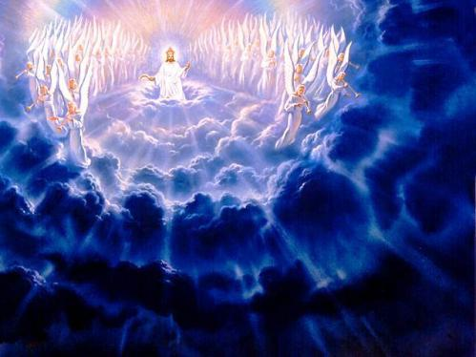
However, they can't explain "I am coming quickly"
(Rev. 2:16; 3:11; 22:7, 12, 20)
480

Slide 32
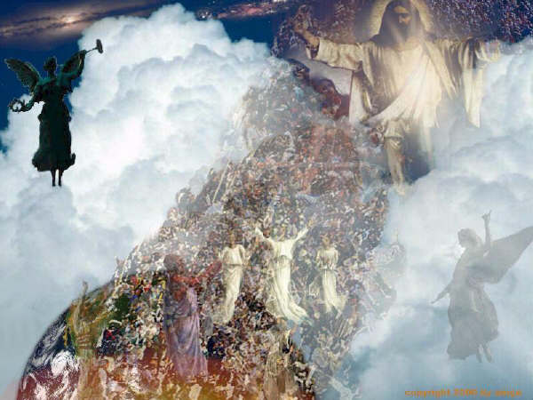
Preterist difficulties
480
Their hermeneutics are not consistent.
It requires great creativity to prove that Jesus has come.
Notes:
The Preterists are inconsistent in their arguments. On one hand, they reiterate the literal view of “shortly coming.” On the other, they cannot explain the phrase “I am coming quickly” (Rev. 2:16; 3:11; 22:7, 12, 20). All Preterists (other than the Full Preterist) await the Second Coming.
When Osborne writes, “Prophecies of future events occur frequently,” he is not just referring to an immediate future, but also to a distant future. A good example is the promise of the “seed” in Genesis 3:15 which was realized in Christ thousands of years later.
Secondly, they are not consistent in using the principles of hermeneutics as they use a literal understanding for phrases like “shortly,” while they employ symbolism for the Rev. 6–19 judgments within the same genre. Hitchcock argues from grammatical and syntactical analysis, concluding that the usage of words like “soon” in prophetic literature does not mean “immediate future” but it has the sense of the type of the “soon return of Christ” which can be distant future.
Thirdly, as noted above, bodily resurrection, the Second Coming and the “wrath of God” (Rev. 6:17) through the seal, trumpet, and bowl judgments have not occurred yet and are future events. For a commentator to see these judgments as symbolic and current ongoing events requires high creativity. They must also draw in a lot of extra-biblical sources and pagan background literature to back up their claims.
Osborne, The Hermeneutical Spiral, 212.
Mark L. Hitchcock, ‘A Critique of the Preterist view of “soon” and “near” in Revelation,’ Bibliotheca Sacra 163 (2006): 467-478 (470-473).

Slide 33

D. The timing of the fulfillment of Matthew 10:23, 16:28 and 24:34
480
Notes:
Important to the Preterists’ position is their understanding of the texts in Matthew. Matthew 10:23 says, “You shall not finish going through the cities of the land of Israel, until the Son of man comes.” In Matt. 16:28, Jesus declares to his listeners that some of them would “not taste death until they see the Son of Man coming in His kingdom.” These two verses coupled with “this generation” of Matt. 24:34 are understood by the Radical Preterists to “prove that the Lord had to have come in the first century.”
—Benware, Understanding End Times Prophecy, 173-174.

Slide 34
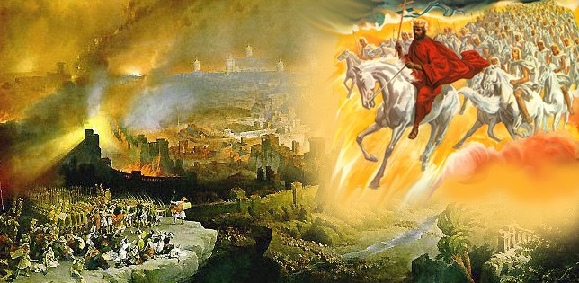
Their Claim
480
Radical Preterists use Matt. 10:23 as support that the Lord must come in the first century: "When you are persecuted in one town, flee to the next. I tell you the truth, the Son of Man will return before you have reached all the towns of Israel."

Slide 35
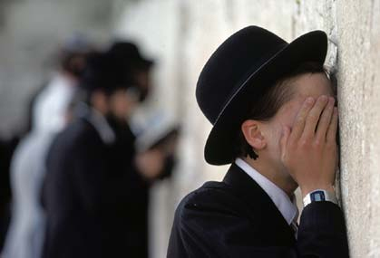

Response:
481
Pt. 1
"The evangelization of the rebellious nation of Israel will not be finished by them but will await His return, which is the point made by Paul (cf. Rom. 11:25-29) and the prophets (Zech. 12:10)"
––Benware
Notes:
The text in Matt 10:23 is understood in its larger context to mean “the evangelization of the rebellious nation of Israel will not be finished by them but will await His return, which is the point made by Paul (cf. Rom. 11:25-29) and the prophets (Zech. 12:10).” It is true that some portions of the text in Matt. 10:16-22 had been fulfilled in that generation. However, those persecutions cannot be equated with the tribulation of Revelation, which will initiate the millennium.
Benware, Understanding End Times Prophecy, 175.

Slide 36
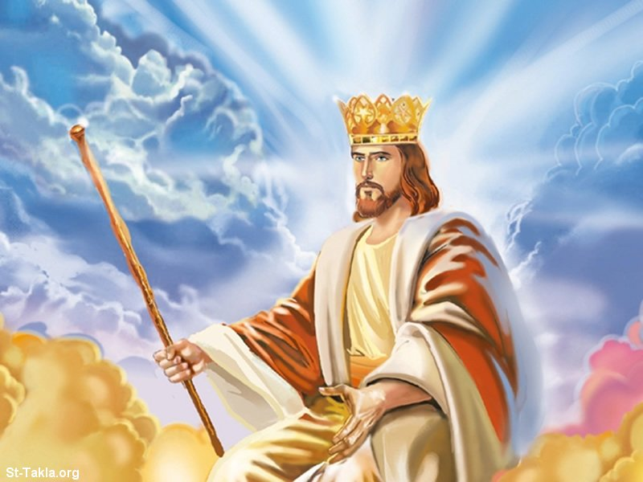
Radical Preterists see Matt. 16:28 as saying that Jesus will come in that very generation
481
Pt. 2
Notes:
The context of Matthew 16:28 is the “Son of Man coming in His kingdom.” In order to understand what kingdom Jesus is referring to, one must connect this with Matt. 22–25 and Revelation 19–20. Then this must be compared with OT texts like Isa. 9, 11; Daniel 2, 9 and the Davidic covenant in 2 Sam. 7.

Slide 37
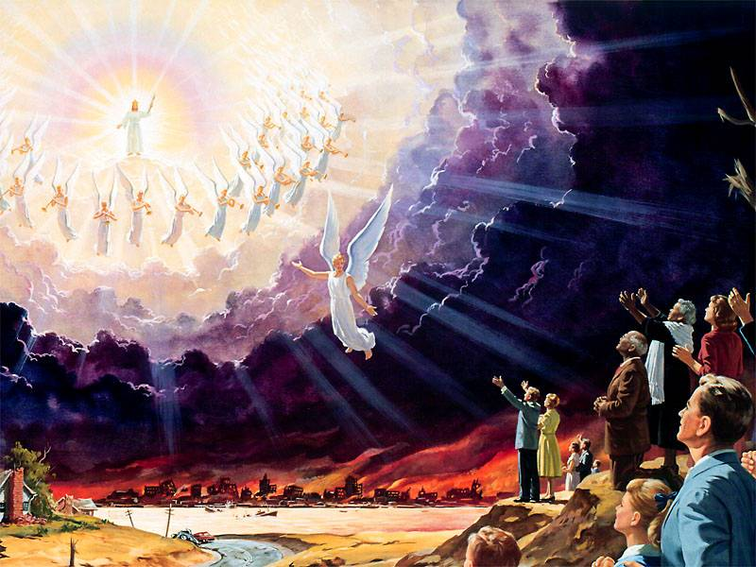
It actually refers to people who will be physically alive when Jesus comes at the end time
481
Pt. 2
Notes:
Putting these texts together in their respective contexts, the “kingdom” refers to the unscheduled future after Daniel’s Seventieth Week and specifically refers to the millennium. The burden of proof lies with the Preterists to demonstrate the reality that the Son of Man has come. The text further says that we will “see” the Son of Man coming, and it is in our judgment that it has not taken place. This kingdom does not refer to the spiritual kingdom but one that will be established at the coming of the Son of Man.

Slide 38
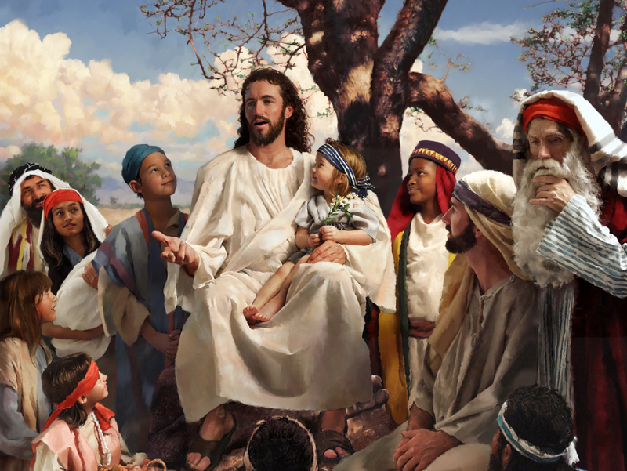
Preterists see "this generation" in Matt. 24:34 as that particular generation who heard Jesus
481
Pt. 3

Slide 39

End Times?
481
Pt. 3
"This generation" refers to a time period when the "birth pains begin" (Matt. 24:8).
It will continue on until "the gospel is preached to the whole world" (Matt. 24:14).
The "abomination of desolation" spoken of by Daniel (Matt. 24:15; cf. Dan. 9:24-27) will have taken place.
The "great tribulation" (Matt. 24:21) will have happened.
Finally, "the Son of Man will come" (Matt. 24:27).
Notes:
“This generation” of Matt. 24:34 does not refer to that generation who heard Jesus. Its preceding and following passages give the context of what Jesus was trying to say. “This generation” refers to a time when the “birth pain begins” (Matt. 24:8). It will continue until “the gospel is preached to the whole world” (Matt. 24:14), the “abomination of desolation” spoken of by Daniel (Matt. 24:15; cf. Dan. 9:24-27) has taken place, the “great tribulation” (Matt. 24:21) has happened and the “the Son of Man will come” (Matt. 24:27). There are partial fulfillments of this prophecy at the destruction of the Jerusalem Temple in A.D. 70, but it does not parallel the complete prophetic data given and hence, it awaits future fulfillment. This is consistent with prophetic literature, as the prophets would integrate immediate present prophecy with distant future prophetic utterances. A case in point would be Isa. 61:1ff, which Jesus Himself reads in Luke 4:18-19a but stops at “… to proclaim the year of the Lord’s favor” (Luke 4:19a; cf. Isa. 61:1-2a). He sees Isa. 61:2bff as future. This would not have been obvious to the Jews in the OT times. Hence to draw on Jewish “apocalyptic understanding” can be off tangent, considering the total revelation in the Canon.

Slide 40
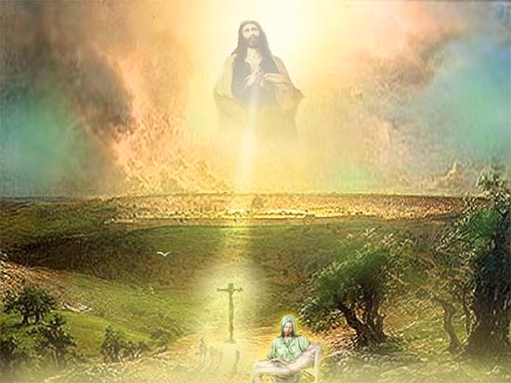
E. The Olivet Discourse of Matthew 24–25
481
They view all or most of these prophecies as fulfilled in the Temple destruction of A.D. 70.
Notes:
Central to Preterist position is their interpretation of the Olivet Discourse of Matthew 24–25. They view all or most of these prophecies as fulfilled in the destruction of the Temple in A.D. 70. They would strongly depend on the phrase “this generation” of Matt. 24:34 to mean that generation who heard the Olivet Discourse. We have addressed some issues from Matthew above.

Slide 41
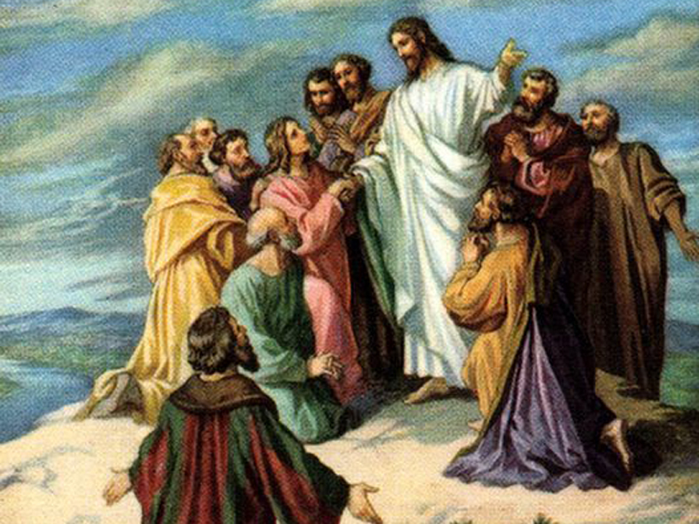
Matt. 24:3
482
"Tell us, when will these things happen?"
Notes:
Some important points to this text are addressed above. Some further contextual observations are necessary. Benware rightly points out that the preceding section of Matt. 23:35-39 clearly demonstrates Christ telling the Jews that the Jerusalem temple would be destroyed.

Slide 42
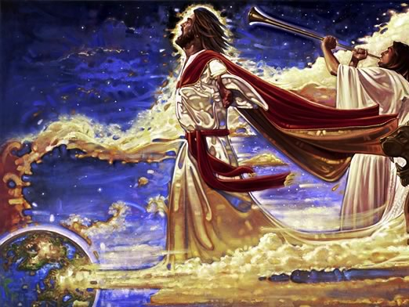
Matt. 24:3
482
"What will be the sign of Your coming?"
Notes:
However, Matt. 23:39 also looks into the future to a time when Israel will welcome the Messiah. The OT prophets foresaw into the future a time when Israel, as a nation, would be restored to their land.
The texts are too numerous but we will highlight a few sample texts without priority or importance given to the order. Many texts see Israel restored in the future, such as Isa. 54 where God affirms an eternal covenant of peace. Ezekiel 36–48 sees Israel in the restored Temple worship. It is strange that we should bring our modern understanding into the text of this temple vision and make it symbolic. It needs to be noted that the vision of the ark and the holy place given to Moses was done exactly according to the given measurements (Exod. 39:32). It would seem even stranger to a non-Christian scholar to change the methodology of interpretation for Ezekiel’s vision of the temple within the same OT Canon.

Slide 43
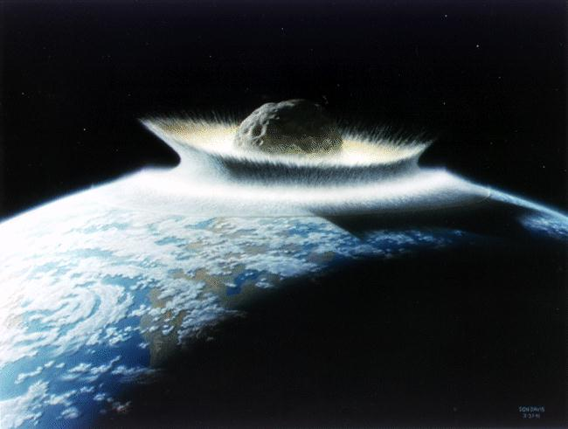
Matt. 24:3
482
"… and of the end of the age?"

Slide 44
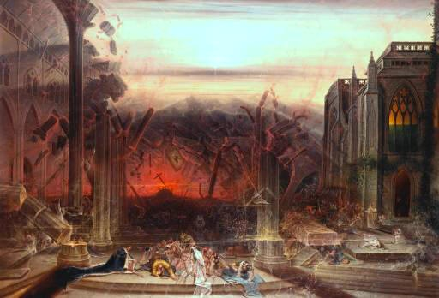
Abomination of Desolation
482
Preterists see this in A.D. 70 by the Romans
Notes:
The “abomination of desolation” in Matt. 24:15 is seen to have occurred by the Preterists during the temple destruction in A.D. 70 by the Romans. However, Benware points out that the “differences between Matthew 24 and Vespasian’s destruction of the temple are great.” The incidence and the texts surrounding Matthew 24 and Daniel 9 need to be taken into consideration. The background to the text lies in the three questions posed by the disciples in Matt. 24:3.
—Benware, Understanding End Times Prophecy, 179.

Slide 45
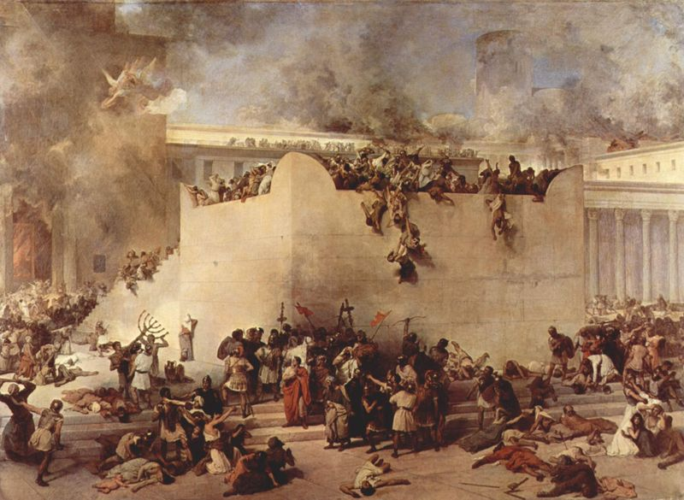
It could not have occurred!!!
482
Context of Matt. 24
OT Prophets see it as future.
Daniel 9:27; 11:31; 12:11
Notes:
First, they ask Him, “Tell us, when will all these things take place?” “These things” refers to Matt. 24:1-2. The answers Jesus gave here move into the far distant future just the way Daniel had asked concerning the seventy years of captivity (Dan. 9:1-2). As he was praying and confessing (Dan. 9:20), the angel Gabriel came and revealed the plan of God till the “end of sin,” which brings “everlasting righteousness” (Daniel 9:24ff).
The second question was “what will be the sign of your coming?” (Matt. 24:3). Jesus responded by giving the signs of His Second Coming that highly parallel Daniel 9 and others.
The third question raised was, “What will be the end of the age?” These last two questions are interlinked, and this is the whole purpose of the Olivet Discourse. Deviation from the context of the disciples’ questions in dealing with these chapters will surely give one a wrong conclusion of the meaning of the text and the timing of its occurrence. The “abomination of desolation” is to be particularly understood with the breaking of the covenant at midpoint of the tribulation (Daniel 9:27) necessitating further outpouring of God’s wrath in the bowl judgments of Revelation. The “abomination of desolation” must not be confused with the destruction of Jerusalem in A.D. 70. The similarities must not mislead us into ignoring the differences between them. Differences, even if there was only one, must be given due consideration in prophetic literature.

Slide 46
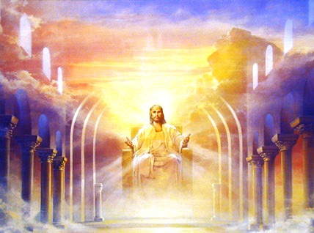
The Coming of Christ
482
Preterists say, "He has come…
although He did not visibly appear"
Notes:
The coming of Jesus has been dealt with above. Preterists would see the “signs in heaven” of Matt. 24:29-31 as a dramatic way of expressing national calamity or victory in battle.” The dangers of such symbolism or allegorizing of the text are very much present in the “health and wealth” gospel today. Spiritualizing such texts would legitimize the modern-day gospel preachers and would do damage to the authority of the Scripture. It would then become a post-modernist way of looking at the text.

Slide 47
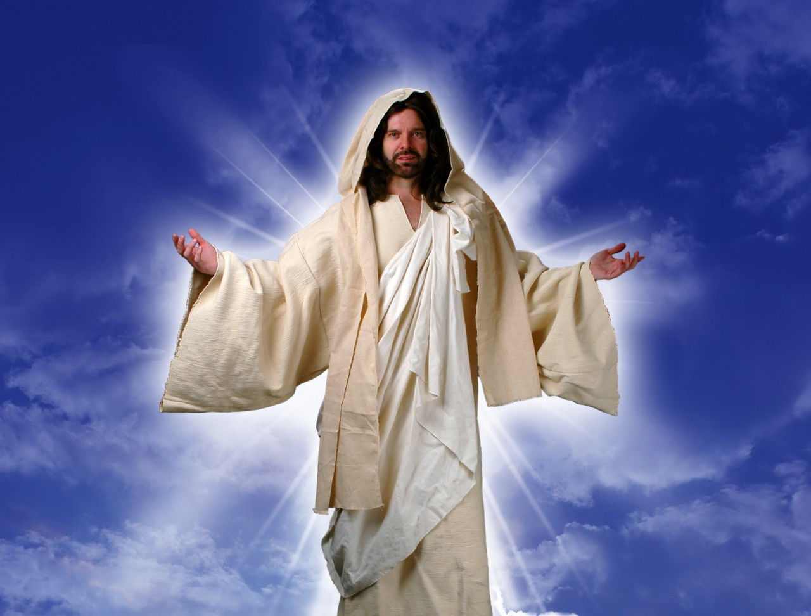

parousi,a—parousia (coming)
482
In the NT, the word always means an actual presence

Slide 48
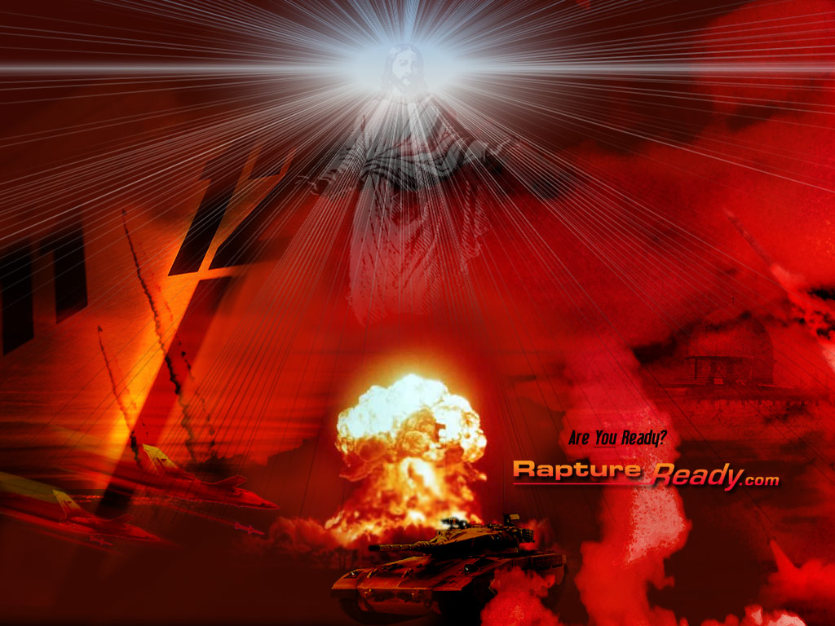
Preterists claim that the "signs in heaven" are only dramatic ways of expressing amazing cosmic signs, national calamity or victory in battle (a non-miraculous approach).
482
Notes:
Footnote: Gentry and Ice, The Great Tribulation, 55. Their line of defense seems reasonable in light of OT texts like “the mountains quake at the presence of the Lord,” where in reality the mountains may not have quaked.

Slide 49

They claim that cosmic signs are not to be taken literally
482
Notes:
This line of argument is taken up by the Preterists. Gentry further comments, “Prophets often express national catastrophes in terms of cosmic destruction.”.

Slide 50

Rebuttals:
482
They are allegorizing the text
The OT context is not taken into account (Joel 2)
Notes:
This point is well taken but what they fail to recognize is that the context of whether the cosmic disturbance is referring typologically to some national destruction, or it is actually referring to actual cosmic disturbances. Contextual understanding and usage of such words by the prophets in view of the culmination of history with texts in Daniel and Revelation would affirm a real occurrence of such cosmic disturbance of immense proportion. Matthew 24:21 makes it clear that this “great tribulation,” referring to great cosmic disturbances, is perfectly in tandem with Revelation judgments, which “has not been from the beginning of the world until now, no and never will be.” No doubt there have been great calamities such as the flood, destruction of Sodom and Gomorrah, the rise and fall of nations in history, world wars, Jewish massacre by Hitler and Stalin, the recent Tsunami and the 9/11 bombings. These have happened, but they are not the “tribulation” referred to in Revelation 6–19 and Matthew 23–24

Slide 51
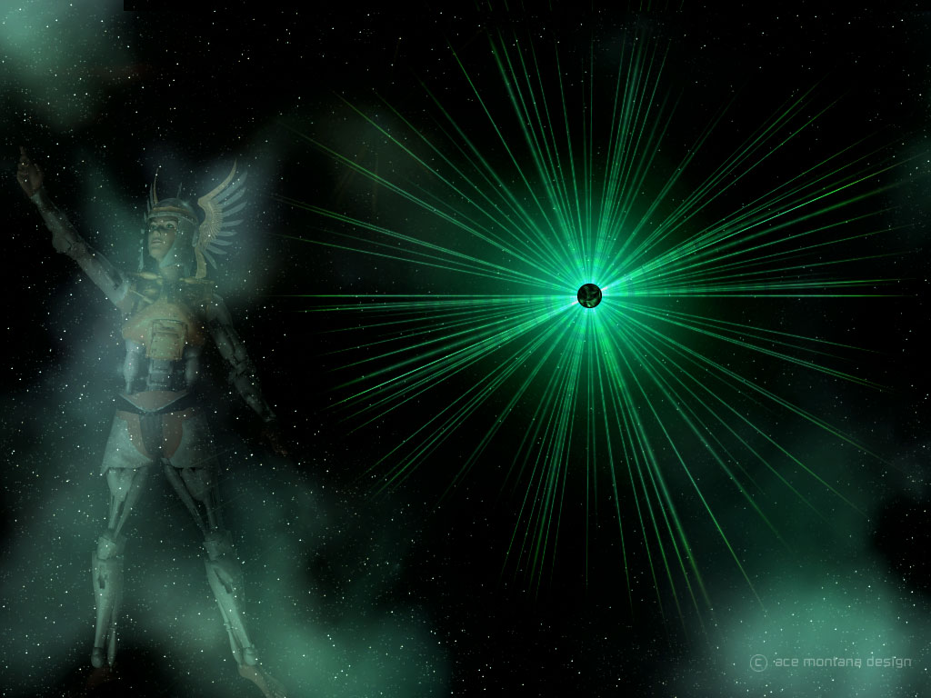
Applications
483
Evaluate other perspectives, but…
"The Lord's bond-servant must not be quarrelsome" (2 Timothy 2:24)
Giving critical evaluation to other views sheds light on your own view
Teach the Scriptures
Notes:
Although there is a tendency for Preterists to be eclectic in their hermeneutical approach, we must not totally disregard their view. It can be helpful to see another interpretation or understanding of Scripture.
That understanding is not there for us to criticize or fight about but for us to learn to see things from a different angle than our own. Paul, in his second letter to Timothy, reiterated, “The Lord’s bondservant must not be quarrelsome” (2 Tim. 2:24). We must come to an understanding that there are many different views and doctrines, but the point is not for us to push through our own understanding and interpretation.
This view needs to be weighed to shed more light on our understanding. Perhaps it gives us an even firmer reason to stick to our own beliefs and understanding. Or does it throw doubt at us? If so, we should then be spurred to dig deeper into the Word of God for further study, understanding, and revelation.
As pastors or teachers, this can then ensure that we are teaching the Scriptures as it is (or at least the way we have understood it, having thought through and debated it) and not mislead others or have anything to do with “irreverent silly myths” or “worldly fables” as was warned by Paul in 1 Tim. 4:7.
We cannot undermine the importance of the future aspect of the Second Coming, the bodily resurrection and the impending future Day of the Lord. It can serve to encourage the believers to live pure, holy and reverent lives before the Lord and before men. It would also give hope in the present time when one goes through difficulties, sufferings and persecutions.

Slide 52

Conclusion
482
Uphold the importance of:
  Second Coming
  Bodily resurrection
  Day of the Lord
"Therefore, be on the alert for you do not know which day your Lord is coming" (Matt. 24:42).
Notes:
This is what it means to live our lives on the “alert” as Jesus said in Matthew 24:42, where he warned, “Therefore be on the alert for you do not know which day your Lord is coming.”

Slide 53
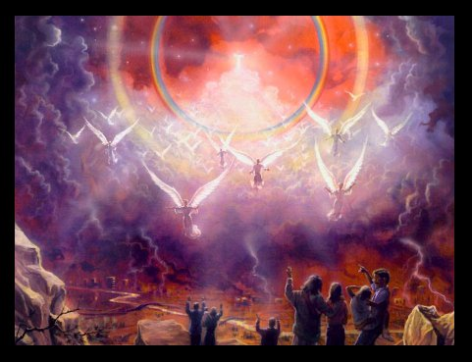
"Yes! I am coming soon!"
Amen! Come Lord Jesus!
The grace of the Lord Jesus be with God's people. Amen.
331
Notes:
Hence, regardless of which eschatological stand we take, we should do exactly that. Be on the alert—live pure, holy and reverent lives, tell others about Jesus and tell them to do exactly the same!

Slide 54
Black

Slide 55


Future (Eschatology) at BibleStudyDownloads.org
Get this presentation for free!
Notes:
Future (fu)
Eschatology

