Slide 1
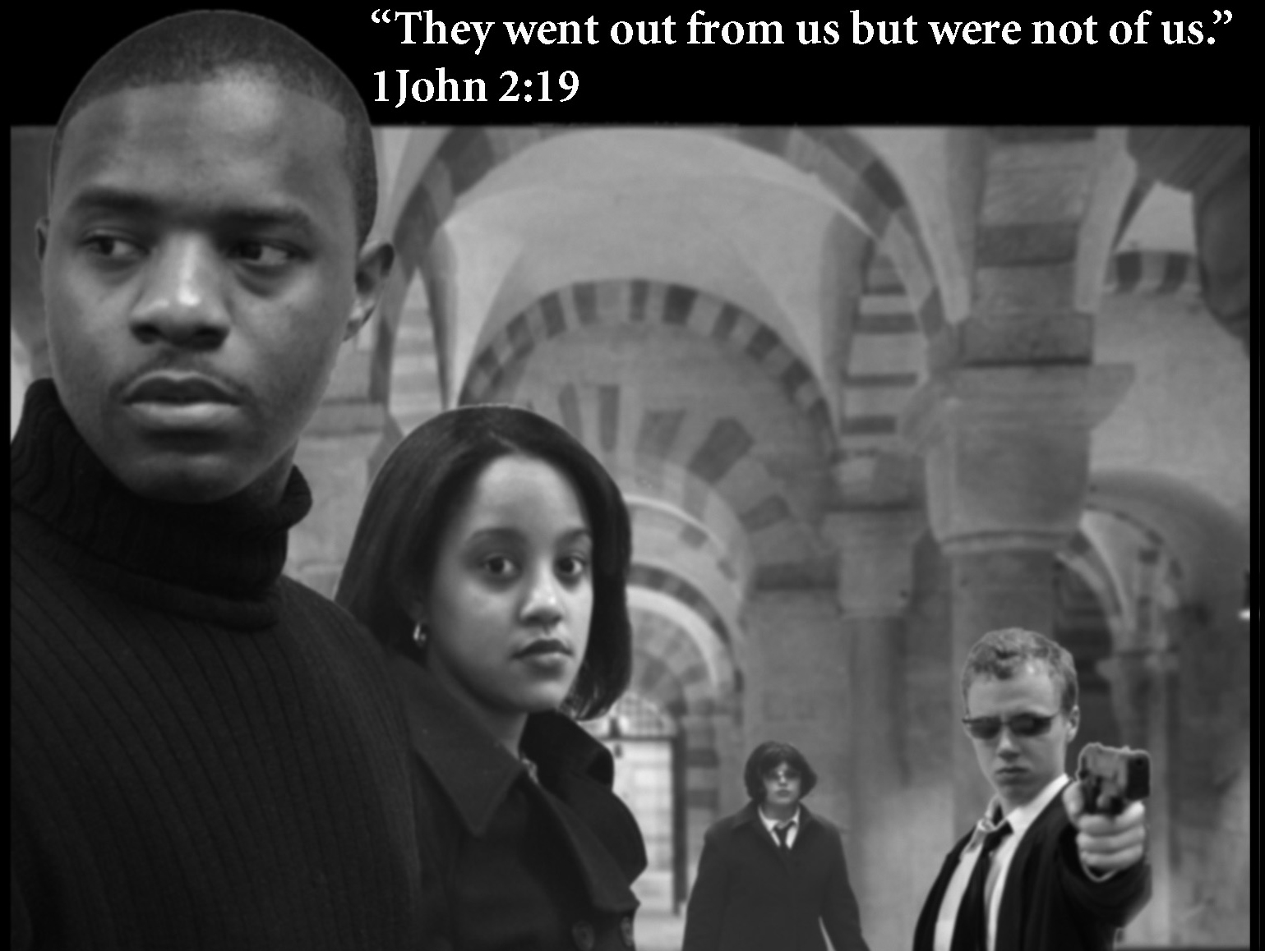
The Antichrist & Daniel 9
“They went out from us but were not of us.”
1 John 2:19
The 4th Beast: Mask of the Antichrist
(the only posttrib film — released 2005)
Dr. Rick Griffith • Jordan Evangelical Theological Seminary • BibleStudyDownloads.org

Slide 2
A Huge Leadership Vacuum
79
Difficult times always set the stage for dictators to rise to the occasion.

Slide 3

Names for the Antichrist
79
Bloody & Deceitful Man (Ps 5:6)
Little Horn (Dan. 7:8)
Man of Sin
(2 Thess. 2:3)
Beast from the Sea (Rev. 13:1)
One Causing Desolation (Dan. 9:27)

Slide 4
The Activity of the Antichrist
79

Slide 5


The Beast
387
"Then I saw a beast rising up out of the sea. It had seven heads and ten horns, with ten crowns on its horns. And written on each head were names that blasphemed God. ²This beast looked like a leopard, but it had the feet of a bear and the mouth of a lion! And the dragon gave the beast his own power and throne and great authority" (Rev. 13:1-2).
Notes:
"The three animals named in Revelation 13:2 remind us of the four beasts Daniel saw in his dream (Dan. 7): a lion (Babylon), a bear (Media-Persia), a leopard (Greece), and a “terrible beast” (the Antichrist). John saw these animals, or kingdoms, in reverse order since he was looking back, while Daniel was looking ahead. The final world empire will be rooted in all the previous empires and unite in one their evil and power. Added to the ferocity of these beasts will be Satan's own power, throne, and authority!" (Wiersbe).

Slide 6
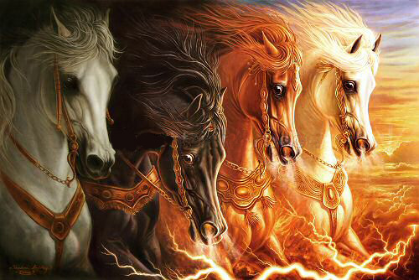
Four Horses (Rev. 6:1-8)
79 A

Slide 7
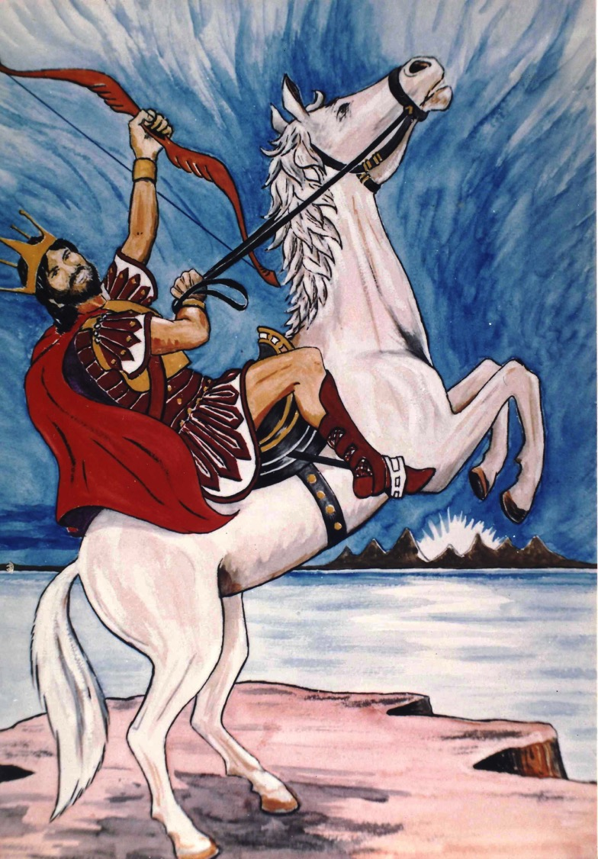
The 1st Seal
79 A
¹Now I saw when the Lamb opened one of the seals; and I heard one of the four living creatures saying with a voice like thunder, "Come and see."
²And I looked, and behold, a white horse. He who sat on it had a bow; and a crown was given to him, and he went out conquering and to conquer.
Artwork by Sunny Chandra

Slide 8
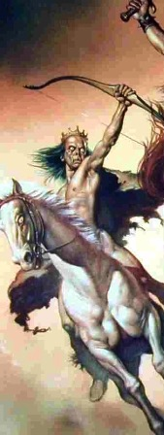
Seal #1 The White Horse Rider Depicts the Antichrist
79 A
How do we know this?
Different from the Lamb
"White" also refers to evil
Many differences with Christ in 19:11-16
Notes:
"The word for crown in Revelation 6:2 is stephanos, which means "the victor's crown." The crown that Jesus Christ wears is diadema, "the kingly crown" (Rev. 19:12). Antichrist could never wear the diadem, because it belongs only to the Son of God" (Wiersbe).

Slide 9
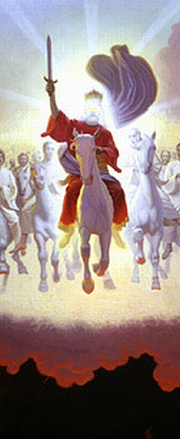
Different Horsemen
79 A
6:1-2
19:11-16
Purposes
Equipment
Names
Fellow Riders
Time
Context
Crown
Daniel K. K. Wong, "The First Horseman of Revelation 6,"
Bibliotheca Sacra 153 (April-June 1996): 212-26
Notes:
"The word for crown in Revelation 6:2 is stephanos, which means "the victor's crown." The crown that Jesus Christ wears is diadema, "the kingly crown" (Rev. 19:12). Antichrist could never wear the diadem, because it belongs only to the Son of God" (Wiersbe).

Slide 10
Different Horsemen
79 A
6:1-2
"The word for crown in Revelation 6:2 is stephanos, which means 'the victor's crown.' The crown that Jesus Christ wears is diadema, 'the kingly crown' (Rev. 19:12). Antichrist could never wear the diadem, because it belongs only to the Son of God" (Wiersbe).
19:11-16
Notes:
"The word for crown in Revelation 6:2 is stephanos, which means "the victor's crown." The crown that Jesus Christ wears is diadema, "the kingly crown" (Rev. 19:12). Antichrist could never wear the diadem, because it belongs only to the Son of God" (Wiersbe).

Slide 11
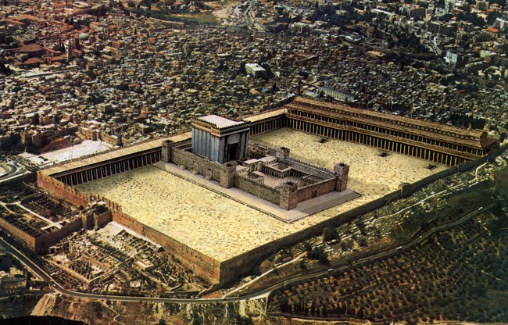
Antichrist will make a 7-year treaty with Israel
79 B
This will likely enable the rebuilding of the Jerusalem temple
Artwork by Sunny Chandra

Slide 12

Modern Temple Mount
49a

Slide 13
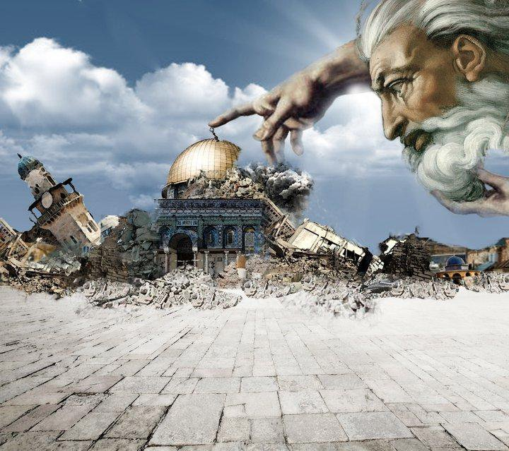
Antichrist will make a 7-year treaty with Israel
79 B
This will likely enable the rebuilding of the Jerusalem temple
Artwork by Sunny Chandra

Slide 14
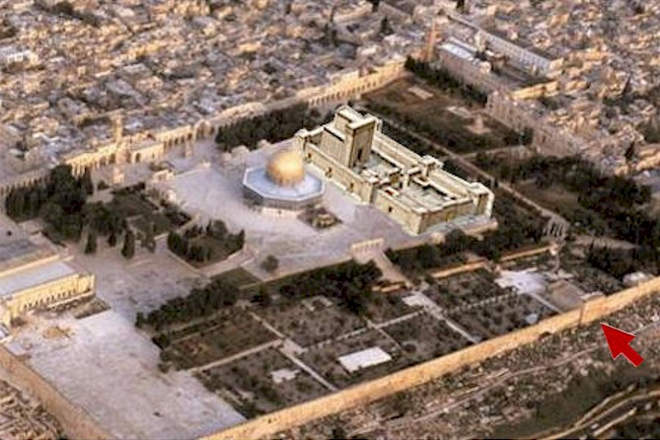
Antichrist will make a 7-year treaty with Israel
79 B
This will likely enable the rebuilding of the Jerusalem temple
Artwork by Sunny Chandra

Slide 15
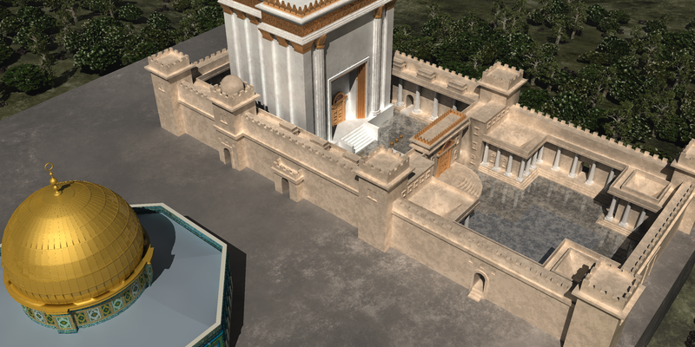
Antichrist will make a 7-year treaty with Israel
79 B
This will likely enable the rebuilding of the Jerusalem temple
Artwork by Sunny Chandra

Slide 16
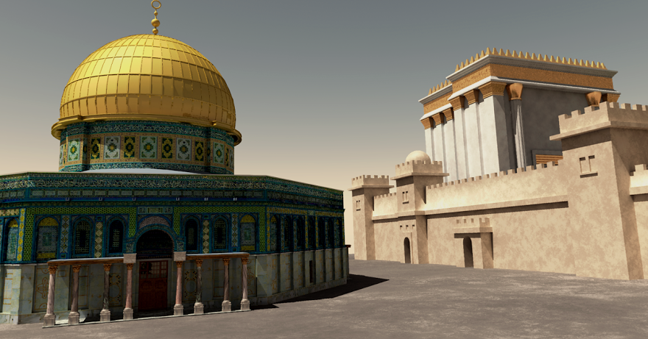
Antichrist will make a 7-year treaty with Israel
79 B
This will likely enable the rebuilding of the Jerusalem temple
Artwork by Sunny Chandra

Slide 17
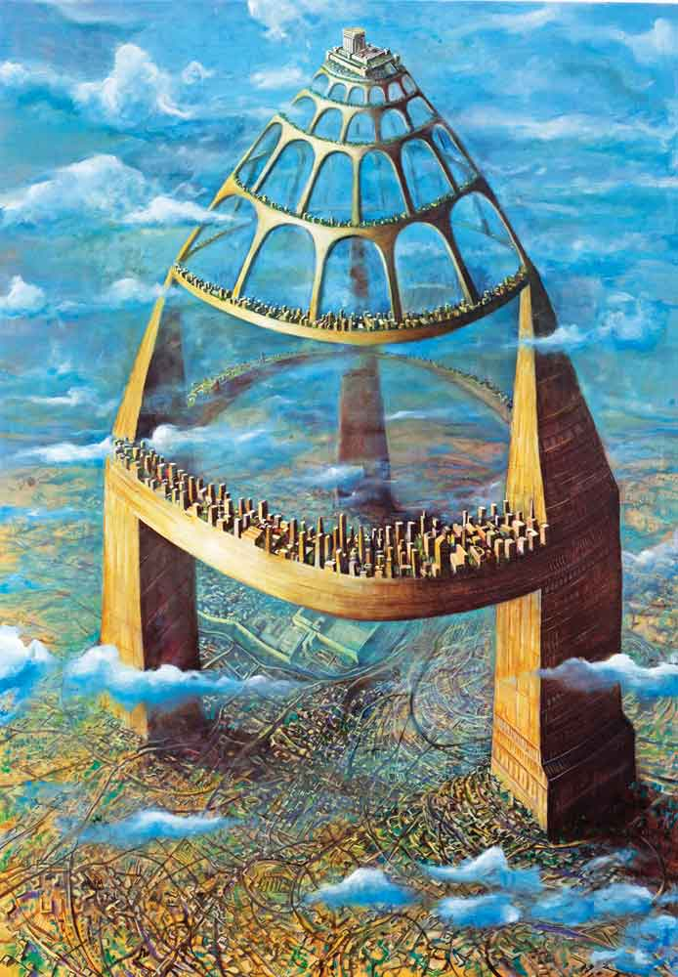
Actually, a temple could be rebuilt above the Dome of the Rock without removing it!
79 B
Artwork by Sunny Chandra

Slide 18
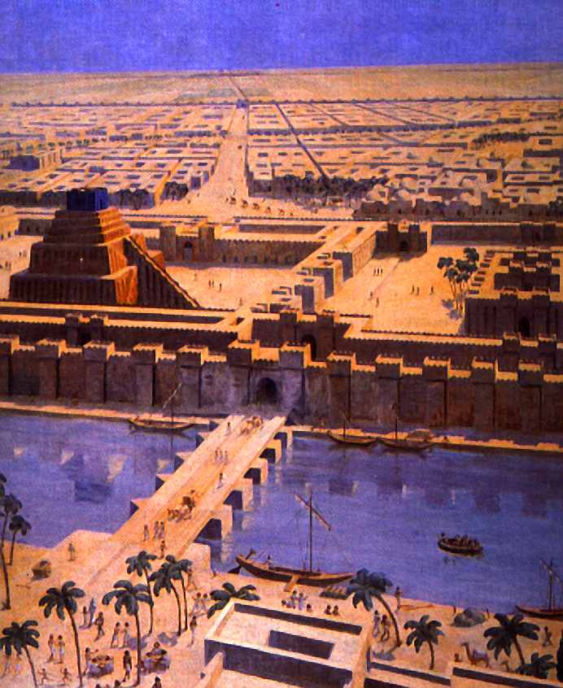
Babylon
80 C

Slide 19
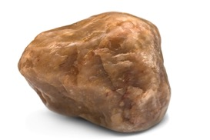
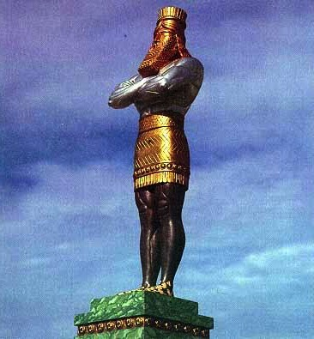
The Image of Daniel 2
80 C
Gold
Babylon
Silver
Persia
Bronze
Greece
Iron
Rome
Iron & Clay
Antichrist
Stone
Kingdom

Slide 20

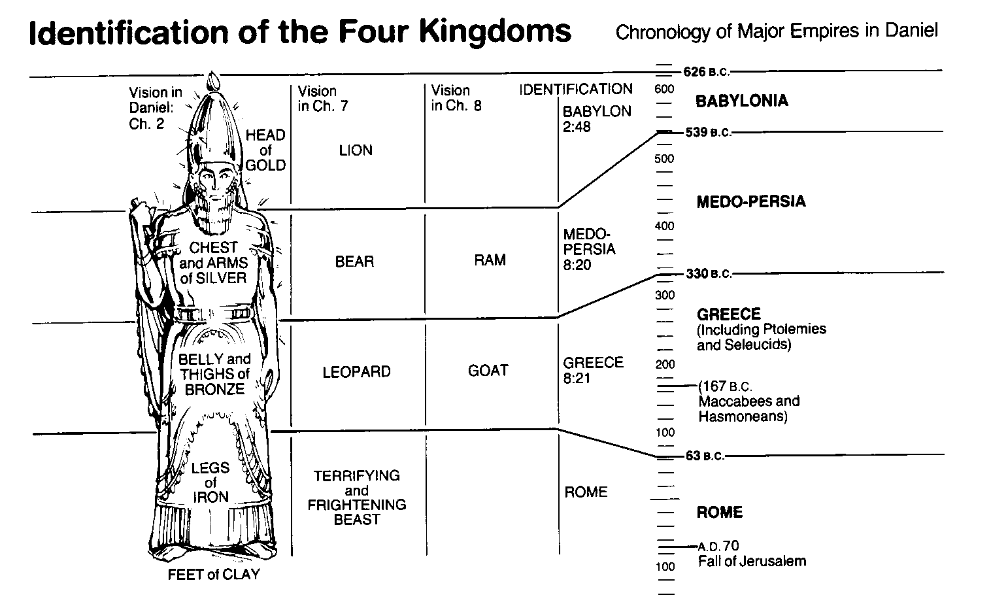
World Empires in Daniel
OTS
545
Bible Visual Resource Book, 133

Slide 21

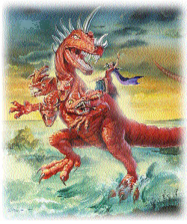

Control of the World Political System:
10
80
C
10
10
10
10
10
10
10
10
10
7 Heads
Roman
Consecutive
Past
17:9-11
10 Kings
Worldwide
Simultaneous
Future
17:12
Beast (8th King)
Worldwide
Controls 10 Kings
Future
17:13

Slide 22

EU States
80
C

Slide 23

Associations
End-Times Babylon (Prostitute)
(17:1–19:2)
80
D & E
at first
sits on (17:3)
later destroyed by beast (17:16)
Beast:
7 Heads
10 Horns
(17:3,12)
rules over (17:2)
desires to rule over (17:17)
Kings of the Earth
(17:2)
All Peoples of the Earth
(17:2, 15)
Notes:
Without identifying these symbols at this point, let us look simply at what the text says:
• First, the harlot rules over all earthly leaders.
• These "kings" in turn rule over the peoples of the planet.
• The prostitute also initially controls the beast with 7 heads and 10 horns.
• But later, the beast gains such control over the harlot that he destroys her.
• The beast wants to control the planet, and the only way to do this is to destroy the prostitute's worldwide control.
________________
ES-12-Antichrist-23
NS-27-Rev13-19-slide 132

Slide 24

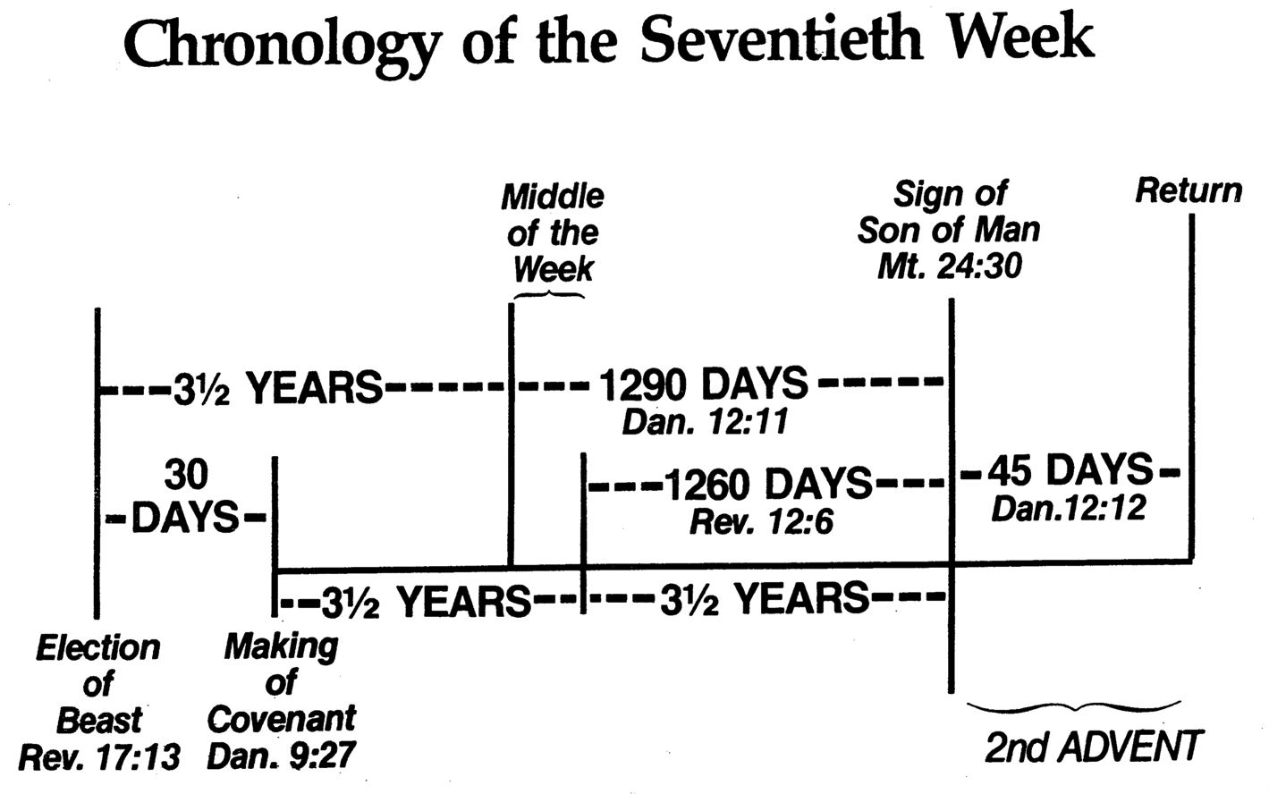
Chronology of the 70th "Week"
80 F
101
Adapted from J. Dwight Pentecost, Dallas Theological Seminary, 1988
Middle of the Week
Sign of
Son of Man
Matt. 24:30
Christ's Return Complete
3½ YEARS
1290 DAYS
Dan. 12:11
30 DAYS
30 DAYS
1260 DAYS
45 DAYS
Rev. 11:3; 12:6
Dan. 12:12
3½ YEARS
3½ YEARS
Election
of Beast
Rev. 17:13
Covenant Made
Dan. 9:27a
Covenant Broken
Dan. 9:27b
2nd ADVENT
The Great Tribulation
The Tribulation

Slide 25
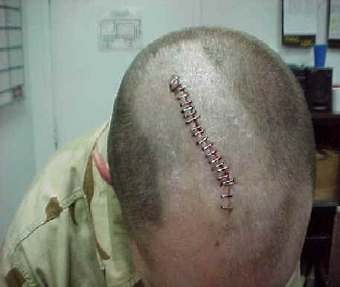
"I saw that one of the heads of the beast seemed wounded beyond recovery—but the fatal wound was healed! The whole world marveled at this miracle and gave allegiance to the beast. ⁴They worshiped the dragon for giving the beast such power, and they also worshiped the beast. 'Who is as great as the beast?' they exclaimed. 'Who is able to fight against him?'" (13:3-4).
80 G
Notes:
Satan worship is becoming much more popular in the USA, even though Satan does not care if people worship him or something or someone else—as long as this is not God! Every major city in the USA has a Satanic church. One former Satanic priest, Mike Warnke, is now a Christian. He estimates that 80% of missing persons who have never been found were offered as human sacrifices.
"Not only will there be wonder, but there will also be worship (Rev. 13:4). Worship is the one thing Satan has always wanted (Matt. 4:8–10), and he will receive it through “the beast.” The second “beast,” described in the last half of this chapter, will organize and promote the worship of Antichrist, making it the official religion of the world!" (Wiersbe).

Slide 26
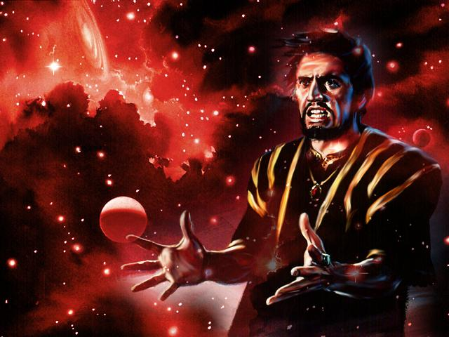
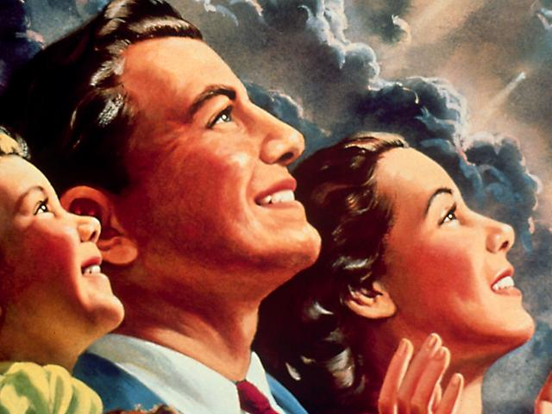
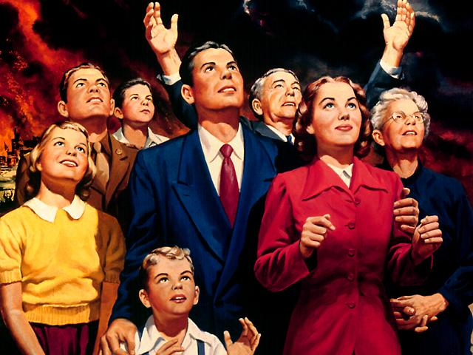
The world will worship the beast
80 H

Slide 27
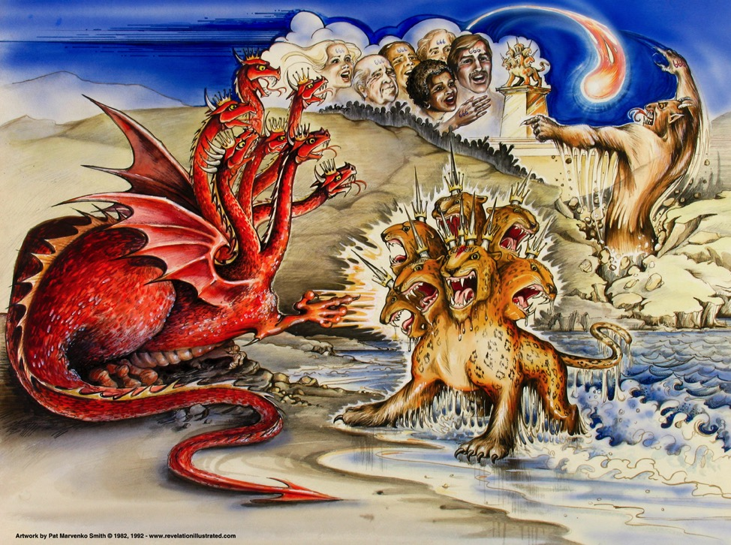
Beasts of Rev. 13
NTS 387
Dragon =
Satan
Land Beast =
False Prophet
Sea Beast =
Antichrist
Used with permission
Dr. Rick Griffith • Singapore Bible College • biblestudydownloads.com

Slide 28

A Satanic "Trinity":
387
"Father" =
Satan
"Son" =
Antichrist
"Spirit" =
False Prophet

Slide 29
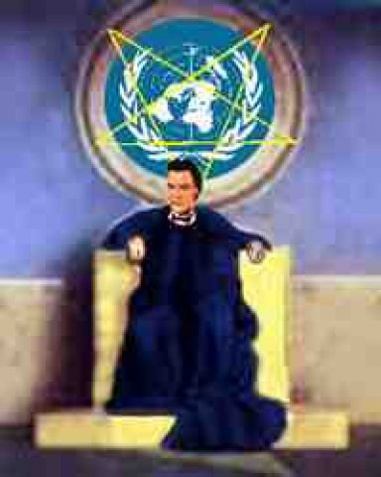
Antichrist Sets Up Image for Worship
(2 Thess. 2:3-4 NLT)
80 I
"Don’t be fooled by what they say. For that day will not come until there is a great rebellion against God and the man of lawlessness is revealed—the one who brings destruction. ⁴He will exalt himself and defy everything that people call god and every object of worship. He will even sit in the temple of God, claiming that he himself is God.”

Slide 30
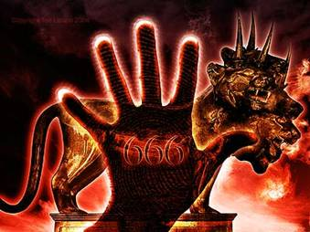
The Mark in the Right Hand
80 J
He causes all, both small and great, rich and poor, free and slave, to receive a mark on their right hand or on their foreheads, and that no one may buy or sell except one who has the mark or the name of the beast, or the number of his name.
Revelation 13:16-17

Slide 31
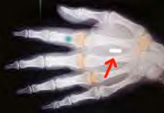
The Mark in the Right Hand
80 J
He causes all, both small and great, rich and poor, free and slave, to receive a mark on their right hand or on their foreheads, and that no one may buy or sell except one who has the mark or the name of the beast, or the number of his name.
Revelation 13:16-17

Slide 32
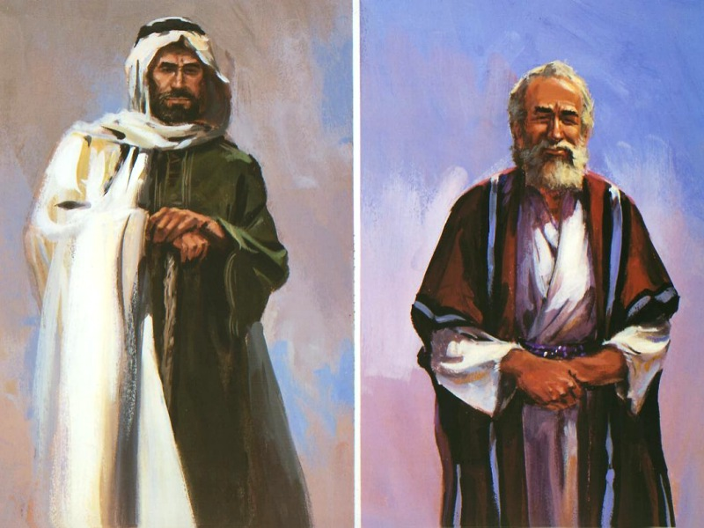
The Two Witnesses (Rev. 11:3)
80 K
And I will give power to my two witnesses, and they will be clothed in burlap and will prophesy during those 1,260 days.

Slide 33
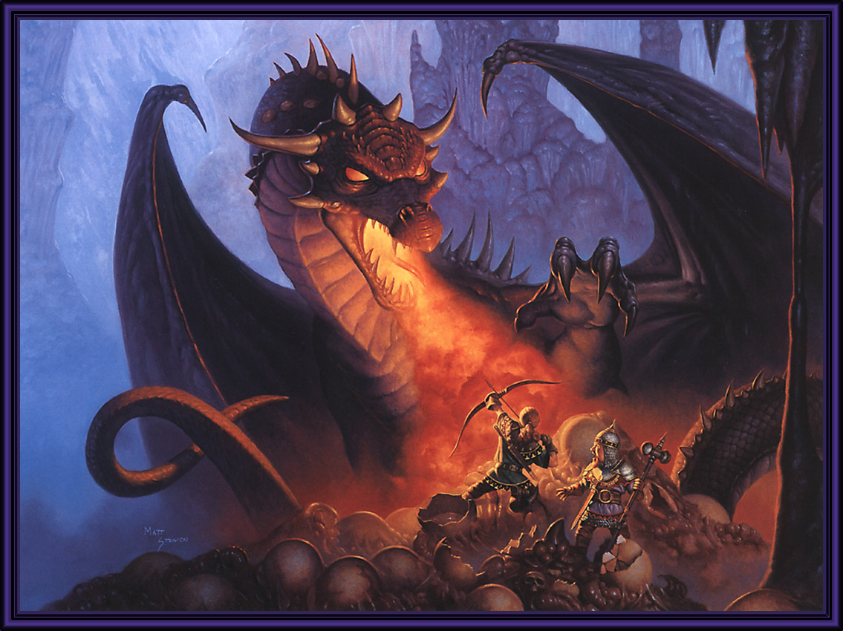
The Beast Attacks (Rev. 11:7)
80 K
When they complete their testimony, the beast that comes up out of the bottomless pit will declare war against them, and he will conquer them and kill them.

Slide 34
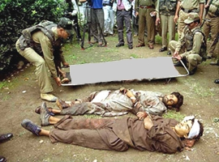
Two Witnesses Killed (Rev. 11:8-9)
80 K
And their bodies will lie in the main street of Jerusalem, the city that is figuratively called "Sodom" and "Egypt," the city where their Lord was crucified. ⁹And for three and a half days, all peoples, tribes, languages, and nations will stare at their bodies. No one will be allowed to bury them.

Slide 35
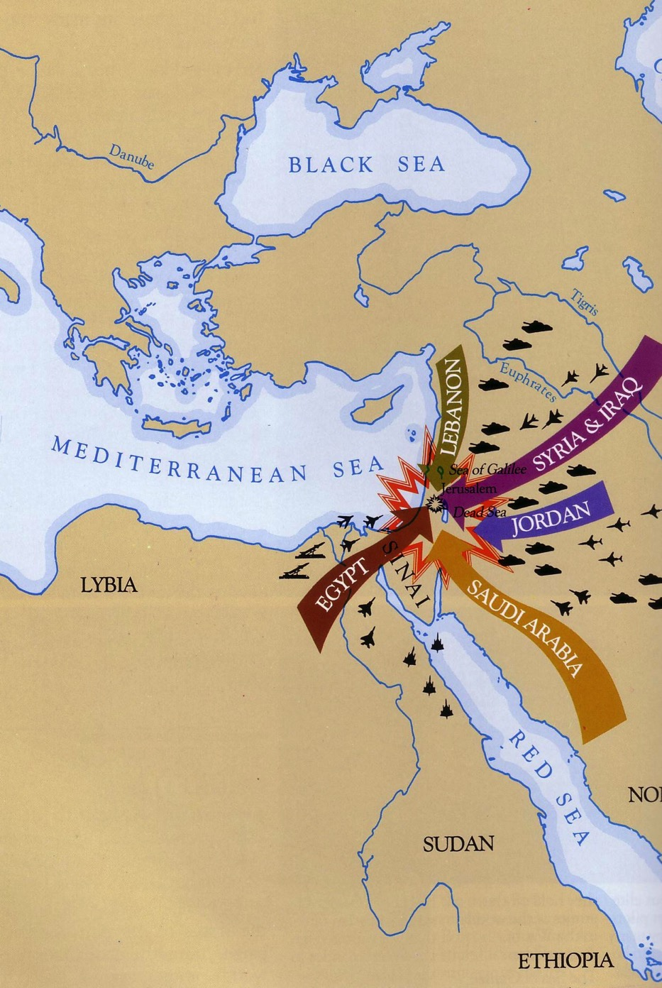
Daniel 11:40
80
L
Israel's enemies will invade her land

Slide 36
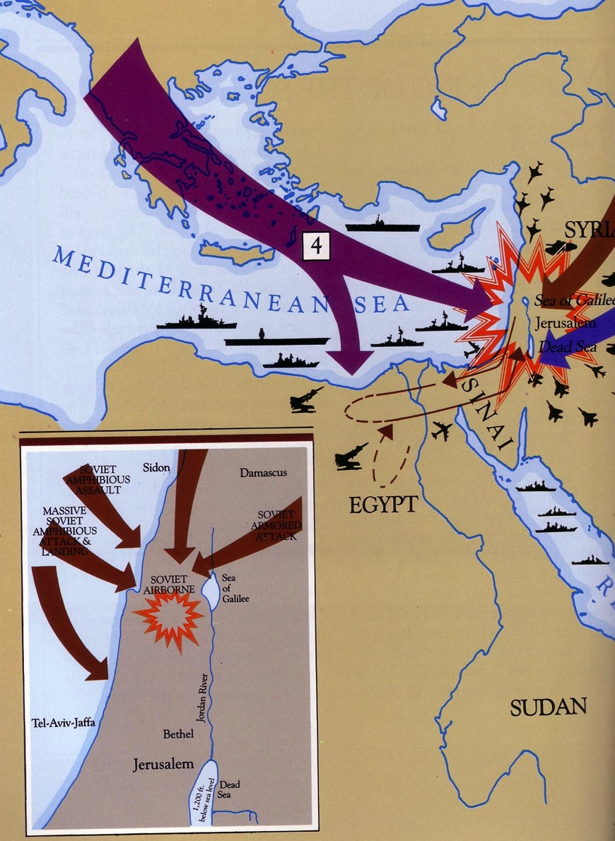
Daniel 11:40-45
Even ships in the Mediterranean will join the battle

Slide 37
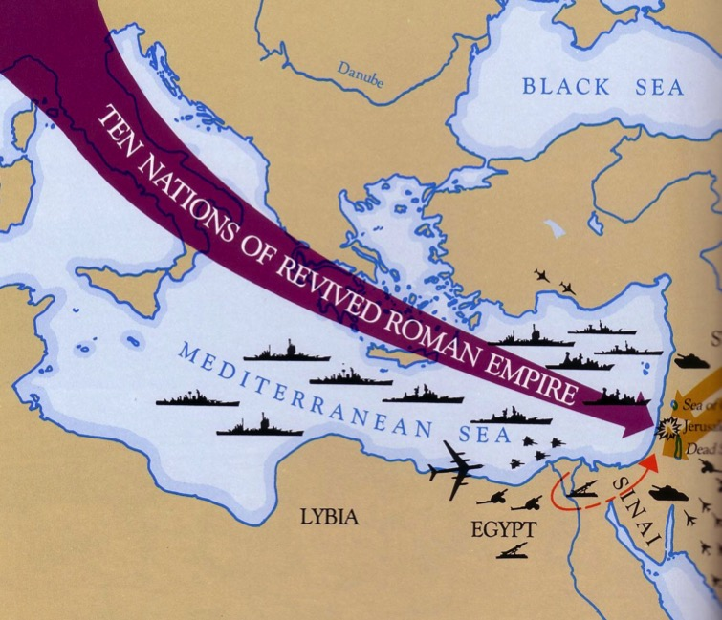
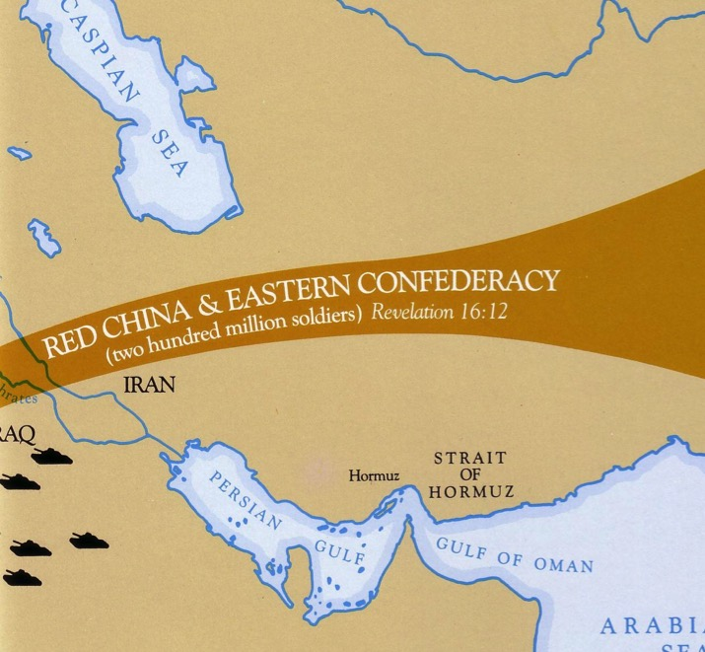
West Meets East (Dan. 11:44)

Slide 38
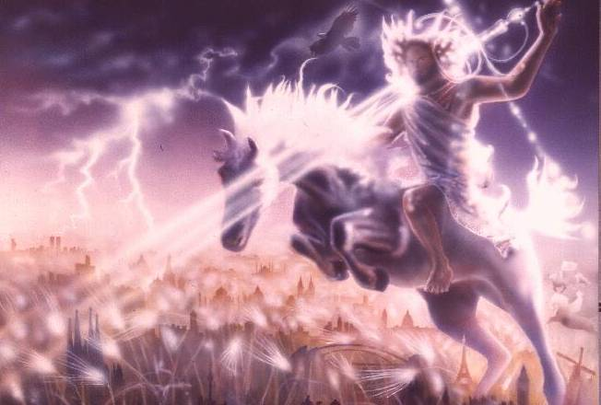
“He will judge the nations”

Slide 39
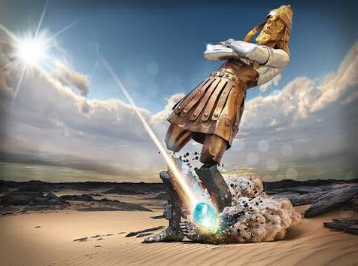
Note that ALL of the kingdoms will fall at the same time!

Slide 40
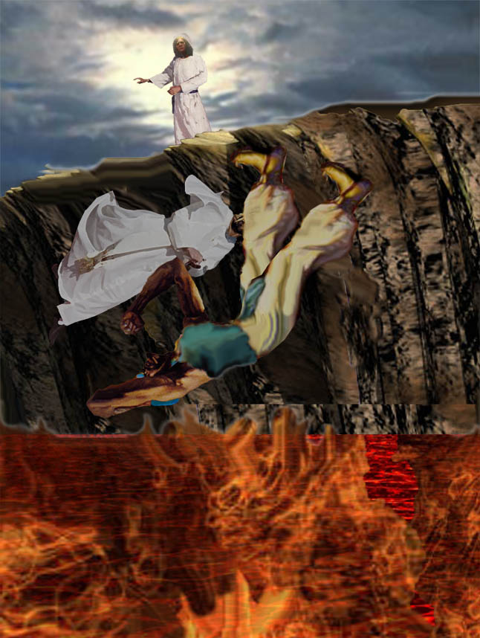
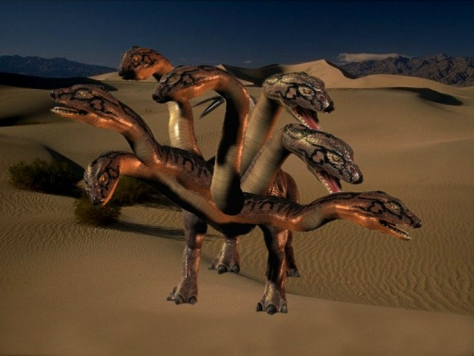
Beast & False Prophet cast into lake of burning sulfur
(19:20)
80

Slide 41
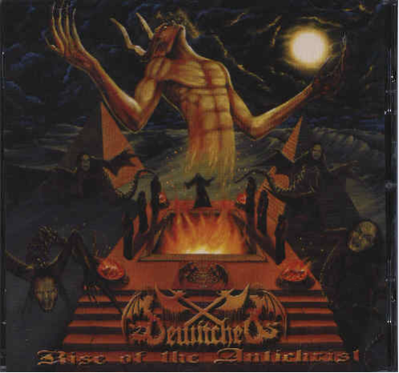
Who is the Antichrist?

Slide 42
The following slides show how some spiritualize "beast"…
388
The Counterfeit
& False
666

Slide 43
The Dragon!
388
Satan:
The arch-enemy of God; the one who hates all truth, all goodness, all of God's creatures; the one who would make himself God, if he could!

Slide 44

The Beast Spiritualized
388
The Beast:
The World's political systems. They demand and achieve worship and obedience from all but those who belong to the Lamb. The effect is to take the world into Satan's power.

Slide 45

The False Prophet Spiritualized
388
The False Prophet:
Every Ideology, Religion and/or Technology which leads mankind astray by highly plausible (but false) principles, miracles or works. His goal is to cause humanity to worship the Beast.

Slide 46
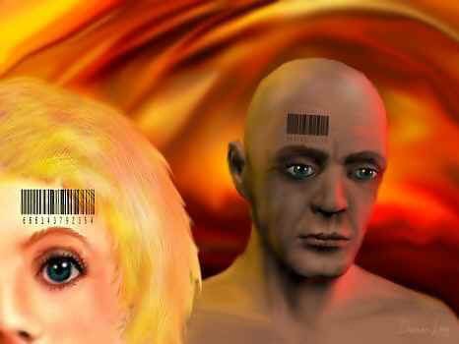
But he is referred to as a person and the number of his name is 666
(Revelation 13:18)
388

Slide 47
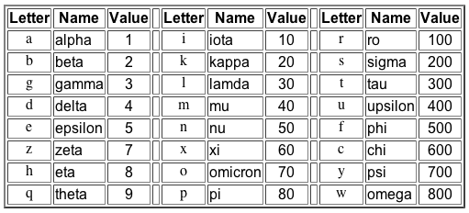
Gematria in Greek
388
Hebrew, Greek and Latin used letters as numbers
http://religion-cults.com/antichrist/666.htm
Notes:
religion-cults.com/ antichrist/666.htm

Slide 48

Nero = 666?
388
http://religion-cults.com/antichrist/666.htm

Slide 49
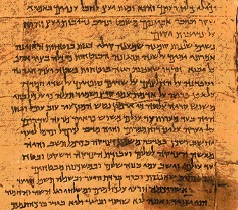
Hebrew Gematria
388
English | Greek | Hebrew | Value
A | Alpha | Aleph | 1
B | Beta | Beth | 2
C | Gamma | Gimmel | 3
D | Delta | Daleth | 4
E | Epsilon | He | 5
F |  | Waw | 6
G |  | Zahyin | 7
H | Eta | Heth | 8
www = 666
http://religion-cults.com/antichrist/666.htm
Notes:
The waw in Hebrew looks like a small "l" in English but it transliterates to "w." Triple it to "www" and some think that the World Wide Web is the Antichrist! This is unlikely, though, as both Daniel and Revelation indicate that he is a human. See slide 28 on The Beast Spiritualized.

Slide 50
English Gematria
388
K | 66
I | 54
S | 114
S | 114
I | 54
N | 84
G | 42
E | 30
R | 108
 | 666
A | 6
B | 12
C | 18
D | 24
E | 30
F | 36
G | 42
H | 48
I | 54
J | 60
K | 66
L | 72
M | 78
N | 84
O | 90
P | 96
Q | 102
R | 108
S | 114
T | 120
U | 126
V | 132
W | 138
X | 144
Kissinger = Antichrist!
Notes:
Another method tried in the early 1970s was to add the number 6 to each English letter of the alphabet, starting with "A" having the value of 6 and so on. This gives the letter "K" the value of 66, which is thought to show us on the right track to identifying the 666 person. The letter "I" then has a value of 54, and so on with KISSINGER summing up to 666. History records, though, that Henry Kissinger, the Jewish US Secretary of State in the early 1970s did not become the world ruler.

Slide 51
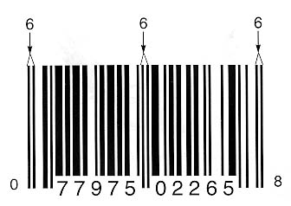
THE UPC BAR CODE
388
BUT WOULD THE JEWS IN THE NEXT VERSE (REV. 14:1) ALSO HAVE AN INVISIBLE CODE?
http://religion-cults.com/antichrist/mark.htm
Notes:
Even the popular bar code is based on three 6s. But this is not a person!
http://religion-cults.com/antichrist/mark.htm and www.soldierofthelord.4t.com/ photo.html

Slide 52
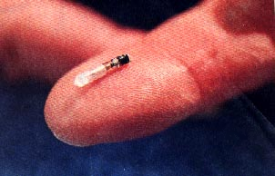


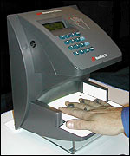
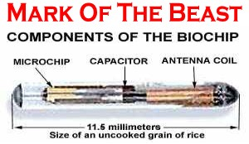
Mark of the Beast Microchip
388
www.soldierofthelord.4t.com/ photo.html
Notes:
Some countries like Sweden are initiating a system where a biochip under the skin can have convenient medical and financial data to help people "buy and sell" more easily (Rev 13:16-17).

Slide 53



Monster Drink!
388
Notes:
Even Monster Energy Drink has a triple "waw" for its logo! This brings us to 666 when "waw" has the value of 6 as in the Kissinger slide above.

Slide 54
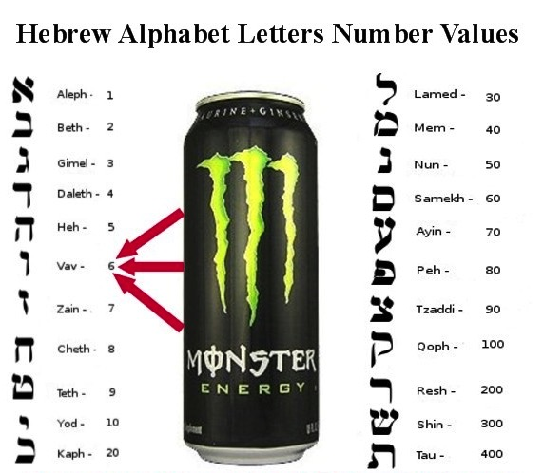
Hebrew Alphabet Values
388
Monster Energy Drink =
666
Notes:
Waw is the sixth letter of the Hebrew alphabet. Triple it, some say, and you have the Antichrist!

Slide 55
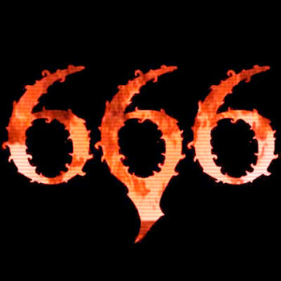
The Sky's the Limit
388
Computations using different systems make each of these total 666: Kissinger, van den broek, lustiger, hitler, deutschland, himmler, new york, us of america, santa claus, kennedy, al gore... Holy Bible, SS number, witchcraft, lustful, monetary, live, son of sin, mark of beast, evil, bullet... internet, billgates+3 (the III), computer, terminal, binary, windows98, teletext, calculation

Slide 56
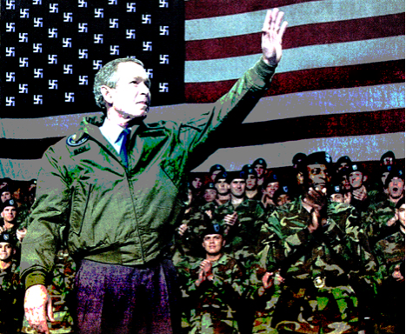
George W. Bush?!

Slide 57
Outline of Daniel
532
UNIVERSAL SOVEREIGNTY IN TIMES OF THE GENTILES
Sovereignty over Daniel |  |  | Sovereignty over Gentiles |  |  |  |  |  | Sovereignty over Jews
Chapter 1 |  |  | Chapters 2–7 |  |  |  |  |  | Chapters 8–12
Narrative |  |  | Visions in Narrative |  |  |  |  |  | Vision
Hebrew |  |  | Aramaic |  |  |  |  |  | Hebrew
Gentile Names for God |  |  | Gentile Names for God |  |  |  |  |  | Jewish Names for God
Third person ("Daniel") |  |  | Third person ("Daniel") |  |  |  |  |  | First person ("I")
Daniel's Example |  |  | Daniel Interprets King's Dreams |  |  |  |  |  | Angel Interprets Daniel's Dreams
The Man Daniel |  |  | Images |  | Kings |  |  |  | Israel's Future
Exile 1:1-7 | Food 1:8-16 | Exalted 1:17-21 | Varied 2 Promoted | Gold 3 Furnace | Neb. 4 Exile | Bel. 5 Party | Dar. 6 Lions | All 7 Beasts | Medo- Persia To Greece 8 | Return to Seventy "7s" 9 | Intertest-ament Period to Tribulation 10–12
Babylon
605-536 BC
Notes:
Not surprisingly, the center section of the prophecy that relates to Gentile nations from chapters 2–7 is written in Aramaic, the trade language of the day. Note also how the writing begins and ends with the Jewish people, which would have been of great concern to Daniel.

Slide 58

Daniel
7-year covenant
1290/1260-day trial
Ten-horned Beast
Revelation
Notes:
Both Daniel and Revelation share these three elements in common.

Slide 59
Chapter 9
86b-d
Daniel's prayer (9:1-19)
God's reply - Seventy x seven (9:20-27)
The interpretation of these seventy weeks is divided into 4 major views. But let's first see the text itself and ask who the “bad guys” are:
“the Anointed One” or the “ruler who will arise”?

Slide 60

The Number of
540
Completion
Creation Gen. 2:2
Rain Gen. 7:4
Sabbath Ex. 20:10
Jericho Josh. 6:4
Sons Job 1:2; Ruth 4:15
Prophecy Dan. 9:24
Forgive Matt. 18:21

Slide 61
Daniel 9:24-27 (NLT)
86b-d
²⁵ Now listen and understand! Seven sets of seven plus sixty-two sets of seven will pass from the time the command is given to rebuild Jerusalem until a ruler—the Anointed One—comes. Jerusalem will be rebuilt with streets and strong defenses, despite the perilous times.
²⁶ “After this period of sixty-two sets of seven, the Anointed One will be killed, appearing to have accomplished nothing, and a ruler will arise whose armies will destroy the city and the Temple. The end will come with a flood, and war and its miseries are decreed from that time to the very end. ²⁷ The ruler will make a treaty with the people for a period of one set of seven, but after half this time, he will put an end to the sacrifices and offerings. And as a climax to all his terrible deeds, he will set up a sacrilegious object that causes desecration, until the fate decreed for this defiler is finally poured out on him.”

Slide 62

70 "Weeks" in Daniel 9:25-27
551
Decree
Anointed One
69 sevens = 483 years
7 sevens + 62 sevens
1 seven
= 7 years
"Know and understand this: From the issuing of the decree to restore and rebuild Jerusalem until the Anointed One, the ruler, comes, there will be seven 'sevens,' and sixty-two 'sevens.' It will be rebuilt with streets and a trench, but in times of trouble. ²⁶After the sixty-two 'sevens,' the Anointed One will be cut off and will have nothing. The people of the ruler who will come will destroy the city and the sanctuary. The end will come like a flood: War will continue until the end, and desolations have been decreed" (Dan. 9:25-26 NIV).
Notes:
Gabriel brought to Daniel the 70 "sevens" vision where God revealed that the full restoration would need Messiah to come twice (9:20-27).

Slide 63
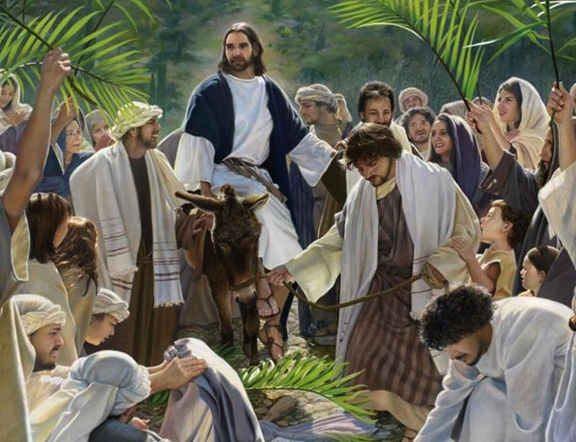
Triumphal Entry: "Anointed One comes"
Zech. 9:9
Dan. 9:25
30 March AD 33
Notes:
Gabriel told Daniel that the Messiah would come 173,880 days after the decree of Artaxerxes. This works out to be on 30 March AD 33 when Jesus came into Jerusalem to present himself as Israel’s king— the most specific fulfillment of Bible prophecy in the Bible!

Slide 64
4 Views on the 70 "Weeks"
554
Jer. 25:11-12
605/ 586 BC
Cy-rus
De-cree
538 BC
Art. 2nd
De-cree
444 BC
Jeru-sa-lem
Re-built
395 BC
Mur-der
of
Oni-as
171 BC
Anti-ochus
De-se-cra-tion
167 BC
Tem-ple
Re-ded-ica-tion
164 BC
Christ Death
AD
33
Titus
De-stroy
Jeru-sa-lem
AD 70
Church Age
7
Yr.
Trib-ula-tion
Mil-len-nial
King-dom
Critical
7 wks
62 weeks
1 wk
Symbolic
7 wks
62 weeks
1 wk
Messianic
7 wks
62 weeks
1 wk
Premillennial
7 wks
62 weeks
1 wk

Slide 65
1. Critical View
555
Jer. 25:11-12
605/ 586 BC
Cy-rus
De-cree
538 BC
Mur-der
of
Oni-as
171 BC
Anti-ochus
De-se-cra-tion
167 BC
Tem-ple
Re-ded-ica-tion
164 BC
Critical
7 wks
62 weeks
1 wk
Critique of Critical View:
  Weeks add up to 422 or 441 years (not 490)
  Antiochus was hardly a Messianic figure!
  Antiochus IV made no covenant with Israel
  Prophecy seen only as imaginative prediction

Slide 66
2. Amillennial Symbolic View
555
Cy-rus
De-cree
538 BC
Art. 2nd
De-cree
444 BC
Church Age
7
Yr.
Trib-ula-tion
Symbolic
7 wks
62 weeks
1 wk
70 seen as indefinite era to lead people to salvation
7 as a mark of divine work, symbolizing completion
  First 7 years begins with the Cyrus decree (538 BC)
  The 62 weeks = the gospel is preached
  The final week = Antichrist rule, Christ lost influence
  70 years end in Christ's second coming

Slide 67
2. Amillennial Symbolic View
555
Cy-rus
De-cree
538 BC
Art. 2nd
De-cree
444 BC
Church Age
7
Yr.
Trib-ula-tion
Symbolic
7 wks
62 weeks
1 wk
Critique of the Symbolic View
  70x7 seen as for all people, not exclusive to Israel
  Glosses over details of prophetic elements
  Cyrus's decree was closest to the time Daniel's prayer but did not restore Jerusalem but only the temple

Slide 68
3. Messianic/Historic View
555
Cy-rus
De-cree
538 BC
Art. 2nd
De-cree
444 BC
Christ Death
AD
33
Titus
De-stroy
Jeru-sa-lem
AD 70
Messianic
7 wks
62 weeks
1 wk
7 wks starts from Cyrus decree
62 wks ends at Christ's first advent (9:26 occurs after this)
Final week – Death of Christ abolished sacrifice
Destruction of Jerusalem in AD 70
  Rejects the gap theory
  The final prince not seen as the Antichrist but as Christ
  Sees Abomination of Desolation (Matt 24:15) as fulfilled in AD 70 (then Matthew wrote about it)

Slide 69
3. Messianic/Historic View
555
Cy-rus
De-cree
538 BC
Art. 2nd
De-cree
444 BC
Christ Death
AD
33
Titus
De-stroy
Jeru-sa-lem
AD 70
Messianic
7 wks
62 weeks
1 wk
Critique of the Messianic View
  Interpretation as new covenant (Heb. 8:13) and desolation (Dan. 9:25-26) lacking
  Does not account for Antichrist in Rev 13:5 who will rule 42 months.
  2 Thess. 2:4 says Antichrist (not Christ) will claim deity in temple
  However, Young does see 11:40-44 as referring to Antichrist (Young, 248, 251)

Slide 70
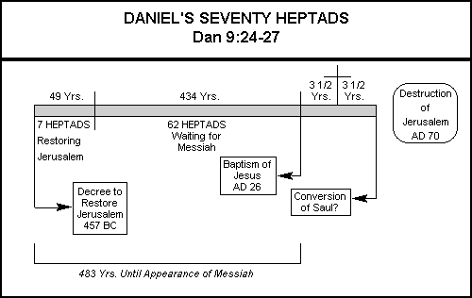
Messianic View of James E. Smith
Problems?
The one who stops the sacrifice (Dan. 9:27) also desecrates the temple (cf. 2 Thess. 2:4; Rev. 13:5)
The Major Prophets (Joplin, MO: College Press, 1995), LOGOS electronic version chart 22

Slide 71
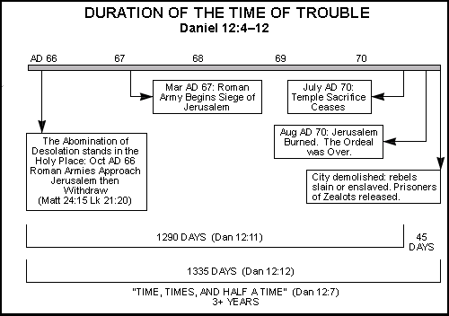
Messianic View of James E. Smith
Problems?
Travel and knowledge did not vastly increase in AD 60s (Dan. 12:2)
No abomination stood in the temple in AD 66
The Major Prophets (Joplin, MO: College Press, 1995), LOGOS electronic version chart 24

Slide 72
4. Premillennial View
555
Jer. 25:11-12
605/ 586 BC
Cy-rus
De-cree
538 BC
Art. 2nd
De-cree
444 BC
Jeru-sa-lem
Re-built
395 BC
Mur-der
of
Oni-as
171 BC
Anti-ochus
De-se-cra-tion
167 BC
Tem-ple
Re-ded-ica-tion
164 BC
Christ Death
AD
33
Titus
De-stroy
Jeru-sa-lem
AD 70
Church Age
7
Yr.
Trib-ula-tion
Mil-len-nial
King-dom
Premillennial
7 wks
62 weeks
1 wk
7 weeks began at Artaxerxes's 444 BC decree to Nehemiah
62 weeks end with Christ's Triumphal Entry
Gap = the church age = times of Gentiles (note Jesus' prophecy in Luke 21:24)
The final week = 7 year Tribulation

Slide 73
The Seventy "Weeks" of Daniel
551
Anointed One
Decree
69 sevens = 483 years
7 sevens 62 sevens
1 seven
= 7 years
444 BC
– 395 BC
395 BC
– AD 33

Slide 74
Questions on the Premillennial View
555
Which decree is in 9:25? Four options:
  (1) Cyrus decree to rebuild the temple (2 Chron. 36: 22-23; Ezra 1:1-4; 6:1-5);
  (2) Darius decree confirming the decree of Cyrus (Ezra 6:6-12);
  (3) Artaxerxes decree #1 (Ezra 7:11-26);
  (4) Artaxerxes decree #2 given to Nehemiah authorizing the rebuilding of the city (Neh. 2:1-8).
Why do we hold that the decree is Artaxerxes #2 in his 20th year (444 BC)? This is because Neh. 2:12-17 pictures Jerusalem in ruins at this time.

Slide 75

An Ominous Day:
Luke 10:41-42 NAU
"When He approached Jerusalem, He saw the city and wept over it, ⁴²saying, 'If you had known in this day, even you, the things which make for peace! But now they have been hidden from your eyes.'"

Slide 76

An Ominous Day:
Luke 10:43-44 NAU
"For the days will come upon you when your enemies will throw up a barricade against you, and surround you and hem you in on every side, ⁴⁴and they will level you to the ground and your children within you, and they will not leave in you one stone upon another, because you did not recognize the time of your visitation."

Slide 77


Mind the Gap

Slide 78
Why the Gap?
82
Six Reasons
Why must there be a gap
between the end of the 69th week
and the beginning of the 70th week?
Anointed One
Decree
69 sevens = 483 years
7 sevens 62 sevens
1 seven
= 7 years
444 BC
– 395 BC
395 BC
– AD 33
Notes:
For a dispensational interpretation of each of these six phrases see the exegetical outline of Daniel 9:24 on the preceding pages.

Slide 79
Why the Gap?
540
552a
83
Reason (a)
Six Reasons
The six prophecies in Daniel 9:24 could not have been fulfilled at Christ's first advent.
These prophecies relate not to the church but to Israel.
Has Israel finished sinning (24a)? No.
Has Israel had atonement for her sins (24b-c)? No.
Has Israel seen everlasting righteousness (24d)? No.
Paul still saw this as future for Israel (Rom. 11:25-27).
Has vision and prophecy culminated (24e)? No.
Has the holy of holies* been anointed yet (24f)? No.
* Although the phrase "most holy" has been sometimes interpreted to mean Christ's anointing (e.g., Young, The Prophecy of Daniel, 201), these are technical words always translated in the Old Testament as "holy of holies." The clear referent is the consecration of the millennial temple (cf. Ezek. 40–46).
Notes:
For a dispensational interpretation of each of these six phrases see the exegetical outline of Daniel 9:24 on the preceding pages.

Slide 80
Before the Curtain Closes (9:24 NLT)
83
“A period of seventy sets of seven has been decreed for your people and your holy city
to finish their rebellion,
to put an end to their sin,
to atone for their guilt,
to bring in everlasting righteousness,
to confirm the prophetic vision, and
to anoint the Most Holy Place."
Tribulation
Millennium
These were NOT fulfilled in the first century––so the 70 weeks must have a future fulfillment

Slide 81
Why the Gap?
OTS 541
552a
83
Reason (b)
Six Reasons
The first word of verse 26, "after" (וְאַחֲרֵ֤י), indicates a gap. This gap occurs after the culmination of the sixty-ninth week at the cutting off of Messiah at Christ's crucifixion after the Triumphal Entry.
Church Age: "The end will come with a flood, and war and its miseries are decreed from that time to the very end" (9:26b)
Christ’s Death
AD 33
Titus
Destroys
Jerusalem
AD 70
7 Yr.
Tribulation
7 wks
62 weeks
1 wk
The traditional-historical school sees Christ's baptism ending the 69 weeks and His death at the middle of the 70th week. If this were so, the text would read that the cutting off of Messiah would occur "during" or "in the midst of" the seventieth week. However, verse 26 says that several events must occur before the beginning of the 70th week, such as Jerusalem’s destruction and many wars.

Slide 82
Daniel 9:25-27 (NLT)
86b-d
²⁵ Now listen and understand! Seven sets of seven plus sixty-two sets of seven will pass from the time the command is given to rebuild Jerusalem until a ruler—the Anointed One—comes. Jerusalem will be rebuilt with streets and strong defenses, despite the perilous times.
²⁶ "After this period of sixty-two sets of seven, the Anointed One will be killed, appearing to have accomplished nothing, and a ruler will arise whose armies will destroy the city and the Temple. The end will come with a flood, and war and its miseries are decreed from that time to the very end. ²⁷ The ruler will make a treaty with the people for a period of one set of seven, but after half this time, he will put an end to the sacrifices and offerings. And as a climax to all his terrible deeds, he will set up a sacrilegious object that causes desecration, until the fate decreed for this defiler is finally poured out on him."

Slide 83
Why the Gap?
OTS 541
552a
83
Reason (c)
Six Reasons
The idea of gaps may seem strange to the 21st century mind, but this was not true of the Jewish mindset.
For example, Isaiah 61:1-2 records the two advents of Christ in a single context. Christ quoted the portion of this passage relating to His first advent in Luke 4:18-19, thus revealing that a separation of many years appears.
Concerning the Jewish mindset, Gundry notes, "The possibility of a gap between the sixty-ninth and seventieth weeks is established by the well-accepted OT phenomenon of prophetic perspective, in which gaps such as that between the first and second advents were not perceived" (Robert H. Gundry, The Church and the Tribulation [Grand Rapids: Zondervan, 1973], 190).
Notes:
For a dispensational interpretation of each of these six phrases see the exegetical outline of Daniel 9:24 on the preceding pages.

Slide 84
Why the Gap?
OTS 541
552a
83
Reason (d)
Six Reasons
The person who confirms the covenant in Daniel 9:27 cannot be Christ.
The "He" in this verse looks back at "the prince who is to come" in the previous verse (Titus in AD 70) as its antecedent.
Also, if Christ is the confirmer of the covenant, then what covenant did He confirm and then break? Certainly not the new covenant!
Notes:
This covenantal perspective finds recent support by Meredith G. Kline, "The Covenant of the Seventieth Week,” in The Law and the Prophets. Old Testament Studies Prepared in Honor of Oswald Thompson Allis, ed. by John H. Skilton (Nutley, NJ, 1974), 452-69, esp. 461-69; cited by Hoehner, 132.

Slide 85

The Temple Stood Until AD 70

Slide 86


Antonia Fortress

Slide 87


Temple Assault by Titus, the "ruler [who] ruler will arise whose armies will destroy the city and the Temple" (9:26)
Sept. AD 70

Slide 88
Why the Gap?
OTS 541
552a
83
Reason (e)
Six Reasons
Since Christ's death did not "put an end to sacrifice and offering" (Dan. 9:27), a gap must exist between the 69th and 70th weeks.
The Jews continued the sacrificial system until God stopped their abhorrent practice with Titus' destruction of the temple in AD 70.

Slide 89

The Temple Veil

Slide 90

The Temple Veil Torn (Matt. 27:51)
It must have been sown up from AD 33-70

Slide 91
Why the Gap?
OTS 541
552a
83
Reason (f)
Six Reasons
Parallel prophecies also have a gap:
Jesus said in Matthew 24:15 that the abomination of desolation will occur after His earthly ministry.
The wicked person of Daniel 9:27 has striking parallels with the future wicked man in Daniel 7:25; Revelation 12, 13, 19.
The events of the second half of the 70th week (Dan. 9:27b) correlate with those of the latter half of the future Tribulation period in Rev. 13:4, 6, 12, 14-15

Slide 92

Daniel's 70 Weeks
(Dan. 9:24-27)
84
69 Weeks
444 BC
AD 33

Slide 93
Chronology of the 70th "Week"
101
Adapted from J. Dwight Pentecost, Dallas Theological Seminary, 1988
Middle of the Week
Sign of
Son of Man
Matt. 24:30
Christ's Return Complete
3½ YEARS
1290 DAYS
Dan. 12:11
30 DAYS
30 DAYS
1260 DAYS
45 DAYS
Rev. 11:3; 12:6
Dan. 12:12
3½ YEARS
3½ YEARS
Election
of Beast
Rev. 17:13
Covenant Made
Dan. 9:27a
Covenant Broken
Dan. 9:27b
2nd ADVENT
The Great Tribulation
The Tribulation

Slide 94
Comments on the Premillennial View
86b-d
Which decree is the decree of 9:25?
  (1) Cyrus decree to rebuild the temple (2 Chron. 36: 22-23; Ezra 1:1-4; 6:1-5);
  (2) Darius decree confirming the decree of Cyrus (Ezra 6:6-12);
  (3) Artaxerxes decree #1 (Ezra 7:11-26);
  (4) Artaxerxes decree #2 given to Nehemiah authorizing the rebuilding of the city (Neh. 2:1-8).
Why do we hold that the decree is Artaxerxes #2 in his 20th year (444 BC)? This is because Neh. 2:12-17 pictures Jerusalem in ruins at this time.

Slide 95

Luke 21:24 Times of the Gentiles
86f
Raymond Ludwigson, A Survey of Bible Prophecy, 181
Notes:
When Jesus referred to the “times of the Gentiles” (Luke 21:24), he meant the period when no Jewish king was on the throne of Israel. Zedekiah was Judah’s last king, deposed in 586 BC. The next king is Jesus, who will rule over Israel until the end of the church period and Tribulation. In this era between these two Jewish kings, other rulers—all Gentiles—have controlled Israel. Even the present State of Israel does not have a king, nor does it have sovereignty in the sense of other nations, for it often must seek approval of Gentile nations such as the USA for simple matters such as security, expansion, etc.

Slide 96
The Jewish Calendar
85
360 days per year
69 weeks of 483 years = 476 solar years
Issue of the decree on 5 March 444 BC to the time that the Messiah is cut off works out to 3 April AD 33. This makes Christ's Triumphal Entry on 30 March AD 33.
Compare 9:27 with Rev 13:5, 14-15

Slide 97

Determinations of the Seventy Weeks
85
Harold Hoehner, Chronological Aspects of the Life of Christ

Slide 98
Determinations of the Seventy Weeks
85
Harold Hoehner, Chronological Aspects of the Life of Christ

Slide 99

Events of the 70th "Week"
556
70th "Week"
All Israel
shall be saved
2018 09 23 John Haller's Prophecy Update
"Surveillance Society” (https://www.youtube.com/watch?v=GE35KQWKCWw)
"He will confirm a covenant with many for one 'seven.' In the middle of the 'seven' he will put an end to sacrifice and offering. And on a wing [of the temple] he will set up an abomination that causes desolation, until the end that is decreed is poured out on him" (Daniel 9:27 NIV).
Notes:
Parallel texts build upon this teaching by saying that the Antichrist will set up this abomination that causes desolation (Matt 24:15) where he will declare himself to be God:
“He will exalt himself and defy everything that people call god and every object of worship. He will even sit in the temple of God, claiming that he himself is God” (2 Thess 2:4 NLT).
“Then the beast was allowed to speak great blasphemies against God. And he was given authority to do whatever he wanted for forty-two months. ⁶ And he spoke terrible words of blasphemy against God, slandering his name and his dwelling—that is, those who dwell in heaven. ⁷ And the beast was allowed to wage war against God’s holy people and to conquer them. And he was given authority to rule over every tribe and people and language and nation. ⁸ And all the people who belong to this world worshiped the beast. They are the ones whose names were not written in the Book of Life that belongs to the Lamb who was slaughtered before the world was made” (Rev 13:5-8 NLT).
______________
OS-27-Daniel-330
OS-Ezekiel 40-48-Slide 16
OS-37-Haggai-96

Slide 100
Black

Slide 101


Future (Eschatology) at BibleStudyDownloads.org
Get this presentation for free!
Notes:
Future (fu)
Eschatology

