Slide 1
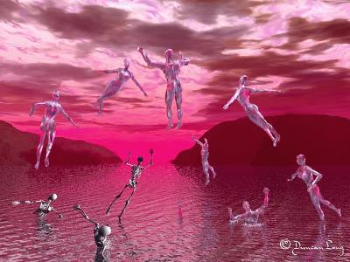
The Rapture
Future (Eschatology) Presentation 9
Dr. Rick Griffith • Jordan Evangelical Theological Seminary • BibleStudyDownloads.org

Slide 2


Slide 3
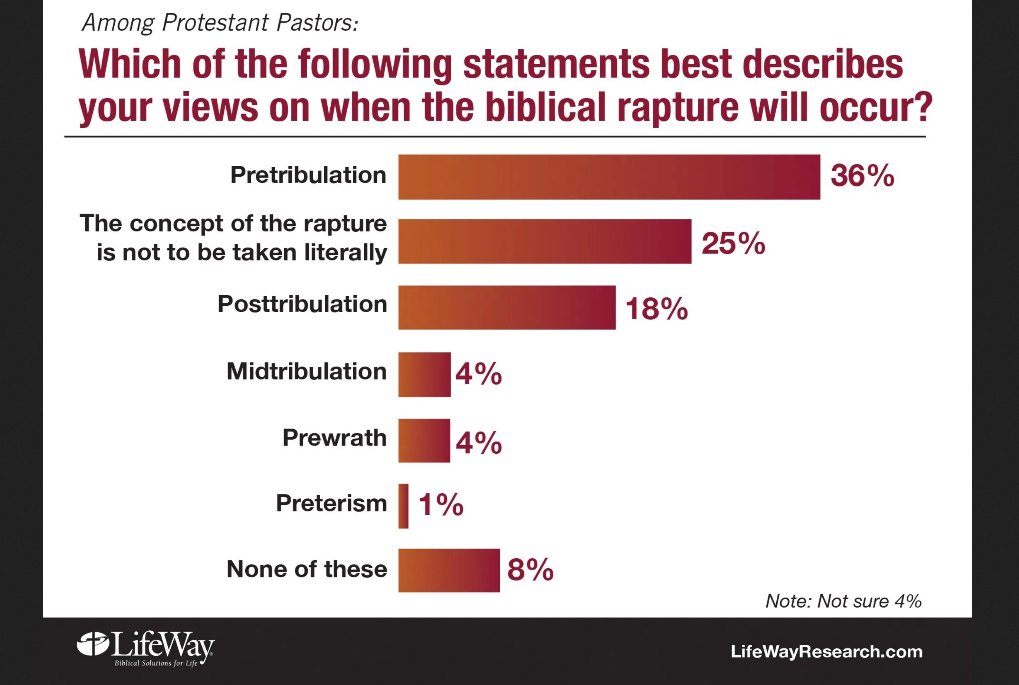
Among Protestant Pastors:
Which of the following statements best describes your view on when the biblical rapture will occur?
Pretribulation
The concept of the rapture is not to be taken literally
Postribulation
Midtribulation
Rapture Views (2016)
Prewrath
Preterism
None of these
Note: Not sure 4%
https://blog.lifeway.com/newsroom/2016/04/26/pastors-the-end-of-the-world-is-complicated/
Notes:
https://blog.lifeway.com/newsroom/2016/04/26/pastors-the-end-of-the-world-is-complicated/
Pastors: The end of the world is complicated
April 26, 2016
By Bob Smietana
NASHVILLE, Tennessee – Most Protestant pastors believe Jesus will return in the future. But few agree about the details of the apocalypse.
A third of America’s Protestant pastors expect Christians to be raptured—or taken up in the sky to meet Jesus—as the end times begin. About half think a false messiah known as the Antichrist will appear sometime in the future.
A surprising number think the Antichrist has already been here or isn’t on his way at all.
Those are among the findings of a new telephone survey of 1,000 Protestant senior pastors and their views on end-times theology from Nashville-based LifeWay Research, sponsored by Charisma House Book Group.
End-times theology remains popular with churchgoers, says Scott McConnell, vice president of LifeWay Research. But it’s not an easy topic to preach about.
“Most people want their pastor to preach about the Book of Revelation and the end of the world,” he says. “But that’s a complicated task. Pastors and the scholars they cite often disagree about how the end times will unfold.”
No consensus about the rapture
Researchers found widely varying views about three aspects of end-times theology:
The timing of the rapture (see 1st Thessalonians 4:15-17 and Matthew 24)
The nature of the Antichrist (found in 1 John and 2 John and other texts)
The millennial kingdom, when Jesus reigns for 1,000 years (Revelation 20:1-10)
About a third (36 percent) of Protestant senior pastors believe in the kind of pretribulation rapture familiar to pop culture. In that scenario, Christians disappear at the start of the apocalypse. Those left behind suffer great trouble or tribulation.
One in 4 pastors say the rapture is not literal. Almost 1 in 5 thinks the rapture happens after the tribulation (18 percent). A few believe the rapture already happened (1 percent) or that it will occur during the tribulation (4 percent) or before the wrath of God is poured out on the earth (4 percent). Others don’t agree with any of these views (8 percent) or aren’t sure what will happen (4 percent).
Mainline Protestant pastors (36 percent) are more likely to say the rapture isn’t literal. Pastors who hold this view include about half of Lutherans (60 percent), Methodists (48 percent) and Presbyterian/Reformed pastors (49 percent). Few Baptist (6 percent) or Pentecostal pastors (less than 1 percent) hold that view.
Evangelicals overall (43 percent) are more likely to believe in a pretribulation rapture.
Education and age also play a role in how pastors view the rapture. Pastors with a master’s degree (33 percent) or a doctorate (29 percent) are more likely to say the rapture isn’t literal than those with no degree (6 percent) or a bachelor’s (16 percent).
Sixty percent of pastors with no college degree believe in a pretribulation rapture. By contrast, 26 percent of pastors with a master’s hold that view.
Pastors under 45 are least likely to believe in a pretribulation rapture (28 percent), compared to their older cohorts. They’re also most likely (23 percent) to believe in a posttribulation rapture.
Most expect the Antichrist, disagree on timing
LifeWay Research also found diverse views about the Antichrist.
(Article continues below chart.)
About half (49 percent) say the Antichrist is a figure who will arise in the future. Others say there is no individual Antichrist (12 percent); that, he is a personification of evil (14 percent) or an institution (7 percent). Six percent say the Antichrist has already been here.
Baptists (75 percent) and Pentecostals (83 percent) are most likely to see a future Antichrist. Lutherans (29 percent), Methodists (28 percent) and Presbyterian/Reformed pastors (31 percent) are more likely to see the Antichrist as a personification of evil.
Education also played a role in how pastors see the Antichrist. Two-thirds of those with no college degree (68 percent) or a bachelor’s (63 percent) believe in a future Antichrist figure. Fewer than half of those with a master’s (39 percent) or a doctorate (49 percent) hold that view.
Premillennialism is commonplace
Pastors also disagree about the details of the millennial kingdom.
About half (48 percent) believe in premillennialism, the view that the 1,000-year reign of Christ happens in the future. A third (31 percent) believe in amillennialism, the view that there’s no 1,000-year reign—instead Jesus already rules the hearts and minds of Christians.
One in 10 (11 percent) believe in postmillennialism—the idea that the world will gradually become more Christian until Jesus returns.
Most pastors were split by denomination:
Baptists (75 percent) and Pentecostals (84 percent) are most likely to choose premillennialism.
Lutherans (71 percent) were most likely to choose amillennialism, followed by Presbyterian/Reformed pastors (52 percent) and Methodists (37 percent).
Methodists (27 percent) were more likely than other denominations to choose postmillennialism.
Education also played a role. Premillennialism is popular with those with no college (71 percent) or a bachelor’s degree (63 percent). Amillennialism is favored by those with a master’s degree (41 percent).
Billy Hallowell, author of the upcoming book The Armageddon Code: One Journalist’s Quest for End-Times Answers, said the research quantifies the prevalence of different end-times theories.
“I’m hoping the data opens a discussion about preachers’ eschatological beliefs, why they hold those ideas, and how congregants and faith leaders can better understand the biblical texts,” he said.
McConnell says it’s not a bad thing that pastors disagree on the details of the apocalypse. Most agree on the main teachings about the Second Coming. The rest of the details don’t affect the day-to-day life of most Christians.
“The big picture of Revelation is clear—Jesus returns, people must be ready, evil is defeated,” he says. “With the rest of the details, there is room for disagreement.”
Bob Smietana is senior writer for Facts & Trends magazine.
The phone survey of Protestant pastors was conducted Jan. 8-22, 2016. These questions were sponsored by Charisma House Book Group. The calling list was a random sample stratified by church size drawn from a list of all Protestant churches. Each interview was conducted with the senior pastor, minister or priest of the church called. Responses were weighted by region to more accurately reflect the population. The completed sample is 1,000 surveys. The sample provides 95 percent confidence that the sampling error does not exceed plus or minus 3.1 percent. Margins of error are higher in sub-groups. The full survey report is available at LifeWayResearch.com.
LifeWay Research is a Nashville-based, evangelical research firm that specializes in surveys about faith in culture and matters that affect the church.
Filed Under: News Tagged With: Antichrist, end-times, eschatology, LifeWay Research, pastors, Theology

Slide 4
Amillennialism
27
155-159
Second Coming
Spiritual reign of Christ
Tribulations
Church Age
Eternal Kingdom
Judgment
Notes:
The amil view of the millennium is that it takes place between Christ’s first and second comings—thus it is in a box above. The Second Coming in this view appears as a single event where saints rise to meet Christ in the air and then immediately enter the eternal state without ever returning to the present earth. They only enter the new heaven and the new earth instead.

Slide 5
Critiques of Covenant Theology
Spiritualizing approach (83-84)
See dispensations but insist on one covenant of grace (8)
Biblical covenants have elements besides redemption (85)
Goal of history not broad enough—excludes purposes for Israel, church, angels, universe (85-86)
Older views not necessarily right (the issue is scriptural)
“Covenant of grace” and “covenant of works” are never found in the Bible (82)
Passages cited (Deut. 6:5, 10-12; 30:15-20) = life in the Promised Land (not heaven) (Ryrie, 189)
Use of deductive (not inductive) interpretation rather than clear statements (Ryrie, 189-90)
Reads the NT back into the OT (Ryrie, 191-93)
Abrahamic Covenant conditional
Paul N. Benware, Understanding End Times Prophecy, 83-86; cf. Ryrie, Dispensationalism, 189, 193

Slide 6
Postmillennialism
27
150-153
Second Coming
Golden Age of the Gospel
Tribulations
Church Age
Eternal Kingdom
Judgment
Notes:
The postmil view of the millennium is that it gradually comes to the earth over a long period of time—so far over 2000 years. Thus it is diagrammed as a polygon that gets larger and larger over time. Finally after the millennium arrives, Christ then comes to the earth. Like the amil view, the Second Coming in this postmil view appears as a single event where saints rise to meet Christ in the air and then immediately enter the eternal state without ever returning to the earth. They only enter the new heaven and the new earth instead.

Slide 7
Premillennialism
27
Second Coming
Second
=
Advent
Tribulation
Millennium
Church Age
Eternal Kingdom
7 years
1000 years
ALL 5 RAPTURE VIEWS ARE PREMILLENNIAL
Judgment

Slide 8
Dispensationalism
28
123-148
Second Coming
Israel
Tribulation
Millennium
Church Age
Eternal Kingdom
7 years
1000 years
Judgment

Slide 9
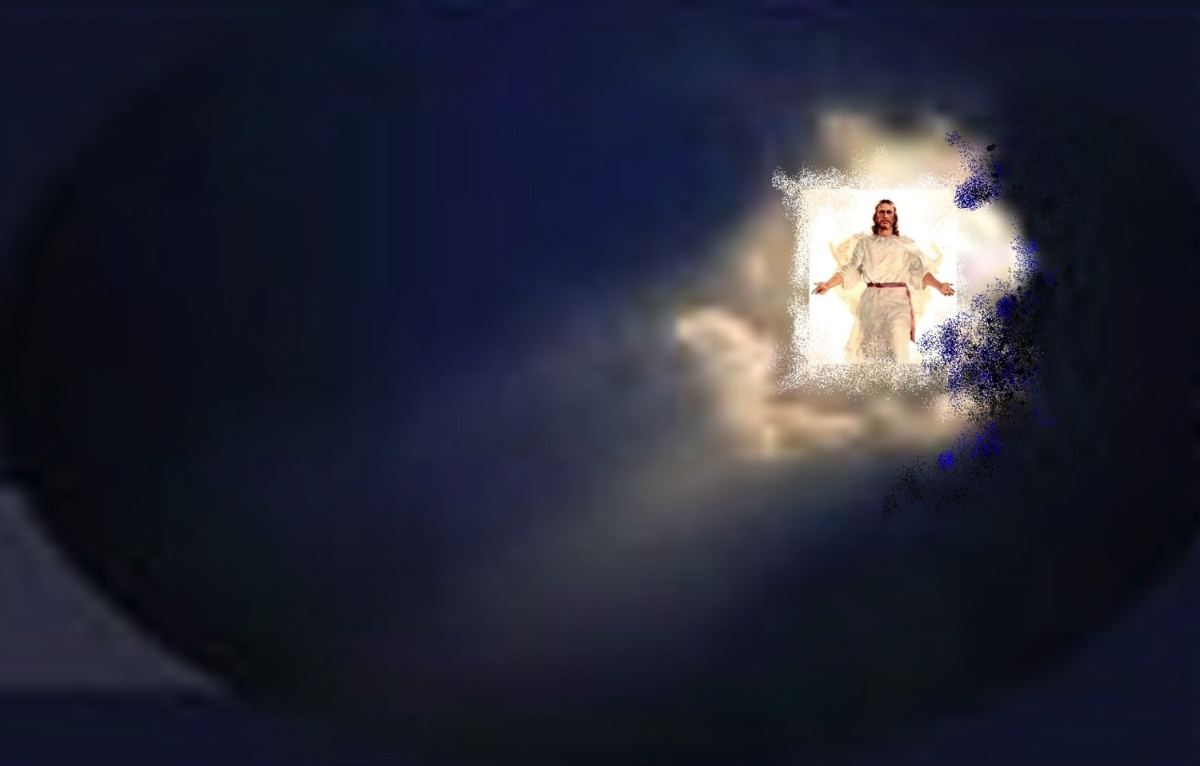
When will the Rapture occur?

Slide 10

Philadelphia (Rev. 3:7-13)
57
Promise
Christ promised Philadelphia believers benefits for their perseverance (3:9-13)
Warning
None
Pergamum
Thyatira
Exhortation
Hold on to what you have
Rebuke
None!
Commendation:
Deeds, keeps Christ's word and does not deny His name, endures patiently
Christ:
Holy and true, holds the key of David
Smyrna
Sardis
Ephesus
Philadelphia
Laodicea

Slide 11

Christ promises honor before enemies (Rev 3:9).
"I have given you an open door that no one can shut" (3:8)
"Look, I will force those who belong to Satan’s synagogue—those liars who say they are Jews but are not—to come and bow down at your feet. They will acknowledge that you are the ones I love."

Slide 12
Deliverance from the Tribulation
57
Second Coming
Israel
Church Age
Tribulation
Millennium
Eternal Kingdom
7 years
1000 years
Judgment

Slide 13
Greek Prepositions
58
"from, out of, away from"
ek
peri
dia
"around"
"through"
eis
"into"
Notes:
"Frequently, but not always, ek means from within, while apo means from in a more general way (e.g., from the outside of, from the vicinity of)" (Eugene Van Ness Goetchius, The Language of the New Testament [New York: Charles Schribner's Sons, 1965], 151).

Slide 14
Premillennialism
56
Second Coming
Second
=
Advent
Tribulation
Millennium
Church Age
Eternal Kingdom
7 years
1000 years
ALL 5 RAPTURE VIEWS ARE PREMILLENNIAL
Judgment

Slide 15
"Pre-Trib" Rapture
57
Second Coming
Rapture
Tribulation
Millennium
Church Age
Eternal Kingdom
7 years
1000 years
Judgment

Slide 16
Why Am I Pretrib?
57
Believers will be kept from (ek) this "hour," or time period (Rev. 3:10)

Slide 17
"Pre-Trib" Rapture
57
Second Coming
1. "I will keep you from (ek) the hour of testing that will come upon the whole world, to test those who dwell upon the earth"
(Rev. 3:10)
Rapture
Tribulation
Millennium
Church Age
Eternal Kingdom
7 years
1000 years
Judgment

Slide 18
"Pre-Trib" Rapture
57
Rapture
Second Coming
1. "I will keep you from (ek) the hour of testing that will come upon the whole world, to test those who dwell upon the earth"
(Rev. 3:10)
"from, out of, away from"
ek
Tribulation
Millennium
dia
Church Age
"through"
Eternal Kingdom
7 years
1000 years
eis
"into"
Judgment
Notes:
"Frequently, but not always, e,k means from within, while e,k means from in a more general way (e.g., from he outside of, form the vicinity of)" (Eugene Van Ness Goetchius, The Language of the New Testament [New York: Charles Schribner's Sons, 1965], 151).

Slide 19
The Only Other NT Occurrence of "Keep From" (tereo ek)
58
The idea of being taken out of the world relates to being removed from the world
1. "I do not ask you to take them out of (ek) the world, but to keep them from (ek) the evil one"
(John 17:15)
sphere of "the evil one"
ek
"from, out of, away from"
Not kept in Satan's sphere
parallels
not kept in Tribulation Period
Notes:
"Frequently, but not always, e,k means from within, while e,k means from in a more general way (e.g., from he outside of, form the vicinity of)" (Eugene Van Ness Goetchius, The Language of the New Testament [New York: Charles Schribner's Sons, 1965], 151).

Slide 20
"Pre-Trib" Rapture
58
Second Coming
2. "I will keep you from (ek) the hour of testing that will come upon the whole world, to test those who dwell upon the earth"
(Rev. 3:10)
Rapture
Tribulation
Millennium
Church Age
Eternal Kingdom
7 years
1000 years
Each time this "phrase occurs… the enemies of the church are always in mind"
- Mounce, 120
Judgment

Slide 21
Why Am I Pretrib?
58
1. Believers will be kept from (evk) this "hour," or time period (Rev. 3:10)
The Tribulation tests unbelievers (Rev. 3:10)
Believers are not under God's wrath (Rev. 6:16-17)

Slide 22
"Pre-Trib" Rapture
58
Second Coming
3. The Church will never come under God's wrath:
• John 5:24
• Rom. 5:9; 8:1
• 1 Thess. 1:10; 5:9
• Rev. 6:15-17
• Rev. 11:18
• Rev. 14:10, 19
Rapture
Tribulation
Millennium
Church Age
Eternal Kingdom
7 years
1000 years
Judgment

Slide 23



Why Am I Pretrib?
58
1. Believers will be kept from (evk) this "hour," or time period (Rev 3:10)
The Tribulation tests unbelievers (3:10)
Believers are not under God's wrath (Rev 6:16-17)
4. The Holy Spirit's work of restraining evil will be absent (2 Thess 2:6-7).
("what restrains" = neuter, 2:6 = gospel preaching)
(“he who restrains" = masculine, 2:7 = a person)
("Spirit" = neuter noun but used of a person)

Slide 24
Why Am I Pretrib?
58
5. The church is never mentioned in the Tribulation chapters (Rev. 4–19) except as the "tabernacle of God" in heaven (13:6; cf. Eph. 2:21-22)

Slide 25
Why Am I Pretrib?
58
6. The Rapture is imminent ("can happen at any time"), so it must also be pretribulational:
a. "…the day of the Lord will come like a thief in the night" (1 Thess. 5:2)
b. "I will come back and take you to be with me" (John 14:3) = "I am coming" in immediate future without signs
c. James 5:8-9; Tit. 2:13; Heb. 9:28; 1 Pet. 1:6-7; 1 John 2:28; 3:2-3; Rev. 22:10, 12
Notes:
25

Slide 26
Stages of the Second Coming
60
 | The Rapture | The Revelation
1 | Pretribulational (Rev. 3:10) | Posttribulational (Rev. 19:11-21)
2 | Christ will come in the air (1 Thess. 4:16) | Christ will come to the earth, His feet touching the Mt. of Olives (Zech 14:4)
3 | A coming for the saints (John 14:1-2; 1 Thess. 4:15-17) | A coming with the saints (Matt. 25:31; 1 Thess. 3:13; Rev. 19:14)
4 | Saints (dead and alive) will be caught up ("raptured") from the earth to meet the Lord in the air and taken to heaven (1 Thess. 4:16-17) | Saints already on earth will remain on the earth (no Rapture) to be ushered into the Millennium (Acts 15:16; Rev. 5:10; cf. Matt. 6:10; chap. 24)
5 | Produces comfort and hope (1 Thess. 4:18) | Produces fear and judgment (Matt. 24:27-31; Luke 21:20-28; Rev. 6:15-17)

Slide 27
Stages of the Second Coming
60
 | The Rapture | The Revelation
6 | Mystery truth revealed only in the New Testament age (1 Cor. 15:51) | Central in OT prophecy but clarified in the NT (Jer. 30:7; Zech 14:1-3; Matt. 24:30; Col. 3:4)
7 | Bodies of church saints glorified (1 Cor. 15:51-58; Phil. 3:20-21) and brought to heaven for seven years (1 Thess. 4:17) | Bodies of tribulation saints left in mortal state to continue to live on the earth in the millennium (Matt. 25:31-34)
8 | Imminent, no signs needed (1 Thess. 4:16) | Not imminent but preceded by spectacular signs in the heavens and on the earth (Matt. 24:29-31; Luke 21:25-28; Acts 2:19-21; Rev. 1:7; chs. 6-19)
9 | Primary purpose is deliverance of the saints from this world (1 Thess. 1:10) | Primary purpose is judgment of unbelieving (Matt. 25:31-46)

Slide 28
Stages of the Second Coming
60
 | The Rapture | The Revelation
10 | Invisible and private as only believers see Christ and since God sends a powerful delusion through the Antichrist (2 Thess. 2:11) | Visible and public since "every eye shall see Him" (Rev. 1:7)
11 | Fulfills a promise to the Church where Jew-Gentile distinctions do not exist (1 Thess. 4:15; cf. John 14:1-3; Eph. 2:11-16) | Fulfills promises to Israel of covenants made in the Old Testament (Gen. 12:1-3; Ps. 89; Isa. 11:11-14; cf. Rom. 11:26-27)
12 | Evil begins to increase (2 Thess. 2:1-12) | Evil is suppressed (2 Thess. 1:7; Ps. 37:9-10)
13 | Church removed (1 Thess. 4:13-18) | Satan removed (Rev. 20:1-3)

Slide 29
Stages of the Second Coming
60
 | The Rapture | The Revelation
14 | Christ shown as Head of the Church and all things (Eph. 1:10, 22; 4:15; Col. 1:18; 2:10) | Christ vindicated as Messiah to Israel (Zech. 14:3-4; cf. Acts 1:6 with v. 11)
15 | Judgment seat of Christ for believers (2 Cor. 5:10; 1 Cor. 3:13) | Judgment of Israel and Gentiles (Ezek. 20:34-38; Matt. 25; Zech. 14:4; cf. p. 160)
16 | The Lord is at hand (Phil. 4:5) | The kingdom is at hand (Matt. 24:14)
17 | Nature subsequently ruined (Rev. 6–16) | Nature subsequently restored (Rom. 8:19-22; Isa. 11:6-9; 35:9; 65:25)

Slide 30
"Mid-Trib" Rapture
66
Second Coming
Rapture
Tribulation
Millennium
Church Age
Eternal Kingdom
7 years
1000 years
Time interval needed for:
Judgment
• Rewards
• Marriage Supper
• Mortal bodies

Slide 31
"Post-Trib" Rapture
70
Second Coming
Rapture
Tribulation
Millennium
Church Age
Eternal Kingdom
7 years
1000 years
Judgment

Slide 32
Critiques of a “Post-Trib” Rapture
70
1 Historical: a doctrine being new does not make it invalid, J.N. Darby was not first “pre-tribber” anyway (245-48)
2 Nature of the Tribulation period is a time of God’s wrath, beginning in Rev. 6 (248-52)
3 Nature of the Church as distinct from Israel, to whom the Tribulation is directed (253-56)
4 Dissimilarity between Rapture & Second Coming texts, despite similar terminology (256-57)
5 Time needed between Rapture & Second Coming for rewards, marriage supper and mortal bodies (257-58)
6 Imminency denied: nothing had to be fulfilled by the time Peter grew old (John 21:18-19; cf. 1 Pet 4:7)
7 Olivet Discourse concerns Israel and lacks a resurrection or glorifying of the church (259-60)
8 Need for non-glorified bodies in the millennium and presence of “sheep” at “sheep and goat” judgment (260)
Paul Benware, Understanding End Times Prophecy, 245-261, summed up in 260-61

Slide 33
Why Am I Not Posttrib?
65a
8. If posttrib, then sheep would already be separated from goats (Matt. 25:31-46).
9. Some people in the millennium will die (Isa. 65:20), but a posttrib rapture gives a glorified body to all believers; therefore, some people must trust Christ in the Tribulation and enter the Millennium in their mortal bodies.

Slide 34
A "Pre-Trib" Rapture explains how the Millennium will have both babies & death
435
Second Coming
Christians
Rapture
Those remaining
Tribulation
Millennium
Church Age
Eternal Kingdom
7 years
1000 years
At the Rapture, believers will go to heaven and unbelievers remain on earth—the Tribulation will start 0% Christian.
After the Tribulation, believers on earth will enter the Millennium in their mortal bodies—the Millennium will start 100% Christian.
Judgment

Slide 35
"Partial" Rapture
68
Second Coming
Raptures
Tribulation
Millennium
Church Age
Eternal Kingdom
7 years
1000 years
Judgment

Slide 36

"Prewrath" Rapture
72
Pre-Wrath
Rapture
Second Coming
God's
Wrath
(Day of the Lord)
Begin-ning of Sor-rows
Great
Tribu-lation
Millennium
Church Age
Eternal Kingdom
“Because you have kept my word of patience”
“I will keep you from the hour”
(here)
Rapture & Day of Lord follow testing
1000 years
Judgment
7 years
Notes:
36

Slide 37

Pretribulational Premillennialism
57
Rapture
2nd Advent
Great
White
Throne
Church Age
Tribulation
Millennium
Battle of
Armageddon
Battle of
Gog and Magog
"How awful that day will be! None will be like it. It will be a time of Jacob's trouble but he will be saved out of it"
(Jer. 30:7)
Notes:
37

Slide 38

“We will rise to meet Him”
(1 Thess. 4:16)

Slide 39

We will join him in the clouds

Slide 40

“We Shall Behold Him”
Sung by Sandi Patti

Slide 41
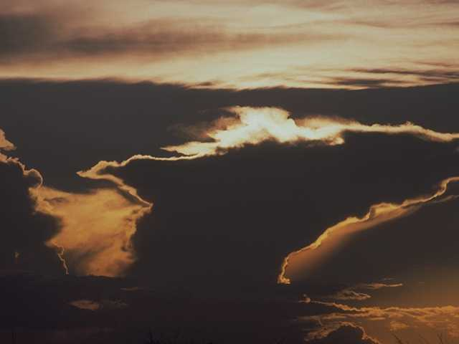
The sky shall unfold…
Notes:
41

Slide 42

…preparing His entrance
Notes:
42

Slide 43

The stars shall applaud Him with thunders of praise
Notes:
43

Slide 44
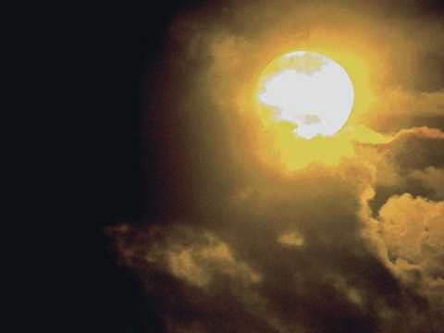
The sweet light in His eyes shall enhance those awaiting
Notes:
44

Slide 45

And we shall behold Him then face to face
Notes:
45

Slide 46
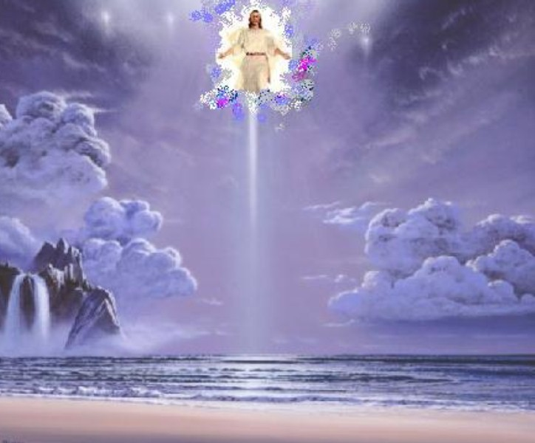
We shall behold Him
We shall behold Him
Notes:
46

Slide 47
…face to face in all of His glory
Notes:
47

Slide 48

We shall behold Him
We shall behold Him
Notes:
48

Slide 49

…face to face, our Savior and Lord
Notes:
49

Slide 50
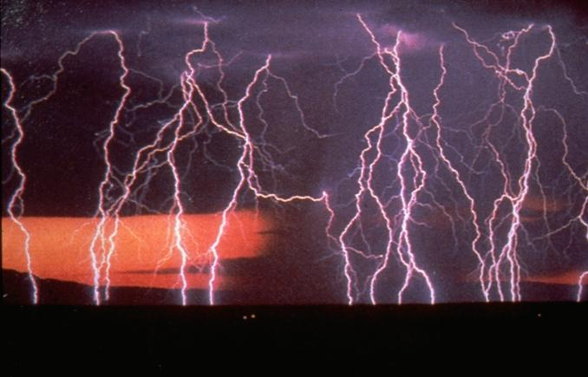
The angels shall sound the shout of His coming
Notes:
50

Slide 51
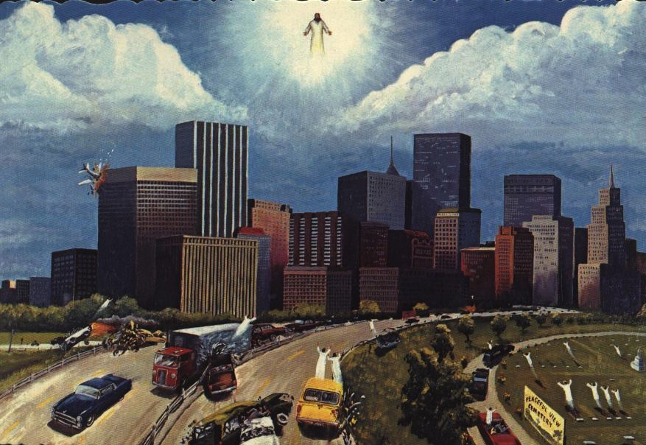
The sleeping shall rise from their slumbering place
Notes:
51

Slide 52

And those who remain shall be changed in a moment
Notes:
52

Slide 53

And we shall behold Him then face to face
Notes:
53

Slide 54
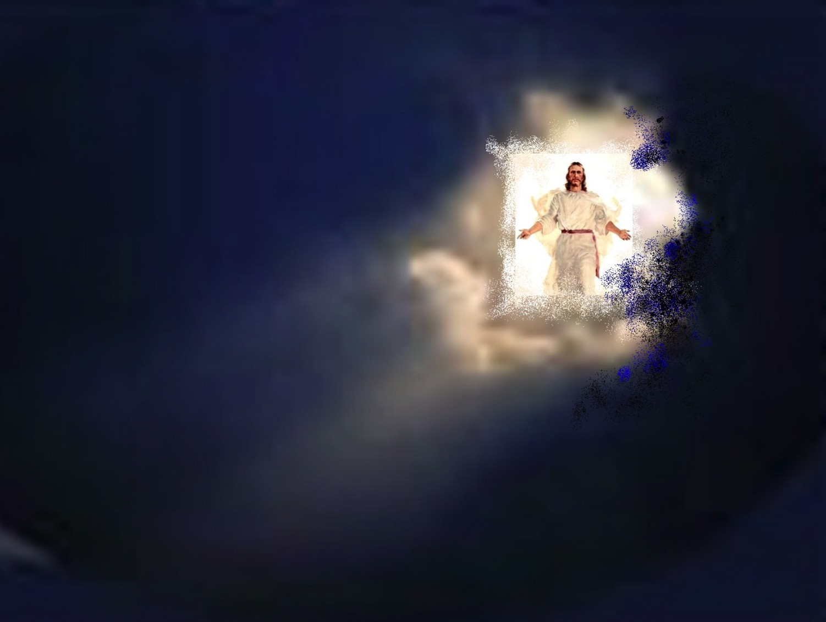
We shall behold Him
We shall behold Him
Notes:
54

Slide 55

…face to face in all of His glory
Notes:
55

Slide 56
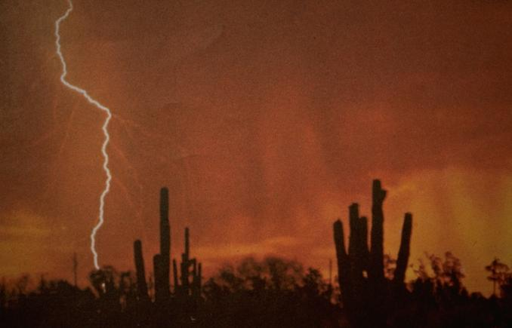
We shall behold Him
We shall behold Him
Notes:
56

Slide 57
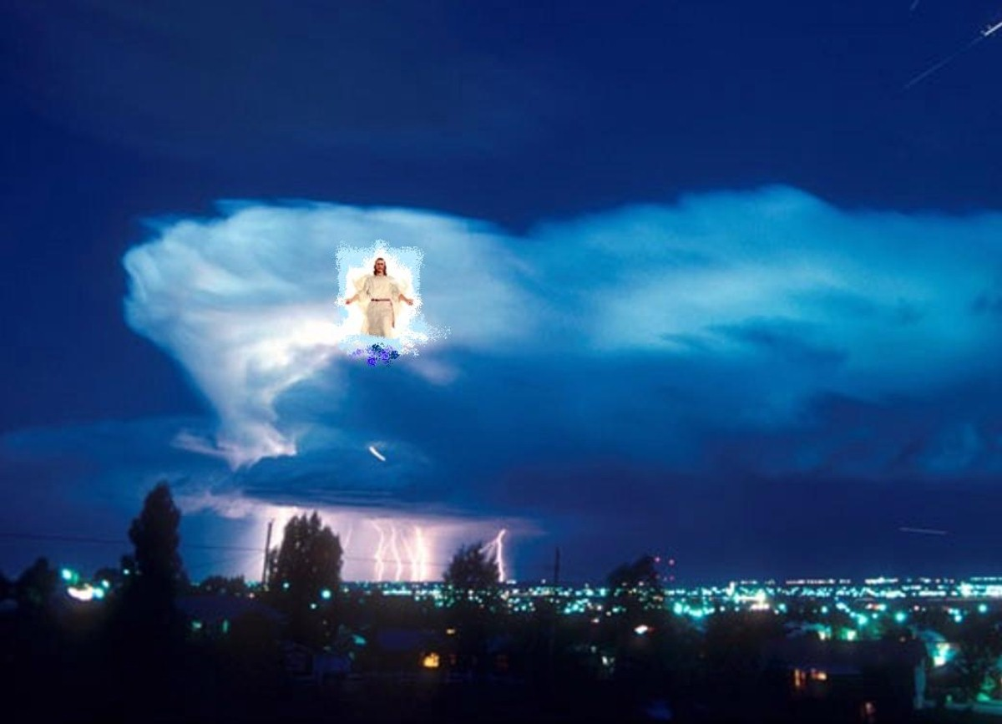
…face to face, our Savior and Lord
Notes:
57

Slide 58

We shall behold Him, our Savior and Lord!

Slide 59
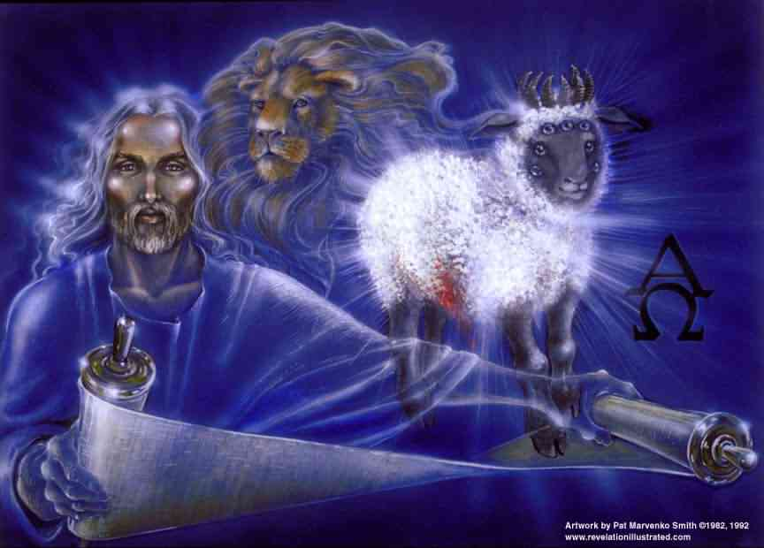
…our Savior and Lord!
Notes:
59

Slide 60
Black
Notes:
60

Slide 61

We will live forever with the One who flung stars into space!

Slide 62
Black

Slide 63


Future (Eschatology) link at BibleStudyDownloads.org
Get this presentation for free!
Notes:
Creation (cr)

