Slide 1
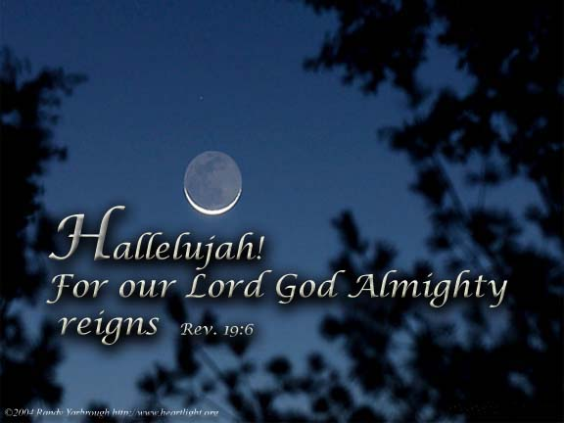
Signs of Christ's Return
Dr. Rick Griffith • Jordan Evangelical Theological Seminary • BibleStudyDownloads.org

Slide 2


Future (Eschatology) at BibleStudyDownloads.org
Get this presentation for free!
Notes:
Future (fu)
Eschatology

Slide 3


So Many Terms, Lah
Partial Rapture
31
Great Tribulation
Millennialism
Dispensational
Pre-Wrath
Tribuation
Revelation
Daniel's Seventieth Week
Pretrib
Posttrib
Midtrib
Rapture
Second Coming
Tribulationalism
Covenant Premil
Amillennial
Premillennial
Postmillennial

Slide 4

Areas Evangelicals Agree
31
Fulfilled Prophecies About Jesus Christ
Intermediate State
Future bodily resurrection
Future divine judgment
Future bodily return of Christ
Eternal State
Immortality of the Soul?

Slide 5
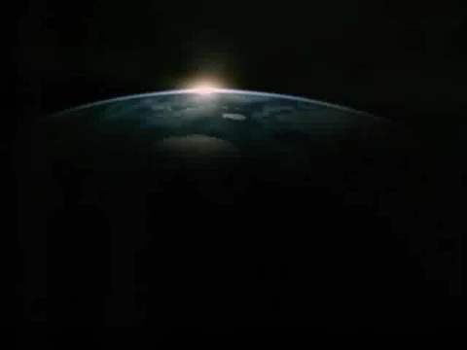

Slide 6

SIGNS OF THE SECOND COMING
31
(Not Signs of the Rapture)

Slide 7
Premillennialism
27
Rapture
Second Coming
Second
=
Advent
signs
Church Age (no signs)
Tribulation
Millennium
Eternal Kingdom
7 years
1000 years
Judgment
Judgment

Slide 8

How Close Can We Know When the Lord Will Return?
32
Three Views:
?
?
?
No
Idea
General
Time
Period
Date Setters
?
?
?

Slide 9
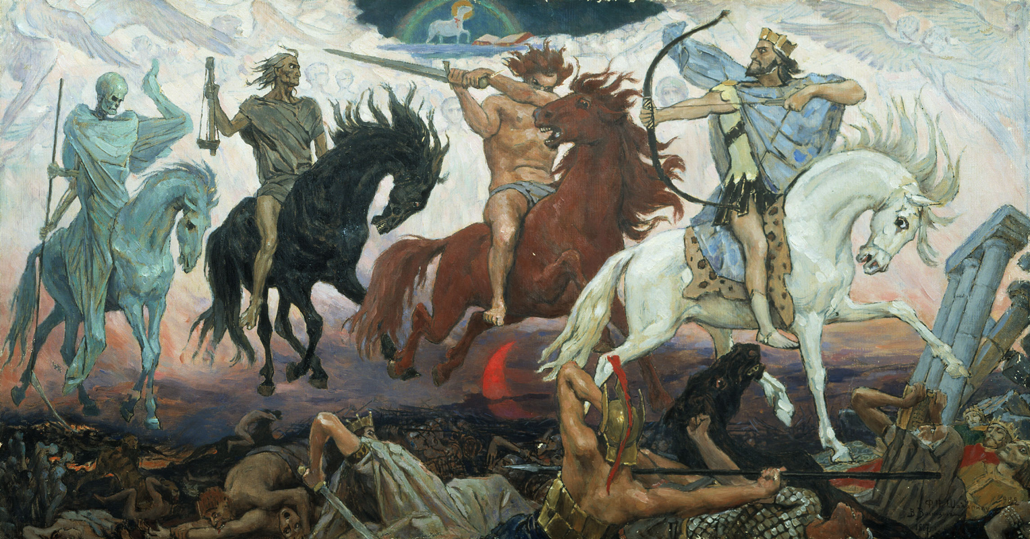

Signs Intensifying in Our Generation
32
These signs have been true to varying degrees throughout the ages but are especially evident today…

Slide 10




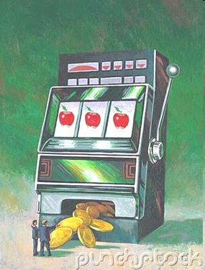
Religious Deception
NEW WINE
"For the time will come when men will not put up with sound doctrine. Instead, to suit their own desires, they will gather around them a great number of teachers to say what their itching ears want to hear. ⁴They will turn their ears away from the truth and turn aside to myths."
2 Timothy 4:3-4
"He replied: 'Watch out that you are not deceived. For many will come in my name, claiming, "I am he," and, 'The time is near.' Do not follow them."
Luke 21:8
Danger
The Da Vinci Code Deception
or Old Deception？
Roger Oakland

Slide 11
War and Aggression
The twentieth century saw two world wars and more ethnic conflict than any other…

Slide 12
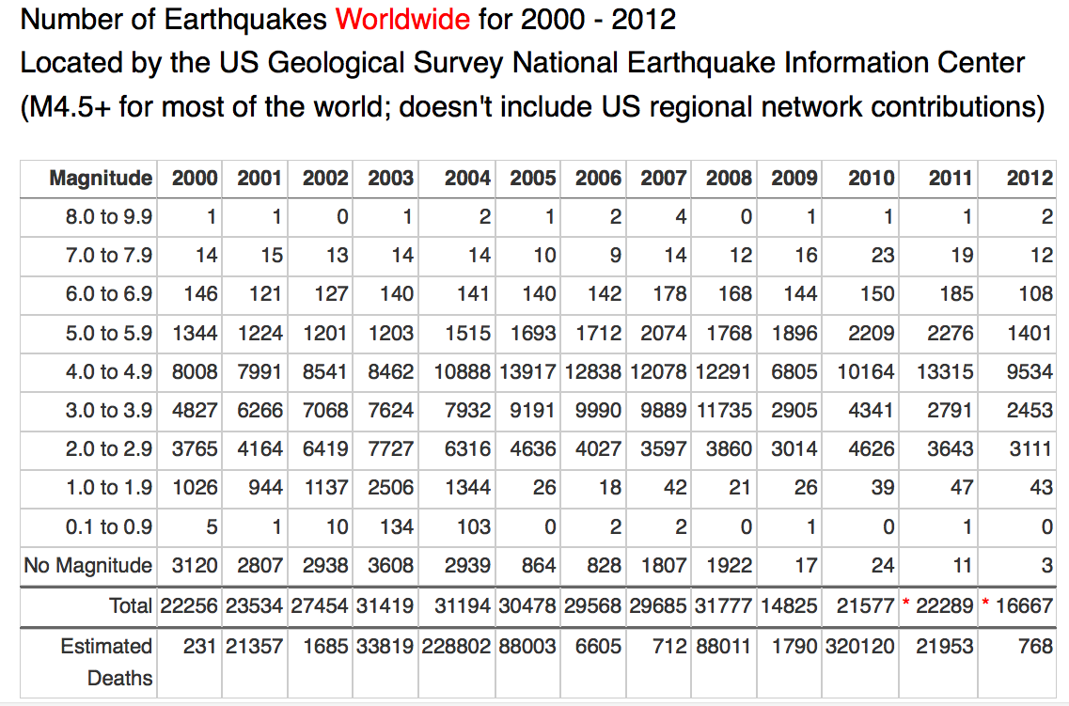
Earthquake Data (2000-2012)
Number of Earthquakes Worldwide for 2000 - 2006
Located by the US Geological Survey National Earthquake Information Center
Magnitude 2000 2001 2002 2003 2004 2005 2006
8.0 to 9.9 1 1 0 1 2 1 0
7.0 to 7.9 14 15 13 14 14 10 4
6.0 to 6.9 158 126 130 140 141 150 22
5.0 to 5.9 1345 1243 1218 1203 1515 1720 211
4.0 to 4.9 8045 8084 8584 8462 10888 13897 1640
3.0 to 3.9 4784 6151 7005 7624 7932 9151 1091
2.0 to 2.9 3758 4162 6419 7727 6316 4639 453
1.0 to 1.9 1026 944 1137 2506 1344 26 3
0.1 to 0.9 5 1 10 134 103 0 1
No Magnitude 3120 2938 2937 3608 2939 866 121
Total 22,256 23,534 27,454 31,419 31,194 30,460 3546
to 16 March
Estimated
Deaths 231 21357 1685 33819 284010 89354 6
http://earthquake.usgs.gov/earthquakes/eqarchives/year/eqstats.php

Slide 13
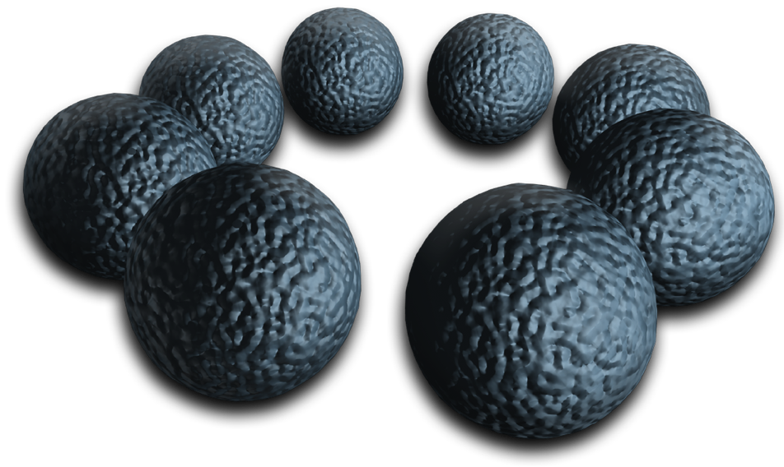
AIDS Continues Protected
UN Tells India to Decriminalize Homosexual Sex to Fight AIDS (India has over five million people infected with AIDS - second highest rate in world)
NEW DELHI, India, January 13, 2006 (LifeSiteNews.com) – Police in Lucknow, the capital of Uttar Pradesh state, arrested four men last week on charges of homosexuality and running an online gay club, part of an ongoing effort to enforce laws prohibiting homosexual activity. Homosexual activity is illegal in India, punishable by prison terms of up to 10 years. The Indian government is currently fighting a court effort to legalize gay activity.
UNAID is protesting India's recent crackdown on homosexual activity in the country, saying it will directly increase the spread of HIV/AIDS by driving homosexual activity underground.
The UN, and other NGO's, have argued that preventing homosexual men from accessing information on safe sex will increase the HIV/AIDS epidemic in India. India has over five million people infected with the virus, the second highest rate in the world, after South Africa.
Gudrun Schultz, Friday January 13, 2006 http://www.lifesite.net/ldn/2006/jan/06011307.html

Slide 14

The multi-purpose Future Card will be the version of our NRIC in the near future. With an embedded smart chip, it can also be used as a passport, store our medical history, driver's license, act as an ATM card, serve as an electronic purse and even be used at the National Library... whatever you do with the card... you will be tracked!

Slide 15
It may also be a tracking device via GPS (Good or Bad, depending on the situation). However, a recent debate has brought to light the questionable control on access, potential information abuse and privacy infringement. As the debate rages on, a likely scenario when ordering pizzas in the near future might look something like this...

Slide 16
Thank you for calling Pizza Hut. May I have your…
Haloh! Pisar Hut-ah? Can I order-ah?

Slide 17
Can I have your Future Card number, sir?
It's arh… hold on prease… arh… it's 790230-88-5551.

Slide 18
Thank you, Mr. Tan Ah Beng. You're calling from Block 345, Teck Whye Ave, #41-1522. Your home number is 6788988, your office number is 6912788 and your mobile is 96788688. Which number are you calling from?

Slide 19
Home-lah, wah, where you get all my phone numbers-ah?
We are connected to the Future Card system, sir.

Slide 20
OK-lah, OK-lah, can I order your seafood pisar?
That's not a good idea, sir.

Slide 21
Why cannot-ah?
According to your latest medical records, you have high blood pressure and high cholesterol level, sir.

Slide 22
What? Wah-lau-eh… medical records also you know. So what you lecomend?
Try our low fat Hokkien mee pizza, I'm sure you'll like it, sir.

Slide 23
Wah, how you know I like Hokkien mee-ah?
You borrowed a book titled 'Popular Hokkien Dishes' from the National Library last week, sir.

Slide 24
OK, OK, beh-ta-han. Give me three family size pisar. How much-ah?
That should be enough for your family of 10. The total is $45. How would you like to pay?

Slide 25
I pay by Future Card, can or not?
I'm afraid you have to pay us cash, sir.

Slide 26
Why?!
Your credit card is over the limit and you owe your bank $6,720.55 since October last year, sir.

Slide 27
Ka-nee-nah… everything also know, chia-lat!
That's not including the late charges of your housing loan, sir.

Slide 28
OK-lah, I run to ATM to take cash before you come to my house-loh.
You can't sir, based on the records, you've reached the daily limit on machine withdrawal today.

Slide 29
What?!
The latest withdrawal is $150 for 4D and Toto at 4:56pm, sir.

Slide 30
Never mind, just send the pisar. I borrow money from my Ah Mah. How long-ah?
45 minutes, sir. But if you can't wait you can collect it with your motorcycle. You are only 5 minutes away.

Slide 31
Where got transport?
According to your Future Card, you own a Honda scooter, registration number FE 3288…

Slide 32
Ka-nee-nah!
Better watch your language, sir.

Slide 33
Why should I?
Remember on 15th July 1987 you were convicted of using abusive language on a policeman…

Slide 34
*[ugh}*
Is there anything else, sir?

Slide 35
Nothing. By the way, please remember to give me the 3 bottles of free Coke as advertised?
We would, sir. But based on the records, you are also diabetic…

Slide 36
I'm going to the hawker centre to tah-pao. Pisar no stock.

Slide 37
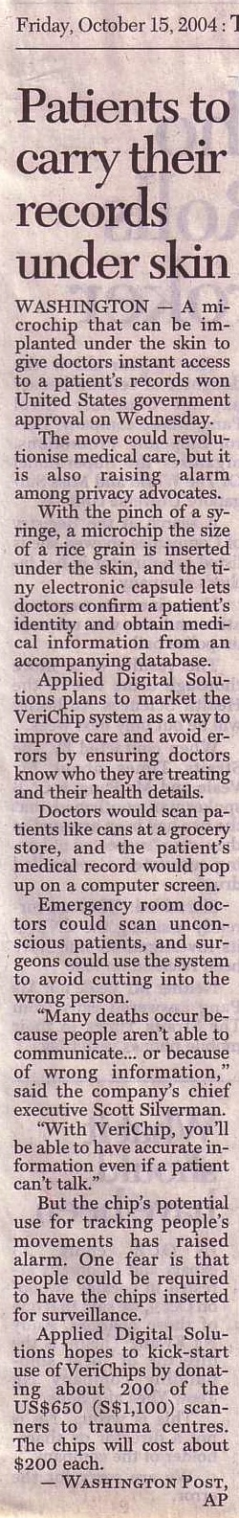
A Convenient Way to Display the
Mark of the Beast
(Rev. 13:16-18)?
32

Slide 38

When are the signs?
They come in the Tribulation

Slide 39

But can God restore Israel as a nation?
33
Who
should not revere you, O King of the nations? This is your due. Among all the wise men of the nations and in all their kingdoms, there is no one like you.
—Jeremiah 10:7—

Slide 40

Hitler motivated the Jews to go to their homeland!

Slide 41

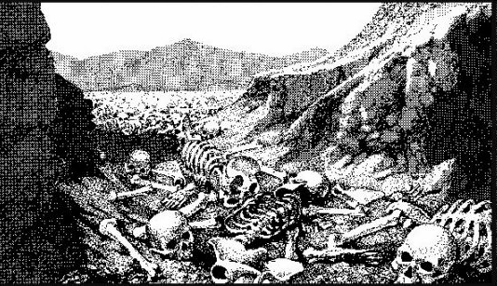
The Dry Bones of Ezekiel 37
33
What do they mean?
When is the fulfillment?

Slide 42
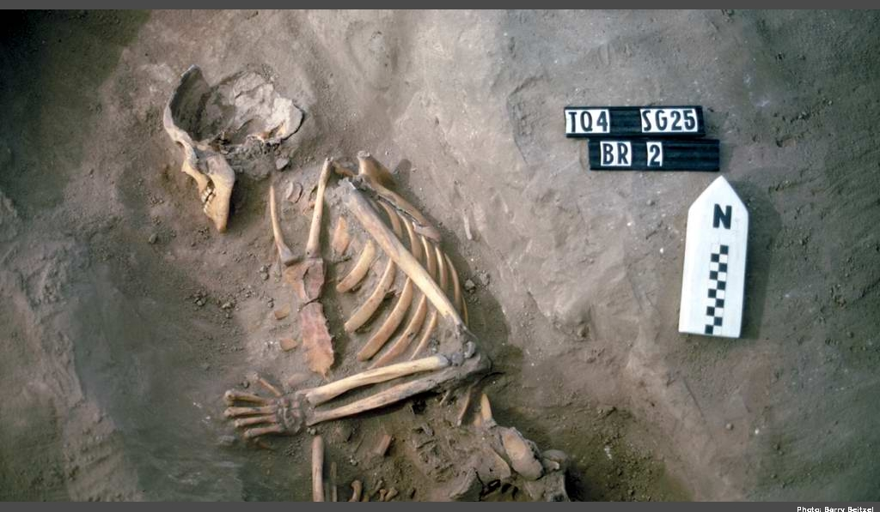
The Valley of Dry Bones (Ezek. 37)

Slide 43
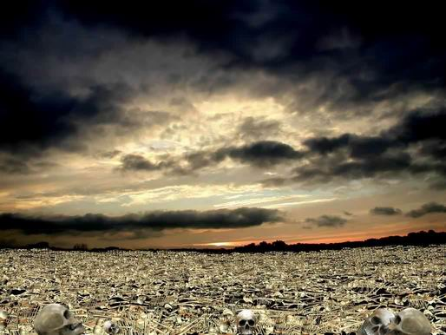
The Valley of Dry Bones (Ezek. 37)

Slide 44
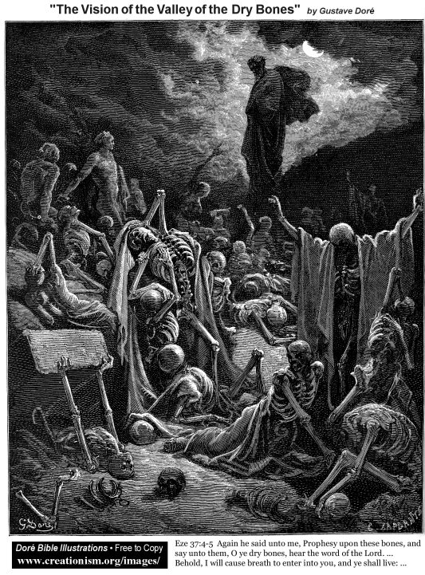
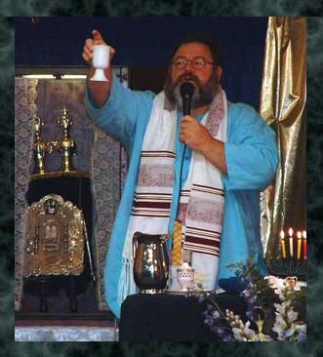
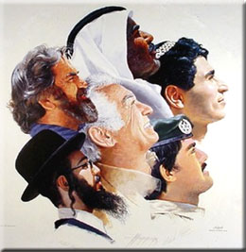
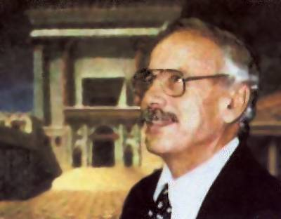
The Valley of Dry Bones (Ezek. 37)
Stage 1:
Return in Unbelief
Stage 2:
Trust in Messiah

Slide 45

A Hebrew Play on Words
"Prophesy to the
breath" (37:5, 9)
"Prophesy to the
Spirit" (37:14)
=
Hebrew insert
"breath, wind, Spirit"
Gen. 2:7
Greek insert
"breath, wind, Spirit"
John 3:5, 8; 2 Thess. 2:8
=

Slide 46

Exiles & Returns
33
Exile
to
Babylon
by
King
Nebuchad-nezzar
(586 BC)
Exile
to
Nations
by
Roman
General
Titus
(AD 70)
Return
to
Israel
by
King
Cyrus
(516 BC)
Return
to
Israel
by
Zionists
(AD 1948)
Ezekiel's Time (597 BC)
But how do we know Ezekiel 37 relates to this second exile and return?

Slide 47

Interpreting Ezekiel's Prophecy
33
Vision |  | Meaning
bones | = | house of Israel
dried bones | = | hope gone, cut off
bones come together | = | Jews return to Israel
breath in them | = | God's Spirit in his people
Adapted from www.bibleweb.org/ MEastStudies/Sem3.htm

Slide 48
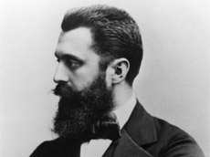
Theodore Herzl
First Zionist Congress
1897

Slide 49

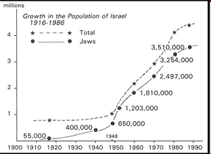
Jews Return in the 20th Century
195b
www.bibleweb.org/ MEastStudies/Sem3.htm
millions
Growth in the Population of Israel
1916-1986
Total
Jews
Notes:
www.bibleweb.org/ MEastStudies/Sem3.htm

Slide 50
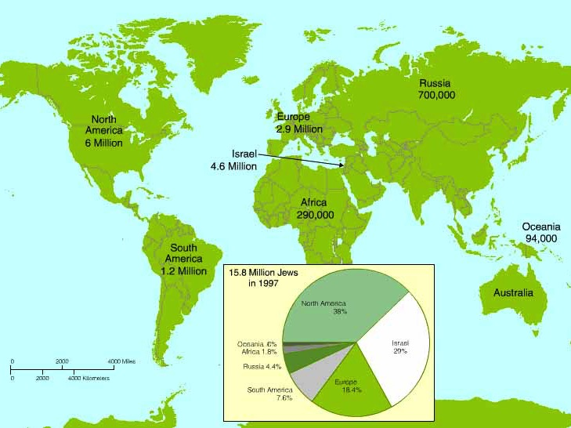
Worldwide Jewish Population in 1997
Note that most Jews still haven't returned to Israel
15.8 Million Jews in 1997
North America
38%
Oceania .8%
Israel
29%
Africa 1.8%
Russia 4.4%
Europe
18.4%
South America 7.6%

Slide 51
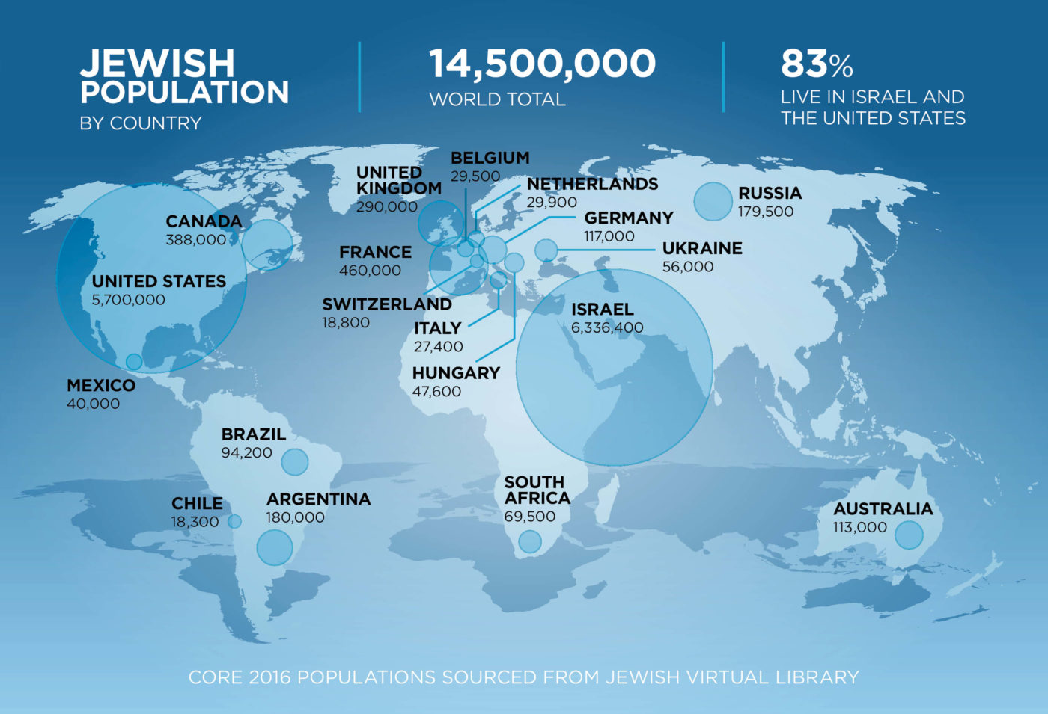
Worldwide Jewish Population in 2016
JEWISH
POPULATION
BY COUNTRY
14,500,000
WORLD TOTAL
83%
LIVE IN ISRAEL AND
THE UNITED STATES
Note that most Jews still haven't returned to Israel

Slide 52
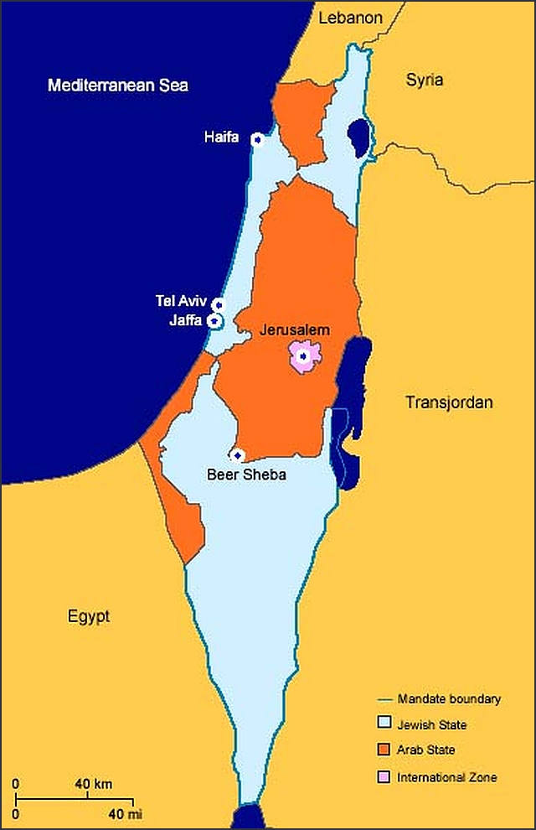
To return to the land of Israel, Jews had to become a nation once again (1948)

Slide 53
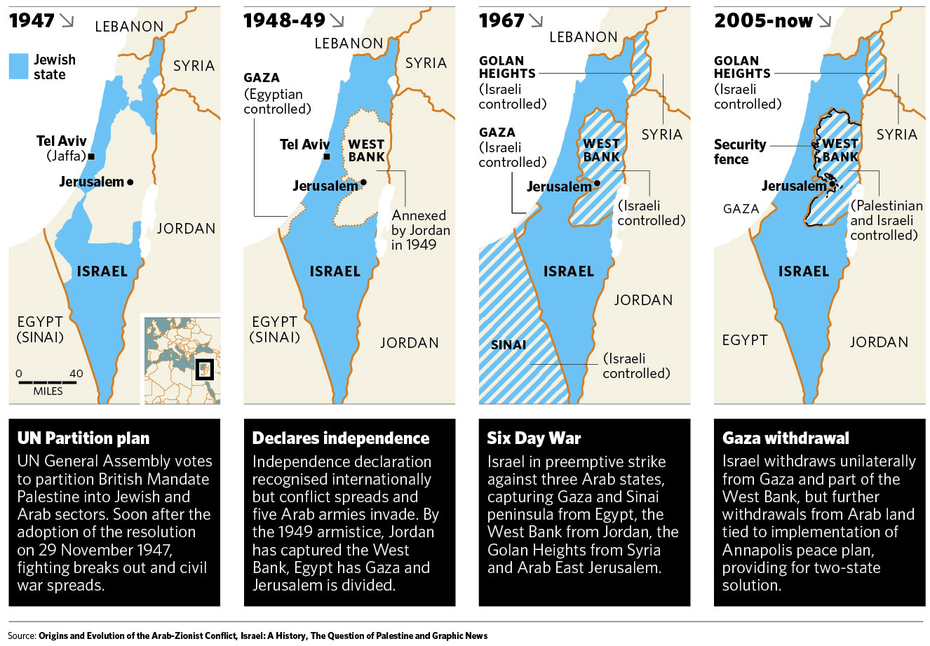
Israel regained ancient borders in stages (1946-2000)
http://kmhouseindia.blogspot.com/2012/11/palestinian-statehood-bid.html

Slide 54
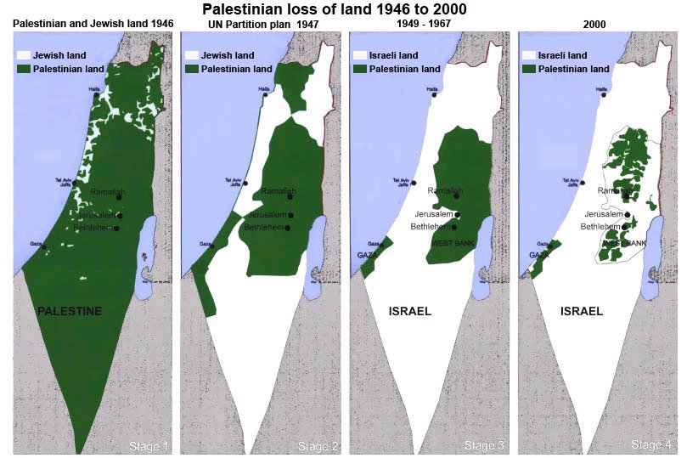
Israel regained ancient borders in stages (1946-2000)
http://tema1tema.blogspot.com/2011/05/stop-israeli-war-crimes-yells-woman-at.html

Slide 55
Jews also needed to regain Jerusalem, which they did in the
Six-Day War (1967)
Foundation for Middle East Peace
(March 2002)

Slide 56
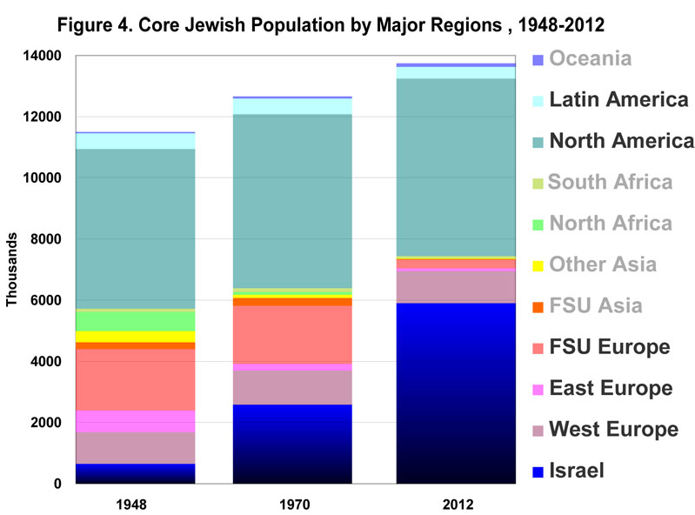
Jewish Population by Major Regions (1948-2012)
14
Oceania
7 million outside Israel
Latin America
12
North America
10
10 million outside Israel
South Africa
11 million outside Israel
8
North Africa
Millions
Other Asia
6
FSU Asia
God is bringing His people back!
4
FSU Europe
East Europe
2
West Europe
0
Israel
1948
1970
2012
––Jews for Jesus
Notes:
David Brickner, "Israel's Salvation" (Jews for Jesus Publication, 8 July 2013) at http://www.jewsforjesus.org/images/population-israel-800w.jpg accessed 17 July 2013

Slide 57

Why does Ezekiel depict the second return?
33-34
Restoration in belief (37:14)
Reunification of Israel & Judah (37:15-23)
Leadership of Messiah (37:24)
Restoration "forever' (37:25)
Permanent temple (37:26b, 28)
Postexilic prophecy (Zech. 10:9-10)
Second regathering (Isa. 11:11)

Slide 58
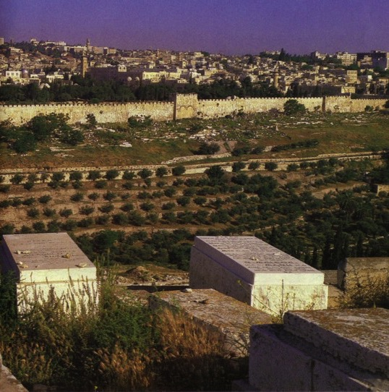
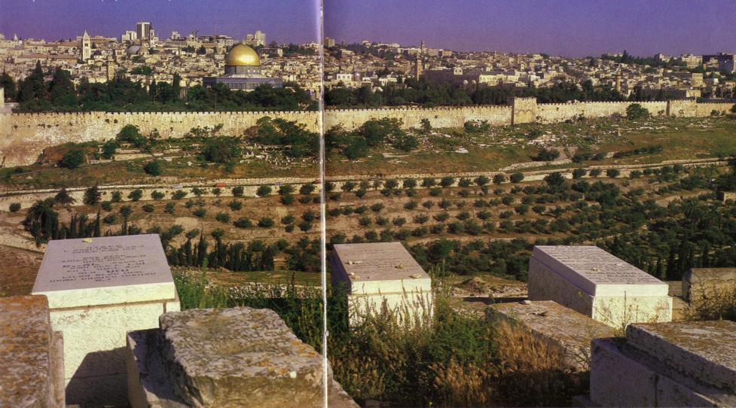
Jewish Hope of Resurrection
47
Jews buried on the Mt. of Olives hope to be the first to enter the Eastern Gate with Messiah when He comes

Slide 59
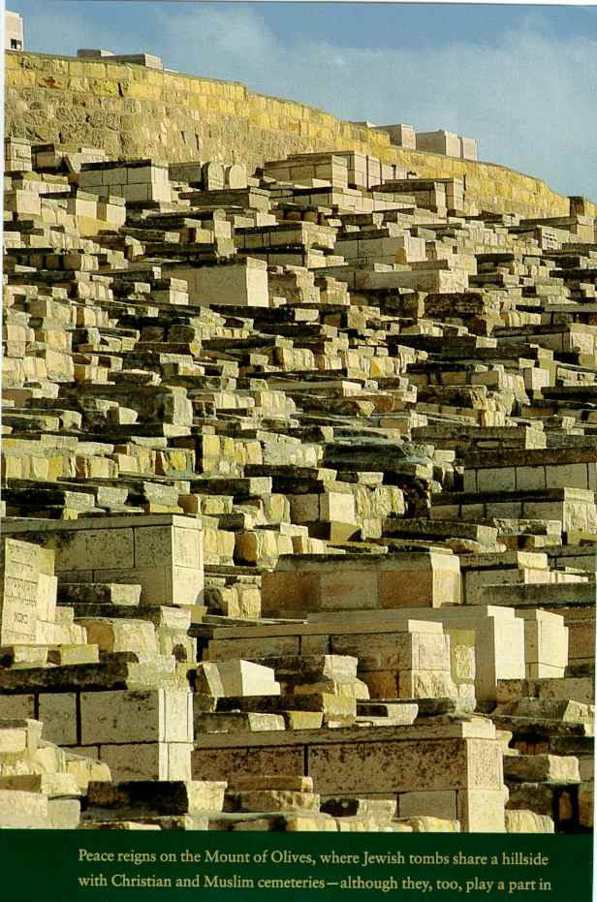
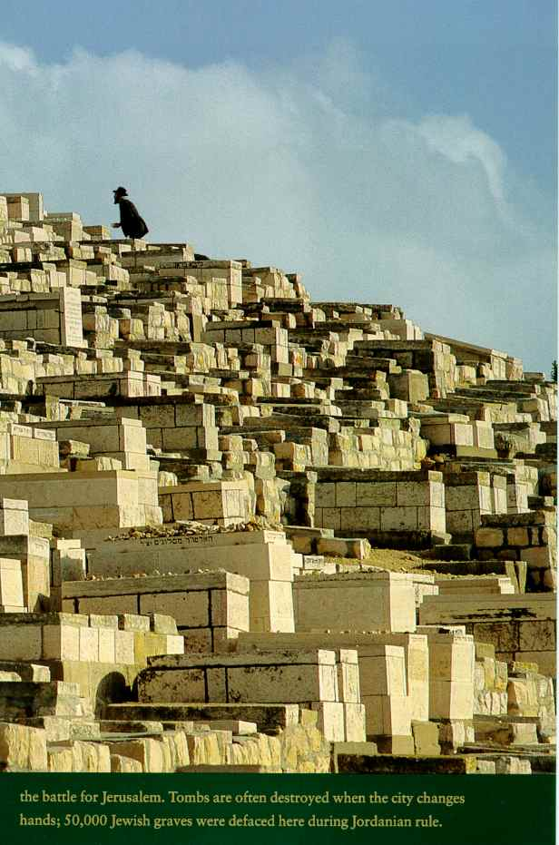
First to Rise?

Slide 60
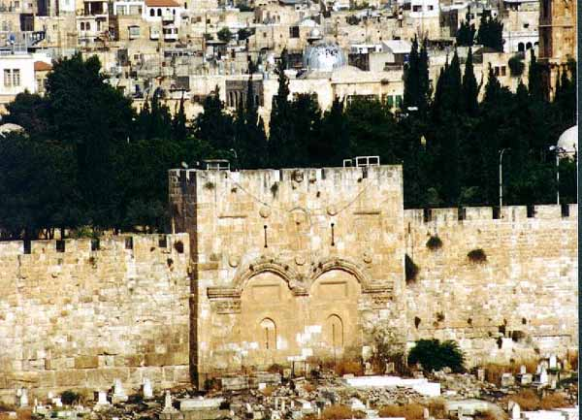
Muslims Sealed the Eastern Gate

Slide 61

Borders of the Land Promised to Abraham
Syria
Lebanon
Israel
Jordan
Genesis 15:18
"On that day the LORD made a covenant with Abram, saying, 'To your offspring I give this land, from the river of Egypt to the great river, the river Euphrates'" (ESV)
India
Egypt
Notes:
God’s promised land stretched northeard from the small wadi of Egypt south in the Sinai to the large Euphrates River in the far north—a HUGE piece of real estate! When today’s boundaries are placed over this land we can see the struggle modern Israel has to claim land from Egypt, Lebanon, Syria and possibly even Jordan on the other side of the Jordan River.

Slide 62

What's the Future for the Dome and World Geography in the Millennium after Christ's Return?

Slide 63

Jewish life then revolved around Solomon's temple for 400 years (959-586 BC)

Slide 64
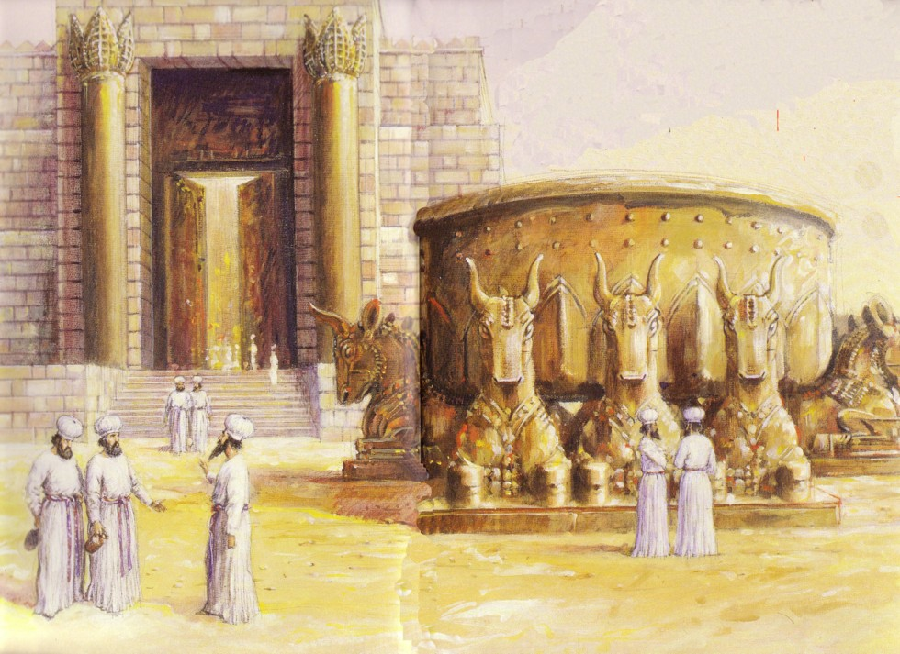
Jews Maintained Holiness at the Basin
586 BC: Temple Destroyed!

Slide 65


After temple rebuilding, in NT Passovers 100,000 Jews visited the Temple!
AD 70: Temple Destroyed Again!

Slide 66

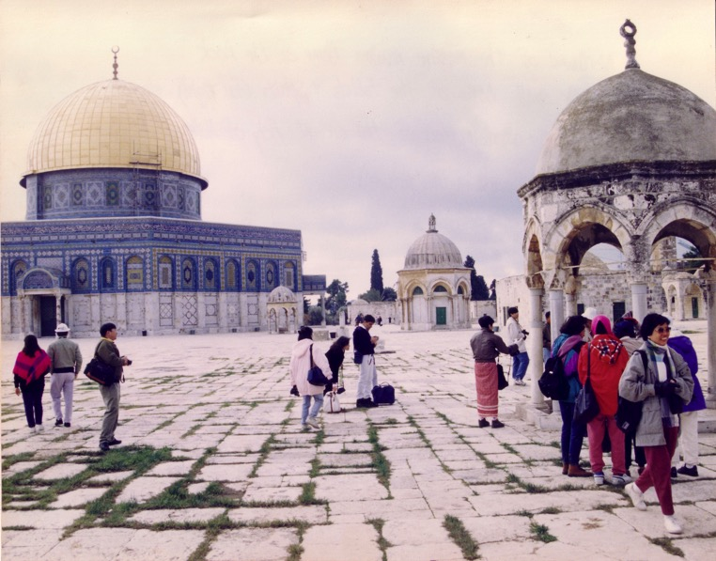

Muslim Control
Mosque of Omar
(Dome of the Rock)
Al-Aksa Mosque

Slide 67
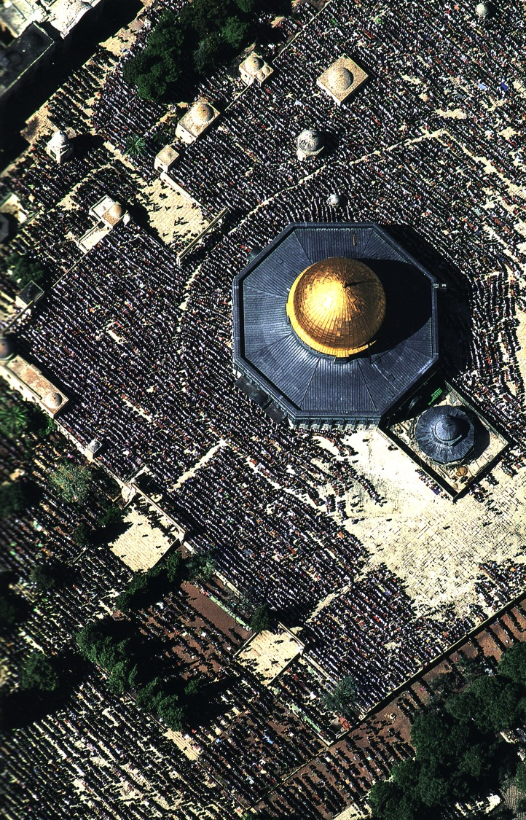
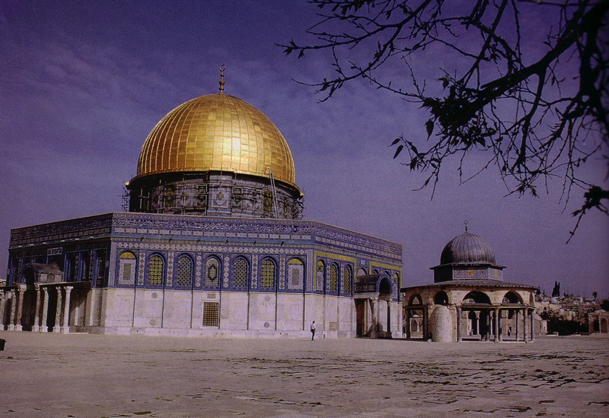
Muslim Prayers at the Dome
135

Slide 68
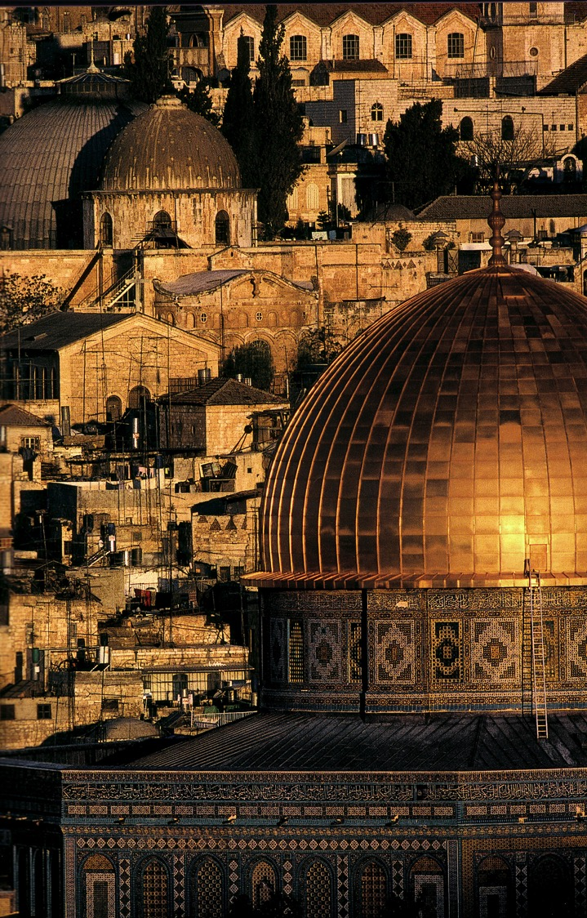
A Dome to Outshine the Dome

Slide 69
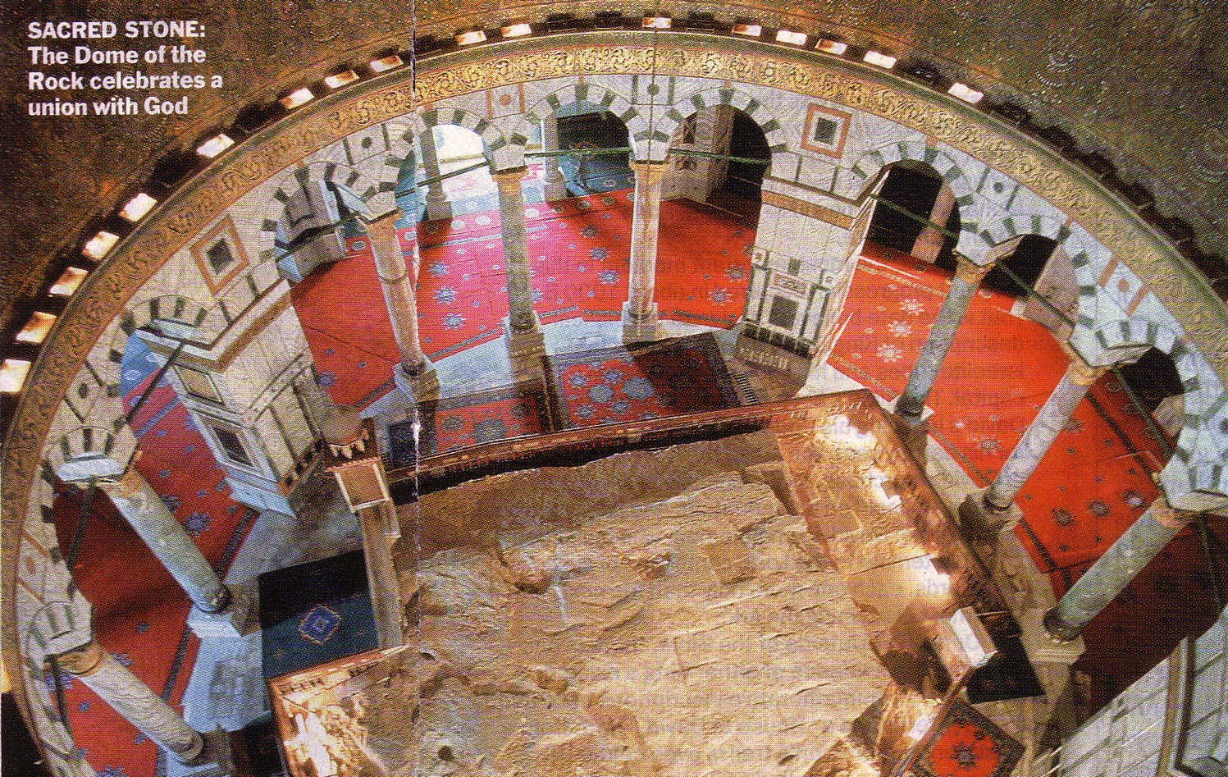
The Rock Inside
137

Slide 70
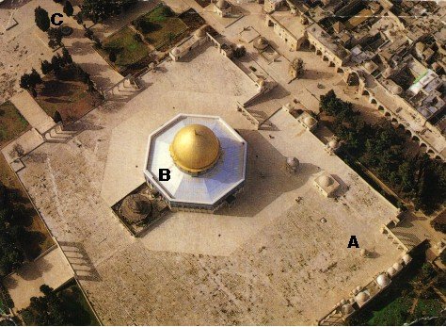
An Imposing Structure

Slide 71

Modern Temple Mount
49a

Slide 72


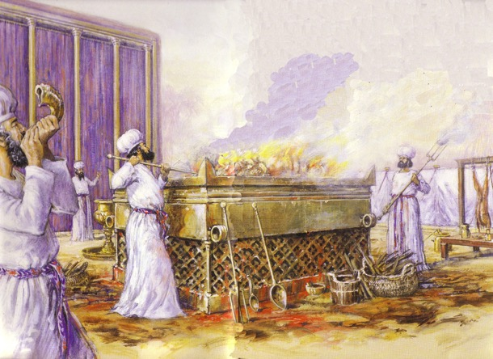
Jewish Western Wall
128

Slide 73
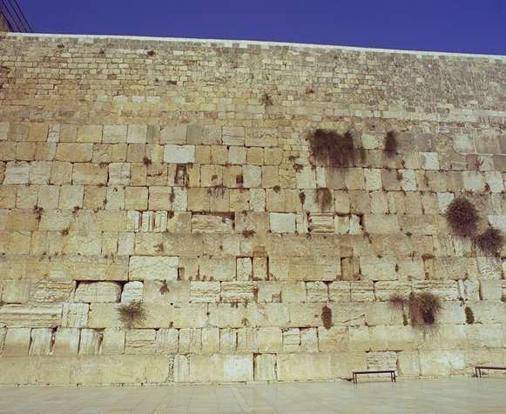
The Western Wall
128

Slide 74

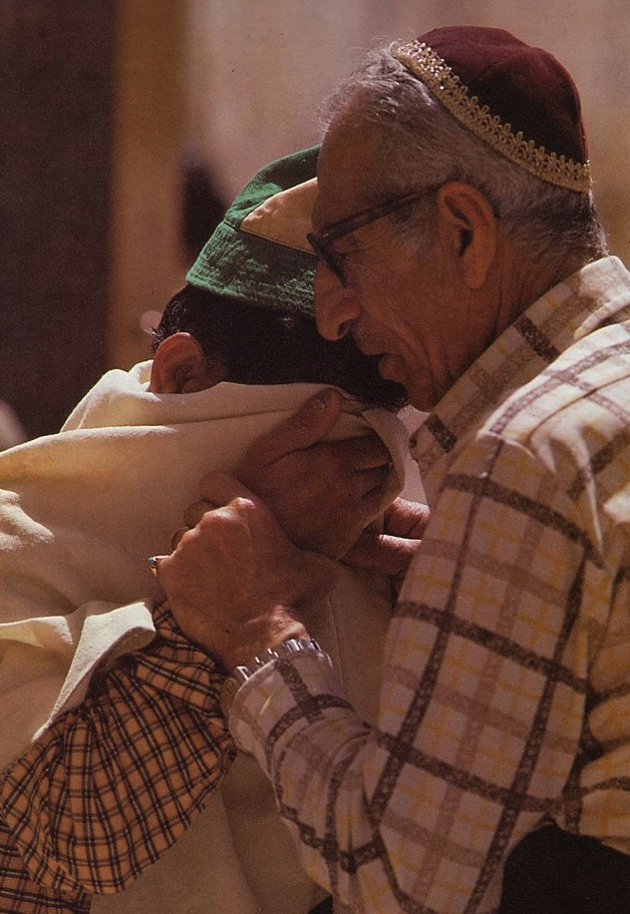
Prayers for the Third Temple

Slide 75

God will do the impossible.
He's an expert at it.

Slide 76
Black

Slide 77
Future (Eschatology) at BibleStudyDownloads.org
Get this presentation for free!
Notes:
Future (fu)
Eschatology

