Slide 1

Biblical Covenants
Dr. Rick Griffith • Jordan Evangelical Theological Seminary • BibleStudyDownloads.org

Slide 2
Kinds of Covenants
18
Covenant Theology (Theological)
Scriptural (Biblical)

Slide 3
Guidelines to Interpret Prophecy
a. Interpret the prophetic passage literally (land boundaries in Gen. 17:8, p. 21)
b. Interpret by comparing prophecy with prophecy (Isa., Dan. & Zech. affect Rev)
c. Interpret in light of possible time intervals (donkey & reign in Zech. 9:9-10)
d. Interpret figurative language scripturally
(dry bones = Israel in Ezek. 37:11)
**First edition: Interpret in light of double reference (e.g., the abomination that causes desolation)
Paul Benware, Understanding End Times Prophecy, 23-33

Slide 4
The Line of Blessing
Adam
3:15
Seth
4:25-26
Noah
Shem
9:18
Terah
= Population
Increase
Abraham
12:1-3
Isaac
Jacob
Joseph
All Nations

Slide 5
Genesis Chart
Primeval History
Patriarchal History
Abraham 12-25:18
Creation 1-2
Nations 10-11
Flood 6-9
Fall 3-5
EVENTS 1-11
PEOPLE 12-50
Human Race
Hebrew Race

Slide 6
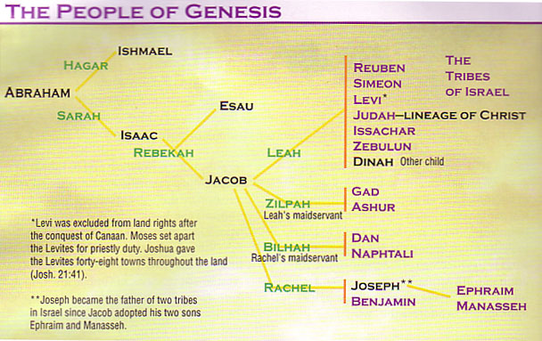
Patriarchal Family Tree

Slide 7
Types of Covenants
20
Covenants
Conditional
Unconditional
Thought Question for Small Groups:
Is marriage a conditional or unconditional covenant?

Slide 8
Types of Conditional Covenants
20
Conditional
Verbal
Handshake
Sandal
Written
Parity (equals)
Suzerain-Vassal

Slide 9
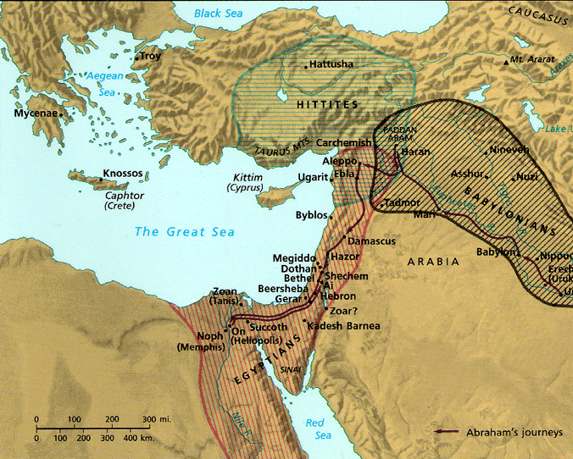
Ancient Conditional Covenants
Suzerain-Vassal
Parity
Hiram of Lebanon covenanted with Israel to build the temple
(1 Kings 5:1)
Hittites were fierce"lords"
(suzerains) who forced servant (vassal) nations
to submit to their rule

Slide 10

The Land of Abraham
21
Genesis 12–24
Haran
Tigris
Euphrates
Canaan
Ur
Egypt
Abraham used to worship the god Sin. After his call he migrated westward to obey God but he didn't know where he was going!

Slide 11

Land-Seed-Blessing
7
ABRAHAM
ABRAHAM
ca. 2000 B.C.
The CALL
AC
L - S - B
AJMJ
Gen. 12:1-3
A LAND
A SEED
ABRAHAM
The CALL
L - S - B
A BLESSING
AN UNCONDITIONAL PROMISE LATER TO BECOME A LEGAL COVENANT!
Handbook pg. 19-24
12

Slide 12

Abrahamic Covenant
20
"I will make you a great nation
and I will bless you;
I will make your name great,
and you will be a blessing.
I will bless those who bless you,
and whoever curses you I will curse;
and all peoples on earth
will be blessed in you" (Gen. 12:2-3)

Slide 13
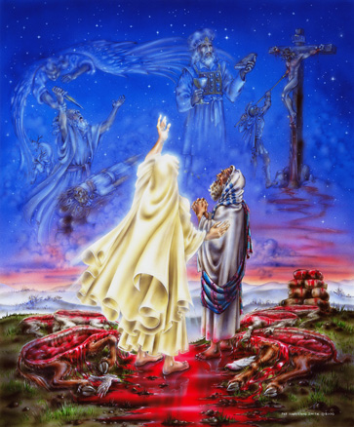
Genesis 15 Ratification
ROYAL LAND GRANT FORM OF THE ABRAHAMIC COVENANT
This painting inaccurately depicts Abram walking through the pieces

Slide 14
Is the Abrahamic Covenant Unconditional?
20
No
Yes
Eternal (Gen. 17:7-8)
No conditions
Covenant ritual (Gen. 15:7-21)
Promised despite disobedience
Israel is eternal (Jer. 31:36)
Immutable (Heb. 6:13-18)
Only obedient (believing) Israelites benefit (Gen. 17:9-14; 18:19)
Individual disbelief does not cancel future national belief (Rom. 9:6)
Blessings in an unconditional covenant are still conditioned by obedience (Pentecost, Thy Kingdom Come, 52-54)

Slide 15
The Three Basic Elements
7
Genesis 12
The Lord had said to Abram,
"Leave your country, your people and your father's household, and go to the land I will show you.
1
"I will make you into a great nation
and I will bless you;
I will make your name great,
and you will be a blessing.
2
ABRAHAM
The CALL
I will bless those who bless you,
and whoever curses you I will curse;
and all peoples on earth
will be blessed through you."
L - S - B
3
Handbook pg. 19-24
13
2

Slide 16
The Three Basic Elements
7
Genesis 12
The Lord had said to Abram,
"Leave your country, your people and your father's household, and go to the land I will show you.
1
A LAND
A SEED
"I will make you into a great nation
and I will bless you;
I will make your name great,
and you will be a blessing.
2
ABRAHAM
The CALL
I will bless those who bless you,
and whoever curses you I will curse;
and all peoples on earth
will be blessed through you."
L - S - B
3
A BLESSING
Handbook pg. 19-24
14
2

Slide 17
The Elements Expanded
21
7
Abrahamic Covenant
Gen. 12:1-3
LAND SEED BLESSING
ABRAHAM
The CALL
L - S - B
12:1
12:2
12:3
"L-S-B"
Handbook pg. 19-24
15

Slide 18
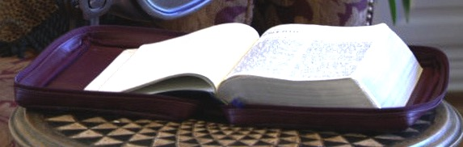
Literal - Eternal - Unconditional
Gen. 13:15; Gen. 15
21
7
Abrahamic Covenant
Gen. 12:1-3
LAND SEED BLESSING
ABRAHAM
The CALL
L - S - B
• LITERAL
• ETERNAL
• UNCONDITIONAL
Handbook pg. 19-24
16
3

Slide 19
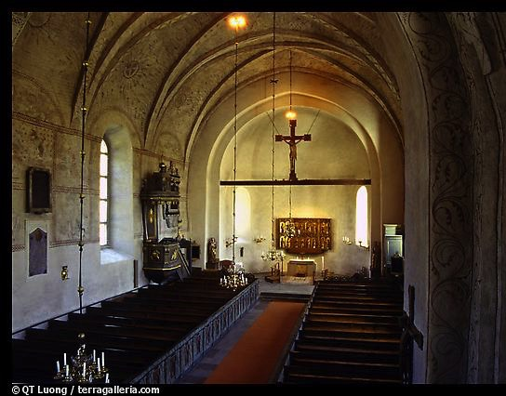
Types of Unconditional Covenants
21
Abrahamic
Land
Davidic
New
Land | Seed | Blessing
Physical | Political | Spiritual
Deut. 30 | 2 Sam. 7 | Jer. 31

Slide 20
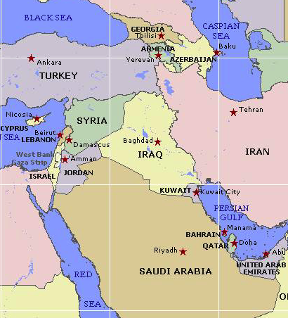

Borders of the Land Promised to Abraham
21
Genesis 15:18
On that day the LORD made a covenant with Abram, saying, "To your offspring I give this land, from the river of Egypt to the great river, the river Euphrates" (ESV)

Slide 21
COVENANT KINDNESS TOWARDS the
DAVIDIC DYNASTY
22

Slide 22
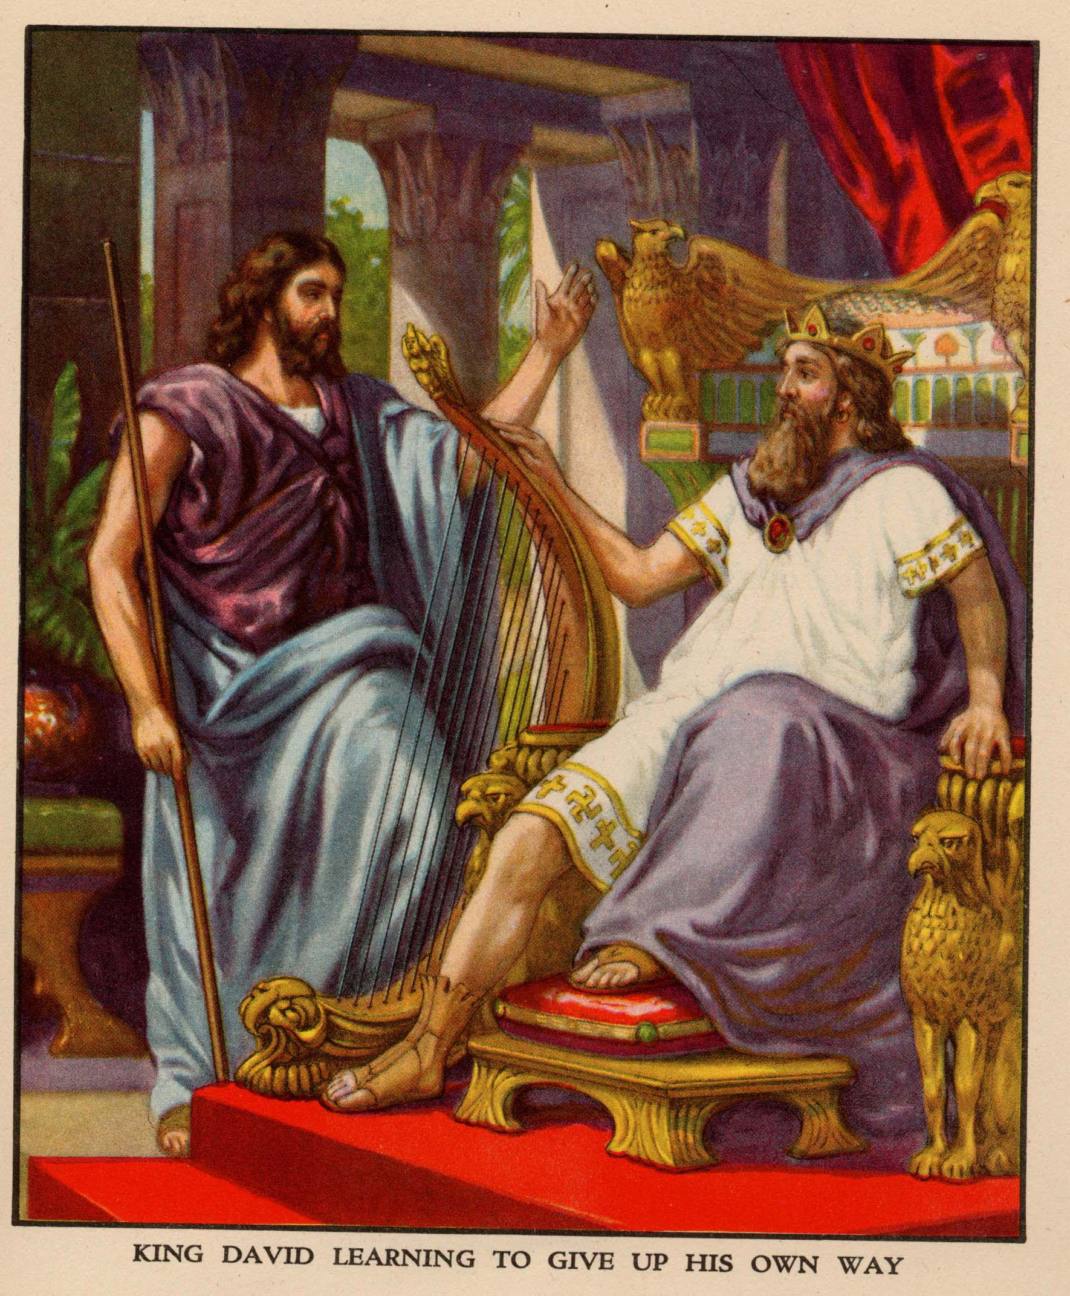
Nathan related God's promise to David (2 Sam. 7)

Slide 23
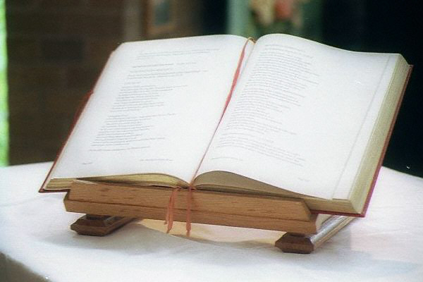
KEY VERSE
22
"For when you (David) die, I will raise up one of your descendants, and I will make his kingdom strong. He is the one who will build a house—a temple—for my name. And I will establish the throne of his kingdom forever."
2 Samuel 7:12-13

Slide 24

Types of Covenants
BLESSING
Walt Russell, Playing with Fire, 121
Covenants of Promise
Amplified by
Abrahamic
Davidic
2 Samuel 7:12-16
Administrative Covenants How to experience the blessing
Mosaic Israel's terms of obedience
Superceded by
New Terms of obedience under Messiah

Slide 25

Promises of the Davidic Covenant
22
What did God promise David in 2 Samuel 7:12-16?
Sons: "house" never wiped out
Kingdom: political dynasty (each Jerusalem king will be one of his direct descendants)
Throne: As an eternal covenant (v. 16), the right to rule will remain with his family forever
Temple: Solomon will build it
Discipline: God will punish disobedient kings but still unconditionally keep these promises

Slide 26
A Literal Kingdom for David's Line
22-23
Ordinary language for "kingdom" is used
Prophets interpreted the kingdom literally
Israel interpreted the kingdom literally
586 BC kingdom overthrown is the same kind
The Davidic Covenant relates only to Israel
David saw the covenant applying only to Israel
Portions have been fulfilled literally
David's throne is not related to Christ's present session in heaven
John, Jesus, the 12, and the 70 all offered Israel a literal kingdom (Matt. 3:11; 4;17; 10:7; Luke 10:1, 9)

Slide 27

The New Covenant
23
IN BRIEF

Slide 28
Four Unconditional Biblical Covenants
21
ABRAHAMIC
Genesis 12:1-3
BLESSING
LAND
SEED
LAND
Deut 30:1-10
DAVIDIC
2 Sam 7:12-16
NEW
Jer. 31:31-34
God's unconditional amplification of the blessing promise in the Abrahamic Covenant where Judah and Israel will experience national and spiritual redemption.
Notes:
A recap of the covenants that are amplified from the Abrahamic covenant of which the new covenant was one of them.
(cf. Deut. 30:1-10) promises:
Land from Wadi of Egypt to Euphrates River (Isa. 27:12)
Eternal possession of land (Gen. 17:8) after exile/restoration
Whole world blessed via the land (Isa. 14:1-2)
2 Samuel 7:12-16 promises perpetual:
Sons ("house" never wiped out)
Kingdom (political dynasty)
Throne (right to rule by descendants)
Temple (son to build it)
Jeremiah 31:31-34 promises:
Forgiveness
Indwelling Spirit
New heart, nature, mind
Reunification of Israel and Judah
No need for evangelism

Slide 29

The New Covenant
23
Jeremiah 31:31-34
³¹"The time is coming," declares the LORD, "when I will make a new covenant with the house of Israel and with the house of Judah.
³²It will not be like the covenant I made with their forefathers when I took them by the hand to lead them out of Egypt, because they broke my covenant, though I was a husband to them," declares the LORD.
³³"This is the covenant I will make with the house of Israel after that time," declares the LORD.

Slide 30
The New Covenant
23
Jeremiah 31:31-34
^{33b} "I will put my law within them, and I will write it on their hearts. And I will be their God, and they shall be my people. And no longer shall each one teach his neighbor and each his brother, saying, 'Know the LORD,' for they shall all know me, from the least of them to the greatest, declares the LORD. For I will forgive their iniquity, and I will remember their sin no more."

Slide 31
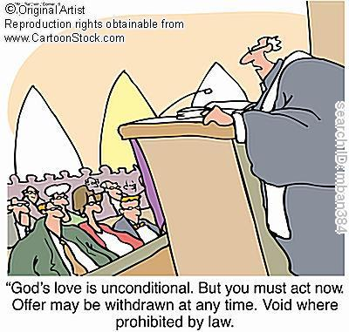
Unconditional Nature
24
Eternal (Jer. 31:36, 40; 32:40; 50:5; Isa 61:2. 8-9; 24:5; Ezek. 37:26)
Amplification of the Abrahamic Covenant, which is unconditional
Unqualified "I will" statements of God
Notes:
How did we know that it was unconditional?

Slide 32


… This cup is the
NEW COVENANT in my blood, which is POURED OUT for you.
The cup (not baptism) is the new covenant sign
LUKE 22:20
Notes:
The Passover had its "cup of redemption" that referred to the salvation of Israel from slavery in Egypt. But Jesus changed the familiar wording on the night of the Last Supper to apply this "cup of redemption" not simply to political redemption. He declared himself as the fulfillment of this cup as it ultimately celebrates redemption in HIS blood as the TRUE Passover Lamb!
__________
Common-389
BE-24-Jeremiah-62?
ES-05-Biblical Covenants-31?
OS-24-Jeremiah-169
NS-03-Luke13-24-slide 161
NS-08-2 Corinthians-83?
NS-19-Hebrews-34?

Slide 33
How could Jesus apply the new covenant promises to his disciples when the other provisions were not fulfilled then?
(What about Israel and Judah reunified? What about all people knowing God?)
Notes:
We must reconcile these seemingly contradictory applications.
__________
Common-390
BE-24-Jeremiah-62?
ES-05-Biblical Covenants-31?
OS-24-Jeremiah-170
NS-03-Luke13-24-slide 161
NS-08-2 Corinthians-83?
NS-19-Hebrews-34?

Slide 34

Views on the Time of Fulfillment
24
Amillennialists often say all of the provisions of the New Covenant are being realized now in the church which they consider the "new Israel." But are they?
1. Partial Fulfillment in the present church age
Only one New Covenant for Israel (Darby)
Two New Covenants: one for Israel and one for the church (Chafer)
One New Covenant with a two fold- application: primarily to Israel, secondarily to the Church
2. Complete fulfillment after the return of Christ
Notes:
Ignores NT, Christ's words, Paul's teachings
Ignore present work of the Holy Spirit cue cards
1)Cannot reconcile same terminology for OT and NT covenants.
2) The distinctions are too sharp.
View most modern pre-mils take. Deals with both OT/NT data, forgiveness and the holy spirit are blessings that we experience now.
Ignoring OT data between the distinctions between church and Israel

Slide 35

Provisions
24
FULFILLED
Indwelling of the Holy Spirit
(Jer. 31:33 with Ezek. 36:27)
New nature, heart & mind
(Jer. 31:33; Isa. 59:21)
Forgiveness of sins
(Jer. 31:34b)
NOT YET FULFILLED
Everyone will know the Lord
(Jer. 31:34a)
Israel and Judah will be reunited (Jer. 31:31)
Notes:
There are debates that exist about the how far or when or to whom the covenant refers to. This is because Jeremiah 31 declares the covenant is for Israel and Judah but in the new testament. (Luke 22:20; 1 Cor 11:25; 2 Cor.3:6; Heb 8:8;9:15 ) it is declared for the church.
.
So questions arise if is there a new covenant? Is it especially for the church? Or is it only for Israel? Or was there two covenants? Or are these promises built upon each other?

Slide 36


"Old" Replaced by "New"
NTS 266hh
Wayne Grudem, Systematic Theology, 521
"What then is the 'old covenant' in contrast with the 'new covenant' in Christ? It is not the whole of the Old Testament, because the covenants with Abraham and David are never called 'old' in the New Testament. Rather, only the covenant under Moses, the covenant made at Mount Sinai (Ex. 19-24) is called the 'old covenant' (2 Cor. 3:14; cf. Heb. 8:6, 13), to be replaced by the "new covenant" in Christ (Luke 22:20; 1 Cor. 11:25; 2 Cor. 3:6; Heb. 8:8, 13; 9:15; 12:24)."
Notes:
What covenant does Jesus mediate that is far better than the old (8:6)?
Christians are not under the covenant with Moses. We are new covenant believers.
_____________
Common-225
BE-05-Deut-46
CH-02-Nature, etc.-104
ES-05-Biblical Covenants-34
OS-02-Exodus-370, 463
OS-05-Deut-185
OS-24-Jeremiah-177
NS-08-2 Corinthians-41
NS-09-Galatians-144
NS-19-Hebrews-298, 344

Slide 37
How to Reconcile?
25
Jeremiah 31:31-34 (for Israel)
'everlasting covenant'
'a new heart'
'a new spirit'
'a covenant of peace'
'a covenant'
Luke 22:20 (for Church)

Slide 38
Views on the New Covenant
25
Restated Mosaic Covenant?
Church Alone
Israel Alone
Two New Covenants
Church Participation

Slide 39
Views on New Covenant Fulfillment
View | Explanation | School & Scholars | Problems
Restated Mosaic | No New Covenant | Critical: –Couturier –Duhm –Schmidt –Potter | 1. OC/NC distinctions in text ignored 2. OC=conditional, NC=unconditional 3. OC=temporal, NC=eternal 4. OC=external, NC=internal 5. OC=no enablement, NC=enablement 6. NC=peace, prosperity, sanctuary, Spirit (parallel passages)
Church Alone | No Israel Participation | Amillennial/ Postmillennial: –Allis –Cox –Smick –Boettner | 1. Ignores OT data by equating Israel & the Church 2. NC introduced ≠ fulfilled to Israel 3. Present need to know YHWH (we still need to obey the Great Commission) 4. AD 70 Jerusalem vs. Jer. 31:40
25

Slide 40
Views on New Covenant Fulfillment
View | Explanation | School & Scholars | Problems
Israel Alone | No Church Participation | Misc/Classical Dispensational: –Darby – Thompson –von Rad | 1. Ignores NT data –Christ's Last Supper words –Paul's statements –Hebrews application to Church 2. Ignores present work of Spirit
Two New Covenants | NC for Israel + NC for Church | Early 1900s Dispensational: –Chafer –Walvoord (old) –Ryrie (old) | 1. Same terminology for OT & NT NCs 2. Israel/Church distinction too sharp 3. Basis of forgiveness the same 4. If 2 NCs then no OC for Church 5. Church doesn't possess Israel's promises
25

Slide 41
My View on New Covenant Fulfillment
View | Explanation | School & Scholars | Problems
Church Participation | Primarily for Israel Secondarily for the Church | Misc/Present Dispensational: –Keil –Lemke –Bright –Scofield –Walvoord (DTS) –Ryrie (DTS) –Archer (TEDS) –Kaiser (TEDS) | Support: 1. Primary fulfillment is future–Rom 11 2. Deals with both OT & NT data 3. Forgiveness & the Spirit are blessings experienced now 4. NC has new law 5. Rebuttals to above views
25

Slide 42

"This cup is the new covenant in my blood" (Luke 22:20)
25
Refers back to Jeremiah 31:31-34
The new covenant replaces the old
The church participates in the covenant promised to Israel
Never does Scripture say that the church replaces Israel since God has not rejected the nation (Rom. 11:1; cf. Jer. 31:35-37)
Notes:
Christians are therefore no longer under the old covenant of Moses. But that does not mean there is no future fulfillment of this new covenant to a believing Israel.
__________
Common-396
BE-24-Jeremiah-62?
ES-05-Biblical Covenants-31
ES-05-Covenants-40
OS-24-Jeremiah-176
NS-03-Luke13-24-slide 161
NS-08-2 Corinthians-83?
NS-19-Hebrews-34?

Slide 43
Signs of the Covenants
25c
Covenant | Definition | Promise | Fulfillment | Sign
Noahic | Unconditional promise not to flood earth again | Gen. 9:12-17 | No more sea (Rev. 21:1) | Rainbow (Gen. 9:12-17)
Abrahamic | Promise to provide Israel a land, rule, and spiritual blessing | Gen. 12:1-3; 15:13-18 | Continues at present (Gal. 3:17) but Israel still has a future (Rom. 11:25-27) | Circumcision (Gen. 17:11)
Mosaic | Conditional stipulations for blessing on Israel | Exod. 19-31; Deut. 28 | Death of Christ (Rom. 7:4-6) | Sabbath (Exod. 31:13)
Land | Promise of physical land from the Wadi of Egypt to the River Euphrates | Deut. 30:1-10 | Land blessed (Amos 9:13-15) | No sign (that I know of)
Davidic | Promise of eternal, political rule of a descendant of David | 2 Sam. 7:12-17 | Rule renewed (Amos 9:11-12) | Christ seated at the Father's right hand (Acts 2:34-36)
New | Promise of spiritual indwelling of the Spirit ("law written on hearts"), forgiveness, and total evangelization of Israel | Jer. 31:31-34 | Paul & the Apostles (2 Cor. 3–4) All Israel saved (Rom. 11:26-27) | Cup of the Lord's Supper (Luke 22:20; 1 Cor. 11:25)

Slide 44
Kingdom & Covenants Timeline
25d
9g
Kingdom Teaching...
22 &
337
Adam rules with God (Gen. 1:26, 28; 2:19)
Satan rules as god of this world (Gen. 3:15;
2 Cor. 4:4)
God covenants with Abraham to reestablish man's rule via Israel as a "kingdom of priests" (Gen. 12:1-3; Exod. 19:6)
Israel's failure to witness to nations as a kingdom of priests is judged via exile under foreign rule
Israel rejects Messiah's offer of kingdom (Matt. 12:41-42; 23:37-39)
Jesus extends His kingdom in mystery form to the Church (Matt. 13)
Christ subdues Israel's enemies and nation believes (Rom. 11:26-27)
Christ rules over everything with saints (Eph. 1:9-10; Rev. 20:1-6; 22:5b)
Fall of Man (Gen. 3)
Noahic Covenant
Genesis 6:18; 9:8-17
Land Covenant
ISRAEL
CHURCH
MESSIANIC KINGDOM
(National Focus)
The "New Man" (Eph. 2:15)
Millennial Eternal
land
Genesis 15:18 (cf. Deut. 30:1-10) promises:
Land from Wadi of Egypt to Euphrates River (Isa. 27:12)
Eternal possession of land (Gen. 17:8) after exile/restoration
Whole world blessed via the land (Isa. 14:1-2)
Israel judged for rejecting Messiah by dispersion away from land for 19 centuries
(AD 70–AD 1948) but now partially restored (Ezek. 37:1-7)
Full restoration (Ezek. 37:8-28) Jerusalem world capital
(Isa. 2:1-5)
New Jerusalem
(Rev. 21–22)
Davidic Covenant
Christ is Head over His Church, which is a spiritual temple (Eph. 2:19-22; 2 Cor. 6:16)
Christ reigns over the world
(Isa. 11)
with saints (Rev. 5:10; 20:4-6)
Christ hands kingdom over to Father (1
Cor. 15:24)
Abrahamic Covenant
2 Samuel 7:12-16 promises perpetual:
Sons ("house" never wiped out)
Kingdom (political dynasty)
Throne (right to rule by descendants)
Temple (son to build it)
Genesis 12:1-3
seed
New Covenant
All
things made new!
(Rev. 21:5)
All 5 elements fulfilled in national restoration (Zech. 8)
Jeremiah 31:31-34 promises:
Forgiveness
Indwelling Spirit
New heart, nature, mind
Reunification of Israel and Judah
No need for evangelism
Mosaic Law replaced with first three elements of the New Covenant (Luke 22:20; 2 Cor. 3:6)
blessing
Mosaic Covenant
Law abolished, fulfilled, and replaced at the cross (Rom. 7:1-6;1 Cor. 9:19-21; Heb. 8:13)
Sixth Edition
15 June 2012
Temporary (Gal. 3:19) and conditional (Deut. 28) to reveal sin (Rom. 7:7) and regulate Israel (Gal. 3:23-25)
Scripture has a dual kingdom-covenant emphasis. Israel's role from Abraham to Christ expands to include the Church (continuity) yet the Church never replaces the nation as the "new Israel" (discontinuity). Israel will again enjoy world prominence after trusting in Christ at His second coming.
Notes:
Slides 13 and 127 repeated

Slide 45


Contrasting Two Key Covenants
25a
 | Abrahamic | Mosaic
Recipient (Date & Place) | Abraham as mediator for all nations in 2060 BC at Ur of the Chaldees | Moses as mediator for Israel in 1445 BC at Mount Sinai
Scripture | Genesis 12:1-3 (but formalized into a covenant in Genesis 15) | Exodus 20–31 is the heart of the covenant
Between God & | A person (for a future nation) | A nation
Scope | Universal ("all peoples will be blessed through you") | Only Israel received the Law (Deut. 4:8; Ps. 147:20)

Slide 46
Contrasting Two Key Covenants
25a
 | Abrahamic | Mosaic
Promises | Land, seed, and blessing (without indication of time of fulfillment) | Blessing for obedience and cursing for disobedience (Lev. 26; Deut. 28)
Conditions | Unconditional: "I will…" (Gen. 12:1-3) | Conditional: "If you will…then I will…"
Partici-pation | Abraham asleep (Gen. 15:17) | Israel agreed to obey (Exod. 19:8)
Analogy | Father to son (royal land grant) | Suzerain (superior king) to vassal (servant nation)

Slide 47
Contrasting Two Key Covenants
25a
 | Abrahamic | Mosaic
Form | Oral (no written stipulations) | Written on tablets of stone & Pentateuch
Emphasis | Blessing over discipline/judgment (five "blessings" in Gen. 12:1-3) | Judgment/discipline over blessing (contrast Deut. 28:1-14 & 28:15-68)
Christology | Ultimate seed (Gen. 12:3; Gal. 3:16) | Typified in tabernacle (Heb. 8–10)
Sign | Circumcision (Gen. 17:11) | Sabbath (Exod. 31:13, 17)
End | Never ending ("eternal" in Gen. 17:8) | Ended at Christ's death (Rom. 7:6; 10:4)

Slide 48
Covenant Implications
24
We're not under the Mosaic Law
We never have to sin
We need not live in fear
We should support Israel's right to exist as a nation
We must reach the nations with the gospel

Slide 49

Animals
God's Creation…Day 6
"Then God said, 'Let the earth bring forth living creatures after their kind: cattle and creeping things and beasts of the earth after their kind"; and it was so. God made the beasts of the earth after their kind, and the cattle after their kind, and everything that creeps on the ground after its kind; and God saw that it was good'" (Gen. 1:24-25).

Slide 50

Man
God's Creation…Day 6
"Then God said, 'Let Us make man in Our image, according to Our likeness; and let them rule over the fish of the sea and over the birds of the sky and over the cattle and over all the earth, and over every creeping thing that creeps on the earth'" (Gen. 1:26).

Slide 51

Woman
God's Creation…Day 6
"So God created man in his own image
in the image of God he created him
male and female he created them" (Gen. 1:27).

Slide 52

Mandate
448
and over the birds of the air
"And God blessed them, and God said to them, 'Be fruitful and multiply, and fill the earth and subdue it;
and have dominion over the fish of the sea
and over every living thing that
moves upon the earth'" (Gen. 1:28 NLT).

Slide 53
An All-Encompassing Theme
25d
Genesis 1:26-28
"Then God said, 'Let us make man in our image, in our likeness, and let them rule over the fish … birds … livestock … all the earth, and over all the creatures that move along the ground…' God blessed them and said to them, 'Be fruitful and increase in number; fill the earth and subdue it. Rule over the fish of the sea and the birds of the air and over every living creature that moves on the ground.'"
Revelation 22:5
"There will be no more night. They will not need the light of a lamp or the light of the sun, for the Lord God will give them light. And they will reign for ever and ever."
The Bible's Theme: God extends His rule to man
Command
Covenants
Fulfillment

Slide 54
Kingdom & Covenants Timeline
25d
9g
Kingdom Teaching...
Adam rules with God (Gen. 1:26, 28; 2:19)
Satan rules as god of this world (Gen. 3:15;
2 Cor. 4:4)
God covenants with Abraham to reestablish man's rule via Israel as a "kingdom of priests" (Gen. 12:1-3; Exod. 19:6)
Israel's failure to witness to nations as a kingdom of priests is judged via exile under foreign rule
Israel rejects Messiah's offer of kingdom (Matt. 12:41-42; 23:37-39)
Jesus extends His kingdom in mystery form to the Church (Matt. 13)
Christ subdues Israel's enemies and nation believes (Rom. 11:26-27)
Christ rules over everything with saints (Eph. 1:9-10; Rev. 20:1-6; 22:5b)
22 &
337
Fall of Man (Gen. 3)
Noahic Covenant
Genesis 6:18; 9:8-17
Land Covenant
ISRAEL
CHURCH
MESSIANIC KINGDOM
(National Focus)
The "New Man" (Eph. 2:15)
Millennial Eternal
land
Genesis 15:18 (cf. Deut. 30:1-10) promises:
Land from Wadi of Egypt to Euphrates River (Isa. 27:12)
Eternal possession of land (Gen. 17:8) after exile/restoration
Whole world blessed via the land (Isa. 14:1-2)
Israel judged for rejecting Messiah by dispersion away from land for 19 centuries
(AD 70–AD 1948) but now partially restored (Ezek. 37:1-7)
Full restoration (Ezek. 37:8-28) Jerusalem world capital
(Isa. 2:1-5)
New Jerusalem
(Rev. 21–22)
Abrahamic Covenant
Davidic Covenant
Christ is Head over His Church, which is a spiritual temple (Eph. 2:19-22; 2 Cor. 6:16)
Christ reigns over the world
(Isa. 11)
with saints (Rev. 5:10; 20:4-6)
Christ hands kingdom over to Father (1
Cor. 15:24)
Genesis 12:1-3
2 Samuel 7:12-16 promises perpetual:
Sons ("house" never wiped out)
Kingdom (political dynasty)
Throne (right to rule by descendants)
Temple (son to build it)
seed
New Covenant
All
things made new!
(Rev. 21:5)
All 5 elements fulfilled in national restoration (Zech. 8)
Jeremiah 31:31-34 promises:
Forgiveness
Indwelling Spirit
New heart, nature, mind
Reunification of Israel and Judah
No need for evangelism
Mosaic Law replaced with first three elements of the New Covenant (Luke 22:20; 2 Cor. 3:6)
blessing
Mosaic Covenant
Law abolished, fulfilled, and replaced at the cross (Rom. 7:1-6;1 Cor. 9:19-21; Heb. 8:13)
Sixth Edition
15 June 2012
Temporary (Gal. 3:19) and conditional (Deut. 28) to reveal sin (Rom. 7:7) and regulate Israel (Gal. 3:23-25)
Scripture has a dual kingdom-covenant emphasis. Israel's role from Abraham to Christ expands to include the Church (continuity) yet the Church never replaces the nation as the "new Israel" (discontinuity). Israel will again enjoy world prominence after trusting in Christ at His second coming.

Slide 55

My View of the OT's Theme
The Old Testament narrates
God's restoring man to participate in His kingdom rule for His own glory
mandated in Eden but lost in the Fall
and accomplished by redeeming man
through Israel as a kingdom of priests
and ultimately through the Messiah,
who will reign as Saviour and King
to fulfill the Abrahamic Covenant

Slide 56
Black

Slide 57


Future (Eschatology) at BibleStudyDownloads.org
Get this presentation for free!
Notes:
Future (fu)
Eschatology

