Slide 1
Covenant Theology
Theological Agreements Taught in Reformed Circles
Dr. Rick Griffith • Jordan Evangelical Theological Seminary • BibleStudyDownloads.org

Slide 2
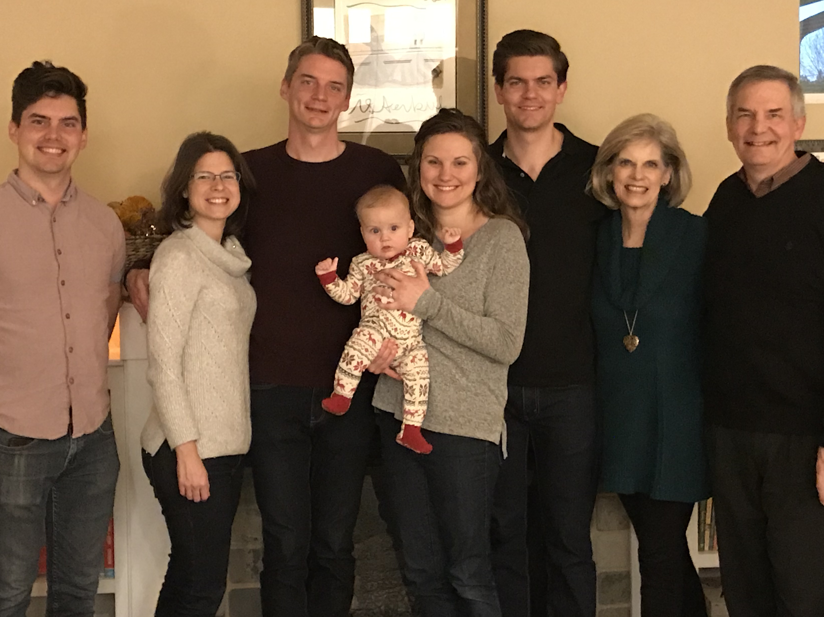
The Griffiths
28 Nov 2019
2019
John
(27)
Rick & Susan
Kurt & Cara (32)
Stephen, Katie & Jesse (30)

Slide 3
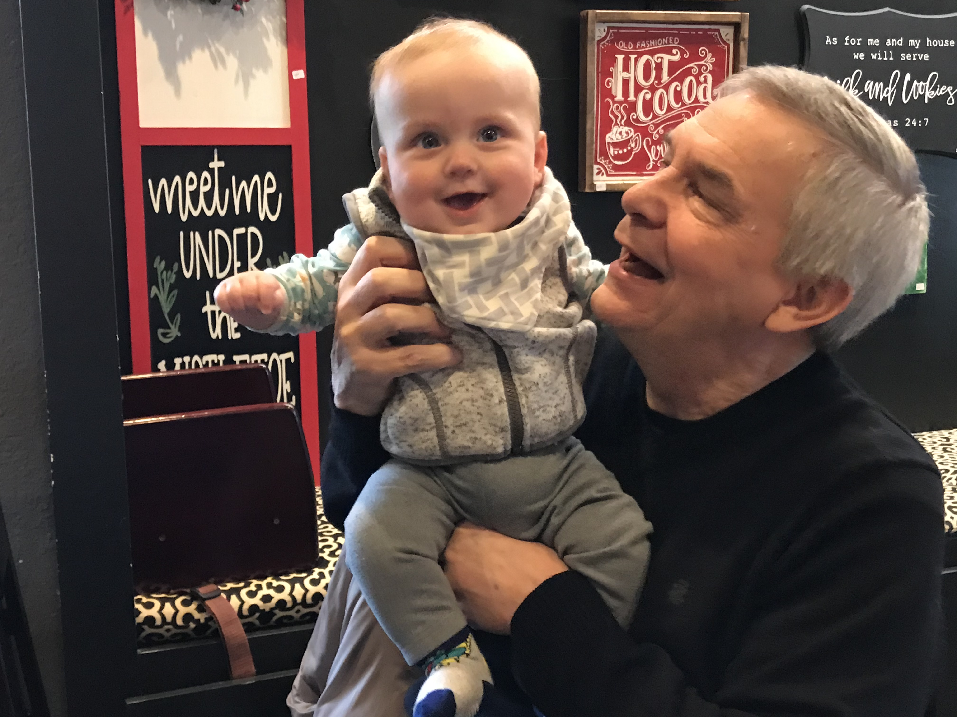
Grandson Jesse

Slide 4
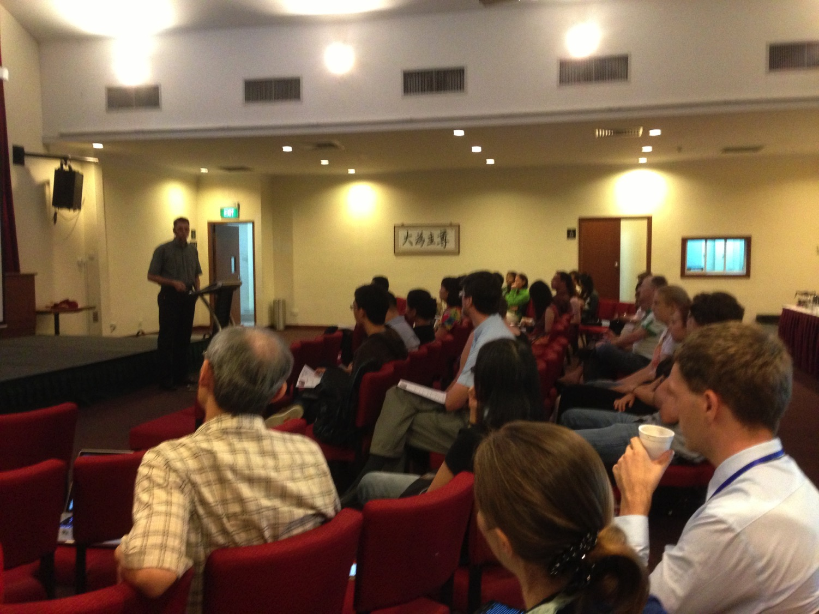

Our People
9
51 people from 11 nations
June 2019

Slide 5


Crossroads People • June 2019
UK
CHINA
JAPAN
UNITED KINGDOM
RUSSIA
NETHERLANDS
FRANCE
MONGOLIA
ITALY
KOREA
HONG KONG
LEBANON
JAPAN
TAIWAN
GERMANY
MYANMAR
CANADA
EGYPT
INDIA
USA
THAILAND
ETHIOPIA
MALAYSIA
ZIMBABWE
PHILIPPINES
SINGAPORE
INDONESIA
SOUTH AFRICA
CIC
NEW ZEALAND
AUSTRALIA
Notes:
Our June 2019 church of 51 people stem from 11 different countries around the world: Australia (David & Fiona), France (Aurelie), Korea (Grace Kim), India (Cynthia), Indonesia (Rena), Japan (Yoshie), Myanmar (Peng), Singapore (Albina), Thailand (Mae), UK (James & Gabi), USA (Miriam).
This does not include people who have recently attended only once: Dowon (Korea)
Nor does it include missionaries living back in their countries but still are members of CIC: Maple (Taiwan), Budmaa (Mongolia)
Previous: Canada (Gloria Lee), Ethiopia (Lele), Malaysia (Aston, Naomi), Netherlands (Dies & Desiree), Philippines (Micah), South Africa (Melody),

Slide 6

SINGAPORE BIBLE COLLEGE
9
Notes:
I've served as a seminary professor with 30 other faculty at Singapore's largest training school: Singapore Bible College

Slide 7
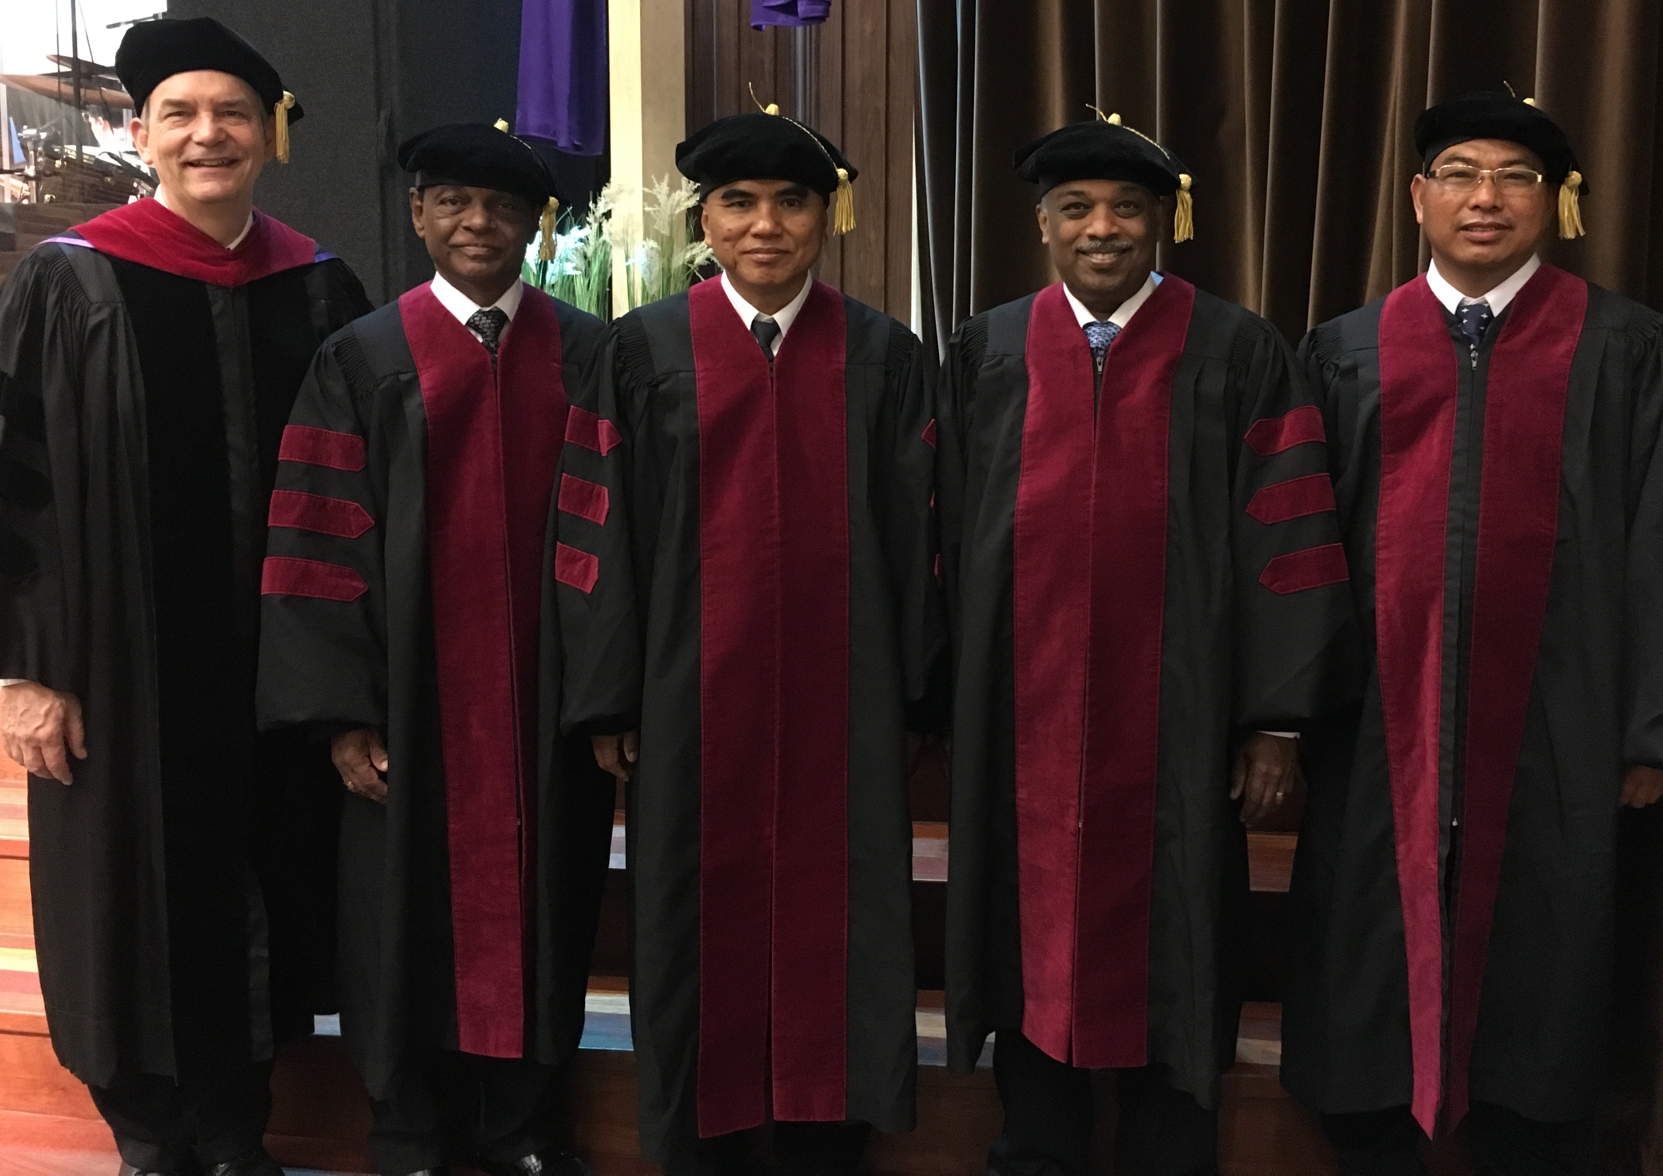
I direct the SBC Doctor of Ministry studies (DMin)
Notes:
I'm also the director of the doctoral program at SBC that trains about 80 seminary professors and pastors throughout Asia in English and Chinese. Generallly each year about 5 of them received their Doctor of Ministry degree.

Slide 8
SBC Courses I Teach
(English • Indonesian • Chinese)
Survey • The Bible…Basically
OT NT Bible Study
Backgrounds • Research & Writing
OT NT Geography
Theology • Creation • Jesus
Church • Spirit • Salvation • Future
Preaching
Homiletics 1 Homiletics 2
Notes:
I get to teach these leaders every book of the Bible in survey courses, plus backgrounds to both the OT and NT, three areas of theology, and how to preach.

Slide 9
Teaching 1997-2019
MONGOLIA
JORDAN
KOREA
CHINA
NEPAL
MYANMAR
INDIA
THAILAND
VIETNAM
MALAYSIA
SRI LANKA
SINGAPORE
SBC
INDONESIA
Notes:
From 1997-Dec 2019 God has seen fit to grant me the privilege to train pastors in 12 other countries on 67 trips. Often pastors in the US team-teach with me on these trips. To help the poor, I avoid the wealthy countries where listeners can pay an honorarium but instead raise the funds to pay my own way and then teach for free.

Slide 10


Future (Eschatology) at BibleStudyDownloads.org
Get this presentation for free!
Notes:
Future (fu)
Eschatology

Slide 11
Types of Covenants
Covenants
Conditional
Unconditional
Thought Question for Small Groups:
Does God consider marriage a conditional or unconditional covenant?

Slide 12
Kinds of Biblical Covenants
18
Covenant Theology Covenants (Theological)
Scriptural Covenants (Biblical)

Slide 13
Theological Covenants
18
Covenant of Redemption
Covenant of Works
Covenant of Grace

Slide 14
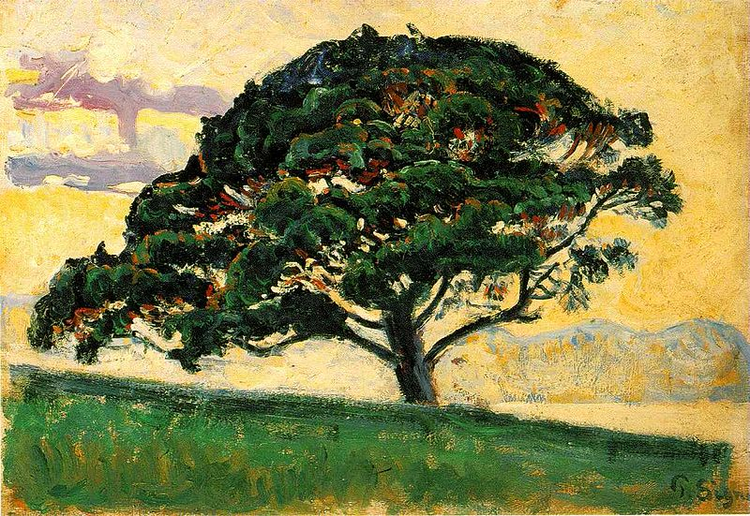
Genesis 2:16 (NLT)
"But the LORD God warned him, 'You may freely eat the fruit of every tree in the garden ¹⁷ —except the tree of the knowledge of good and evil. If you eat its fruit, you are sure to die.'"

Slide 15
Theological Covenants
19
GOD
Father
Covenant of Redemption
between Father, Son, & Spirit
Son
Spirit
Covenant of Works
between God & Adam
ADAM
Covenant of Grace
between God & elect sinners
ELECT
SINNERS
Robert Lightner, The Last Days Handbook, 76

Slide 16
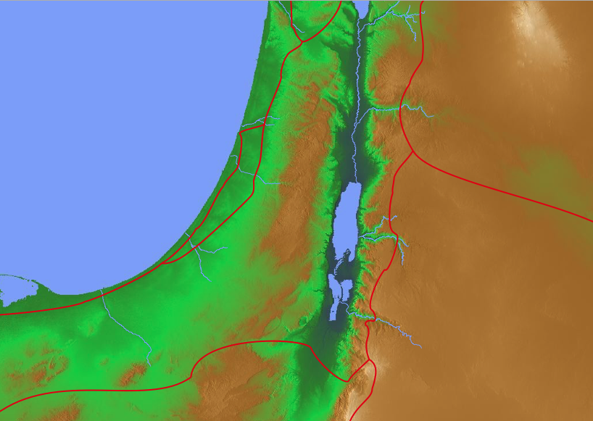
Hosea 6:7 Translations
Adam
"But like Adam, you broke my covenant and betrayed my trust"
(NLT).
"But like Adam, they have transgressed the covenant. There they have dealt treacherously against Me"
(NAU).
"But they like men have transgressed the covenant: there have they dealt treacherously against me"
(KJV).
"But at Adam, they have transgressed the covenant. There they have dealt treacherously against Me"
(RSV).
Notes:
"6:7. Rather than pleasing God, the people had broken the covenant and been unfaithful (bagad ; cf. comments on 5:7) to God. The Hebrew word for like Adam has been translated variously. "At Adam" (RSV) requires a slight change in the Hebrew and suggests a geographical place near the Jordan River. The presence of the word there in the next line, as well as references to other places in 6:8-9, might support this reading. "Like men" (KJV) takes the Hebrew adam in its widely attested generic sense, rather than as a proper name. In this case a comparison is made with fallen mankind, whose propensity to be unfaithful is well established (cf. Isa. 40:6-8, man's hesed ["glory," Isa. 40:6] is as transitory as grass and flowers that wither in the sun). On the other hand, the NIV and the NASB suggest a comparison with the first man, Adam, who blatantly violated God's requirement by eating from the forbidden tree" (BKC, 1:1394).

Slide 17
Theological Covenant Timeline
19
COVENANT OF REDEMPTION
COVENANT OF WORKS
COVENANT OF GRACE
E
T
E
R
N
I
T
Y
F
U
T
U
R
E
E
T
E
R
N
I
T
Y
P
A
S
T
S
I
N
O
F
A
D
A
M
FATHER AND SON
GOD AND ADAM
GOD
AND
MANKIND
OLD
TESTAMENT
Patriarchal/Mosaic
NEW
TESTAMENT
Christian
GEN. 1:27–3:6
GEN. 3:7
REV. 20:15
Charles Ryrie, Dispensationalism (1995), 188

Slide 18
Concepts of Covenant Theology
19
Comparisons | Covenant of Works | Covenant of Redemption | Covenant of Grace
Persons | With Adam | With Father & Son | With mankind
Promise | Physical/ eternal life confirmed | Salvation provided for mankind | Eternal life
Condition | Obedience | ___ | Faith
Warning | Physical death | ___ | Eternal death
Time | Eden before Fall | Eternity past | Eden after Fall
Paul Enns, Moody Handbook of Theology, 509

Slide 19
Kingdom & Covenants Timeline
22 &
337
9g
Dr. Rick Griffith • Singapore Bible College • BibleStudyDownloads.org
Kingdom Teaching...
Adam rules with God (Gen. 1:26, 28; 2:19)
Satan begins rule as god of this world (Gen. 3:15;
2 Cor. 4:4)
God covenants with Abraham to reestablish man's rule via Israel as a "kingdom of priests" (Gen. 12:1-3; Exod. 19:6)
Israel's failure to witness to nations as a kingdom of priests is judged via exile under foreign rule
Israel rejects Messiah's offer of kingdom (Matt. 12:41-42; 23:37-39)
Jesus extends His kingdom in mystery form to the Church (Matt. 13)
Christ subdues Israel's enemies and nation believes (Rom. 11:26-27)
Christ rules over everything with saints (Eph. 1:9-10; Rev. 20:1-6; 22:5b)
Fall of Man (Gen. 3)
Noahic Covenant
Genesis 6:18; 9:8-17
Land Covenant
ISRAEL
CHURCH
MESSIANIC KINGDOM
(National Focus)
The "New Man" (Eph. 2:15)
Millennial Eternal
land
Genesis 15:18 (cf. Deut. 30:1-10) promises:
Land from Wadi of Egypt to Euphrates River (Isa. 27:12)
Eternal possession of land (Gen. 17:8) after exile/restoration
Whole world blessed via the land (Isa. 14:1-2)
Israel judged for rejecting Messiah by dispersion away from land for 19 centuries
(AD 70–AD 1948) but now partially restored (Ezek. 37:1-7)
Full restoration (Ezek. 37:8-28) Jerusalem world capital
(Isa. 2:1-5)
New Jerusalem
(Rev. 21–22)
Davidic Covenant
Christ is Head over His Church, which is a spiritual temple (Eph. 2:19-22; 2 Cor. 6:16)
Christ reigns over the world
(Isa. 11)
with saints (Rev. 5:10; 20:4-6)
Christ hands kingdom over to Father (1
Cor. 15:24)
Genesis 12:1-3
2 Samuel 7:12-16 promises:
Sons ("house" never wiped out)
Kingdom (political dynasty)
Throne (right to rule by descendants)
Temple (son to build it)
seed
Abrahamic Covenant
New Covenant
All
things made new!
(Rev. 21:5)
All 5 elements fulfilled in national restoration (Zech. 8)
Jeremiah 31:31-34 promises:
Forgiveness
Indwelling Spirit
New heart, nature, mind
Reunification of Israel and Judah
No need for evangelism
Mosaic Law replaced with first three elements of the New Covenant (Luke 22:20; 2 Cor. 3:6)
blessing
Mosaic Covenant
Law abolished, fulfilled, and replaced at the cross (Rom. 7:1-6;1 Cor. 9:19-21; Heb. 8:13)
Eighth Edition
29 Aug 2016
Temporary (Gal. 3:19) and conditional (Deut. 28) to reveal sin (Rom. 7:7) and regulate Israel (Gal. 3:23-25)
Scripture has a dual kingdom-covenant theme. Israel's role from Abraham to Christ expands to include the Church (continuity) yet the Church never replaces the nation as the "new Israel" (discontinuity). Israel will again enjoy world prominence after trusting Christ at His second coming.
Notes:
Slides 13 and 127 repeated

Slide 20
Black

Slide 21
Future (Eschatology) at BibleStudyDownloads.org
Get this presentation for free!
Notes:
Future (fu)
Eschatology

