Slide 1

Reincarnation
The What, The Why
& Our Response
Dr. Rick Griffith • Jordan Evangelical Theological Seminary • BibleStudyDownloads.org

Slide 2


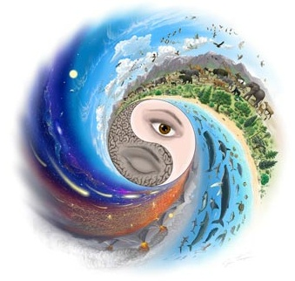
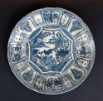

Is history . . .
Cyclical?
or
Linear?

Slide 3

What is Reincarnation?
17a
?
birth
death
life
Subtitle

Slide 4
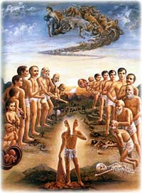
Some Terms
17a
Reincarnation believes that after death people return to earth again in another human body (cf. Latin carne, “flesh”)

Slide 5
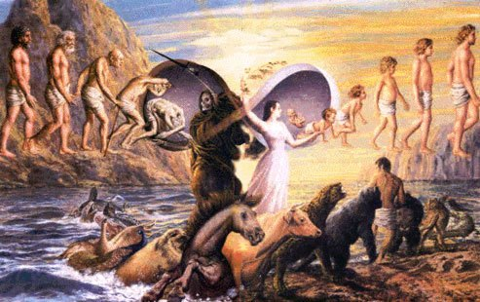
Transmigration is similar, saying one could become an animal (bird, cow, flea, cockroach) or inanimate object (rock, piece of chalk, etc.) in the next life.
17a
Subtitle

Slide 6
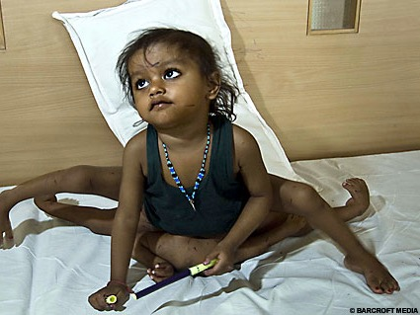
Karma (good and bad thoughts, words, and deeds in this life) decides the status of the new body—economically, intellectually, physically, etc.
17a

Slide 7
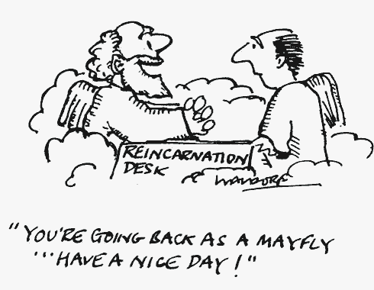
Funny?
"You're going back as a Mayfly…. Have a nice day!"

Slide 8
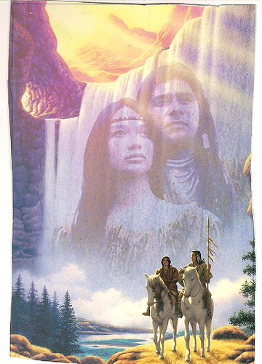
Pantheism Among Native Americans
17a
Pantheism (Greek pan, "all" + theism, "God") is the worldview of reincarnation in which God is an impersonal force; the universe is God and God is the universe.

Slide 9
Reincarnation in America
17a
1 in 5 Americans!
Believe in Reincarnation
Other Views
Gallup Poll 2005
Notes:
http://home.sandiego.edu/~baber/logic/gallup.html
In 1994 it was 27% and 2001 at 25%, so the belief is going down but still strong.

Slide 10


Out on a Limb
Shirley MacLaine's 1987 book influenced the USA towards reincarnation

Slide 11
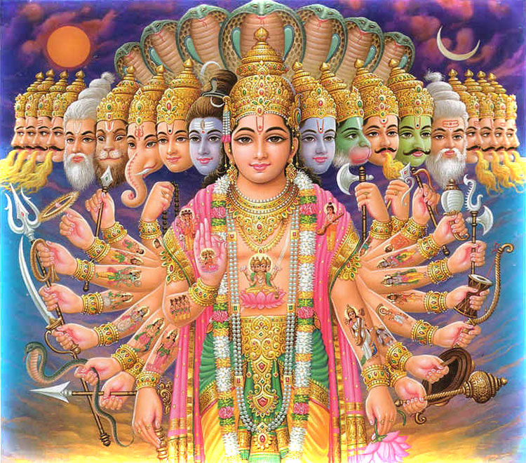
Five Arguments of Reincarnation Critiqued
Each may sound plausible, but the explanation is even more convincing

Slide 12
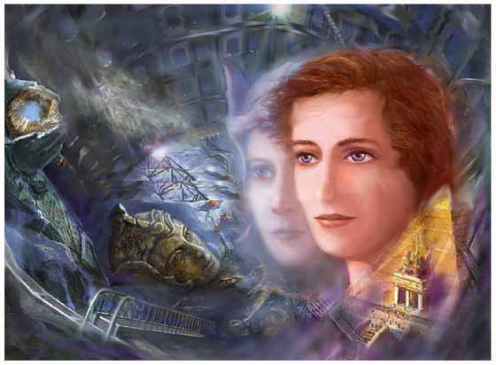
Hypnotic Regression
17a
When someone vividly and accurately describes people, places, and events he or she could not have previously known
RESPONSE?
Some lied or forgot the details… others were influenced by leading questions… more common in south and western Asia

Slide 13
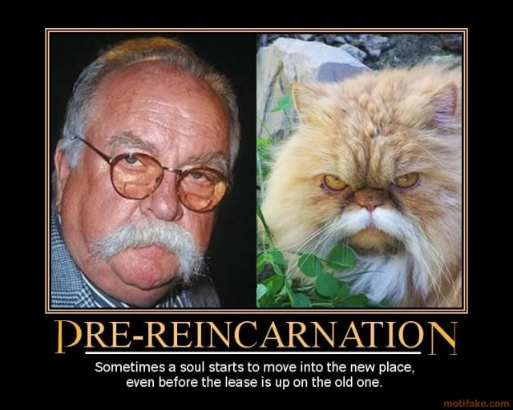
Title
Subtitle
Pre-Reincarnation
Sometimes a soul starts to move into the new place, even before the lease is up on the old one.

Slide 14
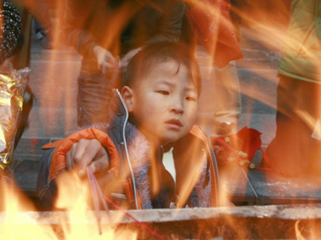
Déjà vu is a feeling that one has done a present action before (e.g., been at a certain place)
17a
RESPONSE?
Researchers say the brain is simply fusing a similar past experience in this life with the current one

Slide 15

Xenoglossy
17a
a sudden ability to speak a language one has never learned
Notes:
http://www.psychics.co.uk/blog/have-you-spoken-foreign-languages-in-dreams/

Slide 16
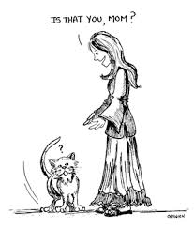
Cryptoamnesia
Is that you, Mom?
RESPONSE?
17a
is more likely (when one recalls previously forgotten data such as languages heard as a child)

Slide 17
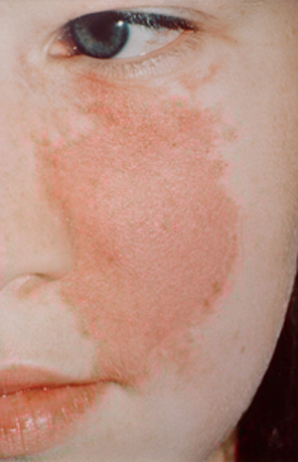

Birthmarks
17a
supposedly support reincarnation since some are similar to those on deceased individuals
But are they identical? Similarity does not prove reincarnation!

Slide 18
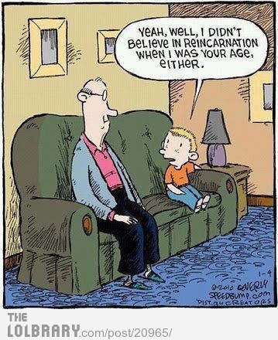
Other Supposed Evidence
Yeah, well, I didn’t believe in reincarnation when I was your age, either.
Child prodigies
Doctor Helen Wambach’s Demographic Studies
Notes:
http://www.toptenz.net/top-10-reasons-for-reincarnation.php

Slide 19

Other Supposed Evidence
Homosexuality and Transgender Tendencies
Notes:
http://www.toptenz.net/top-10-reasons-for-reincarnation.php

Slide 20

Other Supposed Evidence
Hobbies, Interests and Obsessions
HOBBIES
Some people just collect baseball cards.
Notes:
Some of us seem drawn to particular objects, places, or things from earliest childhood, frequently turning them into life-long hobbies and obsessions, but where do these interest come from? For example, why would a person be drawn to studying everything there is to know about the Civil War—a conflict that occurred a century before they were even born—or why does a teenager develop a fascination with the country of France though they have never been there or have any obvious connections with the place? Could these be “echoes” from a previous incarnation? Is a Civil War buff simply pursuing a new interest or is he in some ways still clinging to a past incarnation in which he was a participant in that war? Is the teenager simply attracted to France because she admires its language, customs and history, or could there be more to it? Even if we have no conscious memory of that past persona, might not our present hobbies be a reflection of that individual’s experiences and interests? While reincarnation is only one possible answer, it must at least be considered, especially in those cases where one develops a hobby or interest that seems quite out of the ordinary (such as a boy growing up in land-locked Iowa developing a fascination for eighteenth century schooners). It’s not known how much of our past we might retain into our present, albeit in the most subtle and subconscious ways, but it’s entirely possible that our past may be far more tied into our present (and, by extension, our future) than we can begin to imagine.
Read more: http://www.toptenz.net/top-10-reasons-for-reincarnation.php#ixzz2TdMbTywK

Slide 21
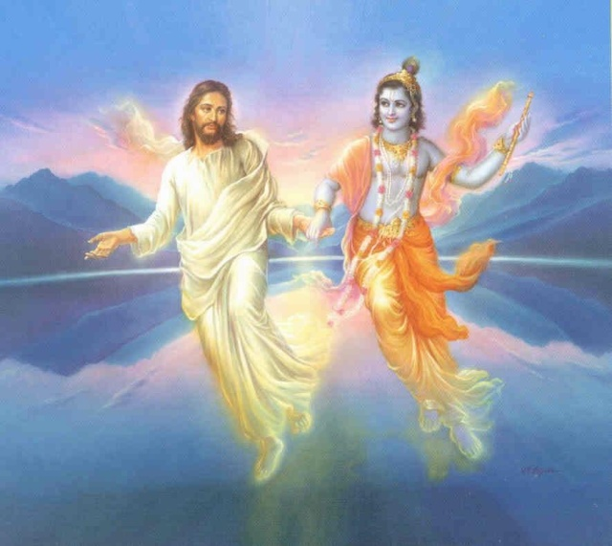
The Bible and Reincarnation
17b
Can we marry the two?

Slide 22
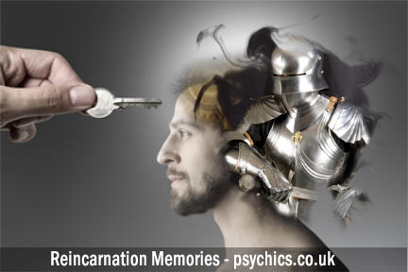
A Biblical Response
17b

Slide 23
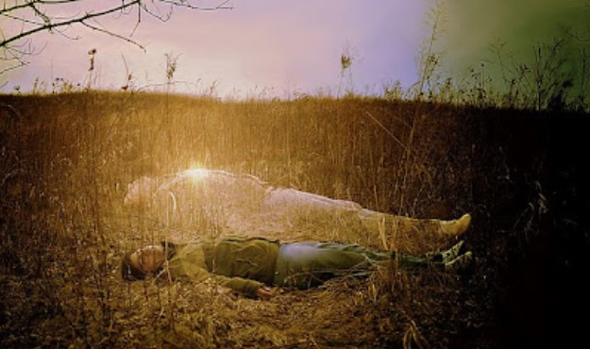
Demonic Possession
17b
Subtitle

Slide 24
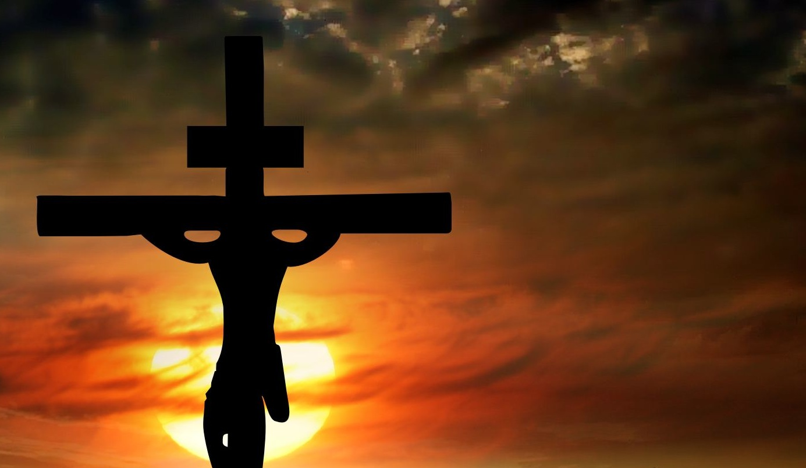
We live once, die once, and then enter our eternal state
17b
But now [Christ] has appeared once for all at the end of the ages to do away with sin by the sacrifice of himself. ²⁷Just as man is destined to die once, and after that to face judgment, ²⁸so Christ was sacrificed once…
(Heb. 9:26b-28a)

Slide 25
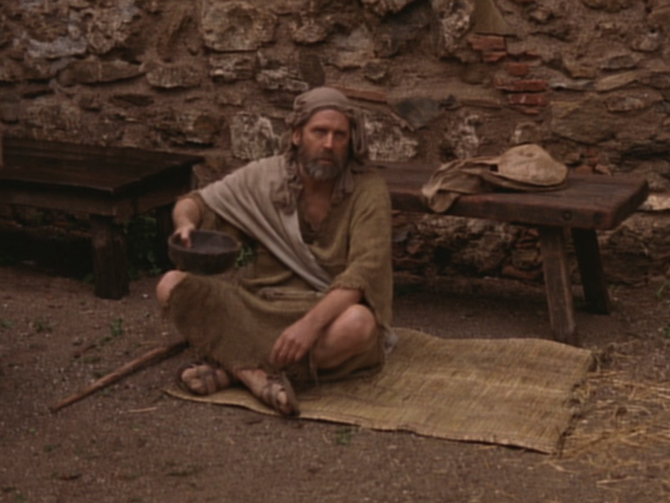
Jesus’ healing a blind man proved he gives spiritual sight too (John 9:1-7).

Slide 26
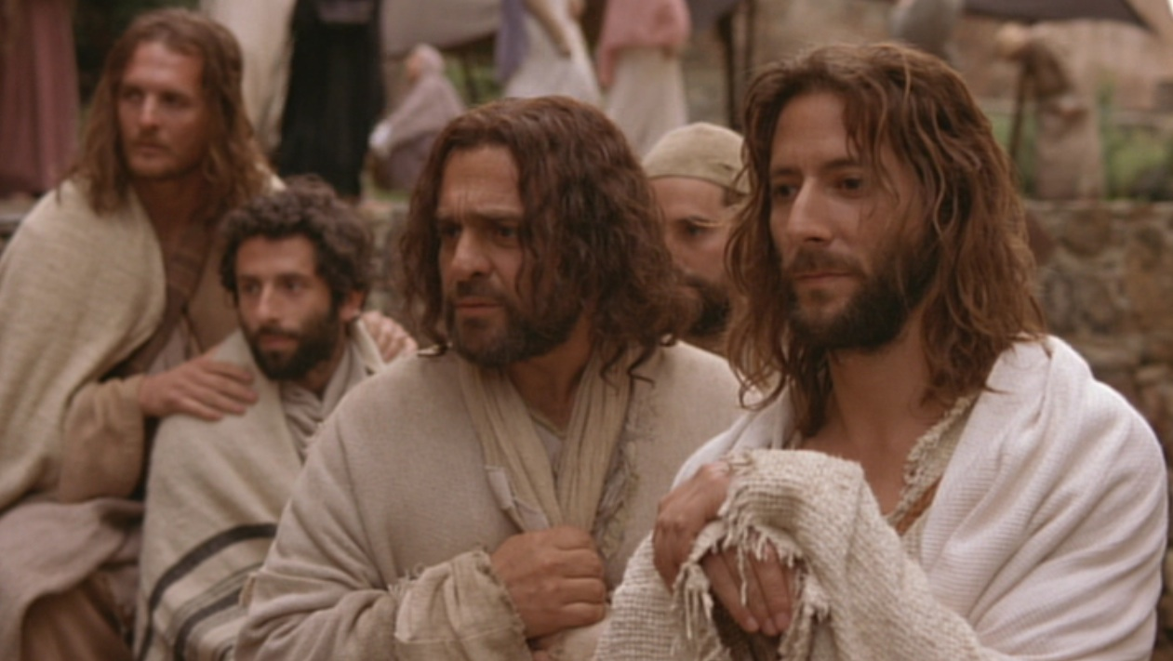
Why this blindness?

Slide 27
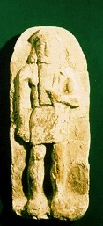
Exodus 20:4-5
Sin
“You must not make for yourself an idol.... ⁵ You must not bow down to them or worship them, for ... I lay the sins of the parents upon their children; the entire family is affected—even children in the third and fourth generations of those who reject me.’”
Suffering

Slide 28
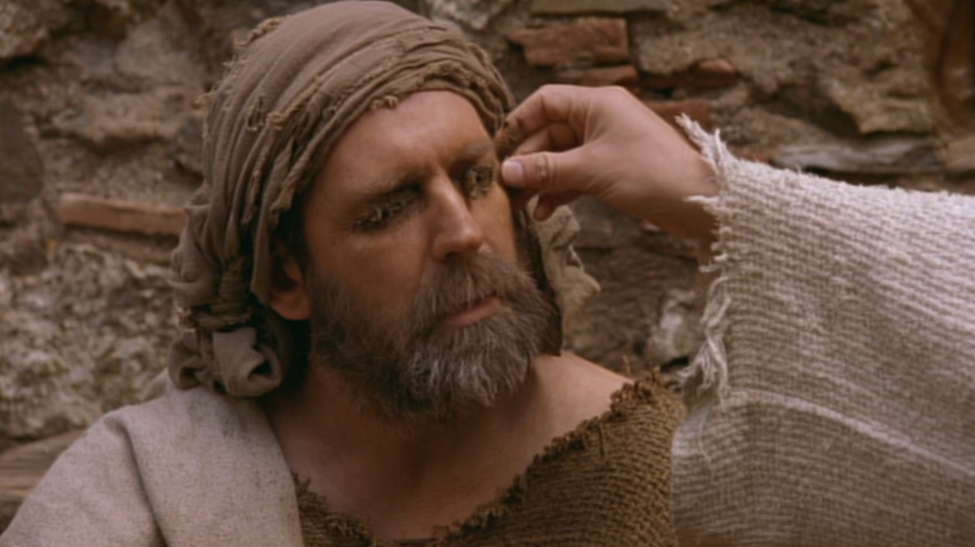
Jesus proved He was the way for eternal life by miraculously healing the man (John 9:6-7).

Slide 29
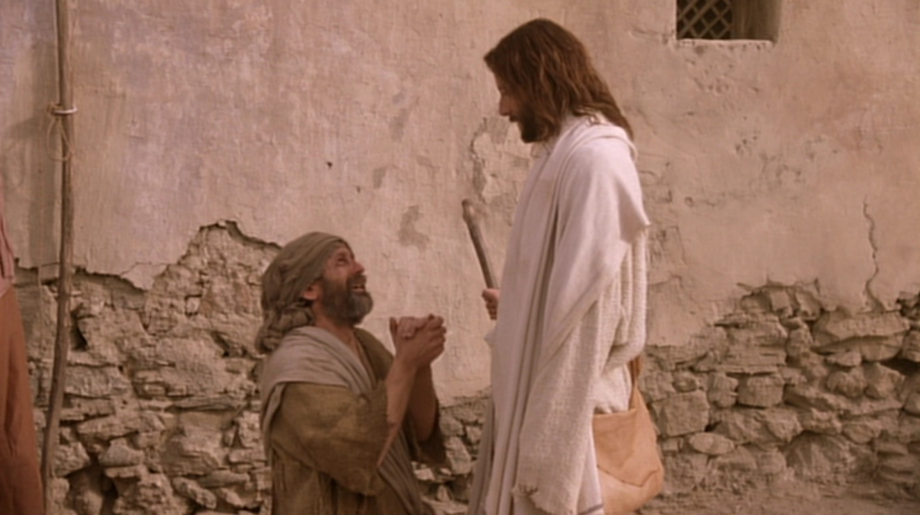
The former blind man confesses Jesus as God (35-38).

Slide 30
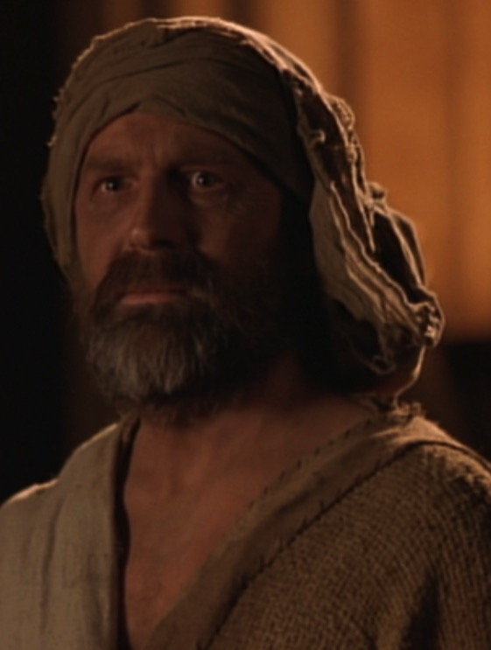
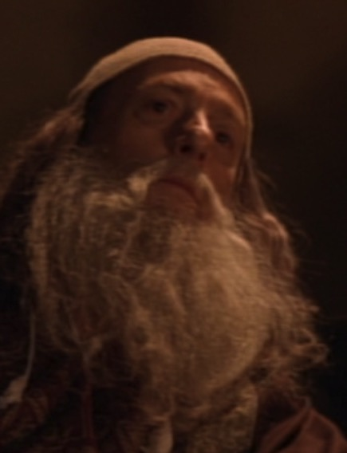
???????
Who's the real blind man?

Slide 31
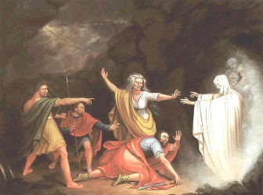
Examples of People After Their Death
Saul saw Samuel (1 Sam. 28)

Slide 32

Resurrection into One Body
17b
The Bible never mentions reincarnation into many bodies

Slide 33
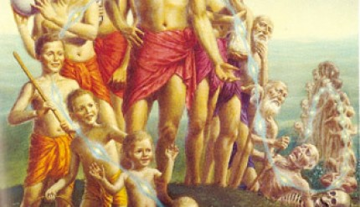
A Philosophical Response
17b
Reincarnation encourages murder
Reincarnation claims all comes from choice
Reincarnation requires every experience
Reincarnation is fatalistic
Reincarnation discourages care for others
Reincarnationists cannot live consistently
Reincarnation makes us immoral
Reincarnation blames God for all evil
Reincarnation believes that evil is eternal

Slide 34
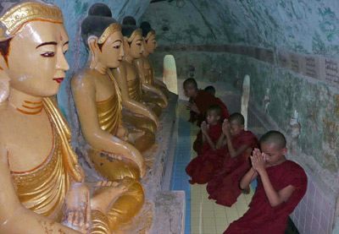
Conclusion
Reincarnation provides no real hope for conquering evil in our world or us. It is a philosophy that even reincarnationists do not believe. They intuitively know that right and wrong exist, so they do not live consistent with the teaching that everything is legitimate. Instead of helping defeat evil in the world, reincarnation provides justification for more of it.

Slide 36
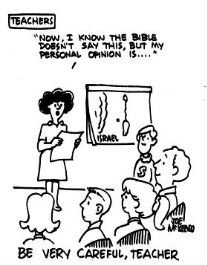

The Spirits in Prison
(1 Peter 3:18-20)
TEACHERS
15
"Now I know that the Bible doesn't say this, but my personal opinion is…"
ISRAEL
BE VERY CAREFUL, TEACHER

Slide 37
1 Peter 3:18-20
15
1 Peter 3:18-20 (NASB)
¹⁸ For Christ also died for sins once for all, the just for the unjust, so that He might bring us to God, having been put to death in the flesh, but made alive in the spirit;
¹⁹ in which also He went and made proclamation to the spirits now in prison,
²⁰ who once were disobedient, when the patience of God kept waiting in the days of Noah, during the construction of the ark, in which a few, that is, eight persons, were brought safely through the water.
"A wonderful text is this, and a more obscure passage perhaps than any other in the New Testament, so that I do not know for a certainty just what Peter means."
Martin Luther

Slide 38
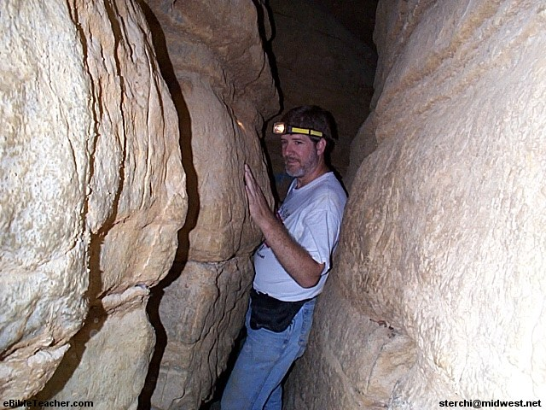
Whatever your view…
15
1 Peter 3:18-20
… you're between a rock and a hard place!

Slide 39
Three Major Interpretations
15
Jesus #3
Spirits of those who perished in flood in Noah's time
Christ in Noah #1
Those who had lived during Noah's time
Jesus #7
Fallen angels of Genesis 6
Between death and resurrection
In Noah's day
After resurrection
To proclaim gospel to the dead and offering a second chance to repent.
To proclaim release to righteous dead awaiting his coming.
To announce judgment on wicked dead
To preach repentance to the righteous and to proclaim judgment on the wicked.
To proclaim his victory and their doom

Slide 40
No Second Chance
15b
1 Peter 3:18-20 (NASB)
¹⁹ in which also He went and made proclamation to the spirits now in prison,
²⁰ who once were disobedient, when the patience of God kept waiting in the days of Noah, during the construction of the ark,
NASB: ¹⁸ For Christ also died for sins once for all, the just for the unjust, so that He might bring us to God, having been put to death in the flesh, but made alive in the spirit;
1. The text nowhere states that any second chance to believe is provided for the recipients of the message.
2. Hebrews 9:27 notes that judgment (not opportunity to believe) follows the death of each person. It says, "man is destined to die once, and after that to face judgment."

Slide 41
Imprisoned Demons
1 Peter 3:19-22 (NASB)
¹⁹in which also He went and made proclamation to the spirits now in prison, ²⁰who once were disobedient, when the patience of God kept waiting in the days of Noah, during the construction of the ark,
²¹Corresponding to that, baptism now saves you—not the removal of dirt from the flesh, but an appeal to God for a good conscience—through the resurrection of Jesus Christ, ²²who has gone into heaven and is at the right hand of God, with angels, authorities, and powers having been subjected to him.
Peter is describing Christ's triumph over death, His resurrection and ascension.
He writes about Christ preaching to spirits in prison.
The main idea of the text is Christ's suffering resulted in victory over death and salvation for us. Verses 19-20 are central to this whole idea of righteous suffering.

Slide 42
Christ's Body v. Spirit
15
having been put to death in the flesh, but made alive in the spirit; in which also He went and made proclamation to the spirits now in prison,
The body died but the spirit continued to live?
The body died and was resurrected?
1 Corinthians 15:44-45 ⁴⁴ it is sown a natural body, it is raised a spiritual body. If there is a natural body, there is also a spiritual body. ⁴⁵ So also it is written, "The first MAN, Adam, BECAME A LIVING SOUL." The last Adam became a life-giving spirit.
Therefore, it is most likely that Christ died, was resurrected and then preached his victory over death to these demons imprisoned since Noah's day.

Slide 43
Three Major Interpretations
15
Jesus #3
Spirit of those who perished in flood in Noah's time
Spirit of Jesus #1
Those who had lived during Noah's time
Jesus #7
Fallen angels of Genesis 6
Between death and resurrection
In Noah's days
After resurrection
To proclaim gospel to the dead and offering a second chance to repent.
To proclaim release to righteous dead awaiting his return.
To announce judgment to wicked dead
To preach repentance to the righteous and to proclaim judgment to the wicked.
To proclaim his victory and their doom
Literal interpretation
Spiritualizing

Slide 44
Two ways texts are interpreted
Literal Interpretation
Spiritualizing
2 Peter 2:5
Angels after sinning were cast into pits of darkness, reserved for judgment.
In Noah's days, only humans could escape judgment, not fallen angels. There is no reason for God to wait patiently for angels.
Jude 1:6
Some angels are in eternal bonds in darkness for the judgment of the great day
In 1 Enoch the disobedient angels sinned not in Noah's day but in the days of Jared.
1 Peter 1:10-11
Prophets discern with the Spirit of Christ within them.
2 Peter 2:5 shows Noah is a preacher of righteousness
1 Enoch 21:1-2
This place is the prison of the angels, and they will be imprisoned here forever.
Jesus, after resurrection, went to proclaim judgment on the angelic spirits held in prison.
Peter uses the ark to mean certain death for those who did not believe. Noah as a type shows the salvation that is now in Christ.

Slide 45
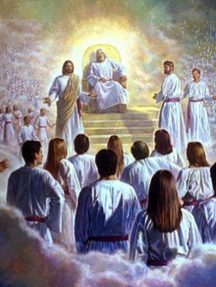
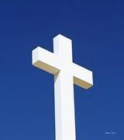
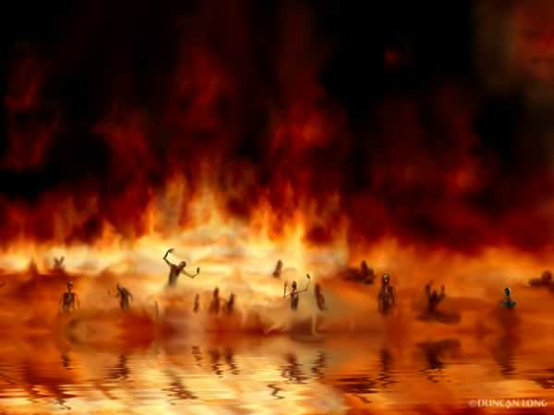
The Transfer of Paradise
"That is why the Scriptures say, 'When he ascended to the heights, he led a crowd of captives and gave gifts to his people.'
⁹Notice that it says 'he ascended.' This clearly means that Christ also descended to our lowly world. ¹⁰And the same one who descended is the one who ascended higher than all the heavens, so that he might fill the entire universe with himself."
14 & 16
NLT
HEAVEN
Eph. 4:8-10
"…today you will be with me in paradise."
"I was caught up to the third heaven…I was caught up to paradise"
Luke 23:43
2 Cor. 12:2-4
S
H
E
O
L
"Christ suffered for our sins once for all time. He never sinned, but he died for sinners to bring you safely home to God. He suffered physical death, but he was raised to life in the Spirit.
¹⁹So he went and preached to the spirits in prison— ²⁰those who disobeyed God long ago when God waited patiently while Noah was building his boat. Only eight people were saved from drowning in that terrible flood."
Paradise
HADES
1 Pet. 3:18-20
HADES
Rev. 20:14-15
Luke 16:26
Hell
Gehenna
Lake of Fire
Lake of Burning Sulfur
Second Death
"…there is a great chasm separating us. No one can cross over to you from here, and no one can cross over to us from there."
"Then death and [Hades] were thrown into the lake of fire... ¹⁵And anyone whose name was not found recorded in the Book of Life was thrown into the lake of fire."
Notes:
OB-38-Salvation-38
NS-08-2Cor-255
FU-03-Reincarnation&SpiritsInPrison-45

Slide 46


Future (Eschatology) at BibleStudyDownloads.org
Get this presentation for free!
Notes:
Future (fu)
Eschatology

