Slide 1

Eschatology
A Study of the End Times
Dr. Rick Griffith • Jordan Evangelical Theological Seminary • BibleStudyDownloads.org

Slide 2
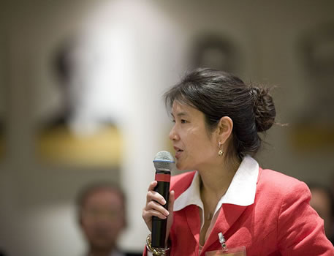
Introduce Yourself!
Name
Country
Programme
Family
Church
Ministry Goal
$20 each for Notes

Slide 3

PRECEPT LADIES BIBLE STUDY ON
HEBREWS
USA • Singapore • New Zealand • Holland

Slide 4

Thailand • Mongolia • Myanmar • Indonesia
Susan teaches SBC student wives also
Notes:
INTERVIEWER: And Susan, what ministries has the Lord granted you?
SUSAN: I have been teaching the wives of leaders at SBC. These 5 women come from 5 different nations!
SUSAN: I also lead the woman's Bible study at our church

Slide 5

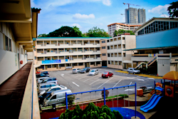
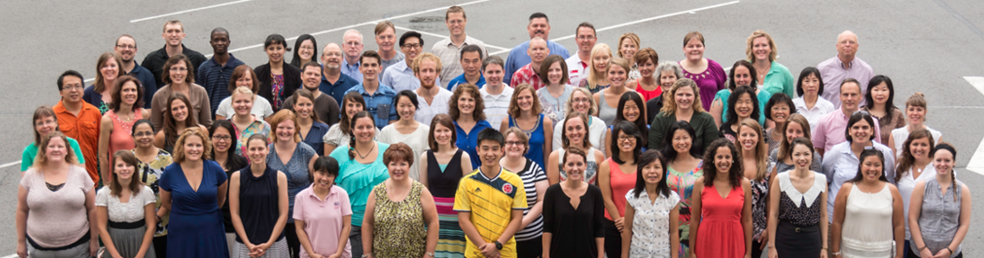
International Community School
(est. 1993)

Slide 6




ICS now has 480 students!
UK
SWEDEN
KOREA
SWITZERLAND
JAPAN
ITALY
USA
THAILAND
INDIA
MEXICO
ICS
VENUZELA
INDONESIA
BRAZIL
SOUTH AFRICA
AUSTRALIAN

Slide 7
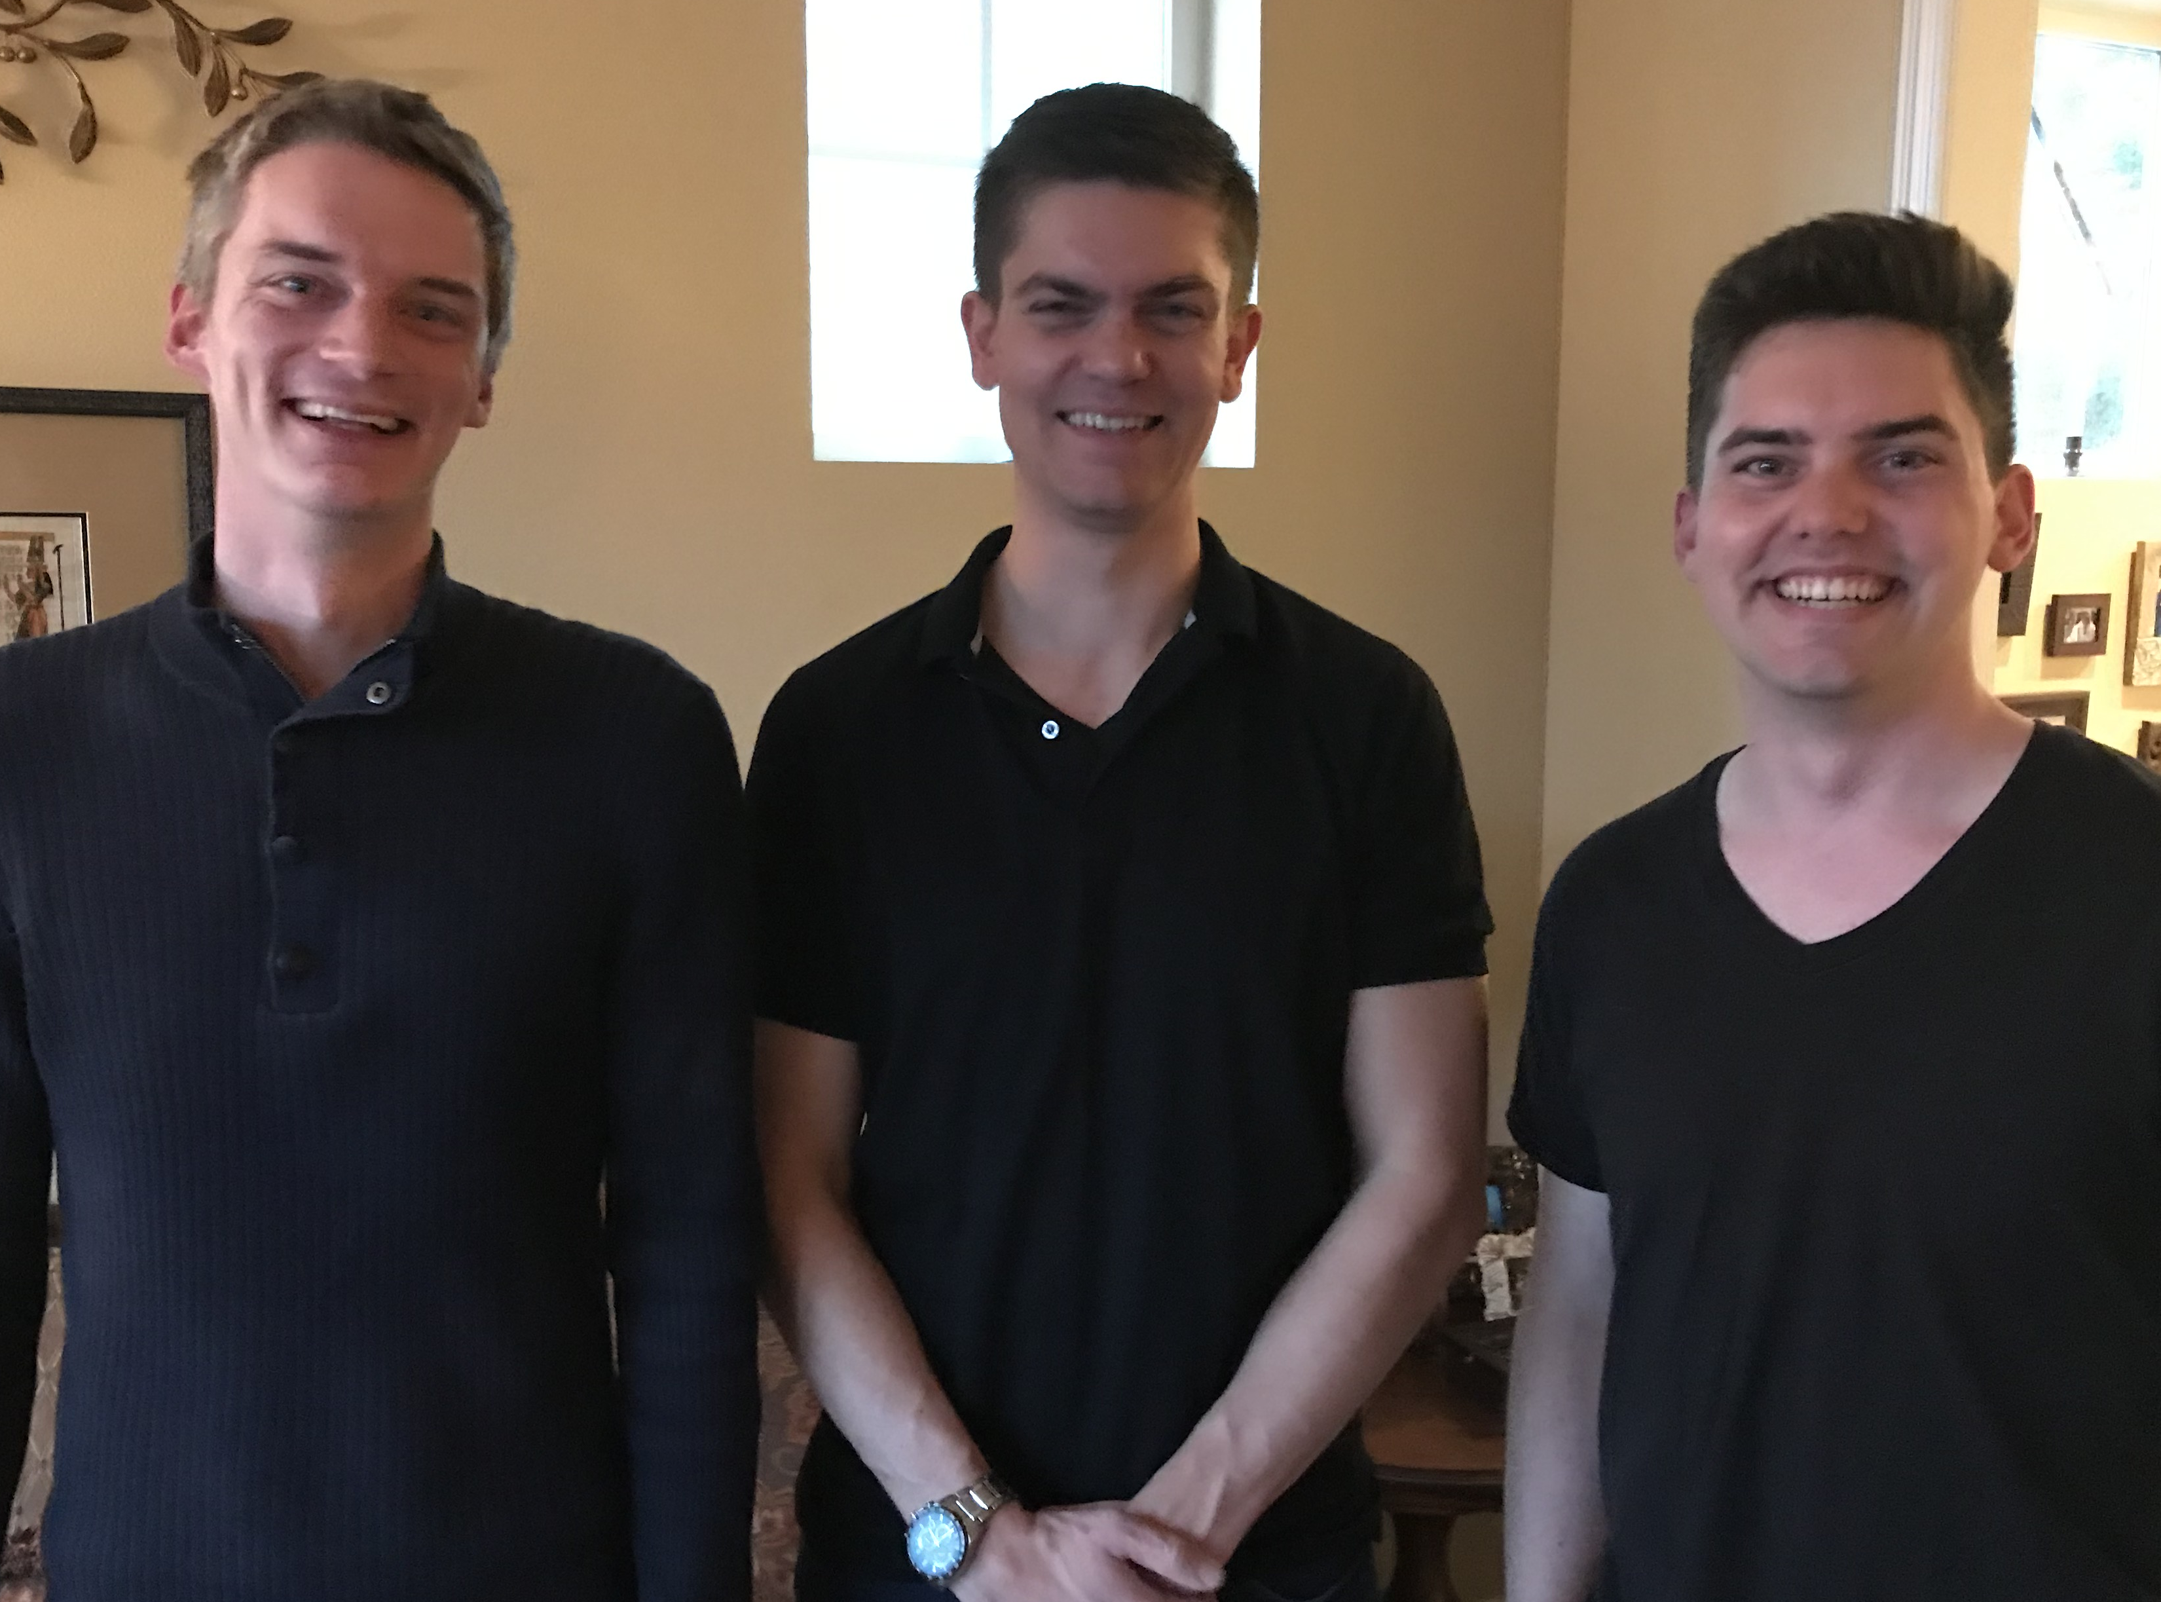
Our Three Sons

Slide 8
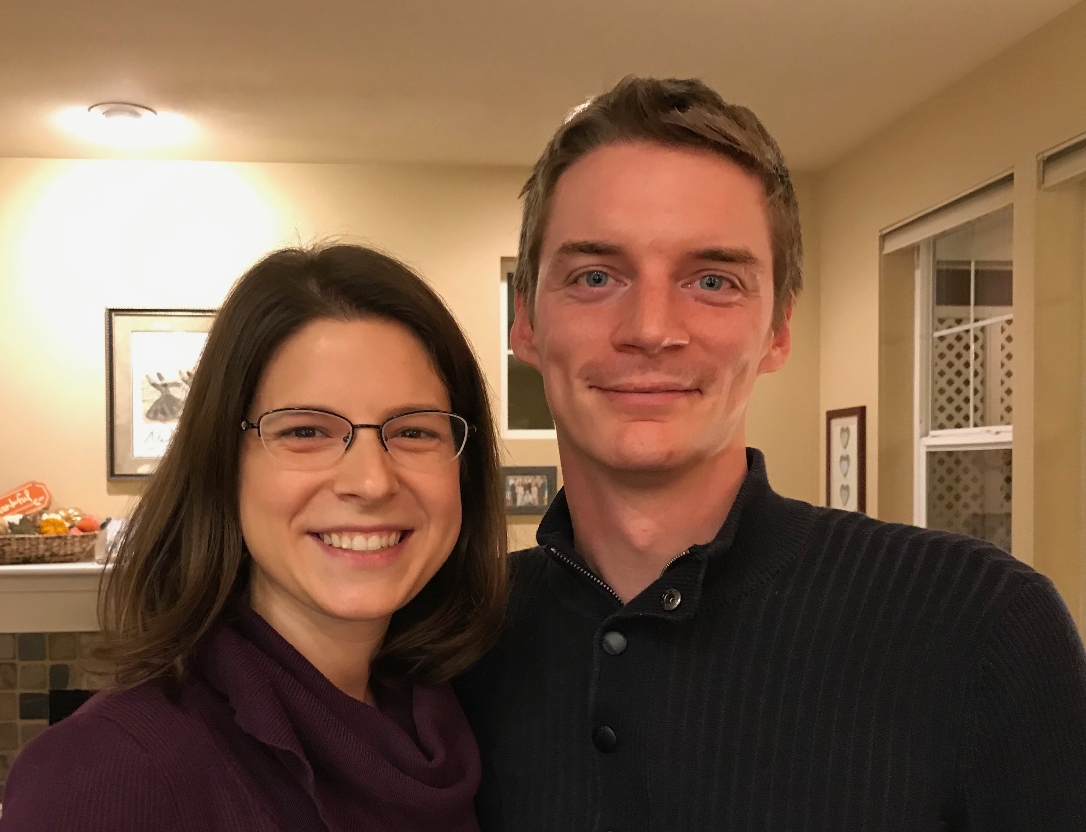
Kurt (33) works in IT and lives in Seattle
Notes:
Kurt and his wife Cara are in Seattle

Slide 9
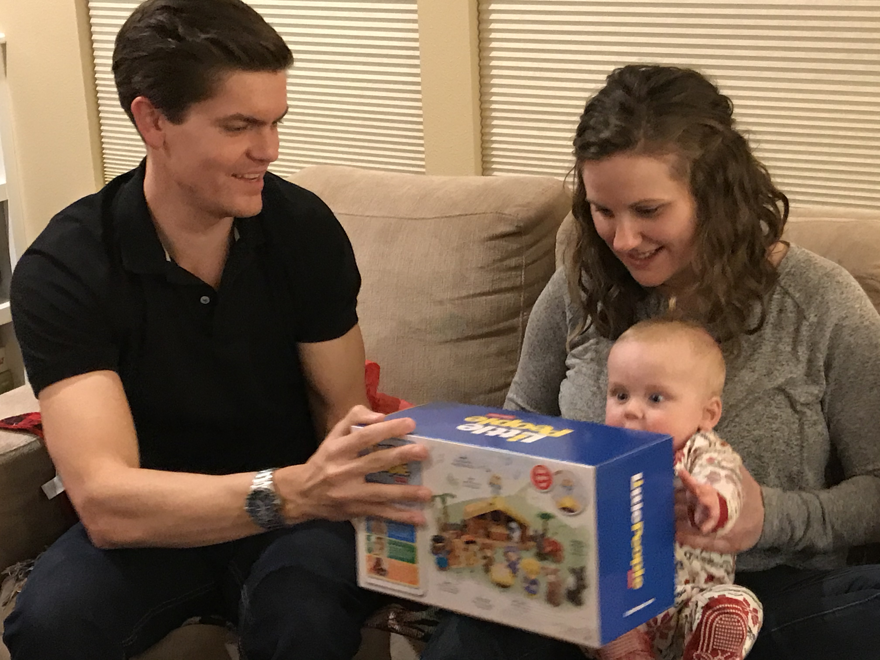
Stephen & Katie gave us Jesse— our first grandson in May 2019
6
Notes:
Stephen and his wife Katie in Boise

Slide 10
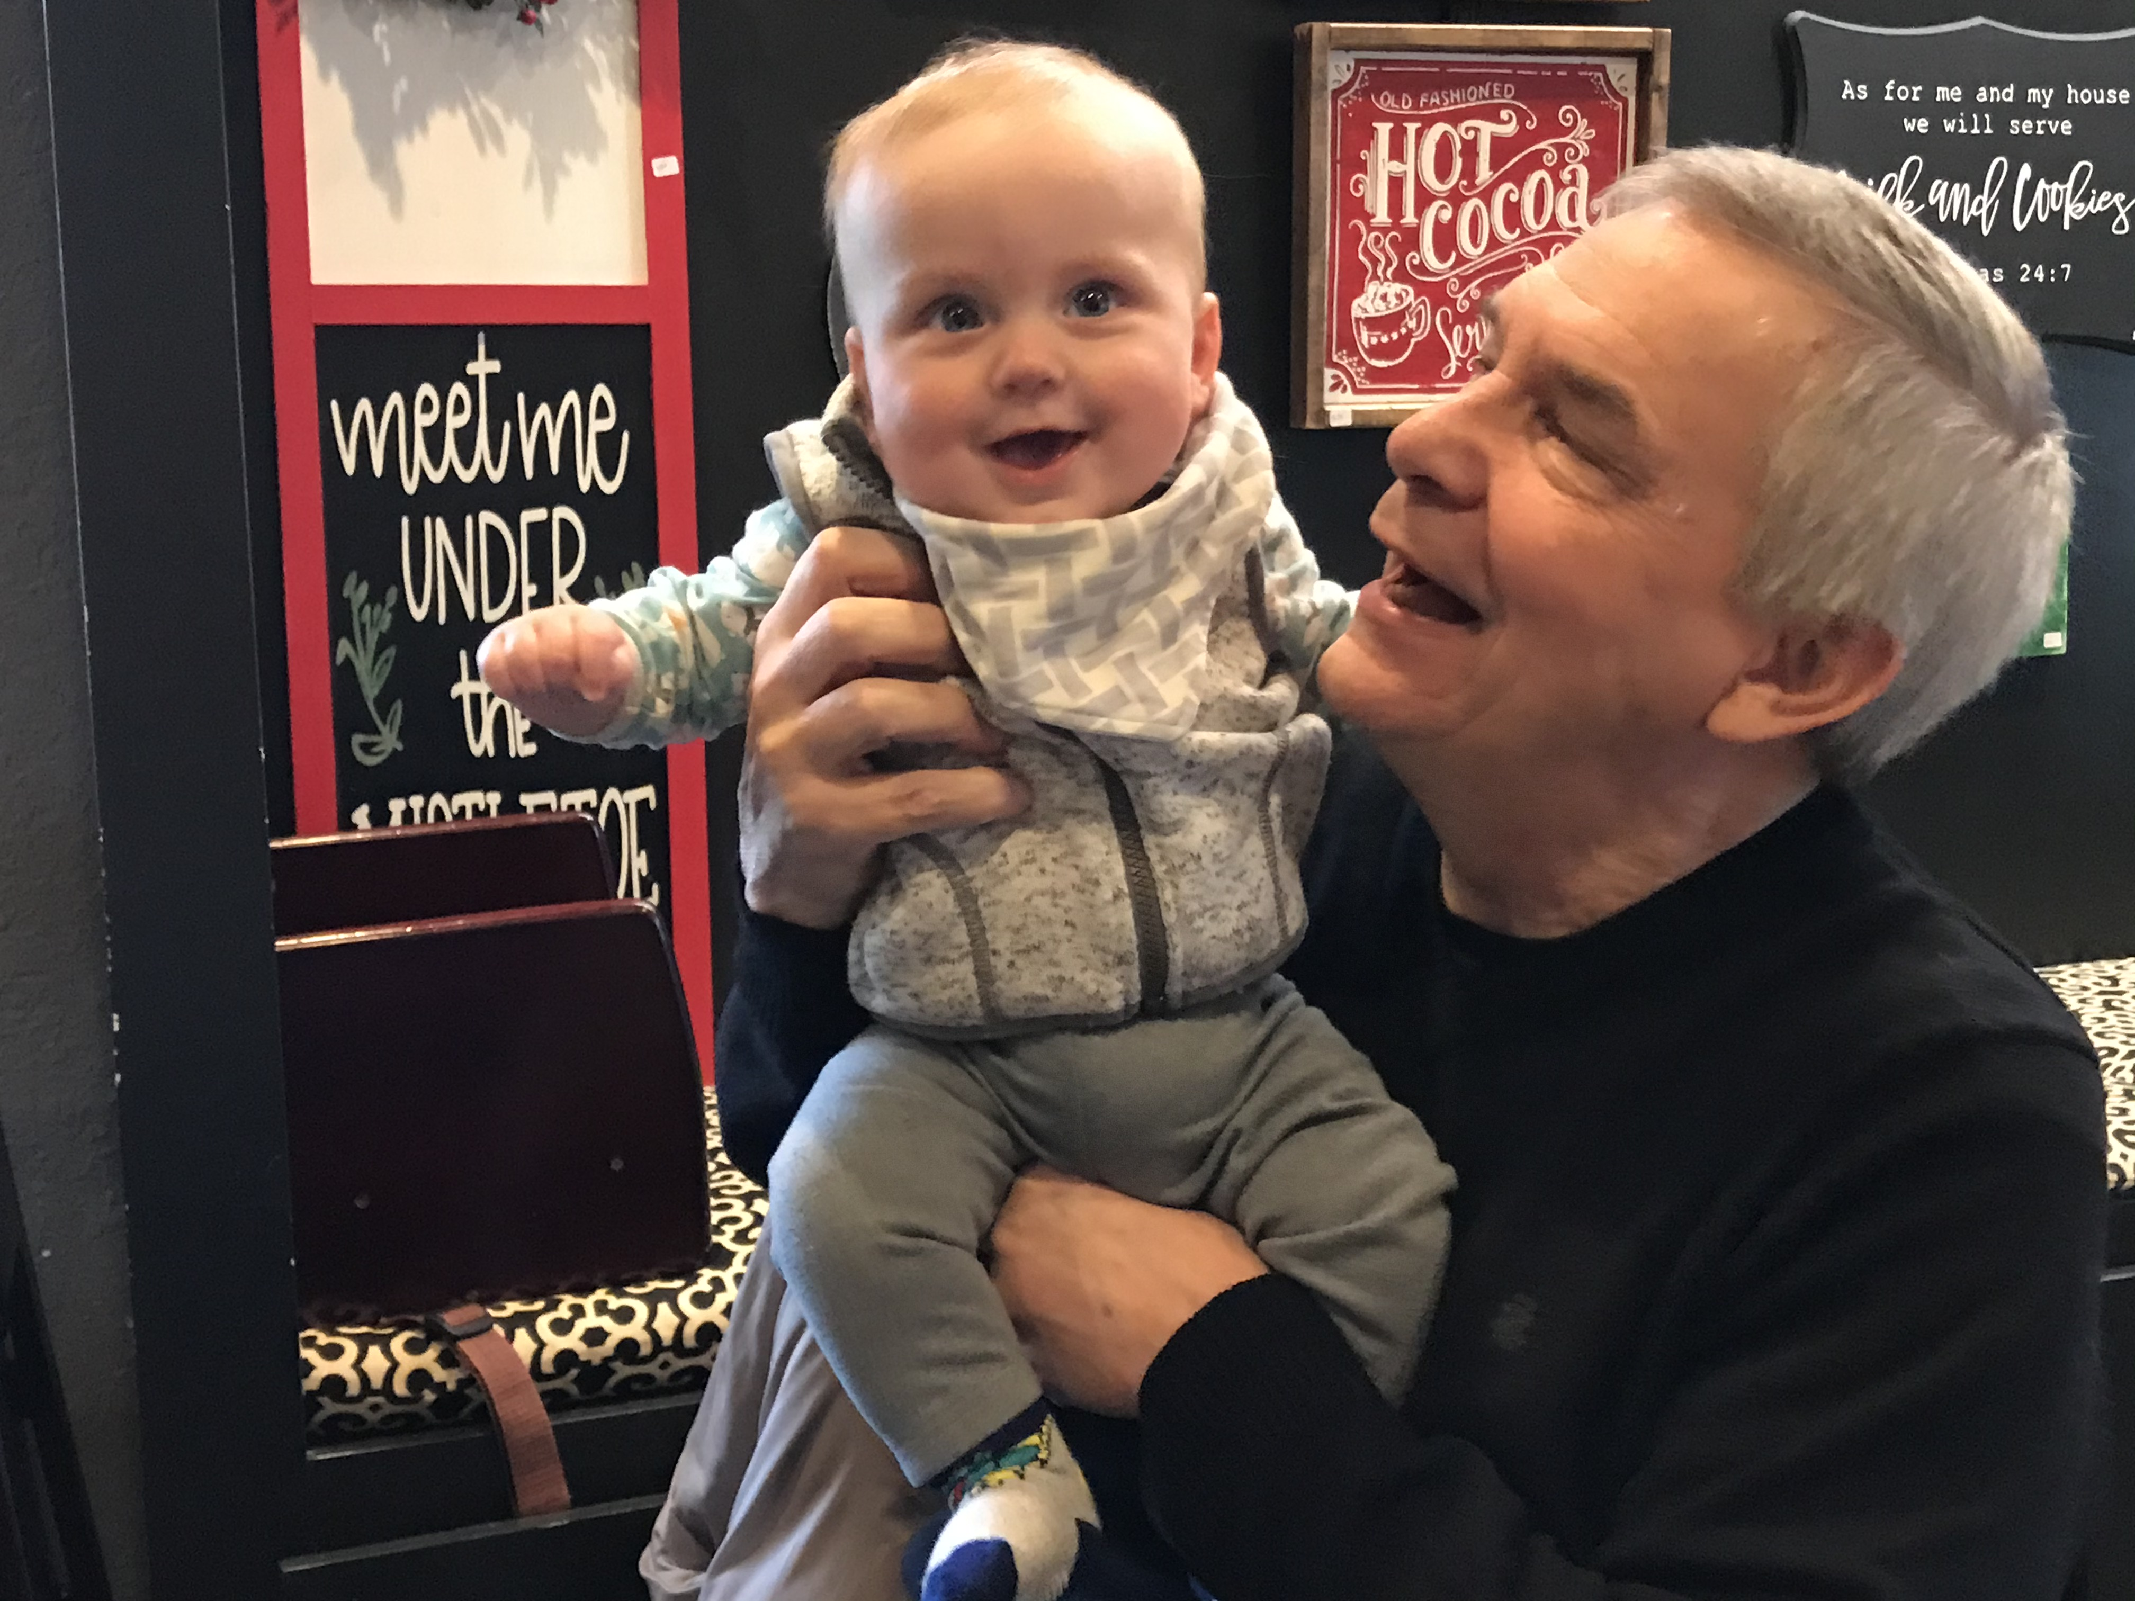
Grandson Jesse

Slide 11
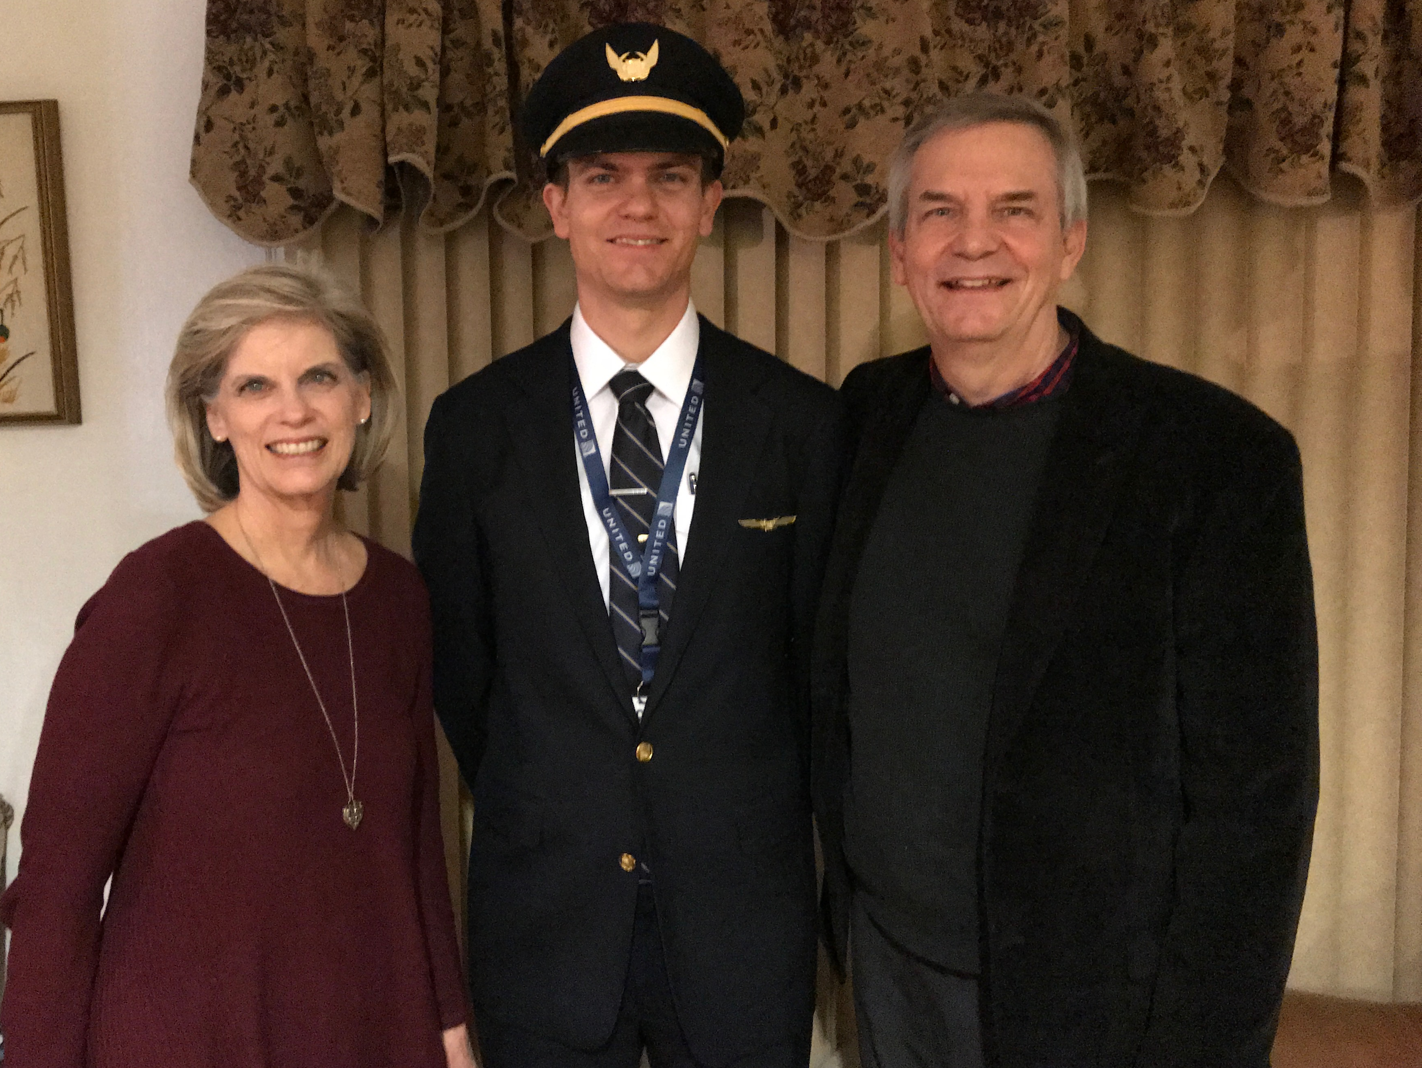

Stephen (30) is a United A320 pilot commuting from Seattle to fly from SFO
6
Notes:
Stephen and his wife Katie in Boise

Slide 12

John (27) is a graphic artist in Redlands, California
8
Notes:
John and his girlfriend Chloe both work for ESRI—Environmental Systems Research Institute—doing web design and graphics for this digital software company.

Slide 13
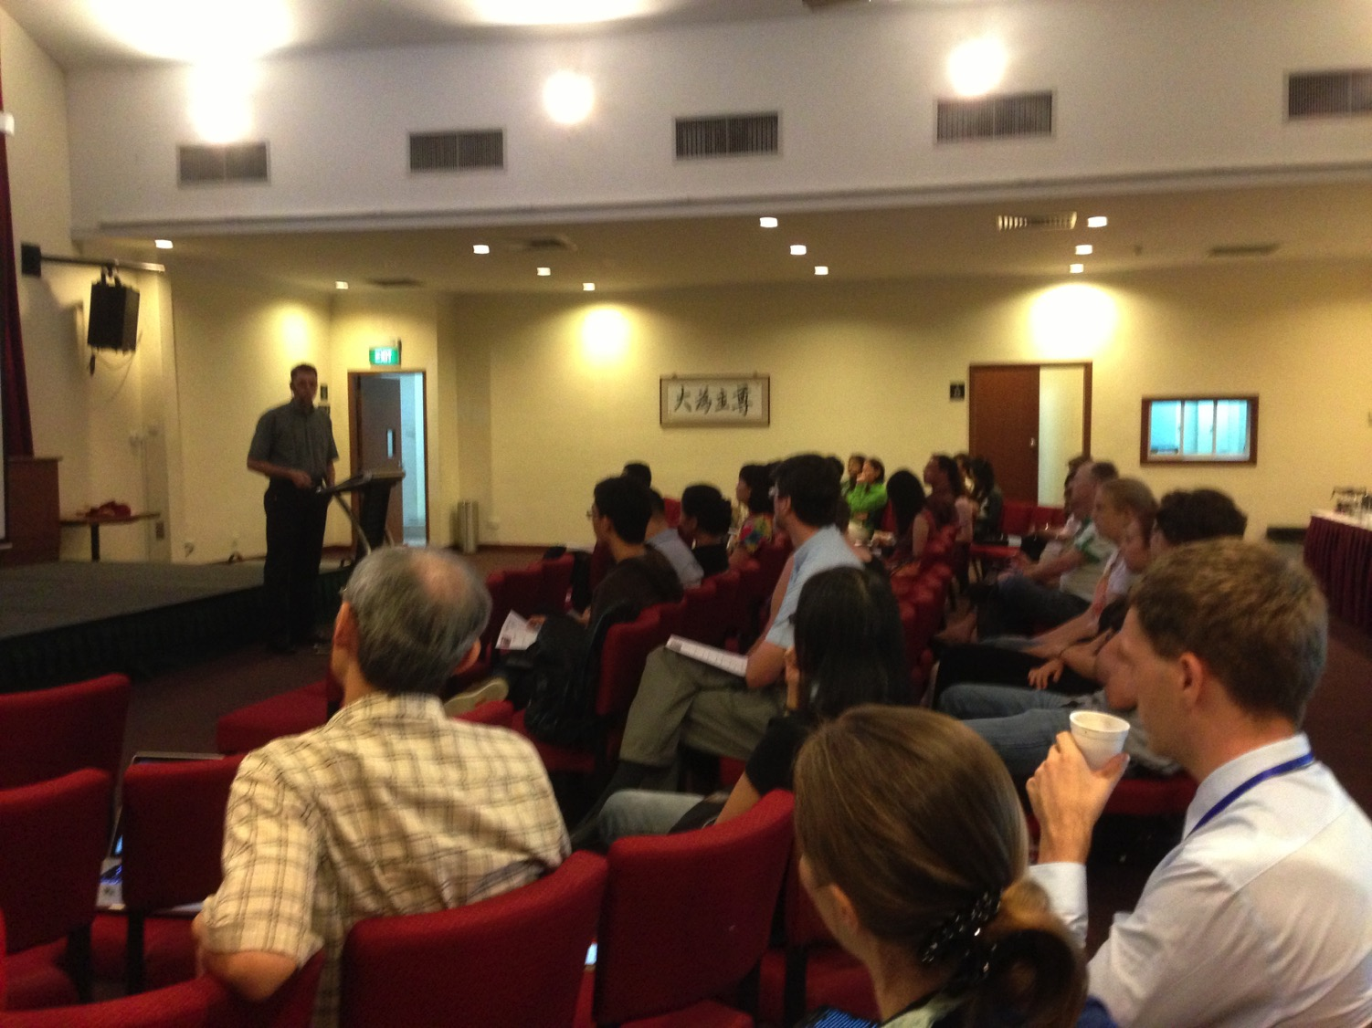

Our People
9
70 people from 13 nations
May 2020

Slide 14
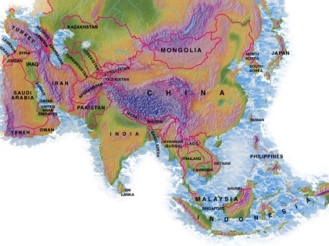

Crossroads People • May 2020
UK
CHINA
JAPAN
UNITED KINGDOM
RUSSIA
FRANCE
NETHERLANDS
MONGOLIA
ITALY
KOREA
HONG KONG
LEBANON
JAPAN
CHINA
TAIWAN
GERMANY
MYANMAR
CANADA
EGYPT
INDIA
USA
THAILAND
ETHIOPIA
MALAYSIA
ZIMBABWE
KENYA
PHILIPPINES
SINGAPORE
INDONESIA
SOUTH AFRICA
CIC
AUSTRALIA
NEW ZEALAND
Notes:
We actually have about 20% Indian at CIC, thanks to St. Thomas, who overcame his initial reluctance to witness for Jesus in India.
Our May 2020 church of 70 people stem from 11 different countries around the world: Australia (Gilli-Anne, David & Fiona), China (Jianji), Korea (Grace Kim), India (Cynthia), Indonesia (Rena, Andrie), Kenya (Judy), Myanmar (Peng), Netherlands (Toes), New Zealand (Ashleigh), Singapore (Albina), Thailand (Mae), UK (James & Gabi), USA (Miriam).
This does not include people who have recently attended only once:
Nor does it include missionaries living back in their countries but still are members of CIC: Maple (Taiwan), Budmaa (Mongolia)
Previous: Canada (Gloria Lee), Ethiopia (Lele), Malaysia (Aston, Naomi), Netherlands (Dies & Desiree), Philippines (Micah), South Africa (Melody),

Slide 15

Our Mission Organization…

Slide 16
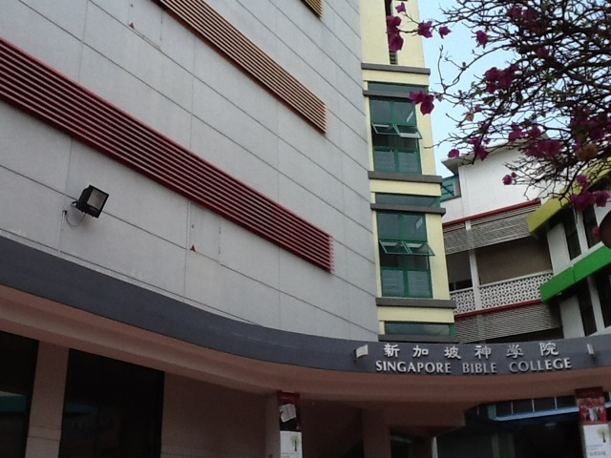
Singapore Bible College
Notes:
So the past 23 years God has allowed me to be a "Paul" to hundreds of "Timothys" at Singapore Bible College.

Slide 17

Singapore Bible College Students
USA
MONGOLIA
JAPAN
KOREA
CHINA
HONG KONG
MYANMAR
INDIA
THAILAND
VIETNAM
PHILIPPINES
MALAYSIA
SINGAPORE
SBC
INDONESIA
Notes:
These faithful leaders are from about 25 countries who come to us in Singapore for masters and doctoral-level training. We train them to build into others back in their home countries.

Slide 18
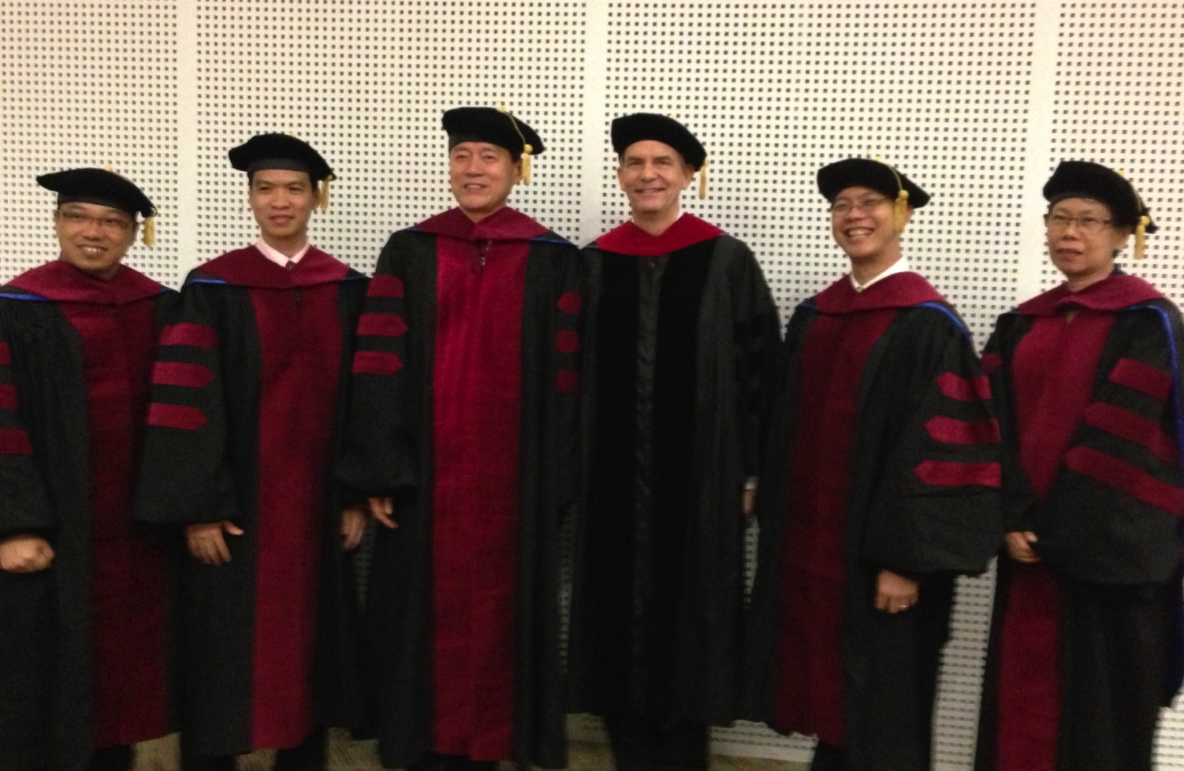
I direct the SBC Doctor of Ministry studies (DMin)
Notes:
I'm also the director of the doctoral program at SBC that trains about 80 seminary professors and pastors throughout Asia in English and Chinese. Generallly each year about 5 of them received their Doctor of Ministry degree.

Slide 19
SBC Courses I Teach
(English • Bahasa • Chinese)
Survey
OT NT
Backgrounds
WOT WNT
Theology
Church Spirit Future
Preaching
Homiletics 1 Homiletics 2
Notes:
I get to teach these leaders every book of the Bible in survey courses, plus backgrounds to both the OT and NT, three areas of theology, and how to preach.

Slide 20

"in the beginning"
Gen. 1:1
An Introduction to Genesis

Slide 21

"pada mulanya"
Gen. 1:1
Pengenalan kitab Kejadian

Slide 22
"起初"
Gen. 1:1
创世记导论

Slide 23

Days of Creation
33
Void
Formless
Forming
Filling
Day 4: Sun, moon & stars arranged
Day 1: Light
Day 2: Water & air separated
Day 5: Fish & fowl
Day 3: Land & sea separated
Day 6: Animals & man
Genesis 1:3-31

Slide 24
Days of Creation in Bahasa Indonesian
Hari-hari penciptaan
64
Kosong
Tidak berbentuk
Dibentuk
Diisi
Hari 4: Matahari, bulan & bintang diatur
Hari 1: Terang
Hari 2: Air &
udara dipisahkan
Hari 5: Ikan & unggas
Hari 3: Darat & laut dipisahkan
Hari 6: Binatang & manusia
Kejadian 1:3-31

Slide 25
六天的创造
空虚
64
充满
混沌
形成
第四天: 太阳，月亮与众星摆列在天
第一天: 光
第二天:
水与空气分开
第五天: 鱼与雀鸟
第三天:
旱地与海分开
第六天: 动物与人
创世记 1:3-31

Slide 26


NT Survey link at BibleStudyDownloads.org
Get this presentation for free!
Notes:
Student translation since 2003 with 700 translators has resulted in Bible teaching and study materials—mostly PowerPoint—in 49 languages! All a teacher needs to do is to click on a file and it downloads for free to teach any book of the Bible and many other subjects.
NT Survey (ns)

Slide 27
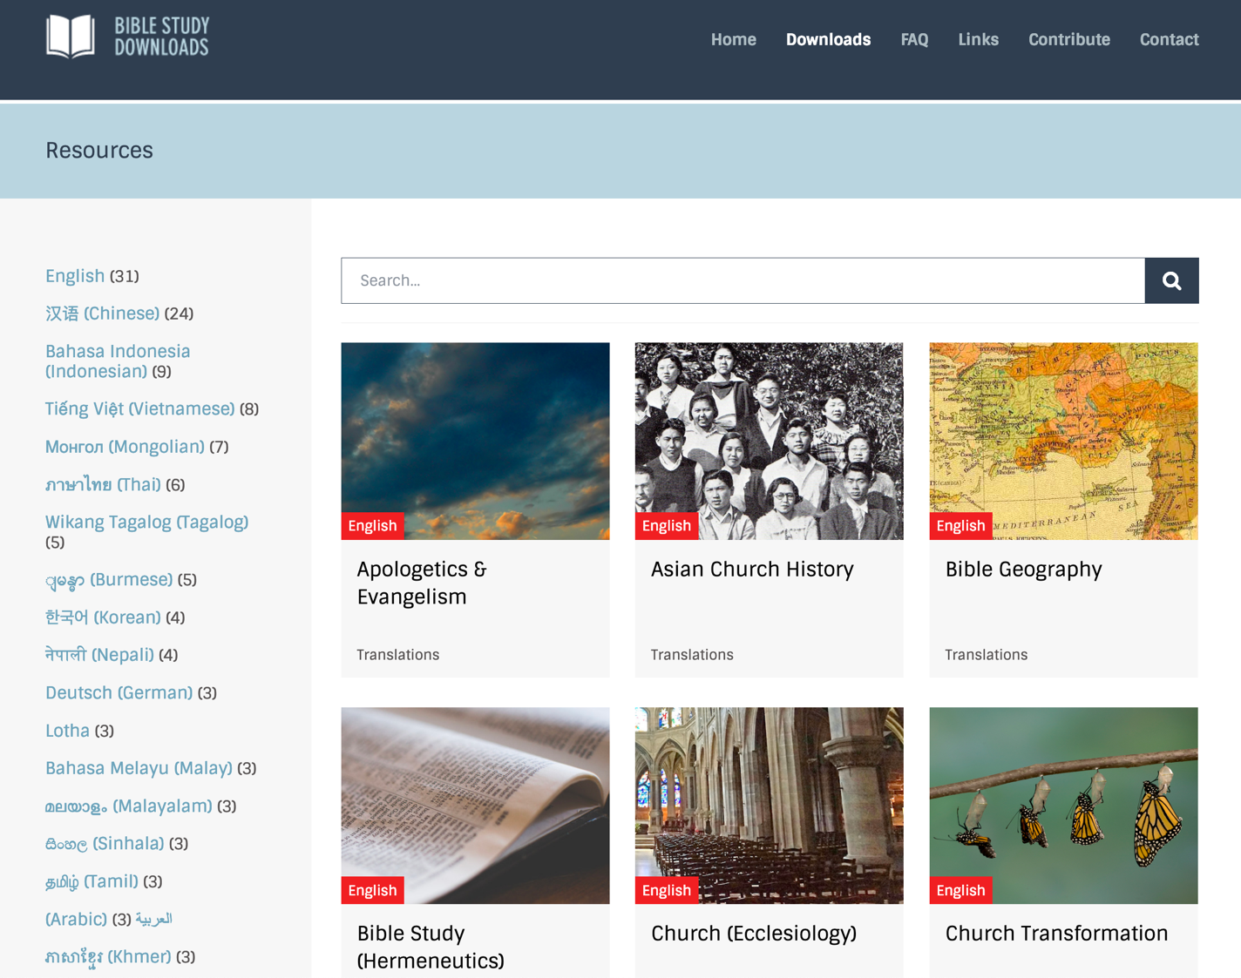
BibleStudyDownloads.org
7
Notes:
My SBC teaching has resulted in Bible teaching and study materials—mostly PowerPoint—in 49 languages! All a teacher needs to do is to click on a file and it downloads for free to teach any book of the Bible and many other subjects.

Slide 28
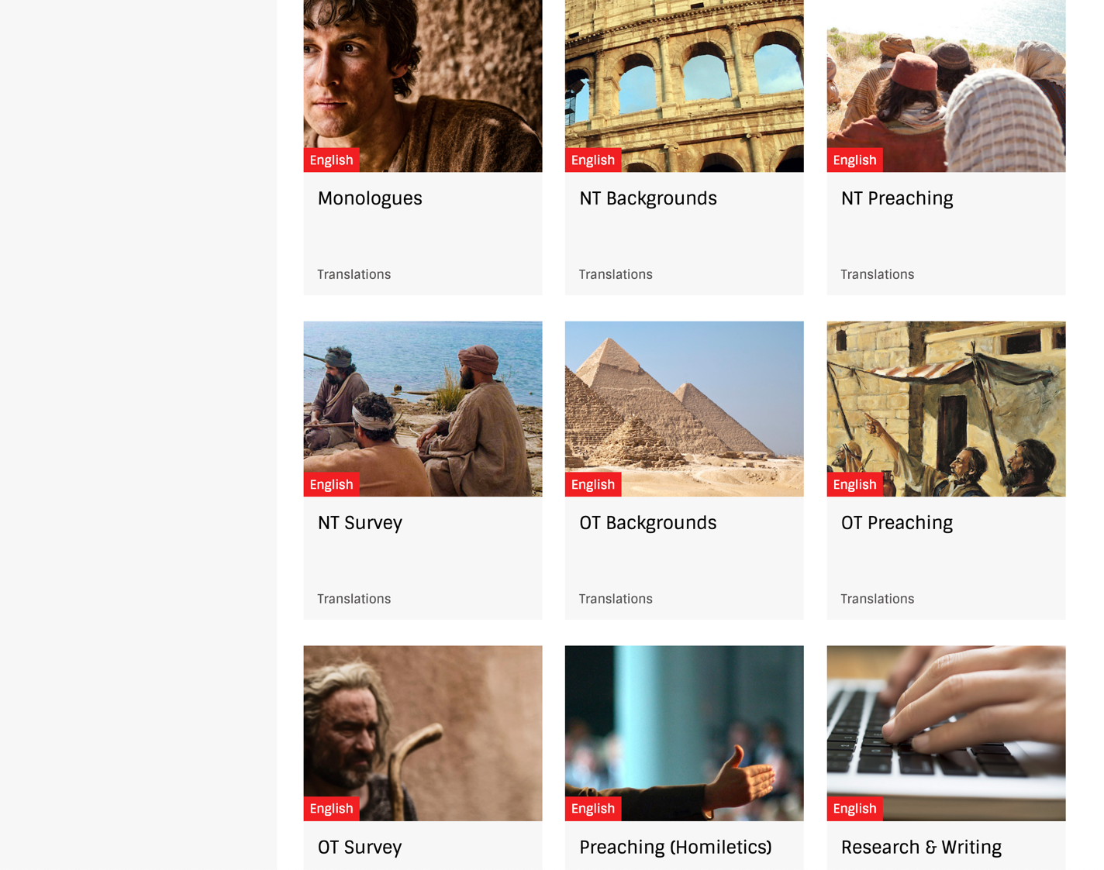
BibleStudyDownloads.org
7
Notes:
My SBC teaching has resulted in Bible teaching and study materials—mostly PowerPoint—in 49 languages! All a teacher needs to do is to click on a file and it downloads for free to teach any book of the Bible and many other subjects.

Slide 29
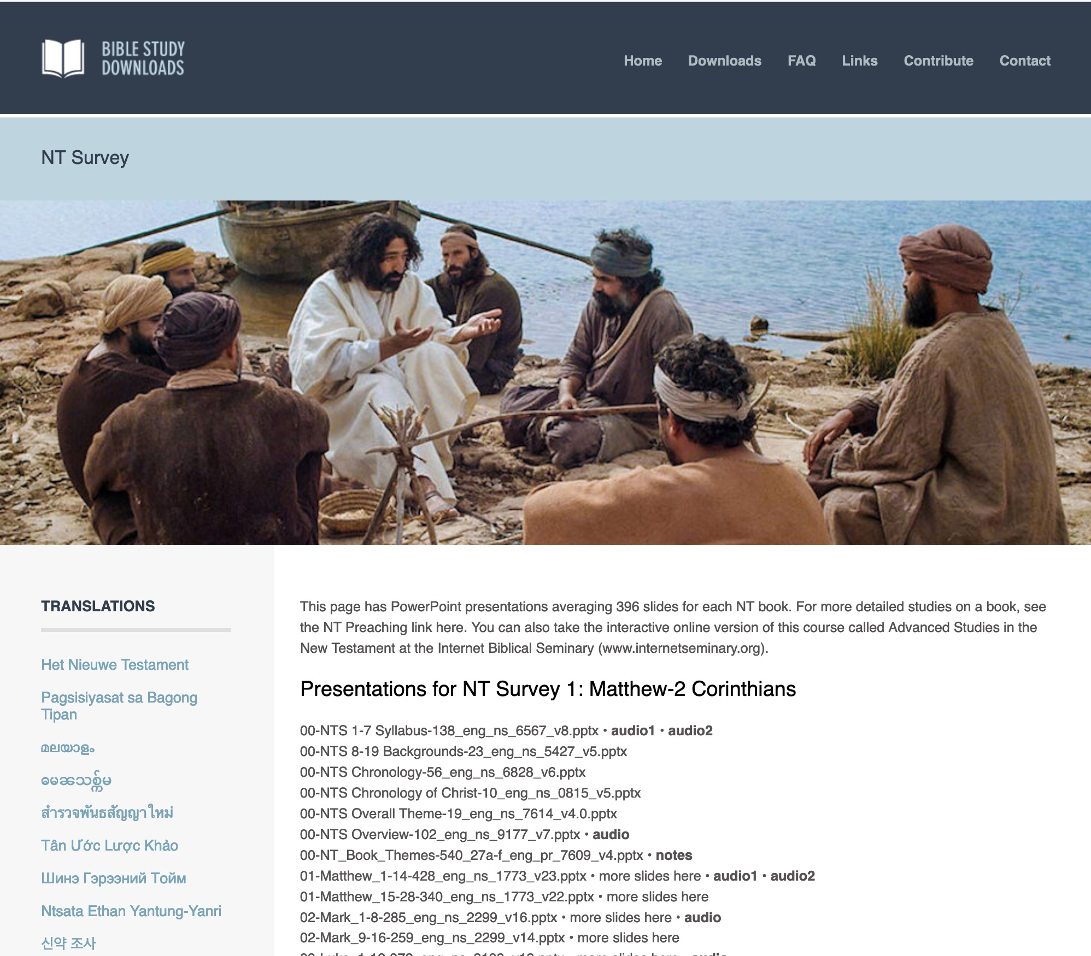
BibleStudyDownloads.org
7
English
Notes:
My SBC teaching has resulted in Bible teaching and study materials—mostly PowerPoint—in 49 languages! All a teacher needs to do is to click on a file and it downloads for free to teach any book of the Bible and many other subjects.

Slide 30
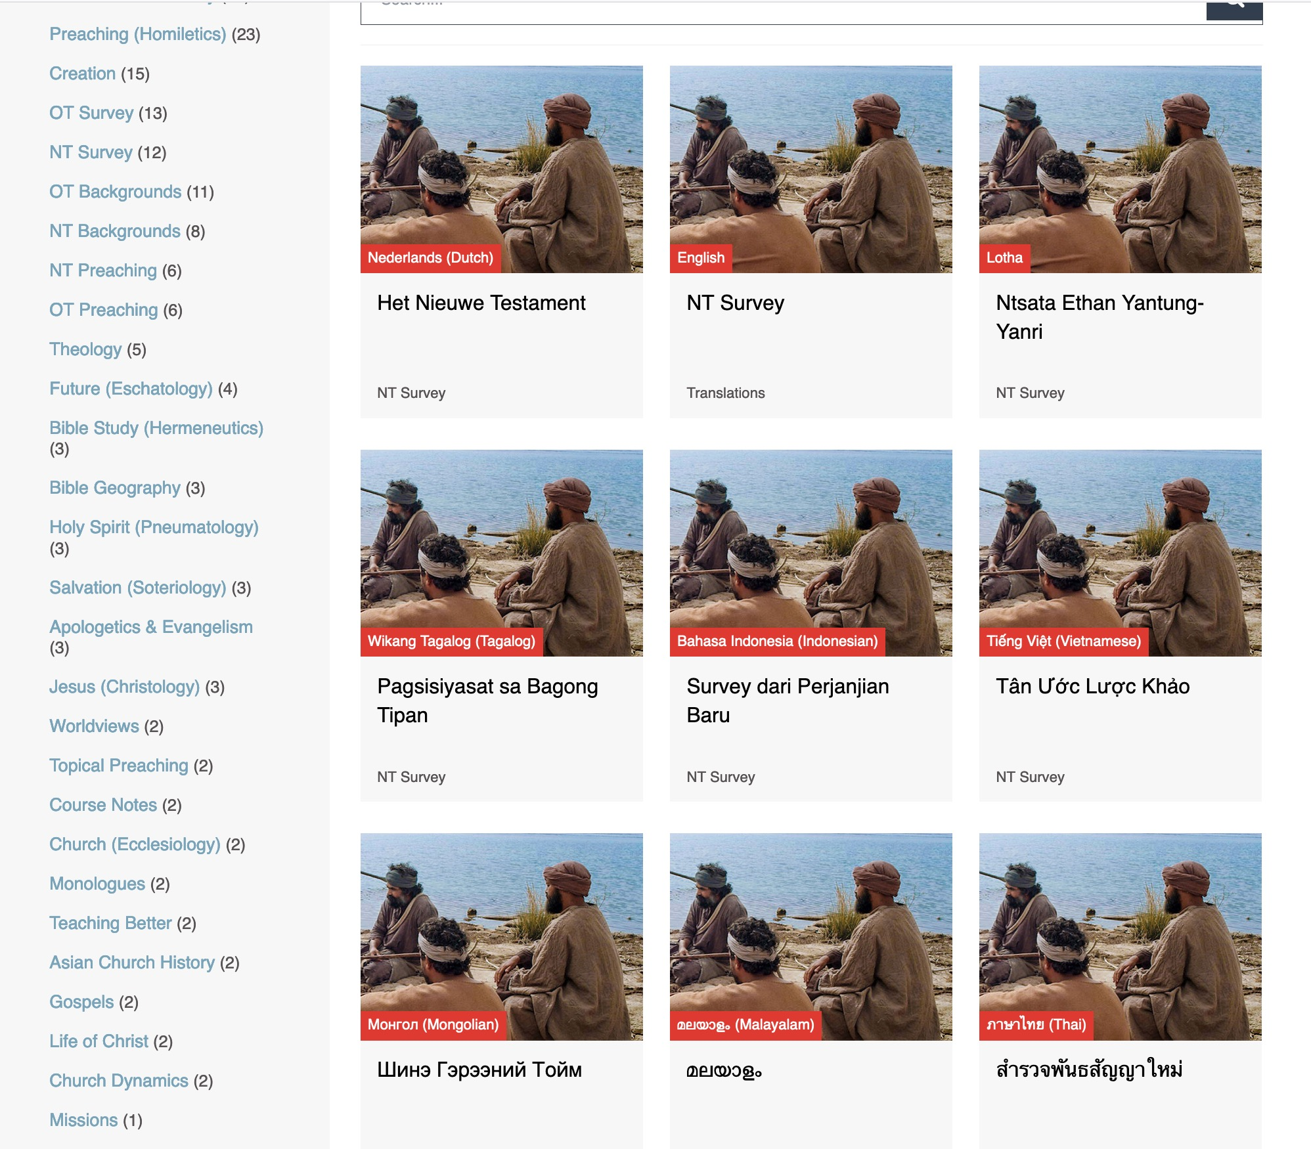
BibleStudyDownloads.org
7
Translations
Notes:
Here are 9 languages featured.

Slide 31
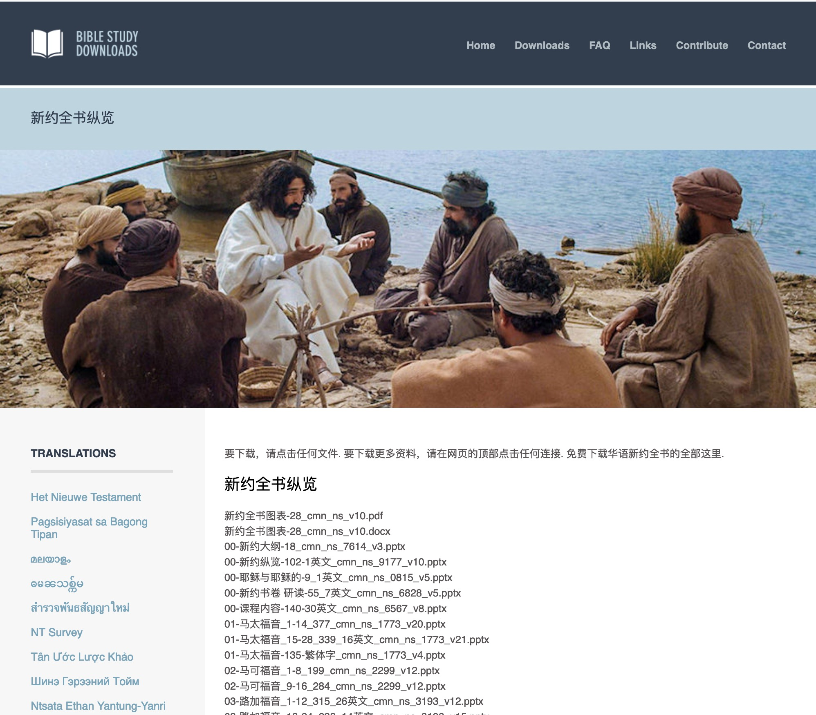
Chinese
7
01-马太福音_1-14_377_cmn_ns_1773_v20.pptx
Notes:
Chinese downloads include more than 37,000 slides as of Jan 2020.

Slide 32
Ministries God Gave Us
WorldVenture Singapore field leader
Singapore Bible College Bible & preaching professor
Singapore Bible College Doctor of Ministry director
Adjunct Professor teaching in 12 nations
The Bible…Basically translation director
BibleStudyDownloads.org web author
Crossroads International Church pastor-teacher

Slide 33
Teaching 1997-2020
MONGOLIA
JORDAN
KOREA
CHINA
NEPAL
MYANMAR
INDIA
THAILAND
VIETNAM
MALAYSIA
SRI LANKA
SINGAPORE
SBC
INDONESIA
Notes:
From 1997-Feb 2020 God has seen fit to grant me the privilege to train pastors in 12 other countries on 68 trips. Often pastors in the US team-teach with me on these trips. To help the poor, I avoid the wealthy countries where listeners can pay an honorarium but instead raise the funds to pay my own way and then teach for free.

Slide 34
Course Description
1
What does the future hold? Do current events in the Mid-East, EU, China, and Russia relate to biblical prophecy? What happens to people after death? When will Jesus return in relation to the Tribulation? What are heaven and hell like? Answers to these questions about eschatology (study of the future) and how they affect you now are explored in this two-part course that uses a 400-page book of class notes ($20).

Slide 35
Course Objectives
1
By the end of this course the student will be able to…
A. Defend the biblical view of personal eschatology (death, intermediate state, existence of hell, judgments, heaven, etc.).
B. Compare and contrast the Church and Israel.
C. Show familiarity with the various eschatological viewpoints on the millennium (pre-, a-, and postmillennial) and the rapture (pre-, mid-, and posttribulational), while at the same time holding one of these views (at least temporarily!).
D. Articulate the biblical covenants and their relationship to eschatology.
E. Feel acquainted with eschatology to be able to confidently preach and teach on the subject.
F. See the relevance of eschatology to personal holiness, world mission, contemporary events, and Asian culture and religions.

Slide 36

Internet Advantages
Interest
Better Learning
Equipping Others
Saves Time

Slide 37
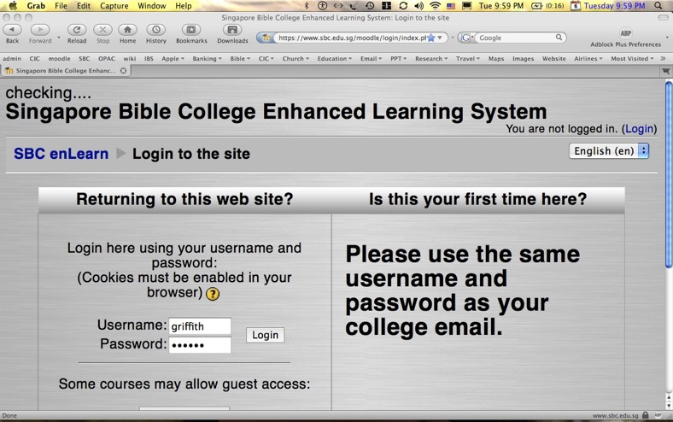
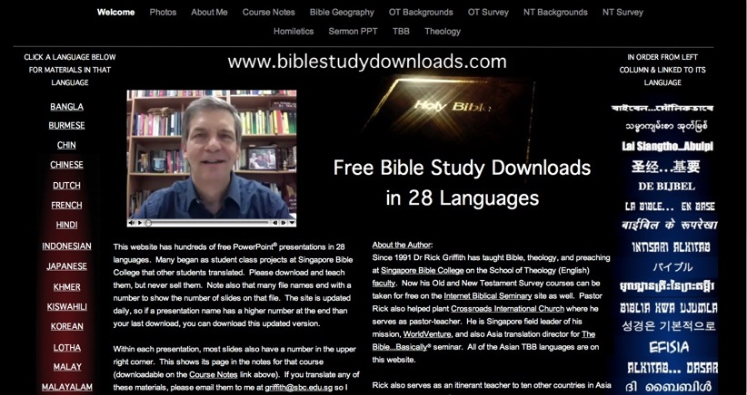
Our Two Websites
1
SBC Moodle
(Quizzes)
Biblestudydownloads.com
(Downloads)

Slide 38
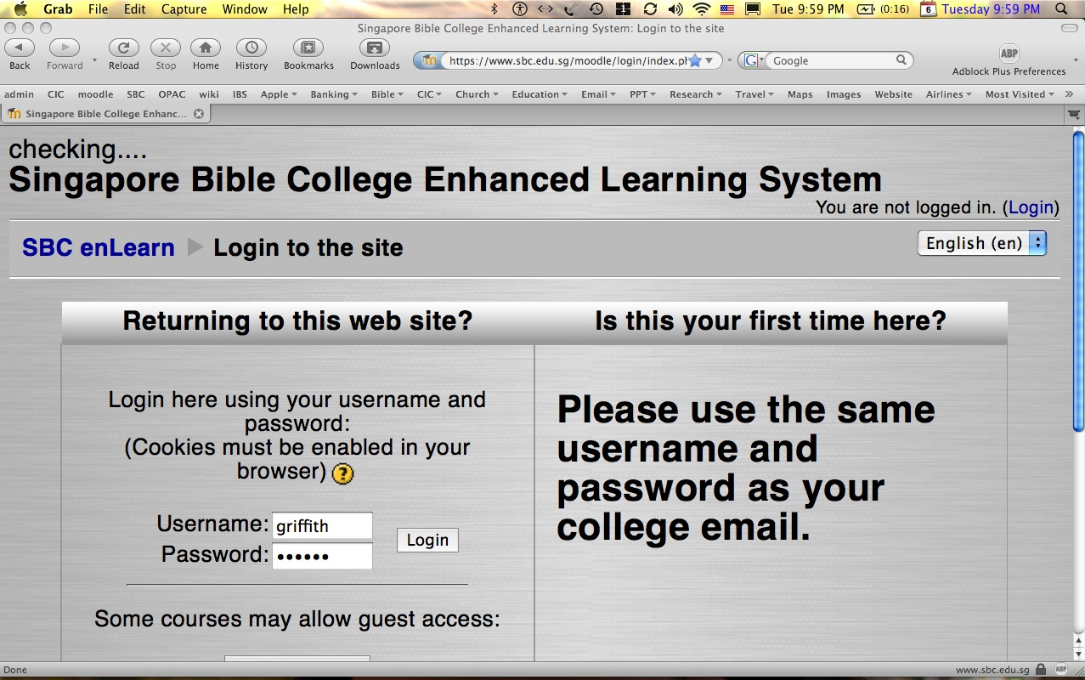
How to Get on Moodle…
1
Log on at sbc.edu.sg/moodle/login/index.php
Type your normal SBC username
Type normal SBC password
Click on the NT Survey course
Take your quiz or post a message

Slide 39
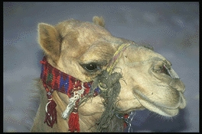
WOLBI Course Requirements
1-2
Readings (40 pts.)
Quizzes (8o pts.)
Final Exam (80 pts.)

Slide 40
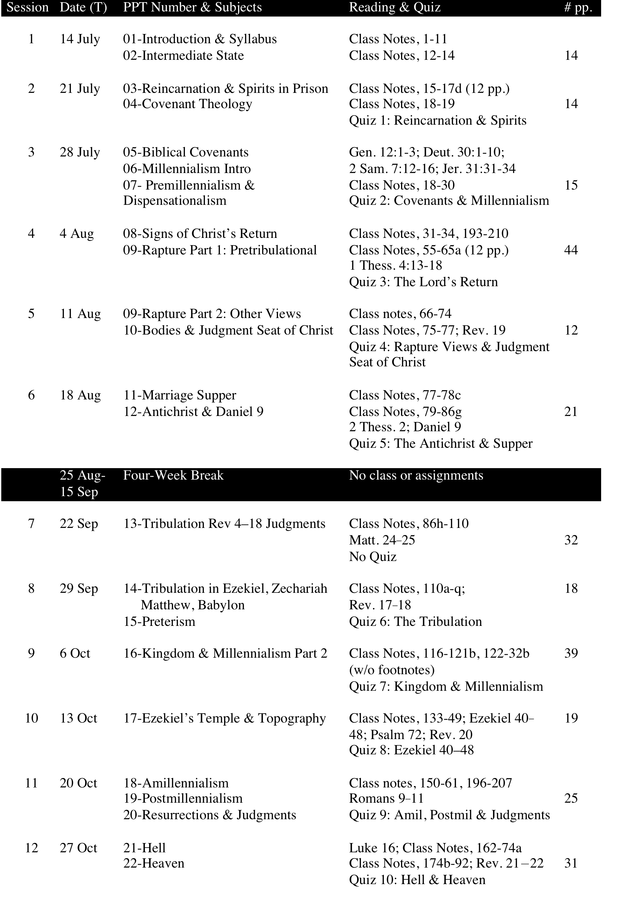
Our Schedule
10

Slide 41


All Quizzes and Exams are Closed Book!

Slide 42

Defining Eschatology
11
1. Definition: the study of last times
eschatos (ἔσχατος) = last, pertaining to:
being at the farthest boundary of an area, farthest, last
being the final item in a series, least, last in time
the furthest extremity in rank, value, or situation, last: last, least, most insignificant
BDAG

Slide 43
Defining Eschatology
11
1. Definition: the study of last times
2. Compound word: eschatos (“last”) and ology (“study of”), taken from logos (“discussion” or “doctrine”).
3. Therefore, eschatology concerns the final outcome of the present order. This presumes a linear view of history unlike eastern religions (cf. pp. 215-17).

Slide 44

Many ignore prophecy today and put their head in the sand.

Slide 45

Why Study Prophecy?
11
Prophecy proves the authority of the Bible (Dan. 9:25-27; cf. pp. 80-86e).
Prophecy reveals God’s power and wisdom since only He knows the future (Isa. 44:7; 45:11).
Prophecy reveals God’s goal for us to reign with Christ as victor (Rev. 5:10; 22:5).
Prophecy is an excellent means of evangelism (Rev. 3:20), showing God’s patience (2 Pet. 3:9).

Slide 46
Why Study Prophecy?
11
Prophecy benefits the believer (Rev. 1:3) by giving him…
Peace, comfort, and assurance (1 Thess. 4:18; cf. Christian vs. unbeliever’s funerals)
Faith (Heb. 11:10), hope (Tit. 2:13), and God’s patience (2 Pet. 3:9)
Motivation for service (1 Cor. 15:58; Heb. 11:10)
God’s perspective on life and values (2 Pet. 3:8-13; 2 Cor. 4:18)

Slide 47
Why Study Prophecy?
11
Prophecy benefits the believer (Rev. 1:3) by giving him…
Protection against materialism (Rev. 21:1; 2 Pet. 3:10)
Protection from liberalism (2 Pet. 3:3-4; liberals don’t study prophecy but do scoff)
Incentive for holy living (2 Cor. 5:6-10; 2 Pet. 3:11; 1 John 3:1-3)

Slide 48
Black

Slide 49
Future (Eschatology) at BibleStudyDownloads.org
Get this presentation for free!
Notes:
Future (fu)
Eschatology

