Slide 1
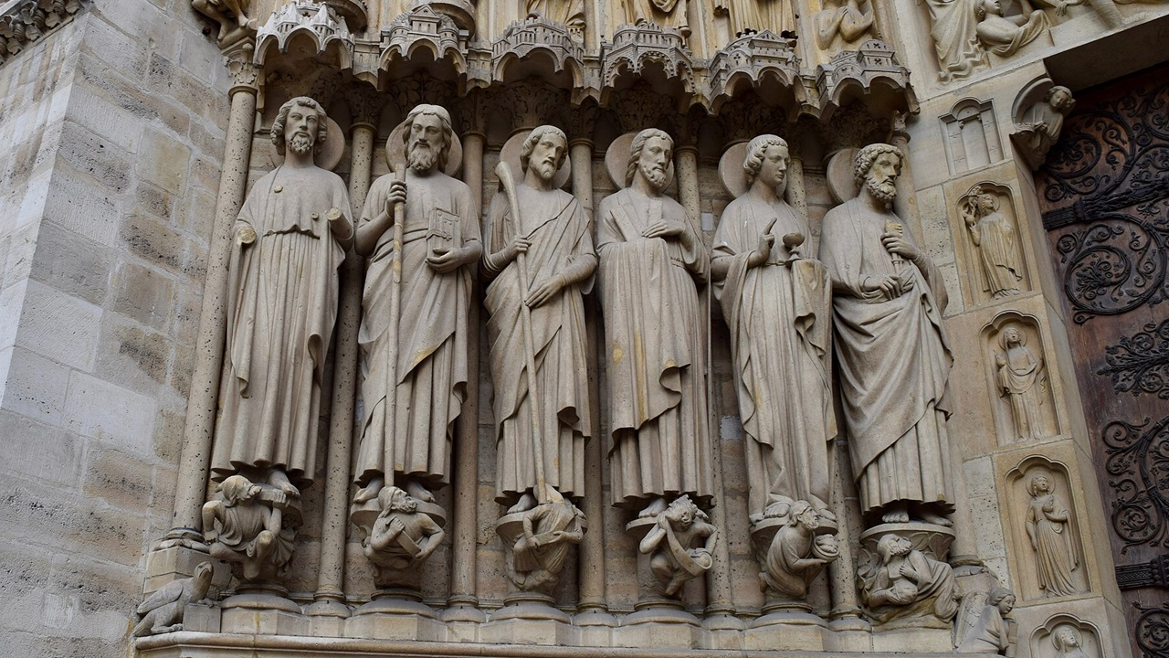
Jesus calls his first disciples
John 1:35-51
Matthew Lyle
at Crossroads International Church Singapore • CICFamily.com
Uploaded by Dr. Rick Griffith • Jordan Evangelical Theological Seminary
Files in many languages for free download at BibleStudyDownloads.org

Slide 2
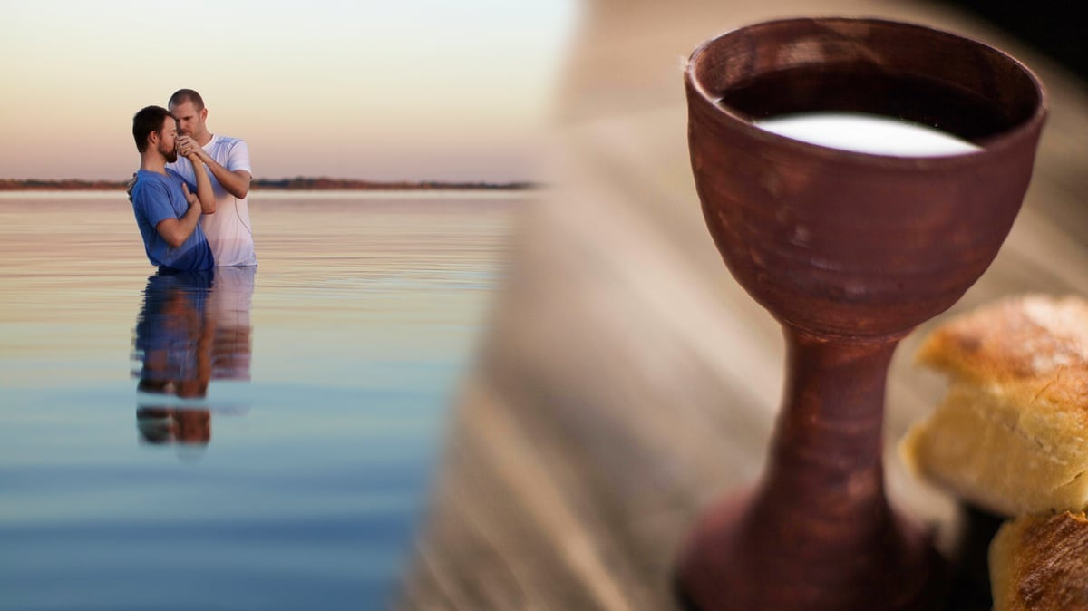
Notes:
When you look at the doctrines and practices
of the three major branches of Christianity,
that is, Roman Catholicism, Eastern Orthodoxy, and Protestantism,
Two common celebrations stand out: Baptism and the Lord’s Supper
In fact, for protestants, we only have these two church rites,
whereas the Roman Catholics and Eastern Orthodox churches have seven.
Another difference is that we protestants call these rites “ordnances.”
Whereas the others call them sacraments.

Slide 3

Notes:
But if you were to look beyond the doctrine and practices
and see what happens when small or large groups of people
from either of these three branches gather,
You will see something they all share in common with one another!
And that is giving one’s personal testimony
about how they came to know Jesus.
At mission conferences, the speakers often begin with a story that shows
how they came to know Jesus
and how they ended up serving where they are.
At seminary, students get to know one another by sharing testimonies.
Even here at CIC, we share our testimony during baptisms.
We do this because we know that listening to Christian testimonies
can be inspiring and encouraging,
and it reminds us of the transformative power of God's grace
and reinforces our own faith.

Slide 4
Relatability
God’s Work
Growth
Notes:
There are many different reasons why personal testimonies are so powerful. One reason is:
Relatability: Testimonies often include stories of struggles, doubts, and challenges an individual faced before conversion. These relatable aspects can help listeners identify with the person's journey and see parallels in their lives.
Another reason testimonies are so powerful is that they are a Witness of God's Work: Testimonies are a way for believers to witness the work of God in someone else's life.
They show how God's love and intervention can lead to profound changes.
They show the reality of God's presence and involvement in people's lives.
A third reason is that listening to different testimonies allows believers to learn and then grow from the experiences of others. We can gain insights into various aspects of faith by listening to the challenges that arise in the Christian walk.

Slide 5
Jesus calls his first disciples
John 1:35-51
Notes:
Today, we will look at John Chapter 1, verses 35 to 51, which is the section of scripture where Jesus calls his first disciples.
In today’s reading, we will see various testimonies about when some of the disciples first encountered Jesus.
Today’s reading is not a how-to guide. The end of John chapter 1 is not a prescription of how to give a personal testimony.
Instead, we will see in these testimonies how several of the disciples came to know Jesus.
We will see how they responded, what they thought, and what they did or didn’t do.
We may see something that we can relate back to our own lives.
We will witness God working in the lives of the disciples.
And finally, we hope to learn and grow from this reading.

Slide 6

Believing
C H R I S T
Responding to John’s Gospel
Notes:
Today’s sermon is the third in a series called Believing Christ, Responding to John’s Gospel account.
And here is a spoiler alert: everyone who hears the gospel, or good news, in our story today, in verses 35-51, responds by believing that Jesus is the Christ.
But, even though we know how they responded, we can still learn something by looking at the various circumstances leading up to,
as well as the differences in their actual reactions.

Slide 7
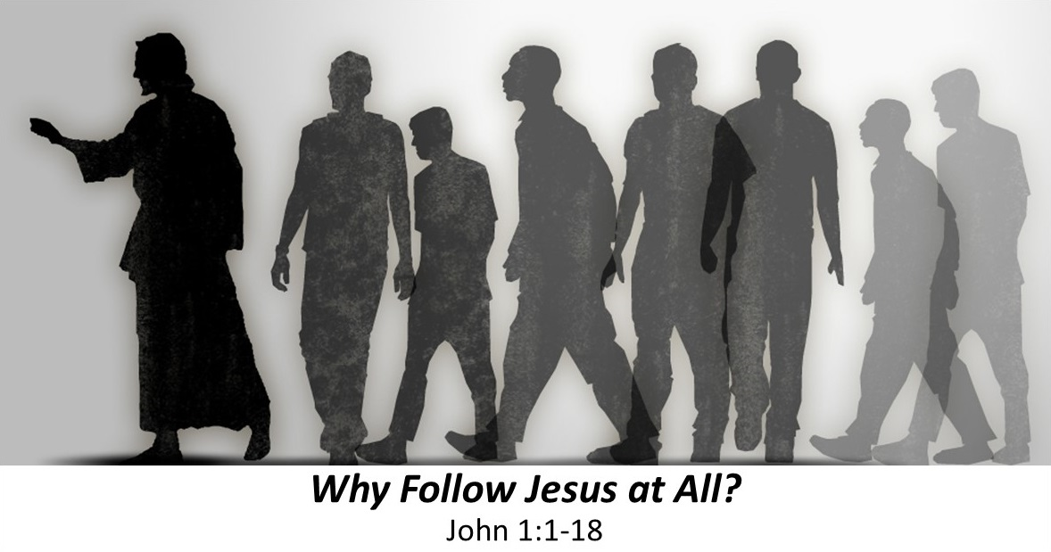
Revelation of Jesus
Purpose of Jesus
Incarnation of Jesus
Notes:
Looking back at the previous sermons:
The first sermon in our series was called, “Why Follow Jesus at All.”
It covered vs 1-18. These verses are known as the prologue
This prologue is a summary of the entire book of John.
This summary can be seen in three sections.
In the first section, John reveals a major spoiler:
In verses 1-5, he reveals that Jesus is God.
In the beginning was the Word, and the Word was with God,
and the Word was God. He was in the beginning with God.
All things were made through him,
and without him was not any thing made that was made.
The next section of the prologue, vs 6-13,
He tells us the why, or Jesus’ purpose:
With a thesis statement in vs 12:
to all who did receive him, who believed in his name,
He gave the right to become children of God,
In the third and final section of the prologue, vs 14-18,
he tells of the incarnation of Jesus, when Jesus came into the world.

Slide 8
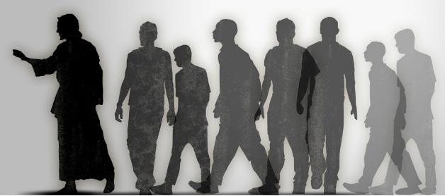
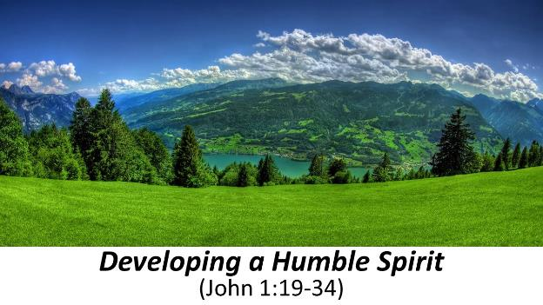
Revelation of Jesus
Purpose of Jesus
Incarnation of Jesus
Forerunner of Jesus
Appearance of Jesus
Followers of Jesus
Notes:
The second sermon in our series was titled, Developing a Humble Spirit,
centered around the testimony of John the Baptist,
John’s testimony had 2 parts, in the first part in vs 19-28,
John the Baptist gave his testimony to the priests and Levites
who were sent by the Pharisees.
John’s testimony was pretty simple,
I am not the Christ, I am not Elijah, I am not the prophet.
In fact, I am a nobody,
not even fit to untie the sandals of the one who comes after me
This is saying the one who comes after me is
not just a prophet, not just Elijah, but in fact, is the Christ,
meaning that he, John the Baptist, is the forerunner of Christ, or Jesus.
In the second part of last week’s sermon,
We see Jesus’s first appearance in the narrative.
Again John testifies that he is nobody, but that Jesus is indeed somebody.
In fact, he concludes with,
“And I have seen and have borne witness that this is the Son of God.”
Today’s sermon on John 1:35-51 really only has one part,
about the followers of Jesus.
Lets dig in and see what we can learn from their testimony.

Slide 9

³⁵ The next day again John was standing with two of his disciples, ³⁶ and he looked at Jesus as he walked by and said, “Behold, the Lamb of God!”
Notes:
Our passage today begins with verse 35, it reads,
“The next day again John was standing with two of his disciples,
36 and he looked at Jesus as he walked by and said,
“Behold, the Lamb of God!”
This is the second “next day” of our story, so it is the third day.
What is interesting that it is also John’s third testimony about Jesus.
His first testimony were to the Priests and Levites who came to ask him questions (that was in vs 19-28).
His second testimony was “the next day” when he saw Jesus “coming toward him.” At that point he said ““Behold, the Lamb of God, who takes away the sin of the world!”
So who was there on the second day to hear John’s testimony? The priests and Levites were probably still around, because it seems John is still addressing them. And looking at vs 35, it seems John’s disciples, and the two specific disciples we will see shortly were there on both day 2 and day 3.
Here is another spoiler alert, although it does not say it here,
the priests and Levites, we will read later,
do not believe John the Baptists testimony
that Jesus is the Lamb of God who takes away the sin of the world.
So now we are on the 3rd day, John’s 3rd testimony,
and Jesus is again moving while they are standing still

Slide 10


2022
World Cup
Shifting Allegiances
. . . “Behold, the Lamb of God!” ³⁷ The two disciples heard him say this, and they followed Jesus.
Notes:
Going into the 2022 World Cup , the Brazil national football team was heavily favored to win.
Yet, as the games series progressed,
many fans shifted their allegiance to Argentina.
This was due mainly to the immense respect
the soccer world has for Lionel Messi, Argentina’s star player.
You can see some similarities in the story of the two disciplines.
They didn’t start following Jesus on day 2, when John the Baptist pointed out Jesus as the Lamb of God.
Instead, they needed another nudge from John.
What about the rest of John’s disciples? Why didn’t they all follow Jesus? John’s message was, “I am preparing the way.”
And Jesus was identified as the way.
I think that some of his disciples realized that John the Baptist and Jesus had distinct roles and ministries, and they felt called to stay with the ministry of John the Baptist.
Even now, Christians who are fulfilling the great commission by making disciples by going, baptizing, and teaching, are simply paving the way for the lost to know Jesus, and are doing this within our families and at our work place, not just at the ends of the world.
So rather than talk about the disciples who stayed with John,
let’s focus on the two disciples who followed Jesus.

Slide 11



. . . “What are you seeking?
. . . and they followed Jesus.
³⁸ Jesus turned and saw them following and said to them,
“What are you seeking?”
Notes:
So now, these two disciples of John,
after twice hearing John say that Jesus is the Lamb of God,
literally followed Jesus.
On Day 2, Jesus was walking toward John.
On day 3, Jesus walked past them, and they started walking behind him.
Jesus turns and asks what are you seeking?
I grew up believing God and following the rules of the church.
But when I looked around, I saw joy
not in people inside my church
but in people in other churches
I was seeking that joy when I started attending other churches
People seek God for many different reasons,
Hope and healing
Comfort and Support
Guidance and direction
Gratitude and thanksgiving
Fear of the unknown
Sometimes the reasons we seek God change
the more we get to know God and his plan for our lives.

Slide 12
⁷ “Ask, and it will be given to you; seek, and you will find; knock, and it will be opened to you. ⁸ For everyone who asks receives, and the one who seeks finds, and to the one who knocks it will be opened. ⁹ Or which one of you, if his son asks him for bread, will give him a stone? ¹⁰ Or if he asks for a fish, will give him a serpent? ¹¹ If you then, who are evil, know how to give good gifts to your children, how much more will your Father who is in heaven give good things to those who ask him!
Matthew 7:1-11
. . . “What are you seeking?
. . . and they followed Jesus.
³⁸ Jesus turned and saw them following and said to them,
“What are you seeking?”
Notes:
Regardless of why you seek,
God promises that whoever seeks him will find him.
In his sermon on the mount, Jesus says
⁷ “Ask, and it will be given to you;
seek, and you will find;
knock, and it will be opened to you.
⁸ For everyone who asks receives,
and the one who seeks finds,
and to the one who knocks
it will be opened.
⁹ Or which one of you,
if his son asks him for bread, will give him a stone?
¹⁰ Or if he asks for a fish, will give him a serpent?
¹¹ If you then, who are evil,
know how to give good gifts to your children,
how much more will your Father who is in heaven
give good things to those who ask him!
When you earnestly seek God you will find him.

Slide 13

. . . “What are you seeking?
. . And they said to him, “Rabbi” (which means Teacher), “where are you staying?” ³⁹ He said to them, “Come and you will see.” So they came and saw where he was staying, and they stayed with him that day, for it was about the tenth hour.
Notes:
These two disciples who decided to follow Jesus,
who were originally disciples of John the Baptist,
were earnestly seeking after the one John was telling everyone about
But they probably didn’t know exactly what they were seeking,
This is why when Jesus asks, “what are you seeking?”
They responded,
Where are you staying
Which is a polite way of saying
we want to walk with you as you go
We know they were not saying,
we will only follow you if you are staying close by
because we see this pattern of obedience that is so common in the Old Testament. God says something, people do it.
Abraham go to land / went to land
Abraham to offer Isaac as sacrifice / went to offer Isaac as sacrifice
Jesus said come and you will see
We see that “they came and saw”
This shows that obedience is important when we are seeking God

Slide 14




Pattern of Obedience in Exodus
25-31
32-34
35-40
Notes:
Another place we see the pattern of obedience in the Old Testament is in the 2nd half of Exodus
Story of Moses, plagues, parting the Red Sea, wandering the desert.
But then, chapters 25-31 contain long and detailed instructions on how to build the tabernacle, including all the furniture inside, and the priestly garments.
As you continue reading, you will notice that chapters 35-40 affirm that the Tabernacle items are being built exactly to God’s specifications.
What is interesting is what is between these two sections. Moses goes up to a mountain, and stays a bit longer than expected,
The Israelites get anxious and ask Aaron to build them a god,
So Aaron melts down their rings and makes a golden calf.
God was not pleased, but Moses interceded on their behalf.
Israel renewed their covenant with God,
This is why the Israelites were so meticulous in following God’s instructions.
Fortunately for our disciples, they obeyed.
When Jesus said come and see, they came and saw.
How do we follow Jesus?
We follow in obedience to his call,
Just as the first two disciples did

Slide 15

The Unknown Disciple
. . . for it was about the tenth hour.
⁴⁰ One of the two who heard John speak and followed Jesus was Andrew, Simon Peter's brother. ⁴¹ He first found his own brother Simon and said to him, “We have found the Messiah” (which means Christ).
Notes:
When it comes to following Jesus by being obedient,
our focus must be on Jesus, not ourselves.
John the Baptist said
he who comes after me, I am unworthy to even untie his sandal
And later in chapter 3, we will read that he says
He must increase, but I must decrease
This same pattern of focusing on Jesus is seen
in the story of the two disciples.
They aren’t named because their names are not important to the story.
But now we get to the story of another disciple.
This disciple is named Simon,
and he is the brother of one of the first two disciples, that being Andrew.
So we know one of the two disciples who followed Jesus was Andrew.
The Bible doesn’t specifically tell us who the second disciple was,
but most say it is John, the writer of this gospel account.
John leaves himself anonymous
because when it comes to following Jesus,
Our focus must be on Jesus, not ourselves

Slide 16

“We have found the Messiah” (which means Christ).
Notes:
Because the first two disciples were obedient to God’s call,
and focused on Him, and not themselves,
they were able to discern who Jesus was.
That is why Andrew found his younger brother, Simon, and told him
We have found the Messiah.
This shows that following Jesus means learning who he is.
He is the Messiah.
In Hebrew . . . / Greek /
In John’s prologue, he tells us that Jesus is God.
But now, in the narrative or story that he tells, John will develop just why that is.
First, he is the Lamb of God, referring to the Passover lamb.
The Passover lamb allowed Israel’s sins to be forgiven but had to be sacrificed every year. Jesus, in obedience to the Father, will eventually sacrifice himself once and for all, for the sins of the whole world, not just Israel
Second, he is rabbi or teacher. And we are called to teach others all that he has taught or commanded us.
Now, he is identified as anointed one, Messiah, Christ. Eventually this becomes Lord and Savior.

Slide 17

“We have found the Messiah” (which means Christ).
⁴² He brought him to Jesus. Jesus looked at him and said, “You are Simon the son of John. You shall be called Cephas” (which means Peter).
Notes:
And when we acknowledge that Jesus is our Lord and Savior,
we will allow God to work in our lives.
This working of God in the disciples’ lives is most evident in Peter.
In fact, this name change, I will call you Cephas, which means Peter, was simply Jesus announcing the changes he will work in Peter’s life.
Cephas is from an Aramaic word for Rock.
Peter is from petros, the Greek word for rock.
God changes Peter from being impulsive and rash,
someone who is seen doing many foolish things,
Into one of the early church leaders.
When we follow Jesus we allow God to work in our lives.
That is why Paul writes in Philippians 1: 6, “And I am sure of this, that he who began a good work in you will bring it to completion at the day of Jesus Christ. ”

Slide 18

⁴³ The next day Jesus decided to go to Galilee. He found Philip and said to him, “Follow me.” ⁴⁴ Now Philip was from Bethsaida, the city of Andrew and Peter. ⁴⁵ Philip found Nathanael and said to him, “We have found him of whom Moses in the Law and also the prophets wrote, Jesus of Nazareth, the son of Joseph.”
Notes:
The next disciple we will look at is Philip.
We see God is already at work in Philip
because of his immediate obedience.
Whereas the first two disciples had to hear twice
that Jesus was the Lamb of God,
it only took once, when Jesus told Philip to Follow me, and he followed.
And immediately, Philip found his friend Nathaniel and told him that
We have found the one
of whom Moses in the Law and also the prophets wrote.
If you want more information about
of whom Moses in the law and also the prophets wrote,
you can listen to last weeks sermon
as that was discussed in detail
as part of the priests and Levites questions to John the Baptist.
I find it interesting how Philip ties the prophetic figures from the Old Testament with the man Jesus, who was known as the son of Joseph.
This is another way of repeating vs 14 And the Word became flesh and dwelt among us, and we have seen his glory,
This shows that when we follow Jesus, we will see how he fulfills the promises of the Old Testament.

Slide 19

Eph 4:14
so that we may no longer be children, tossed to and fro by the waves and carried about by every wind of doctrine, by human cunning, by craftiness in deceitful schemes.
⁴⁶ Nathanael said to him, “Can anything good come out of Nazareth?” Philip said to him, “Come and see.”
Notes:
We now arrive at the final disciple we will look at today.
This disciple was familiar with the promises of the Old Testament,
as we will see later,
But the first thing we might notice about Nathaniel is his skepticism.
Responding to Philip’s claim that we have found the Messiah
and he is from Nazareth, Nathaniel responds
Can anything good come from Nazareth?
Turns out this is not skepticism! This is caution.
This is not being tossed to and fro by the waves and carried about by every wind of doctrine, by human cunning, by craftiness in deceitful schemes, as Paul writes in Ephesians 4:14
Philip probably knew about Nathaniel’s caution, which is why he said
come and see for yourself
This shows us that following Jesus means knowing him personally,
not just from the testimony of others
<a href="https://www.freepik.com/free-photo/serious-thoughtful-man-making-assumption-looking-right-thinking_9902339.htm#query=unsure&position=7&from_view=search&track=sph">Image by cookie_studio</a> on Freepik

Slide 20
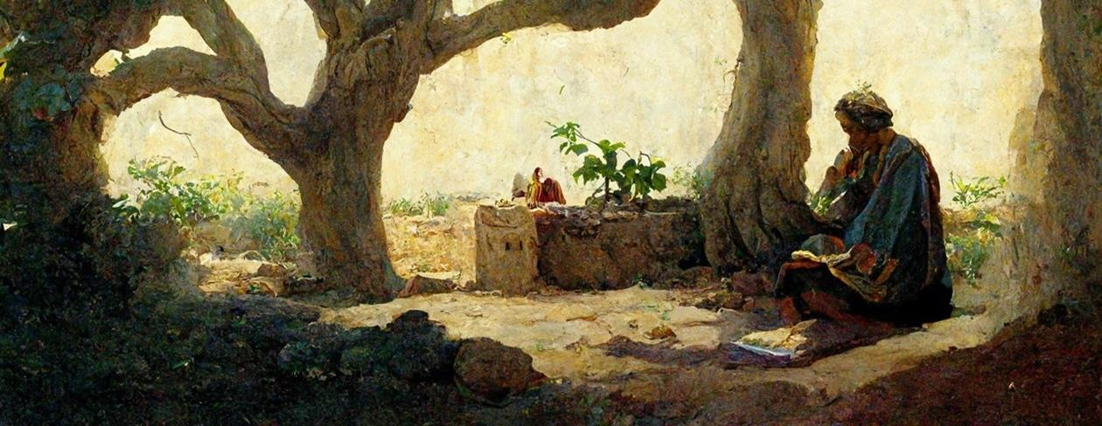
Under the Fig Tree = Safety and Leisure
1 Kings 4:25; Micah 4:4; Zech. 3:10
⁴⁷ Jesus saw Nathanael coming toward him and said of him, “Behold, an Israelite indeed, in whom there is no deceit!” ⁴⁸ Nathanael said to him, “How do you know me?” Jesus answered him, “Before Philip called you, when you were under the fig tree, I saw you.”
Notes:
Because Nathaniel was studious,
he was invited to come and see if Jesus was the Messiah.
How do we know he was studious? Jesus says so.
First, Jesus affirms that Nathanial was not a skeptic
saying in him there was no deceit.
Second, the phrase “under his vine and under his fig tree”
is synonymous with safety and leisure because of God’s provision.
This is based on several Old Testament references
Such as 1 Kings 4:25, Micah 4:4, and Zechariah 3:10
Therefore, it is said that many people would mediate under a fig tree.
Being in Singapore, and all the lush vegetation,
It is easy to sit under a vine or other large shade tree.
But the important thing for followers of Jesus
is to meditate on God’s word,
Whether it be under a tree or a vine,
or from the safety and comfort of your own flat.

Slide 21

Who is Jesus
⁴⁹ Nathanael answered him,
“Rabbi, you are the Son of God!
You are the King of Israel!”
Notes:
By meditating on God’s word, Nathaniel was able to recognize Jesus for who he was
The son of God
The King of Israel
And as we have seen,
he is also the Lamb of God who takes away the sins of the world.
He is rabbi and teacher.
He is Messiah and Christ.
He is the one of whom Moses in the Law and also the prophets wrote
He is Lord of Lords and Kings of Kings.
He is my Lord and my God.
Are you following Jesus?

Slide 22
Following Jesus
John 1:35-51
Notes:
Following Jesus is the title of our sermon today. Looking at the testimony of these first four disciples, we saw many aspects of following Jesus.

Slide 23
1. Following Jesus requires obedience (35-39).
2. Following Jesus means focusing on Him, not ourselves (40).
3. Following Jesus means learning who he is (41).
4. Following Jesus means allowing God to work in our lives (42).
5. Following Jesus means telling others about Him (41 & 43-45).
6. Following Jesus means seeing how He fulfills the promises of the Old Testament (45).
7. Following Jesus means knowing him personally, not just from the testimony of others (46).
8. Following Jesus means meditating on God’s word (47-48).
Following Jesus means knowing he is the son of God (49).
Following Jesus means witnessing great things (50-51).
Notes:
As we read through this list, ask yourself this
Are there any areas where you could be a better follower of Jesus?
1. Following Jesus requires obedience (35-39).
2. Following Jesus means focusing on Him, not ourselves (40).
3. Following Jesus means learning who he is (41).
4. Following Jesus means allowing God to work in our lives (42).
5. Following Jesus means telling others about Him (41 & 43-45).
6. Following Jesus means seeing how He fulfills the promises of the Old Testament (45).
7. Following Jesus means knowing him personally, not just from the testimony of others (46).
8. Following Jesus means meditating on God’s word (47-48).
Following Jesus means knowing he is the son of God (49).
The last aspect of following Jesus found in the last verse 50-51 is that
10. Following Jesus means witnessing great things (50-51).

Slide 24
⁵⁰ Jesus answered him, “Because I said to you, ‘I saw you under the fig tree,’ do you believe? You will see greater things than these.” ⁵¹ And he said to him, “Truly, truly, I say to you, you will see heaven opened, and the angels of God ascending and descending on the Son of Man.”
Notes:
In these two verses, Jesus promises Nathaniel that he would see heaven opened, indicating a major revelation.
That major revelation would be Jesus’s reference to himself as son of man
a term he used more than eighty times. This title emphasized his humanity and suffering as well as the perfection of his human nature.
In addition, Jesus could be seen as the new way between heaven and earth (Jacob’s ladder) on whom angels ascend and descend.
This can also be seen as foreshadowing the many signs and miracles Jesus will perform during his ministry.
But what about us today? Will we witness great things when we follow Jesus?
YES! First and foremost is the miracle of a transformed life. Not just our lives, but of those around us as well.
Second, when we look, we can see the miracle not only of creation, but God’s hand in everything around us.
Are you ready to follow Jesus today?

Slide 25

Although there are many ways to follow Jesus, there is only one way to heaven: THROUGH JESUS.
Notes:
Although there are many ways to follow Jesus,
There is only one way to heaven.

Slide 26
Black

Slide 27


NT Preaching link at BibleStudyDownloads.org
Get this presentation and script for free!
Notes:
NT Preaching (np)

