Slide 1

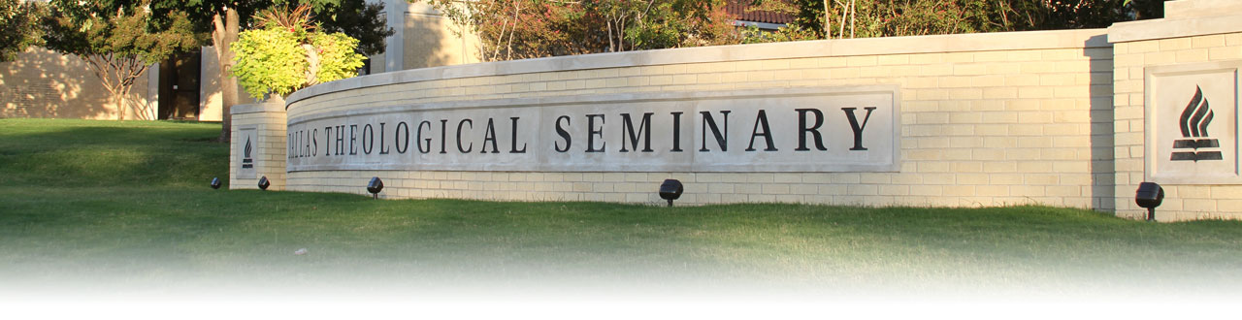
Discipleship
Dallas Theological Seminary Model

Slide 2

Background
In 2005, the board of DTS decided that spiritual formation is important to develop godly servant-leaders of their students. Thus, they created Spiritual Formation and Leadership department as an academic department in DTS.

Slide 3
Background
In 2013, The Christian Education and Spiritual Formation & Leadership departments merged to create the Educational Ministries and Leadership (EML) Department.

Slide 4
The Educational Ministries and Leadership (EML) Department
Purpose
to contribute to the Seminary's purpose of developing godly servant-leaders/Christ’s disciples through the use of:

Slide 5
The Educational Ministries and Leadership (EML) Department
Leadership studies and courses to develop student knowledge and competency in leadership

Slide 6
The Educational Ministries and Leadership (EML) Department
Biblical curriculum in a relational context designed to encourage character development and spiritual maturity through community

Slide 7
The Educational Ministries and Leadership (EML) Department
Contextually based internship experiences to help students integrate classroom studies and character growth with field ministry as they acquire, reinforce, and refine ministry knowledge and skills

Slide 8

The EML develops students through
2 major programs:

Slide 9
The EML develops students through
2 major programs:
Spiritual Formation:
Small Groups (does not constitute credit
hours in the 120 hrs Th.M. program)

Slide 10
The EML develops students through
2 major programs:
Servant Leadership:
Internships (Servant Leadership Internship
carries a 3 hour credit)

Slide 11
Spiritual Formation
&
Servant Leadership Programs
First and second year students are required to enroll in SF program their first four semesters, followed by the 2-hour Servant Leadership Internship that corresponds to their ministry track.

Slide 12
What is the
Spiritual Formation Program

Slide 13
Spiritual Formation
glorify God and make disciples by providing
a relational context and biblical curriculum
to help future servant-leaders
explore the topics of……….
Experience……….
participate in………..

Slide 14
Spiritual Formation
glorify God and make disciples by providing
a relational context and biblical curriculum
to help future servant-leaders
explore the topics of
  Identity,
  Community,
  Integrity and
  Ministry,
experience transformation (growth in Christlikeness), and
participate in the Spirit's transformation of others.

Slide 15
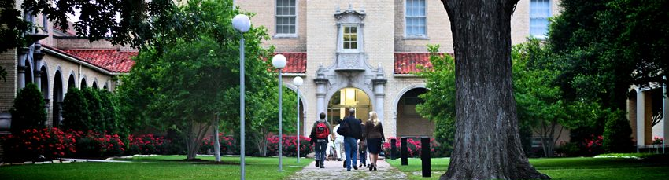
The model
Groups of five to seven students gather weekly for four consecutive semesters to pray, reflect on truth, examine their hearts, share and respond.

Slide 16
The model
In the SF program, students continue with the same SF group for all four semesters to optimize trust and community within the group.
SF groups meet for about 1.5 - 2 hours per week.

Slide 17
How much time does an SF group require?
SF groups meet for about 1.5 - 2 hours per week.
Group members spend about 1 hour per week in preparation for each group session.
In addition, many groups plan additional social gatherings or service projects.

Slide 18
Outcome
This course (required for ThM and MA students, an elective in other programs) is designed to help facilitate students’ growth in four areas:
knowing God,
knowing self,
loving well and
longing for more of God’s transforming work in their lives.

Slide 19
Course Content

Slide 20

The first semester
Identity. The students discover his or her identity: identity in Adam, and then in Christ. The student explores how his or her identity affects the way he or she should live. Here, the student asks, “Who am I? Where do I come from?” The discussion is introspective.

Slide 21
The second semester
Building community. The student shares his or her Life Story, thus, building trust with the small group and allowing the small group to love one another. Here, the student asks, “Do I belong?” The discussion turns toward others.

Slide 22
The third semester
Integrity. Students share their struggles and failures with their caring group of fellow-travelers, their small group. They reflect and practice the spiritual disciplines that will enhance their formation and their walk in the Spirit. Here, the student asks, “Am I alone?” The discussion focuses on relating to others and ways to help one another.

Slide 23
The fourth semester
Ministry. Students consider where and how they will serve the church of God in ministry. The small group provides valuable feedback, direction, and confirmation to the student after he or she shares his or her life vision. Here, the student asks, “What is my purpose?” The discussion reflects on how the student works with the Spirit to help the church with her mission to the world.

Slide 24
How does SF benefit the seasoned minister?

Slide 25

For the seasoned minister,
one’s maturity or ministry background may provide a foundation for a deeper SF experience at DTS.
On the other hand, one’s SF experience at DTS may provide the needed corrective or supplement for more fruitful ministry.
Furthermore, those who have spent time in vocational ministry offer great benefits to those in the group, who are starting out on the same path.

Slide 26
Six values inform the Spiritual Formation ministry
practicing presence,
recalling the past (the historic church),
offering authenticity,
extending grace,
yielding to the Spirit and
listening to the Scriptures.

Slide 27
Who are the SF group leaders?

Slide 28

SF leaders are volunteers
They make investments over and above their Seminary education to prepare for their small groups.

Slide 29
SF leaders are volunteers
They attend additional training in leadership and small group facilitation sponsored by DTS to maximize the SF experience.
SF Staff selects and approves leaders from the list of applicants based on several criteria designed to delimit the best candidates from the ranks of the student body.

Slide 30
Peer-led SF small groups provide many advantages for the student, for the peer leaders, and for the Seminary.
For the students,
peer leaders have great empathy for their fellow-students.

Slide 31
For the peer leaders,
they receive additional training and instruction in today’s most discussed area of Seminary education and training.
all peer leaders attend their SF small groups as participants. They approach the group with openness, ready to learn.

Slide 32
For the Seminary,
peer leadership allows the Seminary to expand its influence in the preparation of these students; this promotes leadership development and competency outside the classroom, yet under the supervision of the faculty and SFL Department. Thus, peer leaders enjoy a safe and supervised laboratory for developing their education and training in leadership and small group facilitation.

Slide 33
What is the
Servant Leadership Internships
Program

Slide 34

Servant Leadership Internships
Purpose
The Servant Leadership Internship bridges what happens in the classroom with what happens in the real world.

Slide 35
Purpose
The field-based education program helps students develop in these areas:
BEING: Christ-like Character
KNOWING: Ministry Knowledge
RELATING: Relational Skills
DOING: Ministry Task Skills

Slide 36
Servant Leadership Internships
Field-based education program helps students:
Develop a specific direction and purpose for ministry/vocation
Identify personal strengths, weaknesses, and sin issues that impact the ability to provide servant leadership in his/her ministry/vocation

Slide 37
Servant Leadership Internships
Field-based education program helps students:
Propose strategies and tactics for personal and professional development
Clearly display how students relate to God, what students are learning about God and what students are learning about loving others

Slide 38

The Model
The student designates a person at the internship site who then serves as his ministry mentor.
The EML department looks to this mentor to equip the student for ministry.

Slide 39
Ministry Mentor
Some requirements for the mentoring relationship are: to spend at least one hour per week with the intern in evaluation, planning, theological reflection, and prayer and to provide a structure that is challenging, educational, and supportive, and to ensure the participation of the church or organization in the internship.

Slide 40
Internship Mentor
The internship mentor comes from the EML department.
His job is to conduct 3 interviews with the student during the internship, namely entrance, mid and exit interviews. One of the interviews will include the ministry mentor.

Slide 41
Field Observers
In addition, students will need to identify at least five “Field Observers” who will consult with the student during the internship.
These field observers can include, but are not limited to, people that work with the student during the internship or his/her SF group.

Slide 42
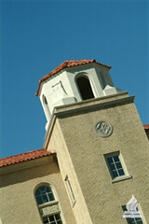
Ministry profile
During the internship, the student has to create a ministry profile. The profile should be as varied and wide as possible. It can contain a resume for future job placement, a video clip of his best sermon delivery during his internship at the local church, a proposal he made for a program for the local church, a paper he writes on some reflections in the church etc.

Slide 43
Ministry profile
This ministry profile will be submitted to the internship mentor who will go through this profile with the student to show him his weaknesses and strength and provide advice for making improvements.

Slide 44
Purpose
This will help the student to improve in his weak areas.
By the time he graduates, the student will have accumulated an impressive ministry profile which will be helpful for looking for a pastoral position.

Slide 45
Purpose
The actual hands-on in the ministry to create the profile together with the internship mentor’s advice are valuable experiences and training for the student for the actual situation in the local church.

Slide 46

Reflection:
How well would a DTS model work for SBC?

Slide 47
The SBC model for training disciples has similarities with that of DTS

Slide 48
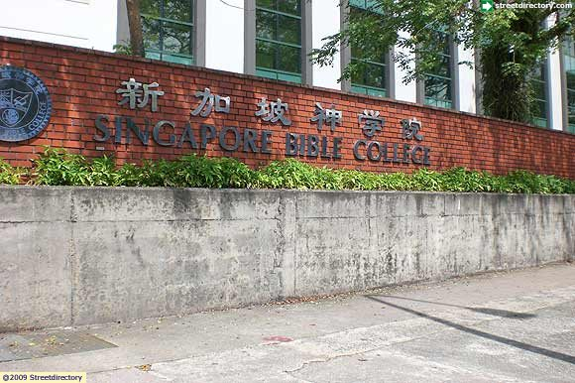
Spiritual Formation Program
SOTC has a 6 semester SF program in the curriculum.
The content is quite similar to that offered in DTS.

Slide 49
Spiritual Formation Program
In first four semesters, students are led to
discover their identity,
build community through sharing Life Story,
discuss integrity through sharing their struggles and failures with their small group, and
consider where and how they will serve the church of God in ministry.

Slide 50
Spiritual Formation Program
Students continue with the same SF group for all 4 semesters.
2 assigned SF lecturers will lead the small groups, rotating every semester.
At the end of each of the first four semesters, all students attend a SF retreat planned by the assigned lecturers.

Slide 51
Spiritual Formation Program
In their final two semesters with SBC, the small groups are combined into one big group.
Another lecturer will be assigned to minister to their spiritual needs as well as help them get ready to go into their chosen ministry.

Slide 52
Observation
Small group discussions allow more interactions among students and with the lecturer in charge.
Topics discussed are specific in helping pastors-to-be become more Christ-like.
Students see the importance of their spiritual walk with Christ from the first day of school.
A helpful blueprint for practicing spirituality is at hand.
Students spiritual lives have been cared for.

Slide 53

Field Education (FE) and
Shadow Internships
SOTC, SOTE, and SCM have Field Education (FE) and Shadow Internships which are coordinated by separate FE directors.

Slide 54
Field Education (FE) and
Shadow Internships
Though both are similar to the internship program in DTS, SBC differs from DTS in that students are given less autonomy in selecting the internship sites and setting formal internship goals.
Further, selecting internship sites by students is not very feasible in Singapore context due to various technical reasons.

Slide 55
Suggestions
We can learn from DTS by getting students to formally set their internship goals.
This will make them think beforehand what they want to learn through this program.
It might help FE Directors to liaise with internship sites to provide the environment for learning and at the same time monitor the progress.

Slide 56
Suggestions
It also allows FE Directors to help students set realistic goals and guide them to achieve these goals.
The goals will also give students some focus during internship and learn some practical skills that they think will be useful for future ministry.

Slide 57
Suggestions
We can also try the ministry profile program for internship.
This will give students opportunity to explore and attempt specific ministry skills in the real world but under the supervision of mentors and lecturers.
This will be a very practical training for students before they step out into ministry.

Slide 58

Looking Forward
For DTS, the SF and internship programs are conducted by the EML department. They also have a powerful team of support staff whose main focus is only guiding and working with students. Thus, they are able to coordinate a comprehensive and practical curriculum to prepare students for leadership roles and being disciples of Christ.

Slide 59
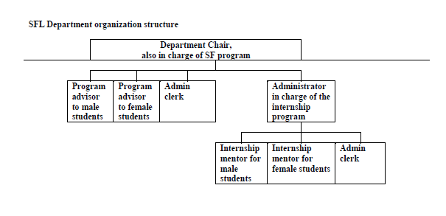

Slide 60

Looking Forward
If we want to focus more on training our students to be Christ’s disciple through SF programs, SBC need to have a person or team with appropriate autonomy and support to helm the SF program. Then he/she will be able to study and coordinate all the programs and college activities to allow this to happen. SBC can do it if we have the budget to employ such a person or reduce a lecturer’s workload so that he can concentrate to develop and oversee this program

Slide 61
Looking Forward
Emphasizing SF/discipleship in our training of godly-servants can be a key highlight in our curriculum. Through placing emphasis on the conscious practice of spirituality through our formal, non-formal, and informal training aspect of theological education, we make our curriculum stands out from other seminaries.
We train pastors. Our graduates are equipped with the necessary skills and knowledge but at the same time are imitators of Christ in heart and work. People would know that SBC is concern with making pastors to be Christ’s disciples first. Disciples would come; those that want to be disciples of Christ would come too. Churches would have confidence in our graduates because they are trained to shepherd cum after the great shepherd’s heart.

Slide 62
Looking Forward
A milder way is to provide intentional and formal mentoring to final year students as they prepare to transit into ministry.
This will be a formal program that seeks to provide mentoring for the student as he/she prepares to transit into ministry and walk with him through the initial transition period.

Slide 63
Looking Forward
The basis of the program is to reinforce the development of various life and ministry skills required for effective ministry under the guidance of an experienced person in the students’ ministry interest.
This is to facilitate faster adaptation into the ministry culture, more competent to contribute and lead in the ministry, an accountability to continue in his/her pursuit to be Christ’s disciple and hence greater fulfillment.

Slide 64
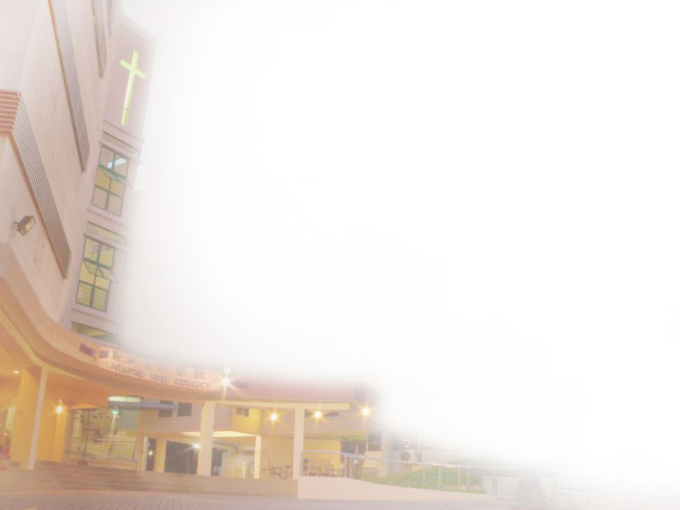
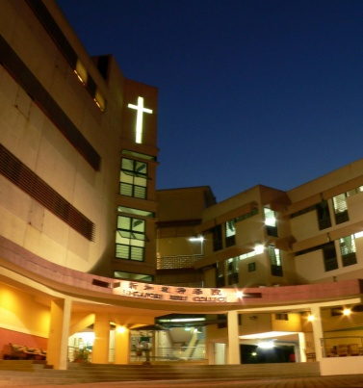
我们竭力
We Endeavor
装备富有创意思考能力，能有效地传递真理，具有仆人心怀之领袖，以切合今日教会之需要，回应全球化世界的挑战。
To train creative thinkers, effective communicators and servant leaders to meet the needs of the church and the global community.

Slide 65
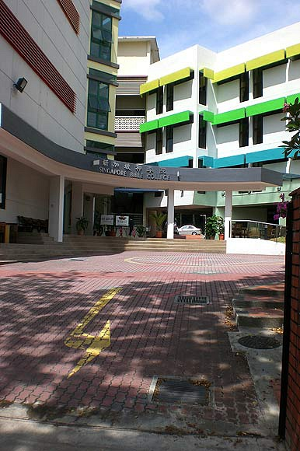
Looking Forward

