Slide 1
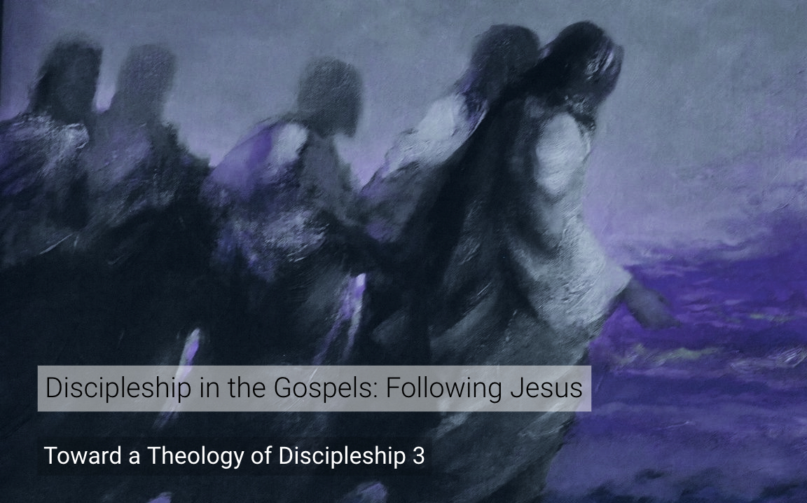
Discipleship in the Gospels
A Survey of the
Ten Disciple-Sayings of Jesus
Dr. Rick Griffith • Jordan Evangelical Theological Seminary BibleStudyDownloads.org

Slide 2
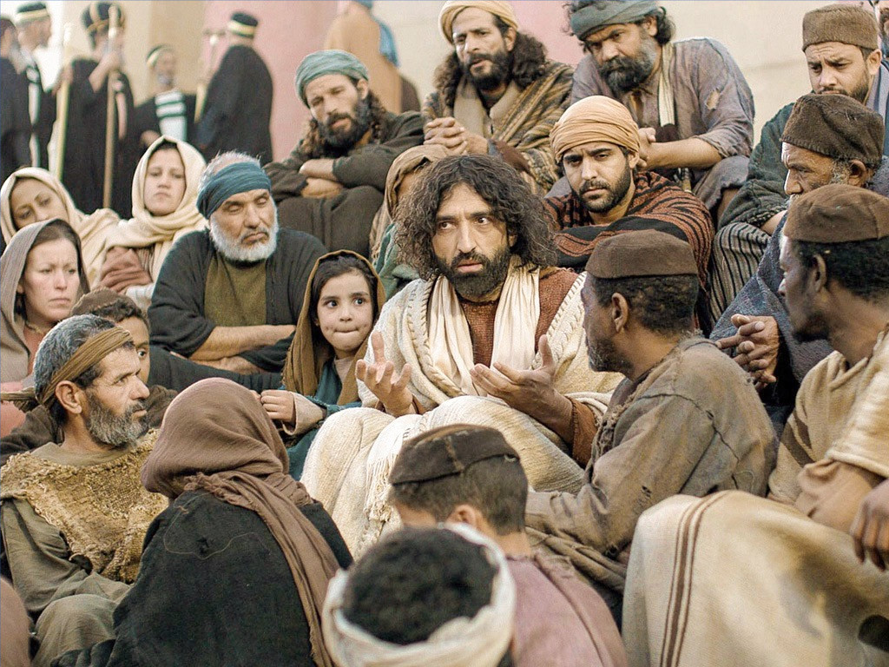
We are confused about discipleship.
Notes:
Ask the average Christian what a disciple is, and you'll get a tremendously varied response today. We have many misconceptions regarding biblical discipleship.

Slide 3

What is a disciple?
Notes:
What is a disciple?
I once heard someone say that a disciple is something like an icicle! Well, they sound alike!

Slide 4
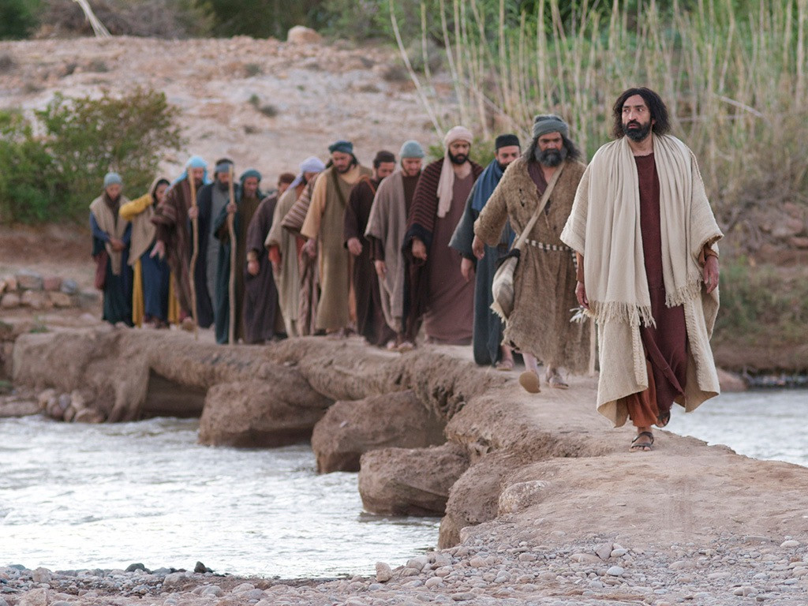
A disciple is a follower.
Notes:
Some argue that "disciple" means "follower," so anyone who follows Christ, regardless of the level of commitment, is considered a disciple.
Some think that every Christian is a disciple, but others disagree.

Slide 5
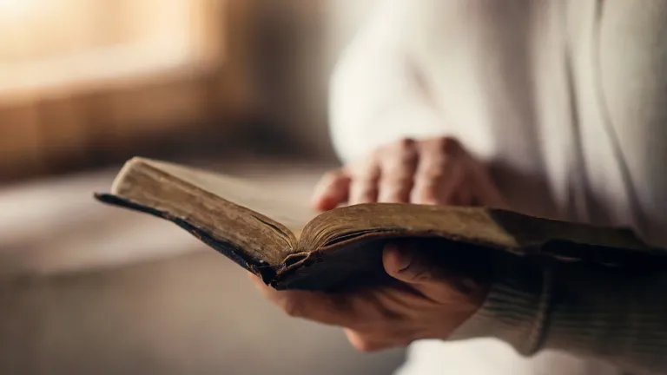
Let's define "disciple" biblically.
Notes:
What do you think? How can you determine if someone is a disciple? More importantly, are you a disciple?
The reason we are confused about biblical discipleship is that we rarely consult the primary source in the Scriptures, especially in the Gospels.

Slide 6
What is a disciple?
Let's explore the ten times Jesus uses the word "disciple"
under three traits
Notes:
We have ten statements by Christ recorded in the gospels about being and making disciples.
These are the only ten times Jesus used the word "disciple" to describe the kind of characteristics that depict those who follow Him as disciples. It may surprise you that there are only ten declarations, but each one is potent and full of force.
• Preview: Today, we'll examine these statements under three categories to understand the true nature of a disciple, followed by a strategy for implementing them in our lives. So we'll discern three primary characteristics of a disciple and how to obtain them.
Subject: Let's explore these three traits of a disciple to answer the question, "What is a disciple?" First of all…

Slide 7
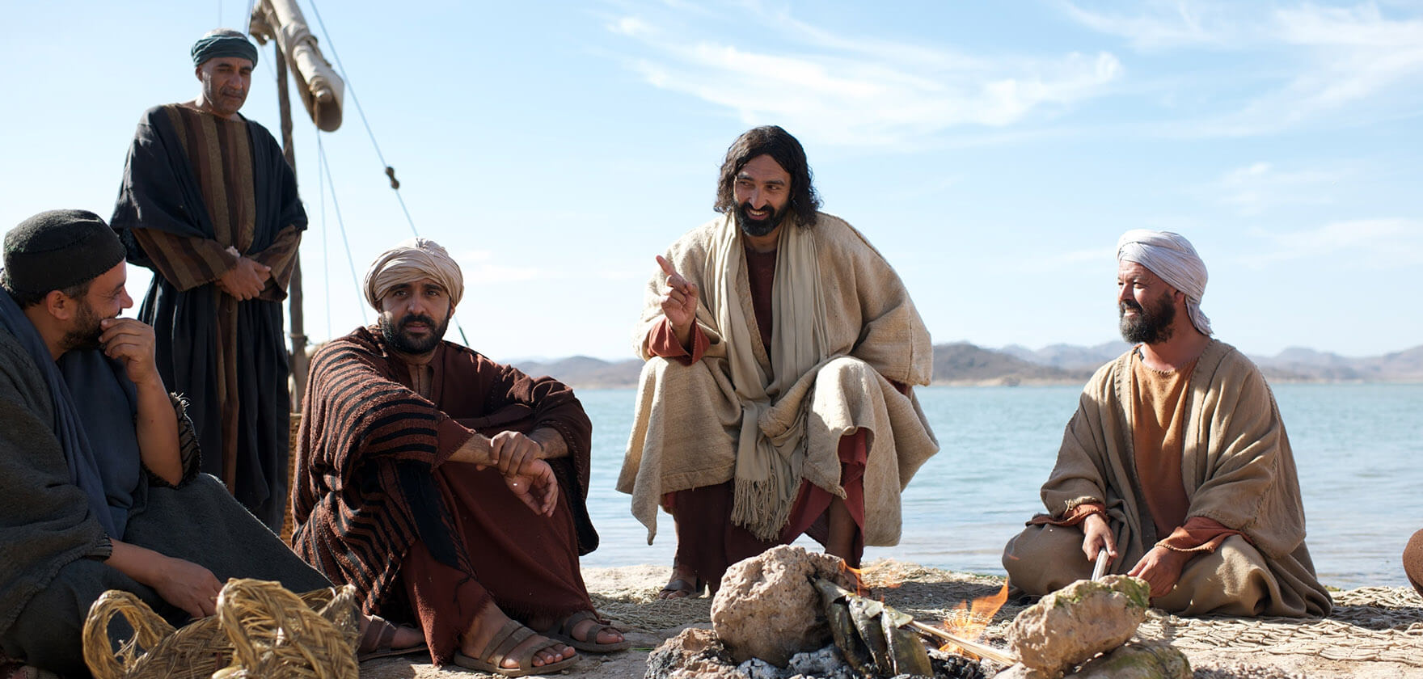
I. A disciple is totally committed to Christ.
Notes:
[A disciple shows complete allegiance to Christ with Him first in their life.]

Slide 8
A. A disciple renounces his family to follow Christ (Luke 14:26a).
Notes:
[A disciple shows complete allegiance to Christ with Him first in their life.]

Slide 9
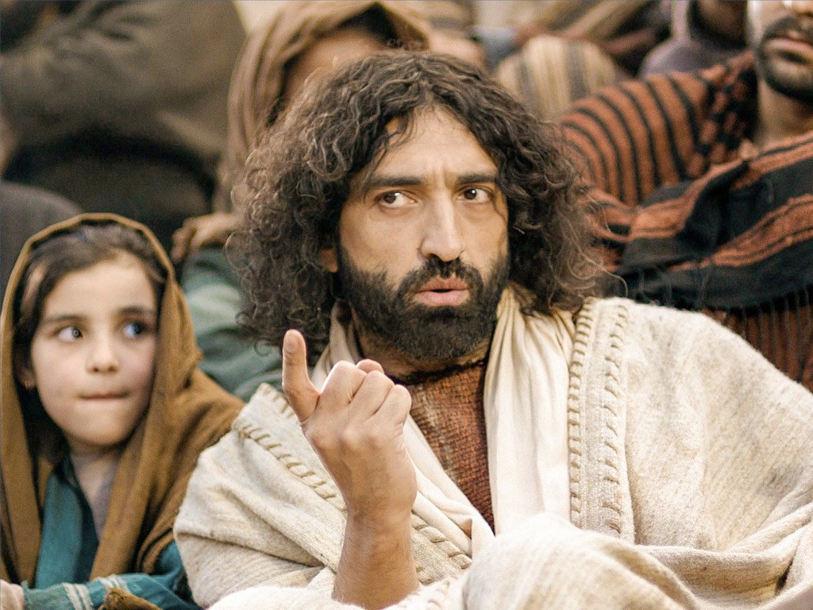
Renounce Your Family (Luke 14:25-26a)
"A large crowd was following Jesus. He turned around and said to them, ²⁶ 'If you want to be my disciple, you must, by comparison, hate everyone else—your father and mother, wife and children, brothers and sisters…'"
Notes:
Apparently, Jesus never read “How to Win Friends and Influence People.” We are commanded elsewhere to love and care for our families, but Christ came right out and demanded that we love Him more than the members of our own family.
After living overseas for years, I still had relatives who told me I should move back to America. Once, two emails from my brother and dad arrived within one month, stating that I should follow my family instead of Jesus.
(Yet Jesus said that a disciple renounces his family. What else does he renounce?)

Slide 10
B. A disciple renounces his own life to follow Christ (Luke 14:26b-27).
Notes:
[A disciple shows complete allegiance to Christ with Him first in their life.]

Slide 11
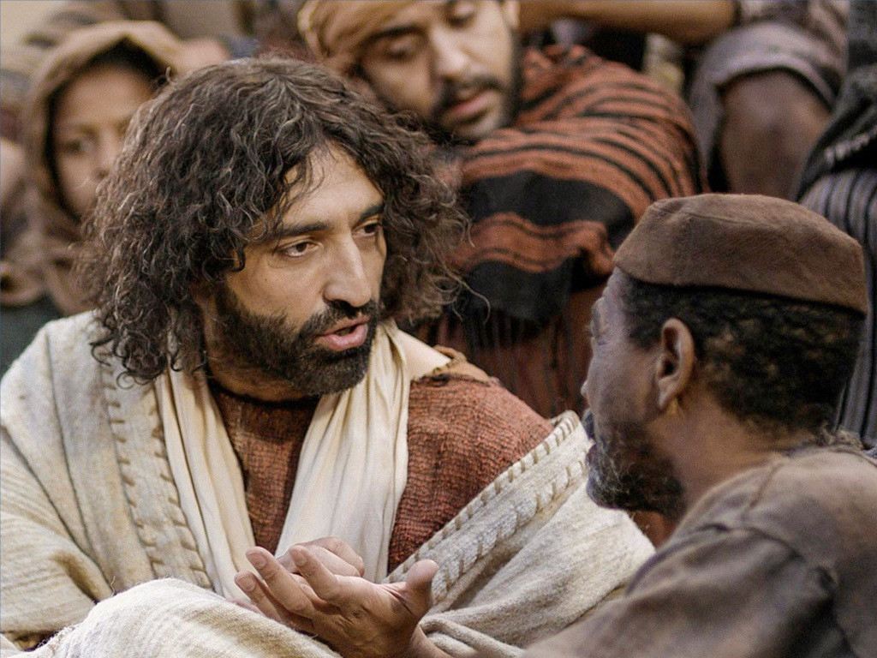
Renounce Your Own Life (Luke 14:26b-27)
"…hate… even your own life. Otherwise, you cannot be my disciple. ²⁷ And if you do not carry your own cross and follow me, you cannot be my disciple."
Notes:
What does it mean to hate your own life to the point of carrying your own cross? It means to be so concerned that Christ's desires for your life be fulfilled that you hardly even think about your desires! How long has it been since you heard someone say, “I hate to do what I want to do!”?
We live in a day of self-fulfillment: "looking out for number one," "you deserve a break today," "go ahead, you're worth it!" Christ demands a radical commitment to Himself as our number one priority.
(Not only does a true disciple demonstrate commitment to Christ by renouncing his family and his own life, but just a few verses later in verse 33, you’ll see that…)

Slide 12
C. A disciple renounces his possessions to follow Christ (Luke 14:33).
Notes:
[A disciple shows complete allegiance to Christ with Him first in their life.]

Slide 13
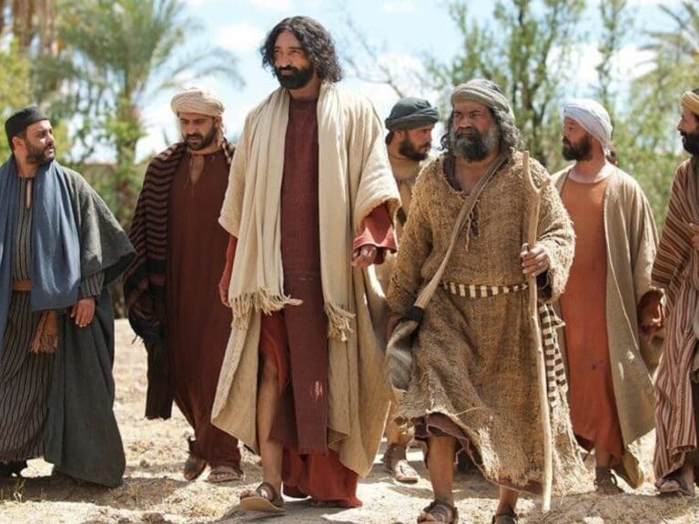
Renounce Your Possessions (Luke 14:33)
"So you cannot become my disciple without giving up everything you own."
Notes:
Does this mean that we must sell all our possessions and give the money to the poor? Christ demanded this of some, but not the majority. Here's the difference between giving away all our possessions and giving up these possessions.
The real question is, "Do you possess things or do things possess you?" A true disciple does not own any possessions of his own. Jesus Christ owns every possession we have, and we are only stewards of them.

Slide 14
D. A disciple renounces his reputation to follow Christ (Matthew 10:24-25).
Notes:
[A disciple shows complete allegiance to Christ with Him first in their life.]

Slide 15
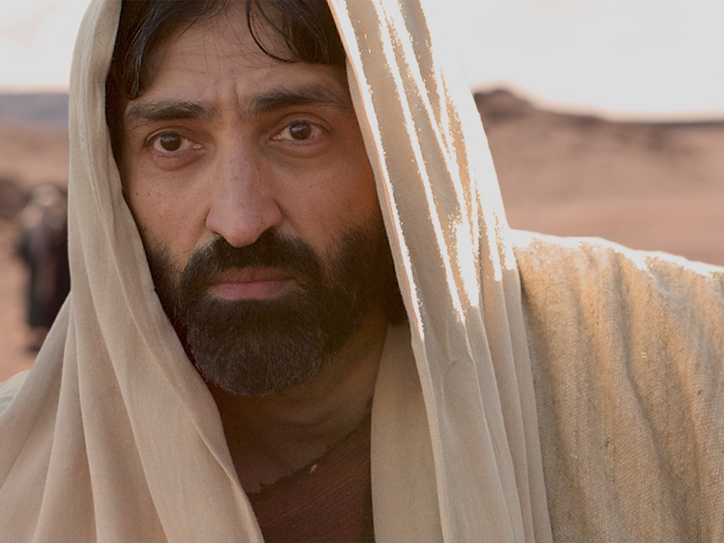
Renounce Your Reputation (Matthew 10:24-25)
“A disciple is not above his teacher, nor a slave above his master. ²⁵ It is enough for the disciple that he become like his teacher, and the slave like his master. If they have called the head of the house Beelzebul, how much more will they malign the members of his household!" (NAU).
Notes:
What does this difficult statement convey? The Pharisees accused Christ of being controlled by Satan, or Beelzebub. Our Lord warned His followers here that if that's what the world thought of Jesus, then they would not consider His followers highly either, since "a disciple is not above his teacher." A genuine disciple is willing to be demeaned like this because his chief concern is to please God, not men.

Slide 16
I. A disciple is totally committed to Christ.
Notes:
[A disciple shows complete allegiance to Christ with Him first in their life.]
(These four things, which disciples must renounce, mean a disciple demonstrates commitment. There's yet a second primary characteristic of the faithful follower of Christ…)

Slide 17
II. A disciple obeys Christ.
Notes:
[True discipleship involves following Christ in the specifics.]
How do we obey to prove our loyalty to Christ as followers? We'll look at passages 5-7 for the answer.

Slide 18
A. A disciple obeys by remaining in God's Word (John 8:31).
Notes:
The guiding force in his life is the Bible.

Slide 19
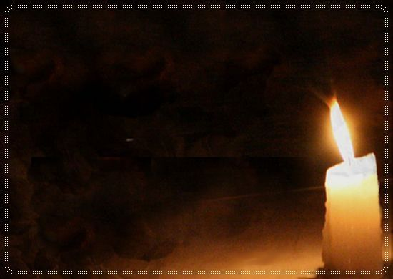
A Disciple Obeys Christ
"Then many who heard him say these things believed in him.
³¹ Jesus said to the people who believed in him, 'You are truly my disciples if you remain faithful to my teachings. ³² And you will know the truth, and the truth will set you free'" (John 8:30-32).
Notes:
When it really comes down to it, what is the real source of authority in your life? When faced with a difficult decision, when people tell us one thing but the Bible says something else, what does it take to get you to go against the Word?
While I was in seminary, my wife's Christian boss fired her from her job. Another brother in Christ recommended that we get a good lawyer and take him to court. Such counsel is totally contrary to 1 Corinthians 6. A faithful follower of Jesus remains in God's Word -- knows it, believes it, and obeys it.

Slide 20
B. A disciple obeys by loving other Christians (John 13:34-35).
Notes:
A faithful follower shows selfless commitment to other believers.

Slide 21

A Disciple Loves Believers
"So now I am giving you a new commandment: Love each other. Just as I have loved you, you should love each other. ³⁵ Your love for one another will prove to the world that you are my disciples" (John 13:34-35).
Notes:
Shocking as it may seem, oftentimes there is more love shown at the local bar than there is in the church. We're mistaken if we think people go to the bar only to get drunk. Many times, there's a genuine sense of fellowship there where people can take their masks off, share problems, hurts, and concerns, get counsel, etc., while at the church, one finds backbiting, division, self-centeredness, and hypocrisy.
Christ said that true disciples love other believers to the point that the world marvels at their love for one another.

Slide 22
C. A disciple obeys by showing compassion to the helpless (Matt. 10:42).
Notes:
Genuine believers obey by meeting the needs of the humble.

Slide 23

A Disciple Shows Compassion (Matthew 10:42)
"And whoever in the name of a disciple gives to one of these little ones even a cup of cold water to drink, truly I say to you, he shall not lose his reward." (NAU).
Notes:
"Little ones" can also be translated as "humble folk" in this context. Hence, the idea is that genuine believers obey by meeting the needs of the humble, whether that be giving cold water, their time, their abilities, or whatever.

Slide 24
I. A disciple is totally committed to Christ.
Notes:
[A disciple shows complete allegiance to Christ with Him first in their life.]

Slide 25
II. A disciple obeys Christ.
Notes:
[True discipleship involves following Christ in the specifics.]

Slide 26
III. A disciple disciples.
Notes:
[A disciple develops other followers of Jesus.]

Slide 27
A. A disciple makes disciples (Matt. 28:19-20).

Slide 28

A Disciple Makes Disciples (Matthew 28:19-20)
"Jesus came and told his disciples, 'I have been given all authority in heaven and on earth. ¹⁹Therefore, go and make disciples of all the nations, baptizing them in the name of the Father and the Son and the Holy Spirit. ²⁰Teach these new disciples to obey all the commands I have given you. And be sure of this: I am with you always, even to the end of the age.'"

Slide 29
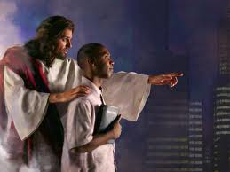

The Great Commission
Matthew 28:18-20
¹⁸Then Jesus came to them and said, "All authority in heaven and on earth has been given to me. ¹⁹Therefore go and make disciples of all nations, baptizing them in the name of…, ²⁰and teaching them to obey everything I have commanded you. And surely I am with you always, to the very end of the age."
Notes:
Christ has all authority but he extends some of it to us as people under his authority. It may appear that there are four commands here, but "make disciples" is the only command here. This happens by us also obeying the three participles: going, baptizing, and teaching.

Slide 30
B. A disciple brings others to Christ (John 15:8).

Slide 31
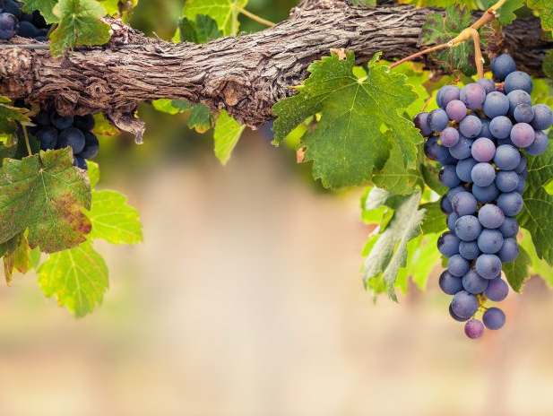
I am the Vine
You are the branches
15
Those who remain in me, and I in them, will produce much fruit. For apart from me you can do nothing.
John 15:5 NLT

Slide 32
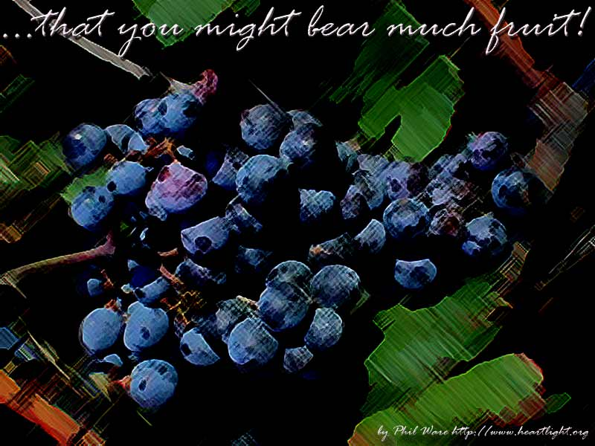
What is the "fruit"?
15

Slide 33
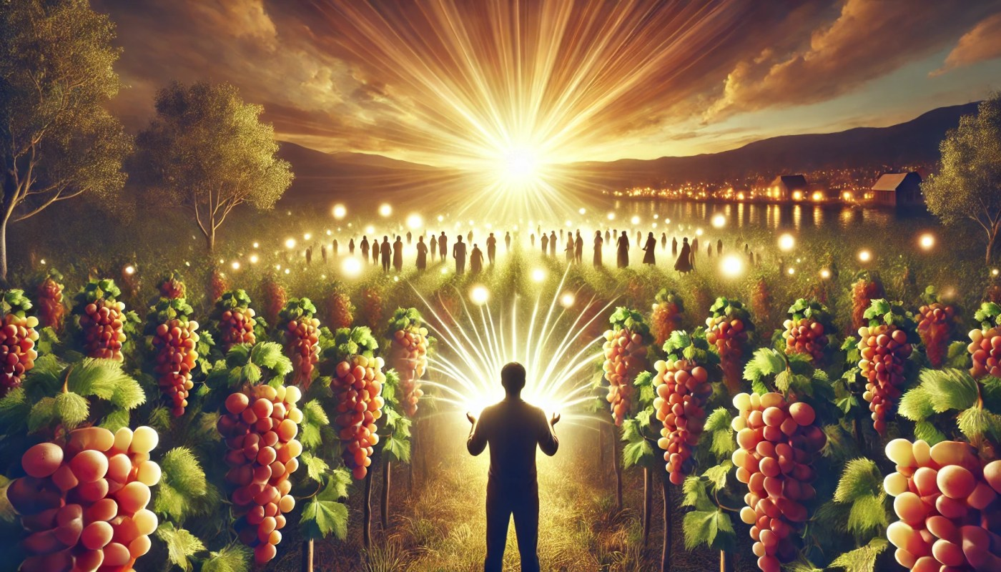
A Disciple Brings Others to Christ
(John 15:8)
"When you produce much fruit, you are my true disciples. This brings great glory to my Father."
Notes:
The fruit is the reproductive part of the plant that contains the seeds, so Jesus is saying that we prove ourselves as His followers when we reproduce, or bring others into the family of God.

Slide 34
C. A disciple teaches others (Matthew 13:52).

Slide 35
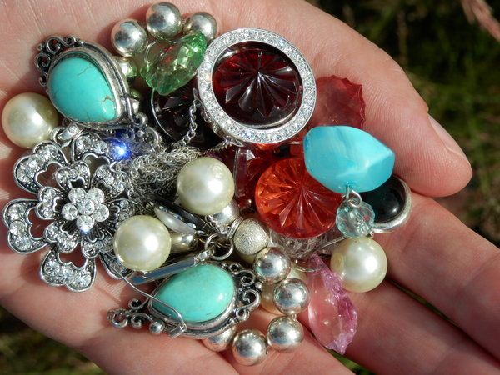
A Disciple Teaches Others
(Matthew 13:52)
"…Every teacher of religious law who becomes a disciple in the Kingdom of Heaven is like a homeowner who brings from his storeroom new gems of truth as well as old.”
Notes:
This verse teaches that all who know about heavenly things should share this knowledge with others, teaching what they have previously known, as well as the new truths they have recently discovered. If you're not passing on what you've learned to someone else, then you're not fulfilling God's requirements of a disciple.

Slide 36
What is a disciple?
Notes:
Here is the question we have sought to answer today.

Slide 37
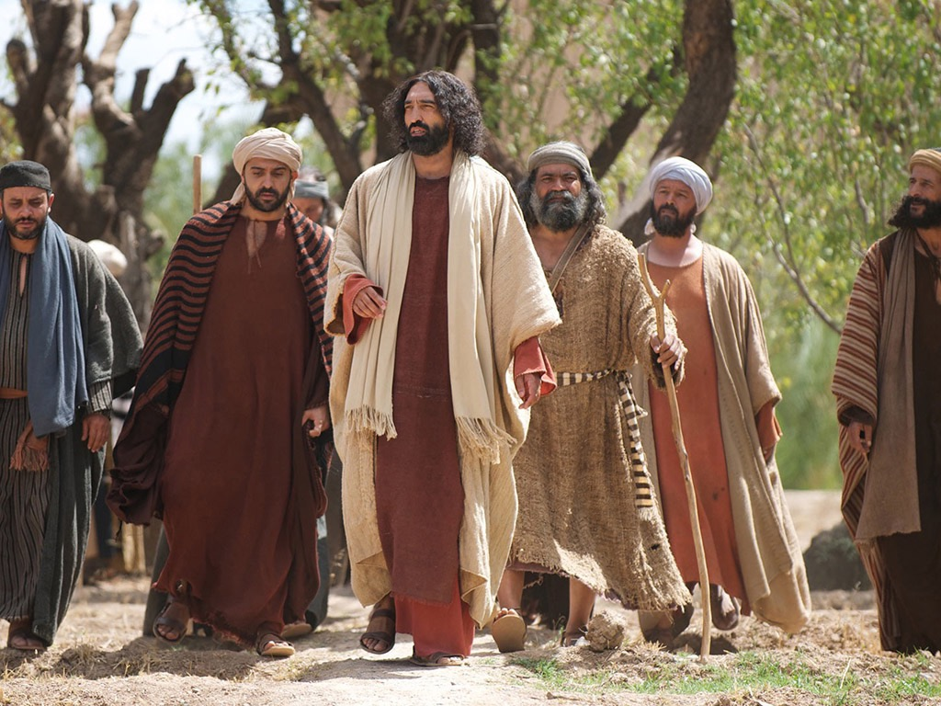
Main Idea
A disciple shows commitment, obedience, and disciplemaking
Notes:
A genuine follower of Jesus puts Jesus first, obeys Him, and multiplies.

Slide 38
I. A disciple is totally committed to Christ.
Notes:
[A disciple shows complete allegiance to Christ with Him first in their life.]

Slide 39
II. A disciple obeys Christ.
Notes:
[True discipleship involves following Christ in the specifics.]

Slide 40
III. A disciple disciples.
Notes:
[A disciple develops other followers of Jesus.]

Slide 41

What About You?
How can you have these qualities as a disciple of Jesus?
• Join a small group
• Commit to disciple someone
Notes:
First, join a small group to hold you accountable each week in your commitment and obedience to Christ. This is what Christ did with the Twelve. He spent time with them, they shared their lives, and they ministered to and with one another. We're no different today. There's nothing like setting individual goals in a small group and having the group hold you accountable in specific areas of commitment and obedience.
Also, commit to disciple at least one other individual to multiply yourself. Be involved in his or her life regularly to pray together, to dig into the Scriptures, and to impart skills such as how to have a quiet time and how to witness. Remember that a true disciple is involved in disciplemaking! A person who's not involved in fulfilling the Great Commission is fooling himself if he thinks he's a disciple.
Let's not fool ourselves that we’re disciples just because we're Christians. There's a vast difference between the two that the world needs to see. Let's let them see it in us.

Slide 42
Black

Slide 43


Discipleship link at BibleStudyDownloads.org
Get this presentation for free!
Notes:
Discipleship (di)

