Slide 1
The Vision
The Ministry Map
The Core Beliefs
The Mission
Taught by Dr. Gordon Penfold for Doctor of Ministry Students Uploaded by Dr. Rick Griffith • Singapore Bible College Files in many languages for free download at BibleStudyDownloads.org
Notes:
The Mission—make disciples. Core Beliefs tie the mission to the vision. The Ministry Map provides the structure. The Vision carries the mission.

Slide 2
Developing Biblically Based Vision
And Ministry Map
Notes:
Many churches have more of a plan for hosting a wedding than they do a plan for reaching their communities with the Gospel. Same with Christmas program, 4th of July picnics and serving in the kitchen.

Slide 3
Review of Key Concepts
Core Beliefs
Core Values/Core Behaviors
Mission
Vision
Alignment

Slide 4
Churches and pastors and ministry leaders are often confused as they consider where they should go and how they should minister.

Slide 6
By way of reminder, here are some descriptions of Core Beliefs and Core Values/Behaviors.

Slide 7
Key Concepts
What are Core Beliefs?
Core beliefs are those beliefs that significantly impact who you are
Core beliefs “define” who you are.
If someone read your core beliefs and knew nothing else about you, they would know who you are at your very center.
If one of your Core Beliefs were not true, was changed or removed you would cease to be who you are.

Slide 8
Key Concepts
What are Core Beliefs?
Core beliefs are the biblical foundation for all you do.
You do what you do because you believe these things are true.
Core beliefs impact, in some way or another, virtually everything you do.

Slide 9
Key Concepts
What are Core Values/Behaviors?
Ministry principles by which you live
The things for which you will spend your lives
The values/behaviors for which you are prepared to die
One Core Value/Behavior per Core Belief
Core Values are what we will DO in light of what we believe.
Notes:
Pastor Cleophas in Kenya—died preaching the Gospel, March 3, 2017

Slide 10
The Role of Mission, Values and Vision in Transformational Leadership

Slide 11
Purpose answers the question “why?” The over-arching reason. The telos. The end result we strive to accomplish.
Mission answers the question “what?”
What is to occur to lead to the fulfillment of the Purpose, to get to the ultimate goal?
Notes:
See Holyoke envisioning process for the description of purpose, mission and vision

Slide 12
Vision answers the question “how?”
With both the purpose (telos) and the mission (what) in mind, vision paints a picture of the path to get there.
Notes:
See Holyoke envisioning process for the description of purpose, mission and vision

Slide 13
Please write down the core values for your church or your ministry.

Slide 14
Please write your vision for the church or the ministry where you serve. Be as clear and succinct as possible.

Slide 15
The Vision
The Ministry
Map
The Core Beliefs
The Mission
Notes:
The Mission—make disciples. Core Beliefs tie the mission to the vision. The Ministry Map provides the structure. The Vision carries the mission.

Slide 16
Churches and pastors are often confused as they consider where they should go and how they should minister. They are not clear concerning Mission and Vision.

Slide 18
Foundations for Developing a Vision for Yourself and the Church You Pastor
1. Understand (know) God--Be Deeply Immersed in the Word of God and Prayer
2. Understand (know) your Gifting and how the Lord has wired you for leadership
3. Understand (know) your Congregation

Slide 19
4. Understand (know) your Community
5. Understand the Enemy of our Souls
6. Understand your mission
7. Count the cost

Slide 20
What is Ministry Mapping?
This is a process that involves several steps:
It begins with the mission of the church
In the process we identify the core beliefs of the church.
From the core beliefs come core values.
An action plan is developed from the core values and the mission

Slide 21
Other Names for the Process
Also called “Envisioning”
Strategic Planning

Slide 22
What is Ministry Mapping?
Brief History of Strategic Planning
Great Mission and Vision Statements
No impact
Mission and Vision Statements don’t motivate
Values motivate
Clarify and articulate your values
Notes:
Duane Boady—we value youth. Why? Because they are the future of the church. Yes. But why? Because people matter to God.

Slide 23
Two Problems
Typical Strategic Planning
Does not start far enough back
Does not go far enough forward
Notes:
--Does not start far enough back
The “Christian” addition
We are people of the Book
Must start with the Bible
We must start with Core Beliefs
Does not go far enough forward
Stops short of goals and action steps
“Annual Plan”

Slide 24
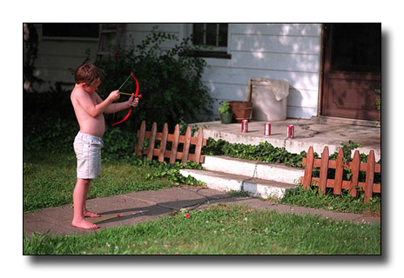
Why Create A Ministry Map?
To achieve greater ministry effectiveness by taking aim and focusing on the target

Slide 25
Why Create A Ministry Map?
To create unity around a commonly understood, widely supported mission and vision
“The problem with most churches is not a lack of vision, but too many visions” (Leith Anderson)
Notes:
CBA Meetings, Spokane, WA 2001

Slide 26
Why Create A Ministry Map?
Judges 21: 25 In those days there was no king in Israel; everyone did what was right in his own eyes.

Slide 27
Why Create A Ministry Map?
To achieve greater effectiveness and satisfaction by establishing specific ministry plans and clear ministry outcomes

Slide 28
Why Create A Ministry Map?

Slide 29
The Mapping Process Results In:
Core Beliefs briefly stated and effective for teaching your people the basic truths upon which your church stands and ministers
Core Values based on your Core Beliefs insuring that your church keeps the main things the main things
A sound Biblical understanding of your church’s Mission

Slide 30
Notes:
Jeff Giles bumper sticker

Slide 31
The Mapping Process results in:
A clear, concise and compelling Vision of what it will look like as your church fulfills its God-given Mission
A focus that leads to ministry effectiveness by enabling you to evaluate everything you do by its contribution to your accomplishing your Mission and Vision

Slide 32
Fundamentally Spiritual Process
We build upon their Biblical beliefs
We are guided by their core values
We agree on their Biblical mission
We bathe the process in prayer
We seek the Spirit’s wisdom

Slide 33
Listening Process
Listen to God through Scripture
Listen to God through His Spirit (Prayer)
Listen to each other
Listen to knowledgeable and experienced people as they lead the process

Slide 34
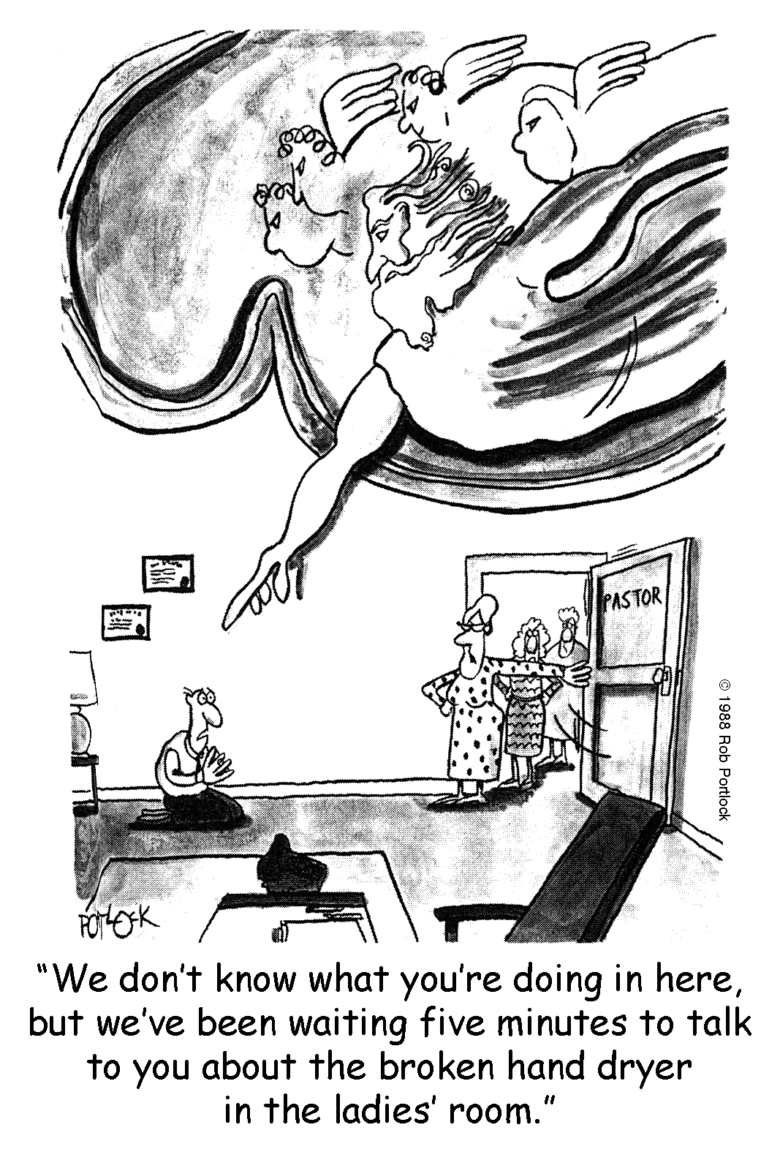
"We don't know what you are doing here but we have been waiting 5 minutes to talk to you about the broken hand dryer in the ladies' room."

Slide 35
The Process
Option 1:
Takes 6-8 days
Friday (5:00 PM – 9:30 PM)
All day Saturday (8:30 AM – 5:00 PM)
Schedule the dates
Coach them on the Team make-up
Obtain contact information for Team members

Slide 36
The Process
Distribute Primary Teaching Passages and Instructions
Collect their initial attempts at writing Core Beliefs
Sharpen their Core Beliefs
Develop their Core Values
Create the Ministry Map

Slide 37
The Process
Option 2
Share the process with the church or ministry
Ask people to look at the passages and state the essential truths that each passage teaches in the particular area of study.
Encourage church members to write out their own statements of Core Beliefs
Bring the results to the study group that will develop the core belief statements.

Slide 38
The Process
Teach the planning process
SMART Goals
S
M
A
R
T
Notes:
More on this later

Slide 39
The Process
Teach the planning process
SMART Goals
Specific
Measureable
Aligned
Results-oriented
Time-constrained

Slide 40
Most Churches
10
9
On a mission
4
1
7
3
6
8
Courtesy of Ken Bratz, Leadership Resources and Consulting
5
2
Current Situation
Notes:
FBC Douglas. When I showed this slide, a woman immediately rose and left the room. This church had just experienced a devastating split. I thought to myself, “What have I done now?” She returned tso the room and held up the church‘s organizational chart and pointed at this slide and said, “That’s our organizational chart!”

Slide 41
The Process
Create the Annual Plan
One or two primary SMART Goals
From Key Measurement Areas
Conversions
Attendance
Assimilation
Lay Involvement
Small Group Involvement
Leader Development
Tithers

Slide 42
The Process Diagrammed
Plan It / Do It / Measure It
ORGANIZATIONAL PLAN
ORGANIZATIONAL DEVELOPMENT
ORGANIZATIONAL RESULTS
Strategic Analysis
Vision & Strategy
Strategic Objectives
Integrated Tactical Plans
Leadership
Motivation
Productivity
People Skills
Indicators of Performance
Monthly Strategic Review
Performance vs. Plans
Corrective Action
Courtesy of Ken Bratz, Leadership Resources and Consulting

Slide 43
KRA
Conversion
Attendance
Assimilation
Lay Involvement
Small Groups
Leader Development
Tithers
Annual Plan
Action Steps
Goals
Key Result Areas
Vision
Mission
DNA
Core Values
Core Beliefs
Notes:
DNA is lacking or not recognized in many churches. Asked church, . “What is the purpose of this church?” Jerry K., “We have no idea. Can you help us in this area?”

Slide 44
What is Ministry Mapping?
Core Values
Your Community needs
Vision
Core Beliefs
The Mission
Ministry Map (Plan)

Slide 45
Focusing on the Mission

Slide 46
The Mission
Notes:
The Mission—make disciples. Core Beliefs tie the mission to the vision. The Ministry Map provides the structure. The Vision carries the mission.

Slide 47
Mission Statement
Your God-given task
Biblically based
Unchanging
Churches do not get to pick their mission
The Church’s mission is the Great Commission

Slide 48
What is our Mission in the Church?
"Go therefore and make disciples of all the nations, baptizing them in the name of the Father and of the Son and of the Holy Spirit, teaching them to observe all things that I have commanded you; and lo, I am with you always, even to the end of the age." Amen.—Matthew 28:19-20

Slide 49
Mission Statements

Slide 50
Mission Statement
Many churches simply say, “We exist to make mature (obedient) disciples.”

Slide 51
Mission Statements
We live to transform lives by following and proclaiming Jesus Christ as Savior and Lord.
Our mission is to help people know Christ and grow to be like Him.
We exist to be a community which enables people from all backgrounds to become mature followers of Jesus Christ through the power of the Holy Spirit.

Slide 52
Mission Statements
We exist to equip God's people to do His work in His world.
We exist to carry out the Great Commission, live out the Great Commandment, and serve the Great Commander.
We are a family of faith, lovingly adopting lost children.

Slide 53
Mission Statement
“The purpose of our church is to glorify God by finding, keeping and building people.”
Gary McIntosh, One Size Doesn’t Fit All

Slide 54
Mission Statement
“Our mission is to make more and better disciples.”
Holyoke, Colorado

Slide 55
The Core Beliefs
The Mission
Notes:
The Mission—make disciples. Core Beliefs tie the mission to the vision. The Ministry Map provides the structure. The Vision carries the mission.

Slide 56
Focusing on Core Beliefs

Slide 57
Core Beliefs are not . . .
Clarity begins by understanding what they are NOT.
Core beliefs are not a comprehensive recitation of fundamental theological beliefs.
Core beliefs are not a doctrinal statement rehearsing your entire belief system.
Core beliefs are not your statement of faith.
Core beliefs are not values. Values flow from your core beliefs.
Notes:
Jim K. I think its foolish to do this! Why? We’re getting people in the Word at more than a superficial level. Were not plugging in a video. We are having people wrestle with core beliefs. How can that be foolish?

Slide 58
IVY HILL CHURCH MEMBERSHIP CLASS
CREEDAL STATEMENT
DUTIES & OBLIGATIONS
THEOLOGICAL VOCABULARY
WORSHIP ETIQUETTE
PARKING PROCEDURES
DRESS CODE
UNSPOKEN EXPECTATIONS
"Some churches use the acronym TULIP to remember their beliefs. We use CHRYSANTHEMUM."

Slide 59
Core Beliefs Are . . .
Core beliefs are those beliefs that significantly impact who you are
Core beliefs “define” who you are.
If someone read your core beliefs and knew nothing else about you, they would know who you are at your very center.
If one of your Core Beliefs were not true, was changed or removed you would cease to be who you are.

Slide 60
Core Beliefs are . . .
Core beliefs are the biblical foundation for all you do.
You do what you do because you believe these things are true.
Core beliefs impact, in some way or another, virtually everything you do.

Slide 61
State Core Beliefs . . .
Briefly.
As simply as possible. These are not comprehensive statements articulating the nuances of a biblical truth or doctrine.
Avoid obscure theological terms, Christian terminology and “churchy” language.

Slide 62
State Core Beliefs . . .
Think “Common Language”, in the sense that an unchurched person just off the street could readily understand.

Slide 63
How Do We State Core Beliefs?
Use words that will create a teaching moment.
They open doors for further conversation.

Slide 64
Core beliefs are used to . . .
They are…
The “leading edge” of declaring a vital, deep and often complex Biblical truth.
“Taught through” annually.

Slide 65
How Are Core Beliefs Used?
They are…
Printed and are used a part of the process of “introducing” the church to an inquirer or potential member. They would be reviewed as part of a new member orientation process.
Part of a cluster of “defining declarations” – your Core Beliefs, Core Values, Mission and Vision Statements.

Slide 66
Focusing on Core Values

Slide 67
Core Values
Not an academic statement listing your entire value system
Identification and articulation of those values that significantly impact who you are and what you do
The things that motivate you and shape what you do, not what you say

Slide 68
Core Values
Ministry principles by which you live
The things for which you will spend your lives
The values you are prepared to die for
One Core Value per Core Belief
More brief than Core Beliefs
Core Values are what we will do in light of what we believe.

Slide 69
Core Values
The verbal construct…
Not “We believe...,” “Therefore we value…”
“We believe…,” “Therefore we will…”
Express values in terms of behavior

Slide 70
Core Values—The Process
Each person writes a statement on their own
The team puts all the statements together
The team shows them all
The team formulates one statement—a core belief
Then a team member or facilitator works to sharpen the wording

Slide 71
Facilitator’s Position Description
Assignment
Create a “Ministry Map” which will guide the Church in its ministry planning and implementation over the next three to five years.
The “Ministry Map” will be the foundation upon which the church’s staff (Paid and unpaid, full and part time) will build their Annual Ministry Plans.

Slide 72
Facilitator’s Position Description
Tasks
The “Ministry Map” is comprised of the church’s Core Beliefs and Values, Mission and Vision Statements,
The Mapping Team will work together to:
Identify and articulate the church’s Core Beliefs
Identify and articulate the church’s Core Values
Clarify the church’s Mission
Articulate the church’s Vision

Slide 73
Mapping Team Makeup
Not less than 5 and not more than 9
Mixture and Balance of…
Long-timers and relatively new but involved
Pastoral staff (minimally Senior or Transitional Pastor)
Governing Board Members
Ministry Leaders
Systems thinkers
People who are good with words

Slide 74
Mapping Team Makeup
Personal Qualities
Cooperative and collaborative
Verbal people, good with words
Willing to speak up and lobby for their viewpoint
Cannot be:
Argumentative
Domineering
Judgmental
Rigid

Slide 75
Mapping Team Makeup
Personal Qualities
Biblically literate (Knowledgeable)
Theologically astute (Insightful)
Person who tends to think “outside the box”
Sees things from “different” point of view
Readily sees alternatives
Flexible and creative
Deeply committed to the church
Happy to be part of the mapping process

Slide 76
Preparatory Materials
Primary Teaching Passages
God
God the Father
God the Son
God the Holy Spirit
Bible
Humankind, Sin, Salvation
Church
Worship
Prayer

Slide 77
Beginning the Process
Initially your envisioning team, individually and together, will spend time reading, studying and meditating on these primary teaching passages of Scripture. After having spent time with these Scriptures have each team member write a brief Belief Statement for each of the following areas. “Brief” means Nine words or less, not counting the “I believe.”
God the Father—email me by . . .
Jesus—email me by . . .
Holy Spirit—email me by . . .
Etc.

Slide 78
Coaching the Process
Your role is to:
Frame the discussion
Guide the discussion
Move the process along
Develop sense of when to let the discussion go and when to cut it off and force a decision
Vote early and often
Help them with clarity in writing

Slide 79
Coaching the Process
Remember, in the end…
The work must be theirs

Slide 80
Coaching the Process
Brevity is mandatory. We will use enough words to say it well but not one word more
Core Beliefs are typically stated in 15 words or less
Core Values are typically stated in 8 words or less

Slide 81
Coaching the Process
Great scientific insights are measured in paragraphs and pages.
In 1923 Louis de Broglie provided one of the fundamental insights of quantum mechanics in a four page paper.
Einstein’s theory of relativity was encapsulated in a series of five articles totaling 75 pages.
Lincoln’s Gettysburg Address , one of the greatest speeches in US history, was given in just over two minutes.

Slide 82
Coaching the Process
Avoid wasted words (like “that”) and superfluous adjectives
Avoid “churchy language,” Christian jargon, unnecessary Biblical or theological words
State Biblical and theological concepts in words that the unsaved, unchurched, untaught and uninitiated can readily understand

Slide 83
Coaching the Process
Use Biblical and theological words when…
They are the clearest, most accurate and richest words we can think of
The concept is so fundamentally crucial that we intentionally want to create “a teaching moment”
Notes:
In Holyoke, I used the term, “substitutionary atonement.” Mark Farnsworth said, “Pastor, I don’t think people will understand this.”

Slide 84
Coaching the Process
Whenever possible use present tense, active voice verbs
Avoid verbs like “is,” and “are” in favor of verbs like wants, loves, directs, frees, calls, sends, saves, instructs, etc.
Avoid lists

Slide 85
Breakout Session

Slide 86
Core Beliefs and Core Values
Write out a core belief statement about God followed by a core value statement.

Slide 87
One, Comprehensive Statement
We believe God, the loving Father, Son and Holy Spirit wants all people to be saved.

Slide 88
One, Comprehensive Statement
We believe there is one true God: Father, Son and Holy Spirit as revealed in the Bible.

Slide 89
One, Comprehensive Statement
We believe the God of grace and love desires to be in relationship with all people.

Slide 90
Three Statement Model
God the Father is the creator and sustainer of all.
God the Son, Jesus Christ, purchased our forgiveness and frees us to live Christ-centered lives.
God, the Holy Spirit, gifts us with faith and empowers us for a life of love and service.

Slide 91
Four Statement Model
The only true God lives eternally in community as Father, Son and Holy Spirit.
The Father creates all people for a loving relationship with Him.
Jesus, through His death and resurrection enables sinful people to enjoy a life-changing relationship with the Holy God.
The Holy Spirit lives in all Christ-followers molding them into His likeness and empowering them to serve others.

Slide 92
Four Statement Model
The eternal, triune God is:
Father Almighty, Creator and Master of all
Jesus the Son, the crucified, risen and reigning Savior
Holy Spirit who creates faith, motivates for mission and empowers for fruitful service

Slide 93
Developing Vision

Slide 94
The Vision
The Core Beliefs
The Mission
Notes:
The Mission—make disciples. Core Beliefs tie the mission to the vision. The Ministry Map provides the structure. The Vision carries the mission.

Slide 95
Mission Vision
Definition: statement snapshot
Application: planning communication
Length: short short/long
Purpose: informs inspires
Source: head heart
Development: taught caught

Slide 96
What is vision?
A vision is a “clear and challenging picture of the future of a ministry as you believe that it can and must be.”—Aubrey Malphurs
“Moving a church in a direction by passion—that’s vision.”
Bob Humphrey

Slide 97
Vision
Vision is a word picture of what it will look like when you accomplish your mission

Slide 98
Vision
The legendary Walt Disney died before Disney World in Florida was completed. On opening day in 1971, almost five years after Disney’s death, someone commented to Mike Vance, creative director of Walt Disney Studios, “Isn’t it too bad Walt Disney didn’t live to see this?”
“He did see it,” Vance replied simply. “That’s why it’s here.”
Craig Groeschel, IT: How Churches and Leaders Can Get It and Keep It, 48

Slide 99
Vision Statement Principles
Flows from and is consistent with your foundational beliefs, core values and mission
More specific, more distinctive and more “unique” than a mission statement
Brief
Understandable without interpretation

Slide 100
Vision Statement
The church must have a single, clear, concise, widely-known, broadly accepted Vision
A good Vision is compelling
The larger the church, of necessity, the sharper the statement

Slide 101
Vision Statements
Ten percent of Prior Lake’s population will be in weekly contact with our church where they will become partners in God’s plan to shape our community, country and world.
We envision a growing movement of transformed people reshaping the culture to reflect God’s heart—Waterstone Church

Slide 102
Vision Statements
Our Vision is to be a community of people who love Christ, live like Christ, serve Christ and share Christ.
We see FBCP in the heart of the community with the
Sanctuary filled with worshippers
Building filled for God’s purposes
Community filled with transformed lives and
World filled with disciples who share Christ’s love.

Slide 103
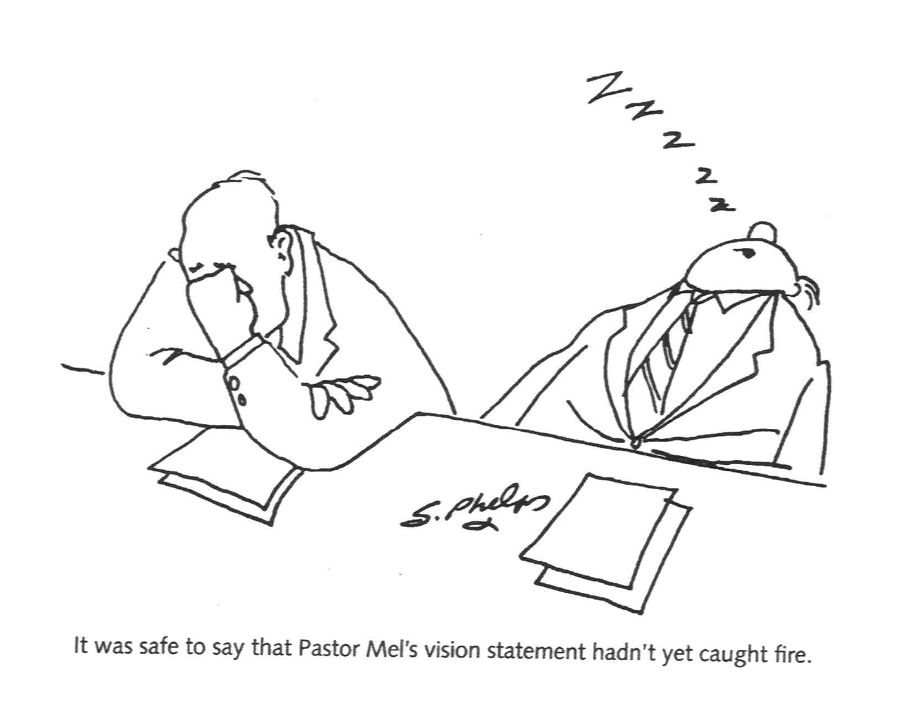
It was safe to say that Pastor Mel's vision statement hadn't yet caught fire.

Slide 104
The Value of Vision
Vision has value only when it…
Shapes our thinking
Aligns what we do
Focuses our efforts
Helps Keep the Main Thing the Main Thing
Results in the making of mature disciples
The Missing Catalyst – Transformational Vision

Slide 105
The Value of Vision
Dramatically changes church’s behavior
Shortens the distance between the idea and the implementation
Transforms the church…
Notes:
Transforms the church…
From inward focus to outward focus
From a culture of activity to culture of effectiveness
From a Country Club to Missional Outpost
From merely having the form of Godliness to living in His power (2 Timothy 3:5)

Slide 106
Transformational Vision
Three Areas
Outreach
Evangelism
Disciple-making

Slide 107
Transformational Vision
Outreach and Evangelism
Many see them as separate and unique
Others see them as interchangeable

Slide 108
Transformational Vision
They are NOT interchangeable
Outreach is just as its name implies – reaching out
A systematic attempt to provide services beyond conventional limits, as to particular segments of a community: an educational outreach to illiterate adults.
Evangelism is the communication of the Good News resulting in conversions

Slide 109
Transformational Vision
Outreach without evangelistic results is incomplete
And evangelism without outreach is ineffective
The biblical case for both…

Slide 110
Matthew 5:16
"Let your light so shine before men, that they may see your good works and glorify your Father in heaven."

Slide 111
Acts 2:44-47
"Now all who believed were together, and had all things in common, and sold their possessions and goods, and divided them among all, as anyone had need. So continuing daily with one accord in the temple…"

Slide 112
Acts 2:44-47
"…and breaking bread from house to house, they ate their food with gladness and simplicity of heart, praising God and having favor with all the people. And the Lord added to the church daily those who were being saved."

Slide 113
1 Peter 2:12
"having your conduct honorable among the Gentiles, that when they speak against you as evildoers, they may, by your good works which they observe, glorify God in the day of visitation" (cp. Luke 9:44—day of salvation)

Slide 114
Transformational Vision
The wedding of Outreach and Evangelism in practice
Bayside of Granite Bay (Sacramento, CA)
Good works…
Produces good will…
Giving opportunity for the Good News!

Slide 115
Transformational Vision
The wedding of Outreach and Evangelism in practice
Our Vision is
to Connect Intimately with God
To connect Deeply with one another
To connect Intentionally with those who need Christ by touching 1000 people annually with the love of Christ.
—Holyoke FBC

Slide 116
An Example
Establish a Goal
Create your Action Steps to achieve the Goal

Slide 117
Core Belief: Begin with your core belief statement about God.
State your core value.

Slide 118
Develop a Smart Goal related to your Core Belief and Core Value
Provide the actions steps necessary to accomplish your Core Belief

Slide 119
Core Belief: The eternal, almighty God longs to sovereignly connect with His creation to produce salvation.
Therefore, we will intentionally connect with people to point them to Christ.

Slide 120
The Lego Challenge

Slide 121
Designing Goals/Alignment
Dr. Lavern (Bud) Brown

Slide 122
God's Mission
Our Church
Our Community
Where God's Mission, receptive people we can reach and our church overlap

Slide 123
The Vision
The Ministry Map
The Core Beliefs
The Mission
Notes:
The Mission—make disciples. Core Beliefs tie the mission to the vision. The Ministry Map provides the structure. The Vision carries the mission.

Slide 124
Black

Slide 125
Church Transformation link at BibleStudyDownloads.org
Get this presentation for free!
Notes:
Church Transformation (ct)

