Slide 1
Leadership and Turnaround: Essentials of Church Transformation
Taught by Dr. Gordon Penfold for Doctor of Ministry Students Uploaded by Dr. Rick Griffith • Singapore Bible College Files in many languages for free download at BibleStudyDownloads.org

Slide 2
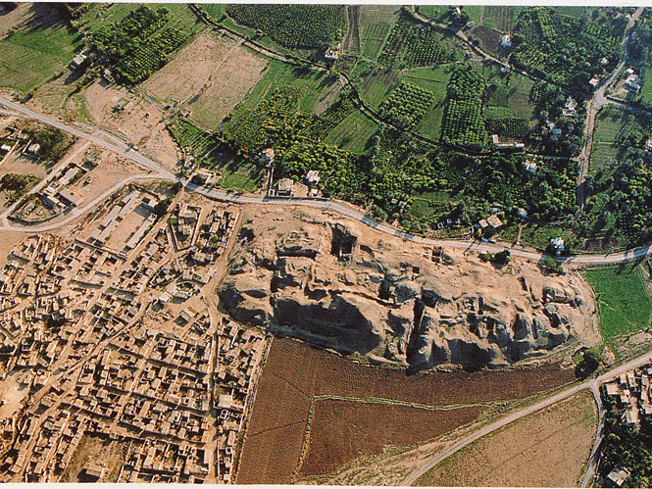
Tell Sultan

Slide 3
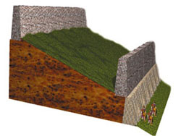
2nd Brick
Rampart
46 feet
6 feet thick,
20-26 feet high
12-15 feet high
Tell Sultan--Schematic cross-section diagram of the fortification system at Jericho based on Kenyon's west trench—AIG

Slide 4
How does one go about changing a dying church?
How does one go about leading a church that is off center?

Slide 5
The Downward Church Spiral (down is easier than up!) Second Law of Spiritual Dynamics

Slide 6
A Painful Reality!
In America, you have at least an 85% chance of pastoring a plateaued or declining church!

Slide 7
The Three Ds: The Backdrop for Re-envisioning Leaders
Understanding Your
Design
Direction
Development
Notes:
Three Ds provide background for how we lead and do ministry. Make up your leader development plan.
Many pastors spend the first 5-years of ministry trying to be someone else. You need to discover who you are and be the person God designed you to be!
We have surveyed pastors in all 50 states. Out of 146 pastors, 108 were in transforming churches. Of the 102 pastors, we have only found two pastors in transformational churches who were not leaders. In one church, the pastor had a visionary elder. In the second, the pastor had a visionary board. In all the remaining cases, the pastor was the lead.

Slide 8
Your Ministry Best Fit
Design: How God Made You
Direction: How God Leads You
How God
Develops You
Notes:
Design—How are you wired
Direction—Where are you going?
Development
We cannot control “design.” However, we can deal with Direction and Development.

Slide 9
Notes:
Pattern of Decline

Slide 10
Notes:
Pattern of Decline

Slide 11
Preparation for Ministry?
“When I graduated, I felt I had all the information I would need to accomplish all that God would demand of me as a pastor. I had a verse for everything. For the next few years, as an associate pastor over college students and as an itinerant preacher, I found very few gaps in my training and was extremely pleased with what I had paid so dearly for in money, hours and study.

Slide 12
“But, my perceptions changed quickly when I became the lead pastor of the Village. It didn’t take me long (about a month and a half) as a twenty-eight-year-old pastor to figure out that I had more to learn than I had time to learn. The gaps in my training weren’t biblical, theological, or even philosophical. My gaps were in the areas of leadership and people.

Slide 13
“In the five years of theological training we never talked about how to hire the right people or remove people who need to be removed. There was never a class on how to build a board or work with an existing board. There wasn’t one seminar offered on how to set salaries, conduct performance reviews, or create clear job descriptions.

Slide 14
“Although the Scripture taught me the spirit by which I was to interact with people and the grace I was to show even my enemies, I was at a loss regarding the practical aspects of leading a team—and a team of leaders at that.”
Larry Osborn, Sticky Teams, Keeping your leadership and staff on the same page, (Grand Rapids, MI: Zondervan, 2010), 13-14, In the foreword written by Matt Chandler.

Slide 15
Our Development
2 Timothy 3:14 But you must continue in the things which you have learned and been assured of, knowing from whom you have learned them,

Slide 16
Our Development
Philippians 3:9
The things which you learned and received and heard and saw in me, these do, and the God of peace will be with you.

Slide 17
Characteristics of Turnaround Pastors and Effective Leaders
In your church you must . . .
Embrace your mission - Matt 28:18-20
You must communicate God’s vision for your church with passion!
Notes:
Purpose: Evangelism, Exaltation, Worship, Edification, Service

Slide 18
Essential Keys for Turnaround
Seek the Face of God Neh 1
Pray and ask the Lord for His direction, for His vision Neh 1
We discovered that effective leaders don’t just jump in to complete a task. Rather, they pray, process and then act. Ineffective leaders do the just opposite.

Slide 19
Essential Keys for Turnaround
Survey the church situation (Nehemiah) —use a consultant or a coach if needed!
Develop great people skills

Slide 20
Essential Keys for Turnaround
Recognize your Employer!
Do not be a people pleaser, but a God pleaser
“The fear of man brings a snare, But whoever trusts in the LORD shall be safe.” Proverbs 29:25
Notes:
Problems with the candidating process. We sell our future just to get the position.

Slide 21
5. Recognize your Employer!
1 Thessalonians 2:4 But as we have been approved by God to be entrusted with the gospel, even so we speak, not as pleasing men, but God who tests our hearts.
Notes:
Problems with the candidating process. We sell our future just to get the position.
On the way here, Todd Musser asked, “What’s the greatest detriment to solid ministry on the part of the pastor?” I responded, “Insecurity.” As we continued to talk about issues with pastors, insecurity continually rose to the surface.”

Slide 22
Essential Keys for Turnaround
Preach well – Lifeway Christian Resources (LCR) (TAP—22 hours vs 4 hours for NTAP)
Make the most of your opportunities!

Slide 23
Essential Keys for Turnaround
Preach well – Remember that we are called to make disciples, not just make converts. Become a student of Scripture.
Whitefield vs. Wesley

Slide 24
“When I began to preach, people looked up to preachers. In New York City, the sermons of New York ministers were published in The New York Times. People admired the church . . . That was 65 years ago. Today that has changed. Today the preacher has lost the respect of the people, lost its authority. We live in a day in which the wind is against us. All the games are away games.”
--Haddon Robinson
Distinguished Professor, Gordon-Conwell Theological Seminary,4/27/12 at Biola University

Slide 25
Essential Keys for Turnaround
Meet people outside the church (TAP—5 hours sharing Gospel vs 0 hrs NTAP) (must behave like an extrovert—LCR)
Delegate responsibilities to others (NTAP - 33 hours in pastoral care, TAP - 10 hours -- LCR). (Social)
Develop a team

Slide 26
Essential Keys for Turnaround
Develop new leadership
Learn good conflict resolution skills
Become a problem solver
Seek a mentor or a coach

Slide 27
Essential Keys for Turnaround
Know your spiritual gift mix and use your primary gifts.
Empower others to use their gifts.
Lead without being domineering (directive, not passive).
You must be more “tell” than “suggest”

Slide 28
Essential Keys for Turnaround
Love the Lord and your people deeply!
Be more innovative than traditional.
Embrace necessary Change.
Notes:
The legendary Walt Disney died before Disney World in Florida was completed. On opening day in 1971, almost five years after Disney’s death, someone commented to Mike Vance, creative director of Walt Disney Studios, “Isn’t it too bad Walt Disney didn’t live to see this?”
He did see it,” Vance replied simply. “That’s why it’s here.”
Craig Groeschel, IT, How churches and leaders can get it and keep it, p 48.
Mark Johnson—do you love these people? (while pastoring a very difficult church)

Slide 29
Essential Keys for Turnaround
Be more of a leader than a manager (though both are necessary).
Count the cost for you, your spouse and your family!
Notes:
The legendary Walt Disney died before Disney World in Florida was completed. On opening day in 1971, almost five years after Disney’s death, someone commented to Mike Vance, creative director of Walt Disney Studios, “Isn’t it too bad Walt Disney didn’t live to see this?”
He did see it,” Vance replied simply. “That’s why it’s here.”
Craig Groeschel, IT, How churches and leaders can get it and keep it, p 48.
Mark Johnson—do you love these people? (while pastoring a very difficult church)

Slide 30
Turnaround Can Happen!

Slide 31
Attendance Charts from 1910- 2006 First Baptist Church, Holyoke

Slide 32
Attendance Charts from 1910- 2006 First Baptist Church, Holyoke

Slide 33
FBC Holyoke Attendance from 1988- 2014

Slide 34
Pass the Torch! 2 Timothy 2:2

Slide 35
Black

Slide 36
Church Transformation link at BibleStudyDownloads.org
Get this presentation for free!
Notes:
Church Transformation (ct)

