Slide 1
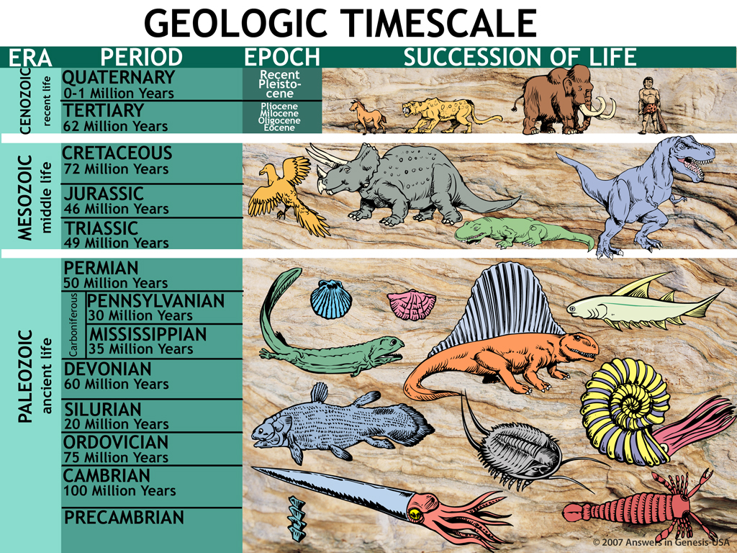

Geologic Timescale 00089
1.9—3.8 Billion Years
Millions of Years: Where did the idea come from?
According to Evolution
Designed by Dr. Terry Mortenson
Uploaded by Dr. Rick Griffith • Jordan Evangelical Theological Seminary
All files in many languages for free download at BibleStudyDownloads.org

Slide 2
Geologic Timescale 00089
1.9—3.8 Billion Years
According to Evolution

Slide 3

2 Corinthians 10:4-5 NAS
2 Corinthians 10:4-5
4. for the weapons of our warfare are not of the flesh, but divinely powerful for the destruction of fortresses.
5. We are destroying speculations and every lofty thing raised up against the knowledge of God, and we are taking every thought captive to the obedience of Christ,

Slide 4
Col. 2:8 NAS
Colossians 2:8
See to it that no one takes you captive through philosophy and empty deception, according to the tradition of men, according to the elementary principles of the world, rather than according to Christ.

Slide 5

Operation vs Origin science
Operation Science
vs
Origin Science
Notes:
As a content template, this is best suited for standard content such as outlines, quotations, Scriptures, and maybe illustrations or photos. Presentation Team recommends 48–60 pt. font for headings and 28–40 pt. for body text. Because of eye flow and visual psychology, the top line may be a little closer than all other sides. This also contains a floating AiG logo that can be repositioned or removed as appropriate for the overhead's content.

Slide 6
Operation science defined
OPERATION SCIENCE
“Scientific Method”
The use of observable, repeatable experiments in a controlled environment to discover patterns of recurring behavior in the present physical universe.

Slide 7

Observational Science 01160
EXPERIMENTAL
SCIENCE

Slide 8
Origin science defined
ORIGIN SCIENCE
The use of reliable, eyewitness testimony (if available) and circumstantial evidence to determine the cause(s) of some past, unobservable, singular event.
“Legal-Historical Method”

Slide 9

Historical Science painter 01159
HISTORICAL
SCIENCE

Slide 10

Car—origin vs operation
Car Mechanic
(Operation Scientist)
Car Manufacturer
(Origin Scientist)

Slide 11
New Theories of earth history
1770-1830
New Theories of Earth History

Slide 12
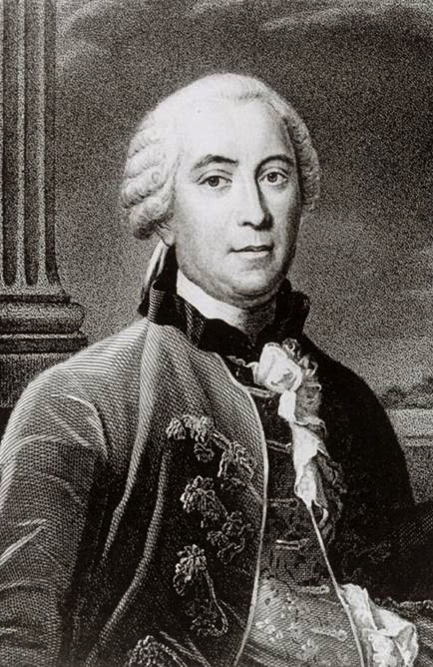

Purple blank
Comte de Buffon
(1707-1788)
Naturalist
Epochs of Nature (1778)
Notes:
Source: Ian Taylor
Wide-ranging scientist with writings in mathematics, zoology, botany, astronomy and physics
Based on cooling experiments with various metal balls he estimated that the earth was about 75,000 years old. But based on his limited knowledge of sedimentary rocks he estimated as long as 3 million years for the formation of the earth (the latter figure was only in his manuscript—the published version of the book had the lower number). Though he attempted to say that his seven epochs of earth history could be seven figurative days of creation, his views were not even acceptable to the Catholic authorities in France, who forced him to recant in writing everything in his works that contradicted the Biblical account of creation.
He believed that a comet slammed into the sun breaking off material that became the planets. Part of the early earth broke off to become our moon. He believed in spontaneous generation of the first forms of life.
Comparing a metal ball to the earth to estimate age is like comparing bananas to alligators. Both are long and narrow. A banana reaches its full size in about 3**** months and since the alligator is about 25**** times longer than a banana it must take 12.5**** years for the alligator to reach full size. In fact, it takes ******

Slide 13
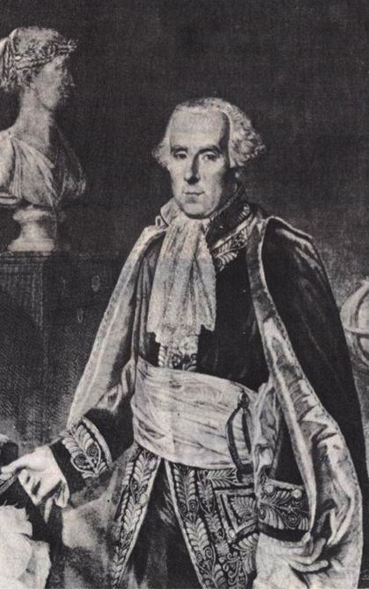
Purple blank
Pierre Laplace
(1749-1827)
Astronomer
Exposition of the System of the Universe (1796)
Notes:
Source: The Historical Perspective (Milton Keynes: Open University Press, 1973), p. 51.

Slide 14
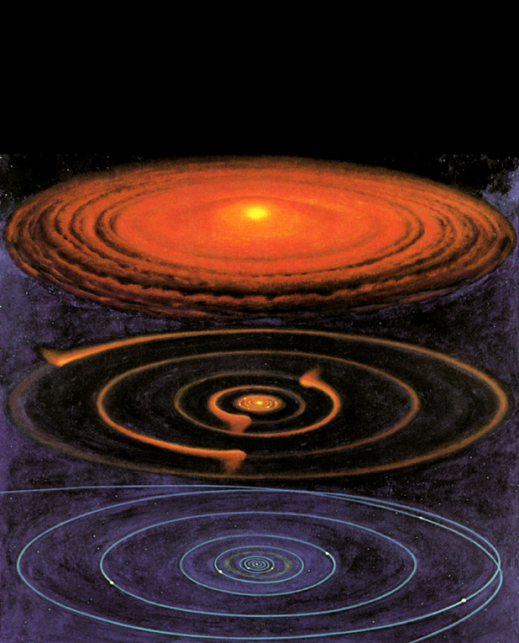
Nebular hypothesis
Nebular Hypothesis
Notes:
This hypothesis has no observational or experimental support, but it speculates that “the solar system was once a hot, spinning gas cloud, which over long ages gradually cooled and condensed to form the planets” (Morternson, CTGWG, 81-82).
Picture from Roy A. Gallant, National Geographic Picture Atlas of Our Universe (Wash. DC: National Geographic Society, 1986), p. 38. Similar to the diagram in Robert A. Wallace, Jack L. King and Gerald P. Sanders, Biology: the Science of Life (Glenview, IL: Scott, Foresman & Co., 1986), p. 426.

Slide 15
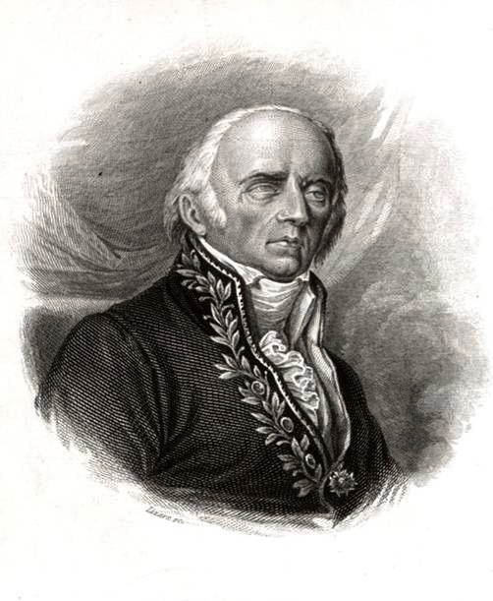
Purple blank
Jean Lamarck
(1744-1829)
Naturalist
Philosophy of Zoology (1809)
Notes:
Biological evolution 50 years before Darwin
Source: Ian Taylor

Slide 16
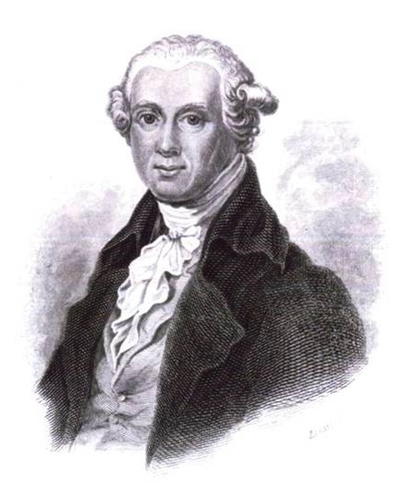
Purple blank
Abraham Werner
(1749-1817)
Mineralogy Professor
Short Classification & Description of the Various Rocks (1786)
Notes:
Source: Ian Taylor
Werner was very kind and helpful to his students but extremely dogmatic about this speculative theory of the earth. As such he had an enormous impact on his students, who swallowed his theory.
This book, based on very little observation, presented his theory of the earth of a slowly receding global ocean over a million years to explain the strata.

Slide 17
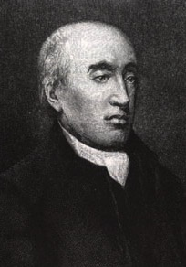
Purple blank
James Hutton (1726-1797)
Doctor,
Agriculturalist, Geologist
Theory of the Earth (1788, 1795)
Notes:
He proposed that the continents were slowly being receded into the oceans. “These sediments gradually hardened by the internal heat of the earth and then raised by convulsions to become new landmasses, which would eventually be eroded into the oceans, hardened and elevated. So in his view, earth history was cyclical, and in a famous statement which brought the charge of atheism from many of his contemporaries he said that he could find no evidence of a beginning in the rock record, which made earth history indefinitely long. He too pay little attention to the fossils in the rocks” (Mortenson, CTGWG, 82).
Source: unknown
Hutton's theory written in incomprehensible English was “translated” by John Playfair (mathematician at Univ. of Edinburgh) in Illustrations of the Huttonian Theory of the Earth (Edinburgh, 1802)

Slide 18
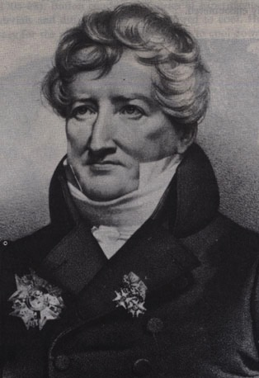
Purple blank
Georges Cuvier
(1769-1832)
Comparative Anatomist, Paleontologist
Theory of the Earth (1812)
Notes:
Source: The Historical Perspective (Milton Keynes: Open University Press, 1973), p. 68.
He believed multiple local or regional catastrophes. All the animals were not killed in these events and creatures migrated in after the events to repopulate the flooded areas.

Slide 19
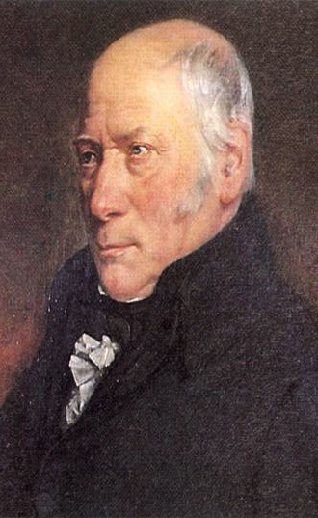
Purple blank
William Smith
(1769-1839)
Drainage Engineer, Surveyor, Geologist
“Father of English Stratigraphy”
Notes:
He was very involved in road work and discovered fossils on the way. He compared fossils from different places to estimate their age based on the rock layer.
Source: The Age of the Earth (London: Institute of Geological Sciences), p. 8.

Slide 20
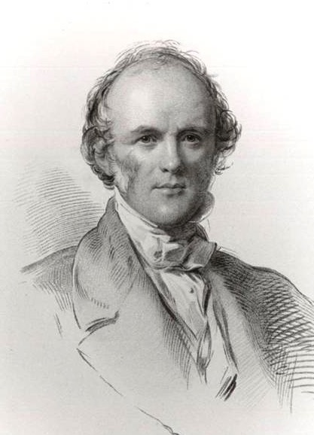
Purple blank
Charles Lyell (1797-1875)
Lawyer,
Geologist
Principles of Geology (3 vol., 1830-33)
Notes:
He invented the theory of uniformitarianism that taught the age of the earth by assuming that the present erosion rate has always been the same in the past.
Source: Ian Taylor

Slide 21

Old-earth theories (1778-1833)
Old-Earth Theories (1778-1833)
Buffon:
Laplace:
Lamarck:
Werner:
Hutton:
Cuvier:
Smith:
Lyell:
Cooling earth, 75,000 yrs.
Nebular hypothesis, long ages
Biological evol., long ages
Receding ocean, 1 mill. yrs.
Uniformitarian, no beginning
Catastrophist, long ages
Fossils date rocks, long ages
Uniformitarian, long ages
Notes:
Buffon's private notes indicate that he thought the earth was actually about a million years old, but he never published this as the Catholic Church already felt his 75,000 year estimate to be in conflict with Scripture.

Slide 22
Early 19C views of earth history new
Early 19th Century Views of Earth History
Catastrophist view (e.g., Cuvier, Smith)
SB
C
C
C
C
P
(millions of years)
Uniformitarian view (e.g., Hutton, Lyell)
SB?
P
(millions of years)
Biblical/Traditional view (Scriptural geologists)
SCW
F
P
(ca. 6000 years)
Notes:
SB = Supernatural Beginning
C = Catastrophic flood
P = Present
SCW = Supernatural Creation Week
F = Flood (Noah's)

Slide 23
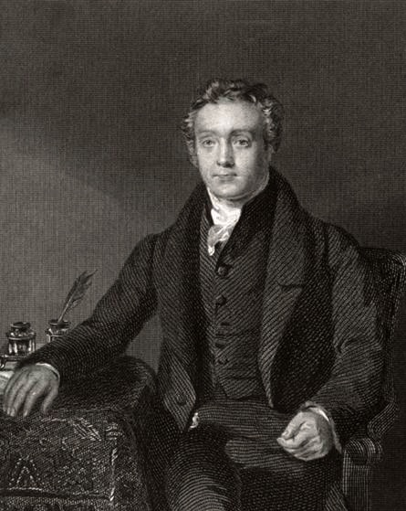
Purple blank
Thomas Chalmers (1780-1847)
Presbyterian Minister & Naturalist
Gap Theory
Notes:
Source: Ian Taylor

Slide 24
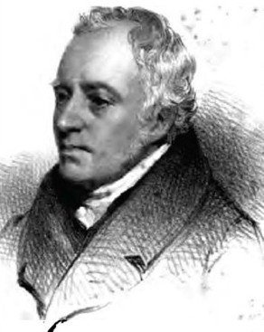
Purple blank
(1773-1854)
Anglican Theologian
Day-Age Theory

Slide 25
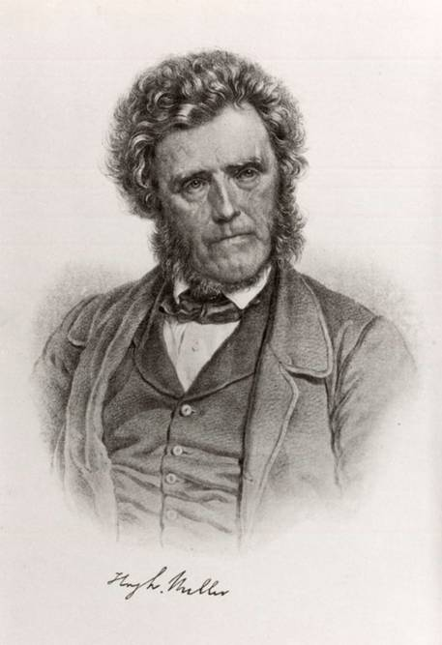
Purple blank
Hugh Miller (1802-1856)
Geologist
Gap theory
then Day-age theory
Notes:
Just before his death by suicide, he switched to the Day-Age Theory
Source: Ian Taylor

Slide 26
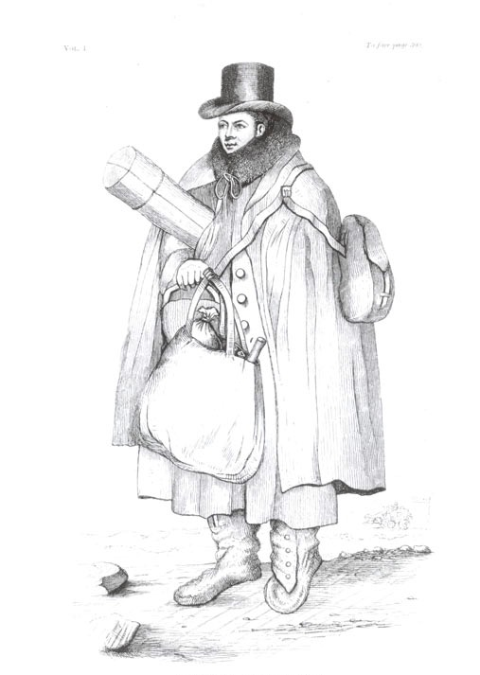
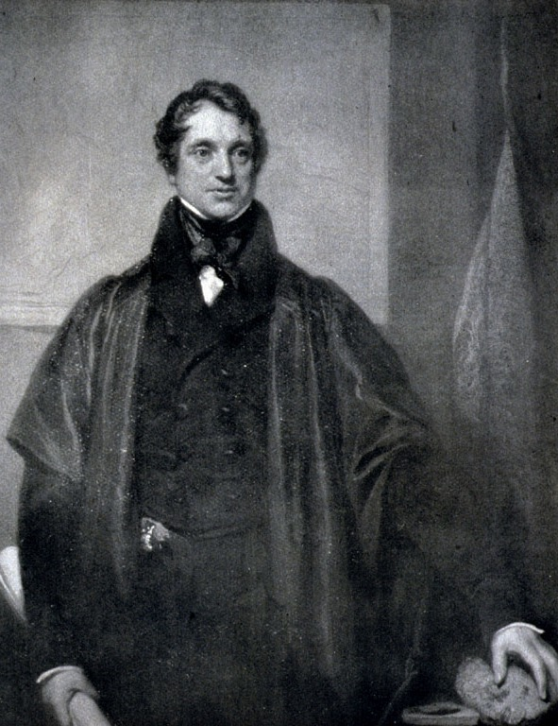
Purple blank
William Buckland
(1784-1856)
Adam Sedgwick
(1785-1873)
Global, geologically limited Flood
Notes:
Source: Ian Taylor

Slide 27
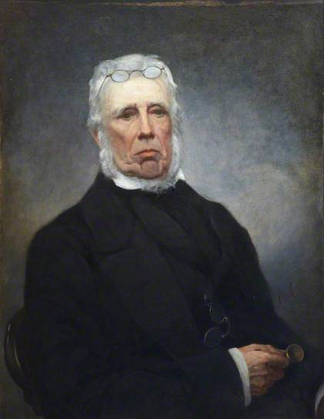
Purple blank
John Fleming
(1785-1857)
Presbyterian Minister & Zoologist
Tranquil flood
Notes:
Fleming published his idea in a journal article in 1826. He said the Bible describes a tranquil flood that didn't displace the plants or even the soil and therefore would have left no geological evidence. Lyell exploited Flemings argument to say the same, especially noting that the dove found an “olive branch” (the Bible says “olive leaf”).
Picture from http://www.bbc.co.uk/arts/yourpaintings/paintings/professor-john-fleming-17851857-125652

Slide 28
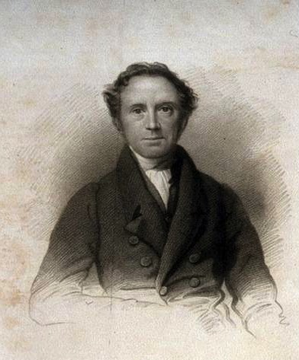
Purple blank
John Pye Smith (1774-1851)
Congregational Theologian
Local Creation & Local Flood
Notes:
He saw these events only depicted as in Mesopotamia
Source: my slide

Slide 29
Purple blank
Liberal Theologians
Genesis 1–11 is mythology.
Notes:
This was held at bay somewhat due to the Great Awakening

Slide 30
Genesis & Geology: 19C #1
Early 1800s: Compromises with Old-Earth Geology
1810s Gap theory (Chalmers)
1820s Day-age theory (Faber)
Tranquil flood theory (Fleming)
1830s Local Flood theory (Pye Smith)
Genesis is myth (liberals)

Slide 31
Genesis & Geology: 19C #2
Early 1800s: Faithfulness to Scripture
1820-50 Young-earth creationism
(“Scriptural geologists”)
Notes:
About 30 of these YEC geologists and clergy (some both) defended the Bible against both the catastrophists and uniformitarian defenders.

Slide 32
The Real Nature of the Debate:
Philosophical and Religious

Slide 33
Deism & Atheism
God
God
THE
UNIVERSE
THE
UNIVERSE
THE
UNIVERSE
Deism
Atheism
Christianity
Notes:
33
Grudem, Systematic Theology (1994), p 268.

Slide 34
Old-earth theology (1778-1833)
Old-Earth Theology
Buffon:
Laplace:
Lamarck:
Werner:
Hutton:
Cuvier:
Smith:
Lyell:
deist or vague theist
open atheist
deist or atheist
deist or atheist
deist or atheist
deist or vague theist
deist or vague theist
deist or unitarian
Notes:
Every one of these men had a bias. And many Christians who were influenced by these writers became semi-deists in their thinking about the world.

Slide 35
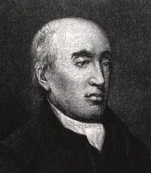
Hutton 1795—past history
“The past history of our
globe must be explained
by what can be seen to
be happening now.
... No powers are to be
employed that are not
natural to the globe, no action to be admitted except those of which we know the principle.”
James Hutton, quoted in Arthur Holmes, Principles of Physical Geology (UK: Thomas Nelson & Sons Ltd., 1965), pp. 43–44.
Notes:
Hutton therefore ruled out any eyewitness account from God.
Original source of last part of quote is James Hutton, Theory of the Earth (Edinburgh: William Creech, 1795), Vol. 2, p 547. I could not find the first part of the quote in vol. 1 or vol. 2. I also didn't find the quote in Hutton's 1788 article.

Slide 36
Hutton 1795—no global floods
“But, surely, general
deluges form no part of
the theory of the earth;
for, the purpose of this
earth is evidently to
maintain vegetable and
animal life, and not to destroy them.”
James Hutton, Theory of the Earth (Edinburgh: William Creech, 1795), 1:273.
Notes:
Section IV, chapter 3, paragraph 6, in the on-line version of this book.
Chapter 3, section 3 in the book version
Quoted in A. Holmes, Principles of Physical Geology, (UK: Thomas Nelson & Sons Ltd., 1965), pp. 43–44.

Slide 37

Present not key to past
The PRESENT is NOT
the key to the PAST.
PAST?
PAST WORLD
PRESENT WORLD

Slide 38

Revelation is key to past
100% Infallible Account of the All-knowing Eyewitness Creator!
Holy Bible
PAST and PRESENT!
PAST WORLD
PRESENT WORLD
REVELATION is the key to the PAST and the PRESENT!

Slide 39
Early 19C views of earth history new
Early 19th Century Views of Earth History
Catastrophist view (e.g., Cuvier, Smith)
SB
C
C
C
C
P
(millions of years)
Present is the Key to the Past
Uniformitarian view (e.g., Hutton, Lyell)
SB?
P
(millions of years)
Biblical/Traditional view (Scriptural geologists)
SCW
F
P
Past is the Key to the Present
(ca. 6000 years)
Notes:
39
SB = supernatural beginning
C = Catastrophic flood
P = present
SCW = Supernatural Creation Week
F = Flood (Noah's)

Slide 40
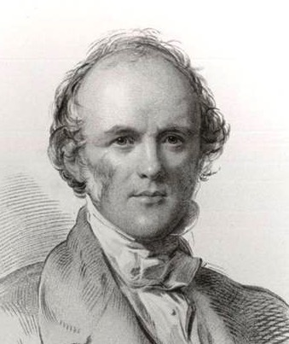
Lyell 1832—geology without Bible
“I have always been strongly impressed with the weight of an observation of an excellent writer and skillful geologist who said that 'for the sake
of revelation as well as of science—of truth in every form—the physical part of Geological inquiry ought to be conducted as if the Scriptures were not in existence'.”
Charles Lyell, quoted in M.J.S. Rudwick, “Charles Lyell Speaks in the Lecture Theatre,” Brit. J. Hist. Sci., IX:2:32 (July 1976), p. 150.
Notes:
lecture at King's College London, 4 May 1832

Slide 41
Philosophical naturalism defined
Uniformitarian Naturalism
Nature or matter is all that exists.
2. Everything can, and indeed must, be explained by time plus chance plus the laws of nature working on matter.
3. Processes of geological change have always been operating in the past at the same rate, frequency and power as today.

Slide 42

Old-earth geologist
Christian
Naturalistic
Assumptions
Biblical
Assumptions

Slide 43

NEUTRAL
GROUND
Notes:
43

Slide 44

But he's still using his naturalistic assumptions!
NEUTRAL
GROUND
Notes:
44

Slide 45
Operation vs Origin science
Operation Science
vs
Origin Science
Notes:
As a content template, this is best suited for standard content such as outlines, quotations, Scriptures, and maybe illustrations or photos. Presentation Team recommends 48–60 pt. font for headings and 28–40 pt. for body text. Because of eye flow and visual psychology, the top line may be a little closer than all other sides. This also contains a floating AiG logo that can be repositioned or removed as appropriate for the overhead's content.

Slide 46
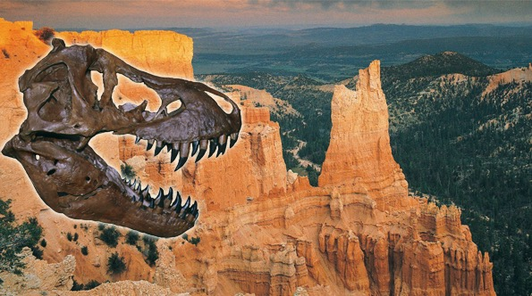
Assumptions Facts-Interpretations astronomy
NATURALISTIC ASSUMPTIONS
BIBLICAL ASSUMPTIONS
It's a battle of worldviews.
OLD EARTH
NO GLOBAL FLOOD
YOUNG EARTH
GLOBAL FLOOD

Slide 47
I Tim. 6:20-21 NAS
1 Timothy 6:20-21
O Timothy, guard what has been entrusted to you, avoiding worldly and empty chatter, and the opposing arguments of what is falsely called knowledge, which some have professed and thus gone astray from the faith.
Notes:
“Science” (from the Latin, scientia, meaning knowledge) is the Greek, gnosis, meaning knowledge.

Slide 48

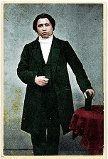
Spurgeon 1855—old-earth (gap) #1
“Can any man tell me when the beginning was? Years ago we thought the beginning of this world was when Adam came upon it;”
C.H. Spurgeon, “Election” (1855), The New Park Street Pulpit (Pasadena, TX: Pilgrim Publ. 1990), vol. 1, p. 318.
Notes:
This is at the beginning of his point that divine election is eternal.
Charles Haddon Spurgeon (1834-92) was 21 years old at this time.
http://www.spurgeon.org/sermons/0041.htm, p. 10.
Sermon was preached on 2 Sept. 1855.

Slide 49

Spurgeon 1855—old-earth (gap) #1
“but we have discovered
that thousands of years
before that God was
preparing chaotic matter
to make it a fit abode for
man, putting races of
creatures upon it, who
might die and leave behind the marks of his handiwork and marvelous skill, before he tried his hand on man.”
C.H. Spurgeon, “Election” (1855), The New Park Street Pulpit (Pasadena, TX: Pilgrim Publ. 1990), vol. 1, p. 318.
Notes:
By 1845 all the commentaries were arguing for the Gap theory or the Day-Age theory.
This is at the beginning of his point that divine election is eternal.
http://www.spurgeon.org/sermons/0041.htm, p. 10.
Sermon was preached on 2 Sept. 1855.

Slide 50
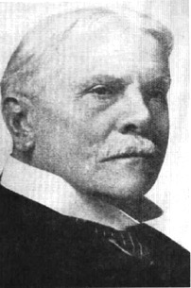
CI Scofield
Scofield Reference Bible
(1909)
Gap Theory
“The first creative act refers to the dateless past, and gives scope for all the geologic ages.”
C.I. Scofield
(1843-1921)
Notes:
That statement is all Scofield said about the gap (1917 edition). No argument, nothing. Just a bald assertion. The 1967 edition said at v. 1, “Scripture gives no data for determining how long ago the universe was created.” At v. 2, it gives two weak statements for the gap theory.
The man -- http://www.higherpraise.com/preachers/images/scofield.jpg
Scofield Reference Bible (revised in 1967 and still in print) has been used by tens of millions of Christians worldwide, many of whom act as if Scofield's notes are as inspired as the Biblical text.

Slide 51
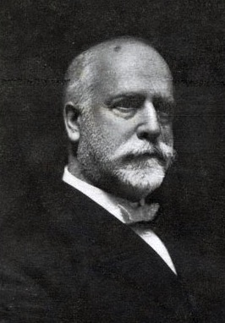
RA Torrey
R. A. Torrey, ed.,
The Fundamentals
(12 vol., 1910)
Old-earth views
Reuben Archer Torrey (1856-1928)
Notes:
6 of 90 articles dealt with Genesis and science. 2 clearly rejected evolution as unbiblical. 2 opposed atheistic evolution and human evolution, but didn't clearly reject theistic evolution of animals and plants. 3 of the 6 clearly accepted millions of years and none of the other 3 clearly affirmed the Bible's teaching on the age of the creation.
R. A. (Reuben Archer) Torrey (1856-1928) was an American evangelist, pastor, educator, and writer. Held evangelistic meetings around the world; called by D.L. Moody to head the Bible Institute of the Chicago Evangelization Society (now Moody Bible Institute); Dean of Bible Institute of Los Angeles (BIOLA); pastorates included Chicago Avenue Church (now Moody Memorial Church) and Church of the Open Door, Los Angeles. Wrote more than forty books.
In 1909 Lyman and Milton Stewart, two wealthy Presbyterian businessmen, financed the publication and mailing of 12 volumes of 68 articles, collectively called The Fundamentals. They were written by some of the leading godly Bible-believing pastors and scholars of the day (from Amer., Can., UK, Germany and from Anglican, Presbyt., Method., Baptist and non-denom. --several were editors of Scofield Bible) and edited by Dr. R.A. Torrey. These articles defended the Christian faith against the onslaught of rationalism and liberal theology invading the churches.
3,000,000 individual volumes of The Fundamentals were sent free of charge to pastors, missionaries, Sunday School superintendents and other Christian workers throughout the English-speaking world. All but a few of the articles were republished in 4 volumes in 1917.
64 of the 68 articles are great defenses of orthodox Christian doctrines. But the 4 articles dealing with science were all compromised with millions of years.
Picture: http://www.freewebs.com/ratorrey/Torrey%202.jpg

Slide 52
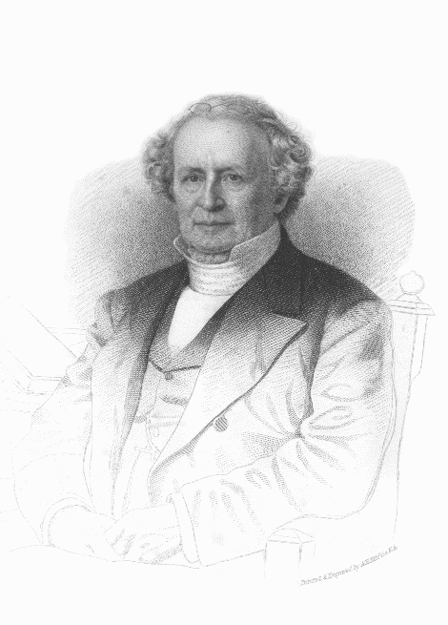
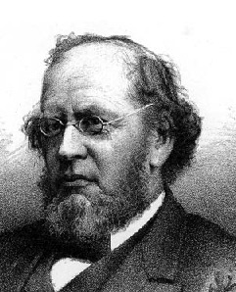
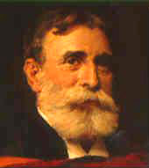
Presbyterian slippery slide
Princeton Seminary
Charles Hodge (1779- 1878)
Old-Earth
A.A. Hodge (1823-1886)
Theistic Evolution??
B.B. Warfield (1851-1921)
Theistic Evolution?
Notes:
C. Hodge (1797-1878)—initially favored gap theory, then by 1860 day-age, but was adamantly opposed to Darwinism, but not theistic evolution
In his 25-page chapter on the doctrine of creation (1871, vol. 1, pp. 550–574), Hodge mentions 6 verses from Genesis, but he discusses none of the Biblical verses relevant to determining the length of the Creation days or the age of the earth. In a couple of sentences he mentions the young-earth view and the gap theory, but no arguments against those views. Rather he has several pages defending the day-age view (mostly by a lengthy quote by an OEC geologist [Dana], but without using any Scripture from Genesis!
A.A. Hodge toyed with belief in evolution, open to gap or day-age but not sure if Gen. 1-11 was history
B.B. Warfield (1851-1921) open to theistic evolution, but not of man, but not sure
Based on Joseph Pipa & David Hall, Did God Create in Six Days? (Taylor, SC: Southern Presbyterian Press, 1999), pp 5-15.

Slide 53
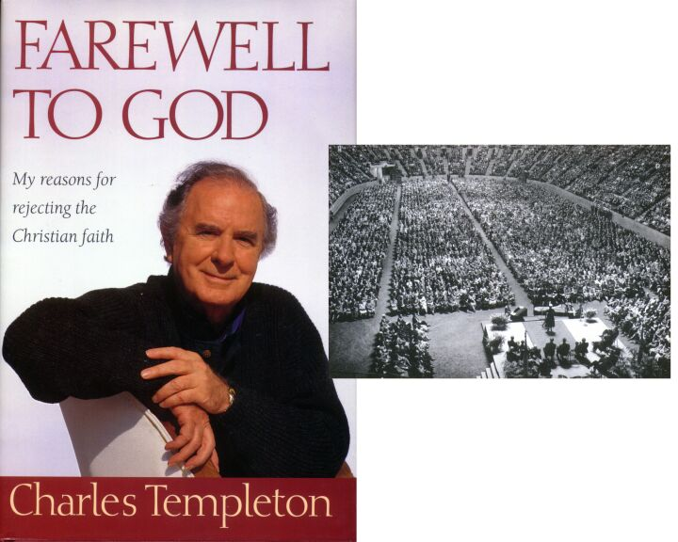
Farewell to God
1915-2001
Notes:
Started and pastored a church in Toronto
1945—became VP of Youth for Christ
1946—designated “best used of God” by Nat. Assoc. of Evang.
During these years growing doubts about Gen. 1-11 because of accepting millions of years and evolution
1948—began studies at Princeton seminary, which only increased his doubts about the authority of Scripture, the historical accuracy of Genesis and the deity of Christ.
After Princeton he continued preaching with the National Council of Churches. He had increasing health problems, esp. chest pains. A doctor said there was nothing physically wrong with him and suggested that the symptoms were the result of his inner conflict about doubting Scripture even as he preached it to others.
1957—left the ministry to become a secular journalist and author
2001—died as an atheist after suffering from Alzheimer's disease.

Slide 54

Q 815 Templeton
"I believe that there is
no supreme being
with human attributes
-- no God in the
biblical sense -- but
that life is the result of timeless evolutionary forces, having reached its present transient state over millions of years."
Charles Templeton, Farewell to God (Toronto: McClelland & Stewart, 1996), p. 232.

Slide 55
Presbyterian slippery slide
Princeton Seminary
Charles Hodge (1779- 1878)
Old-Earth
A.A. Hodge (1823-1886)
Theistic Evolution??
B.B. Warfield (1851-1921)
Theistic Evolution?
Charles Templeton (at P.S. 1940s)
Apostate

Slide 56
Q872 Waltke 2001
“The days of creation may also pose difficulties for a strict historical account. Contemporary scientists almost unanimously discount the possibility of creation in one week, and we cannot summarily discount the evidence of the earth sciences.”
Bruce K. Waltke, Genesis (Grand Rapids: Zondervan, 2001), p. 77.
Notes:
As of 2003 his is Professor of OT at Reformed Theological Seminary in Orlando, FL. Before that he was at Dallas TS, Regent College and Westminster TS.

Slide 57
Cross Series 1

Slide 58

Cross Series 1
Come to Jesus! Come to the cross to be saved!

Slide 59

Cross Series 2
Millions of Years

Slide 60

Cross Series 6
It didn't hit the cross!
GENESIS

Slide 61

Cross Series 7
GENESIS

Slide 62


Cross Series 8
It's just a 'side issue'!
GENESIS
Notes:
Too often Christians think that attacks against Genesis are peripheral matters that do not affect the cross.

Slide 63
Psalm 11:3 NAS
Psalm 11:3
If the foundations are destroyed, what can the righteous do?

Slide 64

Cross Series 9
Age Dating Methods
Evolution
Apemen
No Global Flood
Millions of Years
GENESIS

Slide 65

Cross Series 11
It didn't hit the cross!
Direct Hit!
G
E
I
E
N
S
S

Slide 66

Has God said—museum NAS
Has God said?

Slide 67
Has God said—museum NAS
You will not die.

Slide 68

Cross Series 12
UNBELIEF
G
E
I
E
N
S
S

Slide 69


Cross Series 10
Evolution
Age Dating Methods
Apemen
Millions
of
years
GENESIS
No
Global Flood
Notes:
Layer the explosion stars and smoke that the “Genesis” can be put underneath them

Slide 70

02
CREATION
MINISTRY
GENESIS
02

Slide 71

04
Evolution
Age Dating Methods
Apemen
Millions
of
years
No
Global Flood
CREATION
MINISTRY
GENESIS
04
Notes:
Destroy them by providing answers based on the authority of Scripture

Slide 72

07
WARNING!
WARNING!
WARNING!
Evolution
Age Dating Methods
Apemen
Millions
of
years
No
Global Flood
CREATION
MINISTRY
GENESIS
GENESIS
07
04
Notes:
Now they are able to demolish every argument, provide an answer to everyone, because they are standing on the proper foundation- the authority of Scripture

Slide 73

10
Come to Jesus! Come to the cross to be saved!
CREATION
MINISTRY
GENESIS
10
Notes:
Now the church has a proper foundation, help people understand what sin is and why Jesus died on the cross, the Gospel message is no longer compromised

Slide 74
2 Corinthians 10:4-5 NAS
2 Corinthians 10:4-5
4. For the weapons of our warfare are not of the flesh, but divinely powerful for the destruction of fortresses.
5. We are destroying speculations and every lofty thing raised up against the knowledge of God, and we are taking every thought captive to the obedience of Christ.

Slide 75

Purple blank
“Today it is perhaps the Darwinian view of nature more than any other that is responsible for the agnostic and skeptical outlook of the twentieth century.”
Michael Denton, Evolution: A Theory in Crisis (London: Burnett Books, 1985), p. 358.
Notes:
Denton is medical doctor and PhD molecular biologist.
At the time of his book, he was an agnostic regarding the existence of God.

Slide 76
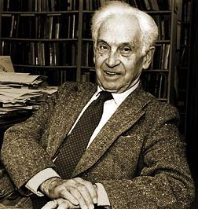
Purple blank
“The [Darwinian] revolution began when
it became obvious that the earth was very ancient rather than having been created only 6000 years ago.
This finding was the snowball that started the whole avalanche.”
Ernst Mayr, “The Nature of the Darwinian Revolution,” Science, vol. 176 (2 June 1972), 988.
Notes:
Mayr (1904-2005, died at age 100), Harvard zoologist
Picture from http://library.mcz.harvard.edu/history/images/mayr.jpg, accessed 19 Feb. 2004

Slide 77
Psalm 40:4 & Prov. 29:25 NAS
Psalm 40:4
How blessed is the man who has made the LORD his trust, and has not turned to the proud, nor to those who lapse into falsehood.
Proverbs 29:25
The fear of man brings a snare, but he who trusts in the LORD will be safe.

Slide 78

Nailing Genesis 1-11 to church
GENESIS
1-11
MAN'S OPIONIONS
MILLIONS OF YEARS

Slide 79








CORRUPTION
CATASTROPHE
CREATION
CONFUSION
THE SEVEN C’s OF HISTORY
CONSUMMATION
CHRIST
CROSS
Notes:
This is fully animated. The Scripture text frame is editable so you can insert a different version if you so desire.
In case you want to know. Each element is a TIFF image with alpha channels. This whole page totals 1.1 MB rather than 11+ MB that flat JPEGs would produce.

Slide 80
Blank end
END

Slide 81


Creation link at BibleStudyDownloads.org
Get this presentation for free!
Notes:
OT Survey (os)

