Slide 1
ORIGINS
How did everything come to be?
Where did we come from?
Why are we here?
Class Project by student Gavin Lu, 2019
Dr. Rick Griffith • Singapore Bible College • BibleStudyDownloads.org

Slide 2
Creation Stories
Creation Stories
Understanding how we came to be tells us who we are and what to do with our lives

Slide 3
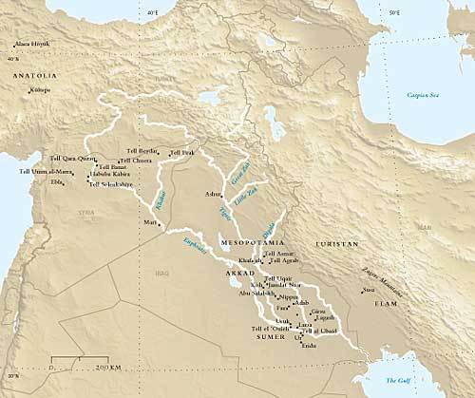
Mesopotamia
Mesopotamia
Cradle of ancient civilizations
Cradle of ancient civilizations
Notes:
Mesopotamia = Middle of two (great) rivers

Slide 4
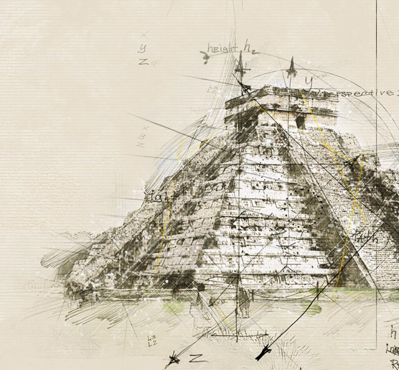
Sumerian
Eridu Genesis - a tablet dating back to 1600 BC
The gods “An, Enlil, Enki and Ninhursaga fashioned the dark-headed people”
Enki and the Ordering of the World – 2000 BC
Enki organized the earth and instituted essential cultural ingredients of human civilization
Notes:
Ziggurat

Slide 5
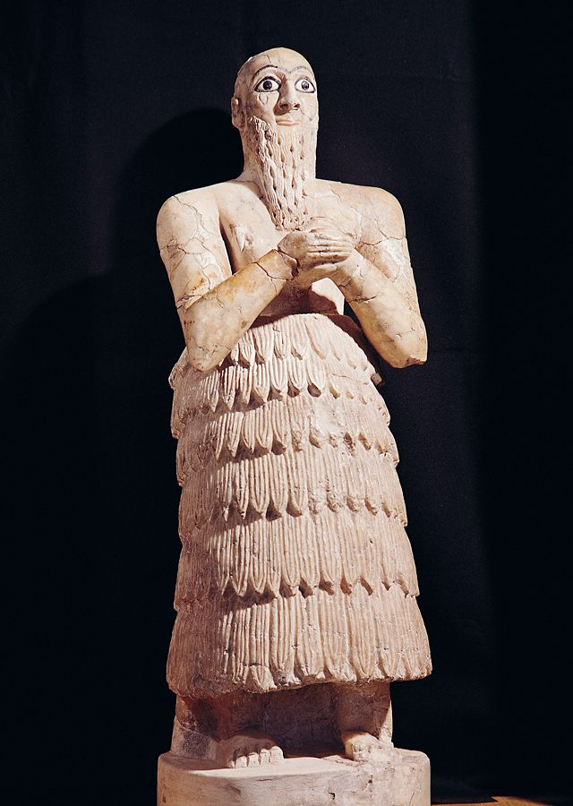
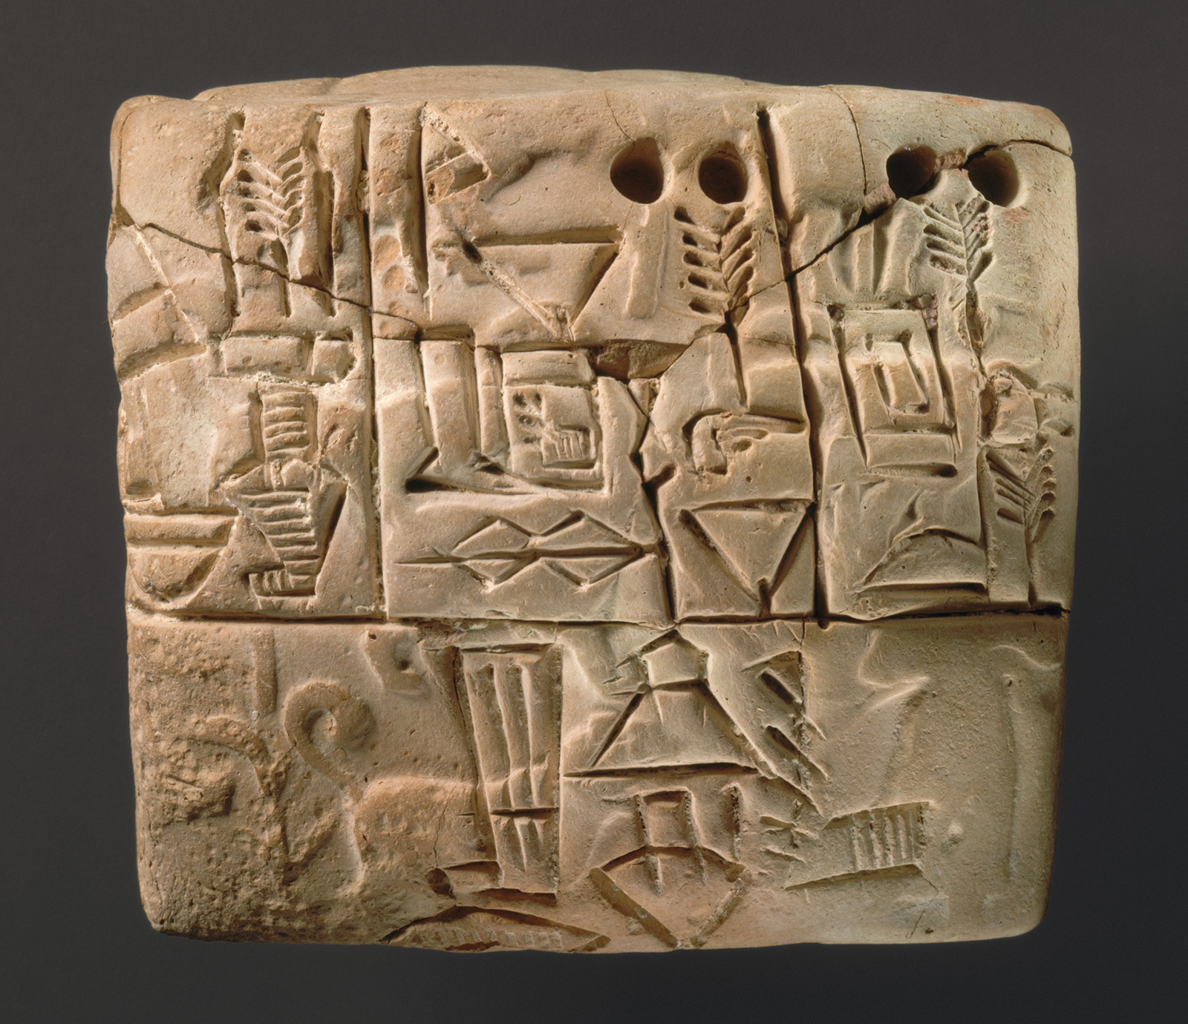
Sumerian
Epic of Atra-khasis - composed around 1000 BC
Many editions from various periods of Mesopotamian history
Humans were created from clay to alleviate the burden of the overworked minor gods
Notes:
Top: Shaved heads + kaunakes Bottom: Writing (Cuneiform)

Slide 6
Akkadian/Babylonian
Enuma Elish - meaning: “when on high,” ~1100 BC
Marduk kills his mother Tiamat (mother goddess personifying the ocean) and uses her carcass to create the universe
Epic of Gilgamesh - account of a global flood
Notes:
Ziggurat

Slide 7
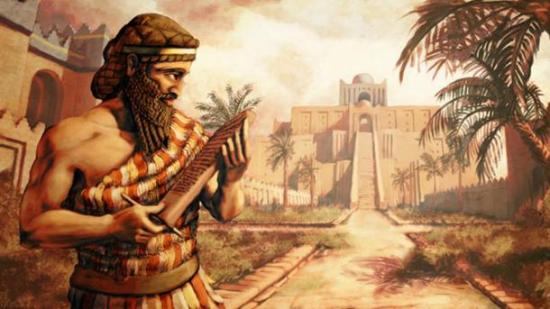
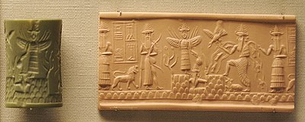
Akkadian/Babylonian
Mankind created from blood of Kingu, consort of Tiamat, to do “the service of the gods” (i.e., manual labor)
The gods built Marduk the grand city of Babylon in gratitude
Notes:
Top: King Sargon
Bottom: Art on a seal (“Adda” seal)

Slide 8
Egyptian
Heiropolis Pyramid Text
Atum, the creator-god, created the other deities and all things when he rose up on the primeval hill from Nun (undifferentiated watery chaos)
Creation by speaking things into existence

Slide 9
Scandinavian/Norse
The gods Odin, Vili and Ve slew Ymir the giant
His blood became the ocean, his skin and muscles the soil, his hair vegetation, his brains the clouds, and his skull the sky
The gods eventually formed the first man and woman, and built a fence around their dwelling-place, Midgard, to protect them from the giants
Notes:
Scandinavian Mythology
https://norse-mythology.org/tales/norse-creation-myth/

Slide 10
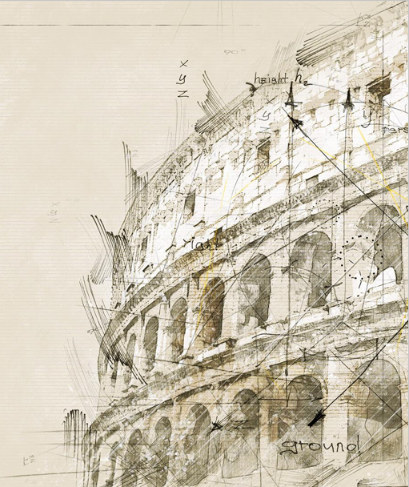
Greek/Roman
Nyx, a bird with black wings, laid an egg from which rose Eros, the god of love
The egg shell became Gaia (Earth) and Uranus (Sky)
Eros caused Gaia and Uranus to fall in love and have many children
Notable descendants: Zeus, Prometheus
Notes:
Greek/Roman Mythology
https://www.cs.williams.edu/~lindsey/myths/myths_16.html

Slide 11
Chinese
Pan Gu chopped his way out of an egg where the forces of yin and yang were in chaotic flux
The forces separated into earth and heavens
Pan Gu stood to keep the two halves separated for another 18,000 years before succumbing
His spirit “never ceased but turned into humans”
Notes:
Chinese mythology
https://www.shenyun.com/explore/view/article/e/URQuh8K0ciI

Slide 12
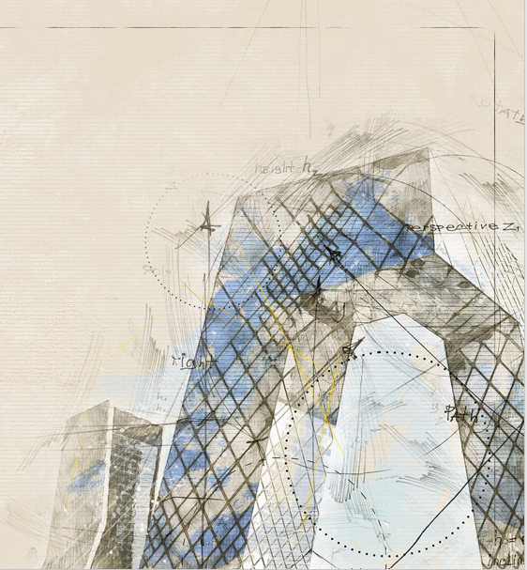
Modern Science
Theory of evolution
Big Bang Theory

Slide 13
What do you believe then?

Slide 14
Israelites
Monotheistic belief about a creator god who made mankind “in his image” to “rule over” the rest of creation in the world
God spoke things into existence for 6 days and rested on the 7th
Man was made from earth and divine breath

Slide 15
Israelites
The first man and woman disobeyed god and were expelled from paradise (“garden of God”)
Man became more evil and God decided to exterminate humankind, save for one man and his family, with a global flood

Slide 16
What I Believe
God created us out of love
He wants us to co-rule creation with Him
We were created to enjoy Him and His goodness but we disobeyed Him
He took it upon Himself to bear the consequences of our mistakes so that we can be reconciled to Him

Slide 17
Black

Slide 18
Creation link at BibleStudyDownloads.org
Get this presentation for free!
Notes:
Creation (cr)

