Slide 1

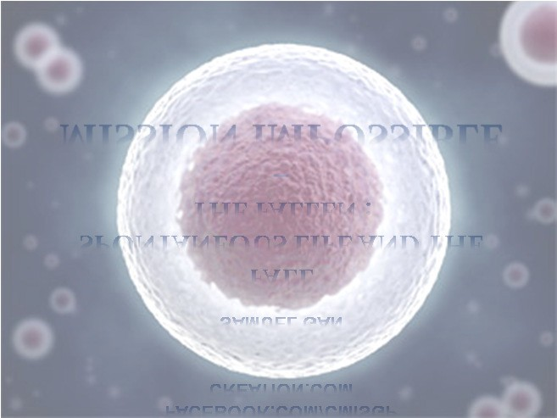
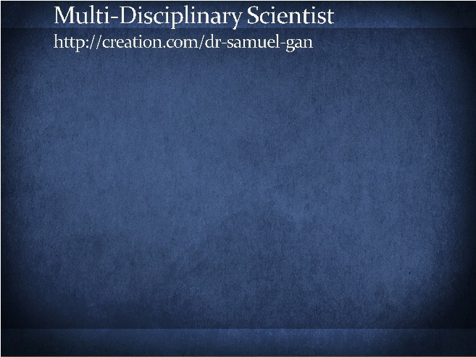
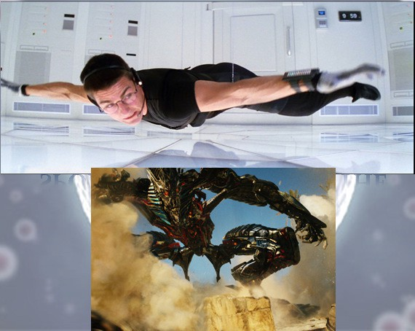


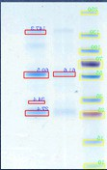







9/12/2016
Bible Student
Mad scientist
Biomedical Research
Antibody Engineering
Virology
Scientific Phone apps and Mobile devices
Psychology Lecturer
Product development (SME)
MISSION IMPOSSIBLE
–
THE FALLEN : SPONTANEOUS LIFE AND THE
FALL
SAMUEL GAN
B.Sc., AKC, AHEA, MBPsS, Ph.D
CREATION.COM FACEBOOK.COM/CMISGP
http://tinyurl.com/7tvt7vq http://tinyurl.com/742apl7
http://tinyurl.com/guidebiblelands The Lord is my Rock and Redeemer facebook.com/TsuriVgoali/
For the invisible things of him from the creation of the world are clearly seen, being understood by the things that are made, even his eternal power and Godhead; so that they are without excuse:
Romans 1:20
Casting down imaginations, and every high thing that exalteth itself against the
knowledge of God, and bringing into captivity every thought to
the obedience of Christ;
2 Corinthians 10:5
And he (Jesus) answering said, Thou shalt love the Lord thy God with all thy heart, and with all thy soul, and with all thy strength, and with all thy mind; and thy neighbour as thyself
Luke 10:27
Also in Matthew 22:37

Slide 2
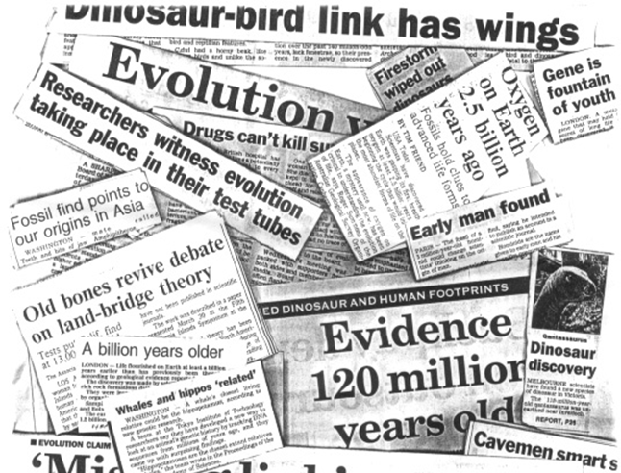

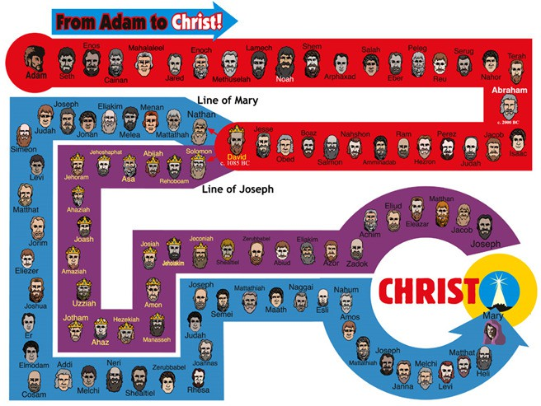

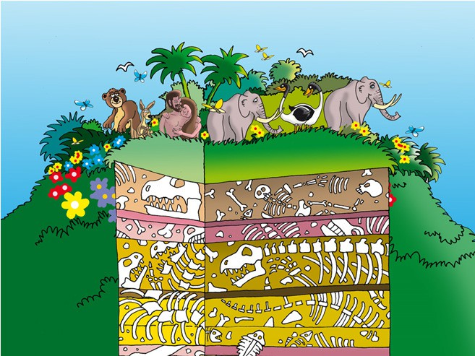

9/12/2016
And God saw every thing that He had made, and, behold, it was very good.
Genesis 1:31
DEATH
SUFFERING
DISEASE
The Genesis account of creation is
foundational to the Gospel message!

Slide 3
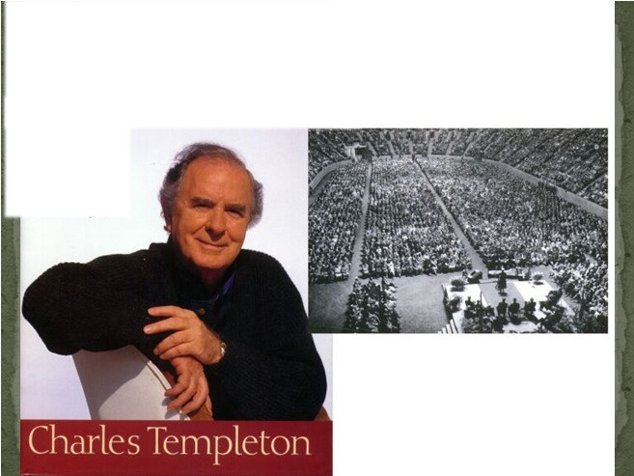
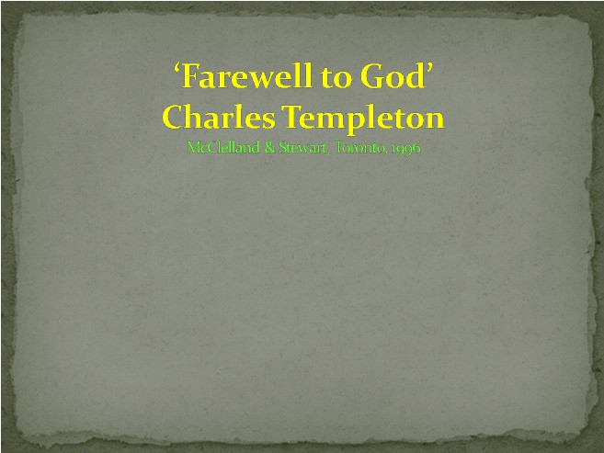

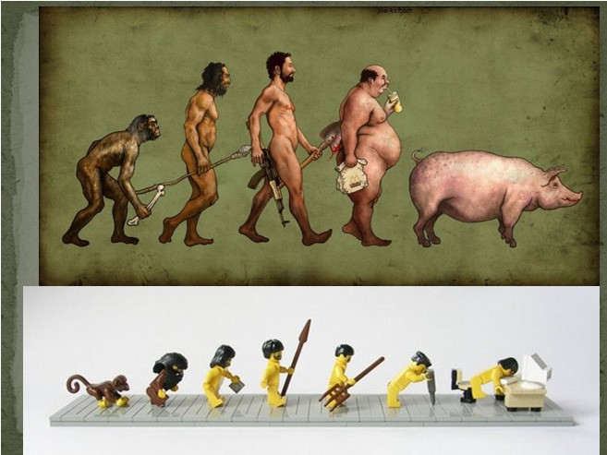


9/12/2016
And the lord commended the unjust steward, because he had done wisely: for the children of this world are in their generation wiser than the children of light.
Luke 16:8
‘I believe there is no supreme being with human attributes - no God in the biblical sense - but that all life is the result of timeless evolutionary forces, having reached its present transient state over millions of years.’
And straightway the father of the child cried out, and said
with tears, Lord, I believe; help thou mine unbelief.
Mark 9:24
Random collisions of molecules over a long time
Life began only once via abiogenesis
Nothing to something
Requires belief in random matter being organized to an orderly fashion
Claims that life is selected over long periods.

Slide 4





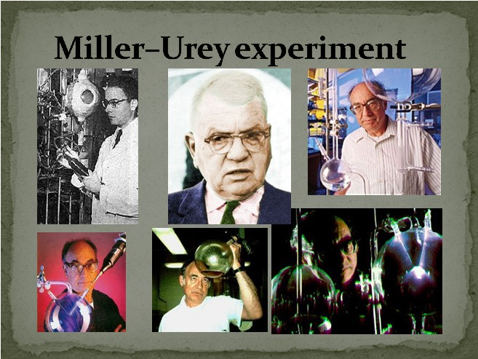
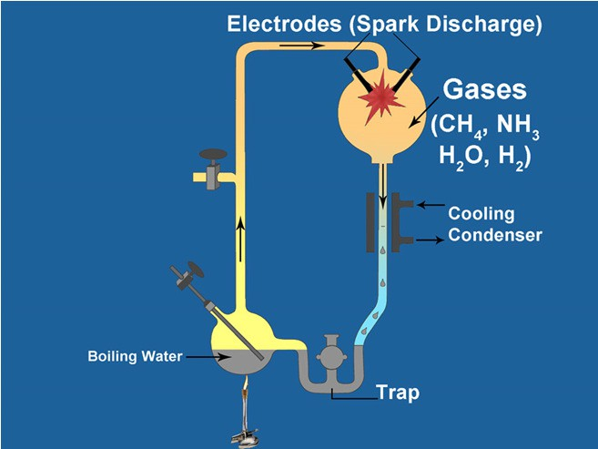
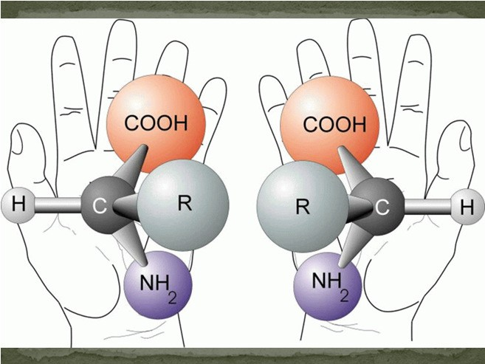
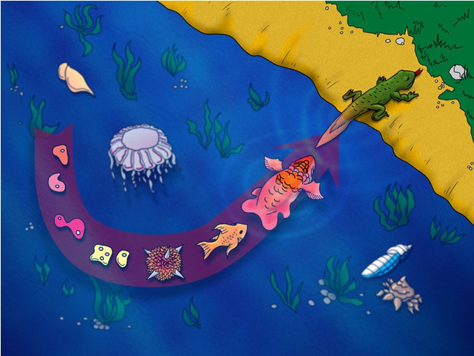
9/12/2016
Runs contrary to the 2nd law of thermodynamics (that states the universe as a whole, is getting more and more random and entropic).
Contrary to the laws of diffusion.
Statistically improbable.
Generally living things beget living things (biogenesis).
Aka biopoiesis is the natural process by which life arose from non-living matter such as simple organic compounds (Wikipedia).
Miller-Urey experiment .
Primordial Soup origins
RNA World hypothesis.
O2 is a problem!
Not all L-amino acids!
Mixture has
D-a mino
which can be fatal!
Noah’s Ark
The real Ark had the same capacity as 522 railroad stock cars!

Slide 5
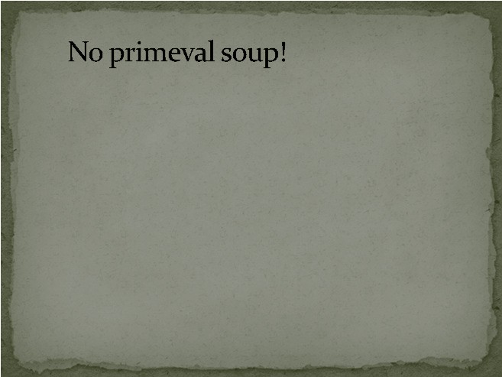


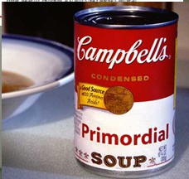

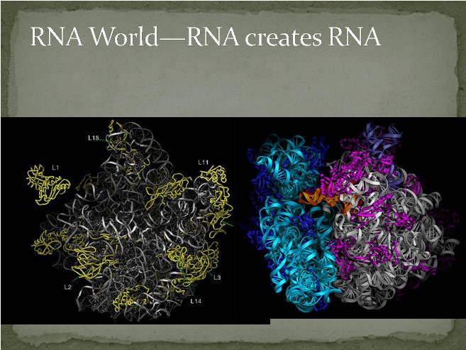
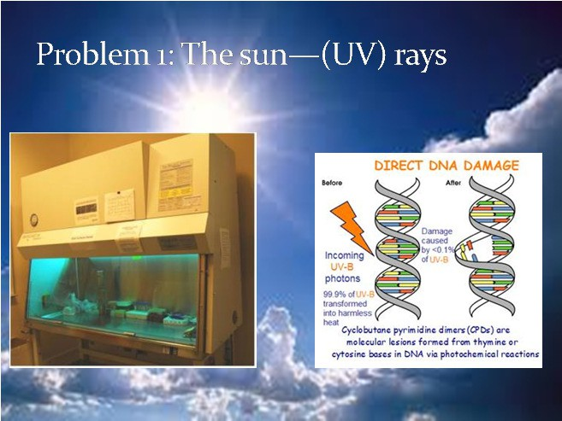
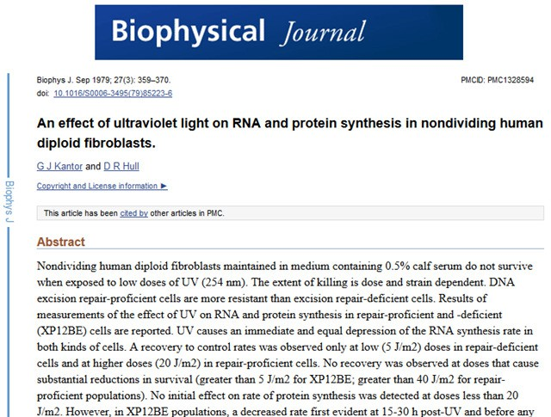
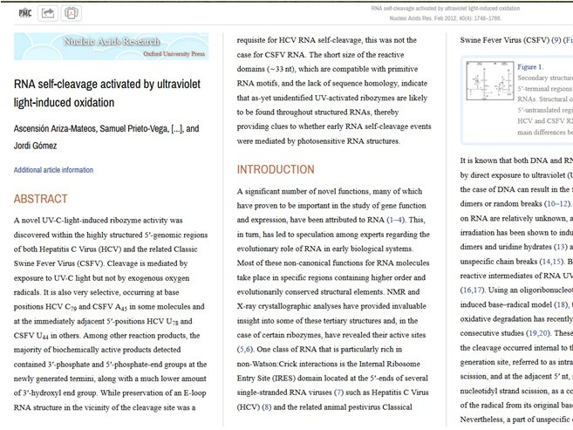
9/12/2016
"The likelihood of the formation of life from inanimate matter is one
to a number with 40,000 naughts after it ... It is big enough to bury Darwin and the whole theory of
evolution. There was no primeval soup, neither on this planet nor any other, and if the beginnings of life were not random, they must therefore have been the product of purposeful intelligence.”
Sir Fred Hoyle, as quoted by Lee Elliot Major, ‘Big enough to bury Darwin.’ Guardian (UK) education supplement, Thursday August 23, 2001.
Retrieved from http://wattsupwiththat.com/2011/03/22/the-gases-of-the-early-atmosphere-and-the-primordial-soup/

Slide 6


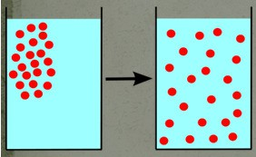
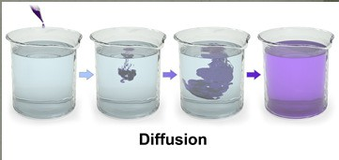
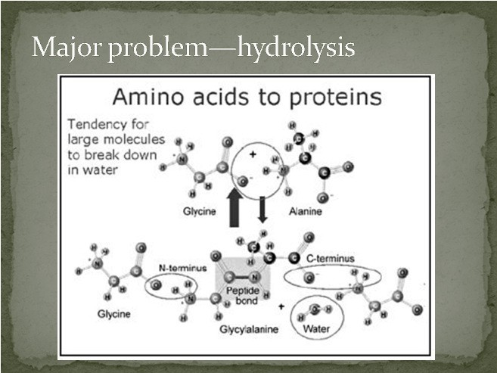



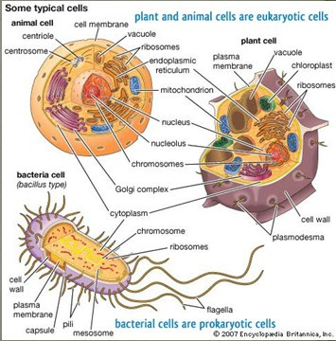
9/12/2016
Ultraviolet rays (UV) damage biomolecules.
O2—ozone problem.
Solar energy systems e.g. photosynthesis immensely unlikely without a repair system.
No sunlight.
Reactions slow down in low temp.
Heat (generates free radicals) which can damage the biomolecules.
Biopolymers (DNA, RNA, proteins) were expected to come together to make information.
Remember there was no copying or repair system of these biomolecules in abiogenesis.
Once damaged or destroyed, it cannot be repaired or proceed to make useful information.
It is unscientific to believe it is possible.
It is far too complex to be by accident
DNA , RNA, proteins break down easily.
Even if the biomolecules could be formed, their purpose is far too complex to arise by accident.
Each of these molecules are part of the message of life.
Deleterious mutations in crucial genes will result in death.
Or disrupt the entire information process in the “Central Dogma of Molecular Biology”.
The first cell is complex, even if it is the simpler Prokaryote.
The first Eukaryote is unimaginably complex.

Slide 7
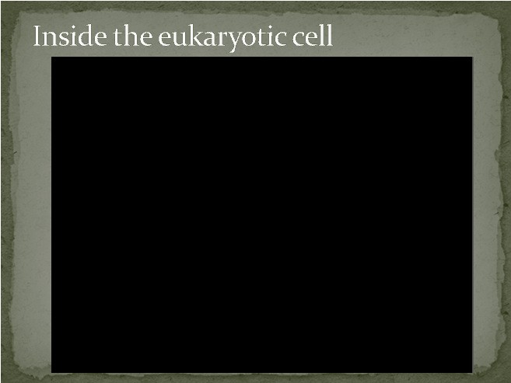
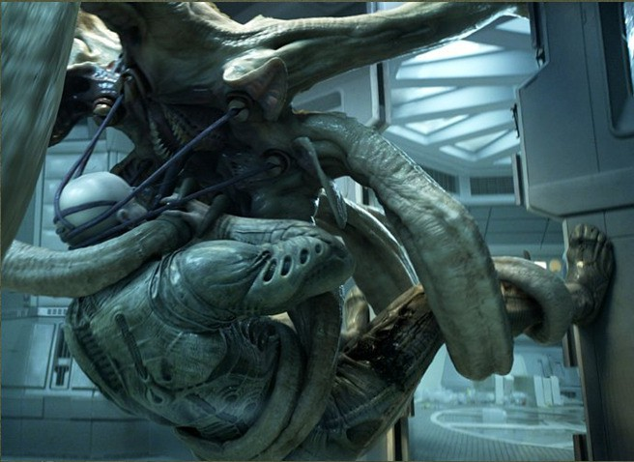
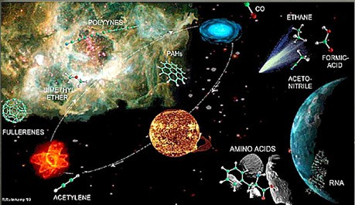
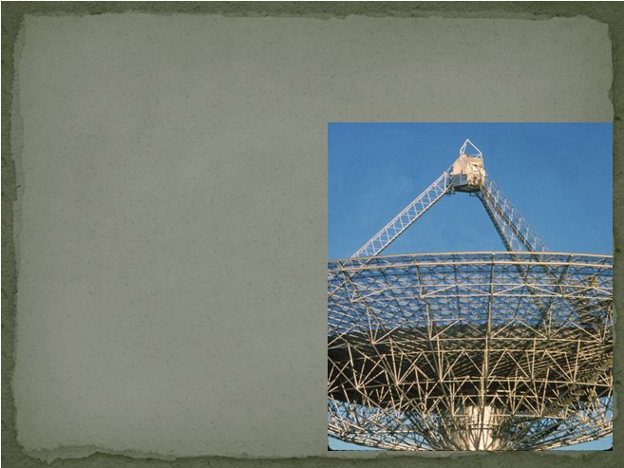

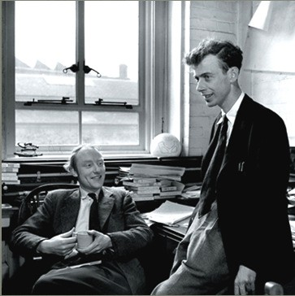
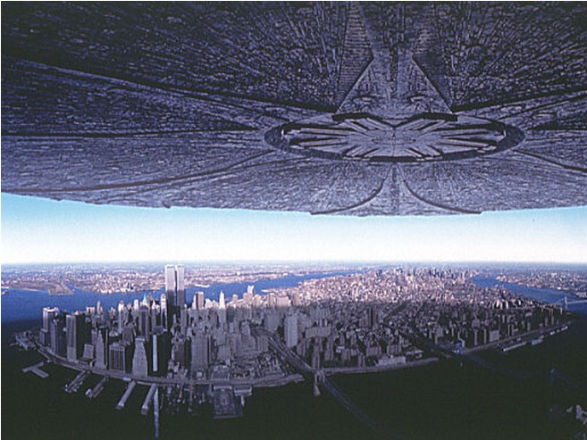



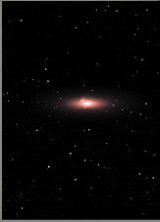
9/12/2016
Panspermia / Exogenesis
http://creationwiki.org/Panspermia
Nobel Prize winners Watson and Crick
Crick says, ‘The aliens did it!’
Creation 25(4) September-November 2003
SETI – The Search for Extra Terrestrial Intelligence
Govts. spend millions of
$$$
Millions of participants worldwide
Scan 28 million radio frequencies per second In 40 years, what have
they found?
Nothing!
At the speed of the Apollo craft, it would take 870,000 years to reach our nearest star.
Energy requirements
It would take the energy of 98 atomic bombs to propel a 500 gram (1.1 lb) ball to 50% speed of light (c). At this speed it would take 4,000,000 years to reach Andromeda, the next nearest galaxy to our own Milky Way.
Detecting approaching objects
There are 100,000 dust particles 1km³ (.24 mile³) of space. At one tenth of c, impact would be equivalent to 10 tons of TNT. A pea-sized object would produce kinetic energy equivalent to 2.2 atomic bombs.
http://bestanimations.com/Military/Explosions/Explosions2.html

Slide 8


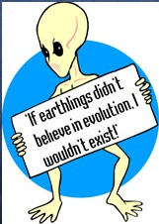








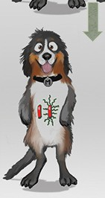





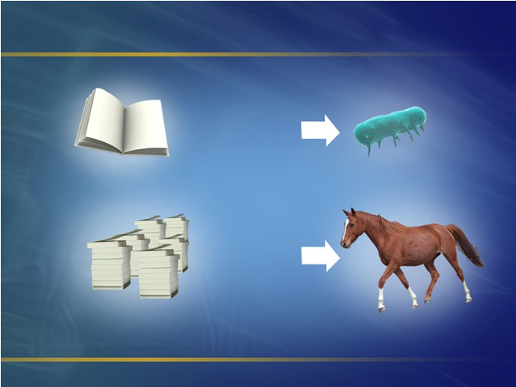

9/12/2016
Professing themselves to be wise, they became fools,
Romans 1:22
ALIEN INTRUSION
From:
X
X
Creatures do change but it’s not evolution
With Dr Don Batten
DNA for single-celled
bacterium
DNA for horse
(Lots of books)

Slide 9




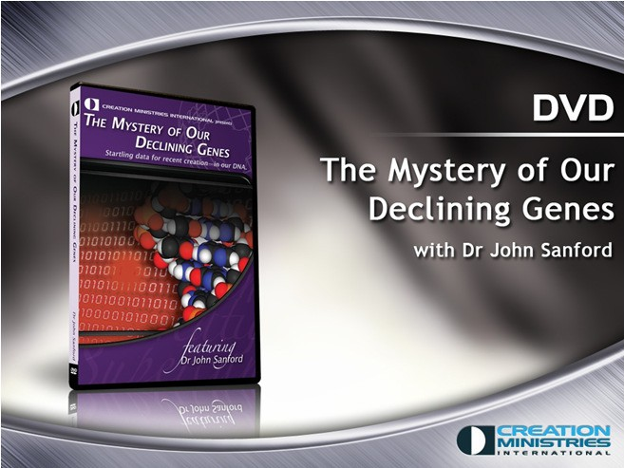
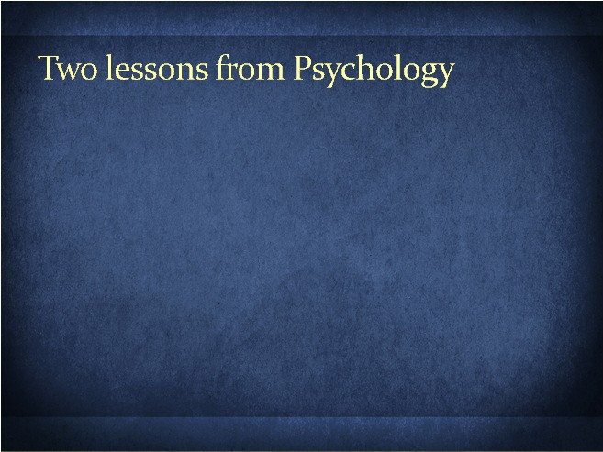
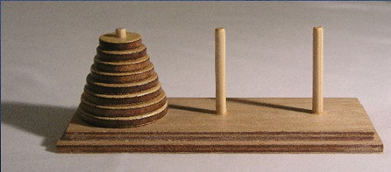
9/12/2016
Romans 8:21
“Because the creature itself also shall be delivered from the bondage of corruption into the glorious liberty of the children of God. For we know that the whole creation groaneth and travaileth in pain together until no
Our declining genes
Former Cornell geneticist John Sanford:
“Even with intense selection, evolution is going the wrong way—toward extinction! … The bottom line is that Darwinian theory fails on every level
…. “
“… all higher genomes must clearly degenerate. … [This is]
powerful evidence that life and mankind must be young.”
Sanford, J., in interview at creation.com/sanford,
2008.
w.”
So what does it mean?
Using the same logic and measure.
Teleological argument for the Lord God Creator
Intelligence, planning, design, strategy
Evil

Slide 10




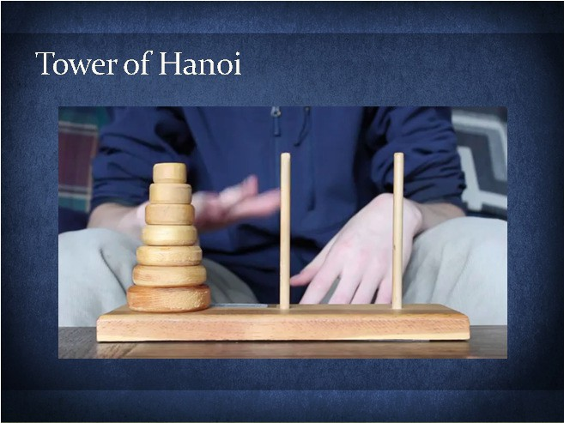


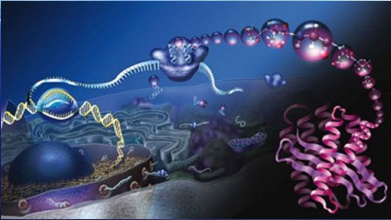

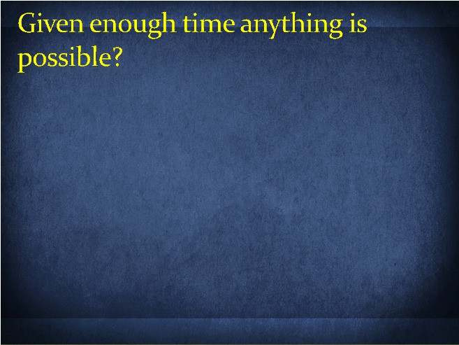

9/12/2016
Tower of Brahma – room in a temple in Kashi Vishwanath
Lucas’s Tower, after Mathematician Édouard Lucas
Used to assess cognitive abilities—intelligence, strategy, planning, memory, problem solving. (Cambridge Neuropsychological Test Automated Battery or CANTAB)
Wikipedia Tower_of_Hanoi
Creation magazine 37(2) 2015
Only one disc can be moved at a time.
No disc can be placed on top of a smaller disc
Each move consists only of taking the upper discs from one stack to another’s uppermost position.
Legend has 64 discs – at 1 disc/sec, it will take 2⁶⁴−1 seconds or roughly 585 billion years or 18,446,744,073,709,551,615 turns.
So what does it mean?
‘Now imagine 10⁵⁰ blind persons (standing shoulder to shoulder, these would more than fill our entire planetary system) each
swcirtahmabled Rubik cube and try to conceive of the chance of them all simultaneously arriving at the solved form. You then have the chance of arriving by random shuffling of just one of the many biopolymers on which life depends. The notion that not only the biopolymers but the operating program of a living cell could be arrived at by chance in a primordial soup here on Earth is evidently nonsense of a high order.’
—Fred Hoyle, The Big Bang in Astronomy, New Scientist
92(1280):527, 1981
Scientifically and logically indefensible proposition
How much time? 14 billion years?
10⁸⁰ atoms in universe
How many experiments possible?
Every msec, every atom an experiment?
= 14x10⁹x10⁸⁰x365x24x60x60x1000
= Error!
= 4.4 x 10¹⁰⁰

Slide 11
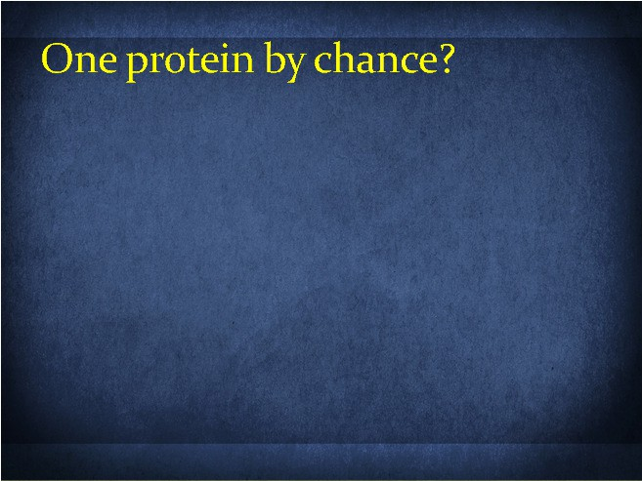
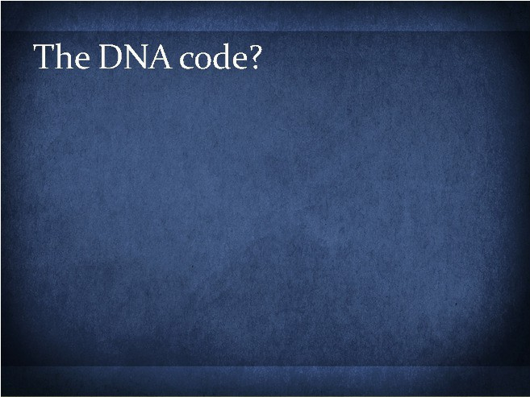
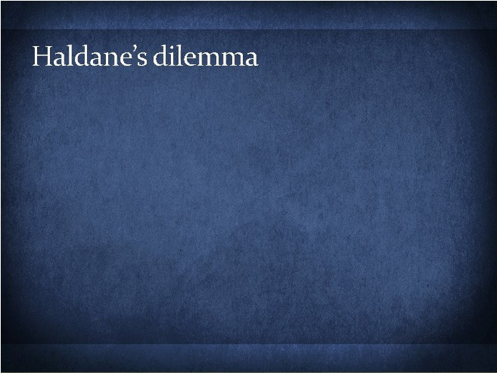







9/12/2016
One ‘average’ protein (300 amino acids)
Assume: only twenty amino acids available by natural processes
Assume they are optically pure
Assume they form amide bonds without enzymes
How many possibilities? 20³⁰⁰ = 10³⁹⁰
Assume 4.4 x 10¹⁰⁰ experiments.
Conclusion: not one protein could form!!
~900 base pairs (minimum)
Assume only the 4 correct nucleosides available
Assume they join together without enzymes
4⁹⁰⁰ possibilities = 10⁵⁴² (worse)
With slightly more realistic assumptions (still optimistic), Haldane calculated that no more than 1667 beneficial mutations could be added in 10 million years of human-type generations.
1667 point mutations = 0.00005% human genome
Information and planning preexisted the existence of biomolecules (Gen “ray-sheeth” 起初& John “ar-khay” 太初)
God does not need a long time!
He created Time!
e
around us.
The first cell and what you are made of, is a powerful creation, a miracle, testifying the power of God.
Something from nothing.
Possible only by an all-knowing (planning), and unlimited God.
Creation testifies that the Power of God is necessary along with the Wisdom of God (General Revelation)
● Creation explains everything that we se
Creation puts God back at the focus.
An all-powerful Spirit, made and interacts with our physical world.
He came and became part of creation as the Lord Jesus Christ! –
●
(The greatest miracle!) John 1:14; John 3:16

Slide 12

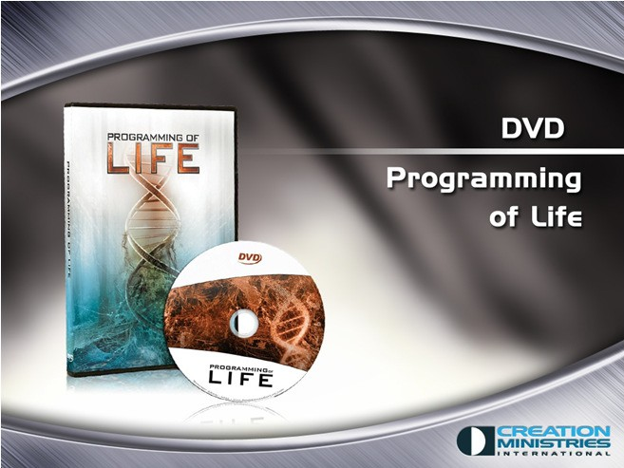

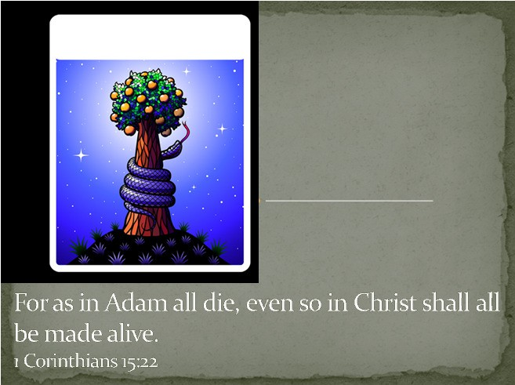

9/12/2016
For the invisible things of him from the creation of the world are clearly seen, being understood by the things that are made, even his eternal power and Godhead; so that they are without excuse:
Romans 1:20
Is there support for the Fall?
The evilness of Man?
The need for redemption and salvation?
Wherefore, as by one man sin entered into the world, and death by sin; and so death passed upon all men, for that all have sinned:
Romans 5:12
‘The first Adam’
1 Corinthians 15:45
‘The last Adam’
1 Corinthians 15:45
‘The last
Adam’
1 Cor. 15:45

Slide 13

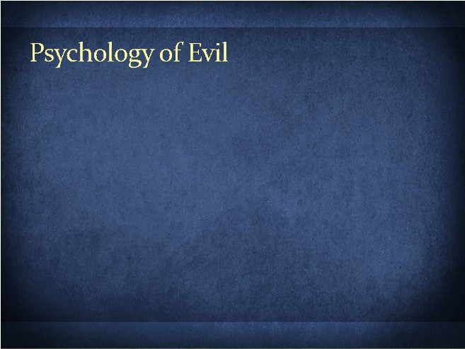

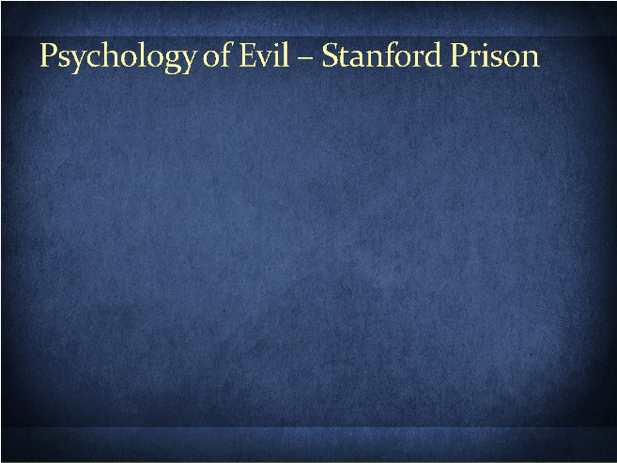

9/12/2016
The Bible describes evil as willful deviation from God’s commands and paths.
Sin by omission (James 4:17) vs sin by commission (Genesis 3:6)
Evolution does not believe in good and evil.
Richard Dawkins (Oxford Prof.):
“we live in a universe which has no design, no purpose, no evil and no good, nothing but blind, pitiless indifference.”
What does Psychology say about this topic of Evil?
Philip Zimbardo’s Stanford Prison Experiment
Stanley Milgram’s Obedience Experiment
College students assigned as ‘guards’ and ‘prisoners’.
Participants “overplayed” their roles.
‘Guards’ used authoritarian and psychological torture.
‘Prisoners’ accepted abuse and harassed other prisoners to prevent abuse.
Zimbardo affected and permitted abuse.
Christina Maslach (wife) initiated stopping the experiment after 6 days.
The only person of over 50 to question morality.
Originally planned for 2 weeks.
Study revisited in Abu Ghraib Prison (2004)
“Evil is the exercise of power. And that’s the key: it’s about power. To intentionally harm people psychologically, to hurt people physically, to destroy people mortally, or ideas, and to commit crimes against humanity..”
Philip Zimbardo. TED Talks, Transcript.

Slide 14
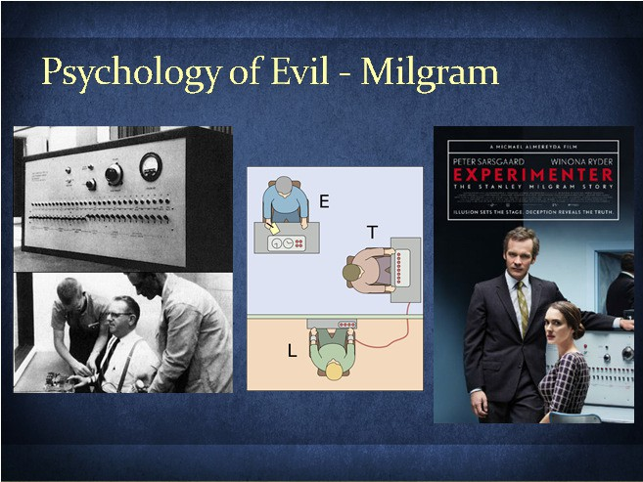
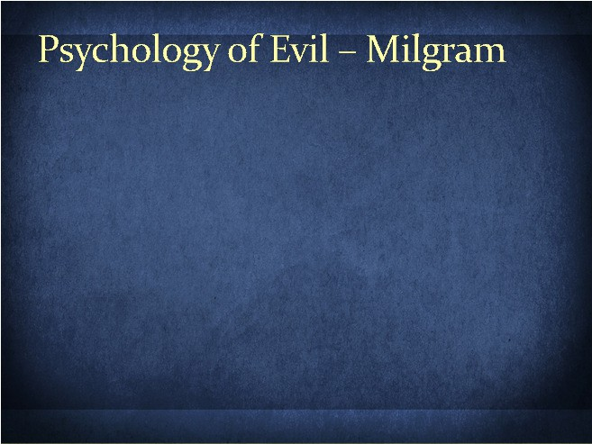
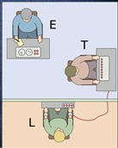
9/12/2016
Psych2go.net
Study of willingness of people to obey an authority figure to do things against their conscience.
Volunteer were to be the ‘Teacher’ and obey ‘Experimenter’ to teach the ‘Learner’.
‘Teacher’ administers shocks when ‘Learner’ responds incorrectly.
65% administered up to “450-Volts reluctantly”.
Shocks were not real.
‘Learner’ acted out pain when shocked.
Milgram concluded that people simply doing their jobs can be agents in a terrible destructive process.
Even when the actions were incompatible with fundamental morality.
Few people have resources to resist authority (or do we?)
The good man is perished out of the earth: and there is none upright among men ….. That they may do evil with both hands earnestly….
Micah 7:2-3
For from within, out of the heart of men, proceed evil thoughts, adulteries, fornications, murders, thefts, covetousness, wickedness,
deceit, lasciviousness, an evil eye, blasphemy, pride, foolishness:
All these evil things come from
within, and defile the man.
Mark 7:21- 23
Let no man say when he is tempted, I am tempted of God: for God cannot be tempted with evil, neither tempteth he any man:
But every man is tempted, when he is
drawn away of his own lust, and enticed.
Then when lust hath conceived, it bringeth forth sin: and sin, when it is finished, bringeth forth death.
James 1:13-15

Slide 15





9/12/2016
Thou shalt not commit adultery.
Exodus 20:14
The famous Kinsey reports (1948 and 1953) estimated that 50% of all married males had some extramarital experience.
Among the sample, 26% of females had extramarital sex by their forties.
Between 1 in 6 and 1 in 10 females from age 26 to 50 were engaged in extramarital sex.
Stats were inflated as couples who have lived together for at least a year were marked as "married“.
Sexual Behavior in the: Human Male(1948) Human Female (1953)
Thou shalt not bear false witness against thy neighbour.
Exodus 20:16
"People tell a considerable number of lies in everyday conversation. It was a very surprising result. We didn't expect lying to be such a common part of daily life…
When they were watching themselves on videotape, people found themselves lying much more than they thought they had…
It's so easy to lie. We teach our children that honesty is the best policy, but we also tell them it's polite to pretend they like a birthday gift they've been given. Kids get a very mixed message regarding the practical aspects of lying, and it has an impact on how they behave as adults.”
Reported in EurekaAlert 10-Jun-2002. Feldman, R. S., Forrest, J. A., & Happ, B. R. (2002)..
When a righteous man turneth away from his righteousness, and committeth iniquity, and dieth in them; for his iniquity that he hath done shall he die.
Ezekiel 18:26
Blessed is the man that endureth temptation: for when he is tried, he shall receive the crown of life, which the Lord hath promised to them that love him.
James 1:12

Slide 16




9/12/2016
And if ye have erred, and not observed all these commandments…..
Then it shall be, if ought be committed by ignorance without the knowledge of the congregation…
Numbers 15:22, 24
Therefore to him that knoweth to do good, and doeth it not, to him it is sin.
James 4:17
Psychological studies support the Biblical state of sinful man.
We do not even know how sinful we are!
We sin constantly, thus the commandments were given.
God reminds us and saves us!
Casting down imaginations, and every high thing that
exalteth itself against the knowledge of God, and bringing into captivity every thought to the obedience of Christ;
2 Corinthians 10:5
Retail S$50.50
Pack price S$32
SAVE S$18.50!

Slide 17






9/12/2016
Covers a wide range of interesting topics!
http://tinyurl.com/7tvt7vq http://tinyurl.com/742apl7
http://tinyurl.com/guidebiblelands The Lord is my Rock and Redeemer facebook.com/TsuriVgoali/
All scripture is given by inspiration of God, and is profitable for doctrine, for reproof, for correction, for instruction in righteousness:
2 Timothy 3:16
Every word of God is pure: he is a shield unto them that put their trust in him.
Proverbs 30:5
The History Book of the Universe!
Exegesis or Eisegesis
GAP THEORY

Slide 18

9/12/2016

