Slide 1
Genealogies & OT Chronology
Genesis 5 & 11
Dr. Rick Griffith • Jordan Evangelical Theological Seminary BibleStudyDownloads.org
Notes:
CR-30-Gen_5_and_11_Genealogies-52_eng_cr_9230_v10-slide 1
OB-20-Chronology-124_eng_ob_7633_v7-Slide 5
OC-10-Gen_5_and_11_Genealogies-52_eng_oc_9230_v10-slide 1

Slide 2
What is OT Chronology?
38
The arrangement of OT events in time, including their dates and correlation with secular history
Purpose: To determine the correct dates of events and persons in the OT as precisely as possible

Slide 3
Why is the Chronology of the OT important?
It describes the building of the nation of Israel, a country with timeless significance
It fits OT events into the extra biblical records of the Near Eastern world
It helps give confidence in the historicity and reliability of the Bible
It builds faith in God and His message

Slide 4
How do Historians Determine the Chronology of the OT?
Sources
The Bible (genealogies, ages, lengths of reigns, time spans, synchronisms with events of other countries)
Historical records of the Ancient Near East (ANE)
Astronomical data
Material remains and archaeological findings
Records of contemporary historians

Slide 5
How do historians determine OT Chronology?
Methods
General: Examine the milieu of the time and compare with other known records to find compatibilities
Establish sequence and time according to Bible
Compare synchronic events in Bible and another reliable source
Verify with other sources
Work from established dates

Slide 6
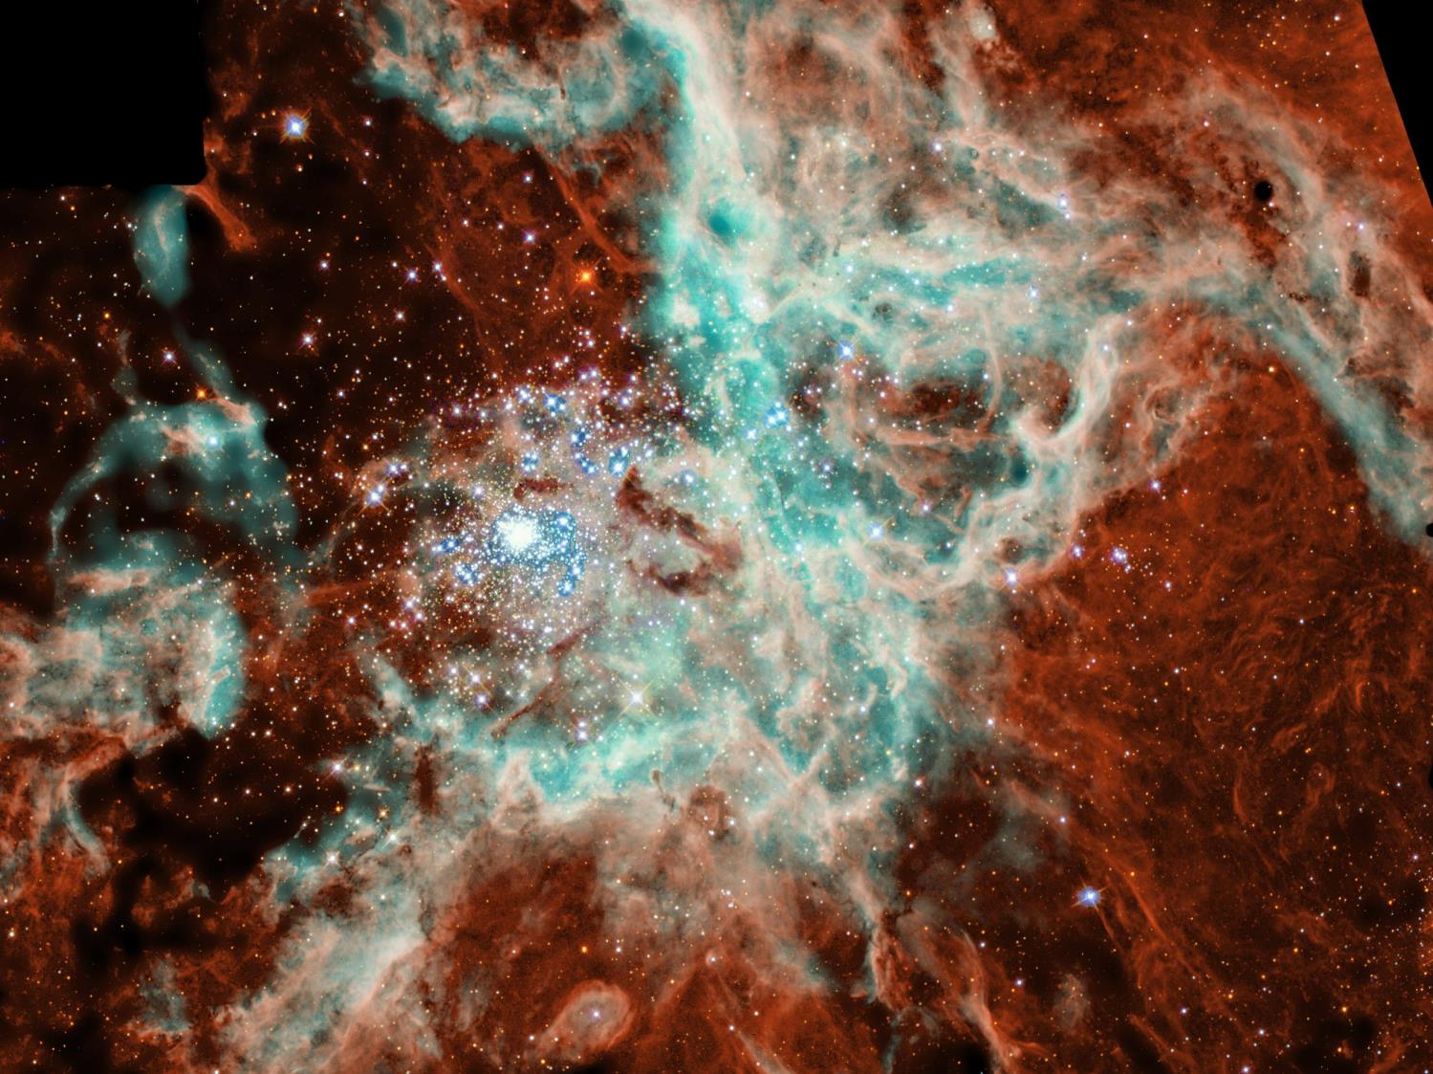
Is Genesis 1–11 Real History?
Theological Problems
OTS 58
3.a.
Myths don't teach "deep truths" better than history
A non-historical approach is very subjective
Genesis 1–11 has vital information otherwise not known
Genesis 1–11 fits into the book's argument on election
Events are presented as historical
Science confirms the Genesis 1–11 historical record
Christ said these events are historical (Matt. 19:4-6)

Slide 7
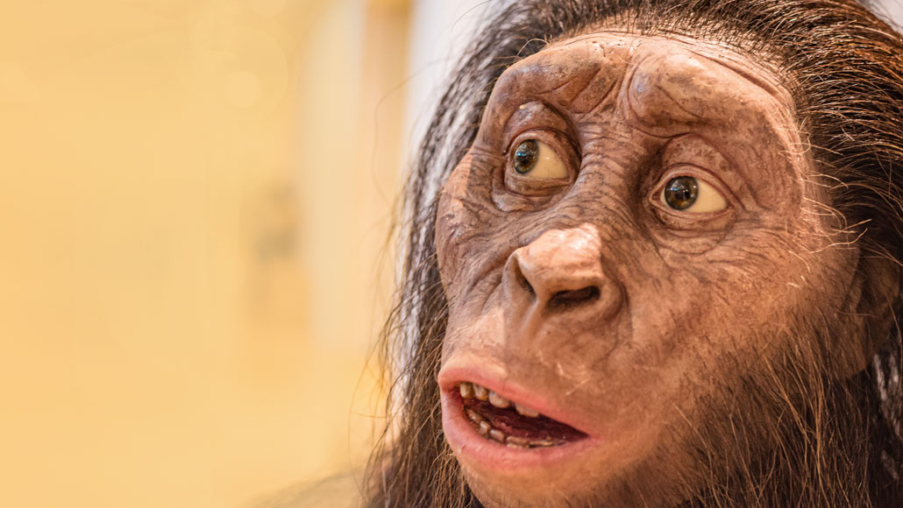
Hominids? Really?
﻿But before [10,000 BC], the “human” story tails back into multimillennia of which we know less, and of which one may well ask which (and what) are humans proper and which (or what) are simply humanlike “hominids.”
Kenneth Kitchen, On the Reliability of the Old Testament (Grand Rapids: Eerdmans, 2003), loc. 9197 of 14432, Kindle ed.; picture of Australopithecus afarensis (https://www.sciencenews.org/article/lucy-species-brain-skull-heralded-rise-long-childhoods-hominids)
Notes:
Picture from:
Lucy’s species heralded the rise of long childhoods in hominids
Prolonged brain growth was already a feature for hominids before Homo genus members appeared
A more than 3-million-year-old hominid species called Australopithecus afarensis, represented here by an adult’s reconstructed skull, foreshadowed the long period of childhood brain growth typical of people today, a new study suggests.
Lorenza photography / Alamy Stock Photo
Share this:
By Bruce Bower
April 1, 2020 at 2:02 pm
Lucy’s kind had small, chimplike brains that, nevertheless, grew at a slow, humanlike pace.
This discovery, reported April 1 in Science Advances, shows for the first time that prolonged brain growth in hominid youngsters wasn’t a by-product of having unusually large brains. An influential idea over the last 20 years has held that extended brain development after birth originated in the Homo genus around 2.5 million years ago, so that mothers — whose pelvic bones and birth canal had narrowed to enable efficient upright walking — could safely deliver babies.
But Australopithecus afarensis, an East African hominid species best known for Lucy’s partial skeleton, also had slow-developing brains that reached only about one-third the volume of present-day human brains, say paleoanthropologist Philipp Gunz of the Max Planck Institute for Evolutionary Anthropology in Leipzig, Germany, and his colleagues. And A. afarensis is roughly 3 million to 4 million years old, meaning slow brain growth after birth developed before members of the Homo genus appeared, perhaps as early as 2.8 million years ago (SN: 3/4/15).
Too few A. afarensis infants have been studied to calculate the age at which this species attained adult-sized brains, Gunz cautions. The brains of human infants today reach adult sizes by close to age 5, versus an age of around 2 or 3 for both chimps and gorillas.
In the new study, Gunz and colleagues estimated brain volumes for six A. afarensis adults and two children, estimated to have been about 2 years and 5 months old. The kids had brains that were smaller than adult A. afarensis brain sizes in a proportion similar to human children’s brains at the same age relative to adult humans.
The new data suggest that, for Lucy’s species, “infant brain size [relative to that of an average adult] may have been proportionally even smaller than in human infants,” says biological anthropologist Zachary Cofran of Vassar College in Poughkeepsie, N.Y., who did not participate in the new study. If so, that pattern would strongly point to an extended period of brain growth for A. afarensis.
A roughly 3.3-million-year-old A. afarensis child’s skull, shown here, has revealed signs of prolonged growth of a brain that nonetheless had a chimplike structure.@ Zeresenay Alemseged Gunz suggests the extended post-birth brain growth among A. afarensis may have eased the physical and nutritional burden on mothers caring for infants, especially if food was scarce. It also “likely provided a foundation for the evolution of long childhoods in the human lineage,” he says.
His group used high-resolution CT scans to study fossilized braincases from an infant A. afarensis and six adults, including Lucy, all found at Ethiopia’s Hadar site. A second A. afarensis infant braincase came from Ethiopia’s Dikika site (SN: 9/20/06). The scans helped the researchers create 3-D digital reconstructions, or endocasts, of impressions made by the brain on the skull’s inner surface. Endocasts display signature folds and creases in brain tissue typical of humans or chimps, although preservation of these neural landmarks varies.
CT scans also let the researchers determine the infants’ ages by revealing microscopic layers of dental enamel that form daily during childhood, which can be counted like tree rings.
The Dikika child’s well-preserved endocast retained a crease and a set of grooves toward the back of the brain that are found in chimps, but not in humans. These impressions mark a prominent neural area involved in vision. Human brain surfaces lack these markings due to expanded neural tissue that integrates visual and sensory information. A South African Australopithecus skull was previously revealed to have signs of a chimplike visual area in the brain (SN: 1/10/19).
Neither of the A. afarensis infants showed evidence of humanlike frontal brain organization, as has been reported for an approximately 300,000-year-old South African hominid, Homo naledi (SN: 4/25/17).
Anthropologist and neuroscientist Todd Preuss of Emory University in Atlanta agrees. Endocasts of the Hadar A. afarensis skulls contain many preserved features from the brain’s visual area that resemble those on an Australopithecus child’s skull from South Africa that dates to about 2.8 million years ago, says Preuss, who was not part of Gunz’s team.
Much remains to be learned about the pace of brain growth in A. afarensis, says paleoanthropologist Aida Gomez-Robles of University College London. Researchers can’t track brain sizes of A. afarensis individuals from infancy into adulthood, so the new results don’t conclusively determine growth rates, she notes. And earlier interpretations of hominid brain organization based on endocasts have sparked frequent debate, leading Gomez-Robles to withhold judgment on the brains of Lucy’s kind.
Questions or comments on this article? E-mail us at feedback@sciencenews.org
A version of this article appears in the May 9, 2020 issue of Science News.
Citations
P. Gunz et al. Australopithecus afarensis endocasts suggest ape-like brain organization and prolonged brain growth. Science Advances. Published online April 1, 2020. doi: 10.1126/sciadv.aaz4729.
About Bruce Bower
E-mail
Twitter
Bruce Bower has written about the behavioral sciences for Science News since 1984. He writes about psychology, anthropology, archaeology and mental health issues.
Related Stories
Humans Year in review: Early human kin could shake up family tree
By Bruce BowerDecember 15, 2015
Humans Ancient jaw may hold clues to origins of human genus
By Bruce BowerMarch 4, 2015
Anthropology Fossil Skull Diversifies Family Tree
By Bruce BowerMarch 21, 2001

Slide 8
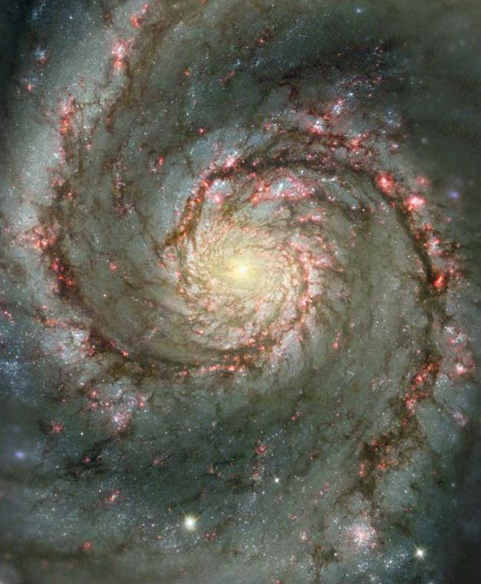
Genesis Questions
Beginnings
When did the creation occur?
Did the patriarchs really live that long?
©2003 TBBMI
7.5.03a.
18

Slide 9
Oh, no… I hit the geneaologies
in my read-through-the-Bible program again…

Slide 10
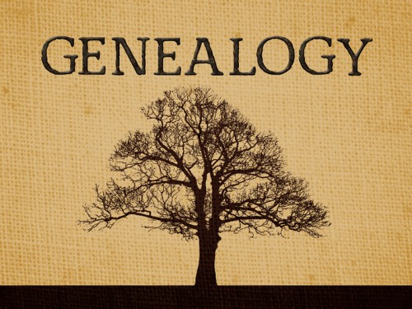
What’s the point?
GENEALOGY

Slide 11
What’s the point?
Genealogies can help you catch up on your sleep?

Slide 12
Can We Find the Date of Creation from Genesis 5 & 11?
Some Say "No"
Other genealogies in the Bible have gaps (e.g., Matt. 1:1-17)
Therefore there must be gaps in Genesis
A "no gap" view puts the Flood at 2487 BC but Egypt's history goes back before 3300 BC
Others Say "Yes"
The other genealogies do not give the father's ages when their sons were born
God wants us to "mark seasons and days and years" (Gen. 1:14)
Why else would God give us the ages of these men?

Slide 13
The Mystery of the Genesis 5 & 11 Genealogies
Genesis 5 carries the genealogy that stretches from Adam to the Flood. Genesis 11 carries the genealogy from Shem (son of Noah) to Terah (father of Abram)
Can information found in the genealogies of Genesis 5 and 11 be used to determine the dates of certain events in history?

Slide 14
Genesis Genealogy Mysteries
Adam
Genesis 5
Noah
Shem
Genesis 11
Terah
Can these genealogies help determine the dates of events in history?

Slide 15
Genesis 5 Genealogy
38
Adam
Seth
Enosh
Kenan
Mahalalel
Jared
Enoch
Methuselah
Lamech
Noah

Slide 16
Why Don't Genesis 5 & 11 Have Gaps?
38
Adam
State lengths of time
Seth
Enosh
Kenan
Mahalalel
Jared
Enoch
Methuselah
Lamech
Noah

Slide 17
Age at Son's Birth
38
Adam-130
Seth-105
Enosh-90
Kenan-70
Mahalalel-65
Jared-162
Enoch-65
Methuselah-187
Lamech-122
Noah-500

Slide 18
Genesis 5 Age at Death
38
Adam
930
Seth
912
Enosh
905
Kenan
910
Mahalalel
895
Jared
962
Enoch
365
God took him without death
Methuselah
969
Lamech
777
Noah
950

Slide 19
Why Don't Genesis 5 & 11 Have Gaps?
38
Adam
State lengths of time
Shorter lengths
Seth
Enosh
Kenan
Mahalalel
Jared
Enoch
Methuselah
Lamech
Noah

Slide 20
Genesis 5 Shorter Than Luke 3
38
Adam
Adam
2006
yrs
Noah
4138
yrs
Christ

Slide 21
Why Don't Genesis 5 & 11 Have Gaps?
Adam
State lengths of time
Shorter lengths
Most natural
Show father-son
Jude 14
Similar ANE chronologies
Seth
Enosh
7
Kenan
Mahalalel
Jared
Enoch
"Enoch, in the seventh generation from Adam, prophesied saying. . . "
(Jude 14a, NASB)
Methuselah
Lamech
Noah

Slide 22
Two Views
Straight chronology
The Bible has the necessary data to map out the basic historical timeline of the OT
Genealogical gaps
There are gaps not mentioned in the Bible
Genealogical information should not be used as the only source for dating events

Slide 23
Arguments Posed for Gaps
It is normal for Scripture to pass over very long periods of time with little or no remark
Omission of unimportant names is the rule rather than the exception
In the ancient world "begat" simply indicated “became the ancestor of,” however far removed that ancestor was
Lack of harmony exists between OT chronologies and neighboring states

Slide 24
Straight Chronology Support
The Bible is filled with much chronological information though scattered in many places
When this chronological information is fully systematized, a straight chronology may be proven

Slide 25
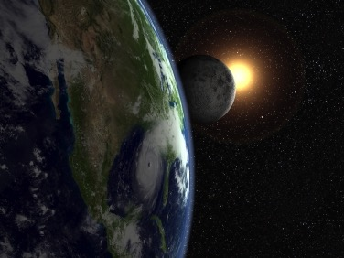
How can you tell the age of the earth?
Just ask the only Eyewitness!

Slide 26
"Just do the math."
"God, how old is the earth?"

Slide 27
Chronology of the Patriarchs (Gen. 5, 11)
38-44
Event
Reference
AH
BC
World created
"God finished"
-6 days
4143
Adam created
"God created man"
0
4143
Seth born
"Adam was 130…"
130
4013
Enosh born
"Seth was 105…"
235
3908
Jacob & family go to Egypt
"Jacob age 130 at 400 years before Exodus in 1445 BC"
2298
1845

Slide 28
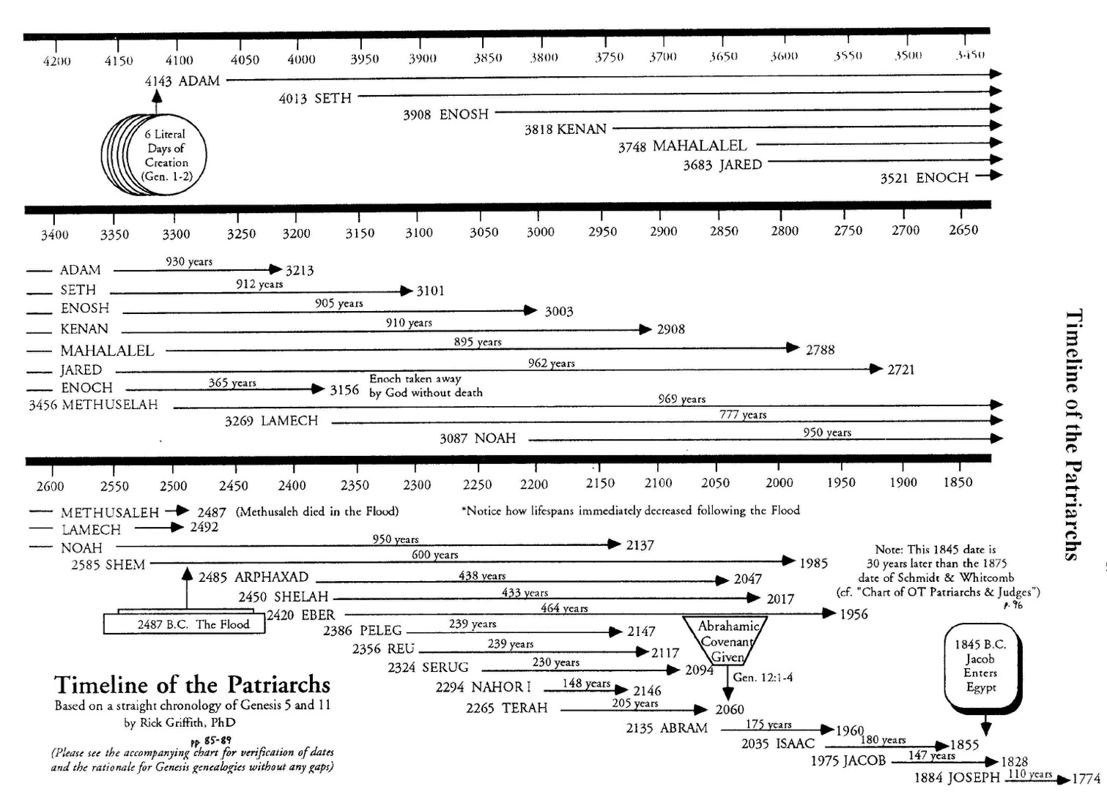
Methuselah's Death
44
Adam & Methuselah contemporaries
Adam probably told Methuselah the creation account, who told Shem, who told Abraham—only 3 retellings apart!
2487
A straight chronology works out exactly to show that Methuselah died in the year of the Great Flood!
2487
Methuselah & Shem contemporaries
Shem & Abraham contemporaries

Slide 29
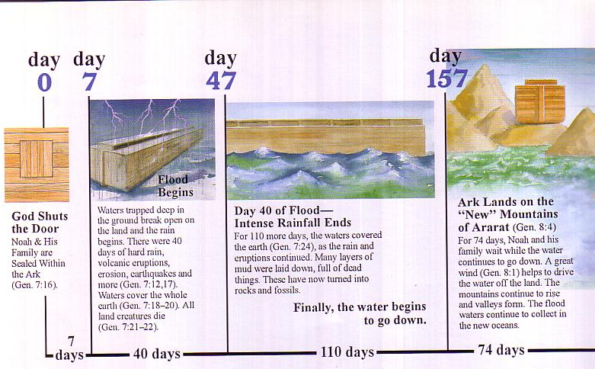
Flood Chronology
A “day” means a “day” in the Flood account.
Day
0
Day
7
Day
47
Day
157
Flood Begins
Waters trapped deep in the ground break open on the land in 40 days of hard rain with volcanic eruptions, erosion, earthquakes, and more （Gen 7：12，17）. Waters cover the whole earth (Gen 7:18-20). All land creatures die （Gen 7:21-22）.
Day 47 of Flood—Intense Rainfall Ends
For 110 more days, the waters cover the earth （Gen 7：24）, as the rain and eruptions continue. Many layers of mud laid down, full of dead things. They have now turned into rocks and fossils.
Finally, the water begins to go down.
Ark Lands on New Ararat Mountains （Gen 8：4）
For 74 days, Noah and his family wait while the water continues to go down. A great wind（Gen 8：1） helps to drive the water off the land. The mountains continue to rise and valleys form. The flood waters continue to collect in the new oceans.
God Shuts the Door
Noah and his family sealed within the ark（Gen 7：16）.
7
Days
40
Days
110
Days
74
Days

Slide 30
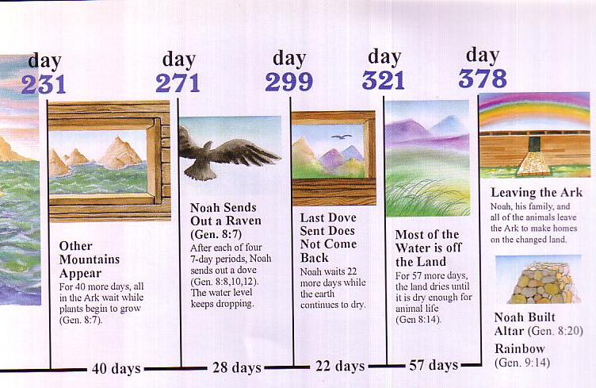
Flood Chronology
So why can’t a “year” mean a “year” in the genealogies?
Day
231
Day
271
Day
299
Day
321
Day
378
Leaving the Ark
Noah, his family and the animals leave the ark to make homes on the changed land.
Noah Sends Out a Raven （Gen 8：7） After each of four 7-day periods, Noah sends out a dove (Gen 8：8，10，12). The water level keeps dropping.
Most of the Water is Off the Land（Gen 8:14）.
For 57 more days, the land dries until it is dry enough for animal life (Gen 8:14).
Last Dove Sent Does Not Come Back
Noah waits 22 more days while the earth continues to dry.
Other Mountains Appear
For 40 more days, all in the ark wait while plants begin to grow （Gen 8:7）.
Noah Builds Altar （Gen 8：20）
Rainbow （Gen 9：14）
40
Days
28
Days
22
Days
57
Days

Slide 31
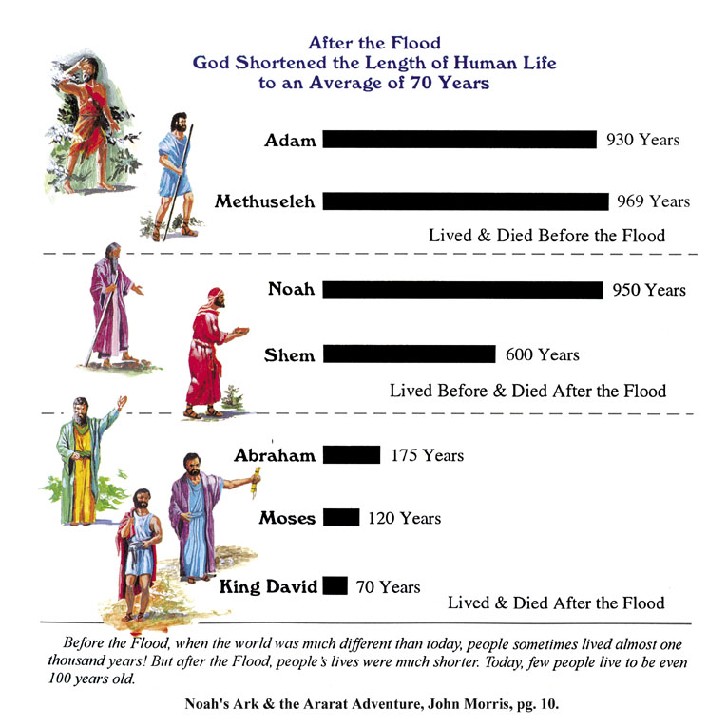
Patriarch's long lives
90
Ages of people when they died
Adam
930 Years
Methuselah
969 Years
Noah
950 Years
Shem
600 Years
The Flood explains why life spans shortened
Abraham
175 Years
Moses
120 Years
David
70 Years
Notes:
From John Morris, Noah's Ark and the Ararat Adventure, p. 10.

Slide 32
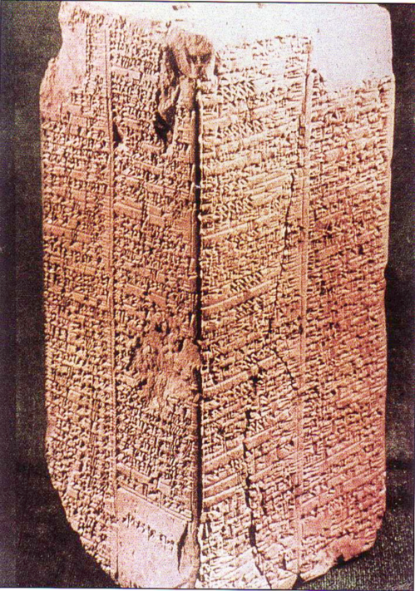
Sumerian King List
Inscribed about 1800 BC (about 600 years after the Flood)
Ten of these kings before the Flood are said to have lived between 21,000 to 43,200 years each
(cf. Gen. 5)
Arnold & Beyer, Readings from the ANE, 150
Notes:
See Clifford Wilson, The Stones Sill Shout, 25 and Arnold/Beyer, Readings from the ANE, 150.

Slide 33
Sumerian King List
OTB, 64a
“When kingship came down from heaven. . .
Alulim became king and reigned for 28,800 years…
Eight kings reigned for 241,000 years. Then the flood waters streamed over the earth.”
King & Years of Reign
Alulim 28,800
Alalgar 36,000
Enmenluanna 43,200
Enmengalanna 28,800
Dumuzi 36,000
Ensipazianna 28,800
Enmeduranna 21,000
Urbatutu 18,600
Total 241,000
Arnold & Beyer, Readings from the ANE, 150
Notes:
See Clifford Wilson, “The Stones Sill Shout p. 25 and Arnold/Beyer, “Readings from the ANE,” 150

Slide 34
Sumerian King List
None of us believe in kings who reigned 28,800 years, but it does show a belief in long ages and a worldwide flood.
Arnold & Beyer, Readings from the ANE, 150
Notes:
See Clifford Wilson, The Stones Sill Shout, 25 and Arnold/Beyer, Readings from the ANE, 150.

Slide 35
Sumerian King List
Kitchen, Reliability of the OT
How long did they really reign?
King & Years of Reign
Alulim 28,800
Alalgar 36,000
Enmenluanna 43,200
Enmengalanna 28,800
Dumuzi 36,000
Ensipazianna 28,800
Enmeduranna 21,000
Urbatutu 18,600
Total 241,000
The Math Kitchen
÷ 600 48
÷ 600 60
÷ 600 72
÷ 600 48
÷ 600 60
÷ 600 48
÷ 600 35
÷ 600 31
Total 402
Notes:
Kitchen proposes that each reign should actually be divided by 600 since the Sumerians invented the numbering system based on the number 6—as in our system of time that has the hour divided into 12 units, the 24-hour day, etc.”
““﻿That process can perhaps be reversed. Our scribes in 2000 B.C., faced with few kings and long periods, may have bumped up the numbers by using sexagesimal multipliers. So, at Hamazi and Uruk, reversing the process, we might take the 36,000 years of Alalgar or of Dumuzi and divide it by the factor 10 × 60 (600), which would give them each a reign of 60 years. Applied to Alulim’s (and others’) 28,800 years, he (and they) would have reigned 48 years; then Enmenduranna of Sippar at 21,000 years would have reigned 35 years. The mighty Enmenluanna at 43,200 years (the local Methuselah) would come out at 72 years — high but not impossible, even if it left Ramesses II (66 years) and Queen Victoria (64 years) just slightly jealous — but more modest than the 94 years of Pepi II, often granted. The more modest Ubartutu at 18,600 years comes out at 31 years, eminently reasonable. The principal works for all the preflood rulers, and no awkward fractions, etc., are left over. After the flood, reigns are still high, until suddenly Gilgamesh’s son Ur-nungal (no longer heroic?) reigns only 30 years, and all his successors are modest too, except in Kish (a special center of Sumerian kingship). Most of the “heroic” postflood kings may thus have been upped by only 60 years (not by 60 × 10). Thus Lugal-banda’s 1,200 years would then have been 20 years, and Enmebaragisi’s 900 years would have been 15 years. Those with 200 years down to 100 years may have had a factor of only 10 × years; but that is a baseless guess for now.”
—Kenneth A. Kitchen, On the Reliability of the OT (Grand Rapids, MI: Eerdmans, 2003), location 9647 of 14432 Kindle Ed.

Slide 36
Genesis 5 Age at Son's Birth
38
Adam-130
Seth-105
Enosh-90
Kenan-70
Mahalalel-65
Jared-162
Enoch-65
Methuselah-187
Lamech-122
Noah-500

Slide 37
Kitchen on Age at Son's Birth
Adam
130
÷ 5 =
26
Seth
105
÷ 5 =
21
Enosh
90
÷ 5 =
18
Kenan
70
÷ 5 =
14
Mahalalel
65
÷ 5 =
13
Jared
162
÷ 5 =
32
Enoch
65
÷ 5 =
13
Methuselah
187
÷ 5 =
37
Lamech
122
÷ 5 =
24
Noah
500
÷ 5 =
100
Notes:
“﻿So much for Sumer. What about Gen. 1–11? There was no sexagesimal system in Hebrew usage, and we are dealing with parents and children (direct or indirect), not reigns. The genealogies in Gen. 5 and 11 differ in the time of life at which children are born to the principal members: after long spans in the preflood one, and virtually normal after the flood. Therefore, as no single formula will apply to both lots, any more than to the preflood and postflood kings in Sumer, let us look at each group separately. Is there a “differential factor” as in Sumer? Overall, in Gen. 5, dividing the biblical number by five produces viable results for the age of the protopatriarchs at the birth of a firstborn from Adam to Lamech, running from 26 (for Adam) down to 16 for Kenan and 13 for Enoch; up to 37+ and 36+ for Methuselah and Lamech.”
—Kenneth A. Kitchen, On the Reliability of the OT (Grand Rapids, MI: Eerdmans, 2003), location 9647 of 14432 Kindle Ed.

Slide 38
Kitchen on Age at Death
Adam
930
÷ 5 =
186
Seth
912
÷ 5 =
182
Enosh
905
÷ 5 =
181
Kenan
910
÷ 5 =
182
Mahalalel
895
÷ 5 =
179
Jared
962
÷ 5 =
192
Enoch
365
÷ 5 =
73
Methuselah
969
÷ 5 =
193
Lamech
777
÷ 5 =
155
Noah
950
÷ 5 =
190
Notes:
“﻿﻿But it gives a consistently high average at death of 180/190 years (except Enoch, who was “translated” at 73), ﻿not unlike the later patriarchs from Abraham to Jacob.”
—Kenneth A. Kitchen, On the Reliability of the OT (Grand Rapids, MI: Eerdmans, 2003), location 9656 of 14432 Kindle Ed.

Slide 39
Alternate Kitchen View
Adam
930
Seth
912
Years Later When Clan Died Out
Enosh
905
Kenan
910
Mahalalel
895
Jared
962
Enoch
365
Methuselah
969
Lamech
777
Noah
950
Notes:
“﻿﻿The large postbirth figures might refer to the supposed life span of the clan, not just the men themselves, if one wished to pursue such paths. Only dear old Noah (having his firstborn at 500 = 100; living, even as “clan,” to 950 = 190 years) is the odd man out.”
—Kenneth A. Kitchen, On the Reliability of the OT (Grand Rapids, MI: Eerdmans, 2003), location 9656 of 14432 Kindle Ed.

Slide 40
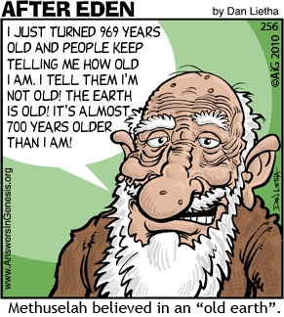
Methuselah
90
I JUST TURNED 969 YEARS OLD AND PEOPLE KEEP TELLING ME HOW OLD I AM. I TELL THEM I'M NOT OLD! THE EARTH IS OLD! IT'S ALMOST 700 YEARS OLDER THAN I AM!
Methuselah believed in an "Old Earth."
Notes:
How old is the earth? Let’s ask the oldest man!

Slide 41
The Meaning of Each Patriarch's Name in the 10 Generations
Notes:
Reading downward with the meanings above, we see that death reigned on the earth. However, their names teach us that at the time of the death of Methuselah in the year of the Flood, through Noah (“comfort, rest”) the world that was renewed through the Flood.

Slide 42
The Meaning of Each Patriarch's Name in the 10 Generations
Notes:
Reading downward with the meanings above, we see that death reigned on the earth. However, their names teach us that at the time of the death of Methuselah in the year of the Flood, through Noah (“comfort, rest”) the world that was renewed through the Flood.

Slide 43
OK, so what's the point?
Notes:
Restatement

Slide 44
Will you take God's Word at face value—even when it is uncomfortable?
Notes:
Restatement

Slide 45
How can you tell the age of the earth?
Trust the Book written by the Eyewitness

Slide 46
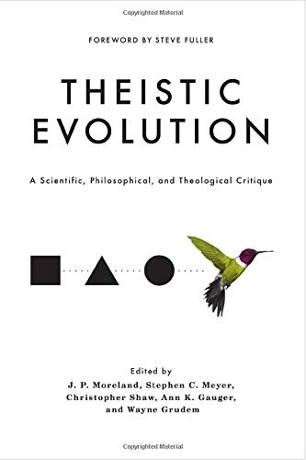
Theistic Evolution: A Scientific, Philosophical, and Theological Critique J P Moreland, Wayne Grudem, editors Nov 2017 —Argues against theistic evolution but still maintains millions of years theory —Includes NO articles by Biblical Creationists who hold to a Young Earth

Slide 47
AiG Web Address 00439

Slide 48
Unformed and Unfilled 04093
Unformed and Unfilled
by Weston Fields
A thorough refutation of the gap theory (2005)
Notes:
Master Books, 2005
245 pages
Amazon: https://www.amazon.com/Unformed-Unfilled-Critique-Gap-Theory/dp/0890514232
Everyone’s heard of it. Many believe it. Is there a “gap in time” between the first two verses in Genesis? Does this alleged gap really represent a vast amount of time? Weston Field’s classic treatment of this subject is now being published by Master Books, and promoted by such important organizations as Answers in Genesis. In this book, Fields makes a detailed study of the gap theory, paying particular attention to the original Hebrew language of Genesis. His conclusion - that this theory is not a reasonable compromise with modern evolutionary theory, but a dangerous diversion from biblical truth - helps readers who struggle with the question of the time taken during the creation week. Was it really six days? Can Christians find a workable solution to the debate about creation and time?
An important book.
A presentation of a variety of views espoused by Christians of all denominations
A professional, scholarly look that can be easily understood by laymen
A fascinating study of the original Hebrew text
A classic work still relevant today
“A brilliant, scholarly refutation of the famed gap theory” - Ken Ham, President, Answers in Genesis

Slide 49
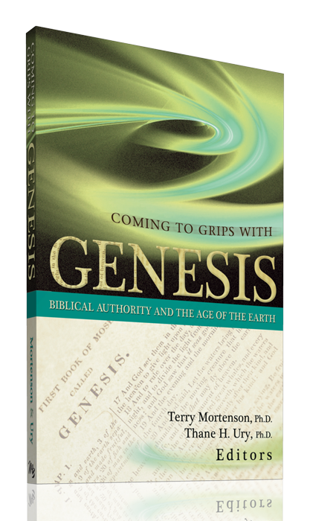
Coming to Grips with Genesis 04702
Coming to Grips with Genesis
edited by Dr. Terry Mortenson and Dr. Thane Ury
14 scholars give a careful biblical & historical defense of
young-earth creationism (2008)
© 2008 Answers in Genesis-USA
Notes:
New Leaf Publishing Group, 2008
450 pages
Fourteen theological scholars address key topics related to the age of the earth, which is the crucial issue of debate in the church today regarding origins. Bringing to bear rigorous biblical, theological, and historical arguments in favor of a six-day creation, the global Flood, and a young earth, they also provide much-needed critiques of a number of contemporary old-earth interpretations of the book of Genesis.
This fresh defense of the literal history of Genesis 1-11 nicely complements other studies which focus more on the scientific evidence of young-earth creationism. As such, this book can serve as a versatile supplement to other works, but is also designed to be used as a standalone text for seminary and Bible college professors and students, pastors, missionaries, and others who want in-depth apologetic resources.
Coming to Grips with Genesis: Biblical Authority and the Age of the Earth includes:
Forewords by Dr. John MacArthur, President of the Master's Seminary and Senior Pastor of Grace Community Church, Sun Valley, CA; and the late Dr. Henry Morris, Founder and President Emeritus, Institute for Creation Research
Detailed analysis of the verbs of Genesis 1
A defense of the Genesis 5 & 11 genealogies as strict chronologies
Reasons for rejecting millions of years of death and natural evil before Adam's sin
Careful reflection on Jesus' teachings regarding a young earth

Slide 50
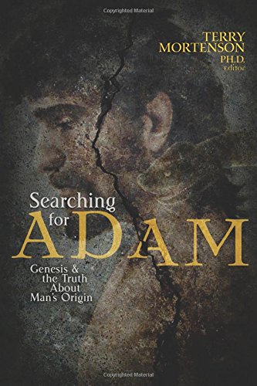
Coming to Grips with Genesis 04702
Searching for Adam: Genesis & the Truth About Man’s Origin
edited by Dr. Terry Mortenson
16 chapters by scholars upholding the literal Adam and Eve (2016)
© 2008 Answers in Genesis-USA
Notes:
October 30, 2016
528 pages
From Amazon website at https://www.amazon.com/Searching-Adam-Genesis-Truth-Origin/dp/0890519757
Accessed 22 Sep 2021
You can believe with great intellectual integrity what the Bible says about Adam and the origin and history of man. Though there are a growing number of books out on Adam, this one is unique in its multi-author combination of biblical, historical theological, scientific, archaeological and ethical arguments in support of believing in a literal Adam and the Fall. A growing number of professing evangelical leaders and scholars are doubting or denying a literal Adam and a literal Fall, which thereby undermines the gospel of Jesus Christ, the Last Adam, who came to undo the damaging consequences of Adam’s sin and restore us to a right relationship with our Creator. This book will increase your confidence in the truth of Genesis 1-11 and the gospel:
Enhance your understanding pertaining to the biblical evidence for taking Genesis as literal history
Discover the scientific evidence from genetics, fossils, and human anatomy for the Bible’s teaching about Adam
Understand the moral, spiritual, and gospel reasons why belief in a literal Adam and Fall are essential for Christian orthodoxy.

Slide 52
Creation link at BibleStudyDownloads.org
Get this presentation for free!
Notes:
OT Survey (os)

