Slide 1
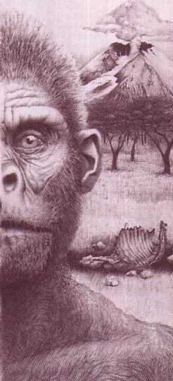
Creation?
187m
Theistic Evolution
Dr. Rick Griffith
Jordan Evangelical Theological Seminary BibleStudyDownloads.org
or Evolution?

Slide 2
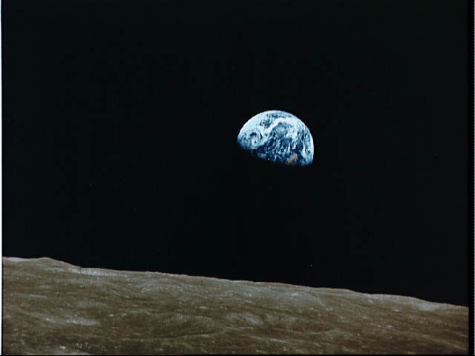
Questions About Origins
187i
How did the Universe get here?
Creation? Or Evolution? Or Theistic Evolution?
What does Genesis say?

Slide 3
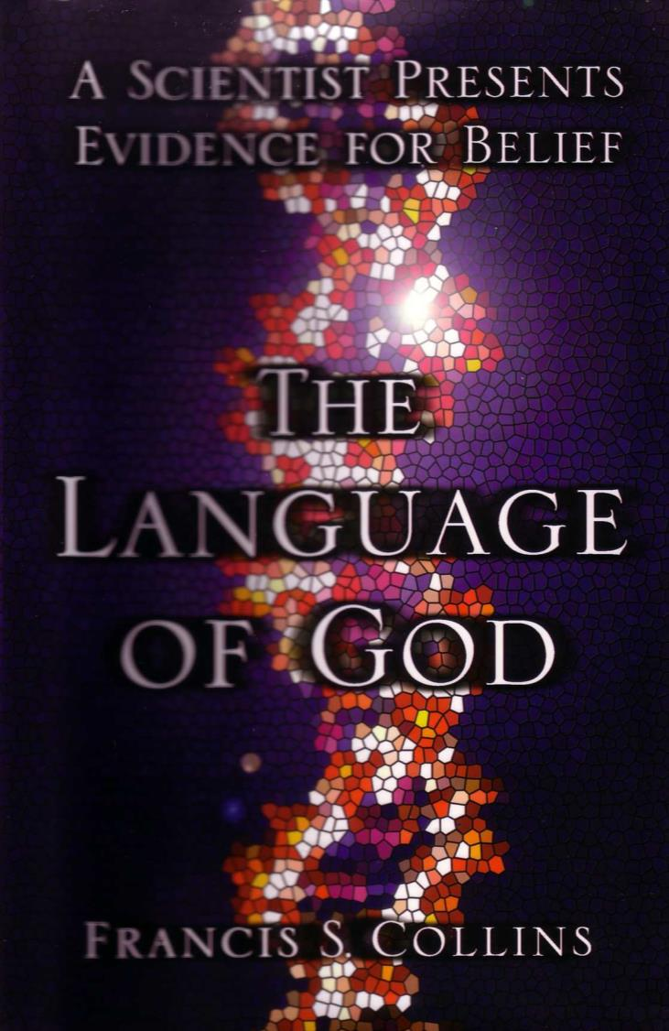
A Recent Defense of Theistic Evolution
70n
A SCIENTIST PRESENTS EVIDENCE FOR BELIEF
THE LANGUAGE OF GOD
New York: Free Press, 2006
FRANCIS S. COLLINS

Slide 4
General Observations
A SCIENTIST PRESENTS EVIDENCE FOR BELIEF
THE LANGUAGE OF GOD
Simple language
Inductive approach
Apologetic stance
Debt to C. S. Lewis
Little interaction with Scripture
FRANCIS S. COLLINS

Slide 5
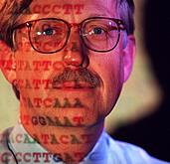
Who is Collins?
One of the world's leading scientists
Former Director of Human Genome Project (DNA)
Former atheist, now Christian
Notes:
Cover and his surrender to Jesus Christ on page 225.

Slide 6
His Surrender
"The next morning,… as the sun rose I surrendered to Jesus Christ" (p. 225)

Slide 7
Great Reviews
"Francis Collins has written an extraordinary personal testimony about the compatibility of God and science. His explanation of DNA as God's instruction book is persuasive. His explanation of his personal faith is compelling reading"
–Newt Gingrich

Slide 8
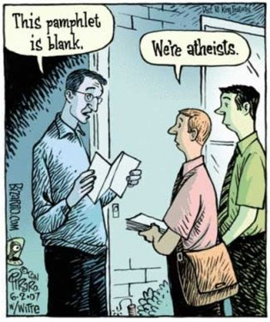
Atheism
This pamphlet is blank.
We're atheists.
"The next morning,… as the sun rose I surrendered to Jesus Christ" (p. 225)

Slide 9
A Spectrum of Views
"Faith is the great cop out, the great excuse to evade the need to think and evaluate evidence. Faith is belief in spite of, even perhaps because of, the lack of evidence…
Faith, being belief that isn't based on evidence, is the principal vice of any religion."
Atheism (Richard Dawkins)
Notes:
R. Dawkins, "Is Science a Religion?" The Humanist 57 (1997): 26-29; cited in Collins, The Language of God, 4.

Slide 10
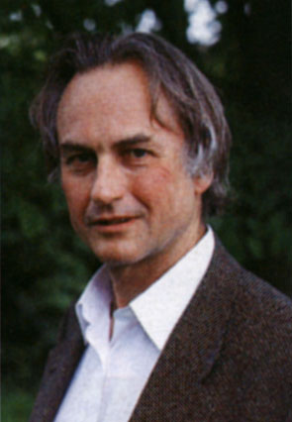
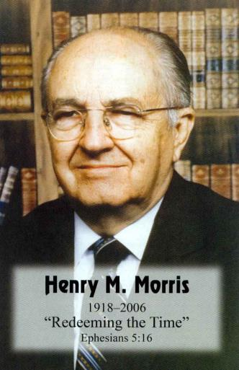
A Spectrum of Views
"Evolution's lie permeates and dominates modern thought in every field… [it] is basically responsible for… disintegrations that have been accelerating everywhere… When science and the Bible differ, science has obviously misinterpreted its data."
Atheism (Richard Dawkins)
Creationism (Henry Morris)
Notes:
H. R. Morris, The Long War Against God (New York: Master Books, 2000); cited in Collins, The Language of God, 4.

Slide 11
A Spectrum of Views
Atheism (Richard Dawkins)
BioLogos (Francis Collins)
Creationism (Henry Morris)

Slide 12
The Episcopal Church reaffirms evolution education
At its 75th General Convention in June 2006, the Episcopal Church passed a resolution supporting the teaching of evolution in schools. The resolution, titled "Affirm Creation and Evolution," declared that "evolution is entirely compatible with an authentic and living Christian faith."
Notes:
http://www.ncseweb.org/resources/news/2006/US/828_the_episcopal_church_reaffirms_6_26_2006.asp

Slide 13
The Episcopal Church reaffirms evolution education
It also encourages state legislatures and boards of education "to establish standards for science education based on the best available scientific knowledge as accepted by a consensus of the scientific community…"
Notes:
http://www.ncseweb.org/resources/news/2006/US/828_the_episcopal_church_reaffirms_6_26_2006.asp

Slide 14
The Episcopal Church reaffirms evolution education
Also occurring at the convention was the election of new Presiding Bishop Katharine Jefferts Schori, who, as well as being the first woman elected to the position, is a former oceanographer with a strong evolutionary background…
Notes:
http://www.ncseweb.org/resources/news/2006/US/828_the_episcopal_church_reaffirms_6_26_2006.asp

Slide 15
The Episcopal Church reaffirms evolution education
Schori said… "Evolution most definitely should be taught in school. It's a well-tested premise and the best model that fits the data available. Creationism can't make that claim. I believe in the creeds. They say God created the world, but they don't say how."
28 June 2006 New York Times
Notes:
http://www.ncseweb.org/resources/news/2006/US/828_the_episcopal_church_reaffirms_6_26_2006.asp

Slide 16
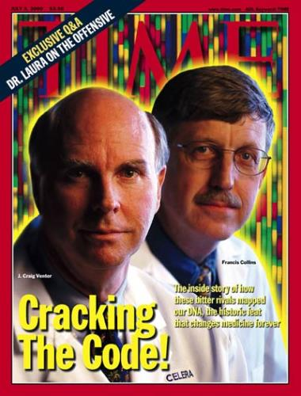
Options by Collins on Faith in Science & God
Atheism & Agnosticism (When Science Trumps Faith)
Creationism (When Faith Trumps Science)
Intelligent Design (When Science Needs Divine Help)
BioLogos (Science & Faith in Harmony)

Slide 17
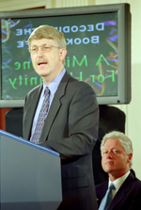
Must we accept evolution?
"No serious biologist today doubts the theory of evolution to explain the marvelous complexity and diversity of life" (Collins, 99)

Slide 18
How is Collins a Theistic Evolutionist?
We normally CONTRAST these, but he believes BOTH
Theism
Evolution
Miracles
Big Bang
God cares
Atoms afterwards
Creation
Earth 4.5 billion yrs. old
Moral Law
Cooling into planets

Slide 19
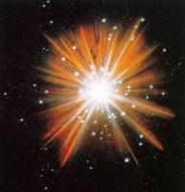
His reasoning for the Big Bang
"If everything in the universe is flying apart, reversing the arrow of time would predict that at some point all of these galaxies were together in one incredibly massive entity… the universe began at a single moment… 14 billion years ago" (Collins, 64).

Slide 20
His reasoning for the Big Bang
Microwave signals throughout the galaxy
Constant ratio of hydrogen, deuterium, and helium throughout the universe
(Collins, 64-65)

Slide 21
Creation Theories
187c
24-Hour Day
1 day = literal 24 hours
Day-Age
1 day = indefinite era
Literary
7 days = symbolic
Prior Creation
Creation | Gap | Re-Creation 1:1 1:2-2:3
Two-Phase
Creation | Gap | Creation
1:1-2:3 2:4-25
Genesis 1

Slide 22
"Now the earth was formless and empty, darkness was over the surface of the deep…"
"…and the Spirit of God was hovering over the waters."
Genesis 1:2 NIV

Slide 23
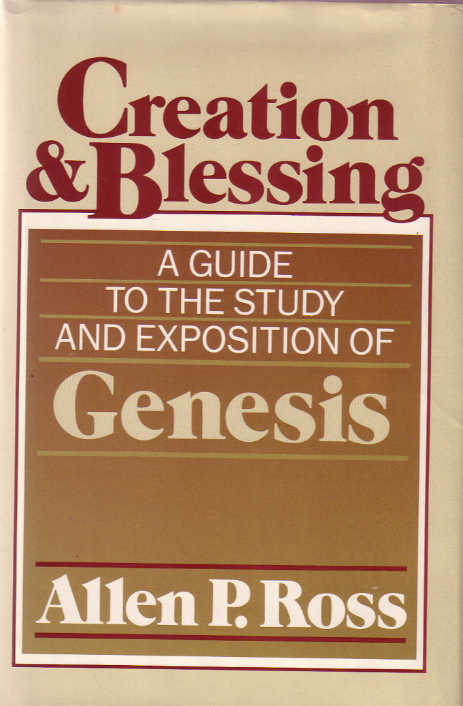
The Best Commentary on Genesis
Creation &Blessing
Very Readable
Exegetical Outlines
Sermon Outlines
Theology of Genesis
Evangelical

Slide 24
How Does 1:1 Relate to 1:2-3?
34
Original Creation (Traditional View)
Leupold, Keil, Cassuto, Griffith
1- Creation of the original mass out of nothing on Day 1
"In the beginning God created the heavens and the earth" (1:1)
2- Three disjunctive, parallel clauses describe the condition of the earth immediately after the creation of the universe.
"Now the earth was formless and empty, darkness was over the surface of the deep, and the Spirit of God was hovering over the waters" (1:2 NIV)
3- An independent, narrative sentence shows the manner in which God worked—by His Word.
"And God said, 'Let there be light,' and there was light" (1:3)
Allen Ross, Creation & Blessing, 718

Slide 25
Gap Theory
34
How Does 1:1 Relate to 1:2-3?
Pember, Hengstenburg, Scofield Reference Bible (1st ed.)
1- An independent narrative of the original, perfect creation
"In the beginning God created the heavens and the earth" (1:1)
Satan's fall
2- Satan fell between 1:1 and 1:2, followed by God's judgment which put the earth into a chaotic state
"Now the earth became formless and empty, darkness was over the surface of the deep, and the Spirit of God was hovering over the waters" (1:2 NIV margin)
-an improbable translation of the Hebrew disjunctive
3- An independent, narrative sentence describes the first step to reconstruct & reform the judged earth
"And God said, 'Let there be light,' and there was light" (1:3)
Allen Ross, Creation & Blessing, 718-19, 721

Slide 26
Relative Beginning (5 variations)
How Does 1:1 Relate to 1:2-3?
34
Rashi/NEB, Speiser, Unger, Young, von Rad/Waltke/Ross
Satan's fall
1- Relative clause (dependent or temporal to 1:2) or title
"When God began to create the heavens and the earth" (1:1)
Implications:
"For the initial creation, or original creation, one has to look elsewhere in the Bible"
"This view in no wise teaches evolution or allows for it… It simply recognizes that 'beginnings' with God are not necessarily absolute beginnings" (Ross, 723)
2- Three circumstantial clauses with negative, disjunctive sense describe the condition of the earth when God spoke.
"Now the earth was formless and empty, darkness was over the surface of the deep, and the Spirit of God was hovering over the waters" (1:2)
3- An independent, narrative sentence shows the manner in which God recreated/refashioned the earth into its present state (not creation out of nothing) after divine judgment.
"And God said, 'Let there be light,' and there was light" (1:3)
Allen Ross, Creation & Blessing, 719-20

Slide 27
GOD: I just created a 24-hour period of alternating lightness and darkness on earth…
ANGEL: What are you going to do now?
GOD: Call it a day.
Notes:
BE-01-Gen-Be Faithful-22
OP-01-Gen-Be Faithful-22
CR-41-Theistic Evolution-27
OB-41-Theistic Evolution-27
OS-01-Gen1-3-Slide 132

Slide 28
Why 24 Hours?
OTS 70b
Instantaneous creation
"By the word of the LORD were the heavens made, their starry host by the breath of his mouth" (Ps. 33:6)
"There is certainly no thought here of delay, or a trial-and-error process, or a gradual, step-by-step fulfillment" – John Whitcomb, The Early Earth, 24

Slide 29
Why 24 Hours?
OTS 70b
Instantaneous creation (Ps. 33:6)
"evening and morning"

Slide 30
Dan. 8:26 alone (besides Gen 1) has "evening & morning" ––with a literal view
"The vision of the evenings and mornings which has been told is true; But keep the vision secret, for it pertains to many days in the future" (NASB).

Slide 31
Why 24 Hours?
Instantaneous creation (Ps. 33:6)
"evening and morning"
Numerical adjective ("second…")
In Hebrew, when "day" (yom) is preceded by a numericial adjective, "day" is always literal!

Slide 32
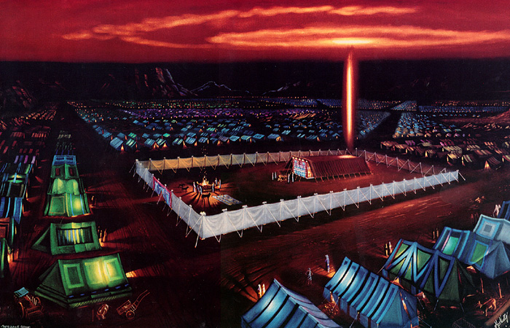
Numbers 7:12
"Now the one who presented his offering on the first day was Nahshon…"

Slide 33
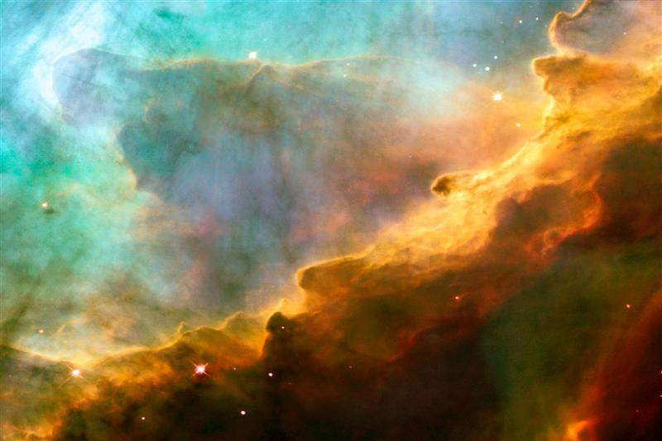
First Day
God's Creation…Day 1
God called the light day, and the darkness He called night. And there was evening and there was morning, one day (Gen. 1:5).

Slide 34
Why 24 Hours?
Instantaneous creation (Ps. 33:6)
"evening and morning"
Numerical adjective ("second…")
Pattern for work & rest

Slide 35
We get our 7-day week from Genesis 1

Slide 36
When to Start the Day…
6 PM
12 AM
6 AM
12 PM
6 PM
12 AM
6 AM
12 PM
6 PM
Roman
Day 1
Day 2
Jewish
Day 1
Day 2
There was evening…
…and morning…
There was evening…
…and morning…
…one day.
…the second day.
Notes:
Our "day" today beginning at midnight came from the Romans hundreds of years after the Jewish reckoning from evening to evening that is used in Genesis 1.

Slide 37
Why 24 Hours?
Instantaneous creation (Ps. 33:6)
"evening and morning"
Numerical adjective ("second…")
Pattern for work & rest
Sun & moon not until day 4

Slide 38
Romans 1:20
OTS 70b
Since the start of creation…
people have seen God
= literal 24-hour days
For since the creation of the world God's invisible qualities-- his eternal power and divine nature-- have been clearly seen, being understood from what has been made, so that men are without excuse (NIV).
For since the creation of the world God's invisible qualities-- his eternal power and divine nature-- have been clearly seen, being understood from what has been made, so that men are without excuse (NIV).

Slide 39
Who believes what?
Creationists (55%)
Theistic Evolutionists (32%)
Darwinists (13%)
(the view that leading scientists and educators accept)
2005 CBS News/New York Times Poll
Notes:
"In a recent survey of beliefs about origins, a 2005 CBS News/New York Times Poll of 885 persons found 55 percent of the general public were creationists, 32 percent were theistic evolutionists, and only 13 percent were orthodox Darwinists (the view that leading scientists and educators accept)." (Theistic Evolution and the Creation-Evolution Controversy (#393) by Jerry Bergman, PhD at http://www.icr.org/article/2701/). Jerry Bergman is on the Biology faculty at Northwest State College in Ohio

Slide 40
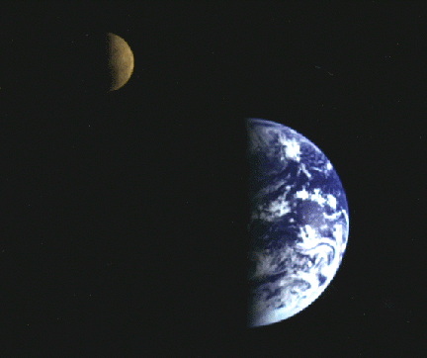
Problems with Theistic Evolution
70n
Scientific and Theological

Slide 41
Young Earth Creationist Groups that Critique Evolution (Both Atheistic and Theistic)
Creation Research Institute –Santee (near San Diego), CA, USA (icr.org)
Answers in Genesis–Kentucky, USA (answersingenesis.org)

Slide 42
Big Bang and Bible order compared
Big Bang
Stars
Sun
Molten
Earth
First
Oceans
15 Billion
Years Ago
10 Billion
Years Ago
5 Billion
Years Ago
4.5 Billion
Years Ago
3.8 Billion
Years Ago
Water Covered
Earth
Dry Land
and Plants
Sun, Moon,
and Stars
Days 1-2
Day 3
Day 4
Notes:
Translators, please move all black boxes to the back, translate the words, then move them back to the top. This slide has several animations

Slide 43
Day | Biblical Creation | Points of Conflict | Big Bang Evolution | Sequence
1 | Earth |  | Light | 1
1 | Darkness |  | Darkness | 2
1 | Water |  | Stars | 3
1 | Light |  | Water | 4
2 | Oceans |  | Solar system | 5
3 | Dry land |  | Earth | 6
3 | First life (vegetation) |  | Dry land | 7
3 | Trees |  | Oceans | 8
4 | Solar system |  | First life (single cellular) | 9
4 | Stars |  | Fish | 10
5 | Fish |  | Trees | 11
5 | Birds |  | Insects | 12
6 | Mammals |  | Reptiles | 13
6 | Reptiles |  | Birds | 14
6 | Insects |  | Mammals | 15
6 | Man |  | Man | 16
Adapted from Dr. John Hartnett (Associate Professor, Physicist, Cosmologist at The University of Adelaide) at http://johnhartnett.org/

Slide 44
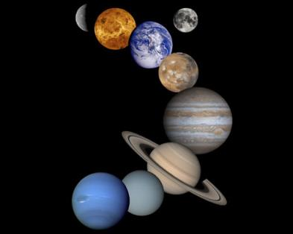
Incompatible Explanations
Big Bang | Bible
Elements beyond hydrogen and helium formed after millions of years | All elements made together
Earth formed long after the stars | Earth formed before stars
Elements beyond hydrogen and helium formed after millions of years
All elements made together
Earth formed long after the stars
Earth formed before stars
www.christiananswers.net/ q-eden/big-bang.html
Notes:
by Dr. Donald B. DeYoung - adapted from Astronomy and the Bible: Questions and Answers, 2nd Edition (Grand Rapids: Baker, 2000), 176 pp

Slide 45
Incompatible Explanations
Big Bang | Bible
Plants evolved after the sun | Plants formed before the sun
Birds evolved from reptiles | Birds created before reptiles, mammals
Plants evolved after the sun
Plants formed before the sun
Birds evolved from reptiles
Birds created before reptiles, mammals
www.christiananswers.net/ q-eden/big-bang.html
Notes:
by Dr. Donald B. DeYoung - adapted from Astronomy and the Bible: Questions and Answers, 2nd Edition (Grand Rapids: Baker, 2000), 176 pp

Slide 46
Incompatible Explanations
Big Bang | Bible
Sun formed before the earth | Sun formed on the fourth day, after the earth
Sun formed from older stars | Sun, moon, and stars formed together
Sun formed before the earth
Sun formed on the fourth day, after the earth
Sun formed from older stars
Sun, moon, and stars formed together
www.christiananswers.net/ q-eden/big-bang.html
Notes:
by Dr. Donald B. DeYoung - adapted from Astronomy and the Bible: Questions and Answers, 2nd Edition (Grand Rapids: Baker, 2000), 176 pp

Slide 47
Astronomers Now Doubt Big Bang
"If the universe came from a big bang, then matter should be evenly distributed. However, the universe contains an extremely uneven distribution of mass. This means that matter is concentrated into zones and planes around relatively empty regions.
Werner Gitt, answersingenesis.org
Notes:
Werner Gitt , "What about the big bang?Even the idea that the universe is expanding is under attack by some astronomers" at http://www.answersingenesis.org/creation/v20/i3/big_bang.asp (accessed 28 August 2006) cites several astronomers who doubt the theory.

Slide 48
Astronomers Now Doubt Big Bang
"Two astronomers, Geller and Huchra, embarked on a measuring program expecting to find evidence to support the big bang model. By compiling large star maps, they hoped to demonstrate that matter is uniformly distributed throughout the cosmos (when a large enough scale is considered).
Werner Gitt, answersingenesis.org
Notes:
Werner Gitt , "What about the big bang?Even the idea that the universe is expanding is under attack by some astronomers" at http://www.answersingenesis.org/creation/v20/i3/big_bang.asp (accessed 28 August 2006) cites several astronomers who doubt the theory.

Slide 49
Astronomers Now Doubt Big Bang
"The more progress they made with their cartographic overview of space, the clearer it became that distant galaxies are clustered like cosmic continents beyond nearly empty reaches of space. The big bang model was strongly shaken by this discovery."
Werner Gitt, answersingenesis.org
Notes:
Werner Gitt , "What about the big bang?Even the idea that the universe is expanding is under attack by some astronomers" at http://www.answersingenesis.org/creation/v20/i3/big_bang.asp (accessed 28 August 2006) cites several astronomers who doubt the theory.

Slide 50
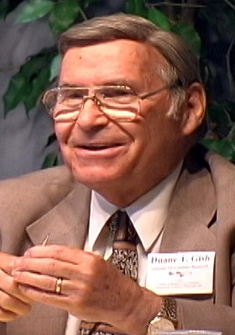
Theistic Evolution is…
70n
Inefficient
Unscientific
Dr. Duane Gish (Creation Research Institute)
Notes:
Duane Gish, Ph.D. earned a B.S. degree in chemistry from UCLA and a Ph.D. in biochemistry from UC-Berkeley. He spent 18 years in biochemical research, including three years at Cornell University Medical College, four years at the Virus Laboratory, UC-Berkeley, and eleven years with the Upjohn Company. Since 1971 he has served with the Creation Research Institute, Santee California, and is presently the Senior Vice President. He is a member of the American Chemical Society and a Fellow of the American Institute of Chemists. At present he has five books in print including Evolution: The Fossils STILL Say No!, Creation Scientists Answer Their Critics, and Teaching Creation Science in Public Schools.

Slide 51
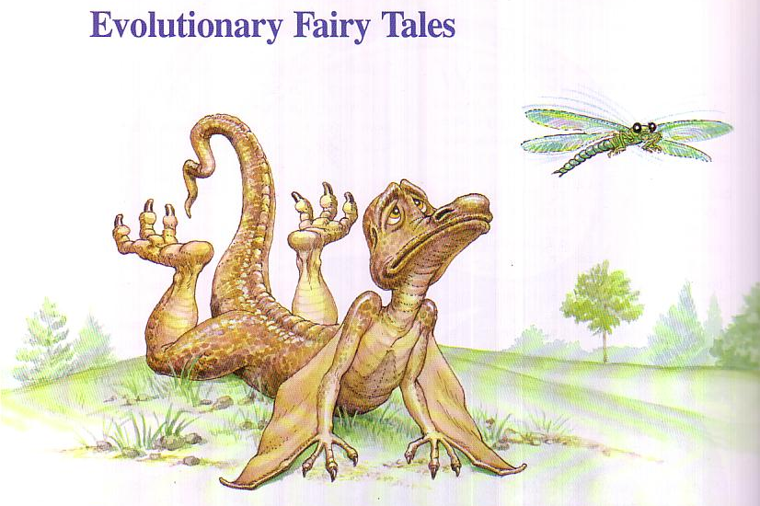
Evolution relies on a theory of transitional forms which would have been easy prey!
Evolutionary Fairy Tales

Slide 52
Did dinosaurs come before man?
Dinosaurs ^{by} Design
Yes. God created dinosaurs earlier on the sixth day of creation!

Slide 53
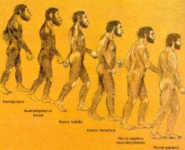
The Descent of Man
Yep. We sure have descended

Slide 54
The Descent Continues
'cuz your "uncle" is behind you all the way!
Believe if you want in Evolution!

Slide 55
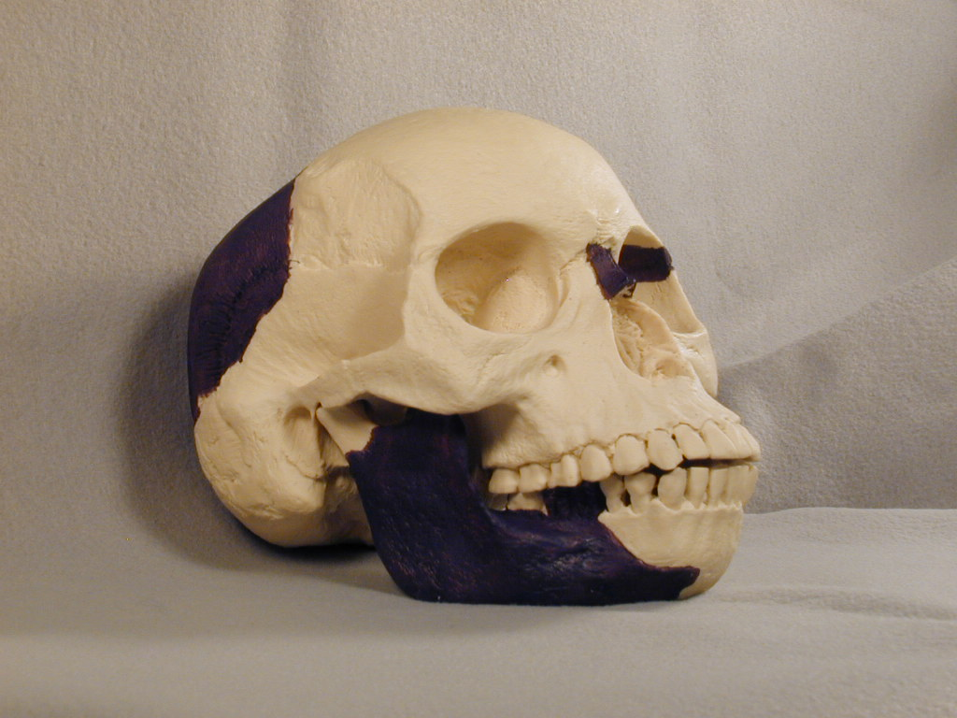
Piltdown Man (1912)
70n
Notes:
Piltdown Man, found in Piltdown England (1912), came from jaw and skull fragments. About 500 books and pamphlets were written about him up to 1950…

Slide 56
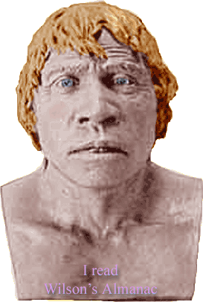
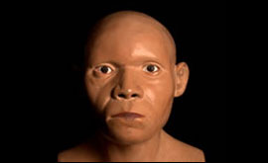
Piltdown Man (1912)
70n
He went from being one of the biggest discoveries of the 20th Century to being its greatest scientific embarrassment. The remains of a human ancestor called Eoanthropus dawsoni, were found during 1911-1915 at Piltdown, Sussex.
www.bbc.co.uk 23 Nov 2003
Notes:
Then in 1950 someone discovered that it actually was the chemically treated skull of a modern human to make it look old and ape teeth filed down to look human! This fraud fooled the world's "experts" for almost 40 years.

Slide 57
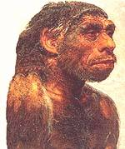
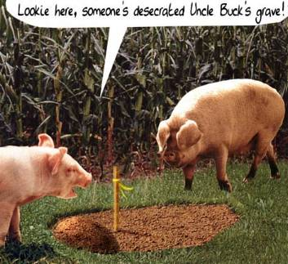
Nebraska Man (1922)
70n
Lookie here, someone's desecrated Uncle Buck's grave!
Notes:
Nebraska Man (1922) was based solely on a single tooth found in Nebraska. Additional bones of the creature later revealed it to be a pig!

Slide 58
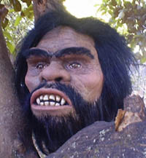
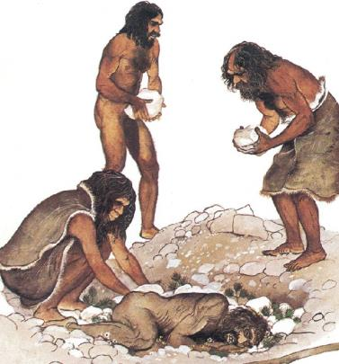
Neanderthal Man (1860)
70n
Hunched over
Flatter skulls
After 1908 shown by Rudolph Virchow to be a Frenchman with arthritis!
Others walked erect
X-rays confirm them to be humans with rickets (caused by lack of vitamin D)
Notes:
Neanderthal Man (1860), found in the Neanderthal Valley in Germany, later had more fossils, such as a hunched-over full skeleton in France (1908). They used tools and had similar brain sizes to modern humans, but their skulls were flatter than ours and appeared primitive in some ways. However, Dr. Rudolph Virchow later revealed the hunched-over skeleton as a Frenchman who had arthritis! Other skeletons have been found which are fully erect, and x-rays of the fossil bones and teeth now confirm that all of the Neanderthals were actually humans with rickets (caused by lack of vitamin D).

Slide 59
"I Love Lucy" (1973)
70n
Australopithecus afarensis (nicknamed "Lucy")
When a knee joint was needed to prove that "Lucy" walked upright, they used one found more than 60 meters lower in the strata and more than three kilometers away!
Notes:
Australopithecus (1924) was believed even by many evolutionists to have been an ape, and included a female version, Australopithecus afarensis (1973, nicknamed "Lucy"). However, when a knee joint was needed to prove that Lucy walked upright, they used one found more than 60 meters lower in the strata and more than three kilometers away! Dr. Solly Zuckerman (head of the Department of Anatomy, Univ. of Birmingham, England) and Dr. Charles Oxnard (Prof. of Anatomy and Director of Graduate Studies at the Univ. of Southern California Medical School) both confirm that Australopithecus did not walk upright like humans and were not man's ancestors. Zuckerman's conclusions are published in his book, Beyond the Ivory Tower (1970). See Gish, 84.

Slide 60
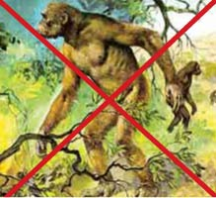
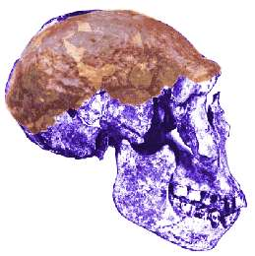
All Others Disproved
70n
Ramapithecus
= Orangutan
Orce Man
= Six-month-old donkey
Australopithecus (1924)
= Ape
Java Man
= Giant Gibbon
Peking Man
= Ape
Cro-Magnon Man
= Modern European
Notes:
Ramapithecus was an orangutan and Orce Man was actually a six-month-old donkey. Australopithecus (1924) was believed even by many evolutionists to have been an ape…Also, Java Man's discoverer (Dr. Eugene Dubois) later identified him as a giant gibbon, Peking Man is an ape, and Cro-Magnon Man a modern European. Now some evolutionists even say that apes evolved from man!

Slide 61
Expelled Movie Clip
Notes:
No wonder why the Ben Stein documentary in 2008 highlighted how many scientists and educators have been EXPELLED for even SUGGESTING that the universe has design! If a theory such as evolution has any merit, then it should be open to evaluation based on evidence. However, in the case of evolution, no intelligence is allowed.

Slide 62
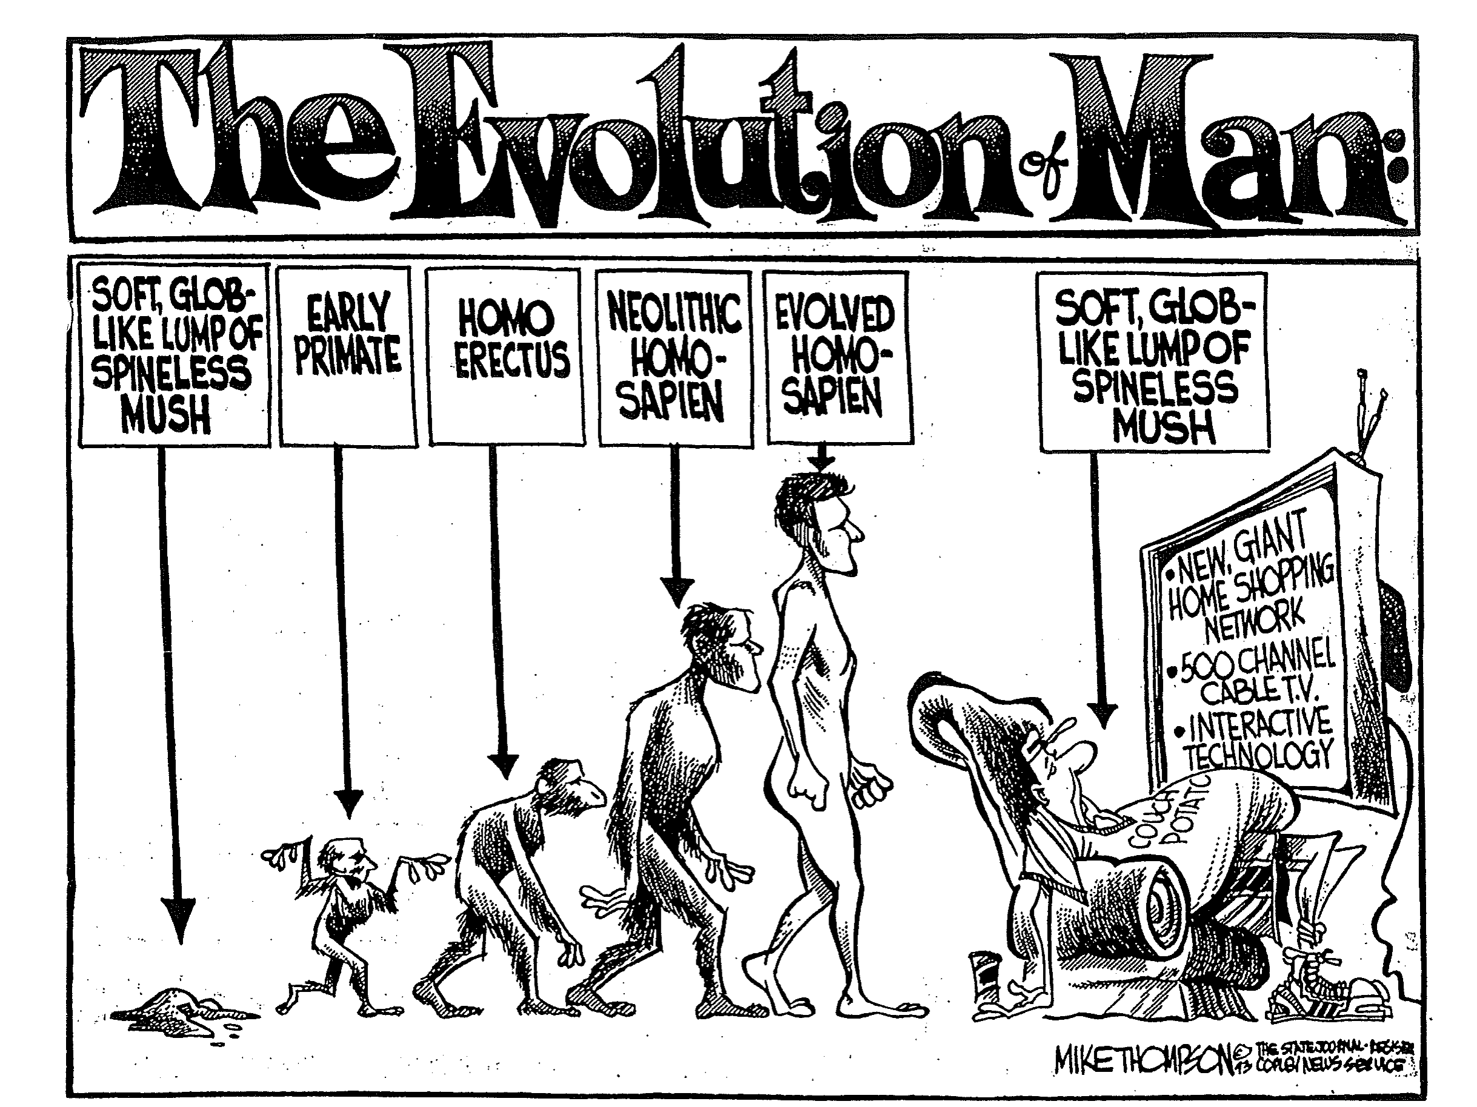
The Evolution of Man
人类进化史
软塌塌的无脊椎胶质
早期灵长类
直立人
软塌塌的无脊椎胶质
新石器时代智人
进化智人
OTS 77d
The Evolution of Man
SOFT, GLOB-LIKE LUMP OF SPINELESS MUSH
EARLY PRIMATE
HOMO ERECTUS
NEOLITHIC HOMO-SAPIEN
EVOLVED HOMO-SAPIEN
SOFT, GLOB-LIKE LUMP OF SPINELESS MUSH

Slide 63
Theological Problems with Theistic Evolution
70o
Like this huge Ozone Hole (2000), I believe theistic evolution has some "theological holes" that must be addressed...

Slide 64
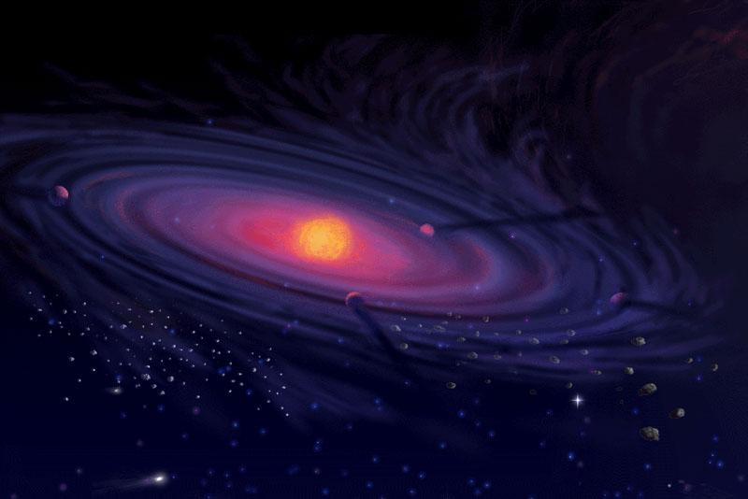
The Creation Account
Theological Problems
70o
3.a.
Genesis 1–2 is a straight-forward account of creation that does not even hint at evolution

Slide 65
When to Start the Day…
70o
3.a.
6 PM
12 AM
6 AM
12 PM
6 PM
12 AM
6 AM
12 PM
6 PM
Roman
Day 1
Day 2
Jewish
Day 1
Day 2
There was evening…
…and morning…
There was evening…
…and morning…
…one day.
…the second day.
Notes:
Our "day" today beginning at midnight came from the Romans hundreds of years after the Jewish reckoning from evening to evening that is used in Genesis 1.

Slide 66
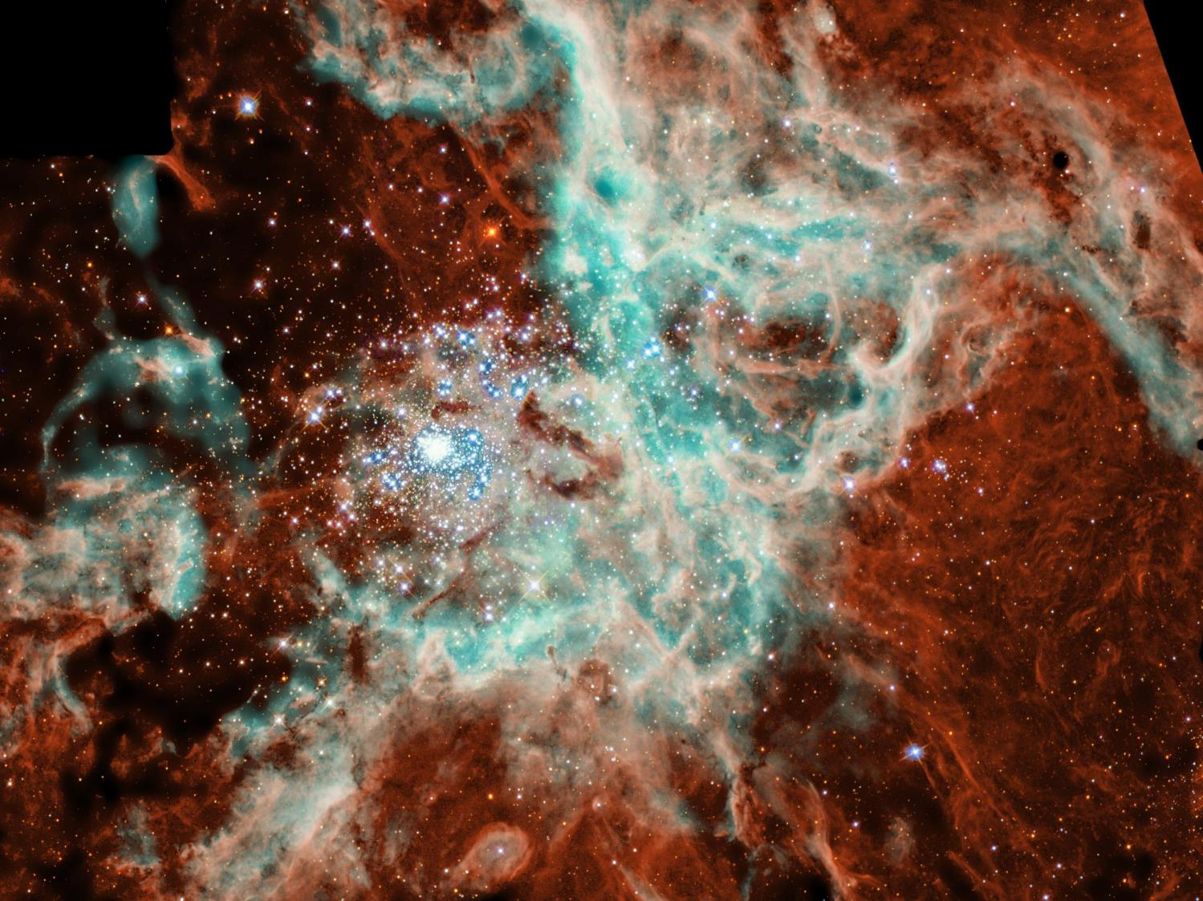
Is Genesis 1–11 Real History?
Theological Problems
OTS 58
3.a.
Myths don't teach "deep truths" better than history
A non-historical approach is very subjective
Genesis 1–11 has vital information otherwise not known
Genesis 1–11 fits into the book's argument on election
Events are presented as historical
Science confirms the Genesis 1–11 historical record
Christ said these events are historical (Matt. 19:4-6)

Slide 67
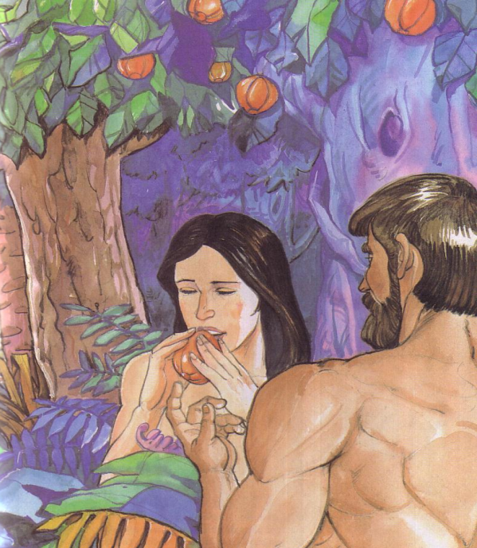
The Fall and the Origin of Moral Evil
Theological Problems
70o
3.b.
The story of Adam and Eve is "a poetic and powerful allegory of God's plan for the entrance of the spiritual nature (the soul) and the Moral Law into humanity" (Collins, 207).
Notes:
Francis Collins, The Language of God, 207

Slide 68
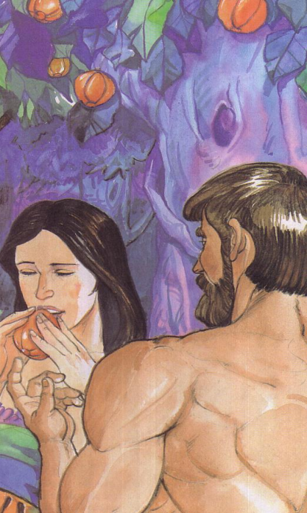
Adam versus Christ
70o
3.b.
Romans 5:12-14
1 Cor. 15:22
1 Cor. 15:45-49

Slide 69
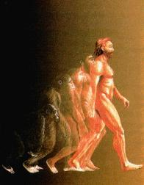
The Origin of Man
Theological Problems
70o
3.c.
Created from dust (Gen. 2:7; Matt. 19:4)
Image of God (Gen. 1:26-27)—not of apes
Eve was "mother of all living" (Gen. 3:20; Acts 7:26)
All sinned in Adam (Rom 5:12)
or…

Slide 70
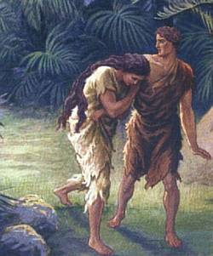
Did death exist before sin?
What do you think?
VERY GOOD
What does it mean that creation was "very good" if death existed then?
Notes:
So did death exist before sin? What do you think? God said that his creation up to this time was "very good." What does it mean that creation was "very good" if death existed then?

Slide 71
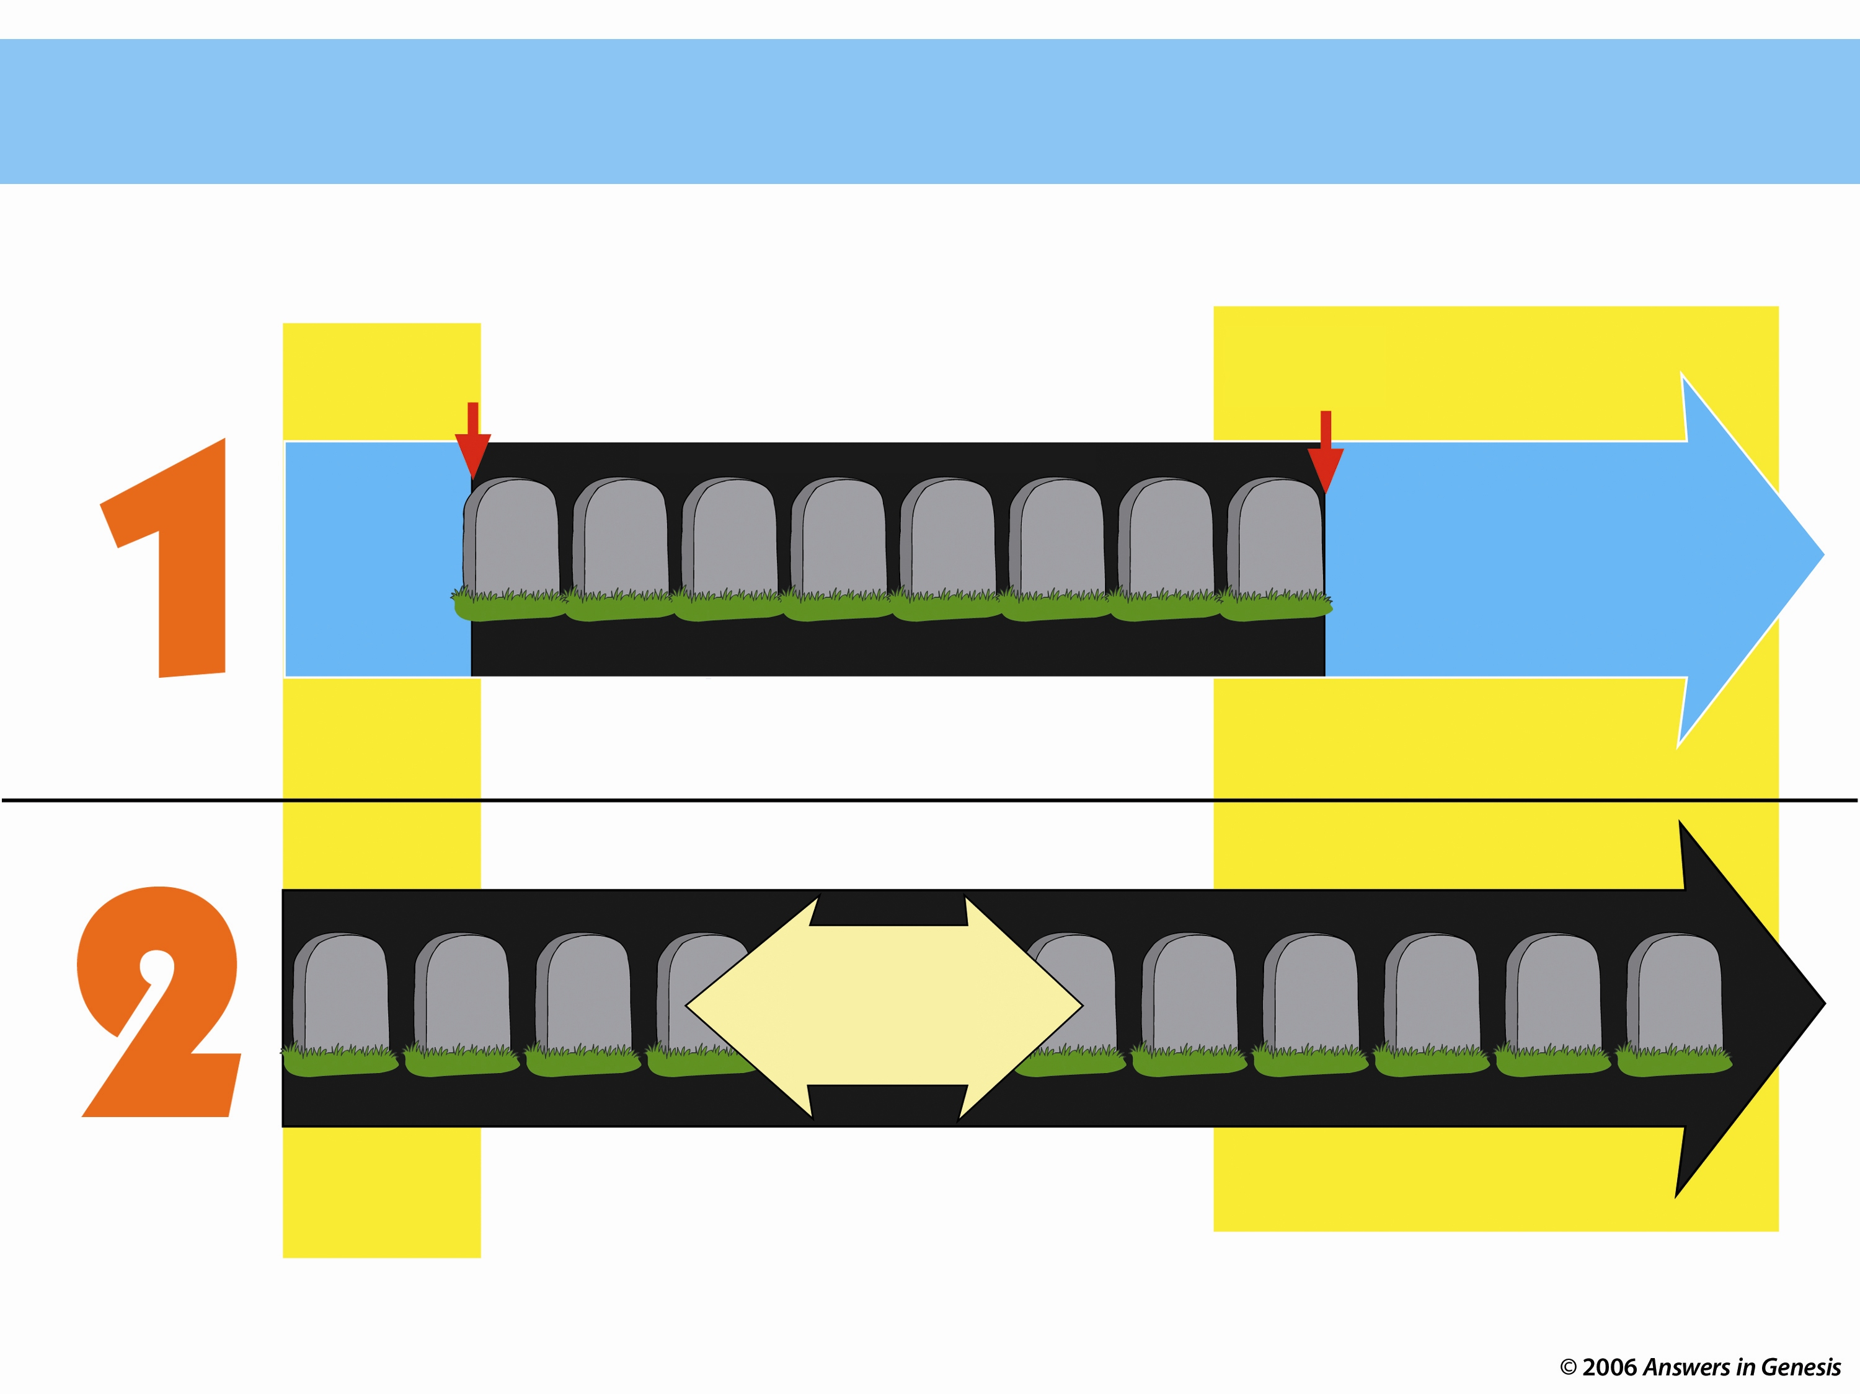
Two Histories of Death
How long has death existed (Rom. 5:12)?
Beginning
Death is an enemy
Future
Man's sin brought Death
DEATH will be done away with
ONLY THOUSANDS OF YEARS
God's Word
NO DEATH
NO DEATH
Death is temporary
Man's Opinion
MILLIONS AND MILLIONS OF YEARS
Life and death have always been together
Death is a permanent part of history
As long as there is life, there will be death
Notes:
Only two options exist, either
God’s Word that teaches no death in the creation and therefore no death in the future, or…
Man’s opinion that death has always existed and always will exist.
Each believer must answer which of these two theologies he will follow.
_____________
Common-48
AP-02-Engaging Athiests-86
CR-29-Theistic Evolution-71
OS-01-Gen1-3-slide219
06-Romans_5-8_slide 26

Slide 72
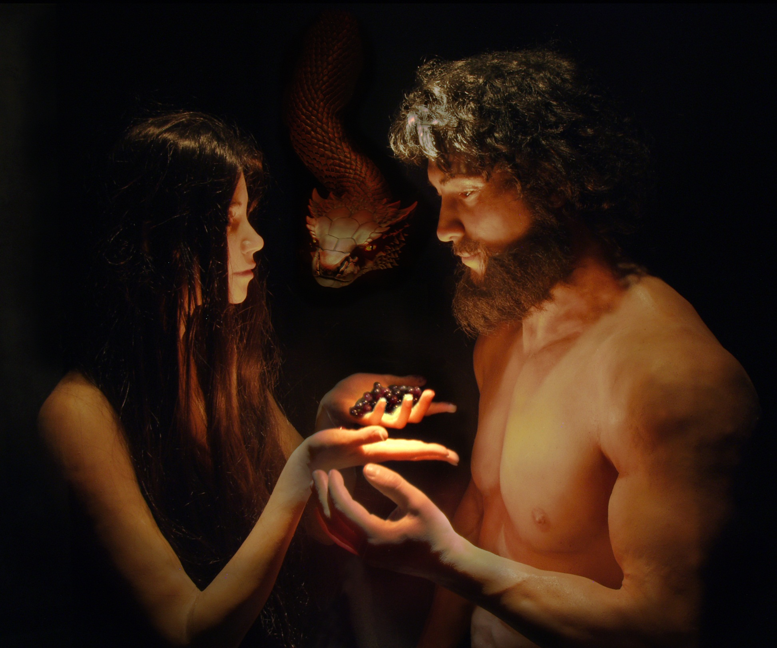
Romans 5:12 (NLT)
"When Adam sinned, sin entered the world. Adam's sin brought death, so death spread to everyone, for everyone sinned"
Notes:
The NLT renders this…

Slide 73
Natural Selection, Death, & Suffering
Theological Problems
70o
3.d.
Creation Going into Genesis 3:
Monotheism
Sovereign God
All is "Good"
Man without sin
No pain or evil
Ruling with God
Notes:
Baldung Grien, Hans: Adam 1520-23; Wood, 208 x 83.5 cm; Museum of Fine Arts, Buda
www.ibiblio.org/wm/ paint/auth/baldung/adam-eve/

Slide 74
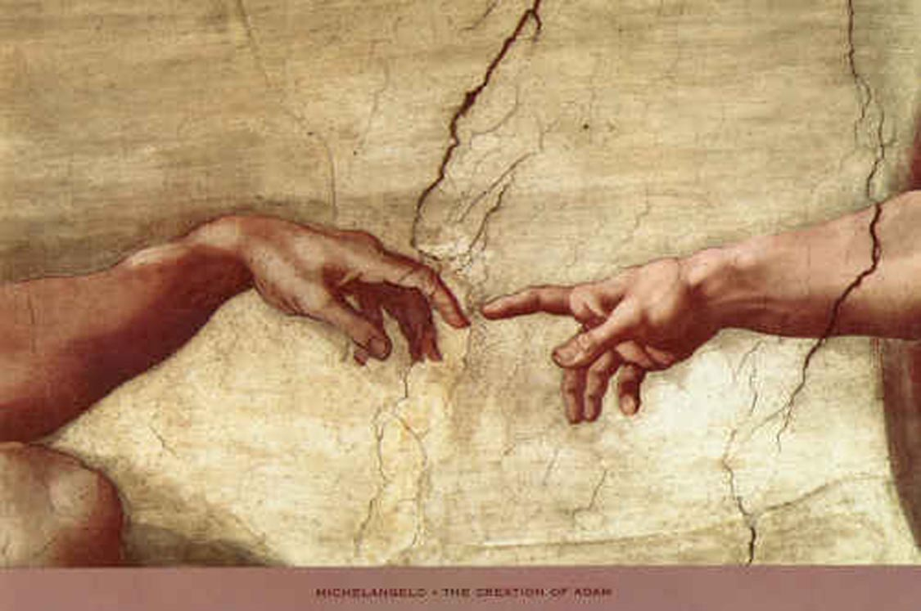
Who is Man–Really?
Theological Problems
70o
3.e.
Created from the dust (Gen. 2:7)–not from lower life forms
Highest of created beings (Gen. 1:26-27)–made in God's image
Commissioned to rule with God (Gen. 1:28)–neither an animal nor a god

Slide 75
Man, like the animals, reproduces after his own kind
Theological Problems
70o
3.e.

Slide 76
Distinctions Between Man & Animals
Theological Problems
70o
35
3.e.
Ability to discern truth (2:16-17)
Ability to speak (2:23)
Marriage & relationships (2:24)
Creative abilities (2:19-20)

Slide 77
What is this image?
Theological Problems
70o
35
3.e.
Right to rule creation (1:26)
Ability to relate to God (2:16ff.)
Dignity of humankind (9:6)

Slide 78
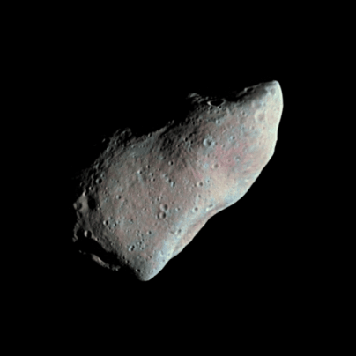
Is there evidence of intelligent design?
Francis Collins argues against intelligent design (pp. 85-88)

Slide 79
The Watch Illustration (William Paley, 1802)
A watch is complex.
A watch has an intelligent designer.
Life is complex.
Therefore, life also has an intelligent designer.

Slide 80
The Critique by Francis Collins
"The fact that two objects share one characteristic (complexity) does not imply that they will share all characteristics" (p. 87)
Electric current in my house consists of a flow of electrons.
Electric current comes from the power company.
Lightning consists of a flow of electrons.
Therefore, lightning comes from the power company.
A watch is complex.
A watch has an intelligent designer.
Life is complex.
Therefore, life also has an intelligent designer.
Do you agree?

Slide 81
A Better Parallel
Electric current in my house consists of a flow of electrons.
Electric current comes from a power source.
Lightning consists of a flow of electrons.
Therefore, lightning comes a power source.
A watch is complex.
A watch has an intelligent designer.
Life is complex.
Therefore, life also has an intelligent designer.

Slide 82
Evangelicals Differ
34
OTS 34
Reasons to Believe
Hugh Ross
Walt Brown
Old Earth
Progressive Creation
Mid-East Flood
Rain waters
reasons.org
godandscience.org
creationscience.com
Creation Research Institute
Henry/John Morris, Duane Gish
Joseph Dillow, Ken Ham
Young Earth
24-hour Creation Days
Universal Flood
Vapor canopy
answersingenesis.org
genesispark.org
icr.org critiques Ross at:
icr.org/pubs/imp/imp-217.htm

Slide 83
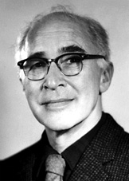
Edwin Did life originate as an accident?
"There are only two possible explanations as to how life arose: Spontaneous generation arising to evolution or a supernatural creative act of God…. There is no other possibility. Spontaneous generation was scientifically disproved 120 years ago by Louis Pasteur and others, but that just leaves us with only one other possibility… that life came as an act of supernatural creation by God, but I can't accept that philosophy because I do not want to believe in God. Therefore, I choose to believe that which I know is scientifically impossible, spontaneous generation leading to evolution."
Dr. George Wald
Professor Emeritus of Biology, Harvard
Nobel Prize winner in Biology, 1971
Notes:
George Wald, "Origin, Lie and Evolution," Scientific American 1978; cited by Joe White and Nicholas Comninellis, Darwin's Demise (Green Forest, AR: Master Books, 2001), 46.

Slide 84
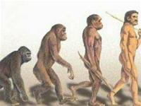
Make Your Choice: How did order come?
By unintelligent random processes?
Or by design from an intelligent God?

Slide 85
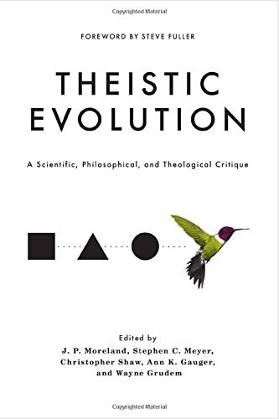
Theistic Evolution: A Scientific, Philosophical, and Theological Critique J P Moreland, Wayne Grudem, editors Nov 2017 —Argues against theistic evolution but still maintains millions of years theory —Includes NO articles by Biblical Creationists who hold to a Young Earth

Slide 86
AiG Web Address 00439

Slide 87
Unformed and Unfilled 04093
Unformed and Unfilled
by Weston Fields
A thorough refutation of the gap theory (2005)
Notes:
Master Books, 2005
245 pages
Amazon: https://www.amazon.com/Unformed-Unfilled-Critique-Gap-Theory/dp/0890514232
Everyone’s heard of it. Many believe it. Is there a “gap in time” between the first two verses in Genesis? Does this alleged gap really represent a vast amount of time? Weston Field’s classic treatment of this subject is now being published by Master Books, and promoted by such important organizations as Answers in Genesis. In this book, Fields makes a detailed study of the gap theory, paying particular attention to the original Hebrew language of Genesis. His conclusion - that this theory is not a reasonable compromise with modern evolutionary theory, but a dangerous diversion from biblical truth - helps readers who struggle with the question of the time taken during the creation week. Was it really six days? Can Christians find a workable solution to the debate about creation and time?
An important book.
A presentation of a variety of views espoused by Christians of all denominations
A professional, scholarly look that can be easily understood by laymen
A fascinating study of the original Hebrew text
A classic work still relevant today
“A brilliant, scholarly refutation of the famed gap theory” - Ken Ham, President, Answers in Genesis

Slide 88
Coming to Grips with Genesis 04702
Coming to Grips with Genesis
edited by Dr. Terry Mortenson and Dr. Thane Ury
14 scholars give a careful biblical & historical defense of
young-earth creationism (2008)
© 2008 Answers in Genesis-USA
Notes:
New Leaf Publishing Group, 2008
450 pages
Fourteen theological scholars address key topics related to the age of the earth, which is the crucial issue of debate in the church today regarding origins. Bringing to bear rigorous biblical, theological, and historical arguments in favor of a six-day creation, the global Flood, and a young earth, they also provide much-needed critiques of a number of contemporary old-earth interpretations of the book of Genesis.
This fresh defense of the literal history of Genesis 1-11 nicely complements other studies which focus more on the scientific evidence of young-earth creationism. As such, this book can serve as a versatile supplement to other works, but is also designed to be used as a standalone text for seminary and Bible college professors and students, pastors, missionaries, and others who want in-depth apologetic resources.
Coming to Grips with Genesis: Biblical Authority and the Age of the Earth includes:
Forewords by Dr. John MacArthur, President of the Master's Seminary and Senior Pastor of Grace Community Church, Sun Valley, CA; and the late Dr. Henry Morris, Founder and President Emeritus, Institute for Creation Research
Detailed analysis of the verbs of Genesis 1
A defense of the Genesis 5 & 11 genealogies as strict chronologies
Reasons for rejecting millions of years of death and natural evil before Adam's sin
Careful reflection on Jesus' teachings regarding a young earth

Slide 89
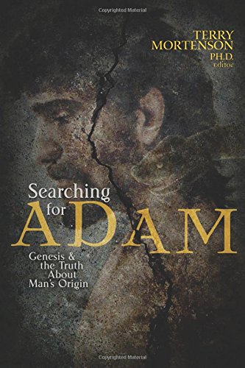
Coming to Grips with Genesis 04702
Searching for Adam: Genesis & the Truth About Man’s Origin
edited by Dr. Terry Mortenson
16 chapters by scholars upholding the literal Adam and Eve (2016)
© 2008 Answers in Genesis-USA
Notes:
October 30, 2016
528 pages
From Amazon website at https://www.amazon.com/Searching-Adam-Genesis-Truth-Origin/dp/0890519757
Accessed 22 Sep 2021
You can believe with great intellectual integrity what the Bible says about Adam and the origin and history of man. Though there are a growing number of books out on Adam, this one is unique in its multi-author combination of biblical, historical theological, scientific, archaeological and ethical arguments in support of believing in a literal Adam and the Fall. A growing number of professing evangelical leaders and scholars are doubting or denying a literal Adam and a literal Fall, which thereby undermines the gospel of Jesus Christ, the Last Adam, who came to undo the damaging consequences of Adam’s sin and restore us to a right relationship with our Creator. This book will increase your confidence in the truth of Genesis 1-11 and the gospel:
Enhance your understanding pertaining to the biblical evidence for taking Genesis as literal history
Discover the scientific evidence from genetics, fossils, and human anatomy for the Bible’s teaching about Adam
Understand the moral, spiritual, and gospel reasons why belief in a literal Adam and Fall are essential for Christian orthodoxy.

Slide 90
Black

Slide 91
OT Backgrounds link at BibleStudyDownloads.org
Get this presentation and notes for free!

