Slide 1
WATER, AIR, EARTH & FIRE
Ron Suter, Melbourne

Slide 2
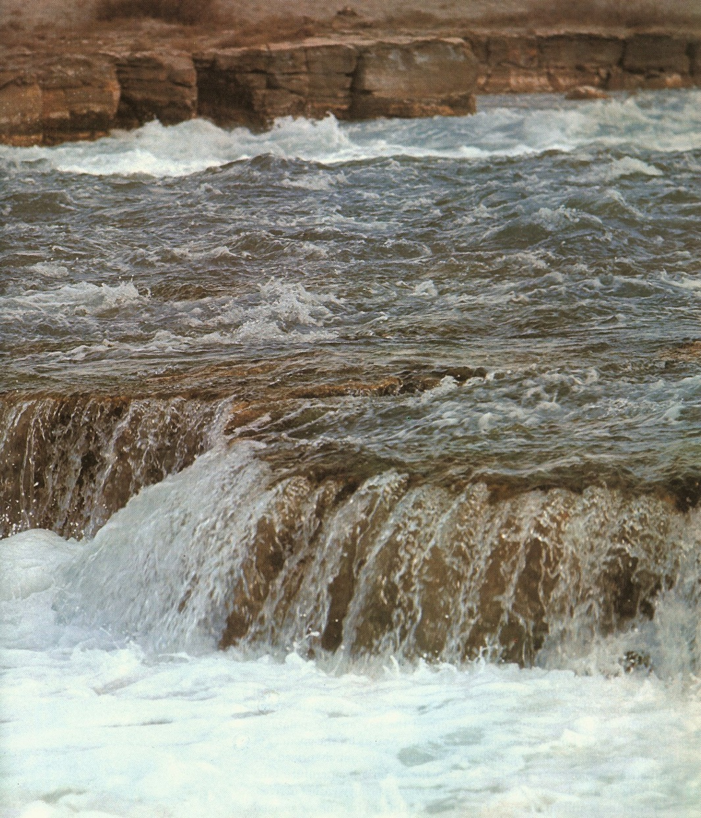
water

Slide 3
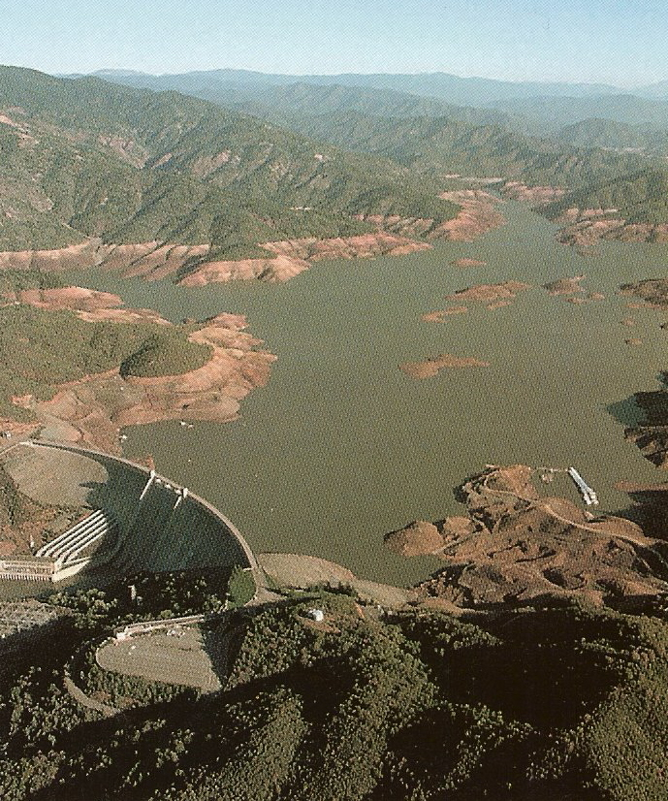
water

Slide 4
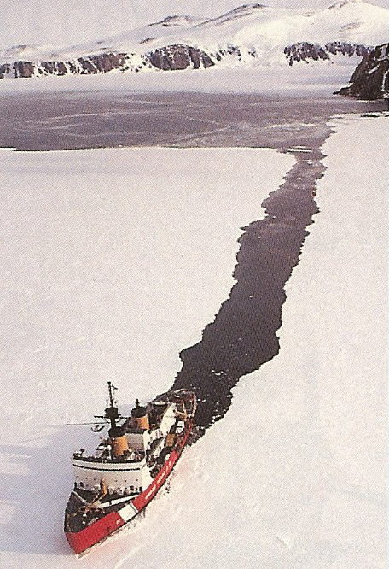
water
Antarctic
Ice-Breaker

Slide 5
WATER... is a compound
A compound is a chemical combination of two or more elements. Examples: CO2, C6H9O6.
A compound may look quite different from its component elements. Examples: NaCl, H2O.
Water (usually a liquid) is a combination of the two gases: hydrogen & oxygen.

Slide 6
Otto
Lilienthal
1895
air

Slide 7
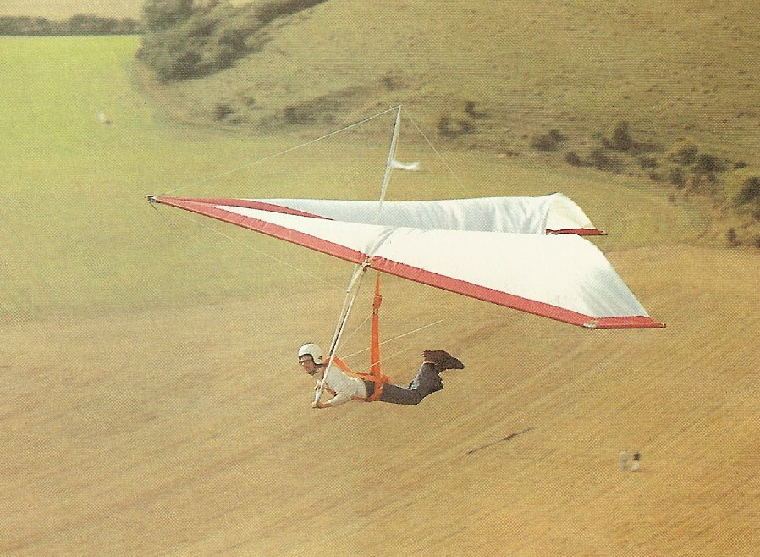
air

Slide 8
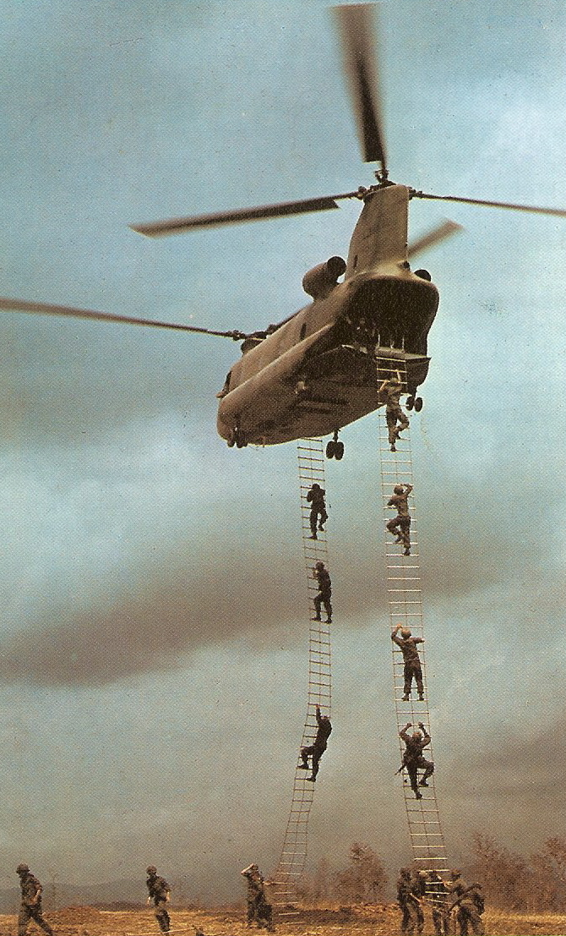
air

Slide 9
AIR... is a mixture
About 78% pure nitrogen (gas)‏
About 21% pure oxygen (gas)‏
About 0.03% pure carbon dioxide
Other gases, including water vapour, are present in much smaller amounts.

Slide 10
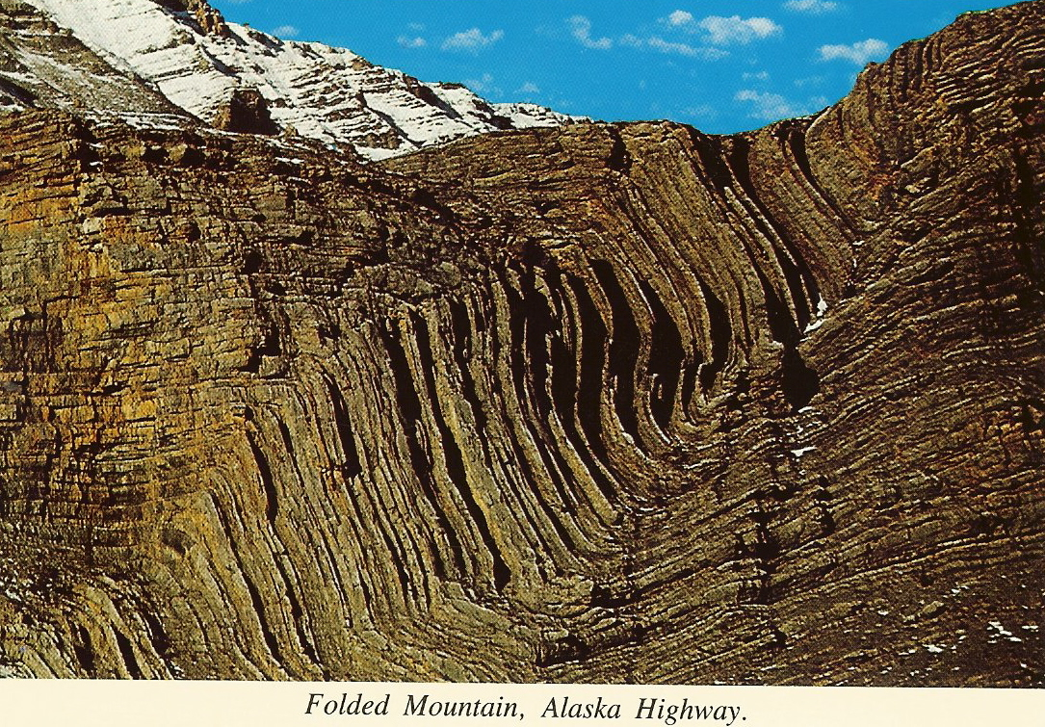
earth - rock

Slide 11
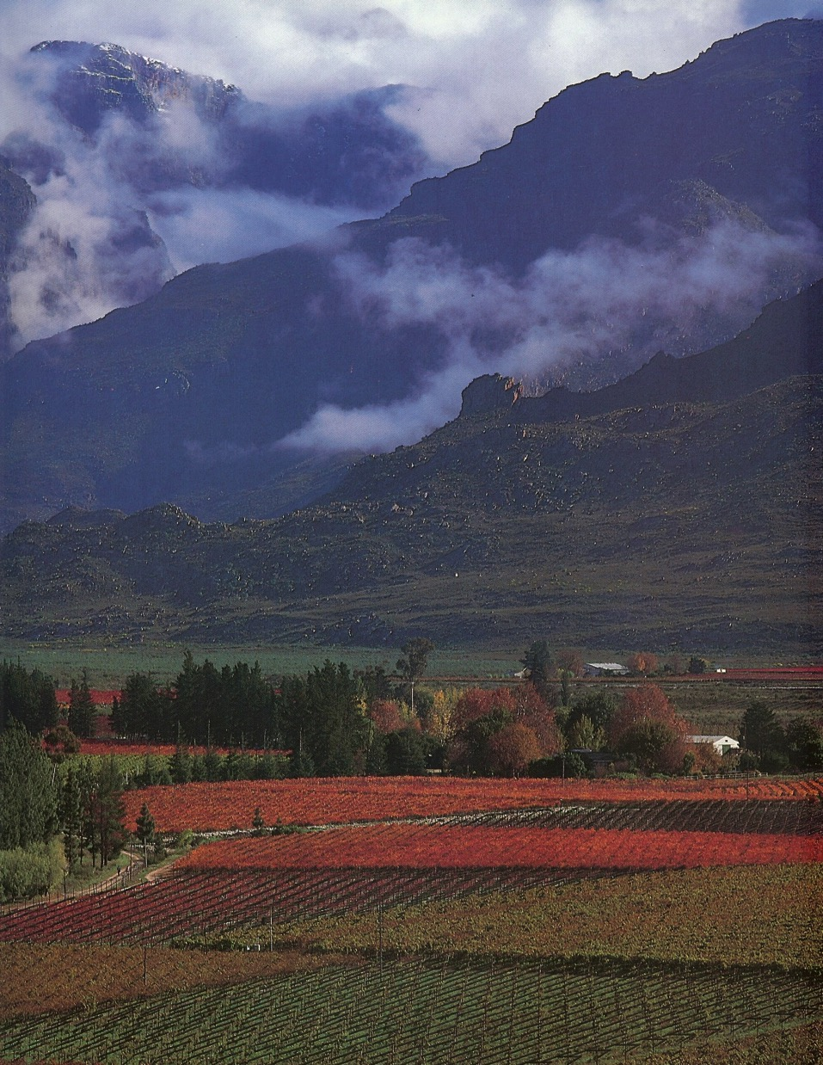
earth – rock & soil

Slide 12
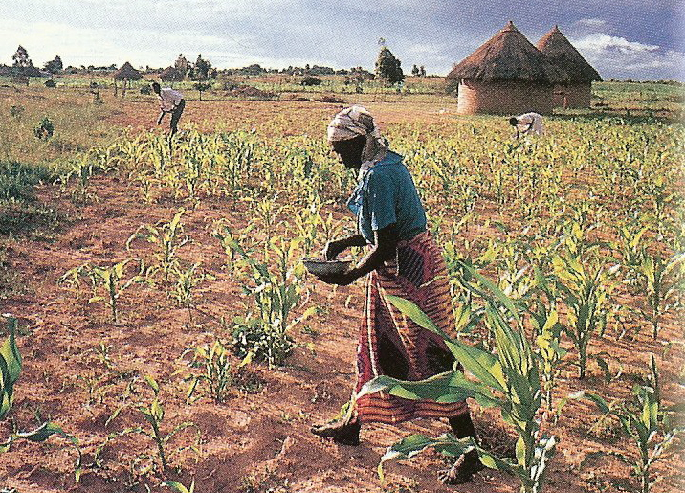
earth - soil

Slide 13
EARTH... is a mixture
(Two-thirds of the earth's surface is covered with water, mostly salty water = the oceans.)‏
The earth that is “dry land” consists of sands, rocks and soils.
These sands, rocks and soils are mixtures of various mineral compounds, many of which are useful to mankind.
The best soils include tiny living things as well as minerals.

Slide 14
Chemical Composition of the Earth's Crust
Element % in Crust
oxygen 46.6 Mineral resources consist of fuels, metal-containing
silicon 27.7 deposits, and non-metal deposits.
aluminium 8.1 Coal, petroleum, & gas are the mineral fuels.
iron 5.0 Metal deposits are usually found in combination with
calcium 3.6 other metals or with a non-metal.
sodium 2.8
potassium 2.6 99% of the earth's crust comprises only 10 elements.
magnesium 2.1 Only 4 (Al, Fe, Mg, & Ti) are industrial metals & only
titanium 0.4 small amounts of these are available for mining.
hydrogen 0.14 The other industrial metals (Cu, Zn, Pb, Sn, Au, Ag)‏
copper 0.007 are found in only minute amounts.
tin 0.004
lead 0.0016 The metal deposits are used commercially in trade,
silver 0.00001 building & manufacturing.
gold 0.0000005 The non-metals (O, Si, & H) are used in glass,
balloons, and in various chemical compounds.

Slide 15
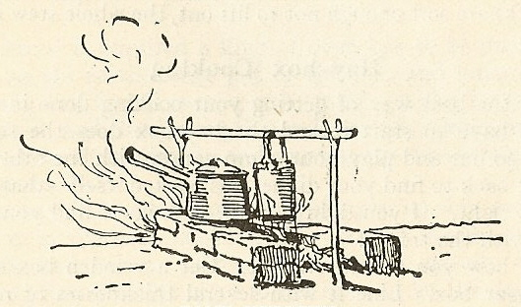
fire

Slide 16
fire

Slide 17
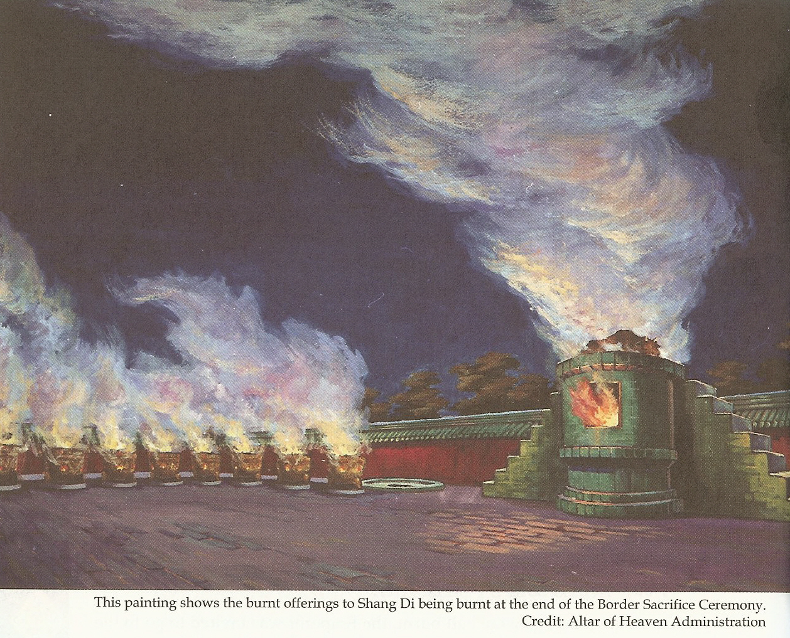
fire

Slide 18
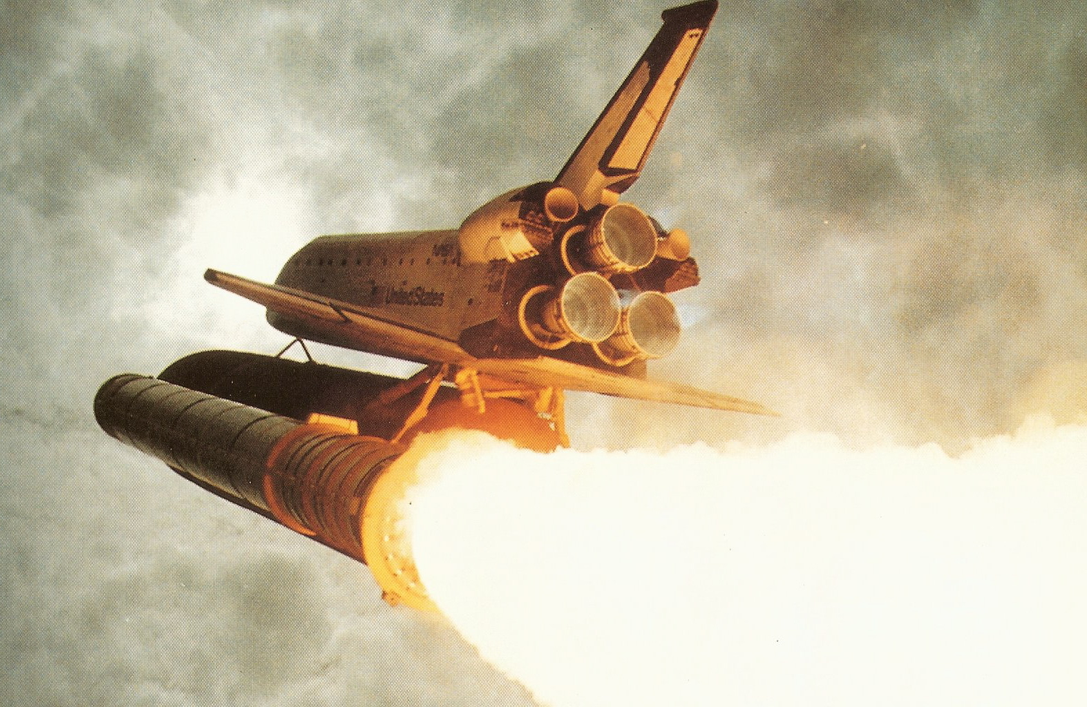
fire

Slide 19
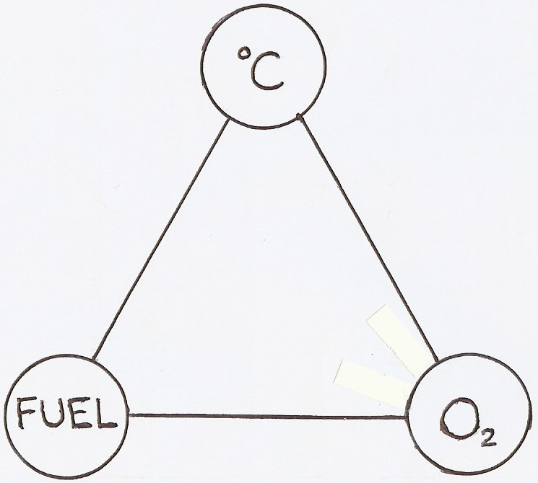
fire

Slide 20
FIRE... is a process
Most fuels contain carbon (= C).
When the ignition temperature of a fuel is reached or exceeded it will start to burn.
Burning gives off heat and light.
The burning process allows the carbon to combine chemically with oxygen, thus forming CO2 and CO.

Slide 21
Objective Science
Water – a compound of two gases.
Air – the atmosphere, a mixture of gases.
Earth - a mixture of solids, mostly compounds, with a few elements.
Fire – the process of combustion: fuel, heat & oxygen are all needed.

Slide 23
The Elements in Our Bodies:
oxygen O 65% Plus faint traces of: flourine F
carbon C 18% silicon Si
hydrogen H 10% manganese Mn
nitrogen N 3% zinc Zn
calcium Ca 1.5% copper Cu
phosphorous P 1.0% aluminium Al
potassium K .35% arsenic As
sulphur S .25%
sodium Na .15%
chlorine Cl .15% Total, for all materials,
magnesium Mg .05% ~ $160 USD;
iron Fe .0004% For “living” tissue,
iodine I .00004% >45M USD

Slide 24
What is the Price of Salvation??
“God showed His love for us by sending Christ to die for us while we were still sinners.”
“For God so loved the world that he gave His only Son, so that whoever believes in Him should not perish but have everlasting life.”
Romans 5:8; John 3:16.

Slide 25
Black

Slide 26
Creation link at BibleStudyDownloads.org
Get this presentation for free!
Notes:
Creation (cr)

