Slide 1
18
The
Young Earth
Dr. John Morris (PhD, Geological Engineering, Univ. of Oklahoma) of the Institute for Creation Research, 2007
Notes:
The following PowerPoint presentation has been created to aid you in presenting the message of The Young Earth. The notes throughout the presentation are included to aid you in your presentation.

Slide 2
Descent from a Common Ancestor
18
Notes:
The theory of evolution is identified by the slogan "decent from a common ancestor. All life goes back to a common ancestor." The twin mechanisms of mutation and natural selection would be highly unlikely to produce new basic categories from old, adding new genes or new body parts. Only the presence of immense time makes this idea even conceivable. The Bible, however, speaks of recent creation, and the concept of creation of basic types is irrelevant to the amount of time. Evolution is impossible given any amount of time.

Slide 3
Time
18
"…Time is in fact the hero of the plot… given so much time, the 'impossible' becomes possible, and the possible probable, and the probable virtually certain. One has only to wait: time itself performs miracles."
George Wald. "The Origin of Life," in The Physics and Chemistry of Life, p. 12
Notes:
George Wald, a leading evolutionary spokesman, writes that "Time is in fact the hero of the plot… given so much time, the 'impossible' becomes possible, and the possible probable, and the probable virtually certain. One has only to wait: time itself performs miracles." In other words: "time is the hero of the plot. Evolution is highly unlikely but in the passage of deep time it will happen sometimes, or so it is thought."

Slide 4
Evolutionary Rug
18
Notes:
Evolution has become somewhat of a rug under is which is swept all the theory's problems including seeming design of all things in the universe, particularly life, and lack of transitional forms.

Slide 5
18
Assumption of
Naturalism
Assumption of Biblical History
data
Evolution,
Billions of Years
Creation,
Young Earth
Notes:
It is important to remember that all scientists, creationists and evolutionists, have exactly the same data. We have the same rocks and fossils and living things. It is just that we interpret them differently; we tell different stories about their unseen origins. The most important part of the interpretation process is the assumptions one has at the start. If one assumes naturalism, that only natural processes have occurred throughout history, then of course he must interpret the data in a naturalistic system. Evolution might be our best guess, but if we start with the assumption that biblical history is true, that Creation, the fall, and the Flood really happened, then we interpret the data in light of that worldview, and we can come to a creationist's interpretation.
We cannot, scientifically speaking, prove creation or disprove evolution; but we can say, and as the following evidence seems to indicate, creation is the preferable scientific explanation. The Bible coupled with archaeological dating gives us an approximate date for creation. The age for the earth of six to ten thousand years is an accurate statement, given the slight variety of ages given in the different Hebrew manuscripts. The only uncertainty is in the meaning of the word 'day'.

Slide 6
"Day"
18
The Hebrew word,
Yom
refers very specifically to a
24-hour day.
Notes:
From Scripture the meaning of the word "day" or Hebrew Yom is very specifically a 24-hour day. There is no legitimate scriptural view for saying that the day is any longer than a solar day, approximately twenty-four hours.

Slide 7
Contradictions Between Genesis and Geologic Ages
18
Evolution
Bible
MATTER EXISTED IN THE BEGINNING
LAND BEFORE THE OCEANS
MARINE ORGANISMS FIRST LIFE
INSECTS BEFORE FRUIT TREES
LAND ANIMALS BEFORE WHALES
DINOSAURS BEFORE BIRDS
MATTER CREATED BY GOD IN THE BEGINNING
OCEANS BEFORE THE LAND
LAND PLANTS FIRST LIFE
FRUIT TREES BEFORE INSECTS
WHALES BEFORE LAND ANIMALS
BIRDS BEFORE DINOSAURS
Notes:
Some say that the days were long periods of time and can be equated with the various geologic ages. But as we see, there are many contradictions in order between the creation and the appearance of things according to evolution.

Slide 8
lapping Days?
Over
18
Some say that the days were not only long periods of time but overlapped. This seems to solve the problem of contradictions in order. In other words some parts of Day Five came before some parts of Day Three.
But does this make sense?
Notes:
Some say that the days were not only long periods of time but overlapped. This seems to solve the problem of contradictions in order. In other words some parts of Day Five came before some parts of Day Three.

Slide 9
Scripture
Twisting
18
The overlapping day concept attempts to make creation truly compatible with the evolutionary order of appearance. This implies that we twist Scripture to make it say something it certainly does not say.
Notes:
The overlapping day concept, to make creation truly compatible with the evolutionary order of appearance, implies that we twist Scripture to make it say something it certainly does not say.

Slide 10
2 Peter 3:3-4 NLT
18
UNIFORMITY
"All things continue"
"Most importantly, I want to remind you that in the last days scoffers will come, mocking the truth and following their own desires. ⁴They will say, 'What happened to the promise that Jesus is coming again? From before the times of our ancestors, everything has remained the same since the world was first created.'"
Notes:
The mindset of today's evolutionists is predicted in Scripture. Peter predicts a time when uniformity will be the creed of latter day scoffers who say who say that all things continue as they were from the beginning of creation.
The principle of these uniformities states that the present is the key to the past so what happens in the present is all that has ever happened.

Slide 11
2 Peter 3:5-6 NLT
18
The World that
Perished
"They deliberately forget that God made the heavens by the word of his command, and he brought the earth out from the water and surrounded it with water. ⁶Then he used the water to destroy the ancient world with a mighty flood. ⁷And by the same word, the present heavens and earth have been stored up for fire. They are being kept for the day of judgment, when ungodly people will be destroyed."
Notes:
These latter-day scoffers are willingly ignorant of two major non-uniform episodes of history. One is creation, when the earth originally created was partially in the water and out of the water. Two is the great Flood of Noah's Day. Uniformity is a way of thinking, a worldview. Uniformity and biology are essentially the evolution worldview; uniformity and astronomy leads to the belief in the big bang. Uniformity and geology leads to belief in millions and billions of years of earth history. According to Scripture it is a false way of thinking.

Slide 12
Where Is the Evidence for Great Ages?
19
In the
rocks
and
fossils
Sedimentary rocks
laid down by moving water
Fossils
mostly marine
Is there another interpretation?
Perhaps Major Flooding
Notes:
Rocks and fossils provide the so-called evidence for great ages. Evolutionists feel that the fossils provide the evidence for evolution through time and that the rocks provide evidence of millions of years.
Another interpretation is that both rocks and fossils were laid down by the great Flood of Noah's Day.

Slide 13
If the Flood made the rocks and fossils, there were no "geologic ages"
19
1 Year
Notes:
If the Flood laid down the rocks and fossils, there is no evidence for evolution or an old earth. Evolutionists misinterpret Flood evidence for evidence of great ages. The proper interpretation is that they were laid down by a world destroying, mountain covering, year-long flood, just like it says in the Bible.

Slide 14
The Principle of Uniformity
19
Extrapolating present processes and process rates into the far distant past
Accounting for the origins of all things by present process
Applying uniformity leads to inconsistent results
World-wide "clocks" show that major events have occurred in the past
Notes:
Uniformity is an elegant way of thinking, but uniformitarian principles yield inconsistent results.
The following four examples do not give an age for things. But using uniformitarian principles that the present is the key to the past, leads to results that even uniformitarians don't like.
These methods are better than most "clocks" in that they are worldwide in scope and have a long history of accurate measurement behind them. Each one gives an age for things that are incompatible with an evolutionary worldview.

Slide 15
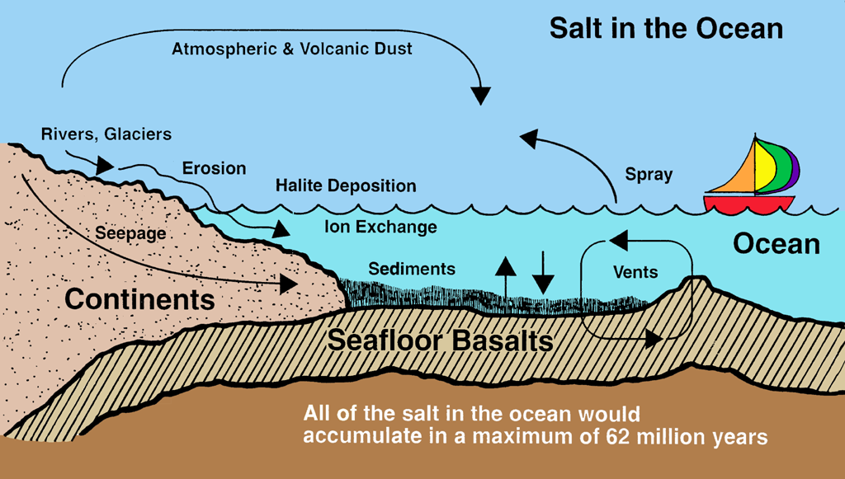
19
Salt
Evidence for a Young Earth
Notes:
Salt is being added to the ocean on a daily basis as rainfall dissolves chemicals, which are returned to the ocean through rivers. We can measure how much salt is in the ocean and how fast it is added to the ocean. Identifying every conceivable source of input and output, we can show that at present rates, the world's oceans could not be anymore than sixty-two million years old.
This is not stating that the oceans are sixty million years old, but that using uniformitarian assumptions, this is a maximum age. It is a critique of uniformitarian assumptions more than an age-dating method.

Slide 16
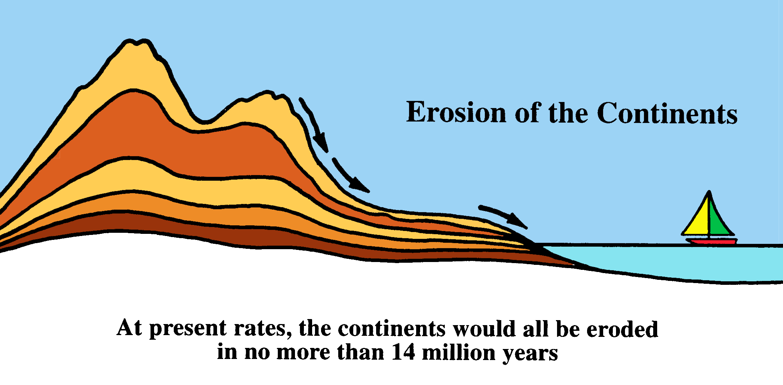
19
of the Continents
Erosion
At present rates, the continents would all be eroded in no more than
14 million years.
Notes:
The continents are eroding in the present so rapidly that all of them will be gone in fourteen million years. This takes into account the rate of continental rise and the increase in erosion rates due to human alteration.
Our continents are thought to be hundreds of millions of years old, evidently eroding so fast now that they will not last.
This shows that uniformitarian assumptions are invalid.

Slide 17
19
of Ocean Sediments
Accumulation
At present rates, all the sediment in the ocean would accumulate in no more than
14 million years.
Notes:
By measuring the amount of sediments in the ocean bottom due to continental erosion we see that this indicator is also incompatible with the evolutionary way of thinking. Again this is a critique of uniformitarian assumptions, not an accurate age-dating method.

Slide 18
ά
ά
19
238
U
234
Th
234
Pa
234
U
230
Th
ά
226
Ra
222
Rn
218
Po
214
Pb
214
Bi
ά
ά
ά
ά
ά
214
Po
210
Pb
210
Bi
210
Po
206
Pb
U²³⁸ Decay Series
Notes:
Some atoms are radioactive; they are unstable. Uranium-238 changes into lead-206 through the decay chain through thorium and protactinium on down to lead.
In eight different decay episodes, an alpha particle is given off consisting of two protons and two neutrons. This is equivalent to a helium nucleus. Thus uranium over time splits into lead and eight helium nuclei.

Slide 19
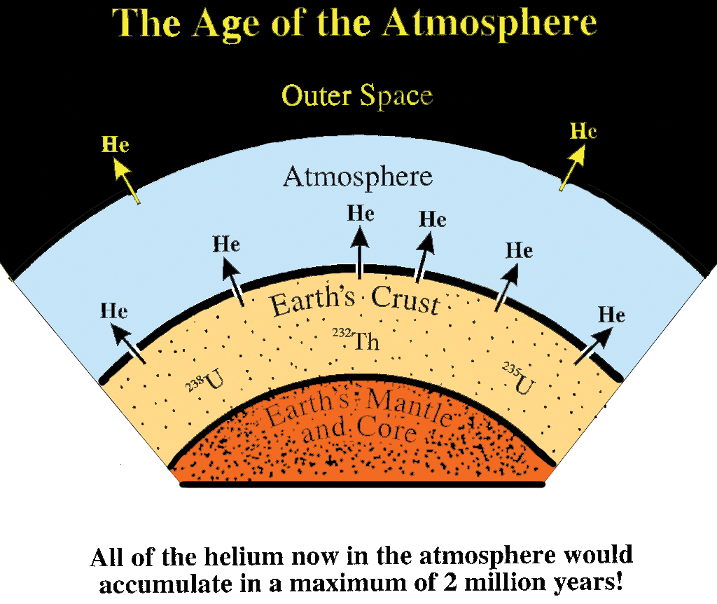
19
The Age of the
atmosphere
Outer Space
Notes:
These helium nuclei eventually percolate through the earth's crust into the atmosphere where they enter our present atmosphere. We can measure how much helium is in the atmosphere and measure how fast helium is added and then estimate how fast helium escapes into outer space. Using the uniformitarian assumption of constant rates and constant conditions, this gives a maximum age of two million years.
Again this is not a "clock" saying that the earth's atmosphere is two million years old; but it is a devastating critique of uniformitarian assumptions. Uniformity is a failed worldview just as the Bible says.

Slide 20
Predictions of Flood Model
20
Catastrophic deposition
Regional stratigraphy
Sediments deform before hardening
Rapid canyon erosion
Dating results not consistent
Notes:
Science is an enterprise limited to the present. It cannot go back in time to observe past events. The scientific method is all about observations of gathering data and inferring conclusions. In the historical sciences we are excluded from observational science.
What must be done is to make predictions about the past. These are not predictions of the future but predictions about the data. Each scientist will say, "If my assumptions are correct, I predict that when I look at the evidence I will see certain things."
If one assumes the biblical Flood as a historical event, he would predict that the data would give evidence of rapid catastrophic deposition operating on a regional scale.
Once we make our predictions we can go to the evidence and see if the evidence fits our predictions.

Slide 21
Predictions of Flood Model
20
Catastrophic deposition
Regional stratigraphy
Sediments deform before hardening
Rapid canyon erosion
Dating results not consistent
Notes:
Let's see if the rocks give evidence of catastrophic deposition or slow and gradual deposition as evolution assumes.

Slide 22
20
"The hurricane, the flood or tsunami may do more in an hour or a day than the ordinary processes of nature have achieved in a thousand years.
In other words, the history of any one part of the earth, like the life of a soldier, consists of long periods of boredom and short periods of terror."
Dr. Derek Ager, The Nature of the Stratigraphical Record, 1981, pp. 54, 106.
Notes:
The famous scientist, Dr. Ager, was a prominent geologist in the United Kingdom before his recent death. He admits that almost all of the rocks in the world give evidence of a catastrophic history.

Slide 23
Tsunami
20
According to a National Geographic Explorer program aired in May 1998, Dr. Walter Dudley of the U. of Hawaii said the tsunami is the "most catastrophic of all phenomena." He stated that a tsunami in the 1940s was recorded at 56' high, but those of "pre-historic times" [the Flood year?] would be upward of 1000' high!
Scientific American, July 1998, p. 45
Notes:
More recent scientists have admitted that the geologic events of the past far surpassed present events in rate scales and intensities. The past was quite catastrophic.

Slide 24
Turbidites
20
One Modern Example
Current speed:
60 miles/hour
Distance:
430 miles
Thickness:
2-3 feet
Area:
40,000 square miles
Notes:
The concept of turbidities has revolutionized geology. Turbidites employs the word "turbid" or "turbulent." The concept is based on one modern example of a catastrophe that set up off the northern coast of Canada in 1927.
An earthquake shook loose sediments packed along the continental shelf, and as it slid down into the Oceanic abyss, it broke various telephone cables stretched across the Atlantic Ocean; therefore, we know the speed and dimensions of the slide.
This was an underwater mudflow flowing at measured speeds of sixty miles an hour, and it covered an area of forty thousand square miles.
A near instantaneous geologic catastrophe!

Slide 25
Turbidites
20
1/3 to 1/2 of all sedimentary rock now found on the continents interpreted as turbidites.
Turbidity flows happen today. One turbidite proves nothing.
The Flood's prediction of a world full of turbidites has been verified.
Notes:
In the 1960s and 70s when submarines were developed and could study oceanic turbidite deposits, we recognized that most of the sedimentary rocks on the continents are best interpreted as turbidites.
One turbidite proves nothing, but a world of turbidites is just as the Flood model predicts.

Slide 26
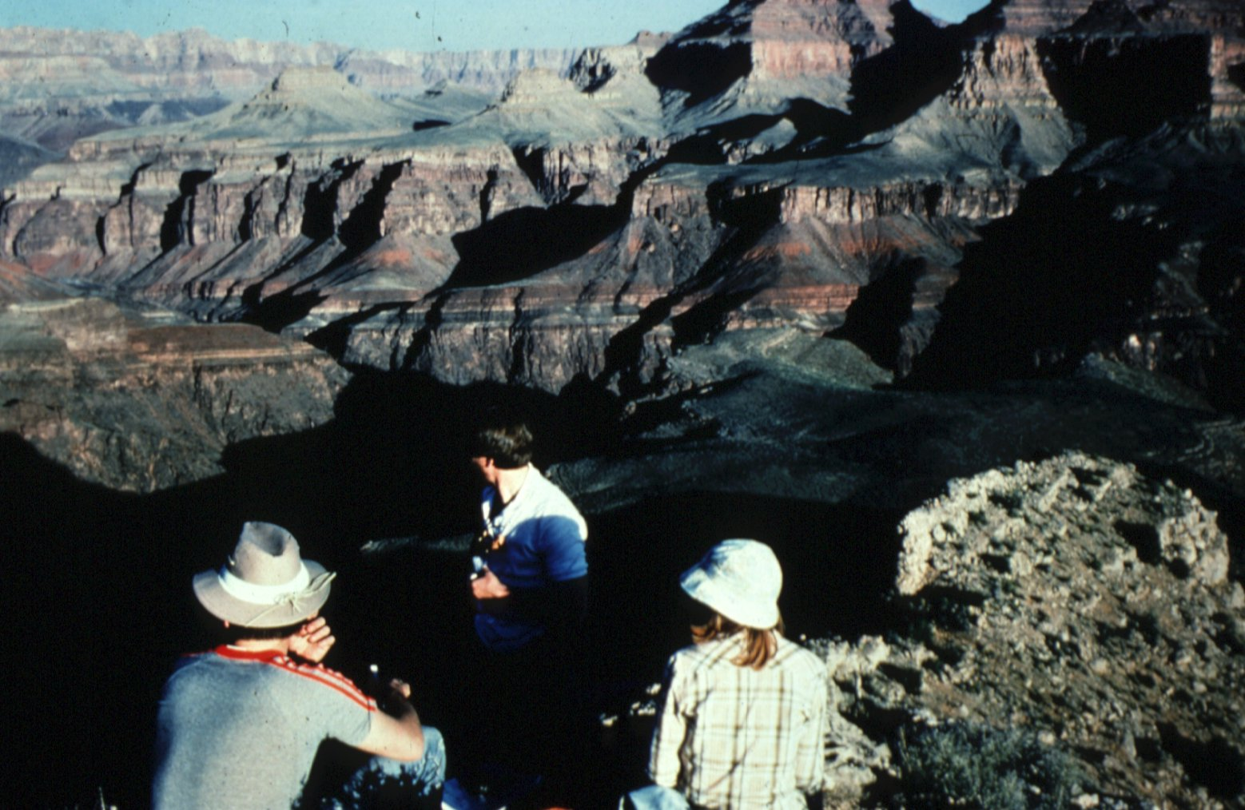
20
Notes:
Many of the rocks in Grand Canyon have been reinterpreted as turbidites or otherwise catastrophic deposits.

Slide 27
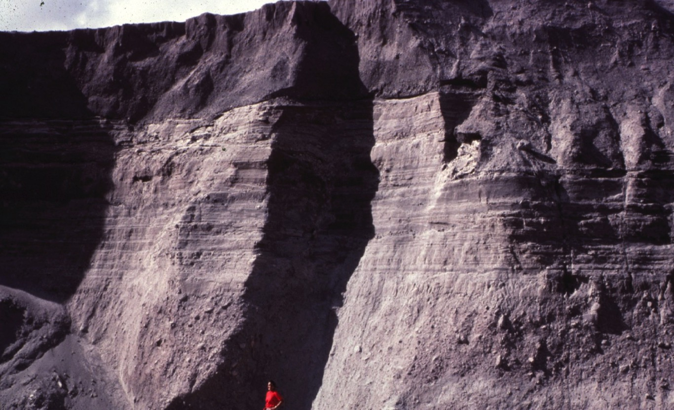
20
Finely bedded and horizontally layered central deposit at Mount St. Helens
Notes:
Many of the rock units deposited during the 1980 eruption of Mount St. Helens and the consequent mudflows give evidence of a likewise catastrophic past. Notice the finely bedded and horizontally layered central deposit here in this cliff at Mount St. Helens.

Slide 28
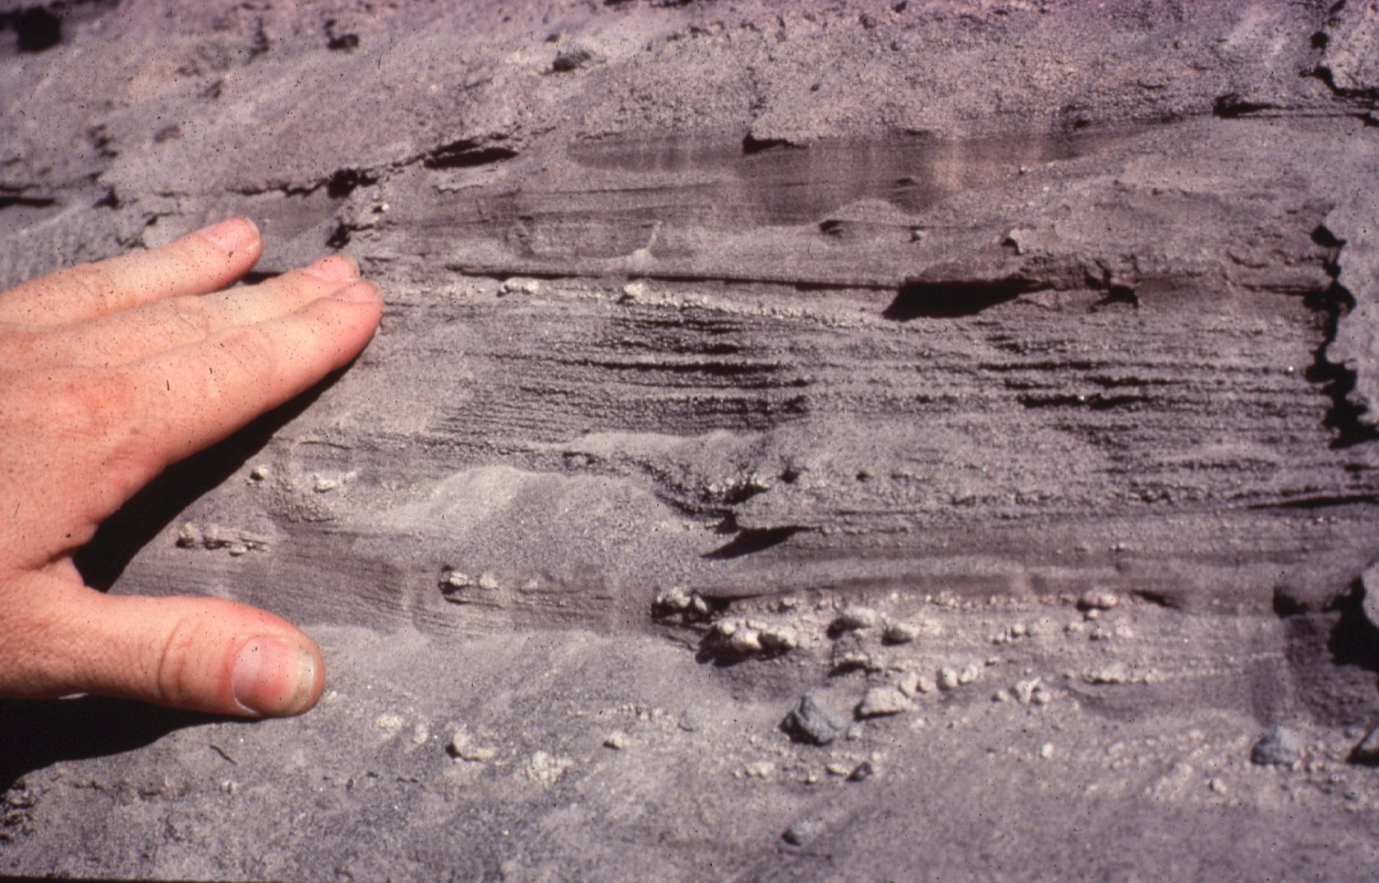
20
Uniformity or Catastrophe?
Notes:
Looking more closely, we see that the layer has numerous millimeter-thick beds. This is the kind of evidence that geologists look for to conclude slow and gradual uniformitarian deposition; but in reality this was a ninety-mile an hour pyroclastic flow that devastated the area surrounding Mount St. Helens. It all happened in the space of a few hours.

Slide 29
20
Notes:
The catastrophic redeposited rocks at Mount St. Helens look very much like the rocks in Grand Canyon.

Slide 30
20
Notes:
We did not see the rocks at Grand Canyon deposited, but their similarity to the ones that we did see deposited at Mount St. Helens in a very short period of time support our conclusion that even the rocks in Grand Canyon were deposited rapidly and catastrophically.

Slide 31
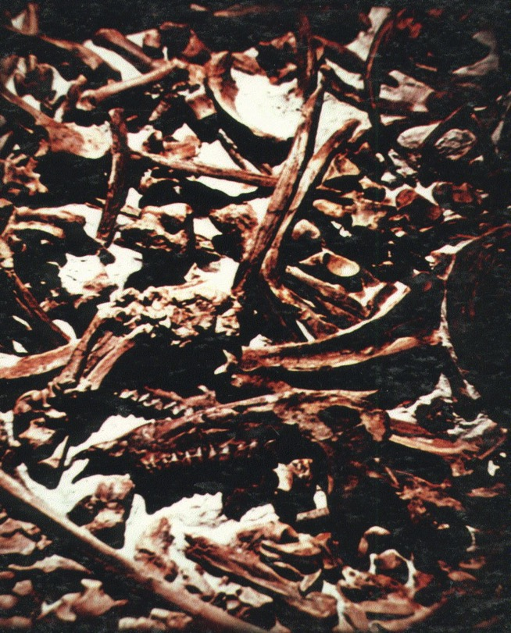
20
The Main Issue:
Fossils
When did the fossils die?
Notes:
In the creation/evolution debate and in a biblical understanding, the main issue is the fossils. When did the fossils die? Did they die millions of years ago as evolution says? Or are they the once-living plants and animals that died in the great Flood of Noah's Day?

Slide 32
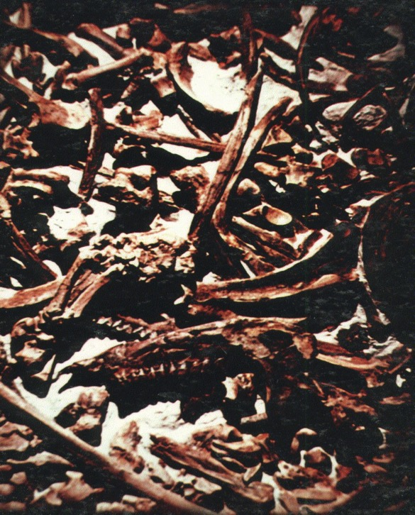
The Bible says:
20
"The wages of sin is death!
The key is
Noah's Flood
Notes:
The Bible says that the wages of sin is death—that there was no death of conscious life before Adam sinned. These dead things must have died after Adam sinned.
• The key is Noah's Flood. This is a time when these sedimentary deposits were laid down full of things that died in the Great Flood.

Slide 33
The Great Flood of Noah's Day
20
Such a catastrophic,
year-long,
world-wide,
mountain-covering,
deluge
would have reshaped
the earth's entire surface.
Notes:
The Flood as described in Scripture was a catastrophic, year-long, worldwide, mountain covering deluge. It would have reshaped the earth's entire surface.

Slide 34
The Great Flood of Noah's Day
20
Its results include vast deposits of sediments, containing extensive remains of plant and animal life.
Notes:
All of the evidence that we now see on the surface of the earth is a result of the Flood. Evolutionists wrongly interpret this evidence and use it in support of evolution and millions of years.

Slide 35
20
If the Flood made the rocks and fossils,
there were no geologic ages.
One Year
Notes:
If the Flood laid down the rocks and fossils there is no evidence for evolution or an old earth, because evolutionists wrongly used rocks and fossils as support of evolution.

Slide 36
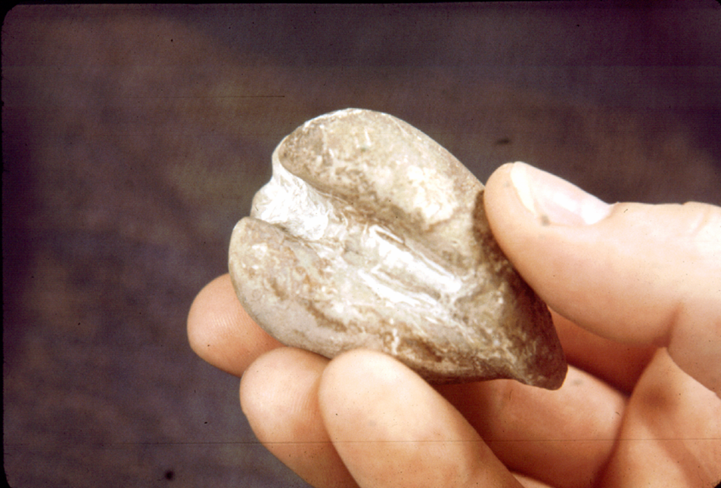
20
Fossils
show rapid,
catastrophic deposition!
Notes:
The fossils themselves show evidence of rapid catastrophic deposition. This clam fossil, one of myriads of clam fossils discovered at an outcrop in Texas, is complete showing both sides tightly shut.
A living clam can burrow underground and do all sorts of remarkable things; but when disturbed it shuts itself tightly. It clams up for protection.
This clam, and the myriads of other clams with which it was buried, was deposited rapidly protecting itself and was buried so rapidly it could not burrow out.

Slide 37
20
Fossil Fish
Notes:
We find fish fossils precisely preserved by the trillions; but a fish when it dies floats to the surface or sinks to the bottom where it is eaten by scavengers. It disappears in a short period of time. These precisely preserved fish fossils give evidence of rapid burial; buried away from bacteria and scavenger action, they would have had time to fossilize.

Slide 38
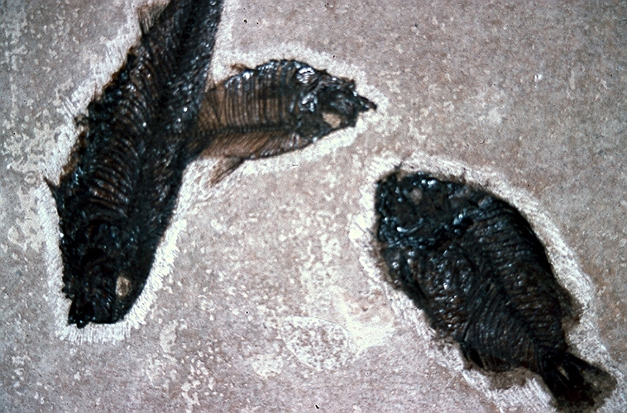
20
Notes:
We find fish buried in huge schools. Fish don't die like this. They were buried like this in a catastrophic event at some time in the past. They were buried so rapidly that they could not decay.

Slide 39
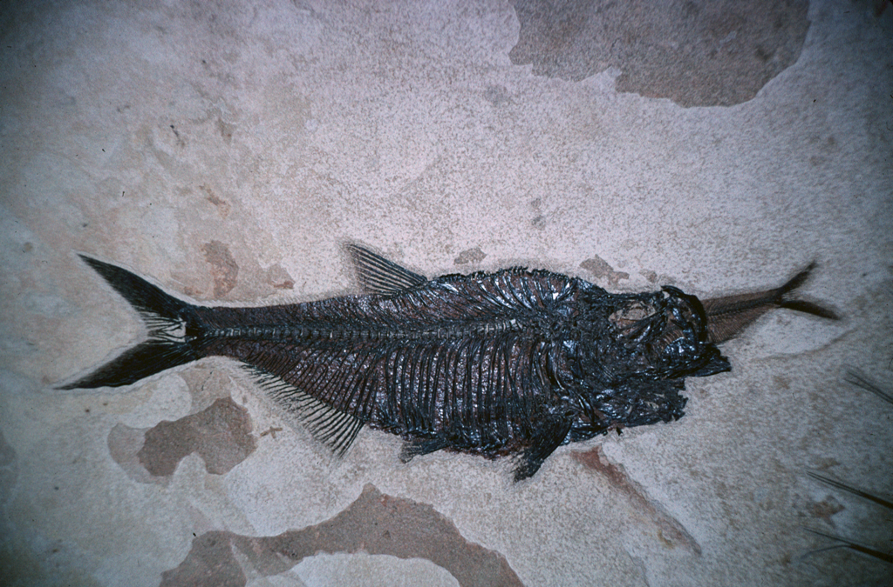
20
Notes:
This fish was buried so rapidly it didn't even have time to swallow its lunch.

Slide 40
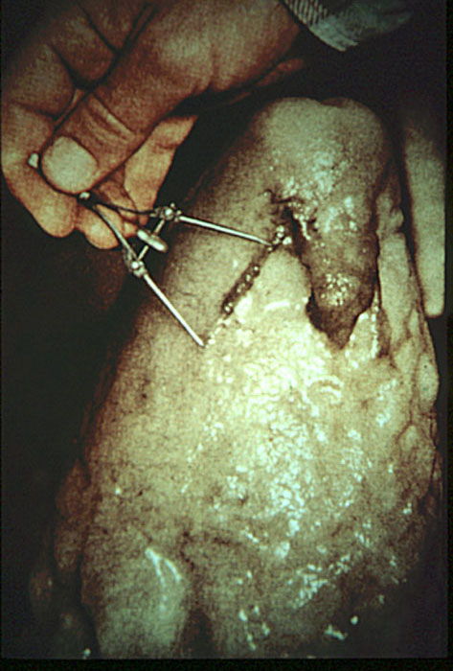
20
stalagmites
stalactites
Notes:
Sometimes we are told that stalagmites and stalactites in caves take millions of years to form. But this stalagmite formed so rapidly that a bat, which had landed on its side, was encased in the rock. Obviously the rate of stalagmite formation in the past was at times greater.
There are many examples of rapid formation of stalagmites and stalactites.

Slide 41
20
Petrified Wood
Notes:
We are also told that it takes millions of years to form petrified wood. But there are many examples of human artifacts being petrified even in natural conditions. This is the part of a fence post that was buried underground. The part above ground rotted away, but underground it petrified.
It doesn't take millions of years to form petrified wood, it just takes the right conditions. The best condition is burial in volcanic ash.

Slide 42
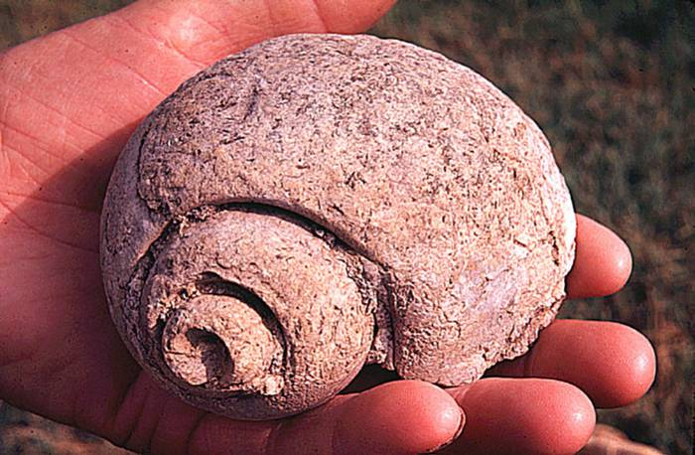
20
Marine Invertebrates
the most common fossils
Notes:
Almost all fossils are of marine invertebrates buried rapidly and catastrophically.

Slide 43
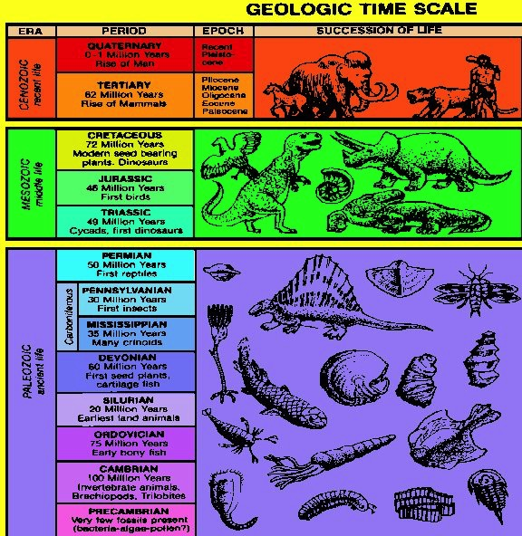
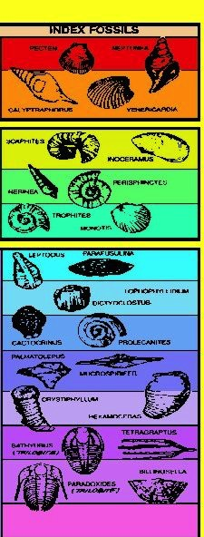
20
Notes:
We are often shown the geologic column with the geologic time scale as if it were an illustration of the fossil record.
• But as you can see on the right, the fossil record is very different. Almost all of the fossils in all of the different layers are marine invertebrates. They do not show the evolutionary progression of simple to complex. They are complex at the start and remain complex throughout.
Furthermore, these same marine invertebrates that dominate the lower levels dominate every layer.

Slide 44
The Real Fossil Record
20
95% of all fossils are marine invertebrates, primarily shellfish.
95% of remaining 5% are plants.
95% of rest are fish.
Most of the rest are insects.
Much less than 1% are land vertebrates.
These usually consist of less than one bone.
Notes:
As we can see, 95% of all fossils are marine invertebrates. Only a minority are all the rest, including the land vertebrates which are very rare indeed.
These marine invertebrates, animals that live in the ocean, primarily shellfish, are all found on the land and in catastrophic deposits. Almost no marine fossils are found in the ocean. The evidence is for total destruction of land using the ocean. We see the evidence recorded in the rocks.

Slide 45
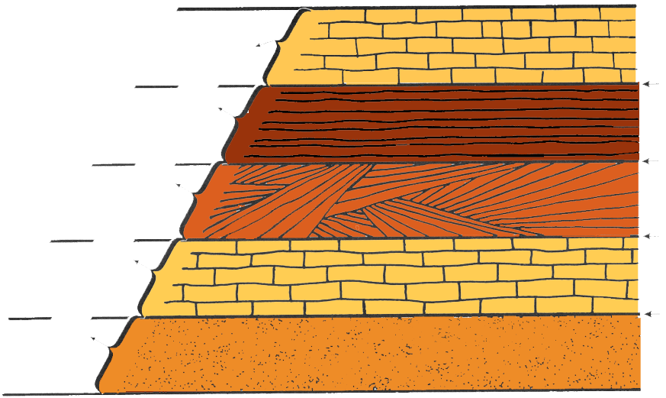
20
Times passes
Rapid Catastrophic Deposition
Times passes
Times passes
Times passes
To a neo-catastrophist, the rocks show evidence of rapid catastrophic processes, requiring little time for deposition. Time passes between the layers where there is no evidence.
Notes:
Geologists in recent years have given up straight uniformitarianism. They now adopt a rather catastrophic view and call themselves neo-catastrophists.
Each horizontally bedded layer in almost every locality is interpreted as a catastrophic deposit being laid down in a very short period of time. Each of these layers, however, is thought to result from a different catastrophe separated by millions of years.
All the rocks speak of rapid catastrophic deposition; but to preserve the time concept needed for evolution, it is thought that great amounts of time passed between the two layers.
Time passes between the layers where there is no evidence. All the evidence is for rapid catastrophic deposition. If time past between the layers, the question remains how much time passed between deposition of two adjacent layers?

Slide 46
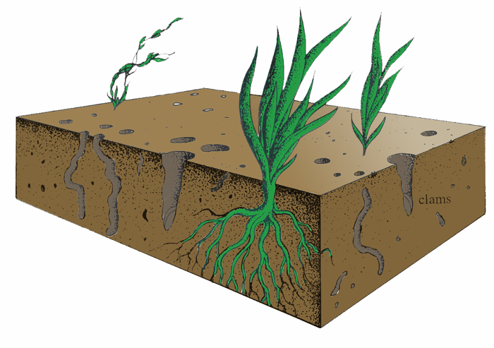
Living Ocean Bottom Ecology
20
Growing plants
clams
worms
Notes:
The next several slides will give several reasons to think that the amount of time which passed between two adjacent layers was not very much.
Virtually all of the rock units are marine deposition. In a modern ocean, organisms live and accomplish much bioturbation. Any internal layering would be disrupted in the normal environment.
Yet we see in rocks much evidence of sedimentary structure, internal layering. Obviously that rock was never on the ocean bottom for very long, because such internal structure would be destroyed.

Slide 47
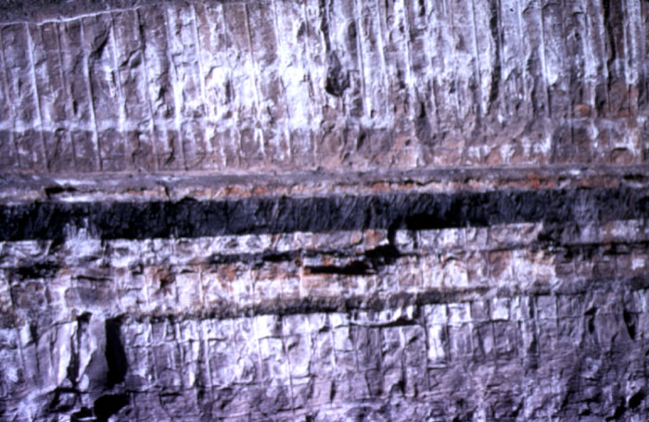
20
Notes:
This shows a coal seam in between two ocean bottom shale/sandstone beds. Coal is thought to be the metamorphose remains of a swamp peat deposit, but swamps are very active biologically. There are also many highs and lows. This coal deposit shows extremely flat bedding and no bioturbation. There is no evidence here of much time having passed.

Slide 48
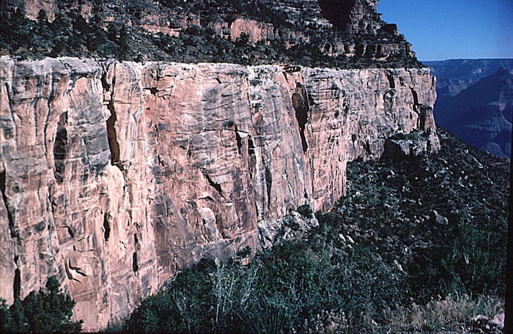
20
Notes:
The same can be said for almost every bed exposed. We see one right on top of the other with little bioturbation, scant evidence of erosion. It looks like they were laid down one right after the other.

Slide 49
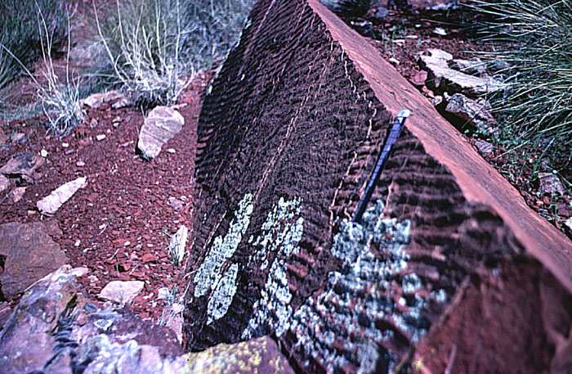
20
Notes:
The surface of many rocks show what we call ripple marks. Just like a retreating tide will leave ripple marks on a sandy beach, which erode with the next tide, so we see this in the rocks. Yet in the rocks, these ripple marks are hardened into "fossilized" ripple marks.
These ripple marks will erode in rock in a space of a few years. In sand they will erode with the next tide. They could not last millions of years waiting for the next catastrophe to deposit the rock unit above.

Slide 50
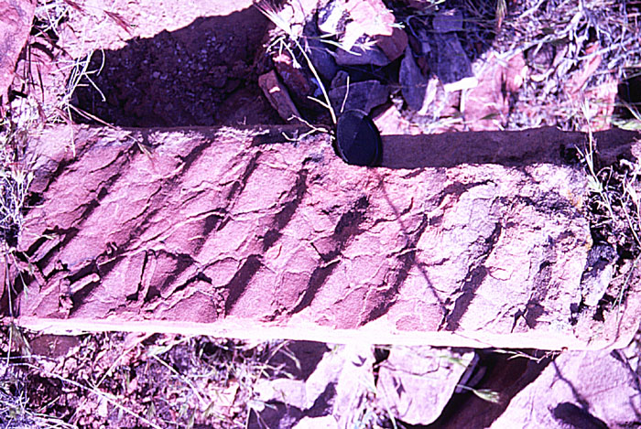
20
Notes:
Another example of ripple marks

Slide 51
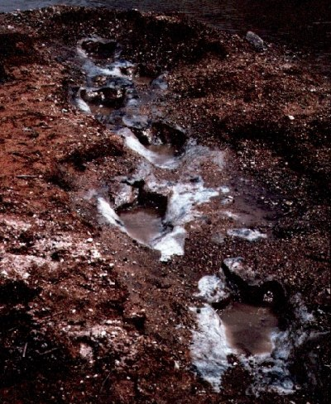
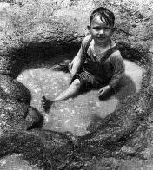
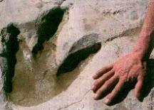
Tracks
20
Dino
Notes:
In many locations we see animal footprints. In this case, dinosaur footprints and a dinosaur trail. These must have been made when the mud was soft and yet are now hardened into solid rock.
The total length of time for deposition for hardening the tracks is obviously short. There is no evidence for millions of years of time passing between this layer and the layer above.

Slide 52
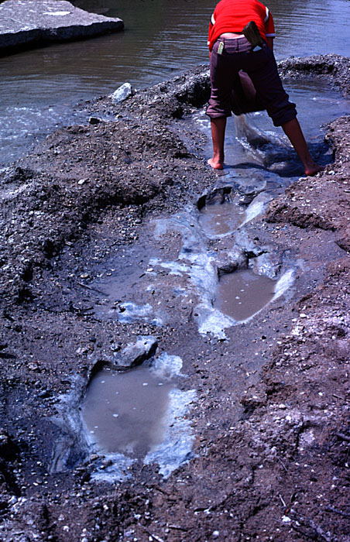
20
Dinosaur
trail
Notes:
Another dinosaur trail

Slide 53
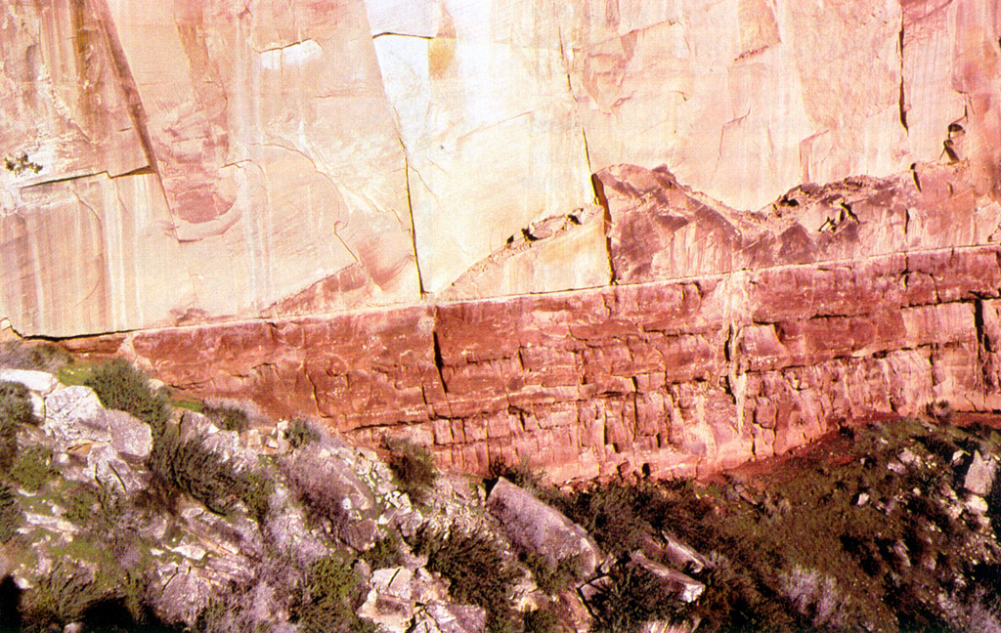
20
Hermit Shale & Coconino Sandstone
Notes:
The reddish layer, the Hermit Shale, is thought to be a deltaic underwater deposit. The tan layer above the Coconino Sandstone is thought to be a desert sand dune deposit. Yet the context between the two is extremely flat and extremely extensive. There is no evidence for much time having passed between the two.

Slide 54
Predictions of Flood Model
20
Catastrophic deposition
Regional stratigraphy
Sediments deform before hardening
Rapid canyon erosion
Dating results not consistent

Slide 55
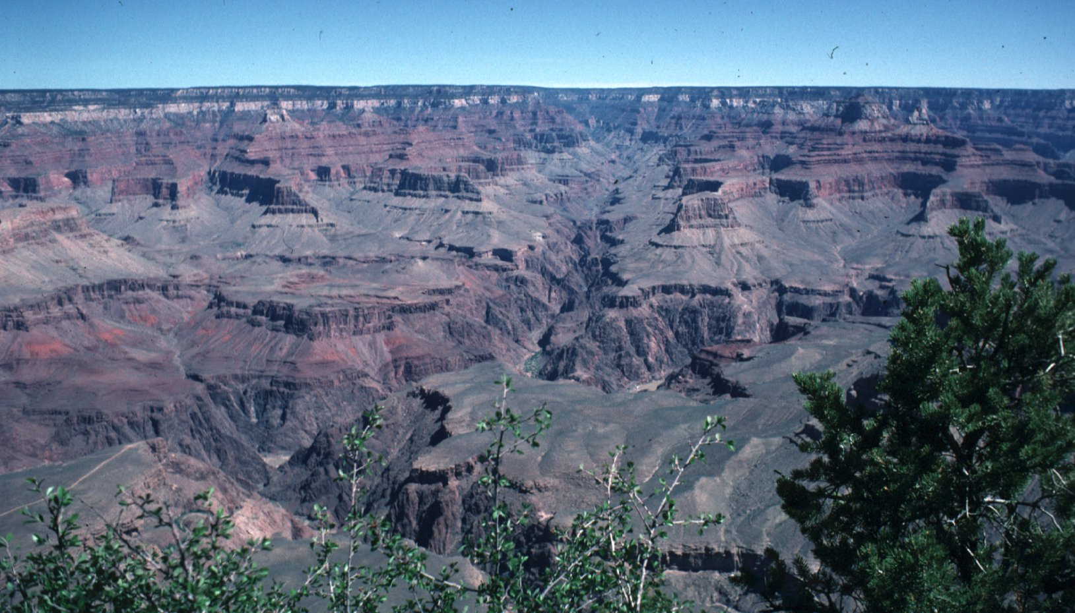
20
Notes:
This catastrophic deposition according to the Flood would have been occurring on a large scale. The Bible says the Flood was global and the individual expressions of that would at least be on continental or regional scale, not local as with the uniformitarian model. The Grand Canyon exposes in side view, about a mile thick of these horizontally layered Flood deposits. The lowest horizontally bedded layer in this picture is called the Tapeats Sandstone. As far as you can see in Grand Canyon, it is horizontally embedded.

Slide 56
Sandstone lithosome at the base of the Sauk Sequence
20
Notes:
When we map out the occurrences of the Tapeats Sandstone it covers much of North America. It's the lowest level of what's called the Sauk sequence of rocks. The series of rocks that is hemispherical in extent. This rock unit is understood as being a series of underwater mudflows at ninety miles an hour. Certainly this is evidence of a great flood such as the Flood described in Scripture.

Slide 57
One Large Coal Seam
20
Notes:
A similar wide area is noted in greater coal deposits. Coal is thought to be the metamorphose remains of peat deposits in a peat swamp. Every peat swamp today is very localized; it would hardly show up on a map of the United States. No peat swamp that we can conceive of could be of the size of our modern-day coals. Something different was going on in the past, something of a regional, perhaps global scale.

Slide 58
Predictions of Flood Model
20
Catastrophic deposition
Regional stratigraphy
Sediments deform before hardening
Rapid canyon erosion
Dating results not consistent
Notes:
If the Flood was responsible for the rocks, then we would expect that some rocks would be deposited and then deformed before they had a chance to completely harden.

Slide 59
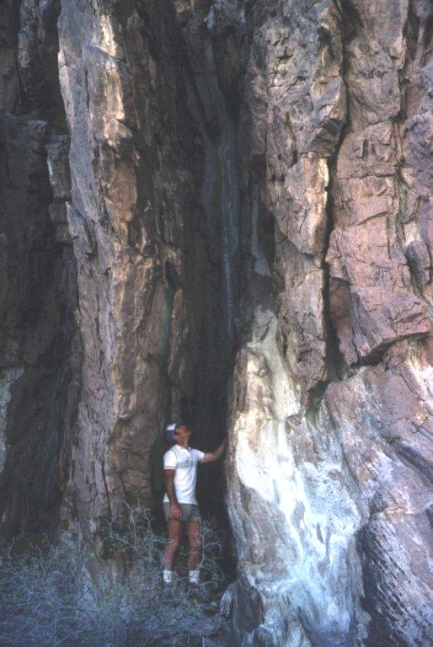
20
Tapeats Sandstone
Notes:
The Tapeats Sandstone, the lowest horizontally bedded layer in Grand Canyon, may have been deposited horizontal, but in some places it is sticking up vertically into the air.

Slide 60
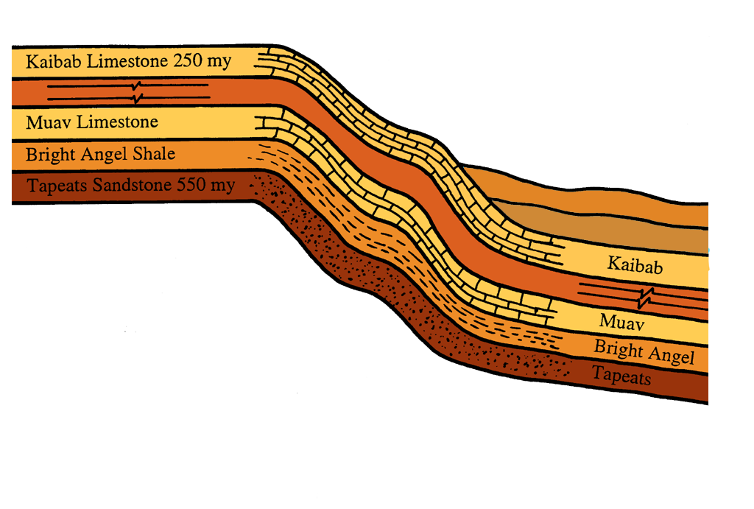
20
Cross section of
Grand Canyon geology showing monocline and Kaibab Upwarp
Kaibab Upwarp
Vishnu Schist
70 my
Notes:
The geologic sequence is shown here in cross sections. An uplift of the area on the left bent the rocks in a monocline down to a lower level on the right. These same rock units are a mile in elevation higher on the left than on the right.
The underground faults, which according to evolution, occurred some 70 million years ago, uplifted the Grand Canyon Rocky Mountain area.
But notice that the Tapeats Sandstone is thought to be 550 million years old today, thus it was 480 million years old at the time of uplift. The question is, would it have had time to harden into solid rock as it is today in four hundred and eighty million years? Of course.

Slide 61
Old-Earth Scenario
20
Young-Earth Scenario
Deformation
Long After
Deposition
Sediments
Brittle
When
Deformed
Deformation
Soon After
Deposition
Sediments
Soft
When
Deformed
Notes:
This shows the two different predictions made by the two different sets of assumptions.
• In the old earth scenario, the deformation, bending, and breaking would have taken place long after deposition; when the sediments would have been completely hard and brittle.
• The young earth idea states that the deformation may have occurred just months after the deposition, possibly later in the Flood year when the sediments may not have had enough time to completely harden; thus they would be soft when deformed.

Slide 62
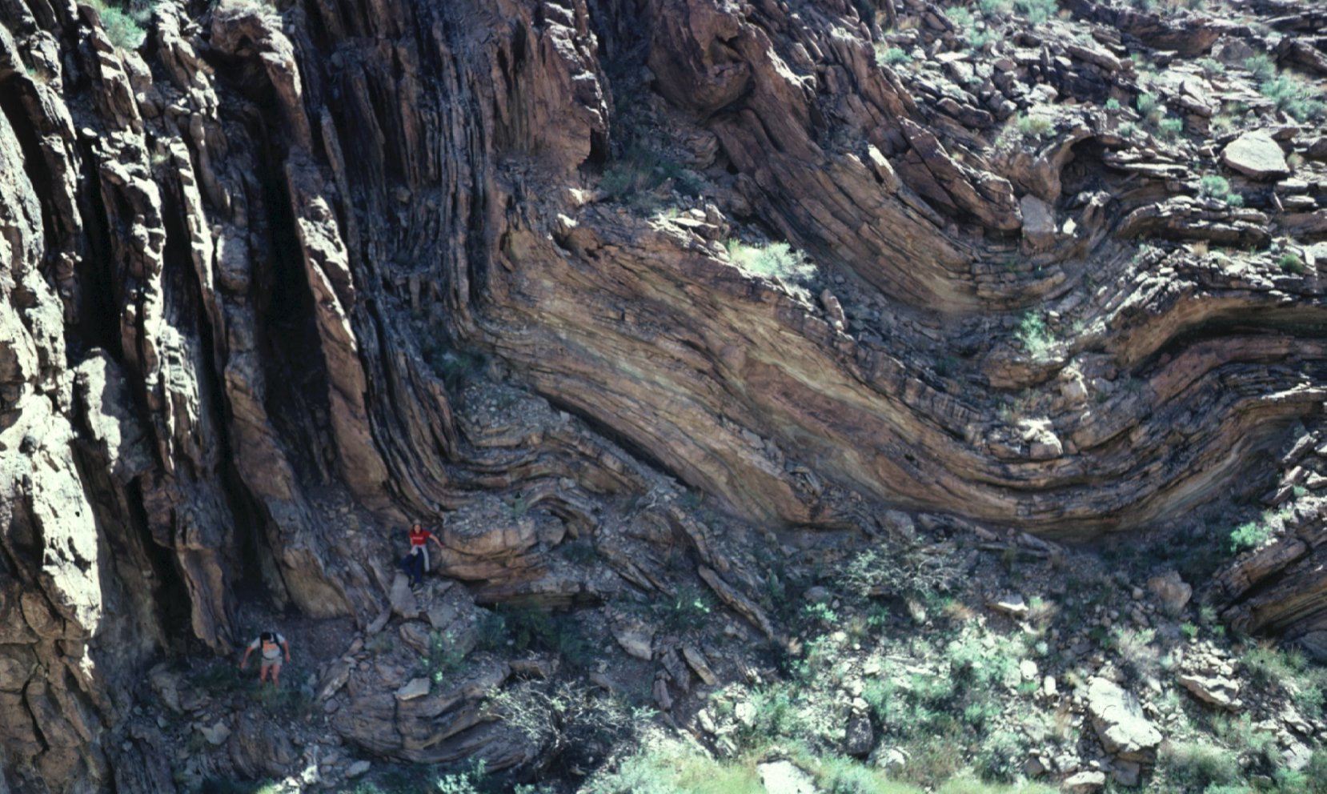
20
Notes:
This slide shows that in the space of 100 feet or so the rocks go from vertical to horizontal. Obviously they were in soft muddy condition at the time of deformation. They had not yet had time to harden into solid rock as they are today. Notice the two climbers for scale.

Slide 63
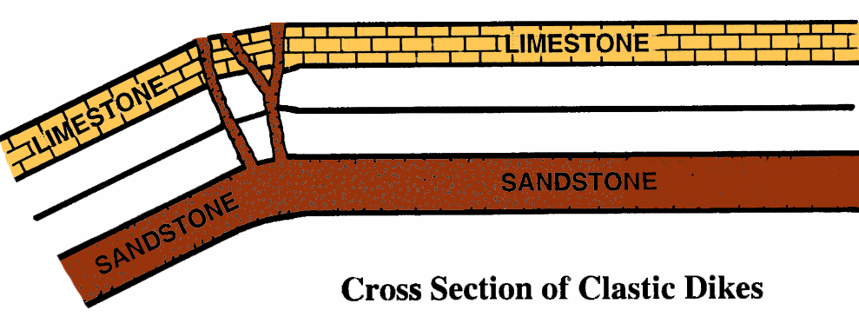
20
Clastic Dikes in Rockwall County, Texas
Notes:
A similar scenario is related to the clastic dikes found in Texas. The bending is thought to have occurred when the rocks were already millions of years old and yet they were still soft enough to squeeze like toothpaste up into cracks and overlying rock to form these interesting rock walls in Rockwall County.

Slide 64
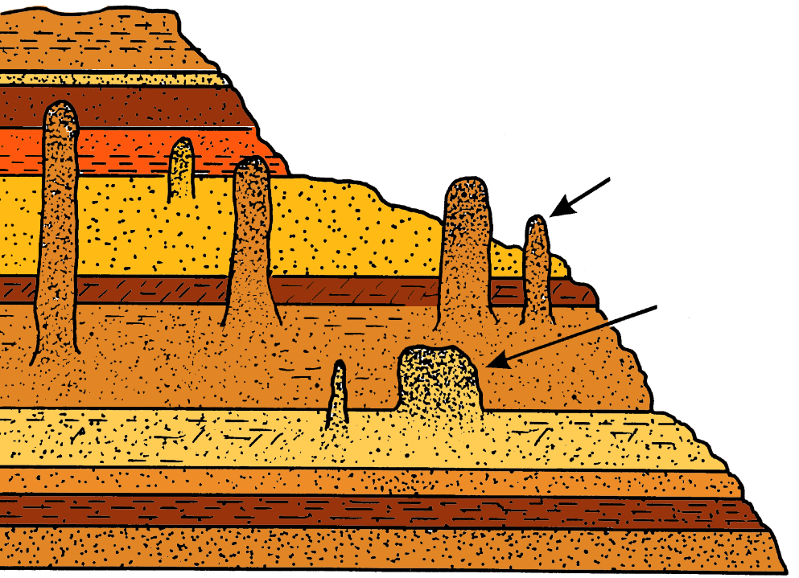
20
Pipe
Dike
Clastic dikes and pipes in
Kodachrome Basin State Park
Notes:
Similarly clastic dikes and clastic pipes are found throughout Utah. An underground tectonic action squeezed these things up into the overlying strata supposedly millions of years after the strata had been deposited. They did not harden into solid rock until they were already in place in the overlying strata, showing that the total sequence of time throughout the area was shorter than the time it takes for the deposit to harden into sandstone.

Slide 65
Predictions of Flood Model
20
Catastrophic deposition
Regional stratigraphy
Sediments deform before hardening
Rapid canyon erosion
Dating results not consistent
Notes:
Another prediction of the Flood model would be that canyons such as Grand Canyon would give evidence of rapid erosion—not slow and gradual erosion as the Colorado River would perform.

Slide 66
20
Carved by Time or Carved by Catastrophe?
Notes:
The Colorado River would never form the kind of canyon that we see in Grand Canyon. It is commonly recognized that modern canyon systems require much greater energies involved in their erosion than are available today.
• As for Grand Canyon, it's thought by most geologists that the Colorado River did not cause the Grand Canyon—that some huge volume of water inundated this area not very long ago and carved this canyon out rapidly. Even though uniformitarian geologists would not acknowledge that Noah's Flood was involved, the modern interpretation of this evidence is very much compatible with the Flood idea. The evidence supports the Flood picture.

Slide 67
If the Flood made the rocks and fossils, there were no "geologic ages"
20
1 Year
Notes:
If the Flood made the rocks and fossils, then there were no geologic ages.

Slide 68
Predictions of Flood Model
21
Catastrophic deposition
Regional stratigraphy
Sediments deform before hardening
Rapid canyon erosion
Dating results not consistent
Notes:
Similarly the radioisotope dating methods would give inconsistent results using uniformitarian assumptions.

Slide 69
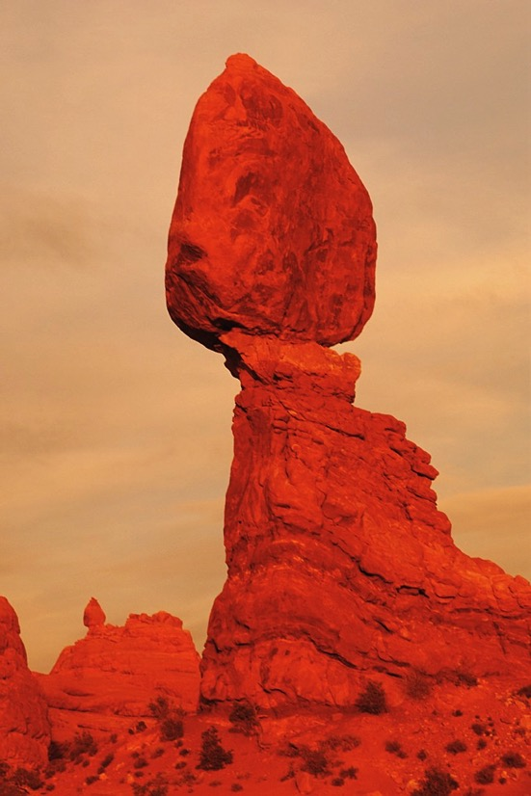
Radioisotope Dating
21
Just how do you date a rock?
Notes:
Just how do you date a rock? Let's use a parable to explain this difficult concept.

Slide 70
21
The Parable of the Potato Basket
or
Uniformitarians and Their
3 Assumptions

Slide 71
21
Assumption #1
Constant rate of decay
Notes:
The parable of the potato basket. Suppose you observe someone peeling potatoes at a rate of one potato per minute. The question, how long has this been going on? is the same question as how old is a rock?
Only igneous rocks can be dated—those which once were in a hot molten condition. The ratio of radioactive isotopes such as uranium and stable isotopes, such as lead, are accurately measured and the rate of uranium decay into lead is also measured. Thus the length of time it would take for that amount of uranium to produce that amount of lead is calculated, which is thought to be the age of the rock.
Radioisotope dating produces the time since the rock cooled from a liquid magma into a solid rock.
Just so in the potato basket you might count the peeled potatoes assuming that the potatoes had been peeled at one per minute. Therefore, twenty-five peeled potatoes would indicate that the system was twenty-five minutes old.

Slide 72
21
Assumption #2
Closed system
Notes:
You've also made the assumption that no one has added peeled potatoes to the basket throughout its whole history.

Slide 73
21
Notes:
Also, you assume that no one has taken peeled potatoes away from the basket. If so, it has messed up the count and you can't make the assumption of a closed system.

Slide 74
21
Assumption #3
Knowledge of initial starting conditions
Notes:
You also must assume that there were no peeled potatoes in the basket to start with. In just the same way, these assumptions must be made in dating a rock. You must make the assumption of 1) a constant rate of decay, 2) a closed system, and 3) knowledge of initial starting conditions.

Slide 75
21
Present World
250 m.y. ago
70 m.y. ago
550 m.y. ago
1 m.y. ago
2 b.y. ago
Notes:
A schematic view of Grand Canyon shows the various horizontally embedded sedimentary rock units. Evolutionists conclude that the interior non-bedded rocks are about 2 billion years old. That the horizontally embedded ones are from 550 to 250 million years old; but that the uplift and canyon erosion is within the last 70 million years.
Only two rock units in the Grand Canyon region are igneous and can at least in principle be dated by radioisotope dating. Sedimentary rocks are obviously contaminated samples that cannot be dated by any technique except the assumption of evolution, usually by using the fossils.

Slide 76
21
Recent Volcanism
Mid-Flood/
Deposition
Late-Flood/
Post-Flood
Uplift & Erosion
Early-Flood/
Erosion &
Deposition
Pre-Flood/
Early-Flood
Deposition &
Tilting
Creation Rock
Notes:
This slide shows how creationists interpret the same rock evidence. The interior rocks are creation rocks and there's pre-Flood and early Flood rock and then the Flood begins in earnest with these horizontally embedded rocks. The whole area was uplifted out of the Flood ocean late in the Flood and erosion could begin. But then there were some recent volcanoes such as the volcanoes which occurred after the Flood.

Slide 77
21
Horizontally
embedded strata
Notes:
This photograph from the South Rim shows the horizontally embedded strata; none of these layers, all of which have some fossils in them, can be dated by radioisotope dating. Only igneous rocks can be dated.

Slide 78
21
Basaltic Rocks of the Uinkaret Plateau
Cardenas Basalts
Notes:
Two of the very few rocks in Grand Canyon that can be dated by radioisotope dating are the Cardenas Basalts near the bottom which dated using the rubidium-strontium isochron method at 1.1 billion years old.
The same method can be used to date similar rocks up at the top. Recent volcanoes containing evidence of Indian habitation, these date at 1.3 billion years old. Obviously the layer on top cannot be older than the layer on the bottom, the method simply doesn't work.

Slide 79
21
Mount St. Helens
Notes:
The eruption of Mount St. Helens involved the production of certain rocks, which are, at least in principle, datable by radioisotope techniques.

Slide 80
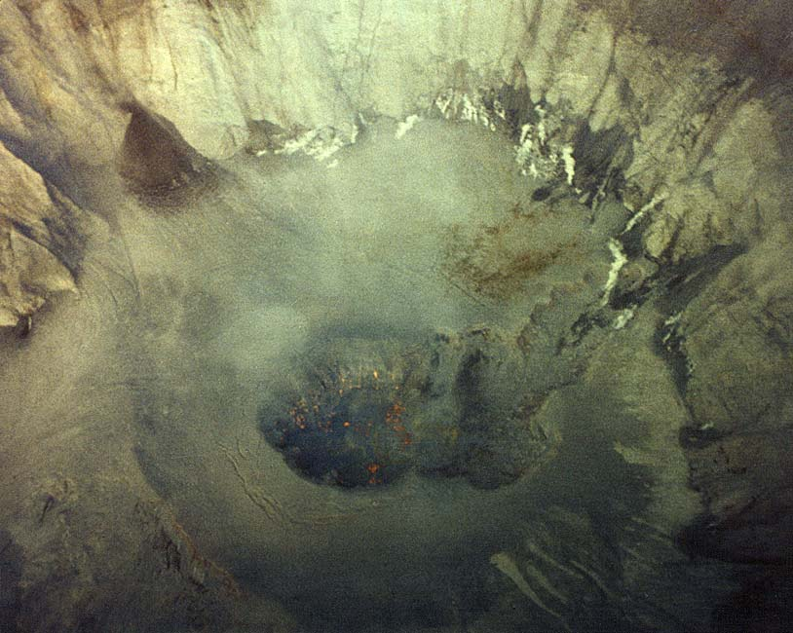
21
Notes:
Looking down from a helicopter into the throat of the volcano you can see certain red hot rocks are in a hot molten condition.

Slide 81
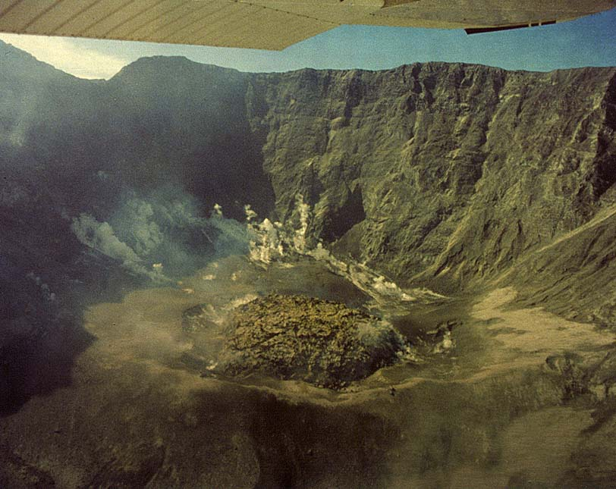
How old is the lava dome?
21
<35 years
How old does it date?
2,400,000 years
Notes:
Now they are building up into a lava dome.
• How old is that lava dome? Obviously less than 31 years since it has erupted since 1980.
• How old does it date? Laboratories dating that rock concluded it is about 2.4 million years old.

Slide 82
Old Dates for Young Rocks
21
Location Expected Measured
Hualalai basalt 200 yrs. .6 my
Mt. Etna basalt 2100 yrs. 25 my
Mt. Etna basalt 29 yrs. 35 my
Mt. Lassen plagioclase 85 yrs. 11 my
Sunset Crater basalt 950 yrs. 27 my
Notes:
There are volcanoes around the world that have erupted in historic times. We know the year, we know the day that these rocks "were born," and yet every time those rocks are dated they come back millions of years old.

Slide 83
21
Old Dates for Young Rocks
Location Expected Measured
Kilauea basalt <200 yrs. 21 my
Kilauea basalt <1000 yrs. 43 my
Kilauea basalt <1000 yrs. 30 my
Kilauea Iki basalt 40 yrs. 8.5 my
Mt. Stromboli 38 yrs. 2.4 my

Slide 84
21
Old Dates for Young Rocks
Location Expected Measured
Hualalai basalt 200 yrs. 22.8 my
Rangitoto basalt <800 yrs. 15 my
Mt. Erebus 17 yrs. 1.6 my
Mt. Etna basalt 37 yrs. .7 my
Medicine Lake obsidian < 500 yrs. 12.6 my

Slide 85
21
Notes:
Mount St. Helens gave us a working laboratory with which to test some of these dating techniques.

Slide 86
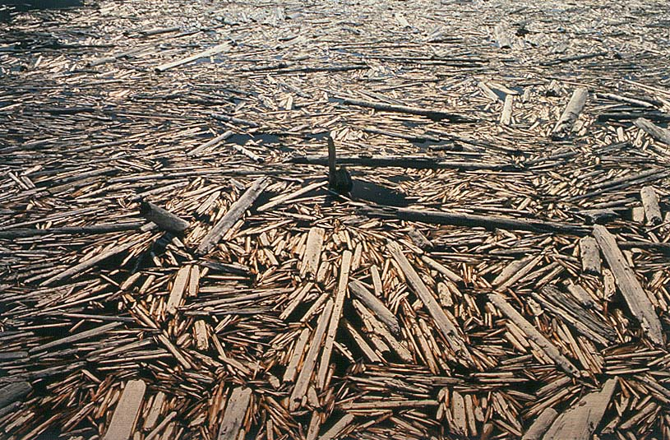
Trees on Spirit Lake
21
Notes:
The eruption destroyed many trees which ended up in Spirit Lake on the north shore of the volcano.

Slide 87
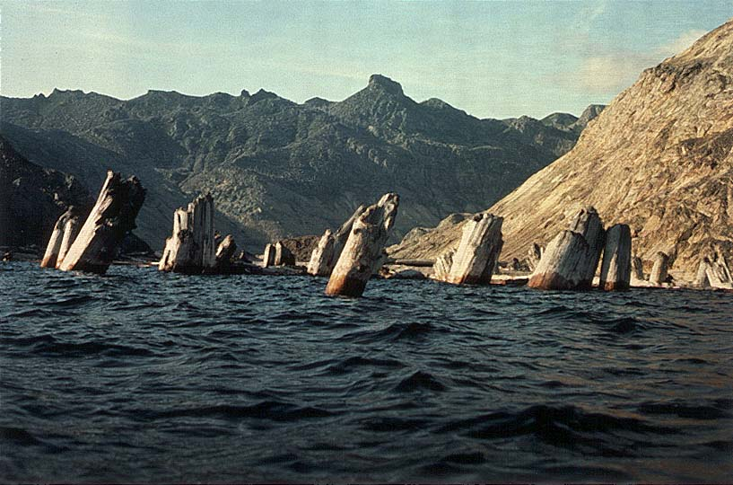
21
Notes:
Over time many of these trees began to float upright sinking roots down and trunks up.

Slide 88
21
Notes:
These upright floaters are in growth position but not growth location.

Slide 89
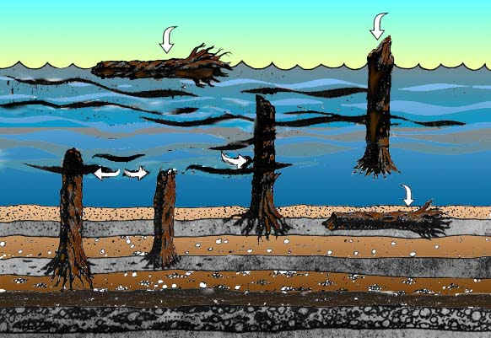
21
Prone floating log
Upright floating log
Upright deposited log
Upright floated & buried logs
Prone buried log
Notes:
A schematic shows how the upright floaters are positioned with the root ends down. Root wood is more dense than the trunk wood, and the tree would waterlog from roots first.
As they sink, some trees would sink in horizontal positions, while some would sink in a vertical position with roots down, trunks up. They did not grow here, they floated here and sunk in this location.

Slide 90
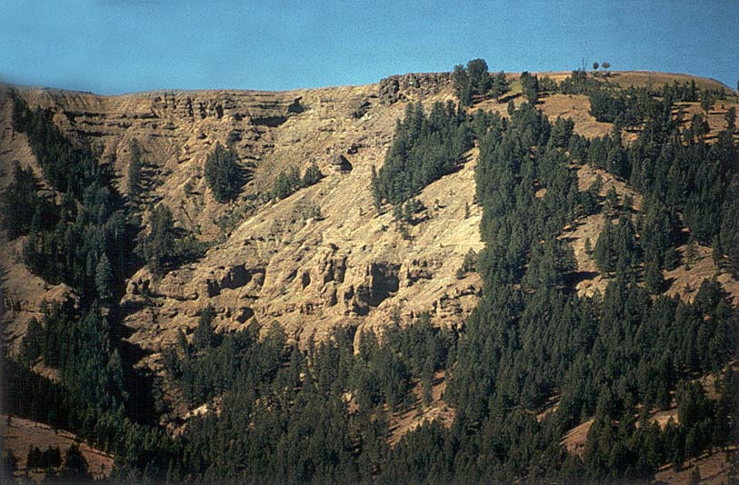
21
Specimen Ridge
Yellowstone National Park
Notes:
It reminds us of a place in Yellowstone Park called Specimen Ridge.

Slide 91
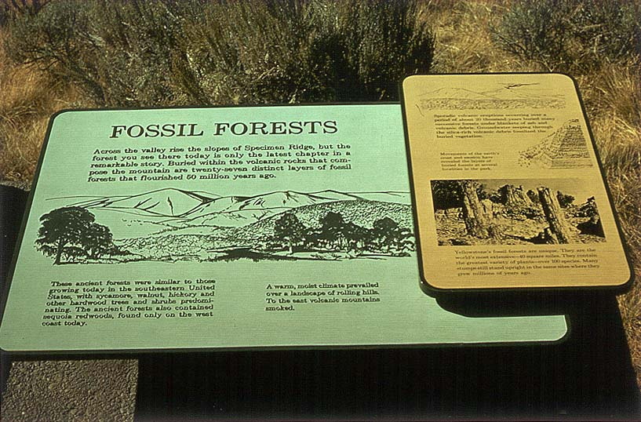
Lessons in Evolution
21
Notes:
The local park service provides a lesson in evolution and old ages. In each one of the layers on Specimen Ridge there are upright petrified trees.

Slide 92
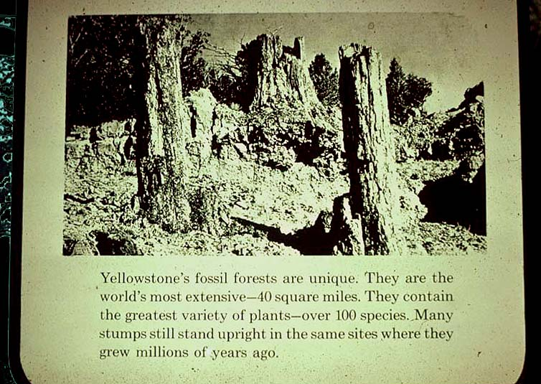
21
"Yellowstone's fossil forests are unique. . . . Many stumps still stand upright in the same sites where they grew millions of years ago."

Slide 93
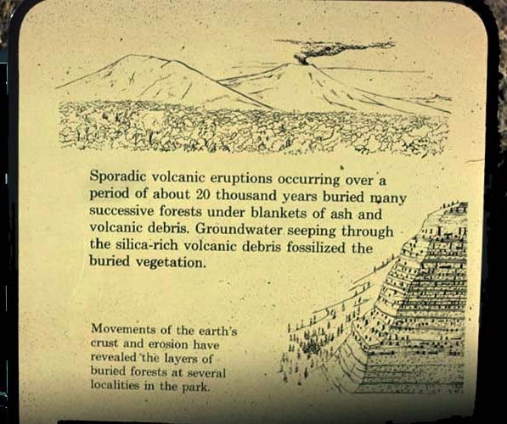
21
"Volcanic eruptions …over… 20 thousand years buried many…forests"
Notes:
It is interpreted as a series of twenty-seven horizontal layers, each one containing petrified trees.

Slide 94
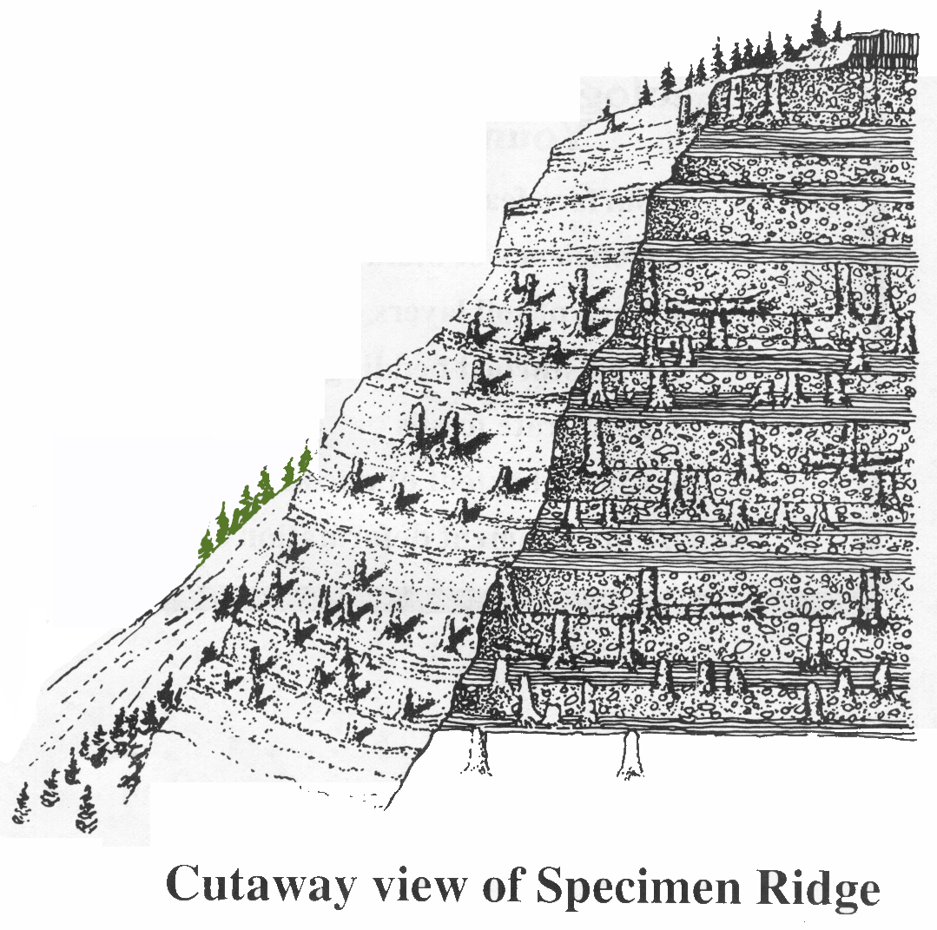
21
Cutaway view of Specimen Ridge
Petrified trees
Petrified trees
Petrified trees
Notes:
The trees in each layer are mature trees some hundreds of years old, thus each layer would take several hundred years to form. This would be a standing forest buried by volcanic eruption. Over time the volcanic ash would harden into soil and grow another forest. The sum total of all the time needed for these twenty-seven layers is more time than the Bible will allow.
This explanation has long been the classic argument for an evolutionist that the Bible is wrong.

Slide 95
21
Growth position
X
Growth location
Notes:
• Some of these petrified trees are absolutely beautiful, trunks up, roots down, in growth position but is it growth location?
• If they grew here the Bible is wrong.

Slide 96
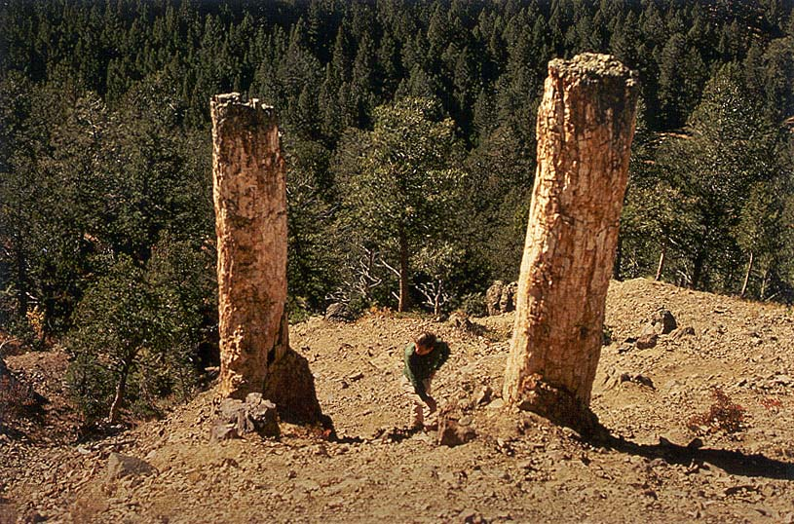
21
Petrified Wood
Notes:
Obviously there are modern trees growing on the same slope, but the petrified trees are of interest. We know that petrification does not take extremely long periods of time. Buried in volcanic ash is the best environment in which to petrify wood.
There are many examples of rapid petrifaction; even in a laboratory it doesn't take long to petrify wood.

Slide 97
21
Notes:
By examining the area, we find certain petrified trees on the edge showing the exposed roots. Roots of the tree are usually much bigger than the tree itself, but in this case the tree roots are broken off and truncated. The root system is not here.
Notice also that the petrified tree is rooted in muds now hardened into stone that give evidence of having floated into this area. Could it be that all twenty-seven of the layers are not twenty-seven different forests, but twenty-seven mudflows bringing trees from the same forest off at some distance? Could some of the trees have maintained an upright posture, grounding and petrifying in an upright position but not in their original growth location?
The question can be answered by comparing the tree rings from the different layers. If the tree rings match, that would prove that the trees grew at the same time and not in successive forests. And in fact the tree rings do match, showing that the trees grew at the same time and not in successive time. The classic argument that the Bible is wrong has been disproved.

Slide 98
Underwater Sonar Testing
21
Notes:
This model was tested back at Mount St. Helens by using underwater sonar seen here. The sonar, which is like radar, prints out a paper record of what's underwater.

Slide 99
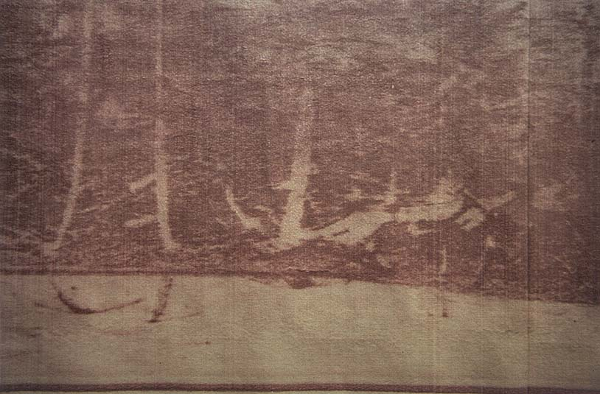
21
Notes:
The paper sonar record shows many upright floaters under water.

Slide 100
21
Notes:
Many of these "floaters" have grounded themselves in the muck at the bottom of the lake. These trees did not grow here, they floated here. The bottom of the lake is higher in elevation than the top of the lake used to be, so much recent sedimentation has occurred here.

Slide 101
21
Notes:
Scientists can scuba dive underneath the logs to see their orientation under water.

Slide 102
21
Notes:
An underwater camera shows an upright floater from below.

Slide 103
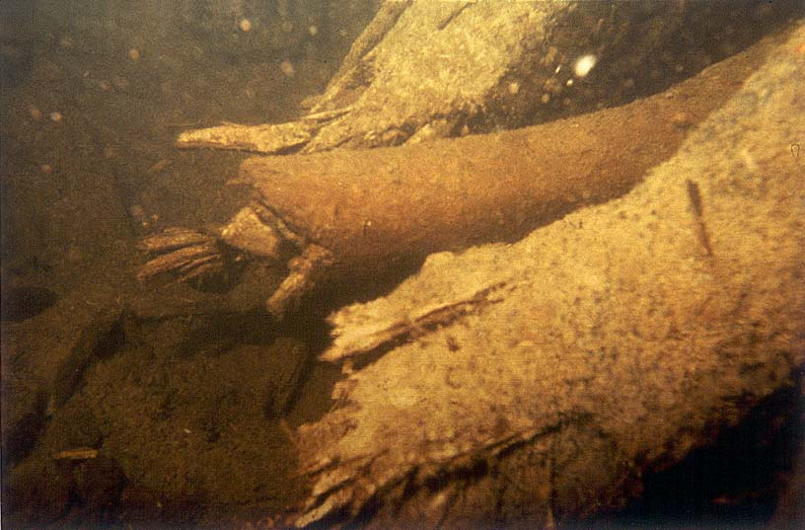
21
Root Ends of a Douglas Fir Log Deposited Upright on the Bottom of the Lake
Notes:
Some trees are grounded in the muck at the bottom of the lake.

Slide 104
This sign was later removed
21
Notes:
After seeing creationist research, the forest rangers at Specimen Ridge, Yellowstone Park removed this sign. However, they have not put up a better sign, accurately portraying the truth about petrified trees. Yet, no sign is better than a false sign bearing evolutionary propaganda.

Slide 105
21
Time is Running out
on the theory of evolution

Slide 106
Black

Slide 107
Creation link at BibleStudyDownloads.org
Get this presentation for free!
Notes:
Creation (cr)

