Slide 1
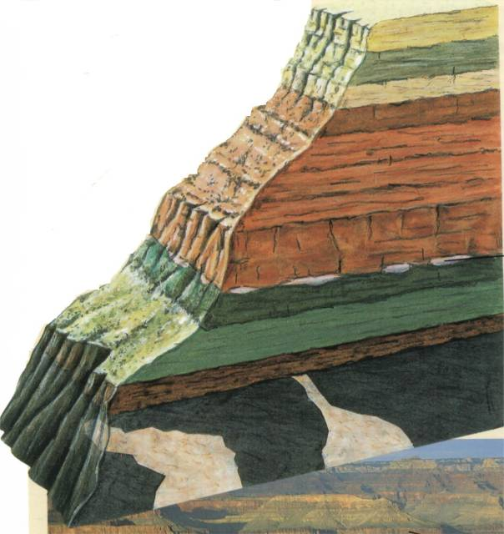
Dating Fossils
and Rocks
Mike Riddle
www.Train2Equip.com

Slide 2
Topics
A primer on radioactive decay
Carbon-14 dating
Radioisotope dating

Slide 3
The Atom
Fundamental unit of matter
Made up of components called subatomic particles
  Proton (positive charge)
  Neutron (no electrical charge)
  Electron (negative charge)
Nucleus
Electron

Slide 4
What Is Carbon?
Carbon-14 is also referred to as:
  C-14
  Radiocarbon
Types of carbon (isotopes)
Atomic mass
9
6
14
6
16
6
C
C
C
Atomic number

Slide 5
Unstable isotopes (Atoms)
An atom is generally stable if the number of protons equals the number of neutrons in the nucleus
Atom (Isotope) | Protons | Neutrons
Stable Carbon | 6 | 6
Stable Nitrogen | 7 | 7
Stable Oxygen | 8 | 8
Carbon 14
6
8

Slide 6
What is Radioactive Decay?
The nucleus of an atom (decays) changes into a new element
The proton number (atomic number) must change
14
6
14
7
C
N
How long does this take?

Slide 7
What is Half-Life?
The rate of decay is measured by how long it takes for half an element to decay (half-life)
The half-life of C-14 is 5,730 years

Slide 8
Half-Life Illustration
5,730 years
1 half-life
11,460 years
2 half-lives
Time = 0
C-14
N-14
1/2
N-14
3/4
C-14
1/2
C-14
If C-14 is constantly decaying,
will we run out of C-14 in the atmosphere?

Slide 9
How Carbon-14 Is Produced
Cosmic Rays (radiation)
C-14 combines with oxygen to form carbon dioxide (CO₂)
Forms C-14
Collision with atmosphere (N14)

Slide 10
Carbon-14 Life Cycle
Cosmic radiation
14
7
14
6
14
7
N
C
N
Carbon-14 is produced in the atmosphere
Carbon-14 decays into Nitrogen-14

Slide 11
Review
There are different types of carbon
There are stable and unstable atoms (isotopes)
Radioactive decay
Half-life (Carbon-14 = 5,730 years)
C-14 life-cycle (N-14 C-14 N-14)
Next Topics
Equilibrium
How the carbon clocks works

Slide 12
Equilibrium: The Assumption
Carbon 14 being added
The amount of C-14 in the atmosphere stays constant
Amount added equals
amount removed
C-14 Atoms
Carbon 14 being removed
Notes:
What has to be done to keep the line (level of c-14) level? Answer: remove an equal amount

Slide 13
Starting the Carbon Dating Clock
Once a plant or animal dies the clock starts
Organism dies
No more C-14 intake
C-14 continues to decay

Slide 14
How the Carbon Clock Works
The C-14 dating method relies on measuring the amount of C-14 in the fossil
Three Scenarios
There is a lot of C-14 remaining in the fossil
There is very little C-14 remaining in the fossil
There is no detectable C-14 in the fossil

Slide 15
What We Need to Know
What do we need to know to determine how many half-lives have expired?
How fast it decays (measured in half-lives). This is known (5,730 years).
The starting amount of C-14 in the fossil.
A critical Detail

Slide 16
Understanding the Starting Point
Illustration
You enter a room and see a burning candle
The candle is burning at 1 inch per hour
How long has the candle been burning?
We need to know the starting height of the candle
We need to know the starting amount of C-14

Slide 17
Understanding the Starting Point
If we find 1,000 C-14 atoms in a fossil, do we know how much C-14 has decayed?
NO
We need to know the starting amount of C-14.
How is this done?

Slide 18

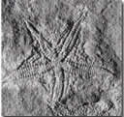
Determining the Starting Amount
There are two types of carbon used in the dating process: C-12 and C-14
C-12 is a stable isotope (it does not decay)
When an organism is alive it has the same ratio (C-12 to C-14) that is found in the atmosphere (1-trillion to 1)
I’m alive
I’m a fossil
Same ratio
Different ratio
Notes:
When an organism dies the ratio begins to change (the clock starts because the C-14 begins to decrease in the organism and the amount of C-12 stays the same)
The ratio difference is used to determine how much C-14 has decayed

Slide 19
How the C-12 / C-14 Ratio Works
Amount of stable C-12
Amount of unstable C-14
Ratio
Years Dead
# Half-lives
100 Trillion
100
1-T to 1
0
0
100 Trillion
50
2-T to 1
5,730
1
100 Trillion
25
4-T to 1
11,460
2
100 Trillion
12
8-T to 1
17,190
3
100 Trillion
6
16-T to 1
22,920
4
100 Trillion
3
32-T to 1
28,650
5

Slide 20
A Critical Assumption
Has the ratio of C-12 to C-14
always been the same (1-trillion to 1)?
This is a key assumption
If this assumption is true then carbon-14 dating is a reliable dating method
If this assumption is false then carbon-14 dating is not a reliable dating method

Slide 21
Dr. Willard Libby and Equilibrium
Richard, Milton, Shattering the Myths of Darwinism, 1997, p. 32. (W. F. Libby, Radiocarbon Dating, 1955)
“He found a considerable discrepancy in his measurements indicating that, apparently, radiocarbon was being created in the atmosphere somewhere around 25 percent faster than it was becoming extinct.
Since this result was inexplicable by any conventional scientific means, Libby put the discrepancy down to experimental error.”

Slide 22
The Facts About Equilibrium
Richard, Milton, Shattering the Myths of Darwinism, 1997, p. 32.
“During the 1960s, Libby’s experiments were repeated by chemists… The new experiments, though, revealed that the discrepancy observed by Libby was not merely an experimental error – it did exist.”

Slide 23
The Facts About Equilibrium
Richard Lingenfelter, “Production of C-14 by cosmic ray neutrons”, Review of Geophysics, 1963, p.51.
“There is strong indication, despite the large errors, that the present natural production rate exceeds the natural decay rate by as much as 25 percent.”
Are there any factors that can affect the amount of carbon in the atmosphere?

Slide 24
Factors Affecting Carbon-14 Dating
Factors that would cause dates to appear older than they actually are include:
Cosmic ray penetration of the earth’s atmosphere
The strength of the earth’s magnetic field
The CO₂ levels in the atmosphere
The Genesis Flood

Slide 25
Atmospheric Levels of Carbon
The Genesis Flood buried much carbon from living organisms to form coal and oil
This buried carbon (mostly C-12) is about 100 times the total carbon in the present biosphere
What does this mean?
The CO₂ level in the pre-Flood biosphere was different (a higher ratio of C-12 to C-14)
C-14 dates using the present ratio of C12/C14 will give incorrect ages – ages that are too old

Slide 26
The Flood and C-14 Dating
James Perloff, Tornado in a Junkyard, 1999, p. 140.
“Assuming the Flood did occur, little if any C-14 may have existed before then. This would give anything older than the Flood a false appearance of great age.”

Slide 27
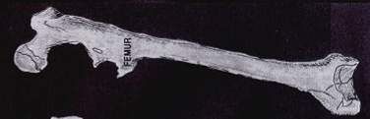
Example of Dating Assumptions
Find a fossil with a measured ratio of 16 trillion to 1 (C12 to C14)
This means 4 half-lives have expired giving a date of about 23,000 years
What if the ratio started at:
2 trillion to 1: 3 half-lives instead of 4 – age 17,000
8 trillion to 1: 1 half-life instead of 4 – age 5,000
Notes:
The ratio has been confirmed to be much higher in the past

Slide 28
The Assumption: Equilibrium
Elizabeth K. Ralph and Henry M. Michael, “Twenty-five Years of Radiocarbon Dating,” American Scientist, Sep/Oct 1974
“We know that the assumption that the biospheric inventory of C¹⁴ has remained constant over the past 50,000 years or so is not true.”
The assumption carbon-14 dating is based upon is FALSE

Slide 29
Carbon-14 and Age
Anything older than 60,000 years should have no detectable C-14
If we detect C-14, it is good evidence that it is not millions of years old
Coal should not contain any detectable C-14. However, coal has been found to contain C-14
Fossil woods estimated to be over 200 million years old still contain C-14

Slide 30
C-14 and Recent Dates
R. E. Taylor, “Major Revisions in the Pleistocene Age Assignments for North American human Skeletons by C-14 Accelerator Mass Spectrometry”, American Antiquity, Vol. 50, 1985, pp. 136-140.
Ancient human skeletons, when dated by the new Accelerator Mass Spectrometer technique, give surprisingly recent dates. In one study of eleven sets of ancient human bones, all were dated at about 5,000 radiocarbon years or less.

Slide 31
Carbon-14 Summary
Carbon-14 can only be used to date organic material
Carbon-14 dating accuracy is dependent upon a consistent ratio between C-12 and C-14 (equilibrium)
The assumption of equilibrium is FALSE
There are factors that can affect C-14 in the atmosphere (Genesis Flood)
Ancient fossils as well as coal contain C-14 residue

Slide 32


One More Thing About Age
About 30,000 years to reach equilibrium
Over 25% out of equilibrium
Conclusion: The earth is young
I’m Young after all

Slide 33
Carbon-14 Dating: Conclusion
Robert E. Lee, “Radiocarbon: Ages in Error,” Anthropological Journal of Canada, 1981, pp. 26-27.
“The troubles of the radiocarbon dating method are undeniably deep and serious. Despite 35 years of technological refinement and better understanding, the underlying assumptions have been strongly challenged….
It should be of no surprise, then, that fully half of the dates are rejected. The wonder is, that the remaining half came to be accepted.
continued

Slide 34
The implications of pervasive contamination and ancient variations in carbon-14 levels are steadfastly ignored by those who base their argument upon the dates….
While the method cannot be counted on to give good, unequivocal results, the numbers do impress people, and save them the trouble of thinking excessively.”

Slide 35
Radioisotope
Dating Methods
Dating Rocks
What are they and how do they operate?
What is the basic perception?
How accurate are they?
Are there any hidden assumptions?

Slide 36
Why People Believe
Scientists have proven the earth old
Peer pressure (specifically the education system)
Intellectualism (science versus religion)
Don’t want to hear the information
Young earther’s are ignoring the scientific evidence
The Bible does not teach how old the earth is
Not an important issue, but it must be old
Most scientists believe in an old earth
Pride

Slide 37
Analyzing statements
Who made the statement and what was their bias?
Does everyone agree?
Am I being given all the information (selective data)?
Does it work in all cases – are there exceptions?
Are there any hidden assumptions?
Are they assuming an answer without presenting supporting evidence?
Are they appealing to ignorance?
Are their attacks on the opposition valid – are they distorting data to make other views look non-credible?
Notes:
When we read statements in textbooks and journals we should ask ourselves some questions

Slide 38
Textbooks
Biology: Visualizing Life, Holt, Rinehart, Winston, 1998, p.177.
“Using radioactive dating, scientists have determined that the Earth is about 4.5 billion years old, ancient enough for all species to have been formed through evolution.”

Slide 39
Radioactive Decay
Parent element
Daughter element
Uranium
Decay
Lead
Potassium
Decay
Argon

Slide 40
Radioisotope Dating
Used to date igneous and metamorphic rocks (basalt)
Cannot be used on sedimentary rocks (limestone, sandstone, and shale)
α
α
238
U
234
Th
234
Pa
234
U
230
Th
α
210
Po
206
Pb
Notes:
Th = thorium, pa = protactinium, Po = polonium, Pb = lead
U = 92 protons, Th = 90 protons, Pa = 91, Po = 84 protons, pb = 82 protons (atomic number)
In nuclear decay the result is a nucleus that contains less energy.
The stability partly depends on the relative number of protons and neutrons.
In alpha decay one element (parent) decays into a daughter by emitting an alpha particle. An alpha particle is a helium nucleus (He-4) - atomic mass-4 and atomic number 2
Example: to decay U-238 to Th-234 we subtract atomic masses (238-4 = 234) and subtract atomic numbers (92-2 =90)

Slide 41


Hour Glass Example

Slide 42
Hour Glass Example
Can you calculate how long you were outside?

Slide 43
Radioisotope Dating Assumptions
The starting amount of the daughter element is known
All the daughter element is due to radioactive decay
The sample was always in a closed environment
The decay rate has always been constant
Critical Thinking
Were all dates taken consistent?
Were the assumptions taken into account?

Slide 44
Four Assumptions
The starting amount of daughter element is known
All the daughter element is due to radioactive decay
The sample was always in a closed environment
The decay rate has always been constant
Parent Element
Daughter Element
Potassium
Argon

Slide 45
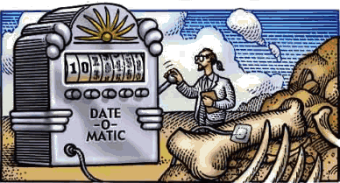
Examples of Dating
Sunset Crater, Northern Arizona
  Potassium-argon: 200,000+
  Reality: AD 1065
Lava flows at Mt. Ngaurhoe, New Zealand
  Potassium-argon: 275,000
  Reality: 1949, 1954, 1975
Hualalai basalt, Hawaii
  Potassium-argon: 1.4 – 22 million
  Reality: AD 1801
Mt. Etna basalt, Sicily
  Potassium-argon: 140,000 – 350,000
  Reality: 1972
Notes:
Apollo 11 brought back some moon rocks. The rocks were dated using 4 different methods. The range between the oldest and youngest date was almost 4-billion years.
Apollo 16 brought back some moon rocks that were dated at 18-billion years. To fix the problem they subjected the rocks to acid to melt out the lead and then re-dated and got 4.5 billion years. (Science magazine Jan 30, 1973)
Sunset Crater in n. Arizona is known to be a recent volcano. Indian artefacts and relics are found within the rocks formed by the eruption. The volcano last erupted some 900 years ago. Two lava flows have been dated giving ages of 210,000 and 230,000.
Hualalai volcano in Hawaii Known to have erupted in 1800-1801 were dated with a variety of methods. 12 dates were taken which ranged from 140 million years to 2.96 billion years. The average date was 1.41 billion. There have been many explanations to explain these results away (as the lava rose, the older material from inside the earth rose with it, but they are unable to explain why such a variance in ages). If this is the explanation, then why could this not also be the case for other dates?
This does not disprove radioisotope dating, but it does demonstrate the tremendous inconsistency in the interpretation of the method.
The conventional K-Ar dating method was applied to the 1986 dacite flow from the new lava dome at Mount St. Helens, Washington. Porphyritic dacite which solidified on the surface of the lava dome in 1986 gives a whole rock K-Ar ‘age’ of 0.35 0.05 million years.
Steven A. Austin, “Excess Argon within Mineral Concentrates from the New Dacite lava Dome at Mount St. Helens Volcano, 1996

Slide 46
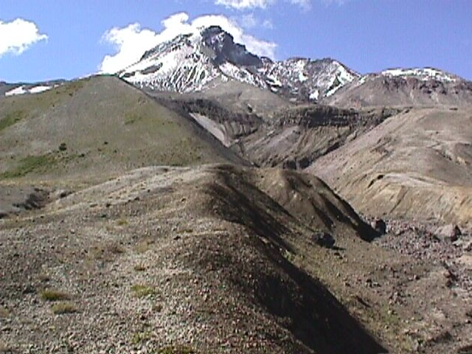
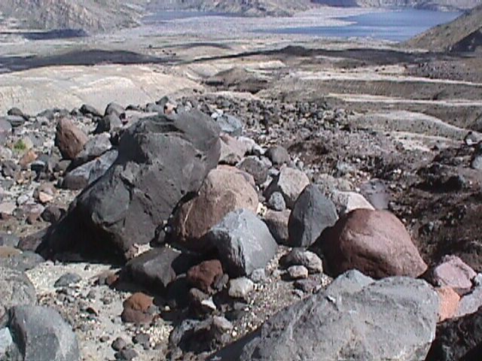
Examples of Dating
Rocks that were created since the 1980 eruption of Mount St. Helens dated up to 2.8 million years old

Slide 47
Basaltic rocks of Uinkaret Plateau
six K-Ar model ages 0.01 to 17 million
five Rb-Sr model ages 1270 to 1390 million
one Rb-Sr isochron age 1340 million
one Pb-Pb isochron age 2600 million
Paleozoic
Precambrian
Gardenas Basalt (Precambrian)
five K-Ar model ages 791 to 853 million
six Rb-Sr model ages 980 to 1100 million
one K-Ar isochron age 715 million
one Rb-Sr isochron age 1070 million

Slide 48
Radioisotope Dating
Reliability and Consistency
If the dates are never right when we know the age of the rocks, how can we be sure they are correct when we don’t know the exact date of the rocks?

Slide 49
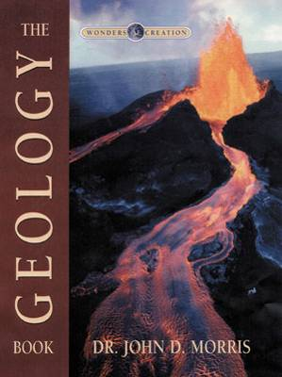
Radioisotope Dating
John Morris, Ph.D. Geological Engineering, The Geology Book, 2000, p. 52.
Reliability and Consistency
“When the same rock is dated by more than one method, it will often yield different ‘ages.’ And when the rock is dated more than one time by the same method, it will often give different results.”

Slide 50

Assumptions
If you base your theory on a wrong assumption, all your work can be correct, but the result will be wrong.

Slide 51
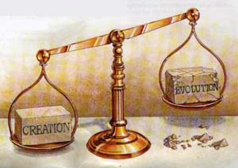
Scientific Evidence
for a Young Earth

Slide 52
Conflict in Dating
In 1993 scientists found wood (trees) buried in basalt flows (69 feet deep)
Wood samples sent to two laboratories to be carbon-14 dated
44,000 years
Basalt sent to two laboratories to be potassium-argon dated
45 billion years (obviously false)
69 feet deep
Wood encased in basalt
Wood embedded in lava flow (basalt)
Notes:
Note from Dr. Rick Griffith: Evolutionists believe the world is 13.7 billion years, so the 45 billion years claimed here is either a typo or else the dating of that age would not even be held by evolutionists. In either case, this is clearly erroneous. Further, how could wood be encased in basalt that would have burned it all up in a lava flow?

Slide 53
Helium in the Atmosphere
Uranium ultimately decays into lead
During this process helium atoms are formed
Helium nucleus
α
α
238
U
234
Th
234
Pa
234
U
230
Th
α
210
Po
206
Pb

Slide 54
Helium in the Atmosphere
Atmosphere
Not enough helium for an old earth
H
H
Helium atoms
H
Radioactive Decay
H
H
H
H

Slide 55
Helium in Granite
Radioactive decay (uranium to lead) produces helium atoms
Helium does not remain long in rocks – it migrates rapidly to the surface and into the earth’s atmosphere
If the earth is billions of years old, we should not find large amounts of helium in granite (zircon crystals)
Over 58% of the helium still remains in the granite (zircon crystals)
What does this mean?

Slide 56
Evidence for a Young Earth
There has not been enough time for the helium to diffuse out of the granite (zircon crystals)
The evolution model of billions of years does not match the data
The creation model of a young earth best matches the data (about 6,000 years)
I’m Young after all

Slide 57
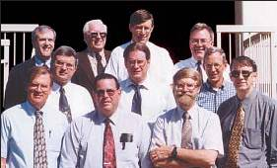
RATE Group
RATE: Radioisotope and the Age of The Earth
John Baumgardner, Ph.D. Geophysics
Larry Vardiman, Ph.D. Atmospheric Physics
D. Russell Humphreys, Ph.D. Physics
Eugene Chaffin, Ph.D. Nuclear Physics
Andrew Snelling, Ph.D. Geology
Steven Austin, Ph.D. Geology
Donald DeYoung, Ph.D. Physics
John Morris, Ph.D. Geological Engineering
Kenneth Cumming, Ph.D. Biology
William Hoesch, M. S. Geology
Stephen Boyd, Ph.D. Hebraic and Cognitive Studies

Slide 58
Evidences for a Young Earth
Helium in the Earth’s atmosphere
Nuclear decay rates (Radioisotope dating)
Sodium in the oceans
Rapid disintegration of comets
Erosion of continents
Sediments in the ocean
Decay of the Earth’s magnetic field
Carbon-14 ratio in the atmosphere
Radio halos for polonium in granites
Population statistics
Recession of the moon
Many more …..
Notes:
Note from Dr. Rick Griffith: Please see the detailed work of Mike Riddle here. He is not saying that the existence of helium in the Earth’s atmosphere argues for a young earth. Rather, the level of helium argues more for a young than an old earth. The same would be true of the other items.

Slide 59

Who Believes in a Literal 6-Day Creation?
The RATE group
Danny R. Faulkner Ph.D. Astronomy
John Byl Ph.D. Astronomy
Tom Greene Ph.D. Astronomy
Dave Harrison Ph.D. Astrophysics
James Dire Ph.D. Astrophysics
Keith Wanser Ph.D. Condensed Matter Physics
Elaine Kennedy Ph.D. Geology
Duane T. Gish Ph.D. Biochemistry
Ross S. Anderson Ph.D. Biochemistry
Jonathan Sarfati Ph.D. Physical Chemistry
Kelly Hollowell Ph.D. Molecular and Cell Biology
Lane P. Lester Ph.D. Genetics
Linda K. Walkup Ph.D. Molecular Genetics
Ray Bohlin Ph.D. Molecular and Cell Biology
Gary E. Parker Ph.D. Biology
Robert Herrmann Ph.D. Mathematics
Bryant Wood Ph.D. Archaeology
Charles Taylor Ph.D. Linguistics (O.T.)
Steven Boyd Ph.D. Hebraic and Cognitive Studies
Robert Cole Ph.D. Semitic Languages
Hermann Austel Ph.D., Professor Bible Exposition

Slide 60
Belief in a Young Earth
Keith Wanser (Ph.D. Condensed Matter Physics), Creation ex nihilo, 1999, p. 39.
“I am convinced there is far more evidence for a recent, six-day creation and a global Flood than there is for an old earth and evolution.”

Slide 61
Conclusion: Five Facts
The earth has not been scientifically proven to be billions of years old
The Bible teaches a literal 6-day creation
Many scientists believe in a literal 6-day creation about 6,000 years ago
New evidence from nuclear decay supports a young earth model
There are many scientific evidences for a young earth

Slide 62
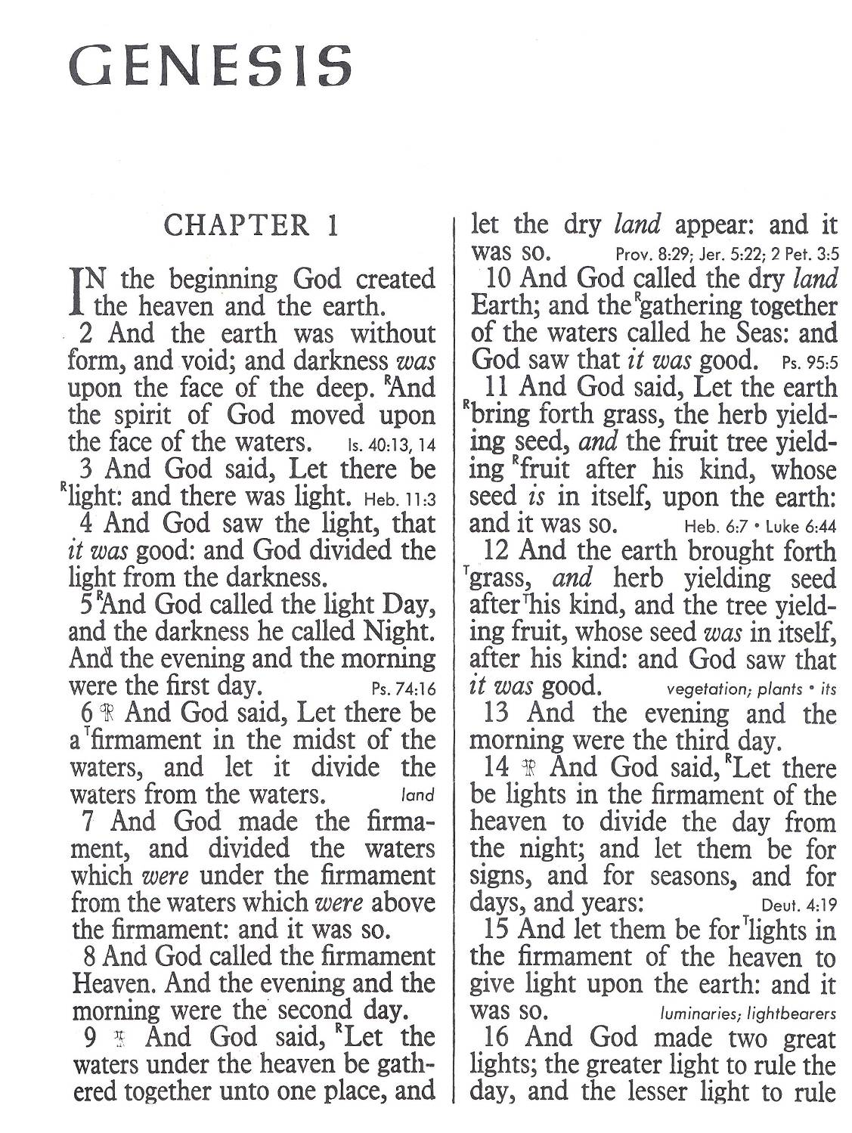
Psalm 118:8
It is better to trust in the Lord than to put confidence in man
John 17:17
Sanctify them through thy truth: thy word is truth

Slide 63
Black

Slide 64


Creation link at BibleStudyDownloads.org
Get this presentation for free!
Notes:
OT Survey (os)

