Slide 1
Mike Riddle
www.Train2Equip.com

Slide 2
Topics
The Bible has answers
The origin of the universe
The origin of life
The fossil record
Origin of dinosaurs

Slide 3
The Bible Has Answers
Who created?
What was created?
How was it created?
When was it created?
How long did it take to create?
God
All things
By His power
In the beginning
6 days

Slide 4
The Days of Creation
Danny Faulkner Ph.D. Astronomy
John Byl Ph.D. Astronomy
Tom Greene Ph.D. Astronomy
James Dire Ph.D. Astrophysics
Dave Harrison Ph.D. Astrophysics
Steven Boyd Ph.D. Hebraic and Cognitive Studies
Floyd Nolen Jones Th.D., Ph.D. Author of Chronology of the Old Testament
Herb Hirt Ph.D. Biblical Exposition
Robert Cole Ph.D. Semitic languages
Brown-Driver-Briggs Lexicon
Holladay's Hebrew-English Lexicon
God - The Ten Commandments (Exodus 20:11)

Slide 5
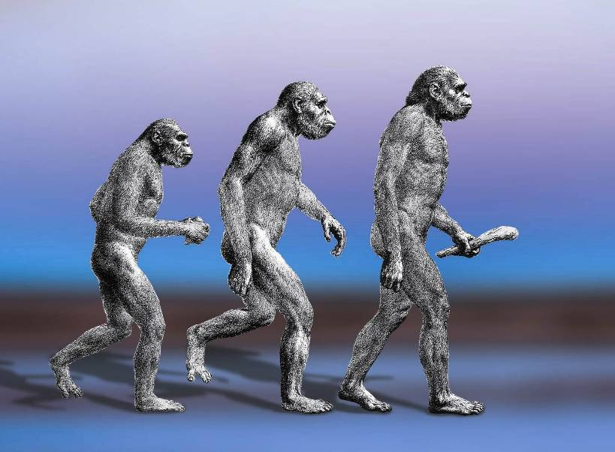
What Is Evolution?

Slide 6
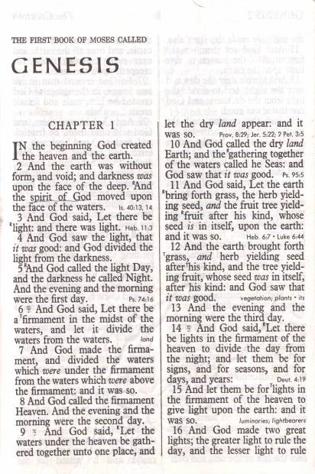
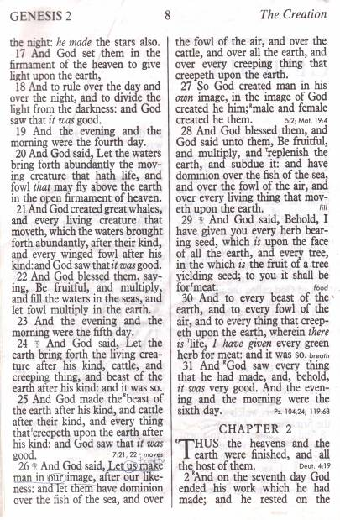
Evolution
Evolution is based on materialism
Evolution is the ideology there is no Creator God

Slide 7
Two Worldviews in Conflict
Evolution
Bible
The universe exploded into existence out of nothing
X
In the beginning God created
Life evolved from a pool of chemicals by natural processes
X
God created all life
Different life forms evolved from a common ancestor over millions of years
X
God created all life after its kind
Notes:
This slide to make sure people know you cannot have evolution and the Bible. These 2 slides point this out
All worldviews: a belief in the existence and nature of God

Slide 8
Origin of the Universe
What do we know?

Slide 9
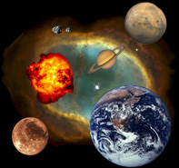
The Big Bang
13-15 billion years ago a big bang, or explosion, occurred, creating the universe. The universe began as an infinitely dense, hot fireball, a scrambling of space and time.
Where did the matter come from that created the fireball?

Slide 10
From Nothing to the Big Bang
In order to have a big bang, we need something (matter/energy) to go bang.
Where and how did this original matter/energy originate?
To dismiss or ignore this question means you have a story with no foundation (= FAITH)
Evolution is based on materialism
Notes:
To dismiss or ignore this question means to abandon evolution and open the possibility to a supernatural beginning

Slide 11
The Origin of the Universe
Where and how did matter and energy originate?
Paul Davies, physicist and evolutionist, The Edge of Infinity
“[The big bang] represents the instantaneous suspension of physical laws, the sudden abrupt flash of lawlessness that allowed something to come out of nothing. It represents a true miracle…”

Slide 12
The Origin of Matter
Joseph Silk (Ph.D. Astronomy and Professor of Astronomy at the University of Oxford), The Big Bang, 2001, p. xv.
“It is only fair to say that we still have a theory without a beginning.”

Slide 13
The Origin of Matter
Sten Odenwald, (Ph.D. Astrophysics and Chief Scientist with Raytheon STX Corp at the NASA Goddard Space Flight Center), The Astronomy Café, 1998, p. 120.
“I was happy to announce that astronomers have not the slightest evidence for the supposed quantum production of the universe out of a primordial nothingness.”

Slide 14
Origin of the Universe
If evolution is unable to explain the origin of matter and energy through naturalistic means, then it is without a foundation.
Why should I accept evolution when you cannot produce the evidence? I already have a faith. Tell me about your faith and I will tell you about my faith.
Therefore
Notes:
Since Evolution is based on naturalism, all things in the universe must be explained in terms of naturalism. If you can't explain where matter came from then evolution is left with a giant whole – no foundation.
Note: don't let the argument go anywhere until they can explain their foundation for the origin of life. They have to accept it by faith.

Slide 15
Logical Deduction
It is rational (reasonable) to believe that God, not unknown magical events, created matter and energy.

Slide 16
Evidence: Evolution or the Bible
Evolution
Bible
Origin of the universe
Origin of life
Fossil record
Dinosaurs
X

Slide 17
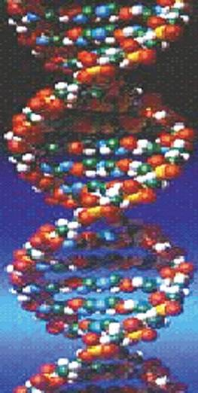
How Did Life Start?
Two possible origins for life
Life evolved by natural processes
Life was created

Slide 18
The Model of Evolution
About 4.6 billion years ago the earth formed
Chemicals formed in the “primordial soup”
Chemicals bonded together to form molecules
Molecules bonded together to make a living cell
+
=
Life?
Life

Slide 19
The Bible
“For by him were all things created, that are in heaven, and that are in earth, visible and invisible, whether they be thrones, or dominions, or principalities, or powers: all things were created by him, and for him.”
Colossians 1:16
God created all life

Slide 20
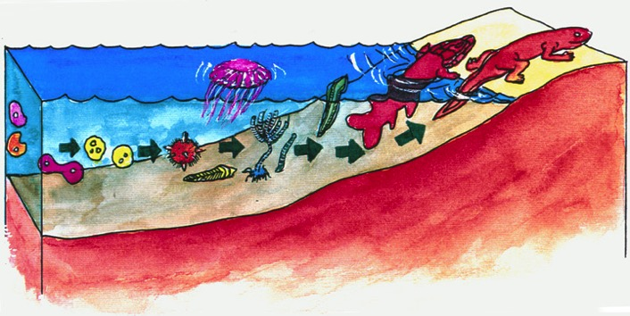
Origin of Life
Life cannot start with oxygen
Life cannot start without oxygen
Did life start in the oceans?
Hydrolysis

Slide 21
Terminology
Atoms The basic unit of matter
Molecules Specific arrangement of atoms (H₂O)
Amino Acids Specific arrangement of molecules
Proteins Specific arrangement of amino acids

Slide 22
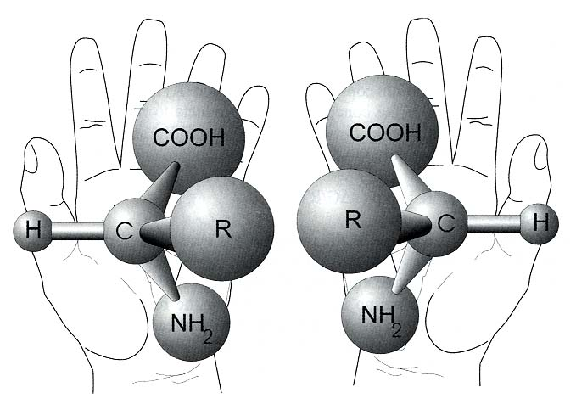
Amino Acids
Over 2,000 types of amino acids
Only 20 are used in life

Slide 23
Counter Argument
Given enough time it can happen
Two Questions
Is this a valid statement?
Is this a scientific statement?
-50
Law of Probability
10

Slide 24
Probability
Origin of a protein
10¹⁹¹
Origin of a cell
10^{40,000}

Slide 25
Probability and Life
Bernard Lovell (Ph.D. Astronomy), In the Centre of Immensities – “effectively zero”
Francis Crick, Life Itself: Its Origin and Nature – “can never have been synthesized at all, at any time”
Robert Gange, Ph.D. (research in the field of cryophysics and information systems.), Origins and Destiny – “Zero”

Slide 26
Origin of Life
Johnjoe McFadden (Evolutionist & Professor of Molecular Biology and Quantum Physics), Quantum Evolution, 2000, p. 85.
“The simplest living cell could not have arisen by chance.”
Notes:
The simplest living cell could not have arisen by chance. Just like the eye, the proto-cell must have evolved from simpler ancestral cells, presumably by a process of natural selection. But this is where the first big problem with the origin of life arises. What were those simpler entities?”

Slide 27
Origin of Life
Franklin M. Harold, Professor of Biochemistry and Molecular Biology at Colo State U., The Way of the Cell, 2001, p. 235.
“The origin of life is also a stubborn problem, with no solution in sight….”

Slide 28
Origin of Life
If evolution is unable to explain the origin of life through naturalistic means, then it is without a foundation.
Why should I accept evolution when you cannot produce the evidence?
I already have a faith. Tell me about your faith and I will tell you about my faith.
Therefore
Notes:
Now that we have an understanding of the foundation of evolution… Why is evolution without a foundation? Because there is no natural process that can cause life to originate
Note: don't let the argument go anywhere until they can explain their foundation for the origin of life. They have to accept it by faith.

Slide 29
Logical Deduction
It is rational (reasonable) to believe that God, not unknown events created life.

Slide 30
Evidence: Evolution or the Bible
Evolution
Bible
Origin of the universe
Origin of life
Fossil record
Dinosaurs
X
X

Slide 31
Fossil Record
Era | Period | Time (mil)
 | Quarternary | 1.8 – present
 | Teritary | 6.5 – 1.8
 | Cretaceous | 14.5 – 6.5
 | Jurassic | 208 – 14.5
 | Triassic | 245 – 208
 | Permian | 290 – 245
 | Carboniferous | 363 – 290
 | Devonian | 410 – 363
 | Silurian | 440 – 410
 | Ordovician | 505 – 440
 | Cambrian | 544 – 505
 | Precambrian | 650 - 544
Cenozoic
Mesozoic
Paleozoic
The foundation
Cambrian | 544 - 505
Precambrian | 650 - 544

Slide 32
Examining the Evidence
Actual Data
Tree of life
Cambrian
Time
Sudden appearance of complex creatures
Created after their kind
Precambrian
Darwinian Model
Morphology

Slide 33
Cambrian Explosion
Ariel Roth (Ph.D. Zoology), Origins,1998, p. 184.
“The Cambrian explosion is not just a case of all the major animal phyla appearing at about the same place in the geologic column. It is also a situation of no ancestors to suggest how they might have evolved.”

Slide 34
The Fossil Record
Ernst Mayr (Professor Emeritus, Museum of Comparative Zoology at Harvard University, hailed as the Darwin of the 20th century), What Evolution Is, 2001, p. 14.
“Given the fact of evolution,
one would expect the fossils to document a gradual steady change from ancestral forms to the descendants. But this is not what the paleontologist finds. Instead, he or she finds gaps in just about every phyletic series.”

Slide 35
Fossil Record
Based on the evolution model, the entire foundation for Darwinian evolution (the fossil record) is missing
Why should I accept evolution when you cannot produce the evidence?
I already have a faith. Tell me about your faith and I will tell you about my faith.
Therefore
Notes:
Now that we have an understanding of the foundation of evolution… Why is evolution without a foundation? Because there is no natural process that can cause life to originate
Note: don't let the argument go anywhere until they can explain their foundation for the origin of life. They have to accept it by faith.

Slide 36
Logical Deduction
It is rational (reasonable) to believe that God, not unknown events created all life after its kind

Slide 37
Evidence: Evolution or the Bible
Evolution
Bible
Origin of the universe
Origin of life
Fossil record
Dinosaurs
X
X
X

Slide 38
Asking the Right Question
Lesser Question
What happened to the dinosaurs?
Important Question
Where did the dinosaurs come from?

Slide 39
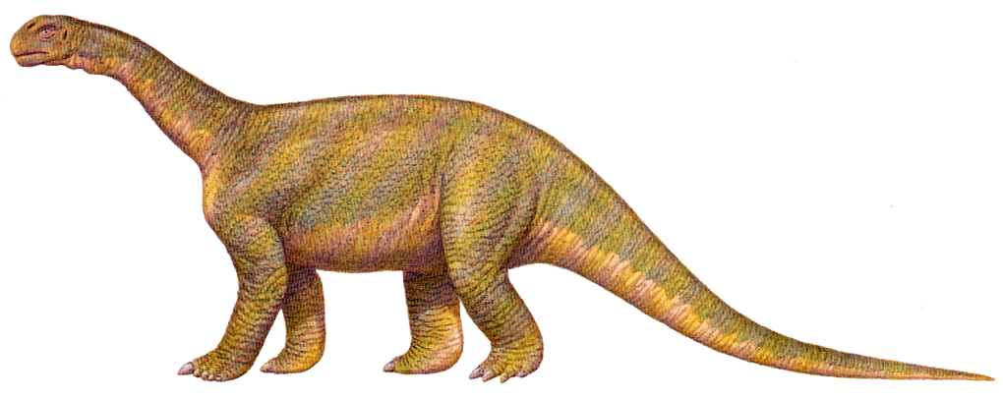
Origin of Dinosaurs?
The Standard Story
Dinosaurs evolved 220 million years ago

Slide 40
Origin of Dinosaurs
The Illustrated Encyclopedia of Dinosaurs, Dr. David Norman, 1985, p. 186.
“The question of the origin of dinosaurs is one that has puzzled paleontologists for many years.”
Notes:
Dr Norman is a lecturer in Zoology

Slide 41
Origin of Dinosaurs
The Natural History Museum Book of Dinosaurs, 1998, p. 12.
“Where did dinosaurs come from? That apparently simple question has been the subject of intense debate amongst scientists for over 150 years,…”

Slide 42
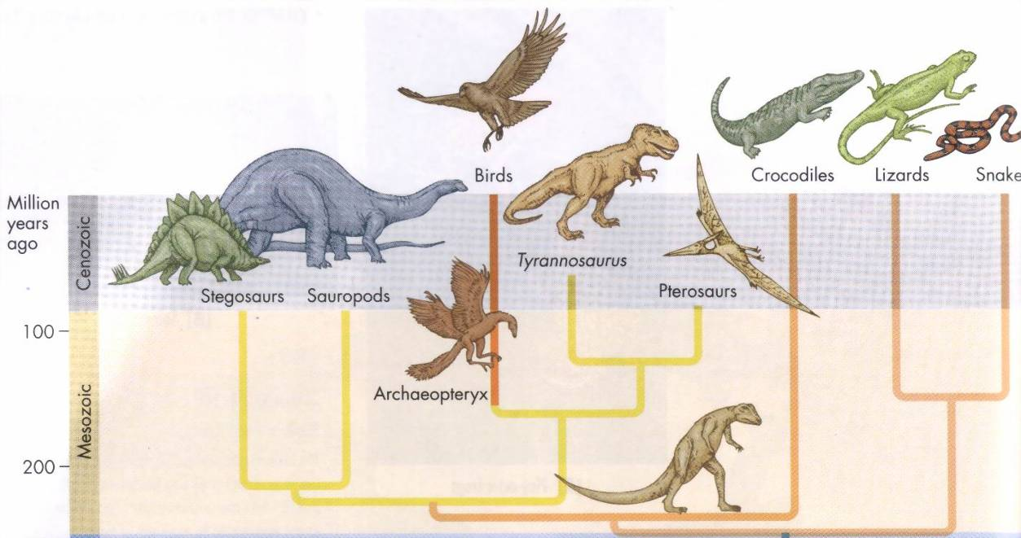
Evolution and Evidence
The Origin of Dinosaurs
Thecondonts
“Small lizards that ran on two legs and gave rise to the giant reptiles collectively known as the dinosaurs”
The Nature of Life, 1995
The only evidence presented in any major biology textbook
Critical thinking

Slide 43
Evolution and Critical Thinking
How could a small reptile evolve into a large dinosaur?
Shouldn't there be thousands (millions) of intermediate fossils?
Why don't we see intermediate dinosaur forms in museums?
Great claims require REAL evidence

Slide 44
Origin of Dinosaurs
Biblical Model
And God made the beast of the earth after his kind, and cattle after their kind, and everything that creepth upon the earth after his kind: and God saw that it was good. . . .
And the evening and the morning were the sixth day.
Genesis 1:25, 31
Notes:
People and dinos lived together. The evolution story is based on faith not real evidence

Slide 45
Origin of Dinosaurs
If evolution is unable to provide the thousands of transitions for the origin of dinosaurs then it is without a foundation
Why should I accept evolution when you cannot produce the evidence?
I already have a faith. Tell me about your faith and I will tell you about my faith.
Therefore
Notes:
Now that we have an understanding of the foundation of evolution… Why is evolution without a foundation? Because there is no natural process that can cause life to originate
Note: don't let the argument go anywhere until they can explain their foundation for the origin of life. They have to accept it by faith.

Slide 46
Logical Deduction
It is rational (reasonable) to believe that God, not unknown events created dinosaurs

Slide 47
Evidence: Evolution or the Bible
Evolution
Bible
Origin of the universe
Origin of life
Fossil record
Dinosaurs
X
X
X
X
What is evolution?

Slide 48
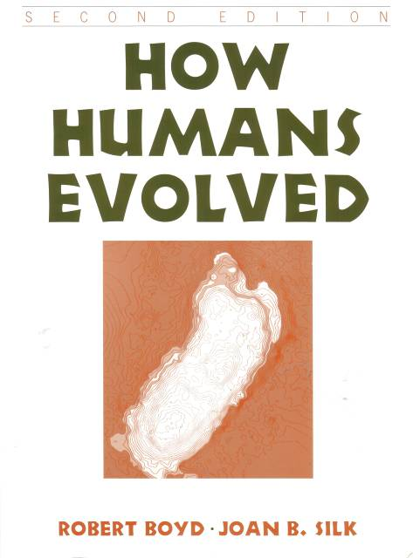
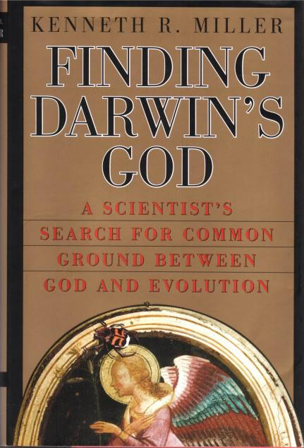
Faith
Evolution is a religious belief system
It must be accepted by faith

Slide 49
The Bible Has Answers
Who created
What was created
How it was created
When it was created
How long it took to create

Slide 50
The Starting Point
Scripture is true (John 17:17)
All Scripture is inspired (God-breathed) (2 Timothy 3:16)
God's Word is understandable
Starting Point
Notes:
John 17:17, 2Tim 3:16

Slide 51
Black

Slide 52
Creation link at BibleStudyDownloads.org
Get this presentation for free!
Notes:
OT Survey (os)

